Slide 1

Skills School - Introduction
Prof Dr Carsten P Welsch, Director

Slide 2
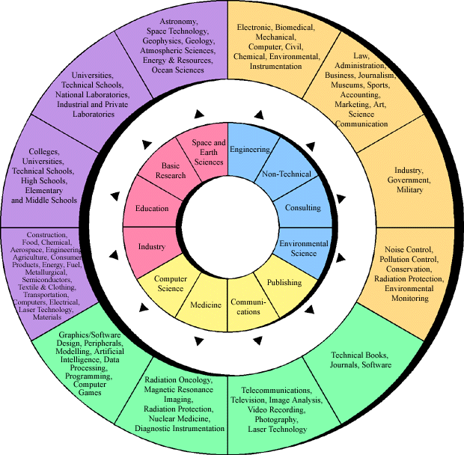
Postgraduate Training
MSc standard;
PhD part of training in most countries;
Broad skills;
Blue sky research vs. applied physics.

Slide 3
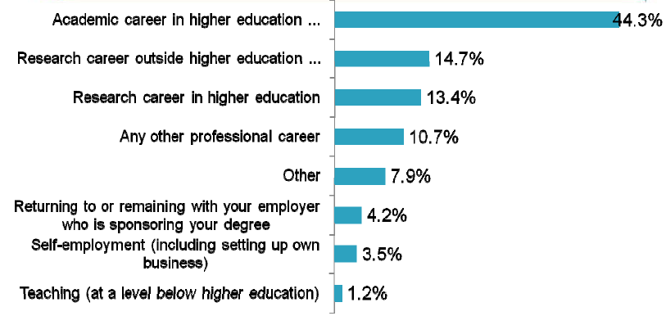
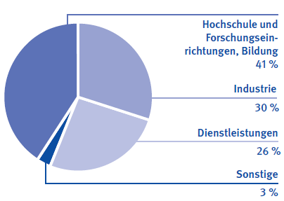
Career – Aspirations vs Reality
57.8 %
Universities, research centres, etc.
Industry
Source: HEA - STEM
Service Industry
Others
Source: DPG

Slide 4
‚Classic‘ PhD training in Europe
Focus on academic career path;
Scientific papers as key quality indicator;
Training through (often blue sky) research;
Very little training in complementary skills – researchers often need to be (re)trained on the job;
Students or researchers?
Evolution: Initial training networks (ITNs)

Slide 5
Marie Curie ITNs
Introduced in EU Framework Programme
2016: 100,000 Marie Curie researchers;
Provides support for early career and experienced researchers (young Postdocs).
Goals
Improve employability of researchers;
Better training through demonstrated international mobility;
Maintain Europe‘s leadership position in R&D.

Slide 6

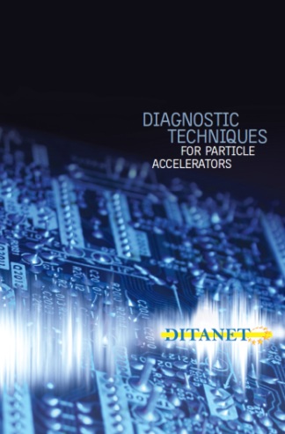



Accelerator Beam Diagnostics
‹‹ novel DIagnostic Techniques for future particle Accelerators:
A Marie Curie Initial Training NETwork ››

Slide 7
Training
Local training by host:
Network-wide schools on expert research techniques;
Intra-network exchange of researchers;
Secondments to partners from industry;
Training in complementary skills
Motivation: Ideal Training.

Slide 8
Training – at each Host
In accordance with national PhD regulations
Provide trainees with broad skills base
Expose to other sector
Promote knowledge exchange and collaboration across the network
100% focus on research project

Slide 9
Training – at each Host
Example: CNA/U Seville, Spain – Z.A. Haidar
Workshops
- Oct 2008 : Workshop on Electronics for Novel Nuclear Physics Detectors at CNA
- Dec 2009 : Workshop on Hadron therapy at CNA
Doctoral Courses
- Dec 2008 : Nuclear Structure (1 week)
- Jan 2008 : Applied Nuclear Physics (1 week)
- Feb 2008 : Experimental Nuclear Physics (1 week)
- Mar 2009 : Nuclear Reactions (1 week)
- May 2009 : Intermediate Energies (1 week)
Schools, Mini Courses and Conferences
- Mar 2009 : 2 day course on Gas Ionization detectors : principles and recent developments
- July 2009 : International School of La Rabida on Basic concepts in Nuclear Physics: theory, experiments and applications (Poster participation: Development of a Tracking System of Exotic Nuclear Beams for FAIR)
- Sept 09 : Biennial of Physics (Spanish Royal Society of Physics) (Poster participation: Development of a Tracking System of Exotic Nuclear Beams for FAIR)
Other
- Tested and learned about several electronics equipments for detectors and data acquisition systems
- 2 semesters of Spanish courses (level 1 and level 2)
- Participated in a contribution to the GSI Annual Report of 2009 : “Fast timing with DSSSD detectors”

Slide 10
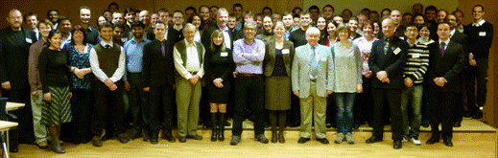
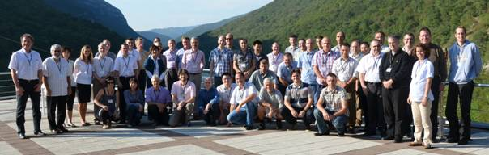
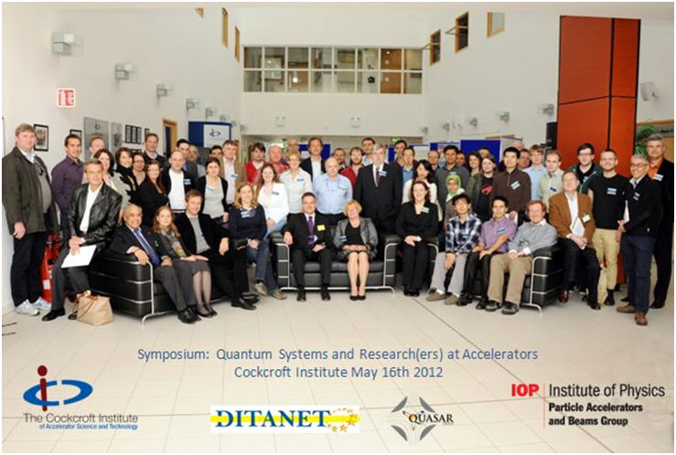
Network-wide Training
2 Diagnostics Schools
Stockholm, Sweden – March
Indico: 112220
> 80 participants and lecturers
8 Topical Workshops
CI, France, Slovenia, Seville, Hamburg
Indico: 145063, 145066, 145070, 135829, 154172
~ 40 participants each
Diagnostics Conference and Symposium
Seville, Spain – CNA
Indico: 135831
Proceedings + PRST-AB special edition

Slide 11
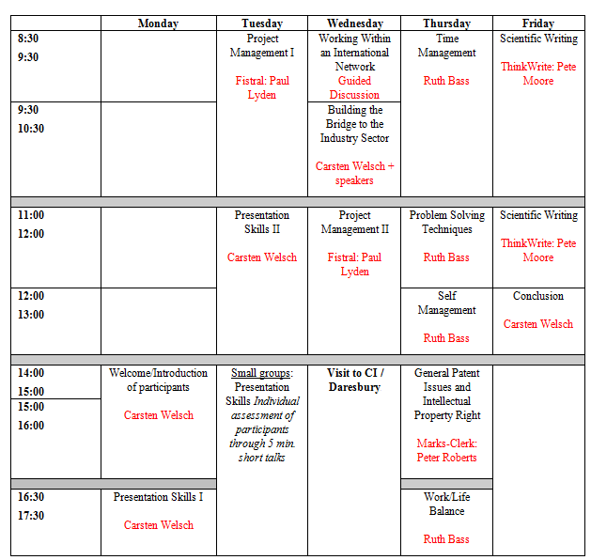
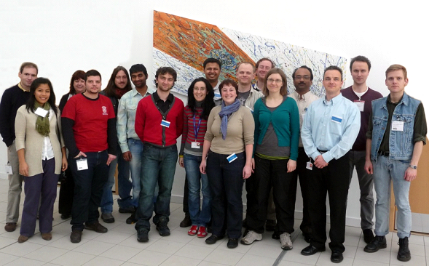
Complementary Skills (2010)

Slide 12
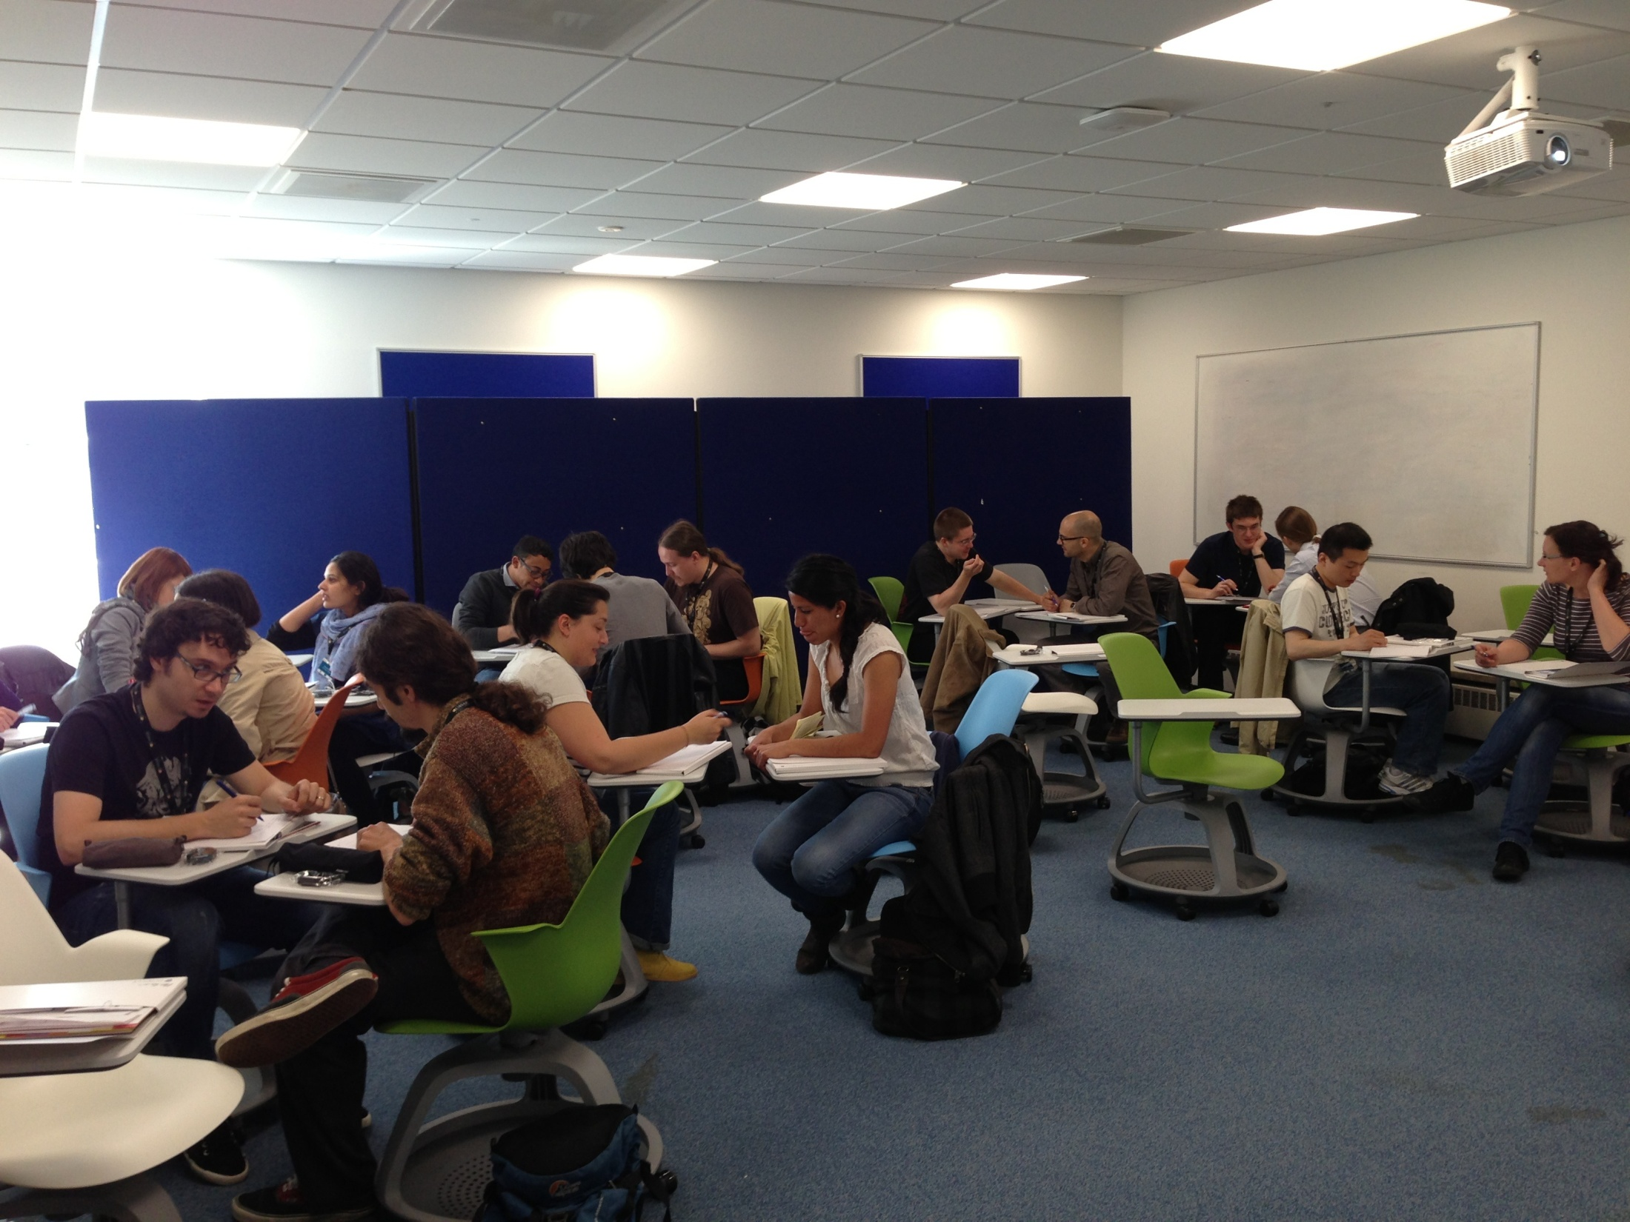
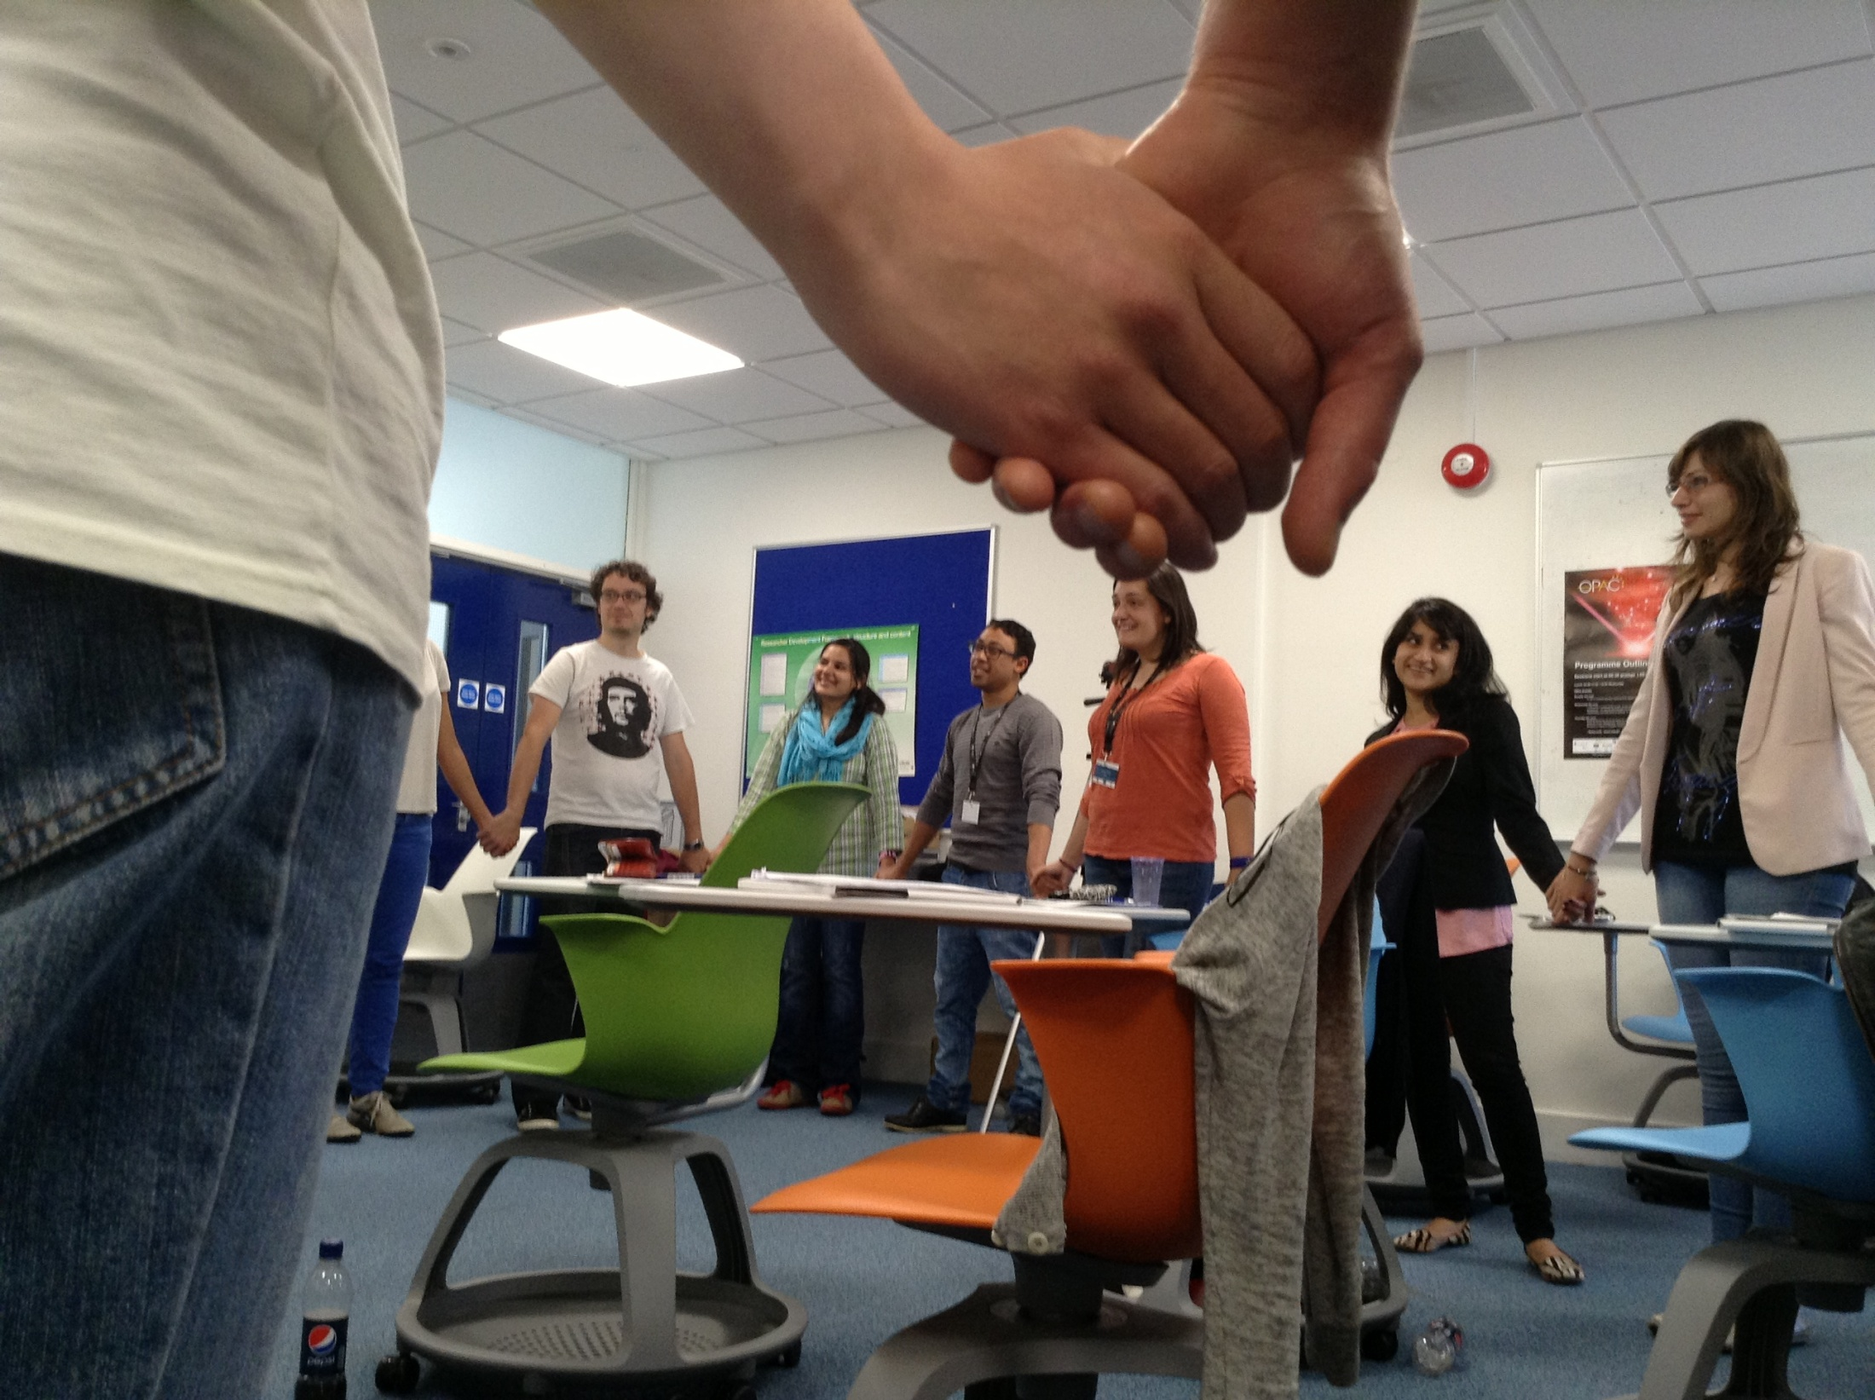

Course Structure
Project-specific part
  Presentation skills
  Scientific writing
  Project management
Generic skills through outreach project
  Team working
  Proposal writing
  Peer review
  Working under (time) pressure
“I hadn’t really thought of myself
as a project manager until today!”

Slide 13
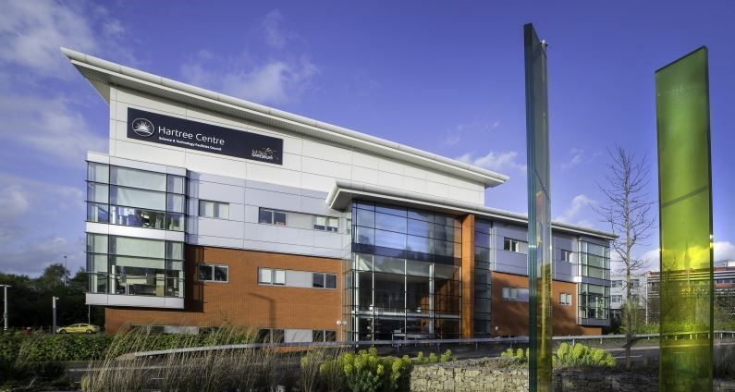
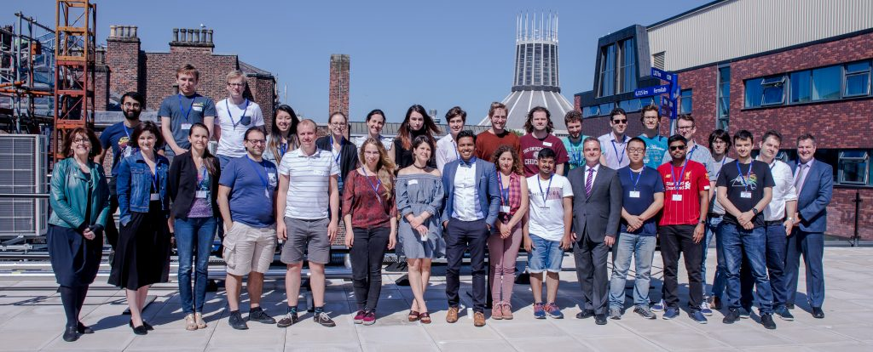
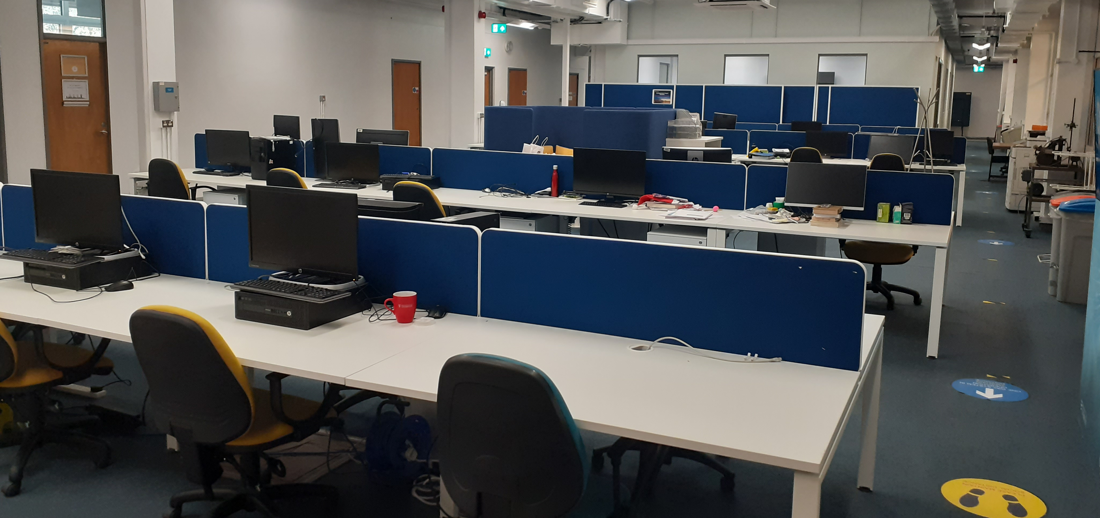

Training environment
Liverpool has outstanding track record in postgraduate training
Cohort-based training in data science, research and innovation, complementary skills, and courses offered by partners
Inclusive environment that offers some unique opportunities for LIV.INNO students (e.g. CUWIP)
Notes:
overall quality of the research training environment and cohort approach to training focused on the student experience. For example, how specific training on data intensive science techniques and innovation will be delivered on a cohort basis
degree to which you are supporting a healthy and inclusive research and innovation culture, including the approach to equality, diversity and inclusion.

Slide 14
Your training time line
Year 1
Year 2
Year 3
Year 4
 | Taster placements | Industry placements
Complementary Skills School Canvas course Data Science |  | School on Data Science and Applications | Advanced Skills School
 | CUWIP 2023 | Outreach Symposium | Careers Workshop
PGCert in Big Data |  | Data Science in Healthcare Workshop
Cohort visit to the STFC Hartree Centre | LIV.INNO Student Seminars
PGR training courses by clusters and LIV.INNO Virtual Seminars
Specialist courses by Hartree and Nvidia |  | DataAid
Development Needs Analysis, updated quarterly

Slide 15
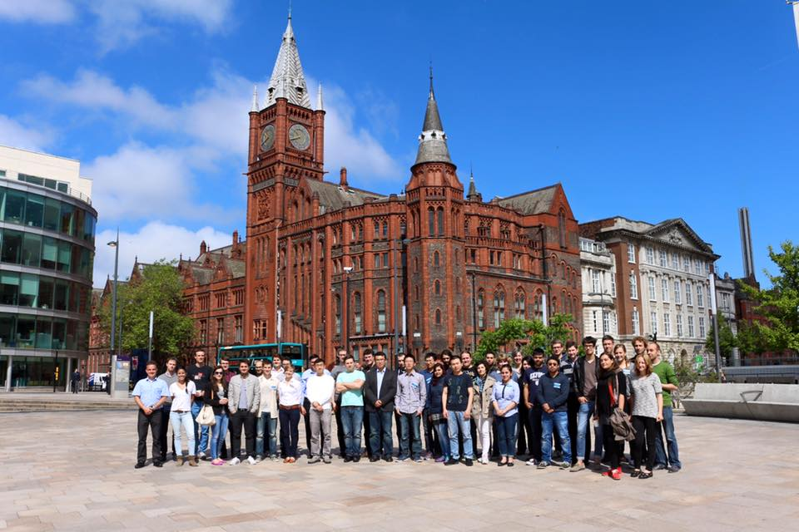
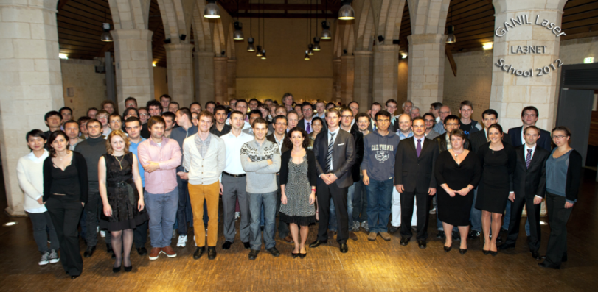
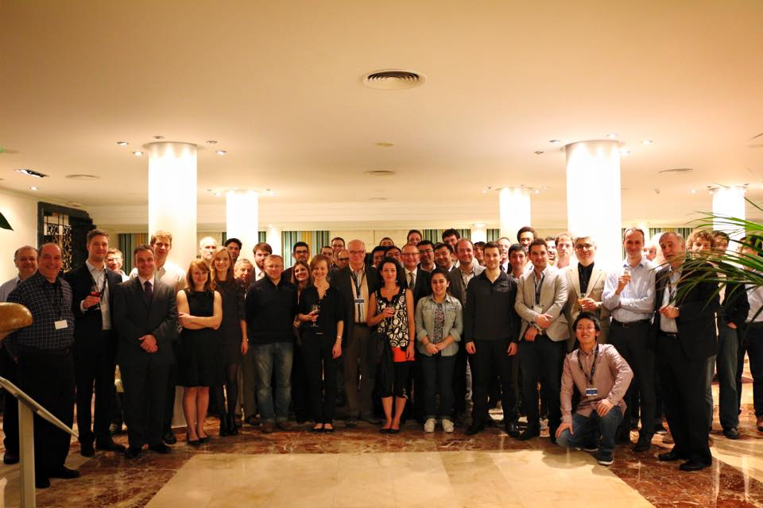
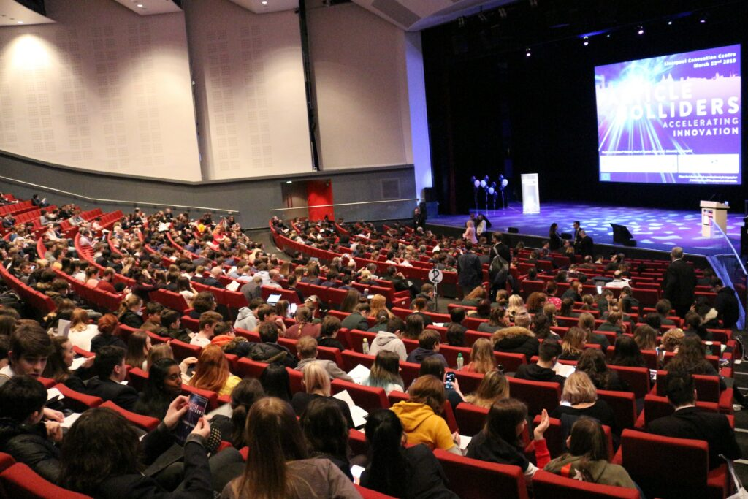
Inter/national events
International Schools, CDTs School
Targeted Workshops on focused R&D area
International Symposium in 2026!

Slide 16
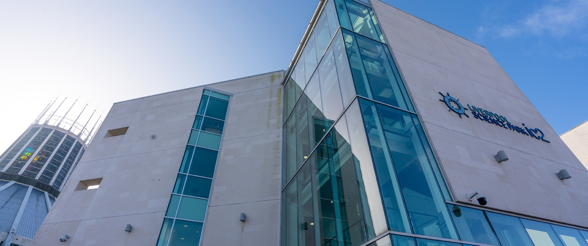
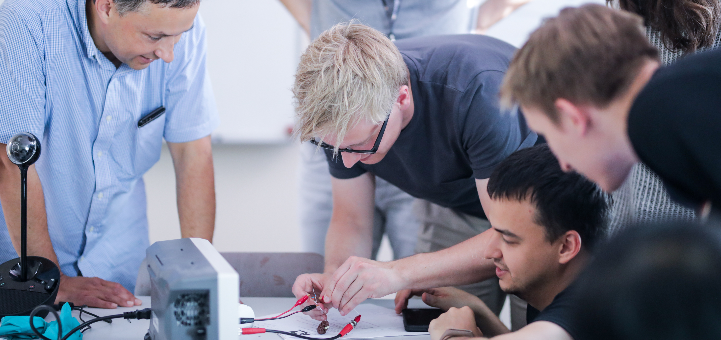

Partnership & engagement
Long-standing collaboration between UoL and LJMU
Strategic partnership with STFC Daresbury
Strong links with research centres and SMEs.
Partners co-define PhD projects, act as co-supervisors and mentors, and provide important input to LIV.INNO management.
This is relevant for all of you!!! => PDR
Notes:
relevance and strength of the links formed with other organisations (particularly local small and medium enterprises) and other potential users
extent of their involvement in determining and providing input to the proposed training programme, in mentoring and co-supervising students and in exploiting the outcomes of the research and training, and overall involvement in helping to manage the centre
- evidence of what plans are there to match students to placements and monitor their progress, and strength of the research innovation arising from those placements.

Slide 17











Support for LIV.INNO
Excellent commitments from partners and universities:
    Large number of studentships confirmed;
    Fantastic placement opportunities and joint projects;
    Bespoke student areas and training spaces;
    Centre Manager and admin support.
Almost a dozen LIV.INNO students have started this year!
But: relevant for all of you – shape your PhD!!
Notes:
Strong commitment from partner institutions
The level of funding, in addition to that provided by STFC and UKRI, that would be available for supporting additional studentships and associated training activities. This includes any support offered to fund placements, contributions from external sources, and the level of commitment from the institutions applying to host the centre.

Slide 18
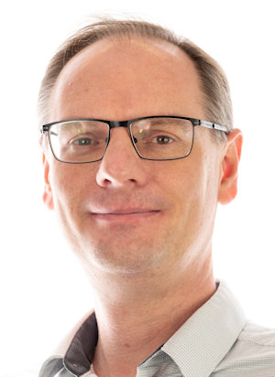
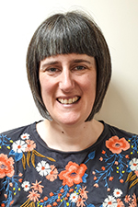
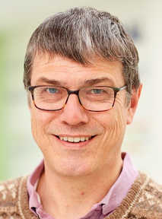
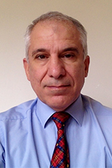
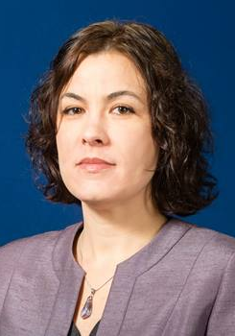
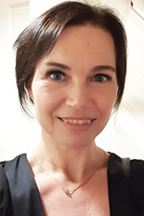
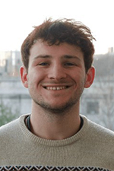
LIV.INNO
…

Slide 19
Summary
This training builds on a long history of trainings we have provided to generations of PhD students. Their feedback has helped shape the program.
The more you engage with all activities, the more you will get from this week! Homework: Consider this carefully and apply to your PhD project!
The outreach activity shall become part of Daresbury Open Week this summer and will also be useful for future events such as as our 2026 Symposium.

