Slide 2
Outreach
LIV.INNO Introductory Skills School
3-6 April 2023

Slide 3
What is outreach?
Engaging others with your work
Specifically those who would not otherwise be engaged
Can be friends and family but more often people who you engage with at an organised event
Engaging people who would know about or want to know about your work anyway don’t count!
Outreach can take many different forms (more about that later)

Slide 4
Why do we do outreach?
To be transparent about what we are doing and why
To help us better understand the public and the public understand us
To show a commitment to our work having a wider societal benefit
To allow the public to take part in informed debate about what we do
To show the relevance of research to people’s every day lives
Public engagement/outreach is usually a requirement of any funding. It should be seen as an integral part of the project and not just as a small add on which is required to satisfy funders.

Slide 5
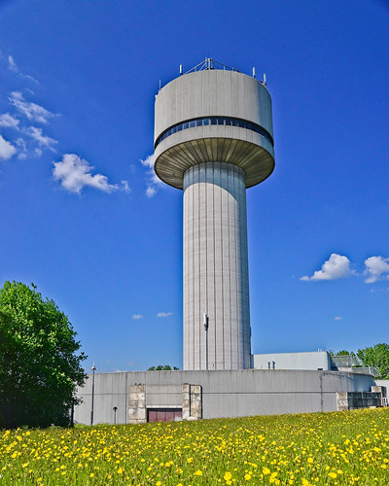
Opportunities for outreach in LIV.INNO
Symposium (due to take place in 2026)
School Visits
Daresbury Open Week (more about that later)
STEM Ambassador Opportunities

Slide 6
STEM Ambassadors
We would like you all to train as STEM ambassadors
Local STEM Ambassador Hub run by All about STEM ambassadors@allaboutstem.co.uk, www.allaboutstem.co.uk
Opportunities to go into schools etc
How many are already STEM Ambassadors?

Slide 7
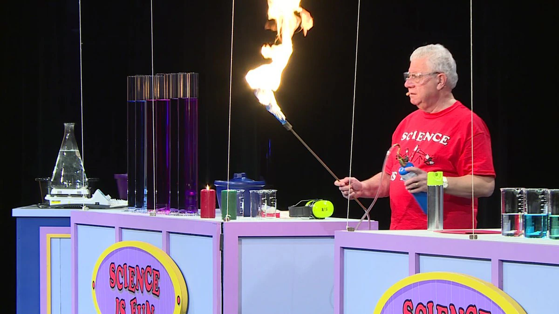
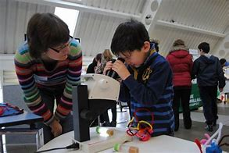
Types of outreach
Talk/lecture/presentation
Lesson in school/workshop
Science Fair
Busking
Pint of Science
Science Show
Online (blogs, citizen science etc)

Slide 8
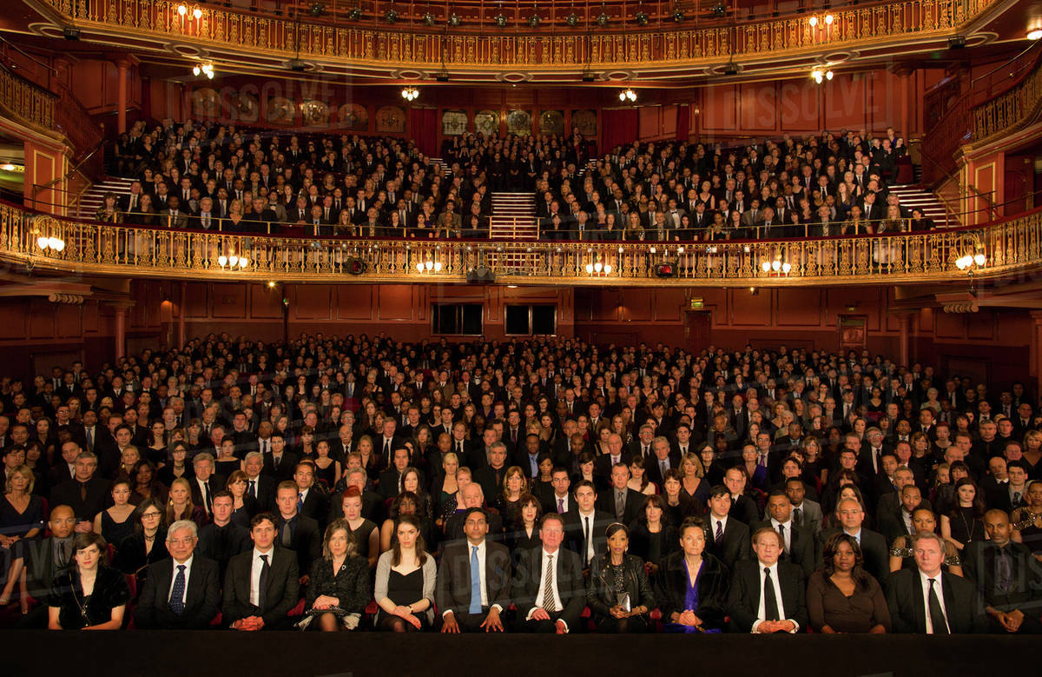
Audiences
Most common audiences
School children
Families
Adults
Outreach can be targeted at people with a particular characteristic
Gender
Age
Science Capital
Socio-economic status
Where they live
Target audience should never be the ‘general public’!

Slide 9
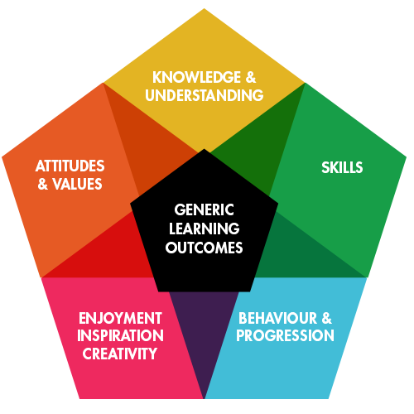
Objectives
What are you trying to achieve with your outreach?
Learning?
Enjoyment?
Change in attitude or behaviour?
Ticking a box for a project?
Generic Learning Outcomes are a good way to think about this
Your objectives should always include some these

Slide 10
Learning Styles
Many different theories of learning style, but all break down roughly into these three categories
Hearing/Listening
Reading/Seeing
Doing
There is no right or wrong learning style, just remember other people may learn differently to you
Not everything can be taught (efficiently and effectively) using every learning style
Try to incorporate as many styles as you can into your outreach

Slide 11
Capturing your audience’s attention
Good demos
Hydrogen balloon
Plasma ball
Magnets
Fascinating/unbelievable facts
The CERN Data Centre stores more than 30 petabytes of data per year from the LHC experiments, enough to fill about 1.2 million Blu-ray discs
Everything that you are made of was once part of a star
Time slows down and objects become heavier when you travel at very high speeds

Slide 12
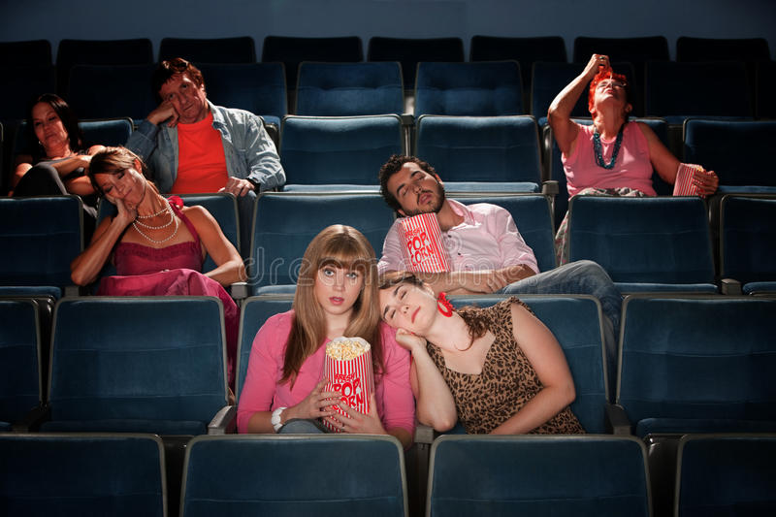
Do you need a PowerPoint presentation?
No, not always. But it can be helpful.
Don’t just read your PowerPoint
It can contain text, but not every word you are going to say
Pictures are much more useful
For outreach to non-specialist audiences
Try to avoid words on your slides
Just include images
Or don’t use a PowerPoint presentation at all

Slide 13
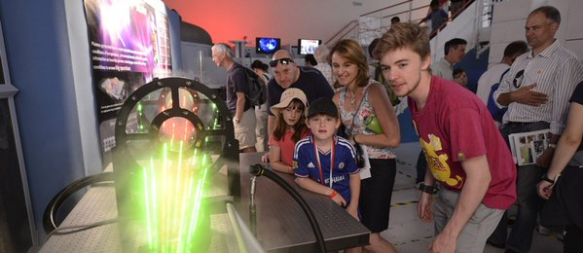
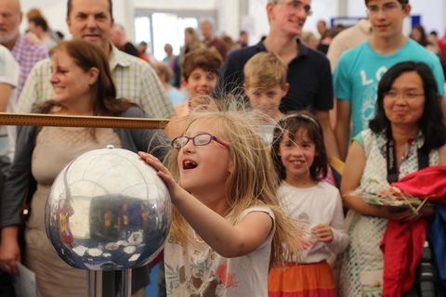
Daresbury Open Week
Takes place at Daresbury Laboratory (near Warrington) on 10th, 11th and 15th July
Schools on Monday 10th and Tuesday 11th July (KS2 – A level)
Public open day on Saturday 15th July with up to 7000 people
Both events include a science fair which we would like you to take part in
Lots of exhibitors in a large marquee
You will have a small space within this area

Slide 14
Your outreach idea
We would like all outreach ideas to be connected to LIV.INNO
Theme of Daresbury Open week is Space
You will all present your ideas to each other on Thursday
Sessions throughout the week to develop these ideas

Slide 15
Groups
Group 1
Jonah Conley
Alex Jury
Patrick Bates
Ned Howarth
Group 2
Lauryn Eley
Andrew Jones
Andrea Sante
Will Butcher
Charlie Kinsman
Group 3
Katie Ferraby
Robert McNulty
Megan Carter
Kieran Leadbetter
Group 4
Rupesh Ghagi
Ryan Roberts
Thomas Wonderley
Bhupesh Dixit
Abbie McCarrick

Slide 16
Monday
What science do you want to present?
How do you want to present it?
Who is your audience for this presentation (you can choose all the groups or just some of the groups already given)?

Slide 17
Wednesday
Are there any IP issues to consider with your proposal?
You should also consider a budget for your idea
Please provide a breakdown of costs (people’s time and anything you need to buy)
Please state the aim and some objectives for your idea
Please provide an analysis of the risks
Please write a project management plan for your outreach idea

Slide 18
Thursday
Consider how you would promote your outreach idea via social media
Prepare a 15-minute presentation on your project to include the points you have been asked to consider each day
What science do you want to present?
How do you want to present it?
Who is your audience for this presentation (you can choose all the groups or just some of the groups already given)?
Are there any IP issues to consider with your proposal?
You should also consider a budget for your idea
Please provide a breakdown of costs (people’s time and anything you need to buy)
Please state the aim and some objectives for your idea
Please provide an analysis of the risks
Please write a project management plan for your outreach idea
Consider how you would promote your outreach idea via social media

Slide 19
Final presentations

Slide 20
Outreach peer review
Discuss the merits of the other presentations you have seen.
Give feedback saying which idea you liked best, why this was and if there are any ways you can think of to impove the idea.
You will have approx. 30 mins to discuss and then 5 minutes of feedback from each group

