Slide 2
Introduction to Science journalism
Andrew Glester

Slide 3
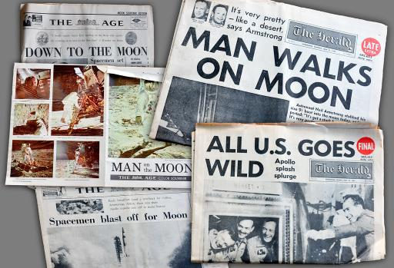
Where do you get your news?
Newspapers
Magazines
Radio factual programming
TV factual programming
Internet news sites
Blogs
Twitter
Facebook
Reddit
Podcasts
Other news and information oriented social media

Slide 4
What is Journalism?
On the roles of scientists, press officer and journalists
Weitkamp, E. & Eidsvaag, T. (2014) Journalism Practice, 8(6) 871-886.
Boundaries
Lowrey (2006)
What is the role of journalism in society?
The Fourth Estate (Shultz, 1998)

Slide 5
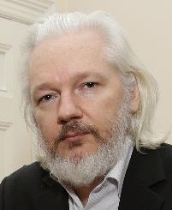
Wikileaks
“Our goal is to bring important news and information to the public. We provide an innovative, secure and anonymous way for sources to leak information to our journalists (our electronic drop box). One of our most important activities is to publish original source material alongside our news stories so readers and historians alike can see evidence of the truth.”
Julian Assange

Slide 6
What is a journalist?
In pairs discuss what a journalist is
Draw a picture and use that to explain your thinking

Slide 7
“There is much to be said in favour of modern journalism. By giving us the opinions of the uneducated, it keeps us in touch of the ignorance of the community.” Oscar Wilde

Slide 8
What is a journalist?
A journalist is someone employed to regularly engage in gathering, processing, and disseminating (activities) news and information (output) to serve the public interest (social role).’ Peters & Tandoc, 2013

Slide 9
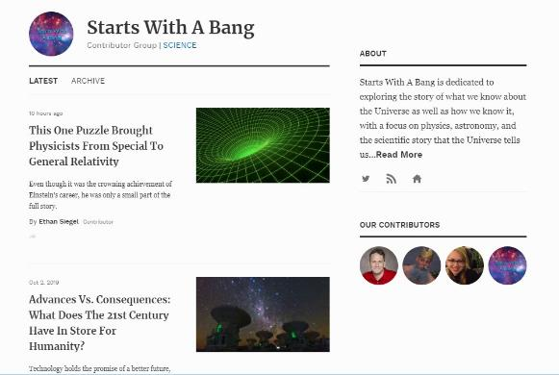
Scientist vs Science Journalist

Slide 10
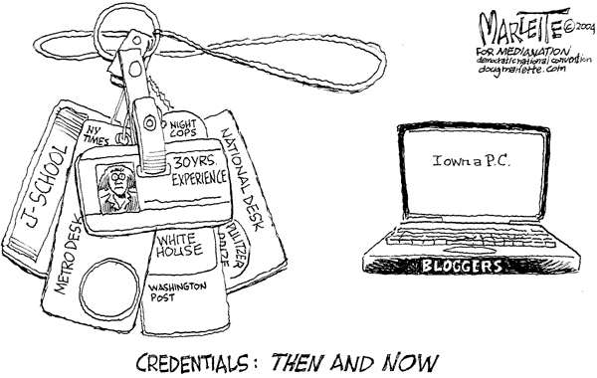
Media landscape
‘traditional’ journalist
Institutional role, professional norms, paid
‘citizen’ journalist
outside institutions, no professional norms, paid?
user generated content (UGC)

Slide 11
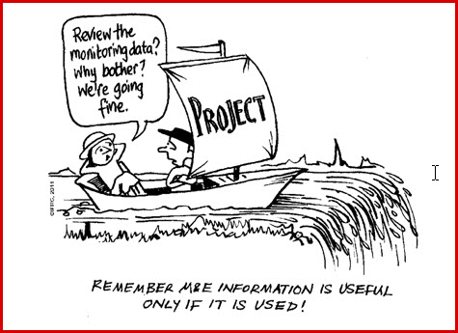
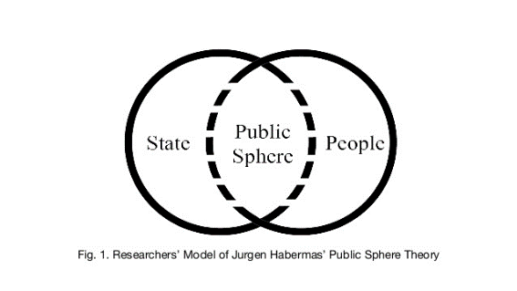
Theoretical Position
Press freedom
Social constructivist view of the media
Propaganda model of media (Chomsky)
Public sphere – place for debate (Habermas)

Slide 12
Qualities of a journalist
Sceptical
Compassionate (for interviewees, victims)
Seek social justice
Acknowledge and work with their biases
Tenacious
Able to secure sources
Adaptable (to changing media landscape)
Know the law
Open minded
Have integrity

Slide 13
Practical tensions for journalists
McQuail identified a number of tensions that journalists face:
constraints (e.g. formulaic writing) vs autonomy
routine (deadlines, house style etc) vs creativity
commerce (eg direct intervention by advertisers but also content needed to meet audiences drawn by advertisers) vs art
profit vs social role
McQuail, 2005

Slide 14
What is News?
"News is a report of what a news organisation has recently learned about matters of some significance or interest to the specific community that news organisation serves" (Fuller, 1999:6)
Something the audience:
doesn’t already know
might find interesting
might talk about or use
ought to know about
See as Entertainment?

Slide 15
News Values
Relevance
Stories that may have a direct impact on the reader
Surprise
Stories reporting unexpected findings
Bad news (conflict stories)
Disasters, such as tidal waves, can be a peg for science stories, as can stories focusing on conflict between scientists
Good news
New cures and treatments, technological advances
Magnitude
Stories with a high potential impact or which might affect large numbers of people
Entertainment
Interesting, fun facts and pretty science based pictures
Power Elite
Stories arising from research conducted at well known institutions or published in top journals, e.g. Science, Nature
Celebrity
Science stories sometimes focus on well known people (scientists or other celebrities)
Follow ups
Stories already in the news can be given a science twist
Media agenda
Science stories that fit the organisations own agenda
(Harcup and O’Neill, 2001:279 also Brake & Weitkamp, 2009)

Slide 16
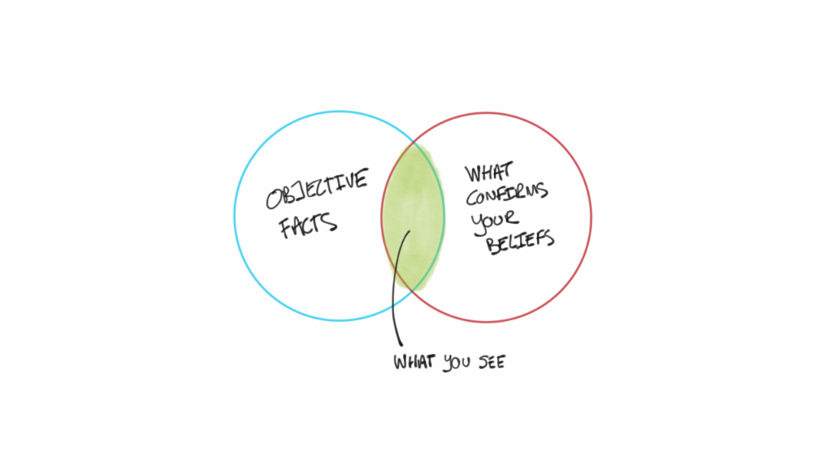
How might News Values lead to a bias in reporting?

Slide 19
References
Brake, M. and Weitkamp, E. (2010) Introducing Science Communication, Basingstoke: Palgrave Macmillan
Fuller, S. (1999) Governance of Science: Ideology and the Future of the Open Society, London: Open University Press
Harcup, T. and O’Neill, D. (2001) What is news? Galtung and Ruge revisited, Journalism Studies 2(2):261-280.
Marshall, M. (2019). Bad PR. [online] Bad PR. Available at: https://badpr.co.uk/ [Accessed 3 Oct. 2019].
McQuail, D.(2005) McQuail’s Mass Communication Theory, London: Sage
Peters, J. and Tandoc, E.C. Jr. (2013). N.Y.U. J. Legis. & Pub. Policy Quorum, 34. http://www.nyujlpp.org/wp-content/uploads/2013/03/Peters-Tandoc-Quorum-2013.pdf
Lowrey, W. (2006). Journalism, 7 477-500
Shultz, J. (1998). Reviving the 4th Estate: democracy, accountability and the media. Cambridge: Cambridge University Press
Weitkamp, E. & Eidsvaag, T. (2014) Journalism Practice, 8(6) 871-886.

Slide 20
Science blogs
An Introduction to Blogging
News article structure and how blogs break the rules.
How a spat on a Kate Bush fan forum led to the creation of blogs.
The purpose of science blogging.
Who reads science blogs.

Slide 21
Typical components of a blog
Personal experience
Description
Background
Comment/opinion
Based on something new
Include a factual element

Slide 22
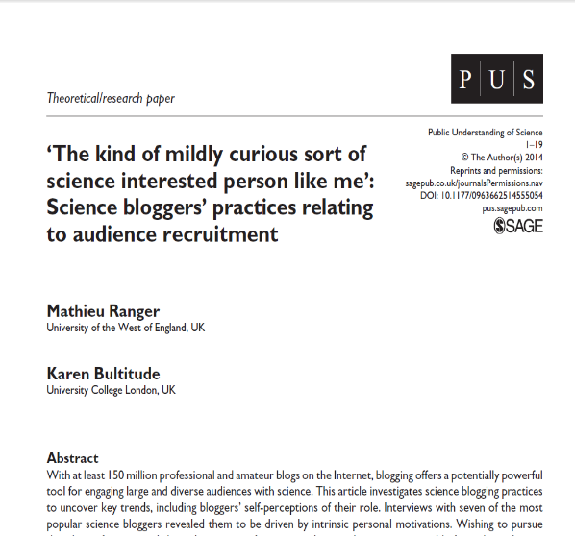
Research on popular science blogs

Slide 23
What they found
Bloggers assume their audience has an interest in science but they don’t necessarily have a background in it.
“The kind of mildly curious sort of science interested person like me”
Average of 4 posts a day
Use non-text elements, such as images and videos to draw people in.
Relatively high word count: average of 466 words compared to 274 for the most popular non-science blogs.
Include the wider context of the science.
Written for non-specialists: avoid jargon and use analogies.

Slide 24
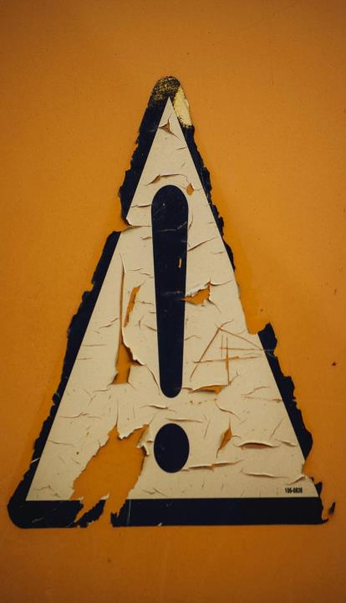
That means…
You need to explain science clearly for those not familiar with it
You also need to get their attention…that means making what you’re communicating is relevant to them and their lives (when the topic allows)
So that involves: reformulation and recontextualisation
Markus Spiske, Unsplash

Slide 25
Reformulation… is important.
It involves writing something in such a way that it will make sense to your reader, given that they will know less about the science your communicating than the authors of the research paper.
Calsamiglia and Van Dijk, 2014
Henry Be, Unsplash

Slide 26
‘Recontextualization’ of specialised knowledge is important so that non-specialised readers can integrate the knowledge into their frame of reference. In other words, what can I take from this? Why should I care?
Calsamiglia and Van Dijk, 2004
Rodrigo Gonzalez, Unsplash

Slide 27
Sometimes it’s a question of taking a step back and explaining concepts/techniques they need to know about to understand what you’re saying or writing

Slide 28
Meet people where they are
It’s all about the audience
Markus Spiske, Unsplash

Slide 29
News article structure
Learning the rules
(Later, we’ll break the rules)

Slide 30
The 5 Ws (…and an H)
Who did the research?
What did they do?
When did they do it?
Where did they do it?
Why did they investigate this?
…and How?

Slide 31
Most newsworthy info: the ‘hook’
Important details
Additional info, including quotes
Background info
More background

Slide 32
Above all….
Keep it simple!

Slide 33
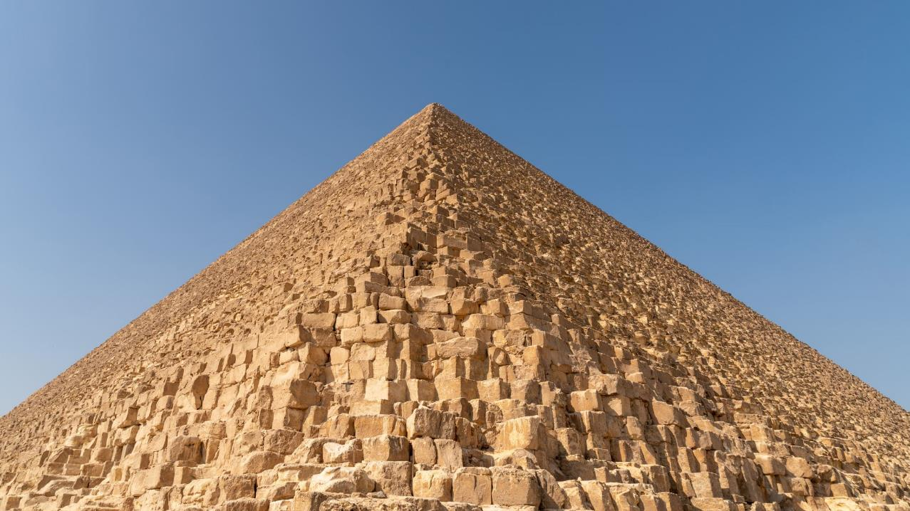
The inverted pyramid
Lead: Who, what, where, when, why?
Details: Expand on facts. How?
Context: Background, related facts.
Adapted from: Martin, M. (2007) Science journalism: an introduction. Routledge.

Slide 34
Narrative
Beginning
Middle
End
Emde, K., Klimmt, C., and Schluetz, D. (2016) Does Storytelling help Adolescents to Process the News? Journalism Studies, 17(5), pp. 608-627.
Yaros, R. A. (2006) ‘Is It the Medium or the Message? Structuring Complex News to Enhance Engagement and Situational Understanding by Nonexperts’, Communication Research, 33(4), pp. 285–309.

Slide 35
News article structure exercise
Lead: Who, what, where, when, why?
Details: Expand on facts. How?
Context: Background, related facts.
Beginning
Middle
End

Slide 36
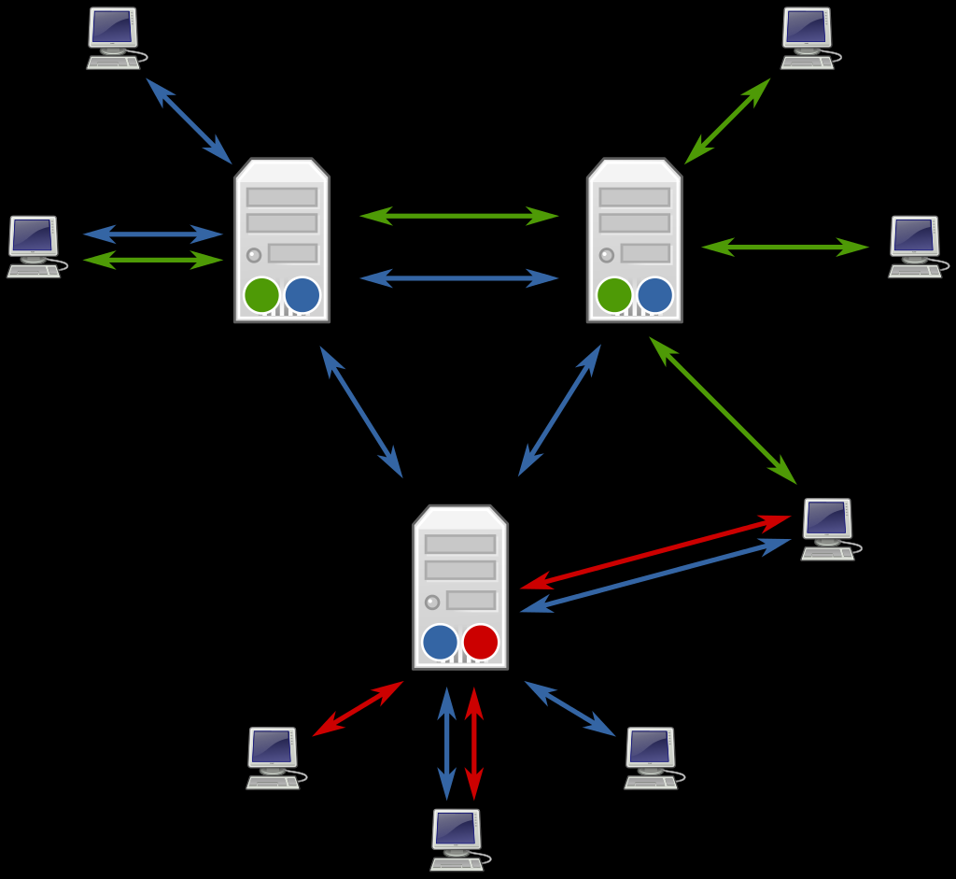
What is a blog?
Some history involving a spat on a Kate Bush fan forum

Slide 37
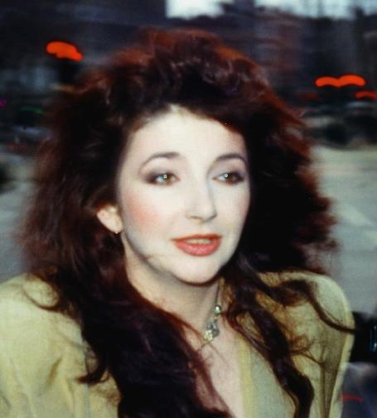
What is a blog?

Slide 38
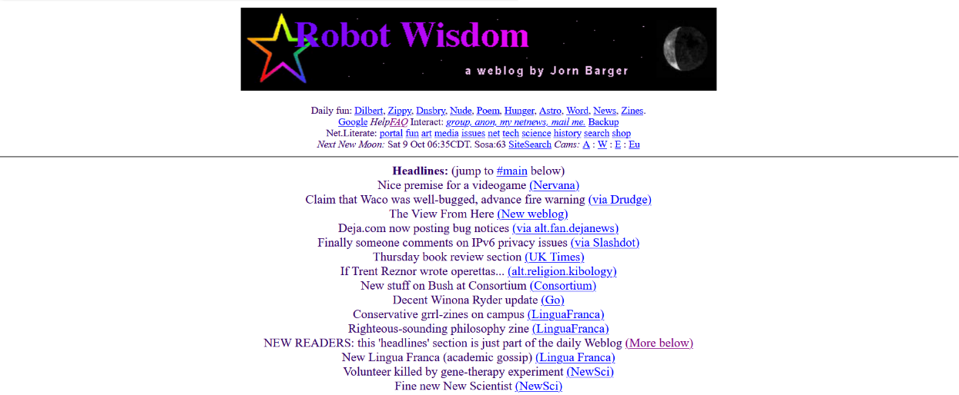
What is a blog?
Barger, J. (1998) Robot Wisdom. Available from: https://web.archive.org/web/19991008162407/http://robotwisdom.com/.

Slide 39
What is a blog?
“A weblog (sometimes called a blog or a newspage or a filter) is a webpage where a weblogger (sometimes called a blogger, or a pre-surfer) 'logs' all the other webpages she finds interesting. The format is normally to add the newest entry at the top of the page, so that repeat visitors can catch up by simply reading down the page until they reach a link they saw on their last visit.”
Jorn Barger 1999

Slide 40
What is a blog?
Merholz, P. (1999) welcome to peterme.com. Available from: https://web.archive.org/web/19991013021124/http://peterme.com/index.html

Slide 41
What is a blog?
Regularly updated
Interactive/community-building
Commentary and insight
Informal
Easy to publish
Low cost
Adapted from: Mollett, A. (2021) Communicating Your Research with Social Media ‘A Practical Guide to Using Blogs, Podcasts, Data Visualisations and Video’ SAGE Publishing.

Slide 42
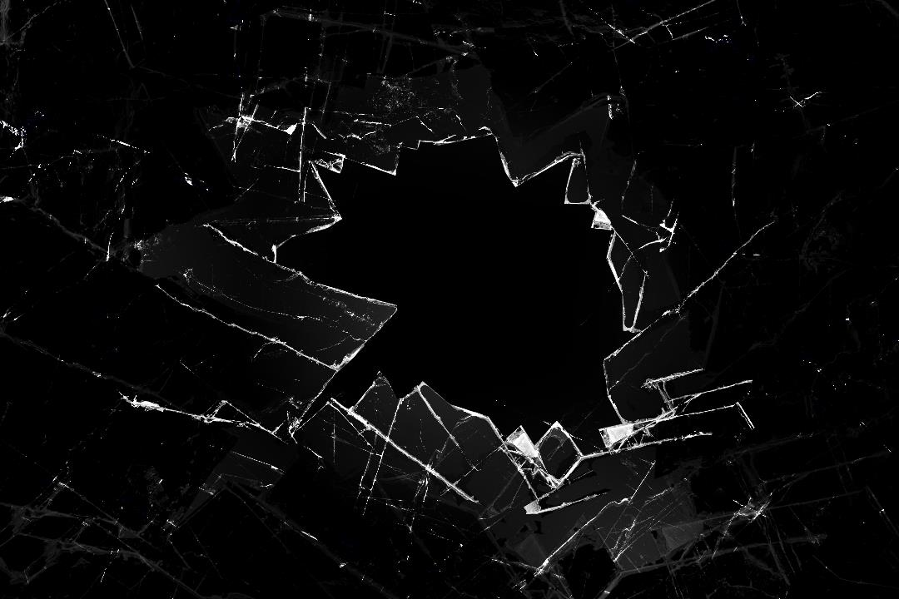
Breaking the rules
Science blogs exist in a space between internal scientific and external public communication (Mehlenbacher 2019)
Blogs are more personal, informal and dialogic, and critique and recontextualise research (Luzón 2013)
Unique feature of blogs is the combining of personal, popularised and specialist styles of writing (Luzón 2013, 2017)
Blogs have a “weaker” structure than traditional articles (Mehlenbacher 2019)
Scientific language often blended with explanatory text and summary (Mehlenbacher 2019)
Fuzzy distinction between news and opinion (Brossard 2013)

Slide 43
Breaking the rules
Types of science blog post:
Explanatory
Roundup
Takedown
Notice
Autobiographical
Pedagogical
Rhetorical Moves:
Establishing interest (lead or hook)
Explaining significance
Illustrating the case
Re-establishing interest
Encouraging action
Citing sources
Personalising
Adapted from: Mehlenbacher, A. (2019) Science Communication Online : Engaging Experts and Publics on the Internet. The Ohio State University Press.

Slide 44
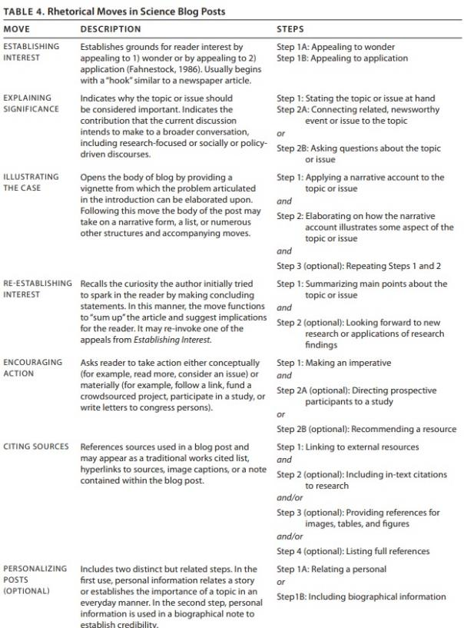

Slide 45
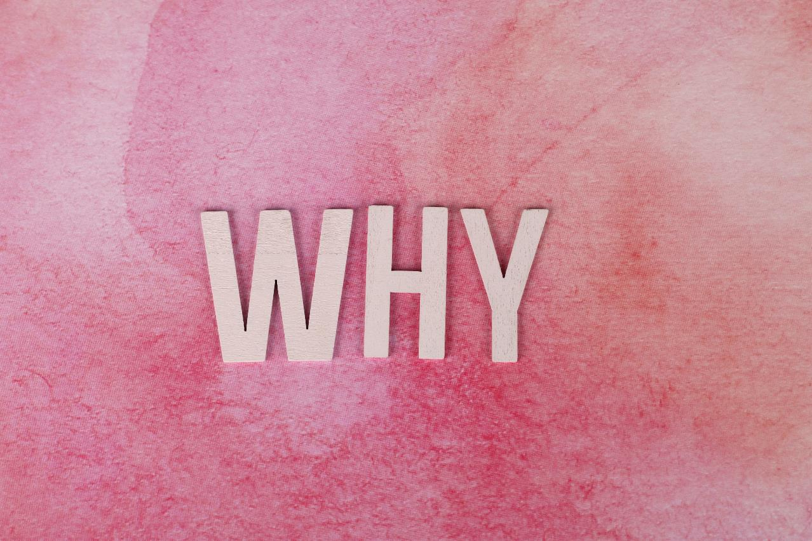
What is the purpose of a science blog?
Or, why blog?

Slide 46
What is the purpose of a blog? (or, why blog?)
Inspire your own research
Have impact on policy
Influence mainstream media
Highlight other research outputs
Adapted from: Mollett, A. (2021) Communicating Your Research with Social Media ‘A Practical Guide to Using Blogs, Podcasts, Data Visualisations and Video’ SAGE Publishing.

Slide 47
What is the purpose of a blog? (or, why blog?)
From: McKenzie, D., & Özler, B. (2014). Quantifying Some of the Impacts of Economics Blogs. Economic Development and Cultural Change, 62(3), 567–597.

Slide 48
Blog reading exercise
Find and read through a science blog post online:
What type of blog post is it?
Explanatory
Roundup
Takedown
Notice
Autobiographical
Pedagogical
What is the purpose of the blog post?
How does the blog post open and establish interest? What is the lead or hook?
How does the blog post explain the significance of the science?
How much detail does the post give?
Does the blog post use any scientific language?
Are there personal or informal elements in the post?
Can you infer the intended audience of the blog post?

Slide 49
The case of #arseniclife
29th November 2010 – NASA publishes an enigmatic press release, hailing an as yet unspecified "astrobiology finding that will impact the search for evidence of extraterrestrial life”, causing wild speculation online.
2nd December 2010 – Science publishes an article which claims to have cultured bacteria which can replace phosphorous with arsenic.
Yeo, S. K., Liang, X., Brossard, D., Rose, K. M., Korzekwa, K., Scheufele, D. A., & Xenos, M. A. (2017). The case of #arseniclife: Blogs and Twitter in informal peer review. Public Understanding of Science, 26(8), 937–952.

Slide 50
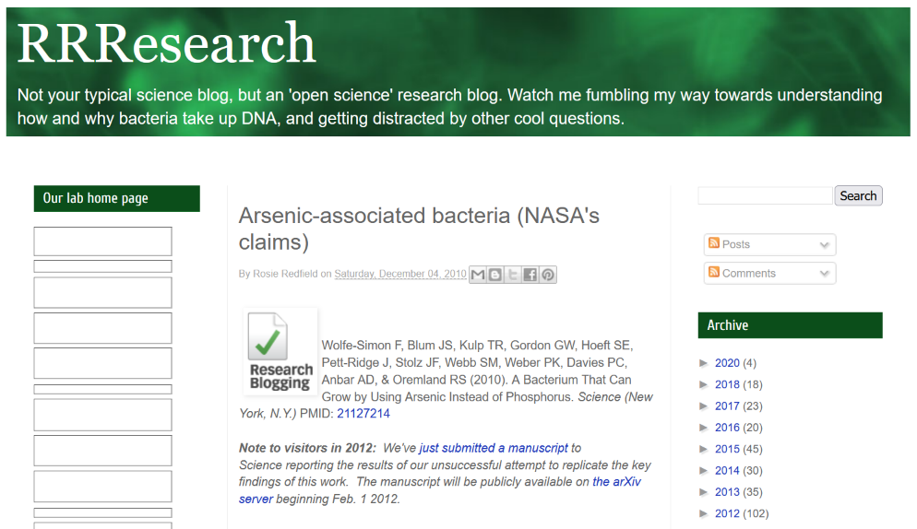
The case of #arseniclife
4th December 2010 – RRResearch publishes a critique of the Science article, citing flaws in the study.

Slide 51
The case of #arseniclife
5th December 2010 – One of the authors responds on Twitter, that academic discussion should be kept in a scientific venue, not done in public.
6th December 2010 – CBS News quotes the RRResearch blog, which generates a flurry of comments and other blog posts.
8th December 2010 – Discover Magazine criticises NASA for being hypocritical, accusing them of doing science “by press release”.
RRResearch publishes a letter to be submitted to Science, asks for feedback and encourages others to write to Science.

Slide 52
The case of #arseniclife
Early 2011 – Public interest in #arseniclife wanes.
27th May 2011 – RRResearch posts decrying the lack of follow up.
1st February 2012 – RRResearch posts, announcing the submission of their #arseniclife paper.
July 2012 - #arseniclife paper published.
… The original Science paper was not retracted.

Slide 53
Discussion: Should blogs be used for informal post-publication peer review?
Should RRResearch have publicly critiqued the original Science article?
Was it right for one of the authors to insist that scientific discussion be kept only to academic publications?
Should the flawed study have been retracted following the RRResearch blog post?

Slide 54
What is the purpose of a blog? (or, why blog?)
Circumvent traditional media (Mahrt and Puschmann 2014; Colson 2011)
Invite cross-disciplinary discussion (Mahrt and Puschmann 2014)
Provide rapid/timely information (Vestergaard 2016; Mahrt and Puschmann 2014)
Informal peer review (?) Increase transparency of research (Yeo et al. 2016)
Share your passion and personal interest (Ranger and Bultitude 2014)

Slide 55
Tips on writing opinion articles
Give your opinion.
Back up what you say with evidence.
Think about your reader.
Grab your readers’ attention.
Making it personal often helps.
Keep it simple
Offer solutions and improvements and avoid banal suggestions.
Don’t feel like you need to give both sides of the argument
Write in the style of the publication you’re writing for
Give your writing personality – your own personality.

Slide 56
Blog writing exercise
Have a go at writing your own blog
Choose a recent science story which interests you (or your own research) to base your post around
Consider the following points:
What is your target audience?
What type of post will you write? What structure will you use?
What is your lead/hook?
What style and tone will you use?
How will you inject personal and informal elements?
Will you use scientific language? What level of explanation is needed?

Slide 57
Who reads science blogs?

Slide 58
Who reads science blogs?
Most science blogs cater to a niche, small, interested audience (Ranger and Bultitude 2014)
Mostly scientists or those interested in a science career (Jarreau and Porter 2017, Jarreau 2016)

Slide 59
Who reads science blogs?
Motivations:
Seeking unique information not available elsewhere
Looking for community
Entertainment
“Ambiance” (author’s perspective, quality writing)
Reader Groups:
One-way entertainment (no science degree or career interest)
Information-seeking (older, most scientists)
Super-users (younger, most students)
All have a high level of science knowledge
“elite, highly educated, mostly scientists or future scientists who actively seek out science media”
Adapted from: Jarreau, P. B., & Porter, L. (2018). Science in the Social Media Age: Profiles of Science Blog Readers. Journalism & Mass Communication Quarterly, 95(1), 142–168.

Slide 60
Considerations
Style
Tone (formal/informal?)
Platform (Wordpress? Blogger? Medium? Substack?)
Target audience
Types of post
Schedule
Promotion and reader engagement

Slide 61
Summing up:
Blogs exist somewhere between scientific and popular communication
An inverted pyramid structure is a good place to start
Science blogs are mostly read by people actively seeking science media

Slide 62
Can’t my writing do the talking?
Sadly not.
Readers have much more choice, less time and much more information
Evolving: new forms, new platforms, new challenges and new opportunities.
Online communications and online presence.

Slide 63
Why work to get my writing noticed?
Accessible to a much wider audience
Make a bigger difference: Change policy, practice, lifestyles or attitude
Highlight the more significant aspects (rather than let someone else craft the take-home message for you)

Slide 64
Digital Disruption
Shorter attention span?
Shorter writing?
A more nuanced future?

Slide 65
Techniques, tips and tricks
Know your audience
01
Know your platform
02
Know your writers
03
Know your editors
04
Hone your craft – practice, practice, practice.
05

Slide 66
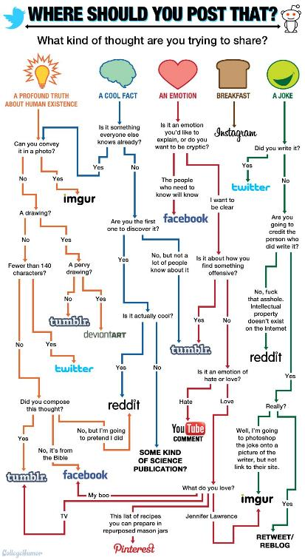
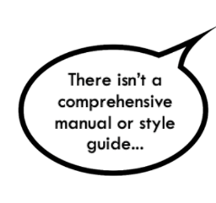
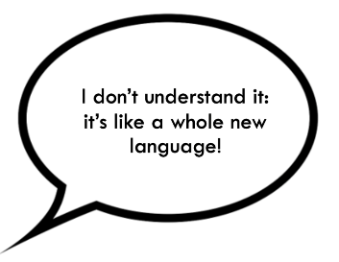
Where to share?

Slide 67
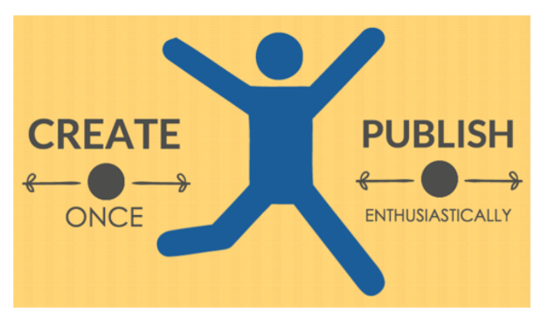
How can science writers use social media?
FOUR STRATEGIES
1. To extend your reach to different audiences
and via links.
2. TO COPE: Create Once, Publish Everywhere.
3. To re-use the wheel (use existing platforms and conversations).
4. By selecting your platforms carefully.

Slide 68
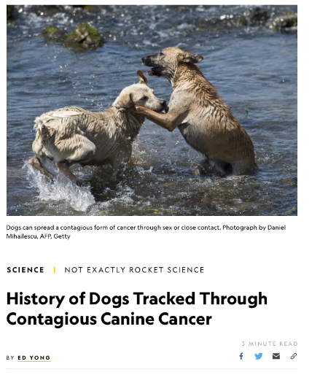
General principles for headlines
Think about your reader: use what readers know or
believe
Avoid jargon, puns and poetry
Active, not passive language
Concrete examples — don’t be abstract
Read it out loud....
https://www.nationalgeographic.com/science/phenomena/2016/05/18/contagious-dog-cancer-batteries/

Slide 69
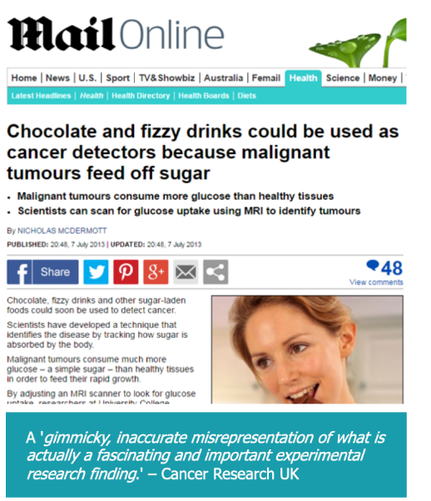
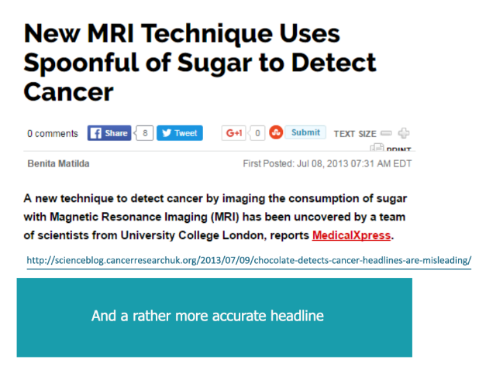

Slide 70
Headline formulas
Do any feel over- familiar?
25 things only biologists will understand
There are many formulas for online headline writing, but many are becoming over-familiar to web users
DON’T just reuse the most shared phrases in your headlines; DO use this type of research to understand what readers want to know and feel.
Assume your audience is NOT interested in your content. Use the most compelling information to craft your headline.
Offer a promise: Show how reading your writing will benefit the reader.
Ask a question.
Ask: does the headline show why the blog or article is worth the readers time?
Spark curiosity!
10 new technologies that will make you understand synthetic biology
Why we need female mice in drug trials
Which of these spark more curiosity?
Could granite solve the hard problem of nuclear waste storage?

Slide 71
Tips for writing headlines or social media posts
Observe convention (in whichever field or platform you want to write for)
Be clear and understandable
Be specific: use specific numbers and data
A single article will probably benefit from having different headlines/posts on different platforms
Write authentically: it’s fine to take advantage of trends and breaking news, but avoid click-bait titles that detract from the perceived value of your content.
Clickbait: exaggerated headlines whose main motive is to mislead the reader to ‘click’ on them.
“Click-baiting” is when a publisher posts a link with a headline that encourages people to click to see more, without telling them much information about what they will see. Clickbait intentionally omits crucial information or exaggerates the details of a story to make it seem like a bigger deal than it really is.” Facebook
(Facebook categorises headlines that withhold information as ‘clickbait’ and demotes them.)

Slide 72
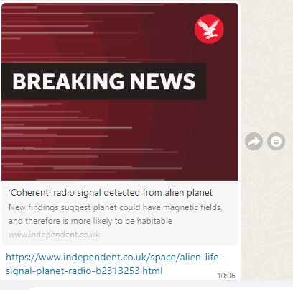

Slide 73
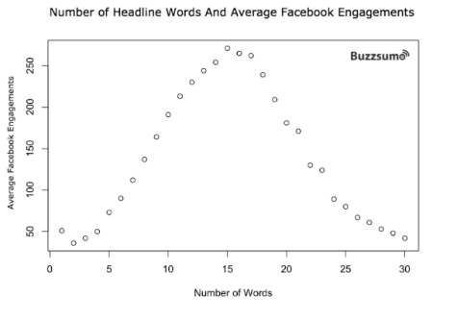
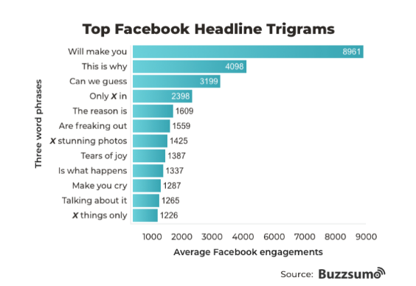
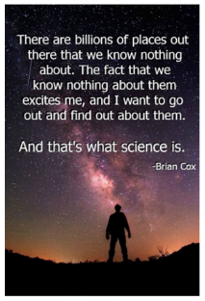
Facebook
Still a widely used social media site
• Concentrate on why the reader should care.
• Emotional phrases were consistently effective.
• Use an eye-catching image or video.
• Appeal to a readers’ curiosity.
• Keep it short and timely
• Link your post to a quote, a statistic, a cause or a question.
BuzzSumo, 2017: https://buzzsumo.com/blog/most-shared-headlines-study/

Slide 74
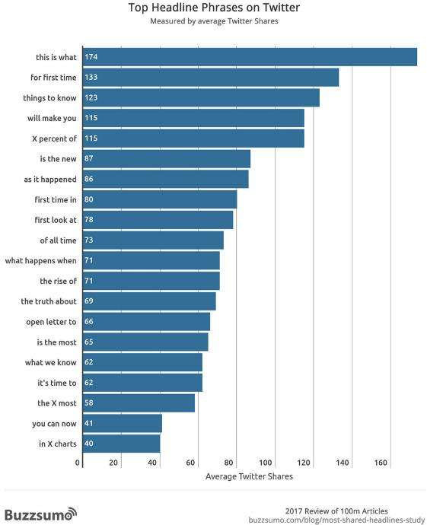
Twitter
With friends
Test:
what works for your audience?
On Twitter
With colleagues

Slide 75
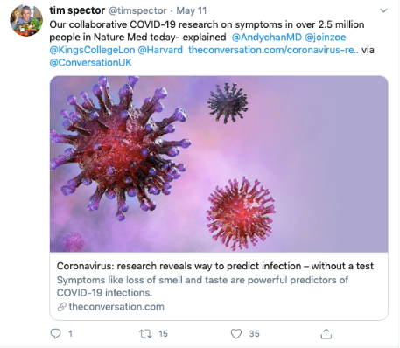
How to write tweets
Use Context; Taste; Currency; Personality
Suggestions for testing your content:
Track what you click on. Click the timestamp – circled in the picture – of the tweets that engage you. After a period, open your browser history to reveal what you clicked on.
Apply what you’ve learned and test by writing and posting two different tweets.
Observe the response and repeat.
You could also test engagement with blog headlines on Twitter before you publish – or before writing your blog!

Slide 76
Twitter
#scicomm #openaccess
#OA
#slomoSTEM
#remotelearning
#inmyshoes
#ecrchat
#fossilfriday
#junkoff
#realtimechem #chemophobia
#SciArt
#phdchat
#dataviz #overlyhonestmethods #scholarsunday #longreads
#truestories
#marchforscience
Hashtag: a phrase beginning with a hash sign, which allows users to aggregate tweets according to topic
SHOULD NOT be used for general descriptive words, as you would optimise a headline for SEO purposes (e.g. #biochemistry #cells)
Be selective: they are much more effective when used carefully to join a pre-existing conversation

Slide 77
Exercise: Write a Tweet and a Facebook post about your reearch

Slide 78
Audio-visual platforms
What opportunities to share science writing on video- and audio-based platforms?
Scripting
Image captions
Video captions
Media multitasking: accessing content on many different platforms simultaneously

Slide 79
Newsletters
Subject line – Honest and Intriguing
Clear Headings (skim reading)
Use Images
Offer Value – who are your readers? What might they want?
Call to action – link to other things
Keep it brief – a paragraph under each heading
Write to an “ideal reader”.

Slide 80
More tips and references
https://buffer.com/resources/a-scientific-guide-to-writing-great-headlines-on-twitter-facebook-and-your-blog
https://sproutsocial.com/insights/
https://journalistsresource.org/tip-sheets/
https://journalistsresource.org/tip-sheets/research/research-communicating-science-dietram-scheufele/
Carr, C.T. & Hayes, R.A. (2015). Social Media: Defining, Developing, and Divining, Atlantic Journal of Communication, 23:1, 46-65, DOI: 10.1080/15456870.2015.972282

