Slide 1





DANSS reactor antineutrino spectrometer: results for 2023
The Applied Antineutrino Physics workshops AAP 2023
18-21 September 2023
The Guildhall York, UK
Yury Shitov, IEAP CTU
for the DANSS collaboration
20/09/2023

Slide 2
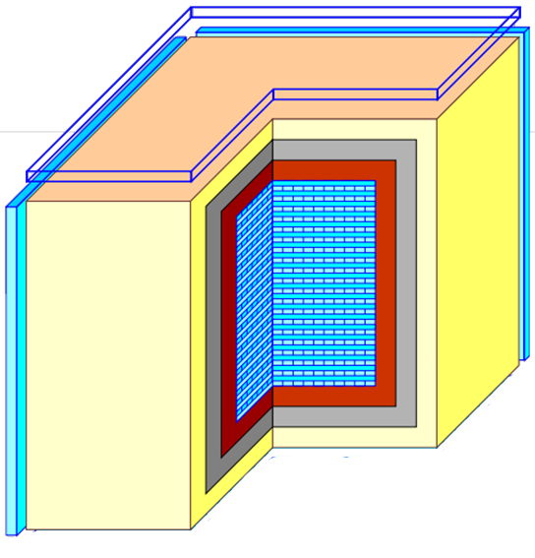
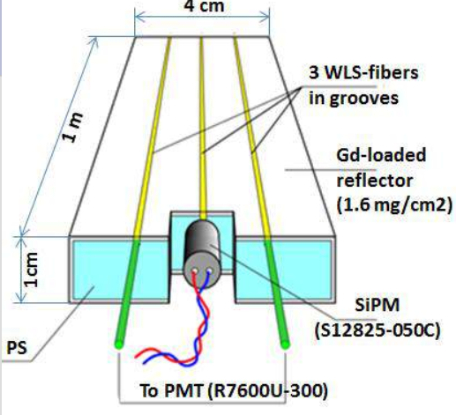
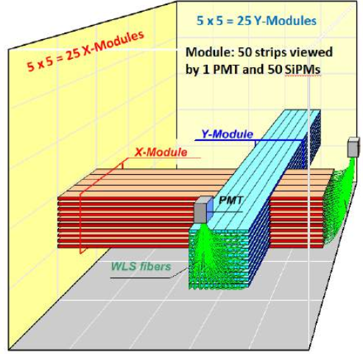
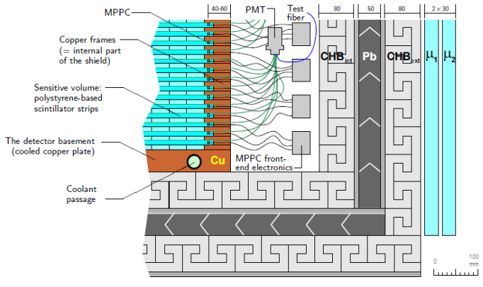
The DANSS design
Detector
Strip
Module
Shield
Cubic meter highly segmented neutrino spectrometer made of 2500 PS strips viewed by 2500 SiPMs & 50 PMTs.
Multilayer passive shielding: Cu/CHB/Pb/CHB=5/8/5/8 cm
Active muon veto made of 2 x 3 cm PS plates from all sides except bottom.

Slide 3
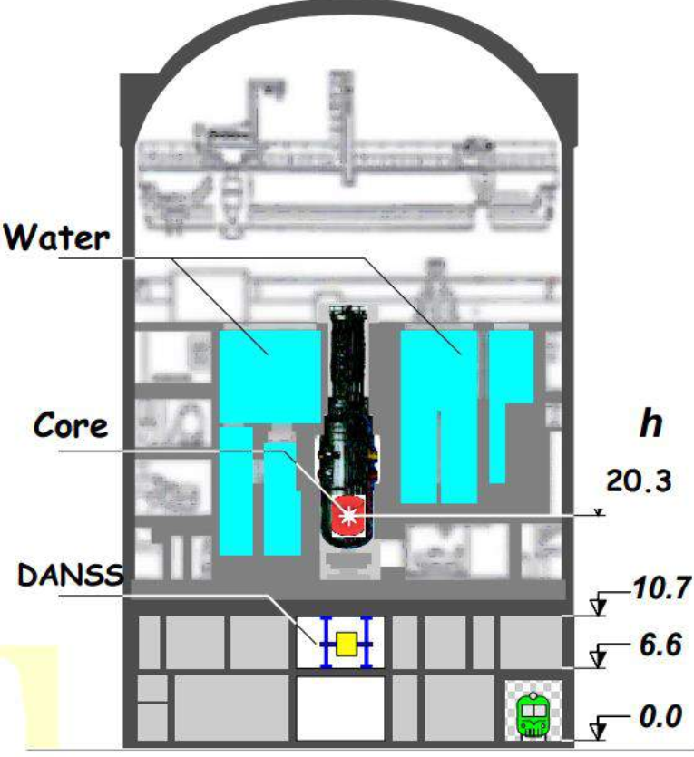
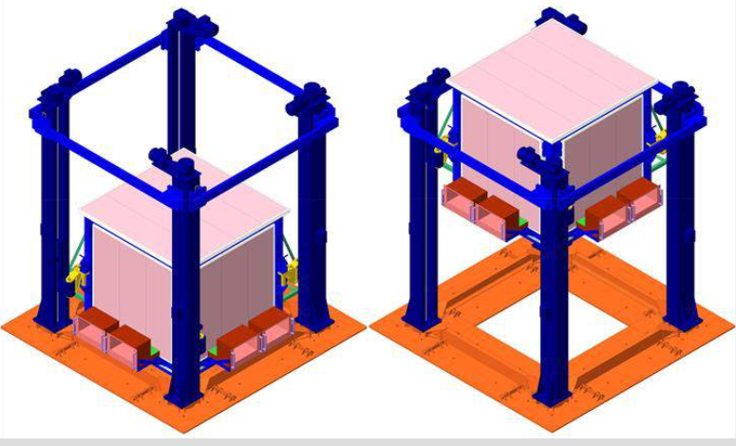
The location and movable platform
The DANSS is located at Kalininskaya NPP (KNPP) under 3 GW WWER-1000 reactor (H=3.6 m, ∅ =3.1 m), which provides ~ 50 m.w.e. (6-fold μ reduction and no cosmic n).
The detector is built on a movable platform.
Data are taken at 3 distances 10.9 m (Up), 11.9 m (Middle), and 12.9 m (Down) from the reactor (center to center), changed sequentially 3 times per week.

Slide 4
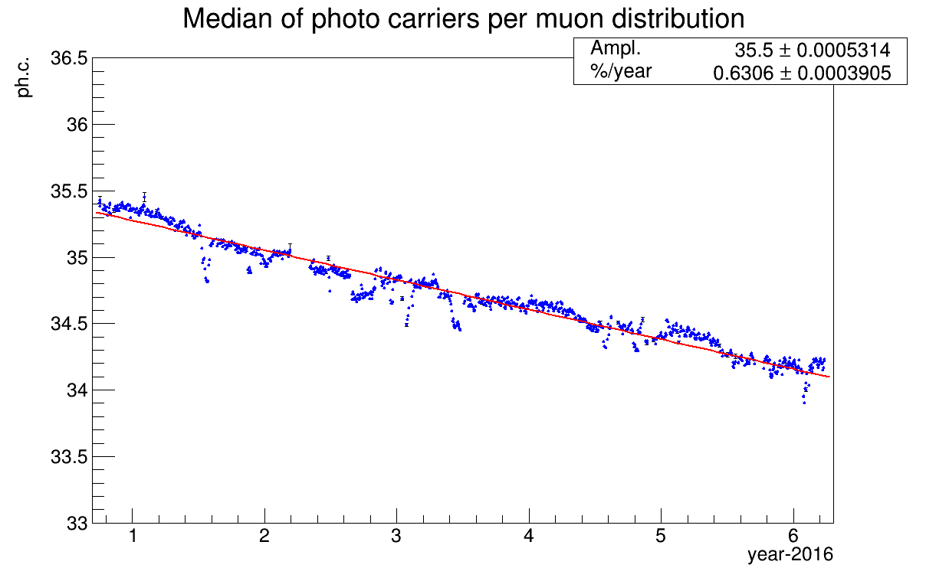
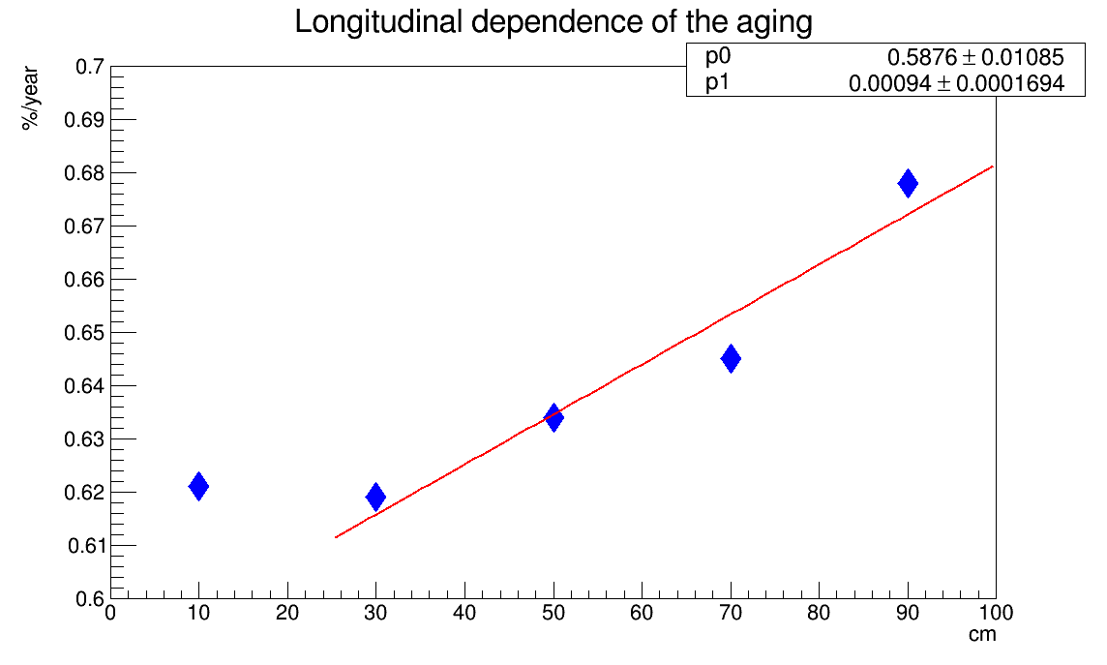
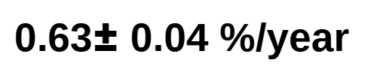
Detector aging
DANSS – 7 years of continuous operation.
Light collection by central WLS fiber KURARAY Y-11(200)M read by SiPM HAMAMATSU
S12825-050C. WLS degradation is also visible with -dL_{att/}dt = 0.37 ± 0.07(stat.) %/year
Close to vertical muon tracks with tgθ < 0.2 selected.
Median of Landau distribution was taken.
T2K (several det-s) — 0.9-2.2 %/year; MINOS — 2 %/year; MINERvA — 7-10 %/year @80F(27.6^{oC})

Slide 5
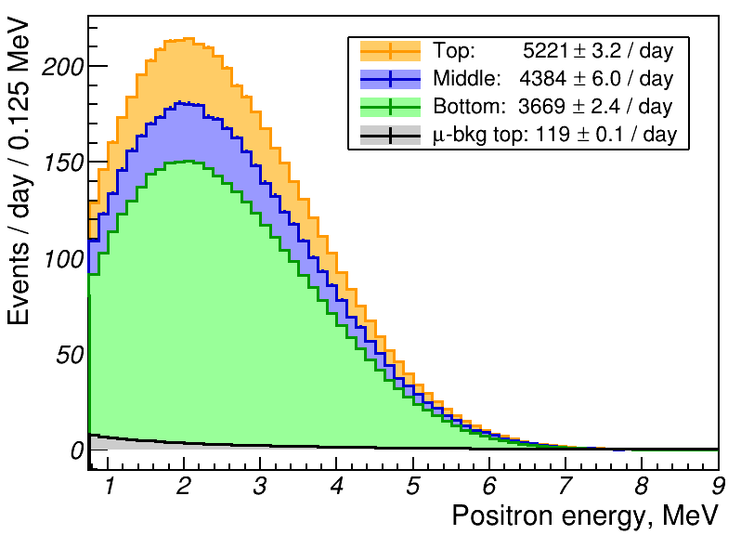
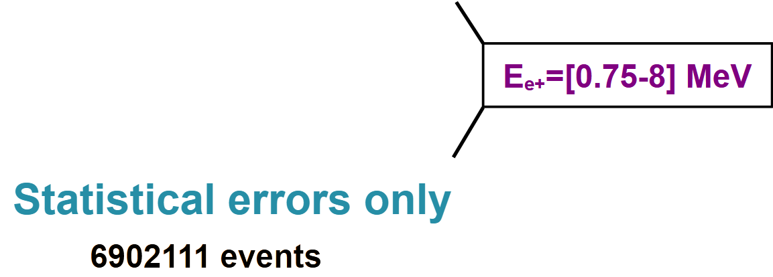
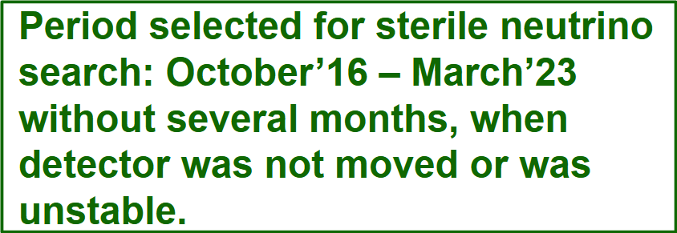
Positron spectrum of IBD-signal
All backgrounds were subtracted including signal from neighbor reactors (0.6% of S @ top position)
> 5000 events/day in fiducial volume (78% of full) @ top position: 7.7M events in 6.5 y.
For positrons with E=[1.5-6] MeV background subtracted @ top position is 1.75% and S/B > 50.

Slide 6
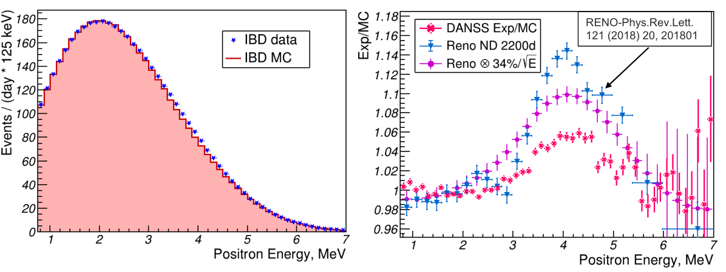
Positron spectrum: experiment vs. theory
For best agreement with H-M model MC spectrum was shifted on +50 keV w.r.t. experimental data. The nature of this shift is still under investigation.
We see like a bump in e+ spectrum similar to other experiments, but smaller than in RENO e.g.
We are not claiming decisively existence of the bump because of high sensitivity of the shape on E scale and shift. Similar energy scale issues should also affect other experiments.

Slide 7
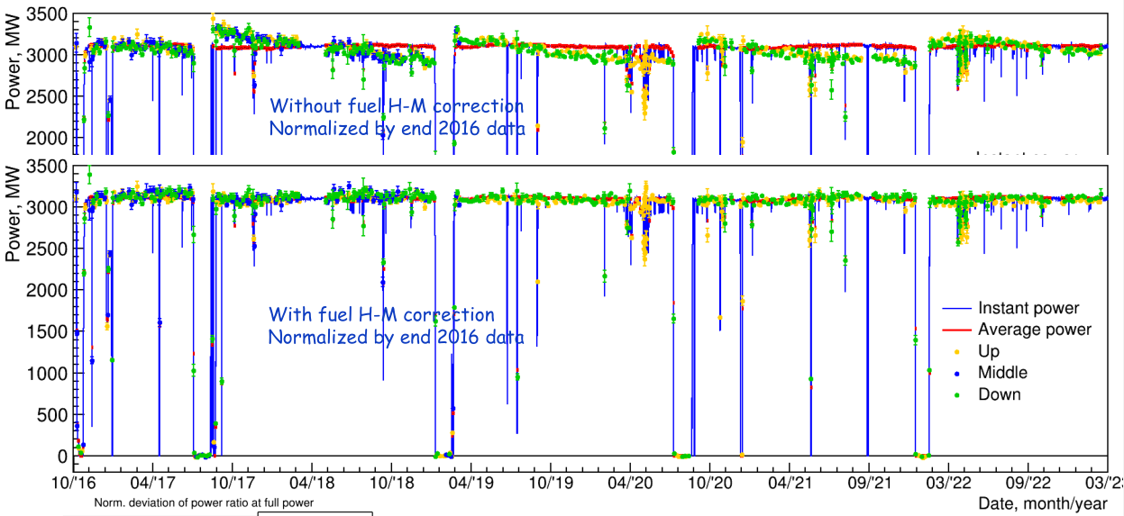
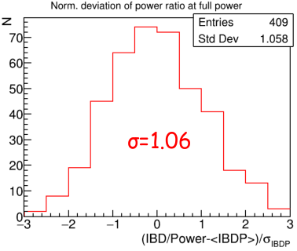
Reactor power monitoring
6.5 years of successful reactor monitoring with 1.5% accuracy in 2 days, no evidence for systematic effects has been observed.

Slide 8
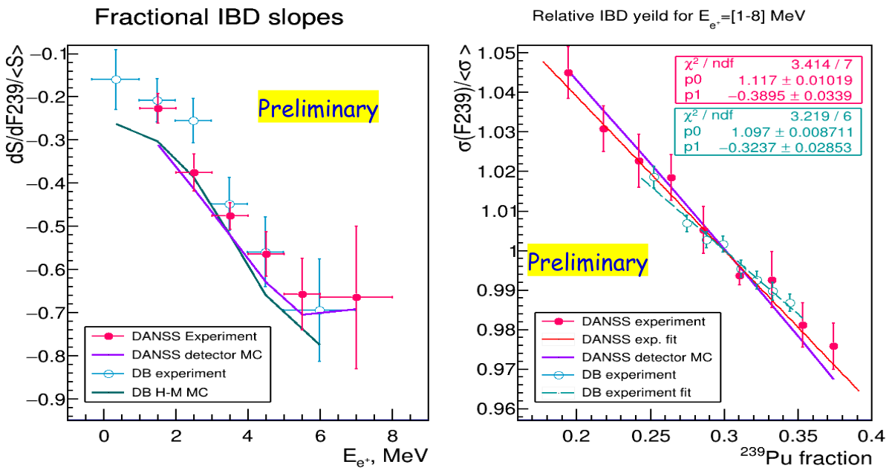
Fuel composition sensitivity
Positron spectrum dependence on fuel composition is clearly seen
IBD rate dependence on ²³⁹Pu fission fraction (dσ/dF239)/σ(F239=0.3) 1.53 ± 0.06 for various positron energies is closer to H-M model (1.53 ± 0.05) than DayaBay result (1.445 ± 0.097).
Errors (probably overestimated) are dominated by systematics from the spread between the reactor campaigns.

Slide 9
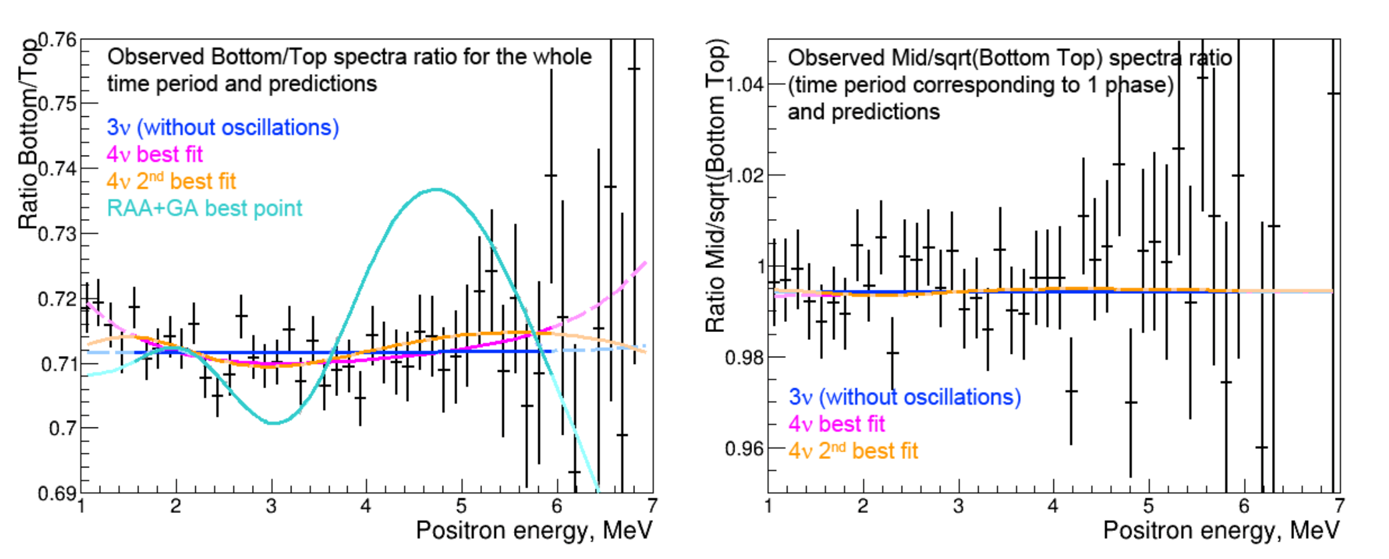
Ratio of positron spectra
Fit is in 1.5-6 MeV range (to be conservative).
Using current statistics 2016-2023 (~5.5 million IBD events with 1.5 MeV < E < 6MeV)
We do not see a statistically significant signal in favor of 4ν signal:
∆χ²=-8.5 (2.1σ ) for 4ν hypothesis best point ∆m²=0.34 eV² , sin²2θ=0.06
∆χ²=-5.7 for 4ν hypothesis second best point ∆m²=1.3 eV² , sin²2θ=0.015
RAA+GA best point was excluded long time ago.

Slide 10
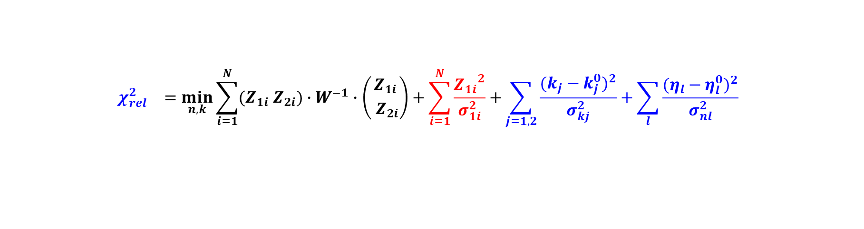


Test statistics
1. Relative method (w/o theory info):
$${χ_{rel}^{2}}^{}=\min_{n,k}{\sum_{i=1}^{N}{(Z_{1i}{ Z}_{2i})}∙W^{−1}∙\left({Z_{1i} \atop { Z}_{2i}}\right)}+\sum_{i=1}^{N}{\frac{{Z_{1i}}^{2}}{σ_{1i}^{2}}}+\sum_{j=1,2}{\frac{{(k_{j}−k_{j}^{0})}^{2}}{σ_{kj}^{2}}}+\sum_{l}{\frac{{(η_{l}−η_{l}^{0})}^{2}}{σ_{nl}^{2}}}$$
3-position movement
Oct.2016-Dec.2018
2-position movement
Mar.2019-Mar.2023
Penalty terms for nuisance
parameters: relative efficiencies and systematics
i – energy bin (36 total) in range 1.5-6 MeV
$Z_{i}=R_{j}^{obs}−k_{i}×R_{j}^{pre}(∆m^{2},\sin^{2}2θ,η)$ for each
energy bin
$R_{1}=\frac{Bottom}{Top}, R_{2}=\frac{Middle}{\sqrt{Bottom∙Top}},$ where
Top, Middle, Bottom – absolute count rates per day
for each detector position
k – relative efficiency,
η – nuisance parameters,
W – covariance matrix
Nuisance parameters and their errors ($σ_{k,η}$):
Relative detector efficiencies – 0.2%
Energy scale – 2%
Energy shift 50 keV
Distance to fuel burning profile center – 5 cm
Cosmic background – 25%
Fast neutron background – 30%
Additional smearing energy resolution:
($6\%/\sqrt{E}$ $⊕$ 2%)
2. Absolute method (with theory info – absolute CRs):

Slide 11
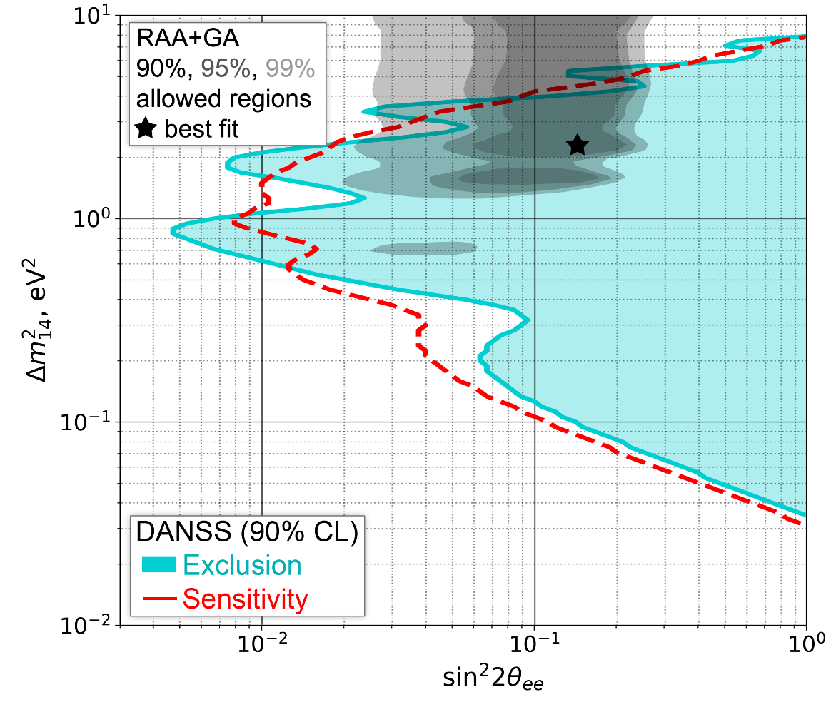
The DANSS limits: related method
This is the model independent result (relative method) obtained w/o information about the reactor antineutrino spectrum
5.5M IBD events with positrons in energy range E=[1.5-6] MeV were used in the χ2 fit (very conservative).
Gaussian CLs method – the most stringent limit reaches sin²(2ϴ) < 5·10⁻³ level
The most interesting region of 4ν parameters space has been excluded
The best point (2.1σ) is not significant enough to claim the signal
RAA+GA best point is deep in the exclusion region. 5σ exclusion already in 2018 [ PLB 787 (2018) 56]

Slide 12
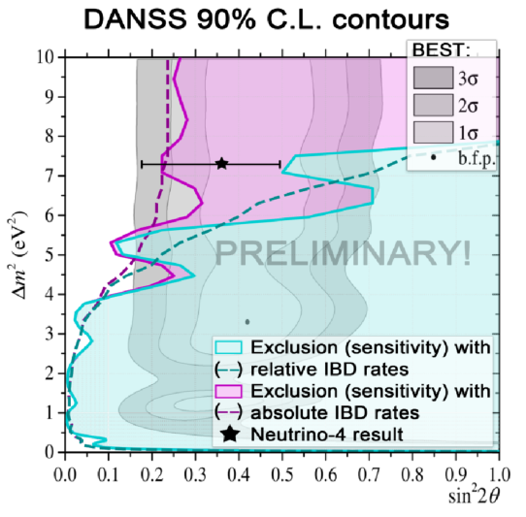
The DANSS limits: absolute method
Model dependent result (absolute method) use HM model and Gaussian CL_{S}
All known systematics is here including dominant flux uncertainty 5% (total err.sys. – 7%).
Almost the entire interesting region of phase space is excluded
The most interesting region of 4ν parameters space has been excluded
Most of the BEST and the best NEUTRINO-4 fit are also excluded

Slide 13
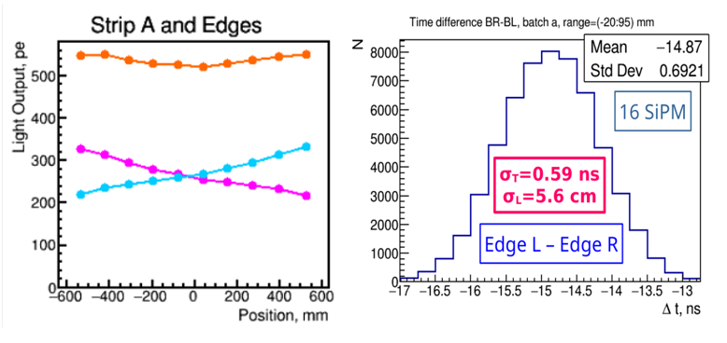
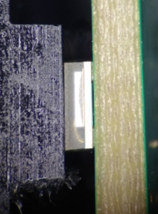
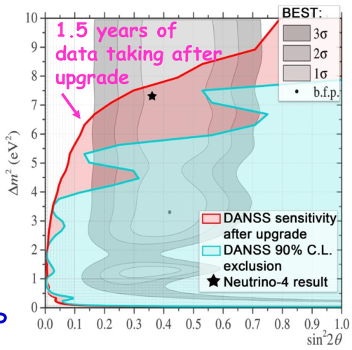
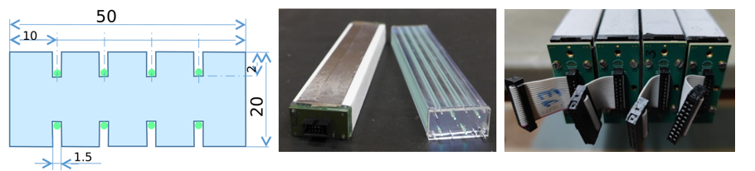
The DANSS upgrade
Main goal: to reach resolution 12%/√E w.r.t. current 33%/√E.
New geometry:
Strips: 2x5x120 cm with 2-side SiPM readout Structure: 60 layers x 24 strips: 1.7 m³ setup used the same shield and moving platform.
Gd is in foils between layers.
New faster YS-2 fibers.
Upgraded strip:
μ-beam tests of new strips: LO > 500 p.e. @ ~ 4MeV, σ_{τ} = 0.6 ns (5.6 cm vertex resolution)

Slide 14
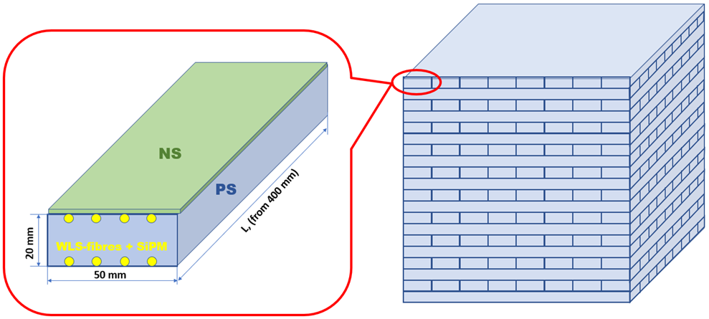
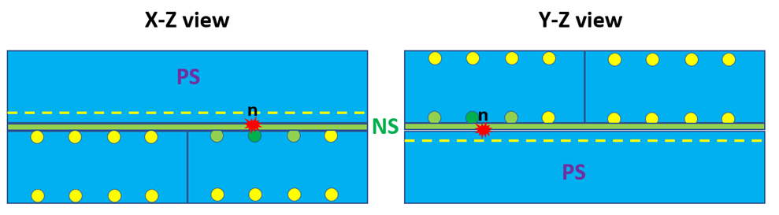
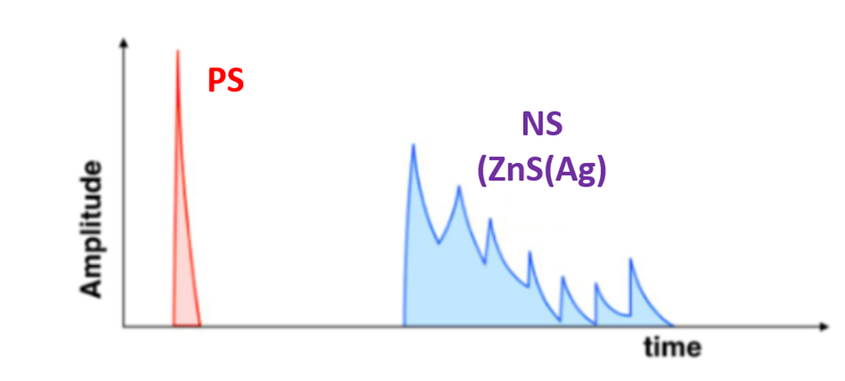
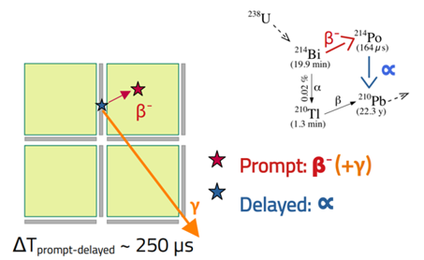
The ENIGMA project (Slovakia-Czechia)
Exploration of Neutrinos: Instrument for Global Monitoring and Analysis (given by ChatGPT-4)
Goal: combine DANSS&SOLID technologies taking the best from them.
Idea: use all optimal geometry found for DANSS-2, but replace Gd with ⁶Li/¹⁰B in neutron scintillator based on ZnS(Ag).
Advantages:
Neutron localization
PSD identification
No edge effect
Directionality
Scalability
Critical point:
NS radiopurity
NS production must be under control
Solved in LBE

Slide 15
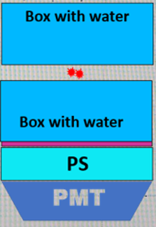
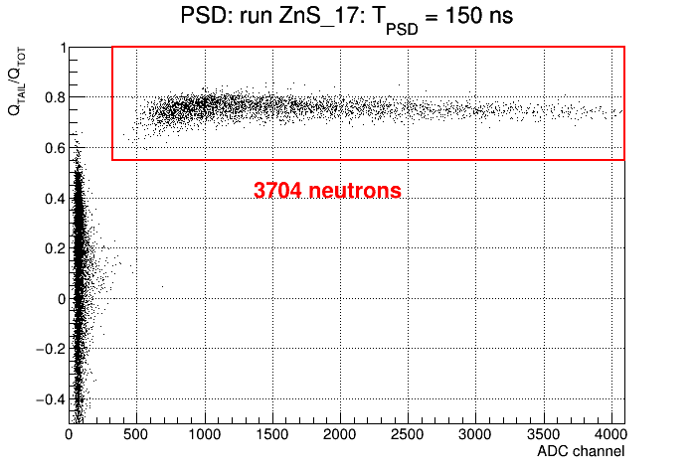
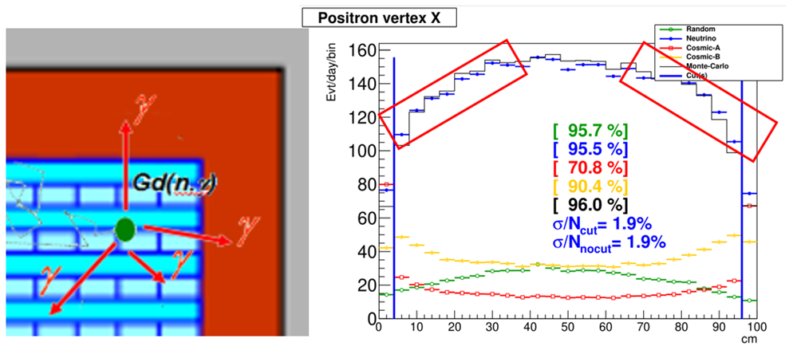
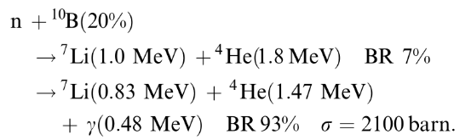
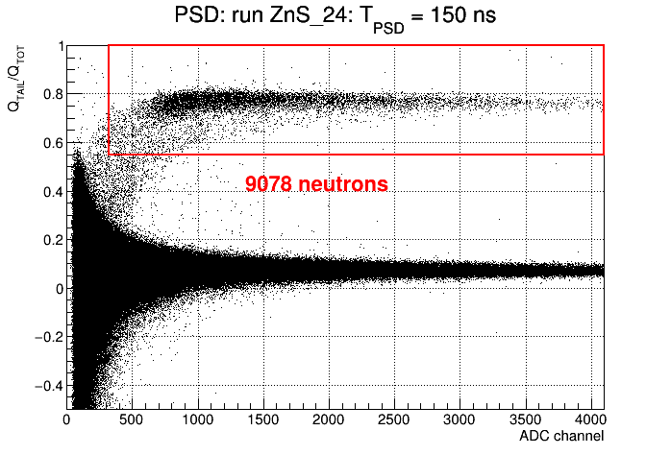
The ENIGMA II
Powder mixture of nano-B with ZnS(Ag): measurements with AmBe source
Edge effects in DANSS
PuBe
NS
A. Pure NS
¹⁰B instead ⁶Li?
Pro:
Available on market @ relatively low price.
No limitation to use
5x times bigger n-capture
γ adds to n pattern!
Contra:
- Weaker signal & shorter paths of n-capture products
A. NS+PS

Slide 16
Summary
DANSS is in operation since April 2016 with regular (physics) data taking since October 2016 at a rate of ~5000 events per day with cosmic background ~ 1.7%, S/B > 50.
Reactor power was measured using anti-ν rate with statistical error of ~1.5% in two days during 6.5 years of operation. Sensitivity to fuel composition was clearly demonstrated in 5 reactor campaigns.
With current data set 2016-2023 (almost 8M events) we have no significant sign of sterile ν oscillations.
σ235/σ239 was measured and is in perfect agreement with HM model unlike DB result.
Indication of 5MeV bump but not decisive.
Preliminary model independent (relative) DANSS analysis (using 5.5M events) excludes a large and most interesting part of parameter phase space for sterile neutrino oscillation including large area of the BEST result. Model-depend (absolute one using CR) analysis excludes practically all BEST region and best N-4 point.
Future plans: further improvements of MC & calibrations & energy scale determination in order to reduce systematics. Modernized DANSS detector will scrutinize further N-4 & BEST results with model-independent analysis.

Slide 17

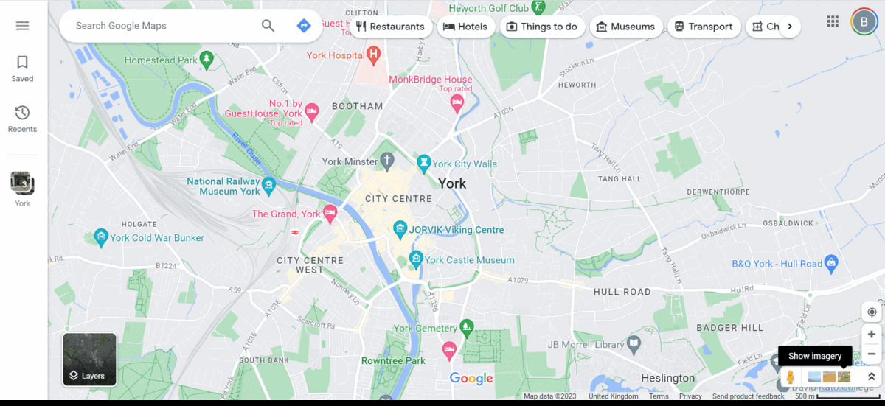
Meanwhile, somewhere in the future...
Gννmap
Ad here

Slide 18
Backup slides

Slide 19
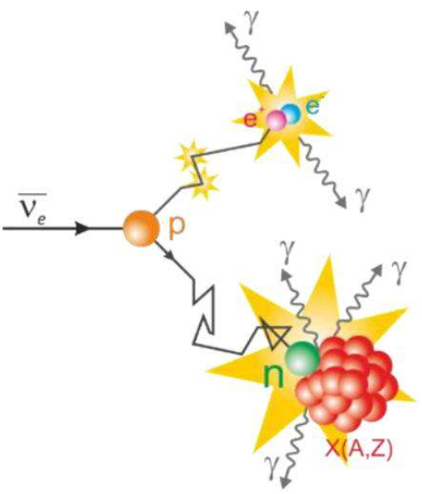
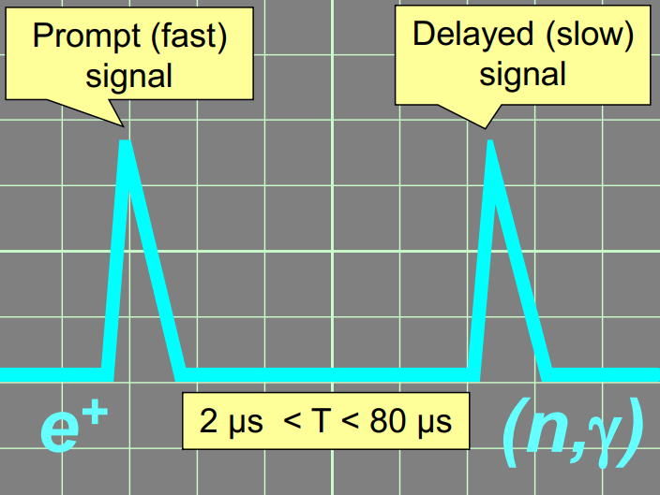
IBD signal pattern & basic cuts
Eν ~ Ep+1.8 MeV
Eν ~ Evis+0.8 MeV
1
50
Main cuts:
• Prompt signal (E > 0.5 MeV)
• Delayed signal (E>2-4.5 MeV)
• Time between signals is in [1, 50] μs
• No muons before prompt signal in 90 μs
Additional cuts:
Spatial cut on distance between fast and slow signal vertices
Hit multiplicities for both signals
Positron clustering pattern cuts
•

Slide 20
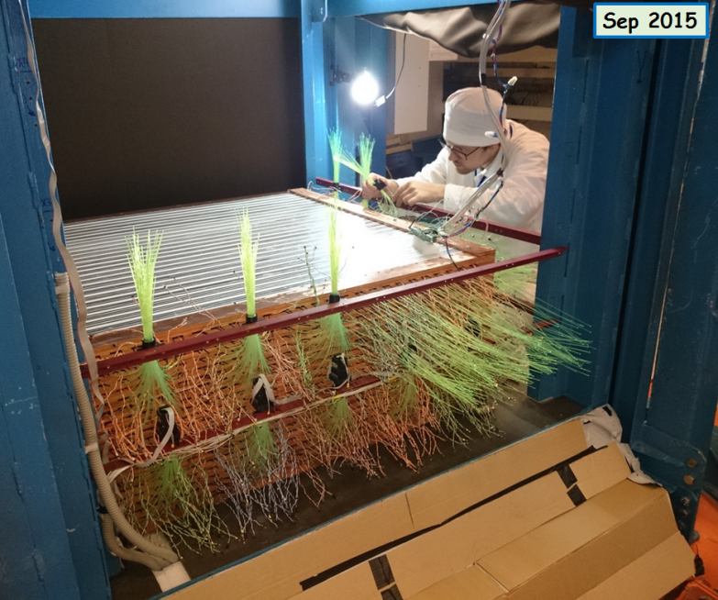
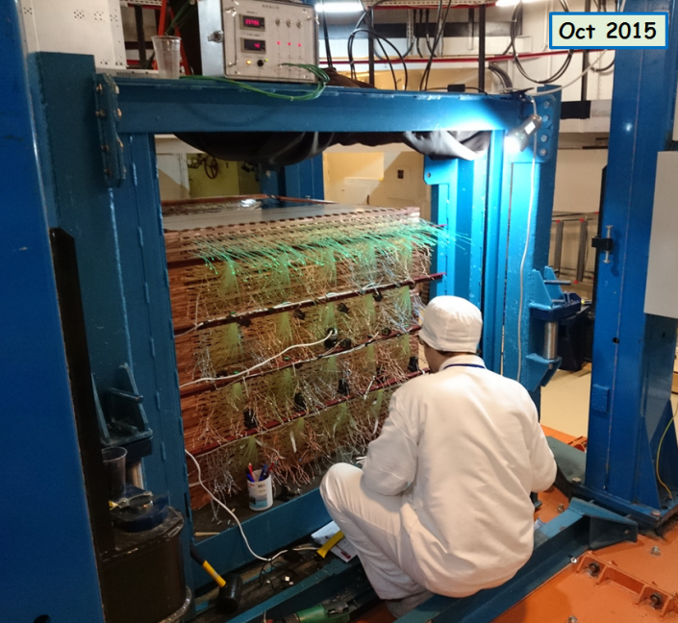
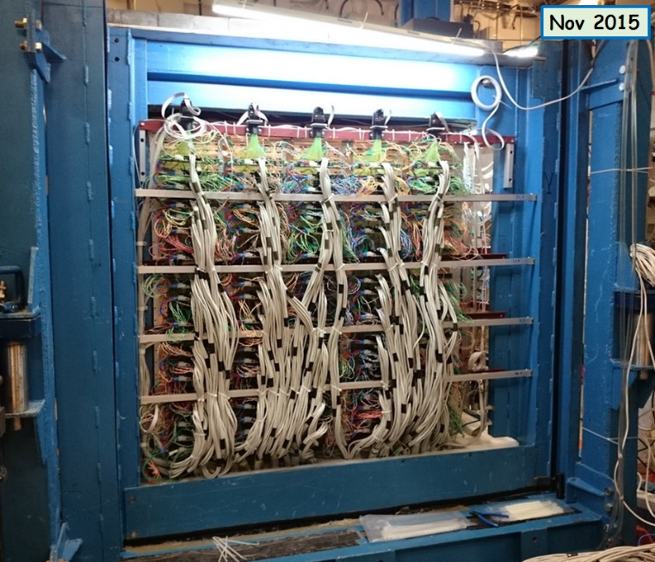
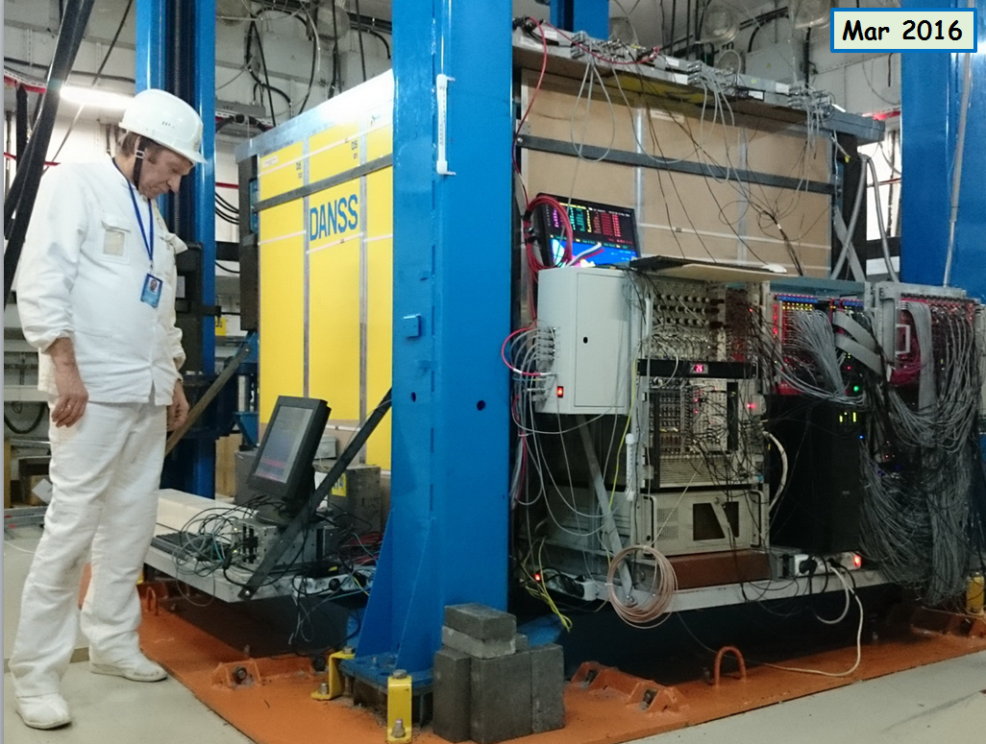
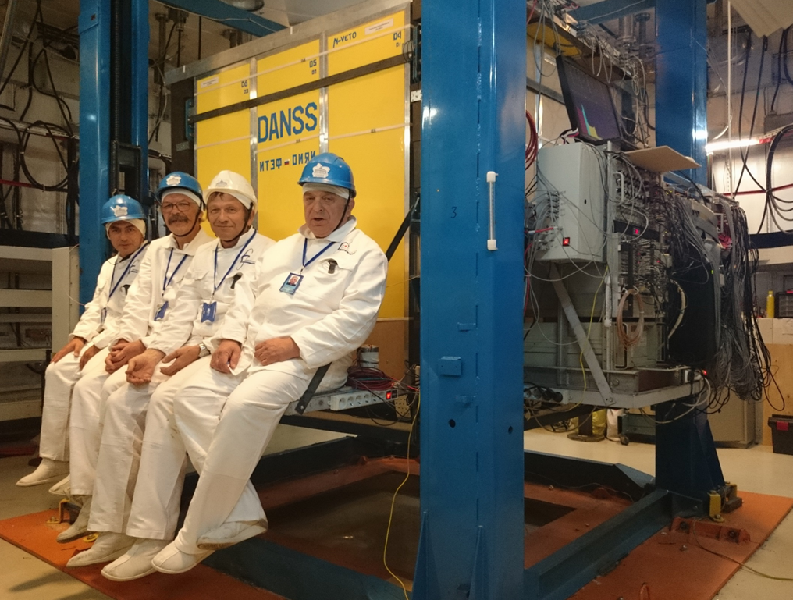
Detector Assembly

Slide 21
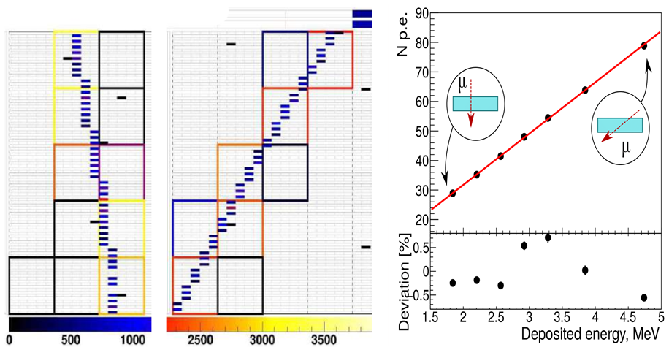
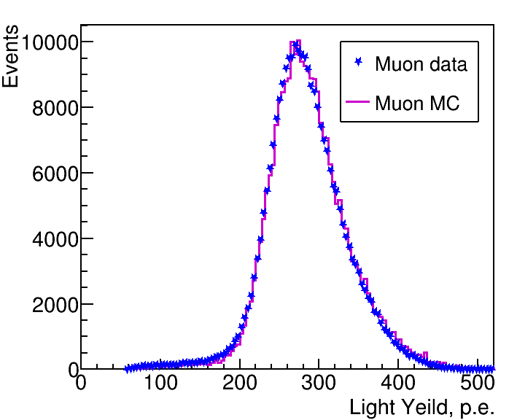
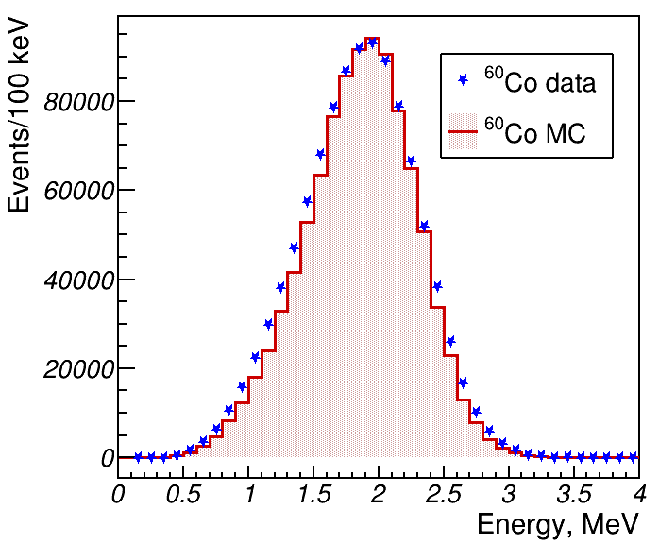
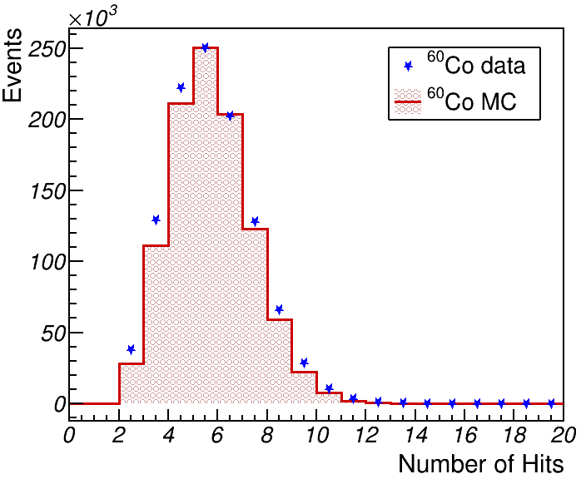
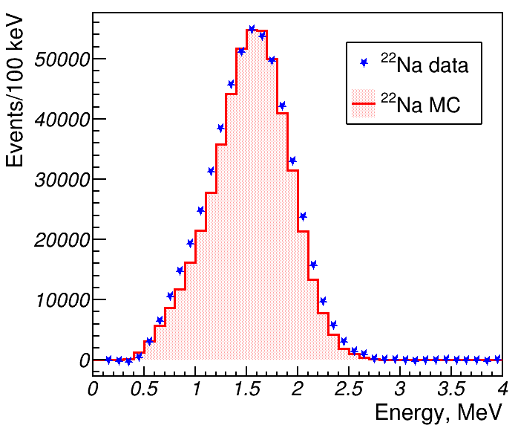
Calibration 1
2500 SiPM gains and X-talks are calibrated every 30-40 min. All 2550 channels are calibrated every 1-2 days using cosmic muons
Several calibration sources are used to check the detector response

Slide 22
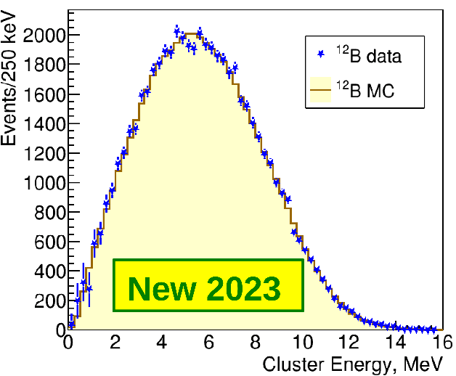
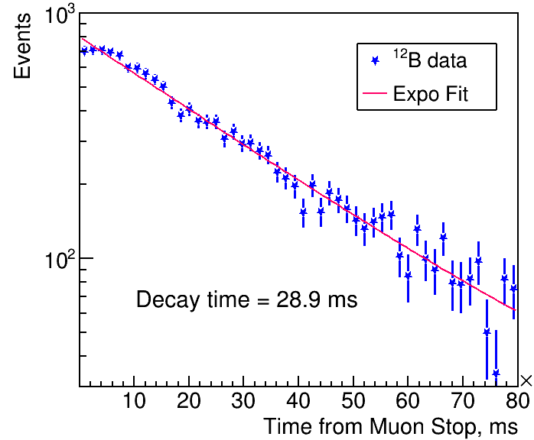




Calibration 2
ΔE=+0.2%
Gd(n,γ)
¹²B(µ¹²C)
H(n,γ)
Fifrelin
cascades
Еxpected 29.1 ms
MC smeared
12%/√E ⨁ 4%
ΔE=-0.2%
¹²B(n¹²C)
Gd(n,γ)
Fifrelin
cascades
τ=29.4±0.6 ms
Еxpected 29.1 ms
Energy scale has been fixed using β-spectrum of ¹²B, which is similar to positron signal
Other sources agree within +/- 0.2% with exception of ²²Na which is 1.8% below.
Systematic error on E scale of +/-2% was added due to ²²Na disagreement
Hope to reduce this error soon

Slide 23

Background

Slide 24

Analysis with absolute CR

Slide 25

Systematic uncertainties in absolute CR

Slide 26

S3: no PMT for compactness
Current DANSS geometry
Future DANSS-2 & S3 geometries
PMT must be removed as collecting fibers take too much space!
To compact detector & shielding size one should use the SiPMs only!

