Slide 1
Anti-Neutrino Flux from the EdF Hartlepool Nuclear Power Plant
Applied Antineutrino Physics Workshop
18-21 September 2023

Slide 2
Dr. Sandra Bogetic,
University of Tennessee in Knoxville/
Lawrence Livermore National Laboratory
Dr Robert Mills,
UK National Nuclear Laboratory
Dr Adam Bernstein,
Lawrence Livermore National Laboratory
Prof. Jonathon Coleman, University of Liverpool
Alex Morgan, University of Liverpool
Dr Andrew Petts, EdF Energy
Based upon
https://doi.org/10.48550/arXiv.2301.07153
Not protectively marked

Slide 3
Anti-neutrinos for non-proliferation
This work is associated with the AIT-WATCHMAN/NEO project
      Advanced Instrumentation Testbed (AIT)
      Water Cherenkov Monitor for Antineutrinos (WATCHMAN) US/UK project
      Neutrino Experiment One (NEO)
Objective: Demonstrate nuclear reactor monitoring for non-proliferation purposes through antineutrino detection using a large, scalable, technology (Gd doped water).

Slide 4
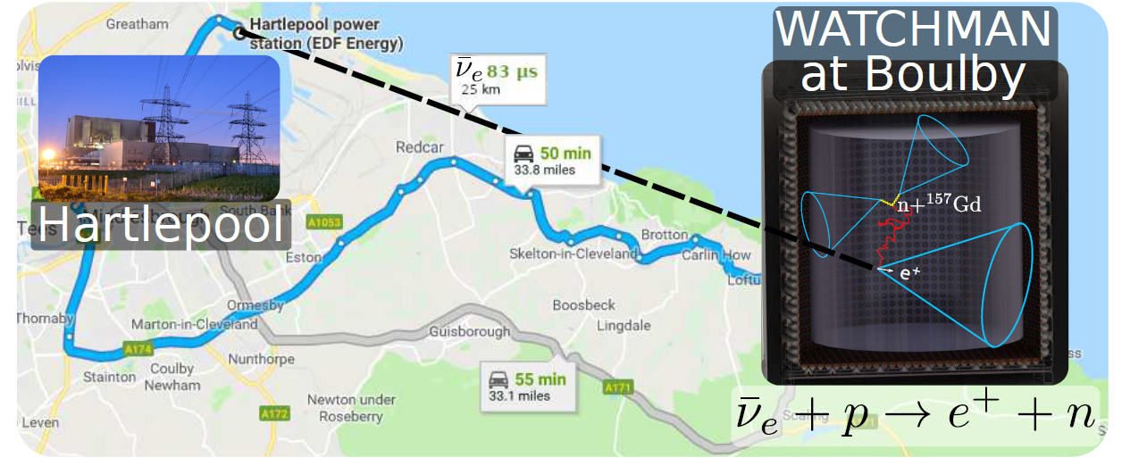
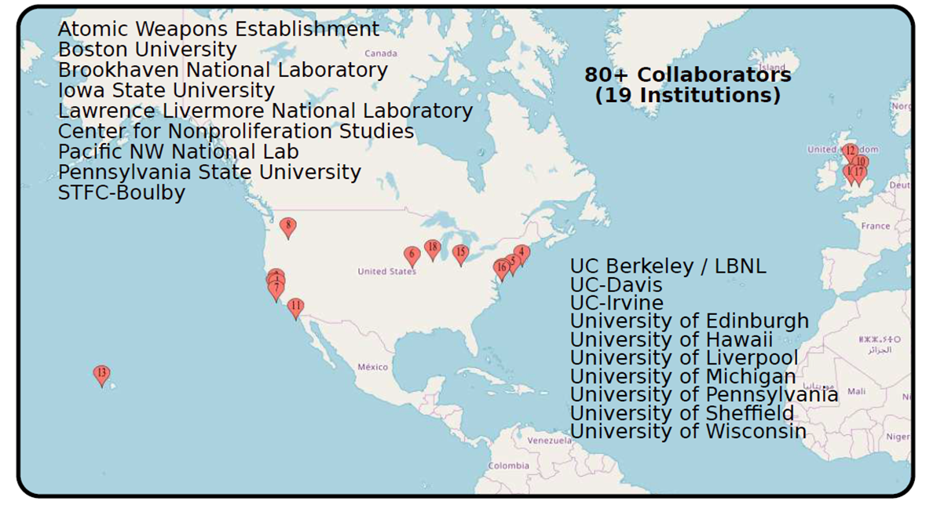
Anti-neutrinos for non-proliferation

Slide 5
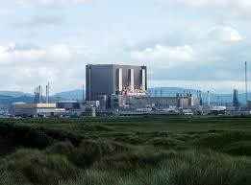
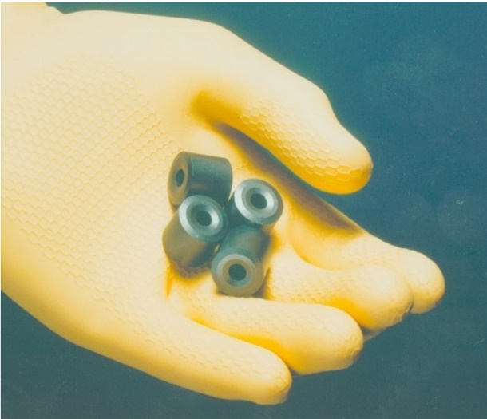
AGR/Hartlepool reactors
UK design of commercial reactor
  Graphite moderated
  Carbon dioxide cooled
  Uranium dioxide fuel
  (cylindrical shell)

Slide 6
Fuel Elements stacked in channel

Slide 7
Hartlepool reactor
Details
  Two cores initially rated at 1500 MW (thermal), now ~1575 MW
  Fuelled with 110 tonnes of enriched uranium
  Each channel has 8 (~1m high) assemblies with 36 pins in a 18/12/6 (outer/middle/inner ring) circular cluster
  Each pin is stainless steel clad with a ridged surface to maximise heat transfer
  The fuel is a hollow pellet consisting of sintered enriched UO₂ with central cylindrical gas gap
  Usually, if possible, one reactor is shutdown whilst the other is
  on-power.
  A fraction of channels are refuelled every ~3-5 months.

Slide 8
Hartlepool reactor information supplied for 2020
Operational data was supplied for all 2592 assemblies in the cores at approximately weekly intervals including
      fuel element irradiation (MWd/te),
      power rating (MW/te),
      initial enrichment, and
      loading dates.
  Power history of the reactors were supplied at hourly intervals.
      The reactor power was determined by EdF Energy using the HEYPEX code based upon plant measurements.
      The individual assembly powers and irradiations were calculated by EdF Energy with the thermal hydraulics-neutronics code PANTHER.

Slide 9
Calculational Route for anti-neutrinos
The anti-neutrino flux and spectra were calculated in several steps:
  For each assembly calculate the fission rates per nuclide [fis/s] from operation data (using initial enrichment, burnup and power with a FISPIN based database).
  Combine fission rates for a whole core to calculate
  (i) whole core fractional fission rates [Not average!] and
  (ii) mean energy release per fission [varies with nuclide!].
  Use the Huber anti-neutrino spectra per fission to generate the total emission and its energy spectra.
  The neutrino rate is calculated for a detector at 1100m below the surface at Boulby, a distance of 26 km from Hartlepool

Slide 10
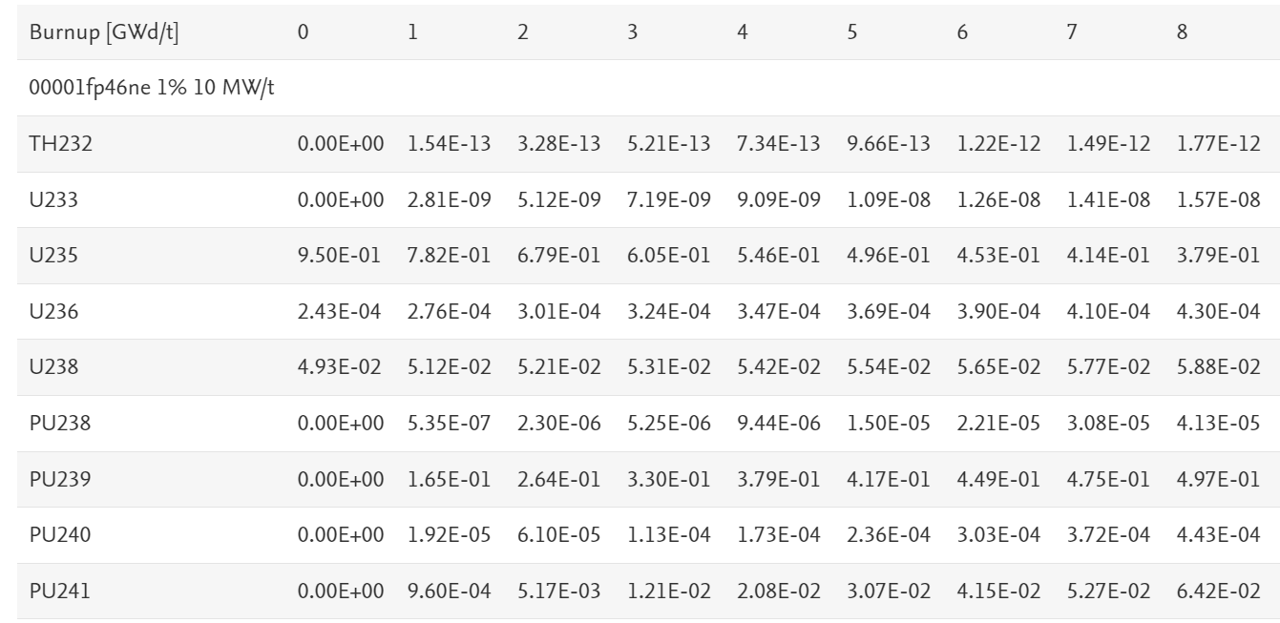
Fission Fractions
AGR fractional fission rates based upon interpolation of tables from the following references:
    Nuclear Engineering and Technology
    Technical note: A simple method for estimating the
    major nuclide fractional fission rates within light water
    and advanced gas cooled reactors
    R.W.Mills, B.M.Slingsby, J.Coleman, R.Collins, G.Holt,
    C.Metelko, Y.Schnellbach
    https://doi.org/10.1016/j.net.2020.03.004
    Mendeley Data (2020), 10.17632/92523hssgv.2
    Commercial Nuclear Reactor Fractional Fission
    Rate Database from FISPIN10A Calculations for
    AGR, PWR and BWR
    Robert Mills, Bethany Slingsby
    https://data.mendeley.com/datasets/92523hssgv/2

Slide 11
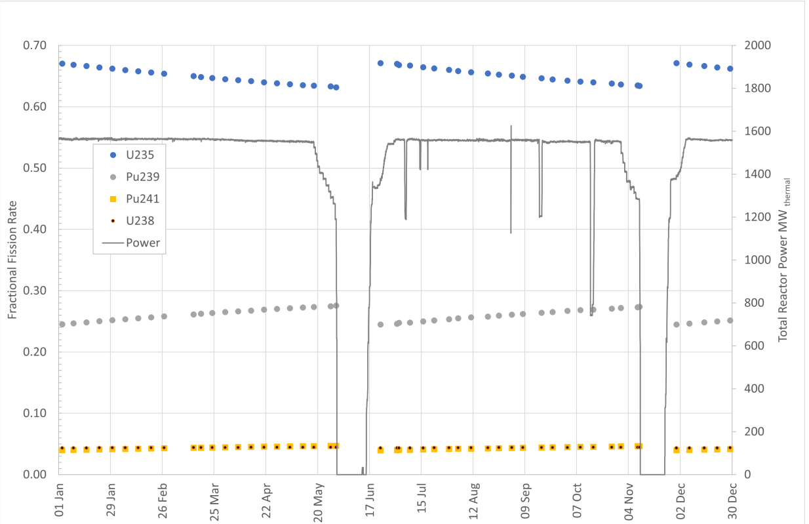
Fractional Fission Rates for the
Hartlepool reactor unit 1 in 2020

Slide 12
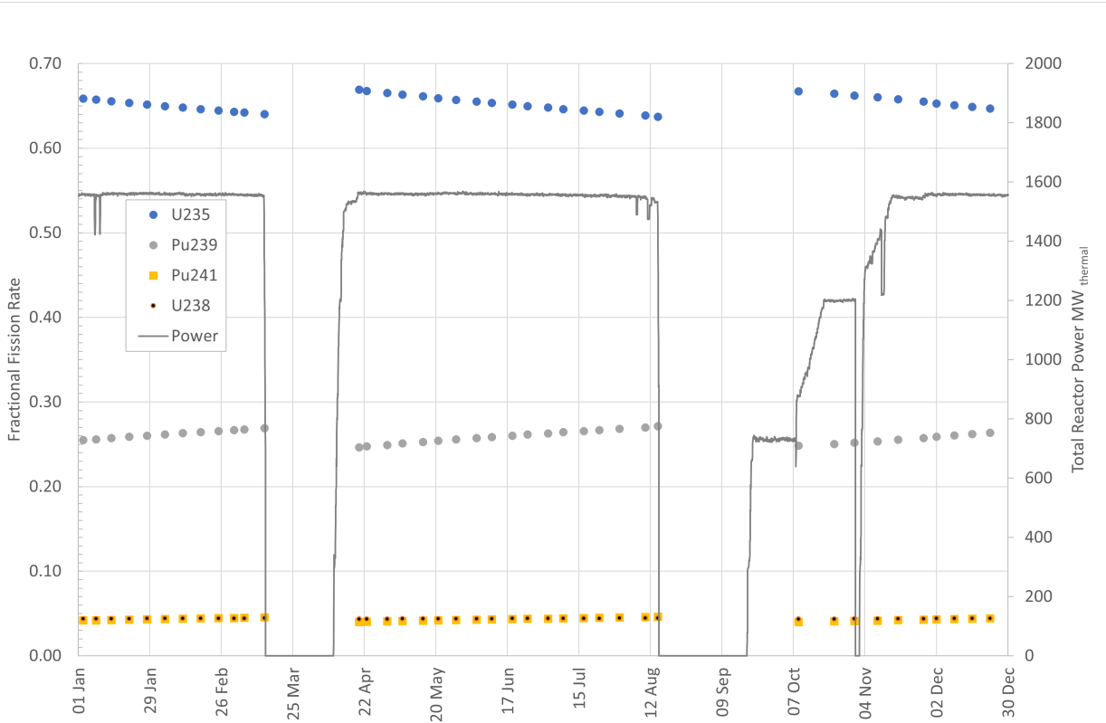
Fractional Fission Rates for the
Hartlepool reactor unit 2 in 2020

Slide 13
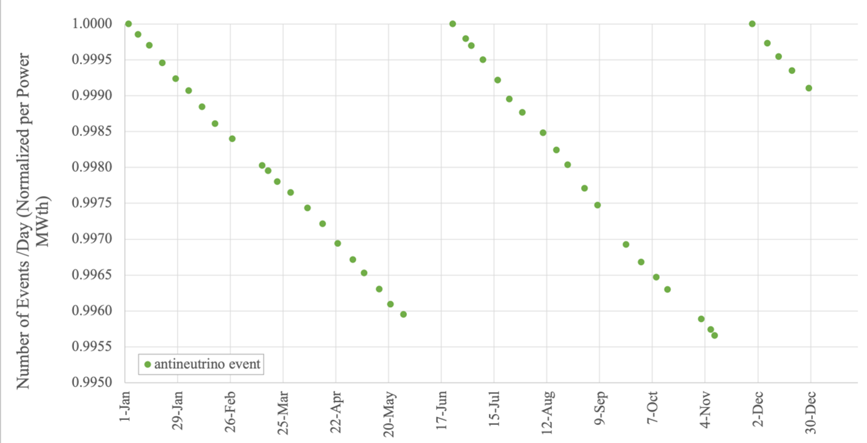
Total antineutrino event rate at Boulby for the
Hartlepool AGR unit 1 in 2020

Slide 14
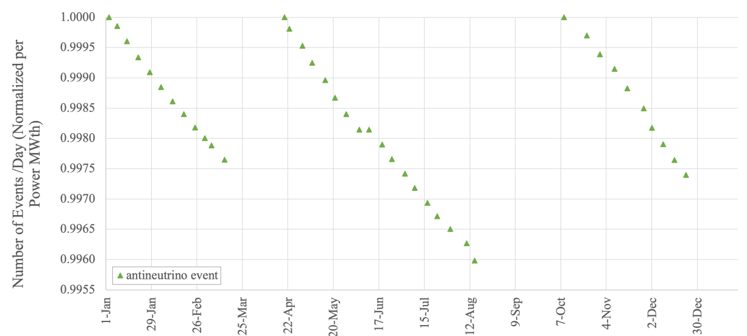
Total antineutrino event rate at Boulby for the
Hartlepool AGR unit 2 in 2020

Slide 15
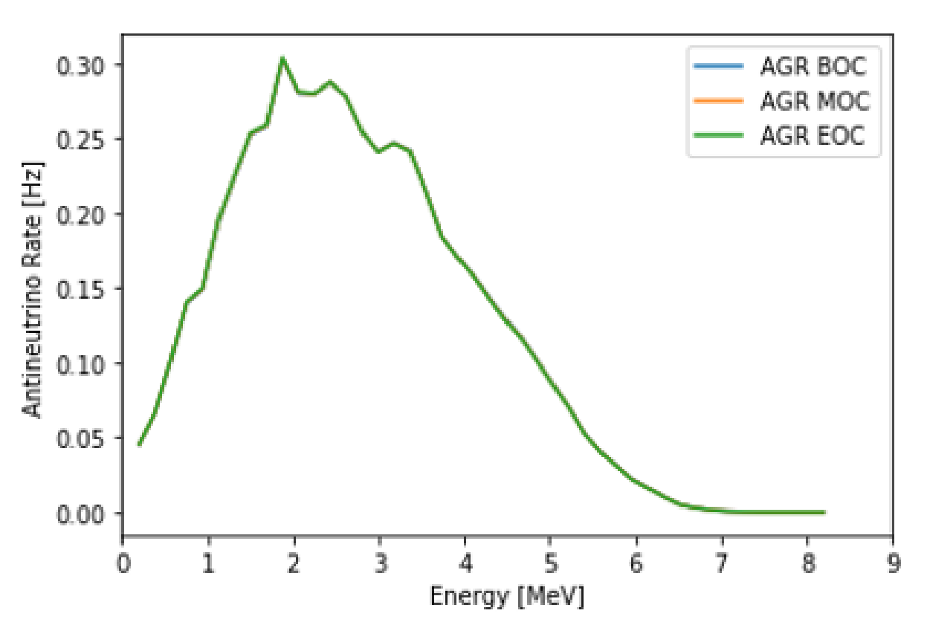
Hartlepool AGR Anti-neutrino spectra at three points in the Reactor Fuel cycle (days: 1, 80, 160)

Slide 16
Initial conclusions
Results show AGR has:
      Small differences in anti-neutrino emissions with burnup
      Practically no change in anti-neutrino spectra during cycle
How does this compare with other reactors?
      Compare to calculations using the simplified method in Nuclear Engineering and Technology,
      R.W. Mills et al (2020).
      Consider against PWRs running a 12- or 24-month refuelling cycle, replacing 33% or 50% of the respective cores.
      Also compare the method with a similar independent calculation in;
          E. Somasundaram, T. Palmer, and A. Soldatov, Nucl. Technol. 179, 160-168 (2012).
          E. Somasundaram, Master’s thesis, Oregon State University (2011). [Results in tables]

Slide 17
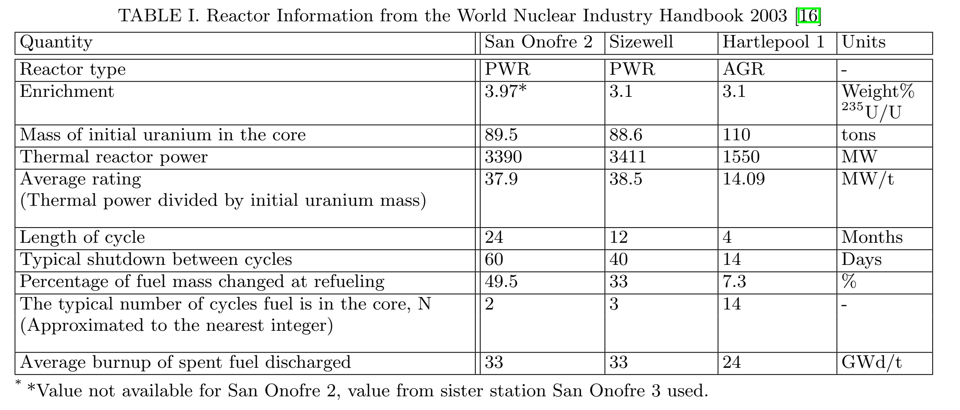
Reactor information to produce comparison calculations
[16] S. Tarlton, Nuclear engineering international: World nuclear industry handbook, Unwin Brothers, UK (2003).

Slide 18
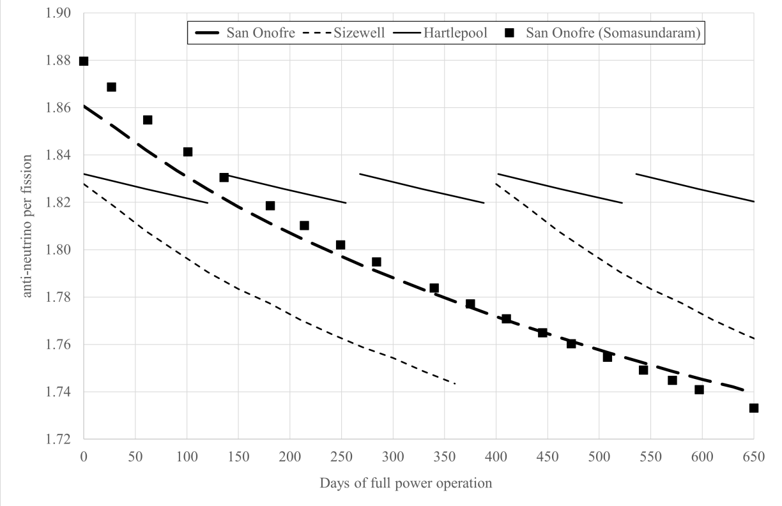
Variation of the detectable anti-neutrinos per fission from the Hartlepool, Sizewell and San Onofre reactors

Slide 19
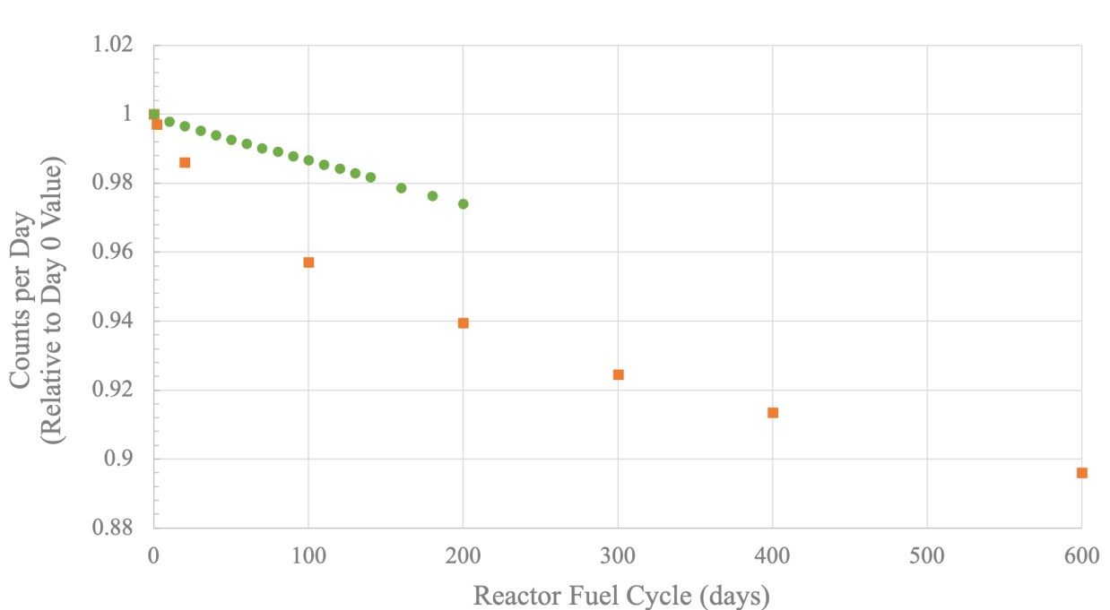
Antineutrino flux rate for the Hartlepool reactor unit 2 and the SONG NPP

Slide 20
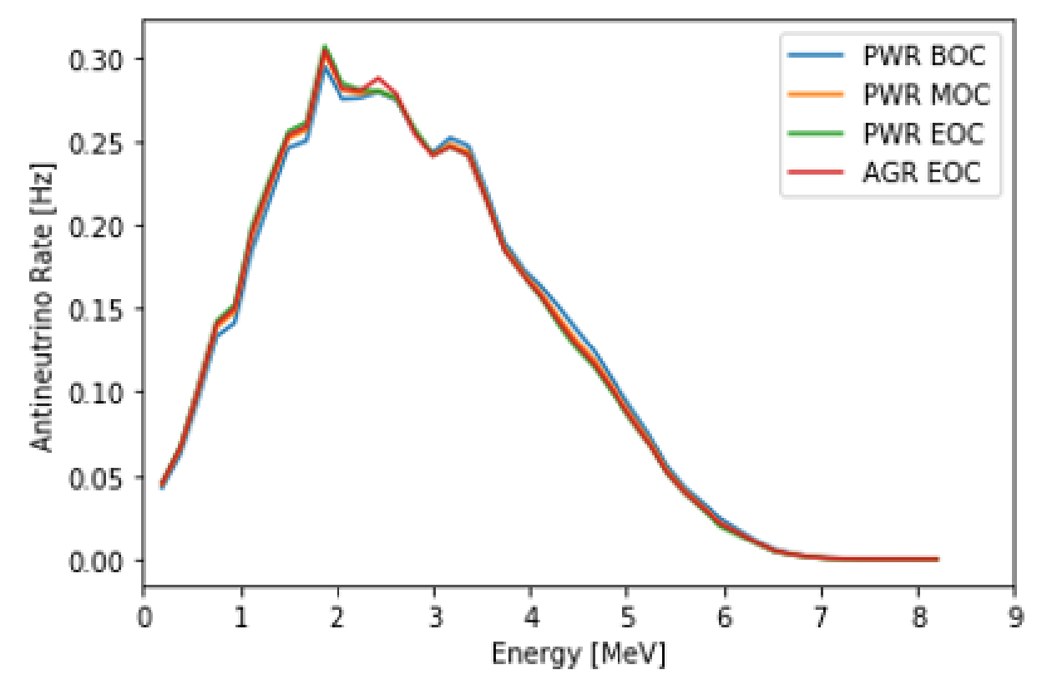
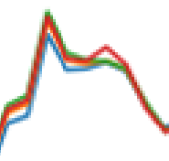
Comparison of anti-neutrino spectra of Hartlepool AGR compared to San Onofre PWR reactor

Slide 21
Summary and Discussion
  Changes in the AGR anti-neutrino emission:
      Flux relative to reactor power throughout the AGR cycle is within 1%.
      Spectral changes through the AGR cycle are negligible.
  Calculations cross checked with simpler models -- consistency with AGR and PWR fission rates trends.
  Operation of reactors change the expected anti-neutrino emission.
      In AGR smaller fraction of the fuel replaced more frequently.
      Lower power (1500 MWth AGR vs 3400 MWth PWR) but similar fuel.
      Changes in the FFR U-235 and Pu-239 are not significant in AGR.
      Lower power reactors/lower burnup fuel produces smaller changes.
      AGR anti-neutrino changes lower than PWR changes.
      AGR has a shorter fuel replacement cycle respectively to the PWR: 160 vs 600 days.
  Reactors with low burnup and frequently replaced fuel expected to be different from PWR with smaller anti-neutrino changes
  (Magnox, Production, …)

Slide 22
Acknowledgements
  This work was performed under the auspices of the U.S. Department of Energy by Lawrence Livermore National Laboratory under Contract
  DE-AC52-07NA27344.
  Dr Mills acknowledges funding from his laboratory’s internal research and development program.
  The University of Liverpool authors acknowledge support by the STFC, and UK National Nuclear Laboratory for co-funding an EPSRC Next Generation Nuclear studentship.
  The authors would like to thank Sebin John and Daniel Gura of EDF Energy for their assistance in the production of the Hartlepool reactor data set.

Slide 23
Thank you

