Slide 1

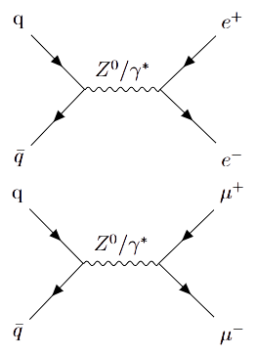
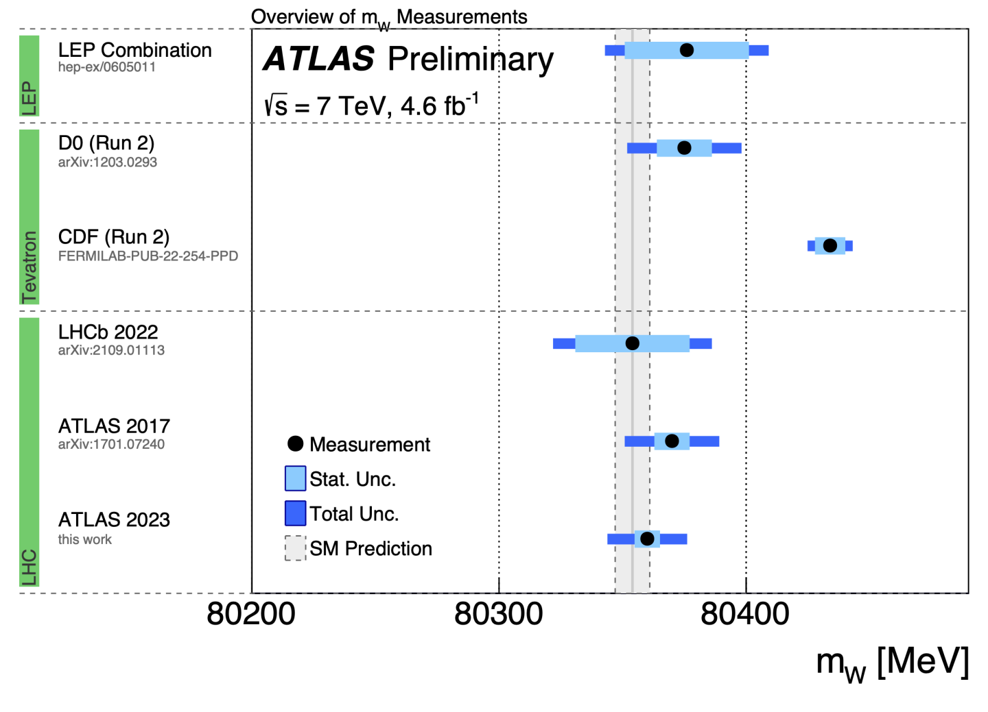
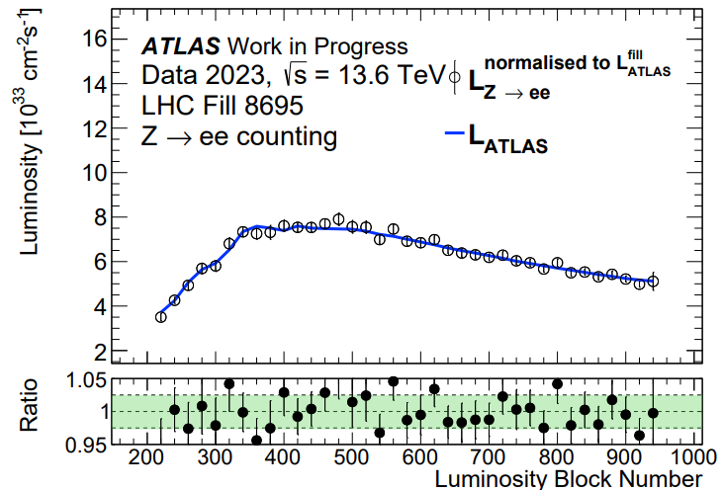
Joshua Newell –
Precision Measurement of the Mass of the W boson
Supervisors: Prof. Uta Klein, Dr Jan Kretzschmar
Precision Measurement of the Mass of the W boson:
ATLAS Authorship Qualification Project –
Z – Counting Luminosity Measurement:
Latest measurement from CDF is in contention with Standard Model – independent high-precision measurements are mandatory to confirm or exclude new physics
Particular emphasis on reducing uncertainties due to proton structure – a limiting factor in prior analyses
Currently working in Liverpool with 2 years in Hamburg at DESY laboratory beginning Oct 2023
Use the decays of Z bosons to electrons or muons to determine LHC proton-proton interaction rate (luminosity)
Self-consistency maintained with in-situ efficiencies and excellent stability with respect to proton-proton interactions (pileup)
Provides a powerful tool for independent monitoring of time and pileup dependence of ATLAS baseline luminosity measurement
7 sigma discrepancy!
NEW DATA TAKEN – 1st MAY 2023!

Slide 2

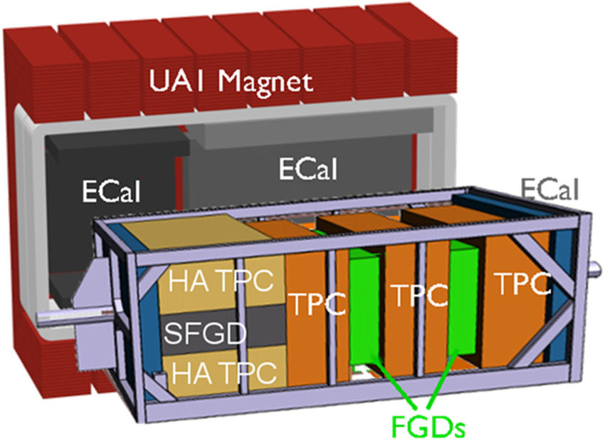
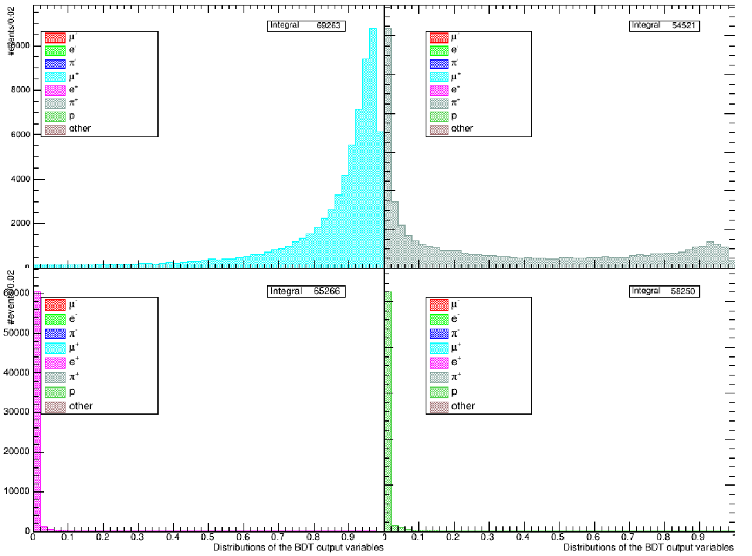
Development of improved PID for the upgraded ND280 near detector
Patrick Bates
Supervisor – Neil McCauley
Developing improved PID for the upgraded ND280 near detector – BDT algorithm
The BDT tool kit was originally developed by Gabriel Penn
Justification for a BDT:
  Current ND280 PID primarily uses traditional rectangular cuts
  The upgraded ND280 will provide us with new information, which must be used to the best of our ability
  Traditional methods are not very efficient
Distribution of BDT muon PID outputs – represents likelihood of an event being a muon
Muon like events
My work so far:
  Gaining an understanding of the BDT
  Reproducing Gabriels results
  Testing how the BDT handles higher energy ranges
  Changing BDT variables – Tree depth
Further plans:
  Test for even higher energy ranges
  Test for high angles
  Check which feature variables the BDT has greatest dependence on
  Introduce new variables the BDT can cut on – i.e., Michel electrons
  Implement the BDT as a global PID in the ND280 analysis
  Will be heading out to Japan for the start of the upgraded run
Pion plus like events
Positron like events
Proton like events

Slide 3

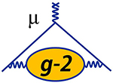
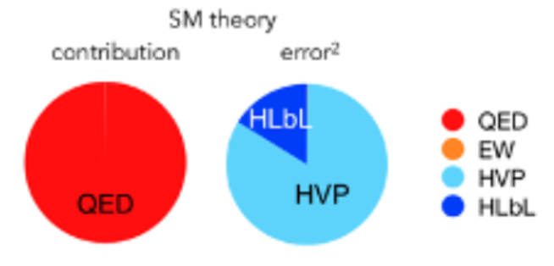
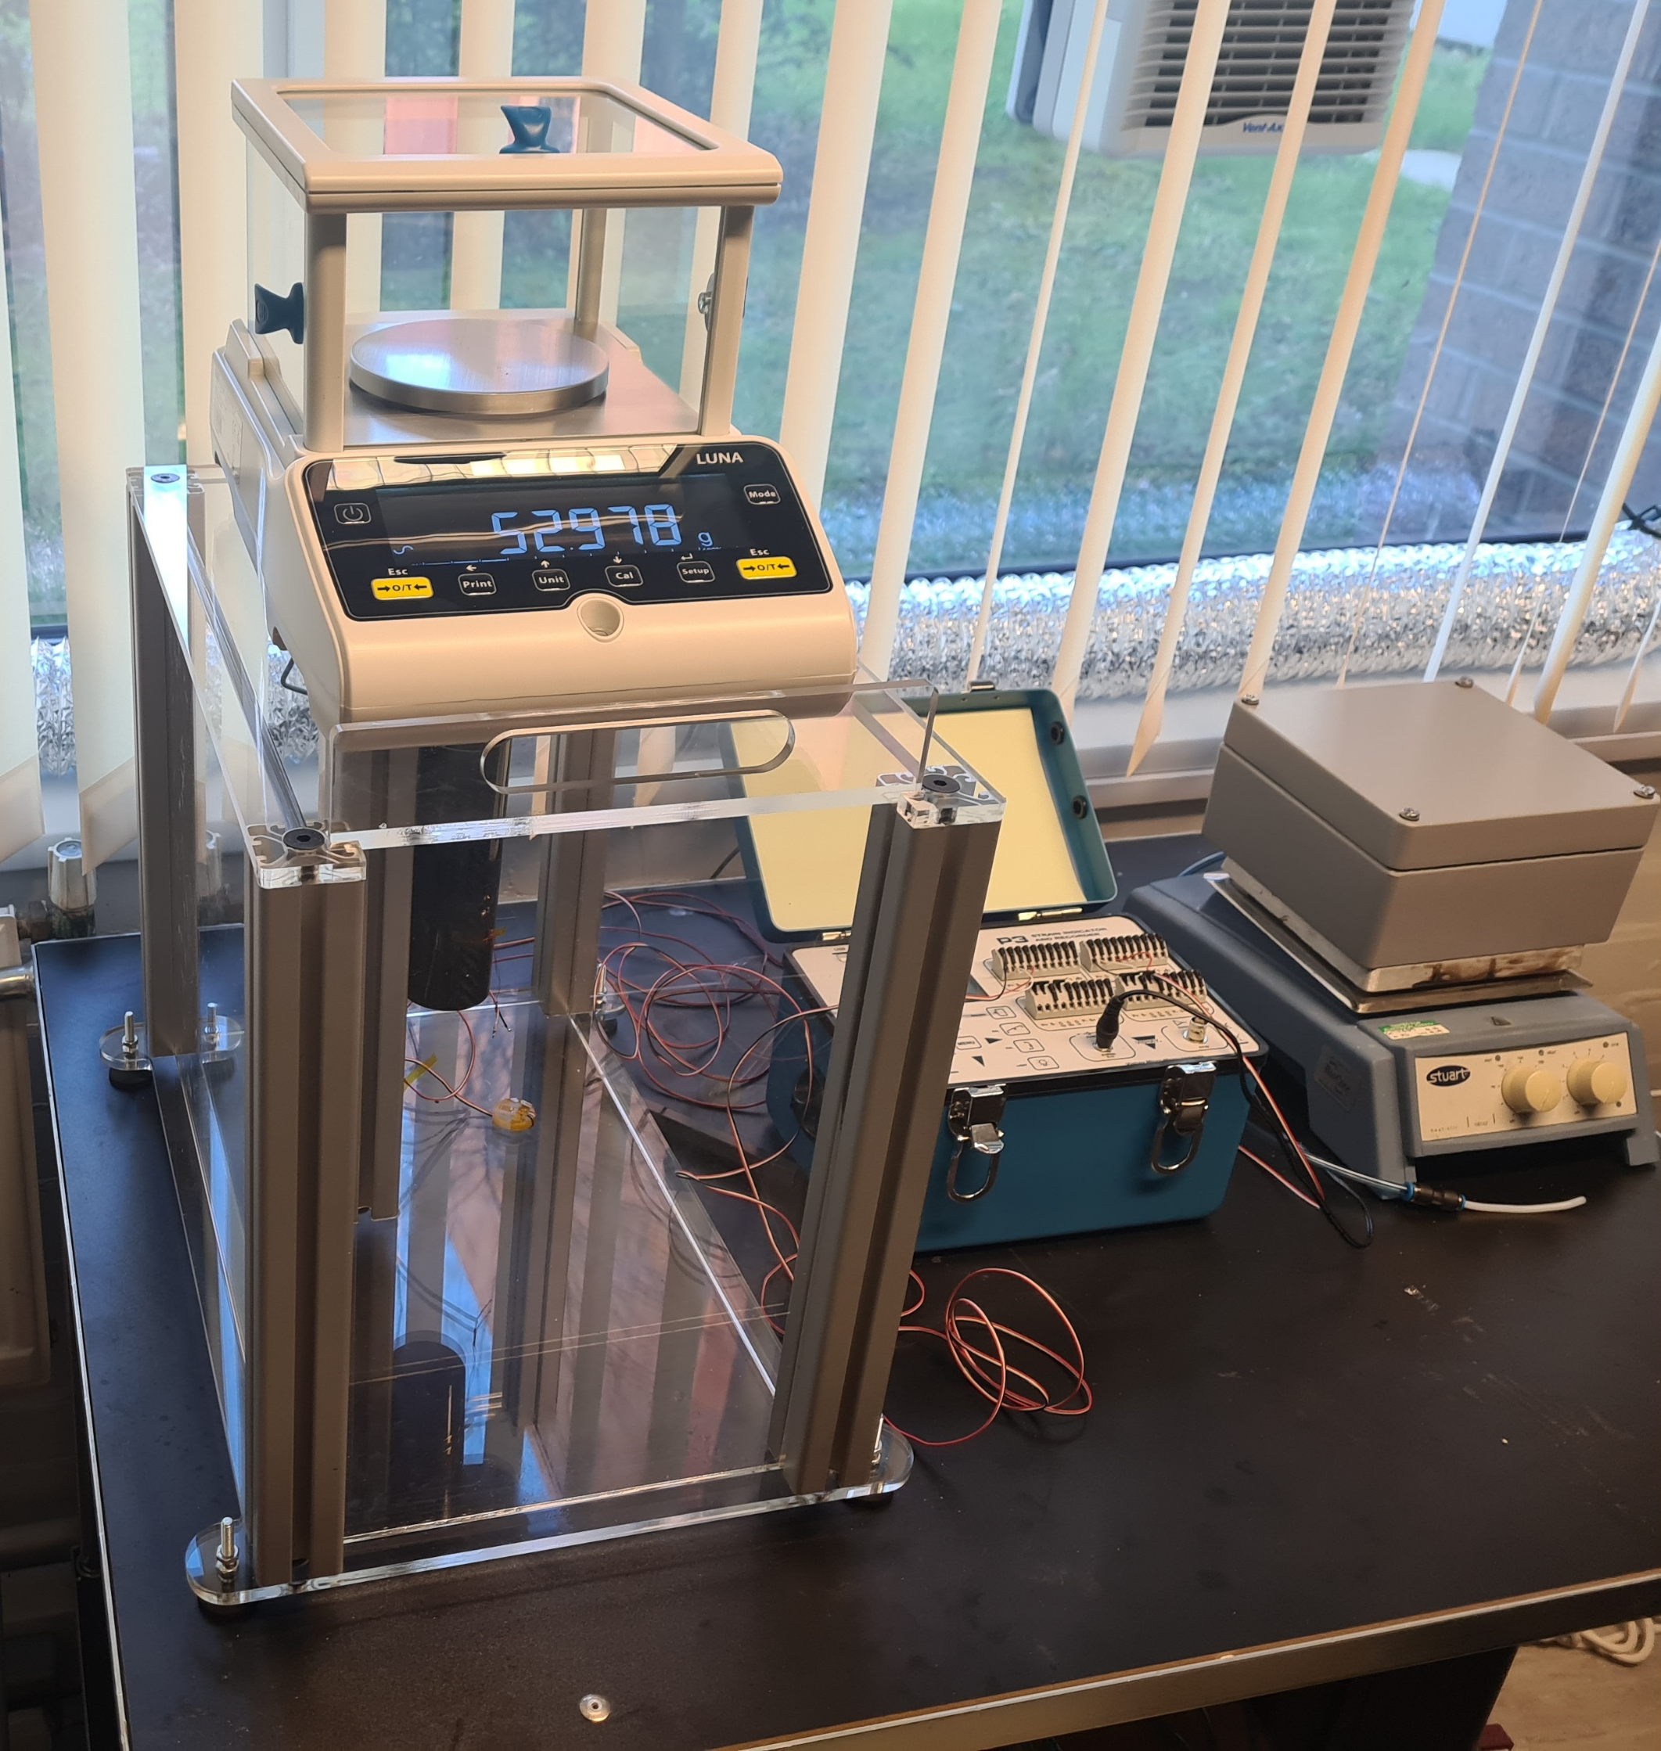
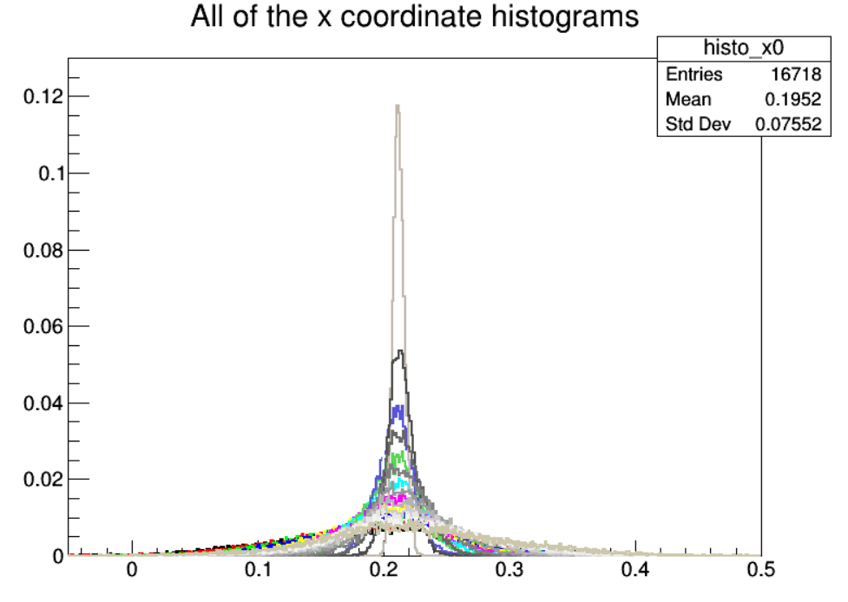
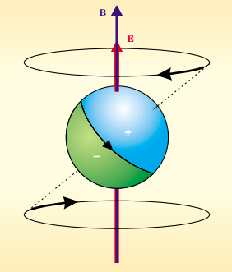
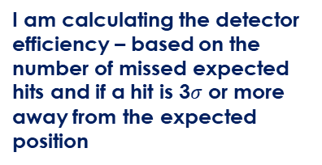
Katie Ferraby
Supervisors: Graziano Venanzoni and Joe Price
Experiments: MUonE and g-2
This is the dominant g-2 uncertainty in the g-2 theory calculation, MUonE aims to measure this value more precisely
My work:
Hardware – I am investigating alternative materials for the MUonE detector support structure
MUonE – I am analysing electron-muon scattering events, specifically working on detector efficiency and detector alignment
G-2 – I am calculating the muon electric dipole moment (EDM)
I am carrying out tests on different materials – e.g. Woven carbon to see how it reacts with temperature and moisture
Contraction/expansion is bad because you need a precise detector position measurement
I am checking that two of the modules in a detector station have the expected alignment by applying linear fits to the data and calculating which test alignment gives the lowest standard deviation
I am calculating the detector efficiency – based on the number of missed expected hits and if a hit is 3$σ$ or more away from the expected position
An EDM introduces a vertical oscillation at the g-2 frequency
I will be applying fits to the data to determine if there is a periodic oscillation – aka. EDM signal

Slide 4
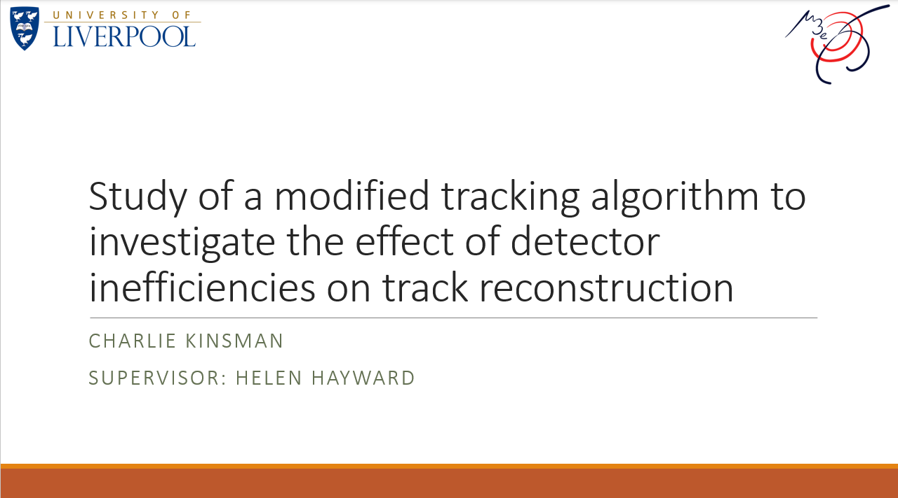

Slide 5
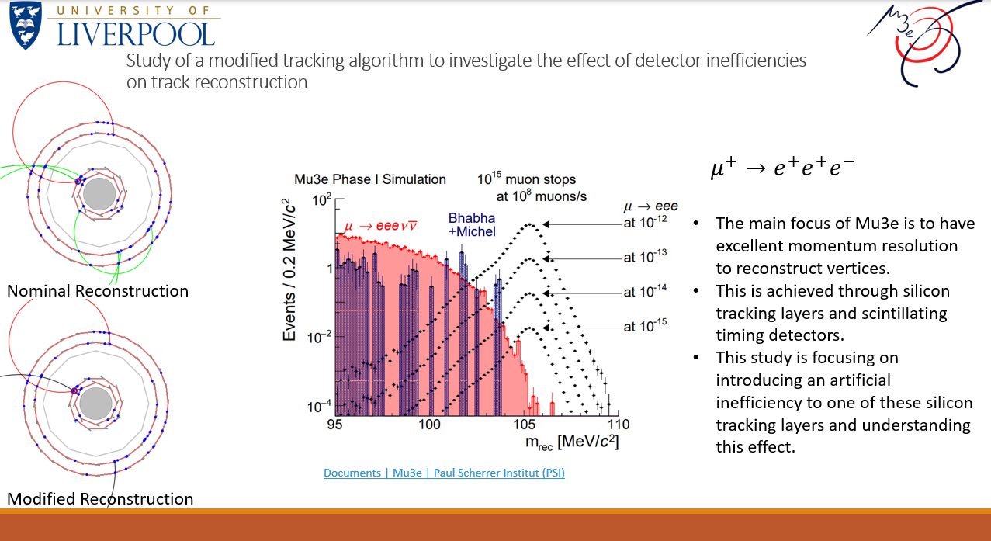

Slide 6


Annual HEP Meeting 2023
New Student Roundtable
Purely Baryonic Decays and First Neutron Studies at LHCb
Ned Howarth
Supervisors: Eduardo Rodrigues, David Hutchcroft , Tara Shears
18/05/2023

Slide 7
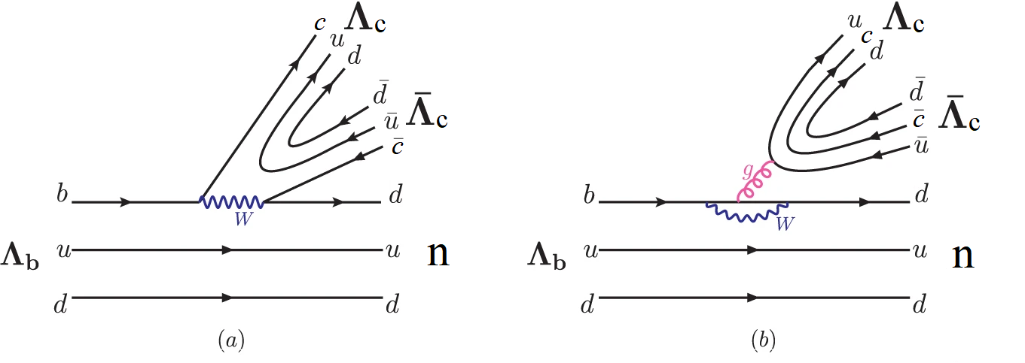
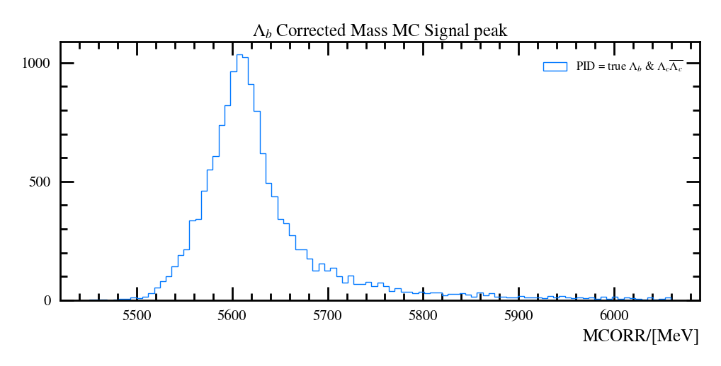
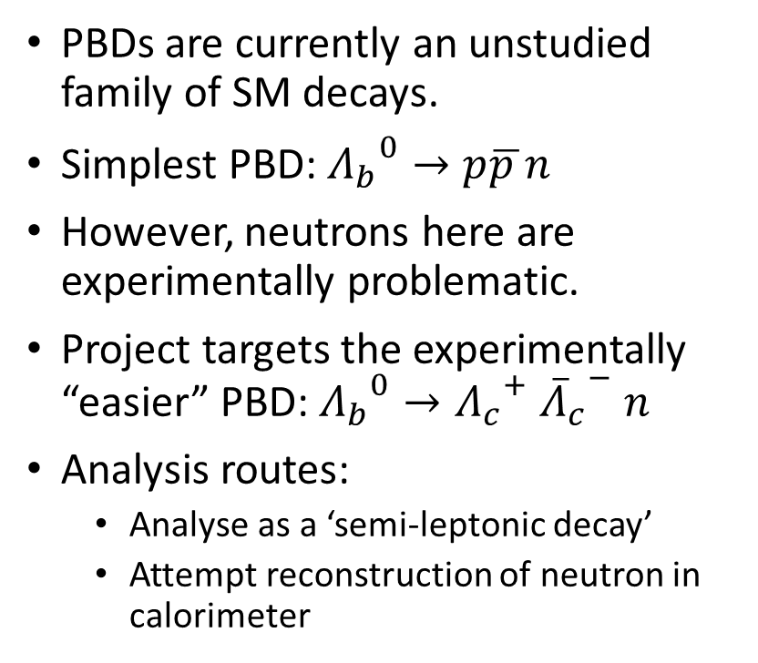
Purely Baryonic Decays (PBDs) & First Neutron Studies at LHCb
PBDs are currently an unstudied family of SM decays.
Simplest PBD: ${Λ_{b}}^{0}→p\overline{p }n$
However, neutrons here are experimentally problematic.
Project targets the experimentally “easier” PBD: ${Λ_{b}}^{0}→{Λ_{c}}^{+} {{\overline{Λ}}_{c}}^{−} n$
Analysis routes:
  Analyse as a ‘semi-leptonic decay’
  Attempt reconstruction of neutron in calorimeter

Slide 8
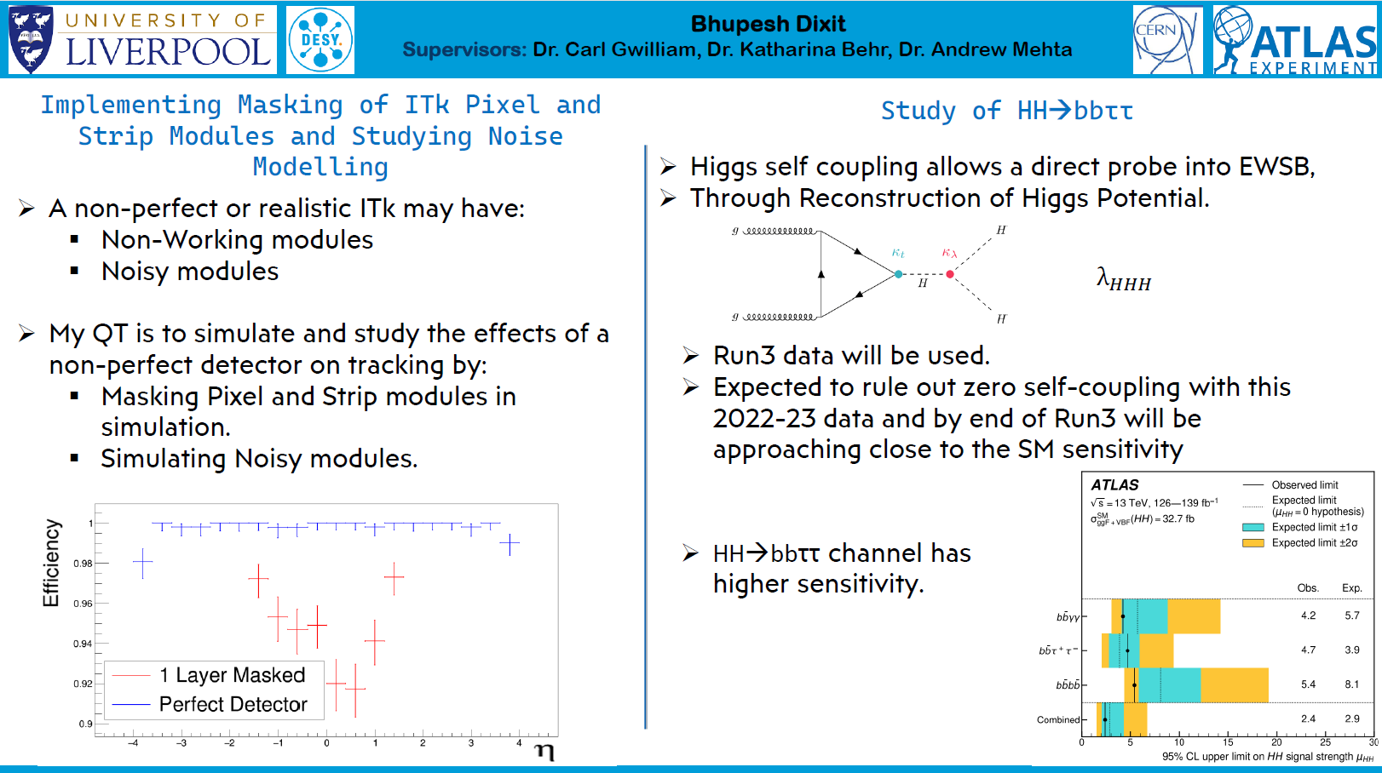

Slide 9


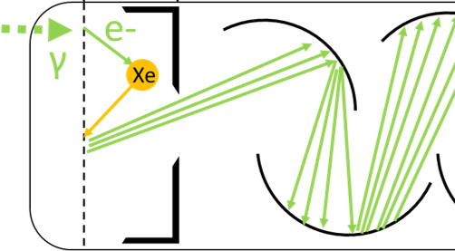
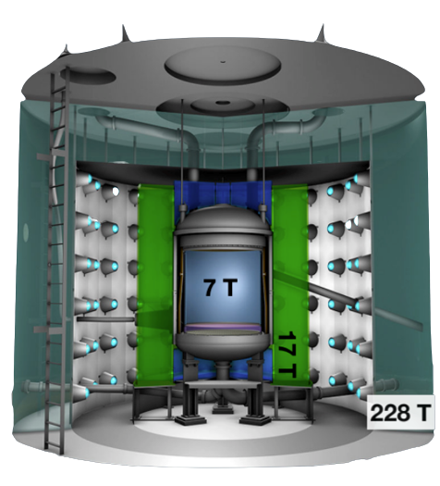
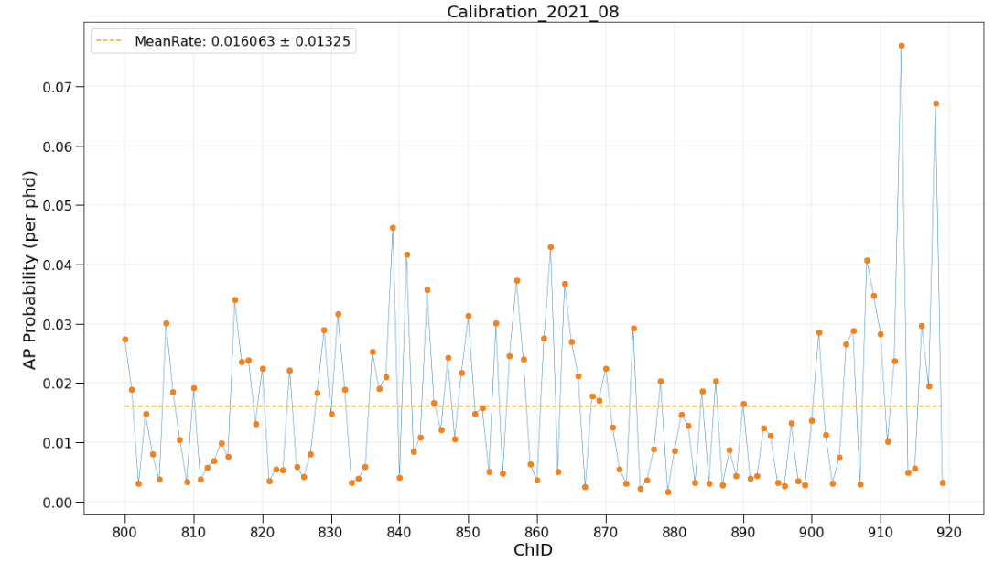
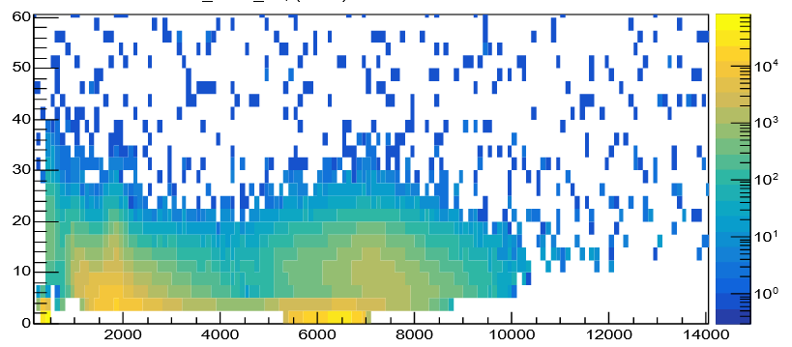
LZ Dark Matter
Megan Carter
Supervisors: Sergey Burdin, Ewan Fraser
Current and future work:
Analysing afterpulsing rates of PMTs in the outer detector.
Using optical calibration system (developed at Liverpool) to track afterpulsing rates for data quality team and monitor PMT health.
Joined team to work on chiral effective field theory analysis in future.
Afterpulsing: an atom in the vacuum space becomes ionised by a phe. It can then be accelerated by the E-field to produce delayed signals at a time dependent on its mass
Pulse Area vs Time
H⁺
Pulse Area (phd)
He⁺
O⁺
or CH4⁺
Time (ns)
megan.carter@liverpool.ac.uk
HEP Annual Meeting 2022
May 2023
Liverpool HEP 2023

Slide 10
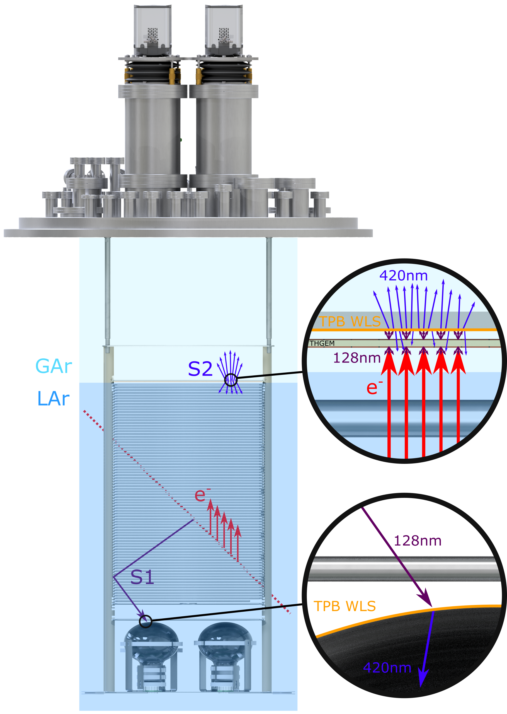
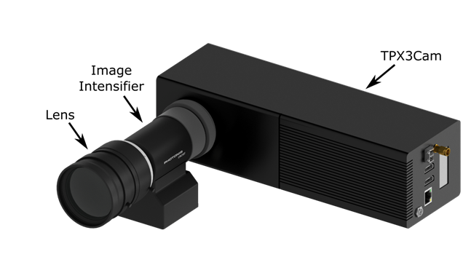
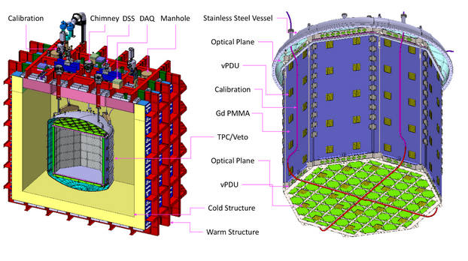
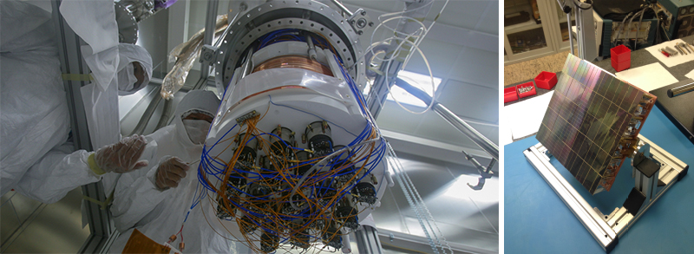
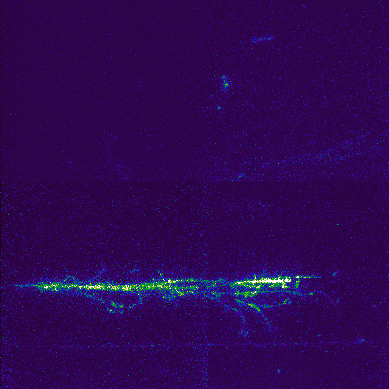
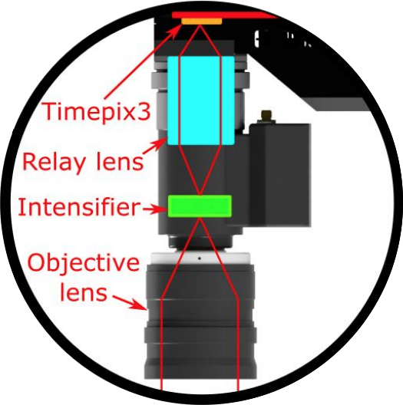


Photon detection systems for Liquid Argon Time Projection Chambers
Ariadne and Darkside-20k
43 cm
43 cm
Direct WIMP search detector
50 ton dual-phase LAr TPC
Uses Silicon Photomultiplers (SiPMs) tiles (Solid State single photon sensitive device)
Detects signals in the visible range
Designed to detect WIMP dark matter with masses around 1TeV.
TPC is shielded by a “Neutron Veto” designed to capture neutrons before they reach the TPC.
Imaging detection of events under Liquid Argon
1 ton dual-phase LAr TPC
Uses THGEM amplify signals in the gas phase.
Uses Timepix cameras
Detects signals in the visible range
Designed to detect particles tracks using S2 signals
Sudikshan Ravinthiran

Slide 11
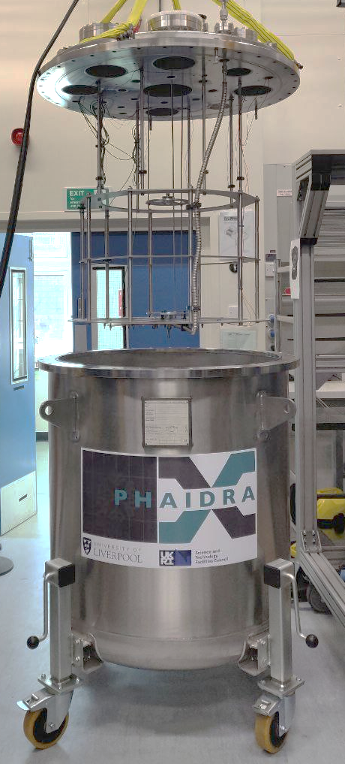
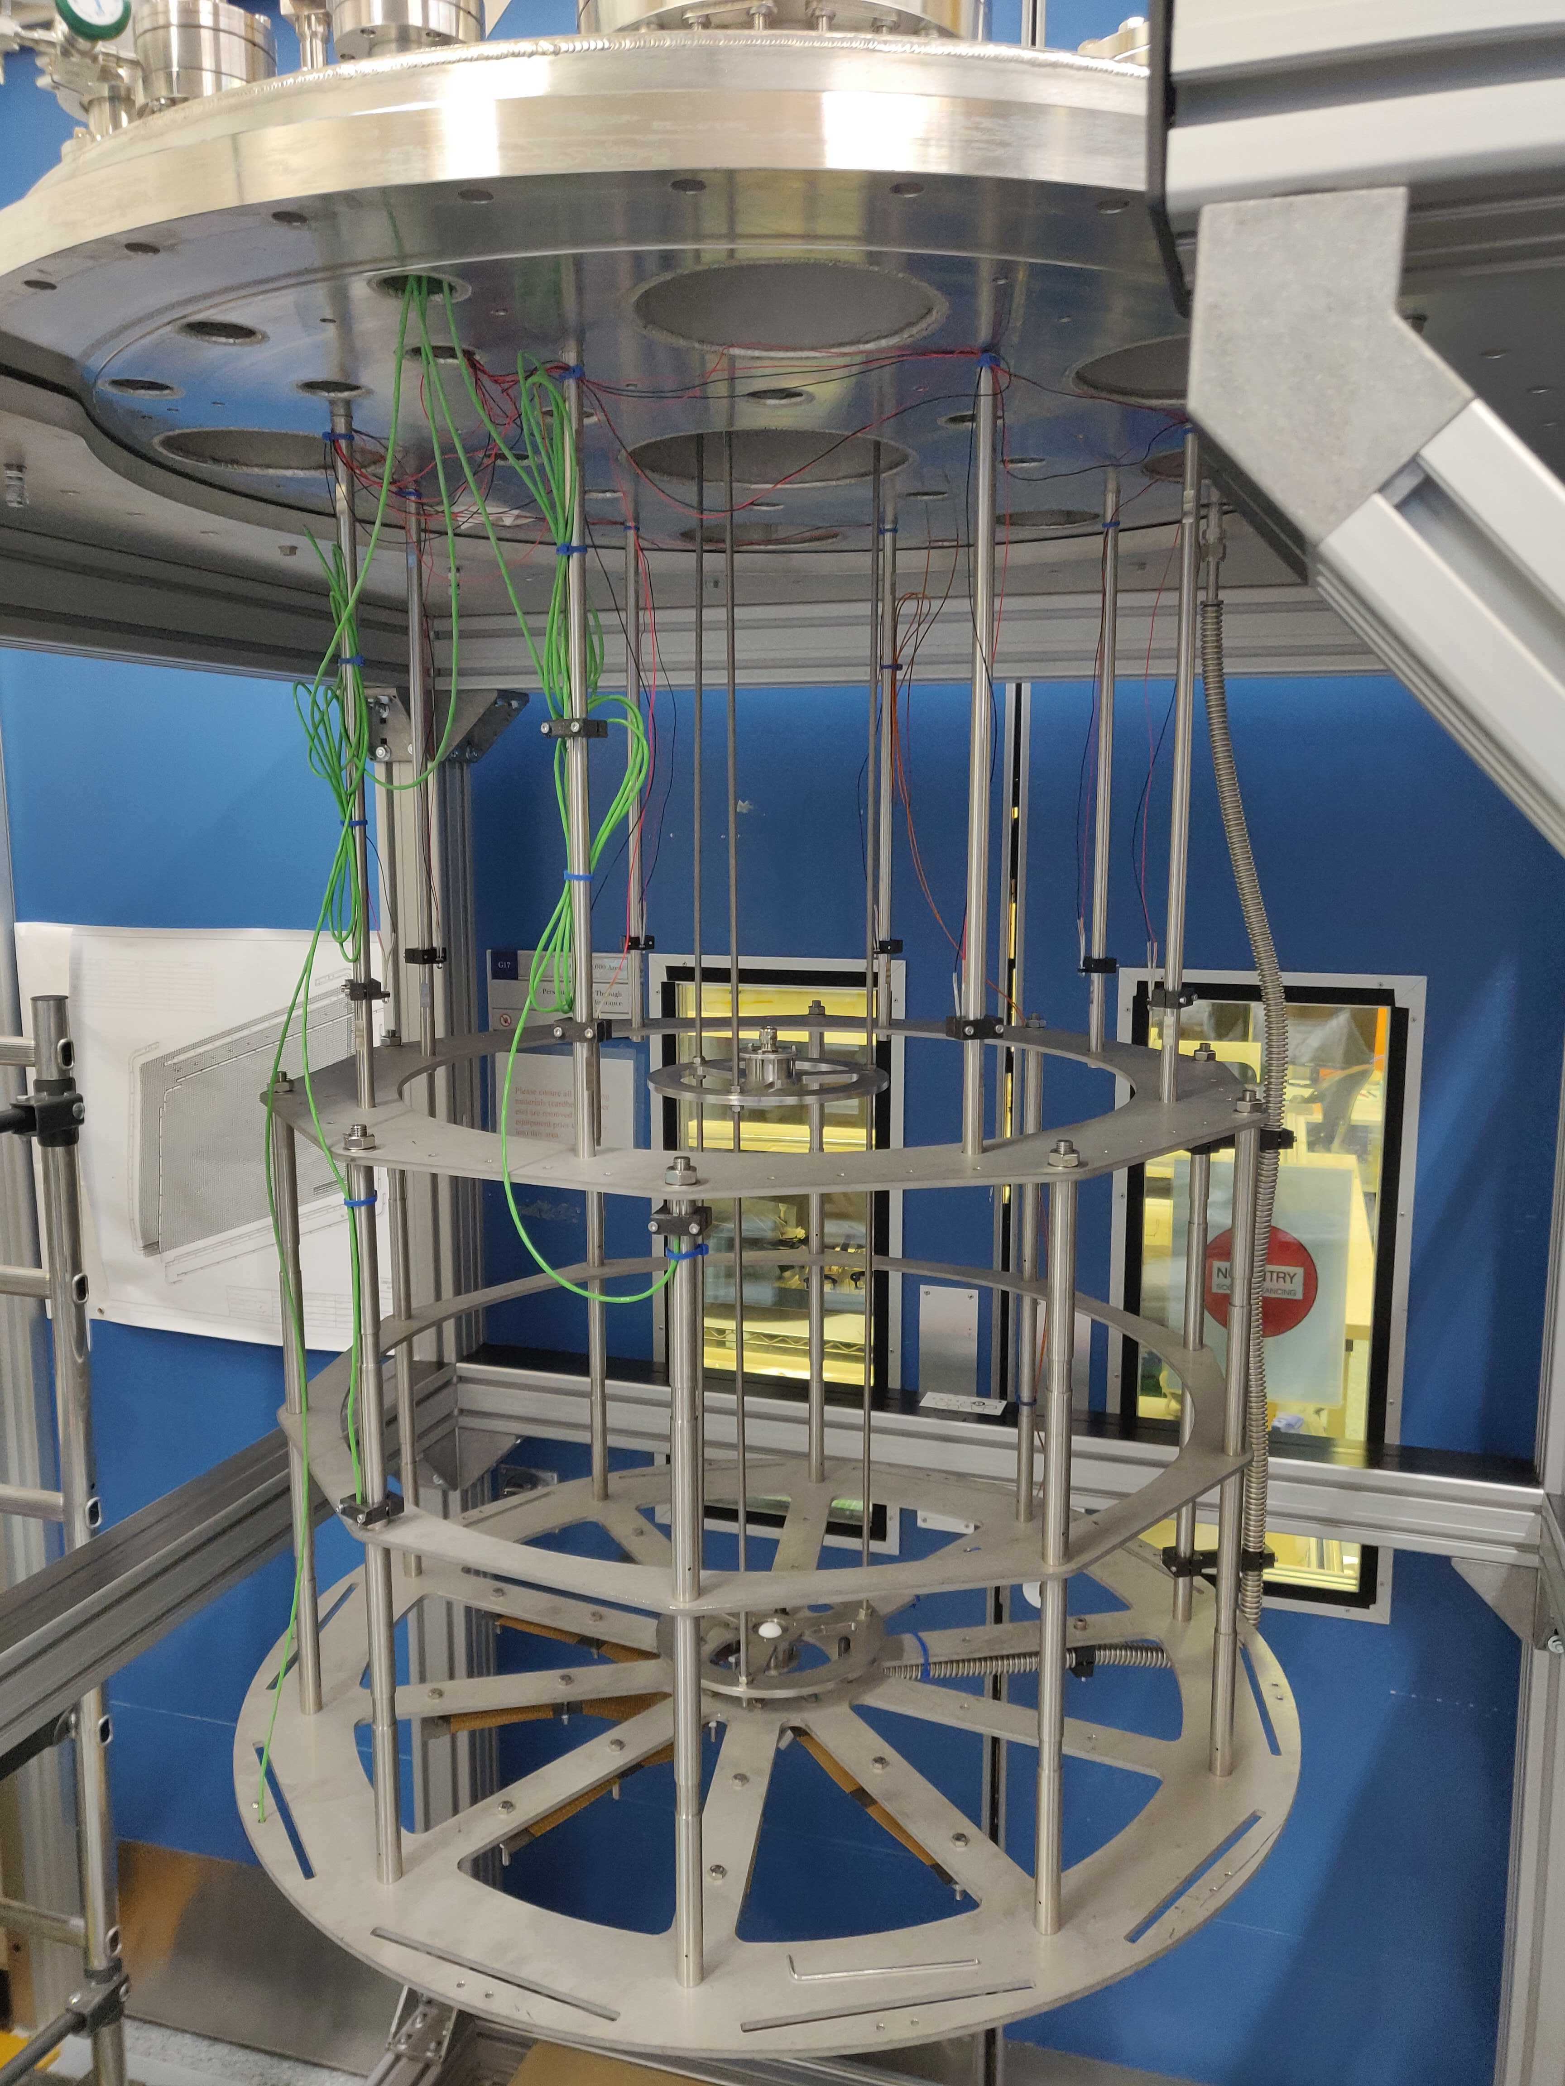
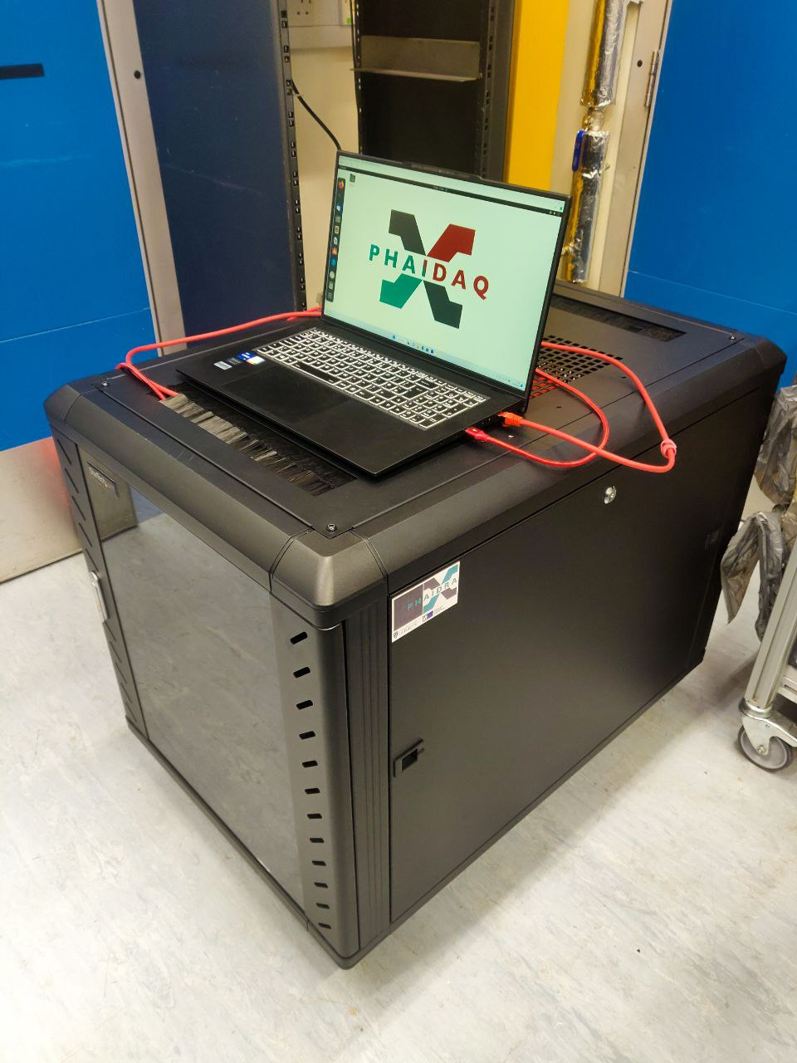
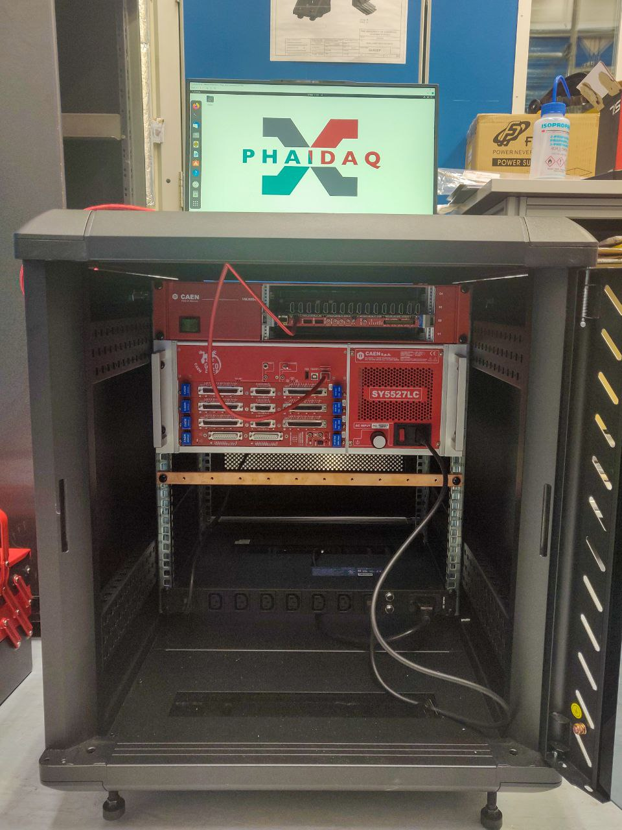
PHAIDRA
PHAIDRA/Phaidaq
PHAIDRA is planned to do cold test for up to 20 PDUs under liquid nitrogen.
Phaidaq will provide the power to the PDUs; Low voltage and High voltage boards in combination with a steering module.
Phaidaq will also have the ability to acquire data and control the physics runs and signal settings for the PDU waveforms.
Sudikshan Ravinthiran

Slide 12




HEP Summer Meeting
AION & MAGIS
Kamran Hussain
Email: Kamran.Hussain@liverpool.ac.uk

Slide 13
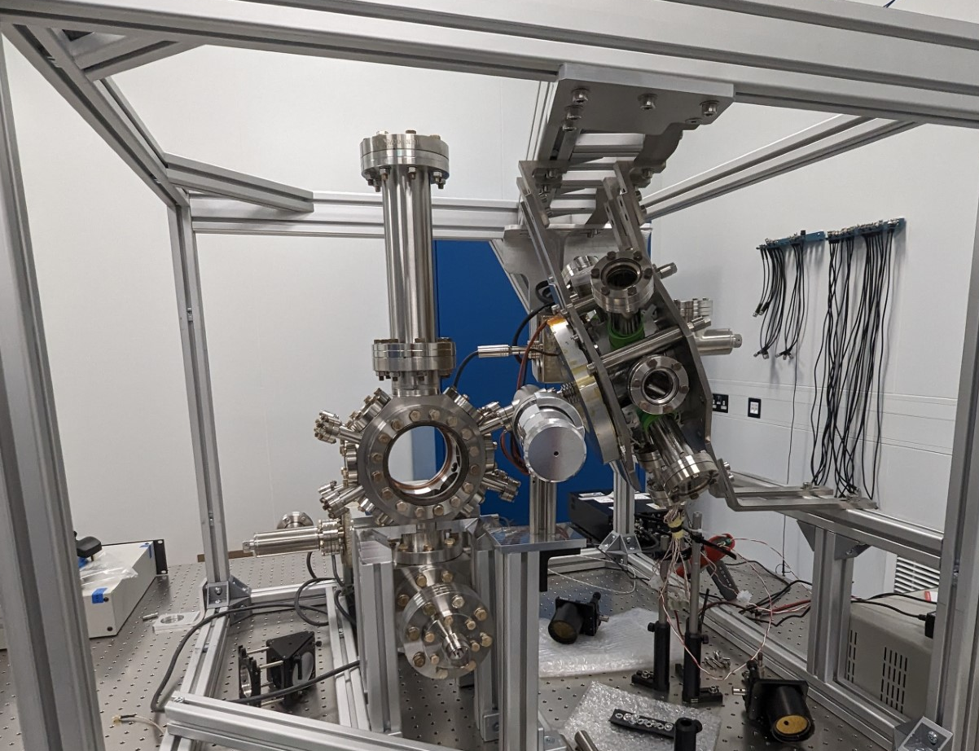
Overview
MAGIS-100: Retro reflection chamber
Track the position of the tip-tilt retro mirror using an optical feedback loop
AION: Strontium Cold Atoms Lab at RAL
Assist with building the optics setup for the 1m Strontium interferometer
Develop an out-of-vacuum retro reflection chamber for the 1m interferometer
Phase Shear Imaging

Slide 17
