Slide 1
Electronic Feedback Loop for Phase Shear Platform Mirror Control HEP Meeting May 2023

Slide 2
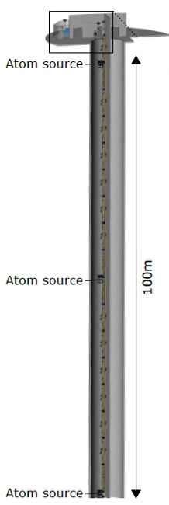
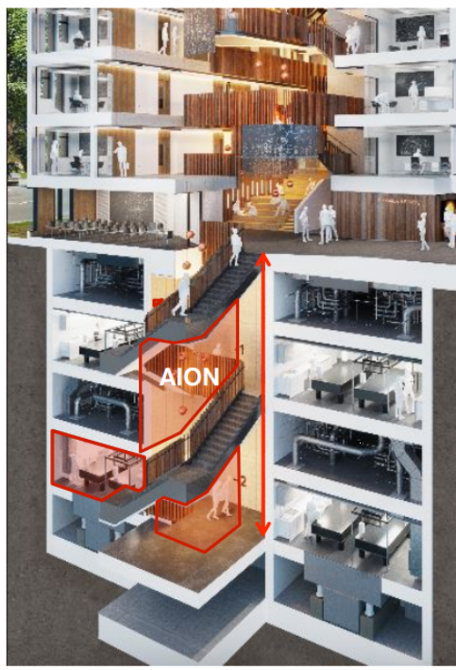
MAGIS-100
AION-10
100 m baseline vertical atom interferometer
Under construction at FNAL
Dark matter and gravitational wave detector
Testbed for 1000 m detector
10 m device based in Oxford University
Prototype for future 100 m & 1000 m detectors
Networking with MAGIS

Slide 3
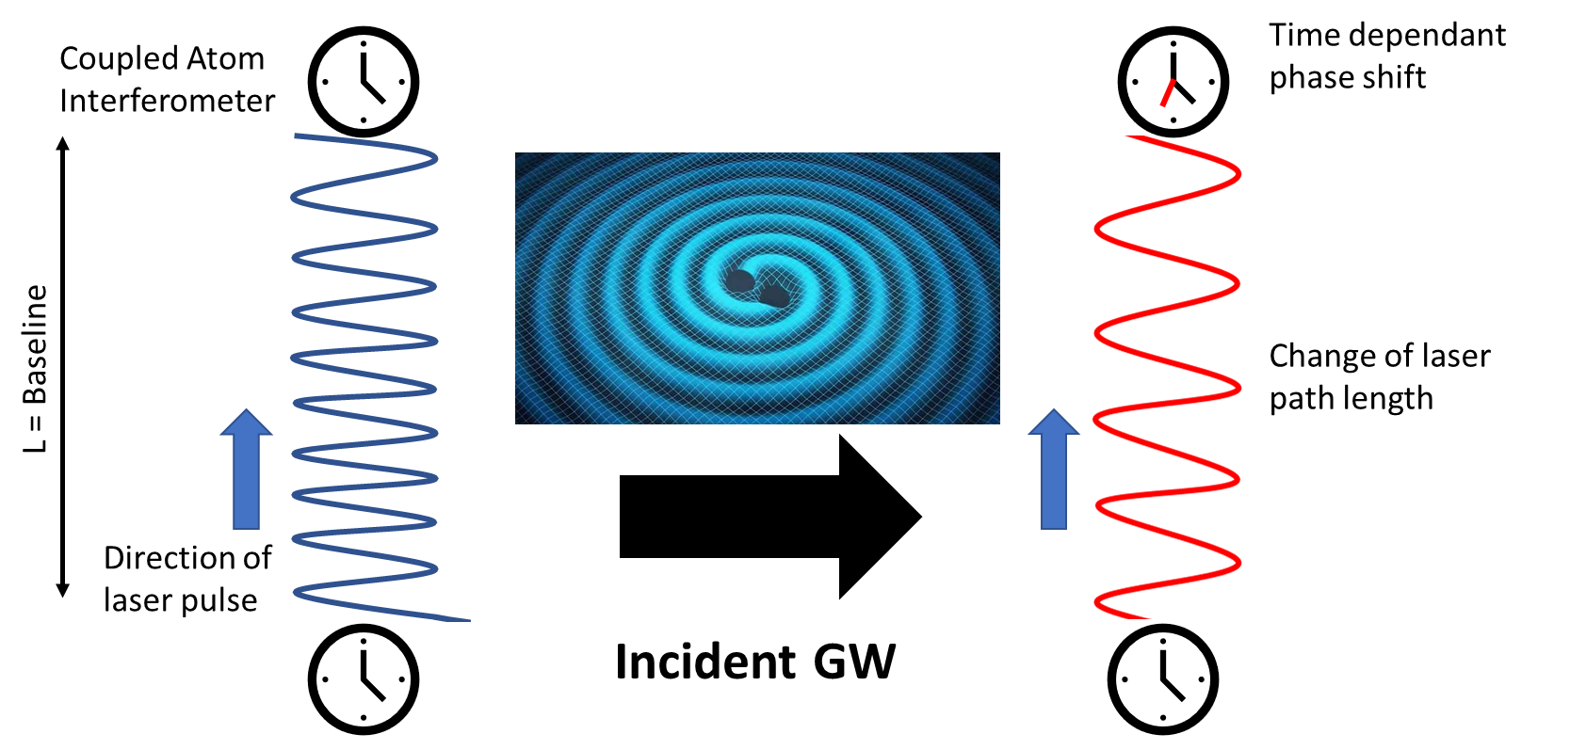
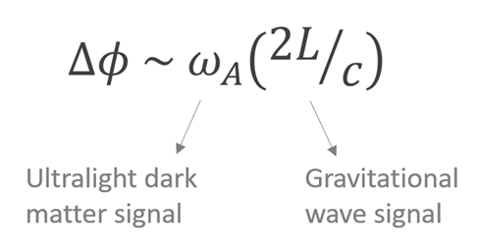
Ultra-Light Dark Matter & Gravitational Waves
Sensitivity to ULDM (10⁻²² – 10⁻¹⁴ eV)
DM field induces oscillations in fundamental constants, shifting atomic energy levels
Manifests as phase shift between interferometer arms
Sensitivity to Mid-band GWs (0.01 – 3 Hz)
Incident waves strain the path length of laser coupling interferometers

Slide 4
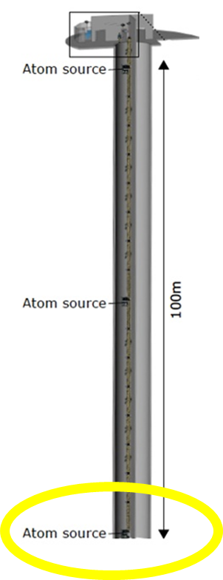
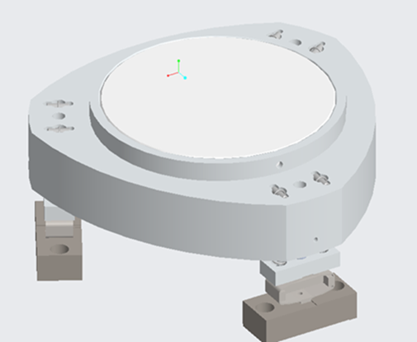
Phase Shear Platform
Atoms in freefall experience Coriolis force
Requires correction with mirror tilt
Additional tilt allows for single shot detection via phase shear readout
Mirror housed in UHV chamber delivered by Liverpool
Mirror movement driven by piezoelectric actuators

Slide 5
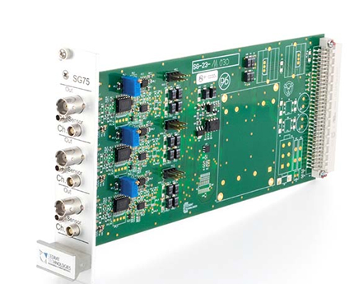
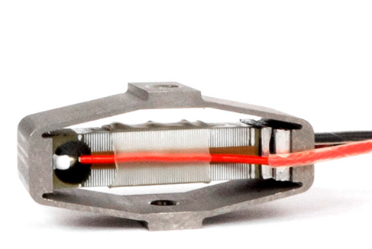
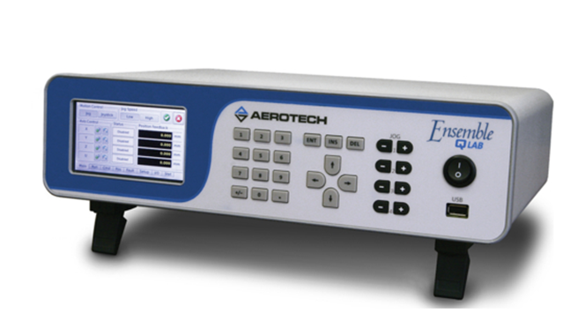
Tip-Tilt Mirror Electronic Feedback Loop
Strain Gauge Signal
Piezos have intrinsic hysteresis that causes a positional lag
Position error introduces unwanted interferometer phase
Solution is to correct movement with closed feedback loop
Cedrat SG-75 Signal Conditioner
Servo - Loop
Amplified Position Feedback
Cedrat APA-60SM
In-Vacuum PZT
Piezo Drive Voltage
Aerotech Ensemble
Piezo Controller

Slide 6
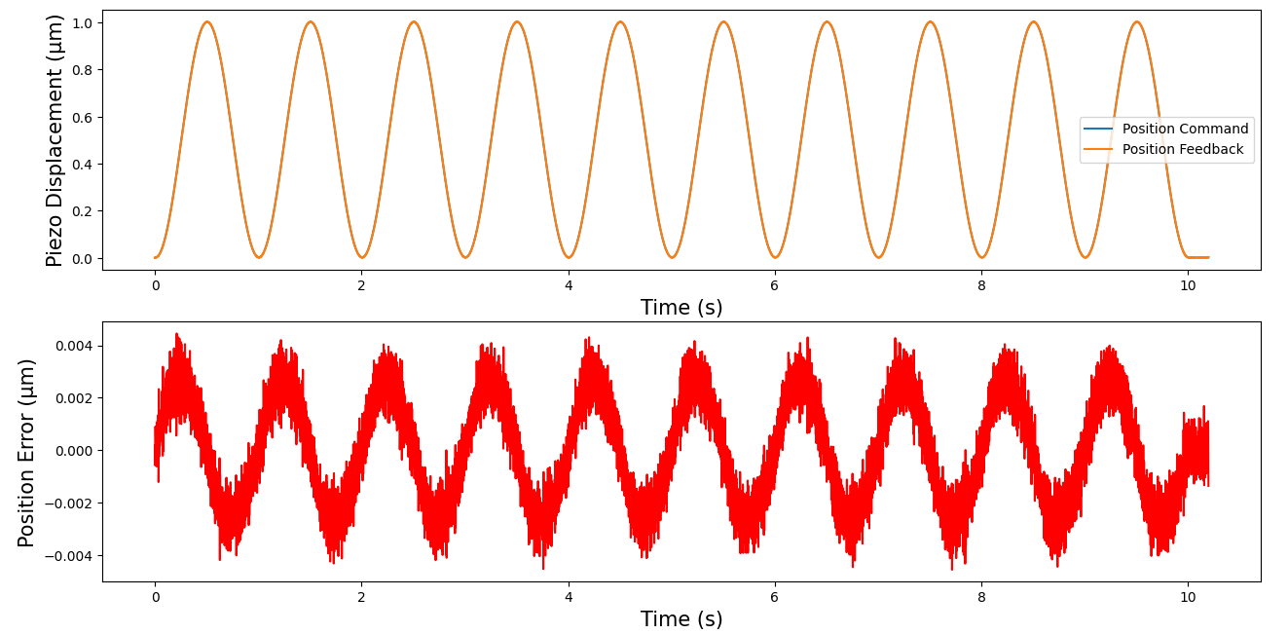
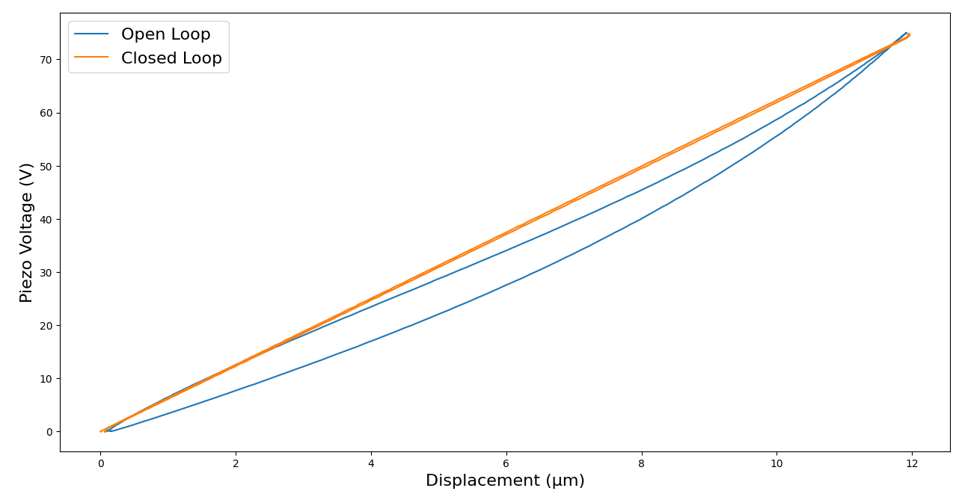
Test-Stand Performance
Fig.1: Sine wave response
Displacement: 1 μm
Frequency: 1Hz
Average error: 1.8 nm
Fig.2: Hysteresis Plot
Piezo strained to full extension then relaxed
Hysteresis shown by the non-linear response of open loop plot (blue)

Slide 7
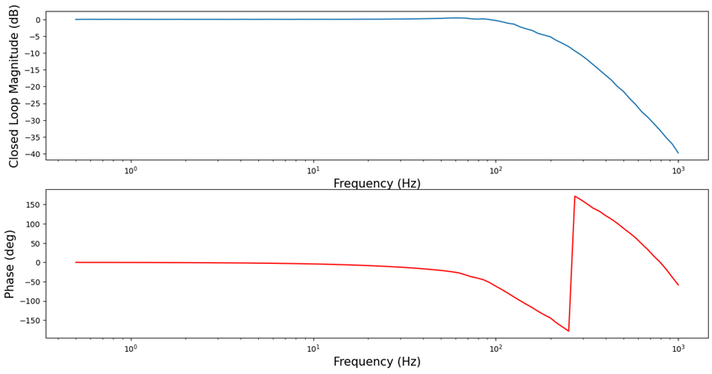
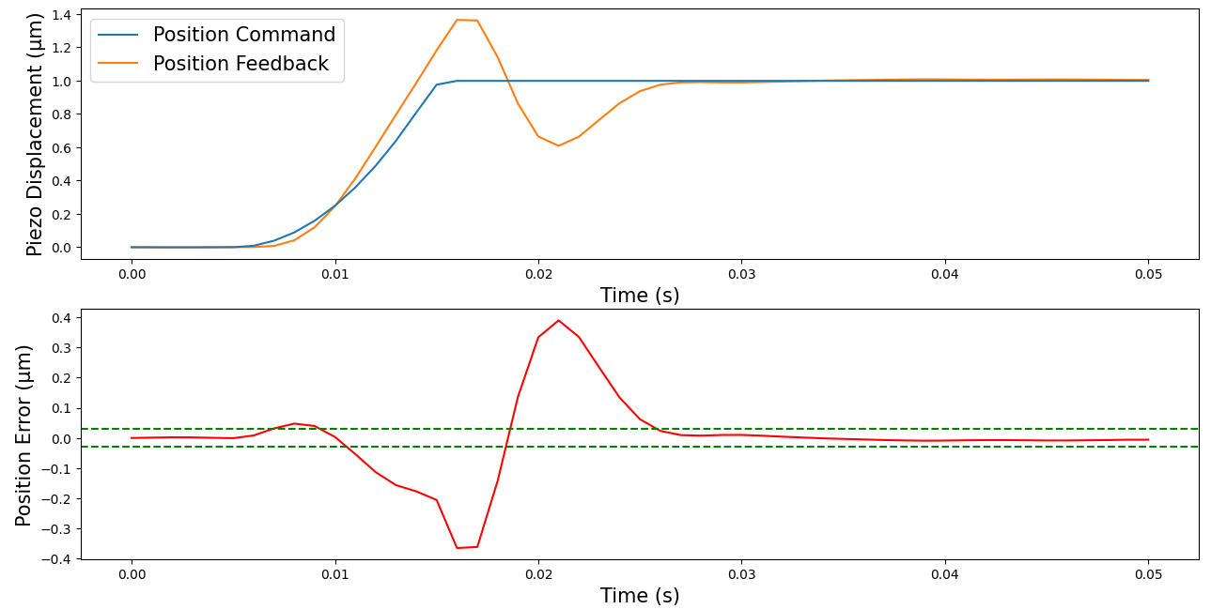
Test-Stand Frequency Response
Fig.3: Closed Loop frequency response
Closed loop response measured at different frequencies
Roll off at ≈100 Hz indicates the bandwidth
Fig.4: Settling time of the feedback loop
Piezo takes time to settle to commanded position
Settling time is inverse to bandwidth
Reduced settling time is required for phase shear readout

Slide 8
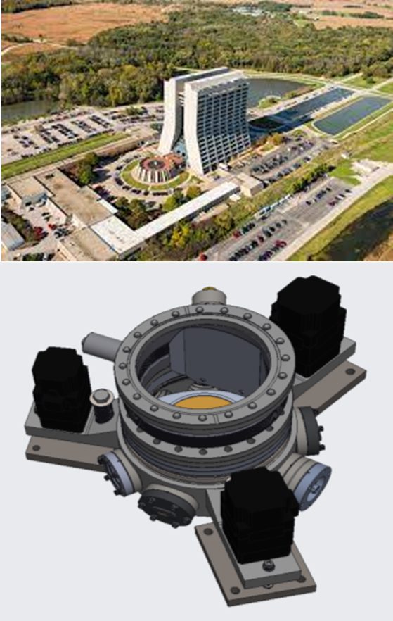
Future Plans
The test stand shows that the feedback loop is functioning well
The UHV retro-reflection chamber is currently being machined at Liverpool (learn more at Gedminas Elertas’ Presentation)
Commissioning of MAGIS / AION retro reflection platform later this year
Future testing of feedback loop with UHV piezos
Demonstration of Coriolis correction and phase shear readout

Slide 9
Back –Up Slides

Slide 10
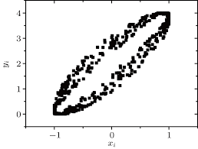
Phase Shear Readout
Additional tilt to final interferometry pulse imprints a fringe pattern.
Interferometry phase can be inferred from fringe pattern.
Allows for single-shot detection.
Conventional interferometry requires 100s of sequences for single measurement.

Slide 11
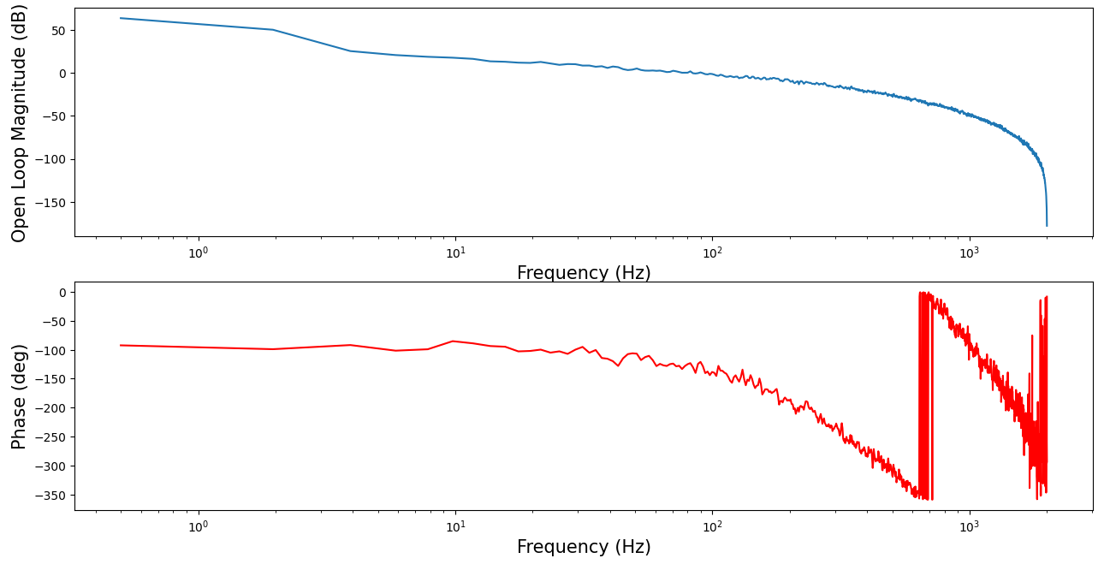
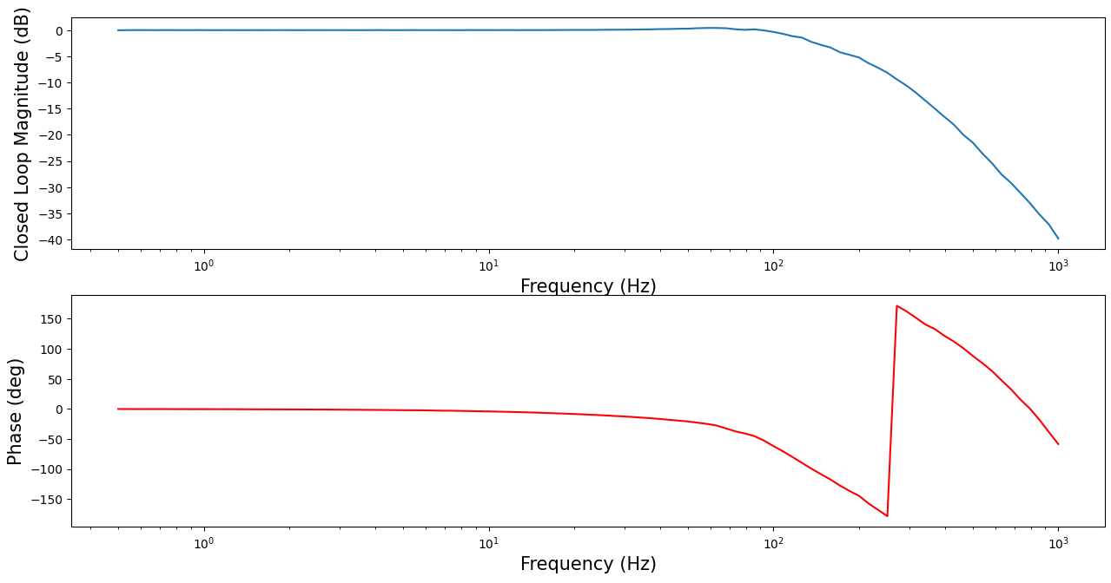
Frequency Response
Driving a sine wave through the system at a range of frequencies
Frequency response used to tune PID gains for servo loop
Currently working to improve bandwidth and stability

Slide 12
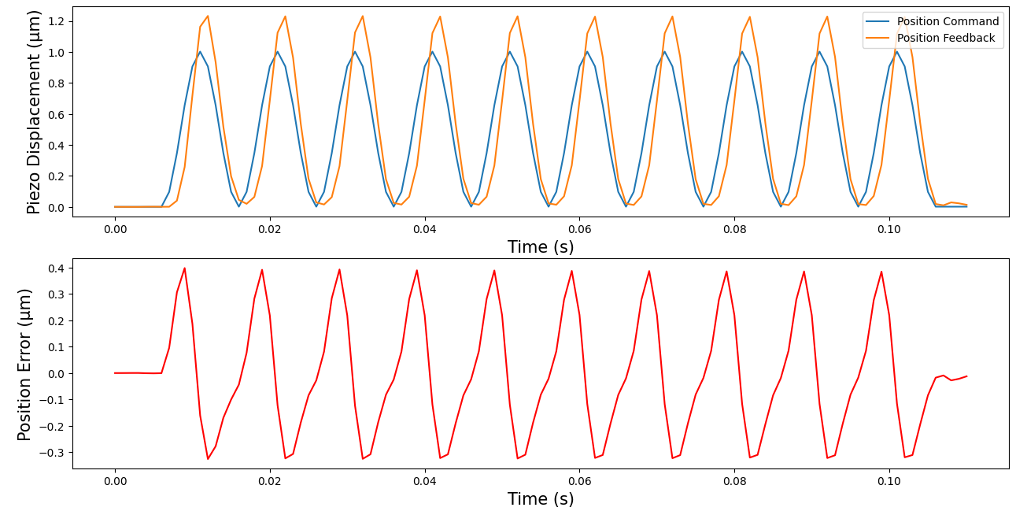
Performance
Displacement:1 μm
Frequency: 50Hz
Average error: 83 nm
Displacement: 1 μm
Frequency: 100Hz
Average error: 182 nm

