Slide 1
LHCb Liverpool Physics and M&O
Dr Paras Naik
Particle Physics Group Meeting
18 May 2023

Slide 2
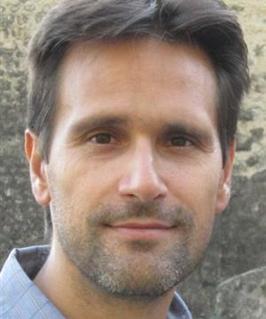
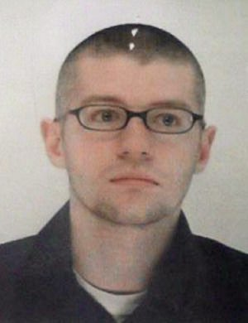
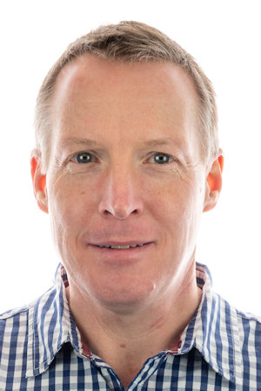
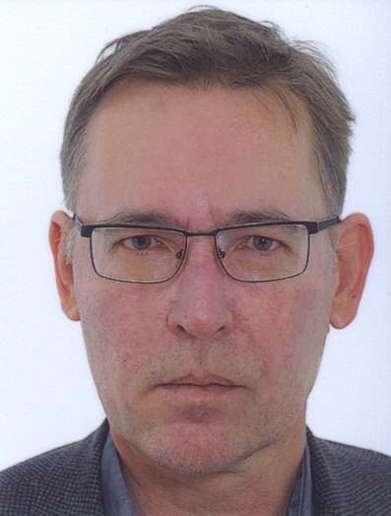
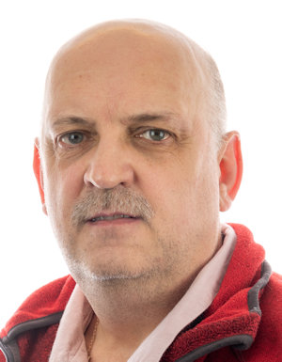
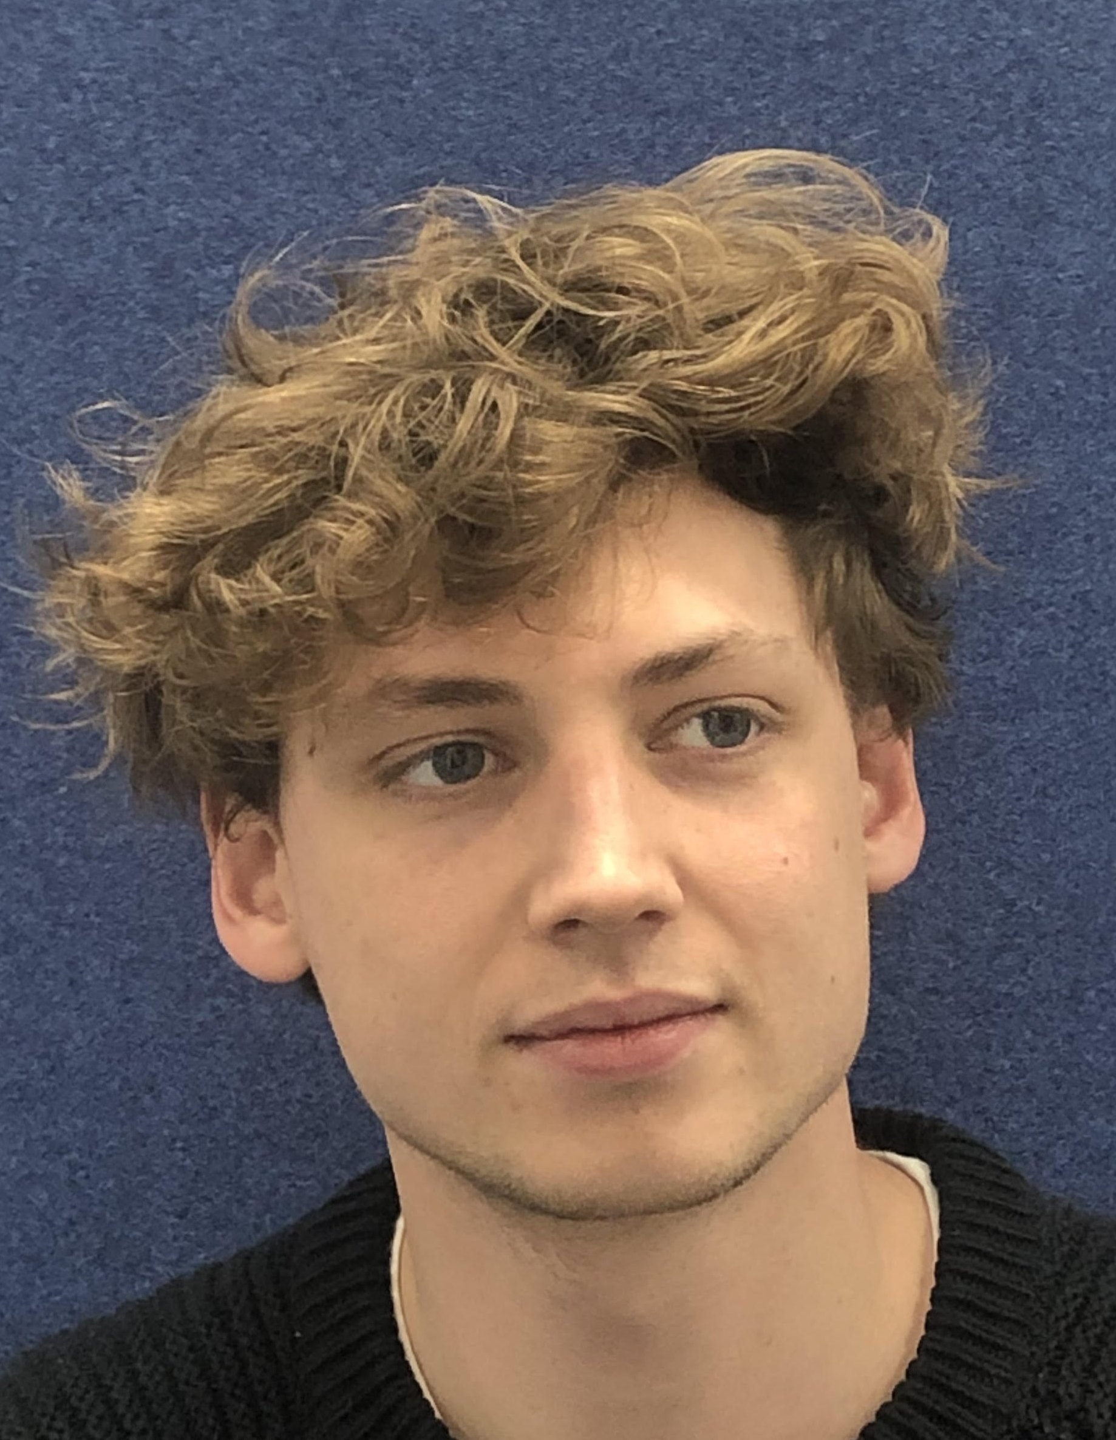
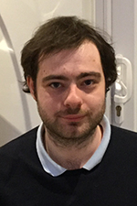
The Friendly Faces of LHCb Liverpool
Tara
Themis
Eva
(at CERN)
Karol
David
Eduardo
(in Liverpool)
Paras
New!
Ayushi
Ashley
Kieran
Kurt
James
(at Karlsruhe)
In October
New RA
+1 (!)
students
John
Abbie
Back from CERN!
Ned
Thomas
Jan
Sigrid
We are an active group, leading the field...
We’ve built/invented detectors, techniques, and tools used to collect/analyse LHCb data.

Slide 3
Two Roads to New Physics
Direct Observations
Indirect Effects
… but they can have an effect as virtual particles, especially in loops
Particles with mc² > E
cannot be produced directly
E = mc²
This kind of approach is sensitive to particles far heavier than those directly produced in a collider.
Flavour physics lets you see beyond the energy frontier...
LHCb is designed for this!

Slide 4
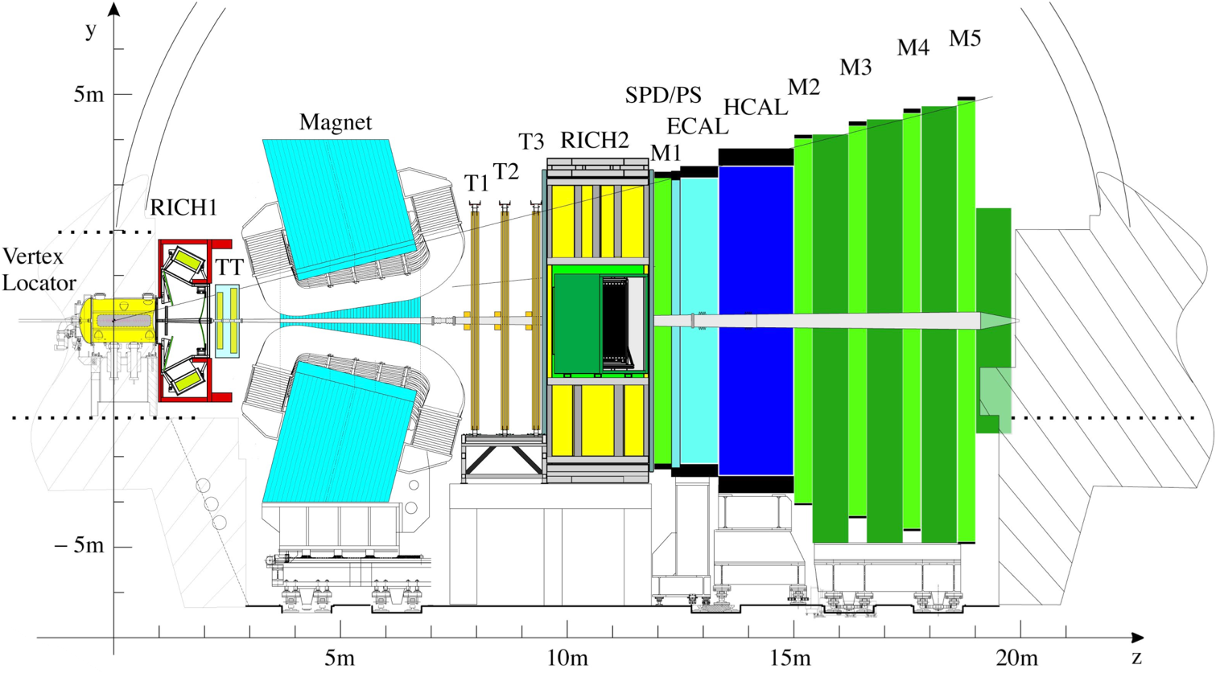
LHCb
1610 members
96 institutes
21 countries
Optimised for quark flavour physics, especially the precision study of beauty quark and charm quark decays.
100,000 b anti-b pairs per second at the LHCb interaction point. (and 20 times as much charm!)
Vast quantities of all b-hadron (B⁰, Bs, ...) and c-hadron (D⁰,Ds, ...) species

Slide 5
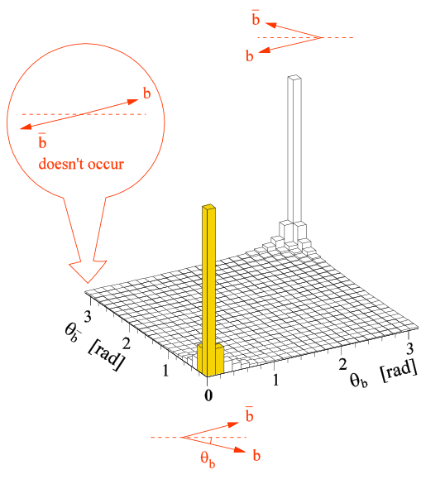
LHCb Experiment
Beauty (and Charm) quarks are produced in forward directions
We built our detector to focus on finding these events,
but we can do much more
Precision electroweak studies
Heavy Ion collision studies
“Fixed Target” (with Beam-Gas)
Not a fixed target experiment
b
b
b
p
_
_
p
_
b
b
b

Slide 6
LHCb Detector
Many detector elements not found elsewhere at the LHC
The VELO - a vertex detector INSIDE the beam pipe, for excellent impact parameter and decay lengths resolution Built at Liverpool
Two Ring Imaging Cherenkov (RICH) detectors provide particle identification.

Slide 7
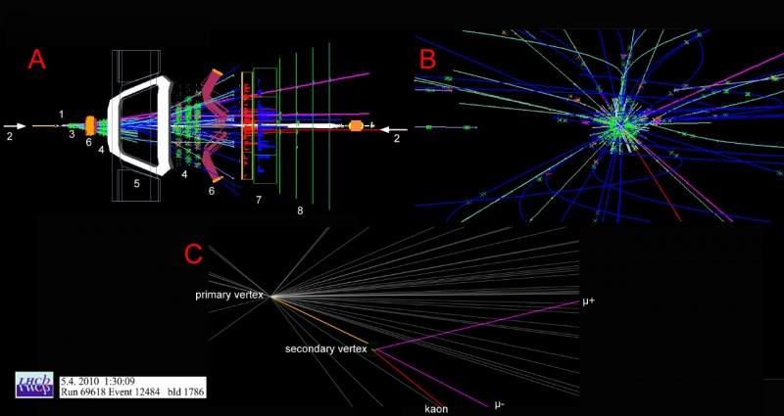
Inside the VELO
Charged particles produced in one proton-proton collision
Here, one neutral particle containing a b-quark travels along the dotted path
It then decays into another particle containing a c-quark and one other charged particle
The c-quark containing particle then travels further and decays into three charged tracks
Inside the VELO!

Slide 8
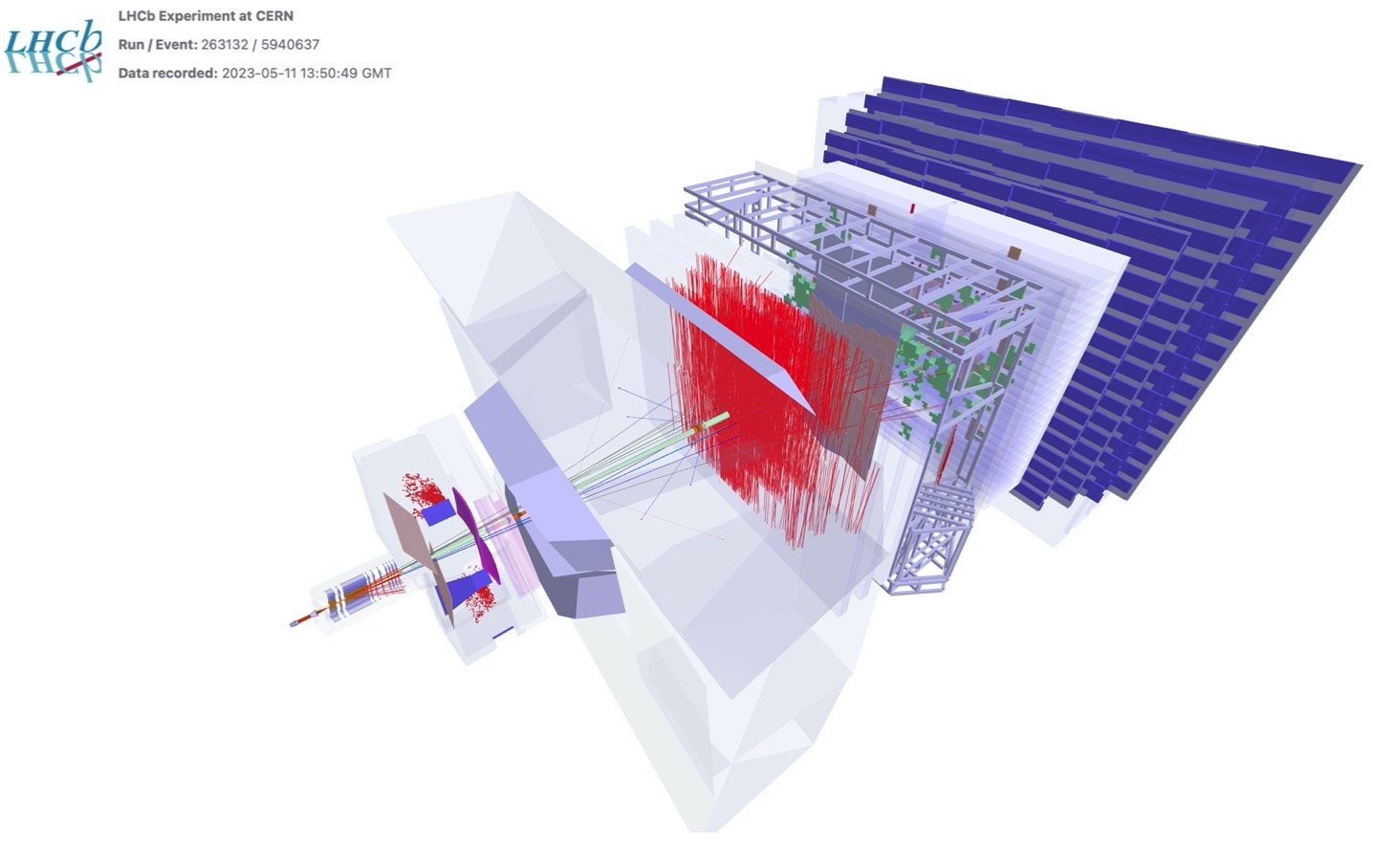
Run3 LHCb Event
9 fb⁻¹ of pp collisions recorded so far during LHC Run 1 and 2
Inside the VELO!
Event display from last week: The first Run 3 LHCb data with all subdetectors included!
First “long” (going through all tracking detectors) tracks

Slide 9
Liverpool LHCb (& related) Service Work
LHCb VELO Installation & Commisioning
LHCb VELO & Alignment Operations
LHCb Mighty Tracker
responsibility
LHCb VELO++ software
See Ashley’s talk
leadership
LHCb Quantum Computing Activities
LHCb VELO simulation lead
LHCb VELO DAQ
LHCb B to Open Charm convener
And many former responsibilities / leadership roles!
LHCb Shift Leader / Data Manager
LHCb Data Processing & Analysis Project Leader
HSF coordination team & HSF PyHEP WG co-convener SWIFT-HEP WP5 (Data Analysis) co-convener
See Eduardo’s talk
HFLAV Charm Decays convener
LHCb RICH alignment leader
Institutional review of LHCb papers
Many LHCb paper committees, etc…

Slide 10
Recent LHCb (& related) Publications
B⁰(s) → p anti-p
B⁰(s) → p anti-p p anti-p
Bs → μ⁺ μ⁻ (and B⁰(s) → μ⁺ μ⁻ (γ) search)
Lauren Yeomans
(Prior Student)
Quantum ML for b-jet charge ID
(As part of DPA)
Measurement of the W boson mass
Stephen Farry
(left LHCb)
Run 2 RICH performance
Novel sources of quantum-correlated charm
Heavy Flavour Averaging Group paper
And several more in review / leadership capacities
See Eduardo’s talk for Computing & Software publications!
published to conference/journal since ~2022

Slide 11
LHCb Conference / Workshop Participation
virtual
Expect more after LHCb Upgrade commissioning!
since 2022
imminent
organised

Slide 12
Liverpool LHCb Grants / Awards / Prizes / etc…
LHCb Upgrade II
(In process)
CERN Scientific Associateship Oct. 2022 - Sep. 2023
Top-up award Bell Burnell Graduate Scholarship Fund (IOP)

Slide 13
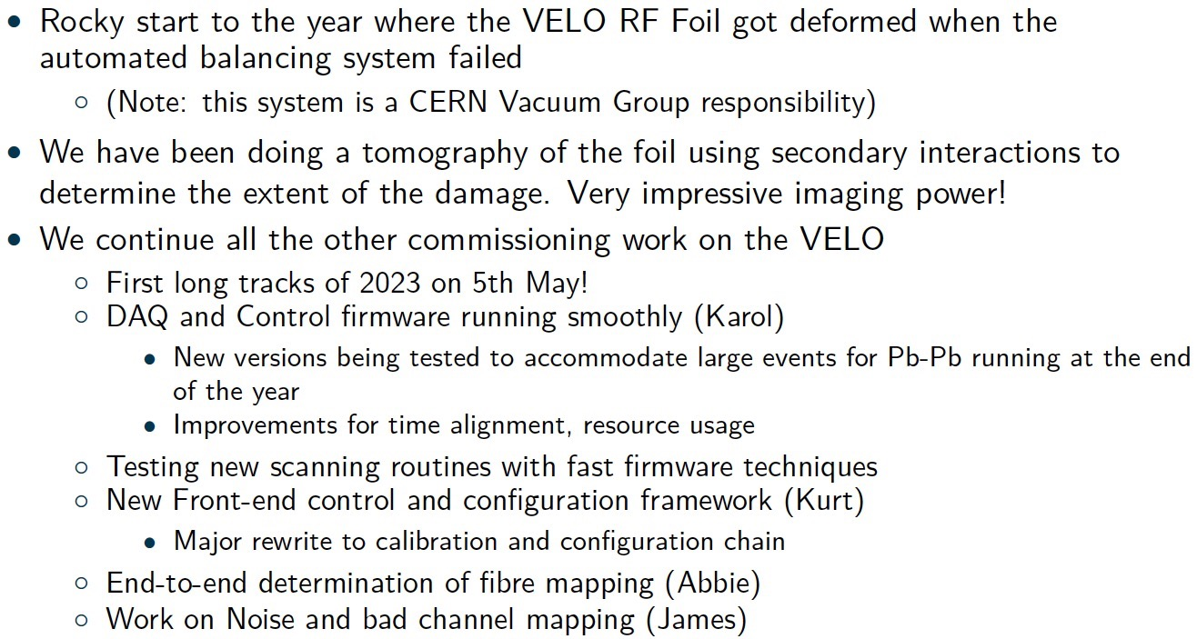
LHCb VELO
, resulting in build up of pressure beyond spec
Note: this system is not the responsibility of the VELO group
(next slide)
Update the VELO simulation to match the new detector (David, Karol, James)

Slide 14
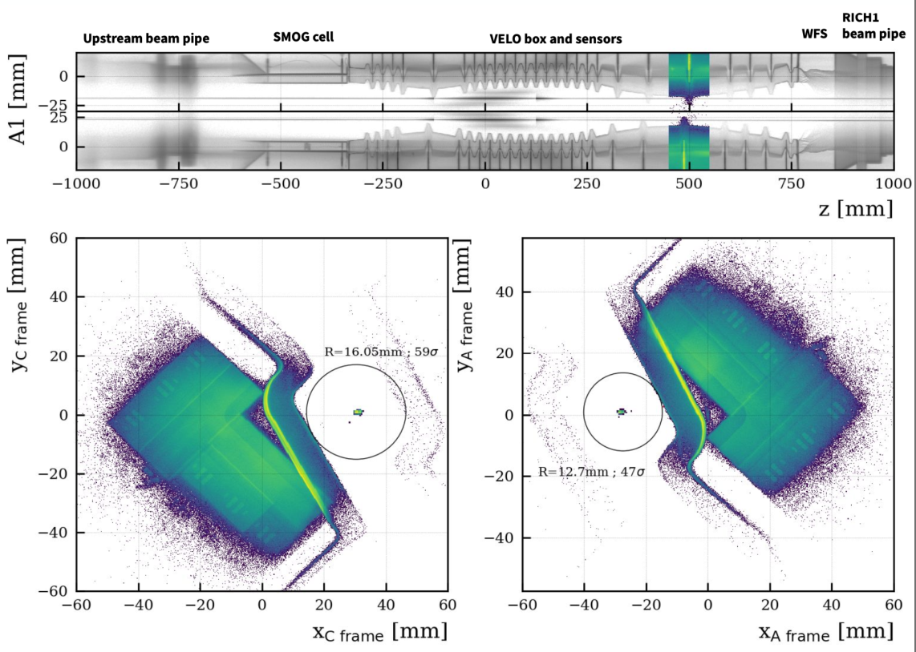
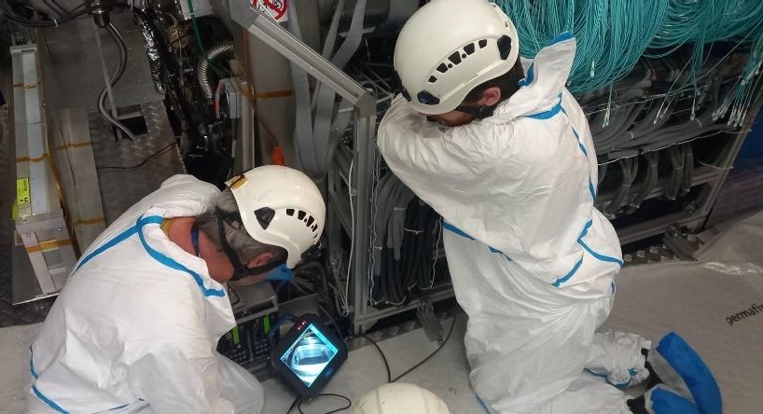
LHCb VELO
Also, after helping to install the VELO, Kieran has been involved in inspections and repairs during the VELO commissioning
Plan is to replace the RF foil at year-end — involves dismantling the entire VELO, support structure and upstream beam pipe
Precise Tomography of the VELO (using beam-gas)

Slide 15
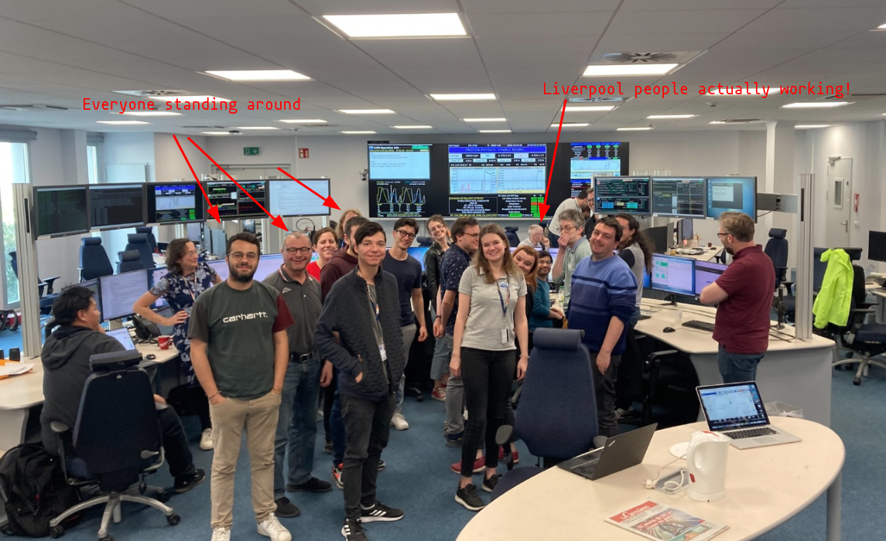
First Long Tracks of 2023!
Liverpool people actually working!
Everyone standing around

Slide 16
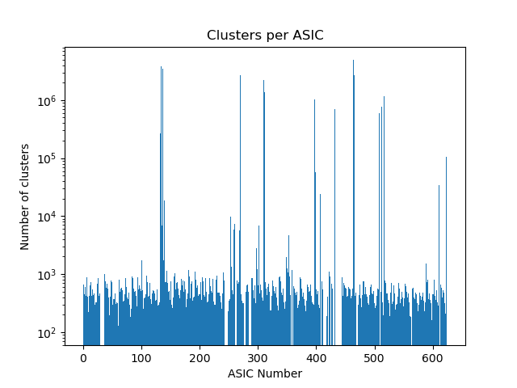
Noise of the VELO
As seen this morning! (James)
Producing masks that filter out noisy pixels present in the ASICs
This will be vital in reducing the noise and keeping the rate output from the ASICs manageable while controlling the quality of the data.
Some chips (having larger than ~10⁵ clusters) will need re-equalising, but the other big peaks likely have noisy pixels that will benefit from masking.
A recent plot of the number of clusters (hits) in the ASICs for a sample of 100k events

Slide 17
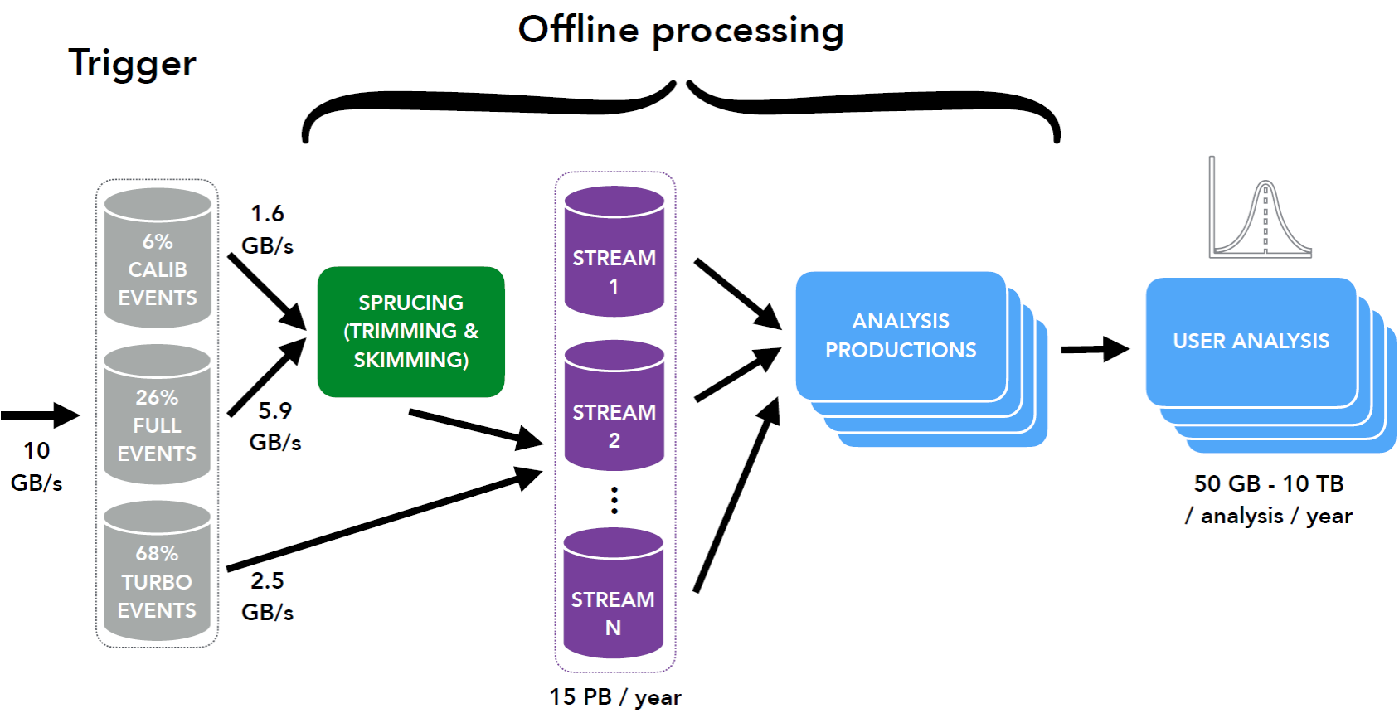
LHCb Data Processing & Analysis (DPA)
The DPA project addresses the challenges due to the very large increase in data volume expected with respect to Run II.
Centralised skimming and trimming of a significant fraction of HLT2 outputs.
Centralised analysis productions for physics analysts.
Heavy contributions to the analysis software itself and innovative analysis techniques, including Quantum Machine Learning (generating great interest even outside LHCb!)

Slide 18
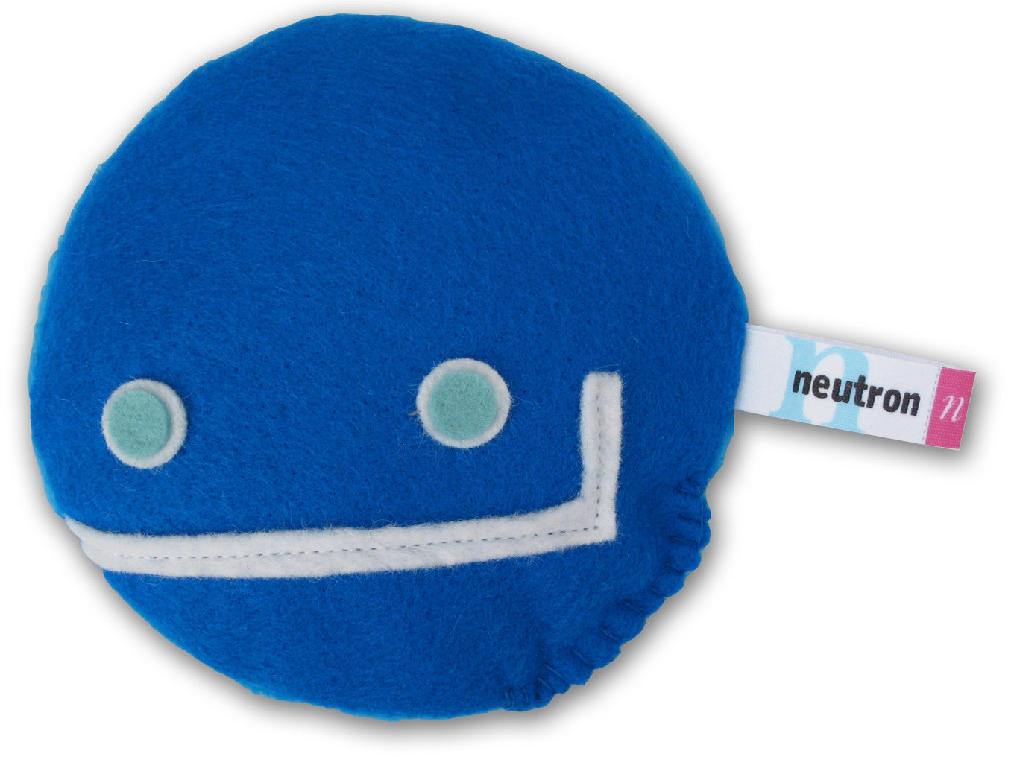
Purely Baryonic B decays
As seen this morning! (Ned)
Unique at Liverpool!
Purely baryonic decays are a class of particle decay that is essentially unexplored
First look at Λb → Λc anti-Λc n
A nice means to measure a decay mode containing a neutron for the first time at a hadron collider experiment

Slide 19
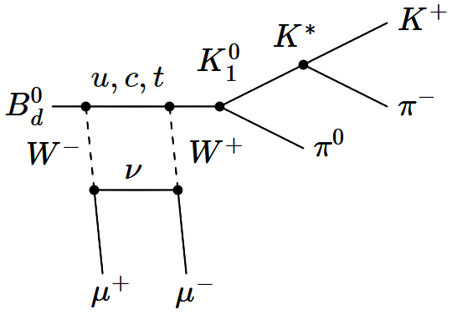
Search for right-handed weak decays
As seen this morning! (James)
To search for right handed weak decays by using parity doubling, we compare two channels with opposite parity products (in this case B⁰ → K1⁰ μ⁺μ⁻ and B⁰ → K^{*0} μ⁺μ⁻) where there is a cancellation of SM interactions that would otherwise dilute any BSM contributions.
Currently working on selections for Run3 and reprocessing the Run1/2 data in preparation to perform the analysis.
The decay process B⁰ → K1⁰ μ⁺μ⁻

Slide 20
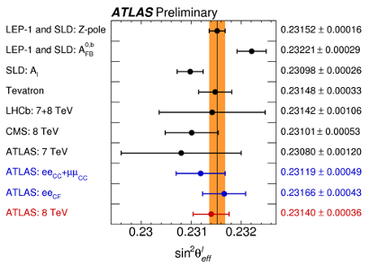
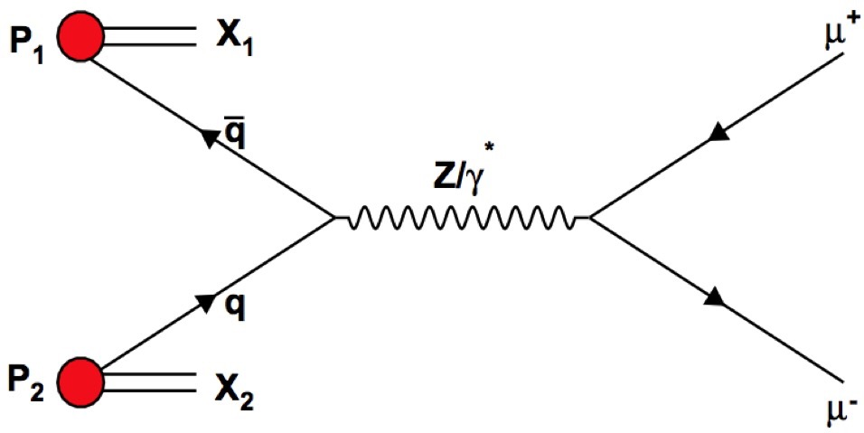
Z decay Forward-backward Asymmetry
Study of the asymmetry AFB in Z → μ⁺μ⁻ decays, with Run 2 (13 TeV) data. The interference between Z boson and virtual photon gives rise to a non-zero AFB value.
Knowing AFB allows us to measure key electroweak parameters, such as sin²(θW)
ATLAS-CONF-2018-037
Performed in Liverpool!
(by Joe Price, et al.)
JHEP 11 (2015) 190
Expect to enter LHCb review process in the later part of the year

Slide 21
Quantum Correlated Charm
Quantum correlated D⁰ D̅⁰ systems have been collected from J^{PC} = 1⁻⁻ sources produced at e⁺e⁻ colliders
JHEP 03 (2023) 038:
These correlations exist in J^{PC}=1⁺⁺ sources as well, including χc1(3872) → D⁰ D̅⁰ {π⁰,γ}
By clever reconstruction
χc1(3872) → D⁰ D̅⁰ γ is forbidden; χc1(3872) → D⁰ D̅⁰ π⁰ doubled
Remove (enhance) C = -1 (+1) D⁰ D̅⁰ resonances in B → D⁰ D̅⁰ X amplitude analyses
χc1(3872) decays can be used to test time-reversal conservation
Discussion about studies at LHCb and other experiments at invitation-only charm workshop

Slide 22
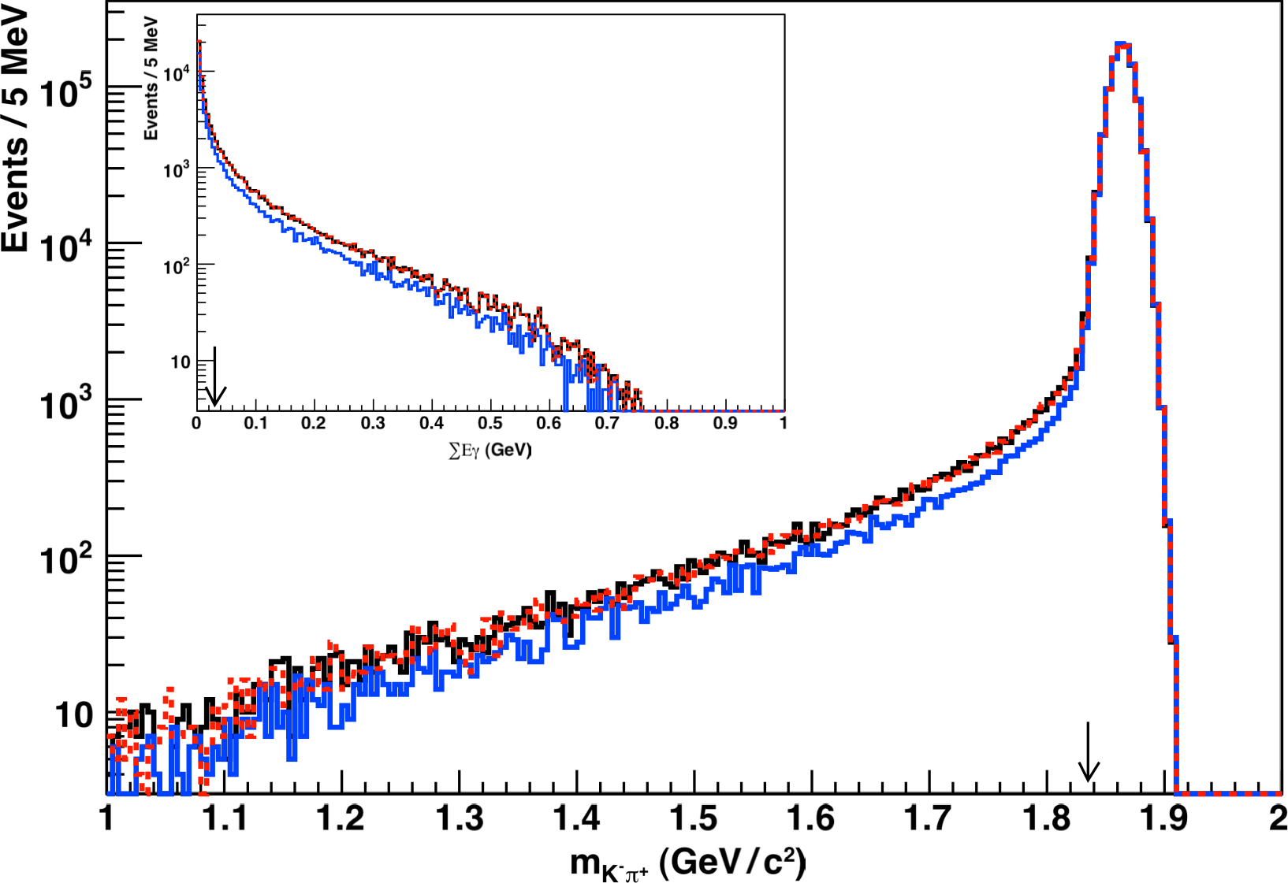
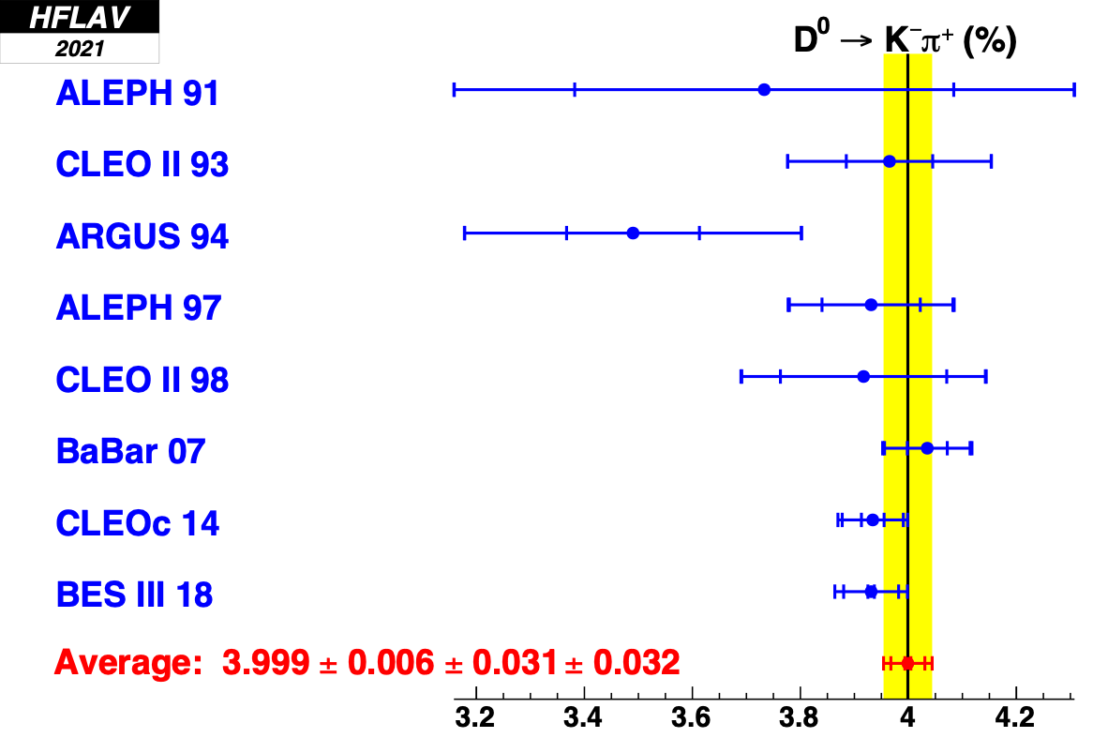
Heavy Flavour Averaging Group (HFLAV)
Informed averages of quantities relevant to flavour physics experiments
Final state radiation (FSR) modeling improved significantly over last 30+ years
Must account for FSR consistently so the accuracy of the average matches experimental precision
average branching fractions accurately by correcting those with poorly modeled efficiency
Phys. Rev. D 107, 052008 (2023)
arXiv:2206.07501

Slide 23
Summary
More in Ashley’s & Eduardo’s talks!
9 fb⁻¹ of data already recorded in Run 1 & 2 Expect plenty of excitement during Run 3!
and more!

Slide 24
Backup

Slide 25
The LHC at CERN

Slide 26
CP violation and the creation of the universe
Somewhere here, matter & antimatter must have behaved fundamentally different - this, in essence, is what CP violation is about. The Standard Model has CP violation, but not enough of it.
Standard Model
Bang!!
Reality
(the SM provides enough CP violation for only about 1 galaxy)
equal amounts of matter and antimatter
1 in 10⁹ matter left over
pair annihilation

Slide 27
LHCb Upgrade

Slide 28
“Fixed Target” & Heavy Ions

Slide 29
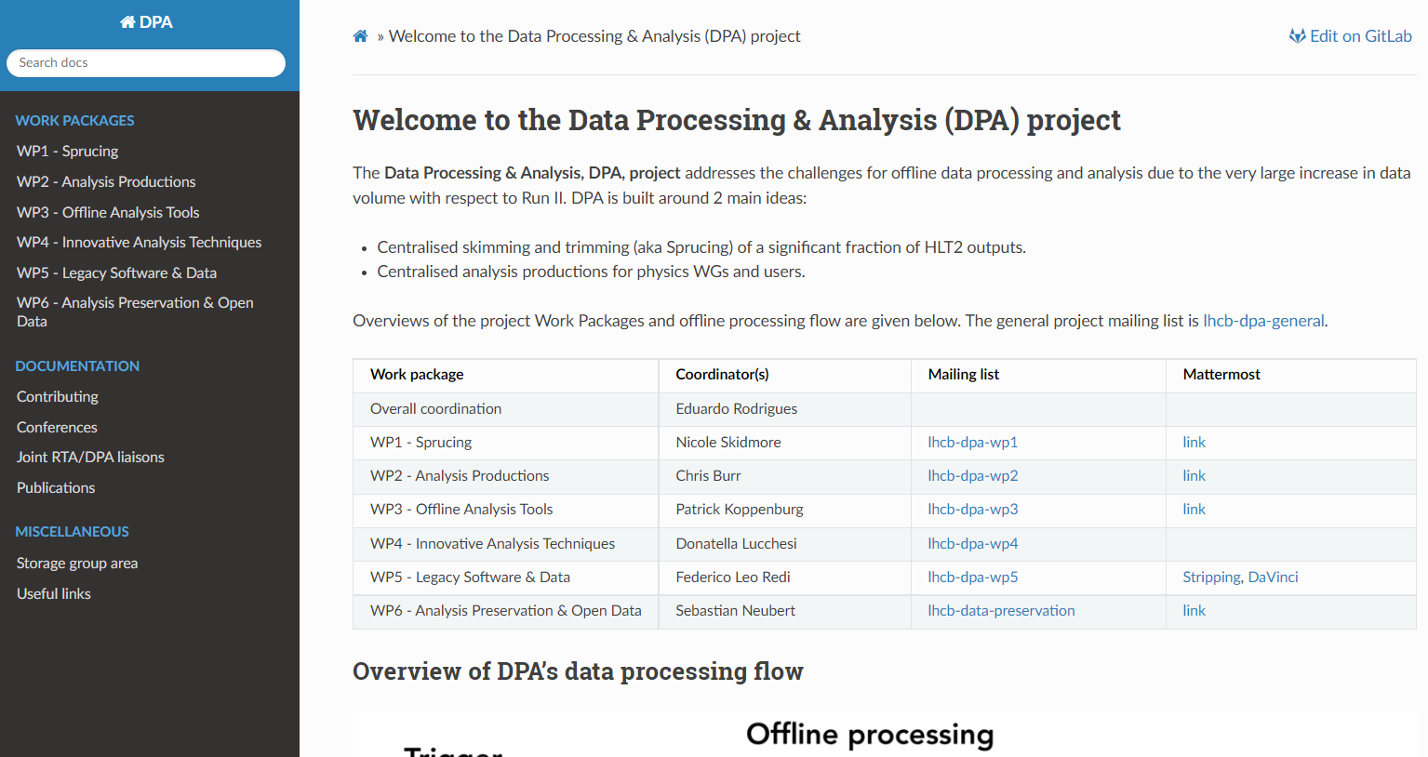
DPA in a nutshell
https://lhcb-dpa.web.cern.ch/

Slide 30
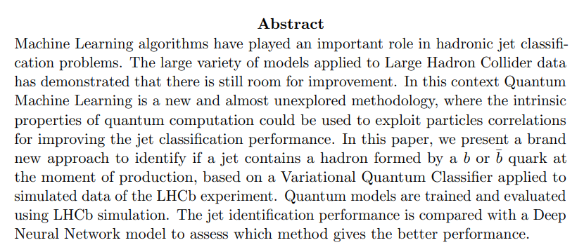
DPA – Liverpool involvement
Expected involvement as project leader
Personally more involved with the analysis software itself and the Innovative Analysis Techniques WP
A lot of focus on commissioning activities in 2023, for obvious reasons. So far we had no real hiccups
The first DPA project paper is a paper on Quantum Computing !
First application of QML to the task of jet charge identification
Paper published in JHEP over Summer 2022
LHCb QC activities presented at several conferences and attracted interest, especially that we are the only ones to publish as “LHCb work” rather than as separate work

Slide 31
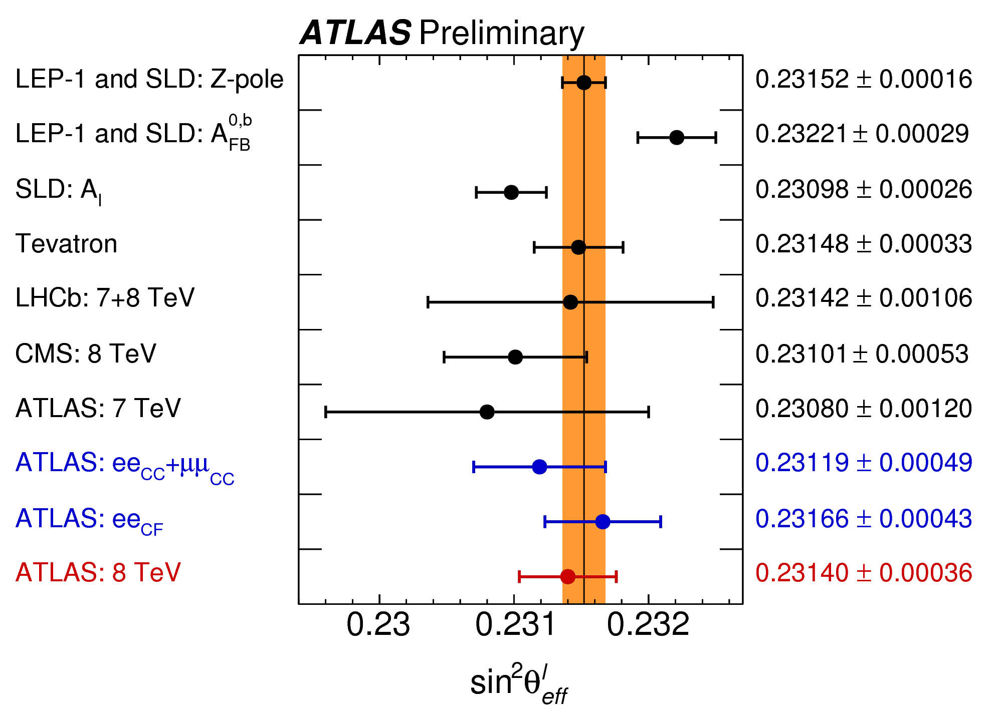
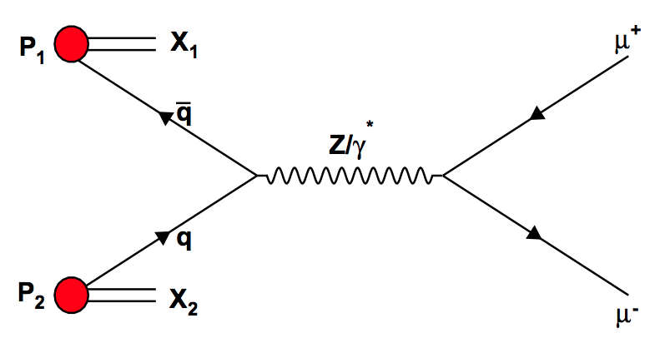
Weak Mixing Angle Sin²θ_{W}
The two most precise measurements (LEP and SLD) measured different processes at similar precision, have a 3.2σ variation
Overall LEP and SLD average shown by the vertical band
Currently measuring Sin²θ_{W} via the forward backward asymmetry (A_{FB}) in Z → μ⁺μ⁻ decays.
The interference between Z boson and virtual photon gives rise to a non-zero AFB value
Sin²θ_{W} cannot be measured directly, it is extracted from the measurement of variables sensitive to it (eg A_{FB})
[ATLAS-CONF-2018-037]
Extracted via a comparison of MC templates and data
Run 2 data, 6fb⁻¹ via the forward backward asymmetry, A_{FB} in Z/γ* → µ⁺ µ⁻
Previous LHCb result used 7 TeV and 8 TeV with 1 fb⁻¹ and 2 fb⁻¹ of data respectively
number of backward events
number of forward events
[CERN-THESIS-2011-202]
Notes:
My analysis’ aim is to ideally solve an outstanding 3.2 sigma discrepancy between the two most precise measurements which is shown in the top right
I am determining the weak mixing angle via AFB (in Z/γ* → µ⁺ µ⁻ decays)
AFB is the asymmetry in angular distribution of positive and negatively charged leptons (in this case the muons) produced by Z bosons. These can be characterised as forward or backward events depending on the muon direction.
LHCb is much more pronounced than other experiments
This is because LHCb is a forward region detector focusing on a rapidity range of 2 – 5 and the asymmetry is more pronounced at higher rapidities
Weak mixing angle is extracted via AFB and so LHCb’s increased sensitivity to AFB produces a more precise measurement of weak mixing angle
This makes LHCb’s measurement of particular interest
At higher rapidities the Z boson has a large longitudinal momentum which leads to AFB being very noticeable as the asymmetry most pronounced when the Z boson direction is correctly known
Therefore making LHCb very sensitive to weak mixing angle and ideal for this measurement
In Z->mu mu decays there is a high momentum valence quark and lower momentum sea antiquark which collide to produce a Z boson
The collins-soper frame is used which aligns the Z boson direction with the Z axis
A forward event is when the muon is in the same direction as the quark
A backward event is when the muon is in the opposite direction to the quark

Slide 32
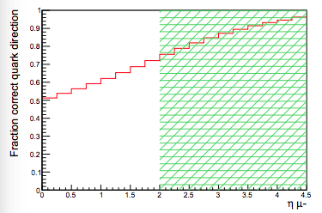
LHCb and Weak Mixing Angle Sin²θ_{W}
LHCb focuses on higher rapidity range, 2 < η < 5, which has high sensitivity to A_{FB} and therefore Sin²${\text{θ}}_{W}^{eff}$
Asymmetry most pronounced when the Z boson direction is correctly known
The further forward the more likely that the Z boson follows the direction of the quark
LHCb focuses on the forward region and the further forward in rapidity, the more likely the Z forward direction is determined correctly
[LHCb-ANA-2015-002 28/09/2015]

Slide 33
Sin²θ_{W} Calculation at LHCb
From the 2015 3fb⁻¹ measurement
Values for $A_{FB}^{pred}$ are found via MC using a range of values for $\sin^{2}{(θ}_{W}^{eff})$
$χ^{2}$ is calculated by comparing $A_{FB}^{pred}$ to data values of $A_{FB}^{}$
Quadratic functions are fitted to the distributions
The difference between $χ^{2}$ values and the minimum $χ^{2}$ value is plotted as a function of the $\sin^{2}{(θ}_{W}^{eff})$ values used in MC
The minimum of the plotted $χ^{2}$ distribution is the final value of $\sin^{2}{(θ}_{W}^{eff})$
[LHCb, 1509.07645]

Slide 34
RK
arXiv:2212.09152
arXiv:2212.09153
The results presented here differ from the previous LHCb measurements of RK and RK*, which they supersede. The RK* analysis uses five times more B meson decays than the previous result. For RK central-q2, the difference is partly due to the use of tighter electron identification criteria and partly due to the modeling of the residual misidentified hadronic backgrounds; statistical fluctuations make a smaller contribution to the difference since the same data are used as in the previous publication. It is interesting to note that the statistical uncertainties remain significantly larger than the systematic uncertainties and therefore additional data will continue to challenge the SM.

Slide 35
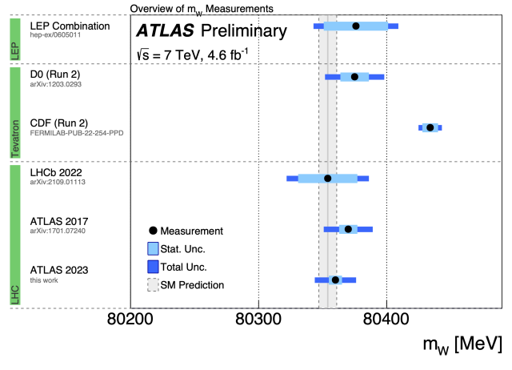
W boson mass
ATLAS-PHOTO-2023-022-2

Slide 36
Heavy flavour production
Huge amounts of heavy quarks produced at LHC (that’s why LHCb is there.)
Production mechanisms not well understood.
Great laboratory to investigate and develop effective QCD models.
LHCb in a special position: Sees more than others, and in a crucial kinematic range, where other LHC experiments are virtually blind.
LHCb’s unique coverage

Slide 37
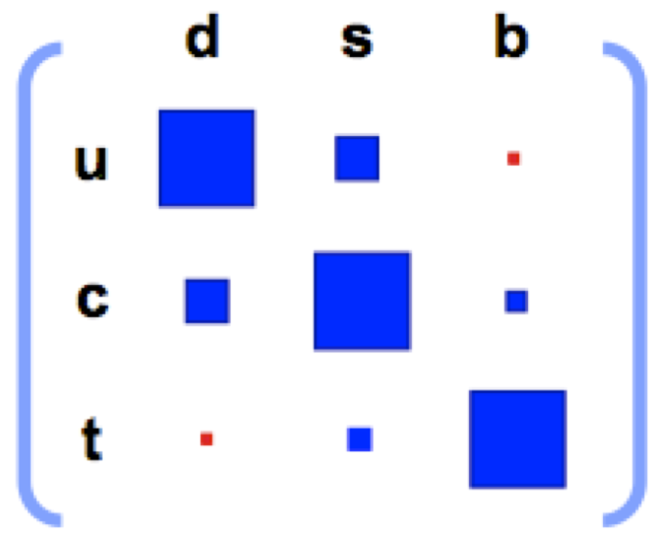
The Unitarity Triangle and γ
Geometrical representation of the relationships of (some) parameters of Kobayashi and Maskawa’s theory
Vub
α
γ
β
The angle γ is one of the phase angles responsible for CP violation...
...but it’s poorly measured, and the least-well known of these angles
γ = arg(Vub*) = xx.xº ± x.xº (from LHCb direct measurements)
LHCb will increase the precision of this measurement in Run 3!
LHCb-CONF-2022-002

Slide 38
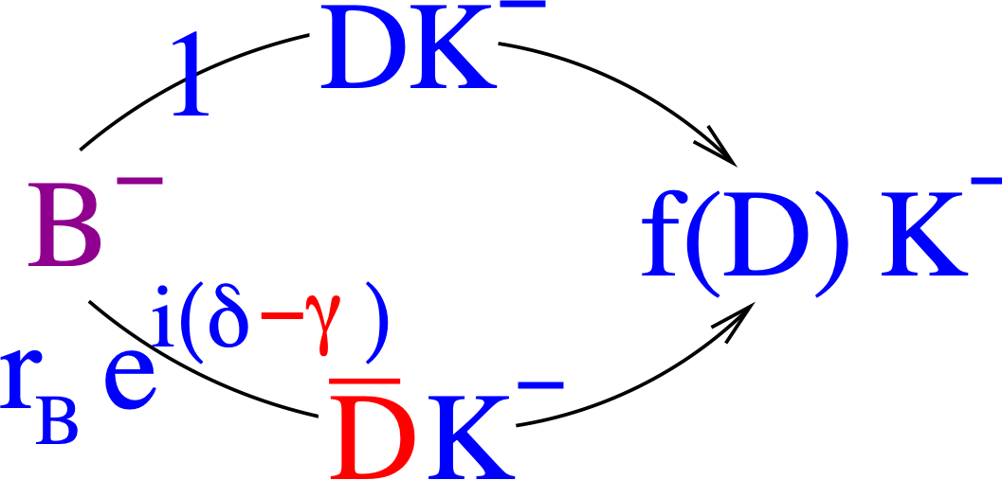
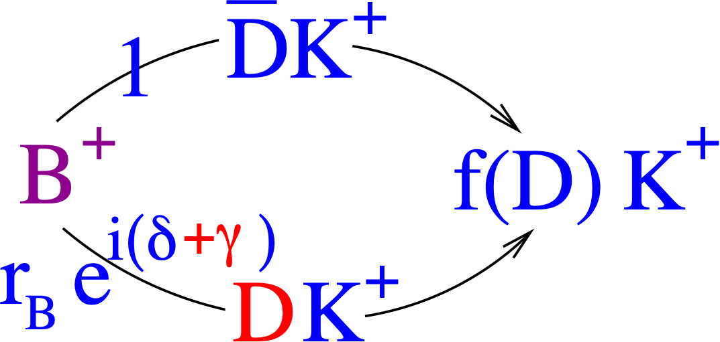
CP Violating phase γ from B±→DK±
+γ
_
_
b
u
D⁰
c
B⁺
_
s
K⁺
u
u
CP-violating phase γ
_
s
K⁺
u
_
_
b
c
–
B⁺
D⁰
u
u
Gronau, Wyler Phys.Lett.B265:172-176,1991, (GLW), Gronau, London Phys.Lett.B253:483-488,1991 (GLW) Atwood, Dunietz and Soni Phys.Rev.Lett. 78 (1997) 3257-3260 (ADS) Giri, Grossman, Soffer and Zupan Phys.Rev. D68 (2003) 054018 Belle Collaboration Phys.Rev. D70 (2004) 072003

