Slide 1
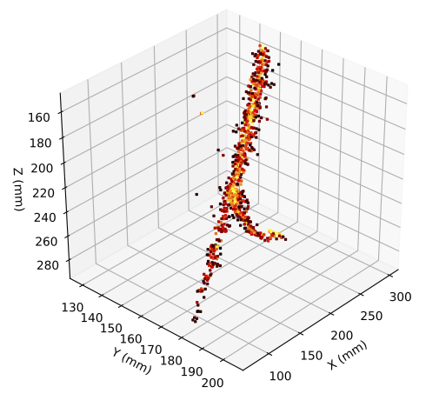
Liquid Argon R&D ARIADNE⁺ results and future testing on ProtoDUNE
+
Adam Roberts
(on behalf of the ARIADNE+ collaboration)
http://hep.ph.liv.ac.uk/ariadne

Slide 2
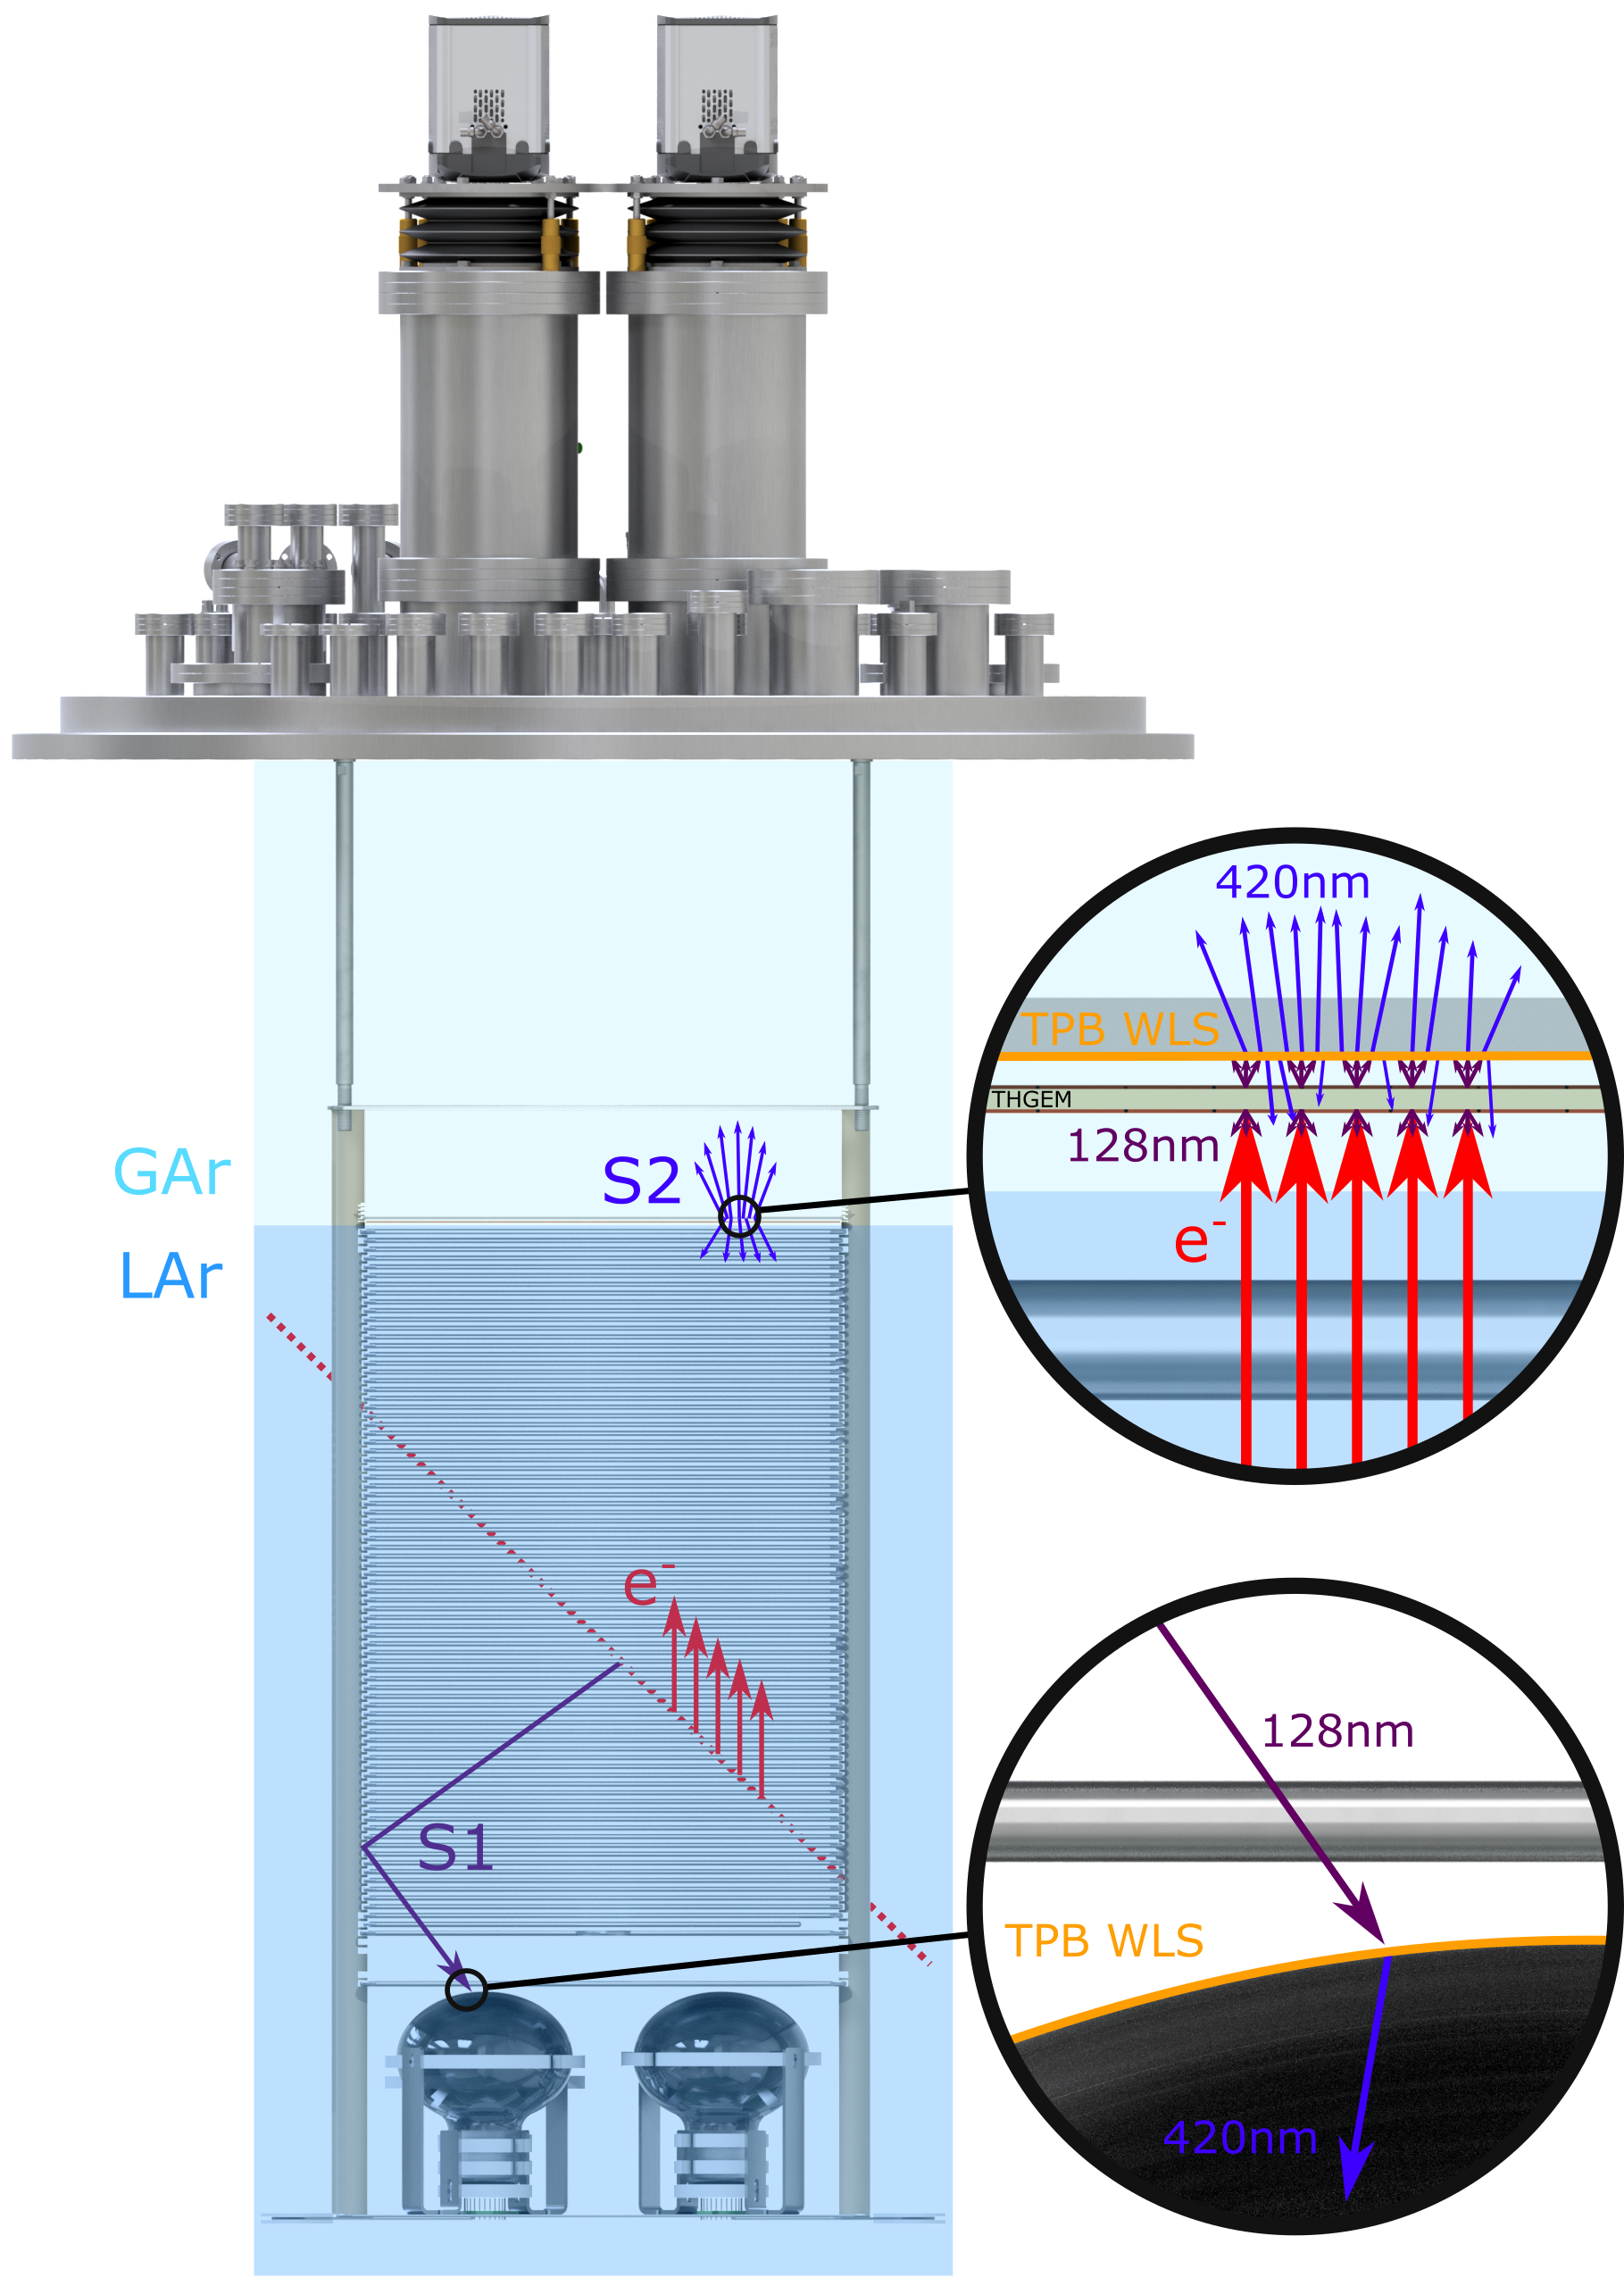
ARIADNE Detection Principle
Cameras
ARIADNE has demonstrated light readout as a viable alternative to charge in dual-phase TPC neutrino experiments
Incoming particles ionise LAr and create prompt scintillation light (S1)
Electrons drift towards the extraction grid situated below the liquid level
A THGEM (THick-Gaseous Electron Multiplier) amplifies drift charge (capable of >30 kV/cm in LAr) generating secondary scintillation light (S2)
WLS (Wavelength Shifting) before imaging with Timepix3 camera
ARIADNE (ARgon ImAging DetectioN chambEr)

Slide 3
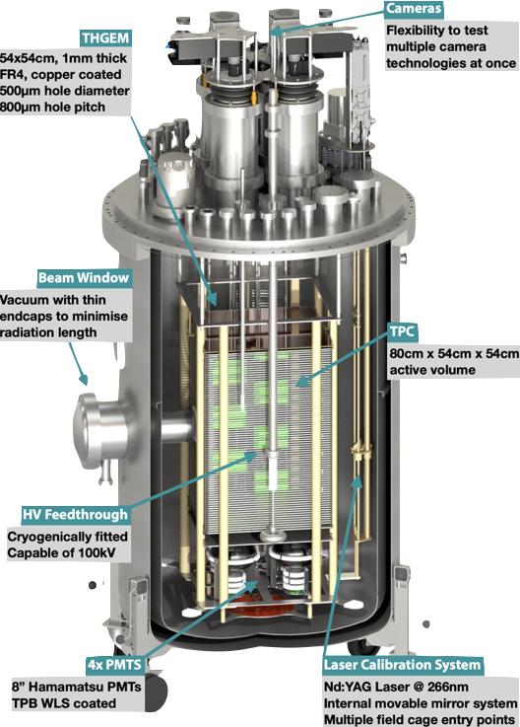
The ARIADNE Advantage - Optical TPCs
Benefits:
High Resolution: For e.g. TPX3 camera has 256 x 256 pixels, imaging 35 x 35 cm area, as on ARIADNE, gives ≈ 1 mm resolution
Sensitivity to low energies: Gain is generated by the THGEM; a THGEM accelerated electron can generate upwards of 100 photons, cameras can be sensitive to single photons
Low Noise: Externally mounted cameras are decoupled from TPC electronic noise sources/acoustics
Ease of Access: Cameras can be accessed while TPC is operating
Cost Efficient: No need for thousands of internal charge TPC readout channels, pre-amps etc.
Available now
Dual phase TPCs enable low energy physics and are the established technology for direct dark matter detection
TDR: https://iopscience.iop.org/article/10.1088/1748-0221/15/03/P03003
ARIADNE 1-ton detector

Slide 4
Larger Scale Demonstration at the CERN Neutrino Platform
Recent Operation March/April 2022
Test optical readout on a scale relevant for DUNE using the existing CERN cold box
CERN LOI: https://cds.cern.ch/record/2739360

Slide 5
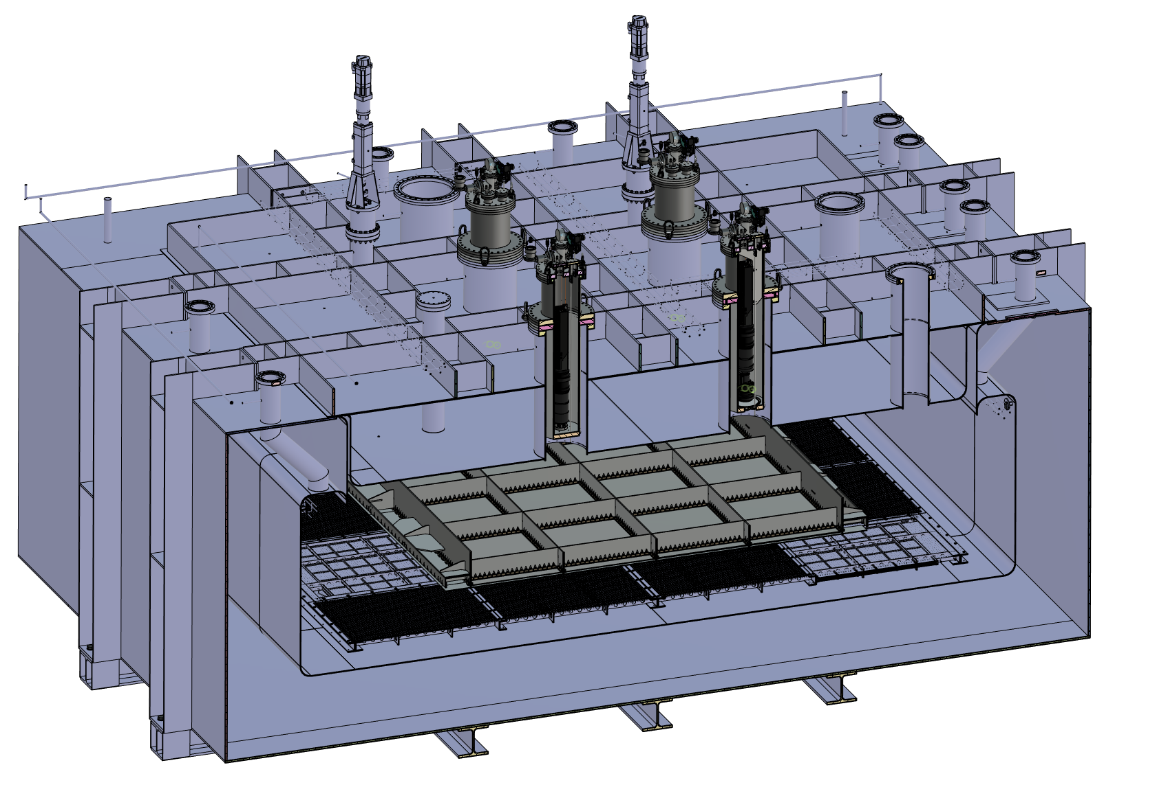
ARIADNE⁺: Cryostat Optical Configuration
TPX3 Camera (1 x VUV)
TPX3 Cameras (3 x visible)
Large scale test of ARIADNE optical readout principle for dual-phase LArTPCs.
Four Timepix3 based cameras, each covering 1m x 1m readout area.
Three cameras detect visible light (wavelength shifter installed above THGEMs)
One camera directly images VUV.
Cathode
Light Readout Plane (LRP)

Slide 6
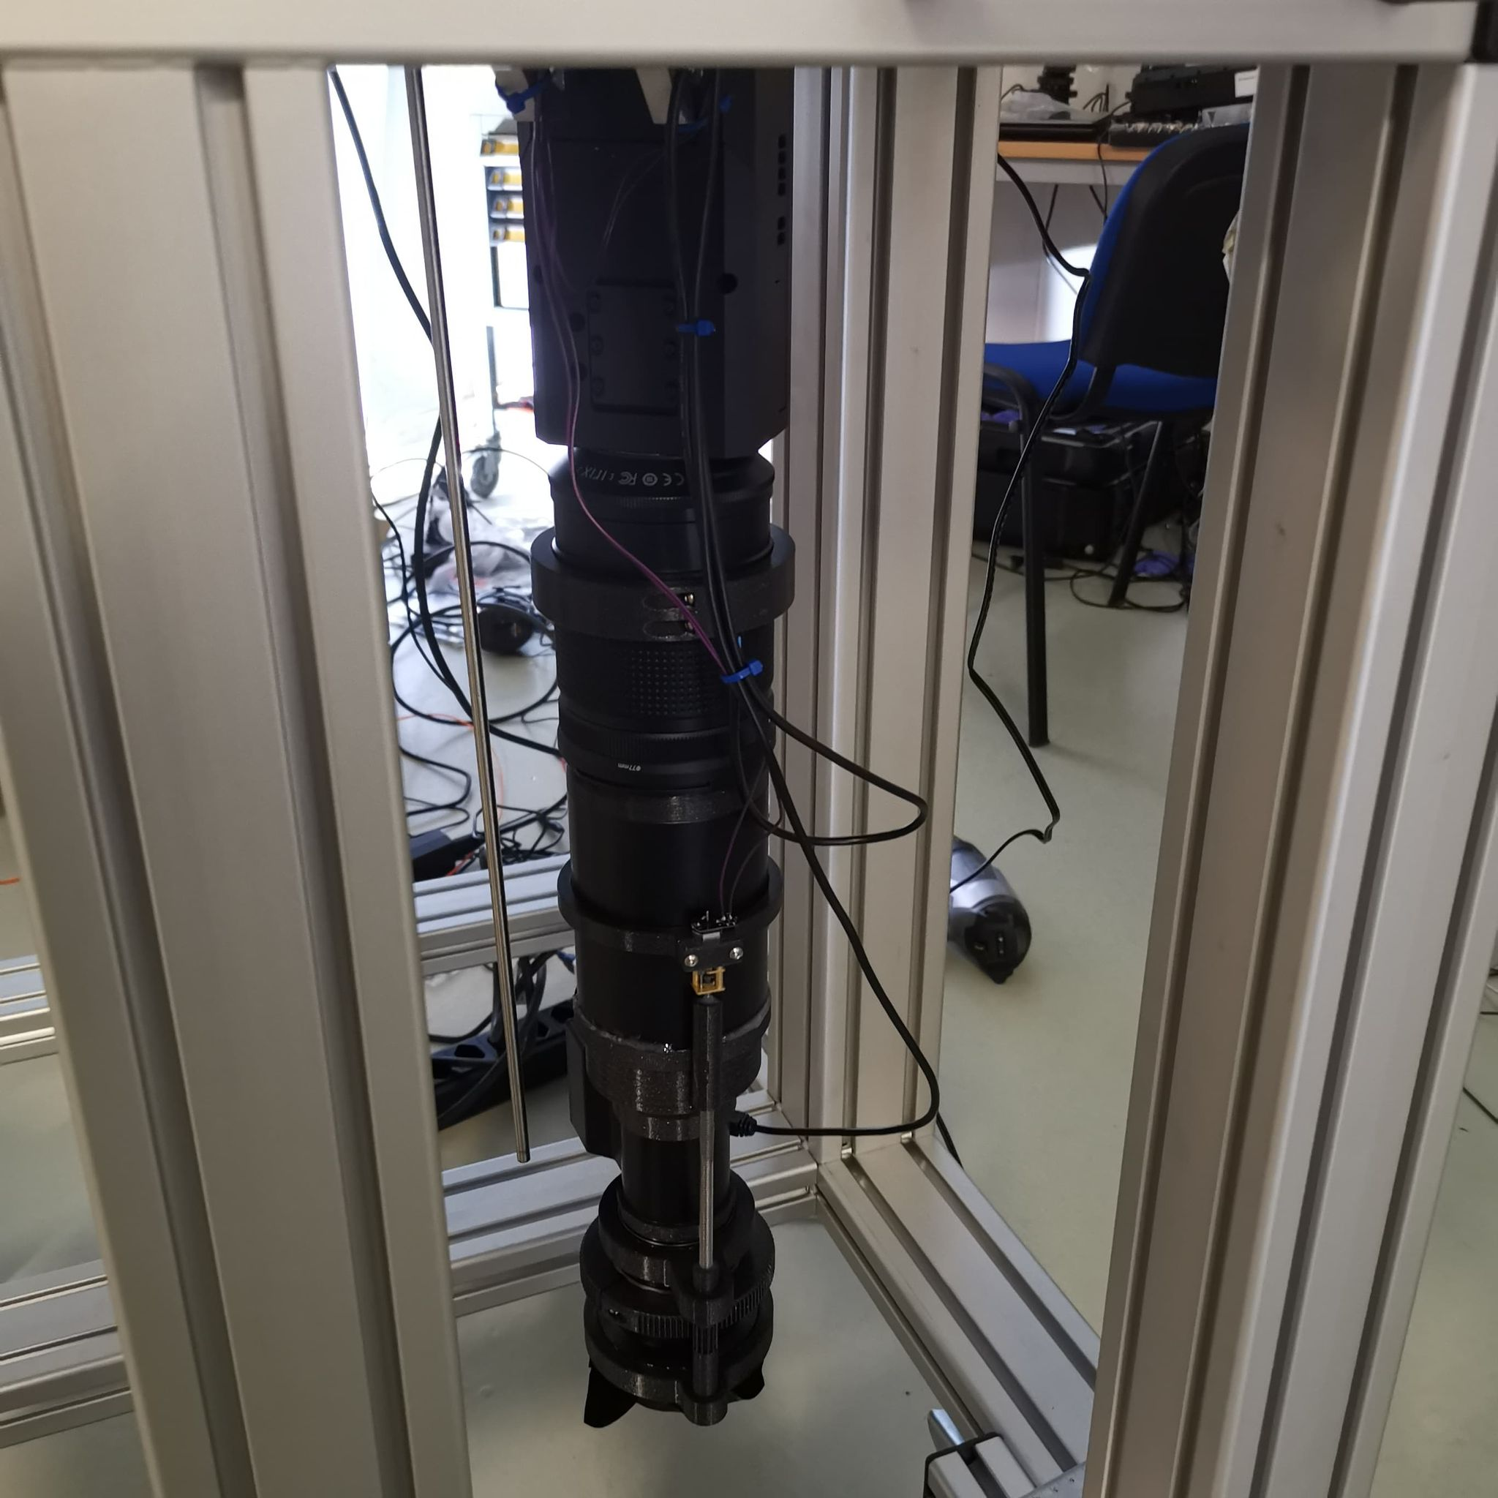
TPX3 Camera System
Timepix 3 Camera
Relay optics
Image intensifier
Objective lens

Slide 7
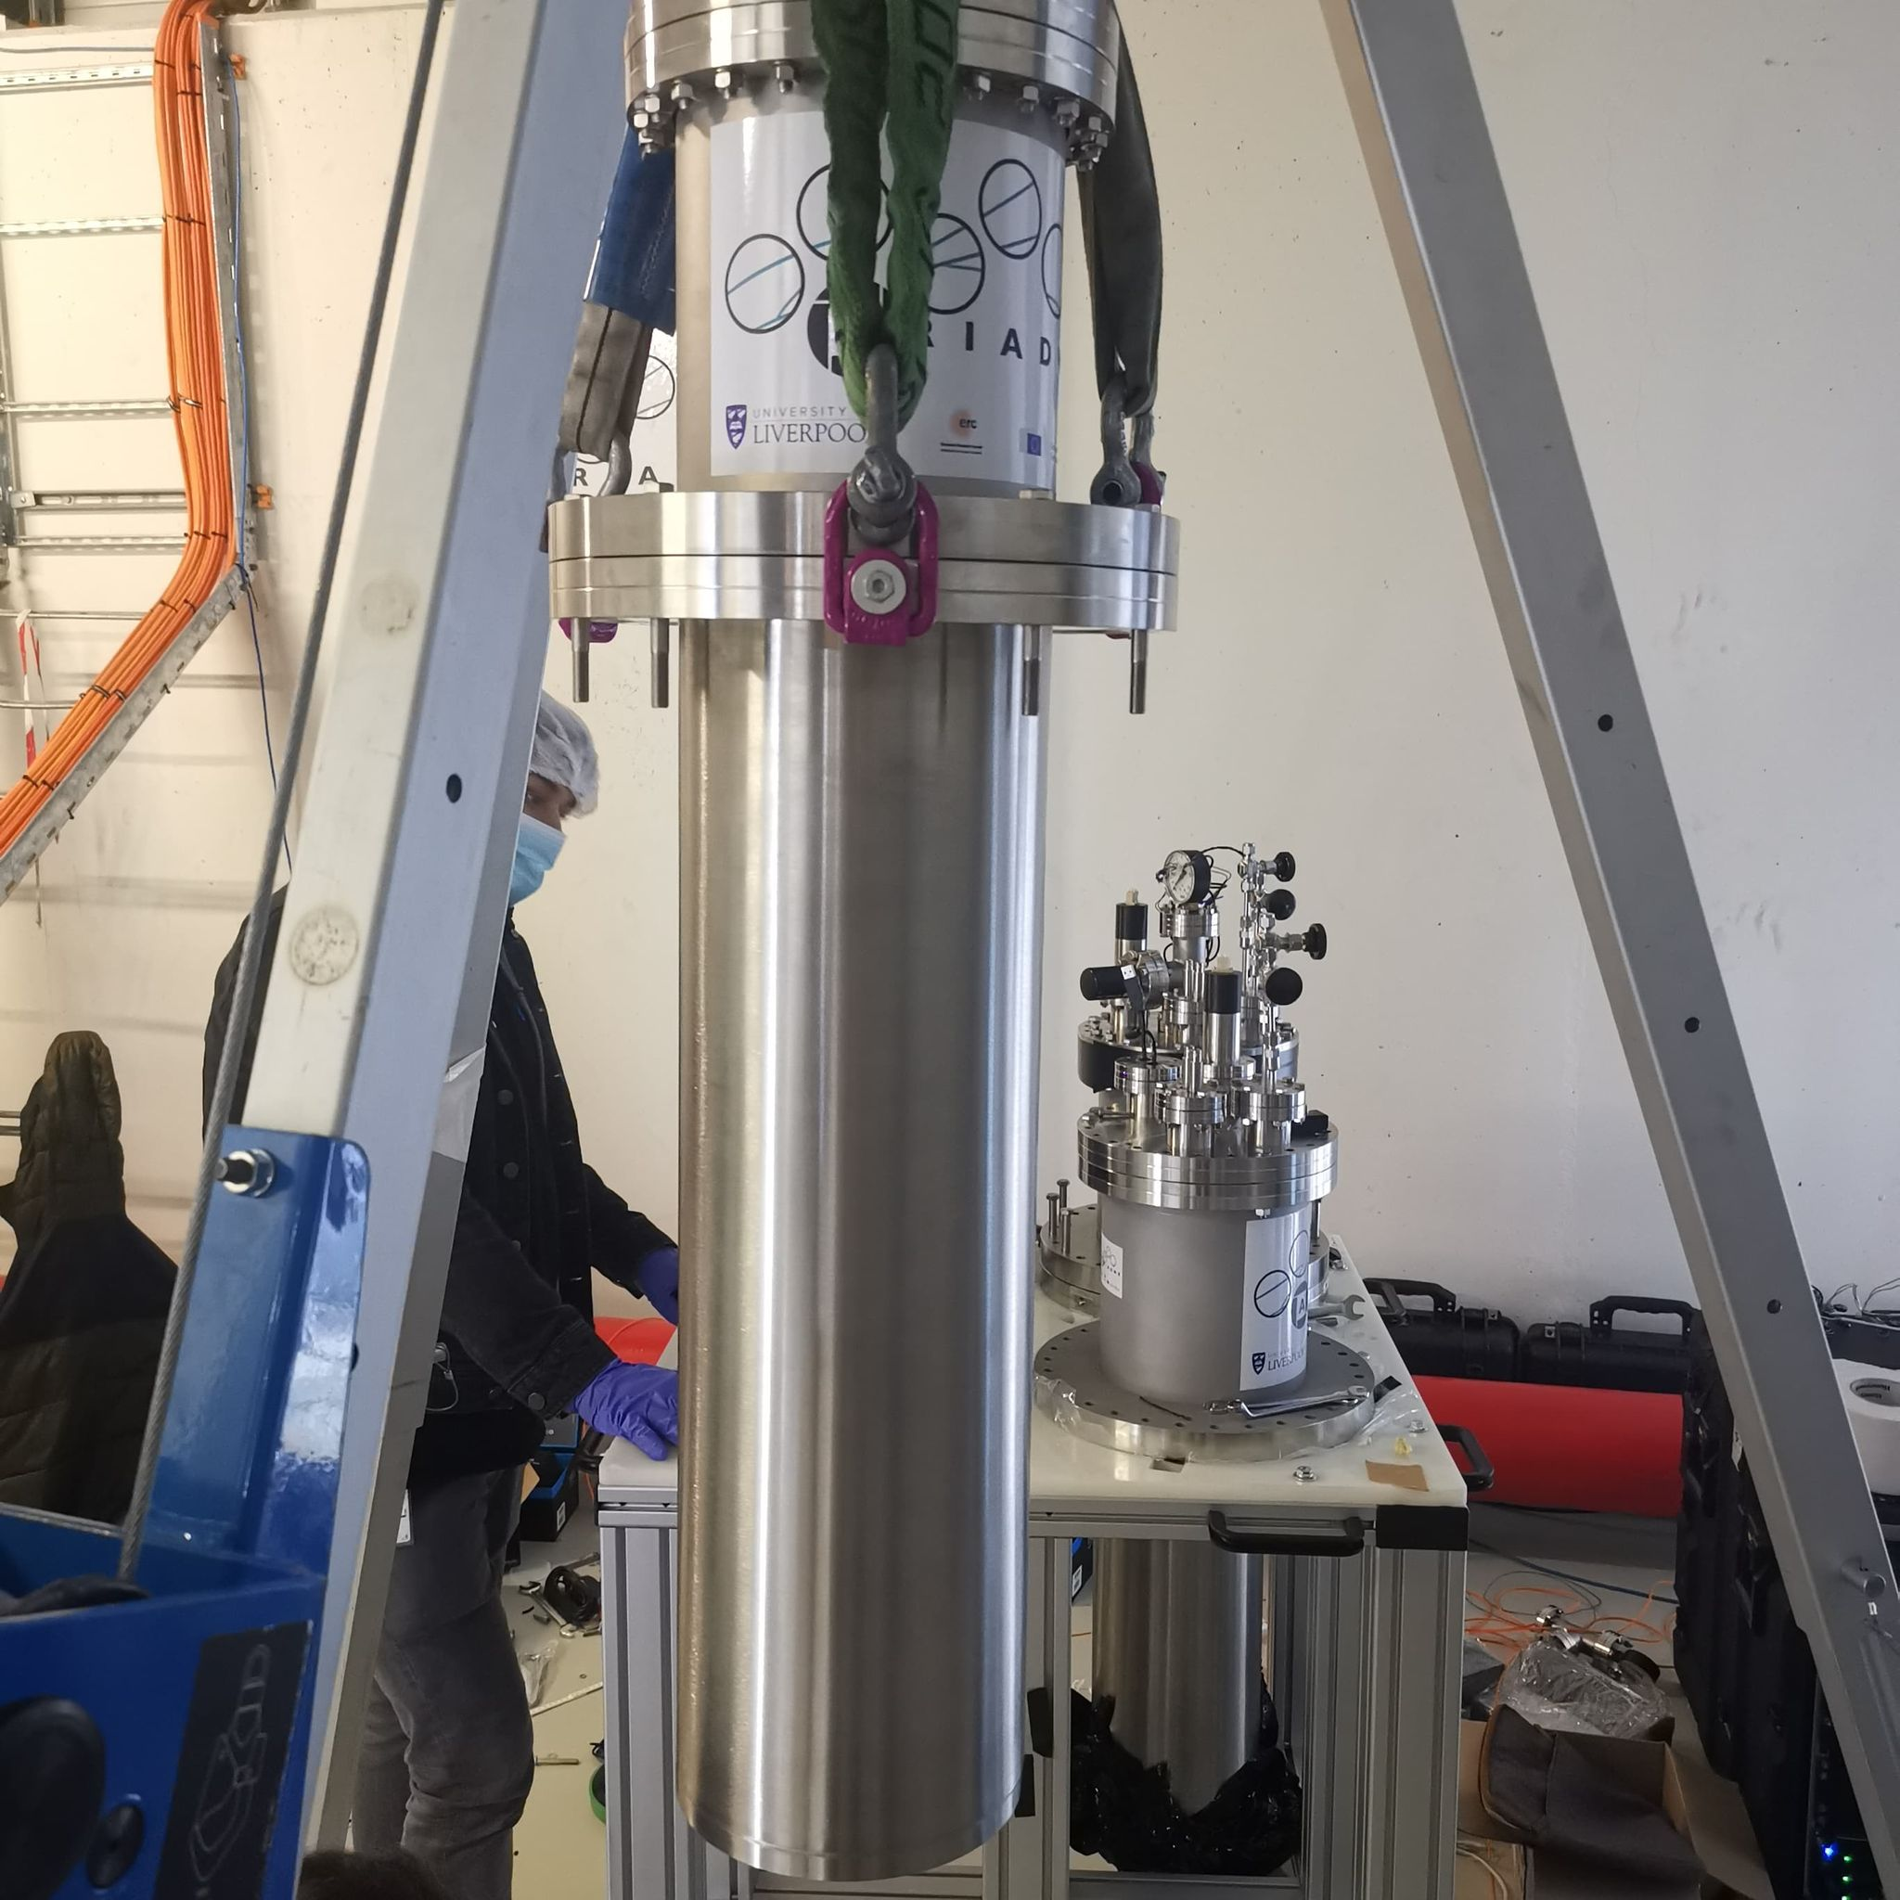
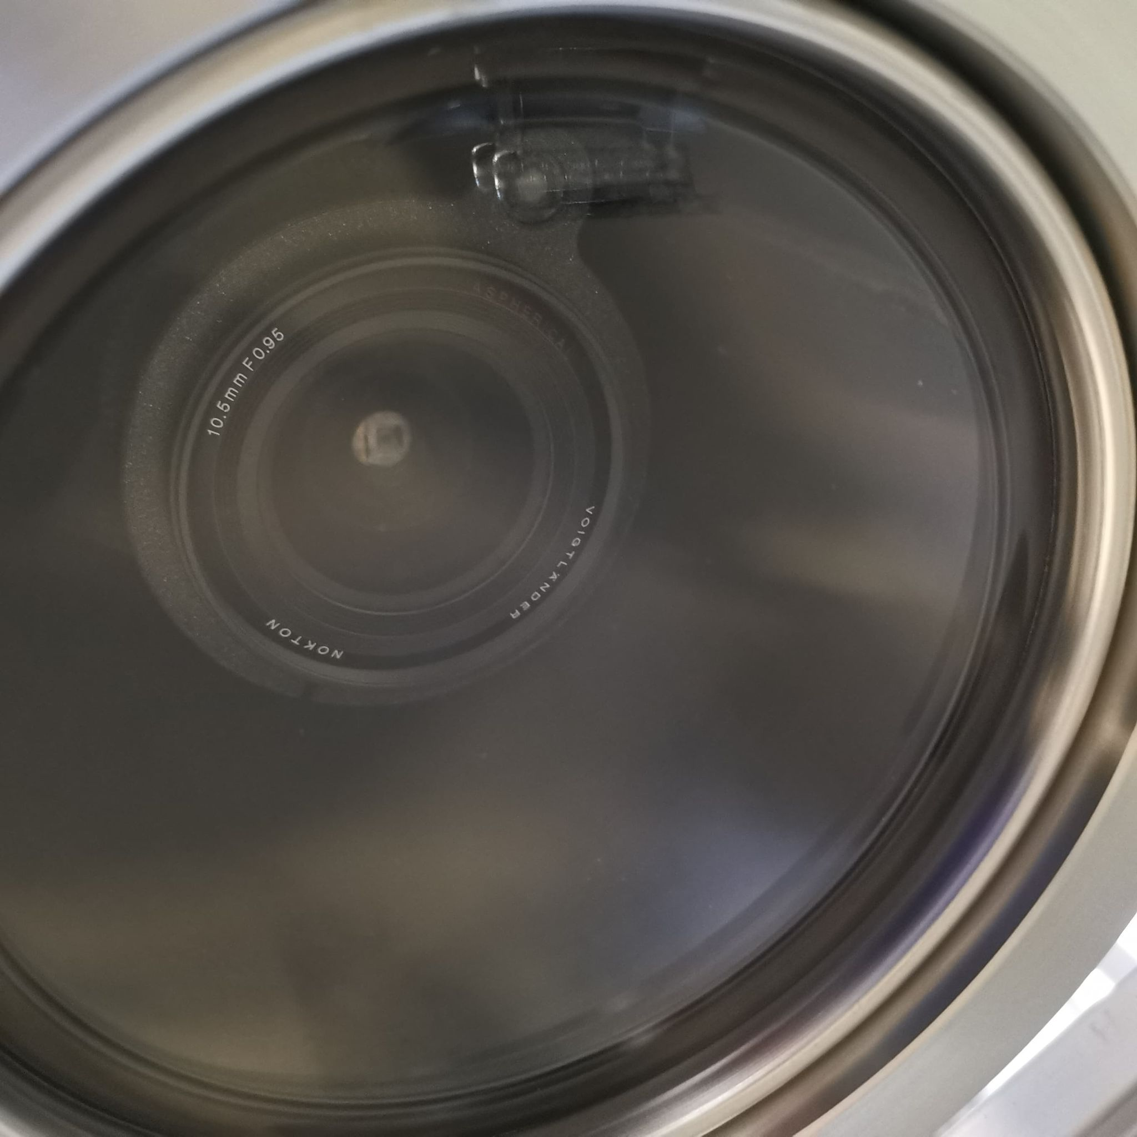
Re-entrance Viewport
Visible lenses (f0.95, 10.5 mm)
Custom made VUV MgF₂ Lens (f3, 11mm, 5mm diameter)

Slide 8
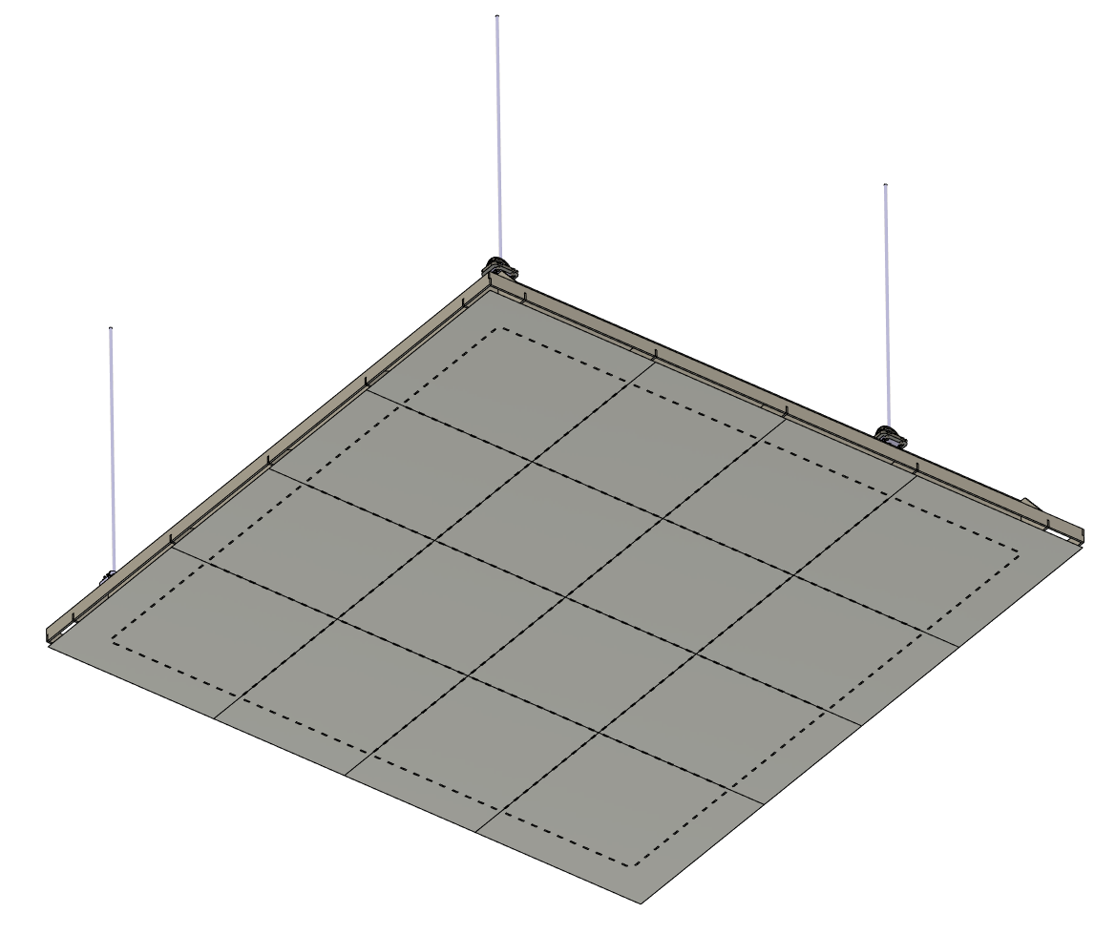
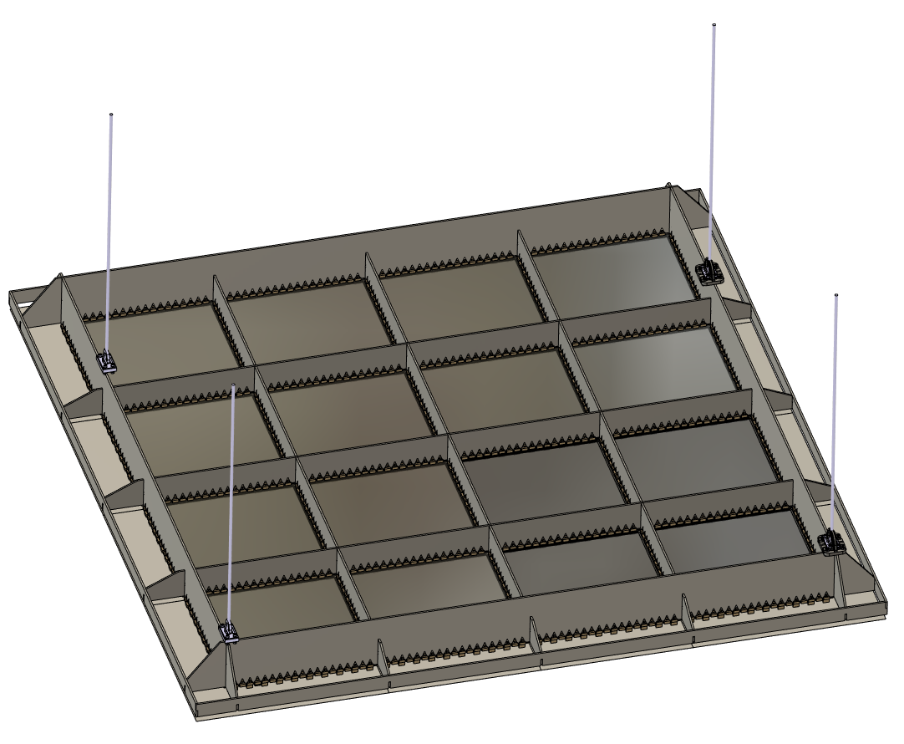
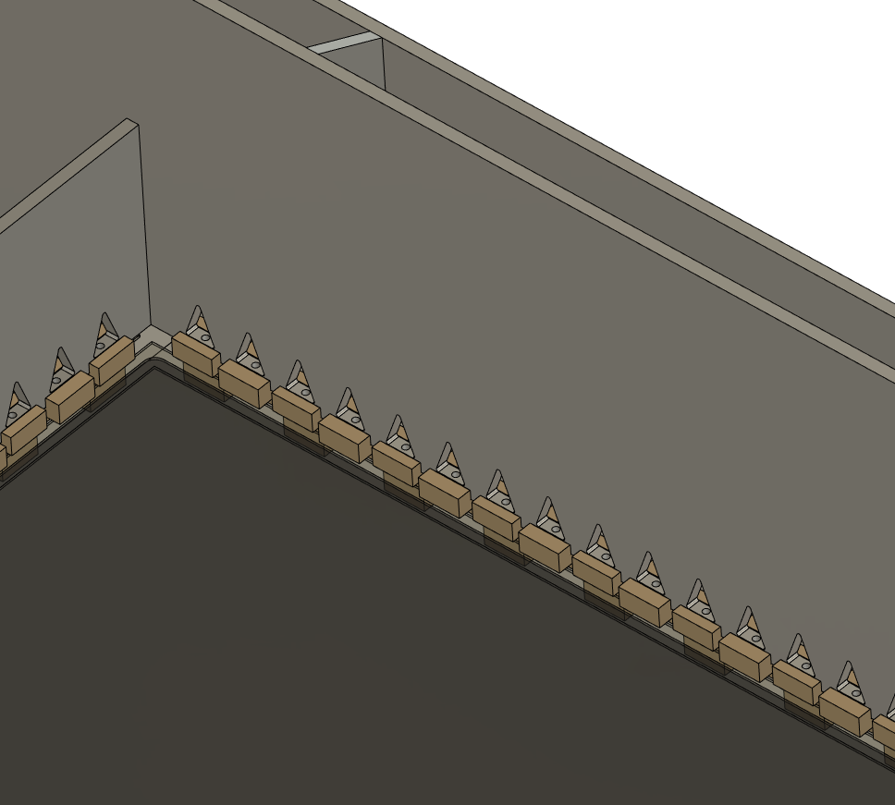
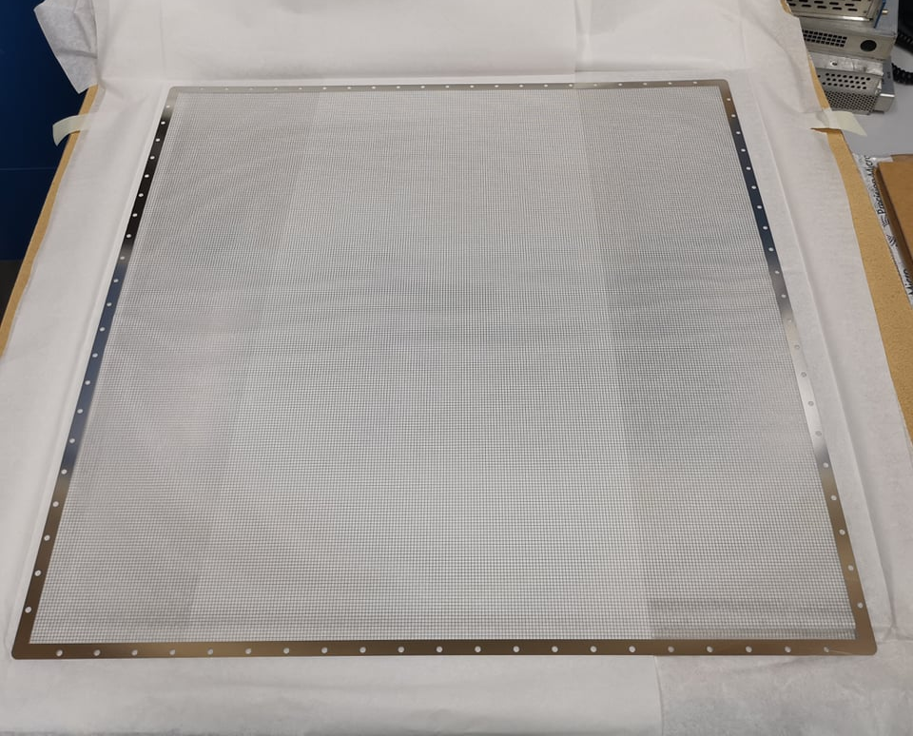
Light Readout Plane (LRP) Design
Modular design which can be applied directly to a DUNE module
Bottom view
Welded Invar structure (Uniquely low coefficient of thermal contraction)
50cm x 50cm G-THGEMs
2.3m
Photochemically etched extraction grids
THGEMs/Extraction grids supported by PEEK Spacers

Slide 9
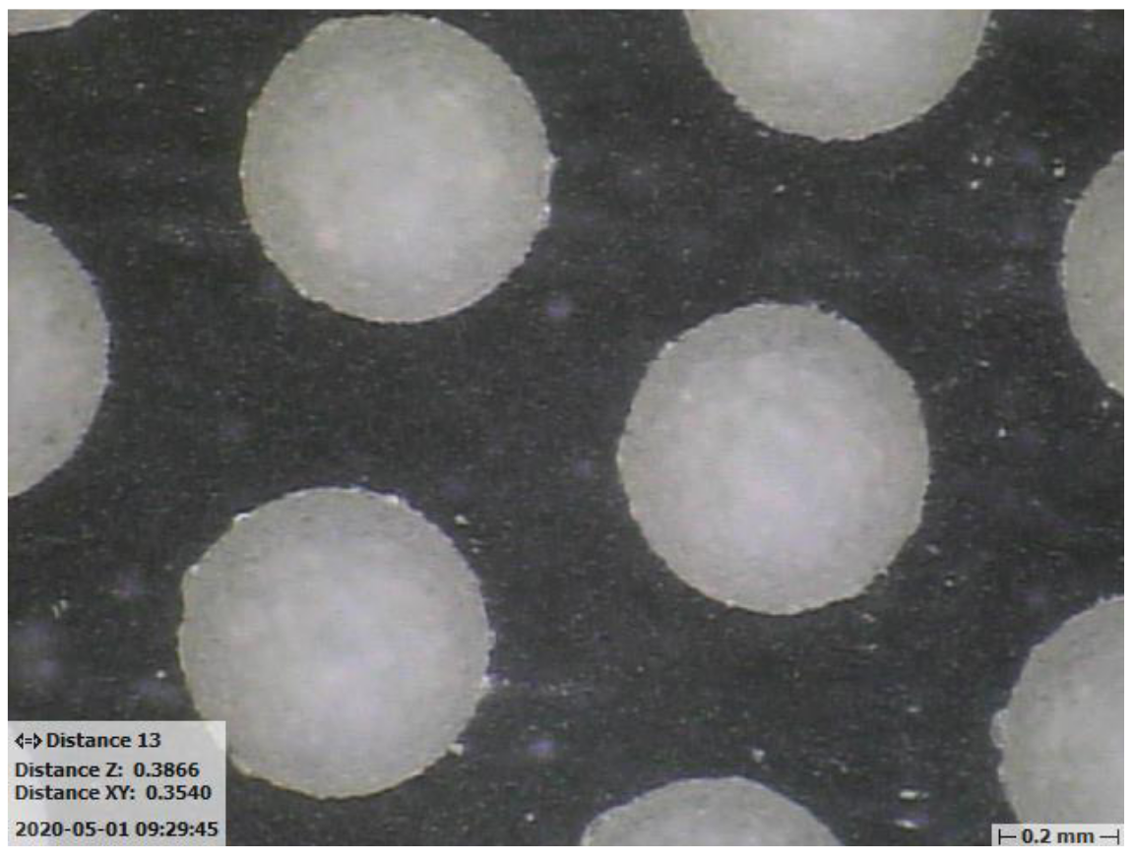
Glass THGEMs
Novel Glass THGEMs developed at Liverpool (Patent accepted GB2019563.2)
Sixteen 50cm x 50cm glass THGEMs
1.1mm thick,
500μm ID holes,
800μm pitch hexagonal array
See for more details:
https://www.mdpi.com/2076-3417/11/20/9450

Slide 10
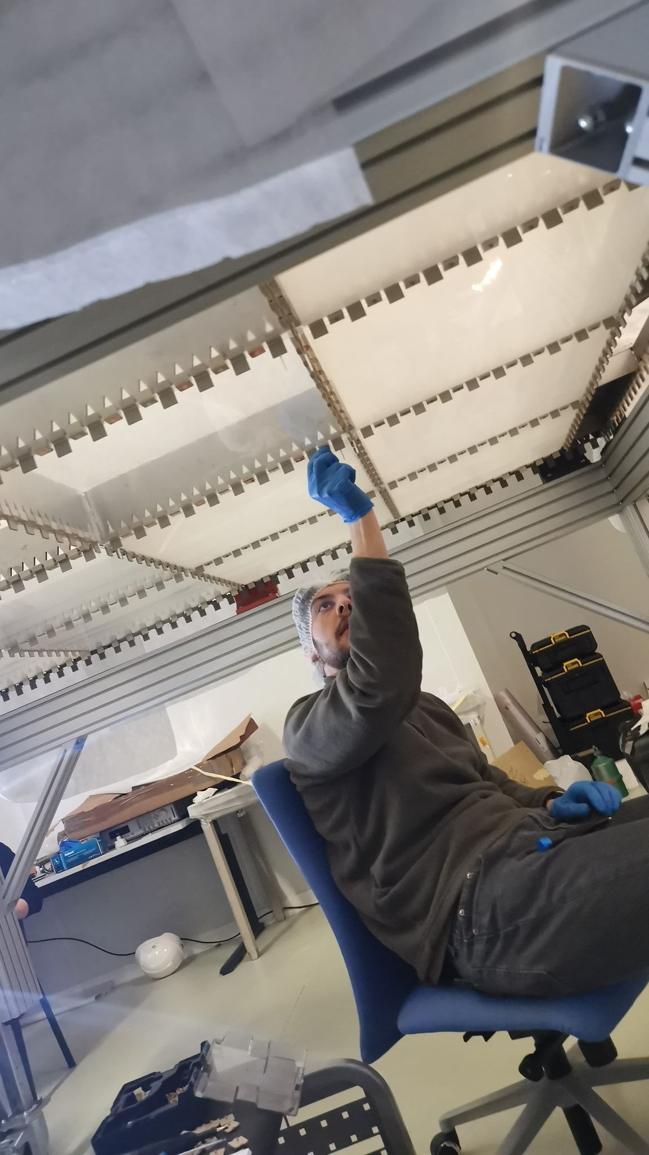
Light Readout Plane (LRP)
LRP assembly at CERN

Slide 11
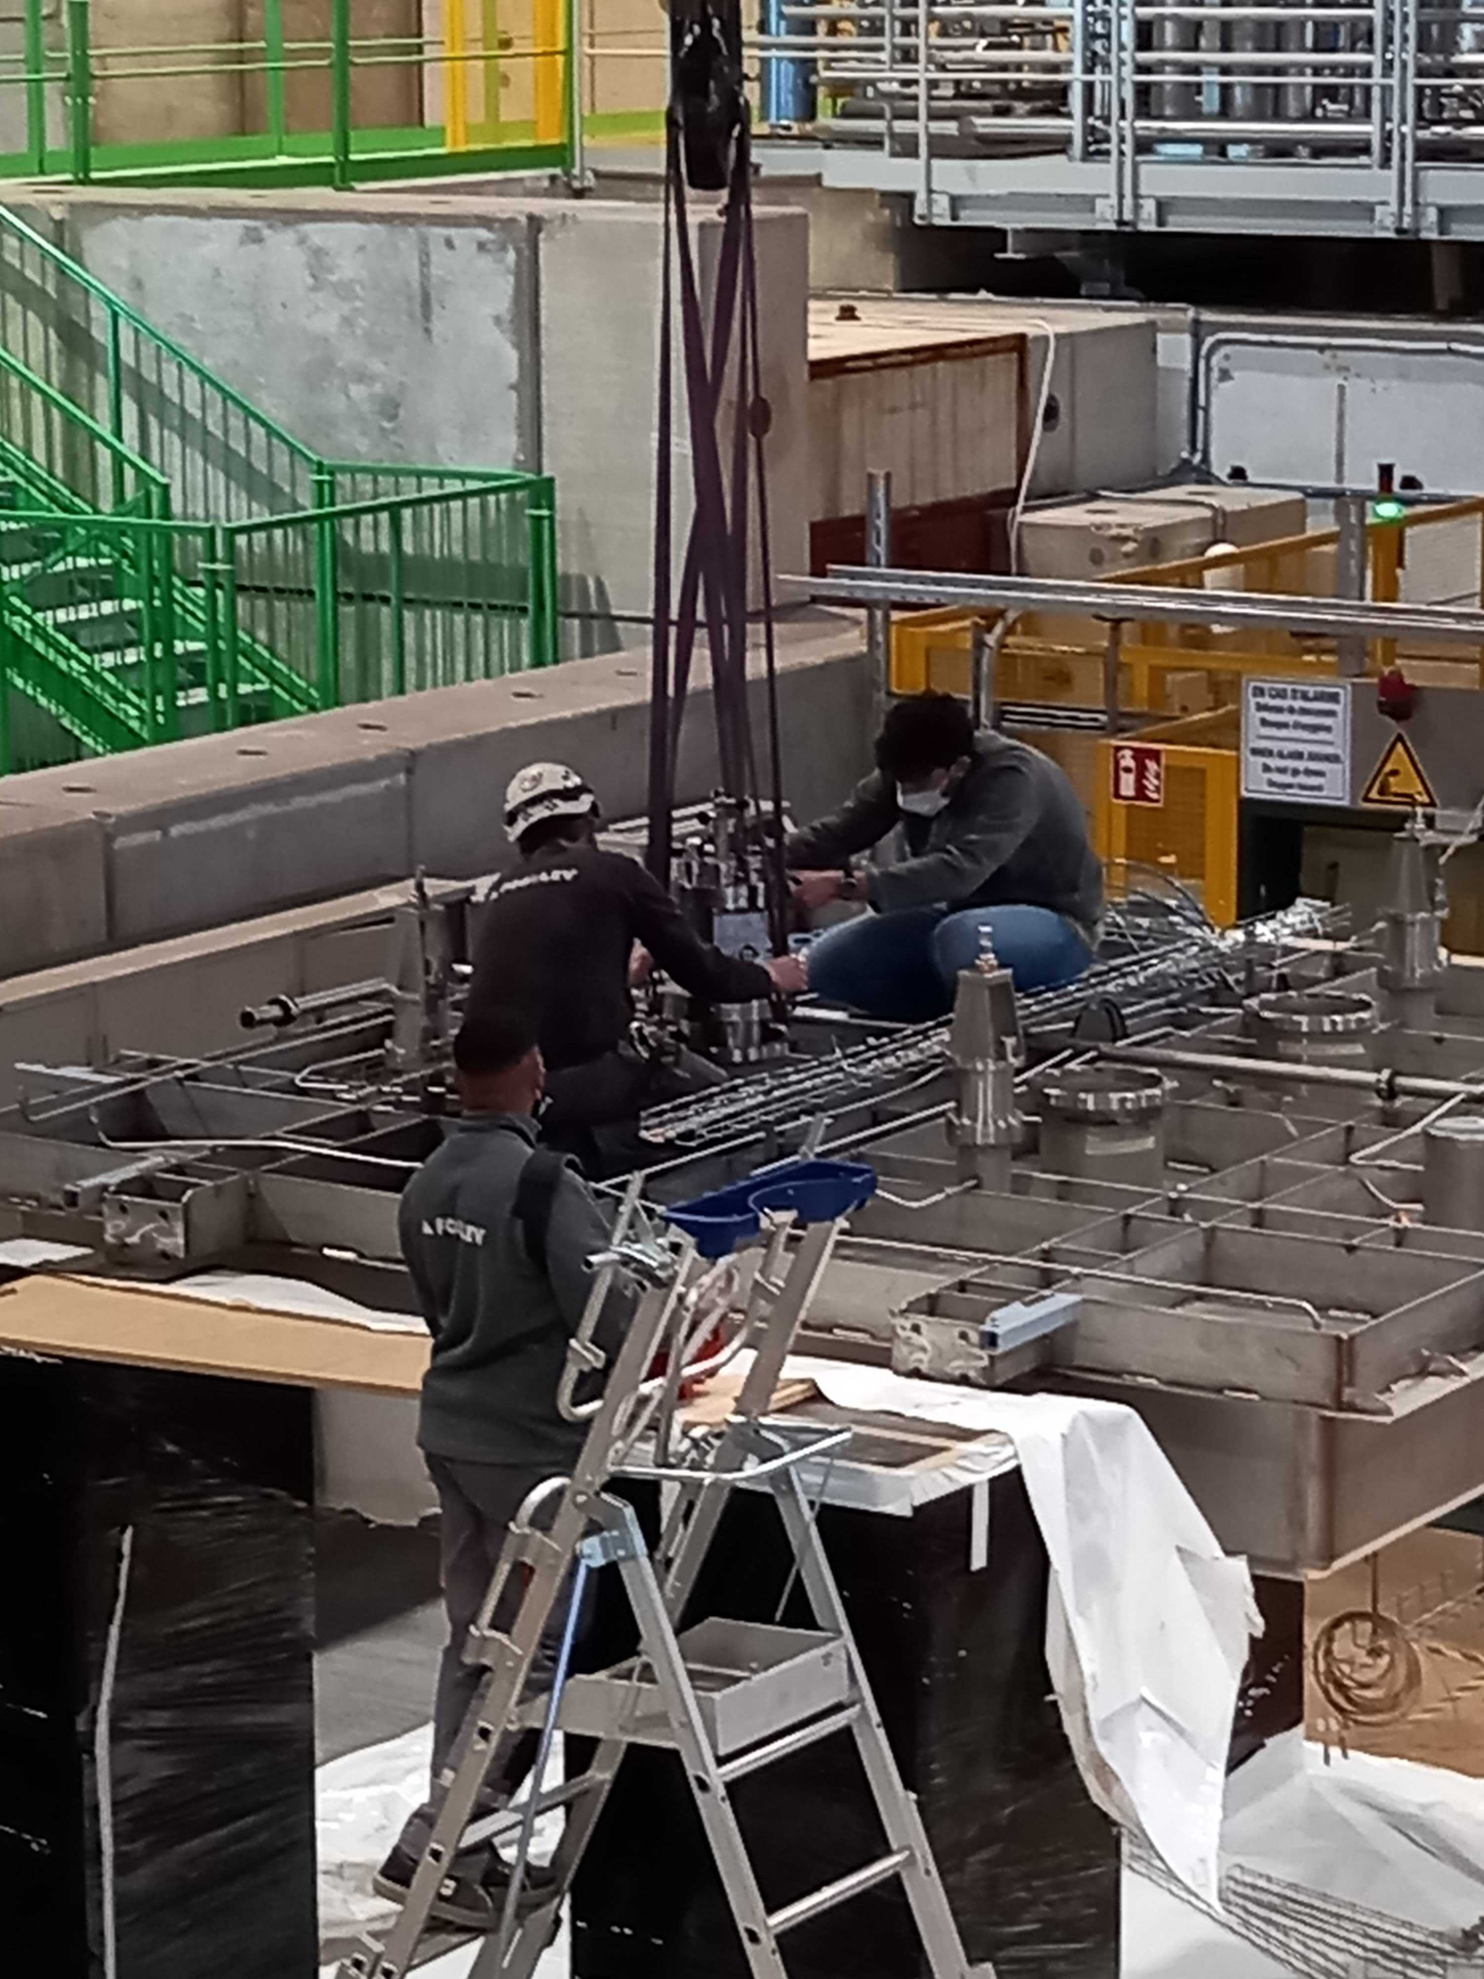
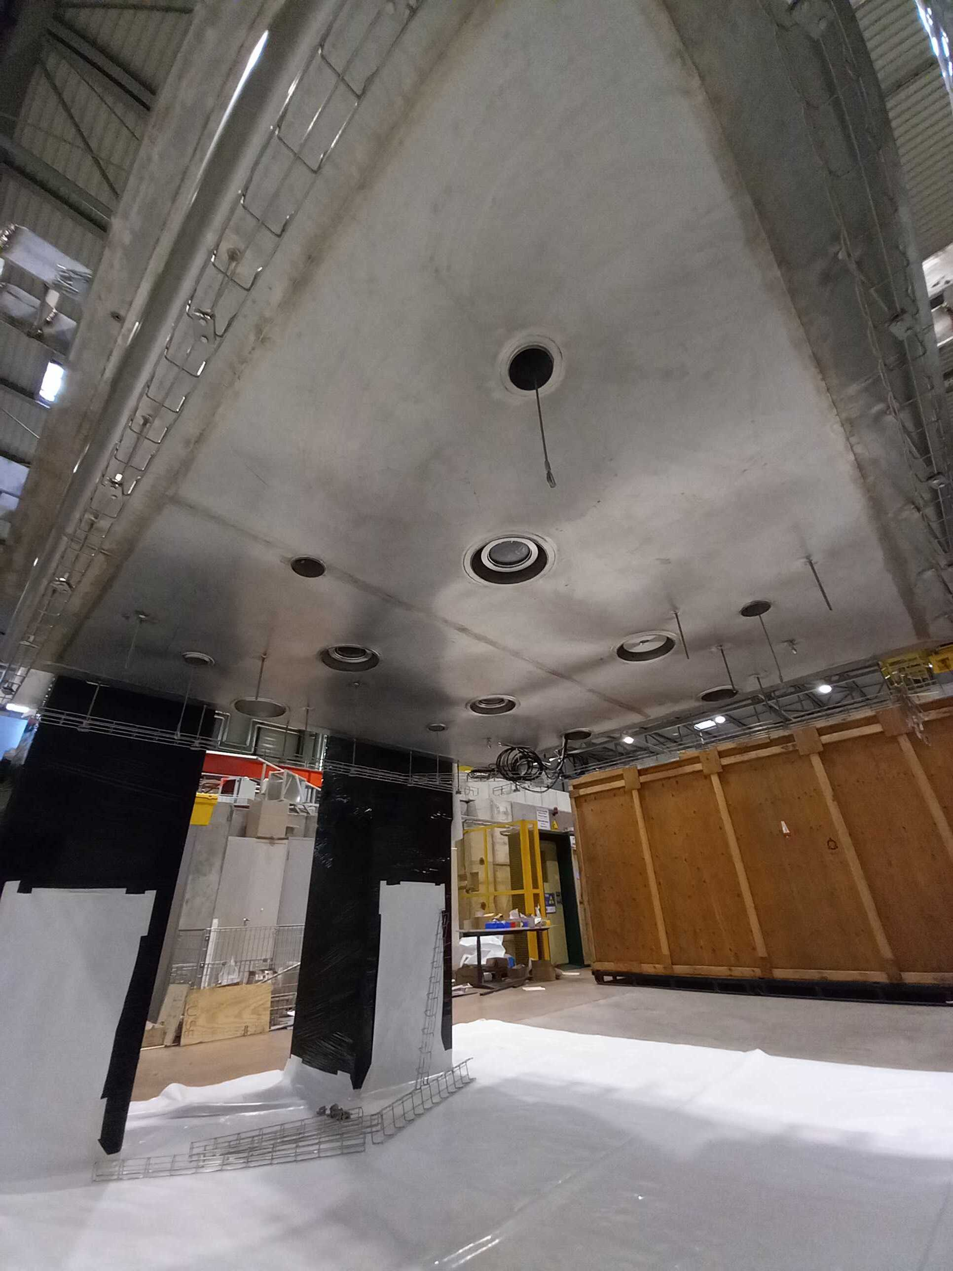
Cold box Integration

Slide 12
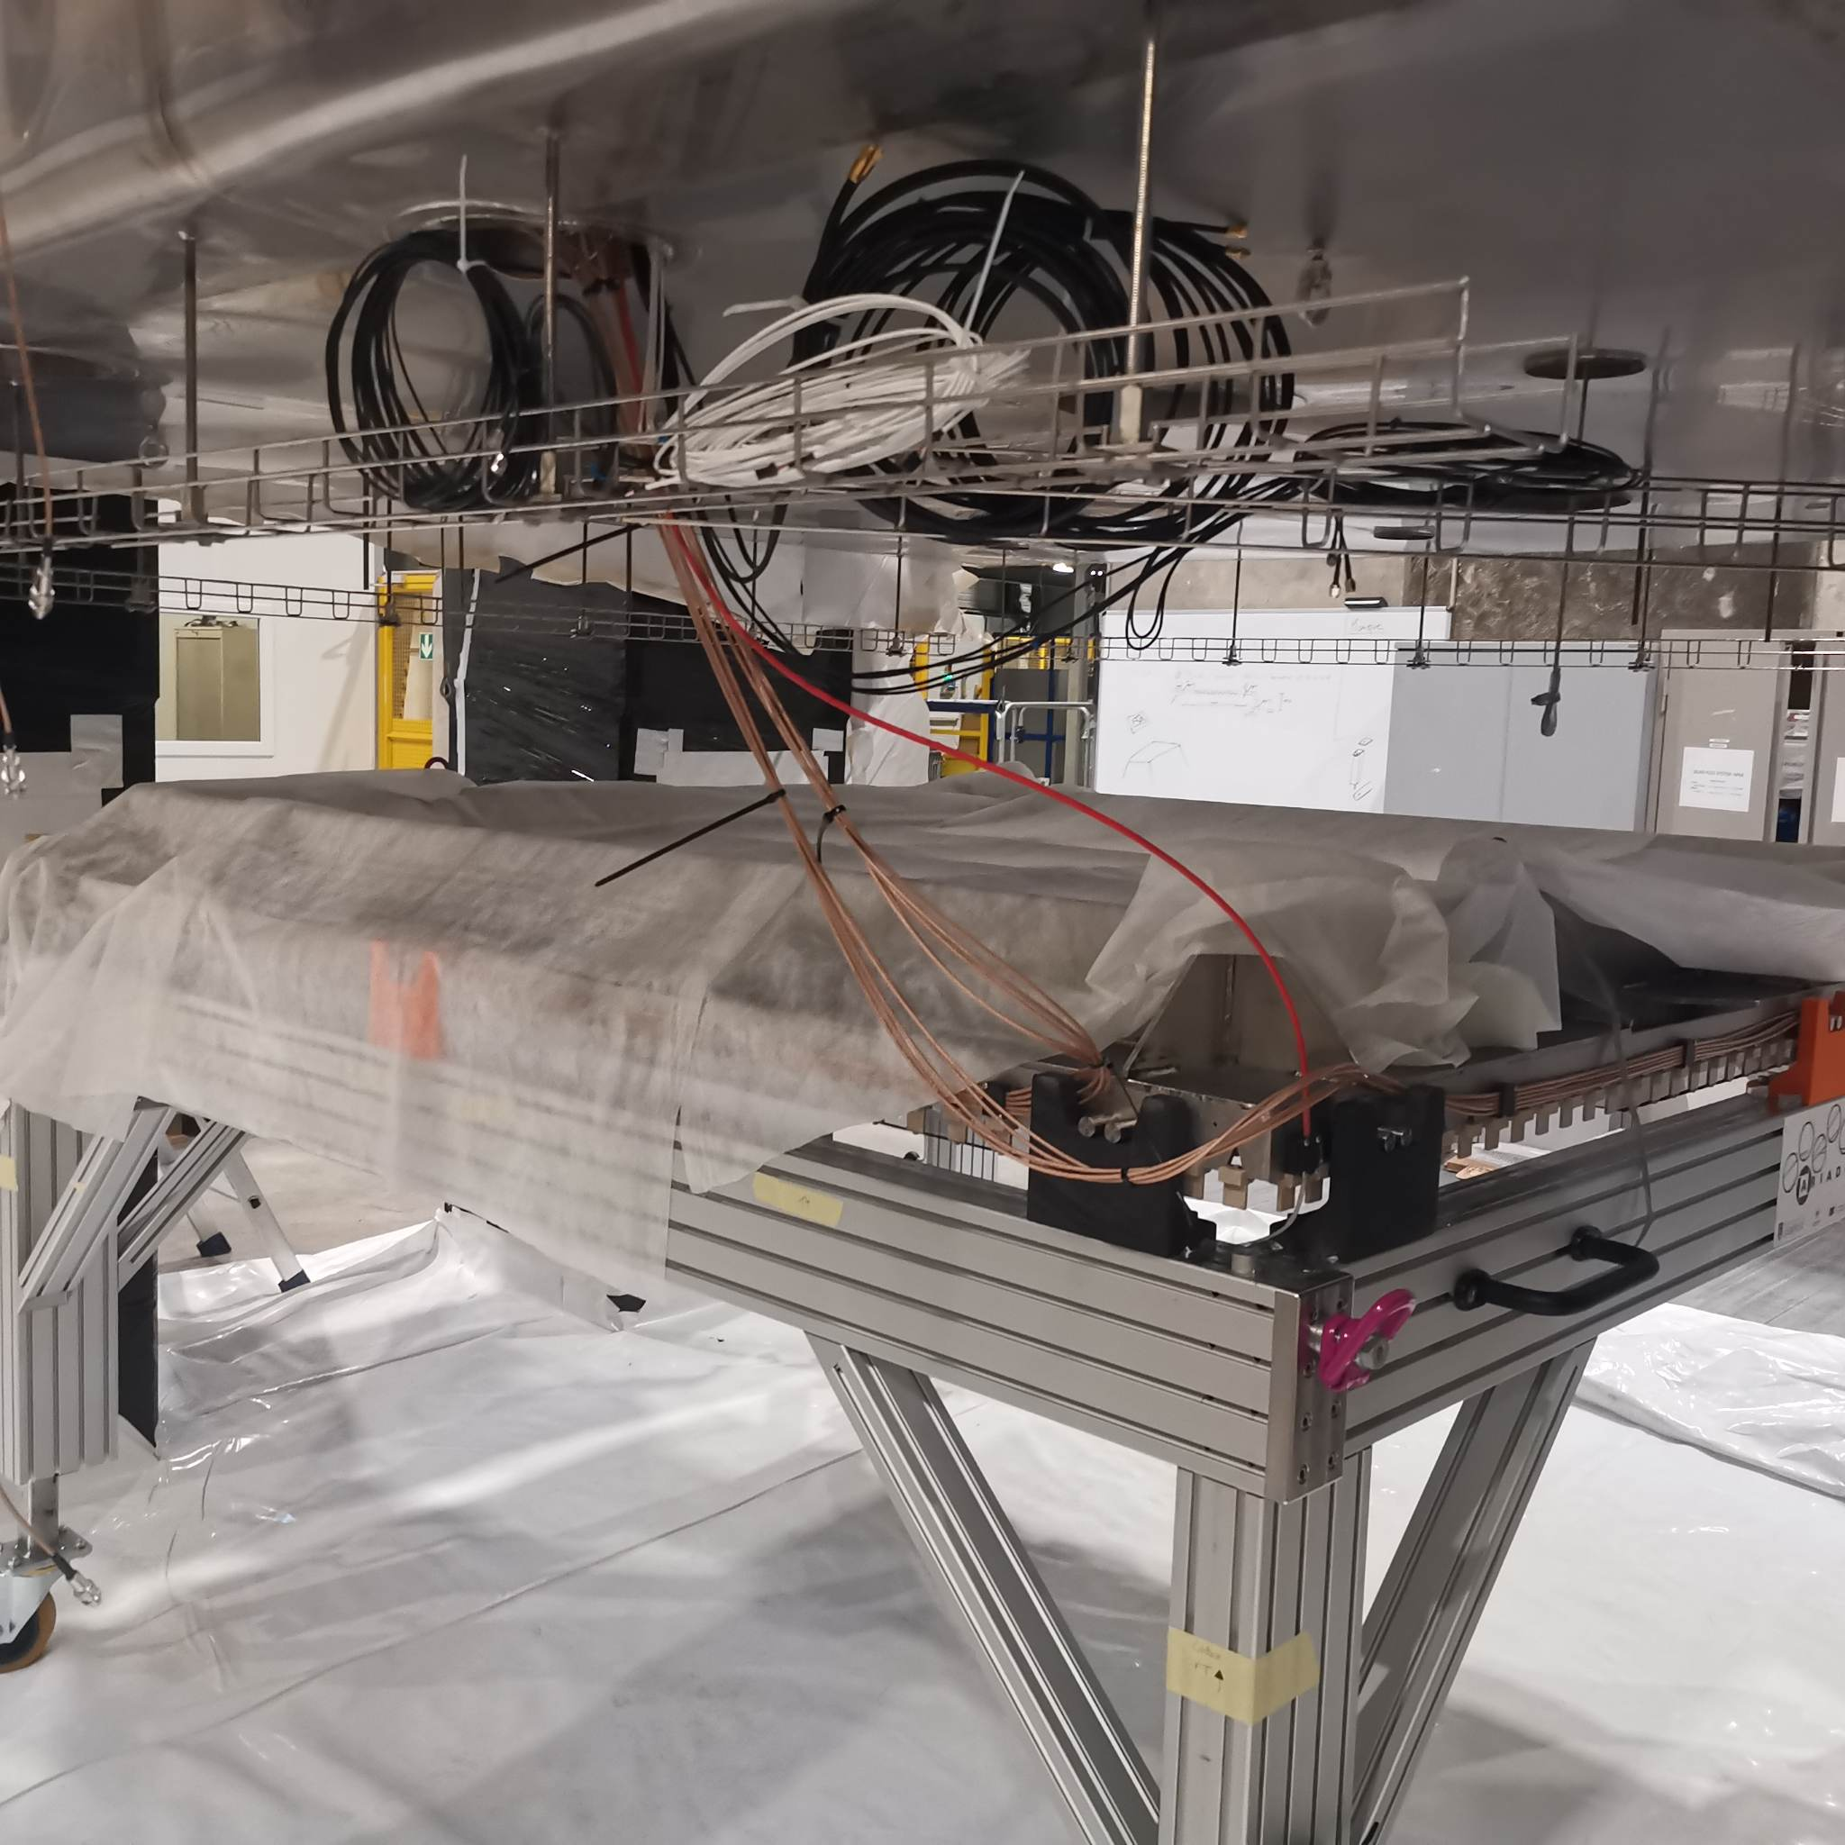
Cold box Integration

Slide 13
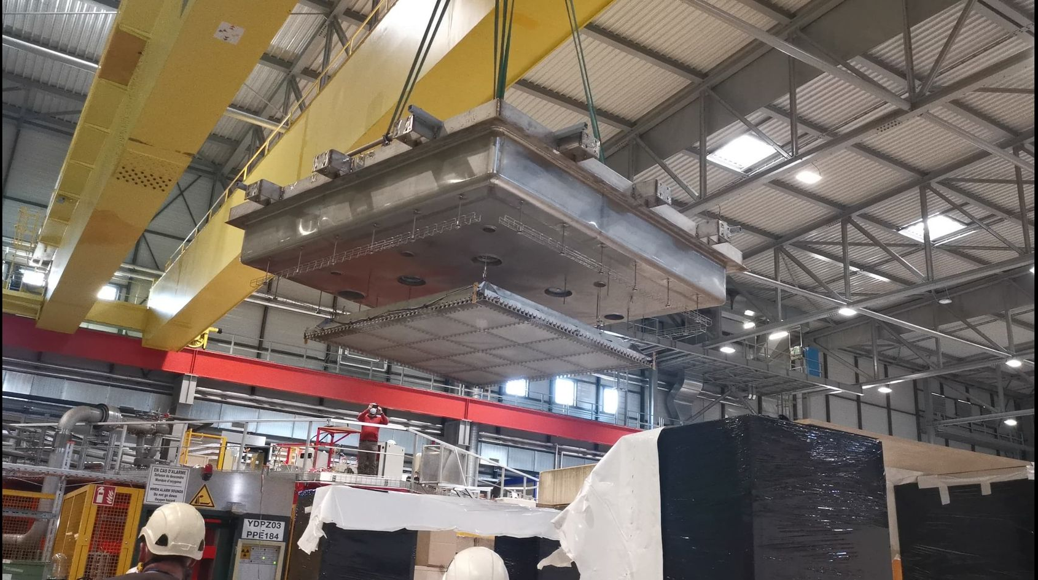
Closing the Detector

Slide 14
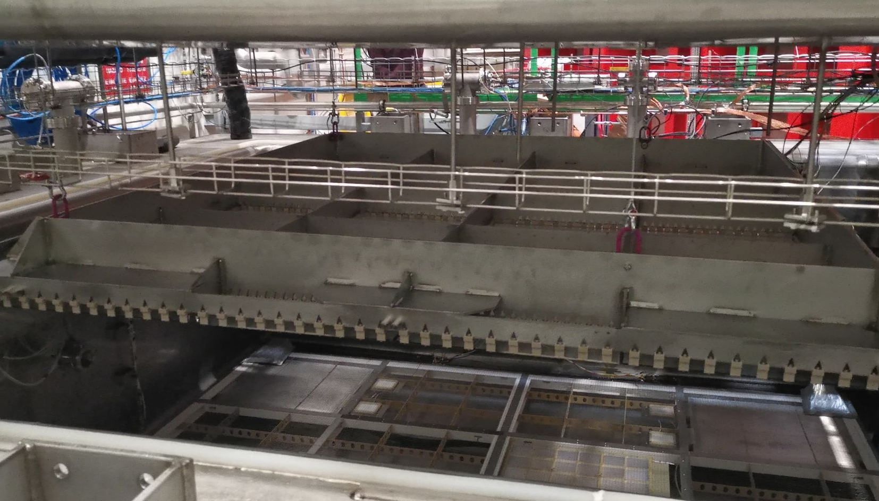
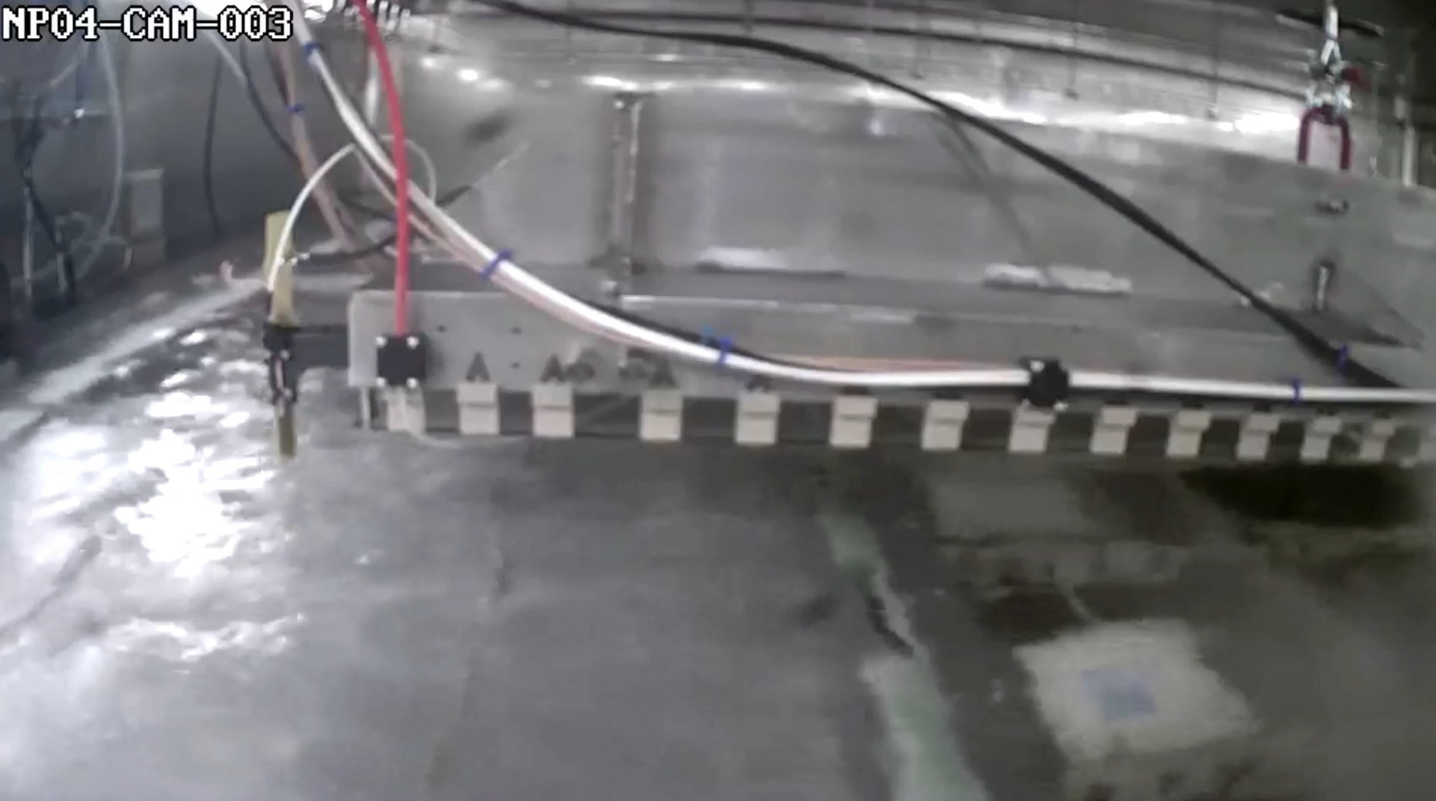
Closing the Detector

Slide 15
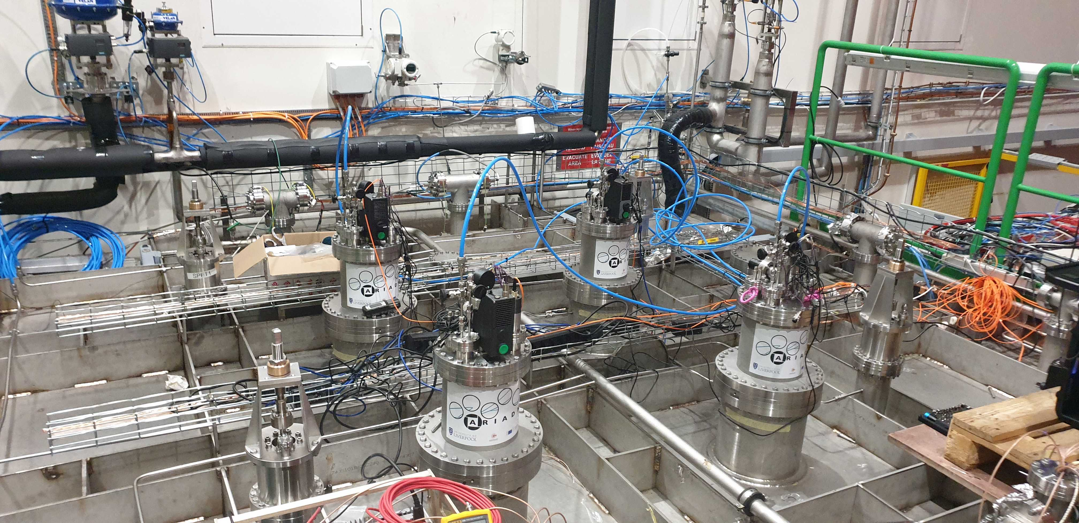
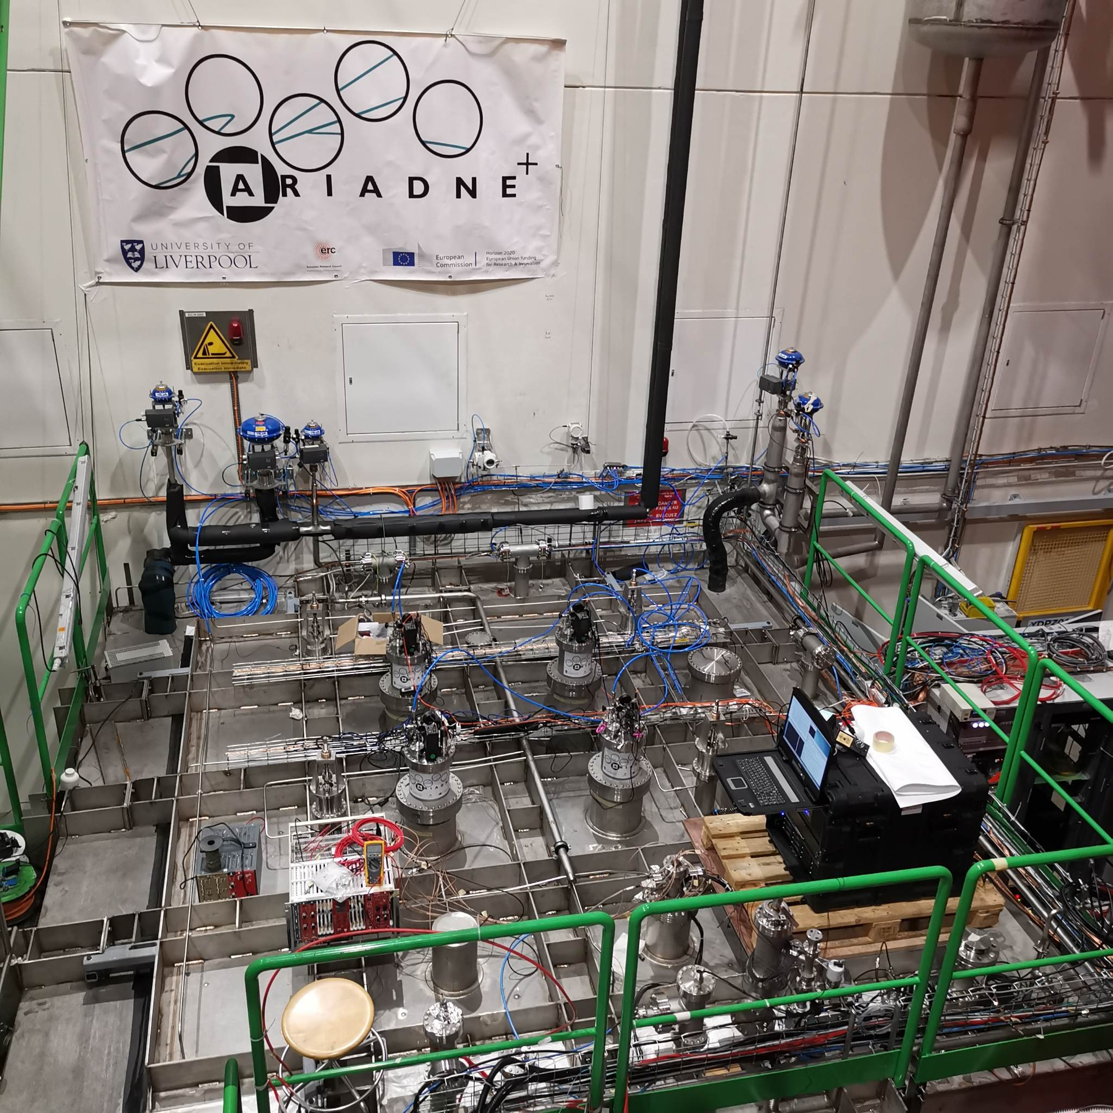
Detector running
Very stable cryogenic operation thanks to the CERN team
Argon purity was approximately 0.5 msec
Three weeks of data collection refilled twice

Slide 16
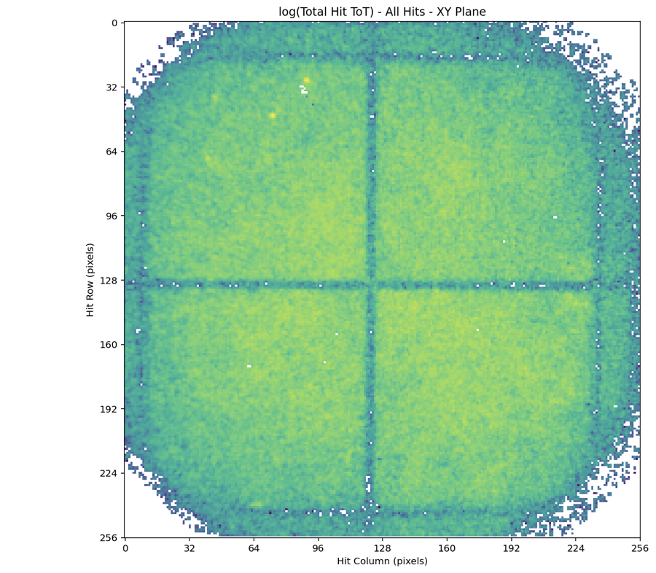
30 Seconds Integral Cosmics
Visible cosmics
VUV cosmics
(Additional vignetting from VUV optics)

Slide 17
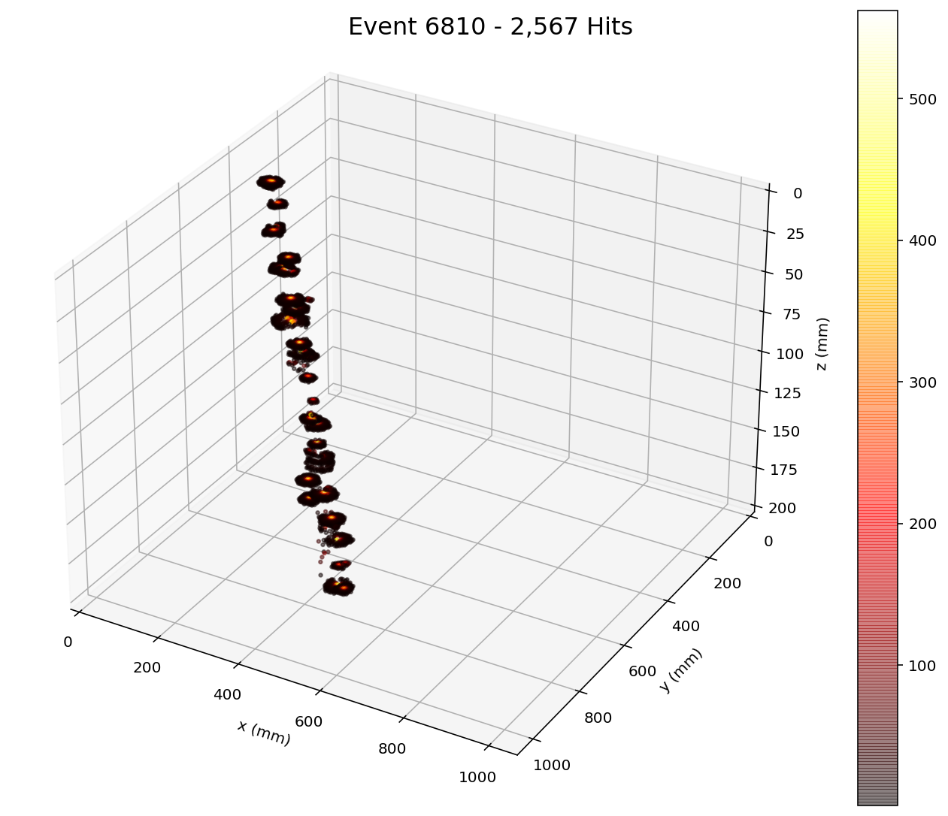
Sample events

Slide 18
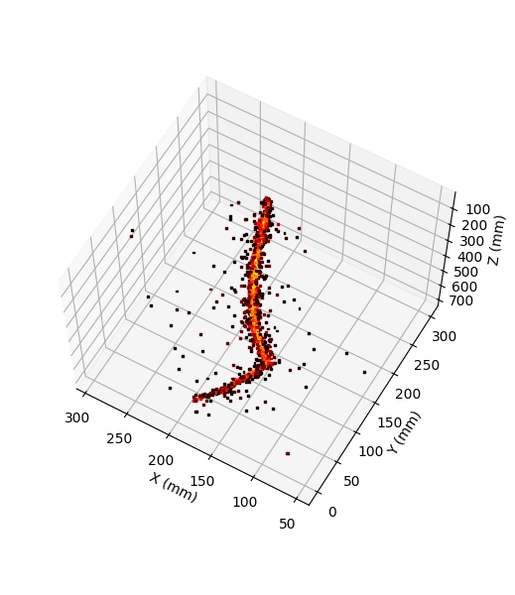
ARIADNE+ Conclusions
Optical readout achieved with stable detector conditions has been demonstrated at the same scales as that for vertical drift tests (CERN Neutrino Platform Cold Box)
Dual phase extraction region very stable at large scale!
TPX3 and Glass THGEM technology is ready for deployment now
An option for DUNE LAr Far Detector, DUNE LAr Near Detector and DUNE GAr Near Detector (if enough light is produced in pressurised gas Argon. Tests are in preparation in collaboration with USC –Diego’s group)
ProtoDUNE is the natural platform to perform the next essential steps

Slide 19
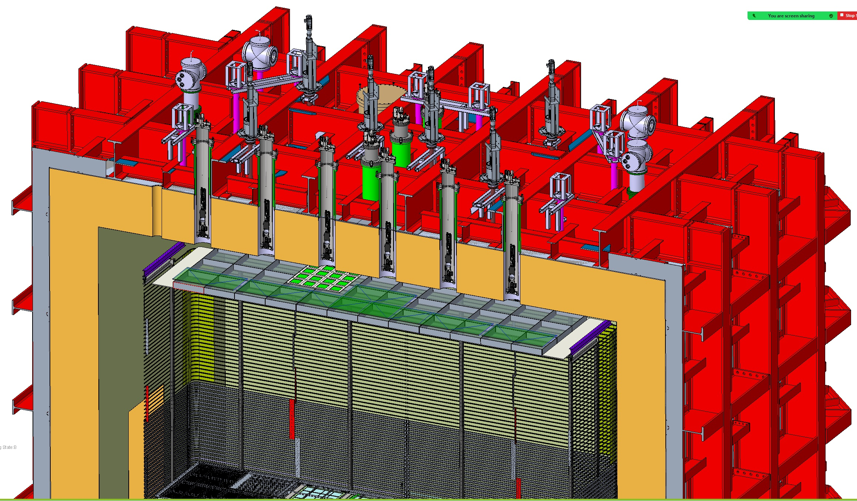
Using ProtoDUNE dual phase to test optical readout for Neutrinos and DM

Slide 20
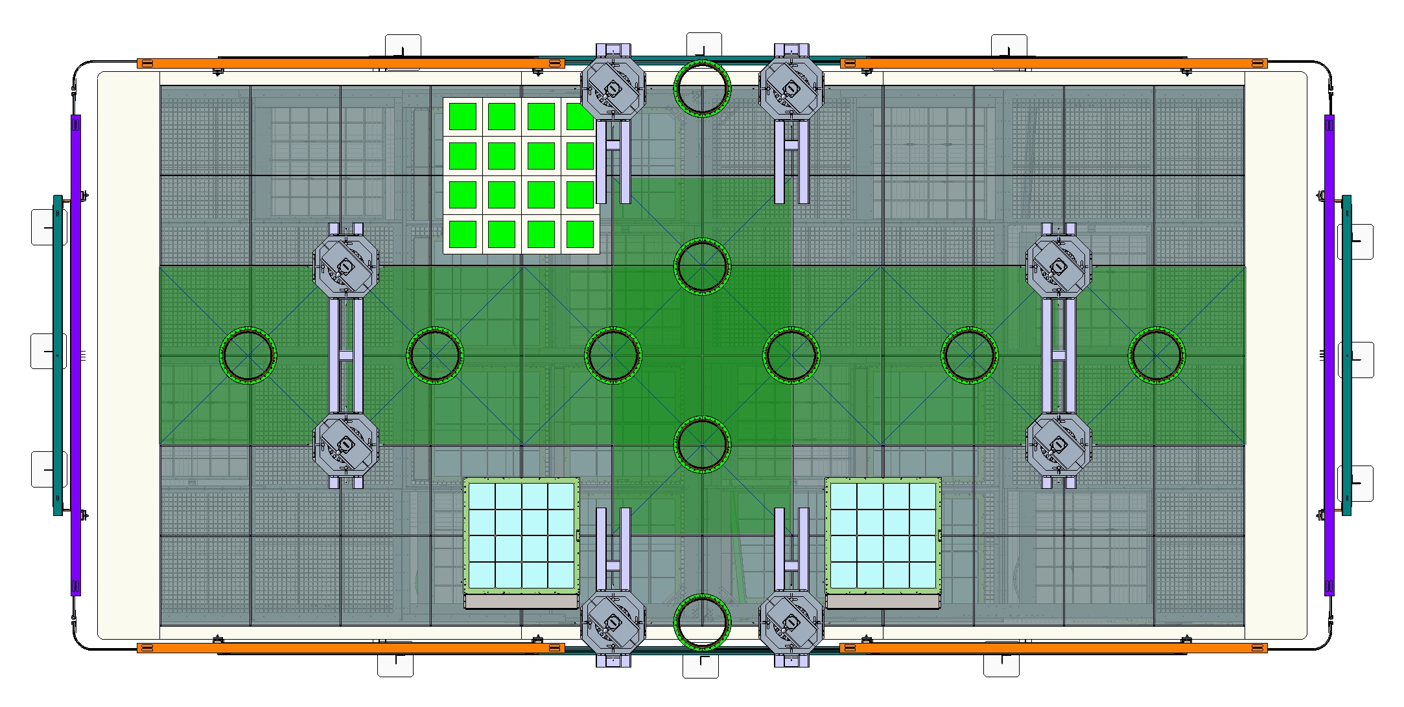
TOP VIEW Optical protoDUNE
16 Darkside-20k PDUs produced in the UK
Eight TPX cameras (1mx1m) using the current cryostat ports (green shaded areas)
Dedicated readout area for other optical sensors (e.g. Darkside SiPMs) for very low energy thresholds
X-Arapucas integrated into the field cage to test light detection technologies for future DUNE modules.
TPX3 Cameras
X-ARAPUCAs

Slide 21
TOP VIEW Optical protoDUNE
16 Darkside-20k PDUs produced in the UK
Eight TPX cameras (1mx1m) using the current cryostat ports (green shaded areas)
Dedicated readout area for other optical sensors (e.g. Darkside SiPMs) for very low energy thresholds
X-Arapucas integrated into the field cage to test light detection technologies for future DUNE modules.
TPX3 Cameras
X-ARAPUCAs

Slide 22
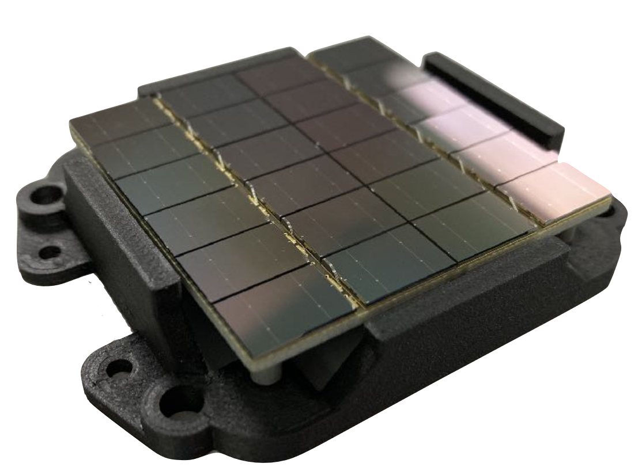
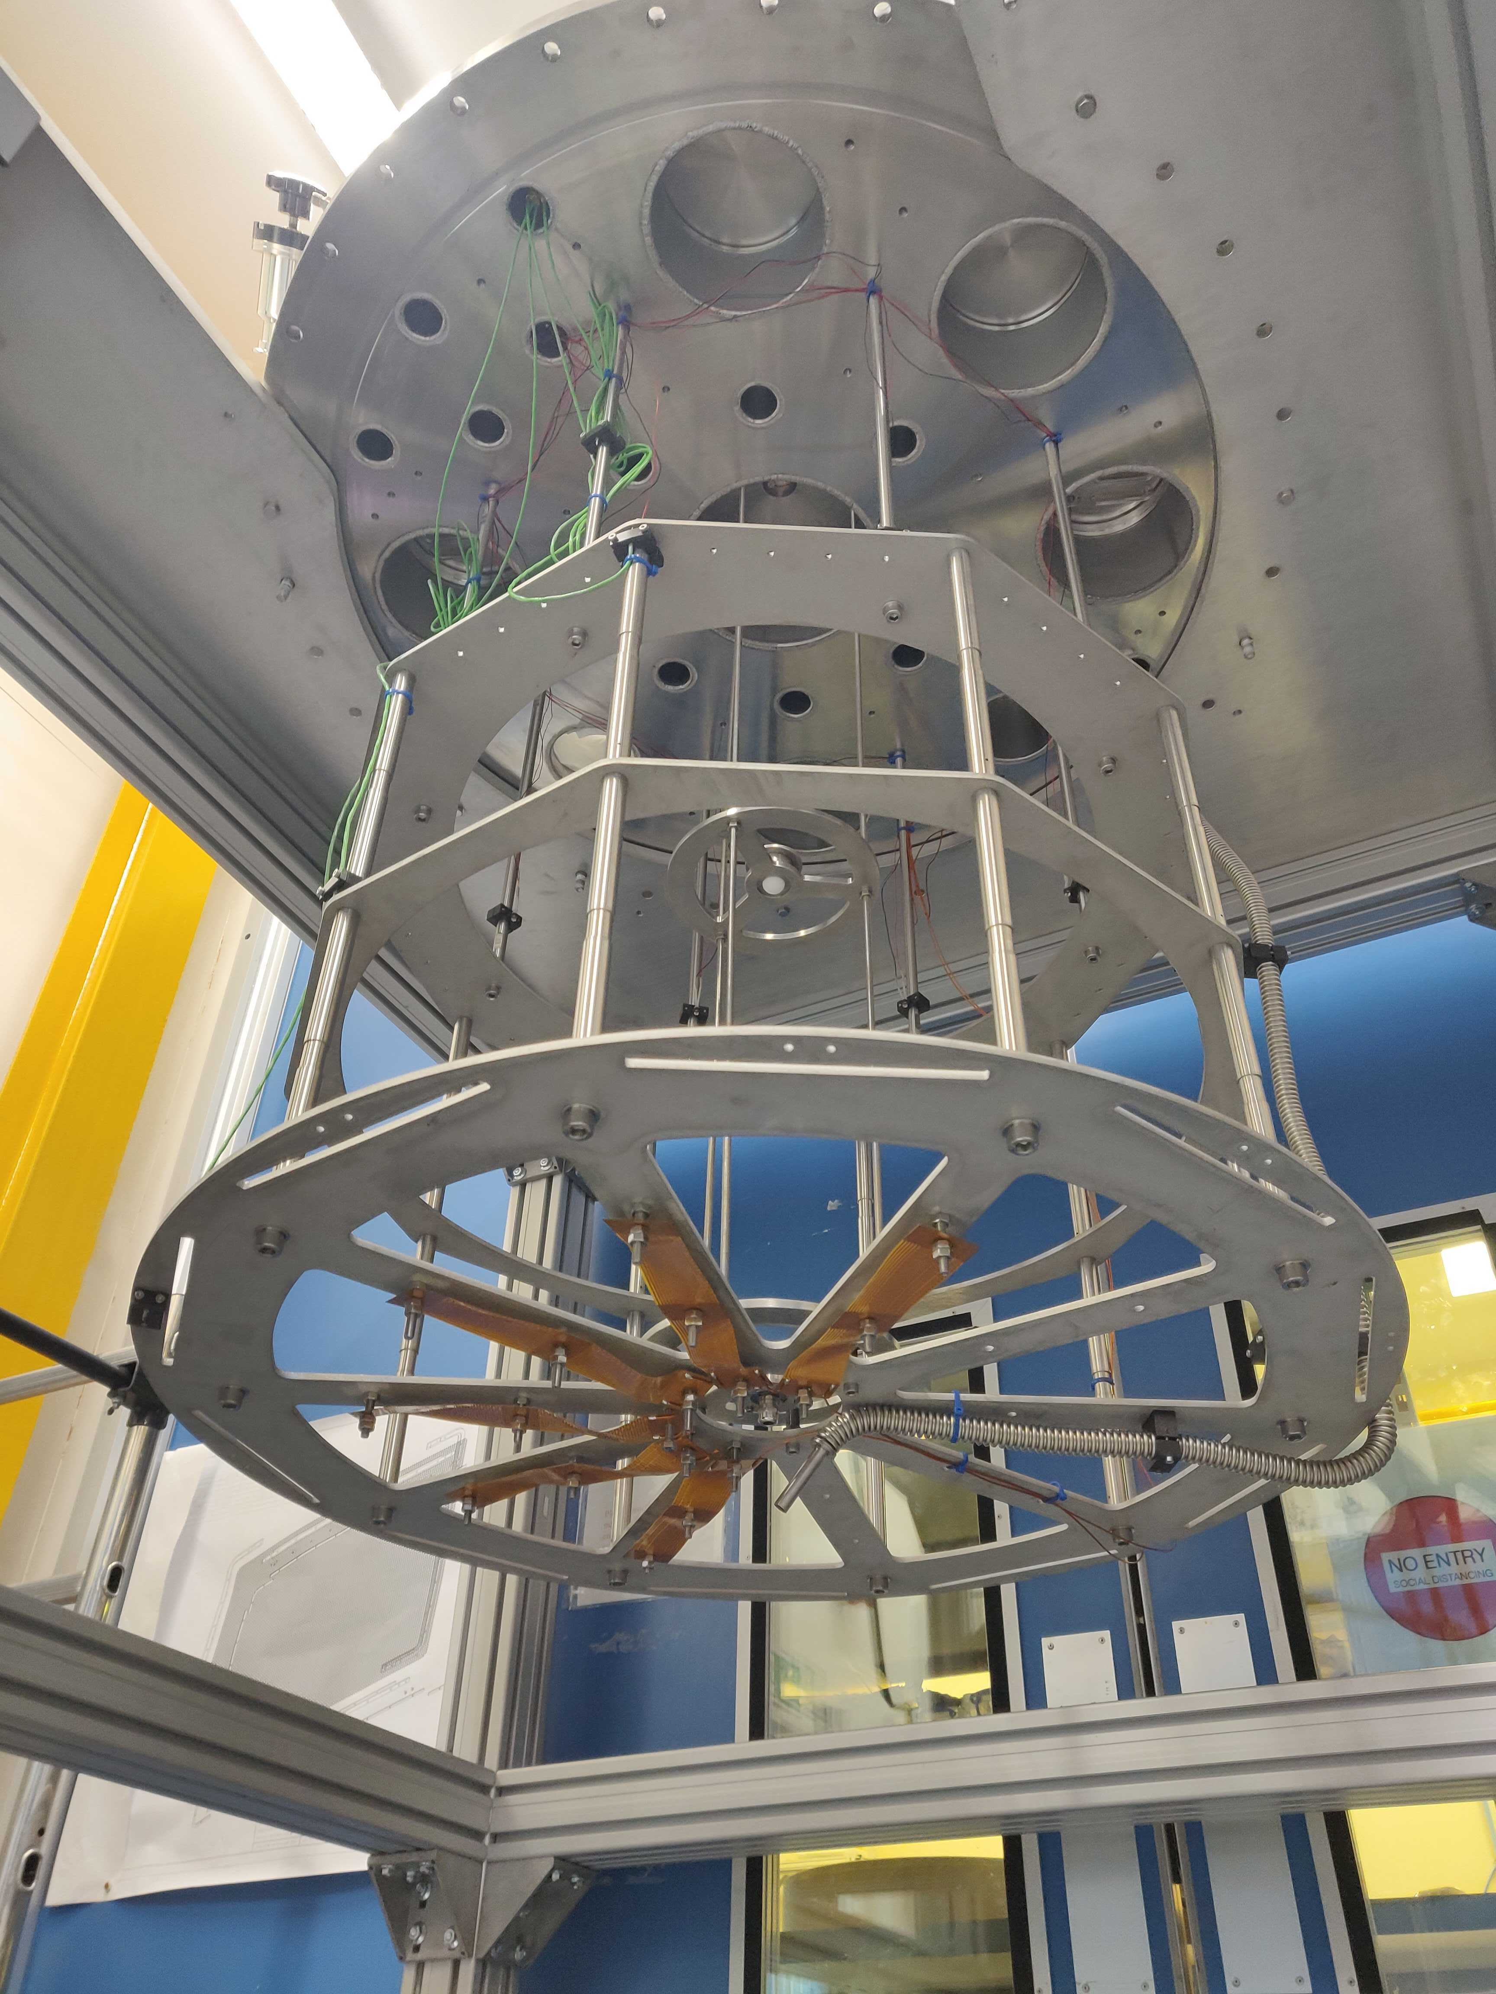
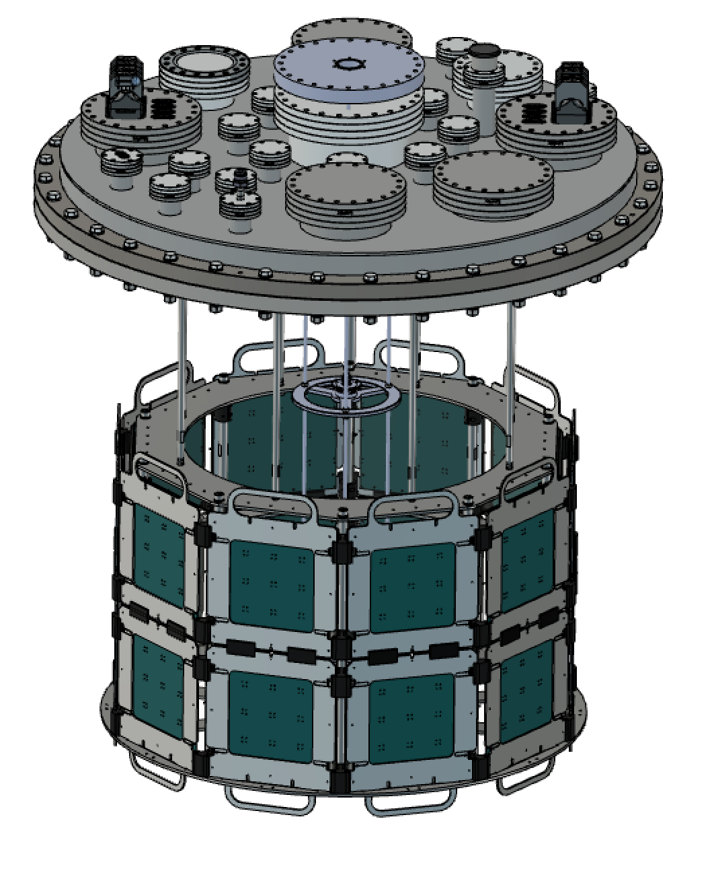
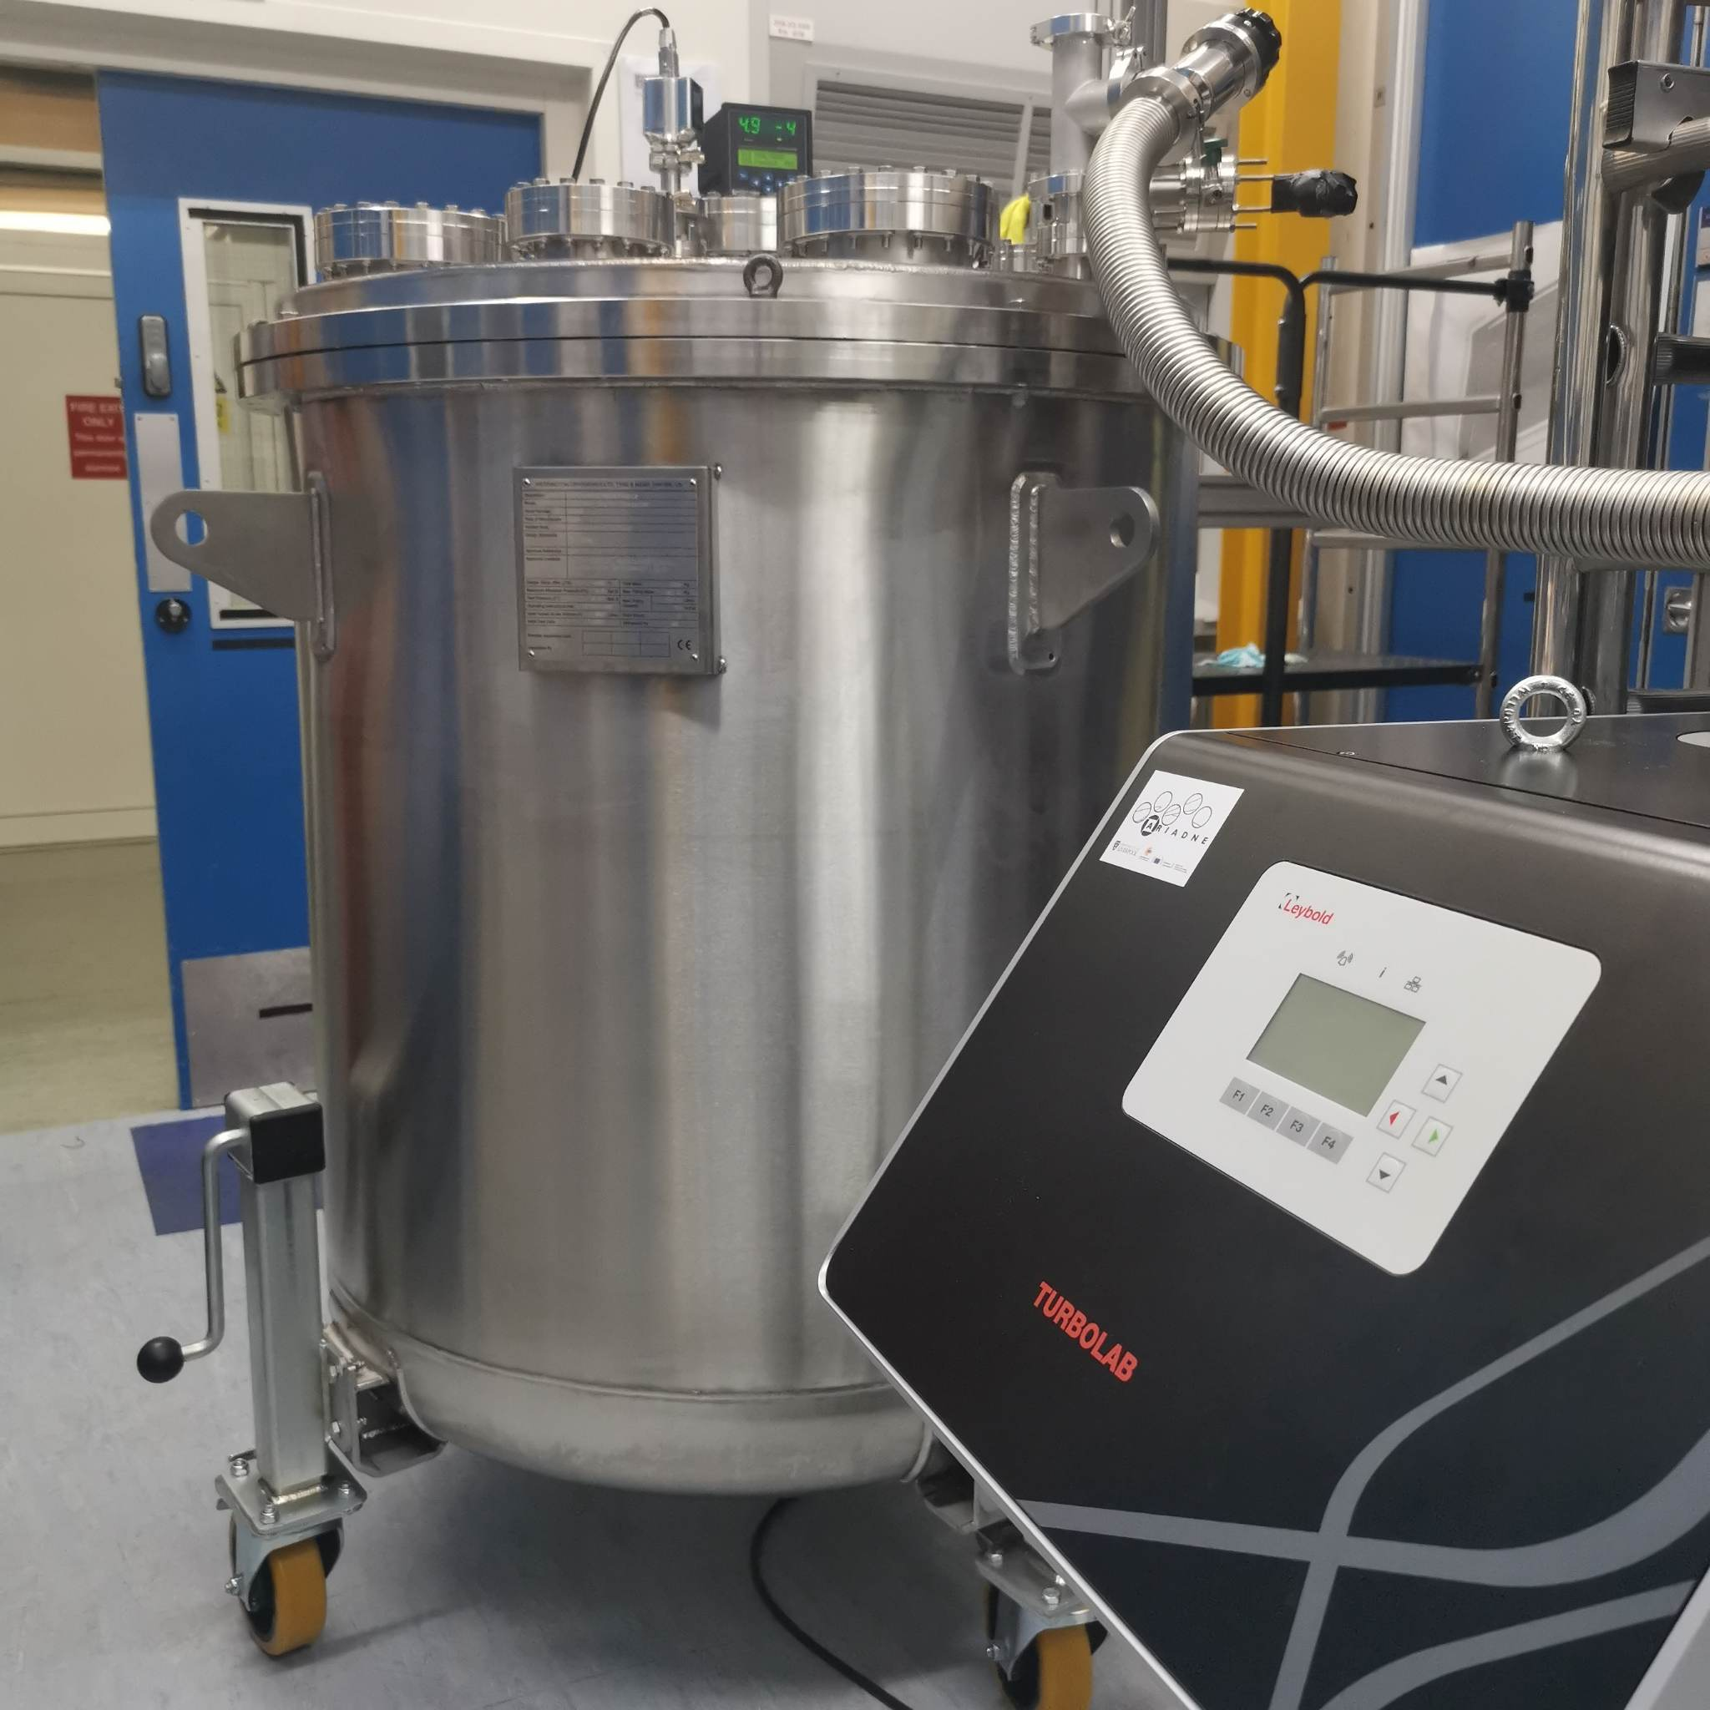
Darkside SiPMs

Slide 23
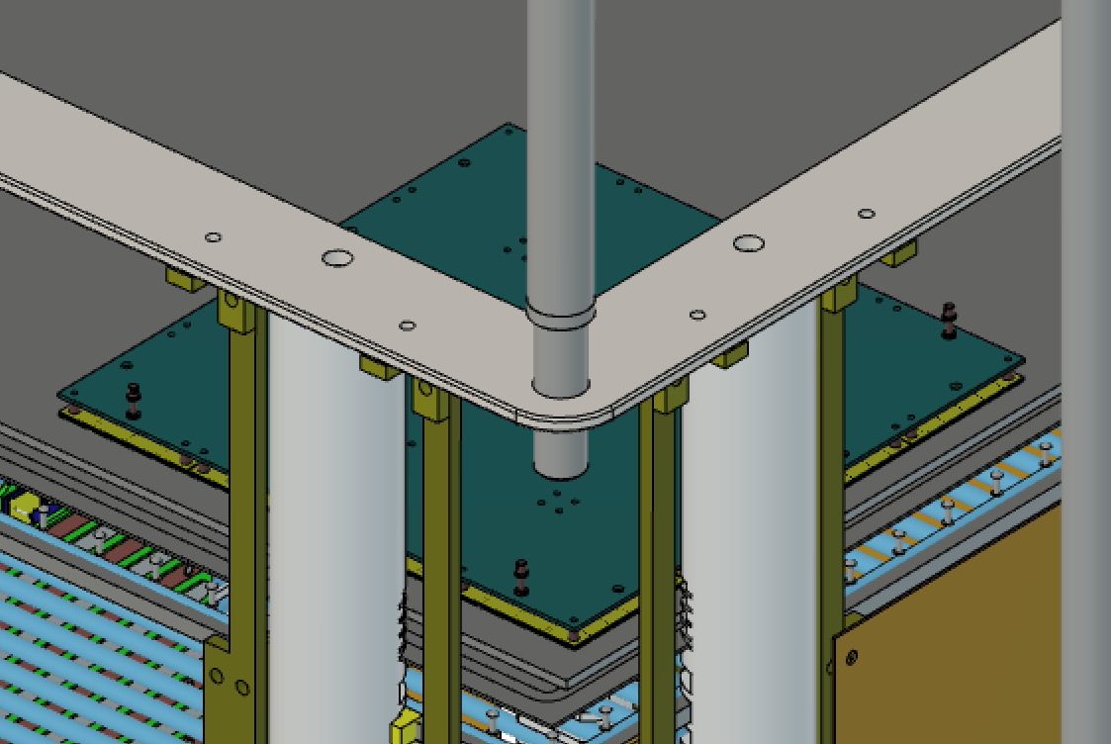
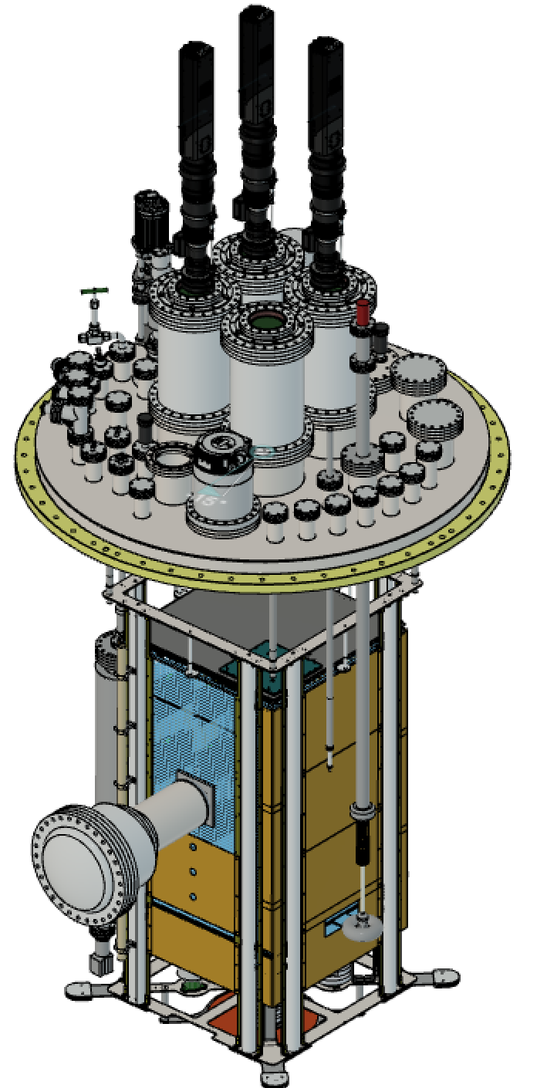
Darkside SiPMs
We plan to soon (before the end of the year) run ARIADNE to test the proposed instrumentation for protoDUNE.
Three cameras will be installed, with the remaining ¼ of the detector dedicated to Darkside SiPMs.
Measure the response of Darkside SiPMs to varying THGEM bias and determine the correct gain for protoDUNE operation.
Study sensitivity/threshold/resolution differences between Darkside SiPMs and Timepix cameras and asses possible new physics which can be accessed in view of DUNE.

Slide 24
Timeline
Today
2024
2025
2026
Testing of Darkside SiPMs in ARIADNE
Design of LRPs for protoDUNE
Facility at Liverpool for GTHGEM production
Formation of protoDune working group (Arapuca, Darkside)
Submit proposal to SPSC
Proposed installation on protoDUNE

Slide 25
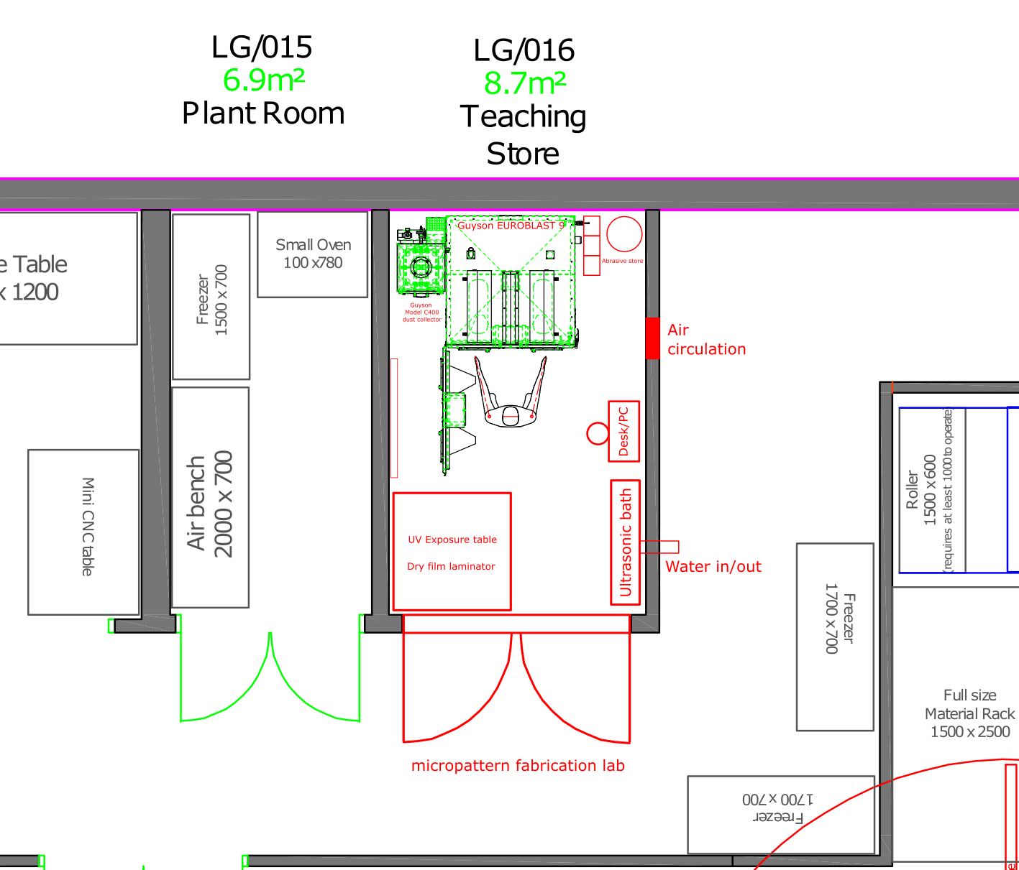
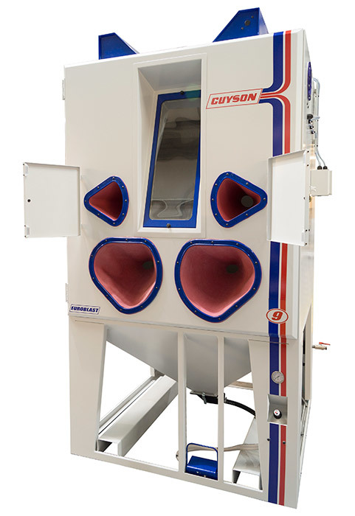
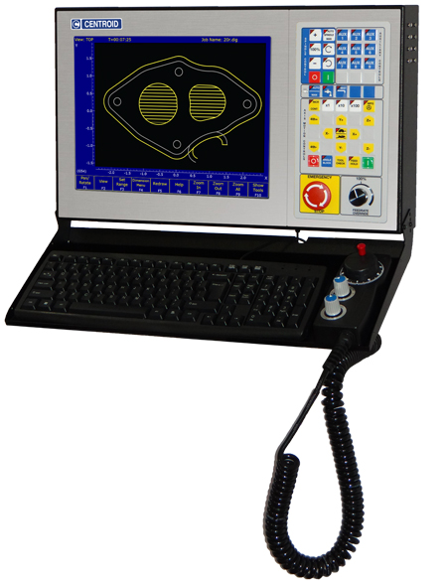
GTHGEM production facility
Guyson Euroblast 9 enclosure which we will fit
with custom mechanics/controls for automated machining process

Slide 26
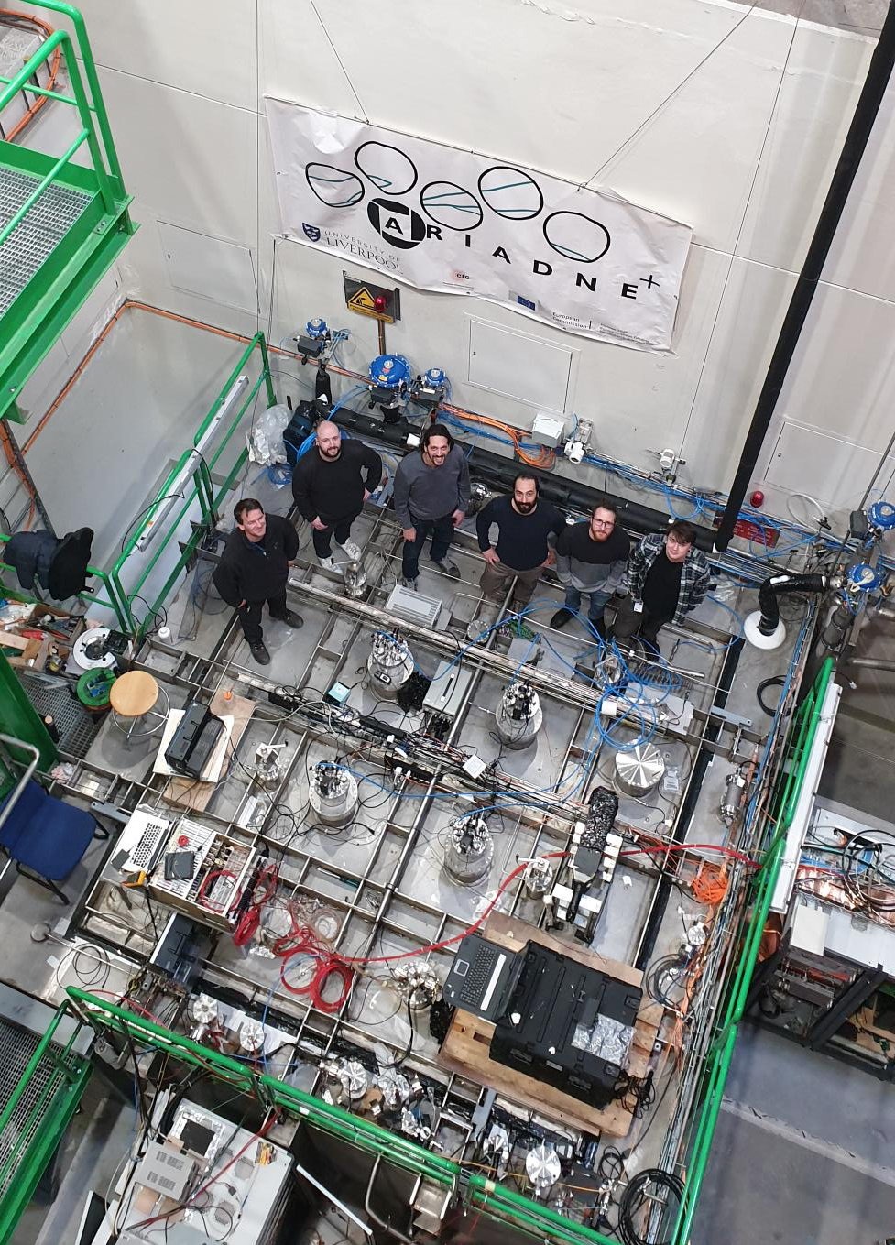
Thank you

