Slide 1

Ultra-high resolution silicon R&D
Gianluigi CASSE

Slide 2
OUTLINE
  Architecture of silicon detectors
  CMOS and sensors
  Limits on the resolution
  A radical architecture change
  Preliminary results
  A funded project

Slide 3
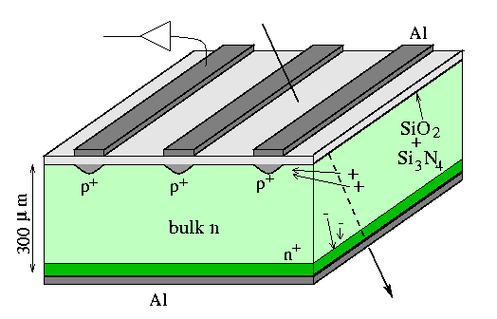
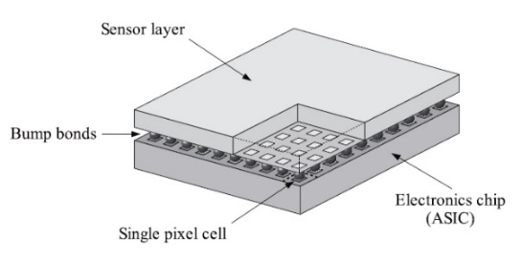
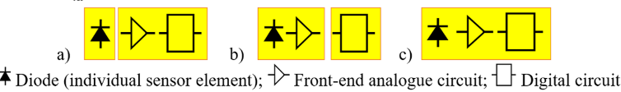
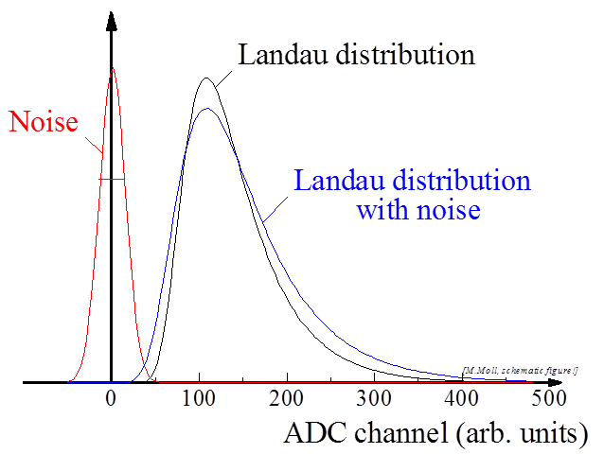
Signal and electronics chain:
Reverse-biased diode collects ionisation charge.
Analogue amplification
Digital processing circuits.
These 3 functional blocks can be on separate chips (hybrid) or on the same chip (monolithic).

Slide 4
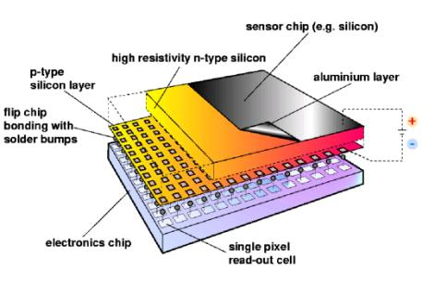
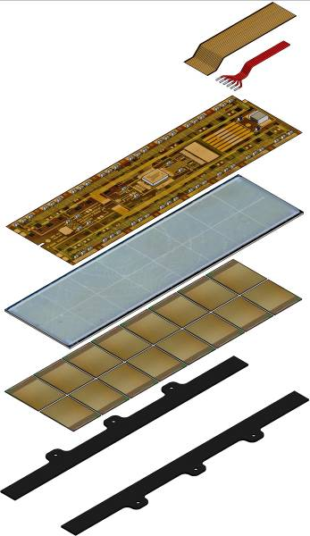
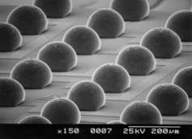
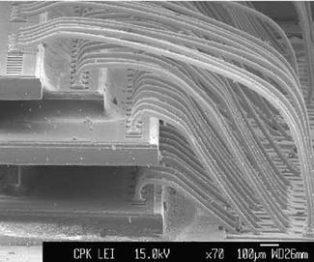
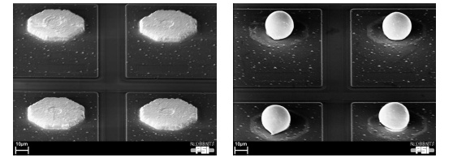
The most used sensor type in high multiplicity environments

Slide 5
State of the art ASICs, ALPIDE

Slide 6
State of the art devices: hybrid pixel ASICs
RD53 65 nm CMOS pixel readout chip for extreme data rates and radiation levels (V. Re et al., CERN/RD53 collaboration)
Advanced readout chip for the pixel layers of ATLAS and CMS Upgrades at CERN.
Analogue area
50 µm
Expected position resolution > 15 µm.
50 µm
Orders of magnitude more transistors per area in the digital section compared to analogue area.
The latter cannot be reduced!
Today’s pixel size cannot be reduced much further, even with smaller feature size

Slide 7
Moore’s law is broken in sensor evolution.
Technology first adopted for Si sensors
Reduction of the transistor channel length (feature size, S) over the years.
First functional 65 nm ASIC produced in spring 2018 (RD53)
End of technological trajectory!
Feature size exploited for mixed signal pixel devices for particle detection.
New paradigm needed!
Pixel sizes followed Moore’s law, but this stopped at 65nm feature size.
For mixed signal devices there is little gain in going to smaller nodes.
End of technological trajectory for mixed signal devices is happening now.
Fully digital devices are the way forward.

Slide 8
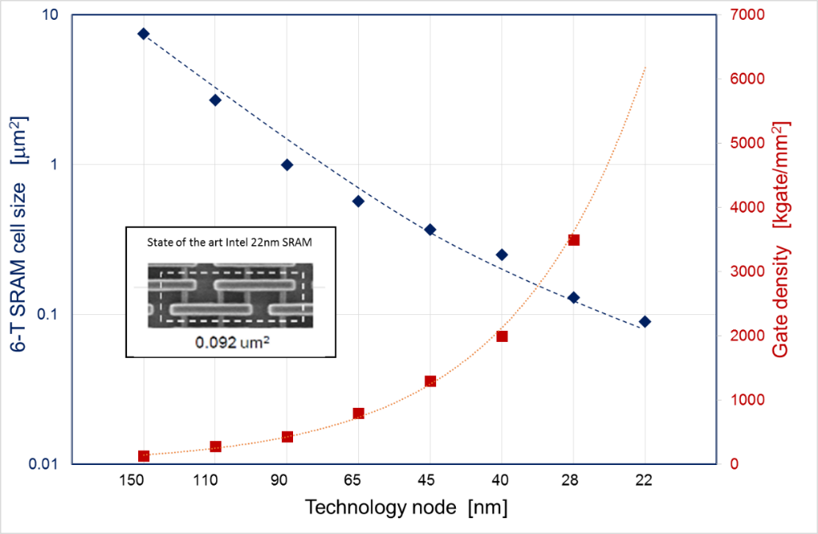
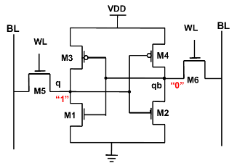
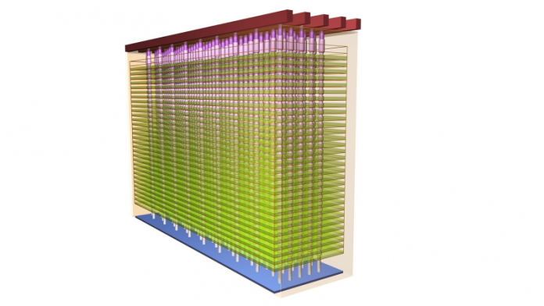
Digital sensors: inspired by stacked memory cells.
Modify cell design for susceptibility to radiation induced bit-flips
Digital-only sensor to bring sensor technology back on track with Moore’s law
Small pixels with reduced number of transistors per pixel
A factor 100 improvement in position resolution
Low power
Multiple detection layers
3D pixel array with sub-micron position resolution and live readout
→ Live Emulsion (LEmu) sensors

Slide 9
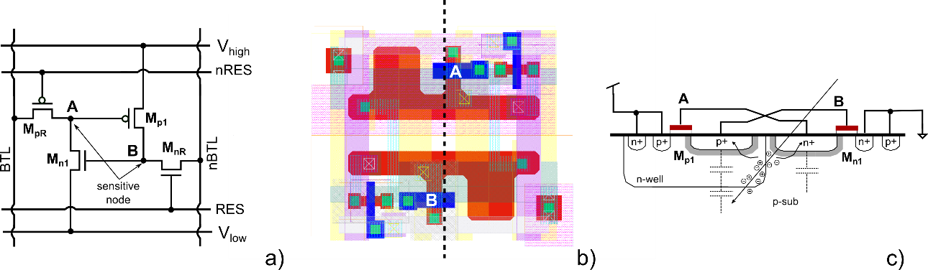
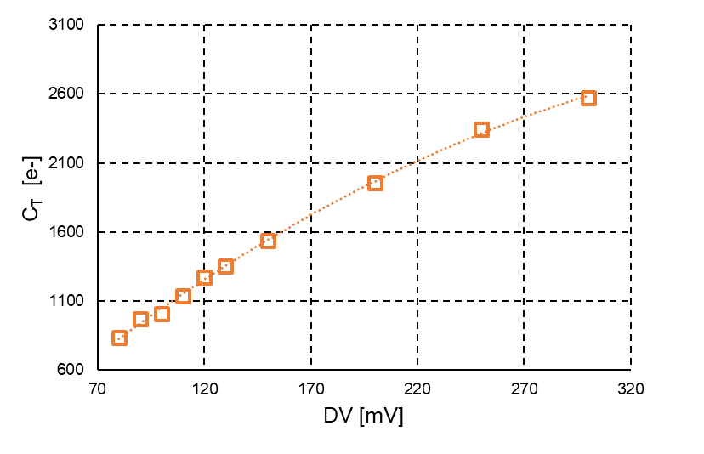
Various layout ideas: LEmu
Circuit schematic, cell layout and vertical cross section of a possible LEmu cell.

Slide 10
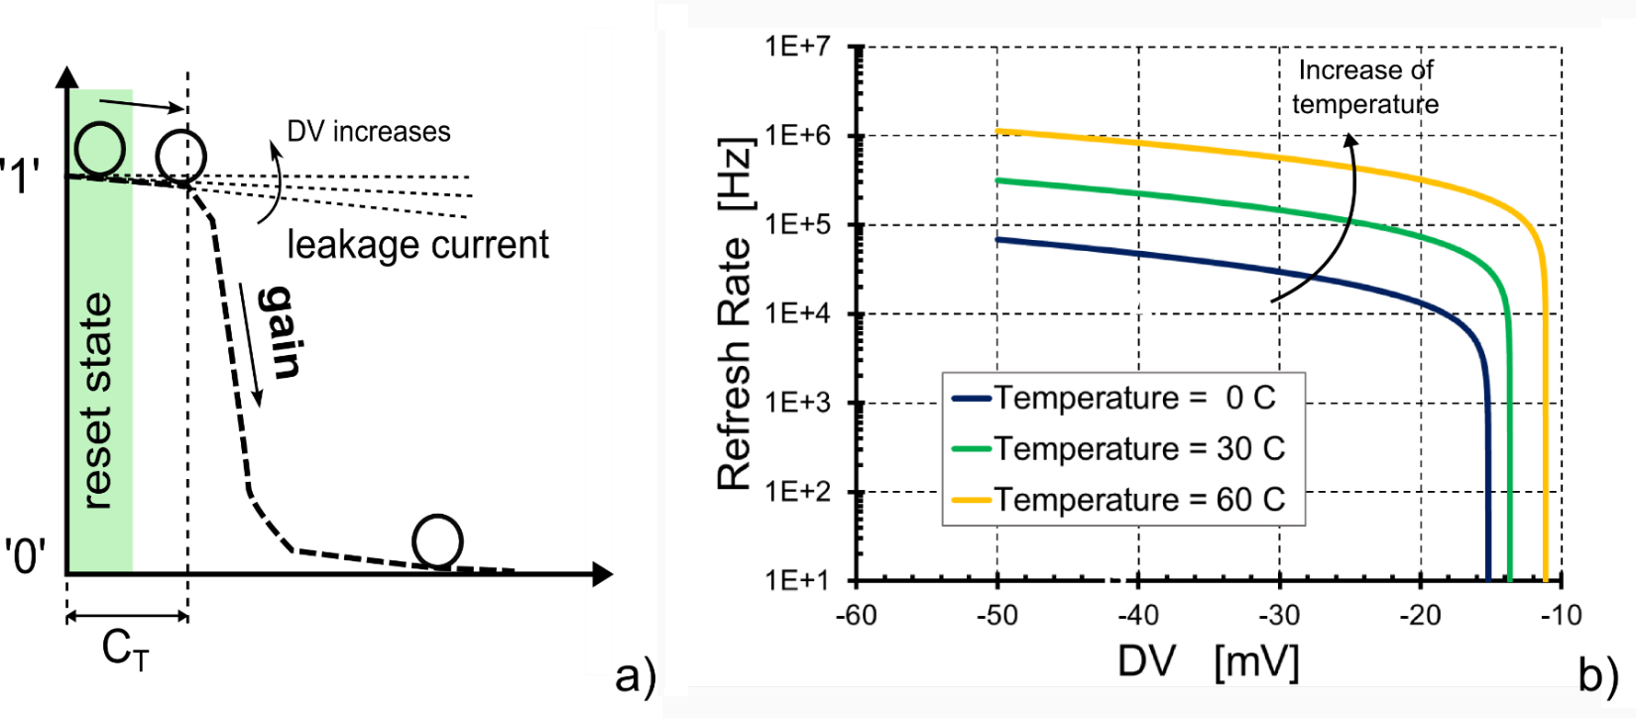
Operations of LEMU cell
c)
a) Working principle of LEmu; b) simulated refresh rate to suppress dark rate induced by leakage current at different temperatures; c) simulated Threshold charge (C_{T}) to flip the cell for two different designs.

Slide 11
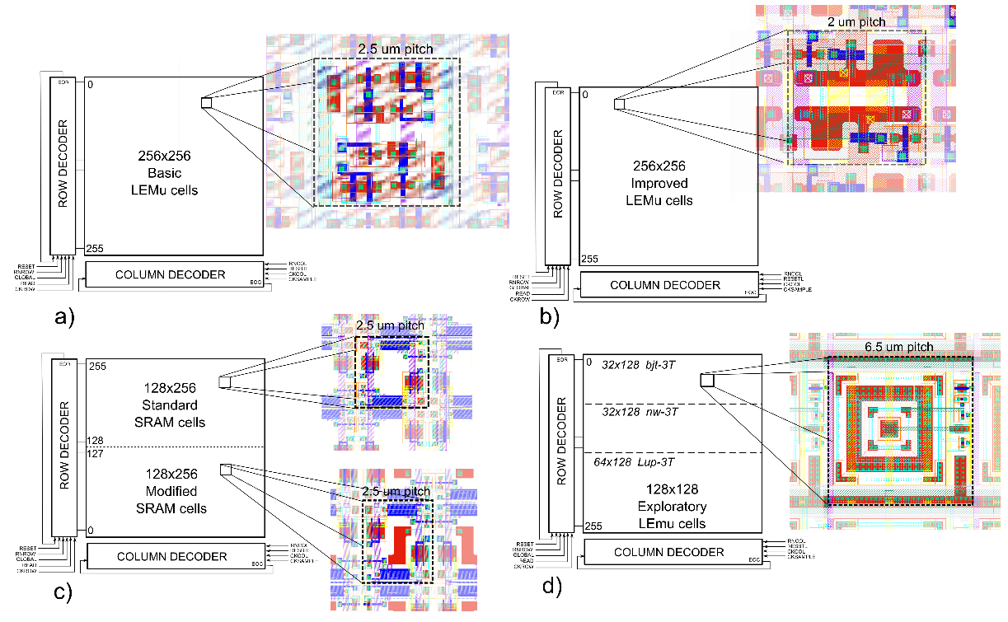
Implementing designs for an MPW UMC 65nm run
Prototype detector with four different arrays: a) 256x256 basic 8T; b) 256x256 improved 4T type; c) 128x128 standard and 128x128 modified SRAM; d) 128x128 exploratory.

Slide 12
Results: pulsed laser (410 nm) injection in LEmu
Response to laser with 10 pulses for each integration time (>DV ~ 100mV).
Response of the sensor to two and a single laser pulse (DV ~ 100mV).

Slide 13
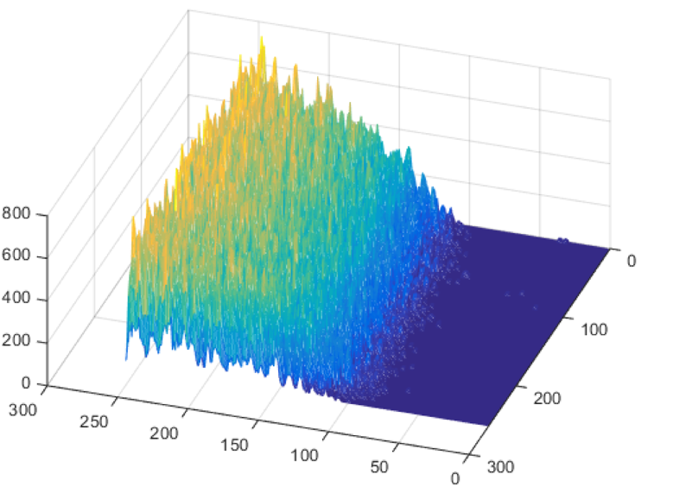
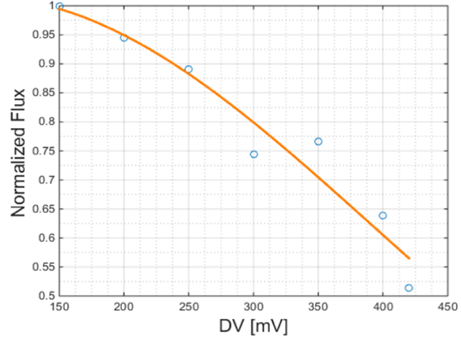
Results: alpha particles (²⁴¹Am) injection
a)
b)
Lemu response to alpha particles: A metallic shield is interposed between the source and the detector in order to cover about half of the surface to the radiation.
Variation of the detected flux of particles as a function of DV.

Slide 14

FUNDING

Slide 15
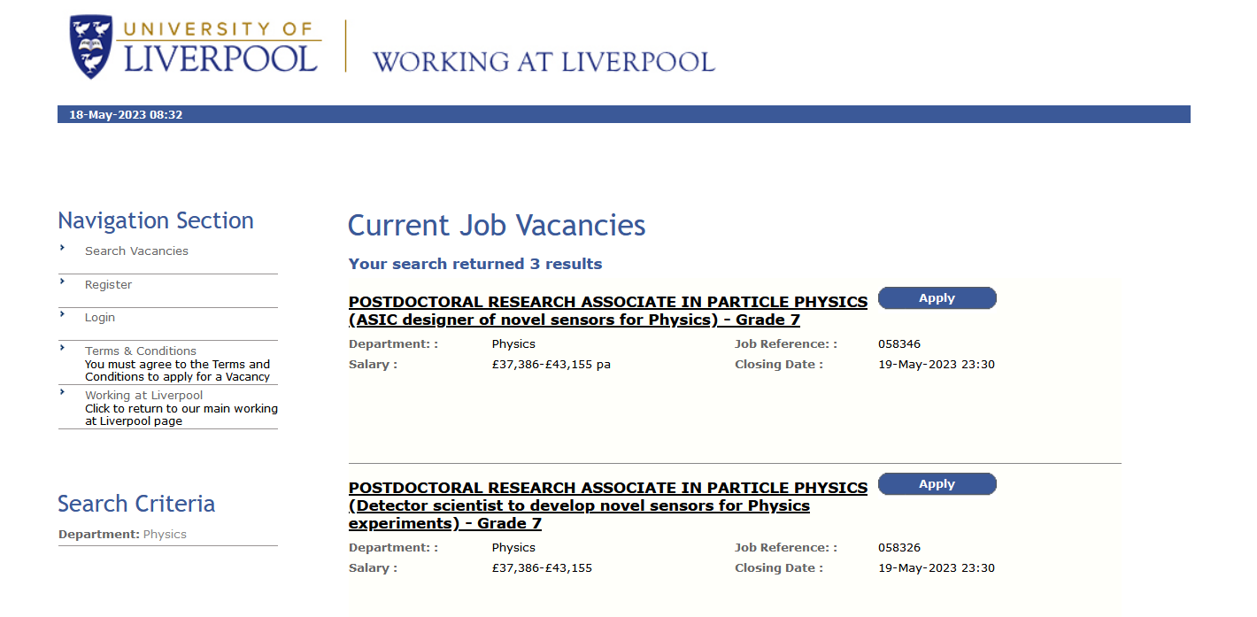


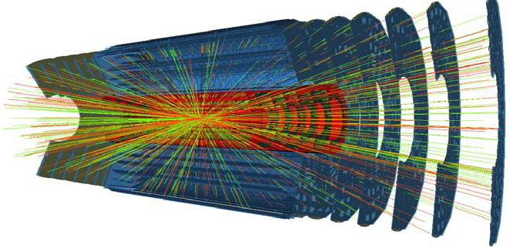
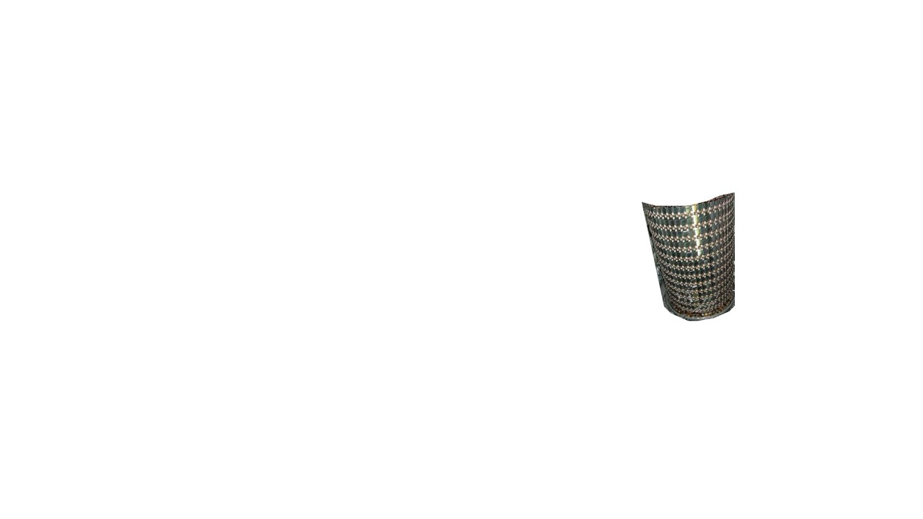
Current ATLAS silicon tracker
Also one PhD position for developing fast readout architectures for very large pixel arrays and systems.
1.1 m
5.5 m

