Slide 1
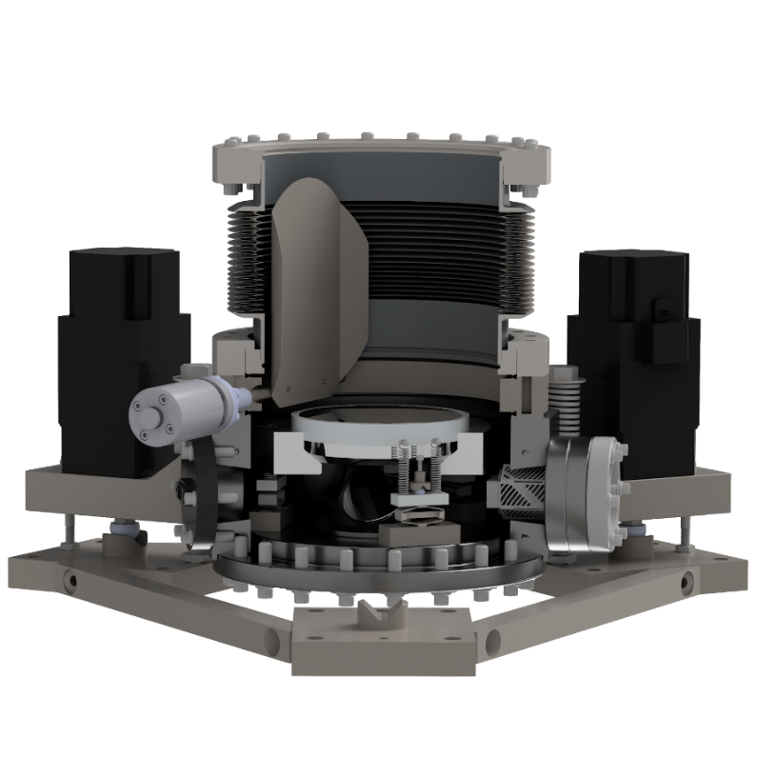
Atom Interferometry: MAGIS & AION @ Liverpool Progress

Slide 2
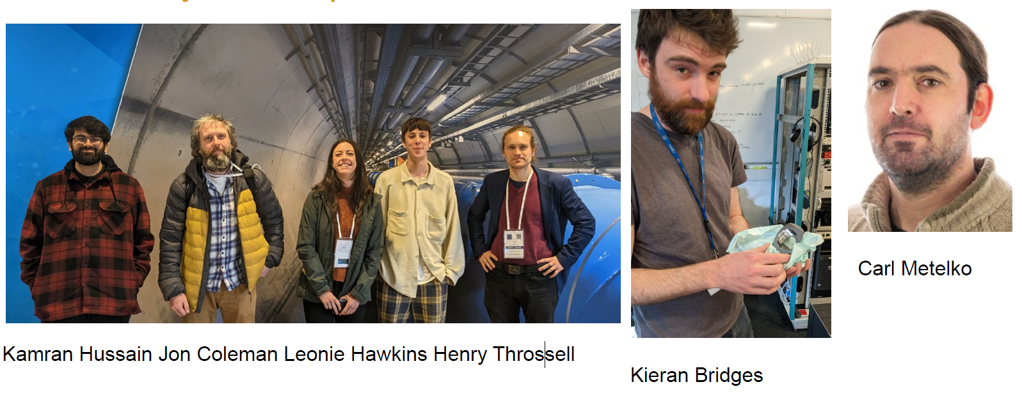
University of Liverpool Team
Sam Hindley

Slide 3
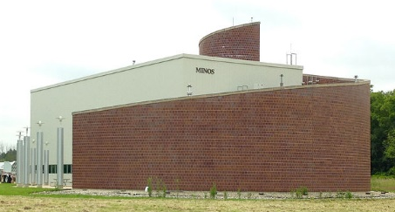
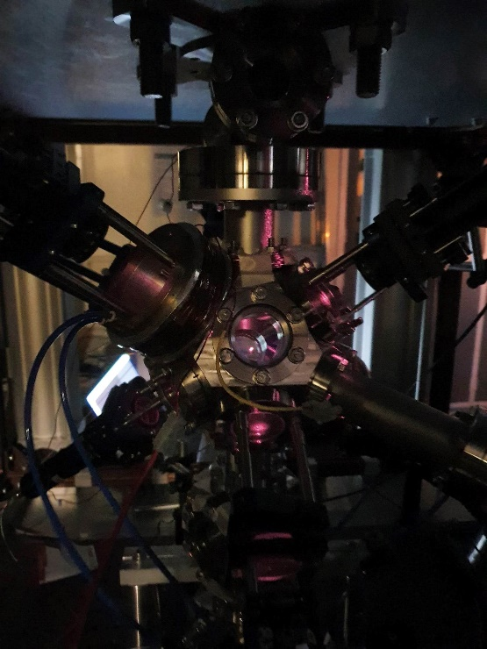
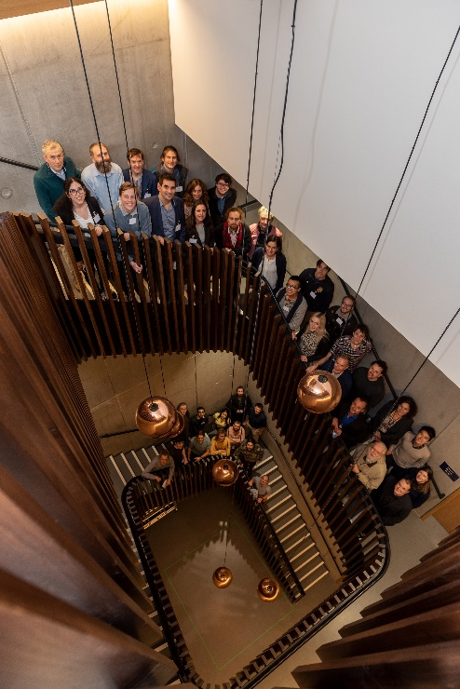
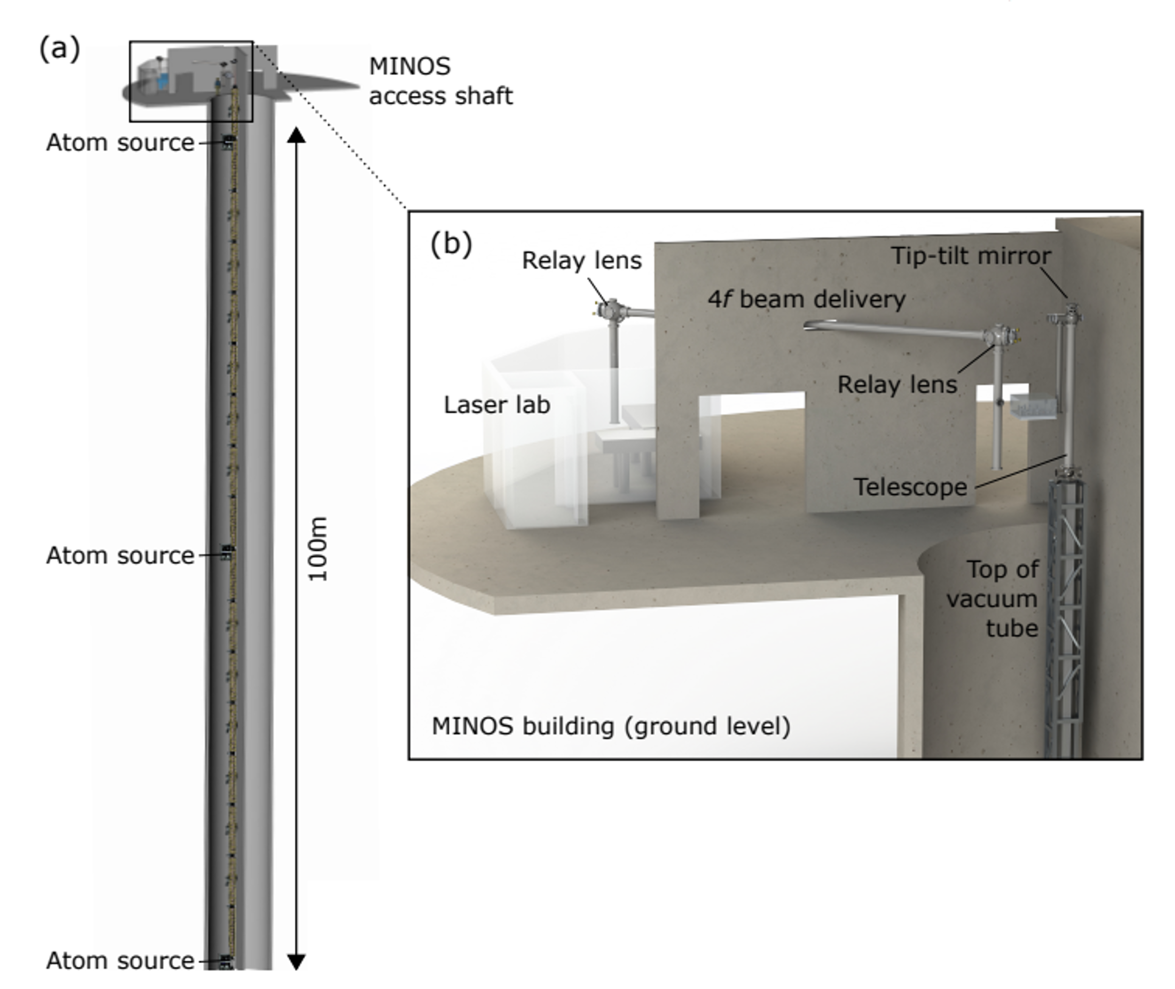
Atom Interferometry at University of Liverpool
Liverpool
(poster of Leonie Hawkins)
AION
MAGIS

Slide 4
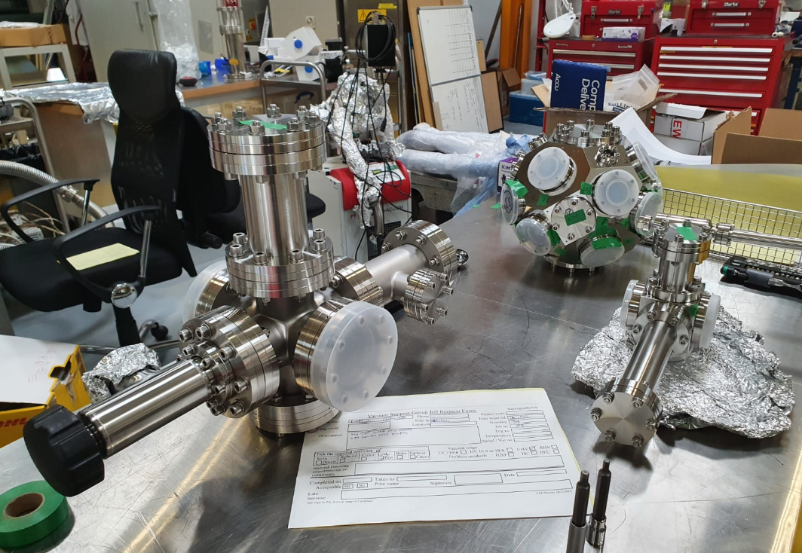
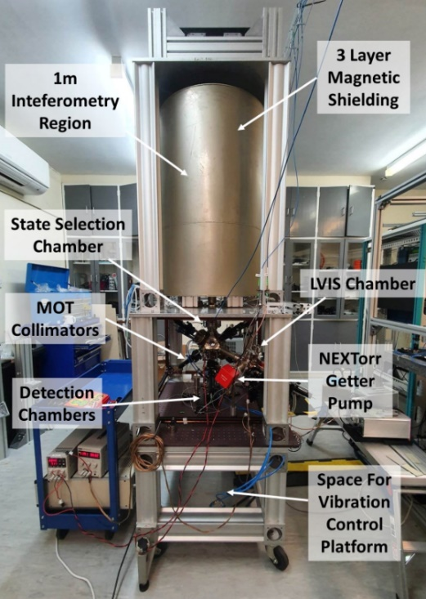
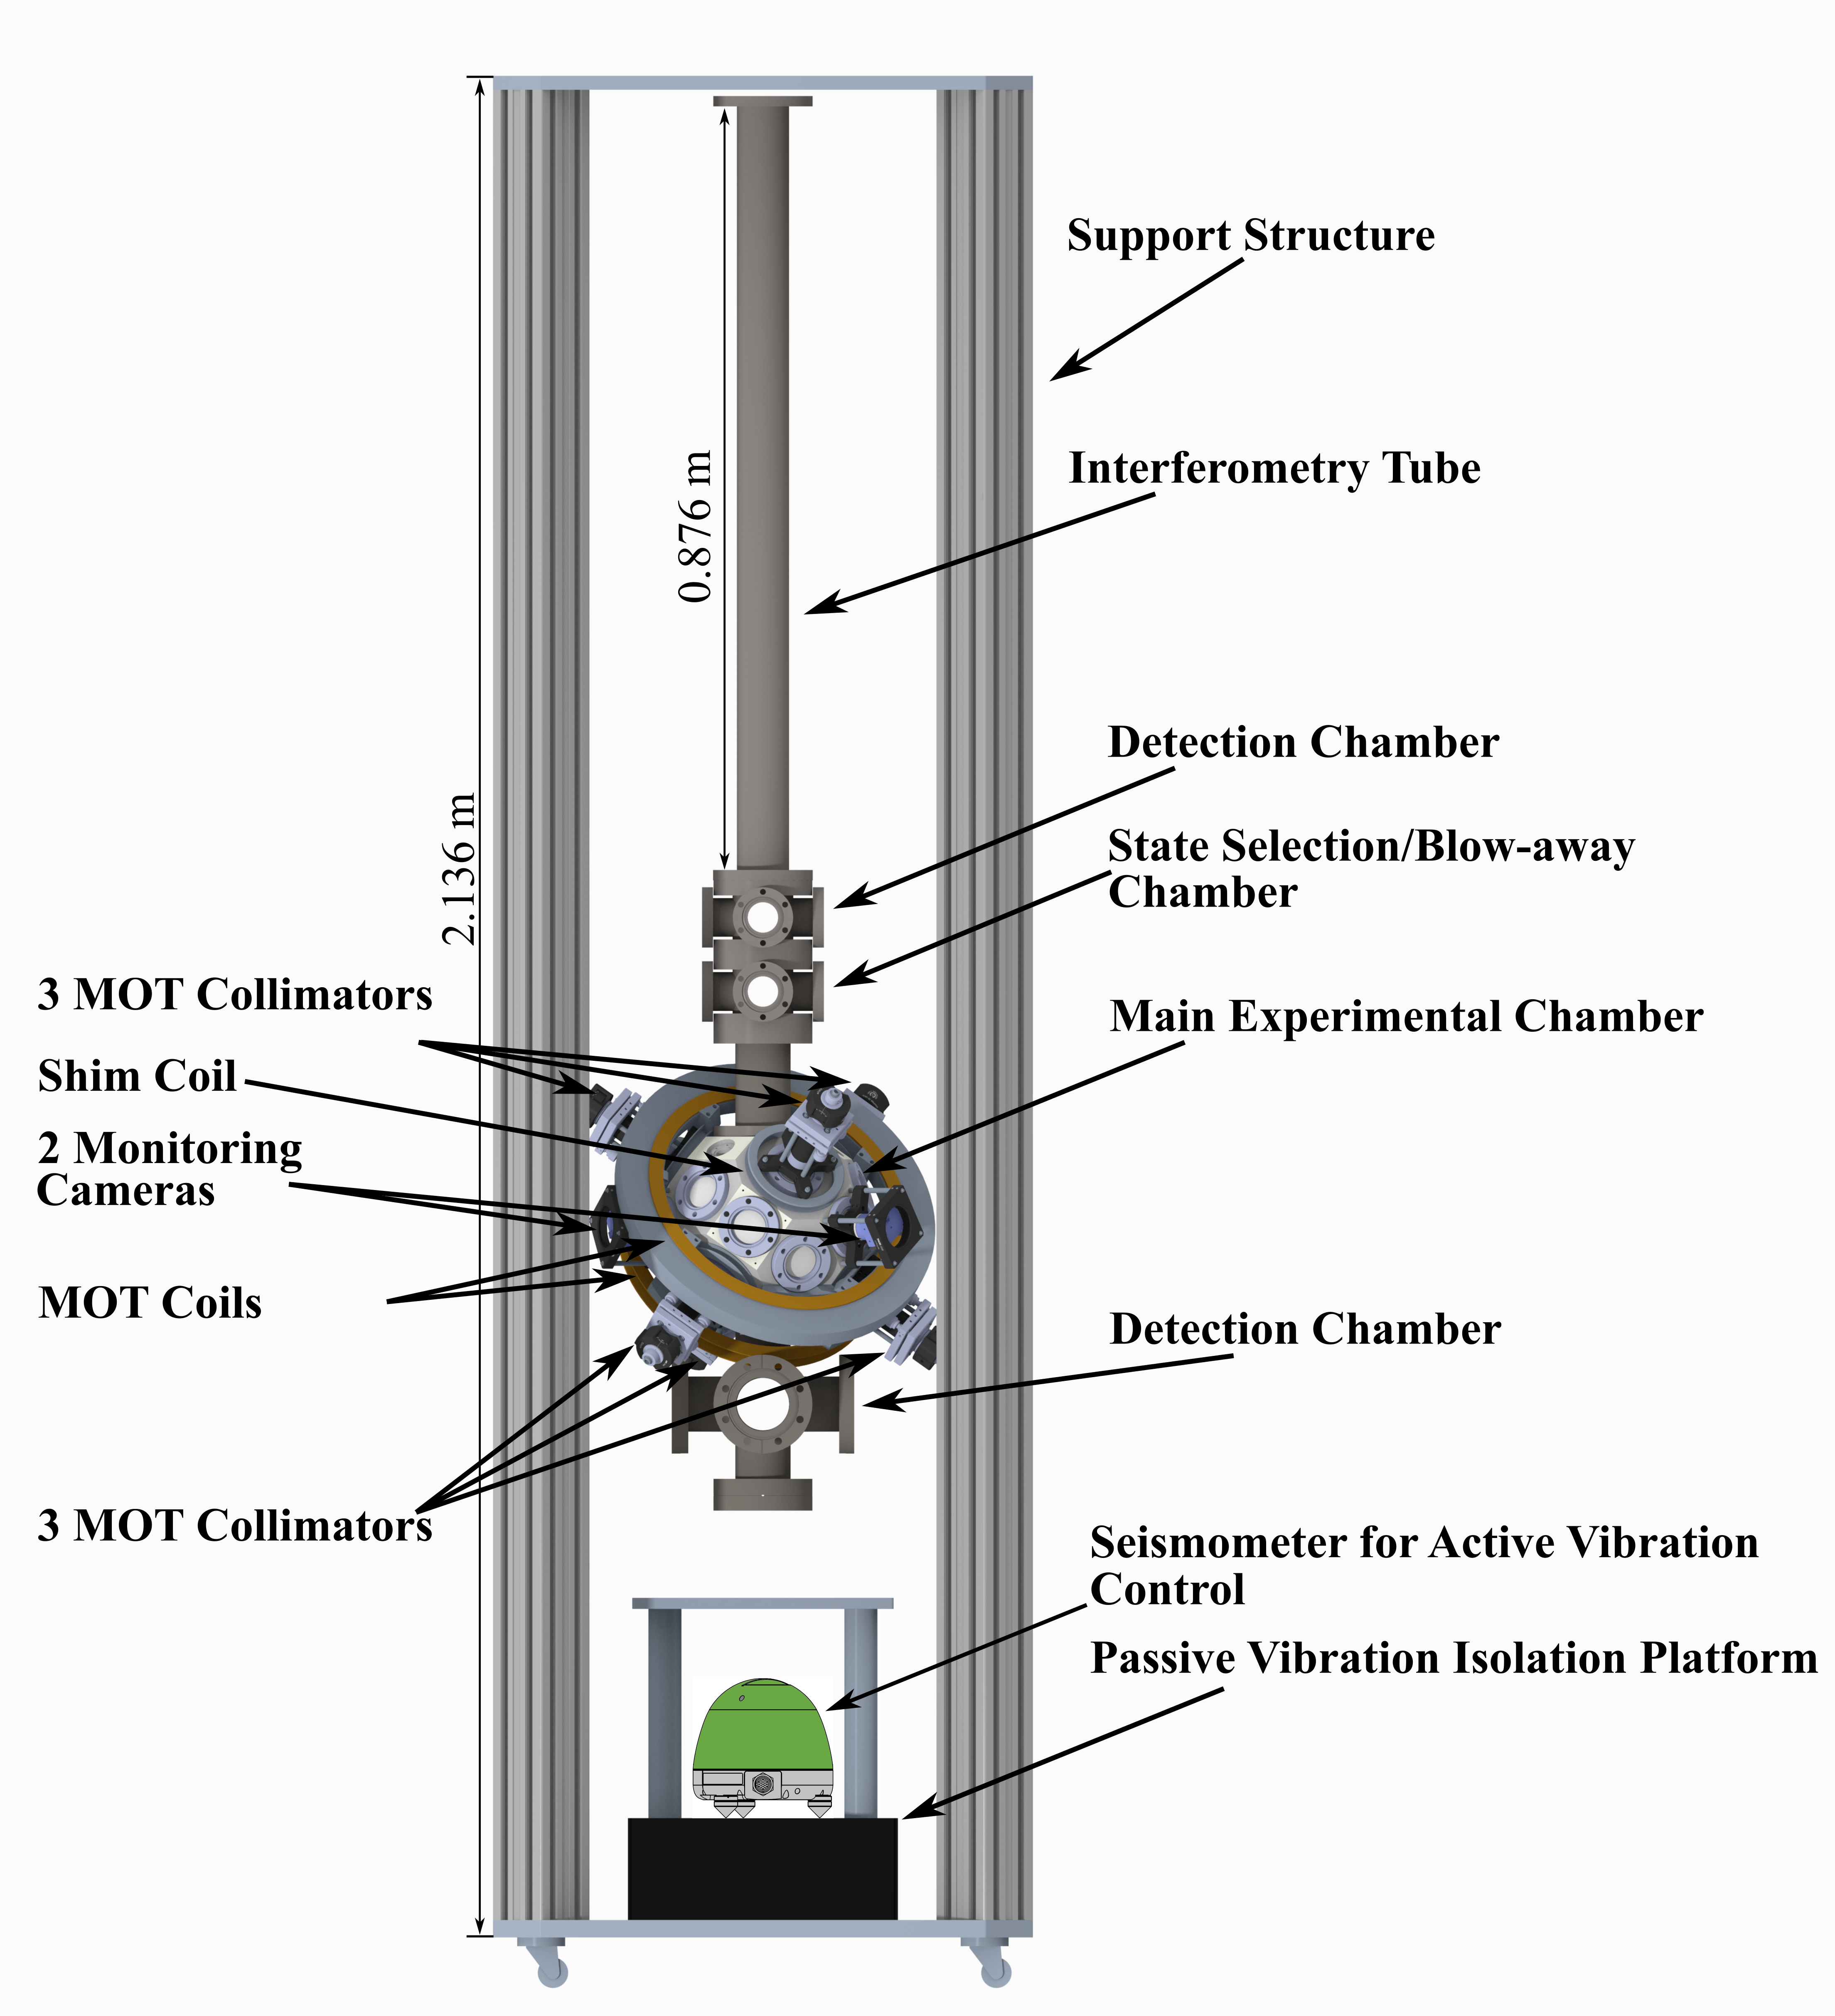
Atom Interferometry at Liverpool
~1m experiment
Old system is being de-commissioned
Two new chambers acquired
One from NPL
One being built in-house
Upgraded the laser system
Allows atom launch
Increased power and frequency control of interferometry beams
2D and 3D MOTs recently achieved!
See Leonie Hawkins poster
New chamber being assembled in Daresbury
NPL chamber in Liverpool

Slide 5
MAGIS-100: DM & GW detector prototype at Fermilab
Matter wave Atomic Gradiometer Interferometric Sensor
100-meter baseline atom interferometry in existing shaft at Fermilab
The construction at Fermilab delayed to 2025
10m prototype under construction in Stanford University
Finalising & prototyping the 100m designs
3 atom sources to realize a gradiometer
Intermediate step to full-scale (km) detector for gravitational waves
Probes for ultralight scalar dark matter beyond current limits
https://iopscience.iop.org/article/10.1088/2058-9565/abf719
Notes:
MAGIS = Matter wave Atomic Gradiometer Interferometric Sensor
Add photo of area….
John Hopkins Logo, STFC, DOE, Kavli

Slide 6
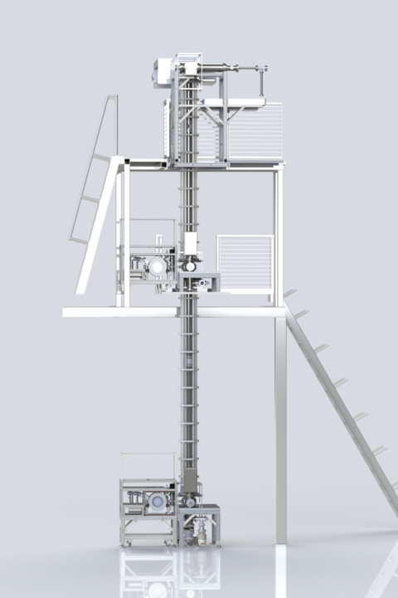
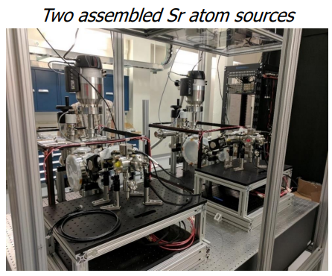
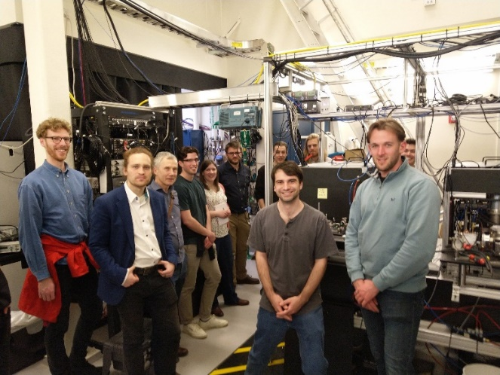
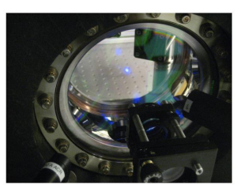
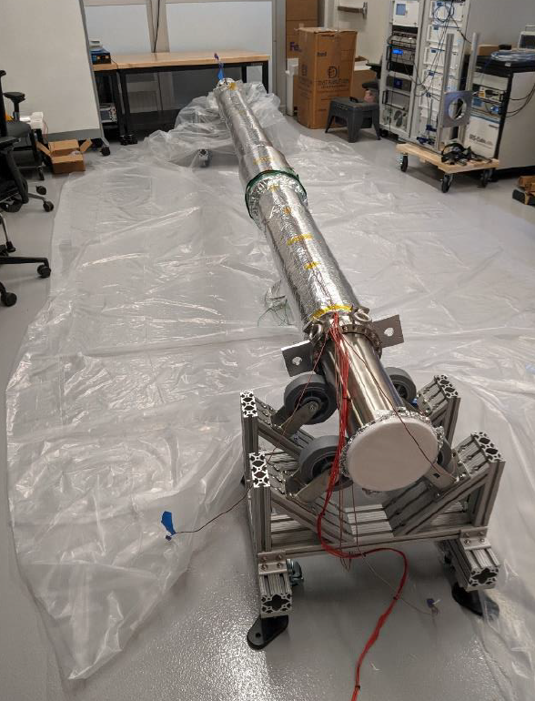
Stanford Prototype MAGIS-10
https://hoganlab.stanford.edu/research/strontium-gradiometer

Slide 7
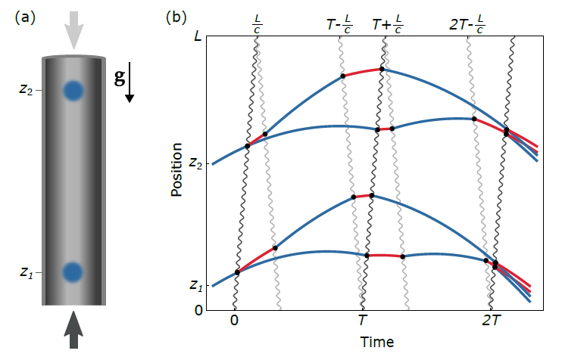
Atom Interferometry & Gradiometry
Two identical atom interferometers are run simultaneously using the same laser sources
Signals is a differential measurement
Enables the cancellation of noise common to both interferometers
Measured phase difference is proportional to the gradient of the local gravitational force
Notes:
Signals is a differential measurement that enables the cancellation of noise common to both interferometers

Slide 8
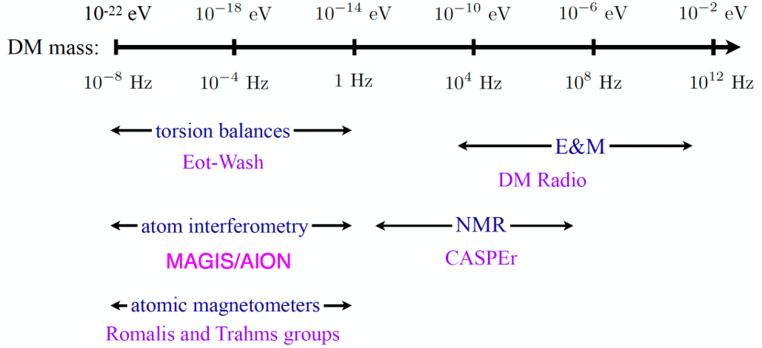
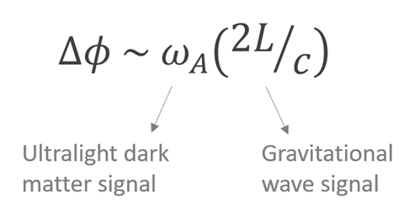
Searches for Light Dark Matter
The ultra-light dark matter acts as a classical field
Many detection techniques, e.g. atom interferometers
DM coupling causes time-varying atomic energy levels:
DM induced oscillation
Dark matter coupling
Time

Slide 9
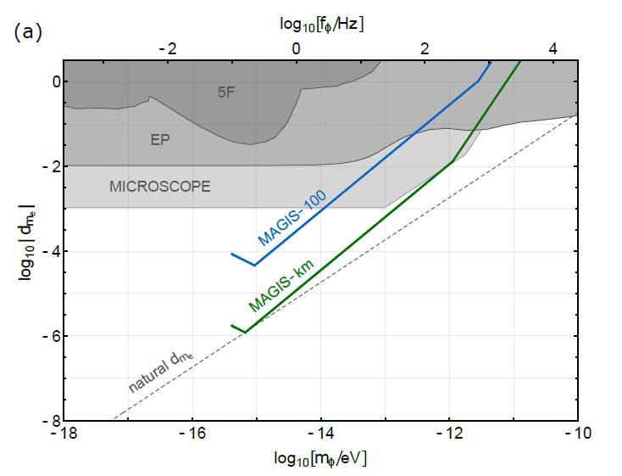
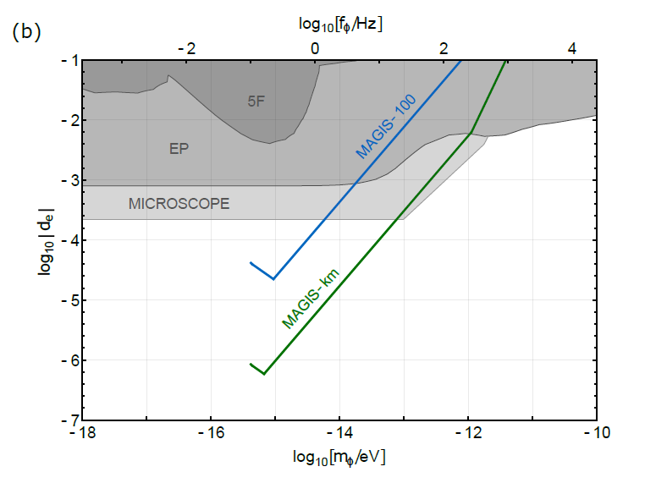
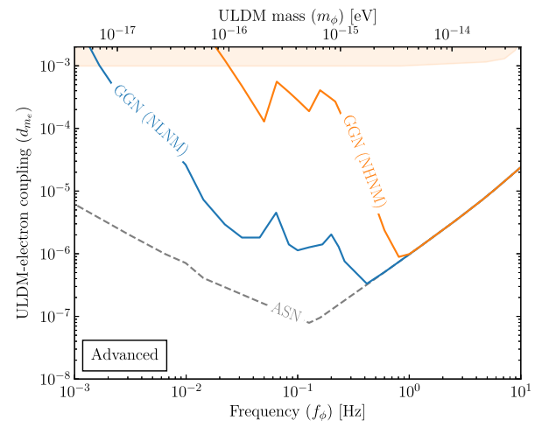
Projected Sensitivity to Dark Matter
1 year of data taking in scalar DM configuration
Assuming atom shot-noise limited phase resolution
Gravity gradient noise (GGN) not included – mass density fluctuations
The updated sensitivity curves including GGN
Phys. Rev. D 107, 055002, 2023
Sensitivity to ultralight scalar dark matter coupled via electron mass a) and fine structure constant b) [Mahiro Abe et al 2021 Quantum Sci. Technol. 6 044003, 2021]
Notes:
The projected reach of these experiments is ultimately limited by fundamental noise sources. Vertical gradiometers such as AION and MAGIS-100 are designed to reach the atom shot-noise limit above ∼1 Hz but would suffer from gravity gradient noise (GGN) at lower frequencies. This type of phase noise arises as a result of mass density fluctuations of the ground and atmosphere, which perturb the local gravitational potential around the atom clouds. In the absence of a well-modeled GGN signal for vertical atom interferometers, previous projections were either abruptly interrupted at ∼0.3 Hz , or arbitrarily extended to lower frequencies by assuming atom shot noise only . [https://journals.aps.org/prd/pdf/10.1103/PhysRevD.107.055002]

Slide 10
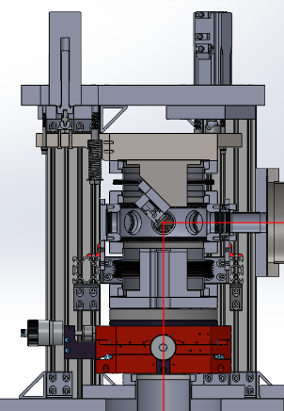
Liverpool deliverables in AION & MAGIS
Design & manufacturing:
In-vacuum optics mounts – almost finished
Big thanks to Liverpool Detector Development Manufacturing Facility & K. Bridges
Top tip-tilt platform – in queue
Phase shear detection system – manufacturing
Retro-reflection chamber & its control
Two control loops are being developed, see H. Throssell & K. Hussain talks
Sourcing in-vacuum interferometry optics
Ordered & being manufactured at Optimax

Slide 11
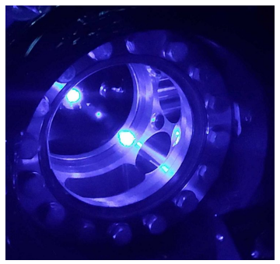
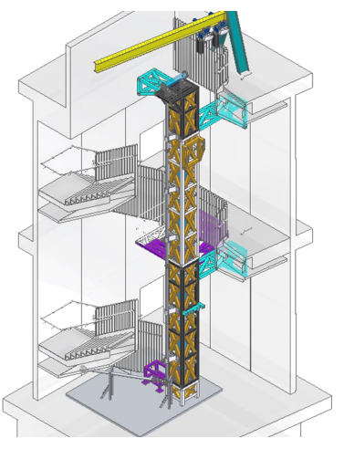
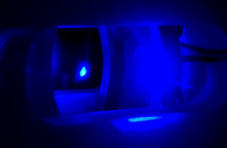
Atom Interferometer Observatory & Network
5 new Sr labs established
5x atom sources/interferometers
Commissioning phase
AION-10 planned construction at Beecroft building, Oxford
Preliminary design review passed
Location of AION-100 Boulby
Network with MAGIS for improved sensitivity to DM & GWs
3D MOT @ Birmingham
3D MOT @ Imperial
Notes:
100m baseline – MINOS access shaft – LARGE NOT LARGEST
Sensitivity proportional to interrogation time
3 interferometers, 3 Sr atom sources
Differential measurements
Networking with AION in UK

Slide 12
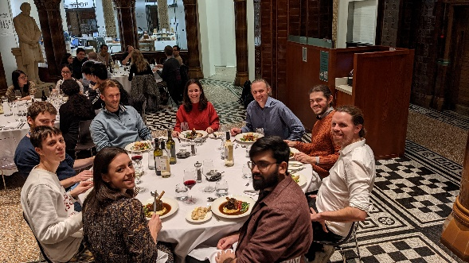
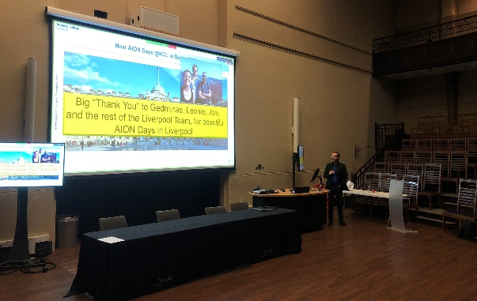
AION Days at Liverpool
Liverpool hosted AION Days in November 2022
2 day event
50 collaborators attended in person
Talks given by core MAGIS team as well

Slide 13
Summary - Deliverables
Retro-reflection phase-shear platform manufacturing is ongoing
PZT cabling design approved
UHV testing done
Prototyping PZT control in-progress
Manufacturing of parts is expected on schedule
Lattice launch mounts shipped (98%)
Most parts of retro-chamber finished (80%)
The design of Top Tip-Tilt platform is completed
Equipment has been specified, ordered & shipped
Manufacturing starting soon of mirror mount and chamber starts in summer
Sourcing in-vacuum interferometry optics completed

Slide 14
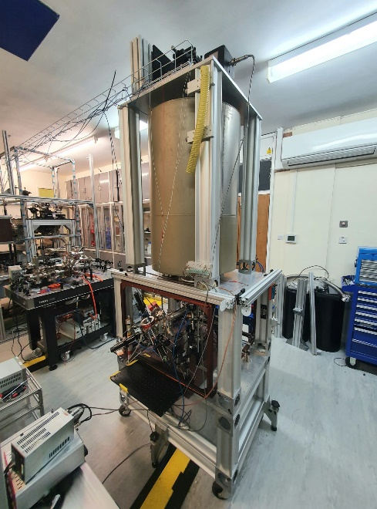
Summary – Key moments
University of Liverpool hosted AION Days
Kamran Hussain started joint PhD with RAL and Liverpool
Going to RAL this summer
Sam Hindley submitted first MAGIS-UK thesis
University of Liverpool laboratory acquired an experimental chamber from NPL
Rb 3D MOT established
New chamber being assembled at Daresbury

Slide 15
Backup

Slide 16
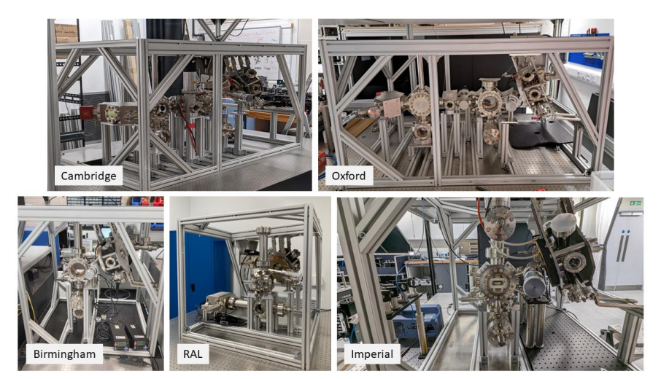
AION Sidearms

Slide 17
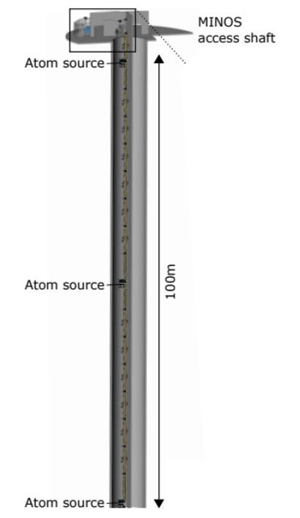
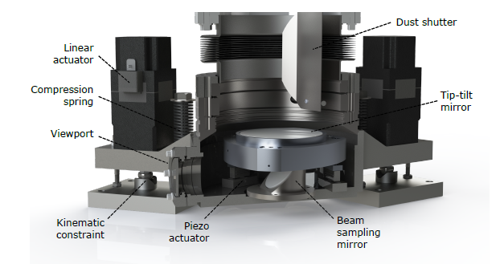
Retro-reflection Phase-shear Platform
UHV chamber housing retro-reflection mirror
Mirror needs precise control for
Phase-shear imaging
Interferometry beam monitoring and alignment
Coriolis corrections
Designed in collaboration with the University of Liverpool, Stanford, Northwestern Universities and Fermilab
AION plans to use the platform too

Slide 20
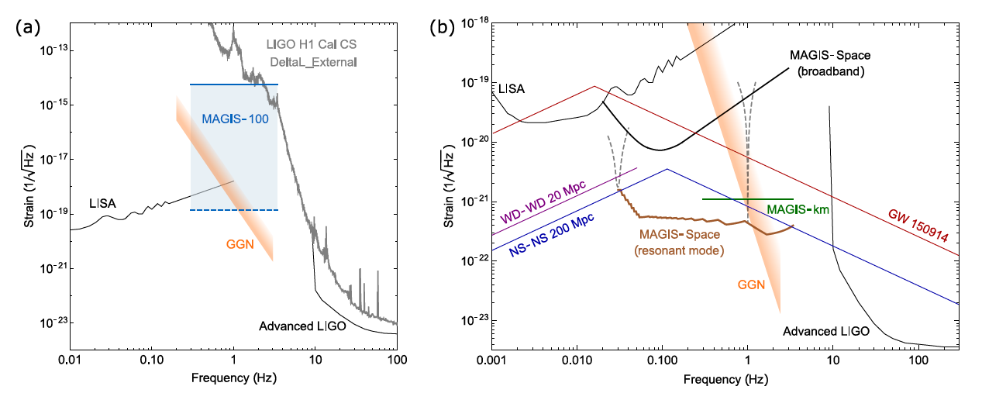
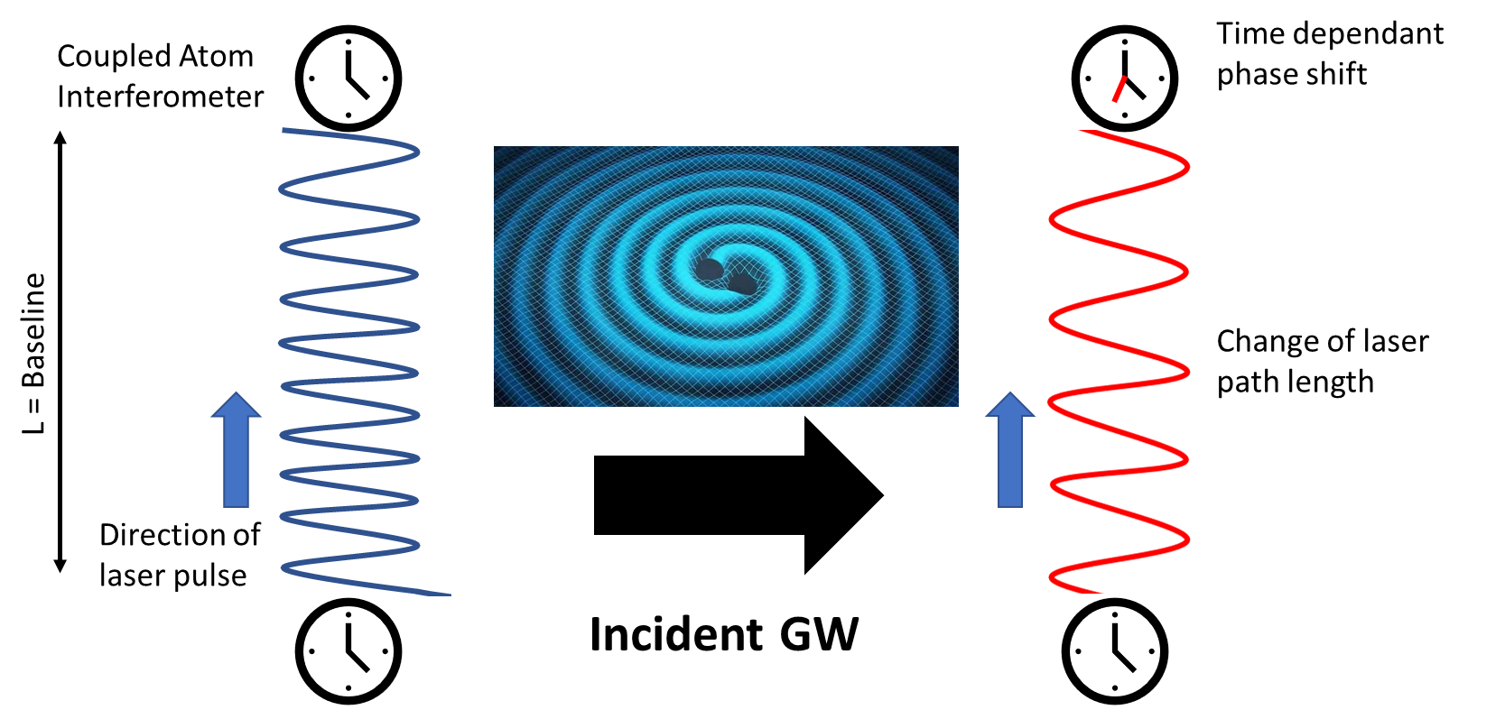
Testbed for GW sensor
Recent discovery of 150 solar mass black hole merger by LIGO is encouraging as heavier mergers would occur in the mid-band frequency range.
Notes:
As a technology demonstrator, MAGIS-100 is not expected to be sufficiently sensitive to detect known candidate sources of gravitational waves. Nevertheless, within its frequency range it aims to achieve a record sensitivity, improving on the current bounds.
Additionally, the recent discovery by LIGO of a binary black hole merger with a total mass of 150 solar masses motivates further studies of intermediate mass black holes. Earlier observations of such binaries at lower frequencies (including mid-band frequencies) would provide valuable astrophysical insight. Moreover, even heavier black holes than the LIGO observation, hundreds of solar masses and above, would merge in the mid-band. Therefore, this would be the ideal band to discover such black holes, if they exist.

