Slide 1
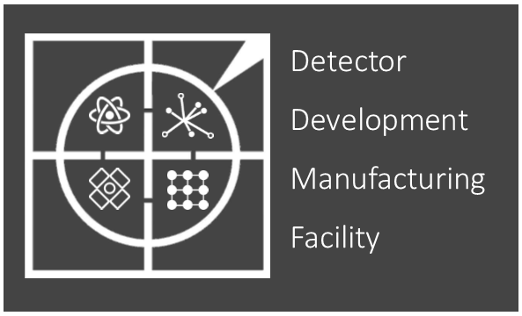
2022-23 Review
Mark Whitley

Slide 2
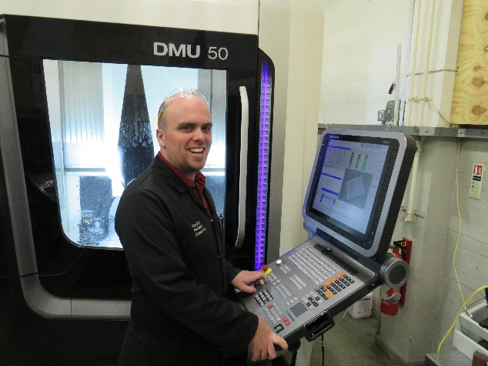
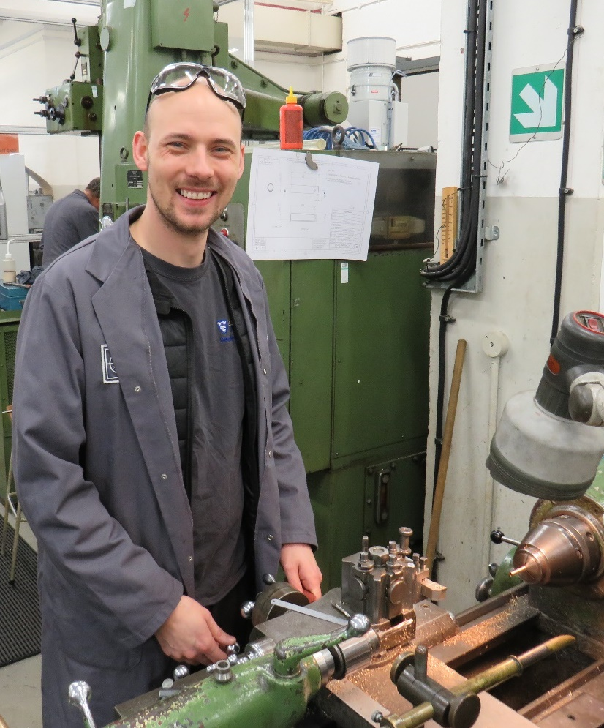
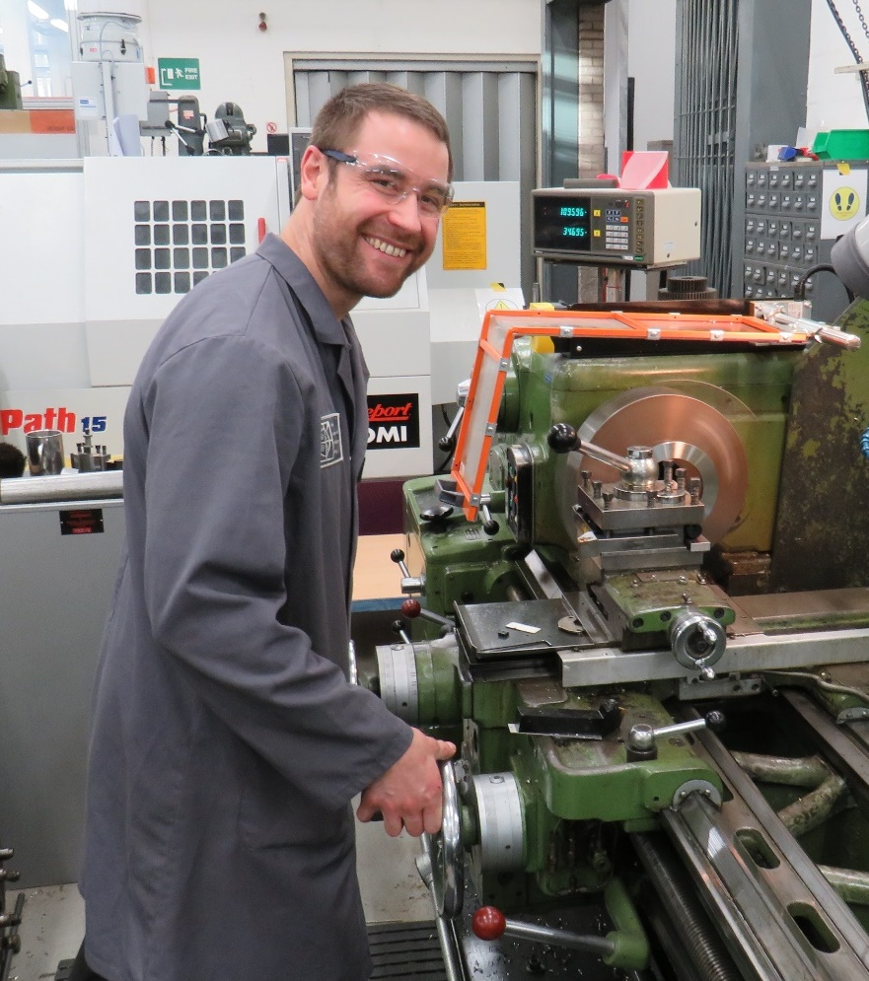
Comings and Goings
Farewell to Mark Farrell
Mark has now moved on to work for Manchester University working on the DUNE project based at Daresbury.
Welcome to
Tom Gibbs and Luke Marshall
Both joined us in July and have fitted in really well, they have both been producing some excellent parts for our project groups.
Tom
Luke
Notes:
8
These are parts for the Atlas half cylinders. Although they look quite simple they are in fact had very tightly tolerances. 25µm on thickness with 50µm on parallelism. Thankfully Dan has been very careful in his procedures and has achieved this well.

Slide 3
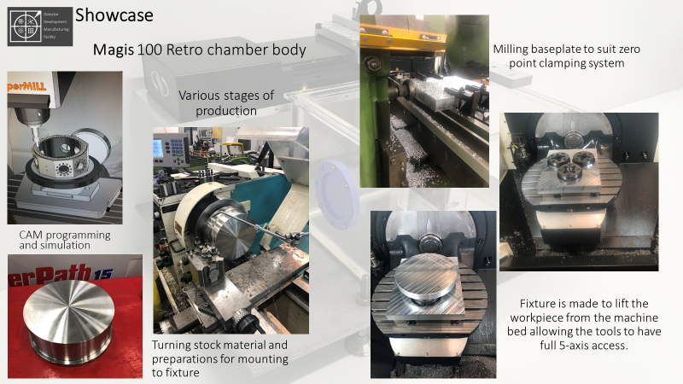
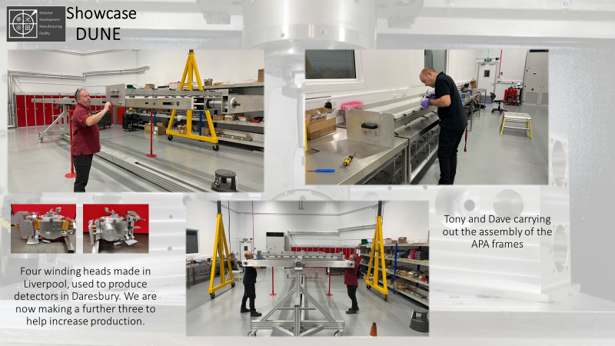
Notes:
3
This shows more components required from various projects.

Slide 4
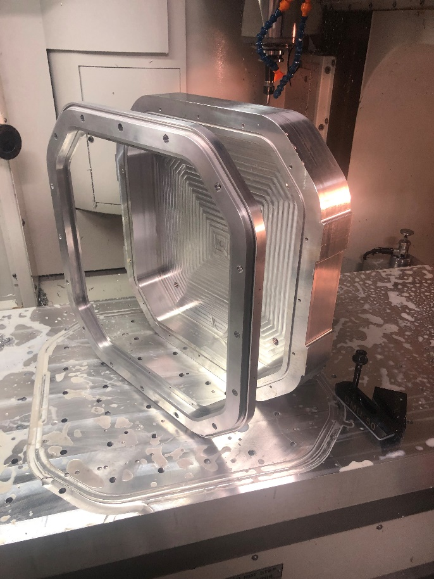
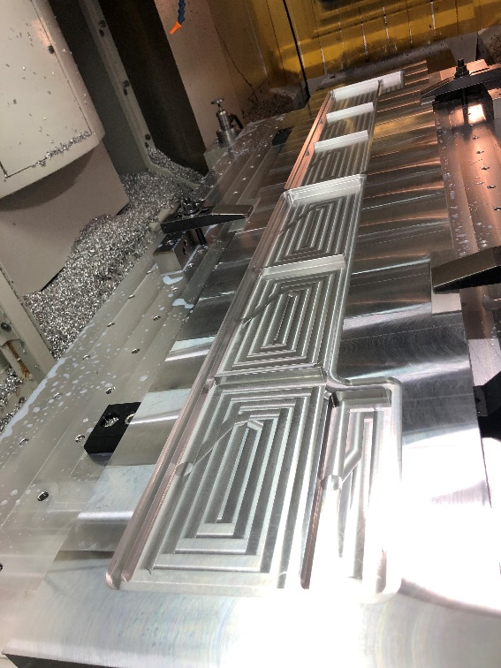
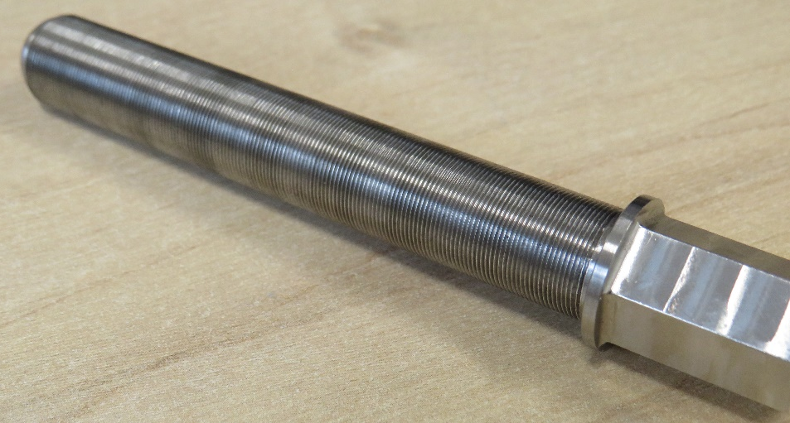
Showcase
Notes:
15

Slide 5
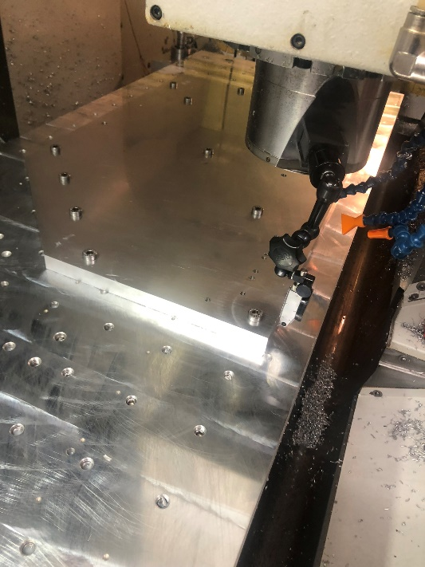
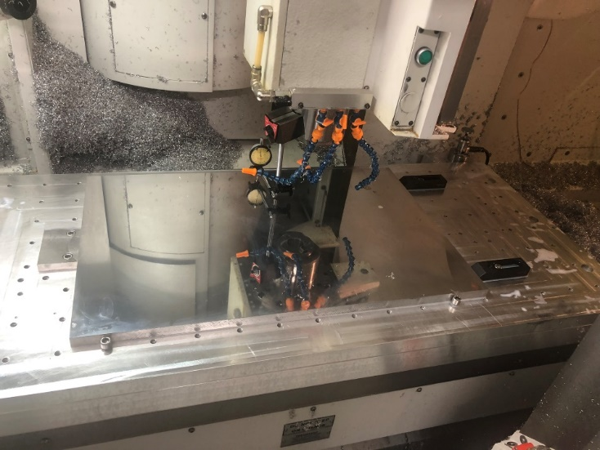
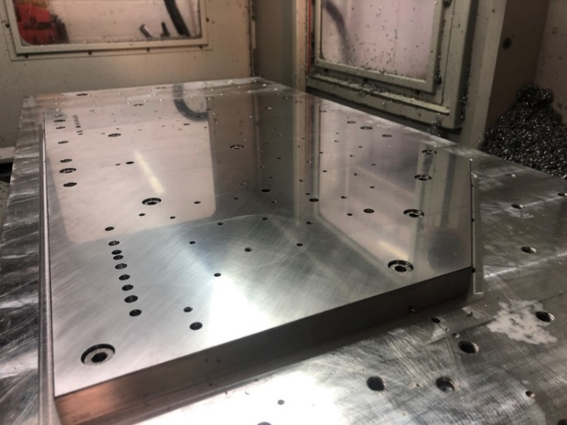
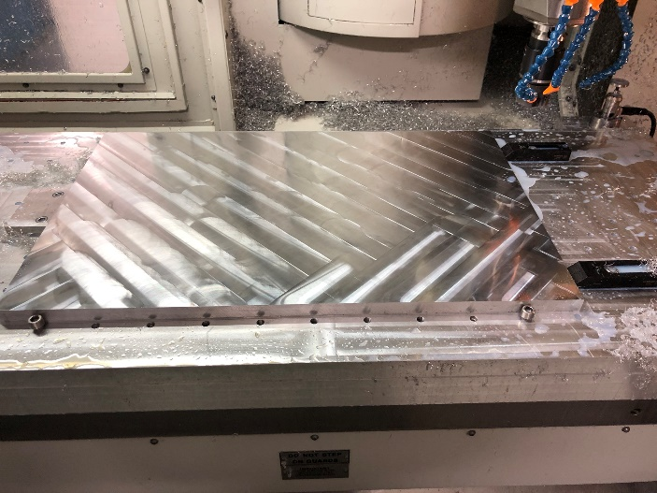
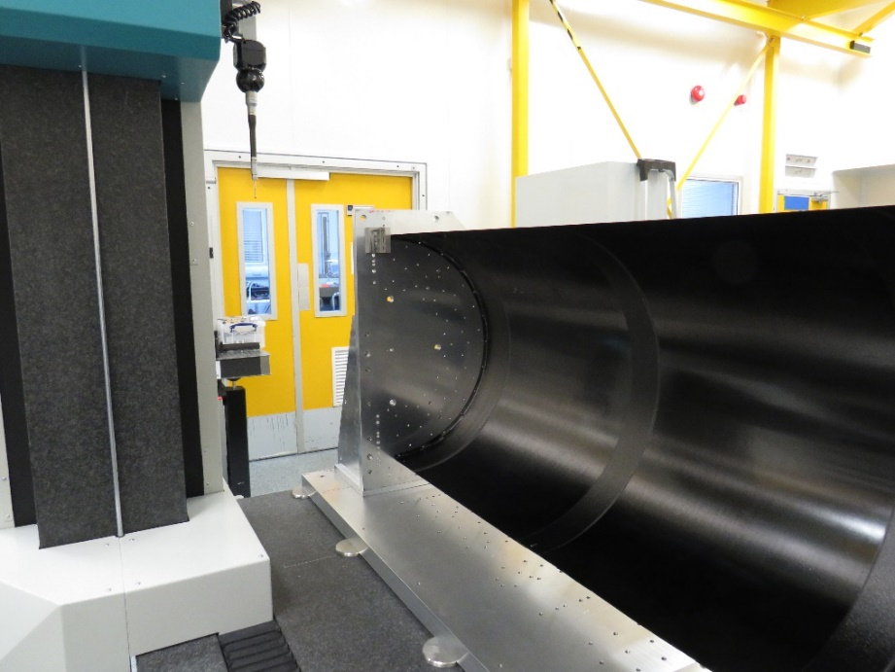
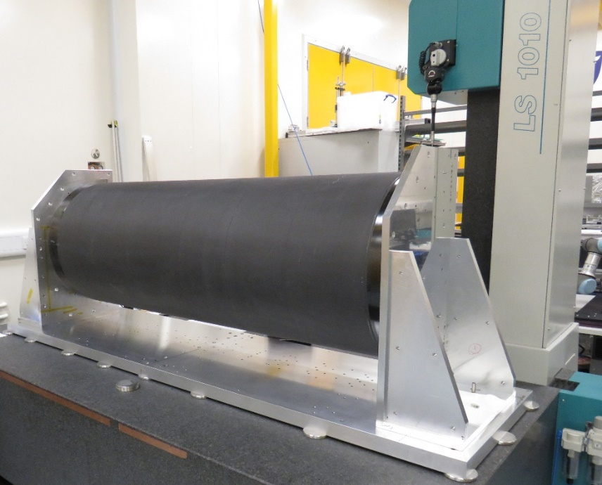
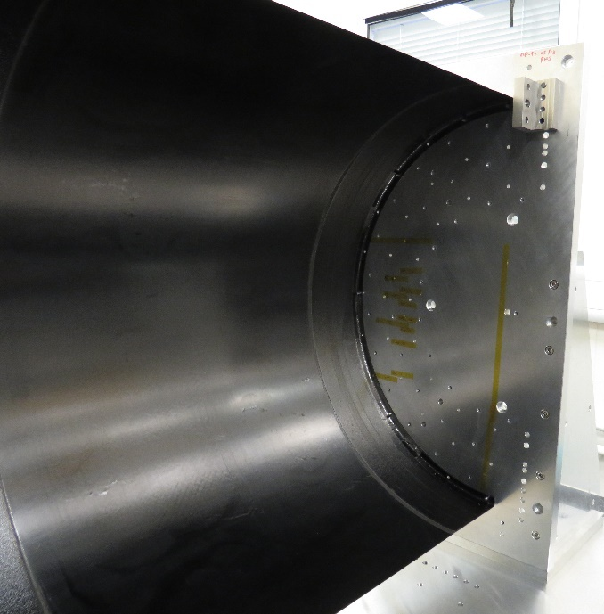
Showcase
Parts for Atlas half cylinder assembly
Atlas
Above parts being manufactured with thickness
tolerance of ± 25µm and parallel to 50µm.
Below same parts assembled in the cleanroom holding a half cylinder
Notes:
8
These are parts for the Atlas half cylinders. Although they look quite simple they are in fact had very tightly tolerances. 25µm on thickness with 50µm on parallelism. Thankfully Dan has been very careful in his procedures and has achieved this well.

Slide 6
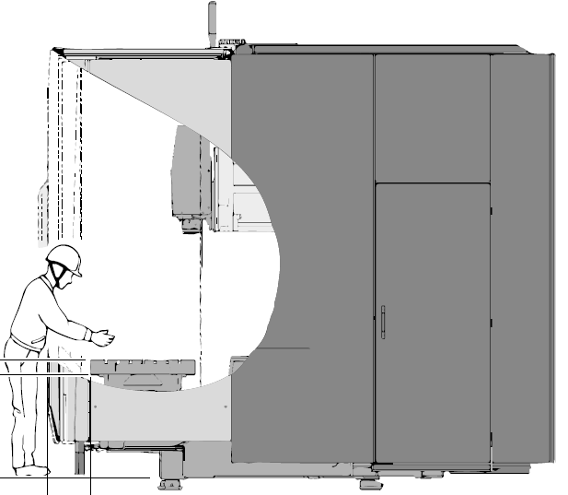
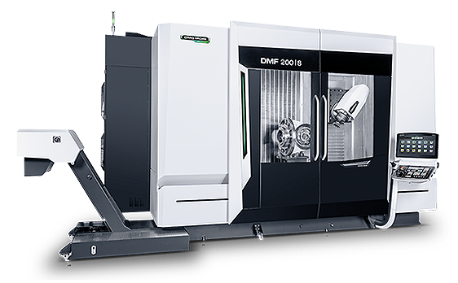
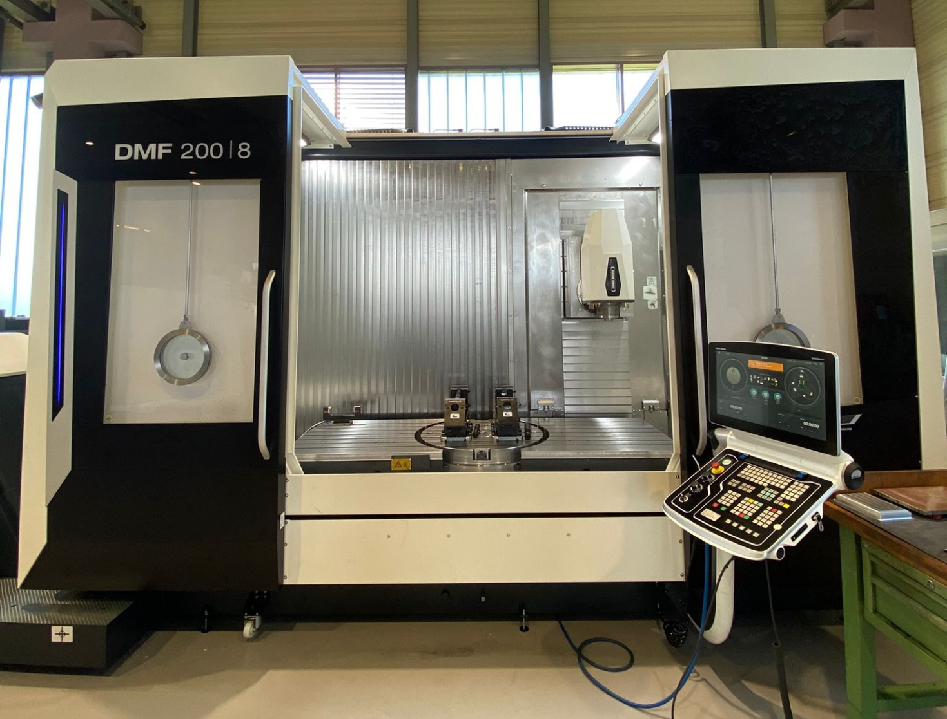
New equipment
We were fortunate in the last round of Capital Investment. We have looked at many different options for a large 5-axis milling machine and decided that the DMG Mori 200/8 was the best machine that we could afford. This will replace some older equipment that that has come to the end of serviceable life.
The DMF200/8 is a big machine, it has a footprint of 8 metres by 5 metres and 3.2 metres tall. It has a machining envelope of X2000 Y800 Z 850 and will take a 2000kg load. It has a 800mm rotary table which will be able to rotate a part up to 1000mm diameter weighing 800kg. The machine weighs ~19000kg it sits on 12 pads that need to be able to withstand up to 40kN under dynamic loading, this means that we can only position it in one area of our machine shop. This will mean that we need to knock a few walls down.
Space has always been a real issue for us. Now more than ever we need to expand. We have been looking at how best to relocate equipment to enable a more efficient working environment.
Notes:
10
We have been incredibly fortunate in receiving funding for a new large area milling machine. We are only able to position a machine of this size in one place within our machine shop, this means that walls need moving in the coming year and many if not all of our machines will need to be repositioned. This will cause considerable disruption, we will endeavour to keep at least one lathe and milling machine operational during this period and we ask for your patients.

Slide 7
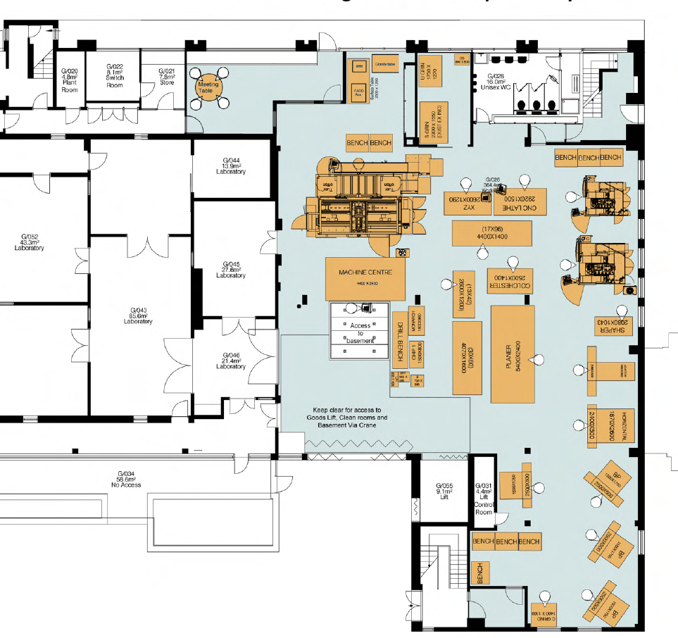
Refurbishment Ground Floor
New floor layout to improve our working space and accommodate machinery.
We will also be brining our area up to date with building regulations creating new fire breaks and a new emergency exit out on to the volleyball court.
We will have a new safe dedicated reception area so we can easily meet and talk without the need to enter the machining area.
We are also having a completely new electrical system along with new lighting, heating and painting of the floors and walls.
Work is due to start 5th June
Notes:
8
These are parts for the Atlas half cylinders. Although they look quite simple they are in fact had very tightly tolerances. 25µm on thickness with 50µm on parallelism. Thankfully Dan has been very careful in his procedures and has achieved this well.

Slide 8
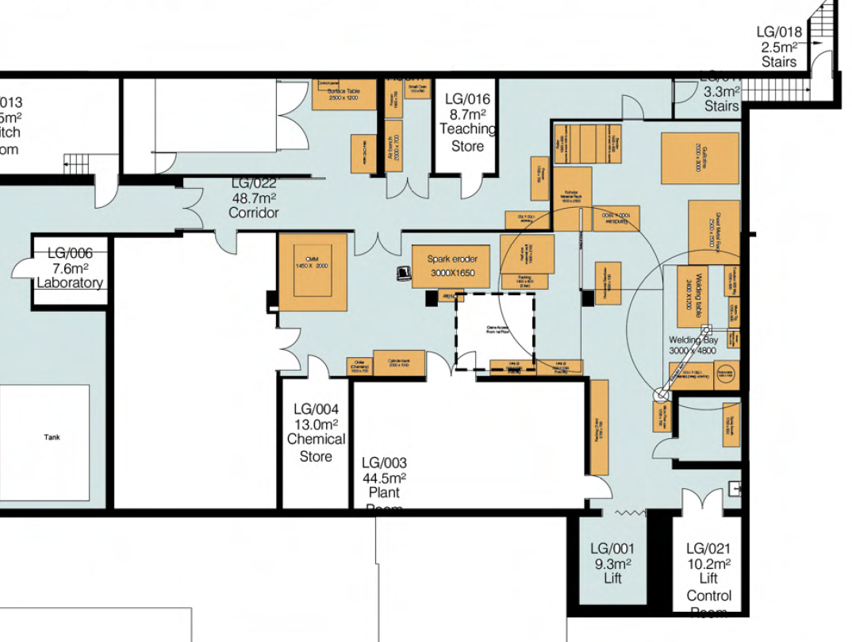
Refurbishment Basement
We are also renovating our basement this is mainly due to the fact that we need space!
We are moving our welding equipment downstairs creating a dedicated welding area.
We are bringing down our wire eroder and possibly the smaller CMM.
We have also lent some of our space to Ariadne/Darkside so they can set up their new abrasive CNC machine
We found extra space for the AML
Due to these improvements we are having a new fire safe corridor and new fire compartmentation of the staircase
New lighting, partial rewire, new extractor for welding and spray booth.
Ariadne/Darkside
AML
AML
AML
Chemistry
Department of
Chemistry
Department
of
Chemistry
Notes:
8
These are parts for the Atlas half cylinders. Although they look quite simple they are in fact had very tightly tolerances. 25µm on thickness with 50µm on parallelism. Thankfully Dan has been very careful in his procedures and has achieved this well.

Slide 9
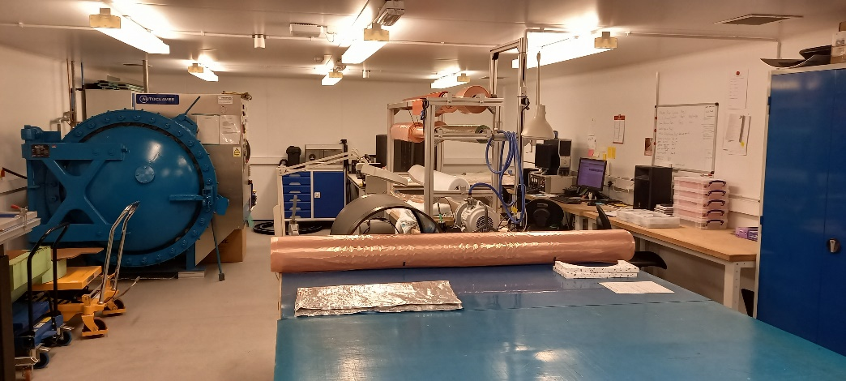
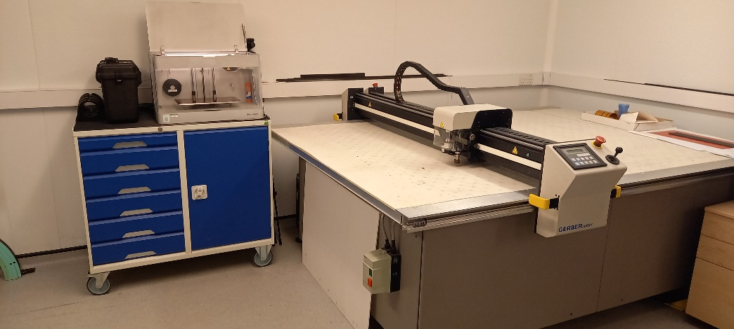
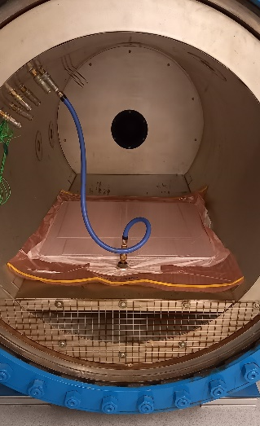
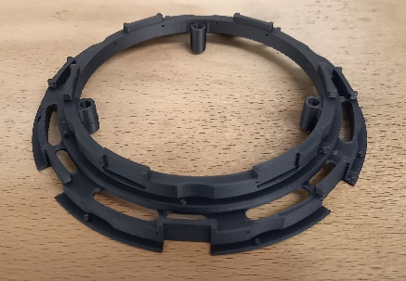
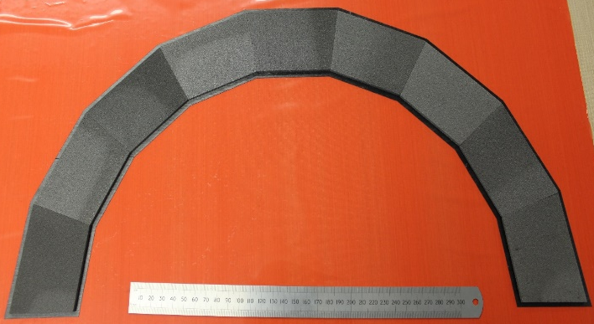
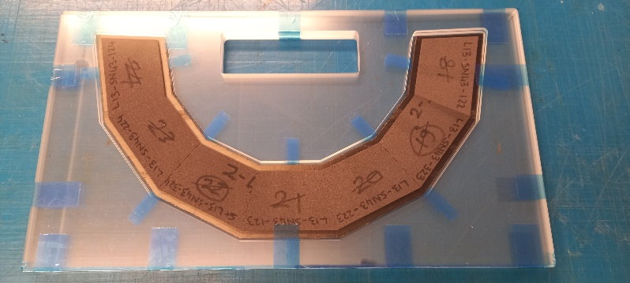
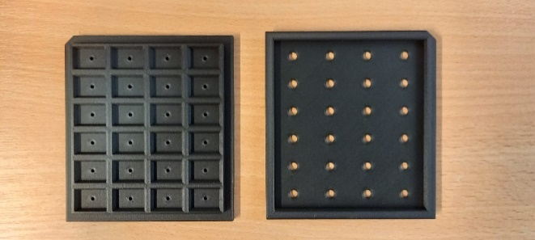
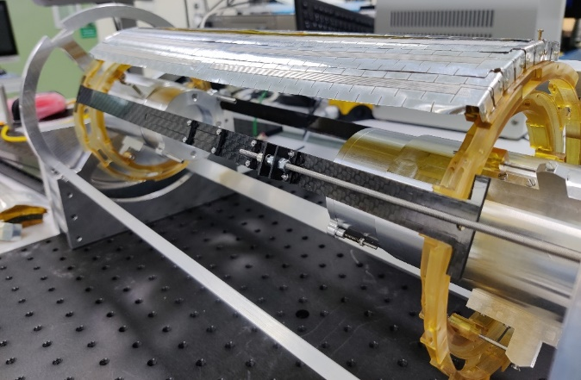
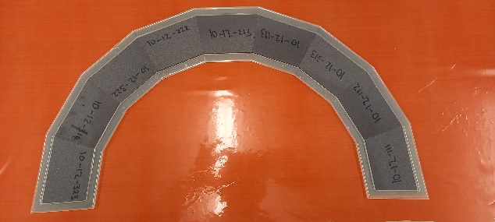
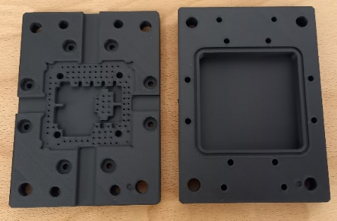
AML
Onyx (Nylon + chopped Carbon fibre) 3D printed parts
Co-curing using carbon foam core structures
Notes:
10
We have been incredibly fortunate in receiving funding for a new large area milling machine. We are only able to position a machine of this size in one place within our machine shop, this means that walls need moving in the coming year and many if not all of our machines will need to be repositioned. This will cause considerable disruption, we will endeavour to keep at least one lathe and milling machine operational during this period and we ask for your patients.

Slide 10
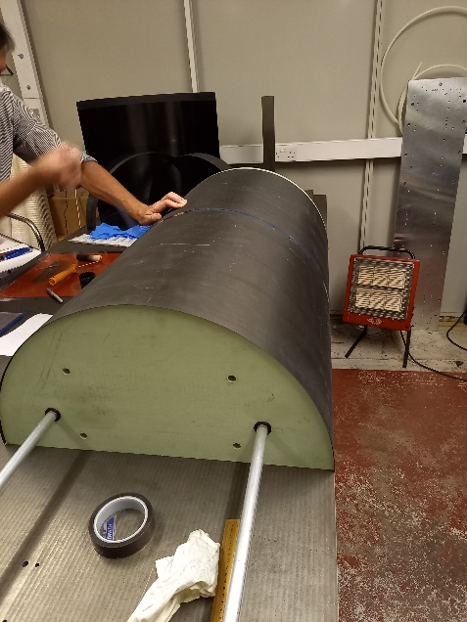
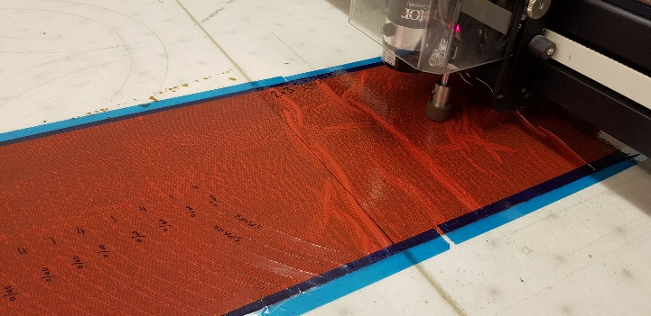
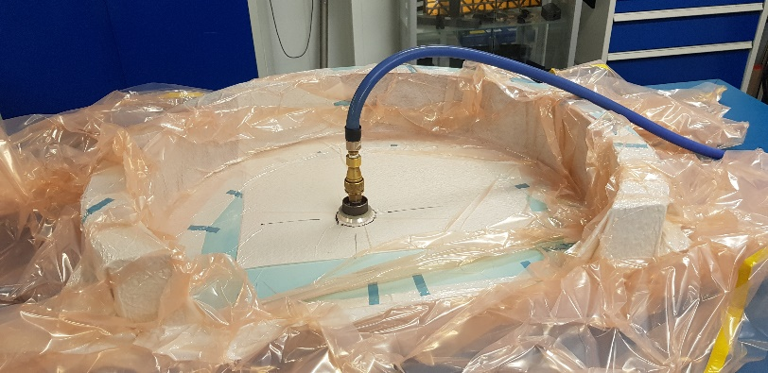
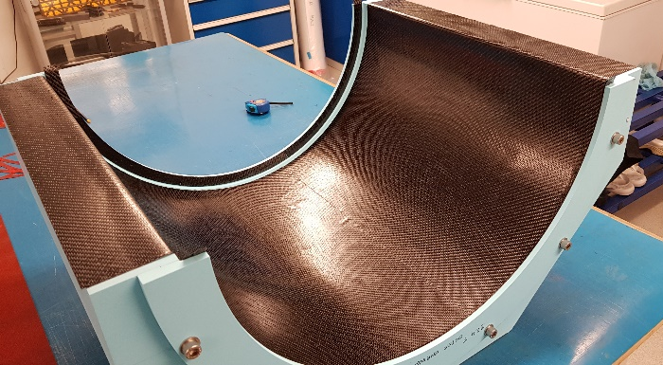
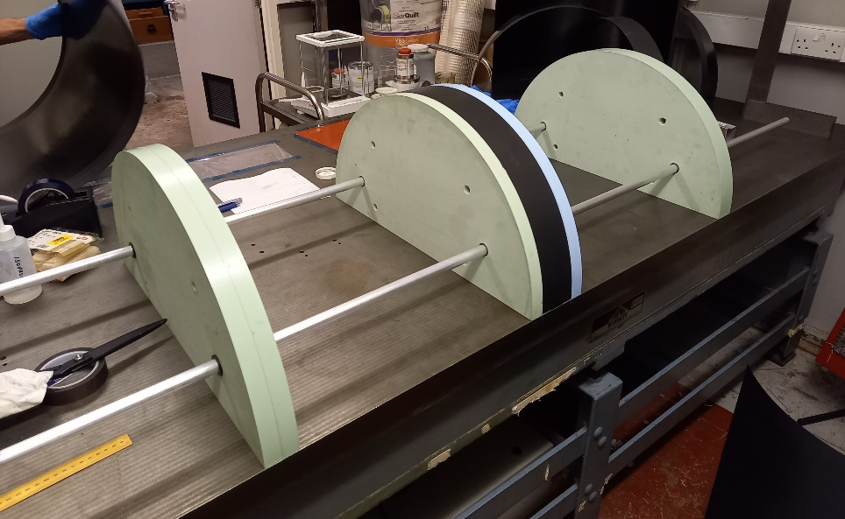
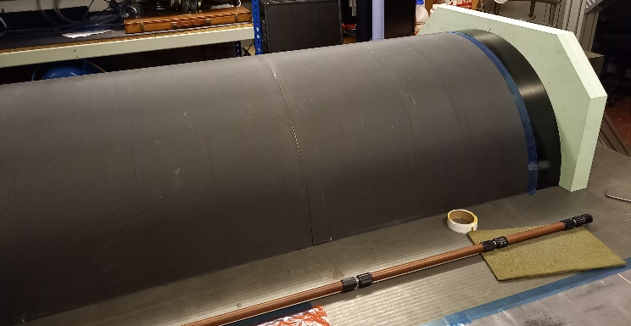
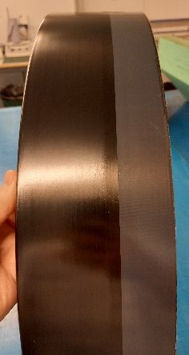
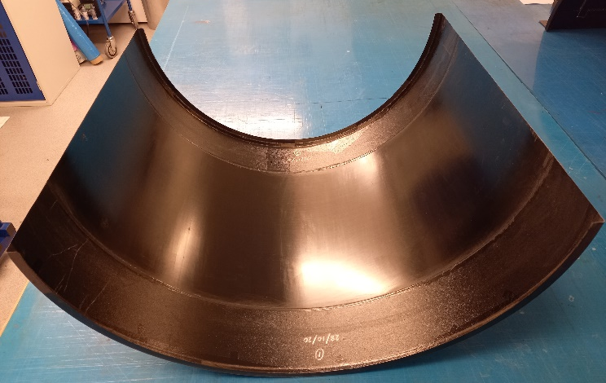
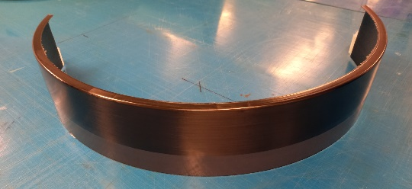
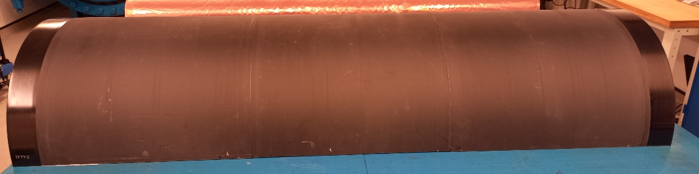
AML
Prototypes for Atlas half cylinders
Notes:
10
We have been incredibly fortunate in receiving funding for a new large area milling machine. We are only able to position a machine of this size in one place within our machine shop, this means that walls need moving in the coming year and many if not all of our machines will need to be repositioned. This will cause considerable disruption, we will endeavour to keep at least one lathe and milling machine operational during this period and we ask for your patients.

Slide 11
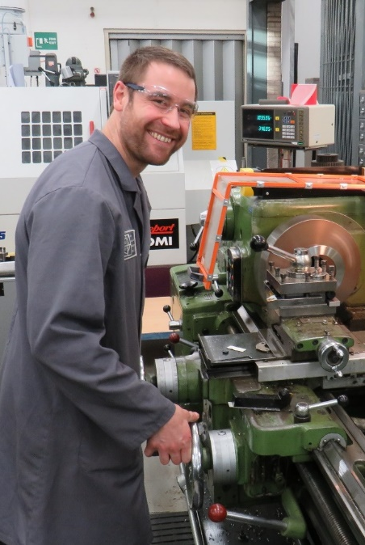
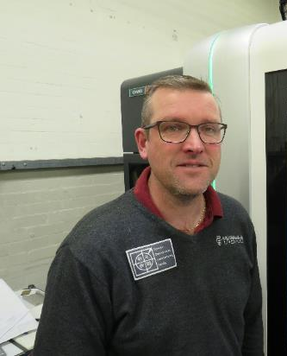
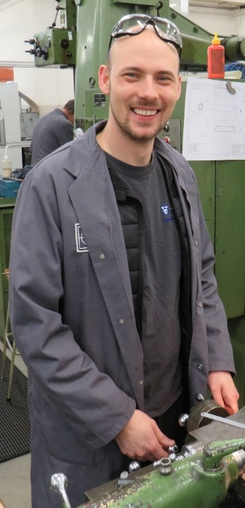
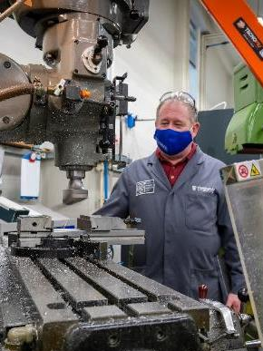
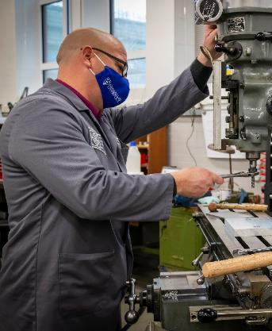
None of this would be possible without…
Daniel Hollywood
Rob Malley
Luke Marshall
Tony Watling
Tom Gibbs
Paul Sinclair
Paul Cook
John Kervin
Emlyn Jones
Kevin McCormick
A massive thank you to them for their excellent effort, help and support throughout what has been another challenging year
Notes:
14
Obviously, none of this is possible without all these people. I would like to give a really big thank you to all of them. So, Thank you.

Slide 12
That’s all folks
thanks for listening
Notes:
15

