Slide 1
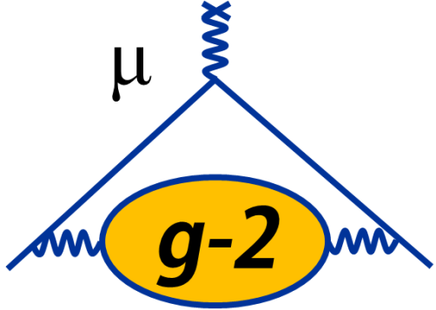
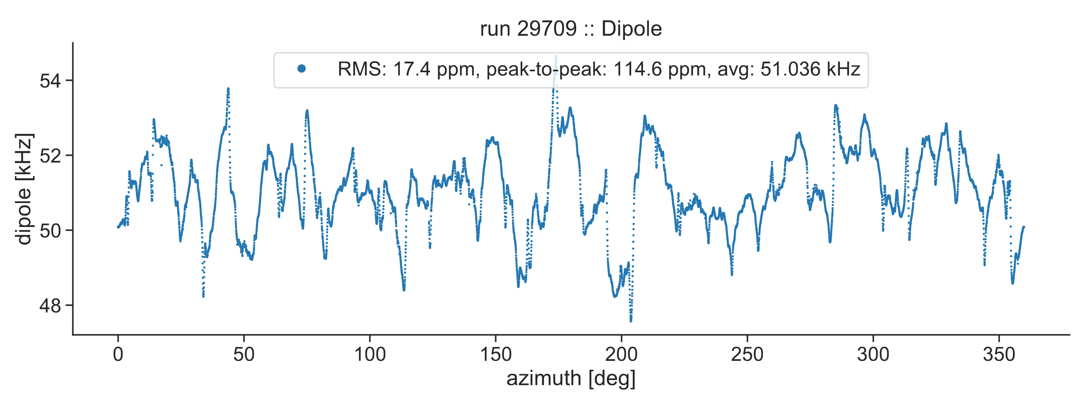
News from g-2 ω_{p} and mu2e
Saskia Charity
Liverpool Annual Meeting
19 May 2023

Slide 2
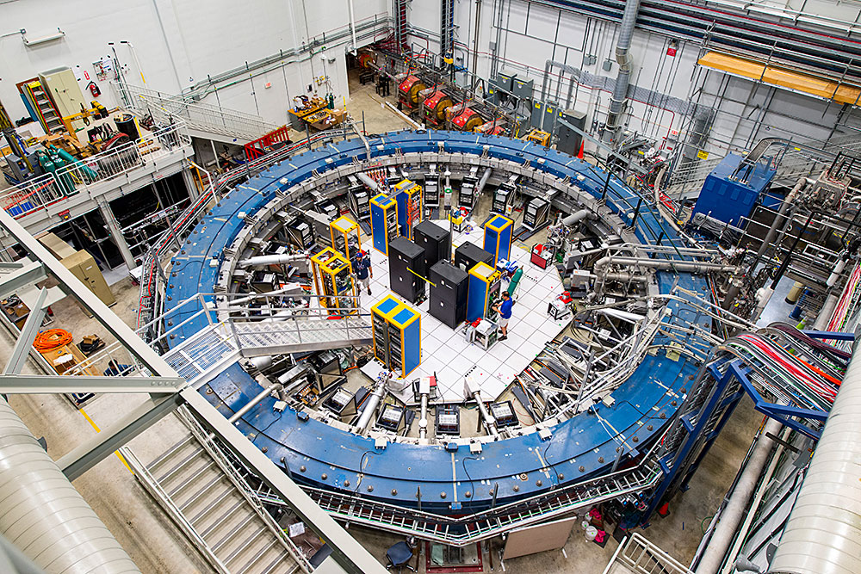
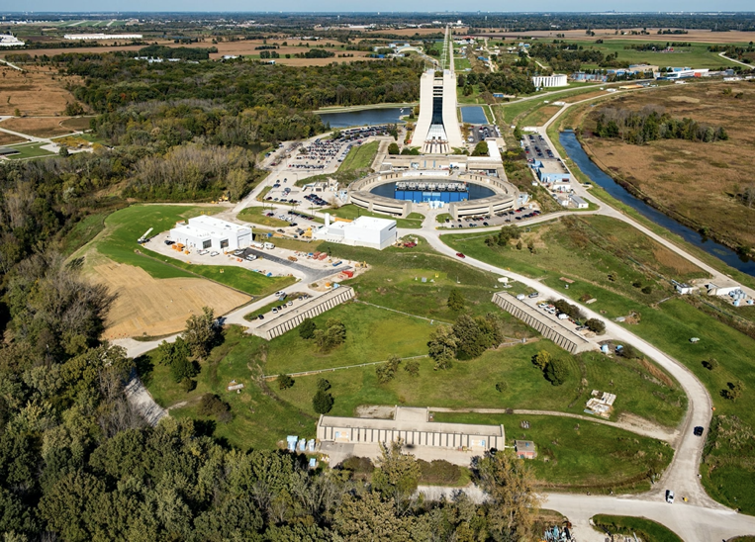
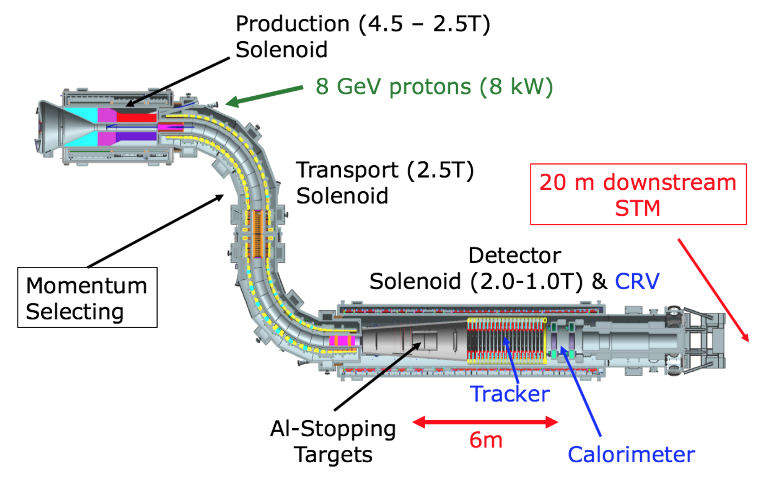
The muon programme at Fermilab
g-2
Chicago
14m
Mu2e
g-2
mu2e
Delivery Ring

Slide 3
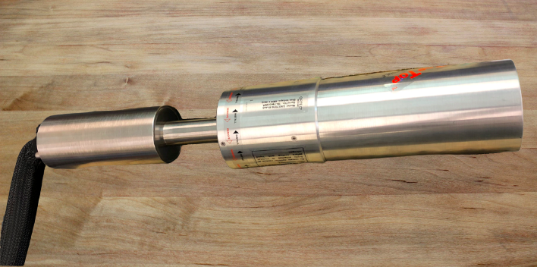
Liverpool @ mu2e
Searching for the neutrinoless conversion of μ to e in the presence of a nucleus: μ⁻ + N -> e⁻ + N
Practically forbidden in SM (~10⁻⁵⁴)
Signal is unambiguous sign of new physics
Liverpool contribution: Stopping Target Monitor (STM)
Measure number of stopped muons (denominator) to 10%
Muon stopped in Al target cause 3 characteristic γ emissions:
347 keV from 2p→1s (prompt)
1809 keV from nuclear capture (864 ns)
844 keV from decay of metastable ²⁶Mg* capture product, 9.5 min
High-purity Germanium (HPGe) detector (Liverpool) : high resolution (1-2 keV) for determination of closely spaced transitions
LaBr detector : high rate capability
HPGe tested at Liverpool and in test beam @ ELBE
Currently being installed at FNAL
30 cm

Slide 4
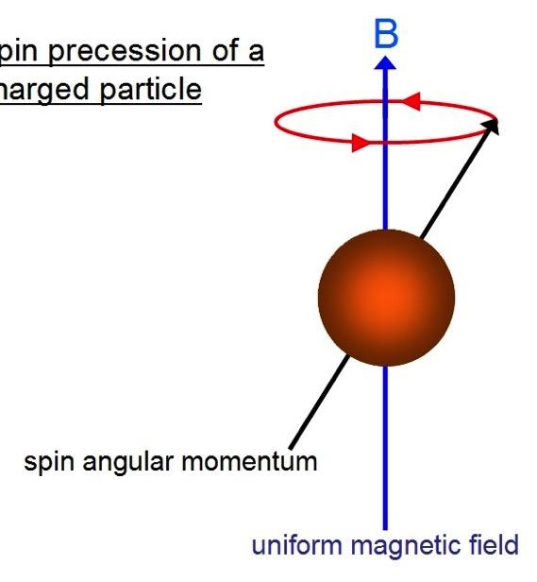
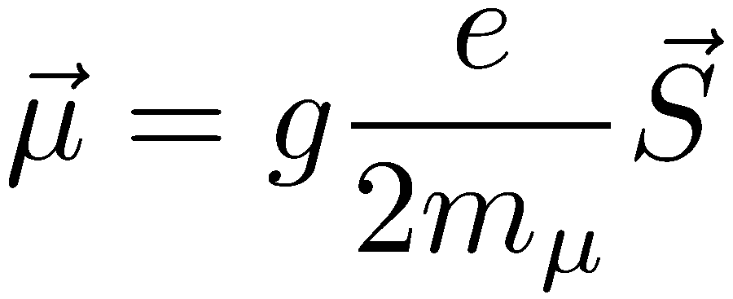
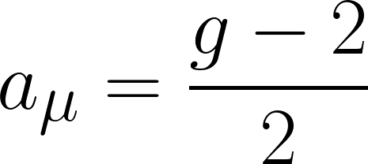
g-2 : the muon anomalous magnetic moment
The muon has an intrinsic magnetic moment that is coupled to its spin via the gyromagnetic ratio g:
Magnetic moment (spin) interacts with external B-fields
Makes spin precess at frequency determined by g
Anomalous magnetic moment

Slide 5
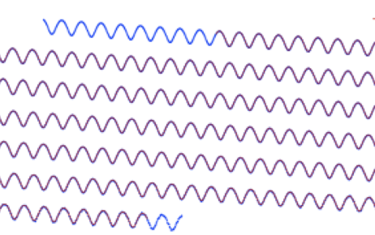
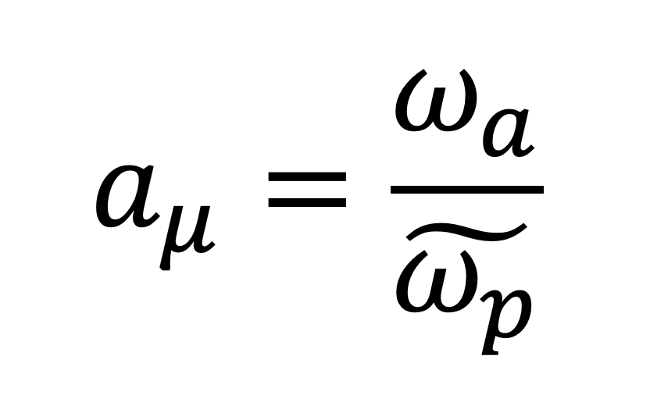
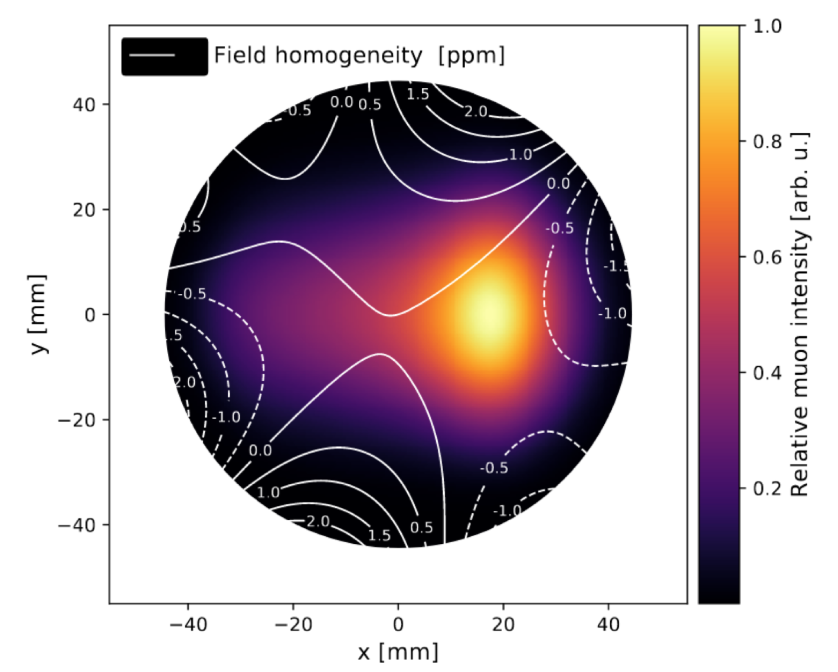
Measuring a_{μ} in the g-2 experiment
See Cedric’s talk
3.09 GeV μ⁺
Muon precession frequency
Measure both terms with equal precision (target: 70 ppb)
Muon-weighted magnetic field

Slide 6
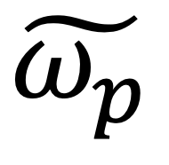
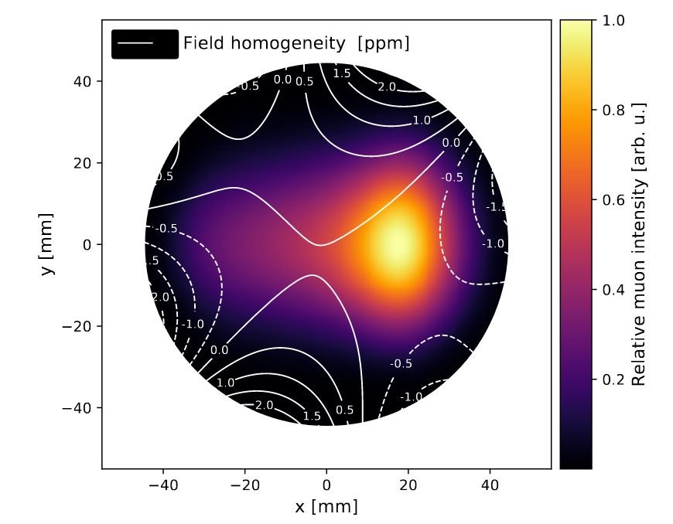
Ingredients for a high-precision measurement of
keep the field highly uniform and stable (passive and active shimming)
systematics: probe resolution, material effects, temperature, tracking uncertainty + …
measure the field in the space traversed by the muons (trolley)
correct for transient fields caused by pulsed HV systems (kickers, quads)
calibrate NMR probes with a well-known measurement standard (plunging probe)
measure the muon beam profile continuously (trackers)
track sub-ppm changes in the field over time (fixed probes)
Phys. Rev. A 103, 042208 (2021)
https://indico.fnal.gov/event/55621/

Slide 7
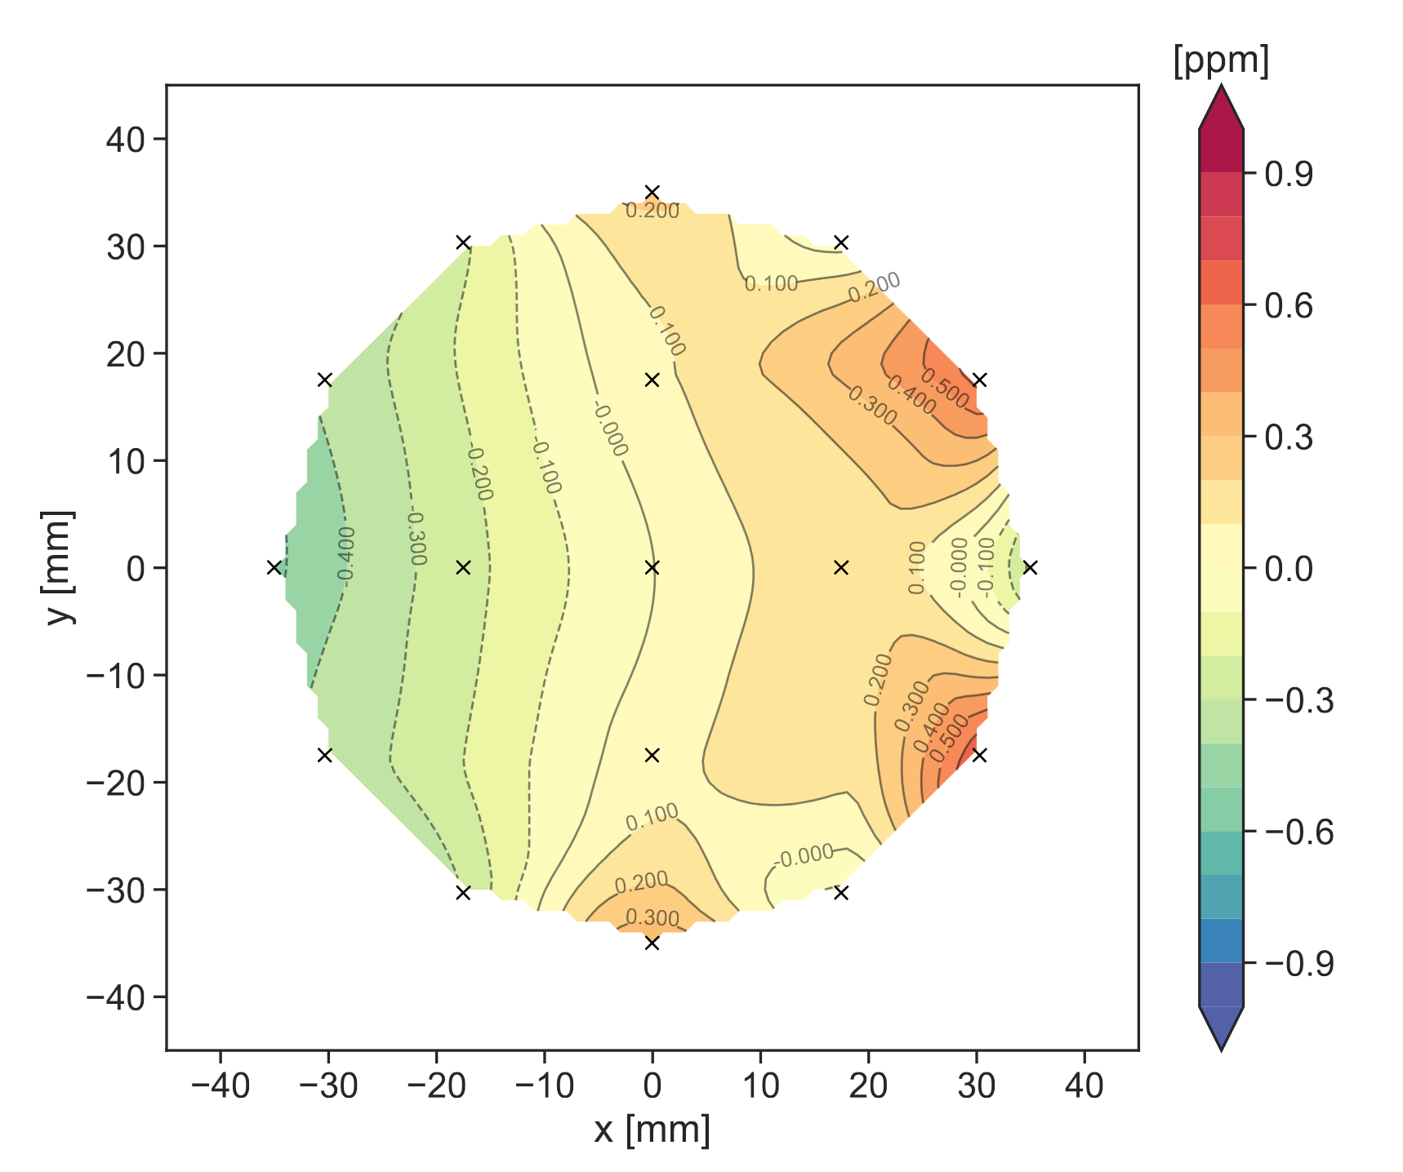
The g-2 Storage Ring magnet
7.112 m radius ‘C’-shape magnet with vertically-aligned field B = 1.45 T
Dipole field has ppm-level uniformity (14 ppm RMS across the full azimuth)
Tiny (ppm) changes in magnet geometry, driven by temperature changes, cause the field to drift over time
Shimming devices minimise gradients (transverse and azimuthal field components).

Slide 8
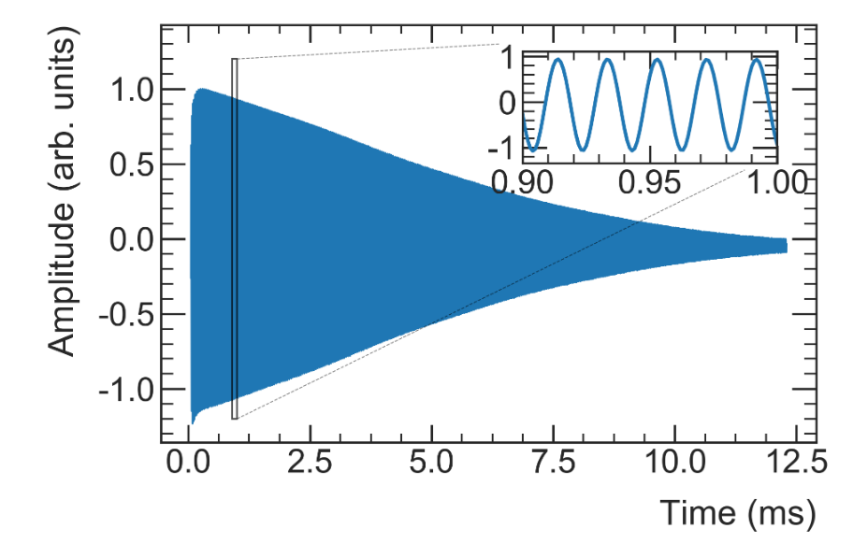
Magnetic field measurement instrumentation
Measured using pulsed NMR – well-known technique, used in wide range of applications to measure B fields at the ppb level
Field measured by extracting frequency from a Free Induction Decay (FID) spectrum

Slide 9
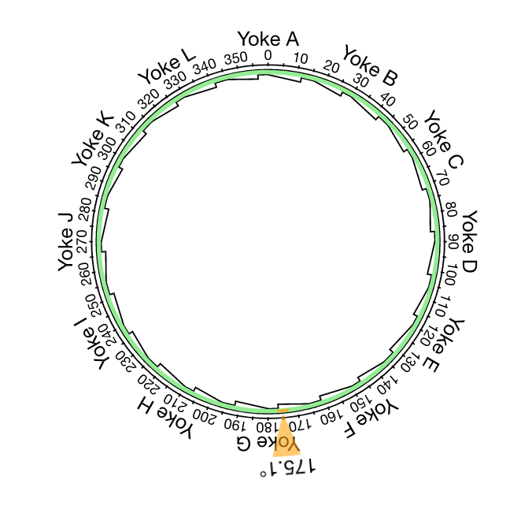
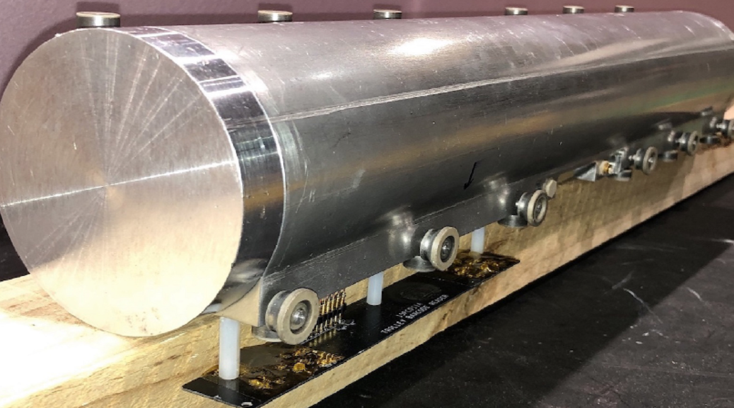
Mapping the field with the trolley
Measure 17 frequencies at each azimuth
Trolley run
Describe shape of field using 2D fit or “multipole expansion”

Slide 10
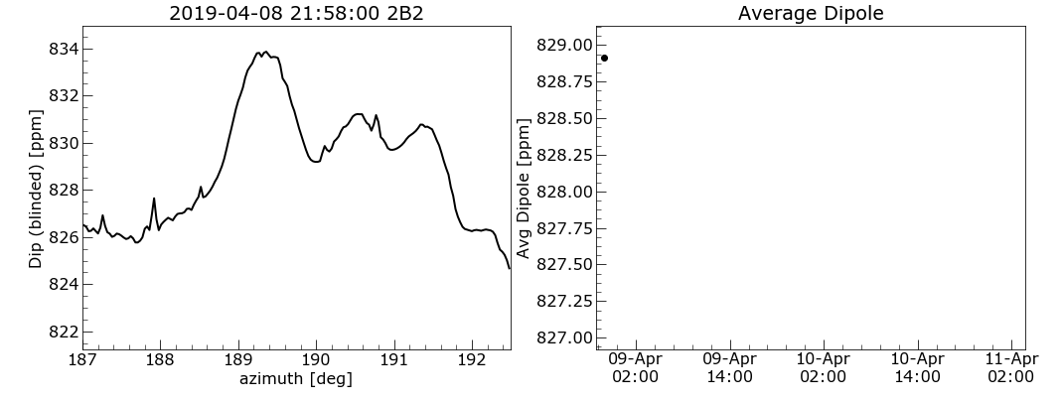
Interpolation and muon weighting
Interpolation Predict shape of field when trolley is not present using fixed probe measurements
Muon Weighting
See Elia’s talk

Slide 11
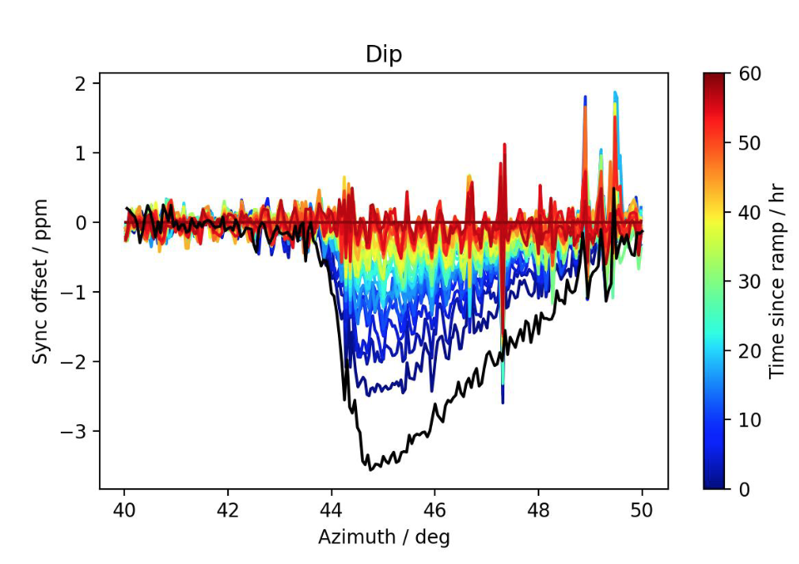
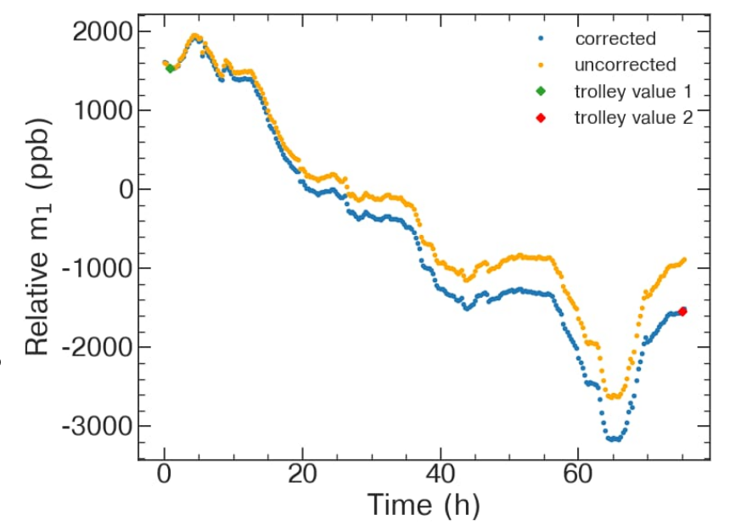
Interpolation uncertainty
Δm
Trolley / Fixed Probe synchronisation drifts over time
Field tracking uncertainty driven by length of time between trolley runs
Larger field changes at yoke boundaries (unseen by FP) shortly after magnet ramp

Slide 12
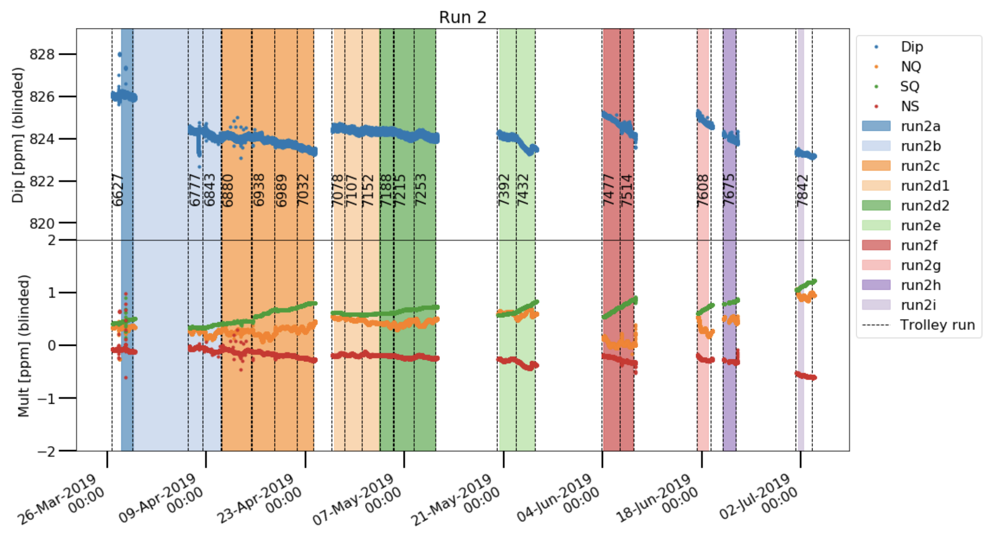
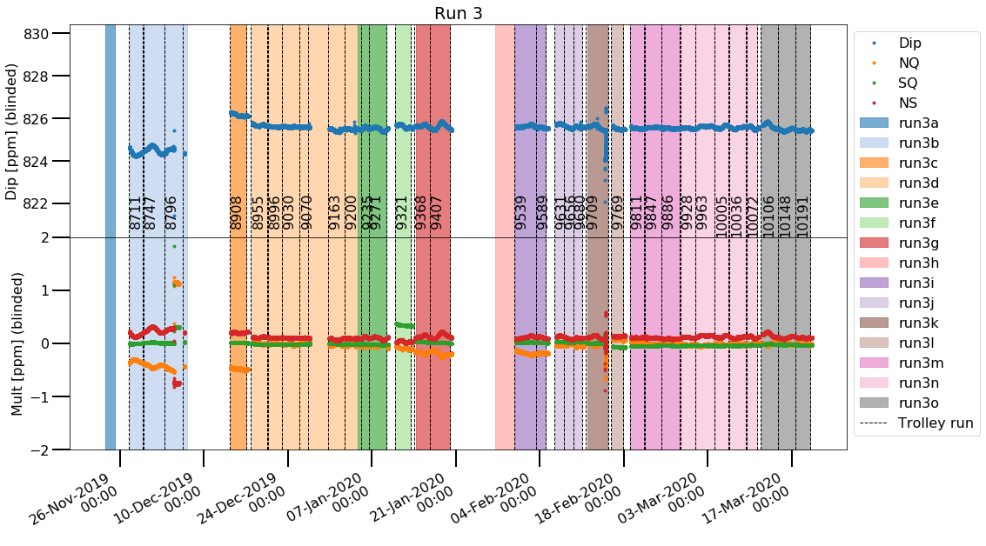
Putting it all together: the field in Run 2/3
PRELIMINARY, BLINDED
PRELIMINARY, BLINDED
Many trolley runs: reduced interpolation uncertainty (and better understanding of ramp effects)
Improved temperature control in the experimental hall: more stable higher-order terms

Slide 13
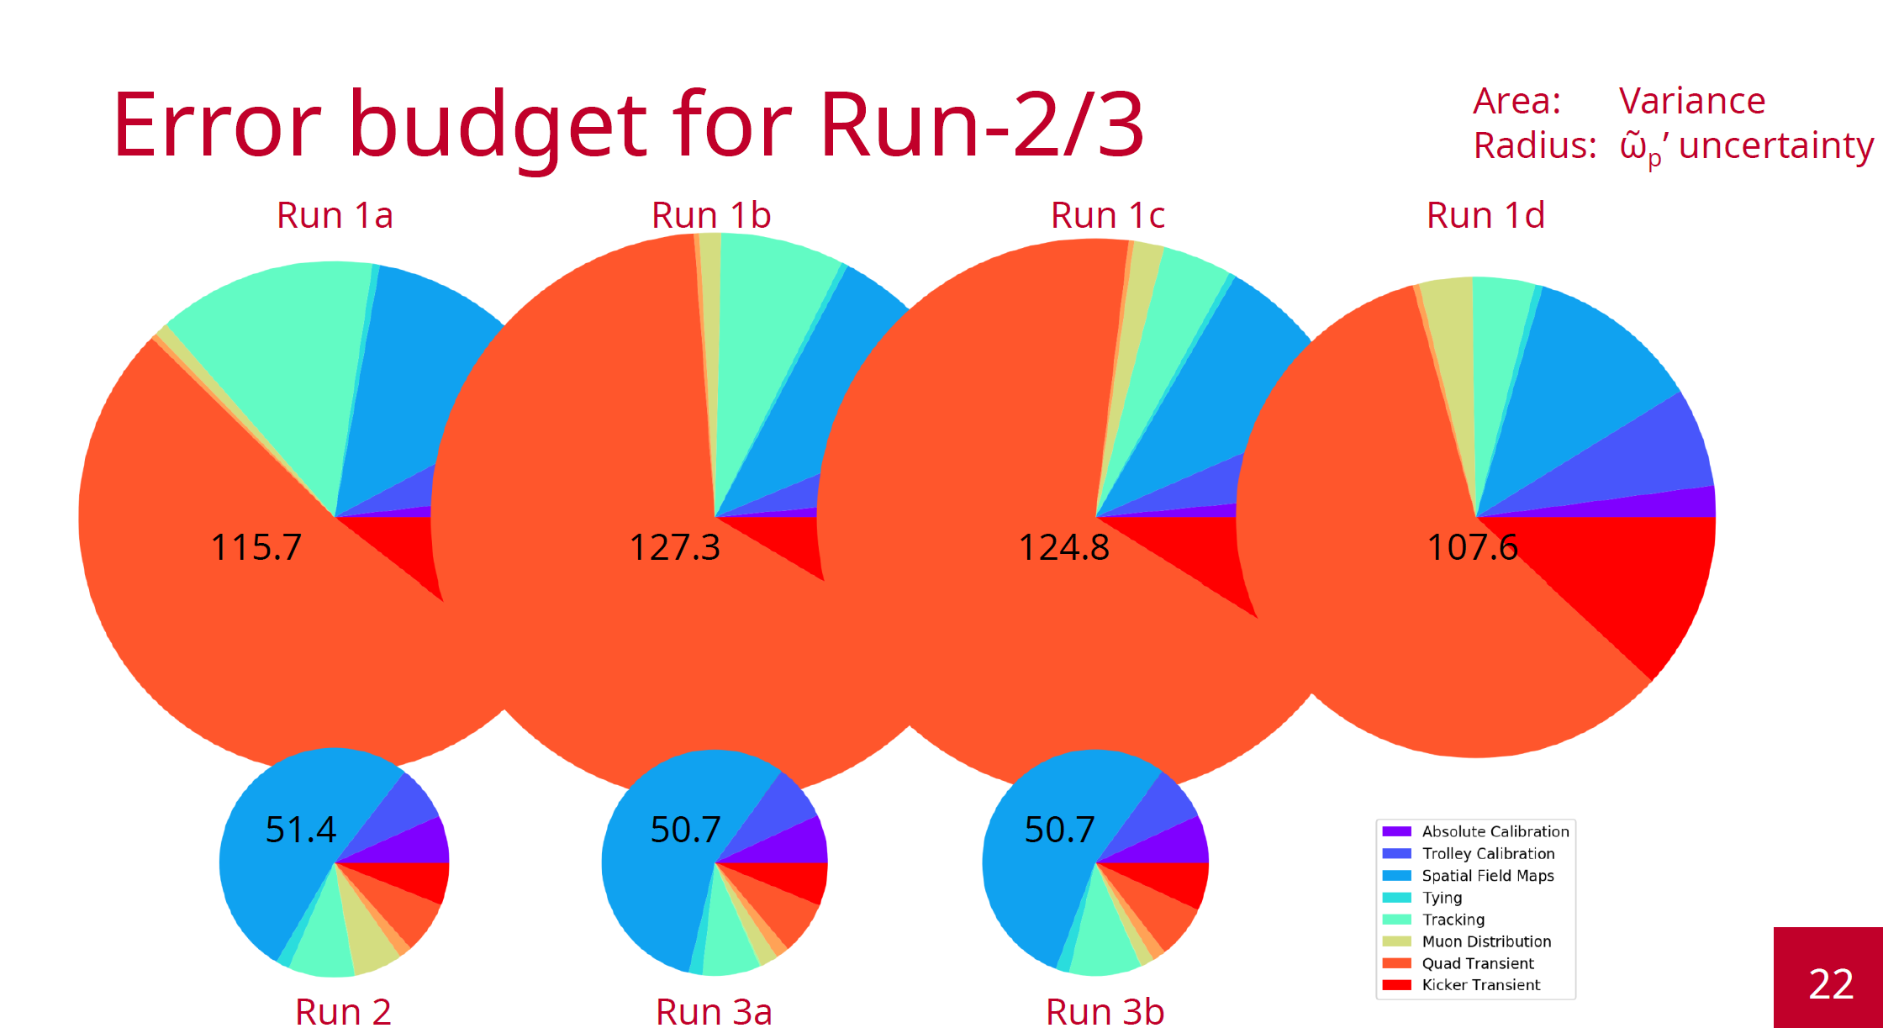
Putting it all together: the field in Run 2/3
Main reduction in uncertainty comes from better understanding of transient field effects
Interpolation uncertainty has also reduced with number of trolley runs
Uncertainty already at required level for full g-2 dataset
PRELIMINARY
Plot by R. Reimann

Slide 14
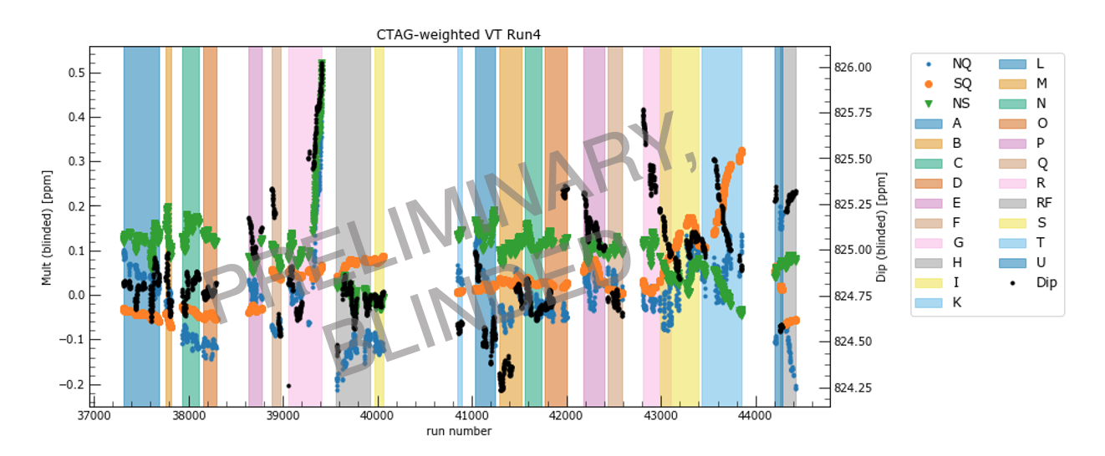
The future: Run 4/5/6 and beyond
Analysis for Run 4/5/6 is already underway
Run 6 finishes in July: end of g-2 (!)
Magnet will stay powered for the next ~year for dedicated field studies
To-do list:
Magnetometer measurements of kicker transient field
Measurements of quad transient field
Radial field measurements (see Dominika’s talk)
Trolley uncertainties: motion effects and eddy currents
Absolute calibration cross-checks

Slide 15
Thank you!

Slide 16
Mu2e STM Test Beam @ ELBE FZDR

Slide 17
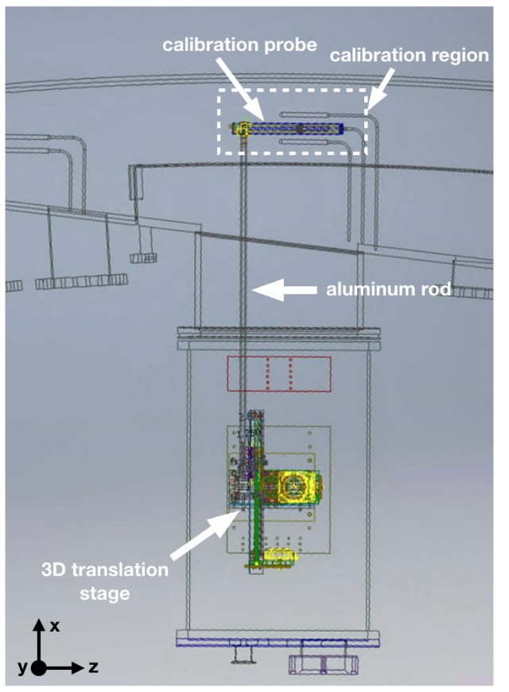
Absolute Calibration
Trolley and fixed NMR probes use petroleum jelly as the proton sample. Chosen for low volatility.
Must calibrate with protons in a water sample (measurement standard) in order to measure a_{𝝻}
A dedicated calibration probe with a cylindrical H₂0 sample is installed inside the vacuum chamber.
In a dedicated calibration campaign, trolley and calibration probes switch places to repeatedly measure the same field in the same place
Calibration probe is calibrated against a different probe with a spherical water sample.
Both calibration probes were cross-checked with a spherical 3He sample (different systematics)
Agreement between all three calibration probes at 10 ppb level

Slide 18
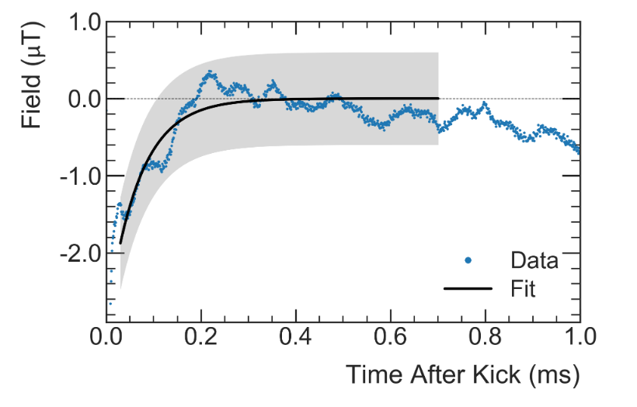
Transient field from pulsed systems
Largest uncertainties in Run-1 come from “fast transient” fields generated by the pulsed systems (kickers and quads)
Muons experience a field change which the fixed probes do not see (due to shielding)
Effects were measured separately during dedicated measurement campaigns.
Grey regions = muon storage times
Quad
Kicker
Measured with a dedicated in-vacuum NMR probe located between quad plates during pulsing
Quad correction (Run-1): -17 (92) ppb
Kicker pulse of 22 mT for 150 ns just after muon injection.
Field change caused by residual field after kicker pulse. Muons present from 30μs to 700μs after the kick (fit region)
Kicker correction (Run-1): -27 (37) ppb

Slide 19
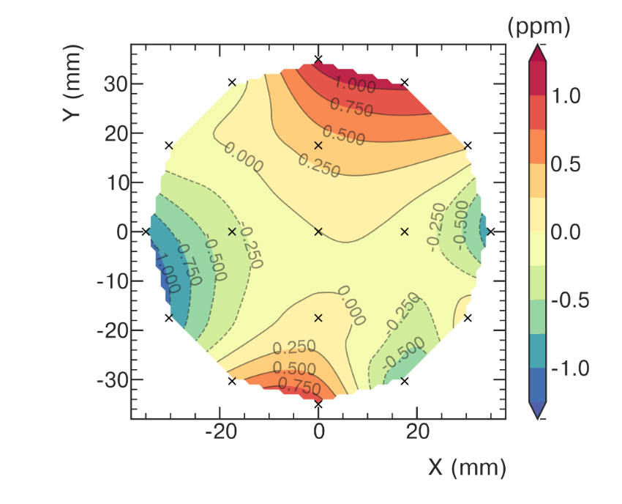
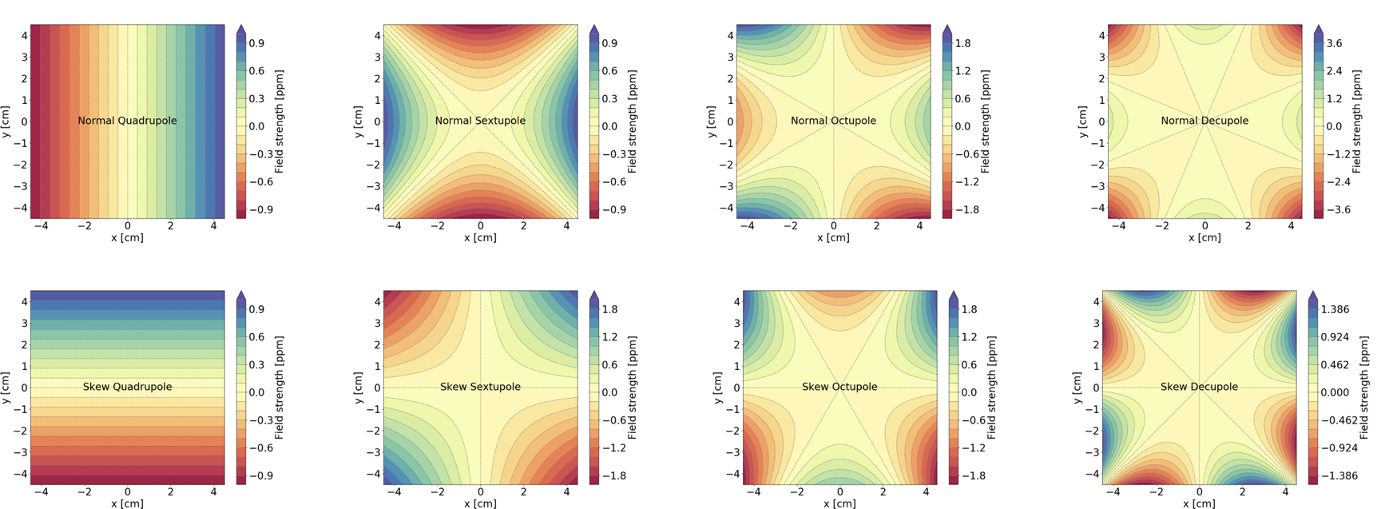
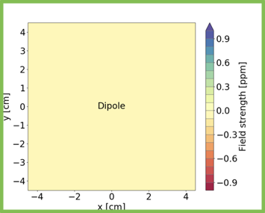
Components of the magnetic field map
Extract terms from a multipole (m) expansion of B in r and θ:
Field gradients in an azimuthal “slice”
“Normal” terms: m2, m4, m6, m8, ...
Dipole (m1)
“Skew” terms: m3, m5, m7, m9, ...
Trolley: Fit the 2D contour plot to extract the multipole terms (m1, m2, m3, ...)
Fixed probes: extract terms from geometric combination of probe frequencies
Fixed probes can track m1, m2, m3, m4 only

