Slide 1

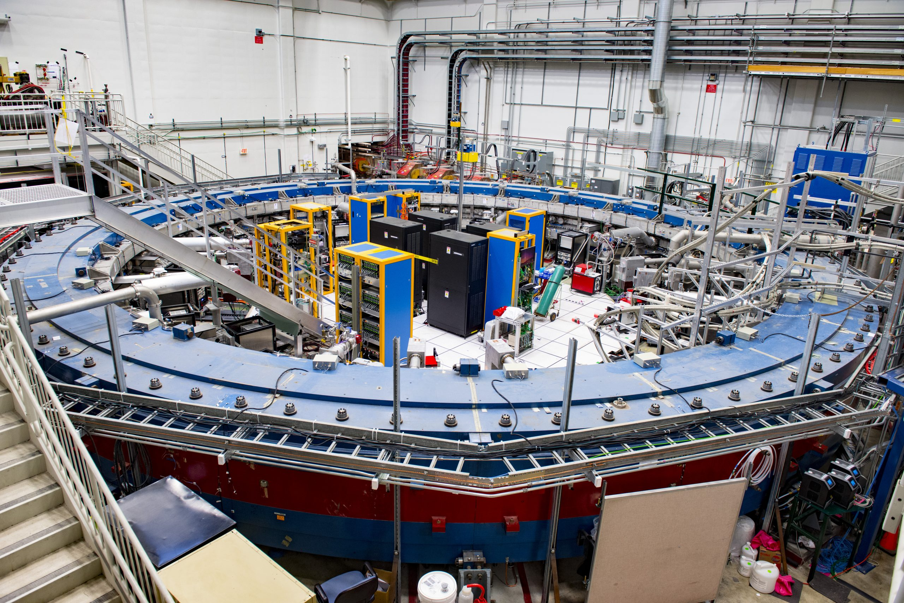
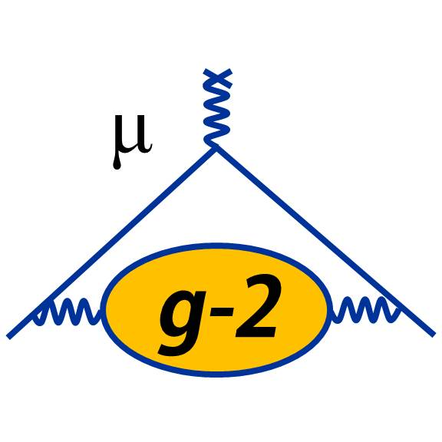


Beam Dynamics in g-2 experiment at Fermilab
E. Bottalico
HEP Annual Meeting
19 May 2023

Slide 2
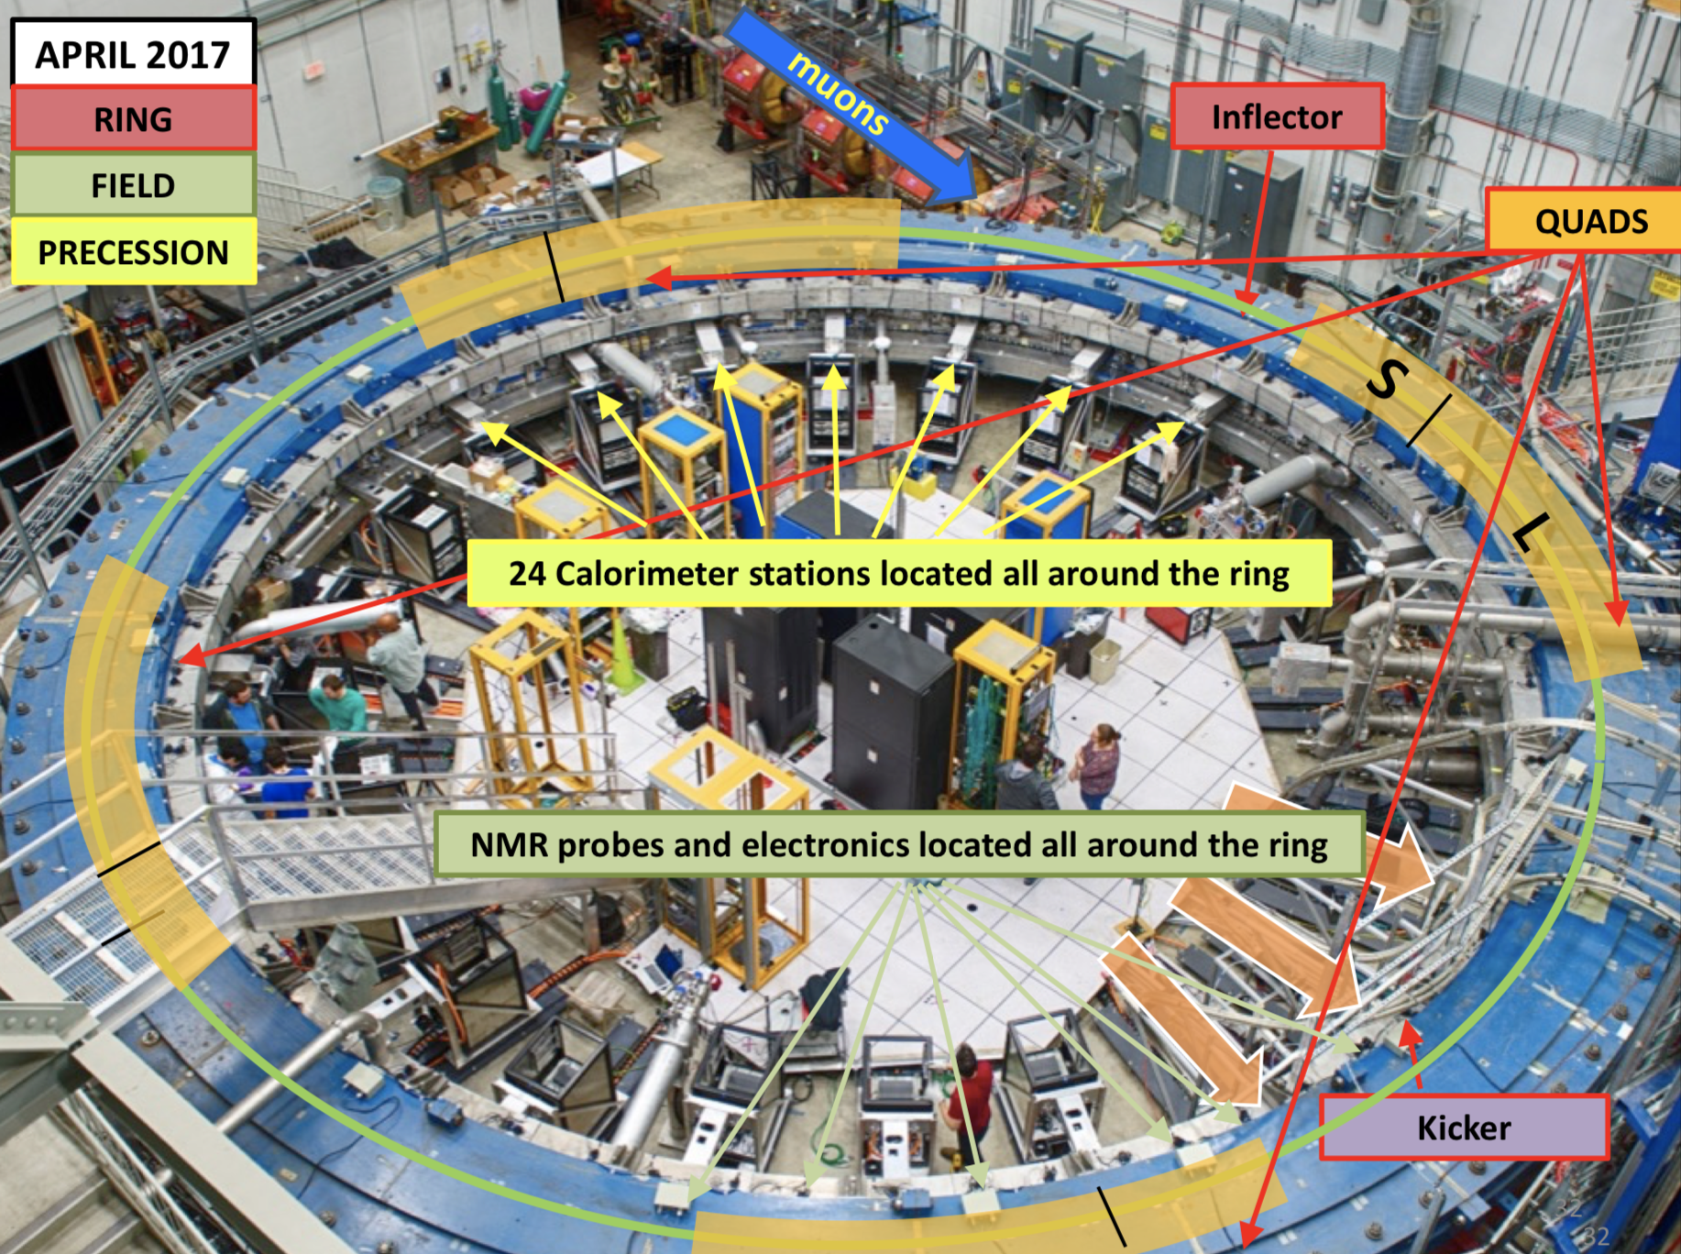
g-2 short recap: The Ring

Slide 3
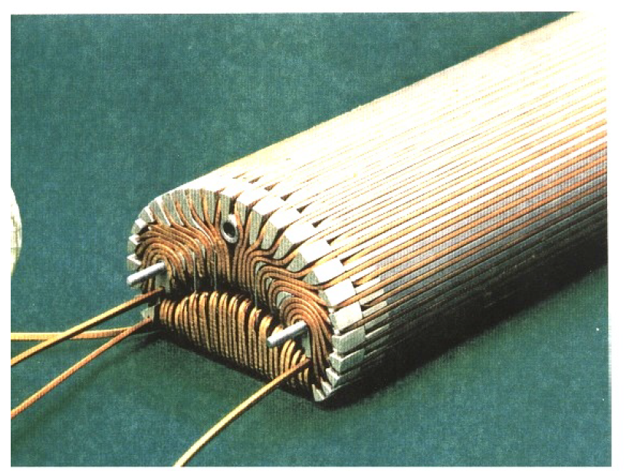
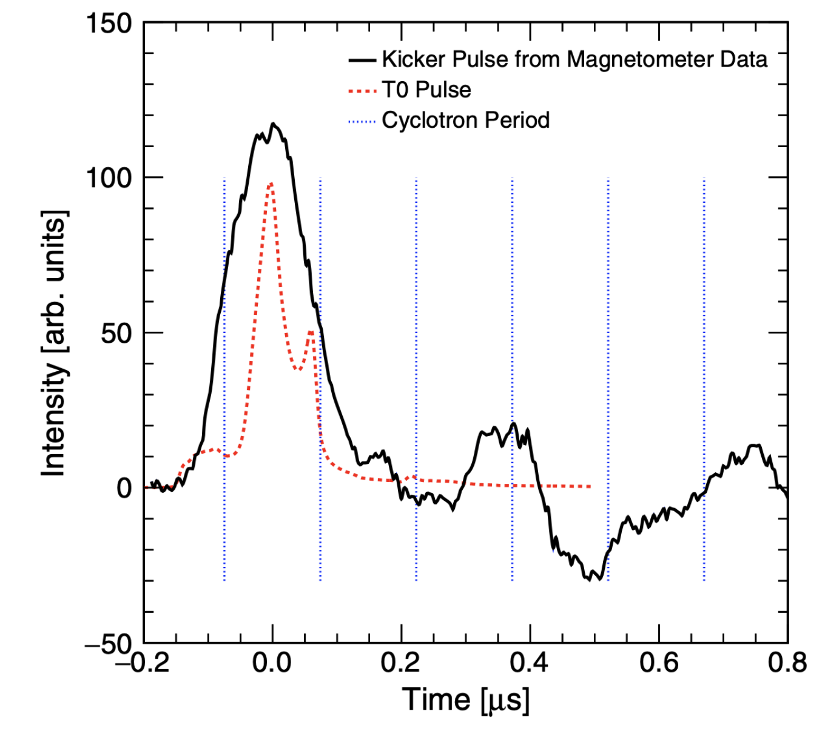
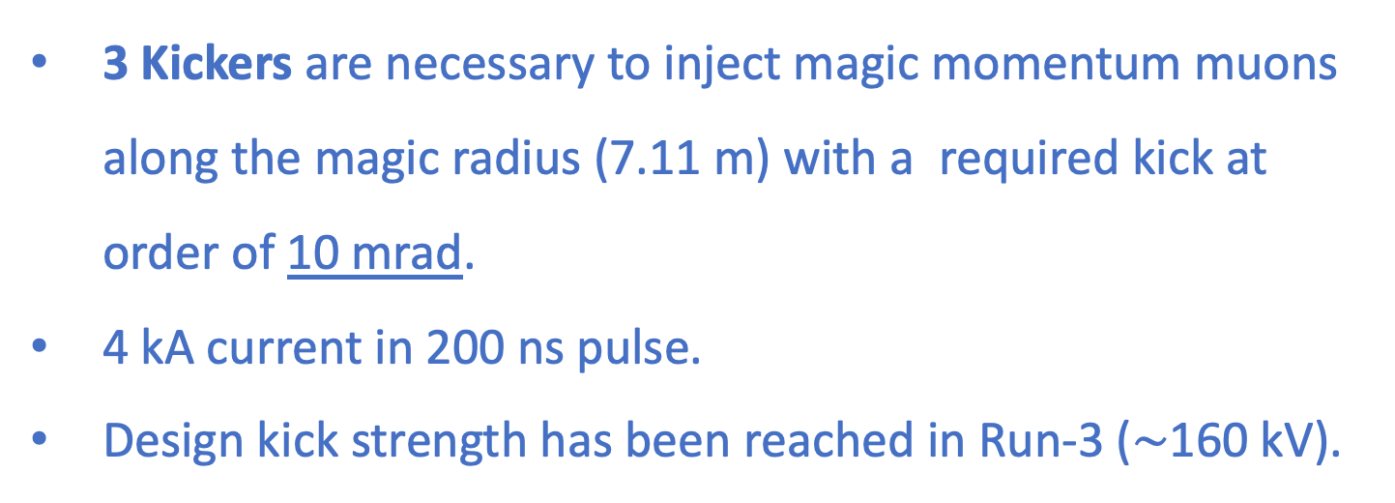
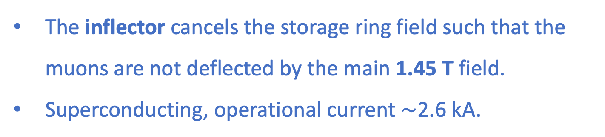
Kickers and Inflector
The inflector cancels the storage ring field such that the muons are not deflected by the main 1.45 T field.
Superconducting, operational current $∼$2.6 kA.
3 Kickers are necessary to inject magic momentum muons along the magic radius (7.11 m) with a required kick at order of 10 mrad.
4 kA current in 200 ns pulse.
Design kick strength has been reached in Run-3 ($∼$160 kV).

Slide 4
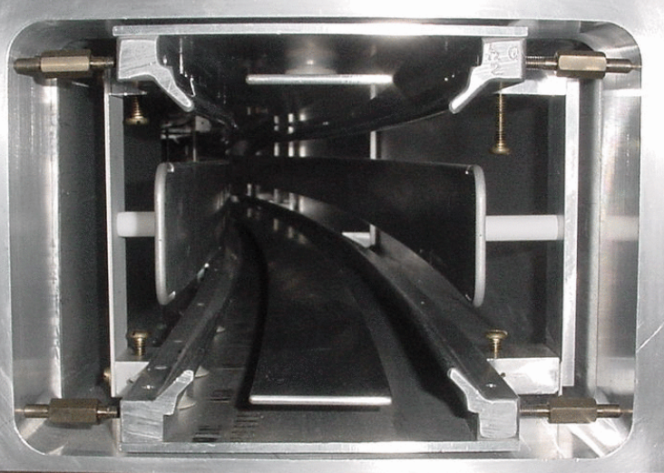
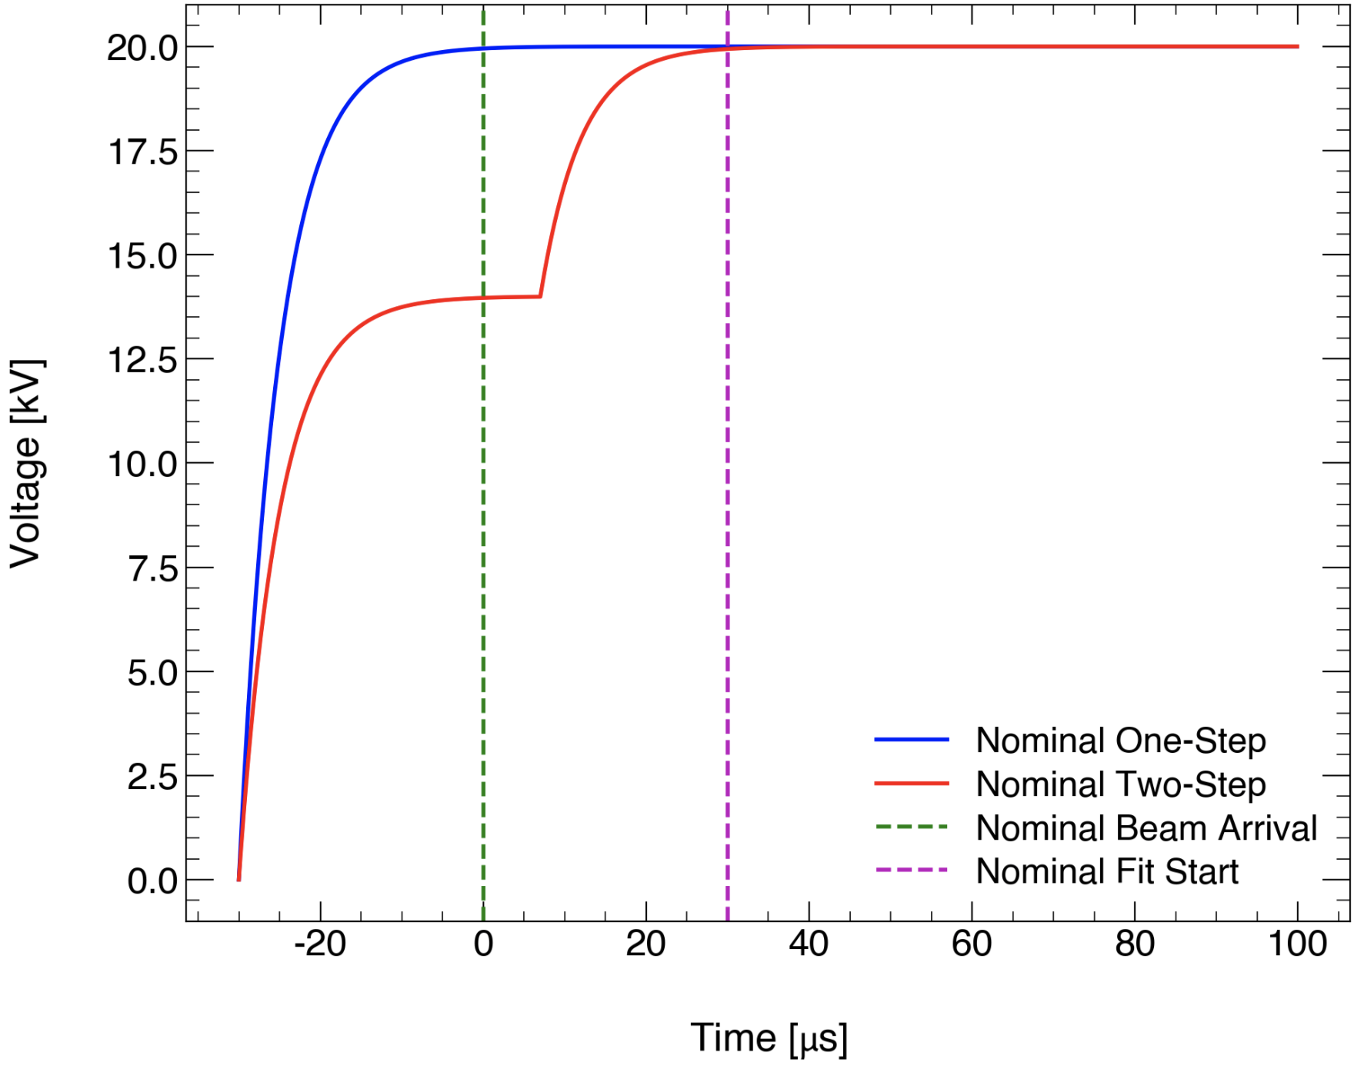
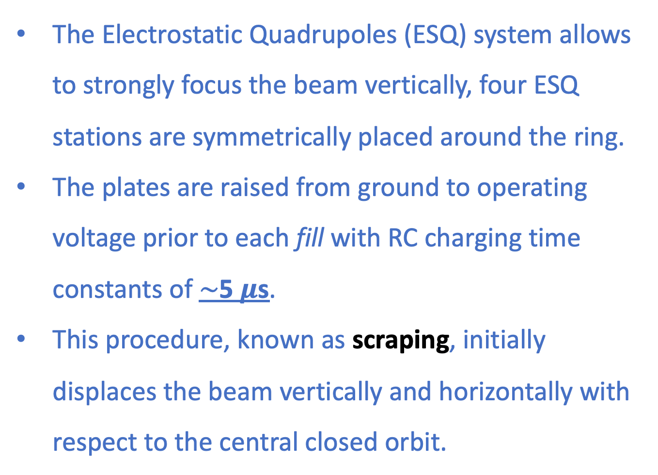
Quadrupoles
The Electrostatic Quadrupoles (ESQ) system allows to strongly focus the beam vertically, four ESQ stations are symmetrically placed around the ring.
The plates are raised from ground to operating voltage prior to each fill with RC charging time constants of $∼$5 $μ$s.
This procedure, known as scraping, initially displaces the beam vertically and horizontally with respect to the central closed orbit.
Time [µs]

Slide 5
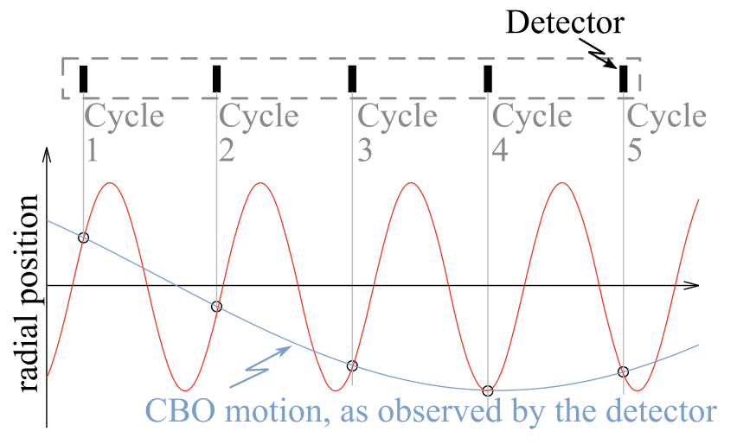
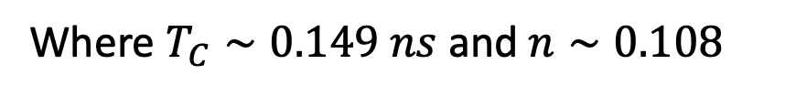


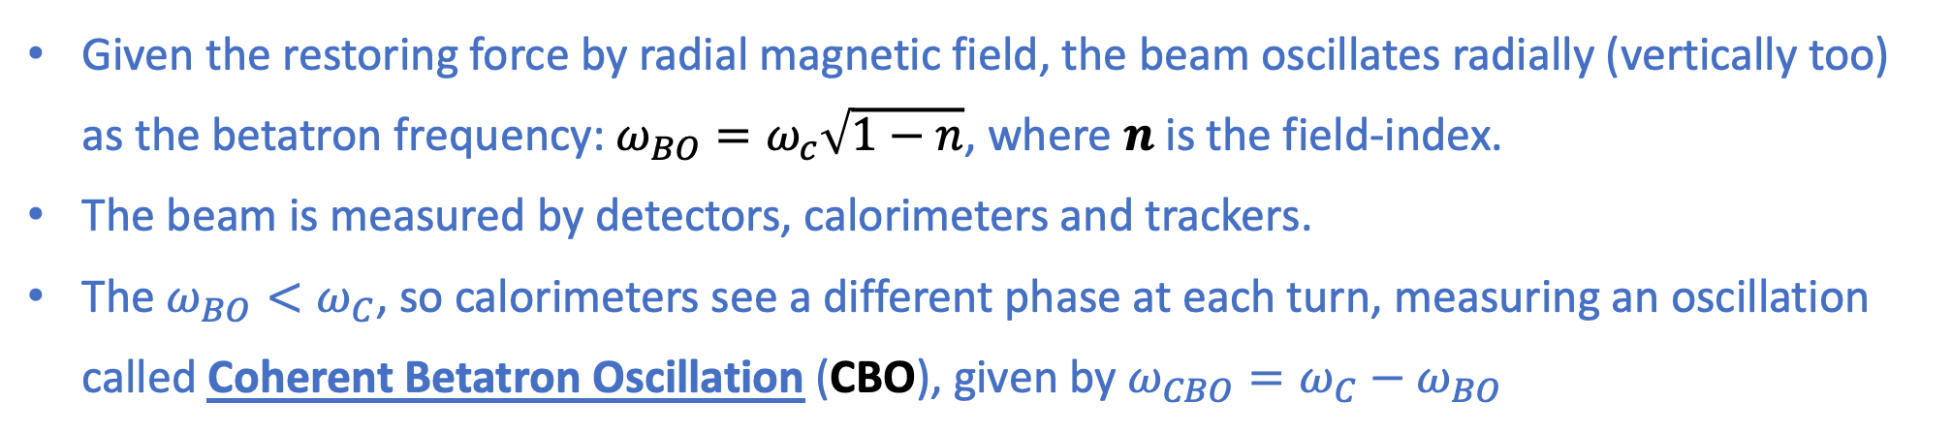

$ω_{a}$ measurement – CBO oscillation
Given the restoring force by radial magnetic field, the beam oscillates radially (vertically too) as the betatron frequency: $ω_{BO}=ω_{c}\sqrt{1−n}$, where $n$ is the field-index.
The beam is measured by detectors, calorimeters and trackers.
The $ω_{BO}<ω_{C}$, so calorimeters see a different phase at each turn, measuring an oscillation called Coherent Betatron Oscillation (CBO), given by ${ω_{CBO}=ω}_{C}−ω_{BO}$
$$2πf_{CBO}=ω_{C}−ω_{BO}=ω_{C}(1−\sqrt{1−n})$$
$$ω_{CBO}=2.34 rad/μs$$
Where $T_{C}∼0.149 ns$ and $n∼0.108$

Slide 6
How does the beam move?
How really does the beam move inside the ring?
?

Slide 7
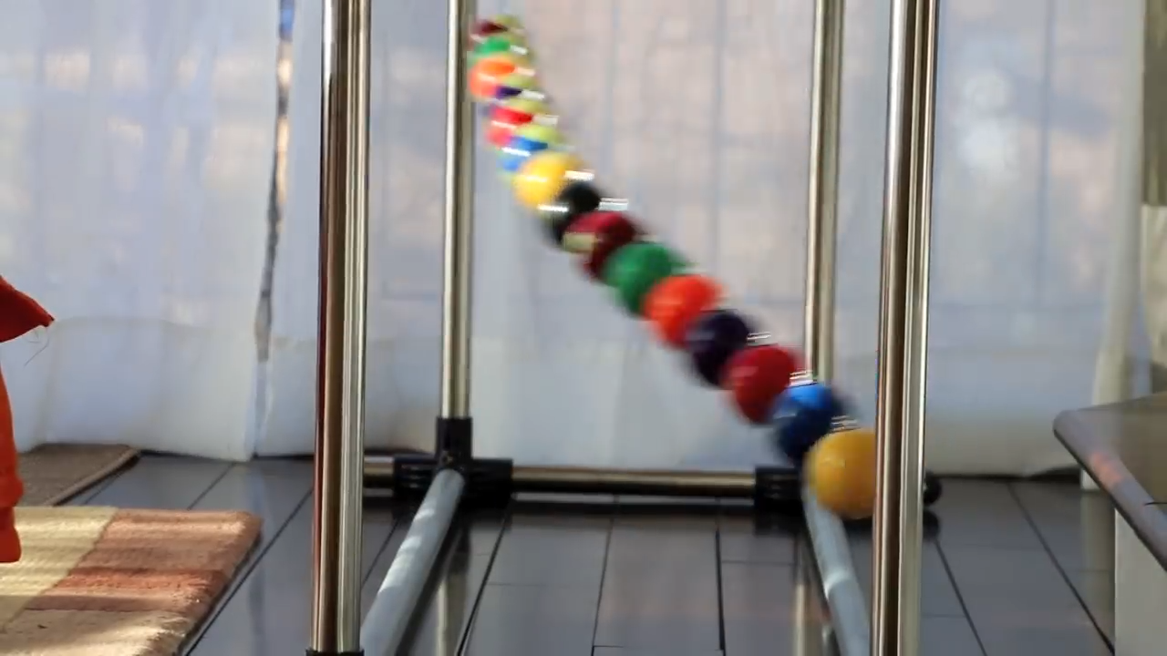
How does the beam move?
Like this!

Slide 8
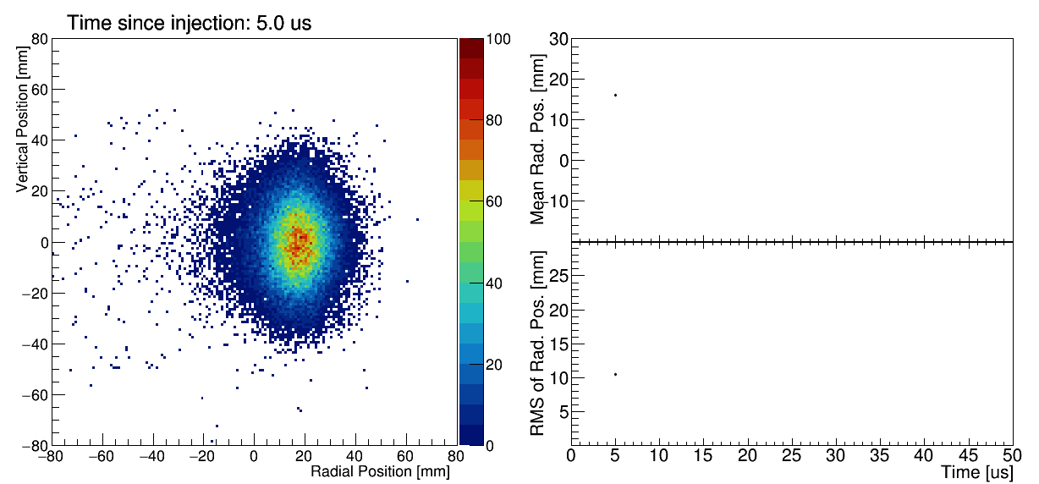
The beam motion inside the ring
What we observe by detectors is the spatial projection and many fill average of the previous representation.
Here what the tracker detectors see:

Slide 9
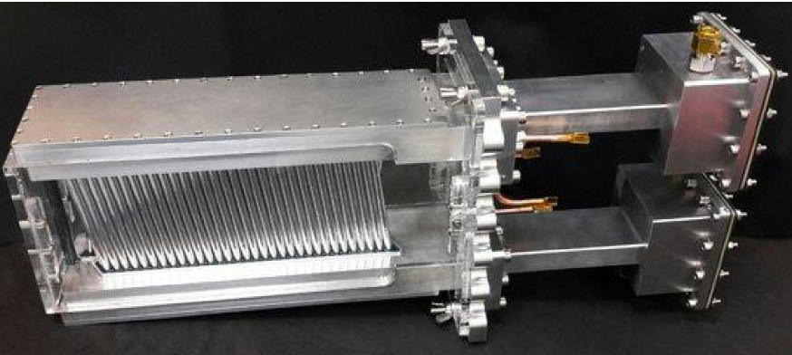
The beam motion inside the ring
What we observe by detectors is the spatial projection and many fill average of the previous representation.
Here what the tracker detectors see:
Two straw tubes trackers:
  32 planes of drift tubes arranged in 8 modules, each module has 4 straw planes.
  The tubes are filled with a 50:50 mixture of Argon and Ethane.

Slide 10
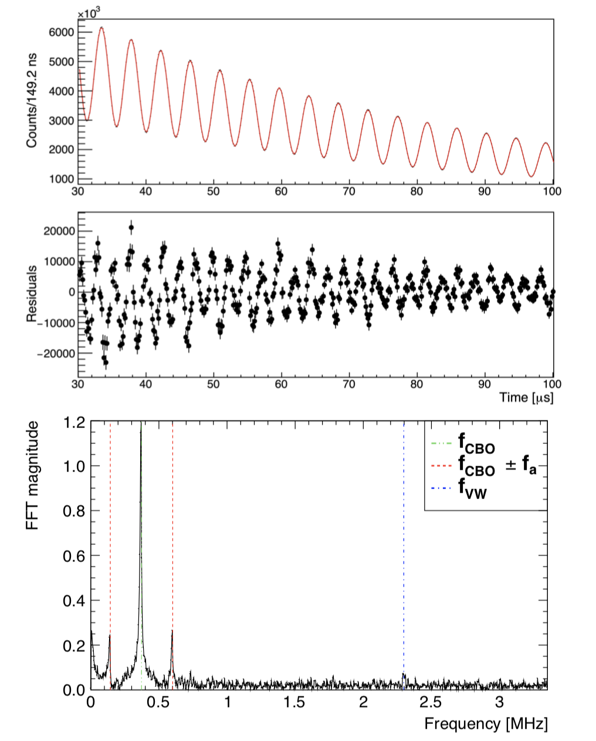
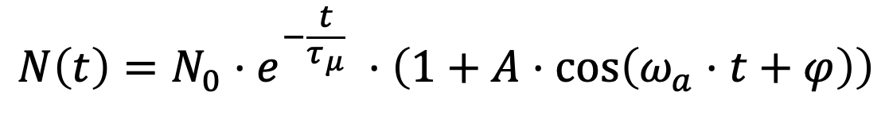

$ω_{a}$ measurement
See Cedric next talk!
The simplest function which describes the number of emitted positron from muon decay (so called “wiggle plot”) is:
Fit start time 30µs
$$N\left(t\right)=N_{0}⋅e^{−\frac{t}{τ_{μ}}} ⋅\left(1+A⋅\cos\left(ω_{a}⋅t+φ\right)\right)$$
From the FFT of the fit’s residual shows many frequency peaks due to beam dynamics effects that are not modeled by the previous function.

Slide 11
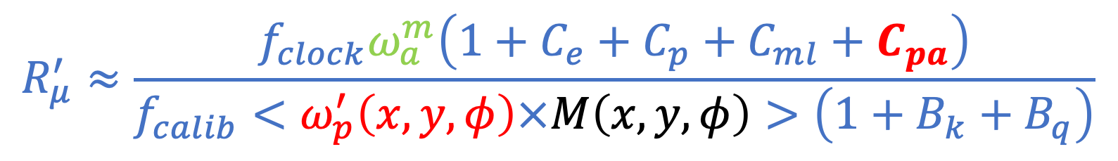
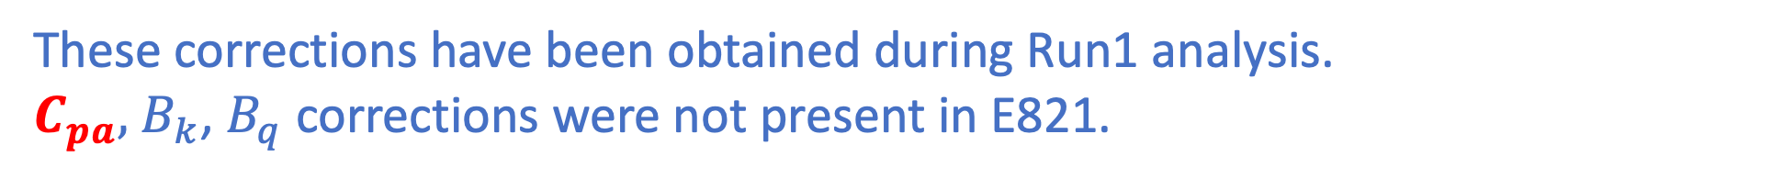

$a_{μ}$ Extraction
For the measurement of $a_{μ}$ the measured $ω_{a}$ and $ω_{p}$ need to be corrected by:
Cedric next talk!
Beam dynamics corrections
$$R_{μ}^{′}≈\frac{f_{clock}ω_{a}^{m}\left(1+C_{e}+C_{p}+C_{ml}+C_{pa}\right)}{f_{calib}<ω_{p}^{′}\left(x,y,φ\right)×M\left(x,y,φ\right)>\left(1+B_{k}+B_{q}\right)}$$
Saskia previous talk
Transient field corrections
These corrections have been obtained during Run1 analysis.
$C_{pa},$ $B_{k}$, $B_{q}$ corrections were not present in E821.

Slide 12
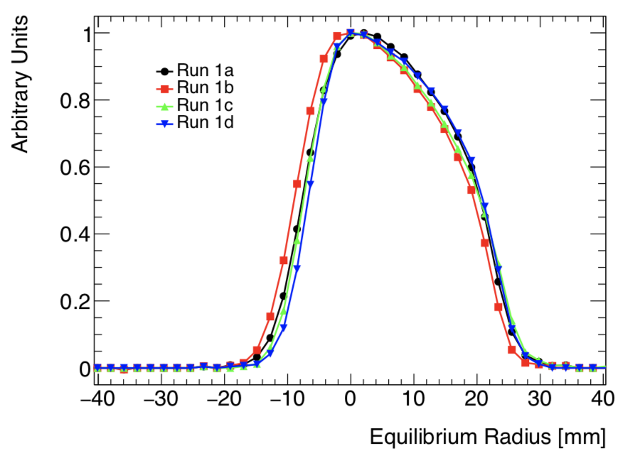
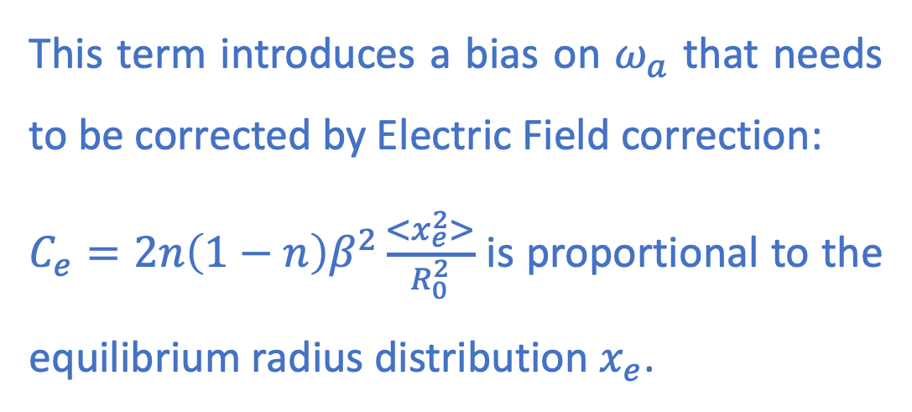
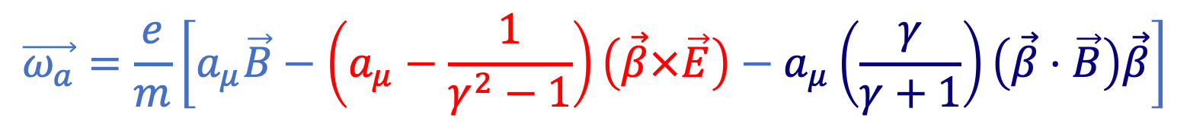

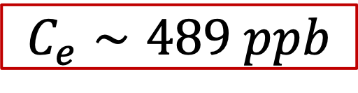
Beam dynamics correction to $ω_{a}$: $C_{e}$
Considering the extended expression of the spin precession frequency in a magnetic field:
$$\vec{ω_{a}}=\frac{e}{m}\left[a_{μ}\vec{B}−\left(a_{μ}−\frac{1}{γ^{2}−1}\right)\left(\vec{β}×\vec{E}\right)−a_{μ}\left(\frac{γ}{γ+1}\right)\left(\vec{β}⋅\vec{B}\right)\vec{β}\right]$$
This term introduces a bias on $ω_{a}$ that needs to be corrected by Electric Field correction:
$C_{e}=2n\left(1−n\right)β^{2}\frac{<x_{e}^{2}>}{R_{0}^{2}}$ is proportional to the equilibrium radius distribution $x_{e}$.
$$C_{e}∼489 ppb$$

Slide 13

$a_{μ}$ systematic sources
Many systematics come from effects that change the phase of the detected positrons over time and introduce a bias on $ω_{a}$:
In general, anything that changes from early-to-late within each muon fill can be a cause of systematic error, as:
    Beam distortion
    Muon losses
    Varying lifetime
    Rate dependent reconstruction

Slide 14
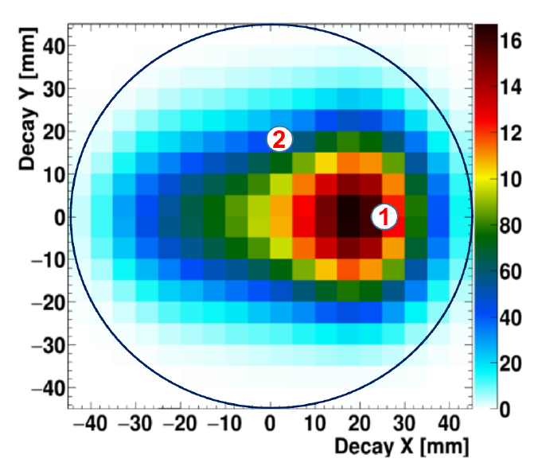
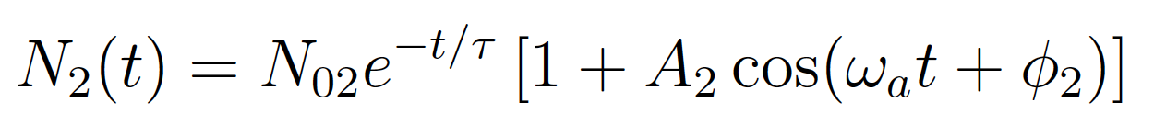

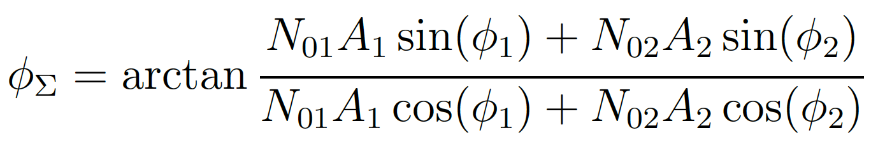

Beam dynamics correction to $ω_{a}$: $C_{pa}$
The measured g-2 phase of the muon is decay vertex position dependent.
It is obtained as weighted average of the phases measured by each (x,y) pair position.

Slide 15
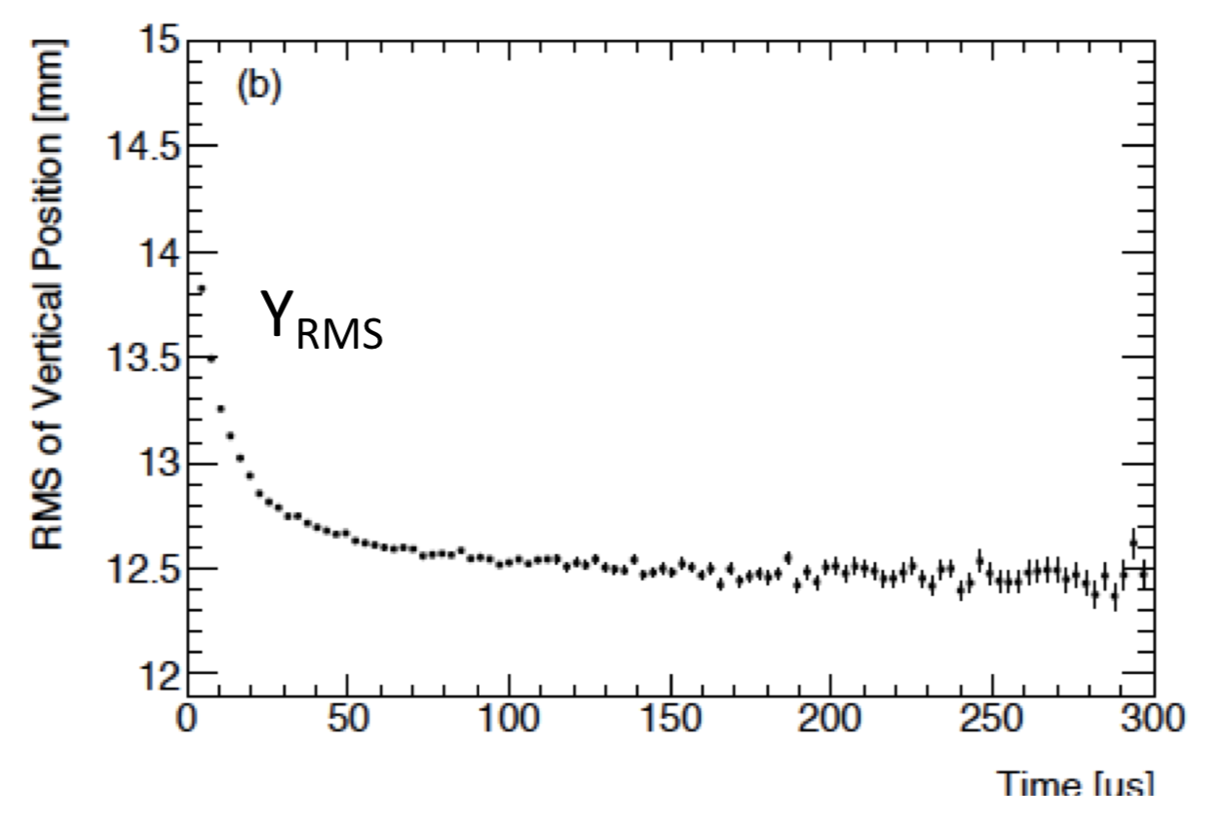
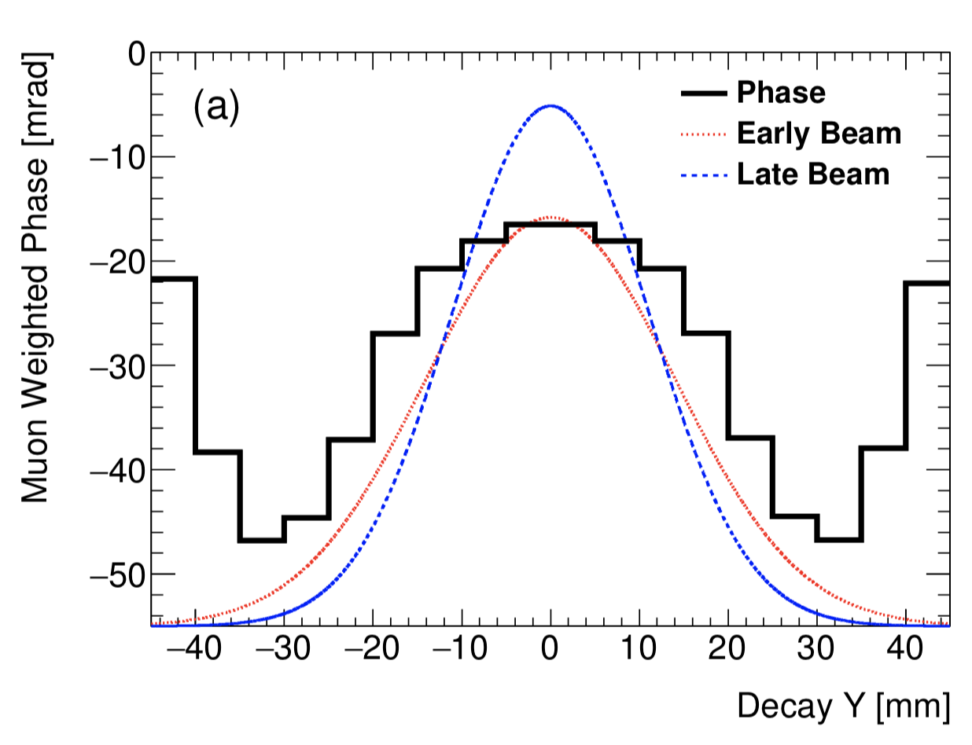
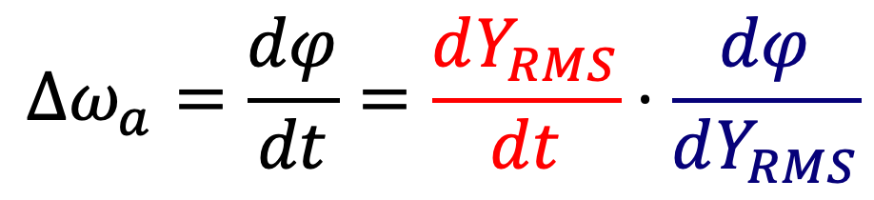
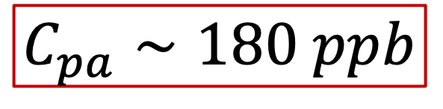

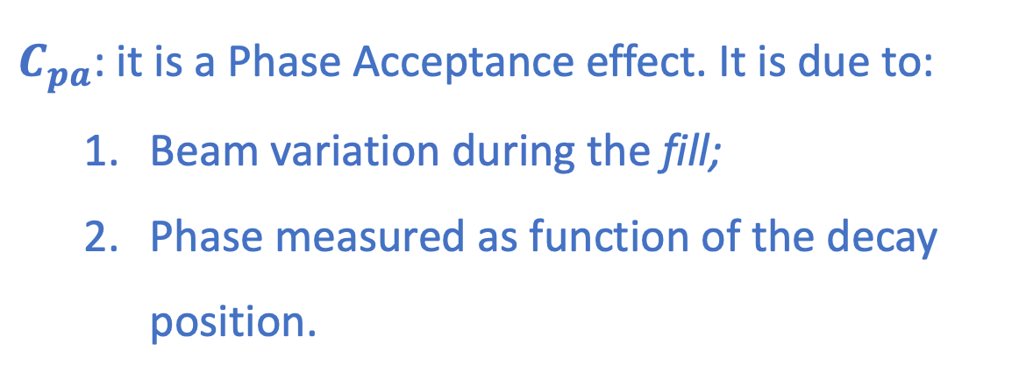

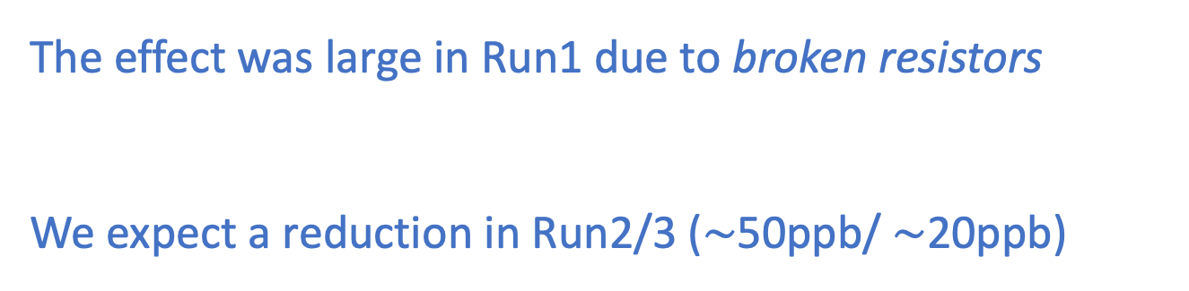
Beam dynamics correction to $ω_{a}$: $C_{pa}$
$C_{pa}$: it is a Phase Acceptance effect. It is due to:
  Beam variation during the fill;
  Phase measured as function of the decay position.
$$\frac{dY_{RMS}}{dt}$$
1)
2)
$$Δω_{a}=\frac{dφ}{dt}=\frac{dY_{RMS}}{dt}⋅\frac{dφ}{dY_{RMS}}$$
The effect was large in Run1 due to broken resistors
We expect a reduction in Run2/3 ($∼$50ppb/ $∼$20ppb)
$$\frac{dφ}{dY_{RMS}}$$
$$C_{pa}∼180 ppb$$

Slide 16
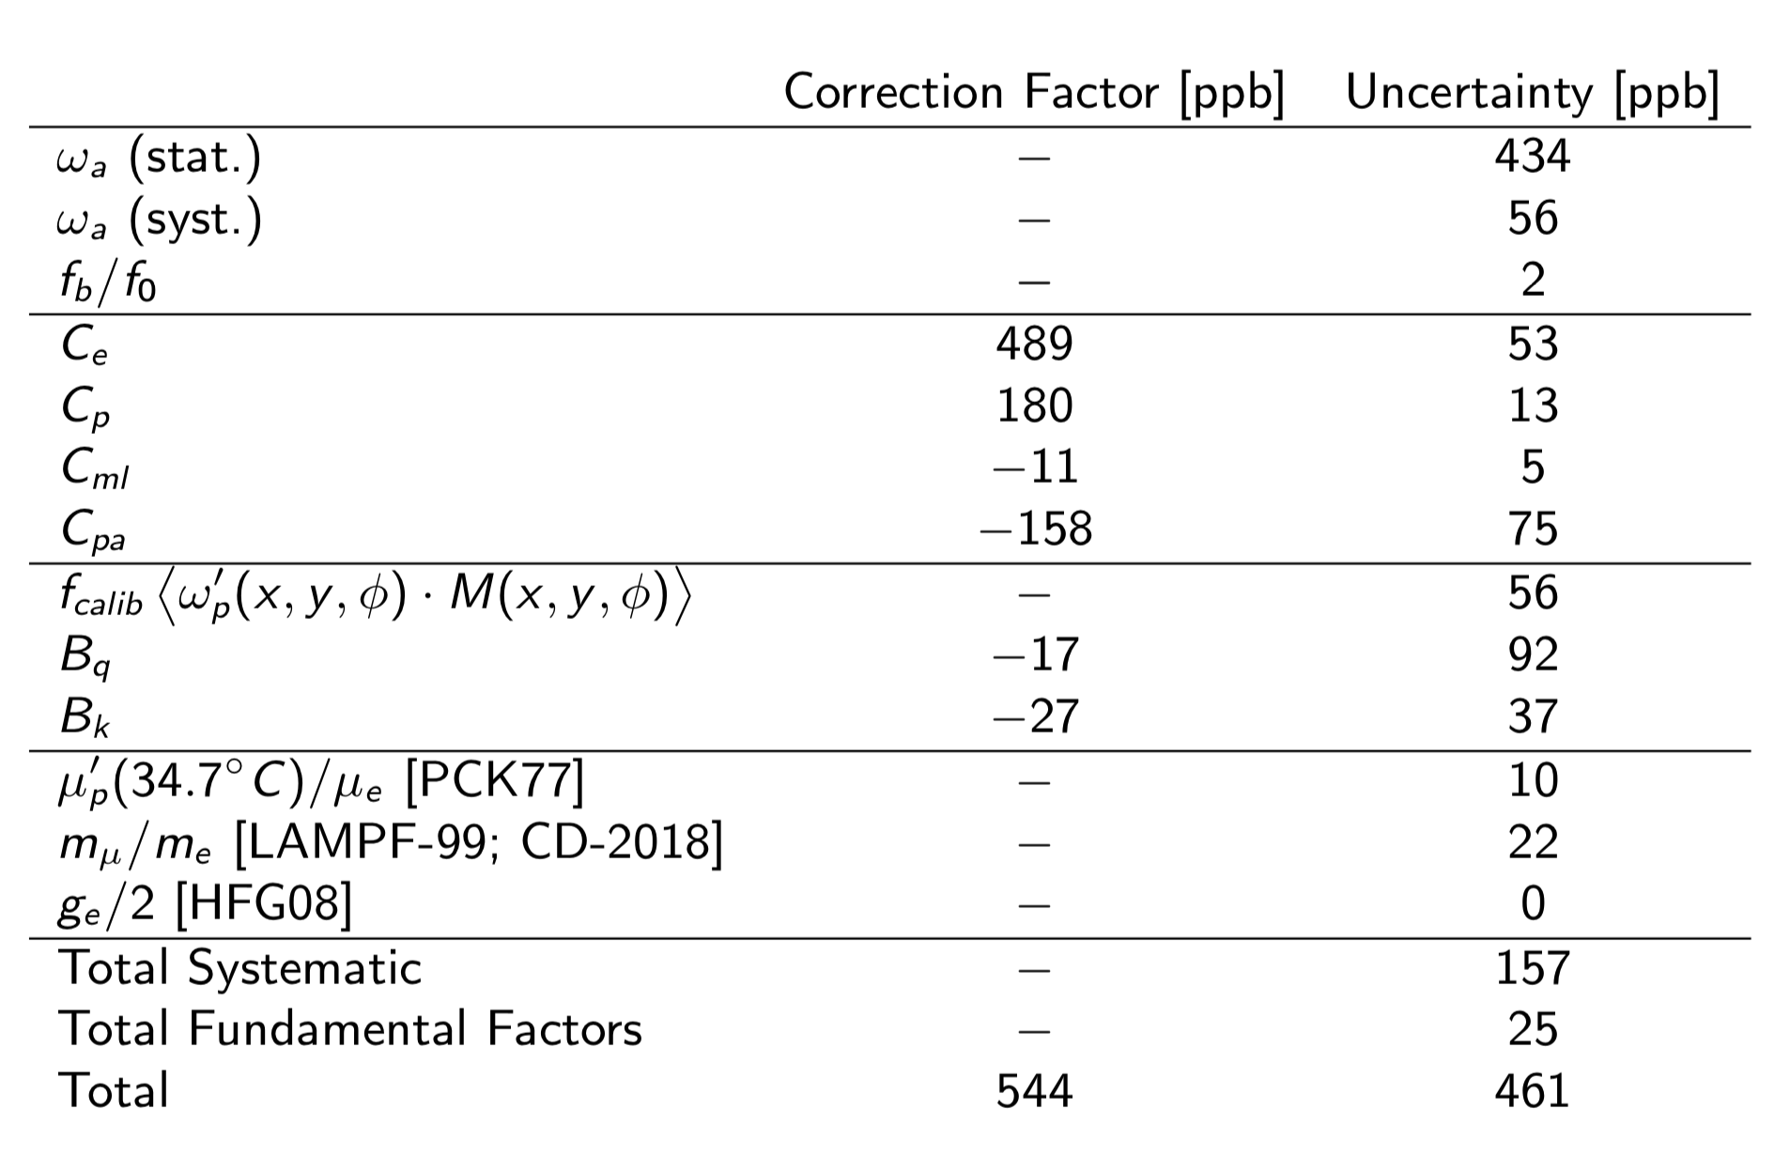
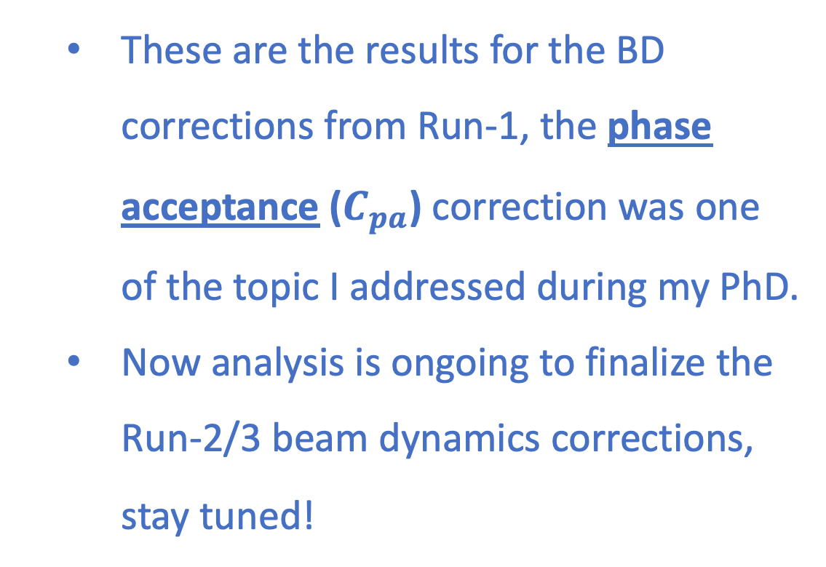

Beam dynamics correction to $ω_{a}$
  These are the results for the BD corrections from Run-1, the phase acceptance ($C_{pa}$) correction was one of the topic I addressed during my PhD.
  Now analysis is ongoing to finalize the Run-2/3 beam dynamics corrections, stay tuned!

Slide 17
Thank you!!!
“The closer you look the more there is to see”
F. Jegerlehner
For any question or just to have a chat – elia@liverpool.ac.uk

Slide 18
BACK-UP

Slide 19
$ω_{a}$ measurement
See Cedric next talk!
The simplest function which describes the number of emitted positron from muon decay (so called “wiggle plot”) is:
Fit start time 30µs
$$N\left(t\right)=N_{0}⋅e^{−\frac{t}{τ_{μ}}} ⋅\left(1+A⋅\cos\left(ω_{a}⋅t+φ\right)\right)$$
From the FFT of the fit’s residual shows many frequency peaks due to beam dynamics effects that are not modeled by the previous function.

Slide 20
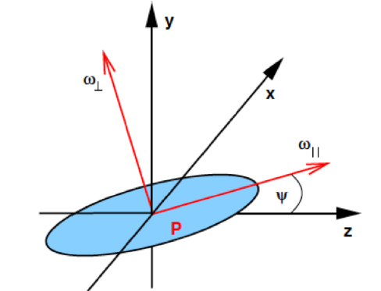
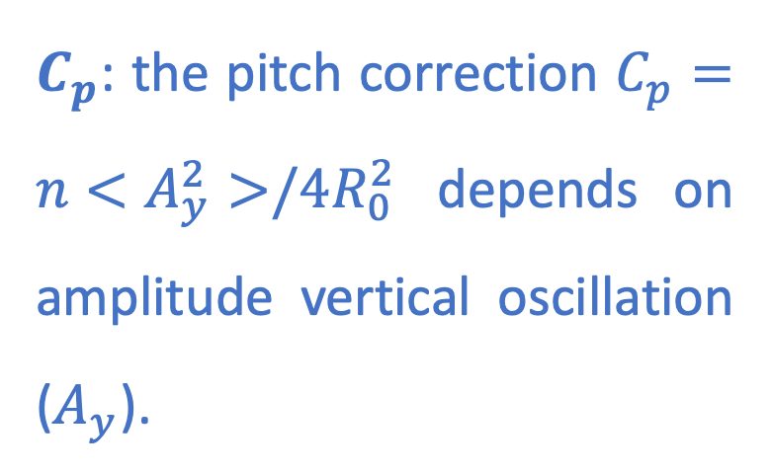

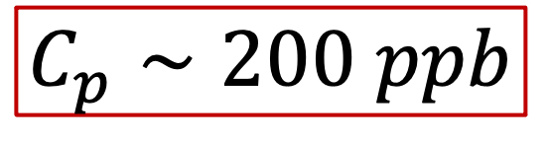
Beam dynamics correction to $ω_{a}$: $C_{p}$
Considering the extended expression of the spin precession frequency in a magnetic field:
$$\vec{ω_{a}}=\frac{e}{m}\left[a_{μ}\vec{B}−\left(a_{μ}−\frac{1}{γ^{2}−1}\right)\left(\vec{β}×\vec{E}\right)−a_{μ}\left(\frac{γ}{γ+1}\right)\left(\vec{β}⋅\vec{B}\right)\vec{β}\right]$$
$C_{p}$: the pitch correction $C_{p}=n<A_{y}^{2}>/4R_{0}^{2}$ depends on amplitude vertical oscillation ($A_{y}$).
$$C_{p}∼200 ppb$$

Slide 21
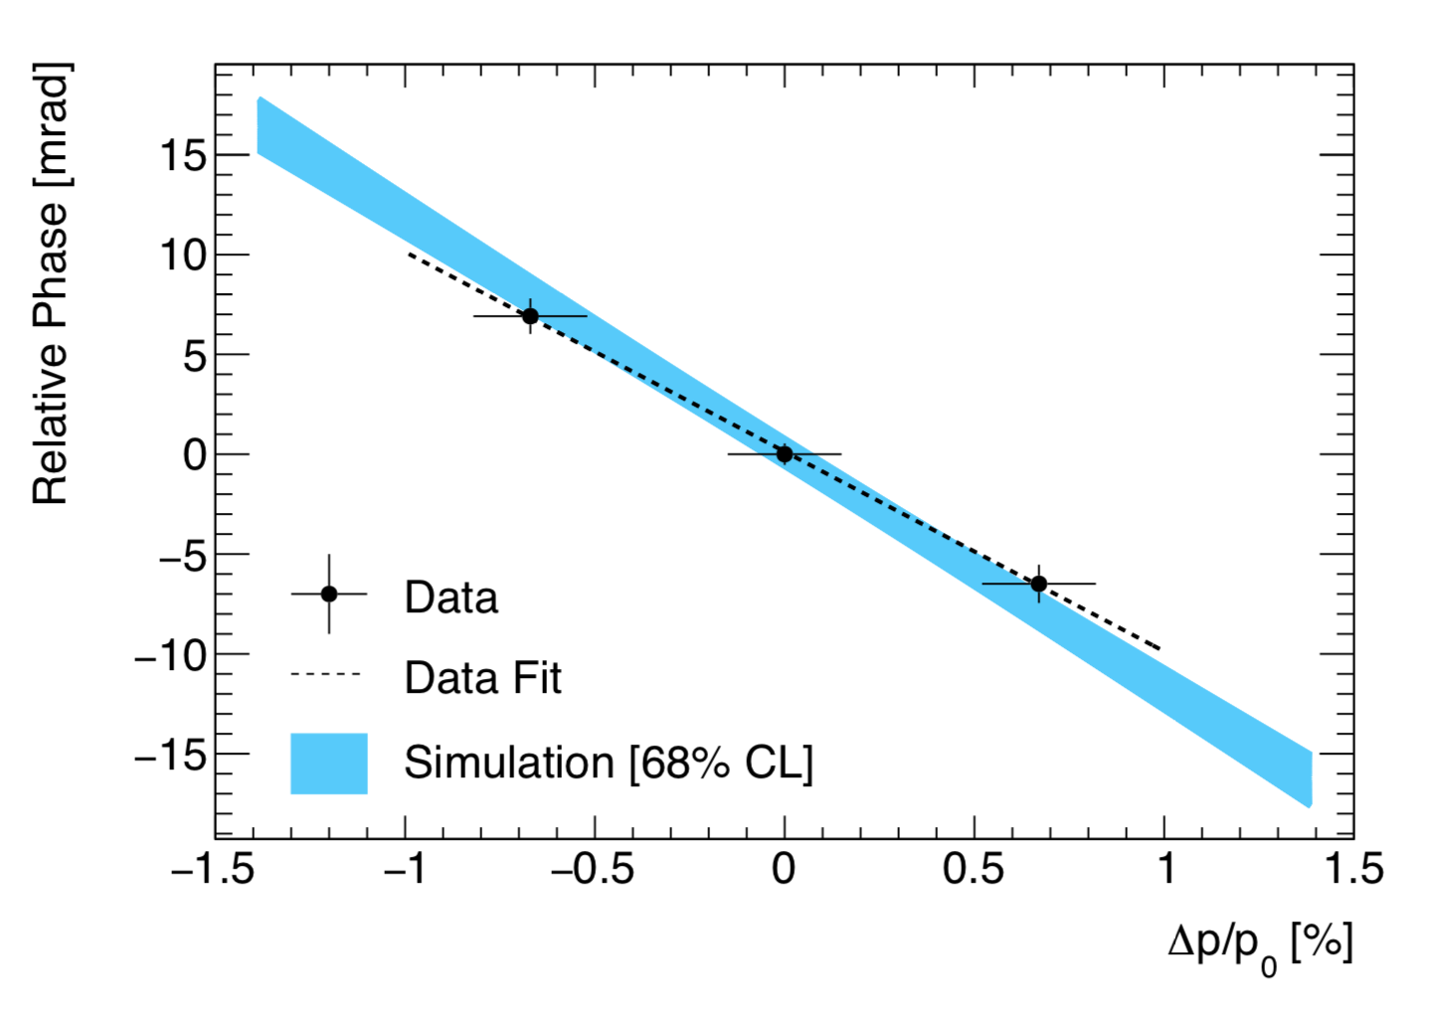
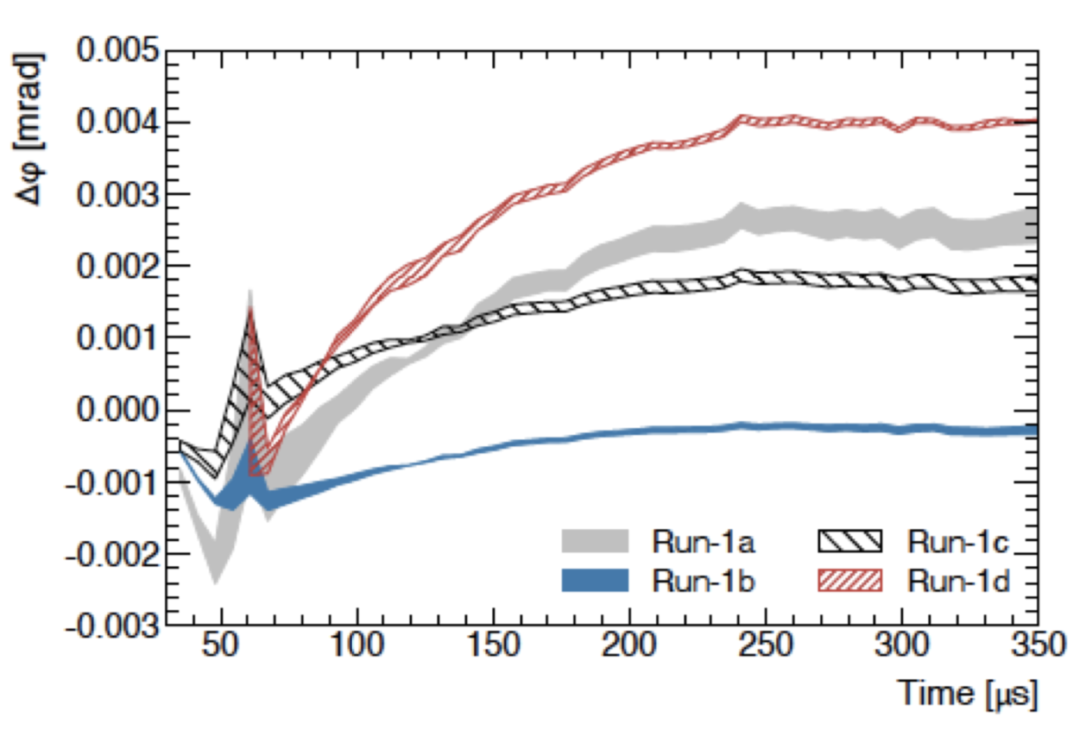
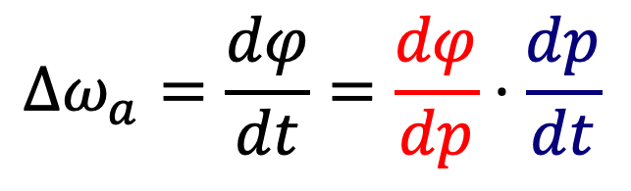
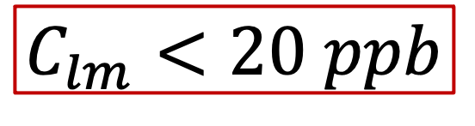
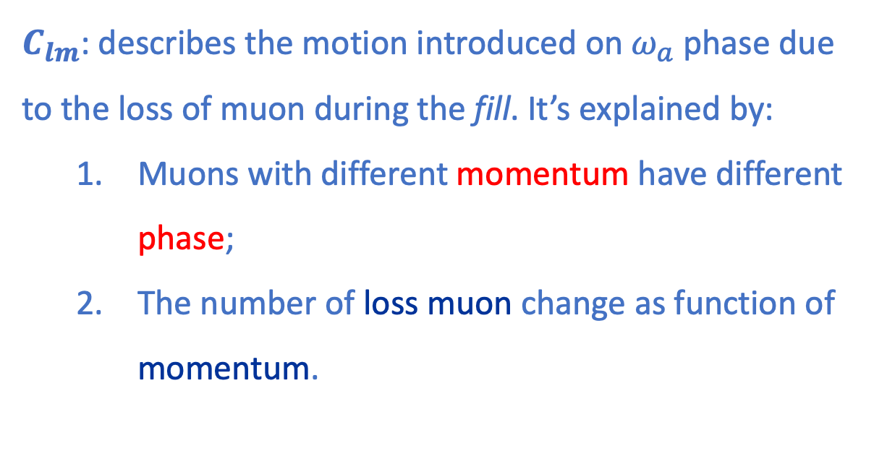


Beam dynamics correction to $ω_{a}$: $C_{lm}$
$C_{lm}$: describes the motion introduced on $ω_{a}$ phase due to the loss of muon during the fill. It’s explained by:
  Muons with different momentum have different phase;
  The number of loss muon change as function of momentum.
$$\frac{dφ}{dp}$$
1)
2)
$$Δω_{a}=\frac{dφ}{dt}=\frac{dφ}{dp}⋅\frac{dp}{dt}$$
$$C_{lm}<20 ppb$$

Slide 22
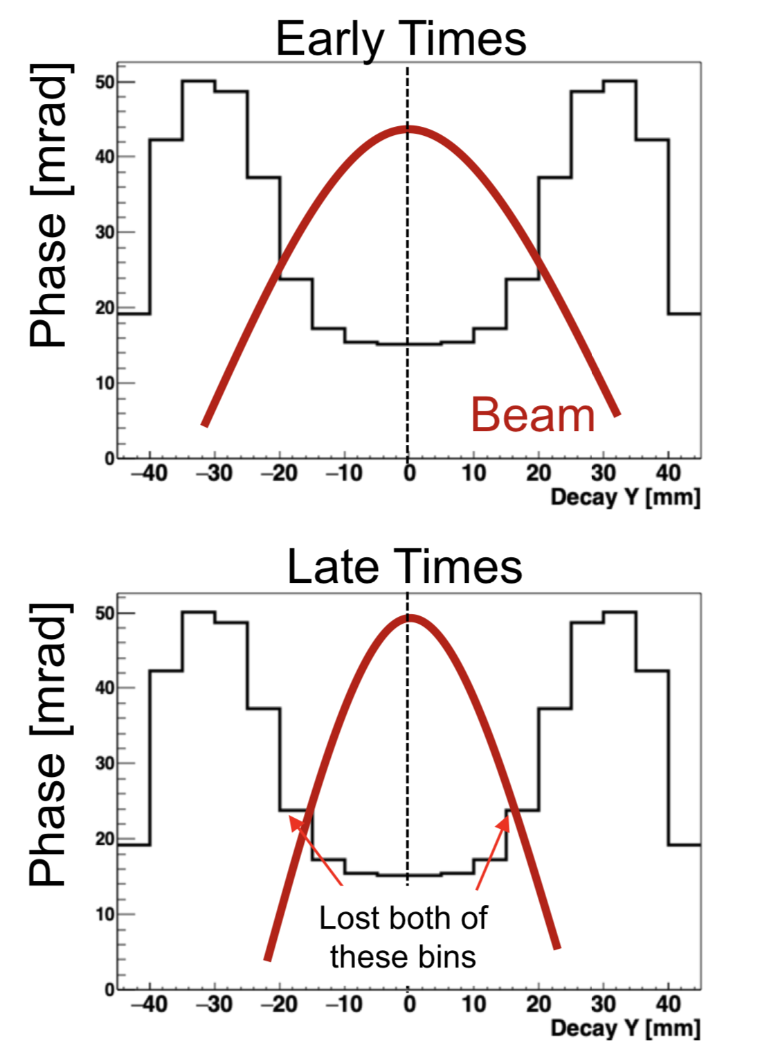

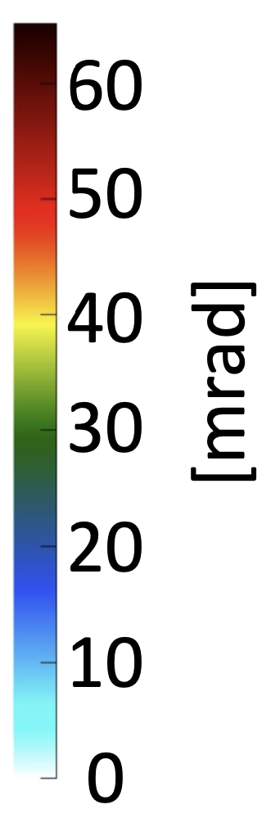
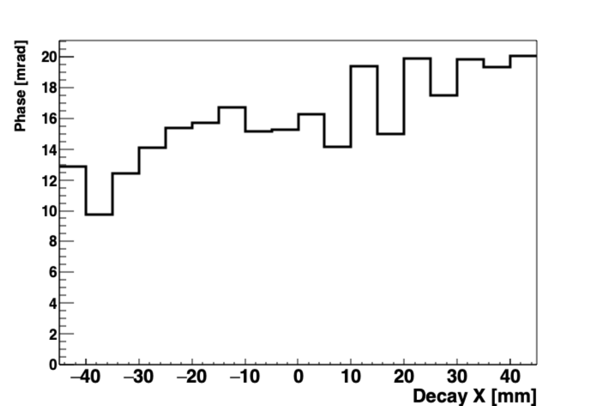





Phase acceptance: Beam Motion Effects
VERTICAL WIDTH VARIATION
$$φ↓$$
$$φ↓$$
RADIAL MEAN VARIATION
Early Times
Late Times
Phase [mrad]
$$φ↑$$
$$φ↑$$
Gained half of this bin
Beam
Beam

