Slide 1
$ω_{a}$ Measurement in Muon $g−2$ Experiment at Fermilab
Ce Zhang
Particle Physics Annual Meeting
19/05/2023

Slide 2
$ω_{a}$ Measurement in Muon $g−2$ Experiment at Fermilab
Introduction to $ω_{a}$
$ω_{a}$Analysis in Run-4/5/6
Data & Expectations
First Result
Changes in Run-4/5/6
Summary

Slide 3
Introduction to $ω_{a}$
Anomalous precession frequency of the muon
Elia’s talk (beam dynamics)
Muon ‘g-2’
Saskia’s talk

Slide 4
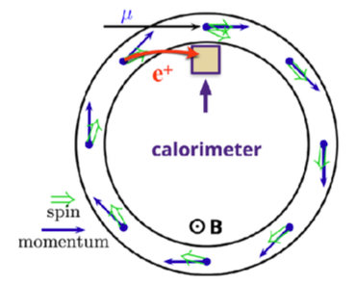
Introduction to $ω_{a}$
Anomalous precession frequency of the muon
Elia’s talk (beam dynamics)
Spin precession frequency
Cyclotron frequency
$ω_{a}$measurement:
Polarized muons from Fermilab beamline
Decay positron follows muon spin
Calorimeters measuring positron energy and time

Slide 5
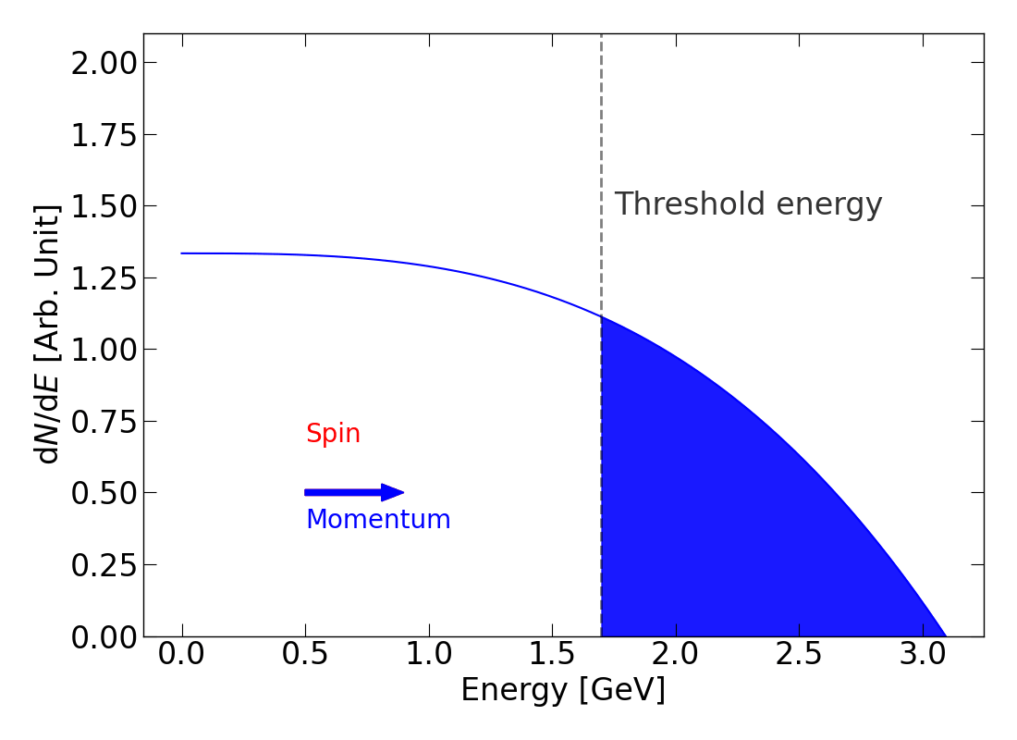
Introduction to $ω_{a}$
Fitting the modulation (“wiggle plot”)
A naïve 5-parameter fit:
Elia’s talk (beam dynamics)

Slide 6
Introduction to $ω_{a}$
The Full fitting function used in Run-2/3:
$$N\left(t\right)=N_{0}e^{−\frac{t}{γτ}}\left[1+A∙A_{BD}\left(t\right)∙cos\left(ω_{a}t+φ_{BD}\left(t\right)−φ_{0}\right)\right]$$
$∙N_{CBO}(t)∙N_{VW}(t)$ $∙N_{y}(t)$ $∙N_{2CBO}(t)$ $∙Λ(t)$ $∙N_{CBOVW}(t)$
$$γτ_{μ}$$
CBO
$$ω_{a}$$
2 CBO
VW
VO

Slide 7
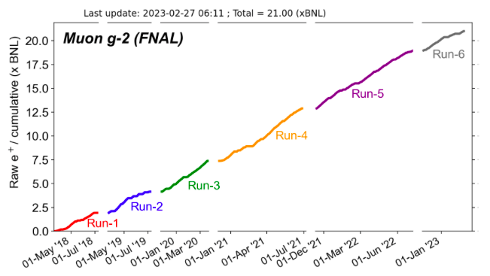
$ω_{a}$ Analysis in Run-4/5/6
Data taking & Expectations
Collected > 21 x BNL data → TDR goal reached this February
Run | Stat. precision [ppb]
Run-1 | 434 | Published (2021)
Run-2/3 | 202 (estimated) | This year
Run-4/5/6 | 107 (estimated) | Just started
Combination
Run-1+2/3 | 183 (estimated)
Run-1+2/3 + 4/5/6 | 92 (estimated)

Slide 8
$ω_{a}$ Analysis in Run-4/5/6
Data taking & Expectations
$ω_{a}$ analysis groups:
$ω_{a}$ analysis groups
Boston
Cornell
Europa (Liverpool + Italy )
IRMA
Shanghai
University of Kentucky
University of Washington

Slide 9
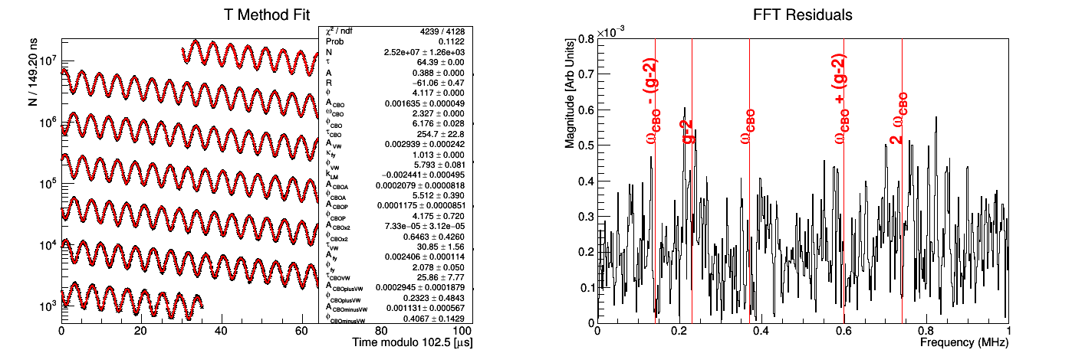
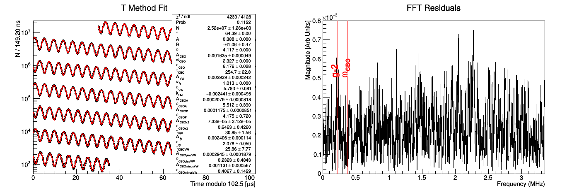
$ω_{a}$ Analysis in Run-4/5/6
First Result (Run-4 subsets A-E)
zoom-in view
$χ^{2}/$ndf | 4239/4128 = 1.027
Prob | 0.1122
R value (‘blinded’ $ω_{a}$) [ppm] | $$−61.06±0.47$$

Slide 10
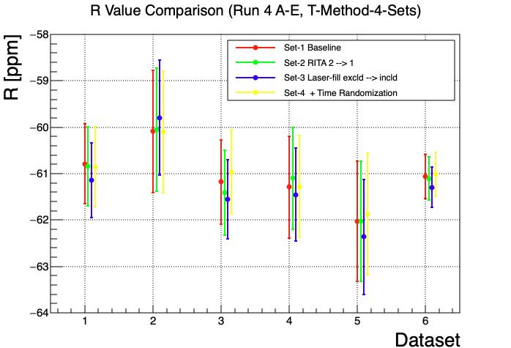
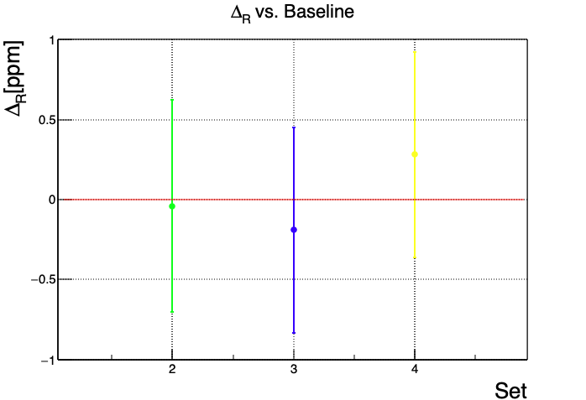
$ω_{a}$ Analysis in Run-4/5/6
First Result (Run-4 subsets A-E)
Less than ~0.5 ppm found within the allowed difference
A B C D E Combine

Slide 11
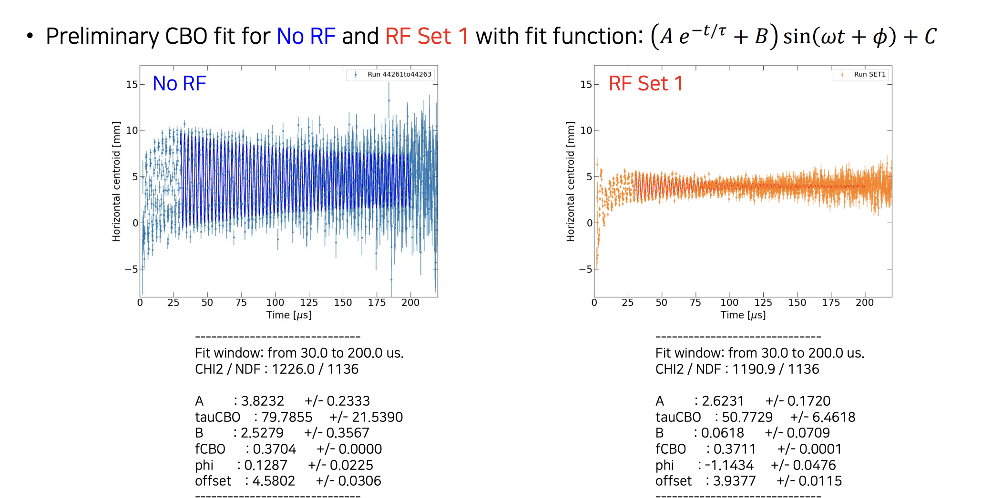
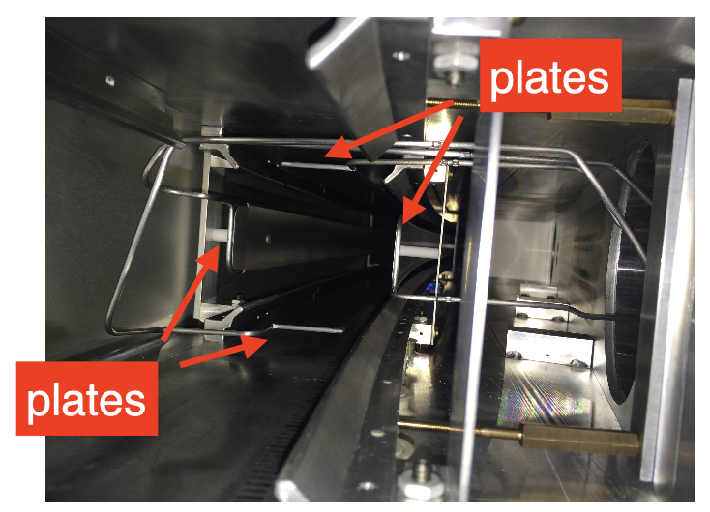
$ω_{a}$ Analysis in Run-4/5/6
Changes in Run-4/5/6
Quadrupole RF On
Start from end of Run-4
Reduce CBO envelope
The CBO envelopes are significantly different with/without the RF on. Our models need to be evaluated.

Slide 12
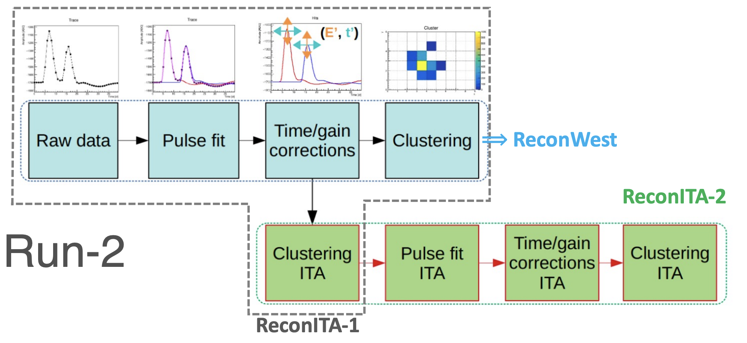
$ω_{a}$ Analysis in Run-4/5/6
Changes in Run-4/5/6
Quadrupole RF On
Start from end of Run-4
Reconstruction updates:
Recon-East
Recon-West
ReconITA1 (Run-2/3) → ReconITA2 (Run-4/5/6)

Slide 13
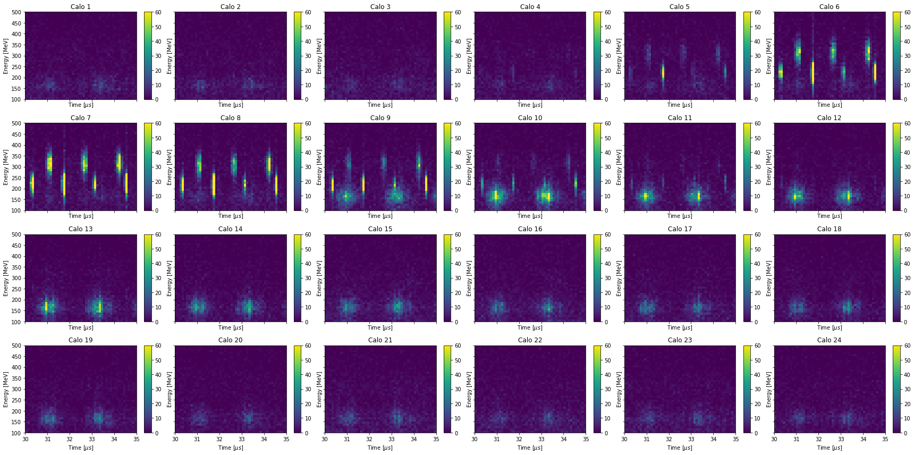
$ω_{a}$ Analysis in Run-4/5/6
Changes in Run-4/5/6
Quadrupole RF On
Start from end of Run-4
Reconstruction updates:
Recon-East
Recon-West
ReconITA1 (Run-2/3) → ReconITA2 (Run-4/5/6)
Proton/Deuteron leakage in calorimeters
Energy-time spec in 24 calorimeters
(Run-4A)

Slide 14
Summary
$ω_{a}$ analysis in Run-4/5/6 in Fermilab Muon g-2 just started
target 21xBNL data taken
Europa group is now leading the analysis
Expected to be a three-year work & publication in 2025
Existing systematics confirmed similar to Run-2/3
New systematics discussed according to changes in Run-4/5/6
Thank you!

Slide 15
Backup

Slide 16
New Puzzles: Protons and Deuterons
Pushing an energy binned fit down to ~300 MeV yielded some interesting peaks in the residuals.
In addition to the previously observed deuterons at ~350 MeV and ~0.5 MHz, there was a new peak at ~200 MeV and ~0.565 MHz.
From Jim Morgan:
$=0.50765544 MHz$
$=0.56785595 MHz$
FFT of Residuals of an Energy Binned fit in Calo 6

Slide 17
New Puzzles: Protons and Deuterons
Run 4A : Triple Coincidences
Triple coincidences in the kicker region are very highly contaminated with proton/deuteron leakage from upstream

