Slide 1
MuEDM Experiment at PSI
Joe Price – University of Liverpool

Slide 2
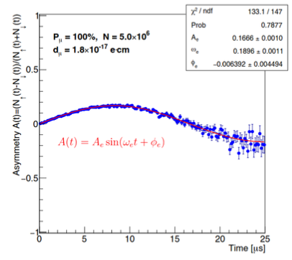
Frozen spin technique
g-2 term
EDM term
Relativistic spin precession of a charged particle (Thomas-BMT equation)
By applying an appropriate radial E-field to the muon we negate the g-2 term.
Ideally any observed spin precession would be due to a non-zero EDM.
Advantage of frozen spin: Every positron is useful!

Slide 3
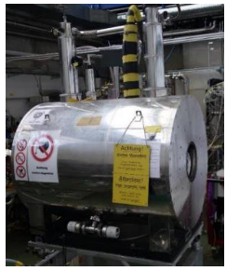
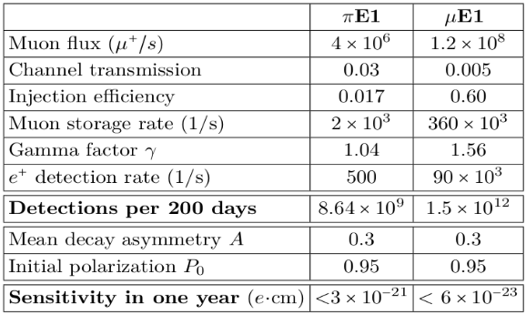
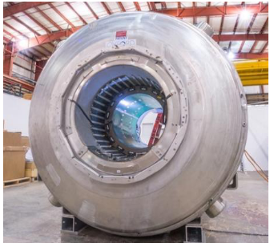
MuEDM experiment at PSI
Phase I
28 MeV muons from πE1
Existing PSI Solenoid at 3T
Bore diameter 200mm
Demonstrate frozen spin technique
Phase II
125 MeV muons
Larger magnet with diameter ~900mm
Lower B-field for better temporal and spatial stability

Slide 4
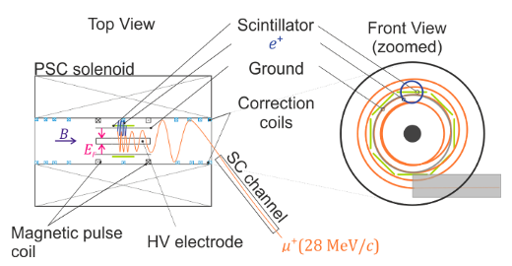
Straw tracker @ PSI
Originally about 100mm of longitudinal space for tracker
The closeness of the layers to the storage region determines minimum momentum acceptance
Possibility of inner and outer layers and more…

Slide 5
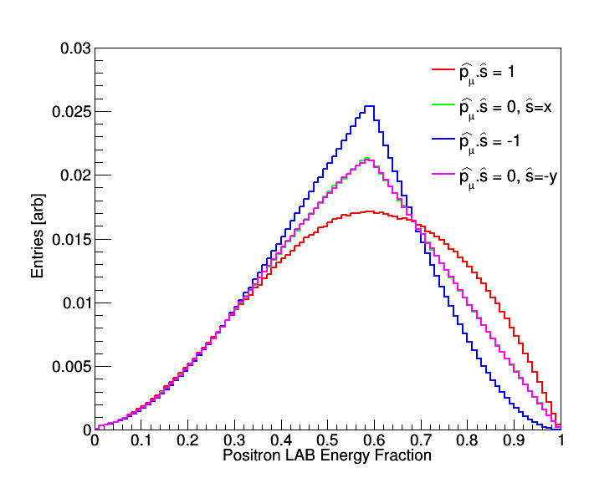
g-2 oscillation – Phase I
For Phase I (p = 28MeV) maximum energy is ~68.65 MeV
LAB frame e⁺ Momentum distribution depends on polarisation orientation
For frozen spin method and no EDM this will have no time dependence
Acceptance will typically cut off low momentum, so will see oscillation in detected number of e⁺
|p_{μ}| = 28MeV

Slide 6
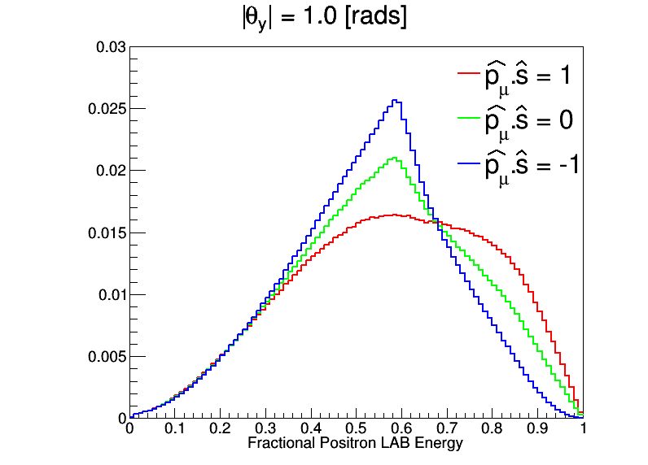
Effect of Acceptance – Phase I
λ=1 → |p|≈68MeV
Apply a simple absolute cut on the longitudinal angle as proxy for acceptance…
|p_{μ}| = 28MeV
Amplitude of oscillation at this λ

Slide 7
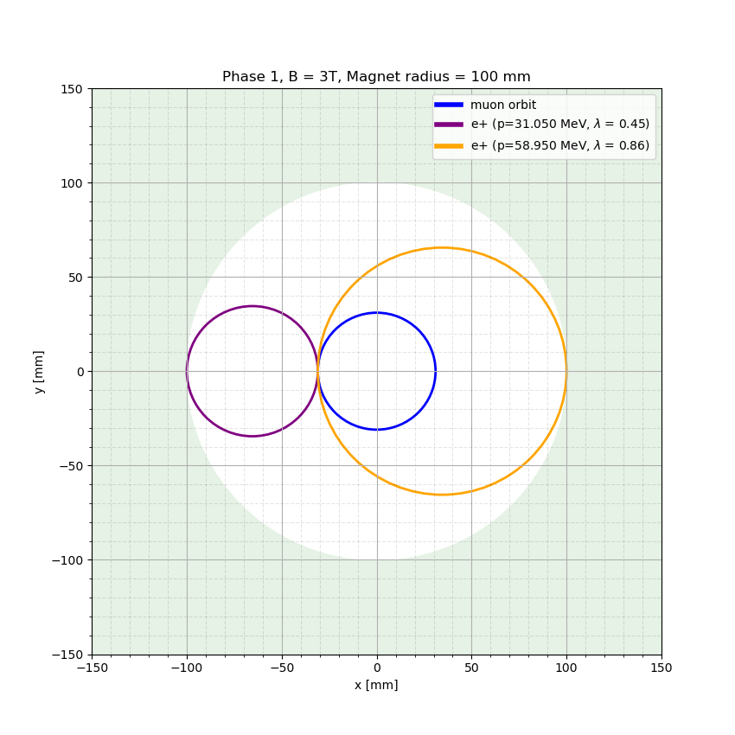
Momentum Acceptance
A simplified version of the momentum acceptance
Here the magnet bore is 100mm radius, and the muon orbit is at r=30mm
Any positron above 59 MeV will hit the magnet, regardless of decay direction
For (31 < p < 59) MeV positrons it depends on the decay direction

Slide 8
Including ‘Petals’
Two layers + petals: In this round of simulation we used 8 ‘petal’ layers, 100mm long
100 mm
magnet
100 mm
47.5 mm
35 mm
35 mm

Slide 9
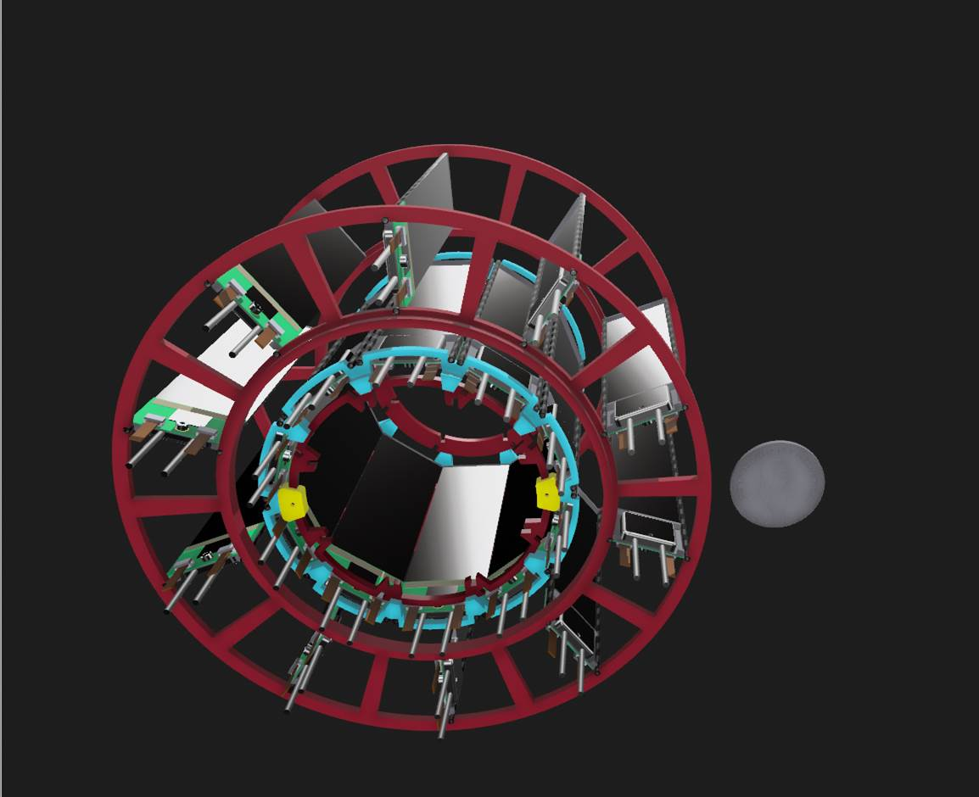
Including ‘Petals’

Slide 10
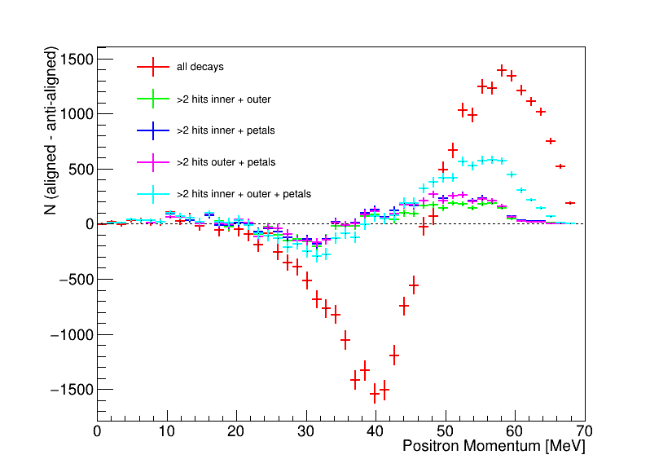
Including Petals – g-2 sensitivity (nhits >= 3 )
Restores sensitivity (somewhat) with extra ‘petal’ layers
To get momentum would need to get longitudinal measurement
Strip detector can only measure transverse momentum…

Slide 11
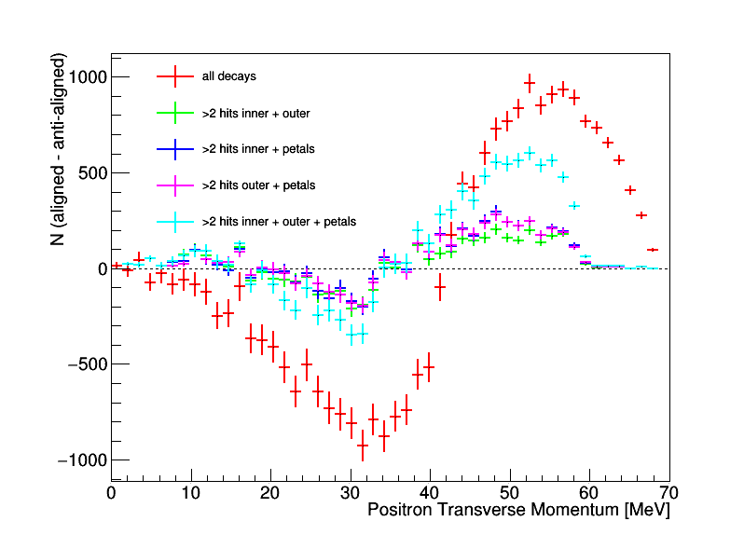
Including Petals – g-2 sensitivity (nhits >= 3 )
Still good sensitivity using transverse momentum only
Figuring out how much would increasing longitudinal dimension help

Slide 12
Conclusions
MuEDM experiment at PSI will be split into 2 phases
Phase I – Demonstrate the frozen spine method
Phase II – Measure the muon EDM to ~10⁻²³e.cm
Tracker used in phase-I to confirm frozen spin method, by checking g-2 oscillation is frozen out
Optimising the detector position/orientation for this purpose
For Phase II we hope a pixel detector can measure both the g-2 oscillation and the EDM

