Slide 1
Storage Ring Proton EDM Experiment
Themis Bowcock
List to be revised and updated

Slide 2
Proposed Experiment at Brookhaven
Includes many labs
Universities not shown!!

Slide 3
Measure pEDM in a storage ring
Proton EDM sensitivity 10⁻²⁹ ecm
Improves sensitivity to QCD CP-violation by three orders of magnitude over neutron EDM
NP reach to PeV
Sensitive probes CP-violation in Higgs Sector
W. Marciano, Overview EDM theory,
.

Slide 4
Recap
Why does quantum chromodynamics (QCD) seem to preserve CP-symmetry?
The strong CP problem is sometimes regarded as an unsolved problem in physics, and has been referred to as "the most underrated puzzle in all of physics."^{[1][2]}
For a single quark mass m
Physical CP (6 quarks) we end up with a non-perturbative prediction that the n/p EDMs depend on the quark masses such that
CP vIolating …
But d_{N} very small <10⁻²⁶ecm
Fine tuning!!!

Slide 5
Sensitivity
Diameter of sun 1.3x10¹¹ cm
10⁻²⁹ ecm distance < 1 fm

Slide 7
How does it work?
The proton beam must be highly polarized in the ring plane
The momentum matches the magic value of p = 0.7007 GeV/c, where the ring-plane spin precession same as the velocity precession
a condition called “frozen spin.”
The polarization must initially be along the axis of the beam velocity.
The electric field acts along the radial direction toward the center of the ring (E) perpendicular to the axis of the EDM.
the spin will precess in the vertical plane

Slide 8
What are we doing?
Design the bending dipoles
Electrical fields (FEA) < ppm precision
Mechanical Control
Design of support, installation of dipoles
10-20% of project (180M$)
Prototype of production of dipole plates (UK)
5MV/m over huge surface
Polarimetry
Already invested effort on CMOS for advanced polarimeter at COSY
Strong candidate for future polarimeter detector

Slide 9
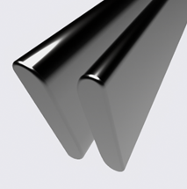
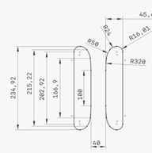
Design of Key Components for Operation

Slide 10
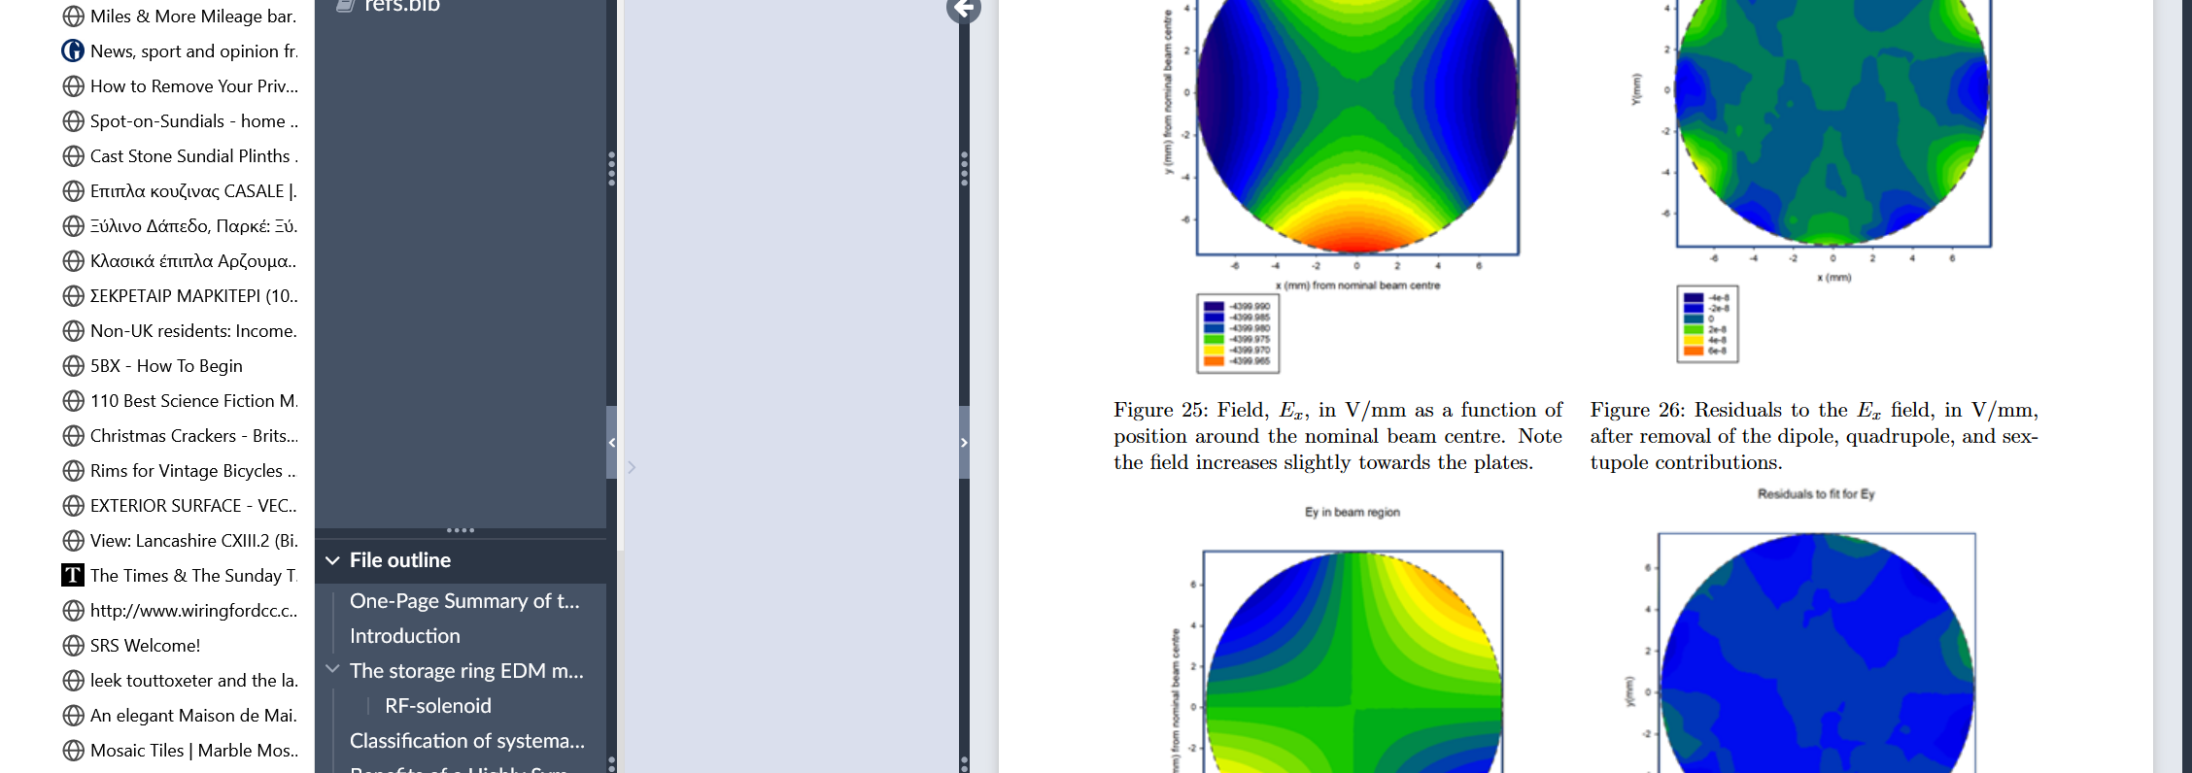
FEA
Optimize electrode shape
Need to know field very precisely, fit up to octupole contibutions

Slide 11
Control Pitch, Roll, Yaw

Slide 12
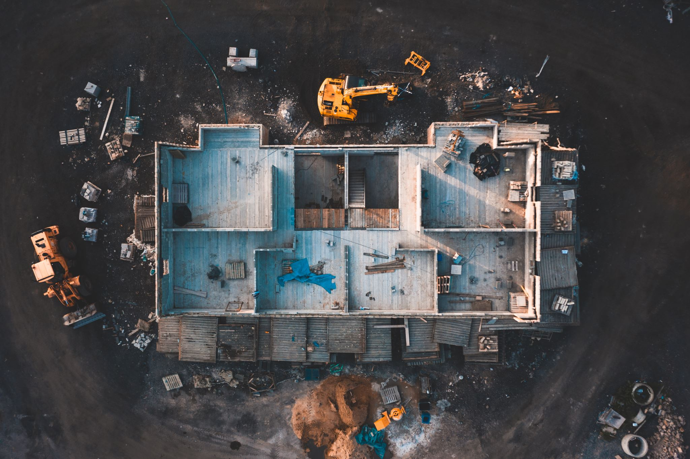
Exciting Project going to P5
Needs to be installed in AGS by ~2032
Look for recommendation by P5 this year
Look for funding by DOE by FY 2026
Could be a major construction project for UK
Opens new technique to very exciting physics

