Slide 1
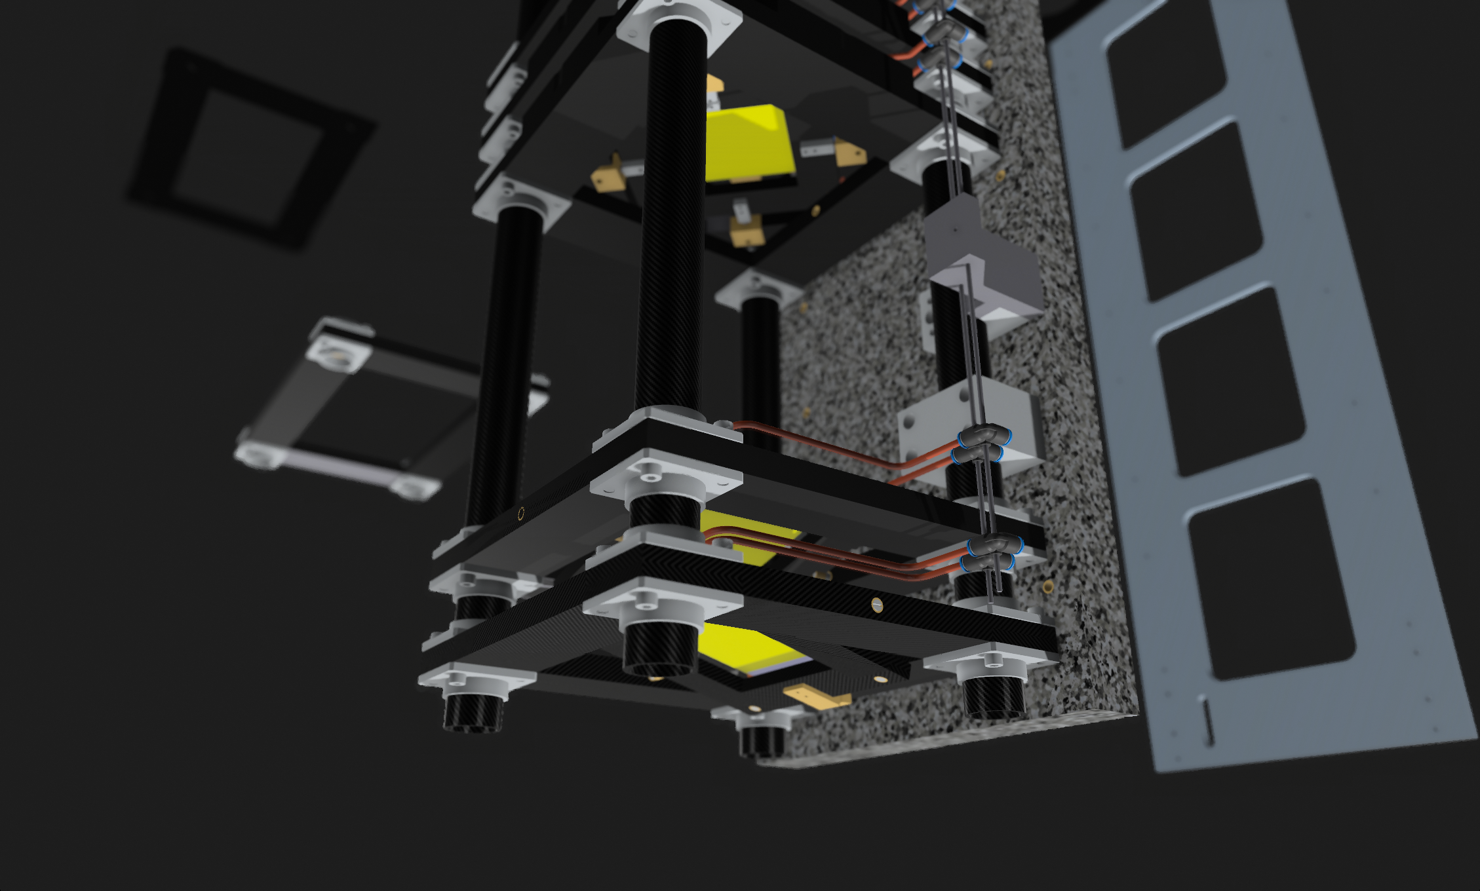
MUonE CF support /BMS+
Status: T.Bowcock
10/10/23

Slide 2
Tracker Station -> BMS
Modules
Thermo-kinematic mounted

Slide 3
Production of Prototype
Materials
CF tubes
Weave
Procured and tested and cut
CHE
CTE
Straightness etcm(Tubes have small taper and bend)
Determined parameters for water-jet cut
Design modified (meeting last week)
Mass Scale Production (!)
Estimate of time for production of 20 stations < 3 months
Make it Easy

Slide 4
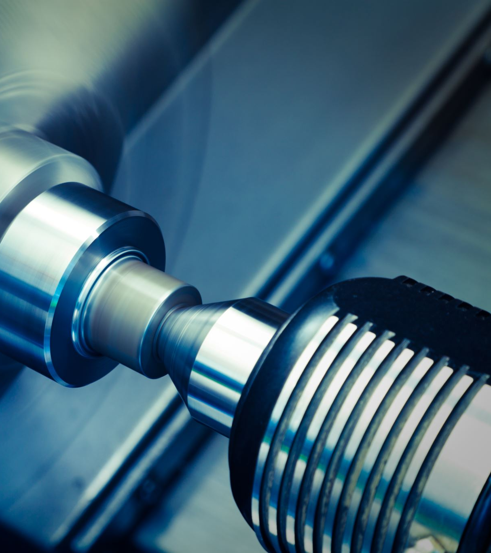
Liverpool workshop being upgraded
3rd 5 axis axis machine (July 23)
2m x 1m x 1m working volume (!)
Substantial building modifications to install(!)
Workshop back online around 1st Nov.
ATLAS, Mu3e and MuonE are the priorities
This can been seen in Nov in our Muon Workshop!!
And parts too….

Slide 5
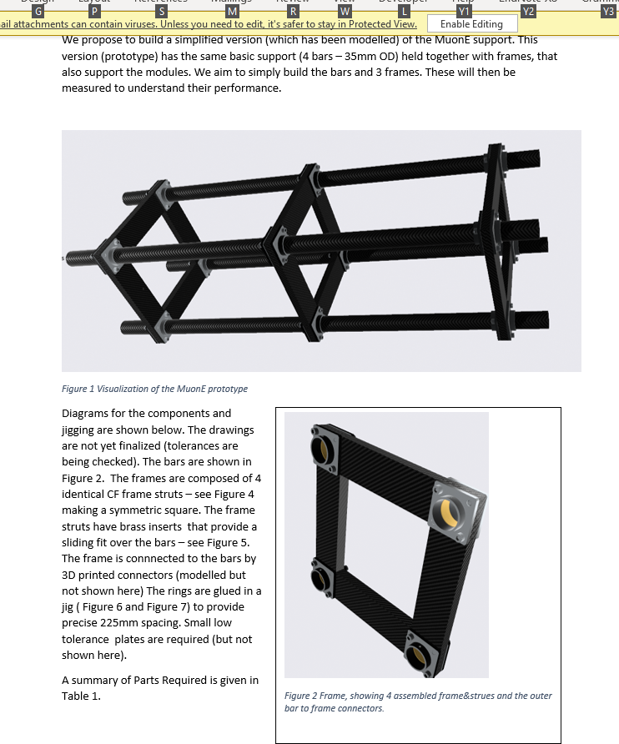
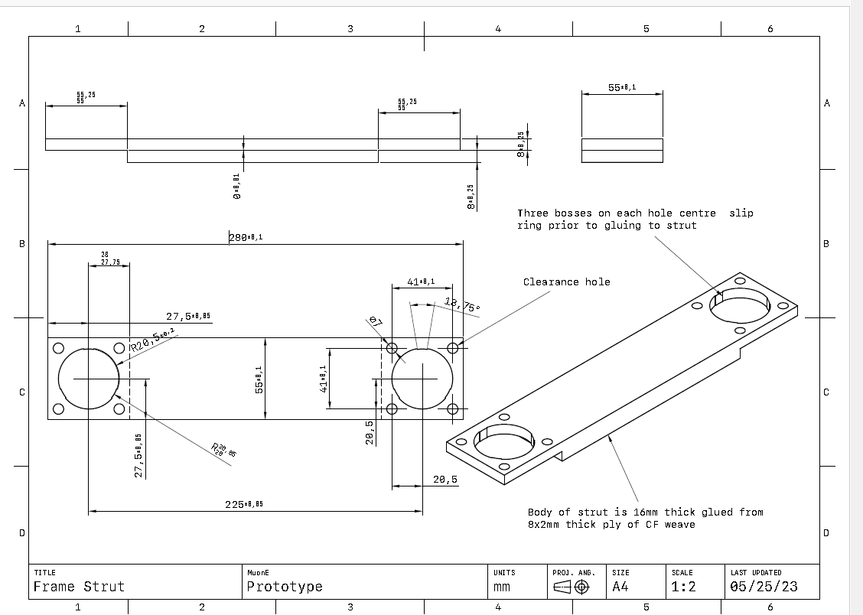

Slide 6
Timeline
First version complete Nov 23
Study Freestanding CTE (attach small “balls”)
Dec 23
Study Al base (onto which mounted)
Compare with Granite Base
Attachment
Sits on feet but clamped in x, y
One side free to “slide” in x,z
Jan 23 Full mechanical prototype
Feb 23 Build inner frames and start on pipes (all the runs designed)

Slide 7
So…
The first version station we will see later today
About to be tested – this/next week
BUT
Preliminary look looks good
We believe this will be close to 0CTE without further work
May be able to substantially simplify module / support
We do know from our engineers it is easy to mass-produce and “accurate” – discussion later.
Technical Discussion to be had (Different for BMS/Tracker)
We can achieve true 0 CTE (designed this way with custom layup)
If we can live with 1-3 ppm / K even easier (almost completely commercial)

Slide 8
Modifications for BMS
Base –once the x,y,z shown to be stable still need proper mounting onto base. We look at either honeycomb on granite Or Al
To be tested
LOW COST
This design is for 100x100 mm Si
BUT can be extended (trivially) to 100x200
Simplified mounting (NO ROTATION)
Assuming also not so strict on 0 CTE
Special thermo-kinematic mounting not required

Slide 9
CF Summary
By Jan/Feb we should be able to have a mechanical version compatible with main MuonE
Initial testing and metrology
For testing in Italy
Next step (another 6 weeks)
Compatible with cameras and CMS module mounting
Inner frames must be built/machined
Modified cooling routing only major change

Slide 10
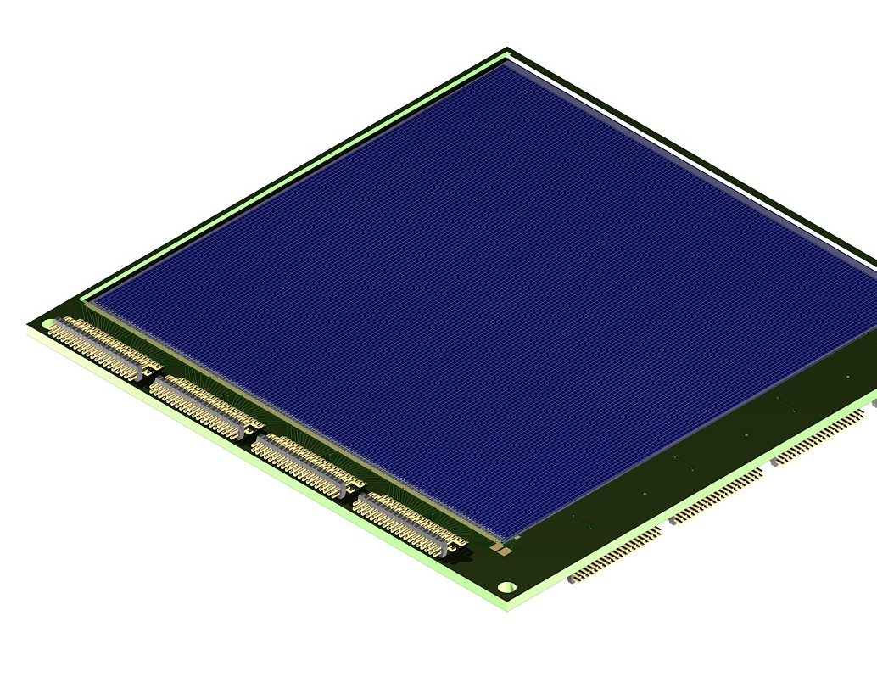
BMS Specific
100x200 module – see talk for where and why
We had planned to look at alternative Si
Micron DAMPE Si (produced for space-project for Italy)
100x100mm Si with O(100) micron pitch
Overkill get < O(20) um resolution
300 microns thick
We have the UK stock of these (20 off)
WE CAN PROVIDE TO EXPERIMENT
Possible to equip with possible ASIC (SALT?)
Design of hybrid etc
This is currently on hold for . Use of CMS modules preferred
Relieves issue of DAQ integration

