Slide 1


Status of the search for a muon EDM using the frozen-spin technique
Philipp Schmidt-Wellenburg :: Scientist :: Paul Scherrer Institute
2nd Workshop on Muon Precision Physics 2023

Slide 2


















CP violation & edm
$$\vec{μ}=μ\vec{s}$$
$$\vec{d}=d\vec{s}$$
A non-zero particle EDM
violates P, T and,
assuming CPT conservation, also CP.
$$|\left.↑\right\rangle$$
$$|\left.↑\right\rangle$$
$$U=− \vec{μ}⋅\vec{B}$$
$$U=− \vec{d}⋅\vec{E}$$
$$ΔU=ℏω_{e}$$
$$|\left.↓\right\rangle$$
$$|\left.↓\right\rangle$$
$$B$$
$$E$$
`
T
T
$$|\left.↑\right\rangle$$
$$U=−\vec{μ}⋅\vec{B}$$
Baryon asymmetry
of the Universe
$$U=\vec{d}⋅\vec{E}$$
$$|\left.↑\right\rangle$$
$$B$$
$$E$$
Arises “naturally” in
beyond SM theories
EDM
CPV
Strong CP violation
($θ$-term)
Notes:
Symmetries and the breaking of symmetries are an important concept of all modern physics theories.
To better understand the violation of discrete symmetries by an EDM I have made this sketch of the energie levels of a spin-1/2 particle in a magnetic and electric field.
The left side every body is familiar with. It corresponds to the classical zeeman splitting in atoms. Depending on the spin of the particle the magnetic moment will lead to an increase or decrease in energy.
Similar on the right side, the electric dipole moment leads to a similar level splitting in the electric field.
Lets concentrate on the spin up state. [click]
Now we apply a Ti

Slide 3
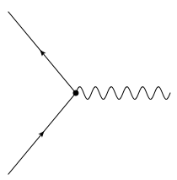



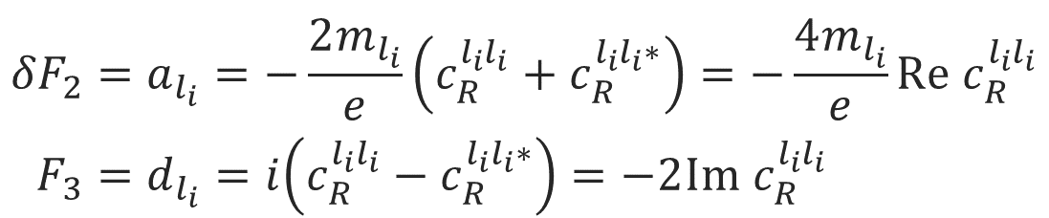

Lepton form factors and dipole moments
$$l_{f}$$
$$ℋ_{eff}=c_{R}^{l_{f}l_{i}}{\overline{l}}_{f}σ_{μν}P_{R}l_{i}F^{μν}+h.c.$$
$$F^{μν}$$
Effective Hamiltonian:
$$l_{i}$$
magnetic-dipole
Anapole - moment
$$\left\langle p′ | J_{μ}^{EM} | p\right\rangle =\overline{Ψ}\left(p^{′}\right)\left[F_{1}γ_{μ}+\frac{iF_{2}}{2M}σ_{μν}q^{ν}+\frac{iF_{3}}{2M}σ_{μν}γ_{5}q^{ν}+\frac{F_{4}}{M^{2}}(q^{2}γ_{μ}−γ^{μ}q_{μ}q_{μ})\right]Ψ\left(p\right)$$
charge
electric-dipole
$${δF}_{2}=a_{l_{i}}=−\frac{2m_{l_{i}}}{e}\left(c_{R}^{l_{i}l_{i}}+c_{R}^{l_{i}l_{i}∗}\right)=−\frac{4m_{l_{i}}}{e}Re c_{R}^{l_{i}l_{i}} \\ F_{3}=d_{l_{i}}=i\left(c_{R}^{l_{i}l_{i}}−c_{R}^{l_{i}l_{i}∗}\right)=−2Im{ c}_{R}^{l_{i}l_{i}}$$
Notes:
For the purpose of a general discussion, effective field theories are particular useful, as no assumptions are needed for the exact realization of a high energy theory.
The most general form in which one can write down the interaction of a lepton current with a external electric/magnetic field is using this electro magnetic current with all possible bilinears.
In this case the first form factor is the electric charge, the second the magnetic and the third the electric dipole moment. The anapole moment I just depicted for completeness
Interestingly the anomalous magnetic moment is connected to the same Wilson coefficient in effective field theories. The real part of this Wilson coefficient is proportional to the anomalous magnetic momentum, while the imaginary part is related to the electric dipole moment.

Slide 4
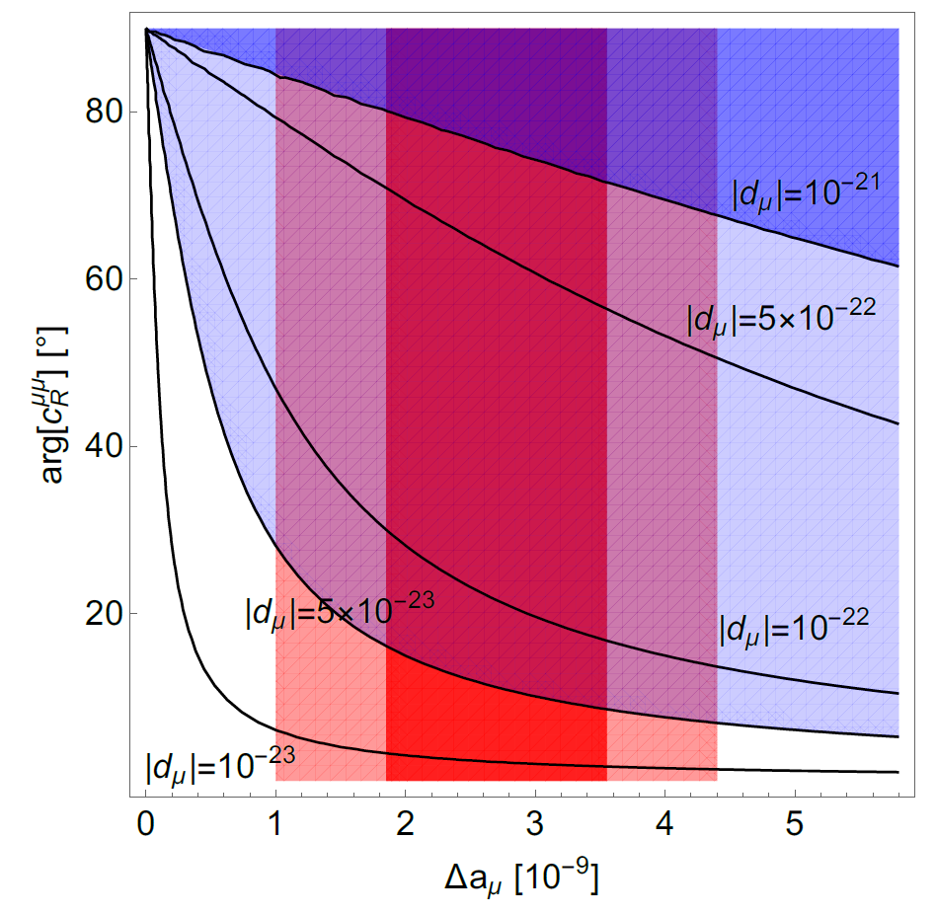
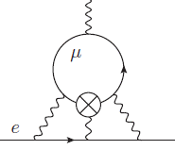
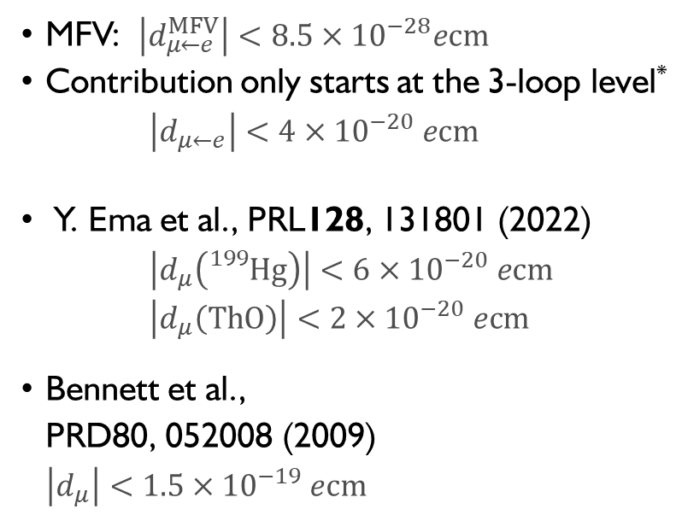
General limits on $μ$EDM
Fermilab/J-PARC
MFV: $\left|d_{μ←e}^{MFV}\right|<8.5×{10}^{−28}ecm$
Contribution only starts at the 3-loop level* $\left|d_{μ←e}\right|<4×{10}^{−20} ecm$
Y. Ema et al., PRL128, 131801 (2022)
$\left|d_{μ}\left({}_{}^{199}{Hg}\right)\right|<6×{10}^{−20} ecm$
$\left|d_{μ}\left(ThO\right)\right|<2×{10}^{−20} ecm$
Bennett et al.,
PRD80, 052008 (2009)
$\left|d_{μ}\right|<1.5×{10}^{−19} ecm$
PSI (frozen spin)
*A.Crivellin, M. Hoferichter, PSW PRD 98, 113002 (2018)

Slide 5
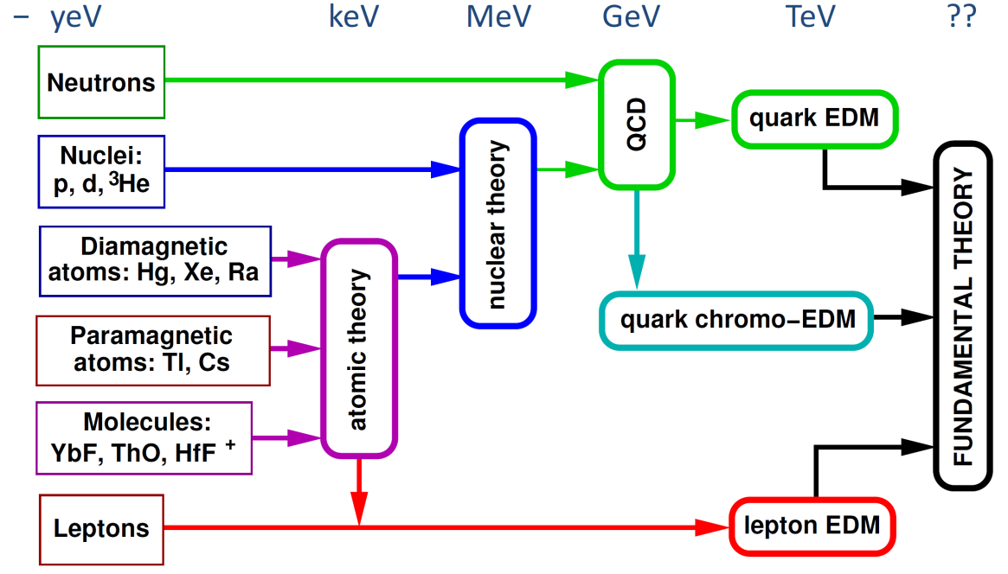
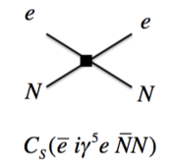

Complementarity of EDM searches
$$≤$$
proton,
neutron
d,³He
electron
Muon
Scheme: adapted from Rob G. E. Timmermans
Notes:
This complementarity will be essential once we stop searching for EDM and actually start finding them.
This Metro map of EDM searches tries to visualize this complementarity. On the far right we see depicted underlying fundamental high energy theory of everything, which should explain the necessary CP violation for baryon asymmetry.
However, already at lower energies you could have CP violating mediated down in effective CP violating terms at low energy.
On the far left you see the actual EDM we are searching and eventually will be measuring. So if you measure the EDM of a bare baryon you only have to make sure to correctly estimate the contributions from the QCD term and quark EDMs,
While the further you walk down the list the more you have an interplay of different contributions to your EDM which could all include some sort of CP- violating effect.
So in polar molecules one will have to understand all the effects of atomic theory, nuclear theory, may be QCD or not…
At the far bottom you have the very simple and pure lepton, essential bare only possible as muon EDM which only relates to leptonic EDM theories – hence a very pure probe.

Slide 6
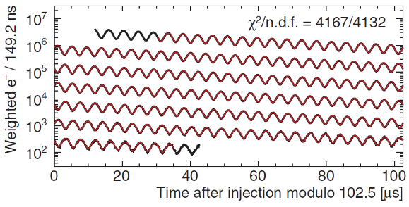
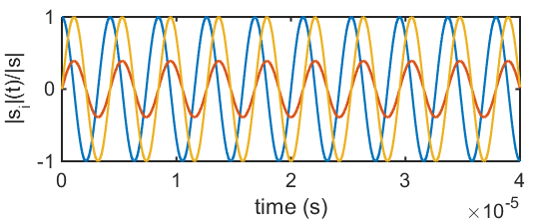

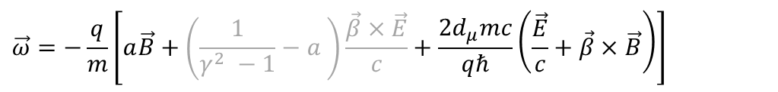


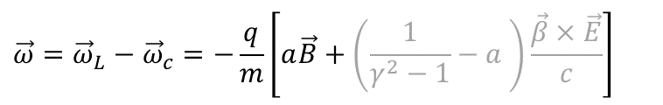







Muon dipole moments and frequencies
$$\vec{ω}=−\frac{q}{m}\left[a\vec{B}+\left(\frac{1}{γ^{2} −1}−a \right)\frac{\vec{β}×\vec{E}}{c}+\frac{2d_{μ}mc}{qℏ}\left(\frac{\vec{E}}{c}+\vec{β}×\vec{B}\right)\right]$$
$$\vec{ω}={\vec{ω}}_{L}−{\vec{ω}}_{c}=−\frac{q}{m}\left[a\vec{B}+\left(\frac{1}{γ^{2}−1}−a \right)\frac{\vec{β}×\vec{E}}{c}\right]$$
g-2 term $ω_{a}$
EDM term $ω_{e}$
B
$${\vec{ω}}_{a}$$
$$\sqrt{{\vec{ω}}_{a}^{2}+{\vec{ω}}_{e}^{2}}$$
$$ζ$$
$$R=7.114 m$$
$$ζ=\operatorname{atan}\left(\frac{2d_{μ}βcm}{a}\right)$$
$$\vec{s}$$
FNAL* & JPARC**:
$$σ\left(d_{μ}\right)≈{10}^{−21}ecm$$
$${\vec{ω}}_{e}$$
[Abi et al., PRL126 141801(2021)]
[*Chislett et al., EPJConf.118 01005(2016), Abi et al., PRL126 141801(2021), **Abe et al., PTEP053C02 (2019)]
Notes:
Many of you probably know about the g-2 measurement of the muon at Fermilab.
The principle physics are described in the equation. The difference between the Larmor frequency of the muon, essentially the precision due to the magnetic moment, and the cyclotron frequency of the muon moving in a magnetic and electric field.
The muon moves along its reference orbit perpendicular to the main magnetic field. Due to the small anomalous magnetic moment the difference is not exactly zero and one can observe the famous wiggle plot by measuring in the number of decay positrons per time.
The electric field is required for steering the muon inside the storage ring. By selecting the correct momentum the electric term can be set to zero and the observed oscillation frequency directly relates to the anomalous magnetic moment.
Now in the presence of a electric dipole moment the plane of oscillation tilts and one could observe a tiny vertical observation of the positron intensity, and the measured frequency would be a little bit larger.
The prospected sensitivity is about 10E-21 ecm for the EDM at Fermilab and JPARC.

Slide 7
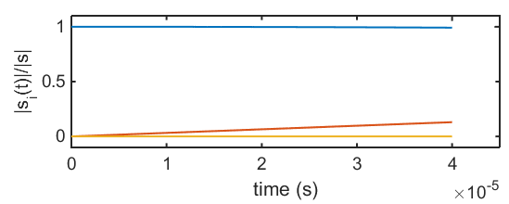



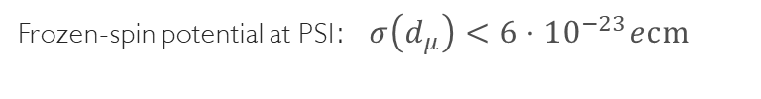


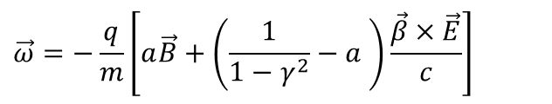

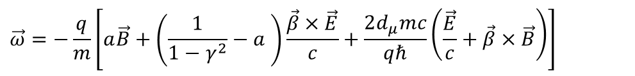


Muon dipole moments –freezing the spin at PSI
$$\vec{ω}=−\frac{q}{m}\left[a\vec{B}+\left(\frac{1}{1−γ^{2}}−a \right)\frac{\vec{β}×\vec{E}}{c}+\frac{2d_{μ}mc}{qℏ}\left(\frac{\vec{E}}{c}+\vec{β}×\vec{B}\right)\right]$$
$$\vec{ω}=−\frac{q}{m}\left[a\vec{B}+\left(\frac{1}{1−γ^{2}}−a \right)\frac{\vec{β}×\vec{E}}{c}\right]$$
g-2 term $ω_{a}$
EDM term $ω_{e}$
$$s_{z}$$
Frozen-spin potential at PSI:$σ\left(d_{μ}\right)<{6⋅10}^{−23}ecm$
B
$$s_{y}$$
$$R=31 mm$$
$${\vec{ω}}_{e}$$
E
$$s_{x}$$
set $E ≅aBcβγ^{2}$
Phase I: $σ\left(d_{μ}\right)<{3⋅10}^{−21}ecm$
[*Farley et al,, PRL93 042001 (2004) ] ,
Notes:
To further increase the sensitivity to a muon EDM we propose to use the frozen-spin technique to measure the electric dipole moment.
By applying a well tuned electric field this entire term can be canceled and the spin exactly follows the momentum, essentially it is frozen to the momentum.
The only term present is the one of the electric dipole moment which leads to a precession of the spin around the radial axis like a bicycle going in a circle.
This in turn leads to a build up of a asymmetry of positron decays along and against the direction of the magnetic field, the signal we are searching for.

Slide 8
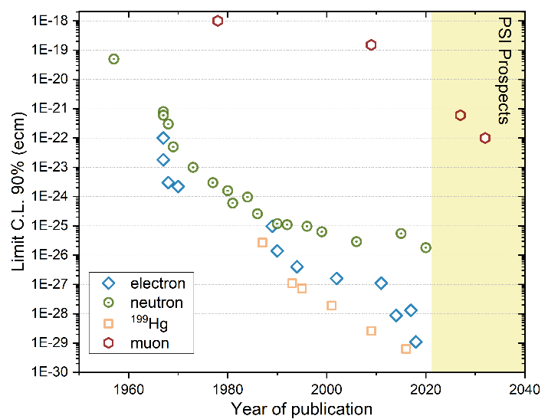
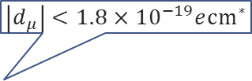
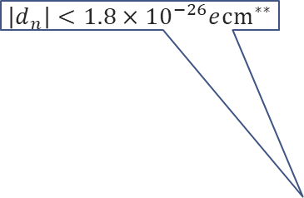

History of EDM searches
$$\left|d_{μ}\right|<1.8×{10}^{−19}e{cm}^{∗}$$
Neutron
Electron
Muon
log(d) /ecm
log(d) /ecm
log(d) /ecm
$$\left|d_{n}\right|<1.8×{10}^{−26}e{cm}^{∗∗}$$
-18
-20
-22
-24
-26
-28
-30
-32
-34
-36
-38
-18
-20
-22
-24
-26
-28
-30
-32
-34
-36
-38
-18
-20
-22
-24
-26
-28
-30
-32
-34
-36
-38
$$\frac{m_{μ}}{m_{e}}$$
10⁶
10¹⁸
*Bennett et al.,PRD80(2009)052008
** Abel et al., PRL124(2020)081803
10⁸
Notes:
Searches for electric dipole moments started a long time ago in the 1950 when Ramsey and Purcell were first searching an EDM using a beam of neutrons.
Since then, the race to the bottom started.
Here on this graph I depicted for you the 90% limits versus the year of publication. In green the neutron, the blue diamonds are measurements on atoms and molecules extracting the EDM off the electron.
In yellow squares the impressive story of the mercury EDM. Lagging far behind is the muon, the only sizable search for an EDM of a particle in the second generation.
On the right side you see the expectation range for standard model EDM from the small imaginary phase of the CKM matrix in relation to the current limit.
The neutron still has another 6 orders of magnitude until they will hit the SM background. The electron another 9 order of magnitude, while the muon is today where Ramsey started 70 years ago and has another 18 orders of magnitude of legroom.

Slide 9
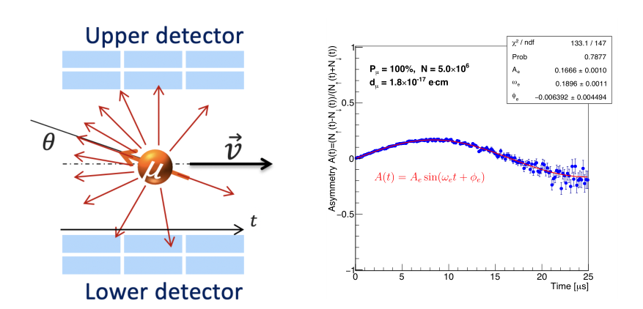



The general experimental idea
If the EDM ≠ 0, then there will be a vertical precession out of the plane of the orbit
  An asymmetry increasing with time will be observed recording decay positrons
If the EDM = 0, then the spin should always be parallel to the momentum
asymmetry should be zero
Some asymmetry could still be
observed due to systematic effects
B
$$R=31 mm$$
$${\vec{ω}}_{e}$$
E
$$A=\frac{N_{u}−N_{d}}{N_{u}+N_{d}}$$

Slide 10
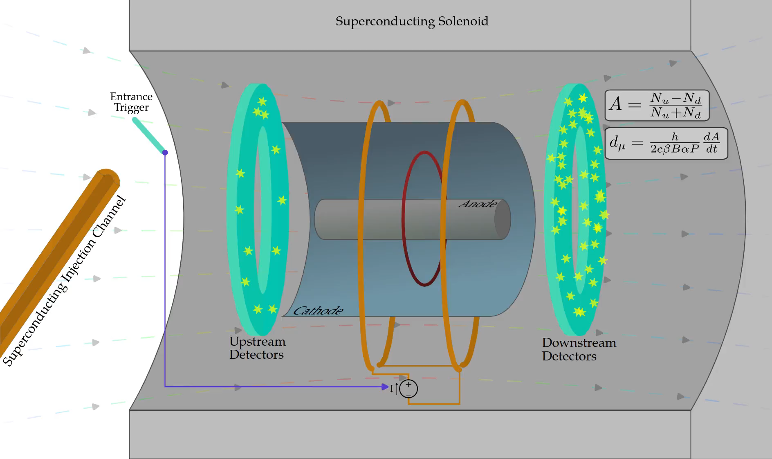
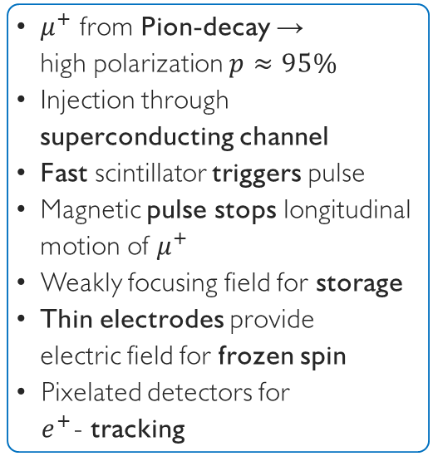
The compact frozen-spin muon EDM search
$μ^{+}$ from Pion-decay →
high polarization $p≈95\%$
Injection through superconducting channel
Fast scintillator triggers pulse
Magnetic pulse stops longitudinal motion of $μ^{+}$
Weakly focusing field for storage
Thin electrodes provide
electric field for frozen spin
Pixelated detectors for
$e^{+}$- tracking

Slide 11
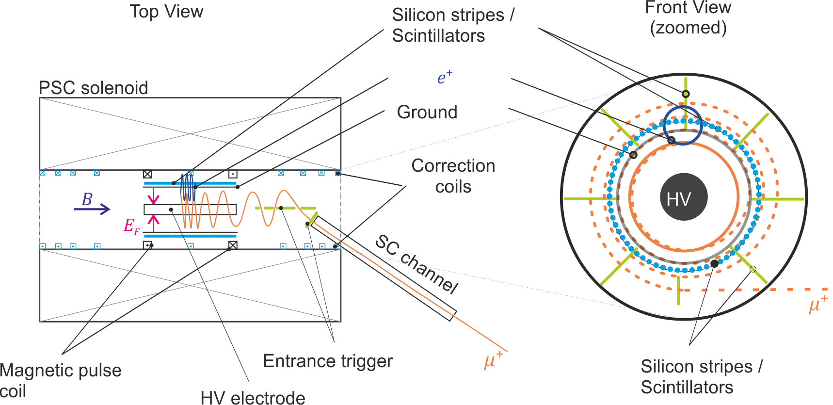
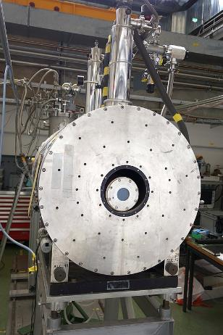

The muEDM phase I on piE1
Test bed and frozen spin demonstrator
muEDM measurement $<3⋅{10}^{−21}ecm$
Notes:
In this application I propose to set up a precursor experiment using an existing soleonid operated at 2T at PSI.
It will feature all relevant technical developments and demonstrate the feasibility of the frozen spin technique.
[click]
A first PhD student will optimize the magnetic field and demonstrate the magnetic pulse for muon storage
[click]
A second PhD student will develop a superconducting injection channel and demonstrate the efficient injection and triggering
[click]
A third PhD student will take care about the high voltage system an demonstrate the frozen spin technique
[click]
We will use scintillating detectors to detect the positrons and trigger the muon acceptance
Finally when all subsystems work we will deploy the frozen-spin technique to measure the muon EDM better than 3E-21 ecm

Slide 12
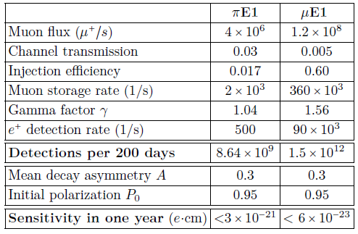
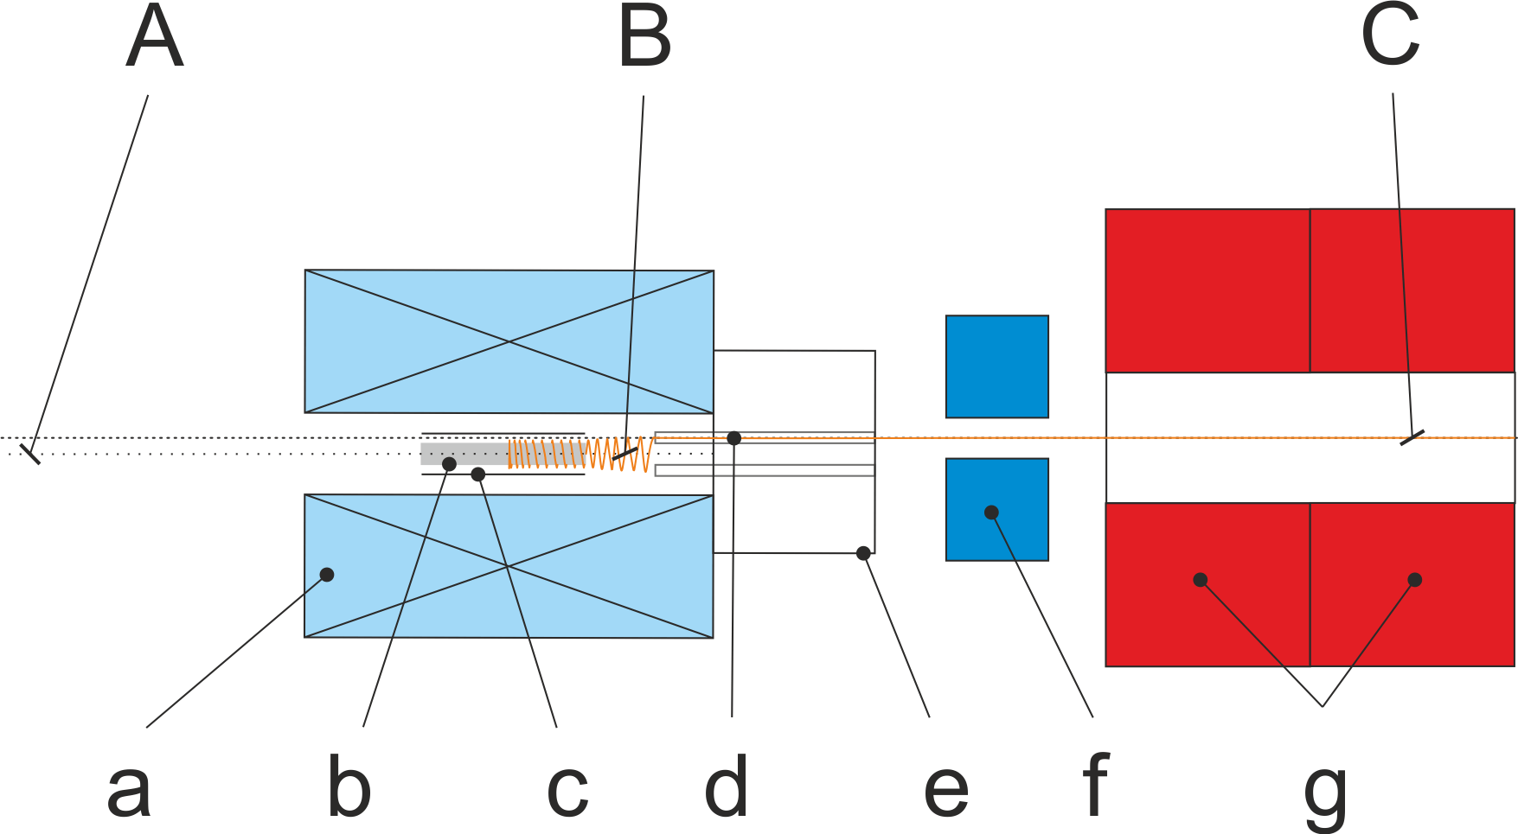
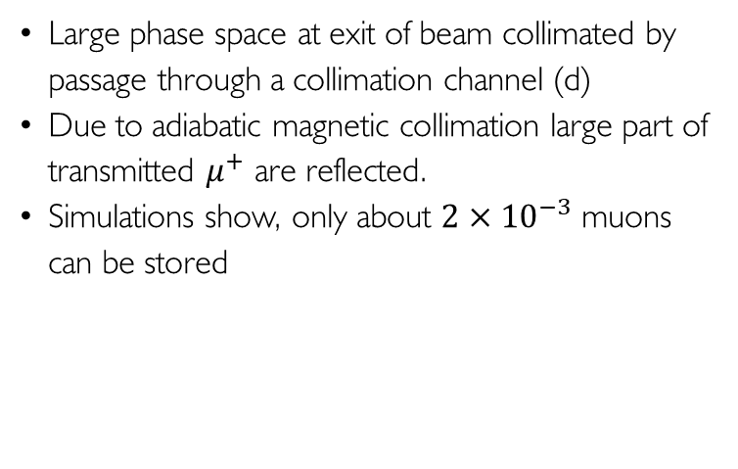
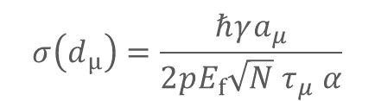
Injection and statistical sensitivity
Large phase space at exit of beam collimated by passage through a collimation channel (d)
Due to adiabatic magnetic collimation large part of transmitted $μ^{+}$ are reflected.
Simulations show, only about $2×{10}^{−3}$ muons can be stored
$$σ\left(d_{μ}\right)=\frac{ℏγa_{μ}}{2pE_{f}{\sqrt{N} τ}_{μ} α}$$
Page 12
Notes:
At PSI we will profit from the highest muon fluxes in the world.
The two possible beamlines provide very different energies and phase spaces.
For the precursor experiment we will use low energy muons and profit from a high transmission through the collimation channel
As the solenoid is not optimized only a small fraction will be stored.
Already this precursor experiment will have a sensitivity better than 3E-23 ecm.
In the long run with a dedicated magnet, using higher energetic muons we expect a sensitivity better than 10E-23ecm.

Slide 13
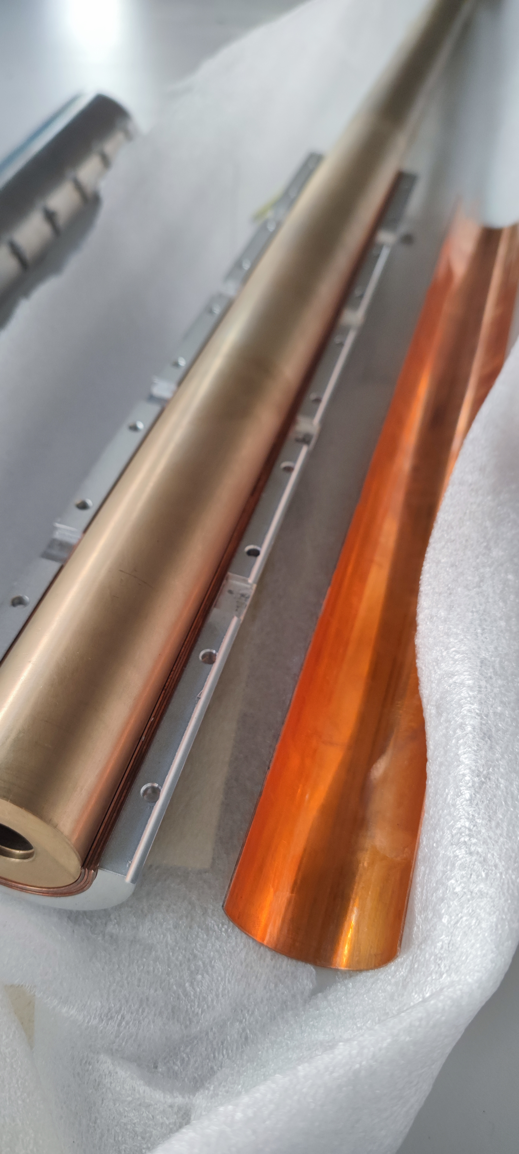
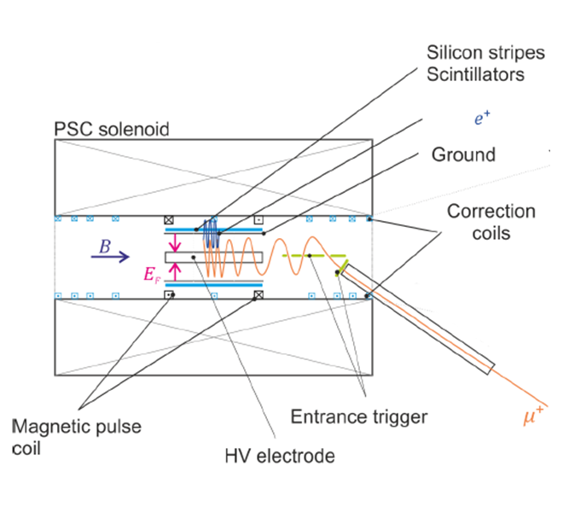
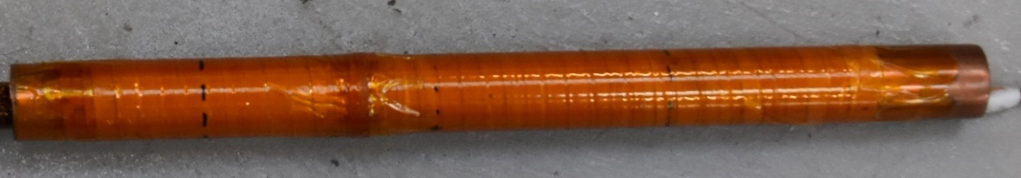
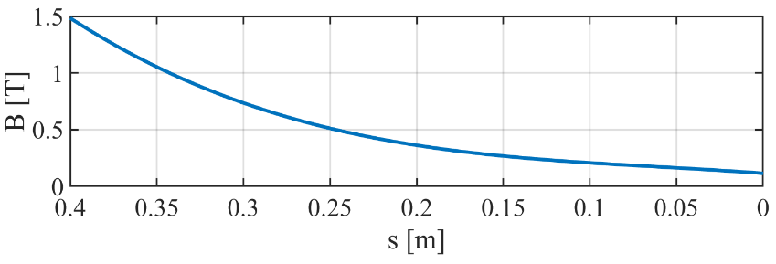


Experimental Setup
$$B≥1.6 T$$
SC shield
Fe shield
$$B_{tube}<0.1 T⇒SF∼15$$

Slide 14
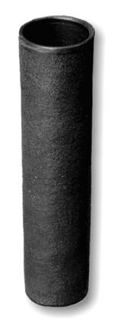

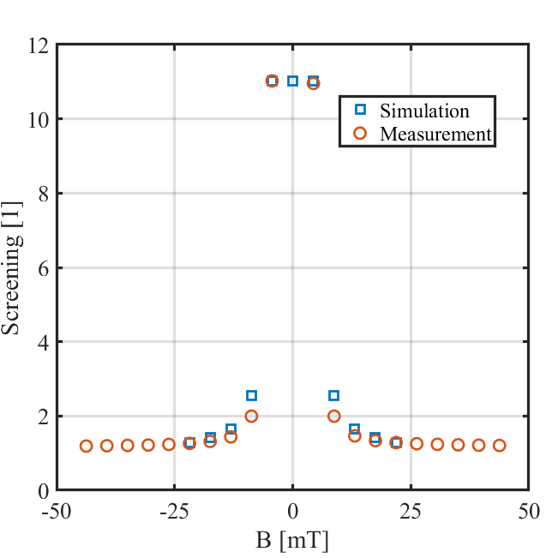
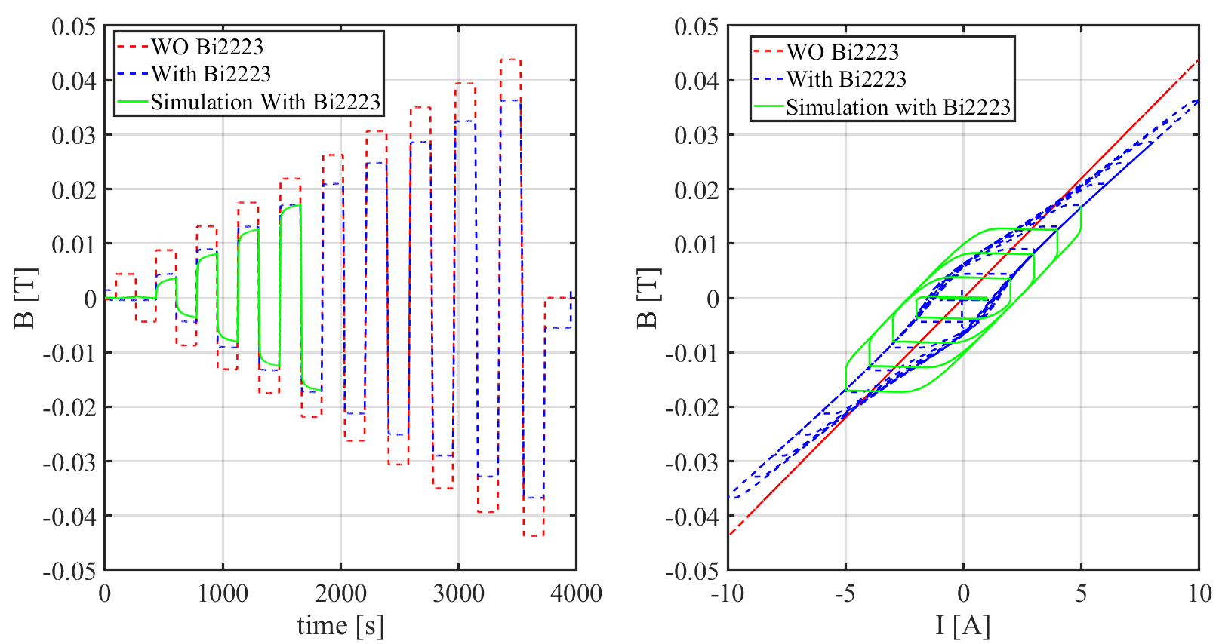
Screening test in LN2
Bi2223 cylinder

Slide 15
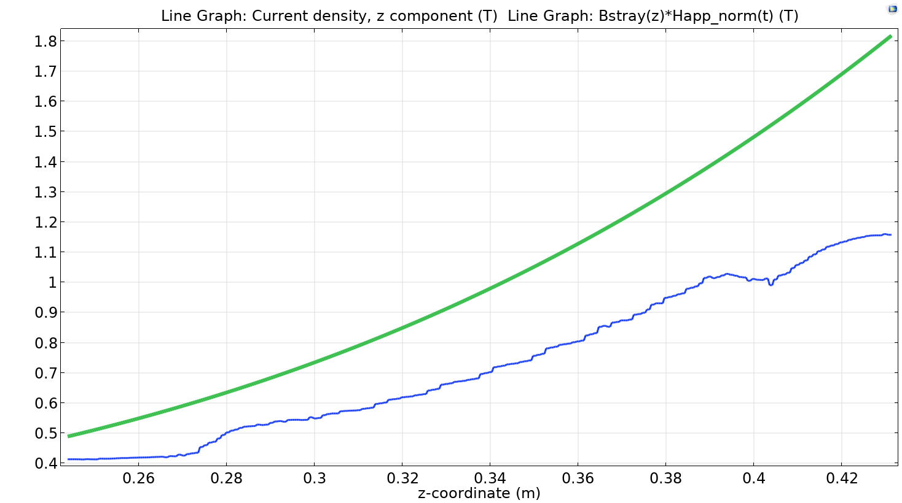
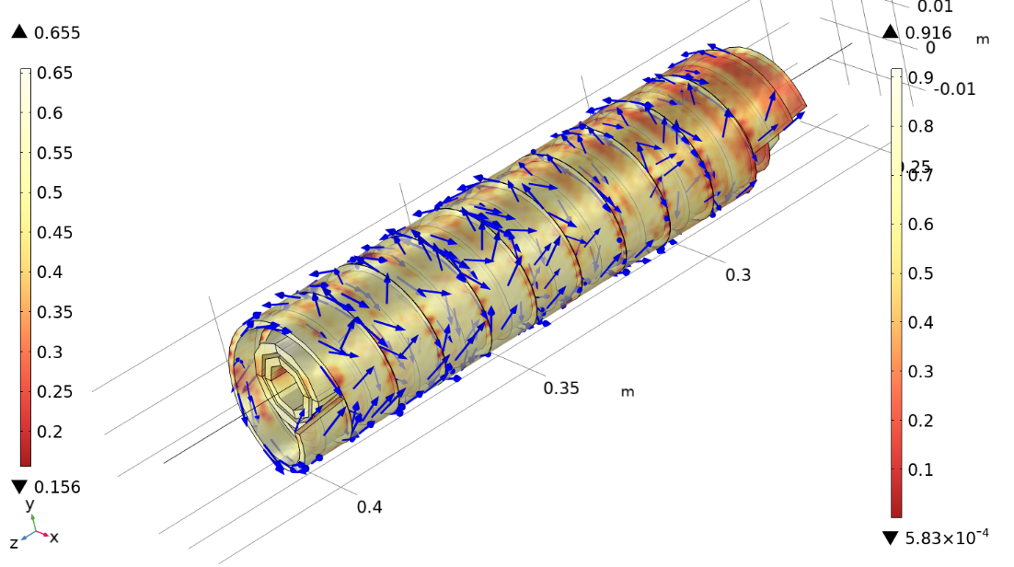
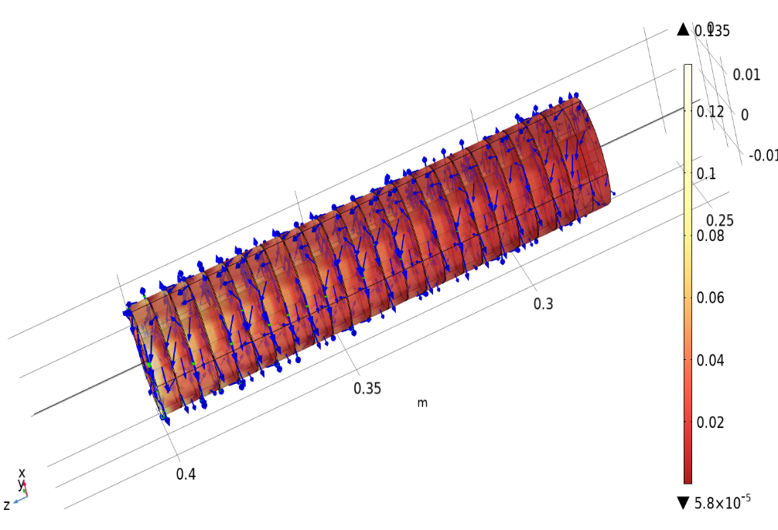
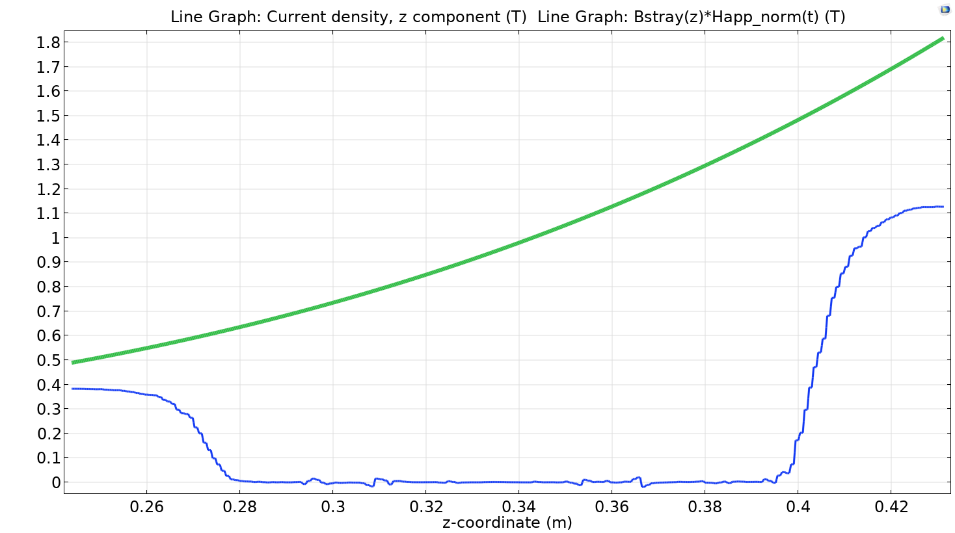
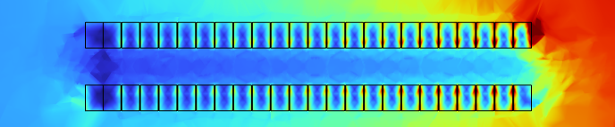
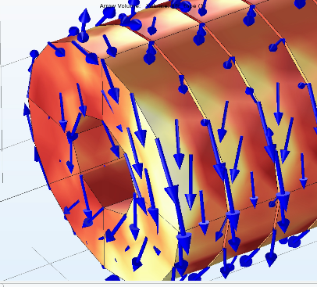
Toward a “realistic” scenario
2 layers YBCO
1)
Top=4.5 K
s=1.5
2 layers Bi2223
2)
Stack of YBCO bulk disks
s>10

Slide 16
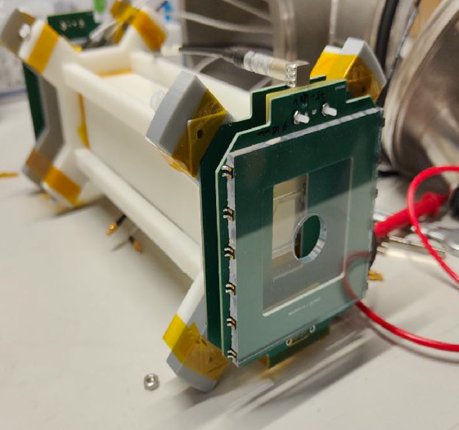
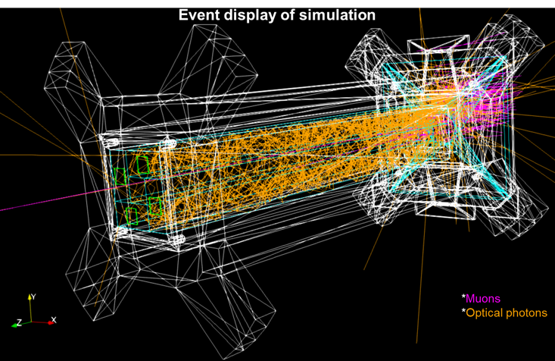
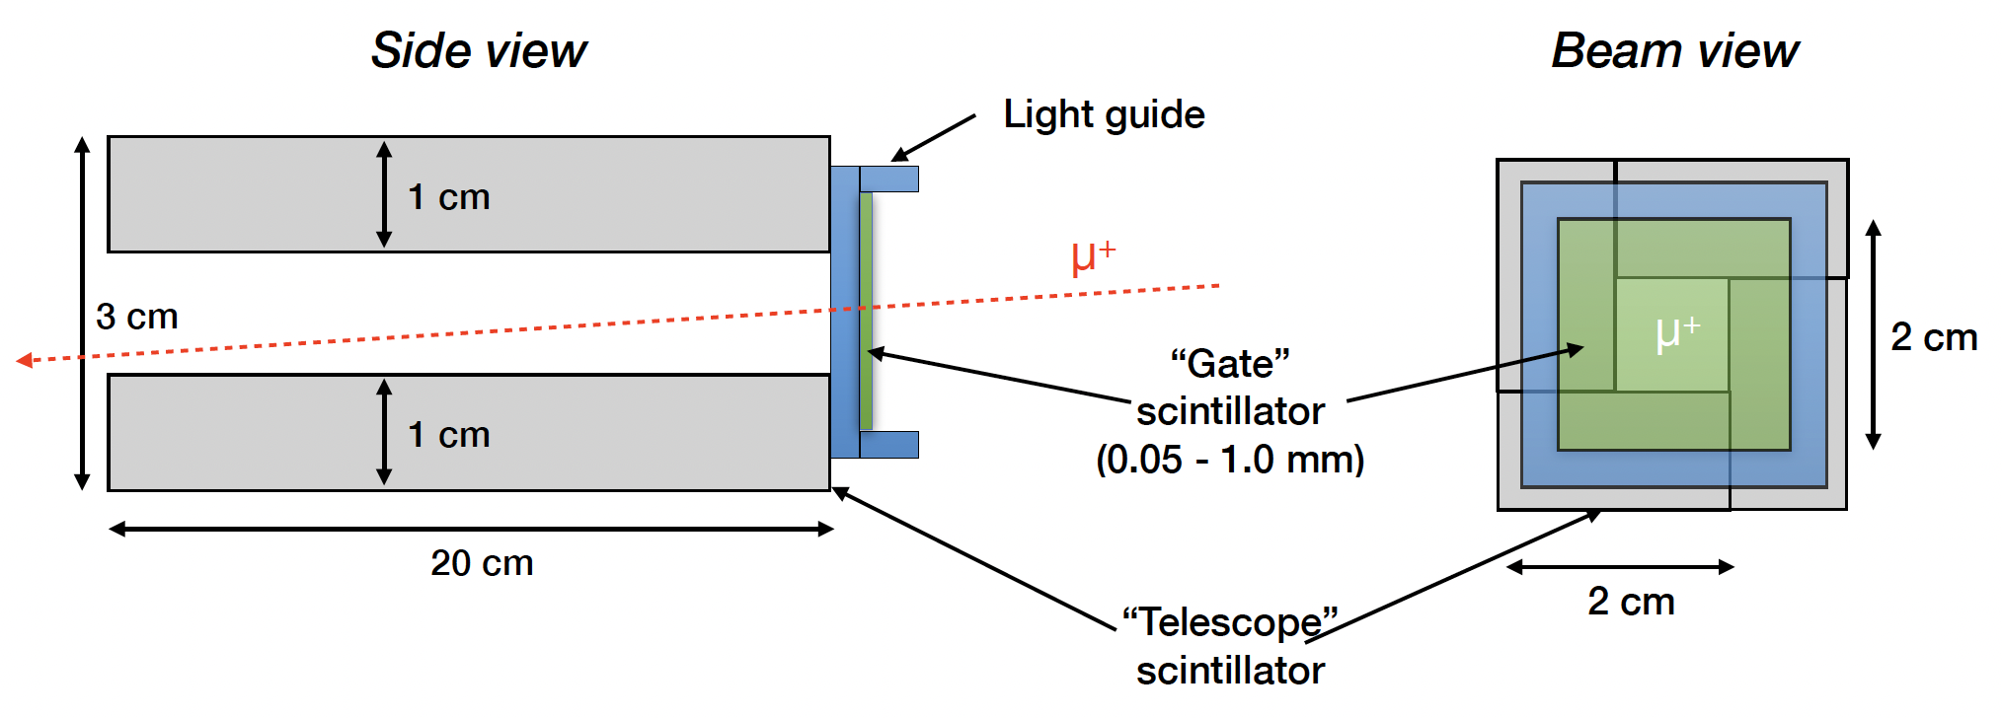
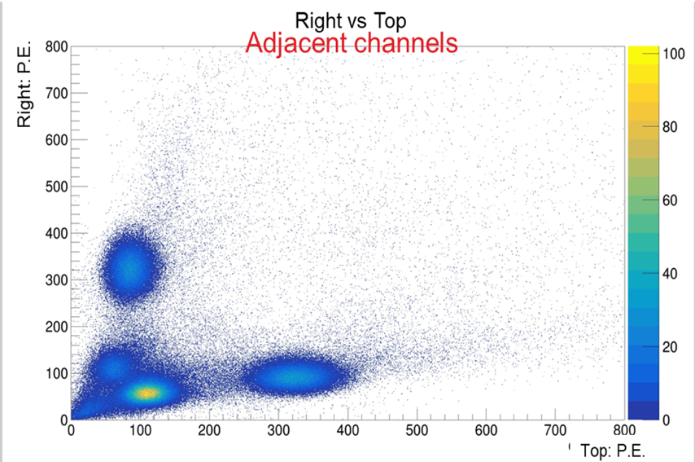
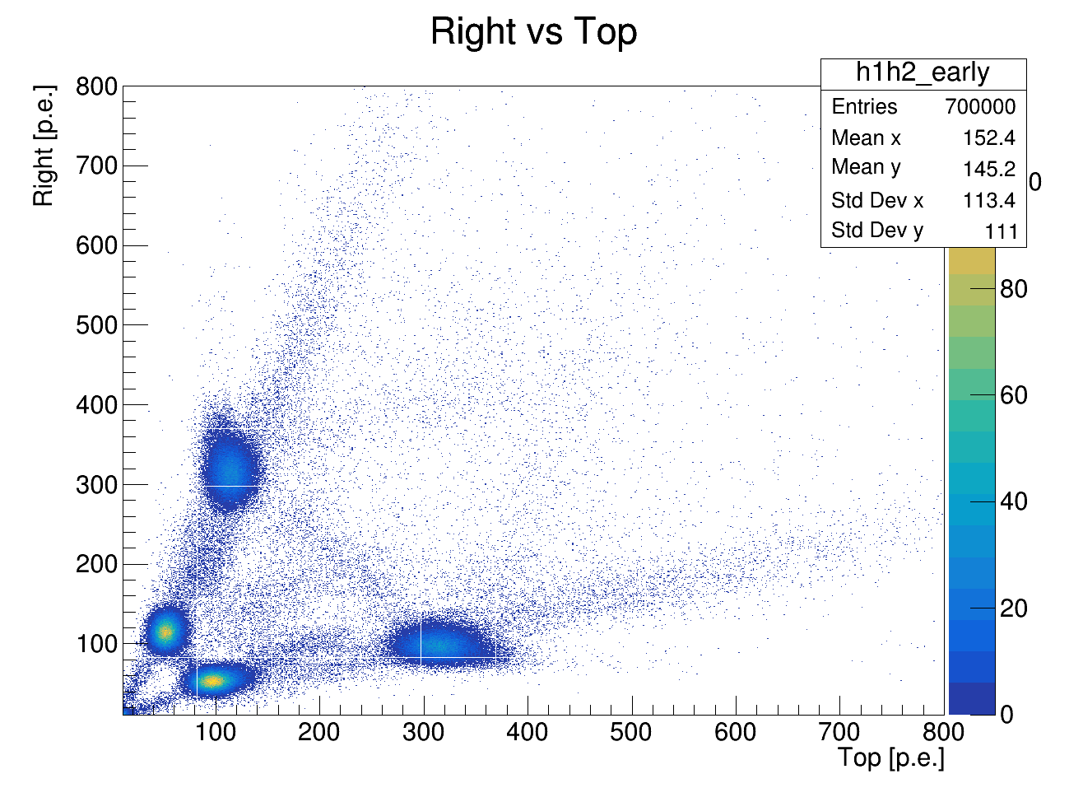
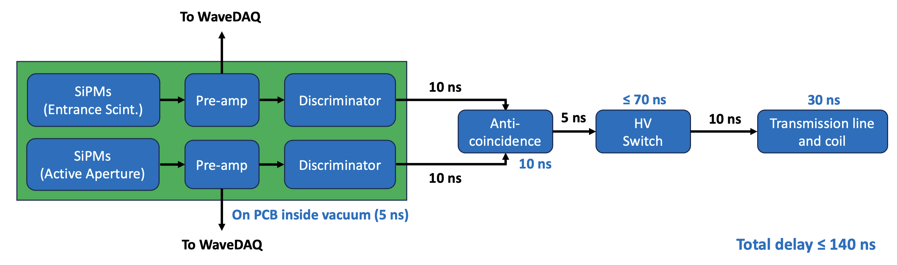
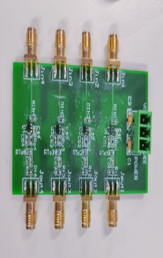
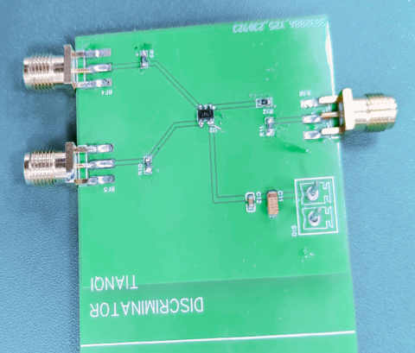
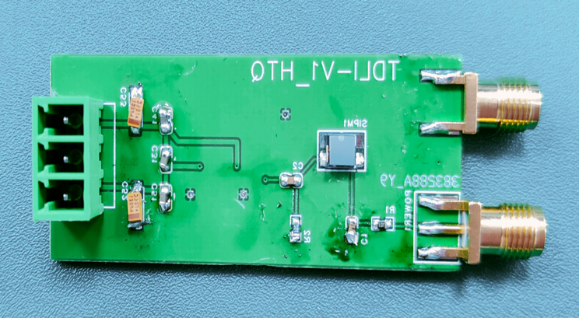
Current status of the PSI muEDM entrance detector
Providing a timing signal for muon entrance into storage solenoid and a trigger signal to the pulsed magnetic kicker
A prototype for PSI beam test 2022
5-10 mm thick scintillators
Data
Simulation
Reproduced detector response after implementing optical photons in the simulation!
nominal muon
trajectory
50-100 μm thin scintillators
R&D for fast electronics in progress
Conceptual design for PCB and logics
Pre-amp
Discriminator
SiPM + pre-amp readout
$$≤60ns$$
Testing of PCBs with individual components completed. Fine-tuning PCB board with multiple components in progress.

Slide 17



Storage and injection
Strength of weakly focusing field in the center region defines “depth” of storage.
The deeper / stronger the weakly focusing field the stronger the pulse needs to be.
deceleration
acceleration
Page 17

Slide 18




Radial magnetic field pulse to kick muons
$$≤60ns$$
Pulse generator
Page 18

Slide 19




Tuning the electric field to the frozen-spin condition
Measure the transverse frequency $|ω|=1/T$ relative to $ω_{a}=1/T_{0}$
Two momentum bins
$28 MeV/c$ $<p_{1}<50MeV/c$
${50 MeV/c<p}_{2}$
Change E field in the range $0<E<2E_{F}$
Extrapolate to $E_{frozen}$ where $ω_{a}=0$
$$E/E_{F}$$

Slide 20



Silicon strip detector for g-2 detection
Silicon strip detector for g-2 detection
Reconstruction of transverse
positron momentum ($Δp≈5MeV/c$)
Timing $Δt≈2ns$
Spatial resolution $≈0.1mm$
(lateral)
Si-Petal detector

Slide 21






EDM measurement
Measure positron decay asymmetry along the magnetic field.
$${\dot{A}}_{exp}\left(t\right)=\frac{d}{dt}\left(\frac{N_{+}−N_{−}}{N_{+}+N_{−}}\right)$$
Positron emission asymmetry:
$$\dot{A}\left(ψ_{0},t\right)={\left.\frac{∂A}{∂ψ}\frac{∂ψ}{∂t}\right|}_{ψ=0}$$
$$0π$$
$$ψ+π /rad$$
$$2π$$

Slide 22





EDM analysis options
Measure asymmetry as function of time.
No energy thresholds, no angular resolution
$α=1/6 ≈ 0.1667$
T-method – measure asymmetry above
energy/momentum threshold $u0$.
  Optimize threshold by maximizing
  figure of merit $F$
2D binned analysis in energy and emission angles.
  Requires tracking capabilities of positron tracker
$$F=α\sqrt{N}$$

Slide 23




Figure of Merit – Phase I and II
T-method – measure asymmetry above
energy/momentum threshold $u0$.
FoM = 0.173
FoM = 0.211
$$α=0.35, N=0.38$$
$$α=0.19, N=0.83$$

Slide 24






Figure of Merit - optimal W method
$$FoM=0.29$$
$$FoM=0.29$$
$$α=0.32, N=0.8$$
$$α=0.3, N=0.87$$

Slide 25



Scintillating fiber detector for EDM-signal
Scintillating fiber detector for EDM asymmetry measurement and timing
Horizontal fiber ribbons with $250μm$
pitch and $100μm$ resolution
Timing resolution $<2ns$
Reconstruction of longitudinal momentum
SciFi-EDM detector

Slide 26


Systematic studies (example)
Systematic effects: all effects that lead to a real or apparent precession of the spin around the radial axis that are not related to the EDM
Major sources of systematic effects in the frozen spin technique:
  Coupling of the magnetic moment with the EM fields of the experimental setup (real)
  Early to late variation of detection efficiency of the EDM detectors (apparent)
Rotations that could mimic the EDM:
  Radial around x
  Azimutal around z
y
x
z

Slide 27








Sources of Ey field: conical central electrode
anode
$$B$$
None constant radius of
cylindrical anode (cone)
Cylindricity on the order of 50 nm is measurable even on large samples and
possible to machine
Ground electrode made of thin foil more difficult to keep deviations from cylindricity below $30μm$
$$E_{y}$$
$$E$$
Will move orbit out of central plane until:
$$\left\langle B_{r}^{∗}\right\rangle =−\left\langle E_{v}/βγ\right\rangle$$
Cancels by reversing $\vec{β}$
needs CW and CCW injection

Slide 28








Geometric phases, and non-uniformities
Magnetic field
Electric field
$$ω_{a}$$
$$ω_{c}$$
$$ω_{a}$$
$$ω_{c}$$
$$ω_{b}$$

Slide 29


Limit on the initial g-2 phase (Phase I)
Assuming a 0.5% difference between the CW and CCW average momenta
(~150 keV).
The control of the initial g-2 phase should be $\sim 50 mrad.$
Above that value the momentum difference starts to dominate.
The maximum allowed Ez becomes ~10⁻⁴.

Slide 30








Test beam in December 2023
Measure TOF of of CW and CWW injection to better than 0.1%
Test entrance monitor and TOF measurement of injected muons
Change magnetic field $\vec{B}→ −\vec{B}$
Change height of injection tube by $±47mm$
$μ$-monitor
$μ$-window
$±47mm$
Segmented $μ−$monitor,
to adjust beam position

Slide 31




















The collaboration open for participation
PSI proposal R-21-02.1

Slide 32



Pulse Generator Preliminary Model
With damping elements tuned, pulse is critically damped with current $<1A$after $t_{0}+220ns$
If the capacitance between quadrants is much larger (x50), stronger damping would be required
If the resistance of the coils is much larger (x500), the pulse decays exponentially
Only extreme variation from measured parameters cause problematic shifts in the shape.

Slide 33


courtesy: M. Seidel

Slide 34

HIPA – high intensity proton accelerator
Pion and Muon
research
Main cyclotron
590 MeV
I_{p} = 2.4 mA
P=1.4 MW
Cockcroft-Walton
800 keV
nEDM
Injector cyclotron
72MeV
UCN area

Slide 35








A search for a $μ$EDM at PSI
$$p_{π}=220MeV$$
p -beam
pion decay channel
(8m, 4-5T)
$μ$-beam:
${10}^{8}μ^{+}/s$
Bunch width
3.9 ns
$$p_{μ}=125MeV/c$$
$$μE1$$

Slide 36



A phased approached
Phase I (small solenoid, surface muons)
Phase 2 (dedicated magnet
muon momentum $≥125MeV/c$)
Argonne 4T solenoid
Existing solenoid at PSI, max 5T
Bore diameters 200mm
Field was measured in 2022
(found suitable for injection)
Large bore (up to 900 mm diameter)
High Temporal field stability (10ppb/h)
Excellent spatial field uniformity
  (<1 ppb/mm)

Slide 37


Surface muons for phase-1
Horizontal Emittance: $200 πmm mrad$
Vertical Emittance: $170 π mm mrad$
Beam rate about $4×{10}^{6} s^{−1}$
Acceptance phase space:
  High transmission through channel 3%
  Injection efficiency about 2%
  Expected $μ^{+}$ storage rate 2kHz
  Expected $e^{+}$ detection rate 0.5kHz
Moderate E field 3kV/cm

