Slide 1
Current Intensity limits and possible upgrades in M2
D. Banerjee on behalf of BE-EA-LE
Date: 09.11.2023

Slide 2
The M2 Beam
Three main operation modes:
High-energy, high-intensity muon beam. Normally for muon momenta up to 200 GeV/c.
High-intensity secondary hadron beam for momenta up to 280 GeV/c with radiation protection constraints.
Low-energy, low-intensity (and low-quality) in-situ electron calibration beam.
Beam Mode | Momentum (GeV/c) | Max. Flux (ppp / 4.8s) | Typical Δp/p (%) | Typical RMS spot at COMPASS target | Polarisation | Absorber (9.9 m Be)
Muons | +208/190 +172/160 | ~10⁸ 2 10⁸ | 3.7% | 8 x 8 mm | 80% | IN
Hadrons | +190 -190 Max. 280 | 10⁸ (RP) 4 X 10⁸ (with dedicated dump) | ₋ | 5 x 5 mm | ₋ | OUT
Electrons | -10 to -40 | < 2 10 ⁴ | ₋ | > 10 x 10 mm | ₋ | OUT
D. Banerjee on behalf of BE-EA-LE

Slide 3
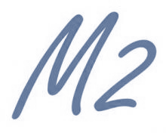
The M2 Beam – Parameters and Principle
Beam Parameters as was used for COMPASS | Measured
Beam momentum p_{µ}/p_{π} | 160 / 172 GeV/c
Proton flux on T6 per SPS cycle | 1.5 10¹³
Muon flux at COMPASS per SPS cycle | 2 10⁸
Beam polarisation | -80% ± 4%
Spot size at COMPASS target (σ_{x} x σ_{y}) | 8mm x 8mm
Divergence at COMPASS target (σ_{dx} x σ_{dy}) | 0.4mrad x 0.8mrad
Muon halo within 50mm from beam axis | 16%
Halo in experiment (6 x 4m2) at |x,y|>150mm | 7%
BEND 6
Hadron
absorber
EHN2
T6
Scrapers
(172 ± 17) GeV/c
p
π,K
µ
(160 ± 6) GeV/c
600 m
400 m
Hadron Decay Section
Muon Cleaning Section
D. Banerjee on behalf of BE-EA-LE

Slide 4
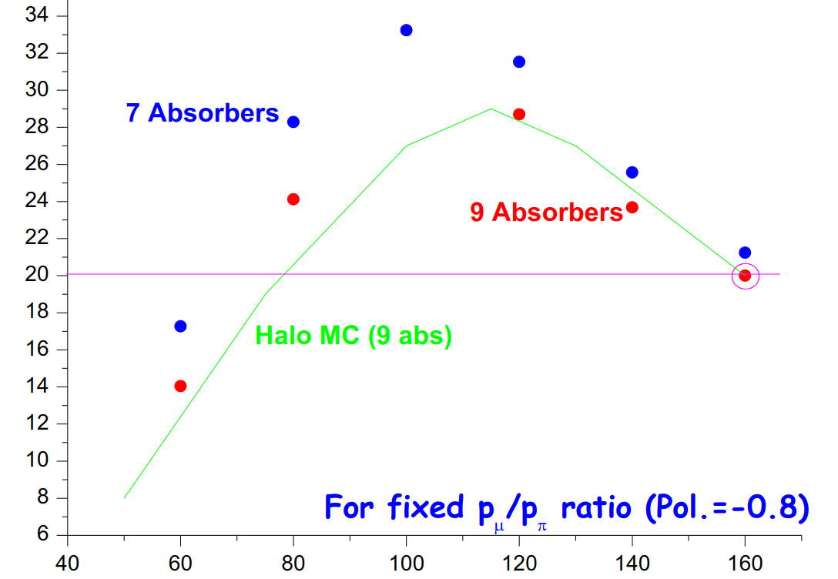
Beam Flux
Muon Flux (x 10⁷)
Flux for µ⁺ at 1.3 10¹³ ppp and for fixed p_{µ}/p_{π} ratio (polarisation = 0.8)
Muon momentum [GeV/c]
Factor typically factor 2.7 smaller for µ– at same momentum.
At around 110 GeV/c the muon rate can be increased by about 40% compared to 160 GeV/c but currently limited by radiation protection considerations.
D. Banerjee on behalf of BE-EA-LE

Slide 5
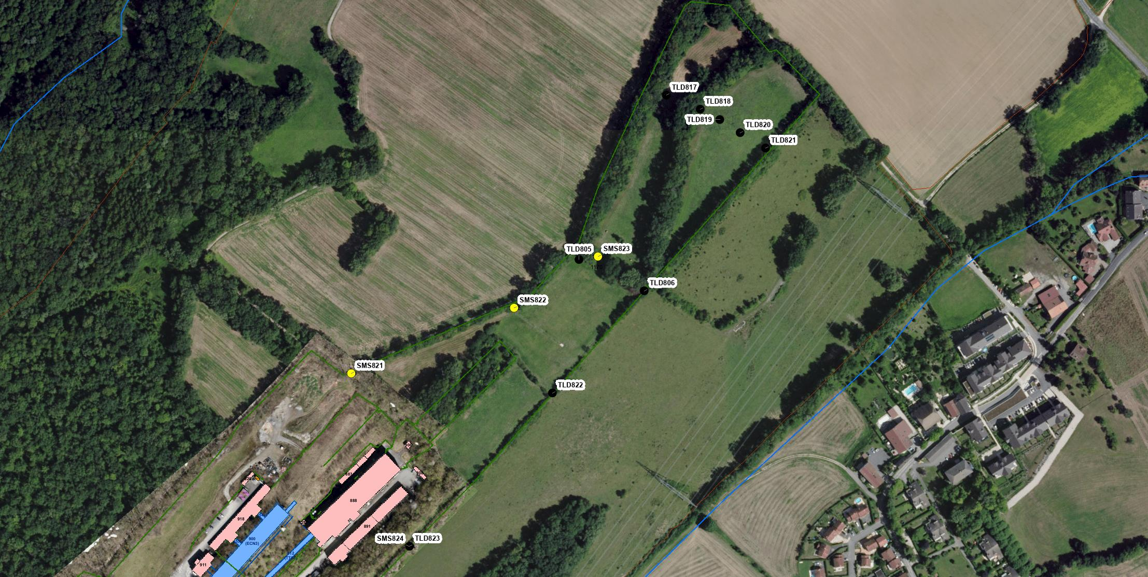
CERN Prevessin site – EHN2
C. Ahdida HSE-RP
Downstream of COMPASS (SMS823)
Dose due to muons
Decision to add TLDs at end of site in 2018
EHN2
Lateral to COMPASS (SMS824)
Dose due to neutrons (skyshine) relevant for hadron beam
2018: Shielding had been increased to mitigate neutron dose, however experimental program also required higher beam intensity than in 2015.
Amongst others, objective was to remain < 1 mSv at the fence (CERN code F)
Stray radiation monitoring stations
TLD (some TLDs added since 2015)

Slide 6
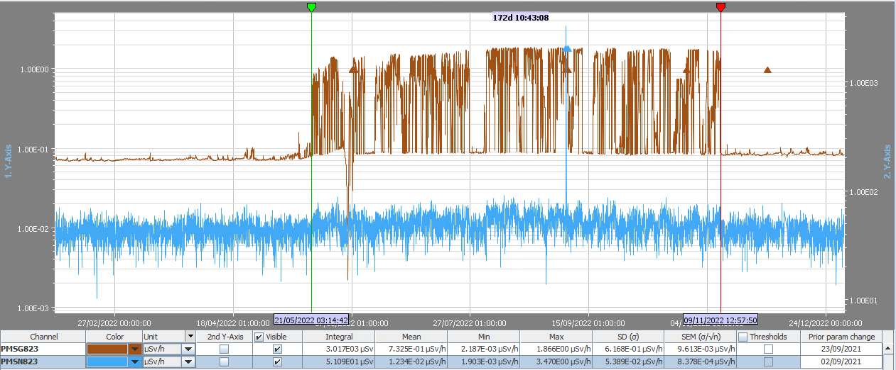
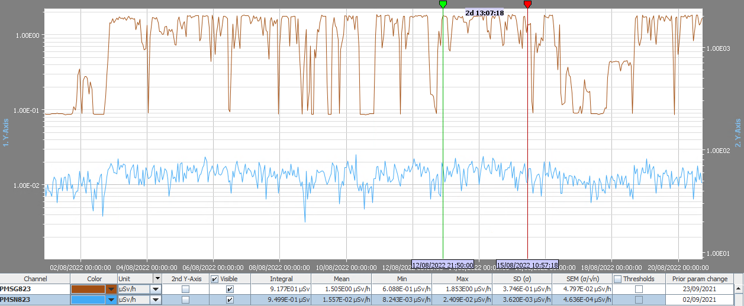
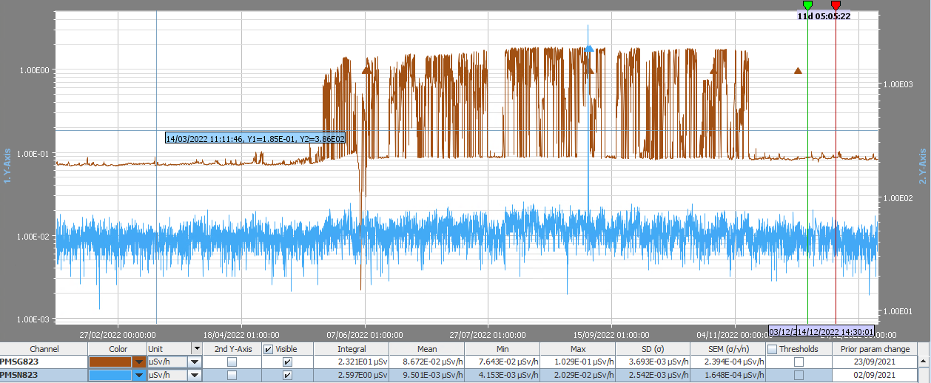
SMS823 dose rates during 2022
C. Ahdida HSE-RP
2022 beam operation
The maximum dose rate registered by SMS823 during COMPASS beam operation in 2022 amounted to a net value of ~1.8 uSv/h
The average dose rate during nominal beam operation amounted to a net value of ~1.4 uSv/h
Dose rate in accessible area upstream and downstream of SMS823 to be below the area classification - limit of 2.5 µSv/h.
Nominal beam period
Background period

Slide 7
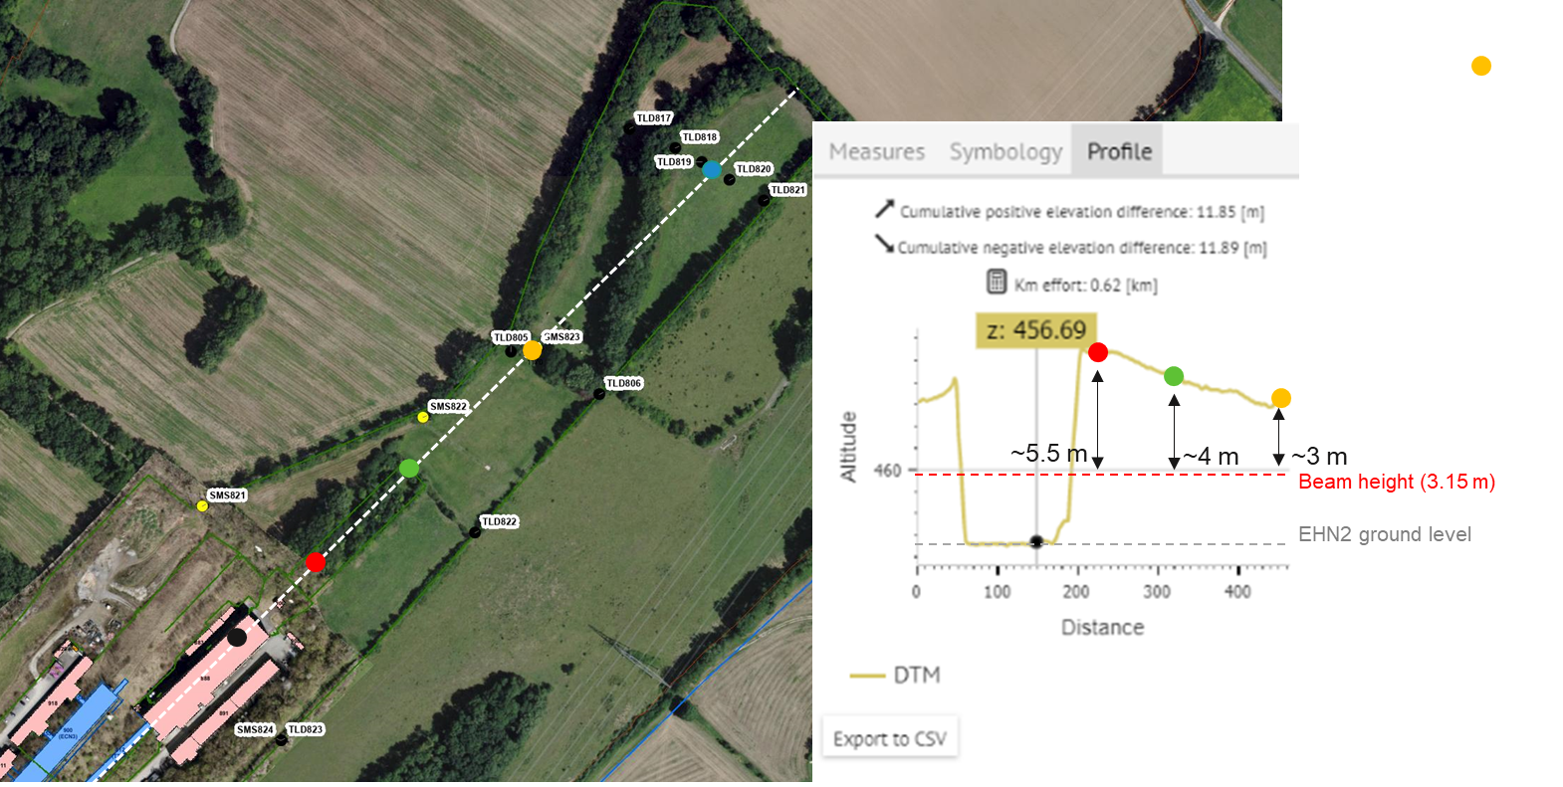
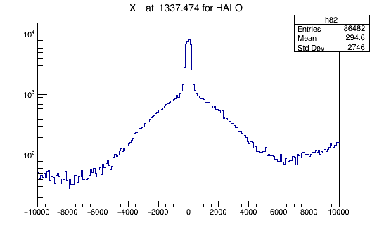
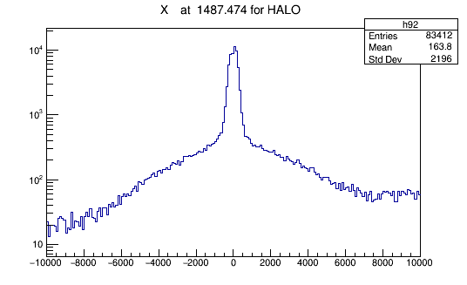
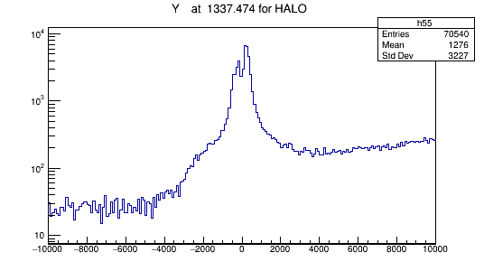
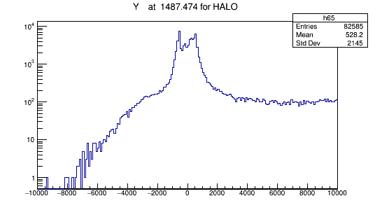
Muon beam profiles downstream of EHN2
C. Ahdida HSE-RP
Downstream exclusion zone
SMS823
HALO simulations performed to study the muon beam distributions downstream of EHN2. Attenuation inside of the soil is neglected
Maximum observed at the beam axes (near the centre)
Up-down asymmetry in the halo particles (as expected) coming from the tunnel, which disperses more downstream at the SMS823 location
At location SMS823 the muon intensity at the ground level is expected to be about a factor 1.3 lower than at the end of the exclusion zone → 1.82 µSv/hr
10²
10²
Ground level
Ground level
Beamline
Beamline

Slide 8
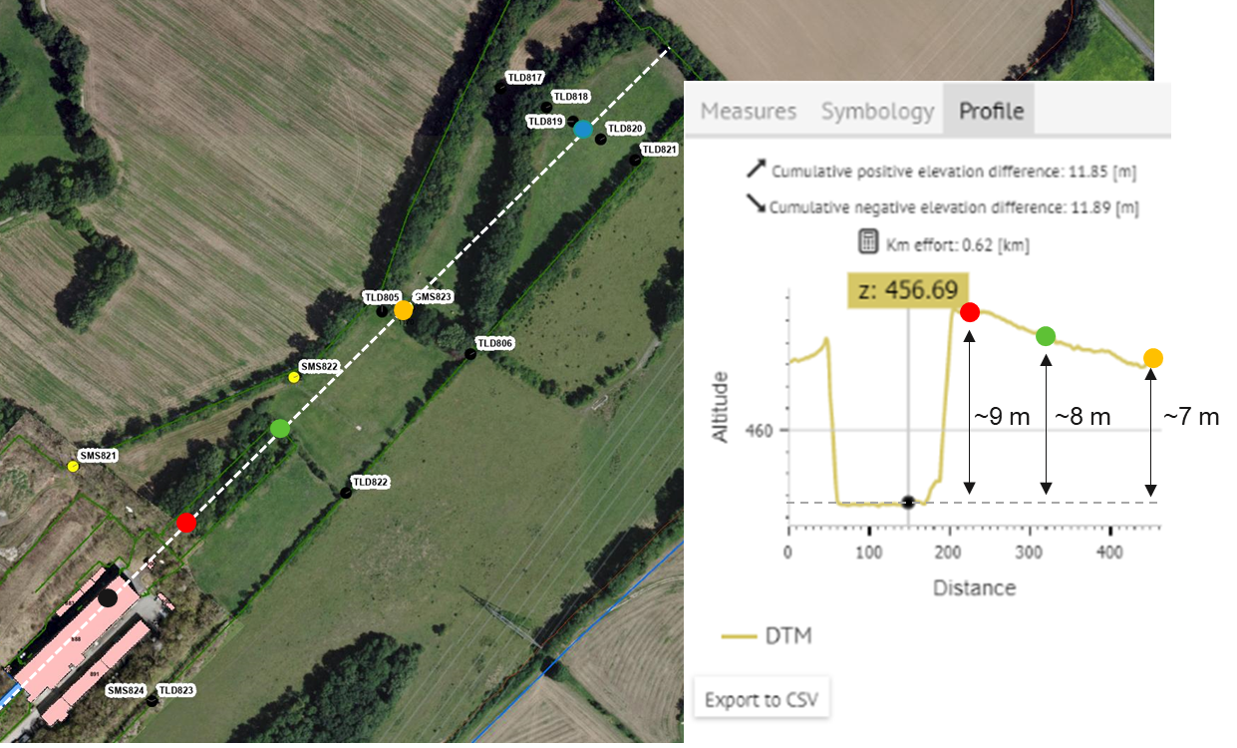
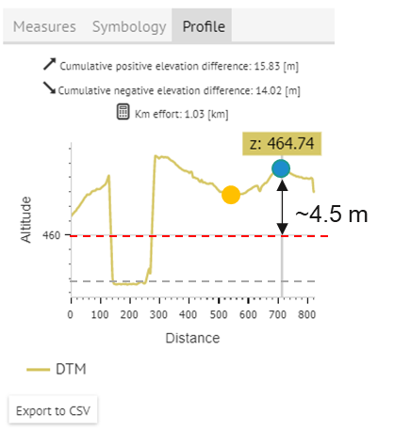
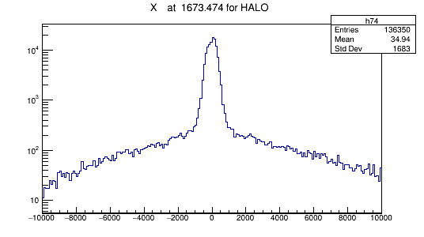
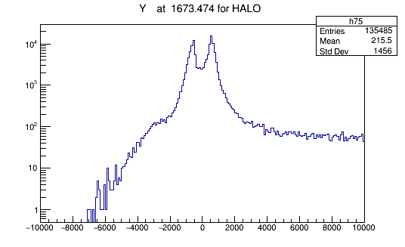
Muon beam profiles downstream of EHN2
C. Ahdida HSE-RP
Far downstream (close to fence)
Far downstream (close to fence)
SMS823
HALO simulations performed to study the muon beam distributions downstream of EHN2. Attenuation inside of the soil is neglected
Maximum observed at the beam axes (near the centre)
Up-down asymmetry in the halo particles (as expected) coming from the tunnel, which disperses more downstream at the SMS823 location
At the location SMS823 the muon intensity at the ground level is expected to be about a factor 2 higher than at the far downstream location close to the CERN fence. → 0.7 µSv/hr
10²
10²
Ground level
Ground level
Beamline
Beamline

Slide 9
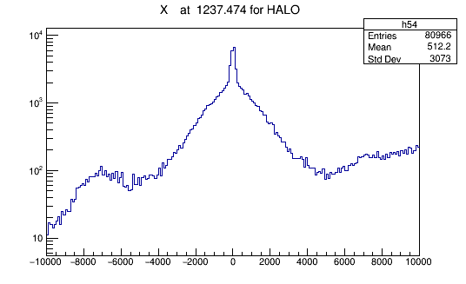
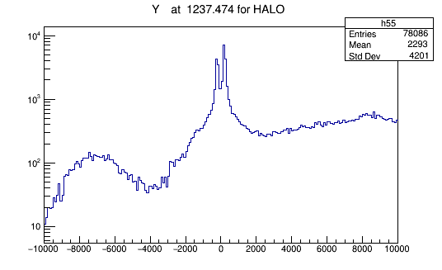
Muon beam profiles downstream of EHN2
C. Ahdida HSE-RP
Exclusion zone
SMS823
Exclusion zone
Beamline
Beamline
Beamline
HALO simulations performed to study the muon beam distributions downstream of EHN2. Attenuation inside of the soil is neglected
Maximum observed at the beam axes (near the centre)
Up-down asymmetry in the halo particles (as expected) coming from the tunnel, which disperses more downstream at the SMS823 location
At location SMS823 the muon intensity at the ground level is expected to be about a factor ~2.8 lower than at the upstream part of the exclusion zone → 3.9 µSv/hr
10²
10²
Beamline
Ground level
Ground level
Beamline

Slide 10
Increased hadron beam intensity Future AMBER DY run post-LS3

Slide 11
Increased annual intensity
A. Devienne, C. Ahdida HSE-RP
In order to improve the accumulated kaons for future AMBER Drell-Yan run the hadron beam intensity increase was also studied.
RP studies were performed to check additional shielding for higher intensities to comply with the radiation area classification, calculate prompt radiation, skyshine optimisation and environmental impact.
The source term used included 190 GeV/c π- beam with an instantaneous intensity of 4.8x10⁸ π-/spill and 240 spills/h on the AMBER target.
The aim was to validate the increase of the accumulated annual intensity to 3 x 10¹⁴ π-/year on the AMBER target.

Slide 12
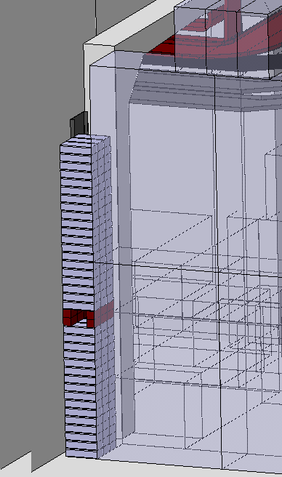
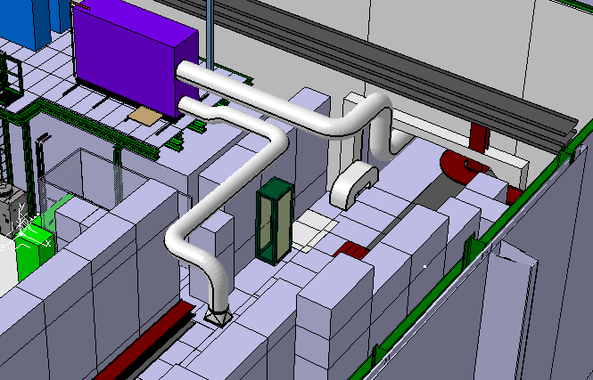
Proposed modifications
S. Girod BE-EA
Hole to be filled with concrete bricks
concrete bricks
(support and fixation to be studied)
Remaining gap beside cables can be filled with steel bricks

Slide 13
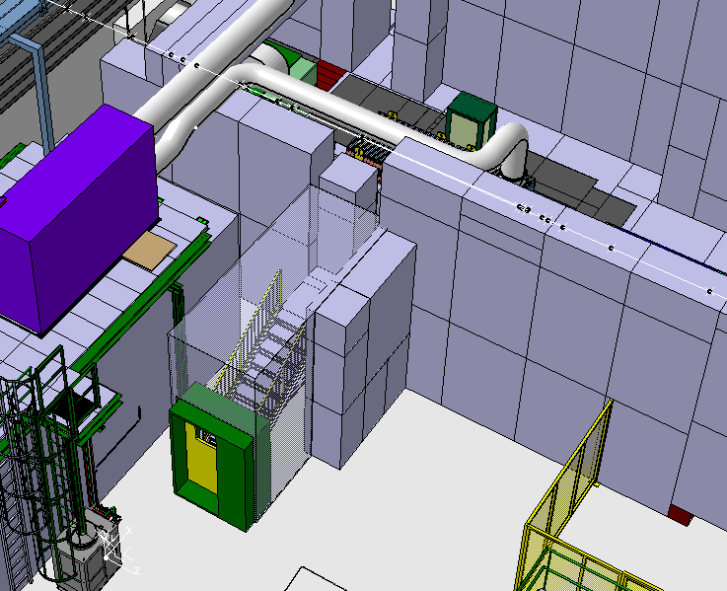
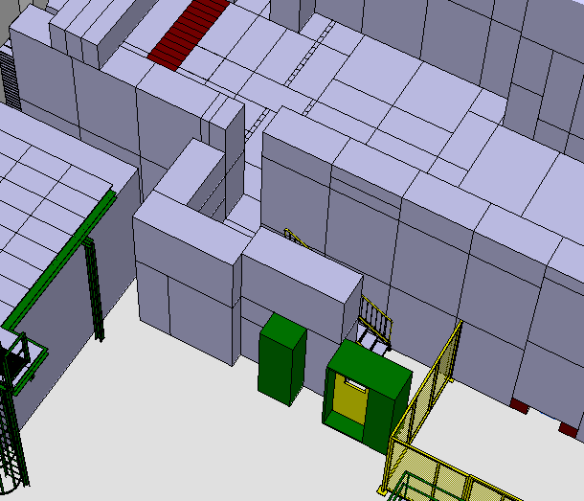
Proposed modifications
S. Girod BE-EA
Today
Proposal
M2
M2
Access chicane
modification

Slide 14
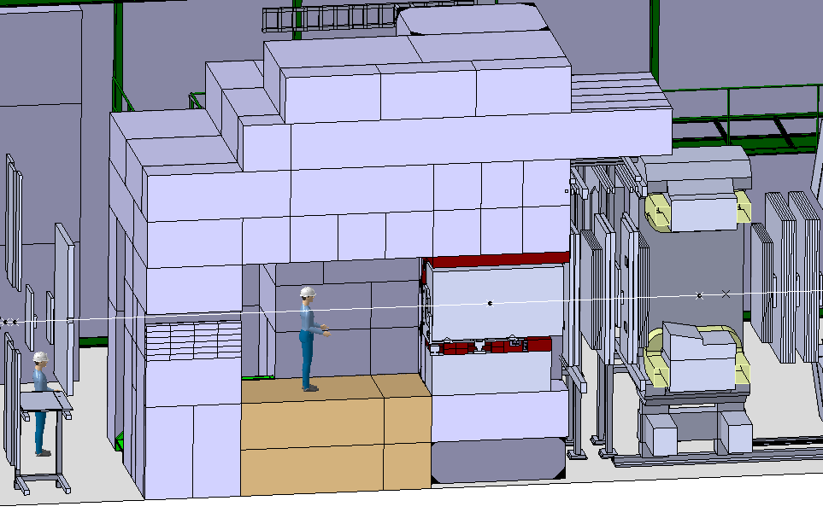
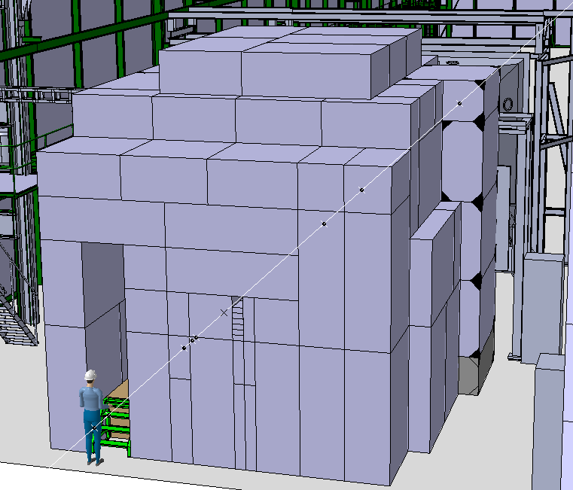
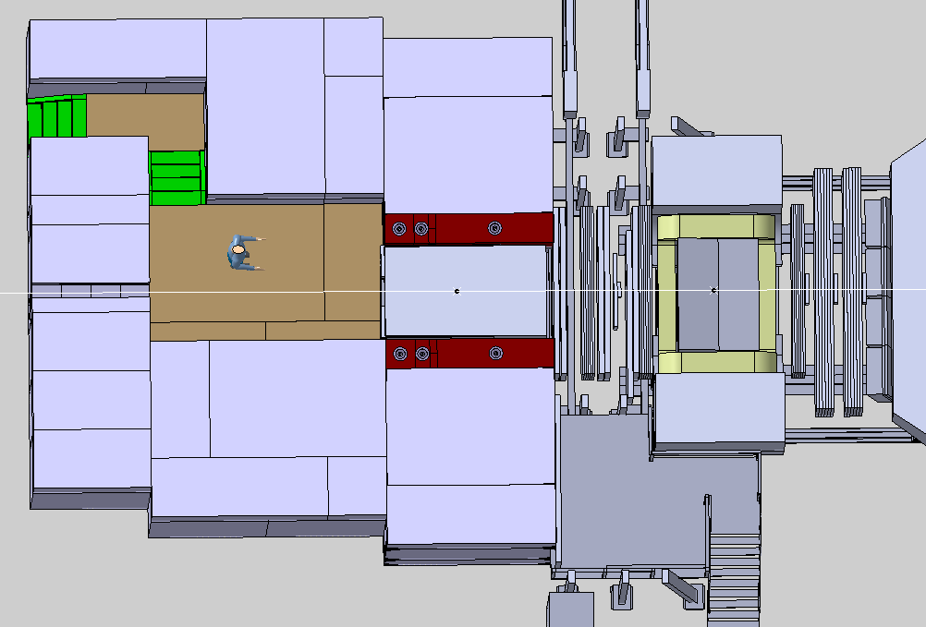
Proposed modifications
S. Girod BE-EA
Side View
absorber
Target Bunker
Target
3.2 m
M2
Front View
1.6 m
3.2 m
2.3 m
Top View
RP fenced door
6.4 m
M2
M2
7.2 m

Slide 15
Results from RP simulations
A. Devienne, C. Ahdida HSE-RP
Prompt ambient dose equivalent rate (µSv/h) for 4.8 x 10⁸ π-/spill and 240 spills/h on Target
Prompt annual ambient dose equivalent rate (mSv/h) for 3 x 10¹⁴ π-/year on Target
The beamline has been simulated in FLUKA with the proposed modifications.
Results show the proposed shielding design is in agreement with radiation area classification.
Air activation for access in EHN2 hall is negligible.
Annual activity in all air volumes is below 0.1 TBq/y for 3 x 10¹⁴ π-/year on target.
Exposure of members of the public due to air releases is below 0.1 µSv/y.

Slide 16
Results from RP simulations
A. Devienne, C. Ahdida HSE-RP
The residual ambient dose equivalent rate has also been checked for 6-month irradiation at 4.8 x 10⁸ π-/spill and 240 spills/h on target for a 2 minute cool-down and a 1h cool down time.
To optimise the access to the bunker a PMI monitor will be requested to monitor the residual dose rate inside the bunker before access.

Slide 17
Summary
For muon beams the rate is limited by the environmental radiation downstream of the EHN2 hall.
The maximal current average dose rate reached is ~ 1.9 µSv/h. Area classification limit at 2.5 µSv/h.
From the beamline considerations rate can be increase by another 40% by reducing the energy but limited by RP.
Measurement campaigns are planned with RP next year to study the optimal position of the environment monitors as this year already the doses registered were greater than in 2022 when SM1/SM2 were off during the high intensity MUonE run.
Shielding improvements does not apply for muons. Only mitigation will be extending the exclusion zone downstream of EHN2 or trying to deflect the muon beam downwards with some magnets, blowing up the beam more etc., - But gain to be estimated following the measurement next year.
For the higher hadron beam intensity of 10⁹ hadrons per spill improved shielding studied by RP and to be implemented during LS3.

