Slide 1
Research & Impact Away Day 2023
Prof Carsten P Welsch
Head of Physics Department
Notes:
All slides must include the University logo top left

Slide 2
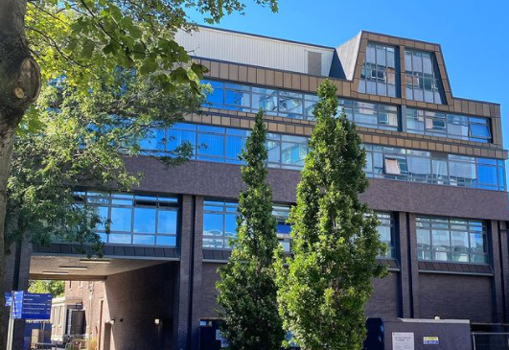
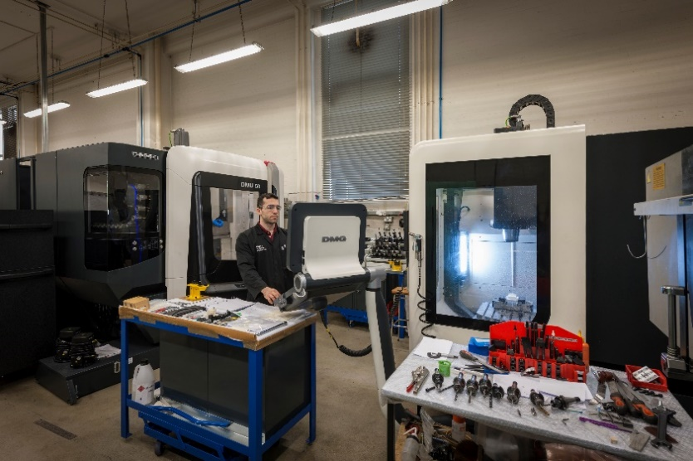
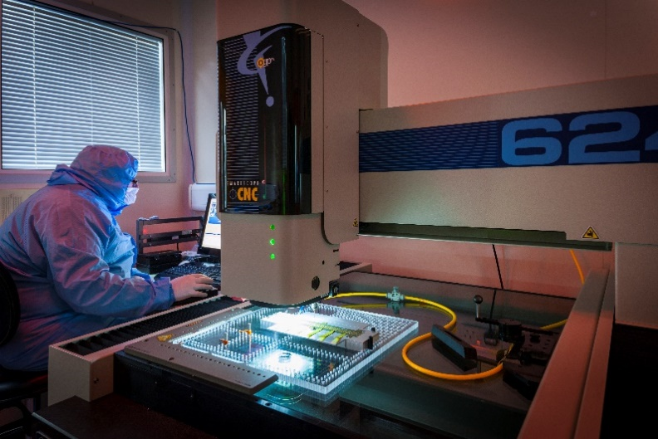
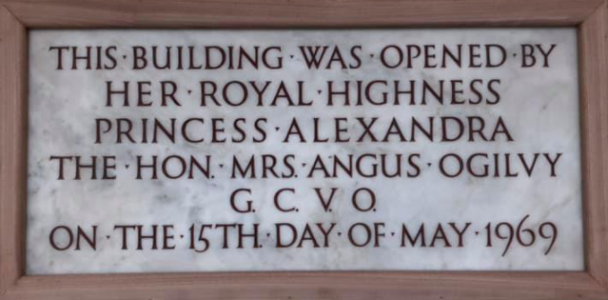
Liverpool physics today
A UK Top10 physics departments for research quality and environment (REF2021)
Based primarily in OLL, recognized for experiment construction + physics exploitation;
45 academics, 400 undergraduate, +100 PhD and +100 PGT students.
Notes:
Aim to use high-quality, professional images throughout your presentation. Avoid using clip art imagery, amateur photography or small photographs that are difficult to make out.

Slide 3
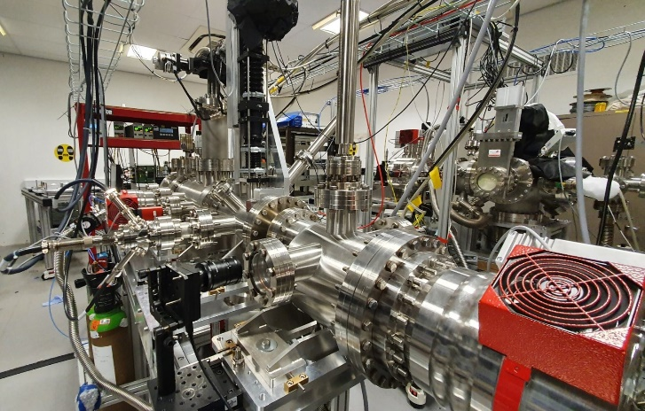
Cutting edge research
Currently five clusters: accelerator science, nuclear and particle physics, condensed matter physics and physics education.
Fundamental Science (ATLAS, LHCb, ALICE, etc), neutrinos, quantum, radioactive ions, next-gen light sources, antimatter, HLLHC, AWAKE, EuPRAXIA, etc.
Applied research with focus on healthcare instrumentation, imaging & diagnostics, nuclear industry, and data intensive science.
Notes:
To delete/replace pictures within the template, right click on the image and choose either ‘cut’ or ‘change picture’ from the drop down menu.

Slide 4
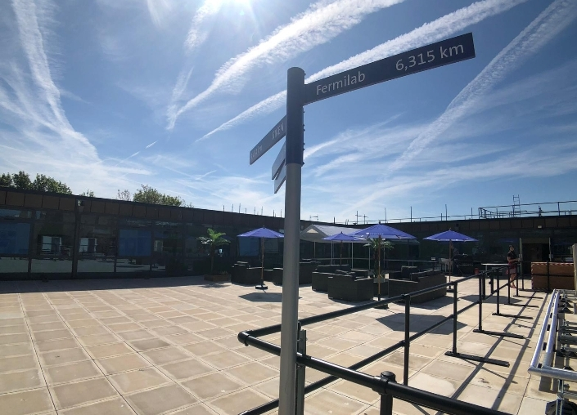

We have signed strategic partnership agreements with key institutions, including:
Daresbury
CERN
GSI/FAIR
TRIUMF
Fermilab/URA
We are ranked among the top 25 institutions globally who collaborate with CERN.
Strategic partnerships
Notes:
If you include your own image as a background, as per the example above, you may need to add in a text box before you type in your content, otherwise it will be difficult to read. To do this, go to: ‘Insert/Text Box’. This will provide you with a cursor symbol that will enable you to make your box by clicking and dragging. To change the colour of the text box, go to ‘Format Shape’ which should appear automatically on the right of the screen when the text box is selected. This allows you to change the colour of the box and change the levels of transparency so you can see the image behind, as above.

Slide 5
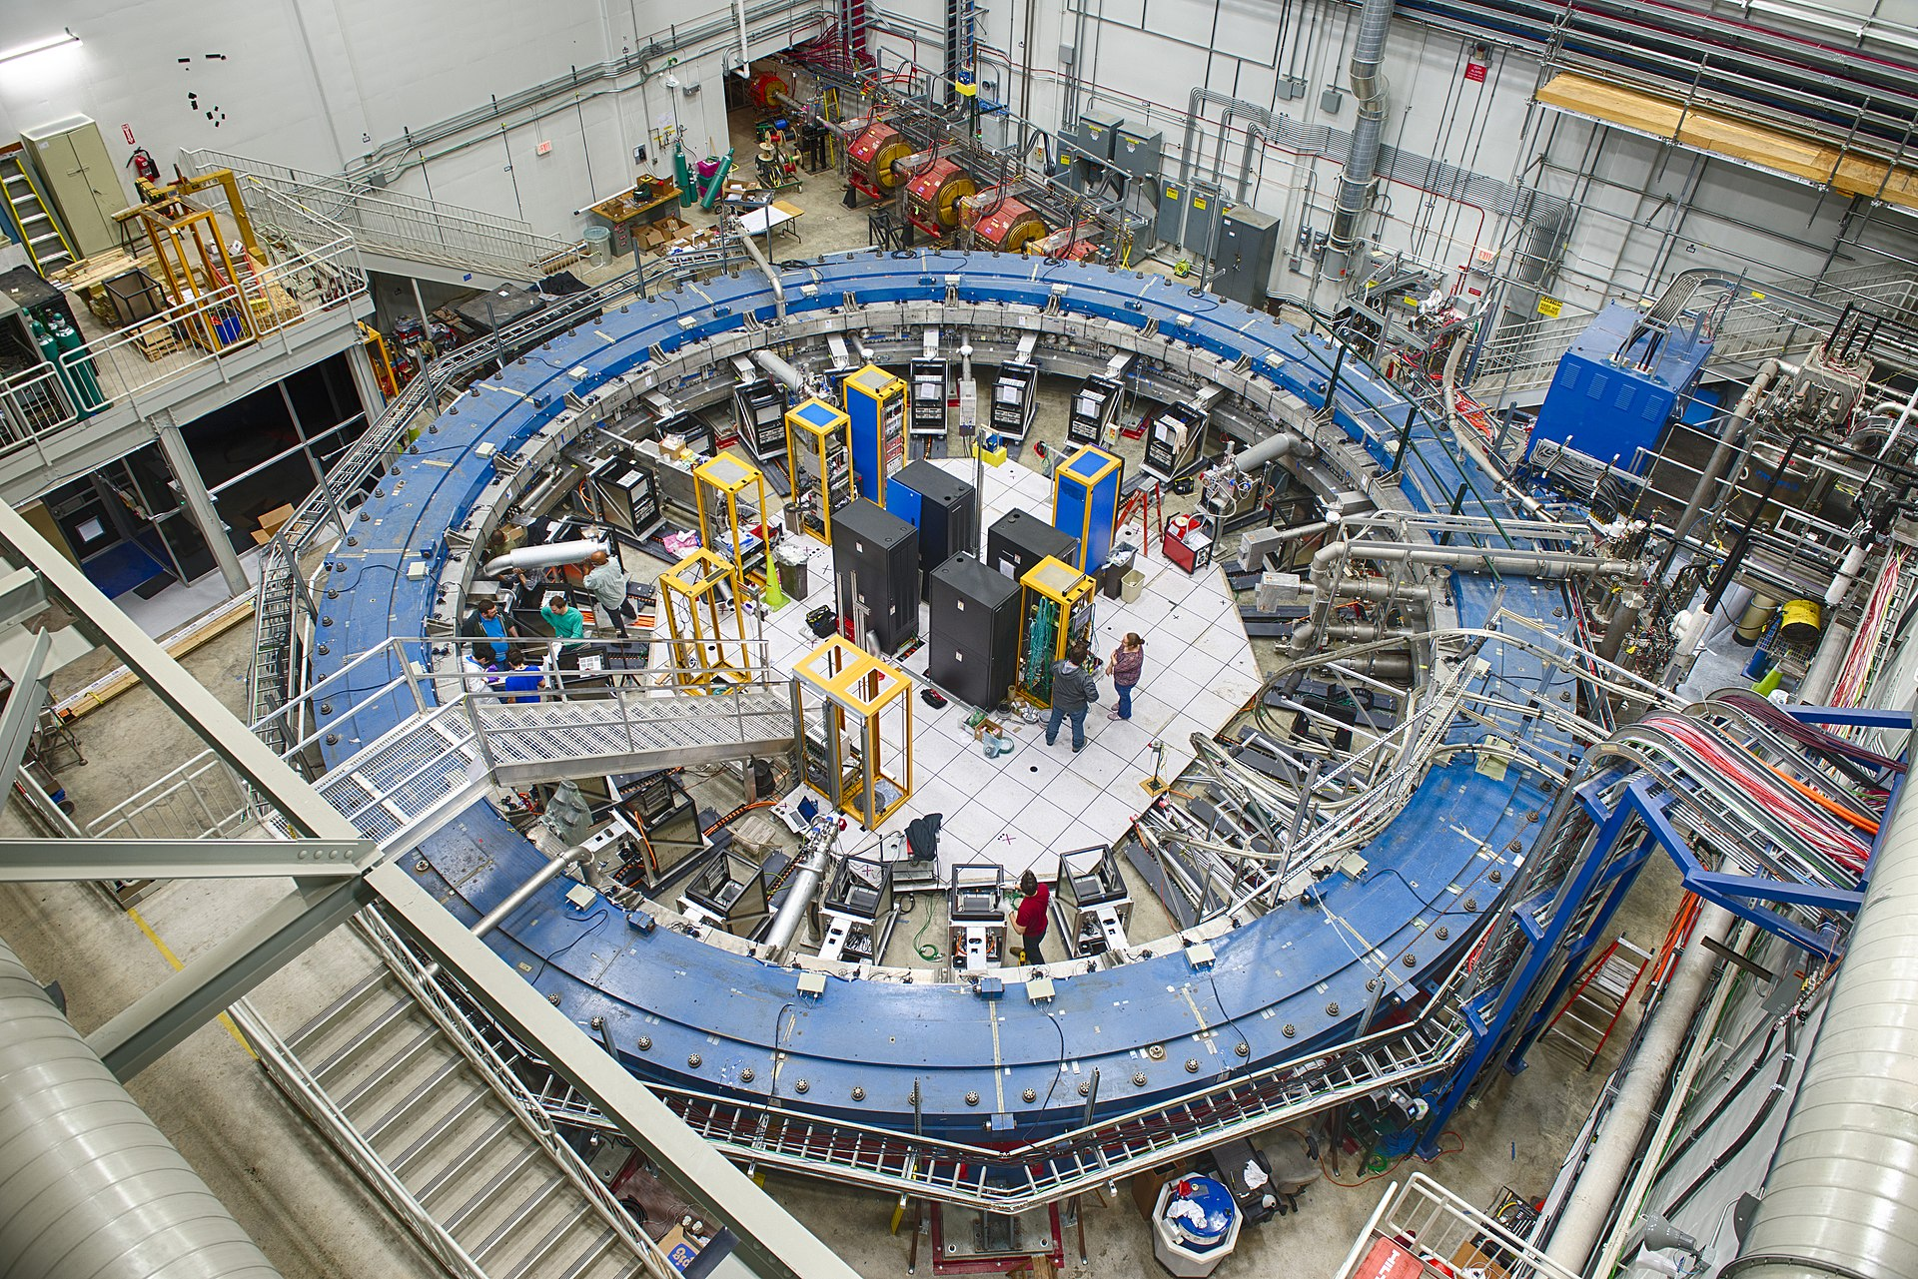
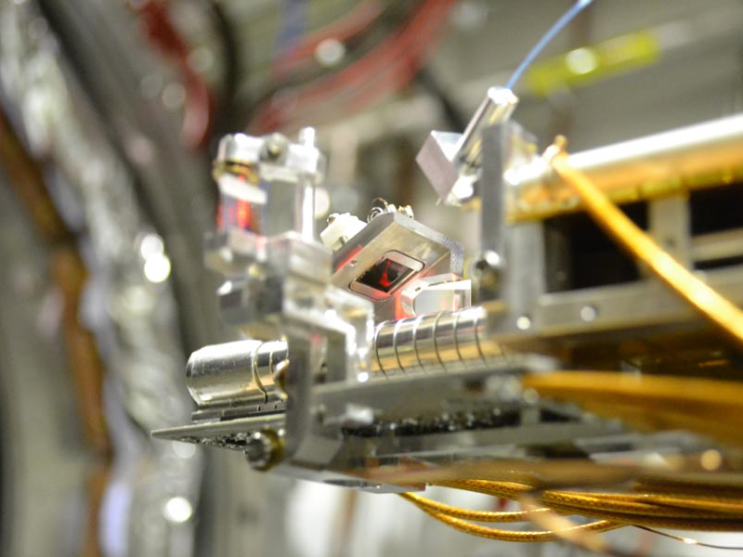
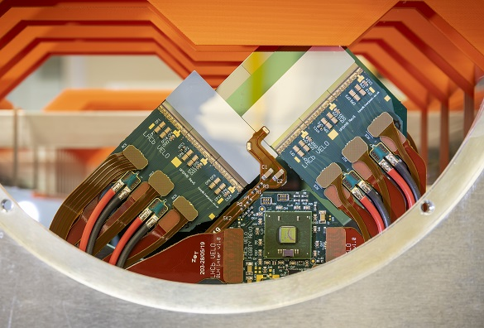

Research: Where are we going next?
further develop and lead research on physics questions of international significance
grow cross-cluster collaboration and promote interdisciplinary research initiatives
build and enhance a research environment which develops our people and embodies Equality, Diversity and Inclusion, including Juno and Athena SWAN principles
develop impact as an integral outcome of our research in focus areas: Energy, Health, Security, and Society
Notes:
Aim to use high-quality, professional images throughout your presentation. Avoid using clip art imagery, amateur photography or small photographs that are difficult to make out.

Slide 6


Slide 7

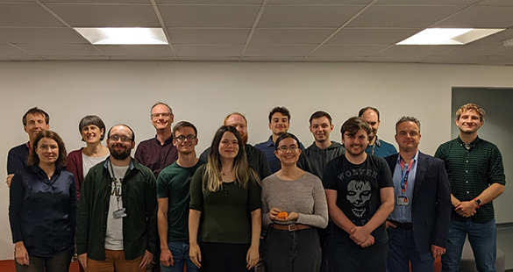
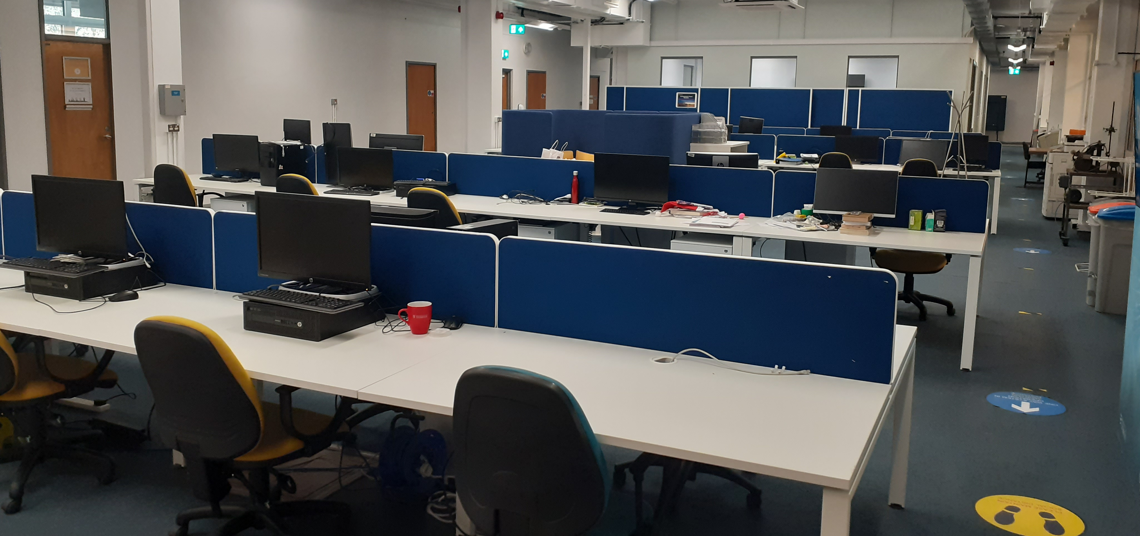
Talent pipeline: CDT
~ Dozen PhD students each year – every position match-funded (!)
Cross cluster collaboration and industry partnership are key features of our CDTs
Our structured training is a template for national PGR skills agenda
Future scientific events will engage wider community and showcase our R&D.
Notes:
overall quality of the research training environment and cohort approach to training focused on the student experience. For example, how specific training on data intensive science techniques and innovation will be delivered on a cohort basis
degree to which you are supporting a healthy and inclusive research and innovation culture, including the approach to equality, diversity and inclusion.

Slide 8

Success stories:
Commercialization of beam diagnostics solutions
Medical instrumentation
Impact
“”
Notes:
If you’re using quotes, it can be effective to increase the font size for maximum impact. If you don’t need a title box, simply right click on it and select ‘delete’.

Slide 9

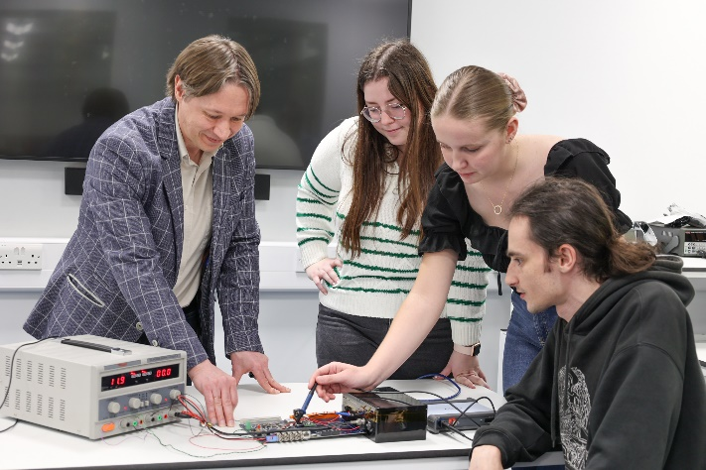
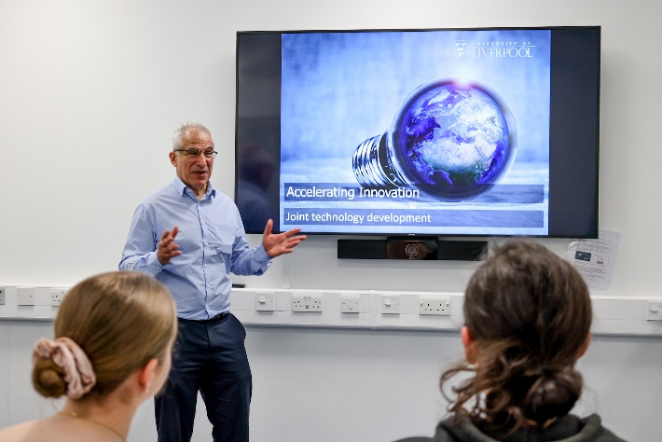
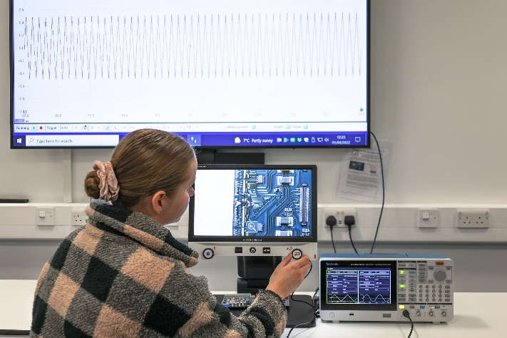
Teaching + industry hack space
Creating opportunities: collaborative space for industry-academia projects, supported by local BDM.
Facilitating workshops, seminars and other small group training events.
Joint technology development, de-risking investment into new product solutions.
Notes:
Aim to use high-quality, professional images throughout your presentation. Avoid using clip art imagery, amateur photography or small photographs that are difficult to make out.

Slide 10
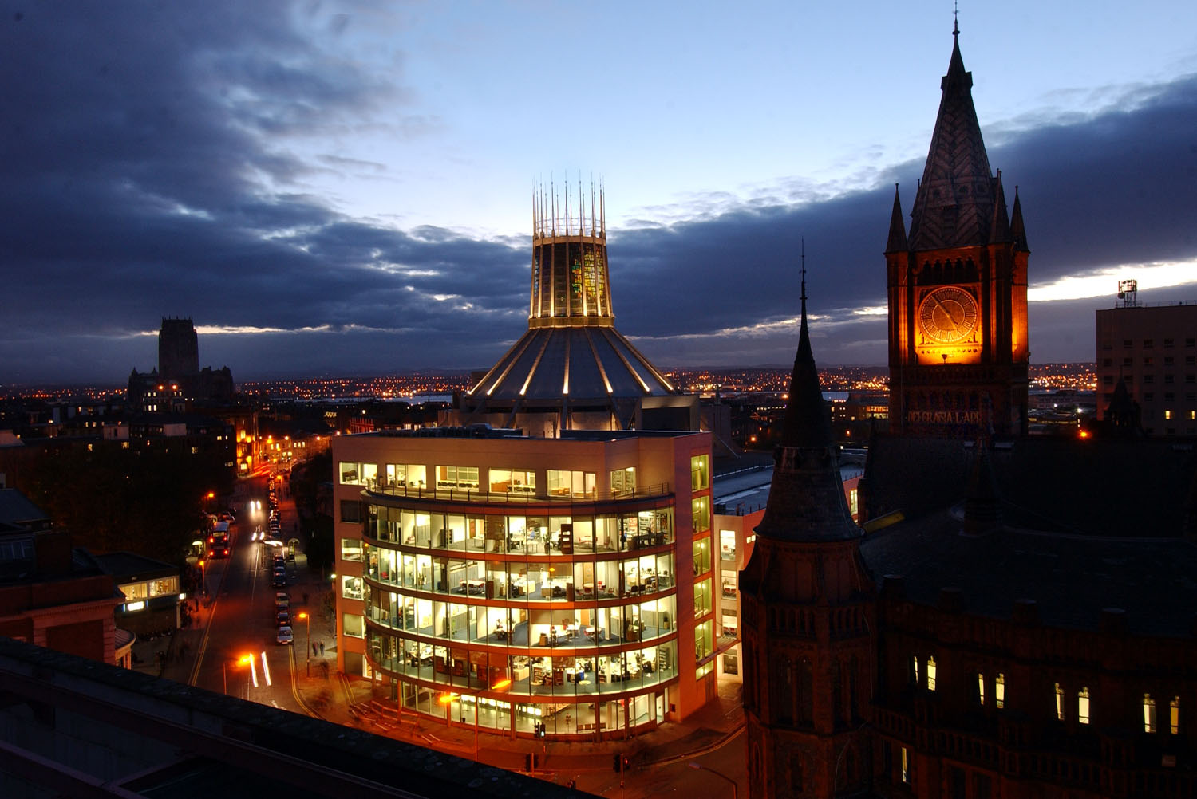
Starting point
Focus on collaborative research
Strategic partners across sectors help drive world-class science and innovation program
Unique design, manufacture and testing capabilities
RISE, CREATE: metrics to inform future directions
Results from today will feed directly into emerging university strategy
Notes:
You can move the text or title around the slide by clicking on the black box and dragging your cursor.

Slide 11
Notes:
If you need any help using this presentation, contact the Marketing Communications team on 0151 794 3214 or email: mcteam@liv.ac.uk.

