Slide 1
Environment
Prof Carsten P Welsch
Head of Physics Department
Notes:
All slides must include the University logo top left

Slide 2
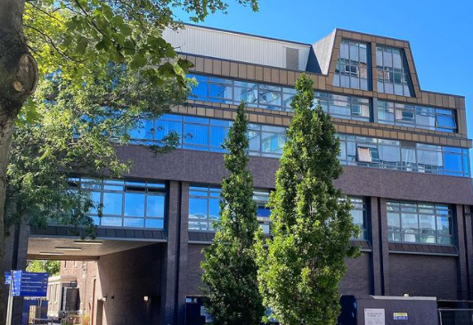
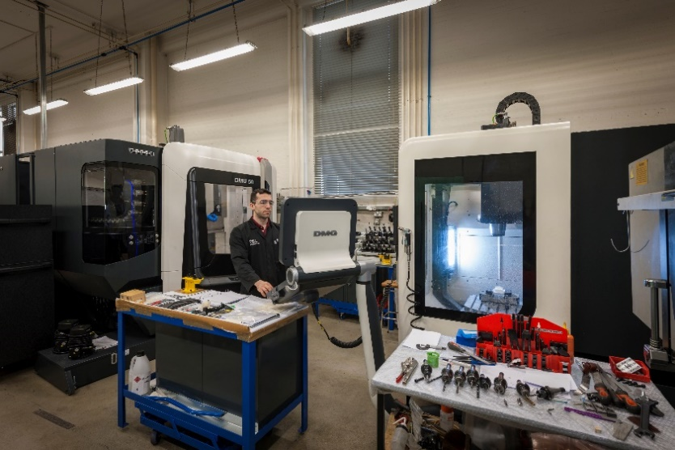
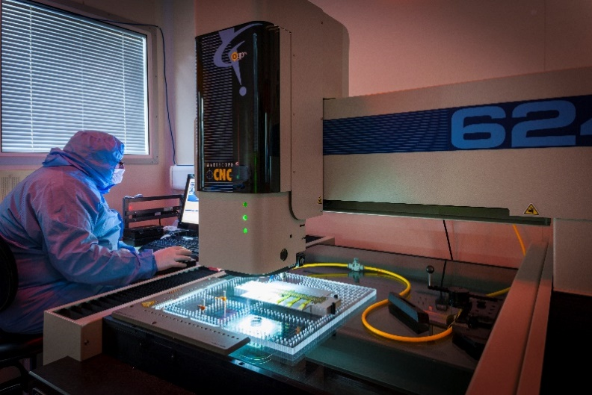
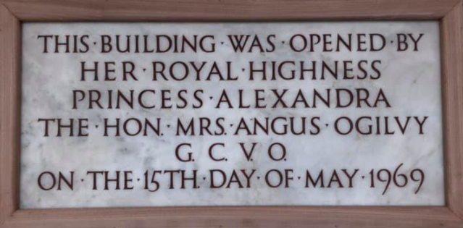
Environment today
7th for our research environment (REF2021), 3rd for overall 3*/4*
Infrastructure needs careful planning and investment;
Recruitment in identified priority areas, developing and expanding current clusters.
Notes:
Aim to use high-quality, professional images throughout your presentation. Avoid using clip art imagery, amateur photography or small photographs that are difficult to make out.

Slide 3
World-class Science and Innovation
Collaboration is key

Slide 4
Attracting, developing and retaining talent
RTP pathway introduced, physics has been behind this change for many years
Embed EDI and Sustainability in all of our activities
Strategic planning of leadership roles, attract prizes & awards, target recruitment in key areas
Notes:
Aim to use high-quality, professional images throughout your presentation. Avoid using clip art imagery, amateur photography or small photographs that are difficult to make out.

Slide 5
Spotlight on Liverpool
PLANCKS in February; largest-ever PLANCKS preliminary.
CUWIP 2023 took place in March with +100 participants from across the UK.
Both very visible events putting Liverpool in the spotlight, attracting the next generation.
Notes:
Aim to use high-quality, professional images throughout your presentation. Avoid using clip art imagery, amateur photography or small photographs that are difficult to make out.

Slide 6
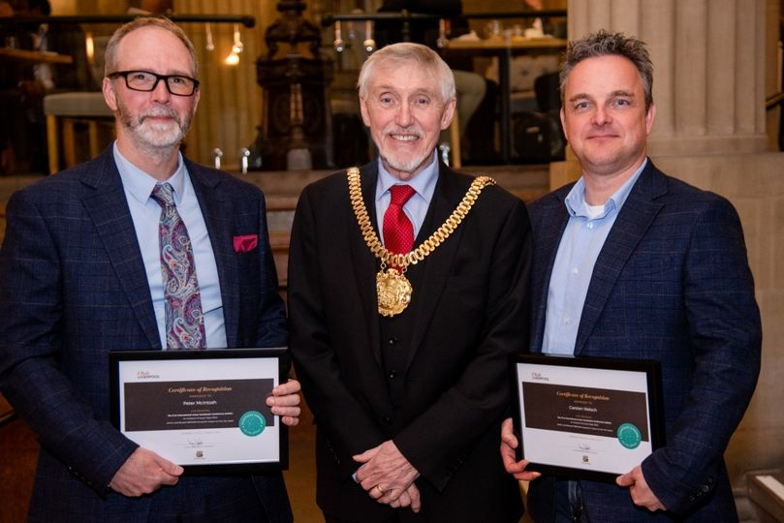
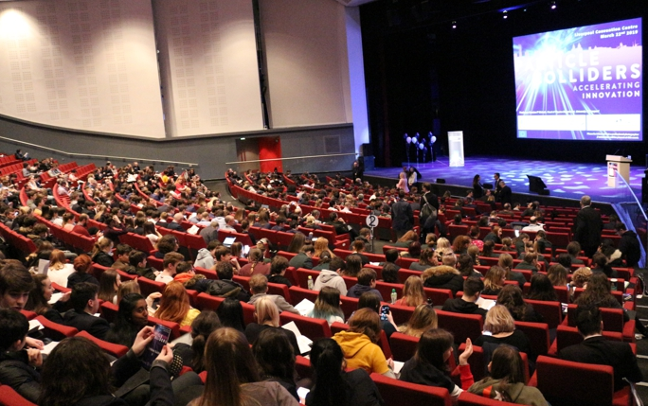
Spotlight on Liverpool
Economic impact: LINAC2022 contributed £990k to LCR.
International Beam Instrumentation Conference (IBIC) 2025 was awarded to Liverpool.
IOP NP/PP joint conference will be held in Liverpool in 2024.
Notes:
Aim to use high-quality, professional images throughout your presentation. Avoid using clip art imagery, amateur photography or small photographs that are difficult to make out.

Slide 7
Trigger questions
Driver: What makes a world-class research environment?
What is working well, what are we currently missing?
Be specific about targets and take broad view (i.e. beyond your own immediate research interests)
This will need everyone’s contribution!

Slide 8
Notes:
If you need any help using this presentation, contact the Marketing Communications team on 0151 794 3214 or email: mcteam@liv.ac.uk.

