Slide 1
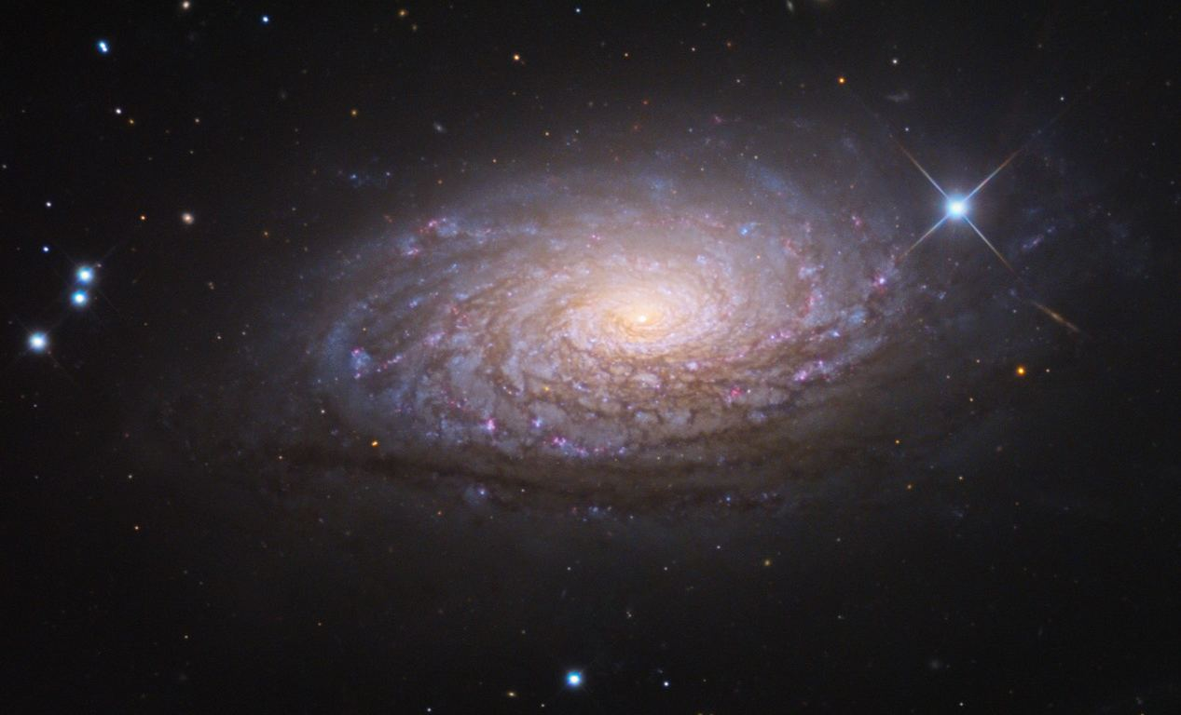
Constraining the Complex Relationships Between Galaxies and their Dark Matter Haloes with Machine Learning
Ryan Roberts

Slide 2
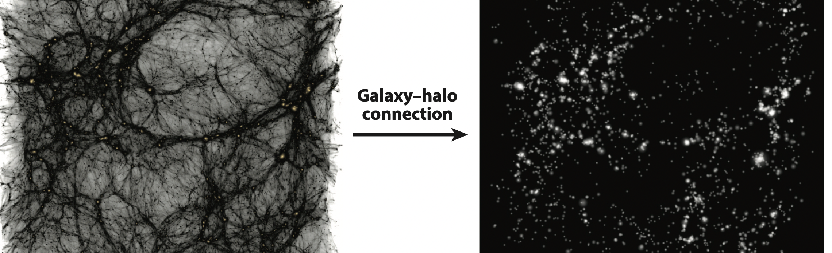
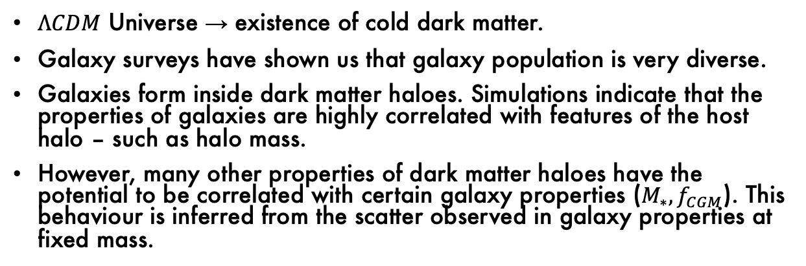
Cosmology and the Role of Dark Matter
Weschler & Tinker (2018)
$ΛCDM$ Universe → existence of cold dark matter.
Galaxy surveys have shown us that galaxy population is very diverse.
Galaxies form inside dark matter haloes. Simulations indicate that the properties of galaxies are highly correlated with features of the host halo – such as halo mass.
However, many other properties of dark matter haloes have the potential to be correlated with certain galaxy properties ($M_{∗}, f_{CGM}$). This behaviour is inferred from the scatter observed in galaxy properties at fixed mass.

Slide 3
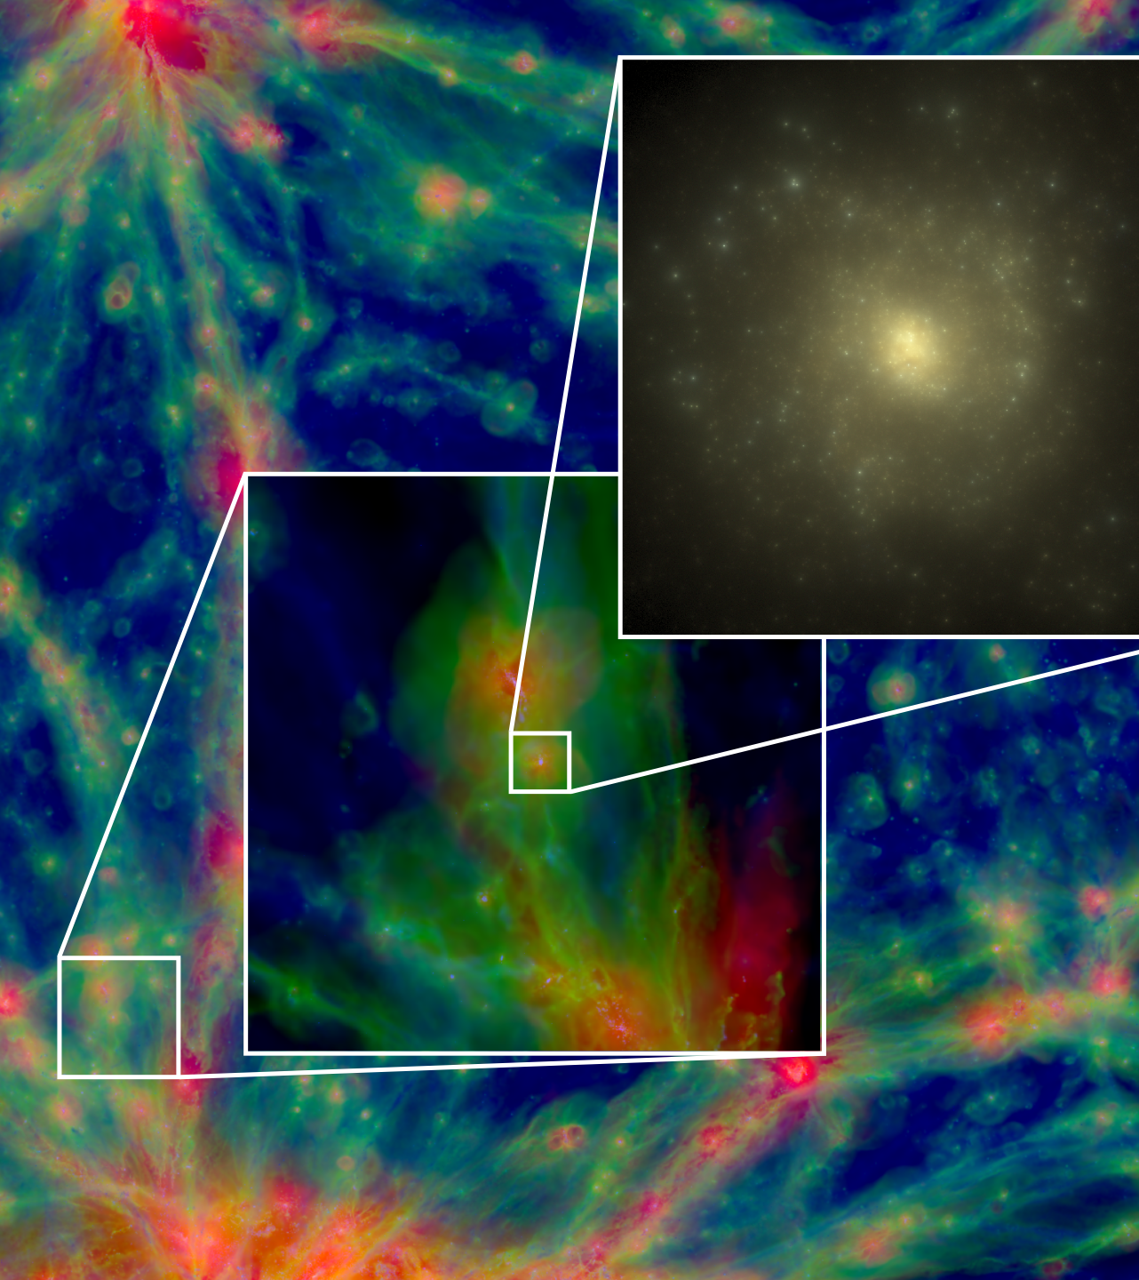
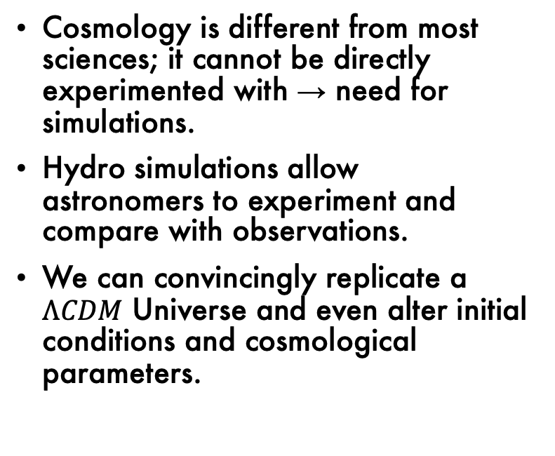
Cosmological Hydrodynamical Simulations
Cosmology is different from most sciences; it cannot be directly experimented with → need for simulations.
Hydro simulations allow astronomers to experiment and compare with observations.
We can convincingly replicate a $ΛCDM$ Universe and even alter initial conditions and cosmological parameters.
Schaye et al. (2014)

Slide 4
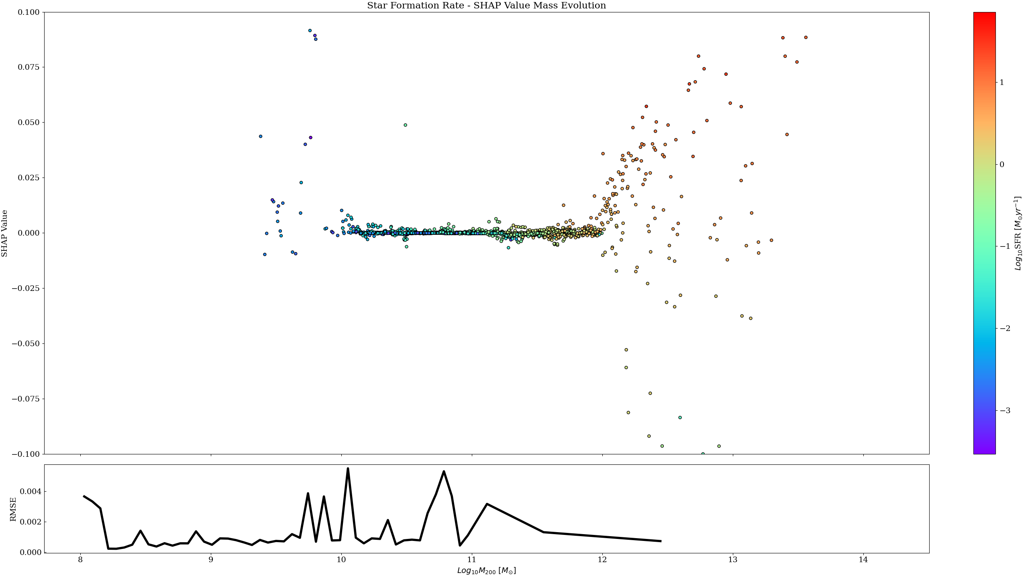

XGBoost and Feature Importances
The halo population itself is very diverse at fixed mass – so many factors can contribute to the observed diversity of galaxies. Since these are generally correlated, we require tools to help quantify covariances in properties.
XGBoost is a form of ensemble predictor; it provides an extra tier of capability by feeding previous tree decisions into new trees.
Ensemble predictors are inherently straightforward to garner feature importances from → crucial for project.
Example: Determine which parameters contribute most towards predicting $f_{CGM}$ in a given mass range. A plot of the SFR against halo mass (coloured by the change in $f_{CGM}$) shows that at the highest mass values, the low values of SFR are attributed to the greatest decrease in $f_{CGM}$. Theoretically, at high masses you would expect to see the highest SFRs at the highest values of $f_{CGM}$, as there is more material that can lead to star formation.

Slide 5
Future Direction / Explainable AI
Feature importance plots are promising, but how trustworthy and explainable are SHAP and other feature importance methods?
Could another ML method be useful for this kind of challenge?
Thank you!

