Slide 1
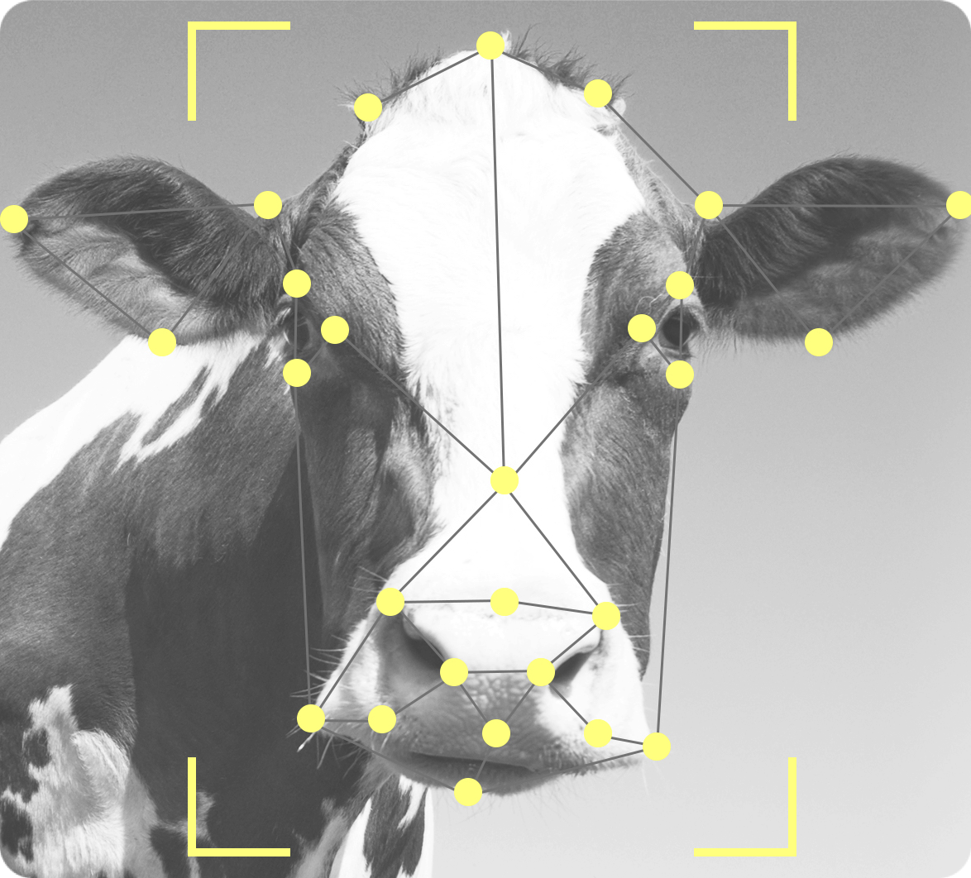
MUCCA Multi-disciplinary Use Cases for Convergent new Approaches to AI explainability CHIST-ERA XAI
From “Which” to “Why”: Interpretation map for
Explainable Deep Learning based on Influence methods
M
U
C
C
A
Andrea Ciardiello
From Graph Neural Networks to Explainable AI: comprehending and trusting Machine Learning algorithms
Liverpool, 21 09 2023
Tommaso Torda, Andrea Ciardiello, Simona Gargiulo, Greta Grillo, Cecilia Voena and Stefano Giagu
Notes:
This work is a part of the MUCCA project.
Ultimate Goal: quantifying strengths and solving weaknesses of new and state of
the art xAI methods.
Strategy: study xAI in heterogenous use cases from High Energy Physics (HEP),
medical imaging, diagnosis of pulmonary, tracheal and nasal disease, neuroscience
xAI : Better understanding of the AI algorithms and promote trust in them
Three phases:
1. Apply xAI techniques
2. Identify shortcomings and metrics
3. Get new transparent algorithms

Slide 2
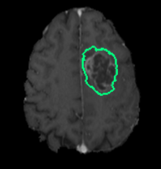
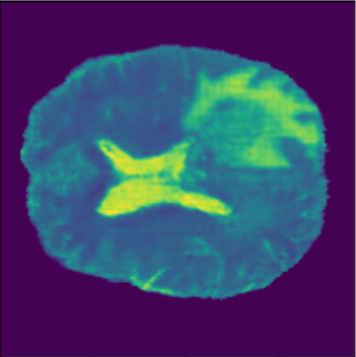
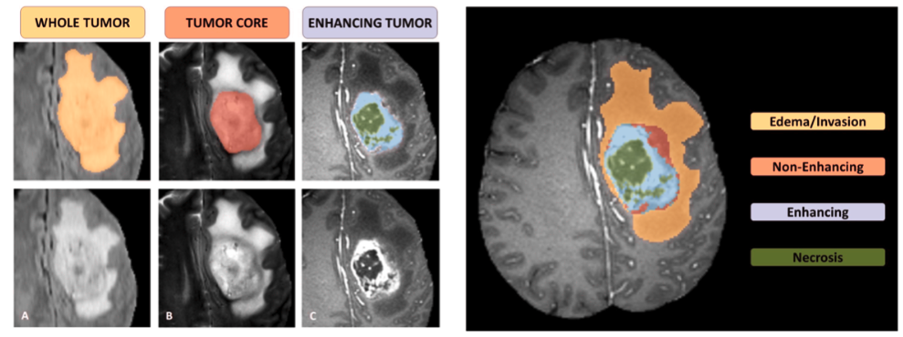
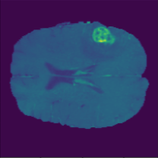
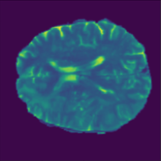
A MUCCA USE-CASE: xAI IN MEDICAL IMAGING
use open MRI images databases to train DNN for segmentation tasks of both anatomical brain structures and healthy/pathological tissue
apply state of the art xAI algorithms and test their ability to produce consensus on final users quantifying it by appropriate metric
study stability of the metric vs different datasets, training strategies, architecture constraints, data augmentation, …
gradient
tracing
saliency
maps
opponent
proponents
BraTs19
UNet , DeepLabV3+, ResNet3D

Slide 3
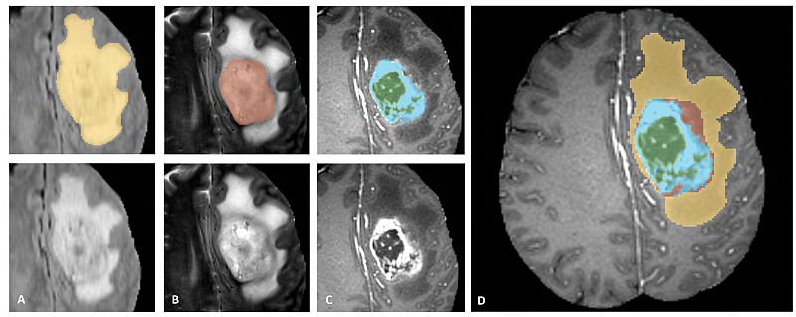
A MUCCA USE-CASE: Brats 2019 Dataset
Brats 2019 Dataset:
4 channels: native (T1), post-contrast T1-weighted (T1Gd), T2-weighted (T2) and T2 Fluid Attenuated Inversion Recovery (T2-FLAIR)
4 labels: background (label 0), necrotic and non-enhancing tumor core (NCR/NET - label 1), peritumoral edema (ED - label 2), GD-enhancing tumor (ET - label 4)
whole tumor (yellow) visible in T2-FLAIR
tumor core (red) visible in T2
the enhancing tutor structures visible in T1Gd, surrounding the necrotic components of the core (green)

Slide 4
TracIn for segmentation task
Segmentation is a classification of groups of pixels
Proponents for different labels can be
We want to isolate contribution for each segmented area

Slide 5
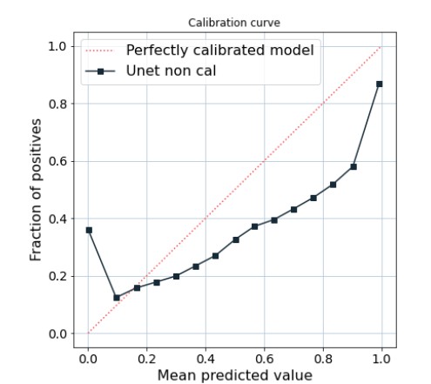
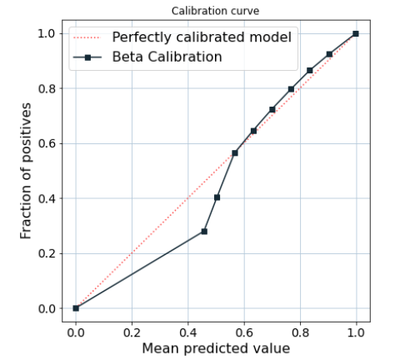
Calibration with temperature scaling
Simple, post training calibration scheme (Guo, 2017)
T is optimized with respect to NLL on the validation set.
T does not change the maximum of the softmax function, the class prediction remains unchanged
Temperature scaling does not affect accuracy
Temperature scaling
Confidence Plots

Slide 6
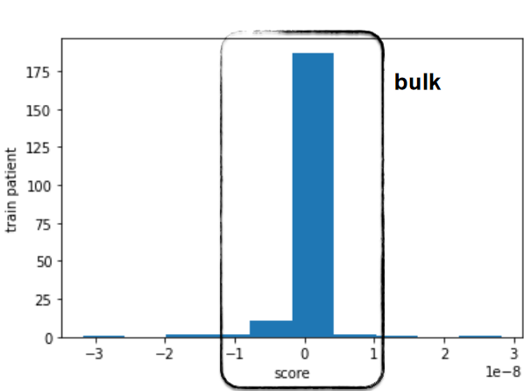
Influence for a test patient
Influence distribution for a test patient
Proponents/Opponents defined as the highest/lowest scoring training examples
Influence can be computed for the whole dataset or for a hand-picked subsample of training points
New elements can be described in relation
Problem: High self influence items in training
A row of Influence relations with train patient is the “explanation”
Proponent
Opponent

Slide 7
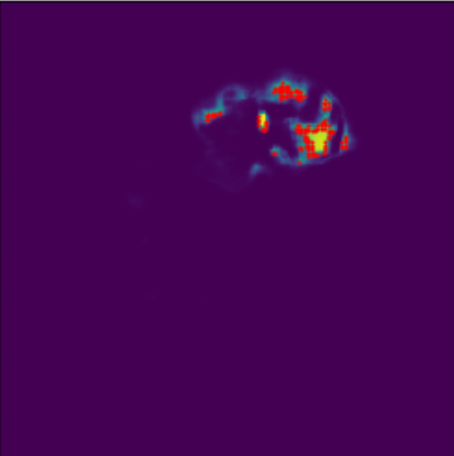
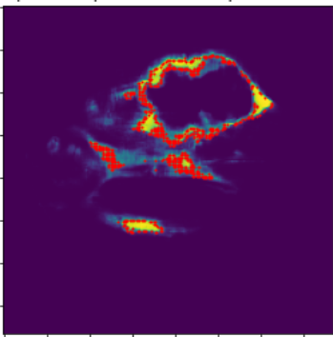
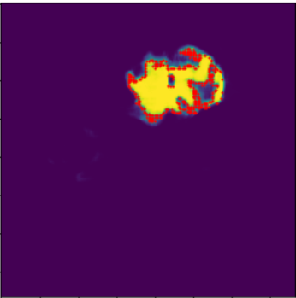
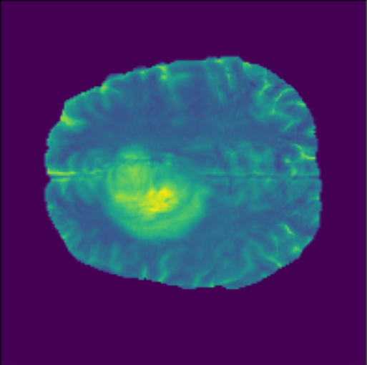
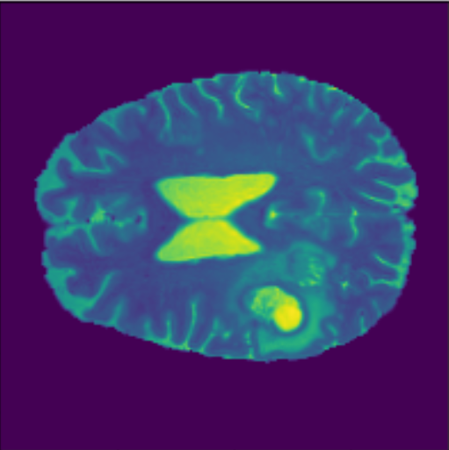
A set of proponents
NCR/NET - label 1
ED - label 2
ET - label 4
Proponents for RED area (confidence under threshold)
Different patients for each label
One modality for each patient is shown (arbitrary chosen)
For the untrained eye, the interpretation of the explanation is difficult
The results are not Robust – The proponents list can change after retraining

Slide 8
Robustness of TracIn
Explanation cosine similarity
After retrain, between folds in a K-fold CV (on test set)
Statistical Robustness
Given a row in the Influence score matrix as the explanation for the patient we can compute the cosine similarity between two explanation after retraining with fixed train parameters
Explanation cosine similarity
Between a test patient original image and after the application of a transformation (same trained network)
Cosine Similarity

Slide 9
Interpretation of Influence?
We are looking for a quantitative interpretation for proponents/opponents that can also be “understandable” by clinicians:
Relation with “classical” texture analysis : Radiomic features
Proponents share the same Radiomic signature?
Relation with modality importance:
Proponents have the same pattern of modality importance?
modality Shapley value φm^{mod} to be the ground truth Modality Importance score for a modality m. Calculated as:
where v is the modality-specific performance metric, calculated as the prediction model accuracy on the test set
M\{m} denotes all modality subsets not including modality m
https://arxiv.org/pdf/2107.05047.pdf

Slide 10
Conclusions and perspective
xAI algorithms can be used to check how AI models are working but hopefully we can use them also to learn something more about the underlying process
xAI to increase the Trust of the Users
xAI algorithms as a Discovery Tools
Influence functions (and approximate measures) are model agnostic and can be ported to numerous use-cases.
An expert is still needed to correctly interpret the results
A subjective evaluation is needed
The insights gained may be more useful from the point of view of the “machine learning expert” than the final user “the clinicians”.

Slide 11
THANK YOU FOR YOUR ATTENTION
Tommaso Torda
tommaso.torda@roma1.infn.it
Andrea Ciardiello
andrea.ciardiello@uniroma1.it

