Slide 1
Outreach
Naomi Smith
University of Liverpool

Slide 2
What is outreach?
Engaging others with your research, specifically those who would not otherwise be engaged
Can be friends/family, but more often people who you engage with at an organised event
Engaging people who know about or want to know about your work anyway doesn’t count!
Outreach can take many different forms (more about that later)

Slide 3
Why do we do outreach?
To be transparent about what we are doing and why
To help us better understand the public and the public understand us
To show a commitment to our work having a wider societal benefit
To allow the public to take part in informed debate about what we do
To show the relevance of research to people’s every day lives
Public engagement/outreach is usually a requirement of any funding. It should be seen as an integral part of the project and not just as a small add on which is required to satisfy funders.

Slide 4
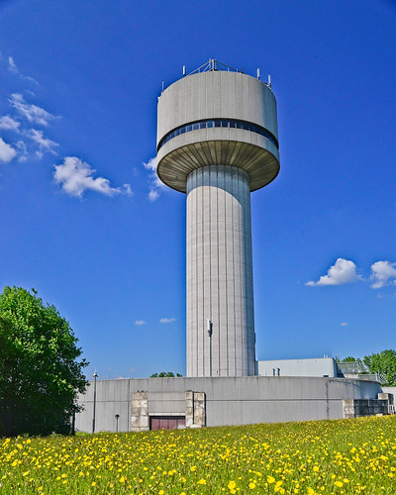
Opportunities for outreach in LIV.INNO/EuPRAXIA-DN
Our Symposium on 10 July 2026 !
School visits
Open weeks at your institution
In UK:
STEM ambassador opportunities
RI Christmas lectures – 14th December

Slide 5
Taking a professional approach
We would like all UK-based students/Fellows to train as STEM ambassadors
Opportunities to go into schools etc
How many are already STEM Ambassadors?
Those based in other countries should try to join an equivalent scheme where they are – most institutions do outreach!

Slide 6
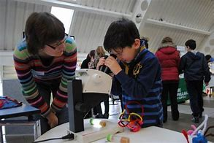
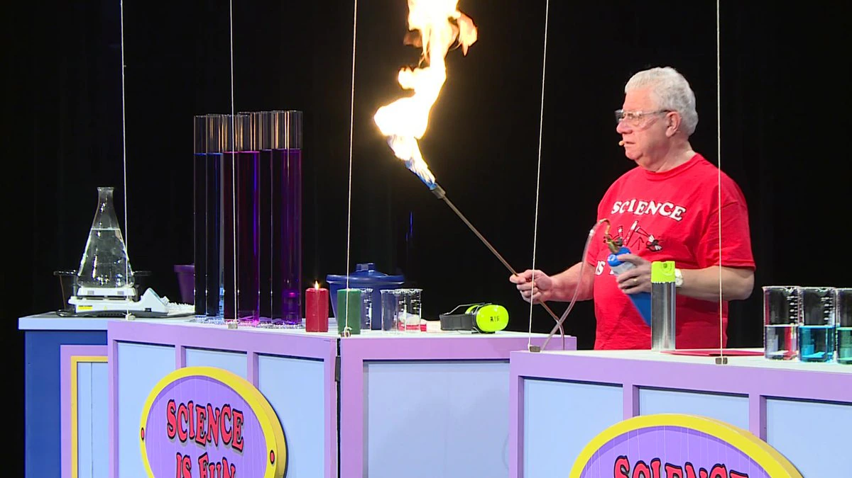
Types of outreach
Talk/lecture/presentation
Lesson in school/workshop
Science Fair
Busking
Pint of Science
Science Show
Online (blogs, citizen science etc)

Slide 7
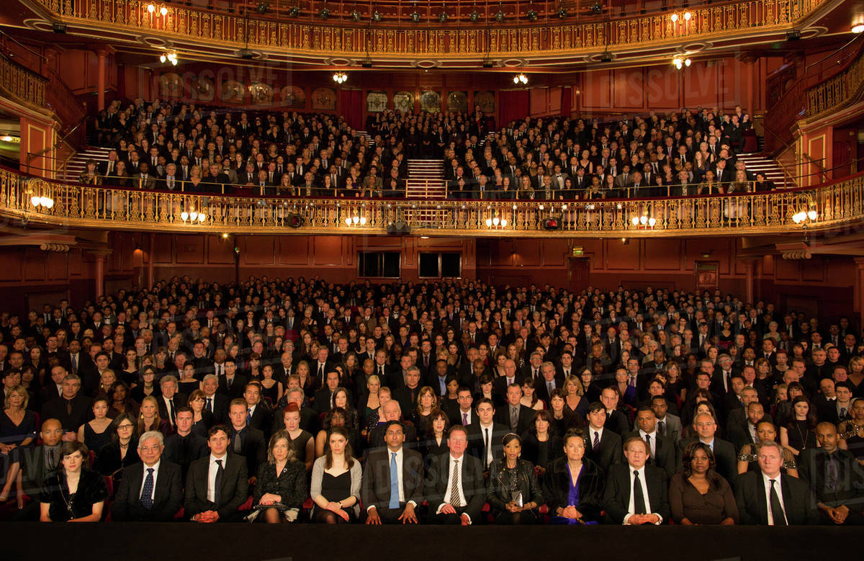
Audiences
Most common audiences
School children
Families
Adults
Outreach can be targeted at people with a particular characteristic such as:
Gender
Age
Science Capital
Socio-economic status
Where they live
Target audience is rarely the ‘general public’!

Slide 8
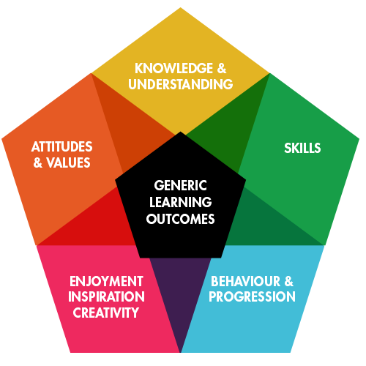
Objectives
What are you trying to achieve with your outreach?
Learning?
Enjoyment?
Change in attitude or behaviour?
Never: Ticking a box for a project
Generic Learning Outcomes are a good way to think about this
Your objectives should always include some these

Slide 9
Learning Styles
Many different theories of learning style, but all break down roughly into three categories:
Hearing/Listening
Reading/Seeing
Doing
There is no right or wrong learning style, just remember other people may learn differently to you!
Not everything can be taught (efficiently and effectively) using every learning style
Try to incorporate as many styles as you can into your outreach

Slide 10
Capturing your audience’s attention
Good demos:
Hydrogen balloon
Plasma ball
Magnets
Fascinating/unbelievable facts:
The CERN Data Centre stores more than 30 petabytes of data per year from the LHC experiments, enough to fill about 1.2 million Blu-ray discs
Everything that you are made of was once part of a star
Time slows down and objects become heavier when you travel at very high speeds

Slide 11
Do you need a PowerPoint presentation?
No, not always. But it can be helpful. Often hands-on activities will be more engaging.
The most important point is to interact with the participants, rather than just talking to them.
A combination of a talk and other activities can work very well (e.g. Physics of Star Wars)

Slide 12
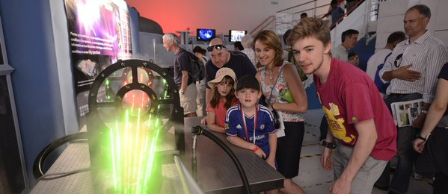
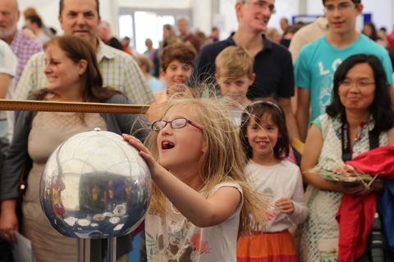
Outreach symposium
Will takes place at The Spine on 10th July 2026
The audience will be industry
There will be talks and an exhibition where you engage with industrial partners
All of you are expected to take part

Slide 13
The challenge
During this week, you will work in groups and develop different outreach proposals, seeking (up to) £10k funding
All outreach ideas should be connected to LIV.INNO or EuPRAXIA
You will need to submit a written proposal and talk by COP Thursday
You will present your ideas in teams to each other on Friday
There will be sessions throughout the week to develop these ideas

Slide 14
Your outreach proposal
Needs to follow the format of an STFC SPARK award:
Rationale – includes overall aims and anticipated outcomes and how the activities will contribute to strategic communication of our research
Engagement activity plan - details of your plans to deliver these activities, including how you will effectively engage your target audiences, how the activities link to the R&D in the project/s and identification of potential risks and appropriate mitigation strategies
Evaluation plan - showing details of how the outputs, outcomes, and impacts will be captured and evaluated
Dissemination plan - detailing how resources, learning outcomes and outputs will be made available to wider audiences
Justification of resources – explaining what you seek funding for
More details will be in the document which you will be sent to fill in.

Slide 15
Tight deadline
Each group must submit a written proposal by the end of Thursday (17:00) to naomi.smith@liverpool.ac.uk and c.p.welsch@liverpool.ac.uk
Each group will also give a 15-minute presentation to everyone else about their idea on Friday morning; this also needs to be ready by Thursday 17:00.
You will need to split tasks in your teams and coordinate activities!

Slide 16
Groups
Group 1
Divya
Ana Maria Guisao Betancur
Sakircan Beyazit
Luke Detraux
Group 3
Marina Maneyro
Phani Deep Meruga
Emily Costello
Sam Godwood
Group 2
Andrés Leiva Genre
Ana Costa Pereira
Joseph Hadley
Qiyuan Xu
Group 4
David Gregocki
Alex Whitehead
Mehul Depala
Sinead Eley

Slide 17
Peer review
Following the group presentations, each group will review and discuss the merits and challenges of the other proposals and presentations on Friday morning.
All groups will give feedback saying what they liked and where they found challenges and how they think a proposal could be further improved. Groups will also decide which idea they liked best and why.
You will have ~30 minutes to discuss the other groups’ proposals and presentations and then 5-10 minutes to provide feedback.

Slide 18
Outreach
Naomi Smith
University of Liverpool

