Slide 1
Accelerator Cluster
Hao Zhang
Notes:
The talk is just meant to be a general introduction of the group, its members, activities, and the locations where it works. Perhaps it would be useful to discuss the group’s contributions to major projects like CERN and the FCC, as well as the major ongoing projects.
I hope this helps, let me know if you have any further questions.
A few PDRAs/fellows and I are organising an away day in September for all staff of a ~postdoc level. The aim is to start to build a community and set up a network of peer support in career progression etc.
As part of the day, we are inviting members of the physics department to deliver overview talks on the various research clusters. Would you be available to deliver a talk on the activities and facilities of the accelerator physics cluster?

Slide 2
What are particle accelerators
Source: https://www.iaea.org/newscenter/news/what-are-particle-accelerators
2
Notes:
Particle accelerators produce and accelerate beams of charged particles, such as electrons, protons and ions, of atomic and sub-atomic size. They are used not only in fundamental research for an improved understanding of matter, but also in plethora of socioeconomic applications related to health, environmental monitoring, food quality, energy and aerospace technologies, and others.

Slide 3
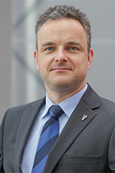
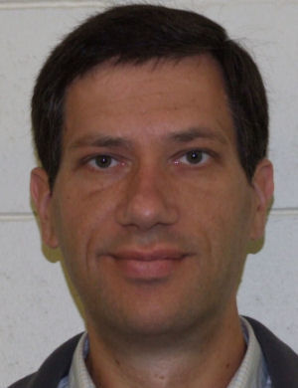
Members
Academic Staff
Research Staffs
Dr. Hao Zhang
Dr. Narender Kumar
Dr. Joseph Wolfenden
Dr. Debdeep Ghosal
Dr. Alex Webber-Date
Dr. Alex Hill
Dr. Daliya Aflyatunova
Dr. Bharat Rawat
Dr. Benjamin Rienacker
Dr. Milaan Patel
Prof. Carsten Welsch
Prof. Andy Wolski
Dr. Laura Corner
(Engineering)
3

Slide 4
Cockcroft Institute
Named after Nobel Prize laureate John Cockcroft.
Four universities
Liverpool
Lancaster
Manchester
Strathclyde
One STFC partner
ASTeC
4

Slide 5
Research Strategy for Quasar group
Frontier Accelerators
In the next decade we will focus on the LHC at CERN, where we lead the development of gas jet monitors for the high luminosity upgrade, and other collider options; on the exploitation of the CLARA facility on Daresbury campus to explore next-generation FEL technologies; on the development and exploitation of the new facilities PERLE and RUEDI; and on the optimization of low energy beam transport and efficient injection into traps at the Antiproton Decelerator, in particular contributions to AEgIS.
Novel Accelerators
As part of AWAKE, we will continue our efforts on novel (high gradient) acceleration techniques. Following the successful demonstration of proton-driven wakefield acceleration in 2018, we are leading the development of novel diagnostics that will give more detailed insight into the physics of the acceleration process and also benefit other large scale plasma accelerator projects such as EuPRAXIA. We will also expand simulation and experimental studies into micro-accelerators using carbon nanotubes and dielectric structures.
Accelerator Applications
For impact, we will carry out R&D into least invasive beam and dose monitors, to help improve patient treatment and medical accelerator operation; continue to develop and optimize novel low dose 3D X-ray imaging systems with Adaptix; drive quantum technologies for accelerator applications; grow our spinout company D-Beam, targeting a product portfolio that benefits accelerator facilities around the world.
A backbone of all areas will be our continued leadership in Data Intensive Science through LIV.DAT and LIV.INNO.

Slide 6
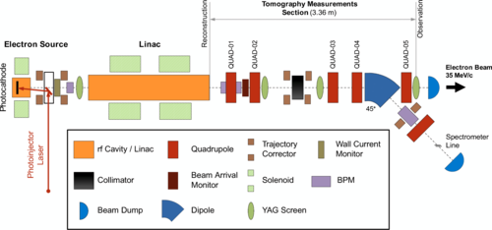
Frontier Accelerators: Daresbury Lab
CLARA facility (UK-XFEL)
6

Slide 7
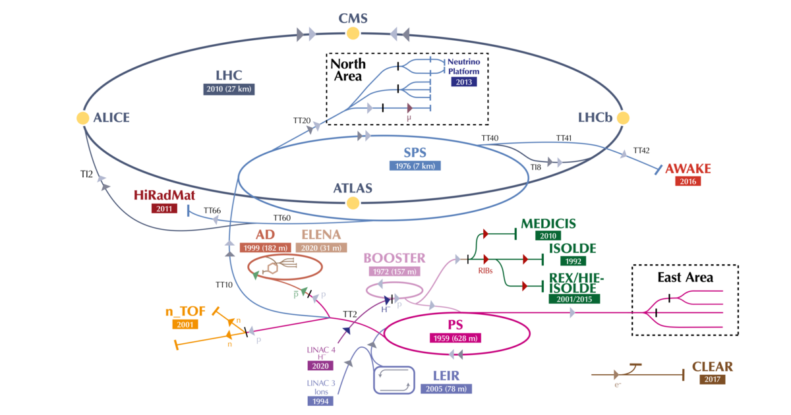
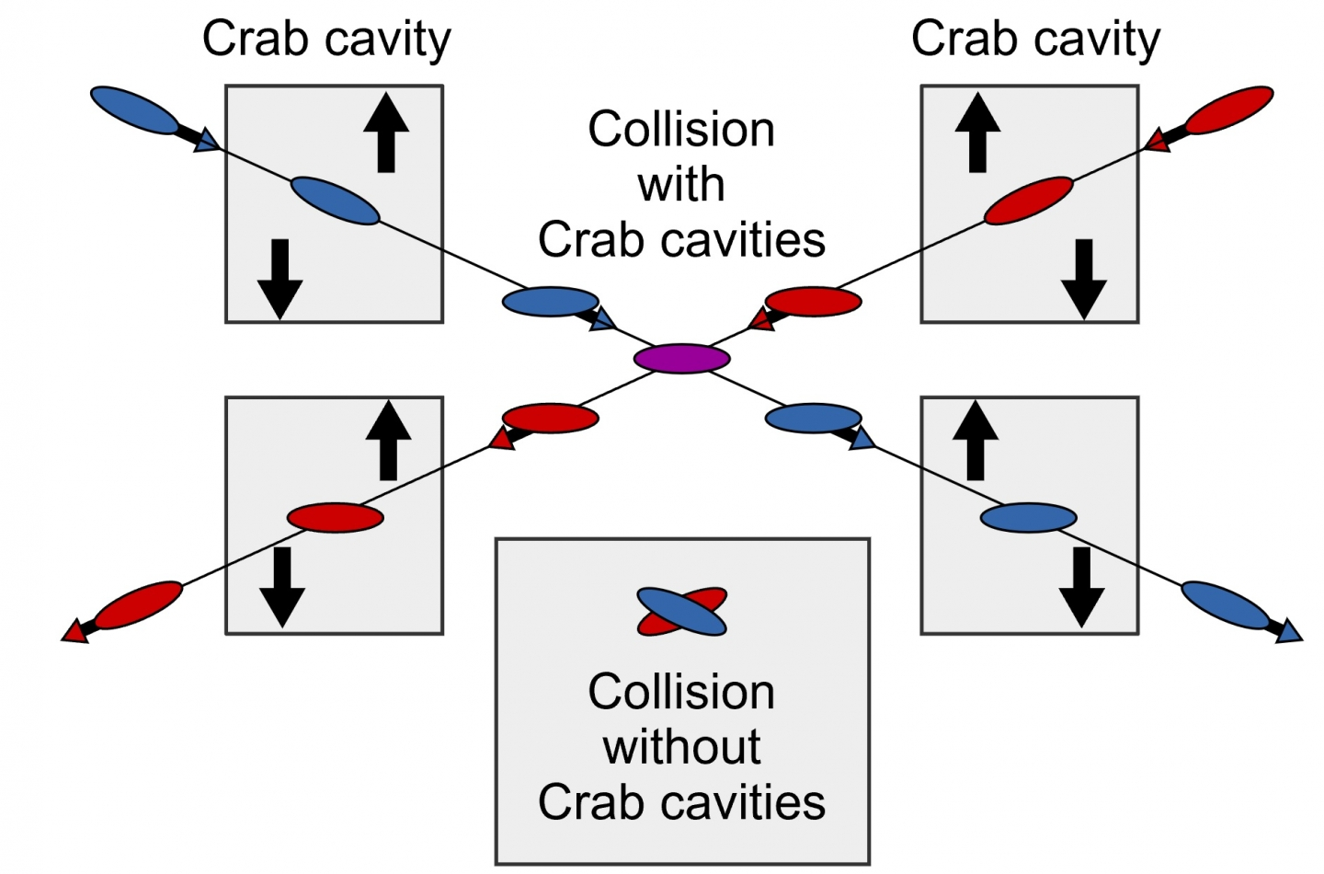
Frontier Accelerators: CERN
HLLHC project
Credit: CERN
Crab cavity development and beam dynamics.
Credit: CERN
7

Slide 8
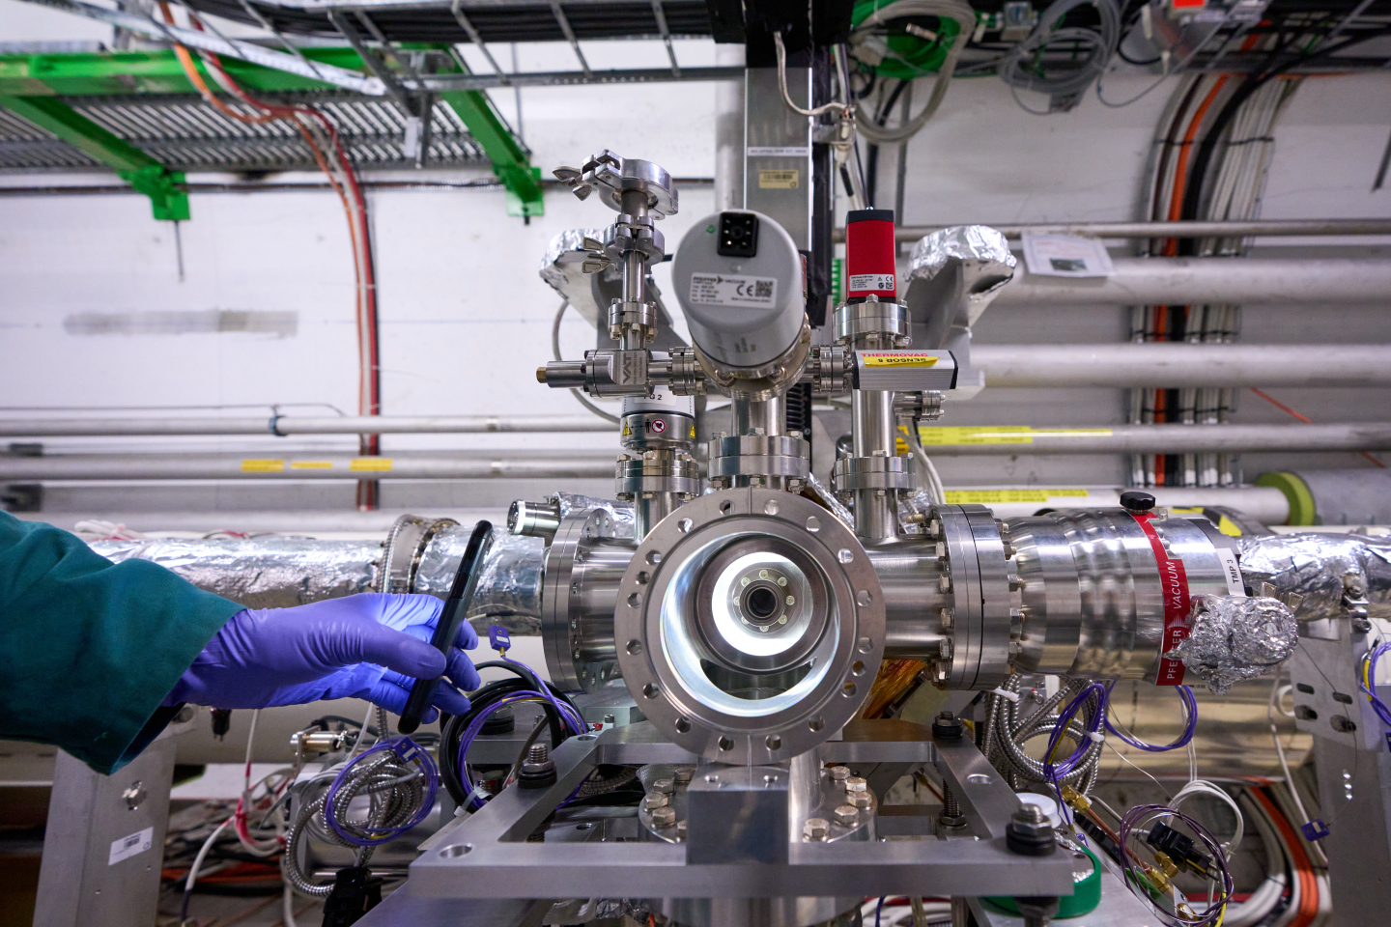
Frontier Accelerators: HLLHC project
Beam Gas Curtain profile monitor
Credit: Accelerating news
Installed into the LHC and began to measure beam profile this year.
8

Slide 9
Frontier Accelerators: Antimatter facility
Beam dynamic Task: Optimization of low energy beam transport and efficient injection into traps at the Antiproton Decelerator
Credit: AEgIS collaboration.
9

Slide 10
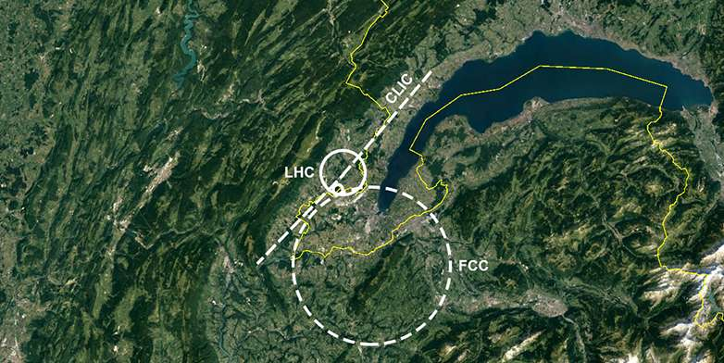
Future mega facilities?
The International linear collider (ILC at Japan?)
The Compact Linear Collider (CLIC at CERN?)
FCC-ee, FCC (CERN) VS CEPC (China)
Muon collider
So many other facilities
4th generation light source
Diamond upgrade
UK-XFEL
ISIS upgrade
10

Slide 11
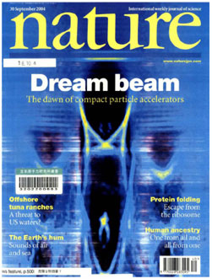
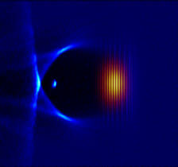
Laser Plasma Wakefield Acceleration
Credit: CAS
Credit: Laura Corner from CLF experiment RAL
Credit: Nature 2004
11

Slide 12
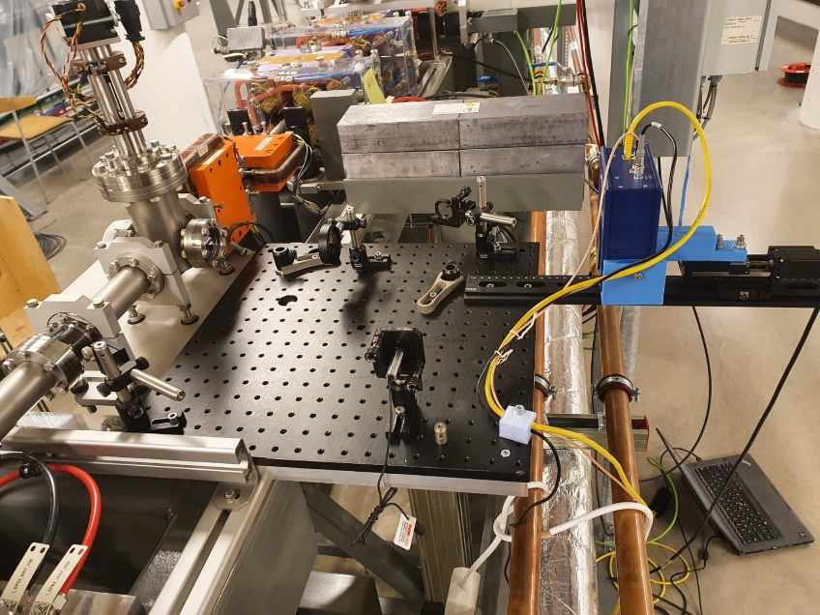
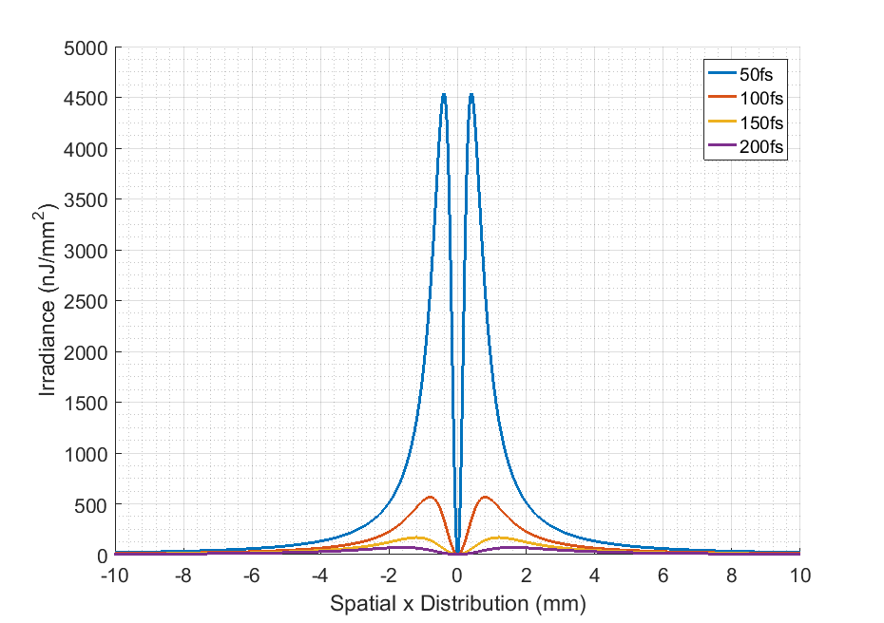
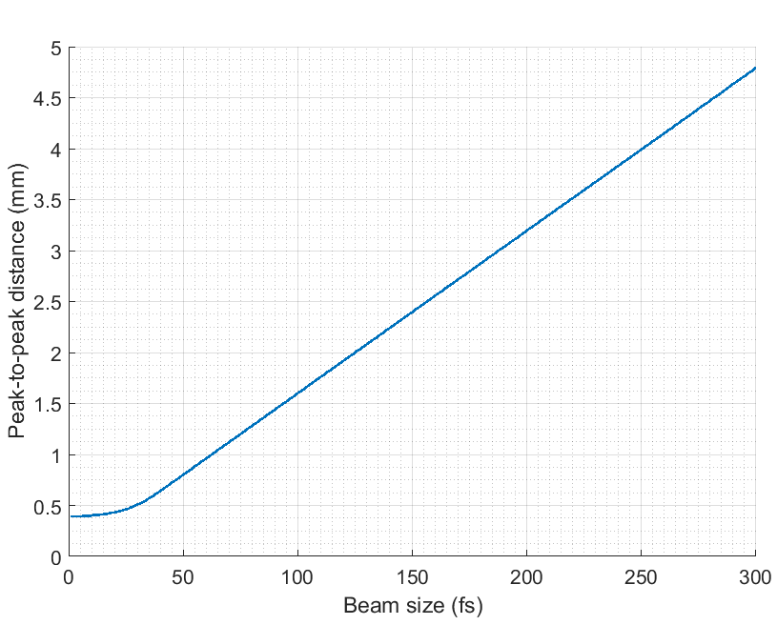
Novel Accelerators: AWAKE Project
Credit: CERN courier
CTR imaging bunch length monitor
Credit: Joseph Wolfenden
HRFZ Si Lens
$$\frac{dI_{bunch}^{i}}{dr}≈N_{e}^{2}\int_{Δω}{\frac{d^{2}I_{e}^{i}}{dωdr}{\left|F_{z}(ρ\left(z\right),ω)\right|}^{2}dω}$$
Pyrocam
12
Pyrocam

Slide 13
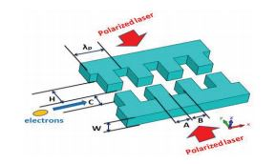
Micro-accelerators
Dielectric laser accelerators
Graphene layer for laser accelerator
Credit: SLAC
Credit: C. Bontoiu
Credit: Y. Wei
13

Slide 14
Accelerator Applications: JetDose
Beamline
(ending with Ti Foil)
Proton
Beam
(in vacuum)
125 µm
Ti Foil
Interaction Chamber
Beam
Dump
Beam Parameters
Beam Species: Proton
Beam Energy: 28 MeV
Beam Current: 150-750 nA (on FC1)
Beam Collimator Area: 4-100 mm²
125 µm
Ti Foil
Proton
Beam
(in air)
Proton
Beam
(in vacuum)
Credit: N. Kumar

Slide 15
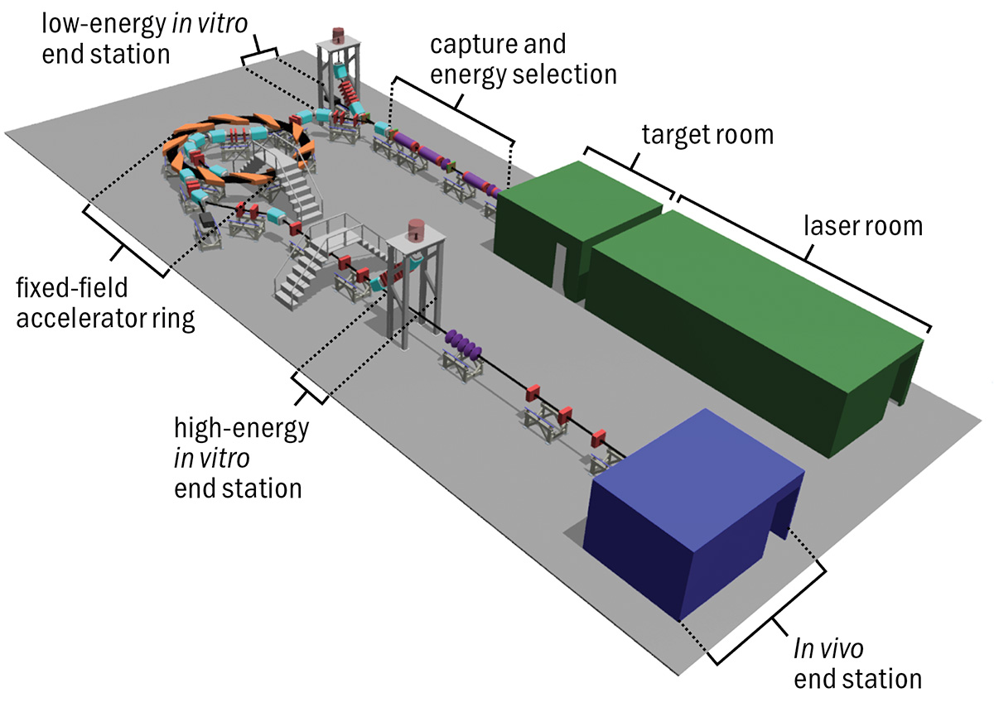
Accelerator Applications: Lhara
Clearly identified clinical benefits – opening opportunities for novel cancer treatment modalities such as LhARA, FLASH and improved ways to operate existing and future facilities;
Project will be realized by consortium with long-standing collaborative links who are recognized leaders in their respective area;
Exceptional international network for collaboration and dissemination established through OMA leadership.
Credit: CERN Courier
15

Slide 16
Accelerator Applications: Adaptix
Credit: T. Primidis
16

Slide 17
Personal taste
Particle physicist used to be good at both Particle physics and accelerator physics historically.
Good combination between physics and engineering.
Nowadays, large accelerators is too big to be afford by a university lab. Collaboration is a must.
New accelerating concepts are emerging, and new techniques were welcomed by the accelerator communities.
Applications of accelerators are expanding.
17

Slide 18
Questions?
18

