Slide 1
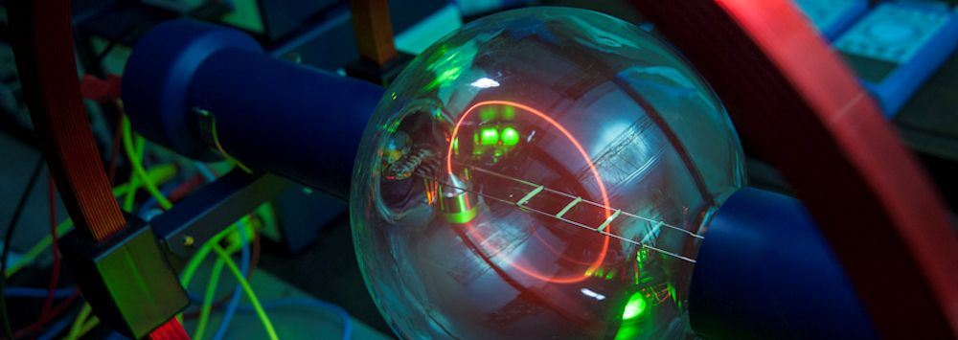
Condensed Matter Physics
“Discipline that treats the thermal, elastic, electrical, magnetic, and optical properties of solid and liquid substances”
Encyclopaedia Britannica
So, things we instinctively understand: crystals, amorphous solids, films, metals, liquids…
But also: liquid- and quasicrystals, superconductors, magnets, glasses, soft materials…
Main idea: “A system of many interacting parts can have properties that the parts do not have”

Slide 2
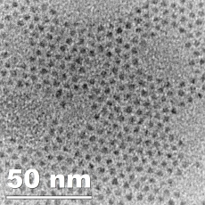
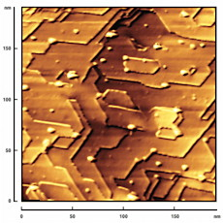
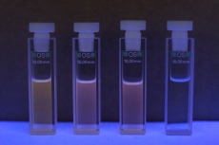
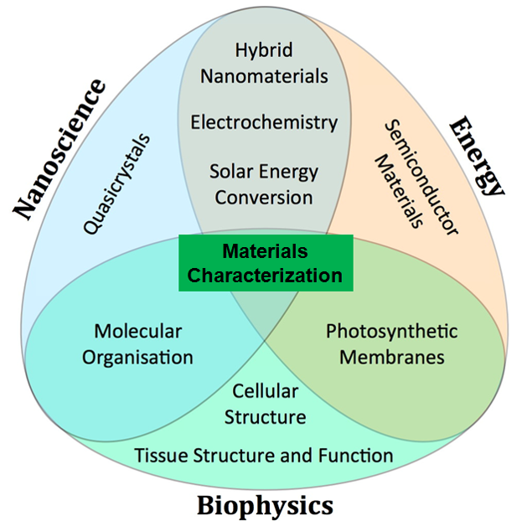
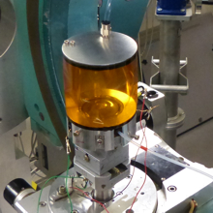
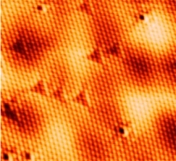
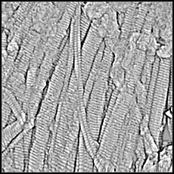
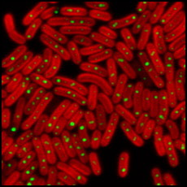
CMP Research Areas at University of Liverpool
https://www.liverpool.ac.uk/physics/research/condensed-matter-physics/

Slide 3
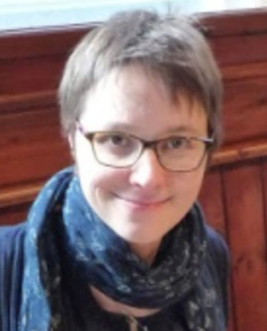
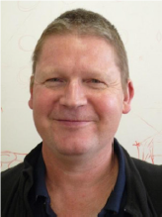
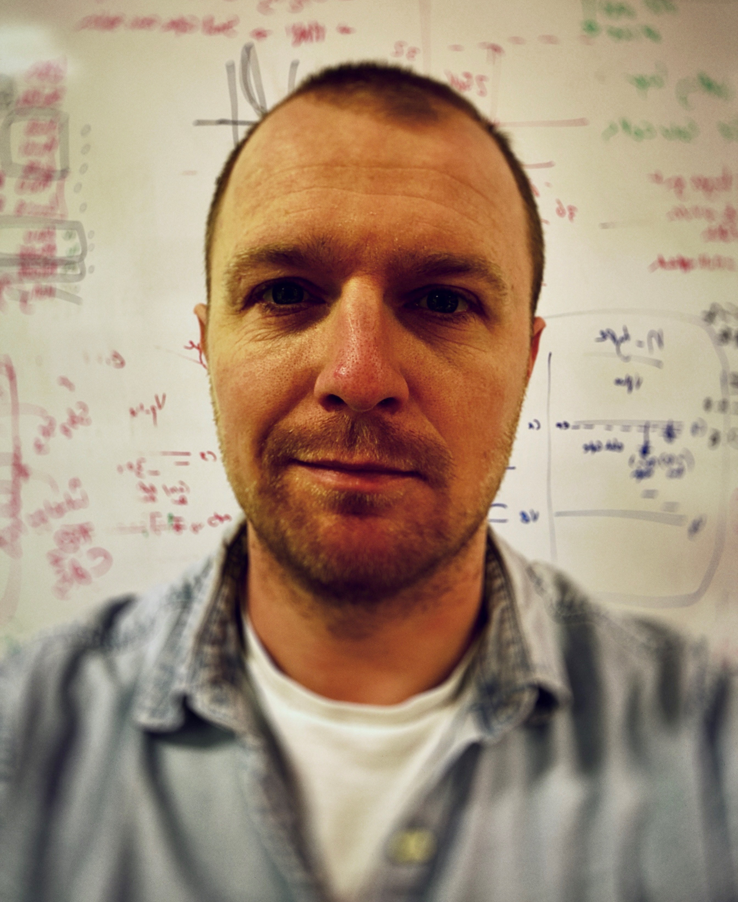
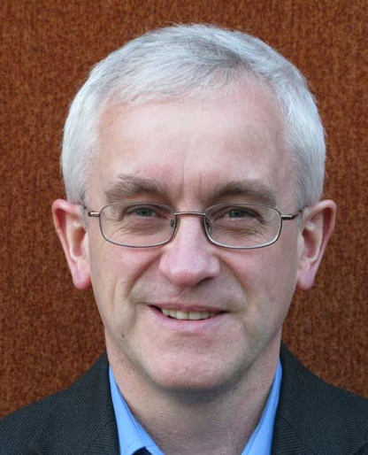
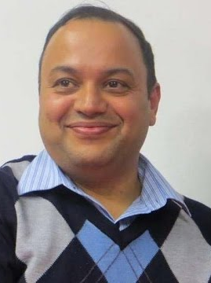
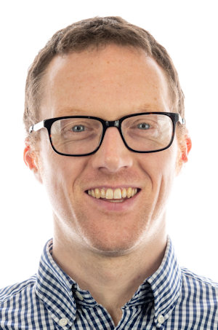
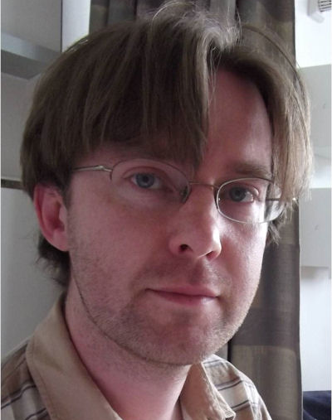
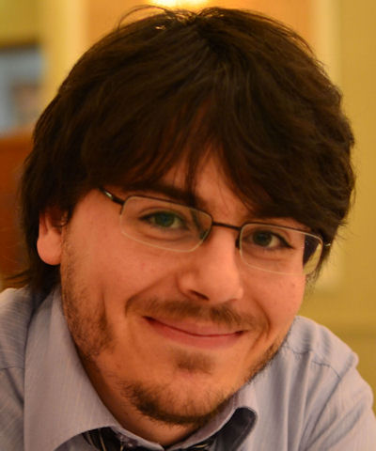
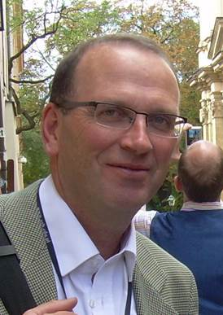
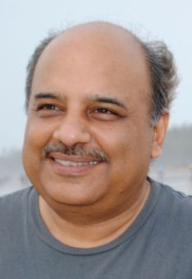
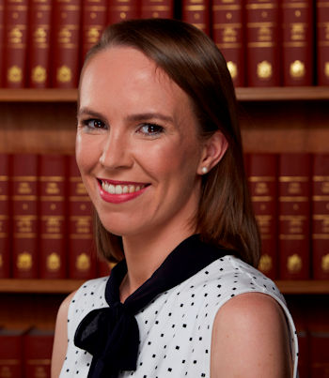
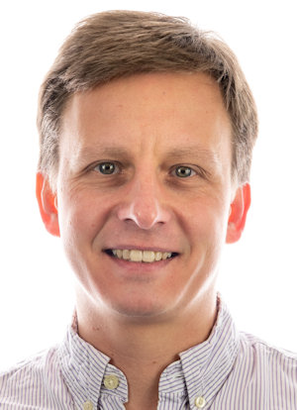
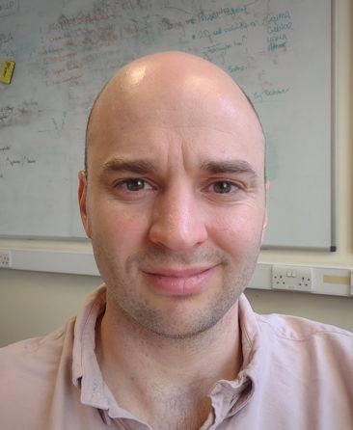
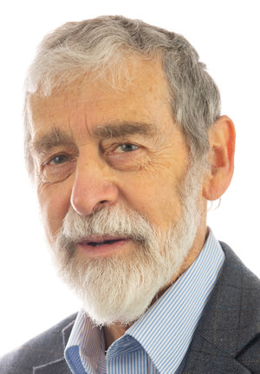
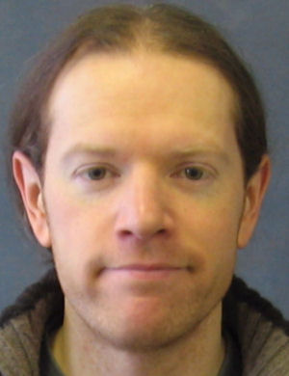
CMP Academic staff at University of Liverpool
Yvonne Gründer
Chris Lucas
Prof. Christopher Lucas
Dr Jonathan Alaria
Dr Stephen Barrett
Prof. Vinod Dhanak
Prof. Ken Durose
Dr Joseph Forth
Dr Yvonne Grunder
Prof. Brianna Heazlewood
Dr Frank Jaeckel
Dr Jon Major
Dr David Martin
Prof. Ronan McGarth
Dr Liam O’Brien
Dr Hem Sharma
Prof. Tim Veal
Prof. Peter Weightman
Dr Laurence Bouchenoire
Dr Samuel Coates
Dr Michael Day
Dr Paul Harrison
Mr Theo Hobson
Dr James Ingham
Mr Jacob Leaver
Dr Rahul Pandey
Dr Laurie Phillips
Dr Vincent Richardson
Dr Maksymilian Roman
Dr Thomas Shalvey
Dr Caroline Smith
Mr Paul Thompson
Dr Paul Unsworth
Dr Didier Wermeille
Jon Major
Ken Durose
Hem Sharma
Liam O’Brien
Tim Veal
Jon Alaria
Ronan McGarth
Vin Dhanak
Brianna Heazlewood
Frank Jaeckel
Joe Forth
Peter Weightman
David Martin

Slide 4
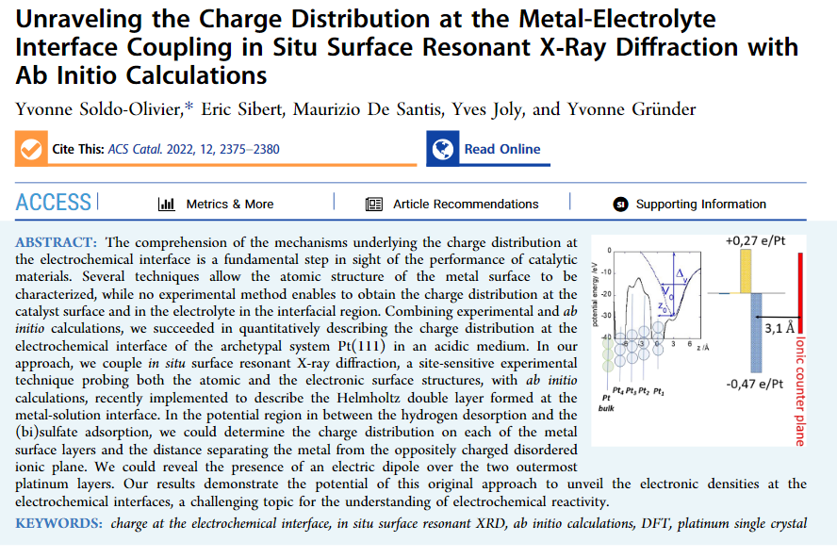

Slide 5
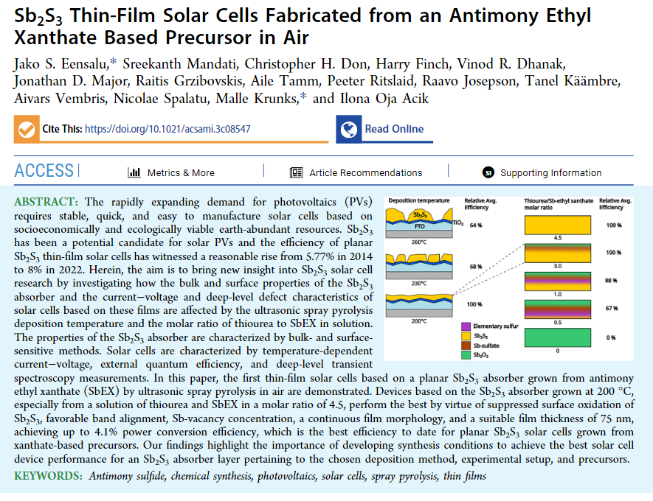

Slide 6
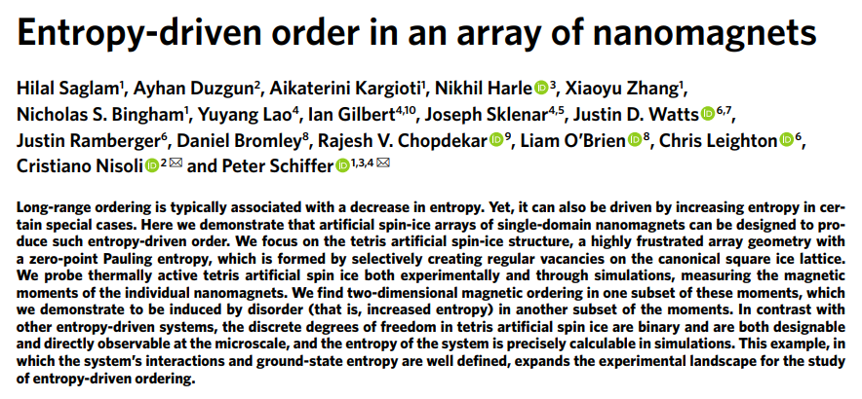

Slide 7
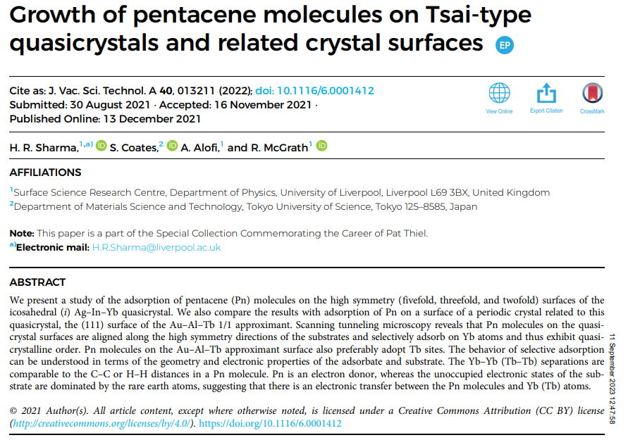

Slide 8
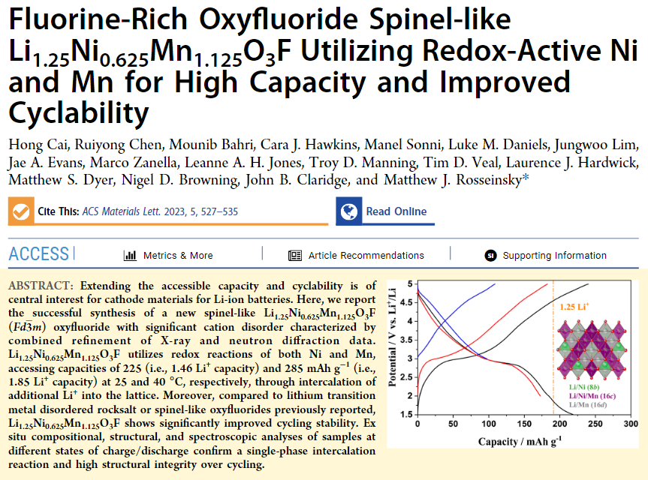

Slide 9
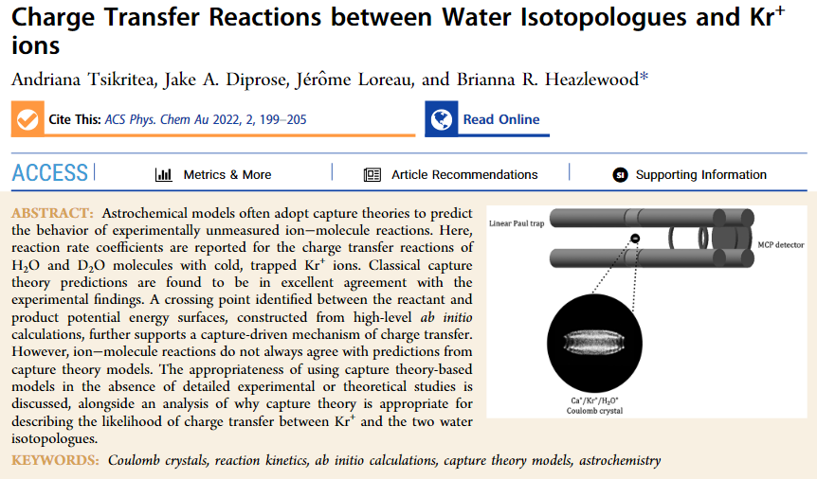

Slide 10
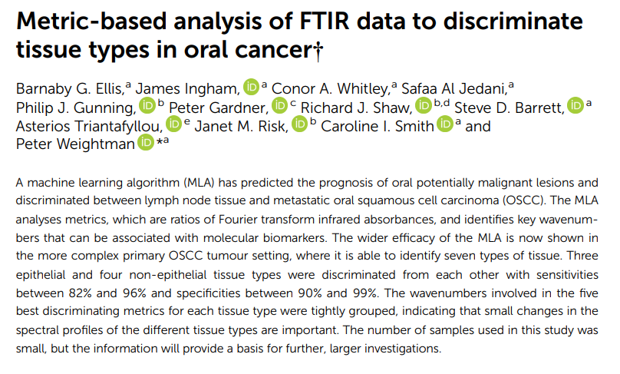

Slide 11
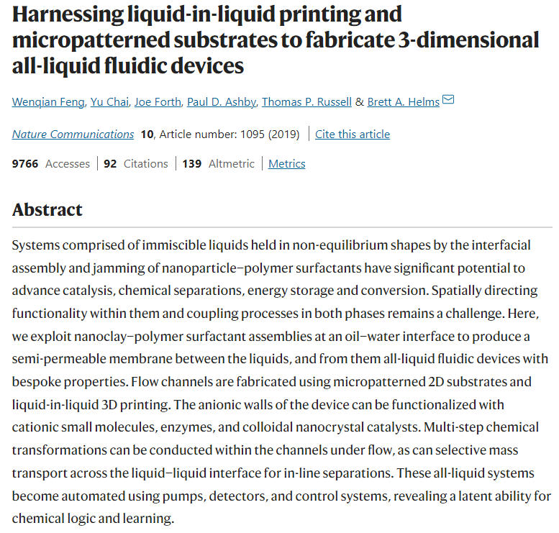

Slide 12
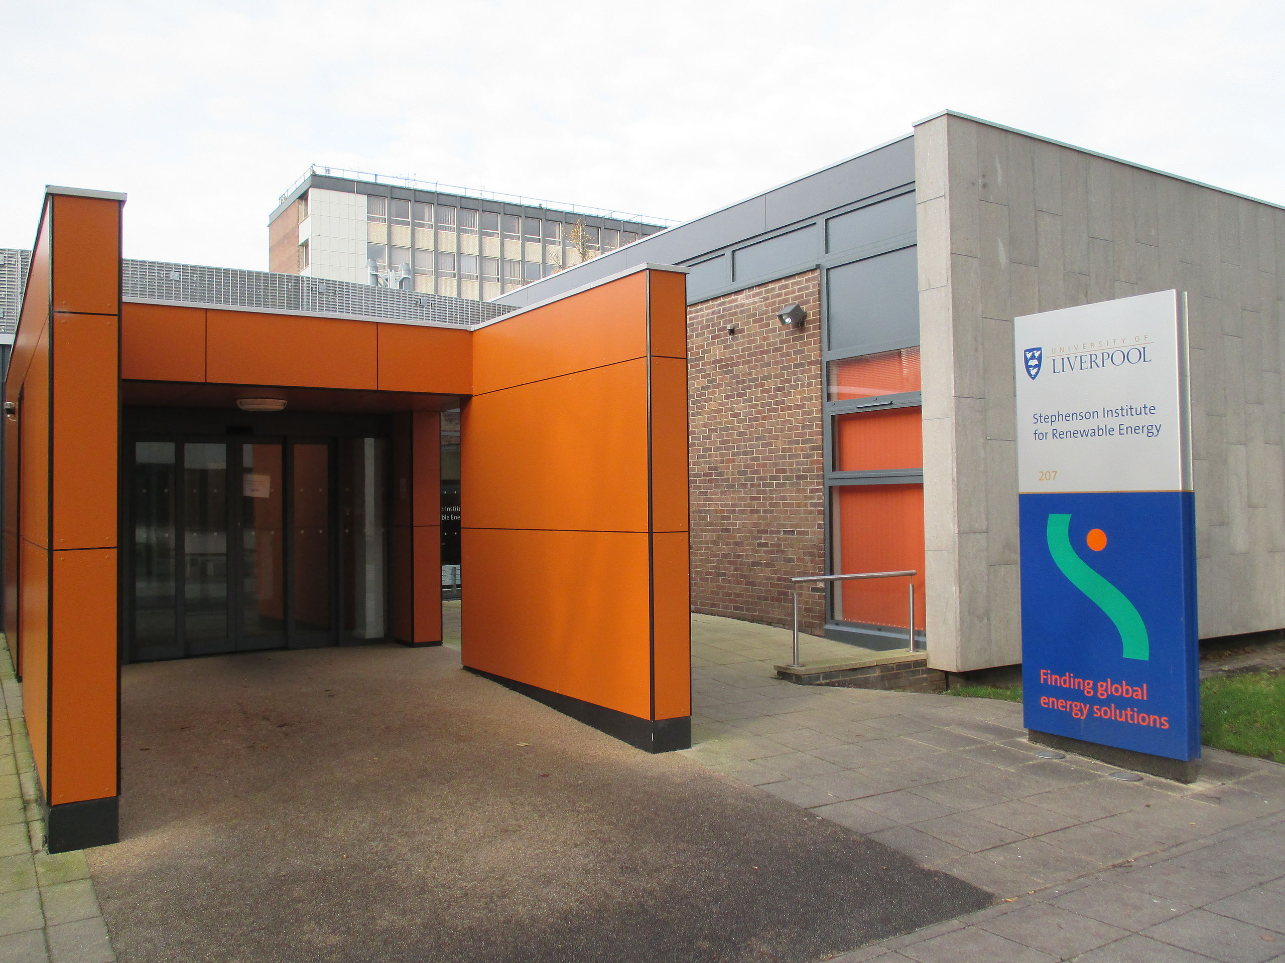
Stephenson Institute for Renewable Energy (SIRE)

Slide 13
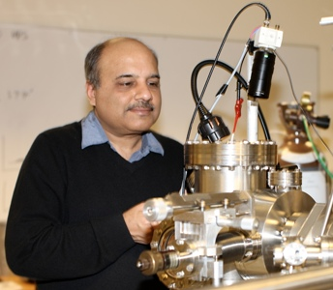
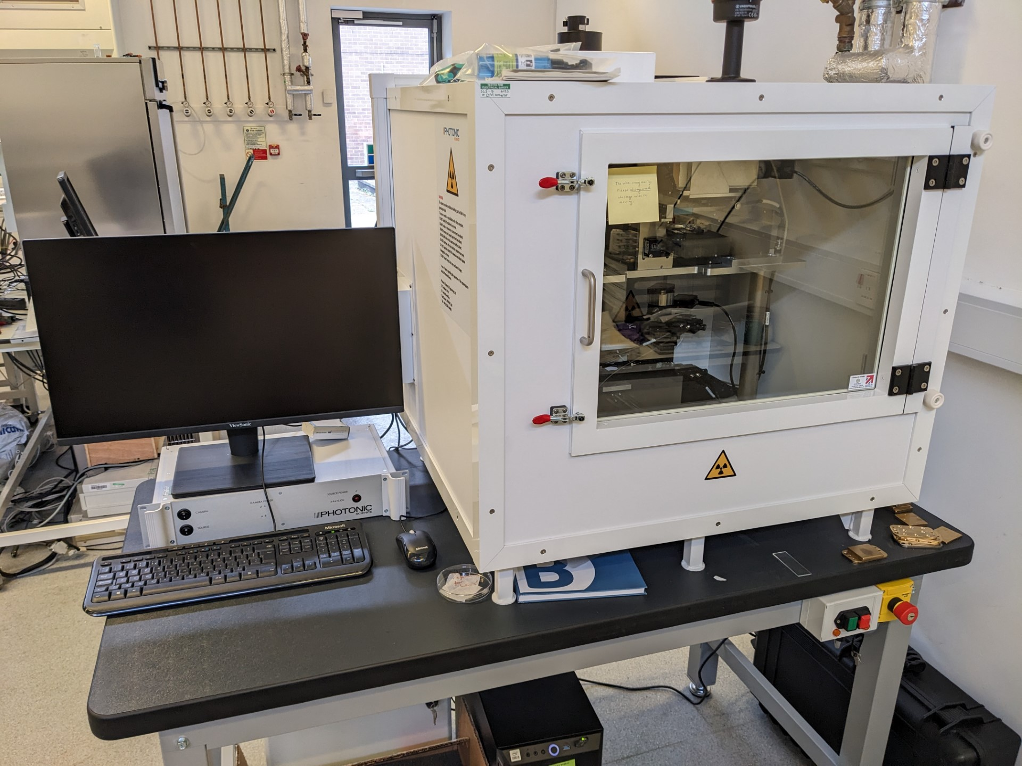
Stephenson Institute for Renewable Energy (SIRE)
Nanomaterials Characterisation Laboratory (NCL) ran by Vin Dhanak - three UHV stations providing techniques such as XPS, UPS, LEED I-V, STM and IPES
Veal Group Facilities ran by Tim Veal - Fourier transform infrared/visible spectrometer, Electrochemical capacitance-voltage profiler, Hall effect system, Seebeck/thermopower measurement system
X-ray facility ran by Jonathan Alaria – available as part of the Shared Research Facility (SRF), advanced structural characterisation
Laue System ran by Ken Durose – X-ray diffractometer with excellent control over the crystal positioning

Slide 14
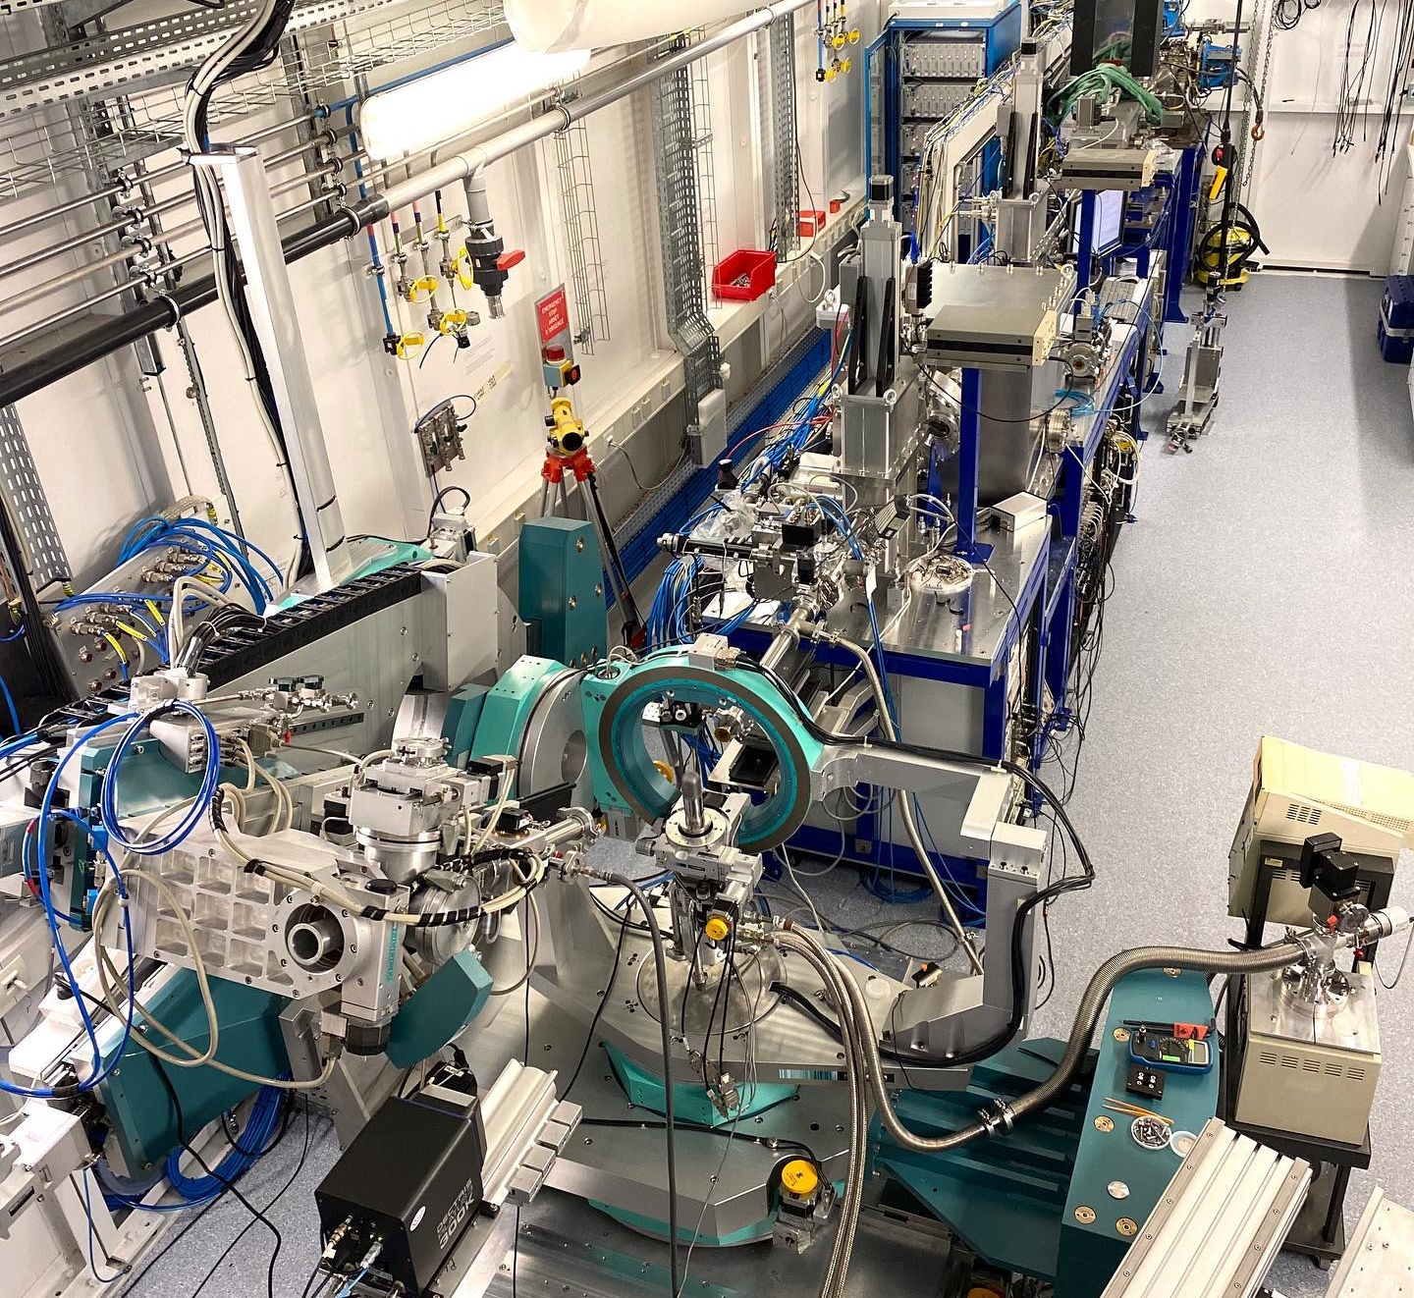
XMaS: The UK X-ray Materials Science facility at the ESRF in Grenoble
Ran by Chris Lucas and Yvonne Gründer
Diffraction
Resonant Elastic X-ray scattering
Grazing Incidence (reflectivity, diffraction, etc.)
Spectroscopy
Small Angle Scattering (>0.01 Å⁻¹)

Slide 15
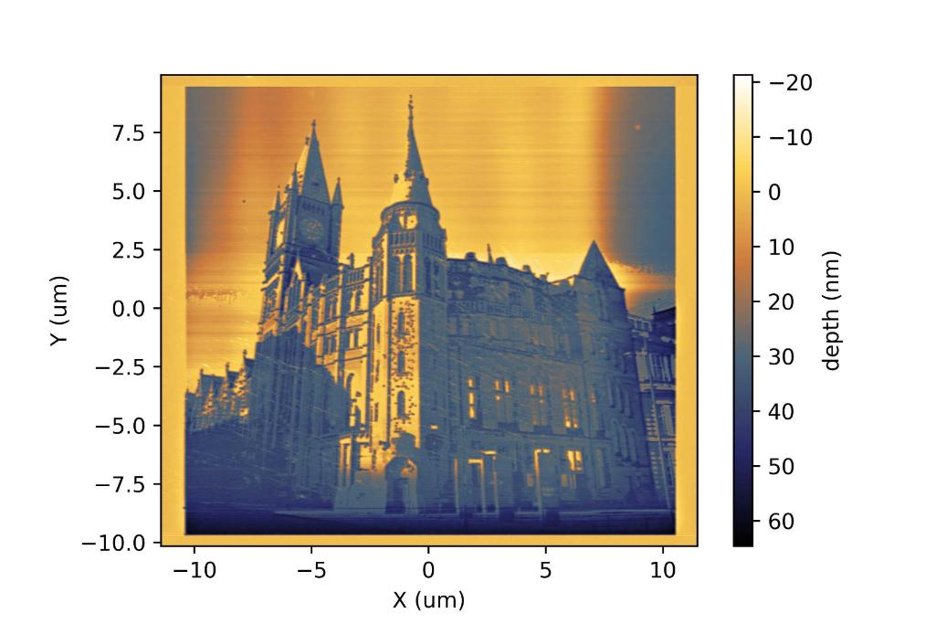
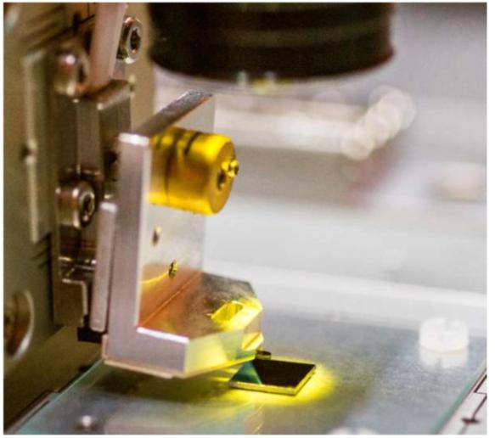
Nanolithography-nanofrazor
Ran by Liam O’Brien in collaboration with Chemistry
Patterning (etching, depositing, writing, printing, etc.) of nanometer-scale structures on various materials and immediate scanning of the product
Part of the SRF

Slide 16
Shared Research Facilities (SRF)
“The Faculty of Science and Engineering has invested in the provision of our Shared Research Facilities in order to facilitate world class research. Our facilities, equipment, and staff are here to support research and teaching for both internal users and external partners and we offer flexible and efficient access to suit a variety of needs.”
Range of instruments/facilities available to book
Includes intruments ran by CMP cluster members:
  X-ray Diffraction Facility ran by Jonathan Alaria
  Nanolithography Suite ran by Liam O’Brien
More info: https://www.liverpool.ac.uk/science-and-engineering/shared-research-facilities/

Slide 17
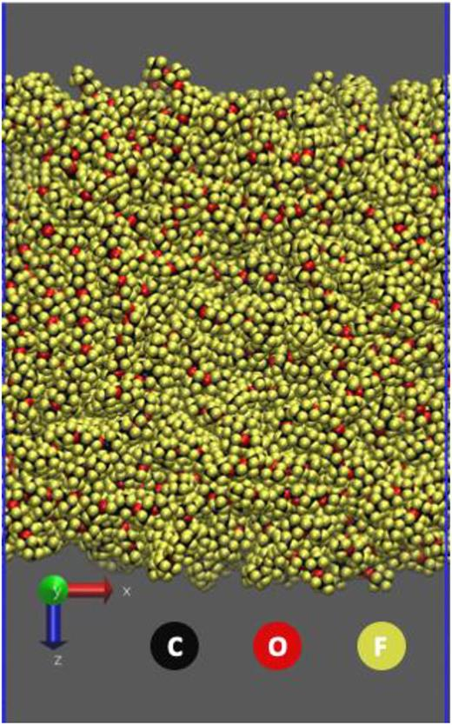
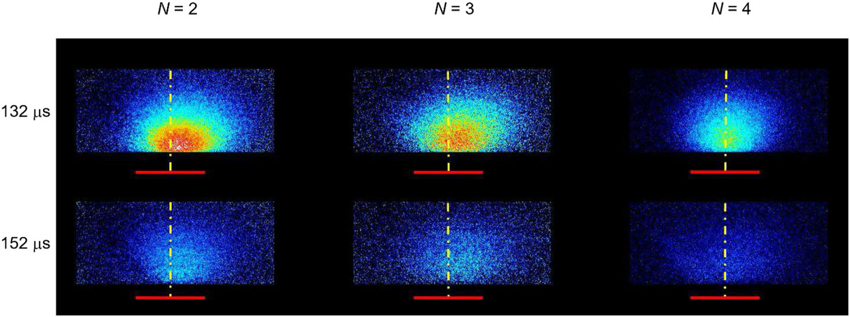
My experience as part of the CMP cluster
Relatively new, joined as PDRA in October 2022
PhD in Physical Chemistry, so distinctively not a physicist
However, researched interactions on the gas-liquid surfaces by studying OH scattering from long-chain hydrocarbons
So, I guess some CMP experience
https://pubs.aip.org/aip/jcp/article/151/5/054201/198655/Real-space-laser-induced-fluorescence-imaging

Slide 18
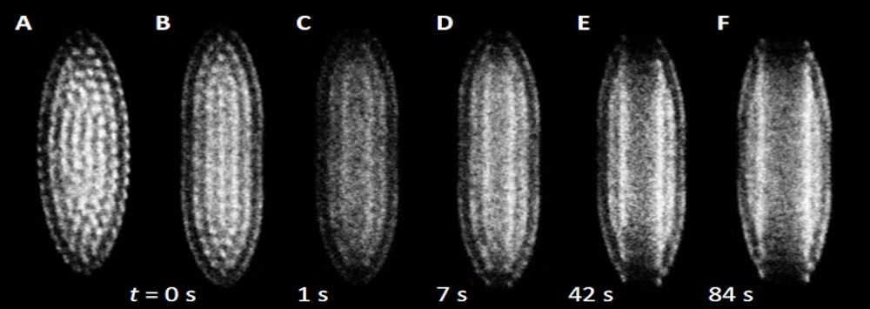
My experience as part of the CMP cluster
Currently working for Brianna Heazlewood on reaction dynamics of ion-radical reactions
Research utilises molecular beam techniques and ion trapping
Trapping ions using electric fields and laser cooling to form Coulomb crystals
“Crystals” make it sound very CMP-like, but in fact they are very long range, with distances of tens of micrometres between constituent ions – not quite “condensed”

Slide 19
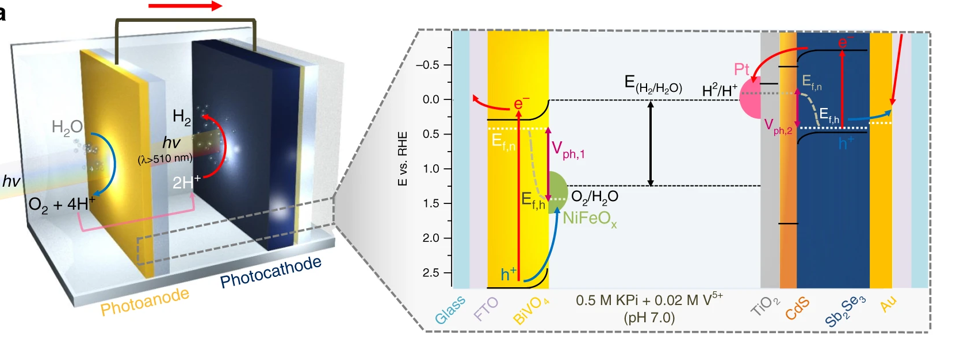
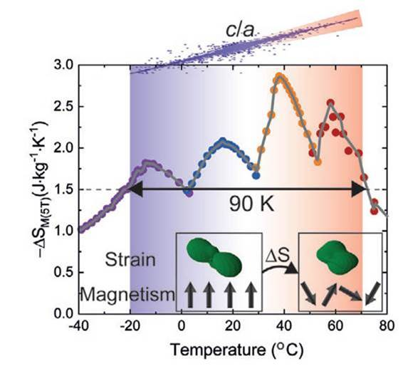
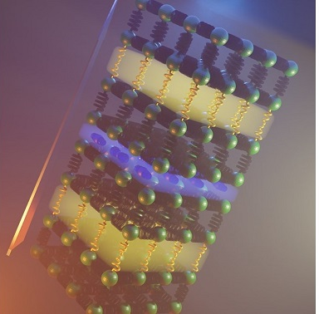
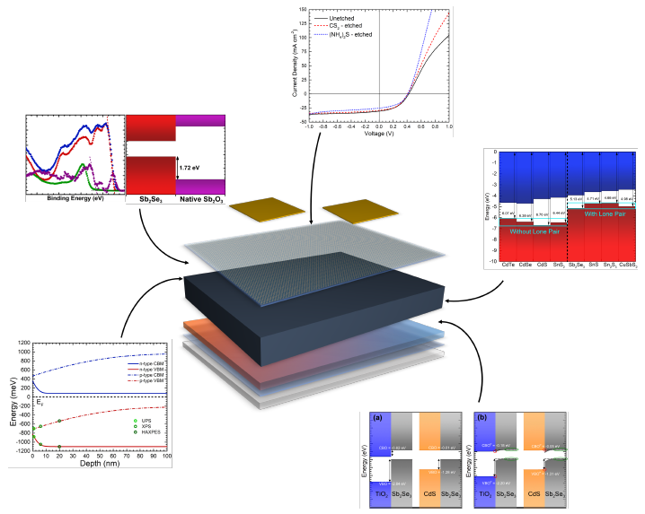
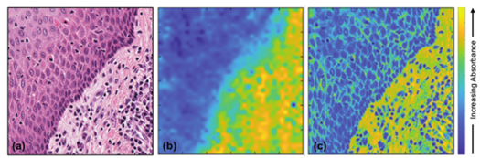
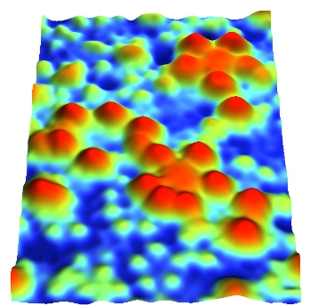
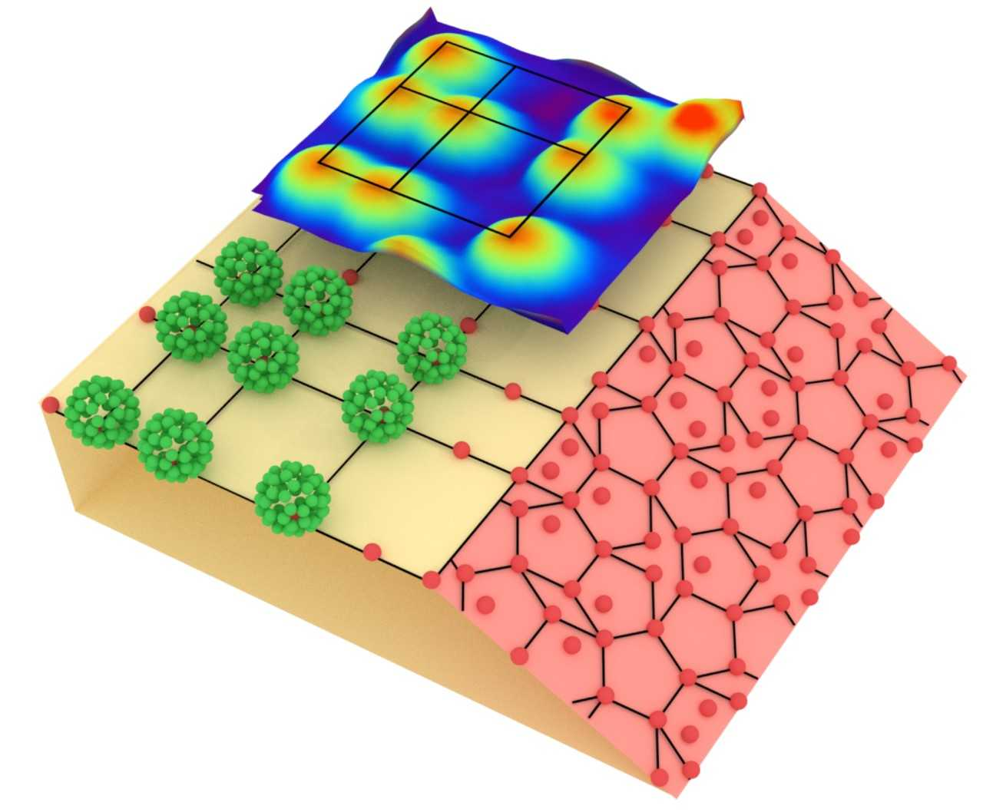
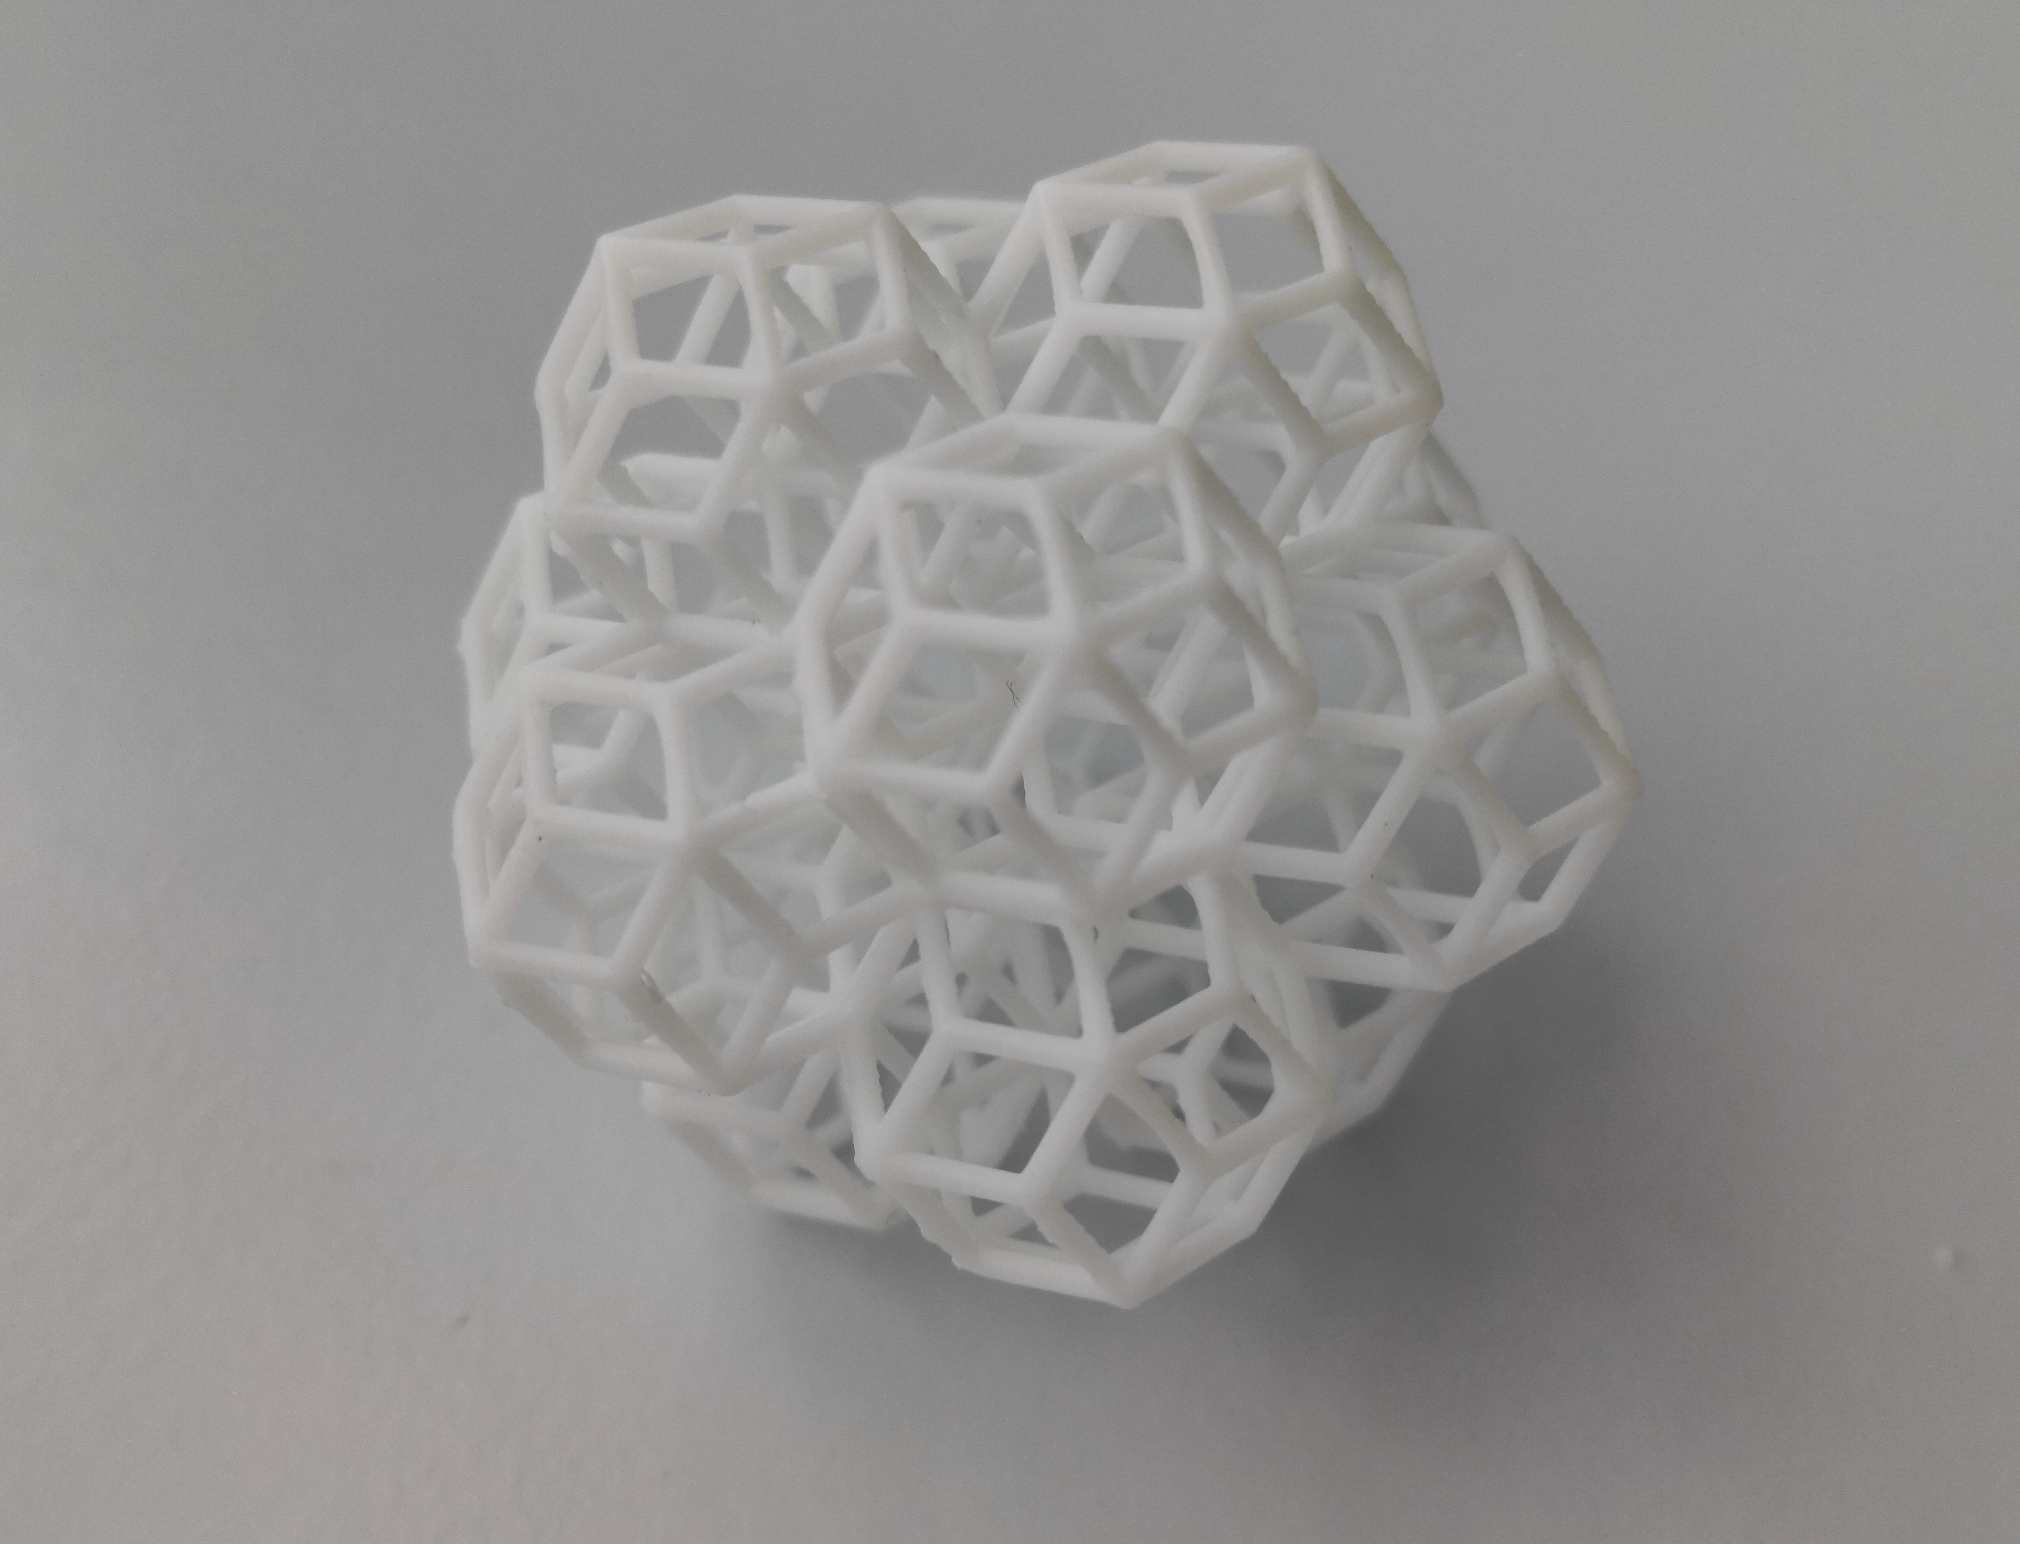
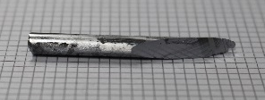
My experience as part of the CMP cluster
Therefore, CMP is an entirely new world to me, everything is shiny and exciting
Doing this presentation really showed me the diversity of research topics that the simple label of “CMP” encompasses
Also, very applicable-to-real-life research, compared to research done previously by me
Solar Cells and Photocatalyst
Light-harvesting in Photosynthetic Bacteria
Magnetic Refrigeration
Inorganic Material with Low Thermal Conductivity
Benchmark performance of low-cost Sb₂Se₃ photocathodes for unassisted solar overall water splitting, Nature Communications 11, 861 (2020)
Combining Experiment and Machine Learning to Make a Cool Choice, Adv. Funct. Mater.2021, 31, 2100108
Using the right chemistry, it is possible to combine two different atomic arrangement (yellow and blue slabs) that provide mechanisms to slow down the motion of heat through a solid. Science 373, 1017 (2021)
Investigating light-harvesting complexes in photosynthetic bacteria using atomic force microscopy
Cancer Diagnosis
Multiscale Quasicrystals
Band alignments and interfaces in Antimony Selenide Solar Cells
Single Crystal Growth
Nano heterostructures for photocatalysis
Quasicrystalline Pb
Nature Communications 4, 2715 (2013).
C₆₀ adsorbs atop Fe/Mn atoms forming unique quasicrystalline structures such as Penrose tiling and Fibonacci square Nature Communications 9, 3435 (2018)
3D printed QC structure
(35 mm diameter)
(a) H&E stained image of a tissue biopsy, (b) corresponding Fourier transform IR image at 1242 cm⁻¹ and (c) the image formed by fusing (a) and (b). Analyst 146 5848 (2021)
h
Antimony selenide
Mo-doped Bi₂WO₆/Fe₂O₃

