Slide 1
Outreach and Public Engagement
Chris Edmonds (cse@liverpool.ac.uk)
School of Physical Sciences Outreach and Recruitment Lead

Slide 2
What is outreach and public engagement:
"Public engagement describes the myriad of ways in which the activity and benefits of higher education and research can be shared with the public. Engagement is by definition a two-way process, involving interaction and listening, with the goal of generating mutual benefit.“ - NCCPE

Slide 3
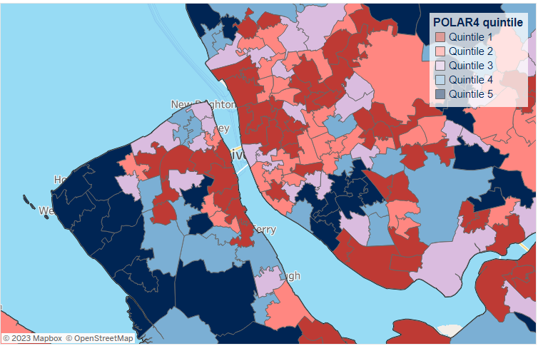
Motivations for Outreach
POLAR4 assigns a quintile to an area based on how many 18-year-olds from that area started a higher education course between 2009-10 and 2013-14

Slide 4
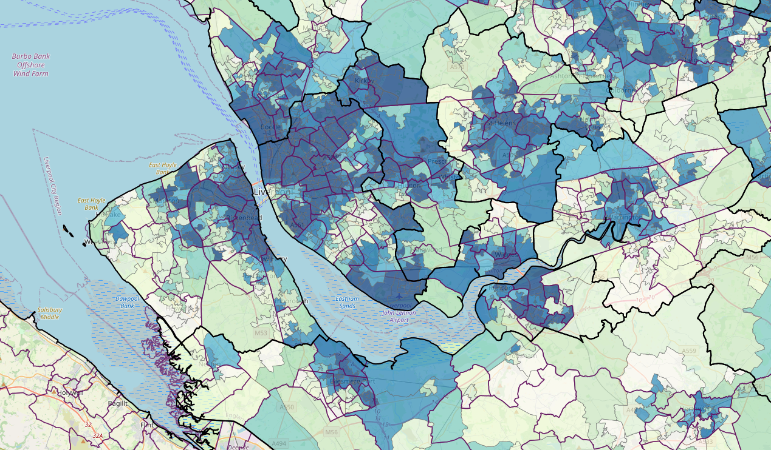
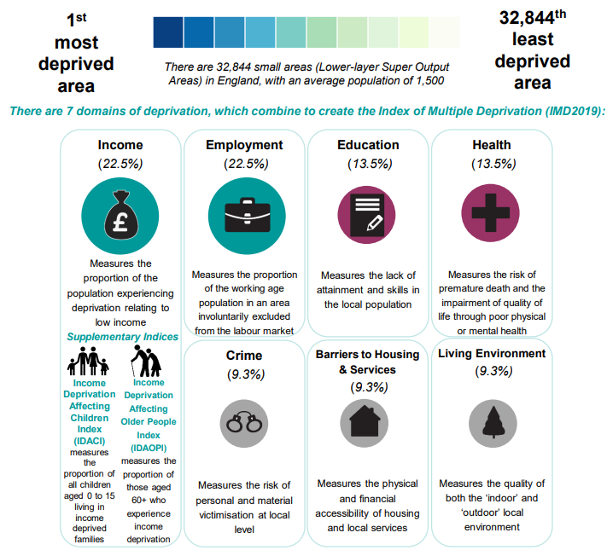
Motivations for Outreach
Indices of Multiple Deprivation

Slide 5
Motivations for Outreach
Specific goals may include:
Raising young people’s aspirations towards science.
Breaking stereotypes.
Encouraging inclusivity and diversity.
Fostering interest and curiousity.
Bringing about societal change.
Training a new generation of physics educators.

Slide 6
Outreach seems ok

Slide 7
but…

Slide 8
Research Council Perspective
UKRI on postgraduate training:
“Students should be encouraged to consider the wider context of their research area, particularly in reference to societal and ethical issues, and the importance of engaging the public with research. Learning and training opportunities should be provided to help develop their public engagement skills.”
Ernest Rutherford Fellowship:
Candidates should “show a credible plan to communicate and disseminate the impact of the research outside of the community, across different audiences, building on previous experience and track record for example, through collaboration with private, public or third sector bodies, publications for a non-academic audience, social media or public engagement activities.”

Slide 9
Public Engagement as a Pathway to Impact
REF defined impact as ‘an effect on, change or benefit to the economy, society, culture, public policy or services, health, the environment or quality of life, beyond academia’.
Two of the department’s REF 2021 submissions were directly linked to public engagement:
‘Accelerator physics reaches new audiences through innovative public engagement’
‘Creating awareness and improving public understanding of particle physics research’

Slide 10
Public Engagement as a Pathway to Impact
We are not alone…
For REF 2014, 47% of REF impact case studies made reference to public engagement.
Different ‘flavours’ of public engagement feature in different discipline areas: for instance, ‘outreach’ is prevalent in physics.
However:
Evidence provided of impact on public understanding and awareness is often weak: usually researchers limit their evidence to a list of the outlets they have used and the numbers of people engaged.
‘The role of public engagement in the REF’ - NCCPE

Slide 11
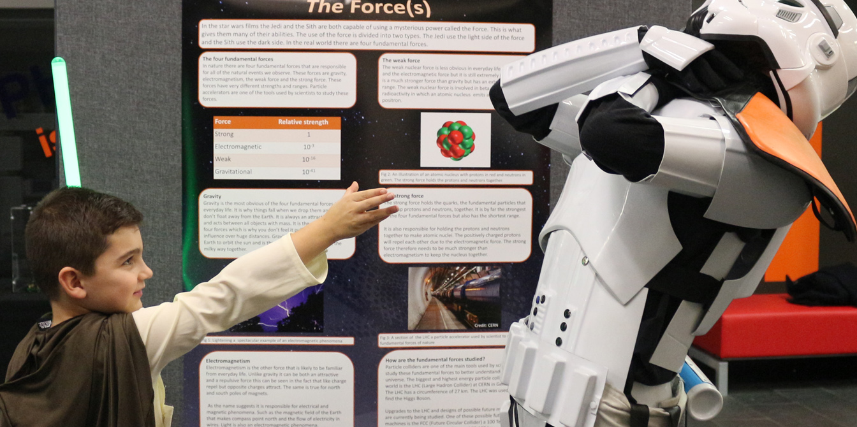
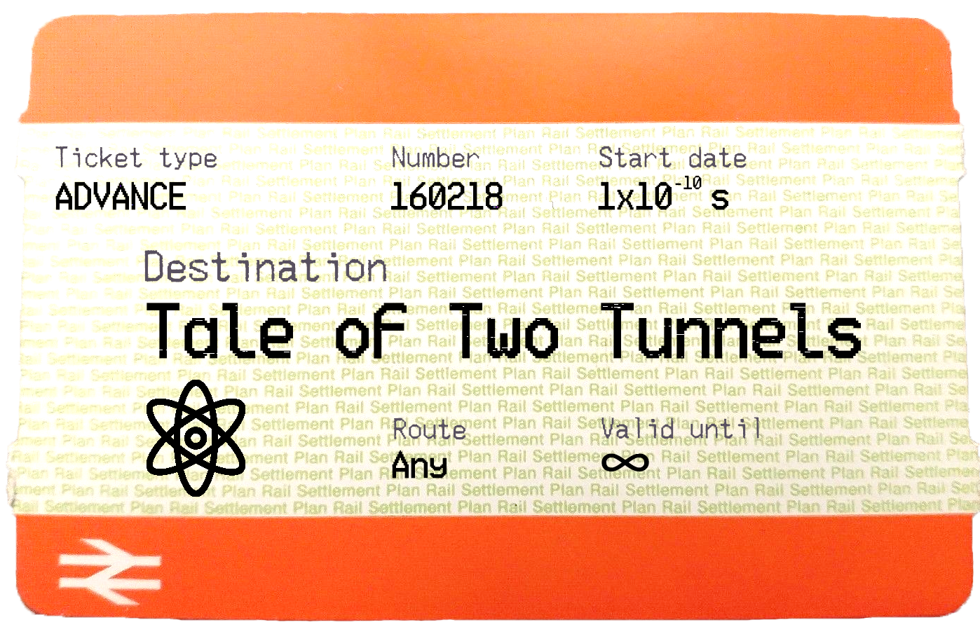
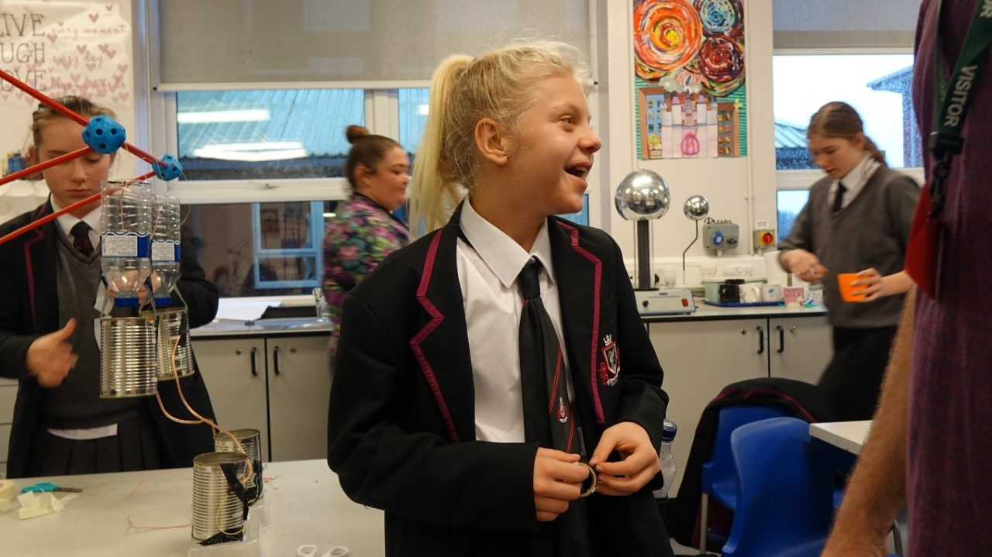
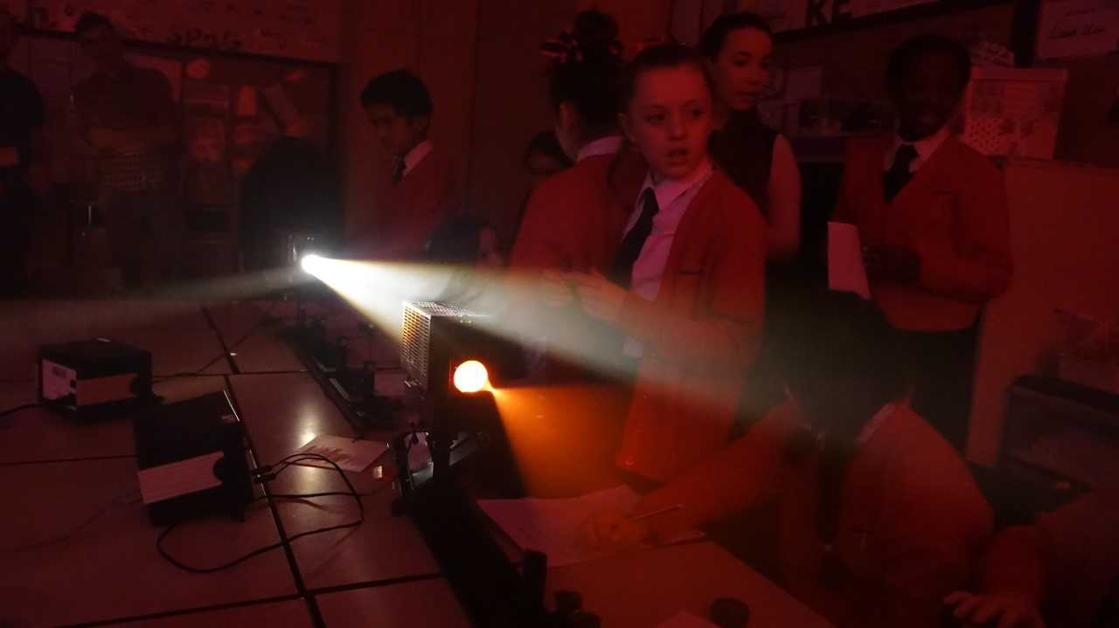
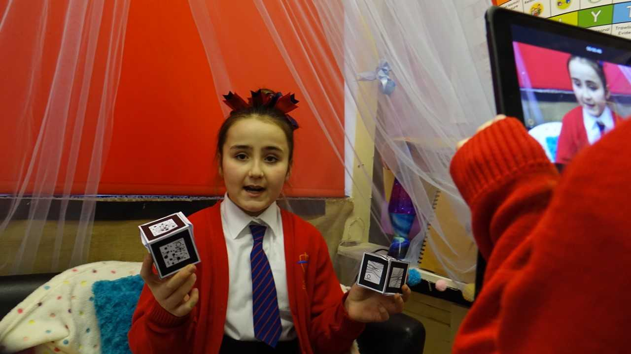
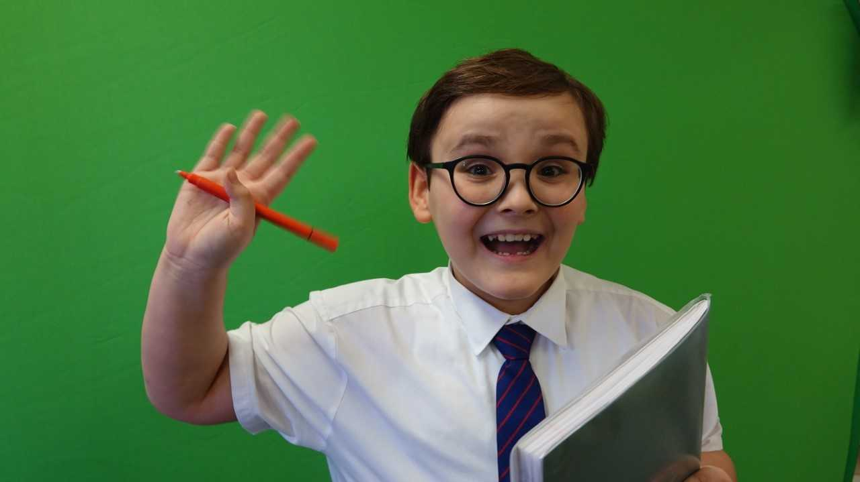
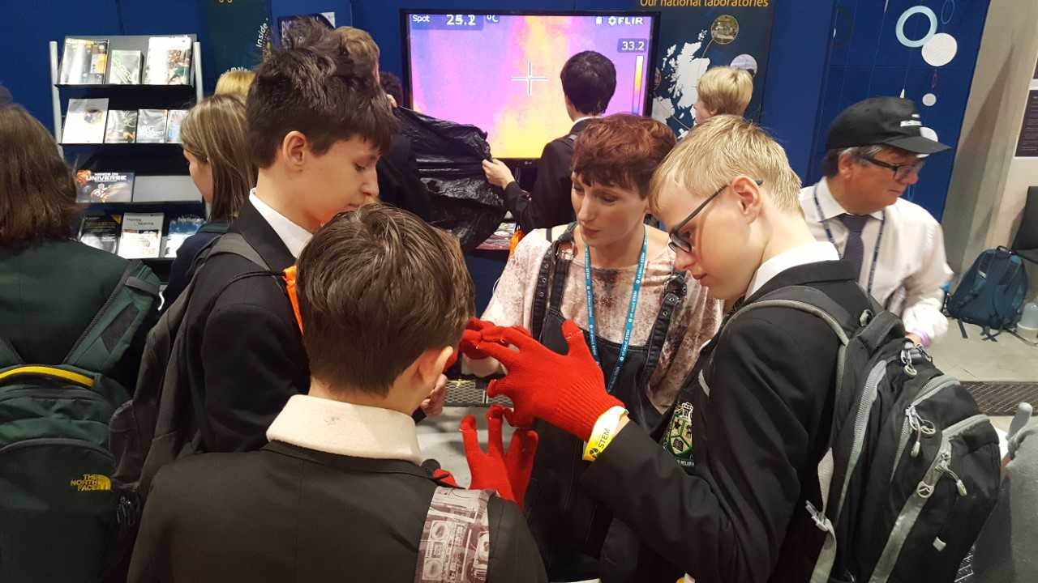
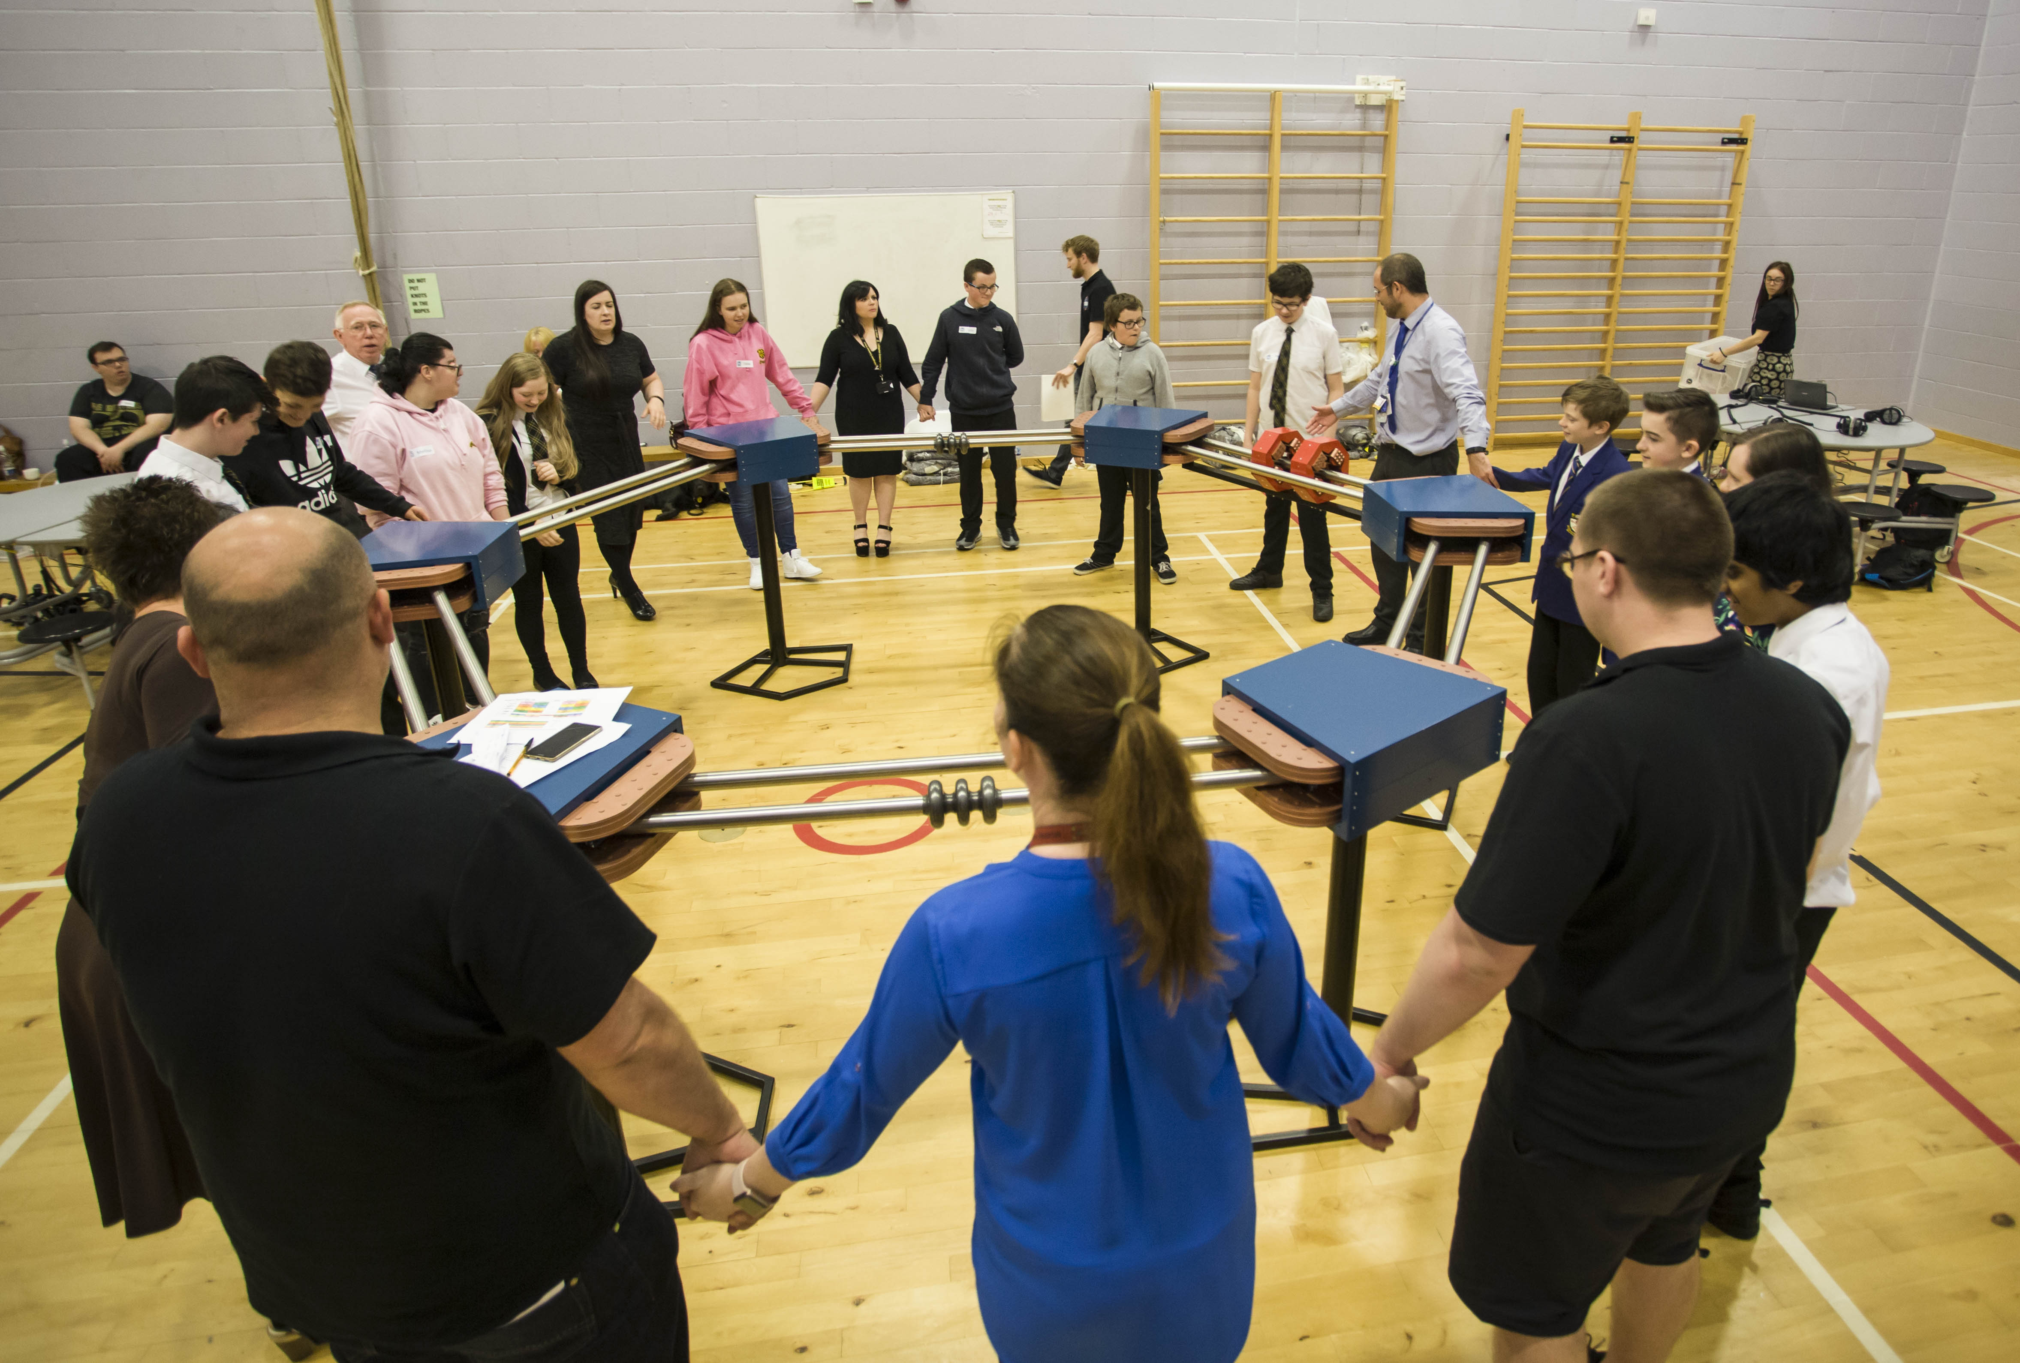
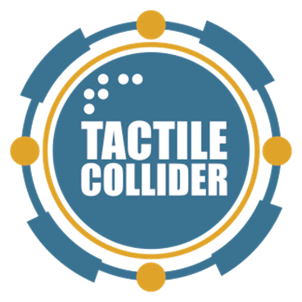
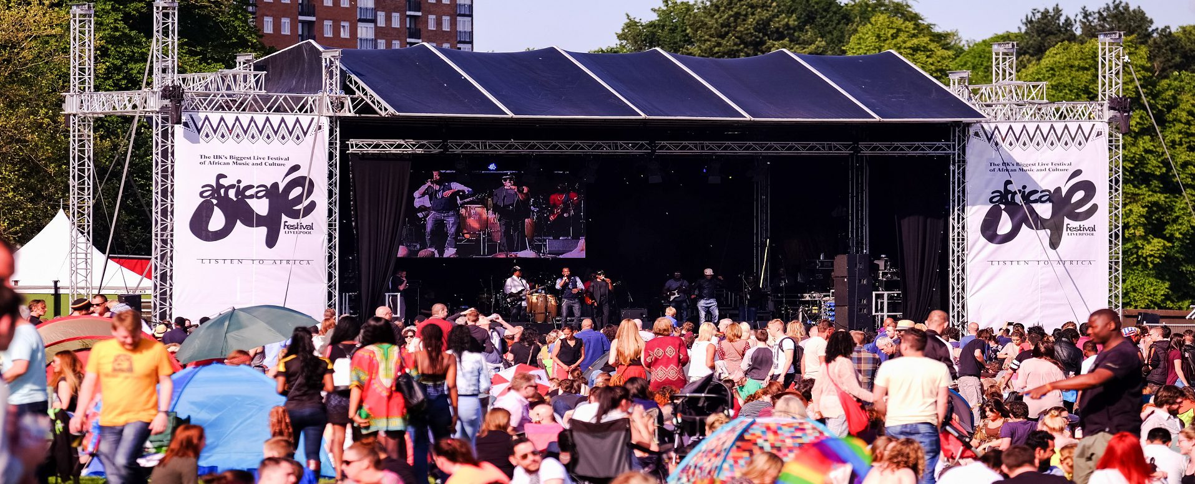
Public Engagement as a Pathway to Impact
10’000+ face-to-face interactions per year
Shared Spaces
Africa Oye
Blue Dot
Big Bang
WOMAD
Home Spaces
Symposiums
Particle Physics Master Class
Physics of Star Wars
Open Weeks
Audience Spaces
Tactile Collider
Tale of Two Tunnels
YouTube
acceleratAR

Slide 12
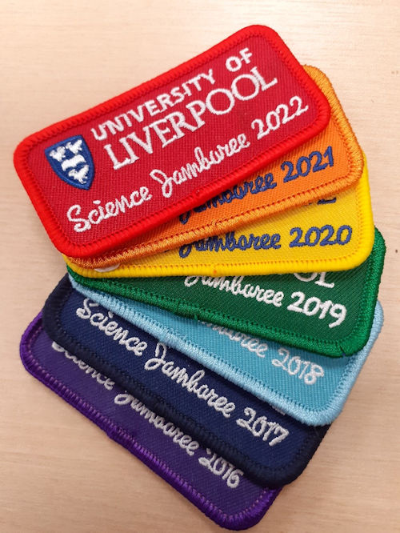
Developing Your Outreach Practice
Lots of avenues for becoming more involved:
Join existing university based initiatives.

Slide 13
Developing Your Outreach Practice
Lots of avenues for becoming more involved:
Join existing university based initiatives.
Support initiatives of external groups.

Slide 14
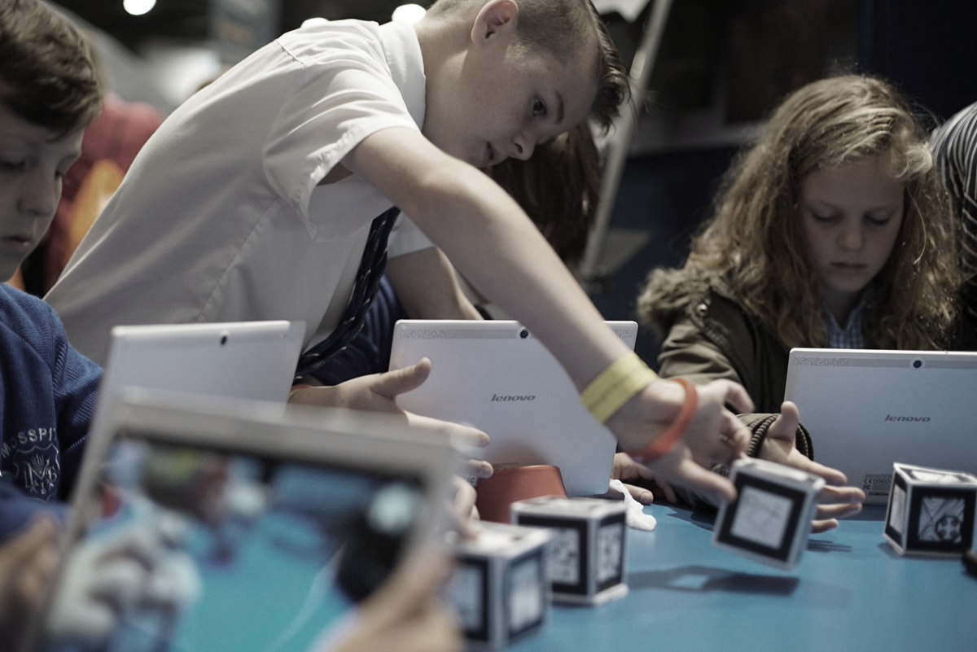
Developing Your Outreach Practice
Lots of avenues for becoming more involved:
Join existing university based initiatives.
Support initiatives of external groups.
Create something new…

Slide 15
Creating your own activity
Recipe
Identify your audience
Illustrated by Quentin Blake

Slide 16
Creating your own activity
Recipe
Identify your audience
Determine the aims of your project are (it’s unlikely to be for everyone!).
Illustrated by Quentin Blake

Slide 17
Creating your own activity
Recipe
Identify your audience
Determine the aims of your project are (it’s unlikely to be for everyone!).
Decide on the format of your activity is.
Illustrated by Quentin Blake

Slide 18
Creating your own activity
Recipe
Identify your audience
Determine the aims of your project are (it’s unlikely to be for everyone!).
Decide on the format of your activity is.
Source required resources.
Illustrated by Quentin Blake

Slide 19
Creating your own activity
Recipe
Identify your audience
Determine the aims of your project are (it’s unlikely to be for everyone!).
Decide on the format of your activity is.
Source required resources.
Deliver ☺
Illustrated by Quentin Blake

Slide 20
Creating your own activity
Recipe
Identify your audience
Determine the aims of your project are (it’s unlikely to be for everyone!).
Decide on the format of your activity is.
Source required resources.
Deliver ☺
Evaluate!
Illustrated by Quentin Blake

Slide 21
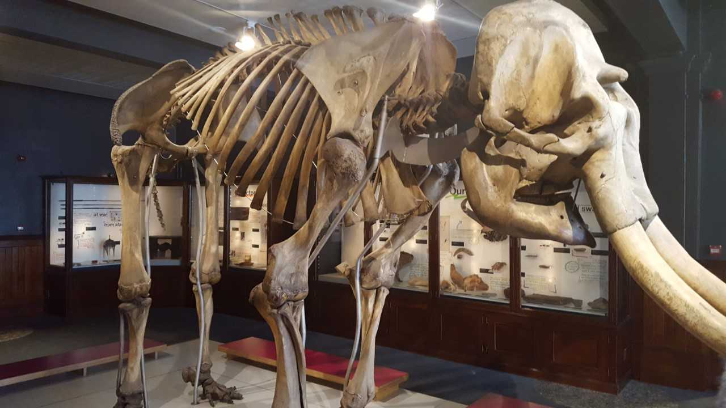
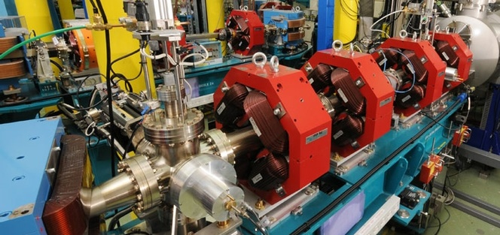
Case Study: Tactile Collider
Recipe
Identify your audience
Determine the aims of your project are (it’s unlikely to be for everyone!).
Decide on the format of your activity is.

Slide 22
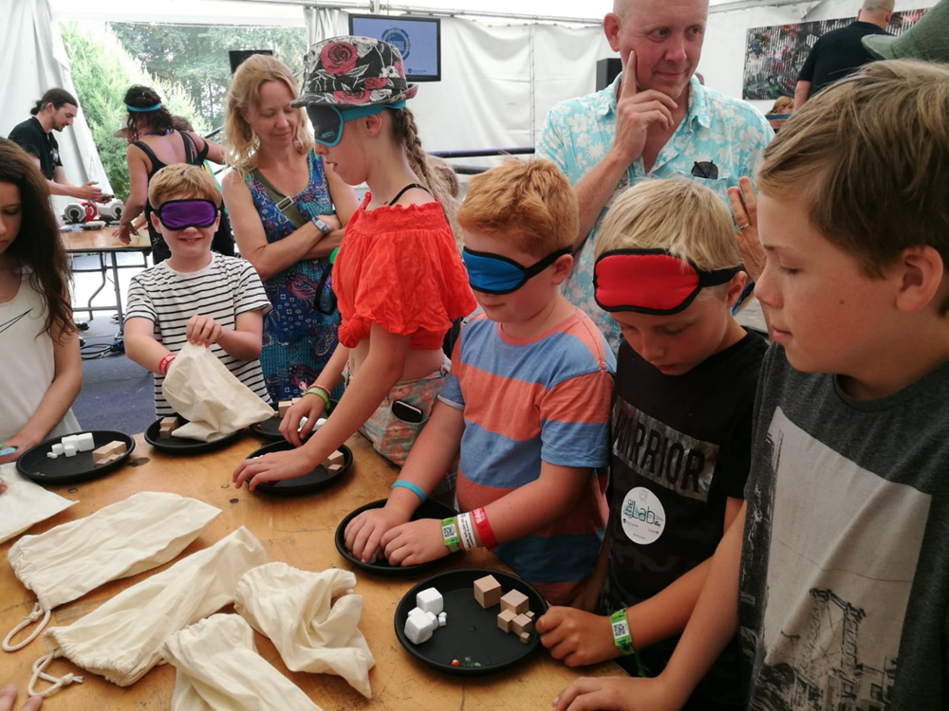
Case Study: Tactile Collider
Recipe
Identify your audience
Determine the aims of your project are (it’s unlikely to be for everyone!).
Decide on the format of your activity is.
Source required resources.
Deliver ☺

Slide 23
Case Study: Tactile Collider
Recipe
Identify your audience
Determine the aims of your project are (it’s unlikely to be for everyone!).
Decide on the format of your activity is.
Source required resources.
Deliver ☺
Evaluate!
Display at ASDC science centre conference
BBC Radio 4 & Bolton FM
WOMAD World Music Festival
CERN open days

Slide 24
Funding Opportunities
Currently open:
STFC – SPARK award (£15k)
Ogden Trust – Physics Education Grants (£5k)
Watch out for:
IoP – Public Engagement Grant Scheme (£5k)
STFC – Nucleus award (£100k, opens October)

Slide 25
Over to you…
Feel free to get in touch to discuss ideas or support needs
We are very keen to see new ideas and initiatives emerge.

