Slide 1
The g-2, MUonE and KLOE experiments
Saskia Charity
Muon Group Meeting 04/12/2023

Slide 2
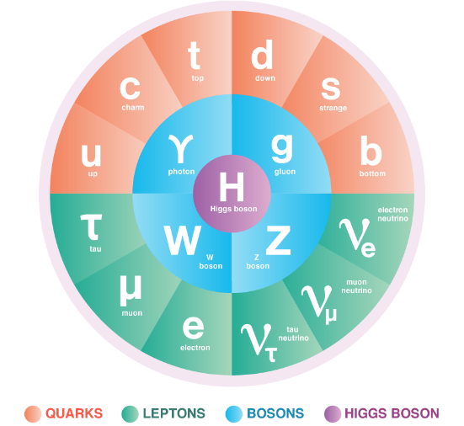
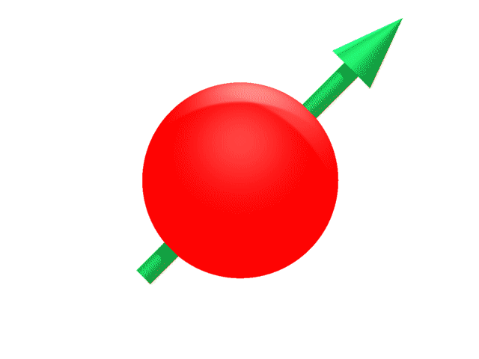
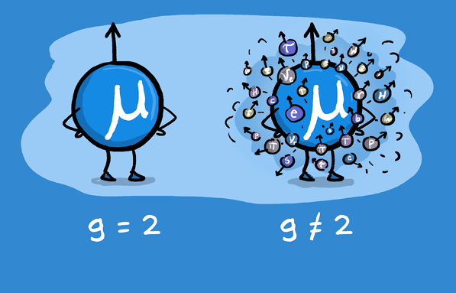
Muons and the Standard Model
Muon: a second generation lepton – like an electron, but 200x heavier
Precession frequency can be experimentally measured and theoretically predicted with equal precision
It has spin
→ behaves like a spinning top in a magnetic field (precession)
Virtual particle interactions affect the spin precession frequency
B
Heavy mass → sensitive to interactions with virtual particles

Slide 3
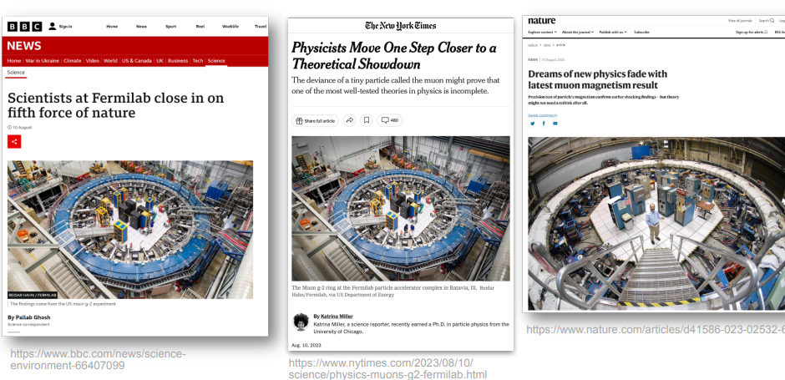
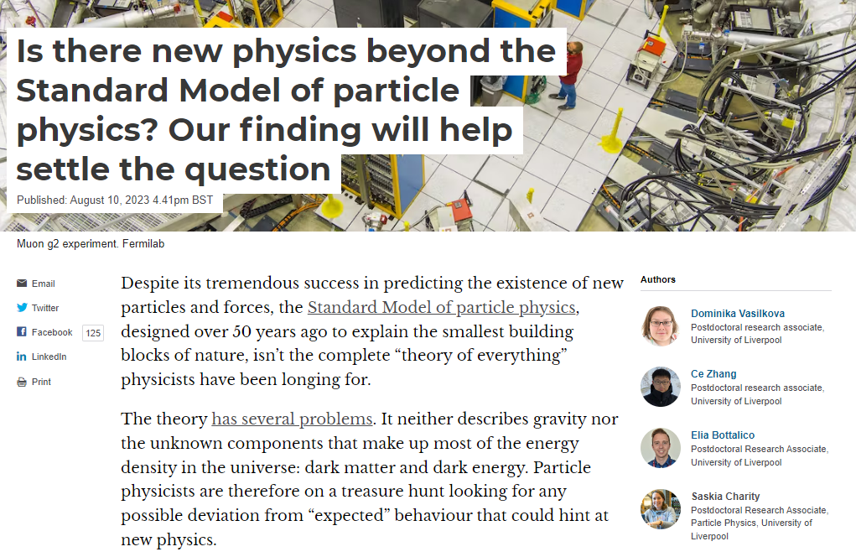
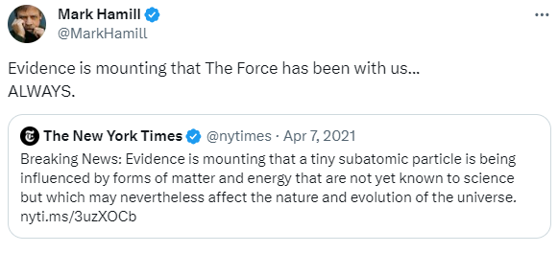
Theory and Experiment
Recent measurement of muon g-2 from Fermilab is significantly different from the most recent “official” theory prediction (see T. Teubner’s talk)
A confirmed discrepancy would mean that the muon is exhibiting behaviour not accounted for by the Standard Model → a new particle or interaction…?

Slide 4
A “theoretical showdown”
Complications on the theory side must be resolved:
1) disagreement between a recent computational calculation and the well-established ‘official’ value
2) tension between some experimental inputs to the official calculation
Three priorities to resolve the situation and confirm if there is a SM-breaking discrepancy:
3. Cross-check the SM prediction with a direct measurement with independent uncertainties → MUonE experiment at CERN
1. Confirm the g-2 result with the full dataset from the Fermilab experiment
2. Confirm the SM prediction by analysing KLOE data

Slide 5
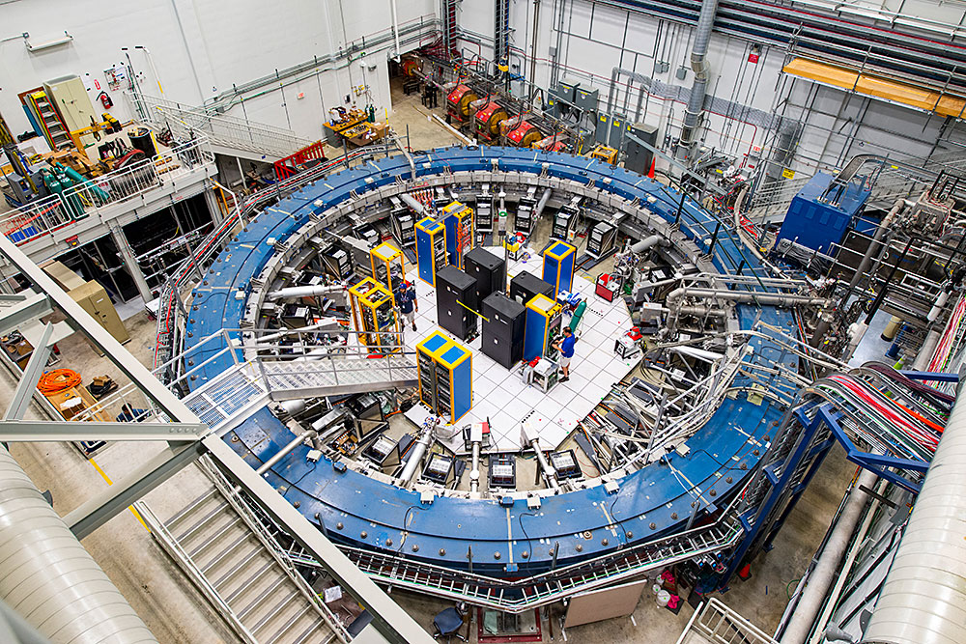
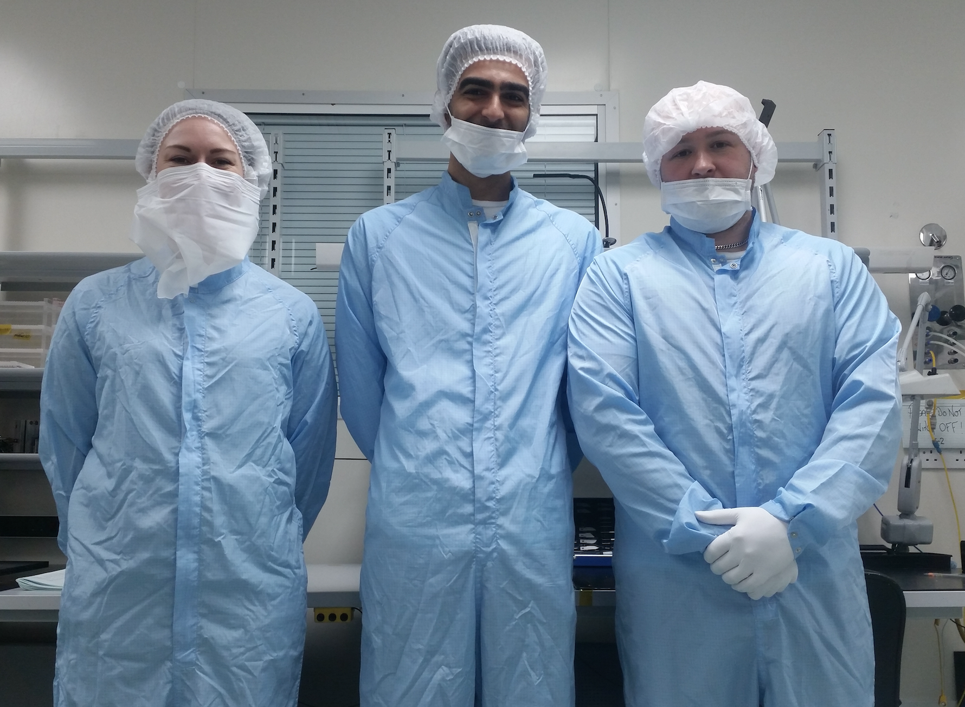
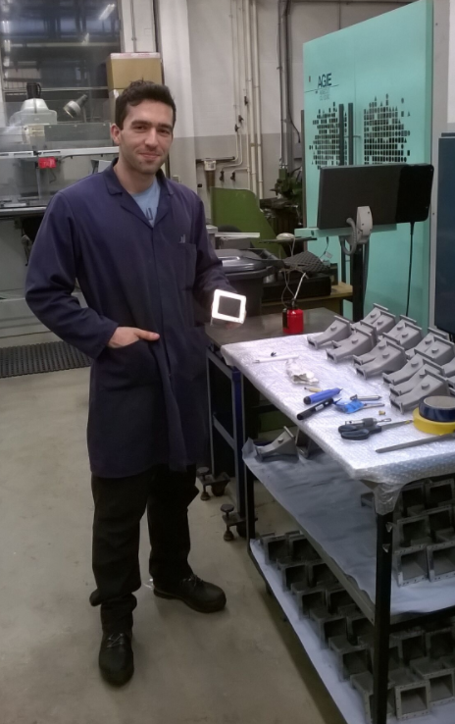
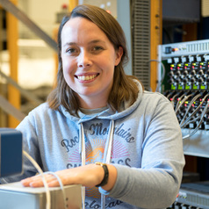
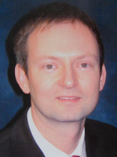
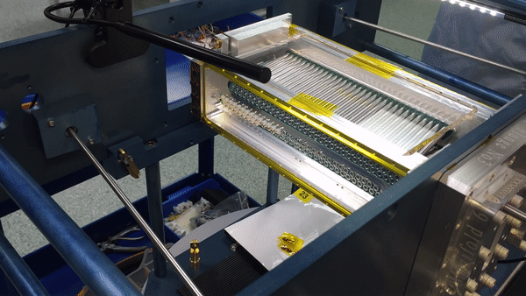
The Fermilab g-2 Experiment
1. Confirm the g-2 result with the full dataset from the Fermilab experiment
Liverpool is the largest group in the g-2 collaboration
Built straw tracking detectors to image the muon beam → crucial to reach uncertainty goal
Leadership in several areas including: magnetic field, beam dynamics, EDM; spin precession. Spokesperson, analysis coordinators, run coordinators, committee membership.
Straw tracker construction in Liverpool clean rooms / workshop

Slide 6
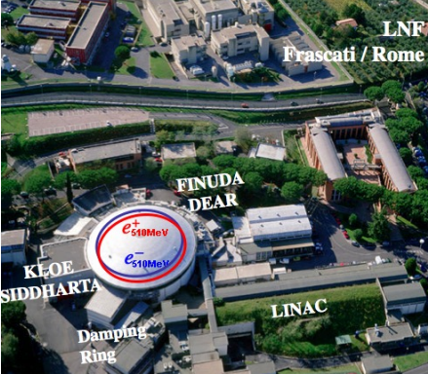
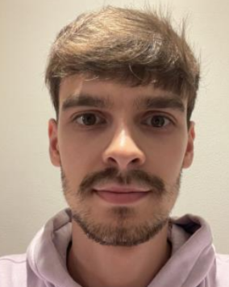
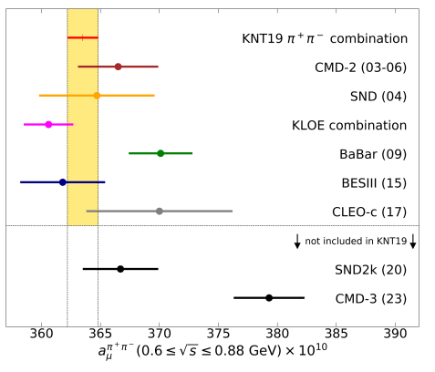
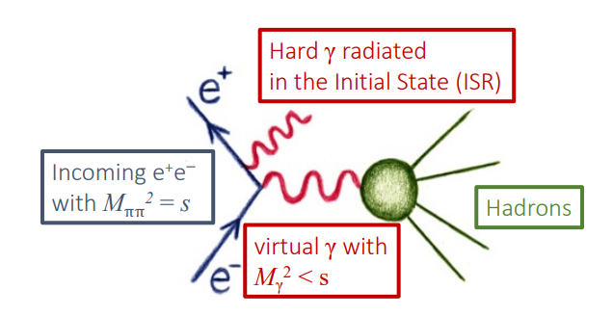
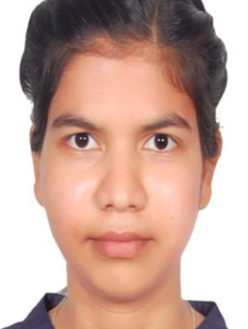
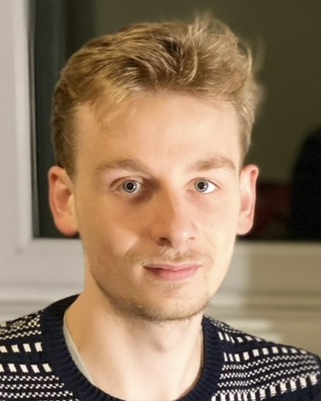
The KLOE Experiment
2. Confirm the SM prediction by analysing KLOE data
Liverpool is leading a novel analysis of data from the KLOE experiment
KLOE data is one of the most significant inputs to the data-driven calculation
Joint initiative between experiment (Physics department) and theory (Maths department)

Slide 7
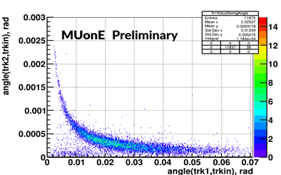
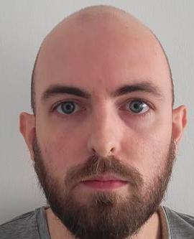
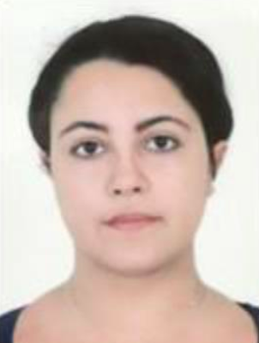
The MUonE Experiment at CERN
3. Cross-check the SM prediction with a direct measurement with independent uncertainties → MUonE experiment at CERN
MUonE experiment proposed at CERN. Phase-I 2025, Phase-II 2026-29
Direct measurement of the leading term in the theory prediction
Liverpool group at the forefront of the Physics analysis and instrumentation
Joint effort between experiment and theory colleagues
Instrumentation: Beam Spectrometer (BMS) detector, CF support for tracking detectors, …

Slide 8
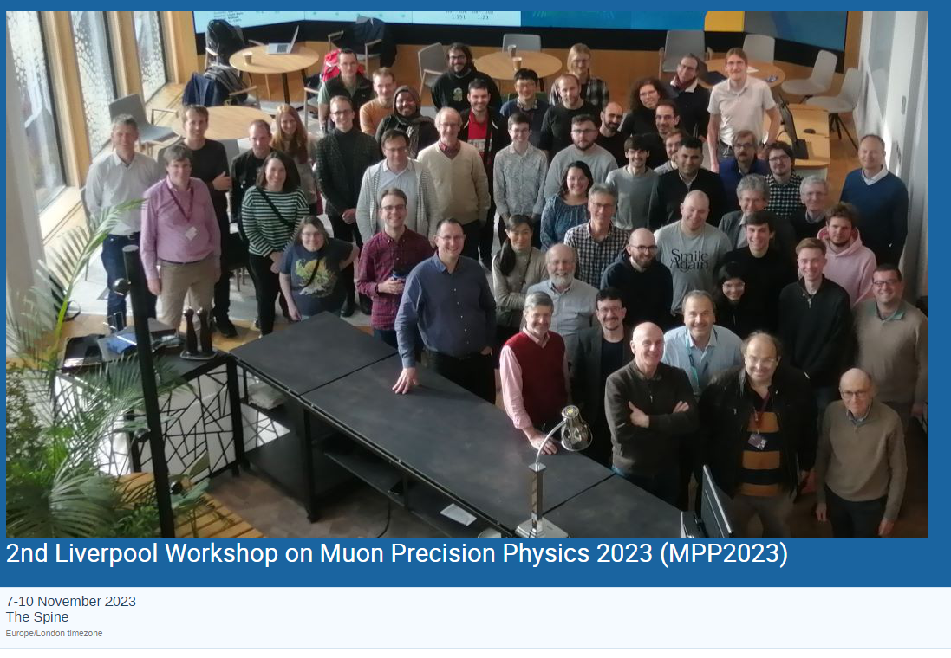
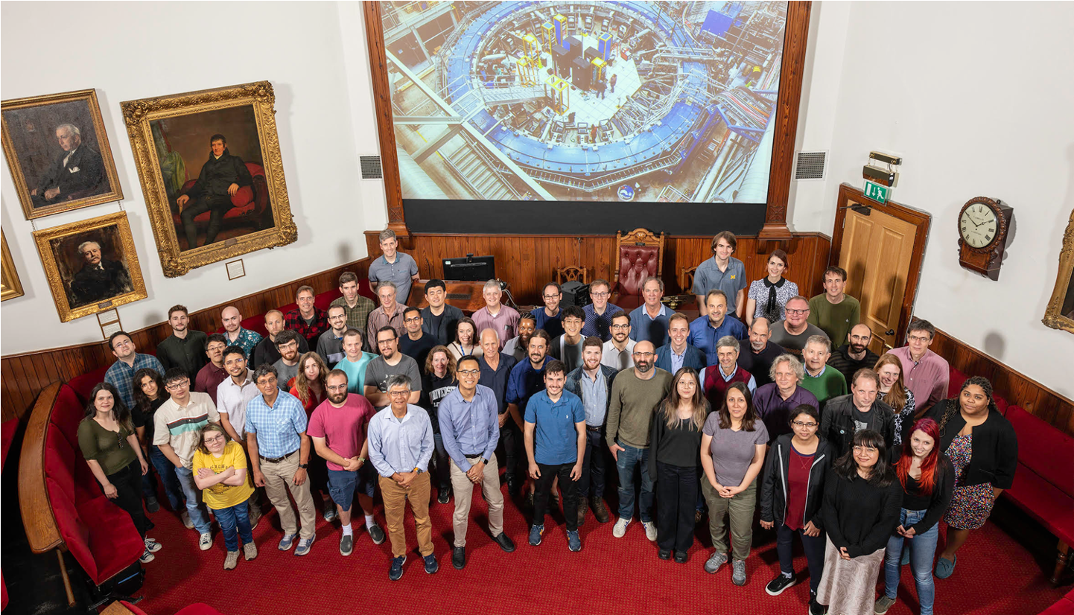
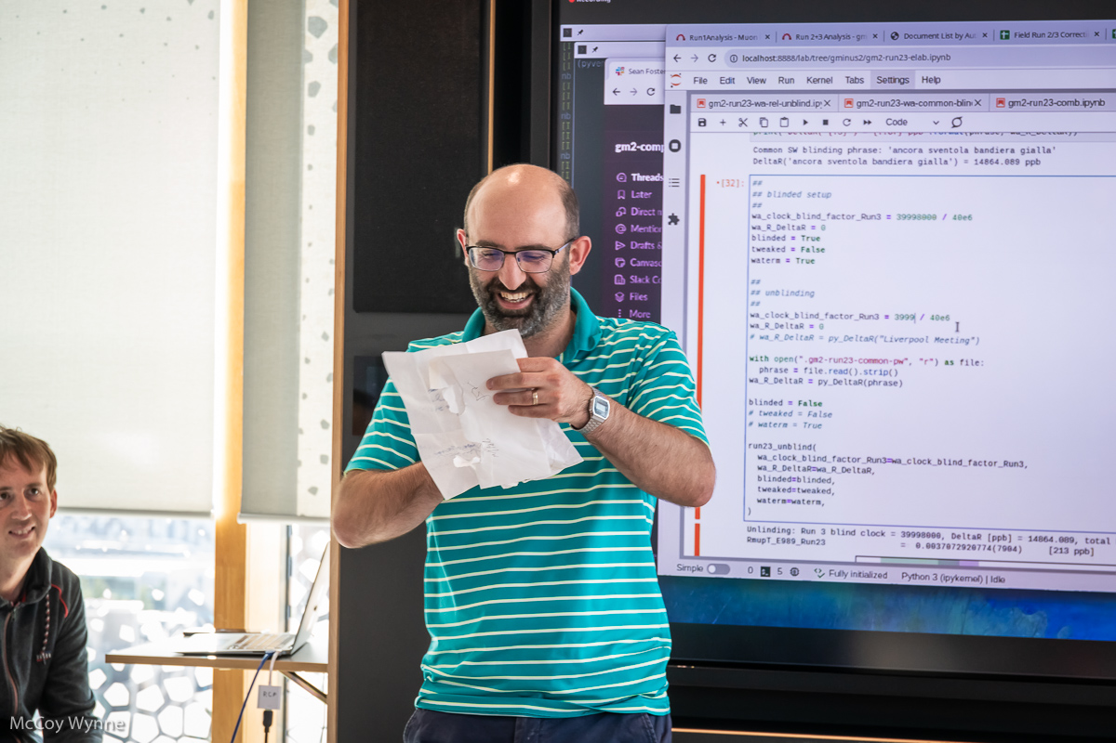
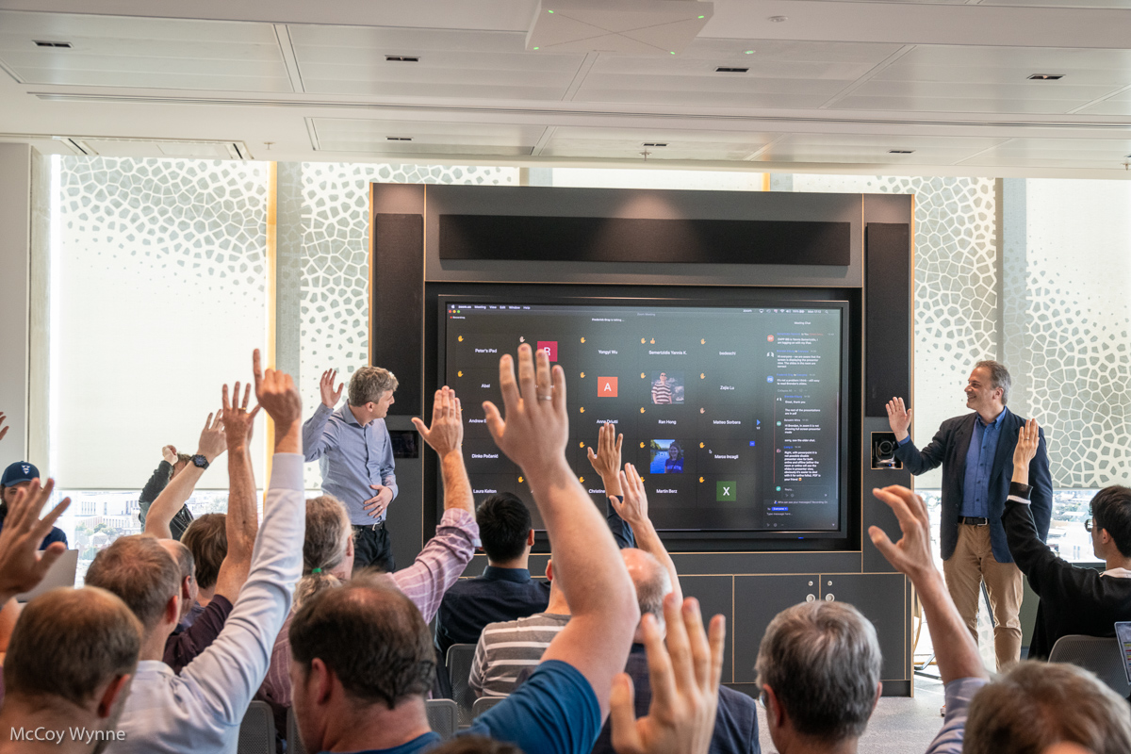
Muon precision physics at Liverpool
Liverpool has hosted two workshops for Muon Precision Physics (Nov 2022 and 2023). Well-attended by experts from the experiment and theory community worldwide.
Liverpool hosted the muon g-2 collaboration meeting in July 2023. Vote to unblind the data and release the result was taken at the meeting!

Slide 9
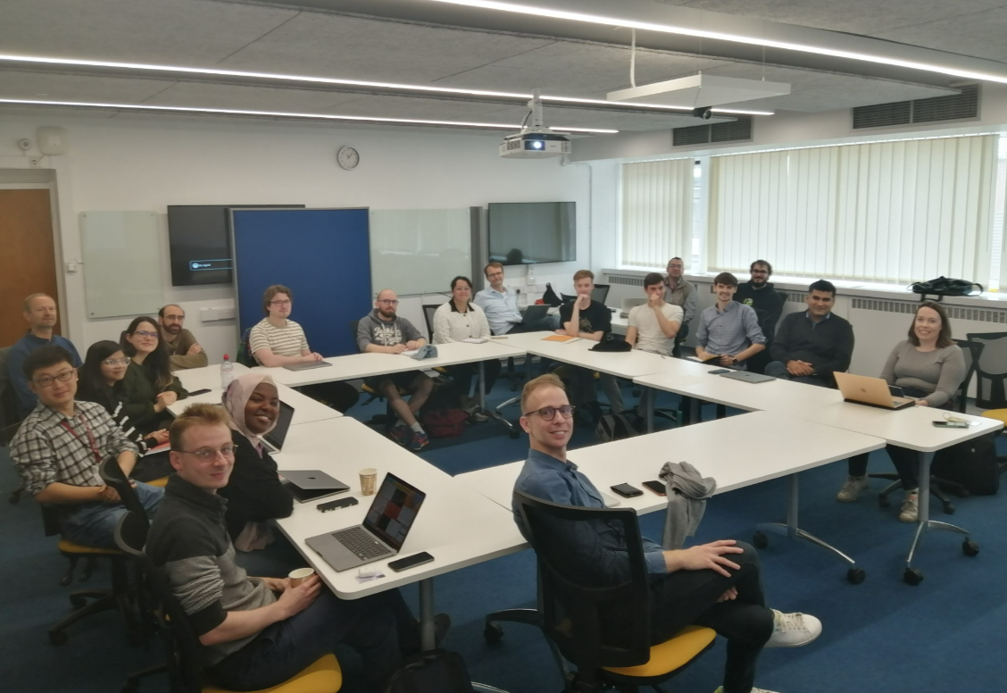
Thank you

Slide 10
Acknowledgements
Department of Energy (USA)
National Science Foundation (USA)
Istituto Nazionale di Fisica Nucleare (Italy)
Science and Technology Facilities Council (UK)
Royal Society (UK)
Leverhulme Trust (UK)
European Union’s Horizon 2020
Strong 2020 (EU)
German Research Foundation (DFG)
National Natural Science Foundation of China
MSIP, NRF, and IBS-R017-D1 (Republic of Korea)

Slide 11
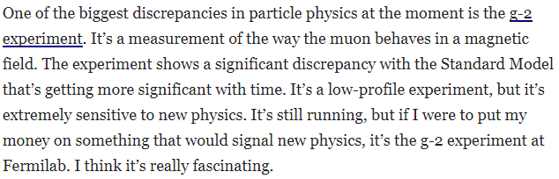
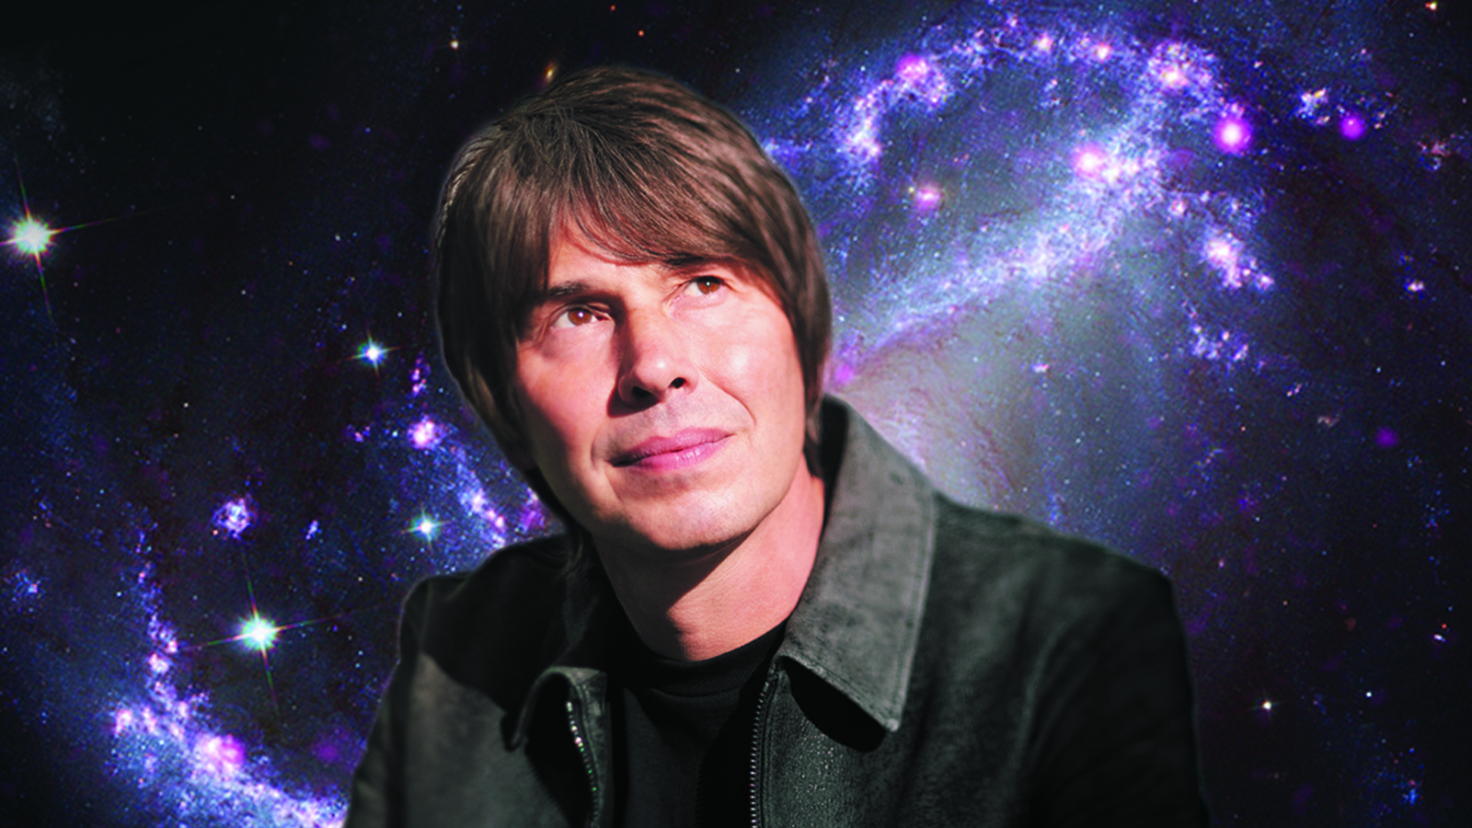
Wonders of the Universe?
Prof. Brian Cox (2018)

Slide 12
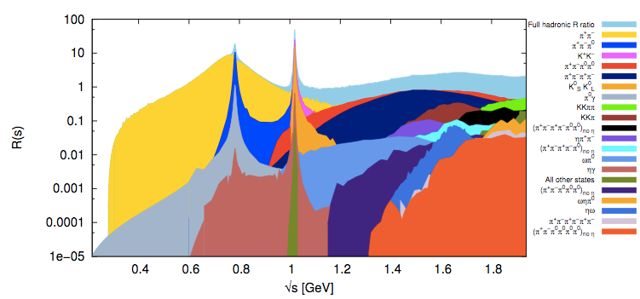
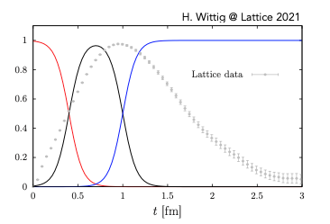
Confirming the discrepancy: theory and experiment
theory calculation: evaluate all terms in this expression
Many different particles to combine
Two approaches: data-driven and analytical (‘lattice’)
Data-driven: combine experimental results from different e+e- colliders around the world e.g. KLOE experiment
Analytical / lattice: perform the calculation using novel computational simulations
Very expensive: hard to reach same precision as data-driven

Slide 13
Muons and the Standard Model
Muon: a second generation lepton – like an electron, but 200x heavier
Precession frequency can be experimentally measured and theoretically predicted with equal precision
It has spin
→ behaves like a spinning top in a magnetic field (precession)
Virtual particle interactions affect the spin precession frequency
B
Heavy mass → sensitive to interactions with virtual particles

