Slide 1



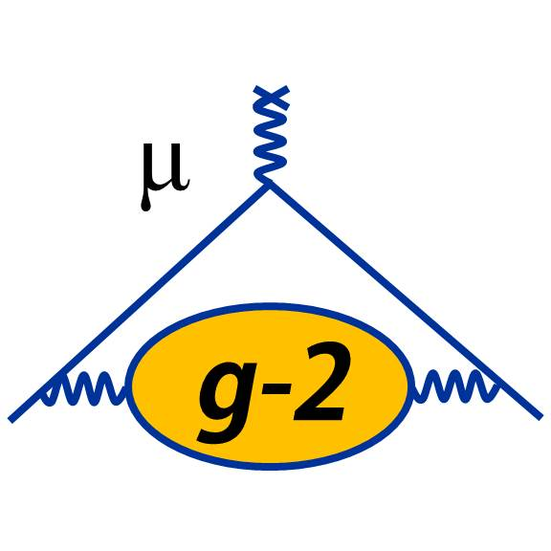






Liverpool Theoretical Physics muon physics and beyond
Muon Group Meeting 4th December 2023

Slide 2
Liverpool Theoretical Physics
13 (+ 2*0.5) Academics + 7 PDRAs + 25 PGRs in three broad Research Areas:
  String Phenomenology & Cosmology
  Precision QFT for Particle Physics
  Lattice Quantum Field Theory
Many TP activities are directly connected to/integrated with experimental HEP:
  Predictions for Dark Matter & Axion signals → DM searches & detection
  [Martin Gorbahn, Juri Smirnov]
  Higher order calculations for QCD, Higgs, Kaon & B meson physics,
  Standard Model Effective Field Theory → New Physics searches, LHC
  [Andreas Vogt, Martin Gorbahn, TT; Joshua Davies]
  Higher order calculations in QED, Monte Carlo generators, Theory/Phenomenology for g-2, MUonE, KLOE → Muon programme
    [TT, Graziano Venanzoni; Fedor Ignatov, William Torres Bobadilla, Jeremy Paltrinieri]

Slide 3
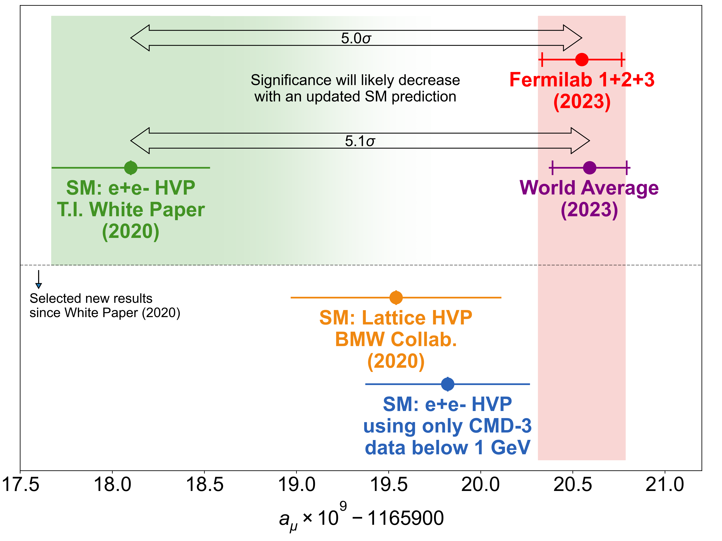
g-2: SM from Theory Initiative vs. Experiment
Measurement of the Positive Muon
Anomalous Magnetic Moment to 0.46 ppm
[Phys. Rev. Lett. 126 (2021) 14, 141801]
… to 0.20 ppm [PRL 131 (2023) 16, 161802]
White Paper [T. Aoyama et al., Phys. Rept. 887 (2020) 1-166]
0.37 ppm
☞ No official
TI predictions:
➥
➤ Liverpool Exp (g-2, MUonE, KLOE) + Th in leading roles to solve the multiple puzzles of g-2

Slide 4
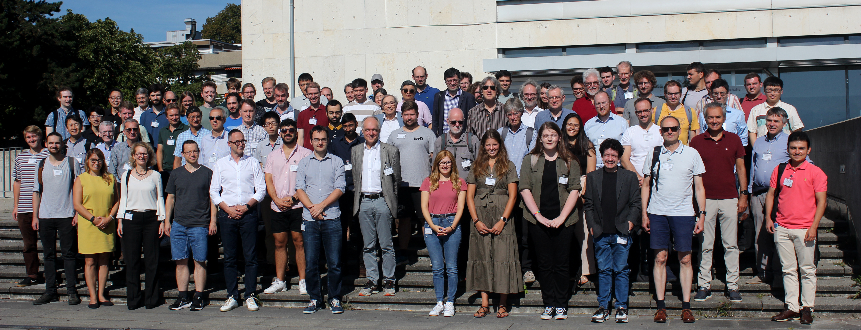
Muon g-2 Theory Initiative est. 2017 https://muon-gm2-theory.illinois.edu
``… map out strategies for obtaining the best theoretical predictions for these hadronic corrections in advance of the experimental result.’’
9 international workshops from 2017-2023, last plenary workshop 4-8.9.2023 in Bern
White Paper posted 10 June 2020 (132 authors, from 82 institutions, in 21 countries)
  ``The anomalous magnetic moment of the muon in the Standard Model’’
[T. Aoyama et al., arXiv:2006.04822, Phys. Rept. 887 (2020) 1-166 > 1000 cites]
Leading contributions from Liverpool [`KNT’, TT member of the Steering Committee]
Group photo from the Bern workshop in September 2023

Slide 5
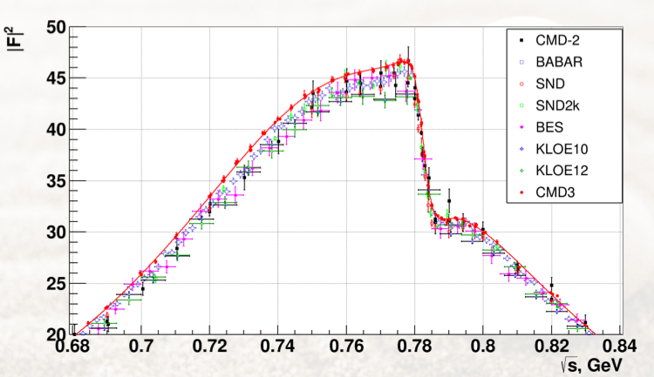
HVP: Landscape of hadronic R data. Most important 𝛑⁺𝛑⁻ channel
[KNT18, PRD97, 114025]
Many hadronic channels
Dominance of 2𝛑
Compilation from KNT
Now KNT+AidanWright
working on better compilation
𝛑⁺𝛑⁻ :
Combination of >30 data sets, >1000 points, contributing >70% of total HVP
Dominance of data from Initial State Radiation
(BaBar, KLOE)
Until new results from CMD-3: (Fedor Ignatov)
Crucial: New KLOE 2𝛑 analysis

Slide 6
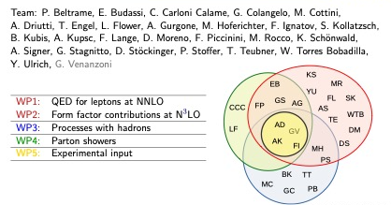
Radiative Corrections & Monte Carlo tools
Crucial for analysis and interpretation of data from MUonE and the hadronic data for g-2
Strong2020 activities: 5th WorkStop/ThinkStart (Adrian Signer’s intro)

Slide 7
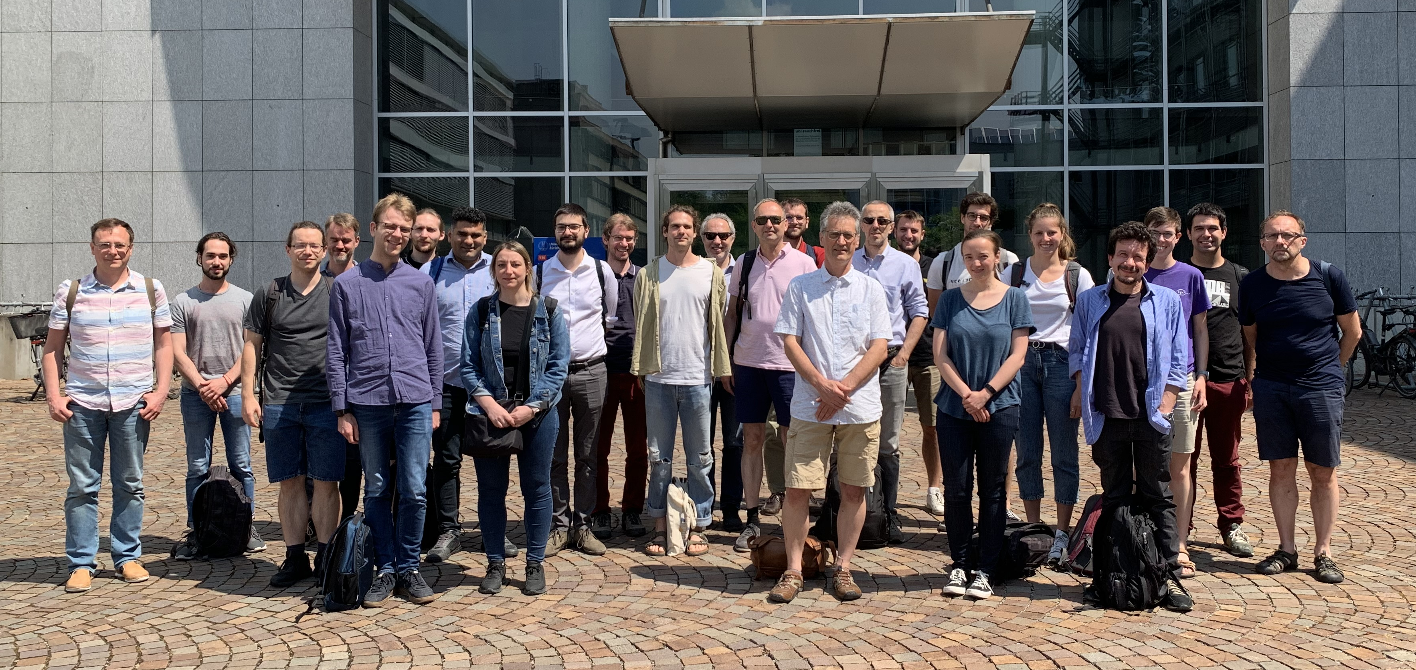
Radiative Corrections & Monte Carlo tools
Strong2020 activities: 5th WorkStop/ThinkStart
Conference in Zurich, 5-9 June 2023

Slide 8
Radiative Corrections & Monte Carlo tools
Liverpool activities:
Calculate and implement (in MC generators like PHOKHARA) all higher order
(real + virtual loop) corrections relevant up to ~0.1%
Will require Next-to-Next-to Leading Order, plus re-summed ISR radiation, and a
better understanding of radiation form hadrons
Work has started with new Leverhulme PGRAs & PGRs
William Torres-Bobadilla, Jeremy Paltrinieri & Tom Dave, Pau Petit Rosas
Two Virtual Photon Exchange: Final State Radiation at Next-to-Leading Order:

Slide 9
Extras

Slide 10
Theory Initiative: Sep. 2023 workshop at Bern
Aida El-Khadra: TI outlook and plans:

