Slide 1
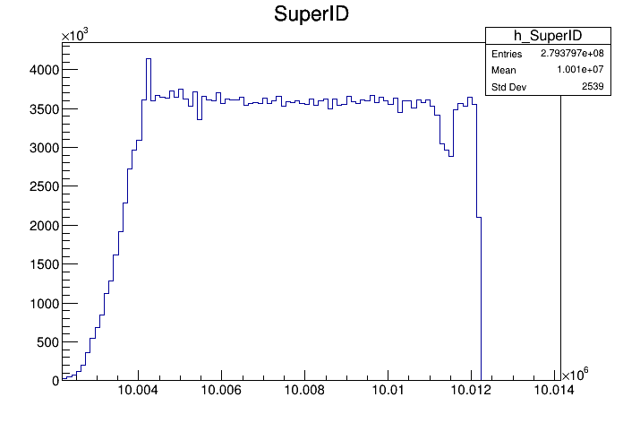
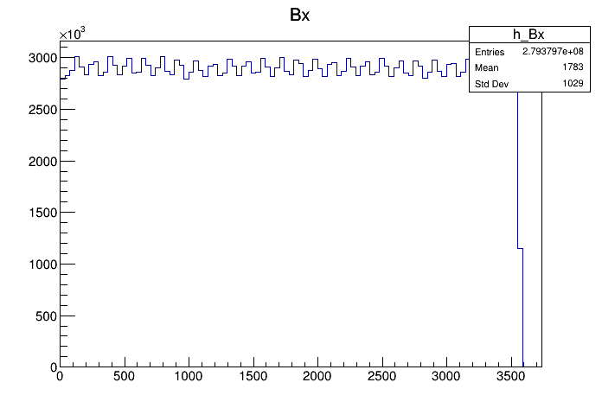
Muon rate from newly merged files
/eos/experiment/mu-e/staging/daq/2023/dgm_merged/
Run | Intensity | Target
Run 2 | Low intensity (expect 2 MHz) | w/o target
Run 5 | High intensity (expect 40 MHz/30 MHz?) | w/o target
Run 6 | High intensity (expect 40 MHz/30 MHz?) | with target (3cm)
Time [second] =
25 ns *(SuperID*3564 + Bx)
Run 6 10002197_10012197
Run 6 10002197_10012197

Slide 2
Module rate
Run 6; 10002197_10012197 (1 file)
Peak at the end of the leading edge
Station 1; module 1-6
Rate is stable at ~30 MHz
Station 2; module 7-12
Rate is ~30-35 MHz
but seems less stable than station 1

Slide 3
Station rate
Run 6; 10002197_10012197 (1 file)
Station 1; module 1-6
Sum of hits on 6 modules
’golden muons’ (6 stubs; 1/module)
~22 MHz
Sum of hits on 6 modules
Single ’golden muons’ (6 stubs; 1/module)
~14 MHz
Sum of stubs on 6 modules
Station 2; module 7-12

Slide 4
Strip rate
Run 6; 10002197_11012197 (100 files)
Station 1
CIC0
Station 1
CIC1

Slide 5
Strip rate
Run 6; 10002197_11012197 (100 files)
Station 2
CIC0
Station 2
CIC1

Slide 6
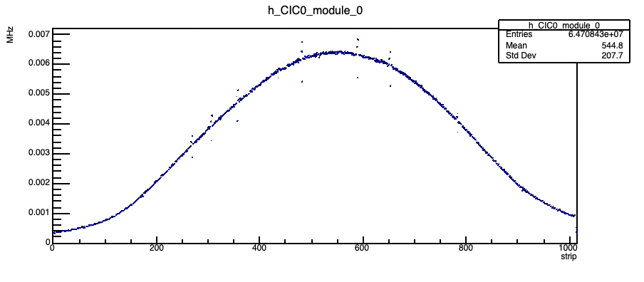
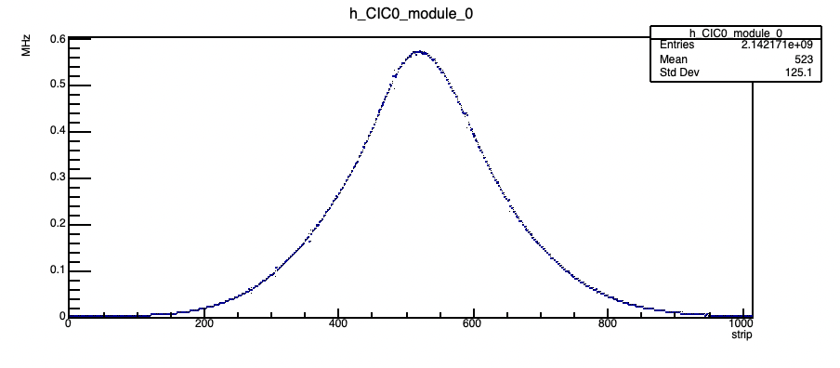
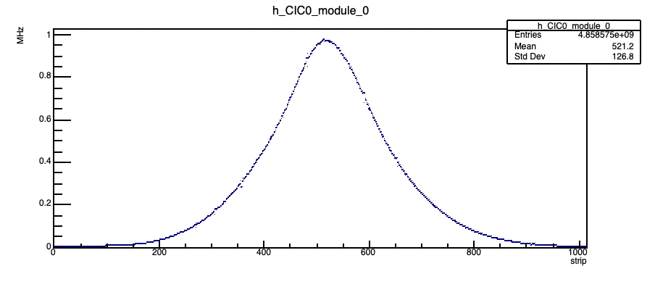
Average strip rate
Run 2, 5 and 6 (100 files)
Project the 2D plot into 1D to get the average rate
Run 2 (LI)
Average strip rate ~0.006 MHz
Run 5 (HI w/o tgt)
Average strip rate ~0.6 MHz
Run 6 (HI w/ tgt)
Average strip rate ~1.0 MHz

Slide 7
Rate summary
Run | Config | Module rate | Golden muon rate | Ave strip rate
Run 2 | LI w/o tgt | 1 MHz | 0.6 MHz (S1 & S2) 0.6 MHz (single ‘trk’, S1 & S2) | 0.006 MHz
Run 5 | HI w/o tgt | 20 MHz | 15 MHz (S1 & S2) 10 MHz (single ‘trk’, S1 & S2) | 0.6 MHz
Run 6 | HI w/ tgt | 30 MHz | 22 MHz (S1 & S2) 14 MHz (single ‘trk’, S1 & S2) | 1.0 MHz

Slide 8
Next
Entire runs check with average rates and the spill time widths
Number of muons for runs (lumi etc)
Rate with FairMUonE-reconstructed tracks

Slide 9
Backup

Slide 10
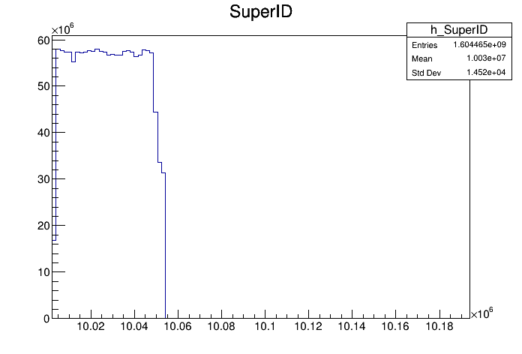
Run 6 merged file check

Slide 11
Strip rate ~ 1 MHz

Slide 12
Average strip rate

Slide 13
Muon rate per module ~ 30-35 MHz

Slide 14
Zoom-in view

