Slide 1
Measurement of the Pion Charge-Exchange Differential Cross Section on Argon with the ProtoDUNE-SP Detector
Liverpool HEP Seminars
Kang Yang (杨康) University of Oxford (*)
21st Feb 2024
∗ Now at Imperial College London

Slide 2
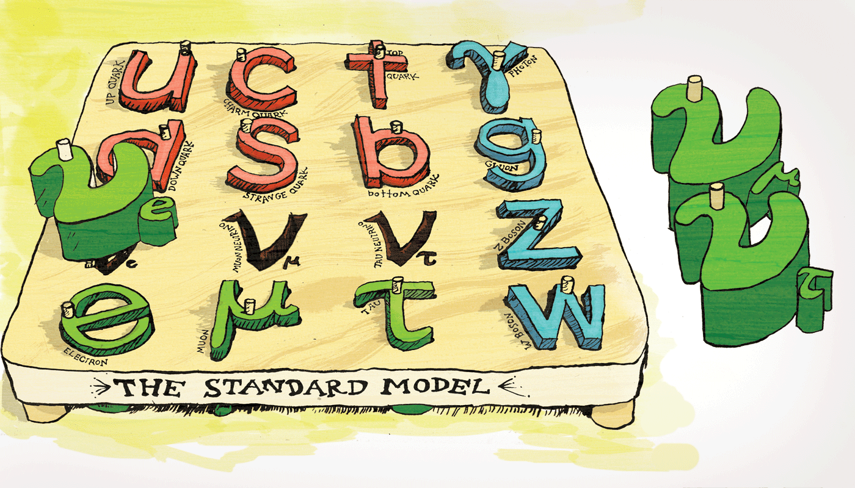
Neutrinos in Standard Model
The Standard Model contains two types of matter particles:
  Hadrons (composed of quarks)
  Leptons (elementary particles)
Neutrinos are leptons without electrical charge.
  Feel only the weak force.
  Very difficult to detect.
  Extremely low mass
@Symmetry magazine
Notes:
Let’s begin with the standard model and neutrinos. Check out the artwork about elementary particles, which I found in Symmetry magazine. It's a great magazine for particle physics. According to the standard model, there are only two types of matter particles: hadrons, which are made up of quarks, and leptons—elementary particles. Neutrinos belong to the lepton family and come without an electrical charge. They only interact with the weak force. So, neutrinos find it extremely difficult to 'see' other particles, making them very hard to detect. They also have an extremely low mass, and for now, we only know the upper limits. So we want to build more detectors to study them.

Slide 3
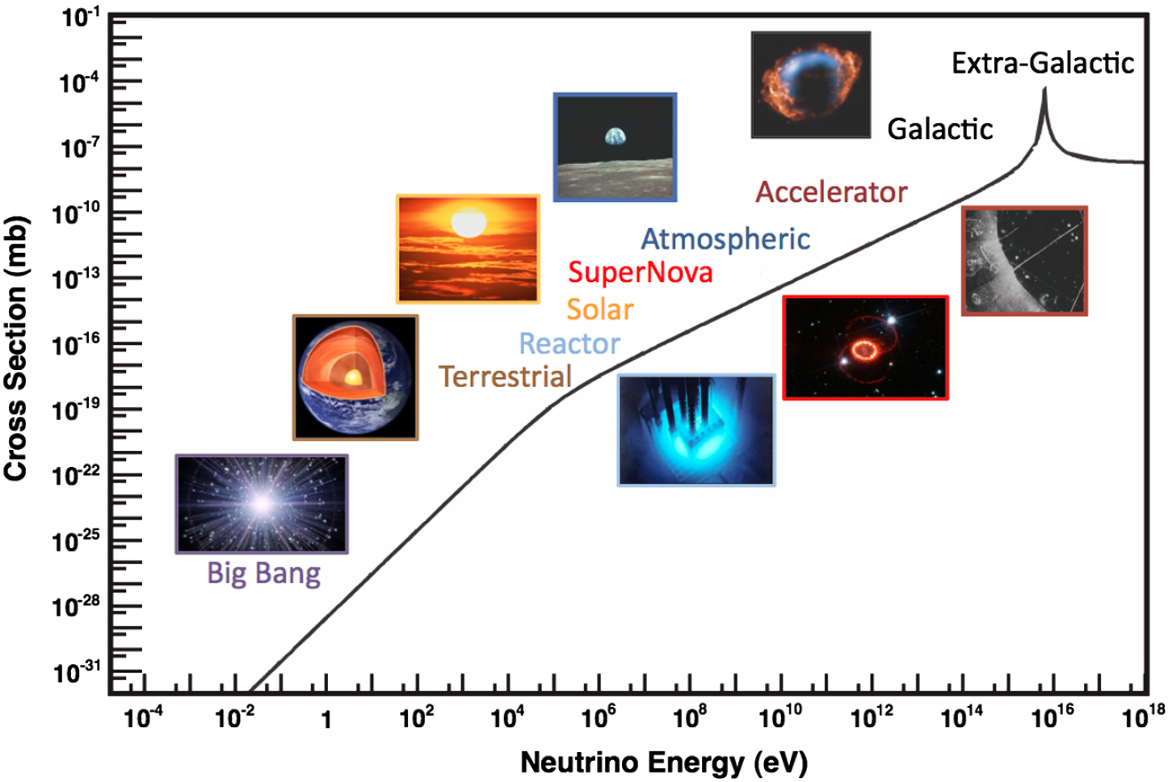
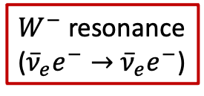
Neutrino Sources
Artificial neutrino sources
  Reactor neutrinos
  Accelerator neutrinos
Formaggio & Zeller, Rev. Mod. Phys. 84, 1307 (2012)
Astrophysical neutrino sources
  Solar neutrinos
  Atmospheric neutrinos
  Supernova neutrinos
  Neutrinos from astrophysical accelerators
$W^{−}$ resonance
(${\overline{ν}}_{e}e^{−}→$ ${\overline{ν}}_{e}e^{−}$)
Notes:
First, let’s talk about the sources that can produce neutrinos. This plot shows the neutrino cross-section as a function of its energy. They are abundantly produced from the big bang with a few eV energy. The Earth can also produce neutrinos at its core. In the energy range that particle physicists are interested in, we can categorize the sources into two kinds: the first being artificial neutrinos, which are created not by nature, but by us. Fission reactors is the best source of low-energy antineutrinos. Muon-type neutrinos, on the other hand, can be produced by allowing pions of the appropriate charge to decay in flight and then stopping the non-neutrino products with a dense absorber, referred to as accelerator neutrinos.
Then, we have some astrophysical sources. The Sun is a 'most copious source of neutrinos,'. Cosmic rays striking the Earth’s atmosphere should produce a significant flux of neutrinos from pion decay. Neutrinos can also come from the core-collapse supernovae and some astrophysical particle accelerators. You might notice a peak in the neutrino cross-section at very high energy, this is the process of the W boson resonance where an anti-electron neutrino can interact with an electron to create a real W boson.

Slide 4
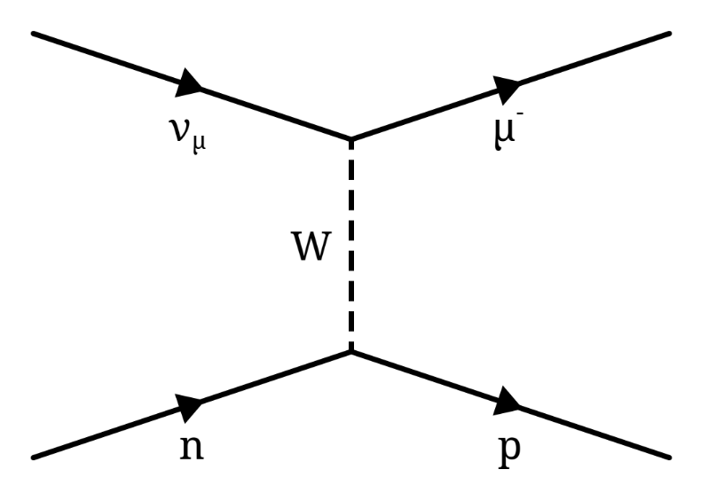
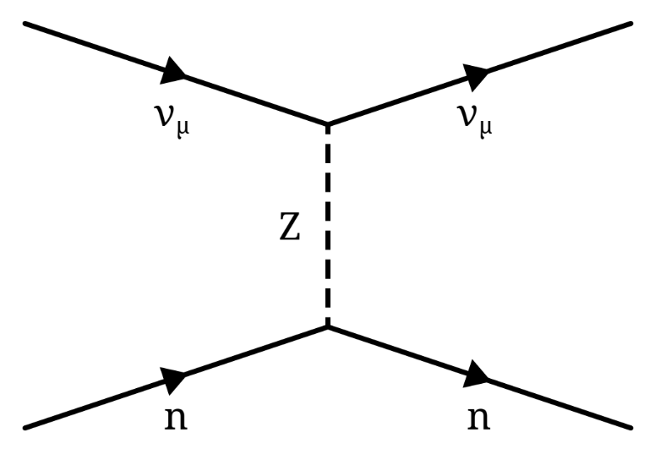









Neutrino Detection
Can only detect the presence of a neutrino if it interacts:
  Charged-current interactions, where the neutrino converts into the corresponding charged lepton.
  Neutral-current interactions, where the neutrino remains a neutrino, but transfers energy. (target recoils or breaks up)
Radiochemical experiments
  Homestake, SAGE
Liquid scintillator experiments
  KamLAND, MiniBooNE
Tracking experiments
  MINERvA, MicroBooNE, DUNE
Cherenkov experiments
  T2K, SNO
Charged-current
Neutral-current
$$ν_{μ}$$
$$μ^{−}$$
$$ν_{μ}$$
$$ν_{μ}$$
$$W$$
$$Z$$
$$n$$
$$p$$
$$n$$
$$n$$
Notes:
We can only detect the presence of a neutrino in our experiment if it interacts. Neutrinos interact in two ways: Charged-current interactions occur through the exchange of a W± particle, neutral-current through the exchange of a Z⁰. In CC, the neutrino converts into the corresponding charged lepton and that’s what we detect. In NC, the neutrino remains as a neutrino, but transfer its energy. What we detector is the target recoil or break up. In principle, charged-current interactions are easier to work with, because electrons and muons have characteristic signatures in particle detectors and are thus fairly easy to identify. They also have the advantage that they “flavour-tag” the neutrino: if an electron is produced, it came from an electron-neutrino.
Various different detector technologies have been used in neutrino experiments over the years. Radiochemical experiment such as Homestake, have a very low energy threshold for solar neutrino detections. Liquid scintillator experiments such as MiniBooNE have good time and energy resolution, but do not preserve directional information. Tracking experiments such as MINERvA and DUNE, have good particle identification and energy measurement. Finally the Cherenkov experiments, such as T2K, They have good time and energy resolution, and good directional resolution for the detected particle.
1. low energy threshold 2. good angular resolution 3. good particle identification and energy measurement 4. good time resolution.

Slide 5
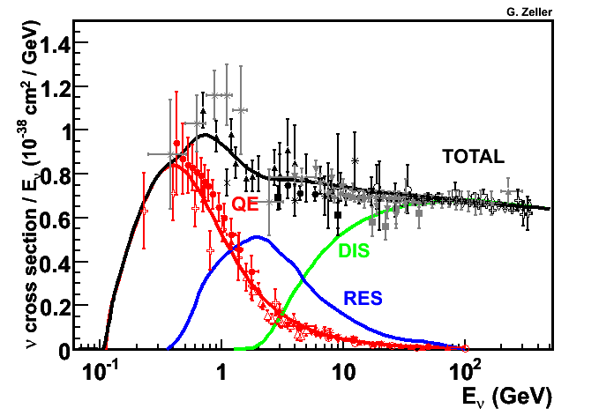
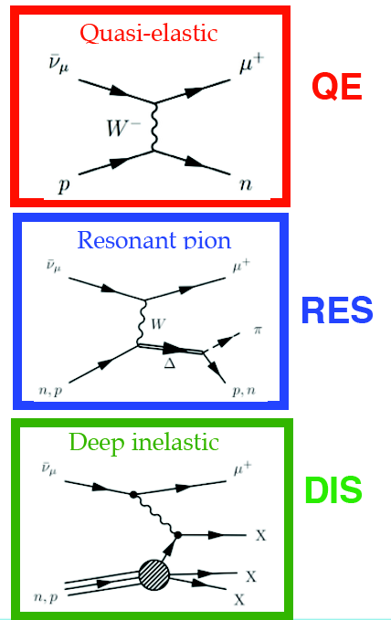
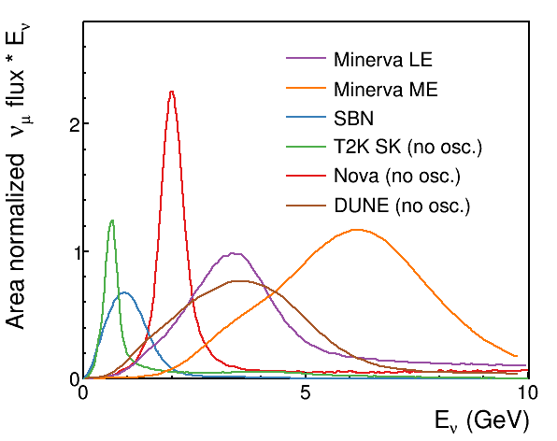

Neutrino Interactions
J. A. Formaggio and G. P. Zeller
Rev.Mod.Phys. 84 (2012) 1307-1341
Resonant Pion
L. Fields
Many pions are expected to be produced with the DUNE neutrino flux.
Important to measure the secondary interactions of final state pions with argon.
NOvA
T2K
DUNE
DUNE <$E_{ν}$> ~ 3 GeV
dominated by RES mode
Notes:
Neutrinos can interact with electrons and nucleons. The plot on the right shows the cross-section per neutrino energy, decomposed by different interaction modes with nucleons. The quasi-elastic interaction is the dominant process at low energy, where the neutrino converts into the corresponding charged lepton, and that’s what we detect. As the energy increases, the extra energy transfer from the neutrino can produce an excited state of the nucleon, which then decays to produce an extra pion. This is the pion resonant process. When the neutrino energy is larger than a few GeV, it can 'see' quarks inside nucleons and break up the nucleons into many pieces—this is the deep inelastic interaction.
For most of the accelerator neutrino experiments, the neutrino energy lies in the range of 1–10 GeV, where you can see these three processes overlapping. This plot displays the neutrino flux for different accelerator neutrino experiments. Regarding the DUNE flux, it peaks at 3 GeV, dominated by the Resonance mode. Consequently, many pions are produced and it’s important to understand the secondary interaction of these pions inside the detector. You will find out later that the hadron beam used in ProtoDUNE is actually trying to simulate these secondary pions and study their interactions.

Slide 6
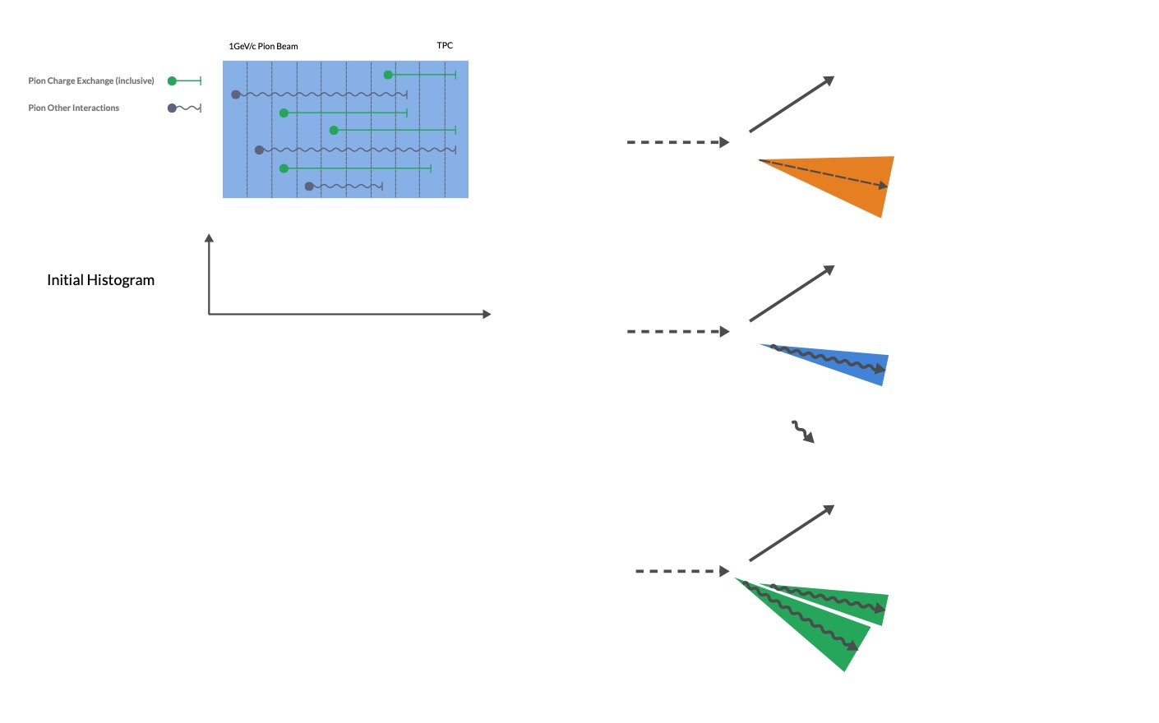












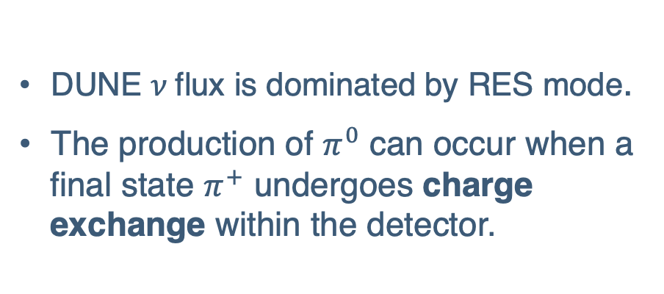


Motivations
$$p$$
Signal : $ν_{e}n→pe^{−}$
$$ν_{e}$$
The $π^{0}$ reconstruction is driven by two key motivations in DUNE:
  $π^{0}$ forms a major background to the $ν_{e}$appearance signal
  $π^{0}$ decay signature can be used as calibration source for EM shower.
$$e^{−}$$
(a)
$$p$$
$$ν_{μ}$$
NC background : $ν_{μ}p→ν_{μ}p{+ π}^{0}$
DUNE $ν$flux is dominated by RES mode.
The production of $π^{0}$ can occur when a final state $π^{+}$ undergoes charge exchange within the detector.
$$γ$$
$$γ$$
$$p$$
(b)
$$ν_{μ}$$
$$γ$$
$π^{0}$ background : $ν_{μ}Ar→ν_{μ}+p+{ π}^{+}$
$$γ$$
($π^{+}Ar{→π}^{0}$+ nucleons)
Notes:
Next, let's discuss the motivation behind this analysis. We'll begin with the electron-neutrino appearance signal in DUNE, starting with a muon-type neutrino and searching for an electron in our detector. We can measure neutrino oscillation. An electron leaves a shower inside the detector. A neutral pion can also create a similar signature inside the detector, especially if one of the photons from the neutral pion decay is missed or two photons are merged into a single shower. Therefore, the neutral pion can be a major background in the appearance measurement. Additionally, the neutral pion serves as a calibration source for shower energy reconstruction.
The neutral pion can be directly produced from the neutrino neutral current interaction, but it can also arise from the secondary interaction of the final state charged pion. This talk focuses on the latter case, we expect a large number of pions being produced from the RES mode in DUNE, so we are interested in the pion charge exchange interaction, where a charged pion converts itself into a neutral pion with nearby Argon. We aim to constrain the current model used in the event generator for pion interaction with argon using ProtoDUNE data, providing a better estimation of this type of background in DUNE’s neutrino oscillation measurements

Slide 7
ProtoDUNE-SP

Slide 8
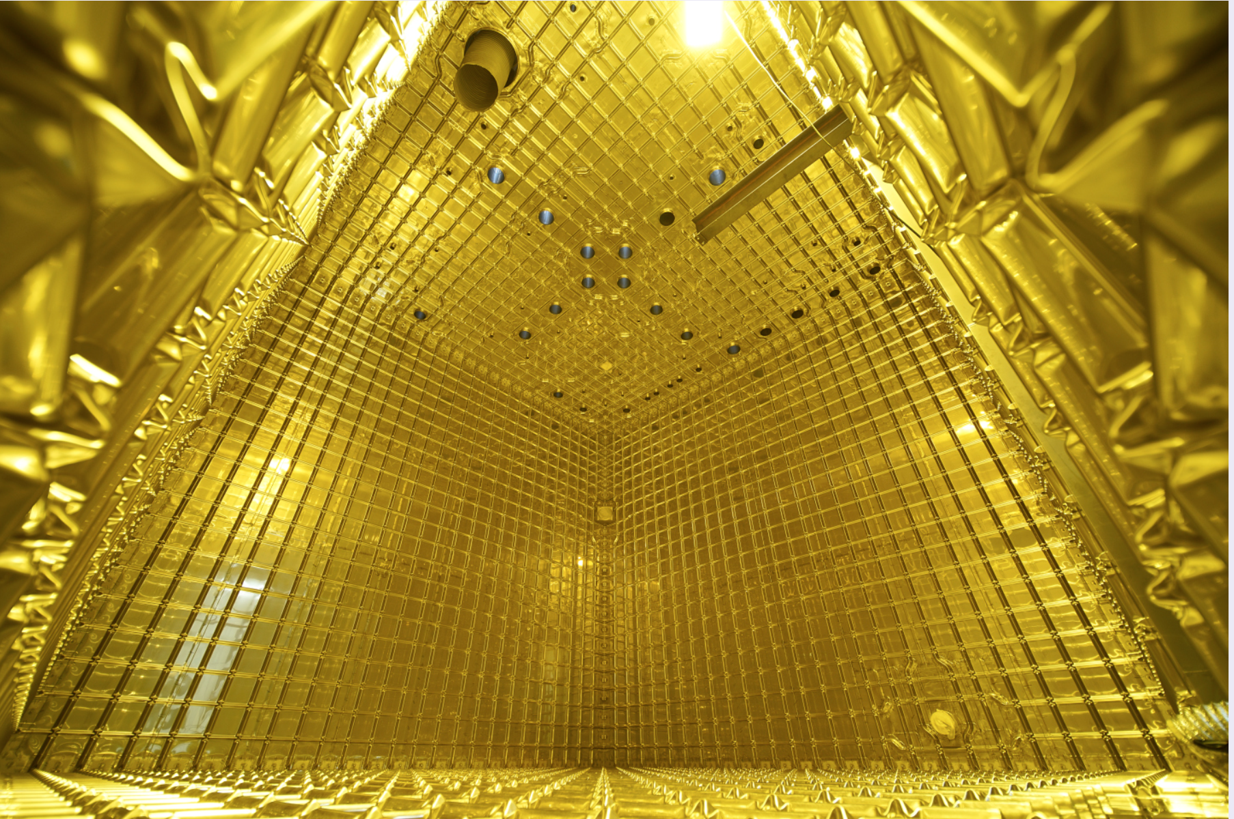
ProtoDUNE in Pictures
Credit: M Brice/CERN-201710-248-1
Often appear in photographs as giant gold-colored cubes
  It’s a trick of the light!
  Yellow light reflects off the stainless-steel surfaces.
  To protect certain properties of the photon detection system.
Notes:
Here is a picture of the ProtoDUNE-SP detector, often appearing as a giant golden cube. That was also my first impression of ProtoDUNE; however, the reality is just a trick of light. If you look closely at the top, you can see the light source. The yellow light reflects off the surfaces to make it look golden. It is said that they are protecting the photon detection system.

Slide 9
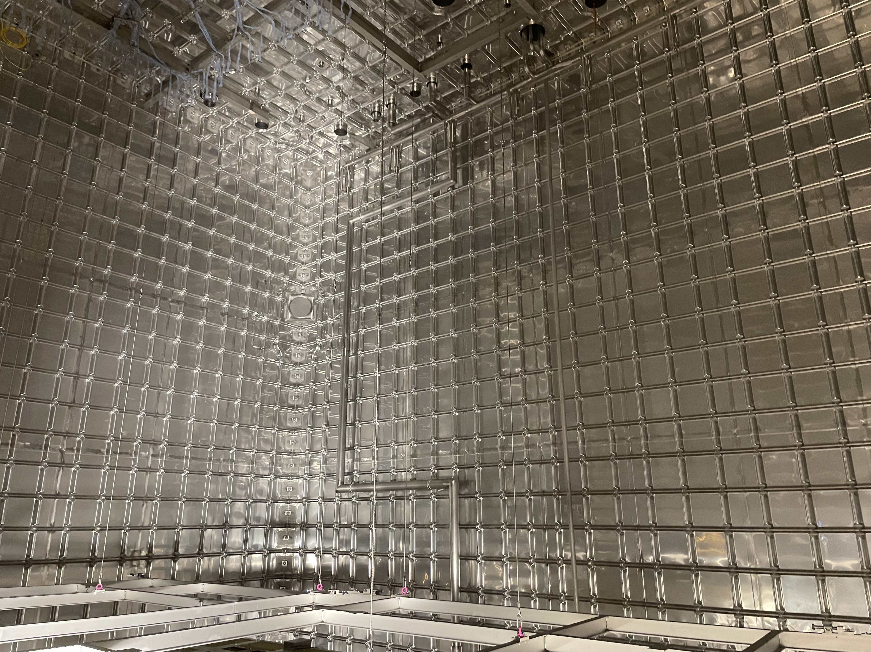
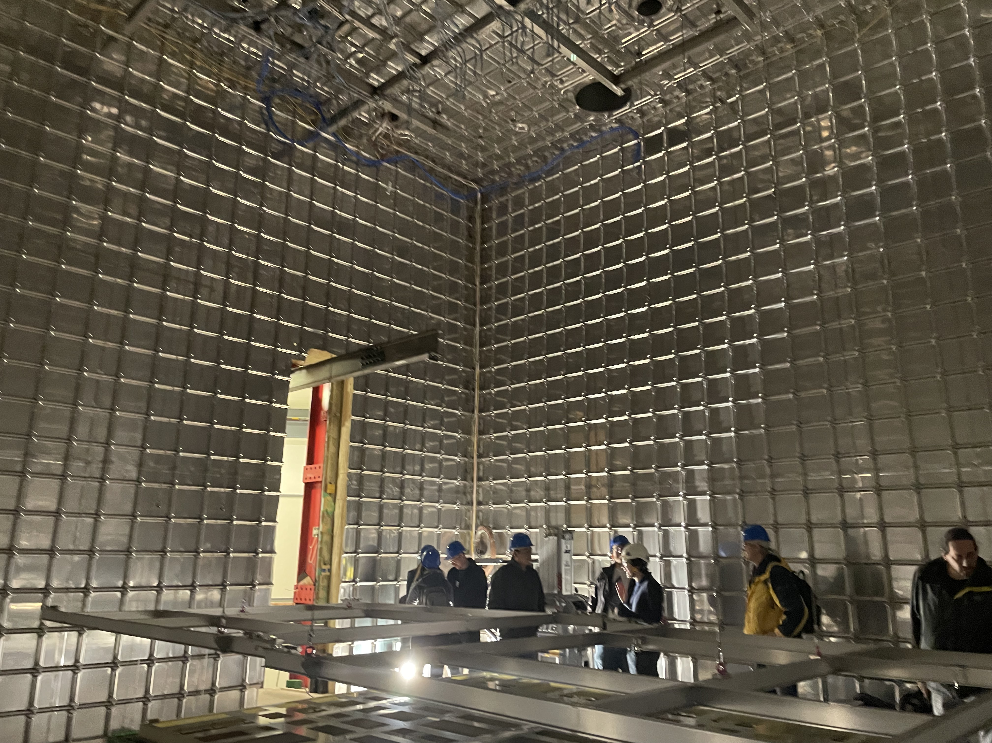
ProtoDUNE in Reality
Credit: Myself ☺ 25 Jan. 2023
Light off ☹
  It’s a huge detector
  DUNE is even bigger
Notes:
In reality, ProtoDUNE looks like this when the light is off; I took these photos about a year ago. Although this isn't the ProtoDUNE-SP but rather the second prototype, called ProtoDUNE vertical drift, where electrons drift vertically, instead of horizontally. To give you a sense of the detector's size, here's a photo with people inside. Keep in mind that the DUNE far detector will have four modules, each module is about 20 times larger than this prototype detector.

Slide 10
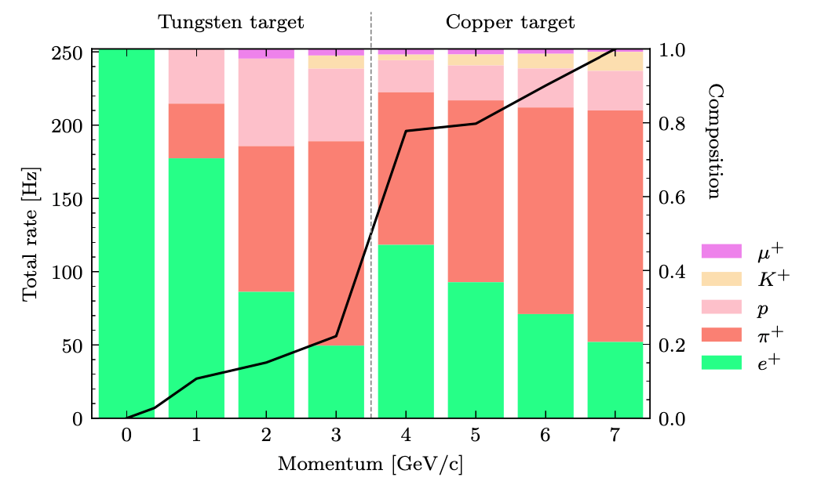
ProtoDUNE Test Beam
Between 10 October and 12 November 2018, ProtoDUNE was exposed to a charged particle beam sourced from the Super Proton Synchrotron (SPS) at CERN.
M. A. Vermeulen, PhD thesis, Nikhef, Amsterdam (2021)
Spectrometer
(Momentum measurement)
Threshold Cherenkov counters
(Particle ID)
At the lower end of the momentum range, the beam predominantly consists of electrons and positrons.
As the momentum increases, pions become the dominant particle in the higher momentum beams.
Notes:
Between October and November 2018, ProtoDUNE was exposed to a charged particle beam sourced from the SPS at CERN. This happened just before the LHC shut down. High energy protons extracted from the SPS interact with a primary target produce a mixed secondary hadron beam, then this is beam is further directed on a secondary target to produce the low energy beam we wanted. Before entering the ProtoDUNE TPC, there will be a dedicated beam line instrumentation to measure the property of the beam, such as its momentum from the spectrometer, time of flight, and its particle type from threshold Cherenkov counters. The composition of the beam varies depending on its momentum as can be seen on the right-hand side plot. At the lower end of the momentum range, the beam predominantly consists of positrons. As the momentum increases, pions become the dominant particle in the higher momentum beams. In this analysis, I’m using the 1GeV/c beam sample to select the pion beam component, the red portion here.

Slide 11
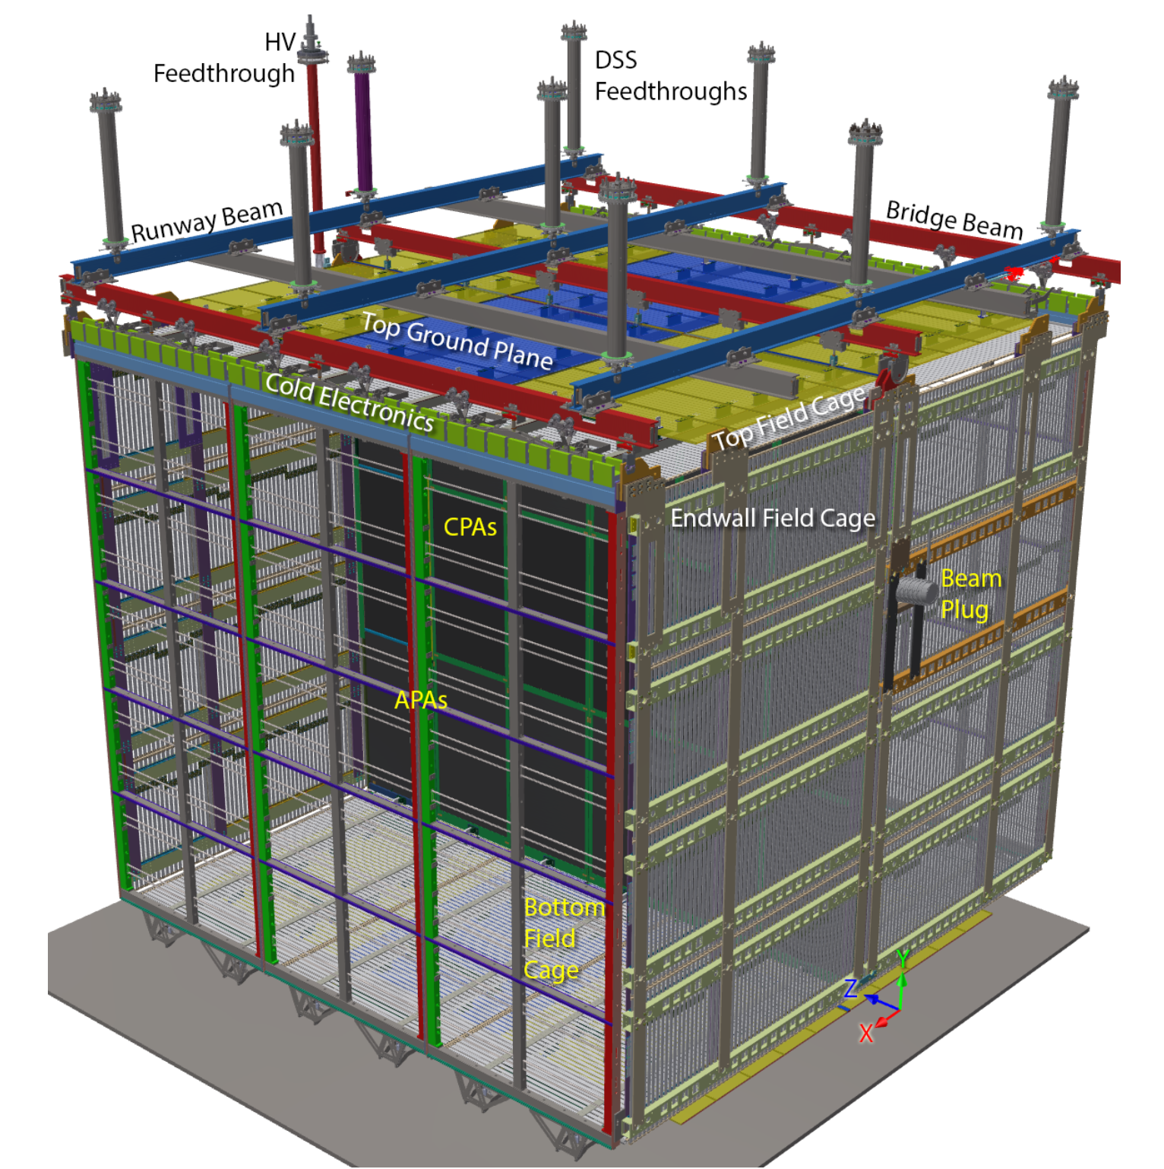
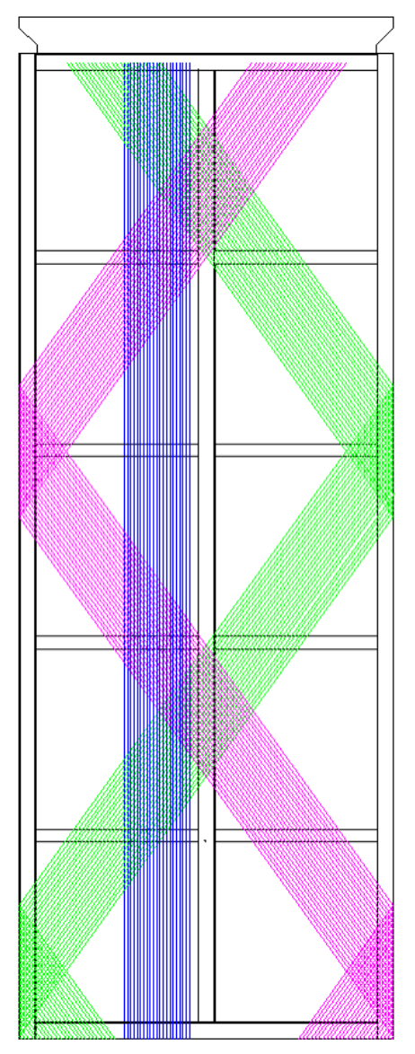
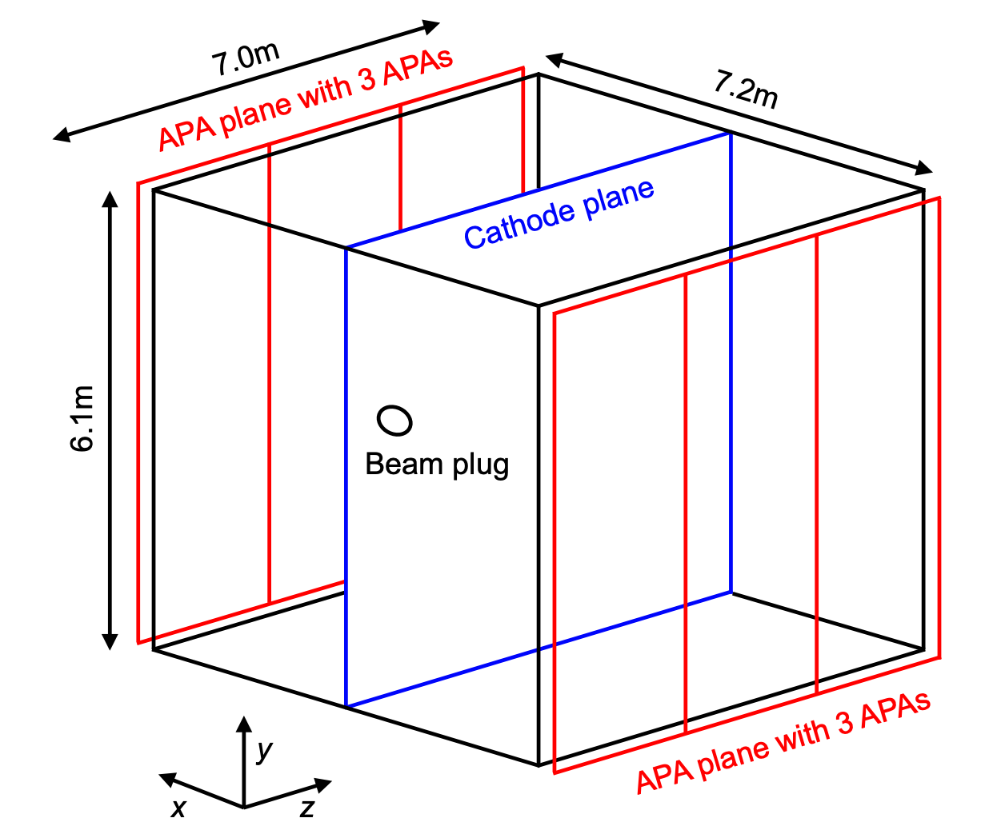
ProtoDUNE Single Phase
The ProtoDUNE single-phase apparatus is a large-scale prototype of the far detector module of DUNE,
@ CERN Neutrino Platform.
Several goals:
  Cryostat design validation (electronics, high voltage, LAr purity)
  Data acquisition and storage
  Detector performance characterisation
  Event reconstruction and analysis
Anode Plane Assembly
U
X
0.76 kt LAr
On surface
6.1 m
V
7.0 m
7.2 m
Notes:
The ProtoDUNE-SP detector is one of the two large liquid argon time projection chamber (LArTPC) that serves as a prototype for the DUNE far detector, located at CERN on surface. The active volume is 6 m (height) × 7 m (length)× 7.2 m (width) and contains 0.76 kt of liquid argon. The TPC is divided into half by the Cathode Plane Assembly (CPAs) at x = 0 in the y-z plane and comprises two drift volumes. There are six Anode Plane Assembly (APAs) in total and three on each side, with 3.6 m away from the cathode. Here is an example of one APA module, three wire planes have different orientations as shown in colours. The APA used in ProtoDUNE-SP will be the same to the one used in DUNE far detector and it requires 150 of them per module. A homogeneous electric field is created within the TPC. The ProtoDUNE-SP uses a right-handed Cartesian coordinate system, with the origin situated at the front face of the detector at the bottom of the cathode plane. The test hadron beam enters the TPC through the beam plug, a cylindrical structure filled with low-density nitrogen gases. This setup is designed to reduce the energy loss of the test beam, as interactions with the detector material may occur before entering the TPC.
One of the main goals of ProtoDUNE is to validate the cryostat design and test the data acquisition and detector performance. The high-level physics analysis is kind of a bonus. As you will see later, the data collected was not sufficient for a precise measurement.

Slide 12
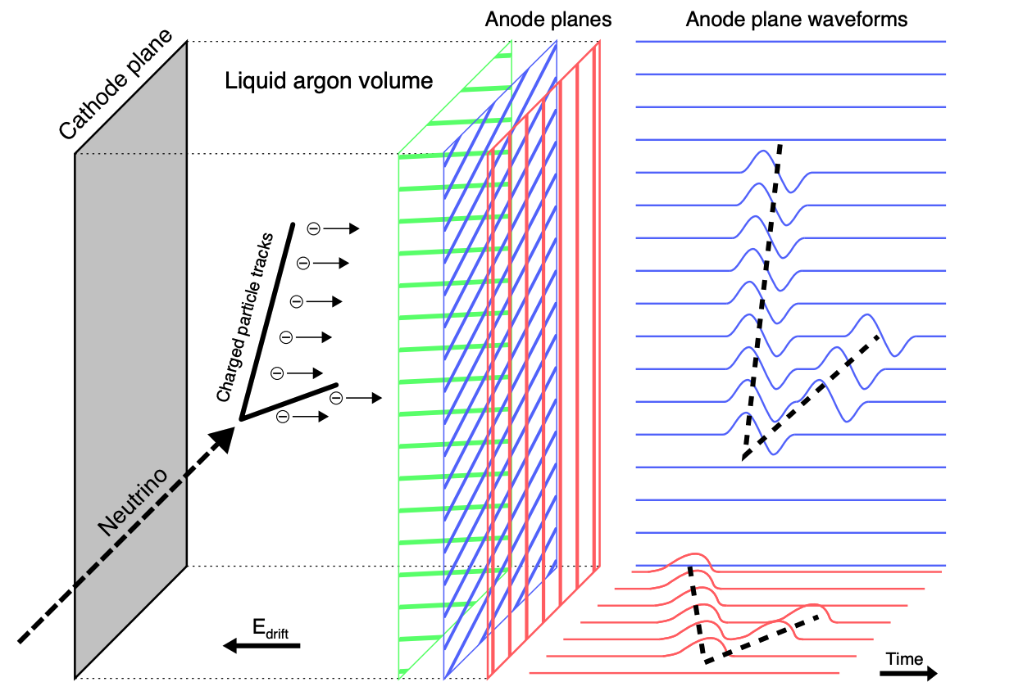
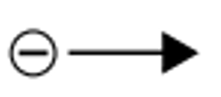

LArTPC Working Principle
M. A. Vermeulen, PhD thesis, Nikhef, Amsterdam (2021)
Free ionised electrons drift towards the anode planes against E field.
  y-z position can be identified.
Scintillation light from the de-excitation of the Argon excimers.
  x position can be determined.
Maximum drift time is 2.25 millisecond with a transverse diffusion of 2 mm perpendicular to their travel direction.
Notes:
A typical LArTPC is shown here with its operating principle. The test beam simulates the charged particles resulting from neutrino interactions at DUNE FD in the closest way possible, with a momentum range from 0.3 to 7 GeV/c. The test beam consists of protons, pions, muons, kaons and positrons.
As charge particles traverse through the LArTPC, electrons will be ionised along their trajectories, and the prompt scintillation photons will be produced as well, which is not shown here. The constant electric field will drift these electrons towards the anode plane. These signals will be collected by three wire planes on the anode. As electrons pass through the first two induction planes, a bipolar waveform will be produced since electrons will alter the measured electric field. The collection plane will finally collect these electrons and produce a unipolar waveform. From the coincidence of signals collected by these three wire planes, the y-z position of the charged particle can be identified. Whereas the photons are collected by the photo-multiplier tubes (PMTs) embedded in the detector’s APAs, providing the time of when the interaction happened. Then, the x position can be determined from the drift electron’s arrival time if the electron drift speed is known.
The photons will be collected on a nanosecond scale, while the drift electron times are on a millisecond scale. The maximum drift time is 2.25 milliseconds for a full 3.6 meters drift volume, and the transverse diffusion of the electron cloud is about 2 mm.

Slide 13
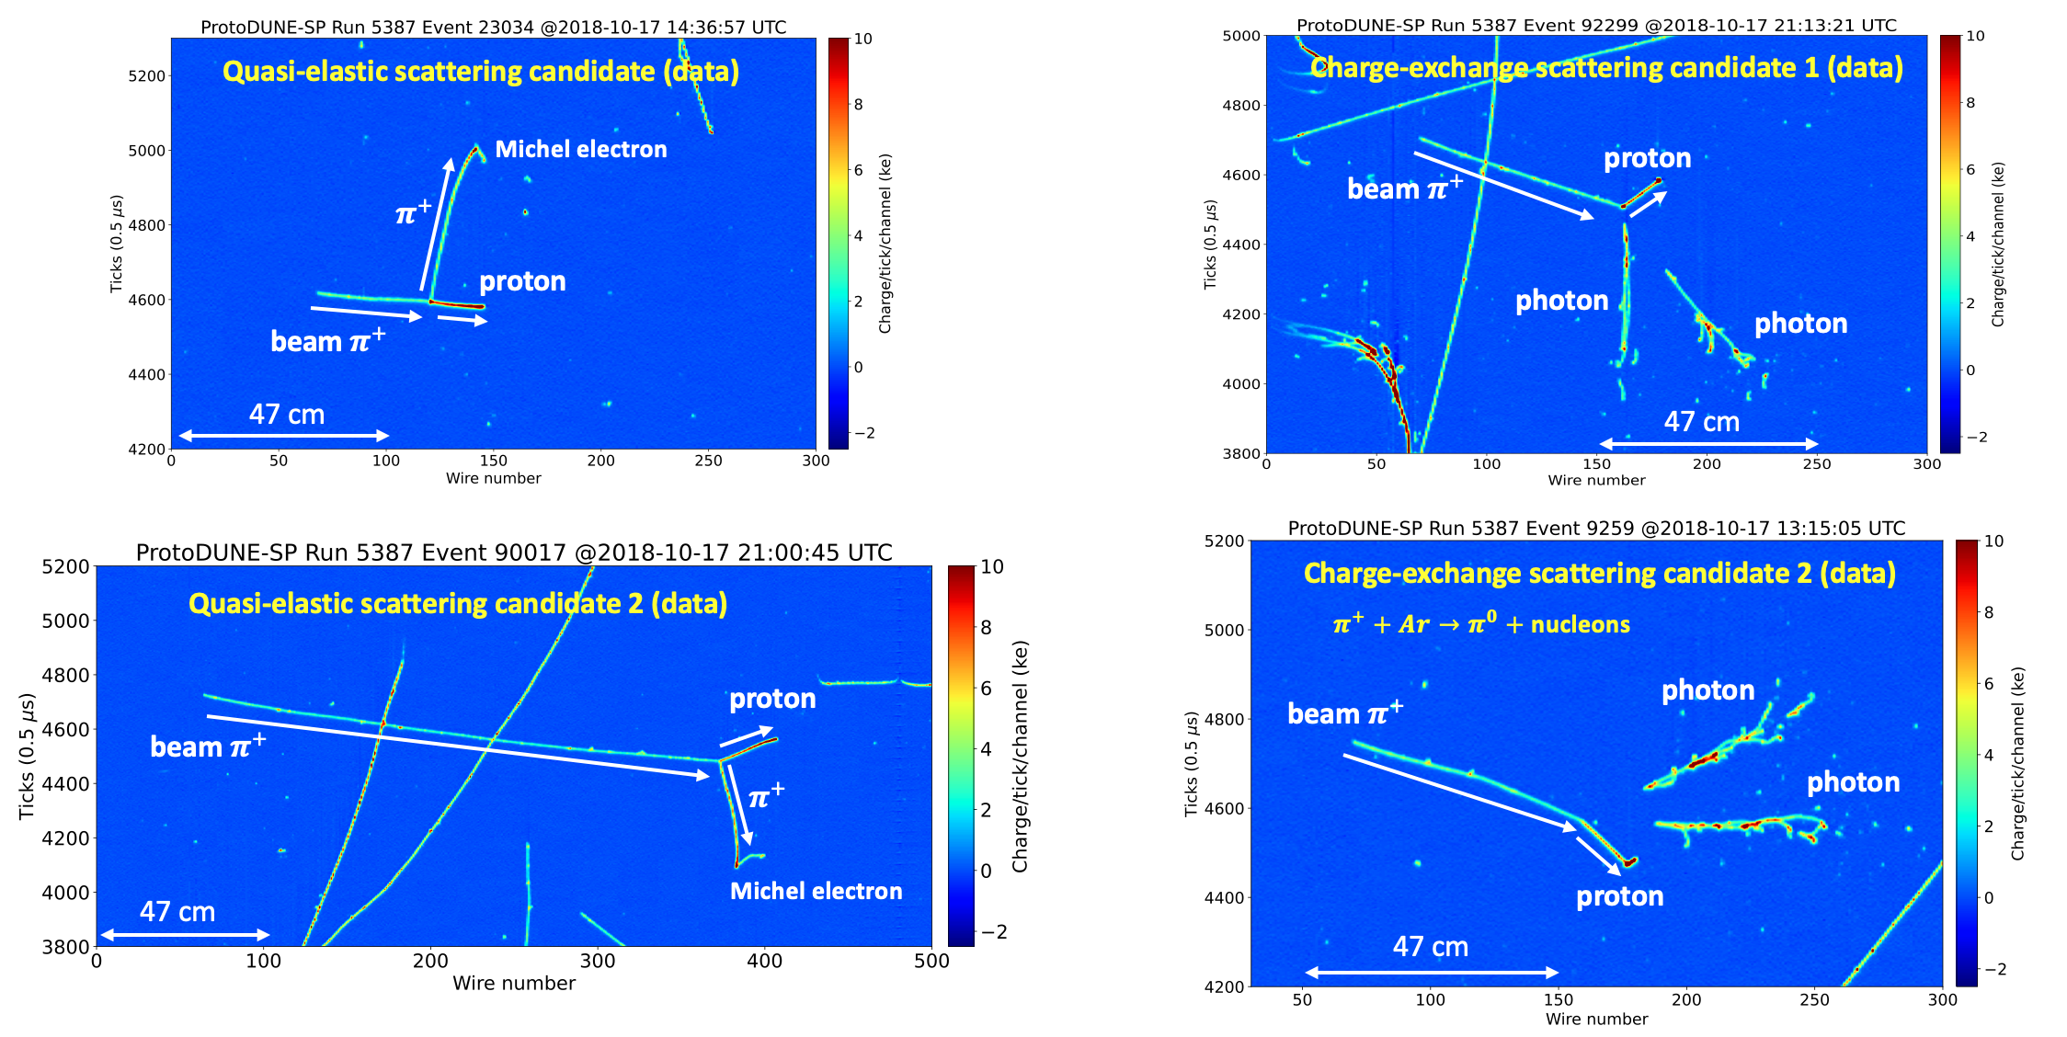
ProtoDUNE Data Event Display (1GeV/c)
Reconstruction by Pandora Software Development Kit arXiv:2206.14521
Notes:
Here are several collection plane event displays using the real 1GeV/c pion data collected in Oct. 2018. The x-axis is the wire number with a wire pitch of 4.7mm and the y-axis is the electron drift time tick.
The beam pion enters the TPC from the left. The vertical tracks are comic muons as the detector is on the surface. The colors in these plots indicate the amount of charges they deposited along their travel.
The left two plots are the pion quasi-elastic scattering candidates, where the pion scatter off from a proton. A Michel electron can be identified from pion decays to muons then decays to electron, the intermediate muon is almost produced at rest and is unable to be observed in the detector. On the right-hand side, the plots show the pion charge exchange events, which is the process we want to measure. The final state neutral pion promptly decays into two photons, forming two showers in the detector.

Slide 14
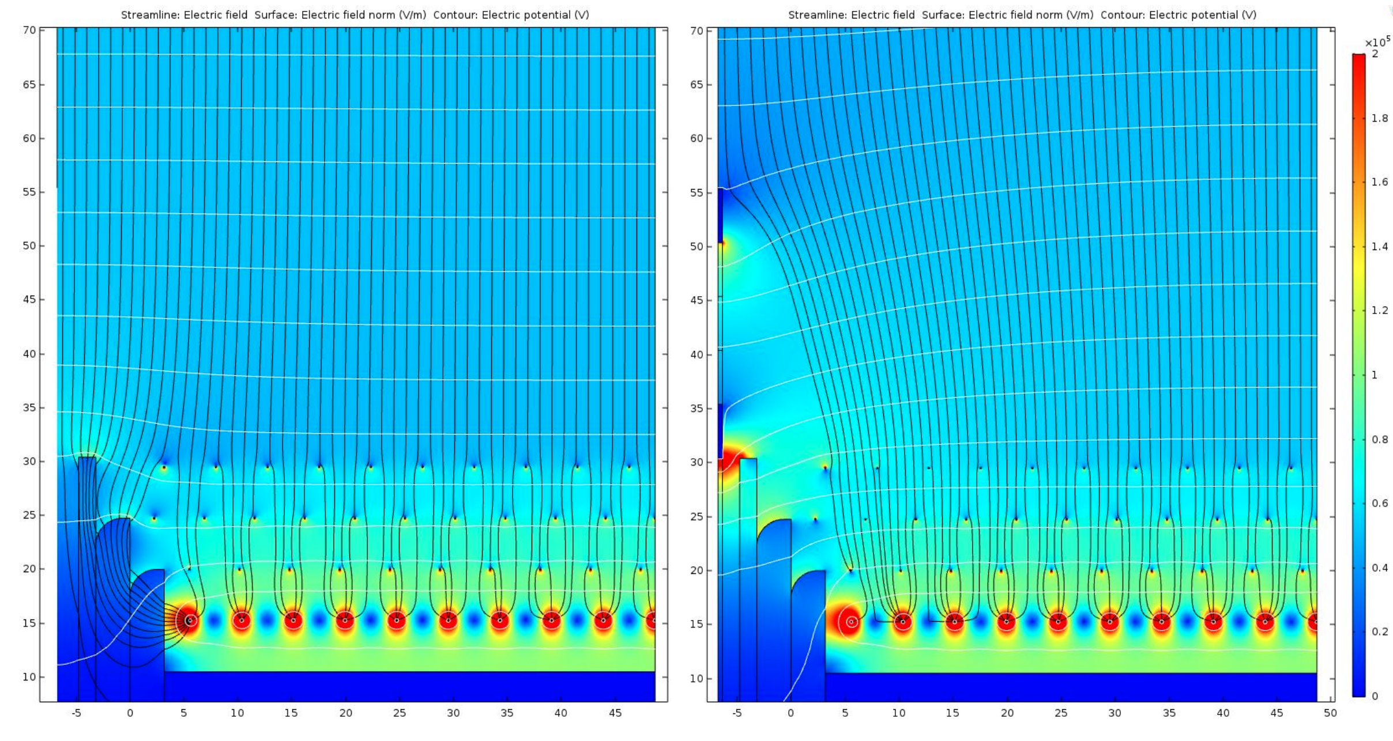
Electron Divertor
[mm]
No Diverters
Active Diverters
~ 20 mm Gap
  Diverters’ power supplies turned off during beam run.
  Later discovered that this meant grounding them (!)
[mm]
APA Boundary
APA Boundary
Notes:
The previous event display are the very optimised cases, most of the time things are much complex. One thing I want to mention before moving on is the electron diverter. Since on each side of the detector, we have three APAs, there is actually a 20 mm gap between adjacent APA, so there are no wires to collect electrons in these region. Therefore we use the electron divertor to nudge the incoming electrons away from the gap, towards an active collection wire. Basically, the divertor is a set of electrode to create a large negative bias. Here are two plots show the eclectic filed line with and without the diverter, you can see the changes in the field line.
It is planned to install electron diverters between some of the ProtoDUNE-SP APAs to determine whether they should be included in the DUNE-SP detector design. However, during the beam run, the power supplier of the divertor was turned off by accident, and it was later discovered all these divertors are grounded.

Slide 15
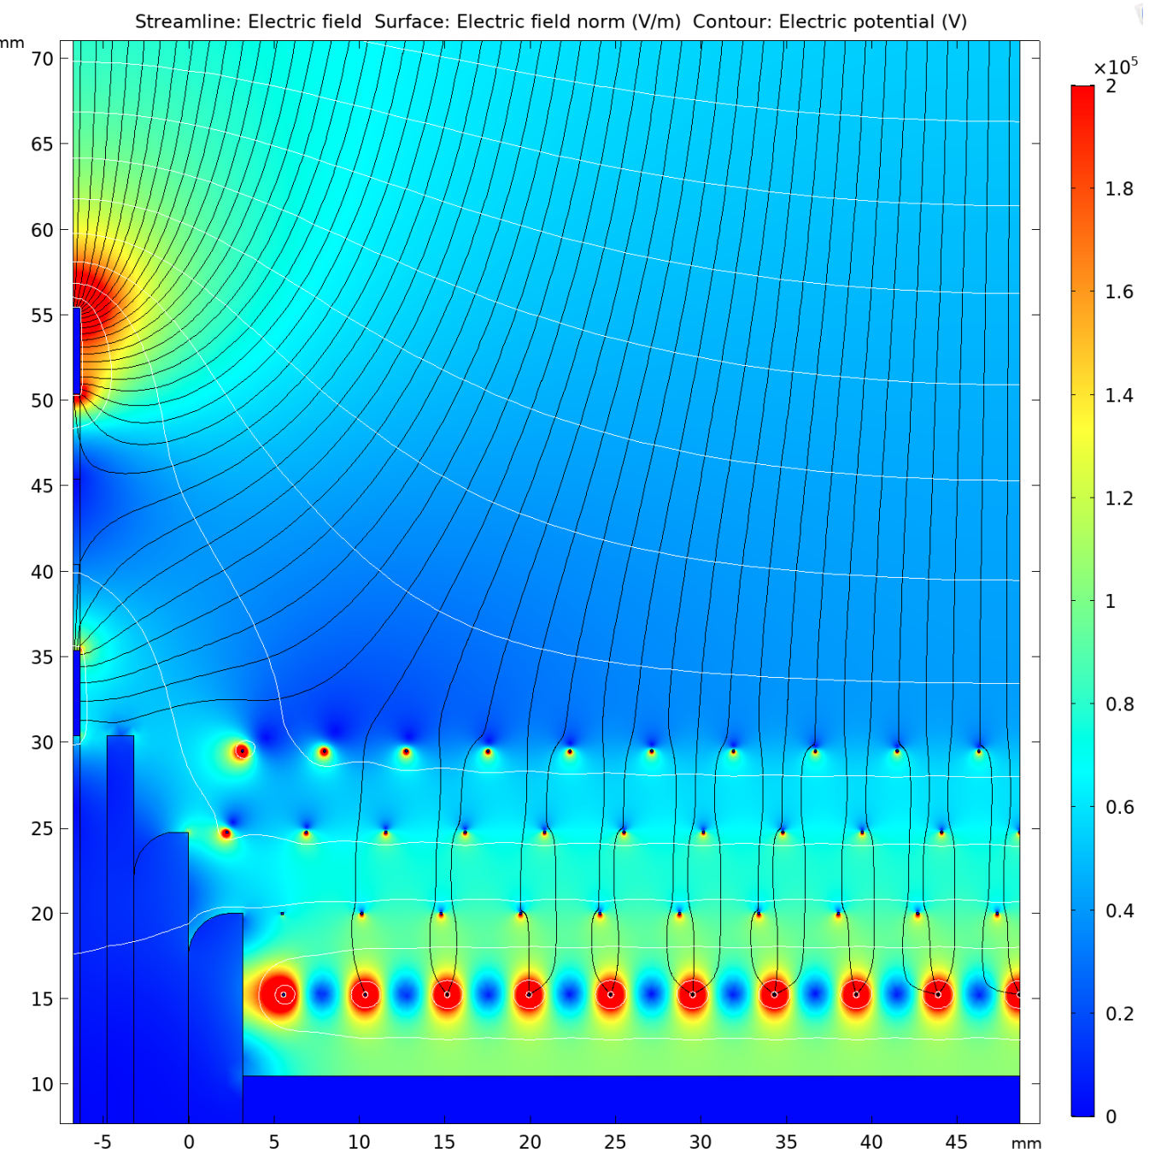
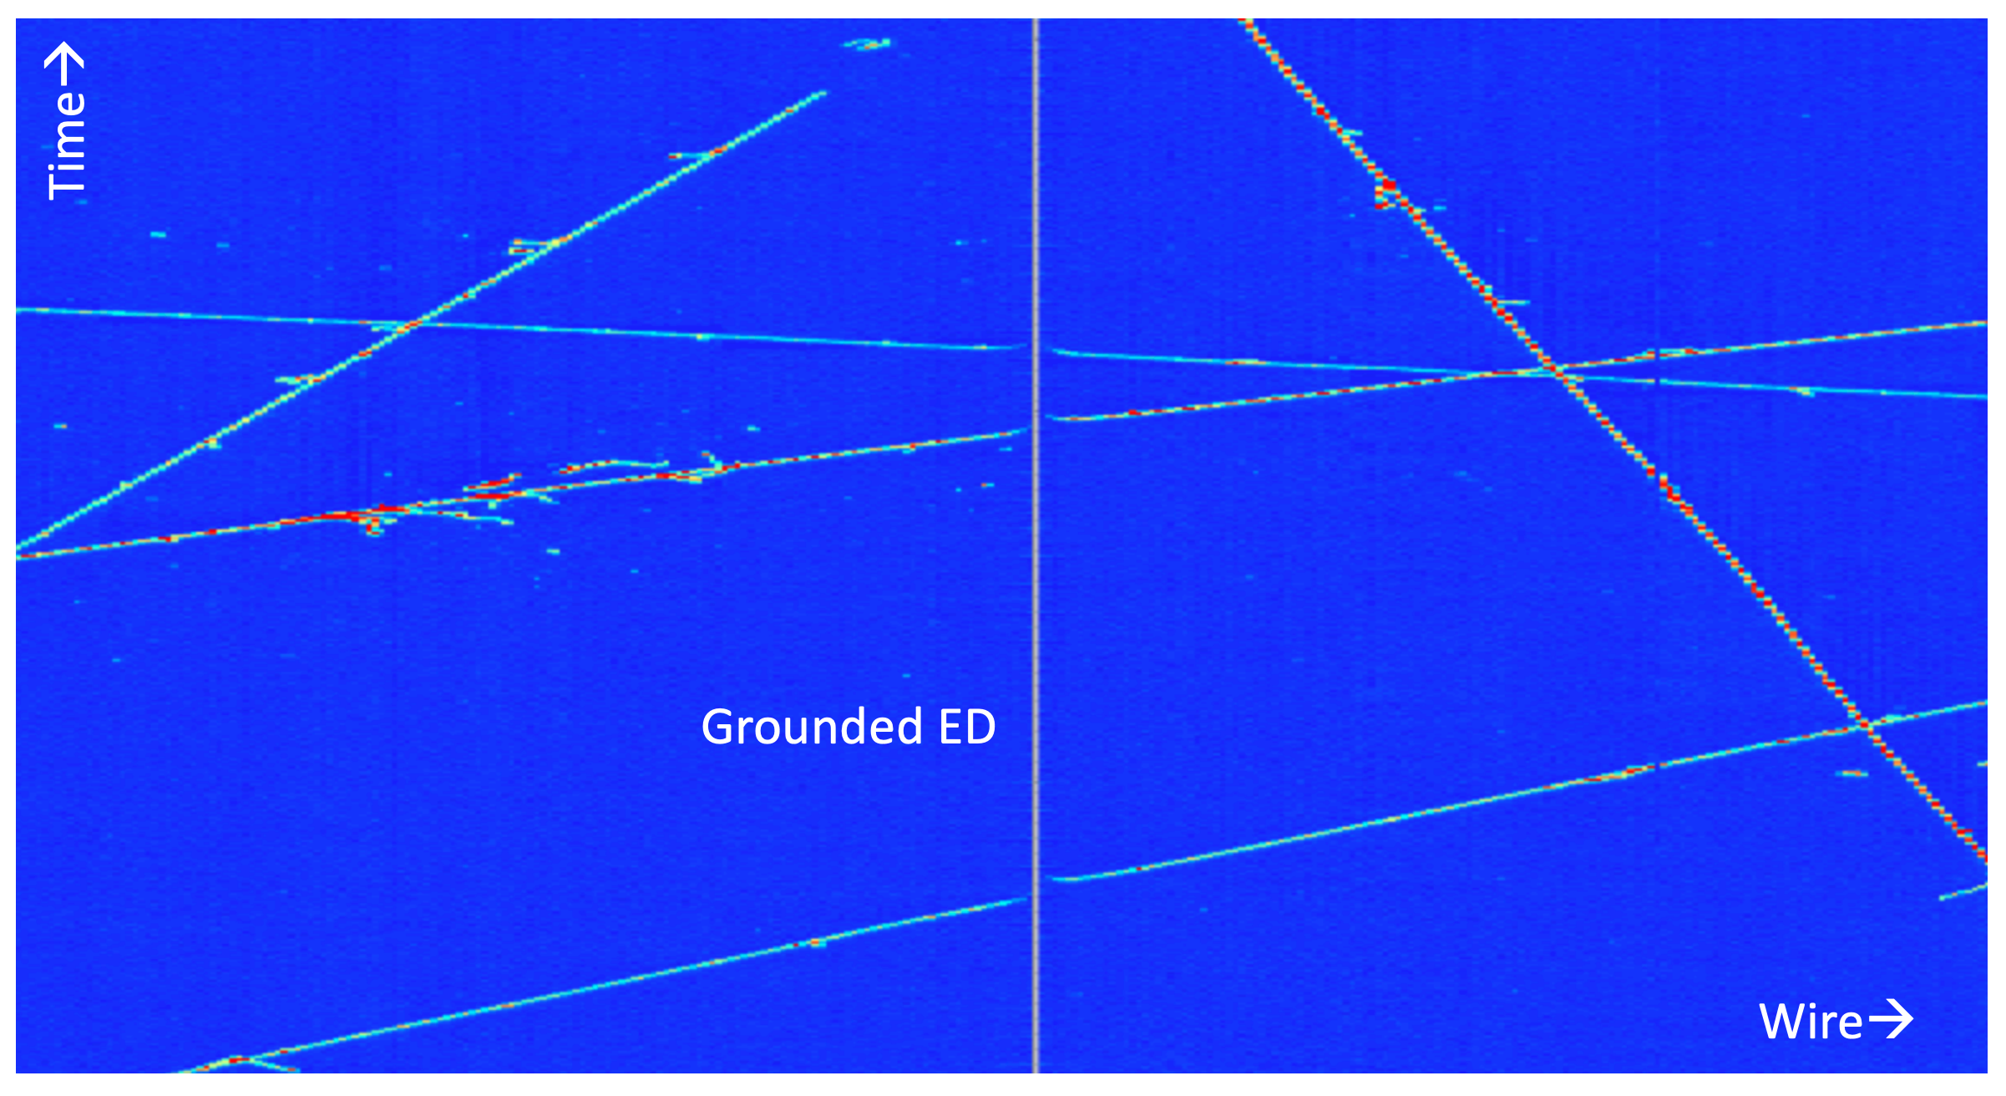
Electron Divertor
[mm]
APA3
APA2
Grounded Diverters
  Instead of pushing charge away from the gap, grounded diverter draws drifting charge towards it.
  Charge loss and spatial distortions present
  Broken tracks (!)
[mm]
Notes:
Now, the field lines look like this. Instead of pushing the electrons away from the gap, the grounded diverter is now drawing the charges towards it. If we look at the event display, you can see some spatial distortion, and the track across two APAs is broken into two pieces. These effects impact our measurement of the low energy pions cross-section, as discussed later. Okay, I think that’s all I want to say about the detector. Now we can move on to the cross-section measurement.

Slide 16
Pion Charge Exchange Cross-section

Slide 17


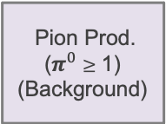
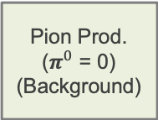
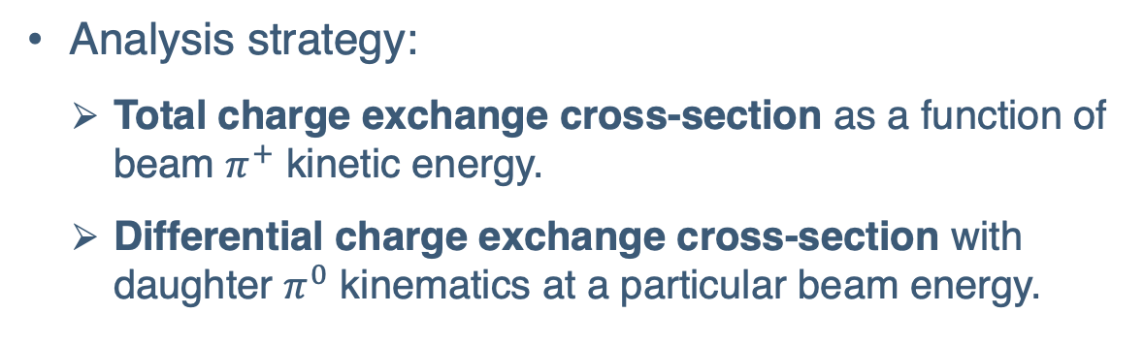
Signal & Background Definition
Pion Prod. ($π^{0}$ = 0) (Background)
Pion Prod.
($π^{0}$ $≥$ 1)
(Background)
Analysis strategy:
  Total charge exchange cross-section as a function of beam $π^{+}$ kinetic energy.
  Differential charge exchange cross-section with daughter $π^{0}$ kinematics at a particular beam energy.
1 +
Number of $π^{±}$ candidate
Absorption (Background)
Charge Exc. (Signal)
0
0
1 +
Number of $π^{0}$ candidate
Notes:
First, let’s define our signal. I’m using the 1 GeV pion beam events. If you look at the bottom-left figure, the horizontal axis represents the number of pi0, and the vertical axis represents the number of charged pions. Depending on the number of daughter pions, I categorize beam events into charge exchange, absorption, and pion production. The pion charge exchange signal is defined as having only one pi0 in the final state and no charged pions. We don’t care about the number of nucleons, as this is an inclusive measurement. The main background comes from the pion productions with 0 pi0 or multiple pi0. There will be two cross-section measurements in this talk: one is the integrated charge exchange XS as a function of the pion beam energy. The other is the differential XS as a function of the daughter pi0 kinematics at a particular beam interacting energy.

Slide 18
Event Selection
Event Selection
Notes:
Here is a diagram summarizing the event selection for the pion charge exchange events. First, there are some dedicated beam cuts to select the pion beam events. After the beam selections, 60,000 pion beam events are selected in MC and about 35,000 in data. Then, we separate the final state particles into two categories: track candidates and shower candidates. For tracks, depending on their energy loss in the detector, we can separate charged pions and protons. Regarding showers, I’ll discuss this later. There will be an MC-driven shower energy correction to correct the energy bias found in showers. After some selections, we have the pi0 shower candidates. Then, two of the leading showers will be combined, and a kinematic fitting will be applied to form the pi0 candidates. In the end, we require one pi0 and no charged pions. We also check for Michel electrons and discard any events containing a Michel, which originates from a charged pion decay. In total, we have about 1,100 CEX events in MC and 700 in data.

Slide 19
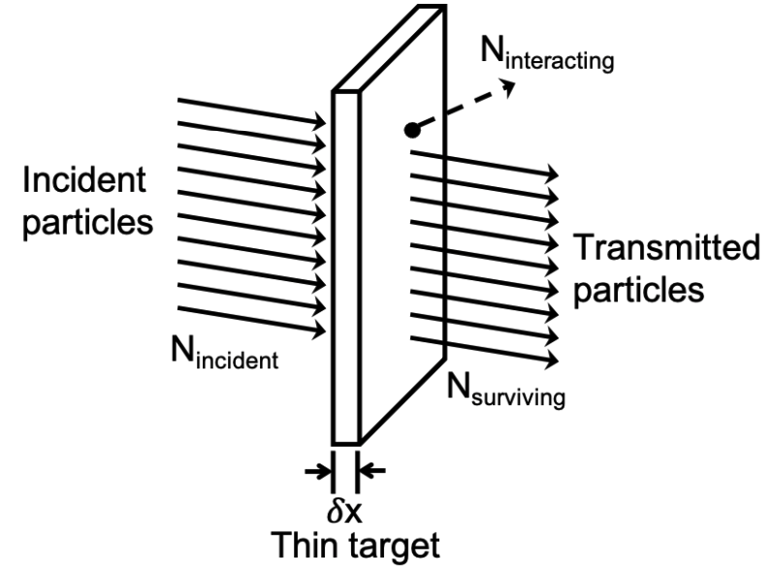
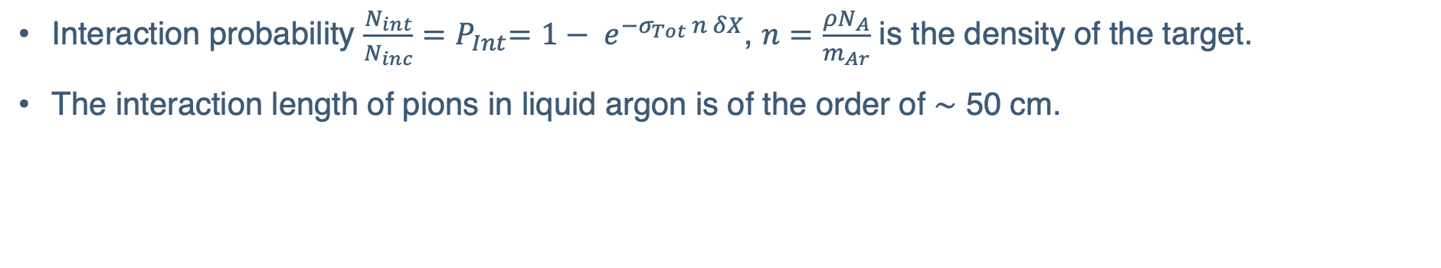
Thin-Slice Method
Thin target experiment
Interaction probability $\frac{N_{int}}{N_{inc}}{=P}_{Int}=1− e^{−σ_{Tot} n δX}$, $n=\frac{ρN_{A}}{m_{Ar}}$ is the density of the target.
The interaction length of pions in liquid argon is of the order of ∼ 50 cm.
Treat the argon volume as a sequence of many adjacent thin targets.
Notes:
Now I want to introduce the method we are using to measure the cross section. The previous pion-nucleus cross section measurement was performed via the thin target experiment, where you have a thin nuclear target and the thickness is much less than the pion interaction length. If you know the number of incident pions and count the number of interacted pions, then you could calculate the interaction probability using the Poisson probability distribution as shown here. However, in the case of ProtoDUNE-SP, the liquid argon TPC is about 7 meters long, and the pion-argon interaction length is of the order of 50 centimeters. So, we can't treat it as a thin target, but we can treat the argon volume as a sequence of many adjacent thin targets and perform several independent thin target experiments. This method was first developed in the LArIAT experiment, and we kind of modified it a little bit for the case of ProtoDUNE. Instead of slicing in space, we make our slices directly on the pion beam energy, but the idea is the same.

Slide 20




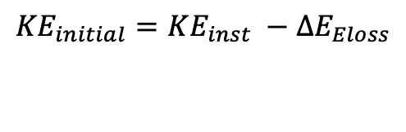
Measure the Initial Energy
Spectrometer
Cryostat
TPC
$${∆E}_{Eloss}$$
${∆E}_{Eloss}$ - Upstream Energy Loss
$π^{+}$Beam
$${KE}_{inst}$$
$${KE}_{initial}$$
(with energy resolution ~ 50MeV)
Interaction point
  Beam entering the TPC via the beam plug
  To minimize the upstream energy loss of beam particles before they enter the TPC
$${KE}_{initial}=KE_{inst} −{∆E}_{Eloss}$$
Estimate from simulations
Notes:
So, it’s really important to understand how we measure the beam energy. The momentum of each pion beam is measured at the beamline using a spectrometer before it entering the TPC. This energy is measured with a resolution about 50 MeV. Then the beam enter the TPC through the beam plus to minimize the upstream energy loss. So we want to know the initial beam energy at the front face of the TPC. We estimate the upstream energy loss from simulations, usually it’s a few MeV, then we can subtract it from the energy measured by the spectrometer to get the initial beam energy.

Slide 21
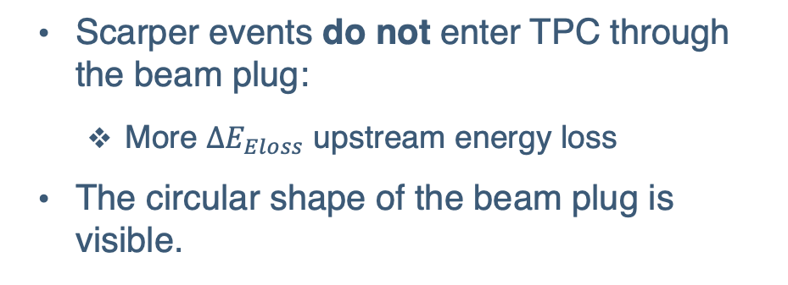
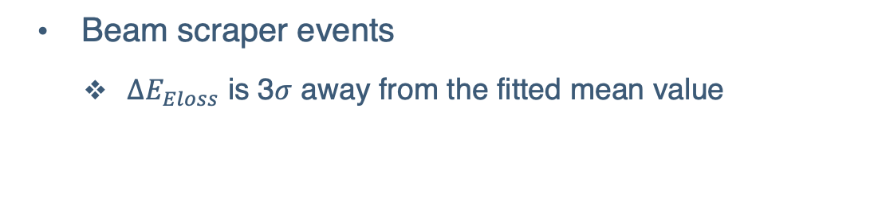
Beam Scraper
Green Points
Red Points
  Scarper events do not enter TPC through the beam plug:
    More ${∆E}_{Eloss}$ upstream energy loss
  The circular shape of the beam plug is visible.
  Beam scraper events
    ${∆E}_{Eloss}$ is 3$σ$ away from the fitted mean value
Notes:
However, when we calculated the upstream energy loss from the MC, we found that there are some events with a significant energy loss, far away from the mean value. Here is an example for beams with energy between 700 to 800 MeV. So the fitted mean upstream energy loss is about 1 MeV, but there are beams with more than 100 MeV energy loss. We define the events where the energy loss is 3 sigma away from the mean as the scraper events. If we plot the position of these events, the red dots represent the scraper events. You can see the circular shape of the beam plug, and the scraper events do not enter the TPC through the beam plug, so they tend to lose more energy. The dashed blue circle is used to remove those scraper events to improve the initial energy measurement.

Slide 22


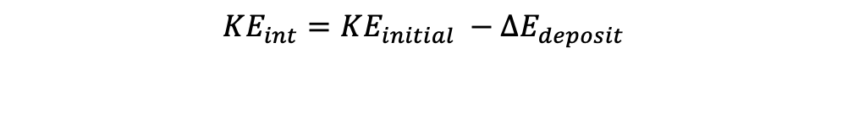
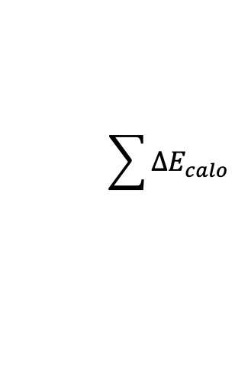
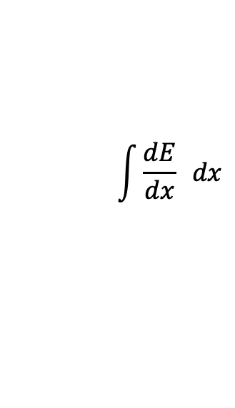
Measure the Interacting Energy
Spectrometer
Cryostat
TPC
$${∆E}_{deposit}$$
$π^{+}$Beam
${∆E}_{deposit}$ - Energy Deposit in TPC
$${KE}_{initial}$$
$${KE}_{int}$$
(with energy resolution ~ 1MeV)
Interaction point
$$\int{{\frac{dE}{dx}}_{ } dx}$$
  Get energy at interaction point from:
    Initial energy
    Energy deposit in the detector
1.
Range based
$${KE}_{int}=KE_{initial} −{∆E}_{deposit}$$
2.
$$\sum{∆E_{calo}}$$
Calorimetry Based
Notes:
Now, we want to determine the beam energy at the interaction point. As the charged particle traverses through the detector, it ionizes electrons and loses energy. We collect these ionized charges and get the energy deposit of the particle. The energy resolution is about 1 MeV. If we then subtract that from the initial energy, we can get the energy at the interaction point. There are two ways to calculate the energy deposit inside the detector. One way is to use the measured particle’s track length, and if we know the energy loss per unit distance of this particle, then we get the energy from the range. Another way is to use the collected charges; in this case, you need to establish the relation between the collected charge and the energy deposit. The energy needed to ionize one electron in Argon is 23.6 eV, and then you multiply the number of electrons you collected to get the energy deposit. Of course, there will be some attenuation correction, as some of the electrons can recombine or get lost and diffused during the drifting.

Slide 23
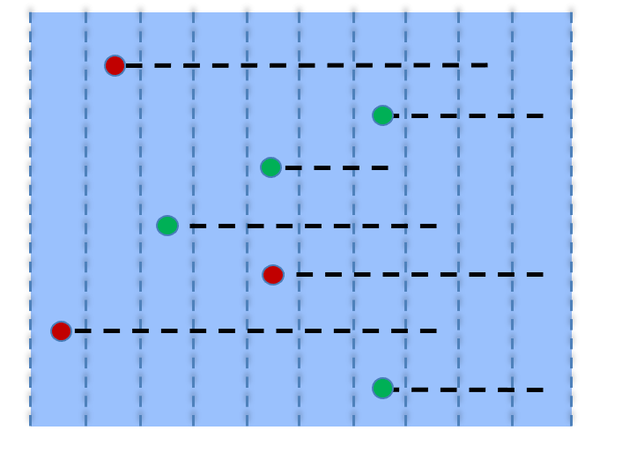









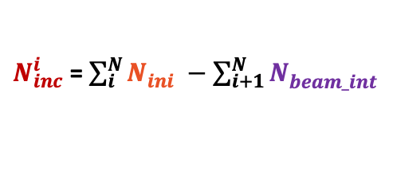
How to Compute Incident & Interacting Flux
1 GeV Beam $π^{+}$
LArTPC
1 GeV Beam $π^{+}$
LArTPC
Initial Energy
Beam Interacting Energy
Interacting Energy
(Signal Charge Exchange)
4 CEX signal events
$$δE$$
$$δE$$
$$N_{int}$$
Initial
histogram
$$N_{ini}$$
Interacting
histogram
E
E
$$∝ σ(E_{i})$$
$$N_{inc}$$
$N_{inc}^{i}$ = $\sum_{i}^{N}{N_{ini}^{ }} −\sum_{i+1}^{N}{N_{beam_int}^{ }}$
$$N_{beam_int}$$
Beam Int
histogram
Incident
histogram
E
E
Notes:
Now, let’s use an example to demonstrate how we compute the incident and interacting flux. Imagine we have 7 pion beams, and they enter the TPC with slightly different energies. Keep in mind that this is in the energy space. We can calculate the initial and interaction energy for each beam particle and fill in two histograms. The initial energy is shown in orange, and the interacting energy is in purple. Now, if 4 of the pion beams interact via the pion charge exchange process, then we record the interaction energy into another histogram, as shown in green. This is our interacting flux for the pion charge exchange signal events. To calculate the cross-section, we are still missing the incident flux, but from the initial histogram and the beam-interacting histogram on the left, we can actually compute the incident histogram by this formula. That is, if you know the start and end energy of the beam and with a predefined slice width, then you can know how many slices it has gone through without an interaction. The incident histogram is shown in red, or you can double-check by counting the number of beams in each slice. Now, if you divide the green and red histograms, the ratio is proportional to the cross-section.

Slide 24
Electron Diverter (Grounded)
Beam end Z position of all beam events
Grounded electron diverter:
  Single track reconstructed as two
  Not well simulated
Tracks to prematurely "break" when they cross one APA boundary
Limits the lowest beam energy range in the following cross-section measurement.
Boundary of APA3 ~ 2.3 m
Notes:
This plot shows the beam end Z position of all selected beams. The first thing that catches your eye is the peak around 220 cm. Remember the grounded electron diverter at the boundary of the APA I described earlier. This position is actually the boundary of the APA. Many tracks are prematurely broken when they cross the two APAs. We tried to simulate this effect in MC, but as you can see, it is not well-simulated; the data and MC are not in good agreement. There are more broken tracks in MC than in the data. So, we have a cut to only select pion beams that interact in the first APA. This problem really limits the lowest pion interacting energy we can access.

Slide 25

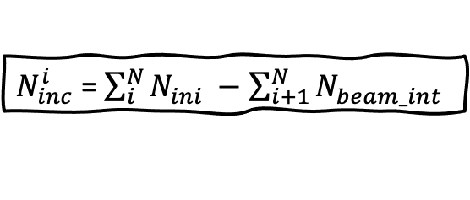
Initial & Beam Interacting Energy
Initial E
Beam Interacting E
The leading background is the beam muon (4.9%) followed by the misidentified secondary pions (4.1%).
The beam pion sample purity after all cuts is 89.1%.
$N_{inc}^{i}$ = $\sum_{i}^{N}{N_{ini}^{ }} −\sum_{i+1}^{N}{N_{beam_int}^{ }}$
Notes:
Here are the measured initial and beam interacting histogram using all 1GeV/c pion data after the full beam selection. The MC is decomposed into different categories using the truth-matched information.
The leading background is the beam muon, which comes from the upstream decay of a beam pion. Then the second largest background is the mis-identification of the daughter pion as a beam pion if the daughter pion is produced relatively aligned with the beam. The purity of the selected sample is around 90% and shows a good agreement between data and MC after some reweighting scheme.
Then, from these two histograms, we can calculate the incident flux using this formula just like the example I showed before.

Slide 26
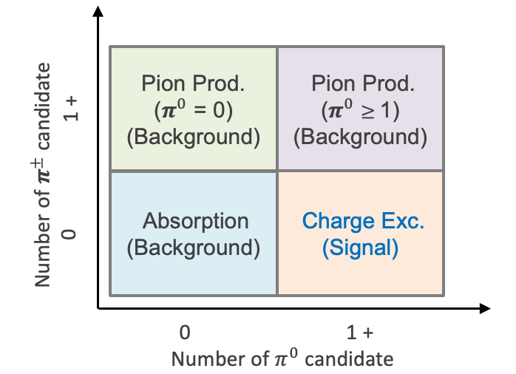

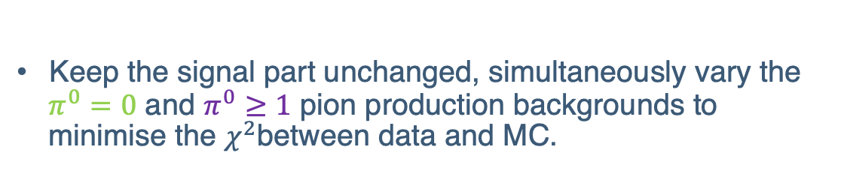

Sideband Bck. Tuning
Fit Background scaling factors
Pion Prod. ($π^{0}$ = 0) (Background)
Charge Exc. (Signal)
Keep the signal part unchanged, simultaneously vary the $π^{0}=0$ and $π^{0}≥1$ pion production backgrounds to minimise the $χ^{2}$between data and MC.
Pion Prod.
($π^{0}$ $≥$ 1)
(Background)
Notes:
Here is the measured interacting energy for the charge exchange signal. The MC now decomposed by different event topology. Here is a reminder about how we defined each channel. There are some discrepancies between data and MC. We can switch the cuts on final state particles to select background rich sidebands. Then we could use sidebands to extract a background scaling factors as a function of the pion energy to scale the background MC in the signal. The scaling factors are obained by keeping the signal part unchanged in these two sidebands, and simultaneously vary the pion production to minimize the chi2 between data and MC.

Slide 27
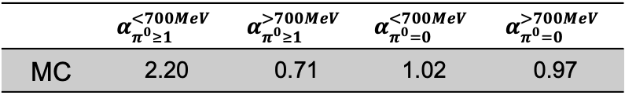
CEX Interacting Energy
CEX Interacting E
Fitted Parameters :
 | $$α_{π^{0}≥1}^{<700MeV}$$ | $$α_{π^{0}≥1}^{>700MeV}$$ | $$α_{π^{0}=0}^{<700MeV}$$ | $$α_{π^{0}=0}^{>700MeV}$$
MC | 2.20 | 0.71 | 1.02 | 0.97
We can now subtract the estimated background from the MC and do the unfolding.
Notes:
I’m using four parameters to control the background tuning. The left-hand side plot shows the default MC in dashed green and the fitted histogram in red. Black dots are the data points. You can see that the agreement between data and MC improved after scaling. This is our interacting flux; we can now subtract the background according to MC. Combined with the incident flux, we are ready to compute the cross-section. However, all of these distributions are affected by distortion and smearing due to detector effects and reconstruction methods. A Bayesian unfolding procedure is used to obtain the true distribution from the observed one. I won't talk about the unfolding in detail, and I will just show you the cross-section results.

Slide 28
Total Charge Exchange Cross Section
Simulation refers as the reconstructed Monte-Carlo events.
The four major sources of the systematic uncertainties are shown.
Notes:
This is the measured integrated pion CEX cross-section as a function of pion beam energy. In ProtoDUNE, we are able to provide the pion data with interacting energy between 450-950 MeV. The lower bound is limited by the grounded electron diverter issue. In this region, the cross-section is rather flat and the measured data shows a good agreement with the input mpdel. The simulations are shown in gray histogram with only statistical uncertainty only. The right-hand side plot shows the fractional uncertainties at each bin, where the statistical uncertainty is shown as the dashed line. We changed the input pion CEX cross-section by 15% to evaluate the uncertainties and the other major sources are beam momentum, upstream energy loss and the reconstructed track length. They are all evaluated by comparing the measured value to the truth value and varied by one sigma of the fitted function.

Slide 29
Pion CEX Differential Cross-section
Notes:
Okay, let’s move on to the differential cross-section measurement as a function of pi0 kinematics. In order to do that, we need to reconstruct the pi0 from two photon showers.

Slide 30
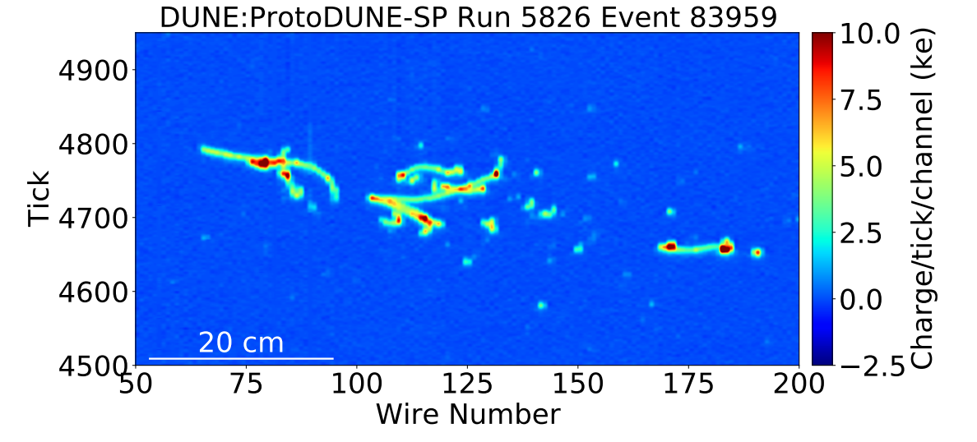
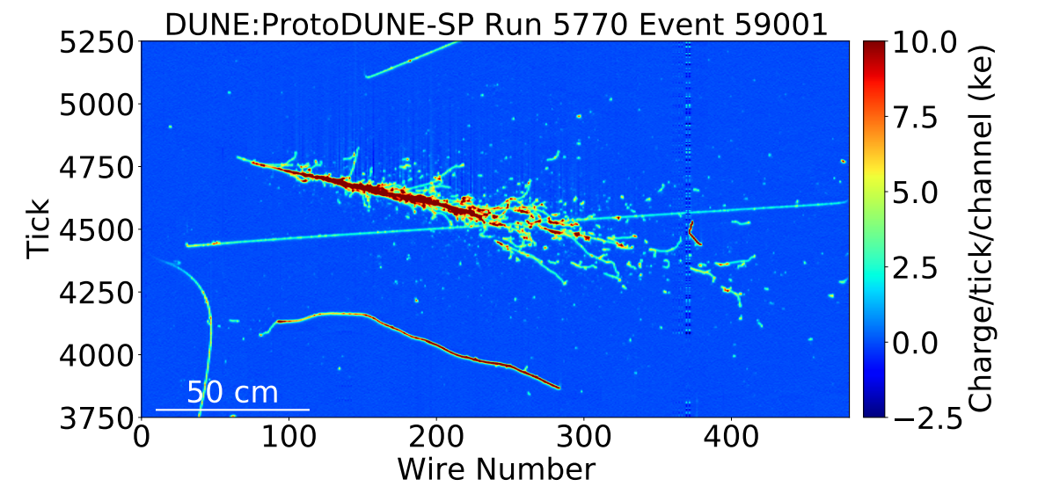
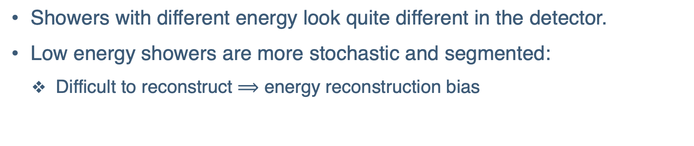
Showers in TPC
0.5 GeV Shower
6 GeV Shower
Showers with different energy look quite different in the detector.
Low energy showers are more stochastic and segmented:
  Difficult to reconstruct $⟹$ energy reconstruction bias
Notes:
Here are two event display to show how different energy showers look like in ProtoDUNE detector. The left had side one is a 0.5 GeV shower and the right one is the 6 GeV shower. You can see that theylook quite differently, and the low energy shower is more stochastic and segmented, which means they are not easy to reconstruct, especially in their energy reconstruction.

Slide 31
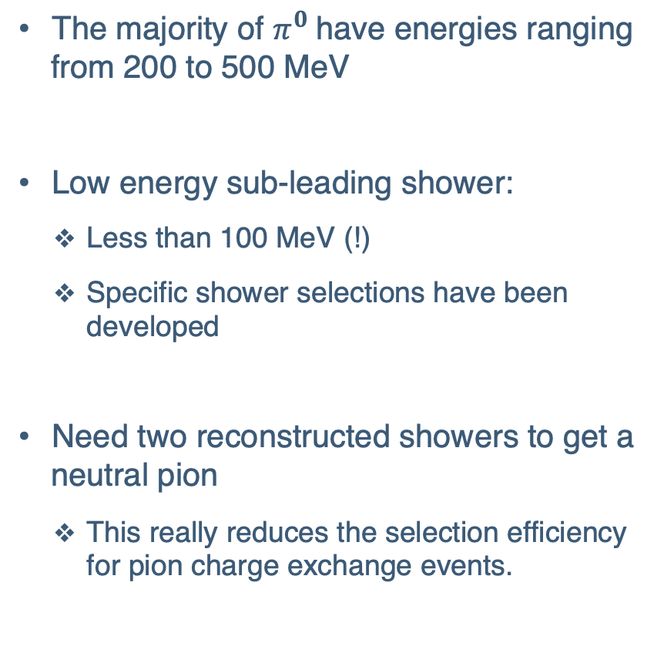
Neutral Pion Energy
The majority of $π^{0}$have energies ranging from 200 to 500 MeV
Low energy sub-leading shower:
  Less than 100 MeV (!)
  Specific shower selections have been developed
Need two reconstructed showers to get a neutral pion
  This really reduces the selection efficiency for pion charge exchange events.
Notes:
This is the energy spectrum for the pi0 and its decay daughters at the truth level. The majority of our pi0s have energies between 200 to 500 MeV. The subleading photon energy is quite low; many of them have energy less than 100 MeV. It's not very possible to reconstruct those showers, and we have to remove those events. This really reduces our pion CEX event selection efficiency by a lot.

Slide 32
Energy Correction
Each date point is the mean fractional bias in that rec. energy bin
  Input: raw shower energy
  Output: correction factor (event by event)
Shower Energy Rec./Truth – 1
A large shower energy bias is found in the whole energy range.
Need MC-driven energy correction to improve the shower energy.
Notes:
This is a 2D plot of the true shower energy versus the reconstructed shower energy. The red points are the mean value of each column. You can see a large bias, about -10%, is found in the shower energy. We used an MC-driven correction function to correct this bias. The correction function depends on the shower energy, as shown here. Each data point represents the mean fractional bias in that energy bin. It takes an input raw shower energy and outputs a correction factor for that shower. So, the shower energy correction is done event by event through this process.

Slide 33


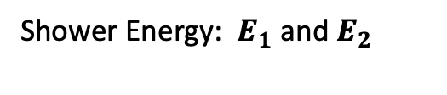






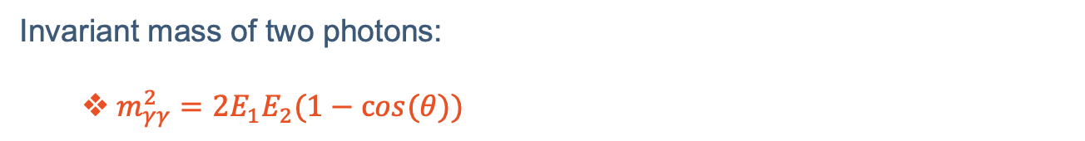


Kinematic Fitting
$$γ_{1}$$
Charge-exchange scattering candidate (data)
$$π^{0}$$
$θ$
$$π^{+}n \left({}_{}^{40}{Ar}\right)→π^{0}p$$
$$E_{1}$$
Opening Angle: $θ$
$$γ$$
Shower Energy: $E_{1}$and $E_{2}$
$$γ_{2}$$
beam $π^{+}$
$$θ$$
$$E_{2}$$
p
$$γ$$
47 cm
Use the invariant mass of two photons as a constraint.
Vary both reconstructed shower energy and the opening angle, subjected to the measurement uncertainty.
Reconstruction by Pandora Software Development Kit arXiv:2206.14521
Invariant mass of two photons:
  $m_{γγ}^{2}=2E_{1}E_{2}(1−cos(θ))$
Notes:
Besides the shower energy correction, we also developed a kinematic fitting algorithm to improve the reconstructed pi0 energy. The pi0 will promptly decay into 2 photons, and we can measure the developed showers of each photon as well as their opening angle, as indicated here. One constraint equation we can use is the invariant mass of these two photons must be equal to the mass of pi0. We can vary both the energy and the opening angle, of course, subject to the measurement uncertainty.

Slide 34
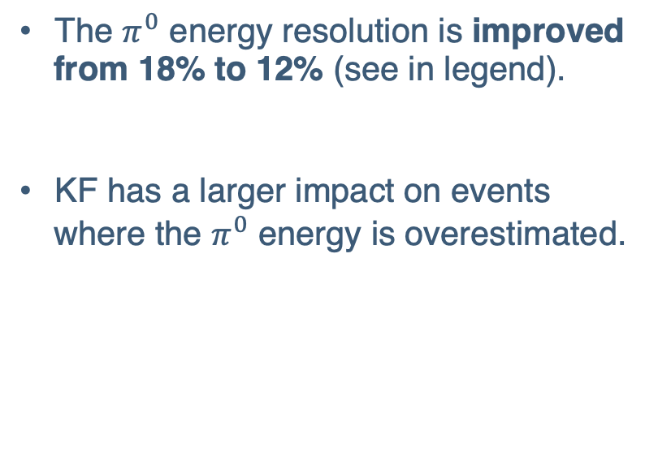
Kinematic Fitting
[1] MINERvA Collaboration, Phys.Rev.D 102 (2020) 7, 072007
[2] MicroBooNE Collaboration, JINST 15 (2020) 02, P02007
The $π^{0}$ energy resolution is improved from 18% to 12% (see in legend).
KF has a larger impact on events where the $π^{0}$ energy is overestimated.
$π^{0}$energy resolution :
MINERvA [1] | MicroBooNE [2] | ProtoDUNE-SP
19% | 10% | 12%
Notes:
This plot shows the pi0 energy fractional bias before and after kinematic fitting. The convergence rate of the algorithm is shown as the purple dashed line. We can see that the pi0 energy resolution has improved to about 12%, obtained from the width of the distribution. The kinematic fitting has a larger impact on pi0s where the energy is overestimated. If we compare with other tracking experiments, we have achieved a performance similar to MicroBooNE

Slide 35


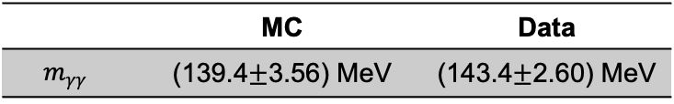
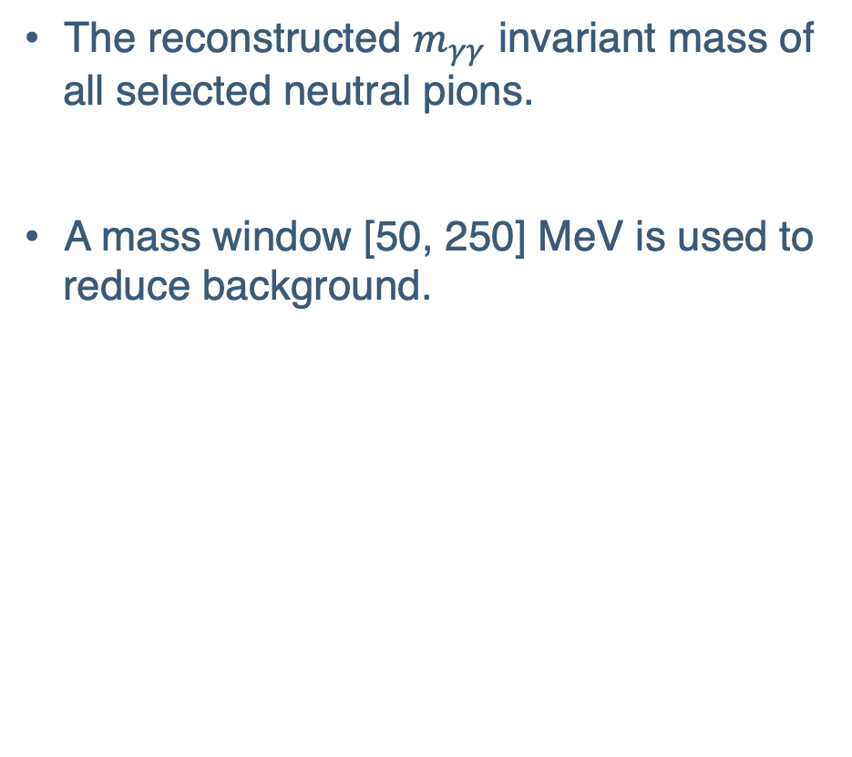
Reconstructed $π^{0}$ Mass
The reconstructed $m_{γγ}$ invariant mass of all selected neutral pions.
A mass window [50, 250] MeV is used to reduce background.
$m_{γγ}$Gaussian Fit:
 | MC | Data
$$m_{γγ}$$ | (139.4$±$3.56) MeV | (143.4$±$2.60) MeV
All $π^{0}$ before event topology cuts
Notes:
We are able to select a sample of neutral pion events, and here is the invariant mass of the two reconstructed photons. The major background comes from the random combination of two photons that do not originate from the same pi0. It can be seen that the correctly matched shower pairs show good agreement with the expected pi0 mass, while continuous backgrounds arise from random combinations of two showers. We placed a mass window cut to reduce background. The fitted peak value of the invariant mass is shown in the table, where the true pi0 mass is 135 MeV.

Slide 36


Reconstructed $T_{π^{0}}$
The reconstructed${ T}_{π^{0}}$ kinetic energy of selected change exchange events.
Pion production with $π^{0}$is the largest background.
${ T}_{π^{0}}$ is peaked around 250 MeV.
Selected $π^{0}$ after event topology cuts and kinematic fitting
Notes:
Here is the reconstructed pi0 kinetic energy after the CEX event topology cuts and kinematic fitting. Again, the pion production with pi0 is the largest background. We perform a similar background tuning, just like what we did in the previous integrated cross-section measurement, then subtract the background out and unfold to remove any detector or reconstruction effects.

Slide 37








Differential Cross-section $T_{π^{0}}$
The differential cross-section as a function of daughter $π^{0}$ kinetic energy (beam $π^{+}$ interacts with kinetic energy 650 - 800 MeV).
Consider the following three regions:
  Low $T_{π^{0}}$ : $T_{π^{0}}$ < 150 MeV
  Middle $T_{π^{0}}$ : 200 <${ T}_{π^{0}}$ < 400 MeV
  High $T_{π^{0}}$ : ${ T}_{π^{0}}$ > 650 MeV
Corresponds to different $π^{0}$ kinematics.
Low $T_{π^{0}}$ :
3 nucleus
Middle $T_{π^{0}}$ :
2 nucleus
High $T_{π^{0}}$ :
$π^{+}+ _{18}^{40}Ar$ $→$ $_{12}^{24}Mg$ + $_{1}^{2}D$ + $_{1}^{2}D$ + 5p + 7n + $π^{0}$
$π^{+}+ _{18}^{40}Ar$ $→$ $_{14}^{28}Si$ + $_{1}^{2}D$ + 4p + 6n + $π^{0}$
$π^{+}+ _{18}^{40}Ar$ $→$ $_{18}^{38}Ar$ + p + n + $π^{0}$
Notes:
This is the Differential Cross-section as a function of pi0 kinetic energy for a subsample of the CEX events, where the beam interacts with energy between 650 to 800 MeV. We can divide the XS into three regions, which corresponds to different pi0 kinematics. The region when pi0 KE is less than 150 MeV, between 200 and 400 MeV and larger than 650 MeV. If I do a scan for the truth events in these kinematic regions, you can see that the energy transfer is shared between final states nucleus and nucleons. As less and less nucleons being producing, pi0 gained more kinetic energy. There are many nuclear models used in the GEANT4, which I don’t really understand, but it seems they did a good job. Although the statistical uncertainty of the measurement is quite large.
The GEANT4 uses the Bertini cascade model to simulate the hadron interaction and transportation. Here are some truth-level process at each region. After the interaction, GEANT4 implemented several models to deal with the nuclear fragment. With A < 12, the nucleus is further de-excited by Fermi breakup. All other nuclei undergo equilibrium evaporation which is performed by the some statistical model. For some heavy nuclei (A > 100) fission may be performed. Relative probabilities for the evaporation of nucleons, light ions (d, 3He, α) are used to implement competition between these processes.

Slide 38


Differential Cross-section $T_{π^{0}}$
$$p_{π^{0}}$$
$$θ_{ }$$
z-axis
$$p_{π^{0}}^{z}$$
Truth Level Information
Low $T_{π^{0}}$ : $π^{0}$ was produced with no prefer direction.
Middle $T_{π^{0}}$ : $π^{0}$ was produced with a forward direction.
High $T_{π^{0}}$ : Most of the $π^{0}$ was produced along the beam direction.
Notes:
The plot on the right shows the cosine theta angle of the daughter pi0s for different kinematic regions. The angle theta is defined as the angle between the pi0 vector with respect to the z-axis. Our beam is sort of along this direction. For low KE region, there is no preferred direction as most of the transferred energy is shared between nucleons and the nucleus. As the kinetic energy of pi0 increases, fewer nucleons are produced, and it tends to move in the forward direction as we expected.

Slide 39


Differential Cross-section $θ_{π^{0}}$
Daughter $π^{0}$ prefers to be produced in the forward direction.
Current results are limited by the statistical errors.
Consistent with the GEANT4 prediction.
Notes:
We can also measure the differential cross-section as a function of the pi0 angle. Here are the cross-sections as a function of pi0 costheta and theta angle. We can see most of the pi0s were produced in the forward direction with an angle around 20 degrees. The ProtoDUNE data are consistent with the GEANT4 prediction. As I said, the high-level physics analysis in ProtoDUNE-SP is just a bonus, and ProtoDUNE-II is around the corner. We hope to collect more data for a more precise cross-section measurement and to better constrain our nuclear model.

Slide 40

Summary
The ProtoDUNE-SP has produced not only technical tests and calibrations, but also provided physics results.
  First results on ProtoDUNE-SP detector performance: DUNE Collaboration, JINST 15 (2020) 12, P12004
  Design, construction and operation of the ProtoDUNE-SP LArTPC: DUNE Collaboration, JINST 17 (2022) 01, P01005
  Identification and reconstruction of low-energy electrons in the ProtoDUNE-SP detector: Phys. Rev. D 107, 092012 (2023)
  Reconstruction of interactions in the ProtoDUNE-SP detector with Pandora: Eur. Phys. J. C 83, 618 (2023)
Several cross-section measurements using $π^{+}$, $K^{+}$, and proton beams with an argon target will be coming up soon.
Stay tuned!
Notes:
In this talk, I’ve shown that ProtoDUNE can not only do technical tests and calibration, but also can deliver some high-level physics analysis. Currently, there are two paper published for the detector performance and two for particle reconstructions in ProtoDUNE-SP. There are several XS measurement using pion, kaon protons beam which is still analyzing, including this analysis. The result should be published in the next few years. So, stay tuned!

Slide 41
Back-Up

Slide 42







DUNE Beam
1000+ scientists
170+ laboratories and universities
30+ countries
$ν$ ($E_{ν}$)
$π$ ($m_{π}$,$p_{π}$)
$$θ$$
LBNF
$μ$ ($m_{μ}$,$p_{μ}$)
Notes:
DUNE is a flagship experiment that seeks to uncover the origins of matter. It is expected to begin operations in the late-2020s and will run for at least 20 years, with the potential for extensions. The experiment is a collaboration between more than 1,000 scientists from 37 countries. At Fermilab, protons are accelerated to high energies of 60-120 GeV and then directed towards a graphite target, where collisions occur and generate electrically charged pions and kaons. These secondary particles are then focused with the help of magnetic horns and allowed to travel through a long decay pipe filled with helium. Neutrinos are produced from the decay of these pions and kaons. There will be beam absorber at the end of the decay pipe to capture other secondary particles and remaining protons, except neutrinos.

Slide 43


DUNE FD
1000+ scientists
170+ laboratories and universities
30+ countries
18 m
17k ton LAr (10k active)
1.5 km underground
4 independent modules
19 m
66 m
Notes:
The DUNE FD (Far Detector) will consist of four LArTPC (Liquid Argon Time Projection Chamber) modules, each with a LAr fiducial mass of at least 10 kt, installed approximately 1.5 km underground. Each LArTPC fits inside a cryostat of dimensions 19 m (w) x 18.0 m (h) x 66.0 m (l) containing a total LAr mass of about 17.5 kt. There are two LArTPC technologies, single phase and dual phase. Two of the modules will be using the SP technology and one module for DP, the last module is undecided yet.

Slide 44


DUNE ND
1000+ scientists
170+ laboratories and universities
30+ countries
Beam axis
Notes:
The DUNE ND comprises three main detector components, two of which can move off the beam axis. Bottom figure shows the DUNE ND components in the ND hall, with both on-axis and off-axis settings. It con-
sists of three primary detector components: ND-LAr (Liquid Argon), ND-Gar (Gaseous Argon), and SAND (System for on-Axis Neutrino Detection). ND-Lar is a LArTPC constructed using ArgonCube technology, which has the same target nucleus and detection principles as the FD. However, it loses acceptance for muons above 0.7 GeV/c due to the lack of containment, which is accomplished by the ND-GAr detector. The ND-GAr detector consists of a high-pressure gaseous argon TPC surrounded by an ECAL and a muon system in a 0.5 T magnetic field. Finally, SAND is a magnetized beam monitor that stays on-axis to monitor the flux of neutrinos going to the FD. ND-LAr and ND-GAr can move off-axis, while SAND remains on-axis to serve as a dedicated neutrino spectrum monitor.

Slide 45


DUNE Physics Program
The primary goals are to:
  Measure the neutrino oscillation by looking for the appearance of $ν_{e}$($\overline{ν_{ }}{}_{e}^{ }$)
  from a pure $ν_{μ}$($\overline{ν_{ }}{}_{μ}^{ }$) beam, including measurements of charge-parity (CP) phase and the determination of neutrino mass hierarchy.
  Search for proton decay.
  Observe the core-collapse supernova $ν_{e}$neutrinos.
Notes:
The primary objective of the DUNE experiment is to study neutrino oscillation by detecting the appearance of electron neutrinos from a beam of pure muon neutrinos from Fermilab. This will enable the measurement of various parameters such as the charge-parity (CP) phase and the determination of neutrino mass hierarchy. In addition to neutrino oscillation, DUNE aims to search for proton decay, which could provide crucial insights into the fundamental forces of nature. Furthermore, DUNE also aims to observe the core-collapse supernova neutrinos, which could provide valuable information about the processes involved in stellar explosions.

Slide 46
Cross-section Measurement Roadmap

Slide 47




Lagrange Multiplier Method
Visualization
Minimize the function $f(x,y)=8x^{2}−2y$ subject to the constraint ${g(x,y)=x}^{2}+y^{2}−1=0$.
Need to find a point where the two graphs are tangent.
  Mathematically we represent it as:
This scalar $λ$ is the Lagrange Multiplier.
Construct the function $L\left(x,y,λ\right)=f\left(x,y\right)−$ $λ g(x,y)$
Set all partial derivatives to zero.
Solve a set of linear equations to obtain $\left(x_{m},y_{m}\right).$
$$f\left(x,y\right)=−2$$
$$f\left(x,y\right)=−4$$
$$∇ f(x_{m},y_{m})= λ ∇g(x_{m},y_{m})$$
$$(x_{m},y_{m})$$
$$f\left(x,y\right)=1$$
$${g\left(x,y\right)=1 (x}^{2}+y^{2}−1=0)$$
Notes:
The Method of Lagrange Multipliers is a technique used in calculus to find the maximum or minimum values of a function subject to a constraint. For example, we want to minimise the function f(x,y) subejected to a unit circle constraint. The right plot shows the visualization of this problem with the constraint as a green circle. The black lines are the contour lines of the function f(x,y). Mathematically we want to find the point where the gradient of these two functions are proportional to each other. The proportional constant is the Lagrange Multiplier. We can then construct the lagranian takes the form as f – lambda* g, by solving a sef of linear equations, we can obtain the constraint minimised point.

Slide 48


$χ^{2}$ Calaculation
Let $α$ be a column vector representing a set of true values and${ α}_{0}$representing the measured parameters without any constraint.
How well we measured parameters${ α}_{0}$, which are subjected to an experimental resolution $σ$, match the true values $α$ can be quantified by computing the value of $χ^{2}$,
$V_{α_{0}}^{−1}$ is the inverse of the covariance matrices ($V_{α_{0}}\text{= }\text{diag}\text{(}σ_{i}^{2}\text{)} \text{for} \text{independent} \text{values}\text{)}$
$$α=\left(\begin{matrix}α_{1} \\ α_{2} \\ \begin{matrix}⋮ \\ α_{n}\end{matrix}\end{matrix}\right)$$
$$α_{0}=\left(\begin{matrix}α_{1}^{0} \\ α_{2}^{0} \\ \begin{matrix}⋮ \\ α_{n}^{0}\end{matrix}\end{matrix}\right)$$
$$χ^{2}=\left(α−α_{0}\right)V_{α_{0}}^{−1}\left(α−α_{0}\right)$$
Notes:
Let’s consider a general measurement in physics. We have a set of measured parameters called alpha_0 and the corresponding truth values alpha. How well we measure the parameters can be quantified by computing the value of chi2 as, the V here is the covariance matrix and it will be a diagonal matrix for independent values.

Slide 49





Toy Example
Measuring the energies of three particles ($E_{1},E_{2},E_{3}$) in unit of MeV and their true values are (4,9,16) MeV. These measured energies have an uncertainty ($σ_{1},σ_{2},σ_{3}$) = (0.5,1,1) MeV.
One constraint equation can be used to improve the resolution,
The covariance matrix $V_{α_{0}}$are computed to be,
$$E_{1}+E_{2}+E_{3}=E_{sum}=29$$
$${H_{1}= E}_{1}+E_{2}+E_{3}−29$$
$$V_{α_{0}}=\left(\begin{aligned}\begin{matrix}\begin{matrix}σ_{1}^{2} & 0\end{matrix} & 0 \\ \begin{matrix}0 & σ_{2}^{2}\end{matrix} & 0\end{matrix} \\ \begin{matrix}0 & 0 & σ_{3}^{2}\end{matrix}\end{aligned}\right)$$
Variables in red are optimized in the end
$$χ^{2}=λ^{ }∗H_{1}+ \left(α−α_{0}\right)V_{α_{0}}^{−1}\left(α−α_{0}\right)$$
$$σ=\sqrt{\frac{\sum{{{(x}_{i}−μ)}^{2}}}{N}}$$
Constraint equation
$χ^{2}$ without any constraint
Notes:
Now what if we want to use some physics of this system to constraint the measured values. For example, we have measured the energy of three particles with an uncertainty of 0.5, 1, 1 MeV. Then one simple constraint we can use is the energy conservation law, here we can construct the constraint equation H1. The the constraint chi2 takes the form like this, where the second the term is the previous chi2 expression and the first term is our constraint equation. Instead of solving the linear equations, we can do optimisation numerically via the TMinuit class in ROOT.

Slide 50



Toy Example Results
$$χ^{2}=λ^{ }∗H_{1}+ \left(α−α_{0}\right)V_{α_{0}}^{−1}\left(α−α_{0}\right)$$
$$E_{1}+E_{2}+E_{3}=E_{sum}=29$$
($σ_{1},σ_{2},σ_{3}$) = (0.5, 1.0, 1.0) MeV
($σ_{1}^{fit},σ_{2}^{fit},σ_{3}^{fit}$) = (0.47, 0.74, 0.74) MeV
Generated 10k random Gaussian numbers:
  Mean values (4, 9,16) MeV
  Sigma (0.5, 1, 1) MeV
Use the energy conservation law as constraint.
Improvement is found in energy resolution for all three particles.
Notes:
Here is the fitting results of this toy example. I generated 1000 gaussian events with the mean value of the true value and sigma of the measurement uncertainty (0.5, 1, 1)MeV . Then after minimizing the constraint chi2 by varying the measured parameters within its uncertainty, the resolution of each value get improved. I also tried to generate the measurements with a -20% bias. After fitting, both the mean value and the resolution get improved.

Slide 51








Extract Cross-section
Total CEX XS for bin $i$ (beam $T_{π^{+}}$ bin) is,
The number of incident $π^{+}$ at each bin $i$ the measured beam $π^{+}$ kinetic energy.
$$σ_{i}=\frac{m_{Ar}}{ρN_{A}δE}{ \left.\frac{dE}{dx}\right|}_{E_{i}} ln{\left(\frac{N_{inc}}{N_{inc}−N_{int}}\right)}_{i}$$
The number of interacting $π^{+}$ via the charge exchange interactions at each bin $i$ of the measured CEX interacting E histogram.
We perform the total CEX cross-section at each bin $i$ of the measured beam $π^{+}$ kinetic energy.
$π^{+}$energy loss per unit length evaluated at each bin $i$ centre using Bethe-Block formula.
Notes:
Here is how we extract our cross-section bin by bin, the pre-factors are just constant and the dE/dx is evaluated at each bin center. We are using the iterative Bayesian unfolding method and these three histograms are unfolded separately. The black points are the unfolded data after background subtraction and the red histogram is the underlying truth distribution. We can compute the incident pions from the right two plots using this formula discussed previously and the interacting pions are computed from the bottom histogram. Then by substitute the number into the formula, we are able to compute the cross-section bin by bin.

Slide 52


Extract Cross-section
Total CEX XS for bin $i$ (beam $T_{π^{+}}$ bin) is,
Initial E
$$σ_{i}=\frac{m_{Ar}}{ρN_{A}δE}{ \left.\frac{dE}{dx}\right|}_{E_{i}}ln{\left(\frac{N_{inc}}{N_{inc}−N_{int}}\right)}_{i}$$
$N_{inc}^{i}$ = $\sum_{i}^{N}{N_{ini}^{ }} −\sum_{i+1}^{N}{N_{beam_int}^{ }}$
CEX Interacting E
Beam Interacting E
Notes:
Here is how we extract our cross-section bin by bin, the pre-factors are just constant and the dE/dx is evaluated at each bin center. We are using the iterative Bayesian unfolding method and these three histograms are unfolded separately. The black points are the unfolded data after background subtraction and the red histogram is the underlying truth distribution. We can compute the incident pions from the right two plots using this formula discussed previously and the interacting pions are computed from the bottom histogram. Then by substitute the number into the formula, we are able to compute the cross-section bin by bin.

Slide 53




Differential Cross Section Formula
$σ_{i}≈\frac{m_{Ar}}{ρN_{A}δE}$ ${\left.\frac{dE}{dx}\right|}_{E_{i}}$ $\frac{N_{int}^{i}}{N_{inc}^{i}}$
Calculate the differential cross section as,
${\left(\frac{dσ}{{dT}_{π^{0}}}\right)}_{ij}=\frac{m_{Ar}}{ρN_{A}δE}$ ${\left.\frac{dE}{dx}\right|}_{E_{i}}$ $\frac{1}{({∆T}_{π^{0}})}\frac{N_{int}^{ij}}{N_{inc}^{i}}$ (Eq. 1)
Thin slice total CEX cross section is,
$σ_{i}=\frac{m_{Ar}}{ρN_{A}δE}$ ${\left.\frac{dE}{dx}\right|}_{E_{i}}$ $\frac{N_{int}^{i}}{N_{inc}^{i}}$ (Eq. 2)
Then the differential cross section formula is (Sub. Eq. 2 into Eq. 1),
$${{\left(\frac{dσ}{{dT}_{π^{0}}}\right)}_{ij}= \frac{1}{({∆T}_{π^{0}})}\frac{N_{int}^{ij}}{N_{int}^{i}}σ}_{i}$$
${∆T}_{π^{0}}$ is the bin width of $π^{0}$ KE
Index $i$ : beam $T_{π^{+}}$ bin,
Index $j$ : daughter $T_{π^{0}}$ bin
Measured total CEX cross-section
Notes:
Now, we can calculate the differential cross section using the formula here. There are now two indices, the index i represents the beam pi+ KE and index j represents the daughter pi0 KE. The denominator is the same which is the number of incident pions at a particular kinetic energy. But now what you are counting in the numerator is the number of daughter pi0s at each j bin for a particular beam kinetic energy. Then normalized it by the bin width of your pi0 kinematic energy spectrum. If you write down the total charge exchange cross-section formula, then you could replace some common factors as shown in red. Finally, here is the formular and the term in blue can be obtained from the daughter pi0 spectrum.

Slide 54








Extract Differential Cross-Section
Bin entry of $π^{0}$ kinetic energy spectrum in previous slide.
Differential XS for bin j (daughter $T_{π^{0}}$ bin) is,
The number of daughter $π^{0}$ at each bin $j$ of the measured daughter $π^{0}$ kinetic energy of selected beam interacts with energy [650,800] MeV.
$${{\left(\frac{dσ}{{dT}_{π^{0}}}\right)}_{j}= \frac{1}{({∆T}_{π^{0}})} \frac{N_{π^{0}}^{j}}{N_{int}^{ }} σ}_{KE=650−800 MeV}$$
The averaged total CEX cross section in the kinetic energy range of $\text{[650,800] }\text{MeV}\text{.}$
We perform the differential cross-section at each bin $j$ of the measured daughter $π^{0}$ kinetic energy (and angles) of selected beam interacts with energy [650,800] MeV.
The total number of CEX interacting $π^{+}\text{of} \text{selected} \text{beam} \text{interacts} \text{with} \text{energy}\text{ [650,800] }\text{MeV}\text{.}$
Bin width of the daughter $π^{0}$ kinetic energy histogram.
Total CEX XS measurement
Backup
Notes:
Here is the differential cross section formular and all the information we need. Following the same procedures, the differential cross section can be calculated using the unfolded histogram. More details about the derivation of this formula can be found in the backup slides. The pre-factor is just the bin width of the pi0 kinematic variable. We have fixed the beam pion interacting energy to be in the range of 650-800 MeV. We can read-off the number of interacting pion via charge exchange process, obtained the averaged total CEX cross-section from previous measurement. Then we can compute the differential cross-section as a fcunton of the pi0 KE bin j.

Slide 55


Extract d$σ$
Differential XS for bin j (daughter $T_{π^{0}}$ bin) is,
$${{\left(\frac{dσ}{{dT}_{π^{0}}}\right)}_{j}= \frac{1}{({∆T}_{π^{0}})} \frac{N_{int}^{j}}{N_{int}^{ }} σ}_{KE=650−800 MeV}$$
Pi0 KE
CEX interacting
Backup
Notes:
Here is the differential cross section formular and all the information we need. Following the same procedures, the differential cross section can be calculated using the unfolded histogram. More details about the derivation of this formula can be found in the backup slides. The pre-factor is just the bin width of the pi0 kinematic variable. We have fixed the beam pion interacting energy to be in the range of 650-800 MeV. We can read-off the number of interacting pion via charge exchange process, obtained the averaged total CEX cross-section from previous measurement. Then we can compute the differential cross-section as a fcunton of the pi0 KE bin j.

Slide 56





Kinematic Fitting
Charge-exchange scattering candidate (data)
$$π^{+}n \left({}_{}^{40}{Ar}\right)→π^{0}p$$
$$E_{1}$$
$$γ$$
beam $π^{+}$
$$θ$$
$$E_{2}$$
p
$$γ$$
47 cm
No obvious energy dependence is found on the absolute difference of rec. and truth shower energy.
Use the shower-energy independent covariance matrix.
Minimizing:
  where
  $V_{α_{0}}^{−1}$ is the inverse of the covariance matrix
$$χ^{2}=λ^{ }∗\{2∗E_{1}E_{2}[1−cos\left(θ\right)]−m_{π^{0}}^{2}\}+ \left(α−α_{0}\right)V_{α_{0}}^{−1}\left(α−α_{0}\right)$$
$α_{ }$ = $(\begin{matrix}E_{1} & E_{2} & θ\end{matrix})$
Notes:
The constraint chi2 we want to minimized takes the form like this, similar to the toy example but with a different constraint equation. I’m using a energy independent covariance matrix based on the simulation study as shown in the top plot. There is no obvious energy dependence on the absolute difference of reco. and truth shower energy. The red arrow just indicates the shower energy and opening angle after fitting.

Slide 57

Pion Charge Exchange Statistics
 | Total Events(MC) | Selected Events(MC) | Total Events(Data) | Selected Events(Data)
Beam PDG Cut | 298,194 | 170,238 | 1,215,251 | 119,545
Pandora Track Cut | 170,238 | 142,362 | 119,545 | 100,150
Beam Quality Cut | 142,362 | 100,824 | 100,150 | 70,441
APA3 EndZ Cut | 100,824 | 82,212 | 70,441 | 54,128
Michel score Cut | 82,212 | 80,616 | 54,128 | 52,872
Chi2/DOF Cut | 80,616 | 76,583 | 52,872 | 49,712
Beam Scraper Cut | 76,583 | 60,174 | 49,712 | 34,783
Two $π^{0}$ Showers | 60,174 | 2,155 | 34,783 | 1,382
No Daughter $π^{+}$ | 2,155 | 1,708 | 1,382 | 1,088
No Michel $e^{ }$ | 1,708 | 1,614 | 1,088 | 1,014
One Daughter $π^{0}$ | 1,614 | 1,146 | 1,014 | 665
 |  | 1,146(840) |  | 665

Slide 58


Shower Energy (After Correction)
Shower Energy Correction Function Parameters :
 | $$p_{0}$$ | $$p_{1}$$ | $$p_{2}$$ | $$p_{3}$$
MC/Data | -0.91 | 1.50 | 0.06 | -0.11
$$E_{cor.}=p_{3}+\frac{(p_{0}−p_{3})}{1+{\left(\frac{E_{raw}}{p_{2}}\right)}^{p_{1}}}$$
Particle Type | Energy/Mom. (frac. bias) | Theta* (deg.) (abs. difference) | Phi (deg.) (abs. difference) | Performance
Daughter Shower | 2.38%$±$0.19 | 2.56$±$5.78 | 0.18$±$8.10 | Good

Slide 59

Upstream Energy Loss
Credit: Sungbin Oh

Slide 60


Upstream Energy Loss
The upstream energy loss is plotted as a function of the beam inst. kinetic energy.
The upstream energy loss is energy dependent.
Color band shows the 1$σ$ region of the upstream energy loss distribution at a particular energy.
Fitted Poly2 Parameters :
 | $$p_{0}$$ | $$p_{1}$$ | $$p_{2}$$
MC/Data | 171.8 | -0.575 | 4.3e-4

Slide 61



Stopping Beam Muon
Event weight $=e^{\frac{−{\left(p−{μ_{fit}}_{ }\right)}^{2}}{{2σ_{fit}}_{ }}} /{ e}^{\frac{−{\left(p−{μ_{true}}_{ }\right)}^{2}}{{2σ_{true}}_{ }}}$
Select stopping beam muons with rec. track length / length from ${KE}_{ff}$ > 0.9.
Fitted Parameters :
 | $$μ_{true}$$ | $$σ_{true}$$ | $$μ_{fit}$$ | $$σ_{fit}$$ | $$p$$
MC | 1.0036 | 0.0595 | 1.0160 | 0.0708 | Truth start P
A similar mismodeling is found in beam stopping muon sample.
Apply a weight on a event by event basis to pion beam using fitted parameters from stopping muons.

Slide 62

Long Track Sample
Need to scale up the muon components by a factor of 1.53 $±$ 0.02.
Select long tracks with rec. track length > 150 cm.

Slide 63



Sideband Background Tuning
Pion Prod. ($π^{0}$ = 0) (Background)
Pion Prod.
($π^{0}$ $≥$ 1)
(Background)
Switching the cuts on the final state particles to select background dominated sideband channels.
Keep the signal part unchanged, simultaneously vary the $π^{0}=0$ (left hist.) and $π^{0}≥1$ (right hist.) pion production backgrounds to minimise the $χ^{2}$ of two histograms above.

Slide 64
Energy Deposit from Calorimetry
The biggest advantage of a LArTPC detector is its granularity when measuring the particles.
We are able to measure the energy deposit every one MeV (this is after the dEdx calibration)
Choose 1MeV slice width and perform the XS measurement in a 50MeV binning is possible.

Slide 65
Unfolding
Unfolding Efficiency
CEX Interacting E
Iterative Bayesian unfolding (RooUnfold package)
Overall efficiency for CEX events is about 5% .
Response Matrix

Slide 66
Unfolding – Initial E
Overall Efficiency is about 45%.

Slide 67
Unfolding – Beam Interacting E
Overall Efficiency is about 45%.

Slide 68
Unfolding - CEX Interacting E
CEX Interacting E
CEX Interacting E
The unfolding efficiency (left) and the response matrix for CEX Interacting E.
Overall efficiency is about 5%.
Unfolding of Initial E and beam interacting E are in the back up slides.

Slide 69
Unfolding – Pi0 KE
The efficiency increases as the energy increases.

Slide 70
Unfolding – Pi0 Theta
Low efficiency for large theta angle (backward moving particles).

Slide 71
Unfolding – Pi0 CosTheta
Low efficiency for backward moving particles.

Slide 72

Sideband Bck. Tuning
Two sidebands defined outside the mass window:
  Backgrounds are allowed to vary through $χ^{2}$minimization in the $π^{0}$mass distribution for each sideband
The fitted two scaling factors in each sideband region are shown in blue.
An underestimation of low-energy $π^{0}$ in the simulation

Slide 73
Estimating systematics
We shift one single parameter and run the simulation again to create an “alternative universe”.
The difference between the distributions gives a measure of the uncertainty due to this shifted parameter.
We make the variation and evaluate all systematic sources on the list.

Slide 74




Covariance Matrix
We need to consider that different bins may be correlated in our analysis.
The covariance matrix is a N x N matrix, where N is the number of bins of our variable of interest.
For any two bins, $i$ and $j$, the covariance matrix is defined as:
$$M_{ij}=M_{ji}= \frac{\sum_{k=1}^{n}{{(x}_{i_{k}}−\overline{x_{i}}){(x}_{j_{k}}−\overline{x_{j}})w_{k} }}{\sum_{k=1}^{n}{ }w_{k}}$$
n is the total number of universes
$w_{k}$ is the weight for a universe $k$ (default value = 1)
$x_{i_{k}}$ is the candidate count in bin $i$ in a universe $k$.
$\overline{x_{i}}$ is the mean candidate count in bin $i$, averaged over all universes.
$$M_{ij}=M_{ji}= \frac{\sum_{k=1}^{n}{{(x}_{i_{k}}−\overline{x_{i}}){(x}_{j_{k}}−\overline{x_{j}})w_{k} }}{\sum_{k=1}^{n}{ }w_{k}}$$

Slide 75
Covariance Matrix
We need to consider that different bins may be correlated in our analysis.
The covariance matrix is a N x N matrix, where N is the number of bins of our variable of interest.
For any two bins, $i$ and $j$, the covariance matrix is defined as:
$$M_{ij}=M_{ji}= \frac{\sum_{k=1}^{n}{{(x}_{i_{k}}−\overline{x_{i}}){(x}_{j_{k}}−\overline{x_{j}})w_{k} }}{\sum_{k=1}^{n}{ }w_{k}}$$

Slide 76
Systematic Uncertainty
Pi0 Theta
Pi0 KE
Pi0 CosTheta

