Slide 1


Searches for CPT and Lorentz Invariance Violation with Fermilab Muon g-2
Breese Quinn, University of Mississippi
University of Liverpool Seminar
5 July 2024

Slide 2
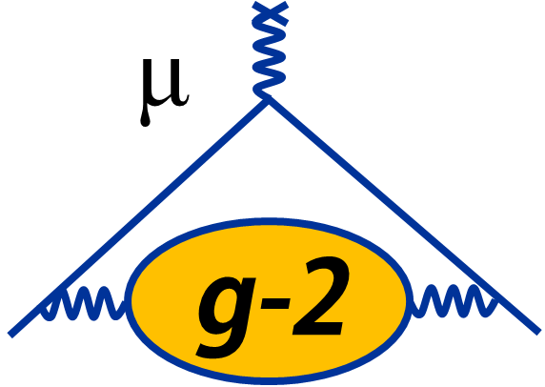
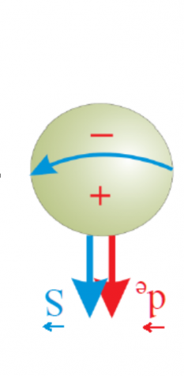
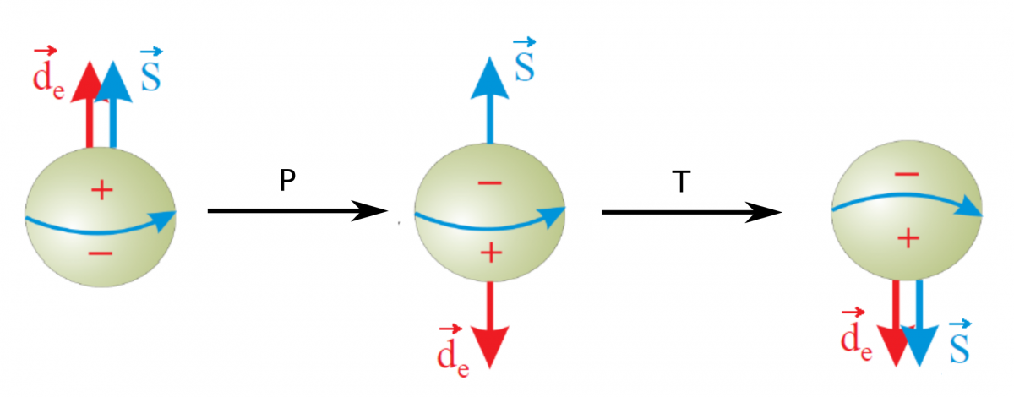
CPT and Lorentz Symmetry
Transformations
  Lorentz (foundation of relativity)
    Rotations about and boosts along 3 spatial directions
  CPT (foundation of Quantum Field Theory)
    C: Charge (particle → antiparticle)
    P: Parity (spatial inversion: mirror + upside down)
    T: Time (flip direction of time flow)
C

Slide 3
CPT and Lorentz Symmetry
Symmetry or Invariance
  Laws of physics are unaffected by transformations
  All symmetries are ONLY as good as the EXPERIMENTAL evidence for them! (i.e. we assume L and CPT invariance in our theories simply because there is no evidence that they are violated)
Why are we always speaking of CPT and L together (CPTLIV)?
  CPT Theorem: certain theories (local QFT) with Lorentz Symmetry must also have CPT Symmetry (e.g. QED, SM, GUTs)
    Implies particles and antiparticles have the same m, τ, q, µ

Slide 4
CPT and Lorentz Symmetry
No evidence for CPTLIV (doesn’t mean it’s not there!)
Relatively easy to form a phenomenological description of CPTLIV, but hard to do so with an underlying theory framework that is compatible with
  Experimental evidence in our universe
  Established QFT (e.g. SM) and GR (both with Lorentz Symmetry)
SME: Standard Model Extension (Colladay and Kostelecky, Phys.Rev.D58:116002,1998)
  Includes all conventional SM and GR properties
  Allows for CPTLIV that is quantitatively described by coefficients to be determined experimentally
    Only “particle LIV”, not “observer LIV”

Slide 5

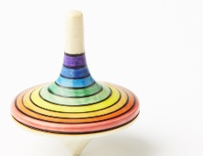


Lorentz Violations
Observer Lorentz Transformation
  Relate measurements of an experiment made from different reference frames (i.e. the experiment stays put)
  David and Breese must agree because simply a change of coordinates
Particle Lorentz Transformation
  Identical experiments are rotated or boosted relative to each other
  David’s 2 expts may or may not agree
  Conventional vacuum: OLT and PLT are just inverse of each other
  Fixed background field: source of Lorentz Violation. Creates preferred direction. If an experiment sensitive to such field is transformed, measurable effects can be observed.

Slide 6
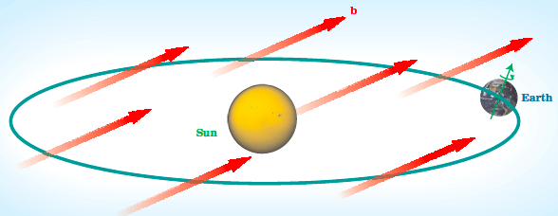
CPT and Lorentz Violations
Lorentz Violation – existence of a preferred direction
  Uniform background vector, b
  What could it come from? Spontaneous Symmetry Breaking, e.g.
    SM: In EWSB, scalar field gets non-zero vacuum expectation value, filling vacuum with Lorentz Symmetric quantities
    SME: Can have Lorentz SB, where vector field gets non-zero vev, filling vacuum with 4-dimensionally oriented quantities → preferred direction in space → LIV!
    Possibilities: string theory, loop-quantum gravity, etc.
CPT Violation
  LIV allows but does not require CPTV, because CPT Theorem no longer holds (but CPTV does require LIV)

Slide 7
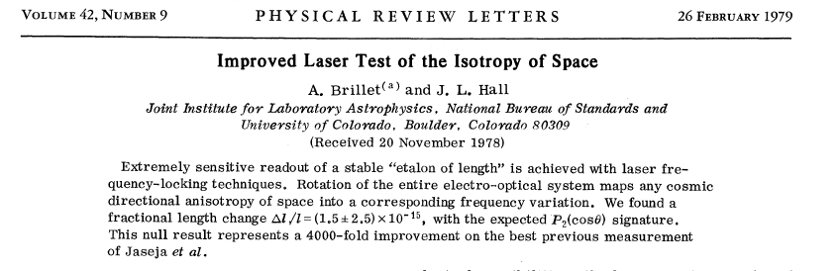
Brillet-Hall: Anisotropy of Space

Slide 8

Hughes-Drever: Anisotropy of Inertial Mass
Search for change in $\vec{μ}∙\vec{B}$ interaction energy as $\vec{B}$ rotates wrt the galaxy center
  Recall there is a mass in the interaction term
Hughes: ⁷Li
  4 equally split levels
  See 1 line (all three transitions are equal)
  If they are shifted by different amounts see triplet, or broadened structure
Only a single line was observed to their uncertainty of 5 ppm, which was dominated by $∆B$

Slide 9
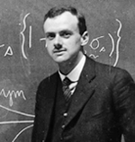
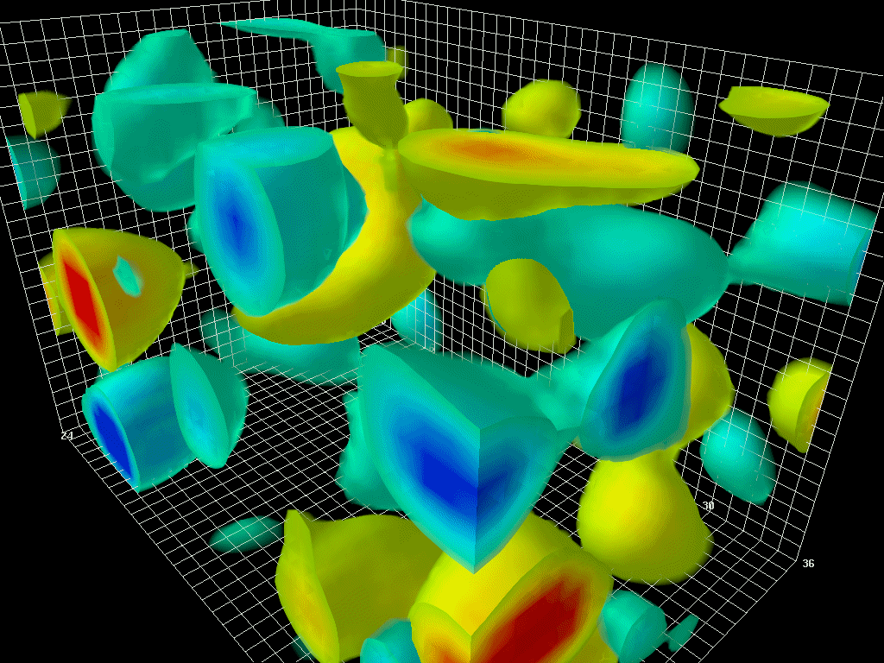
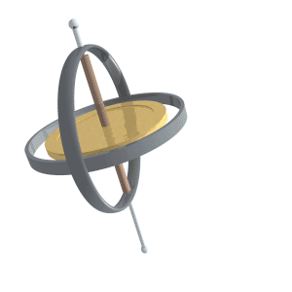
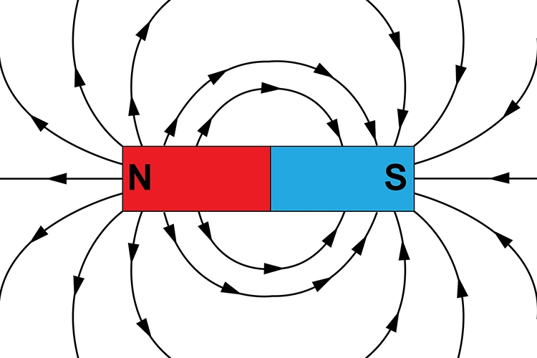
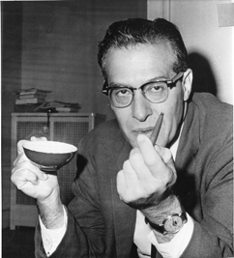
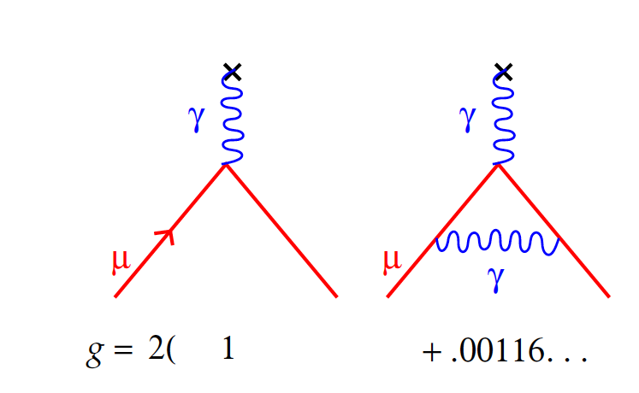
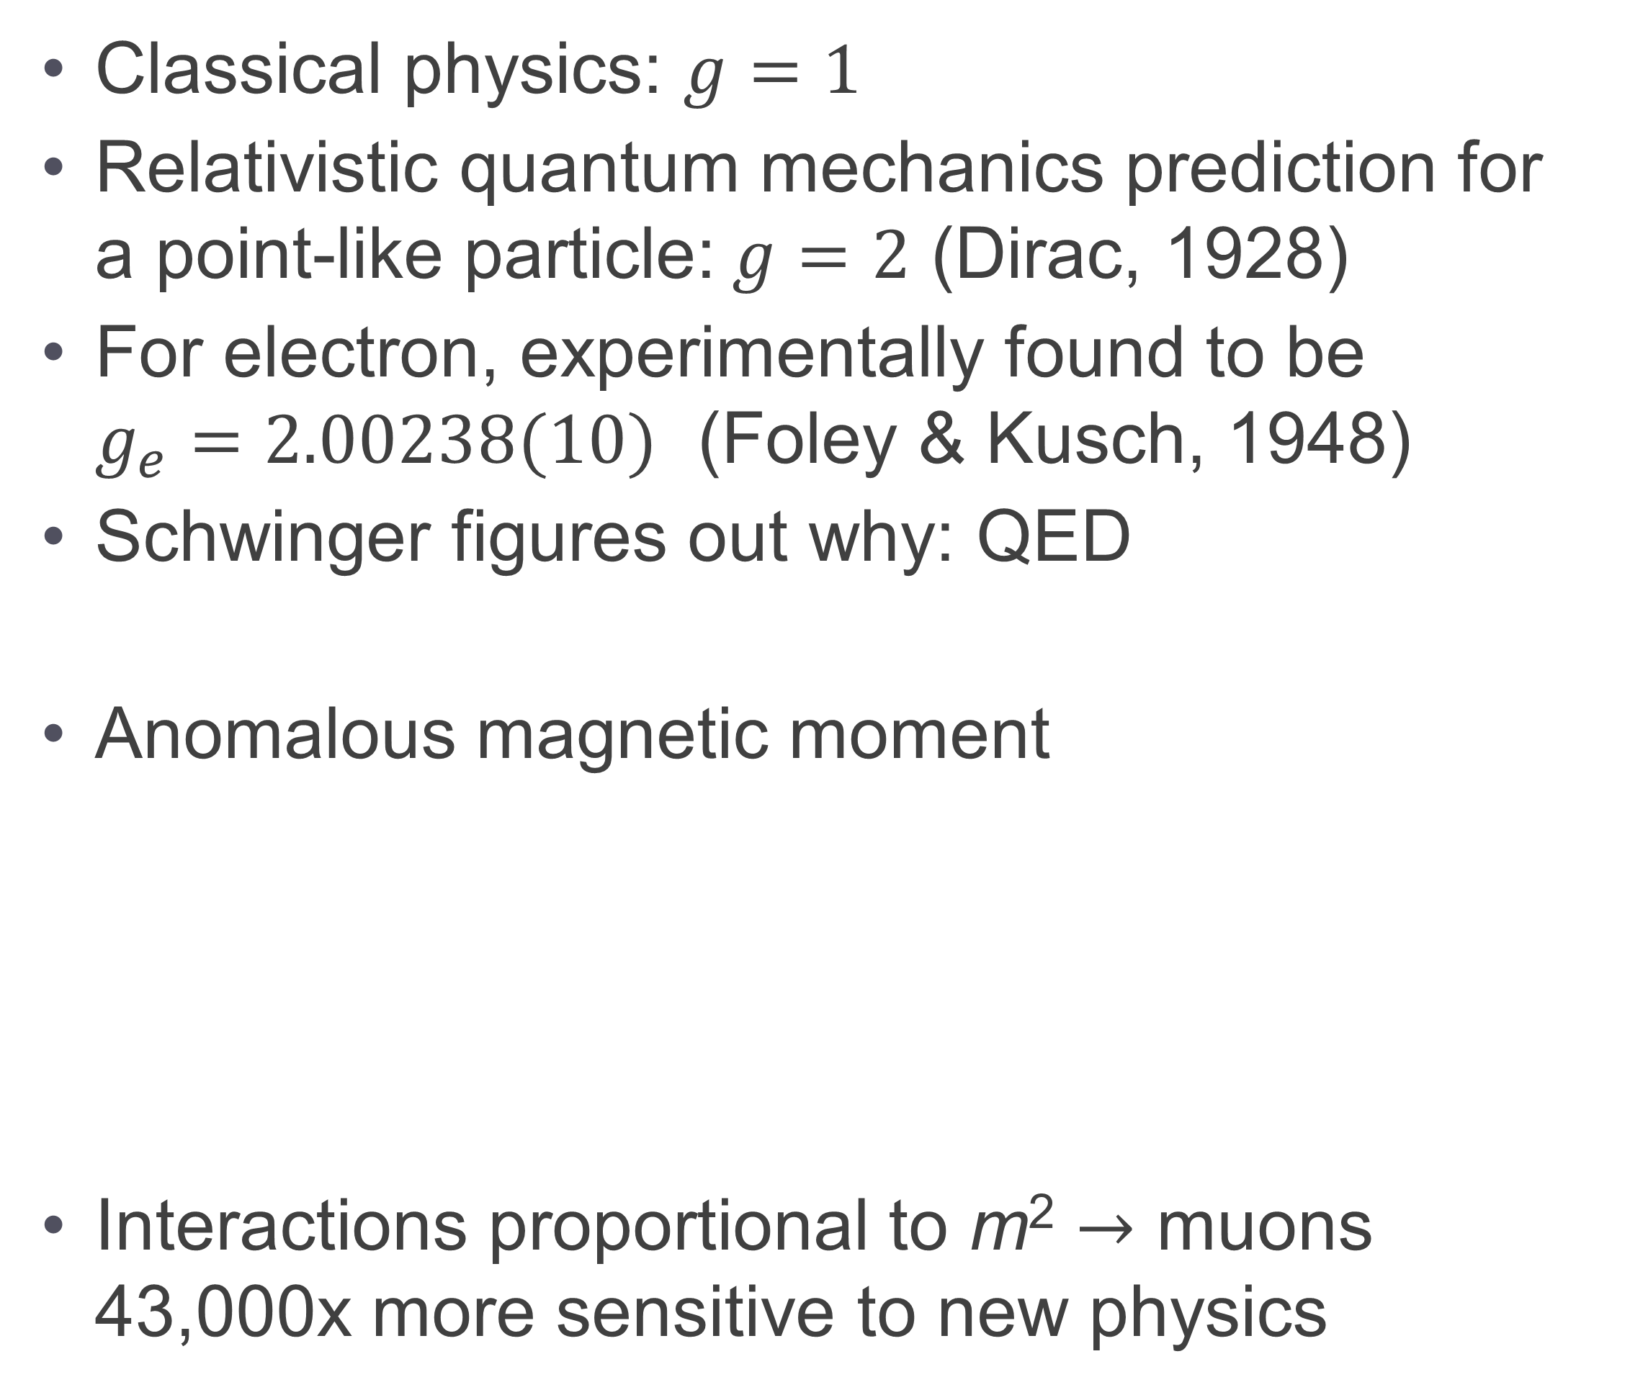
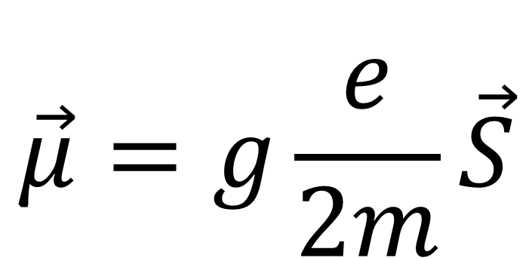

Magnetic Moment: g factor
Classical physics: $g=1$
Relativistic quantum mechanics prediction for a point-like particle:$g=2$ (Dirac, 1928)
For electron, experimentally found to be $g_{e}=2.00238(10)$ (Foley & Kusch, 1948)
Schwinger figures out why: QED
Anomalous magnetic moment
Interactions proportional to m² $→$ muons 43,000x more sensitive to new physics
$$\vec{μ}=g\frac{e}{2m}\vec{S}$$
Image Credits: Derek Leinweber
B
$$\vec{μ}=g\frac{e}{2m}\vec{S}=2\left(1+a\right)\frac{e}{2m}\vec{S}$$
$$a=\frac{g−2}{2}$$
e
e
)

Slide 10
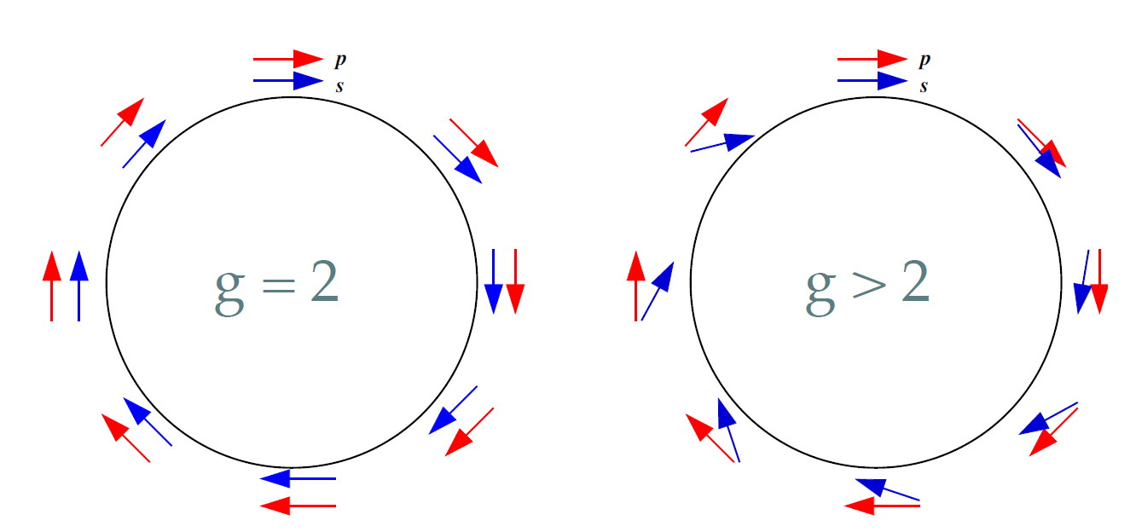
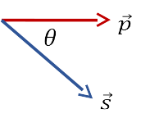
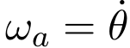
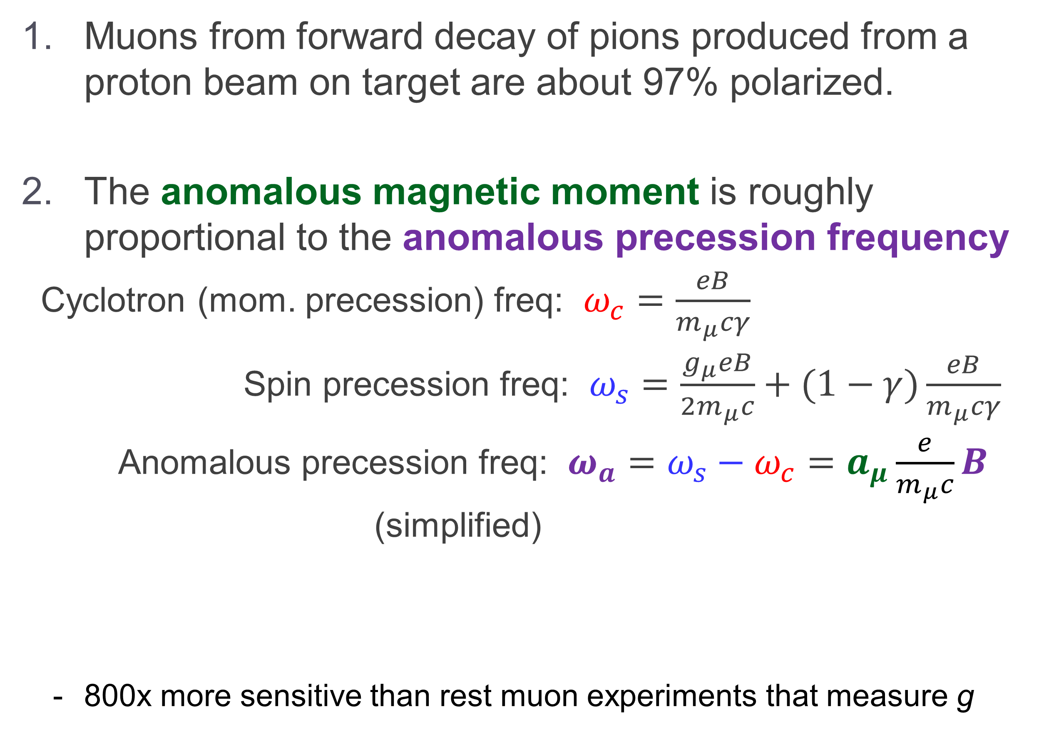
The Key Principles of Storage Ring Muon g-2
Muons from forward decay of pions produced from a proton beam on target are about 97% polarized.
The anomalous magnetic moment is roughly proportional to the anomalous precession frequency
Cyclotron (mom. precession) freq: $ω_{c}=\frac{eB}{m_{μ}cγ}$
Spin precession freq: $ω_{s}=\frac{g_{μ}eB}{2m_{μ}c}+(1−γ)\frac{eB}{m_{μ}cγ}$
Anomalous precession freq: $ω_{a}=ω_{s}−ω_{c}=a_{μ}\frac{e}{m_{μ}c}B$ (simplified)
  800x more sensitive than rest muon experiments that measure g
p
π⁺
μ⁺
ν
π⁺
μ⁺
To get this
Measure these

Slide 11
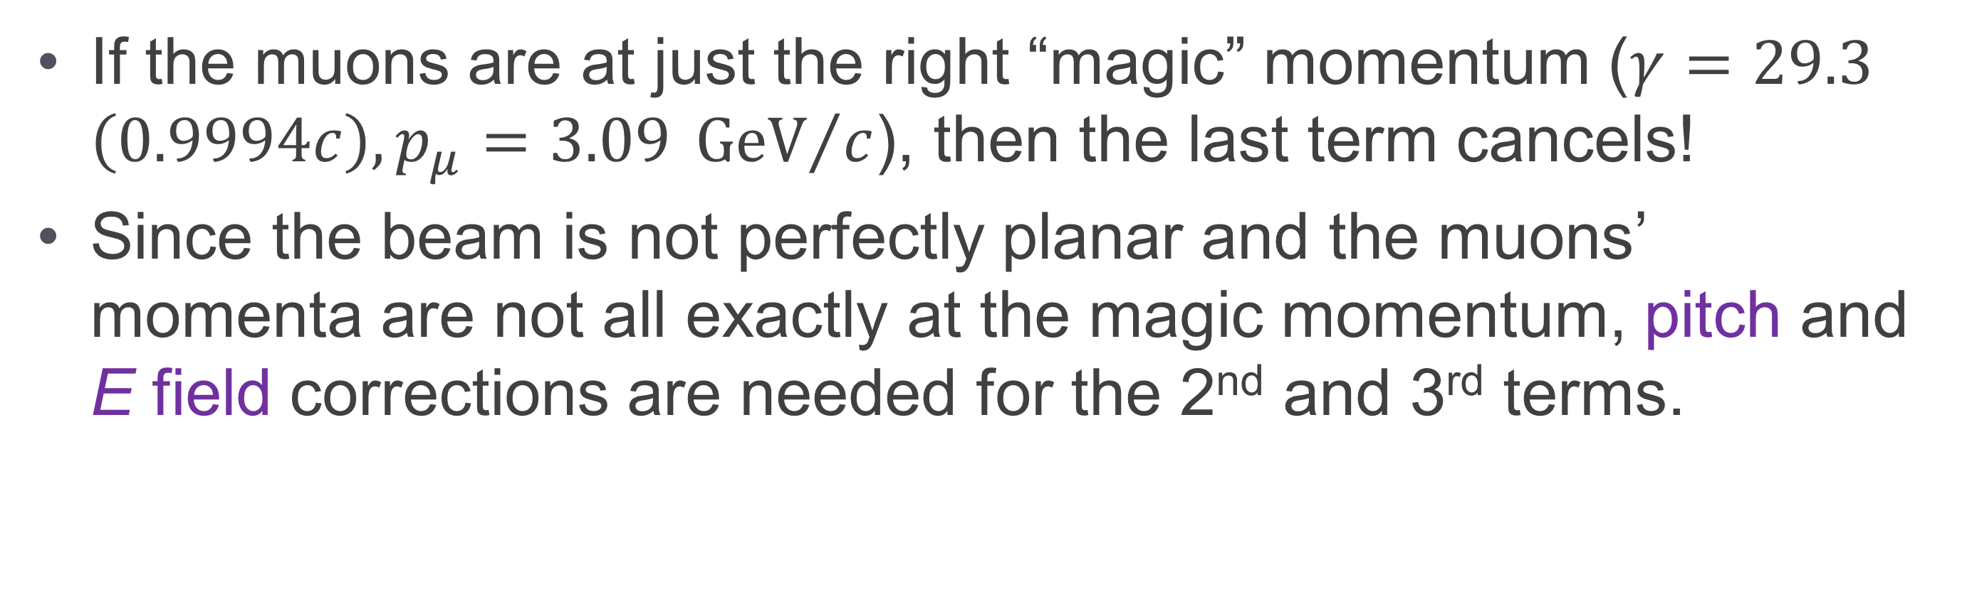
The Key Principles of Storage Ring Muon g-2
There is some vertical beam motion, so need to use electric quadrupole fields to contain the beam vertically (the B field holds them in horizontally). But these facts complicate the expression for the anomalous precession frequency:
$${\vec{ω}}_{a}={\vec{ω}}_{s}−{\vec{ω}}_{c}=−\frac{e}{mc}\left[a_{μ}\vec{B} −a_{μ}\left(\frac{γ}{γ+1}\right)\left(\vec{β}⋅\vec{B}\right)\vec{β}−\left(a_{μ}−\frac{1}{γ^{2}−1}\right)\left(\vec{β}×\vec{E}\right)\right]$$
If the muons are at just the right “magic” momentum ($γ=29.3$ $\left(0.9994c\right), p_{μ}=3.09 {GeV}/c$), then the last term cancels!
Since the beam is not perfectly planar and the muons’ momenta are not all exactly at the magic momentum, pitch and E field corrections are needed for the 2nd and 3rd terms.

Slide 12
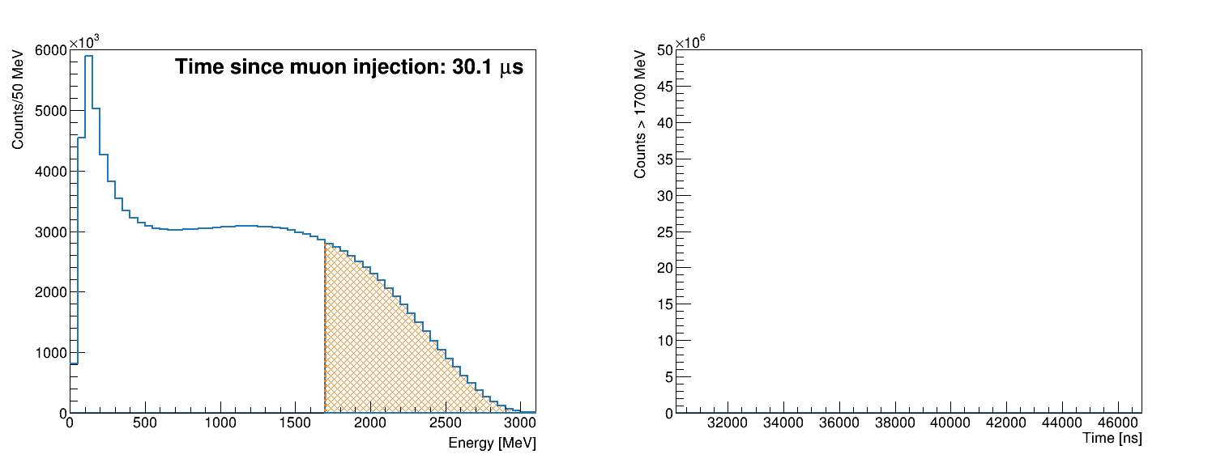




The Key Principles of Storage Ring Muon g-2
Muon decays are self-analyzing: due to parity violation, the highest energy decay positrons are preferentially emitted in the direction of the muon spin.
$μ^{+}→e^{+}ν_{e}{\overline{ν}}_{μ}$
$${\overline{ν}}_{μ}$$
μ⁺
$$e^{+}$$
$$ν_{e}$$
Real data from Run-3
Energy spectrum
Time spectrum
Spin
Momentum
Threshold Energy

Slide 13
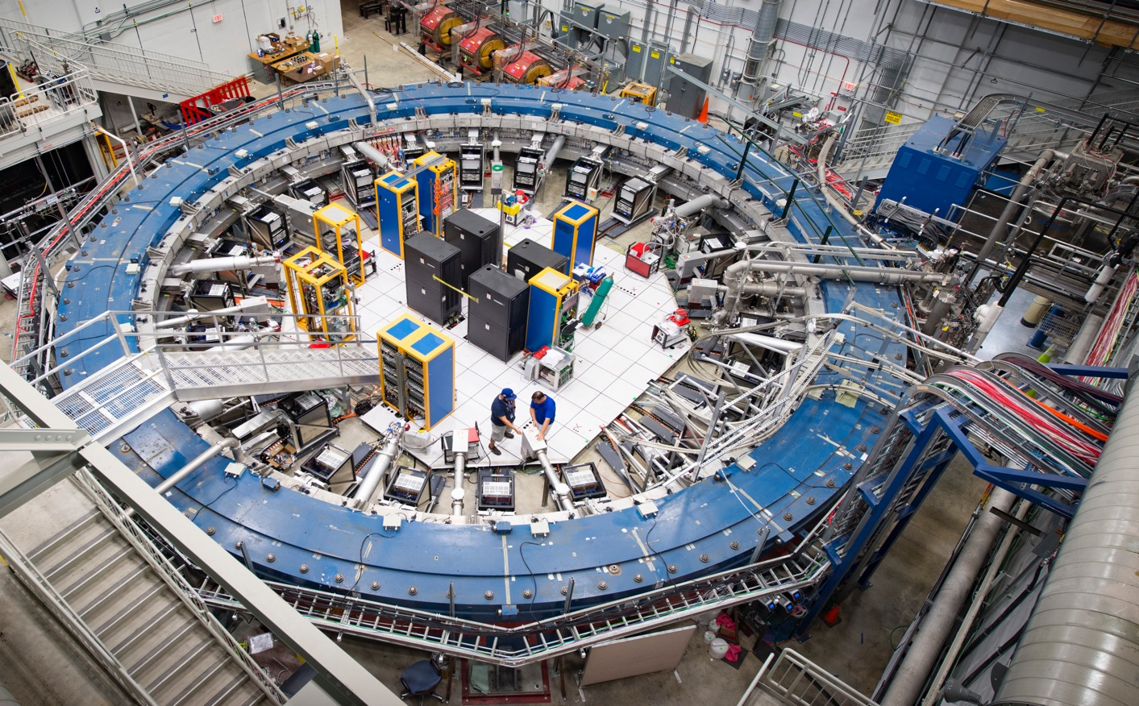
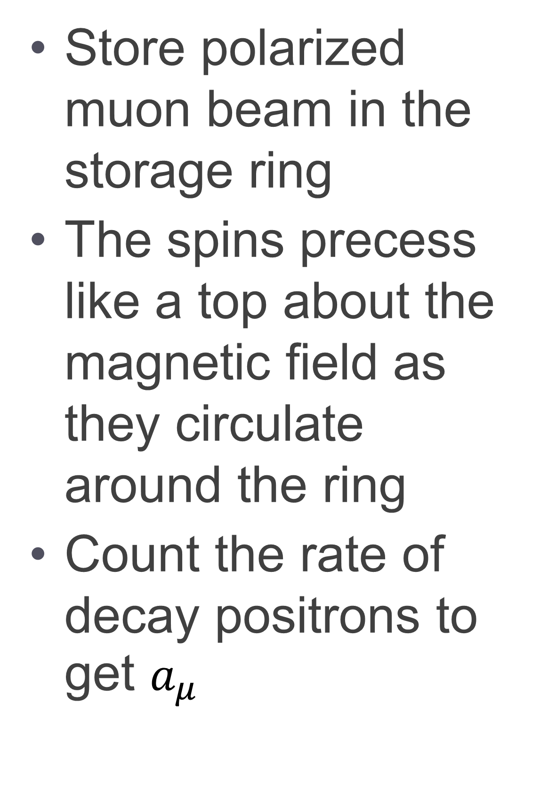
Measuring Muon g-2
Store polarized muon beam in the storage ring
The spins precess like a top about the magnetic field as they circulate around the ring
Count the rate of decay positrons to get $a_{μ}$

Slide 14
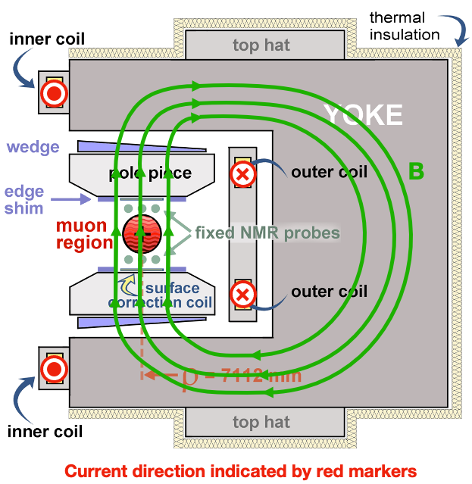
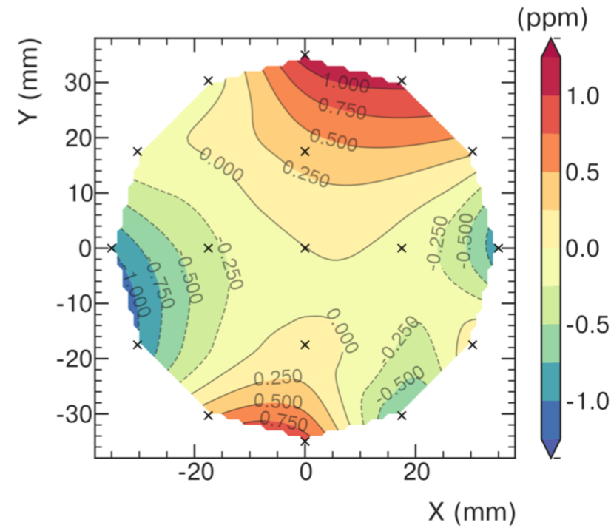
Magnetic Field
1.45 T Superferric Magnet
14 m diameter
12 iron yokes excited by superconducting
coils
Iron top hats (24), poles (72), wedges (864), foil laminations (8000), edge shims and surface coils for field shaping

Slide 15
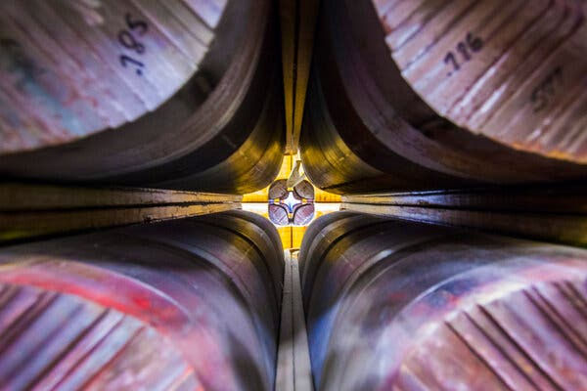
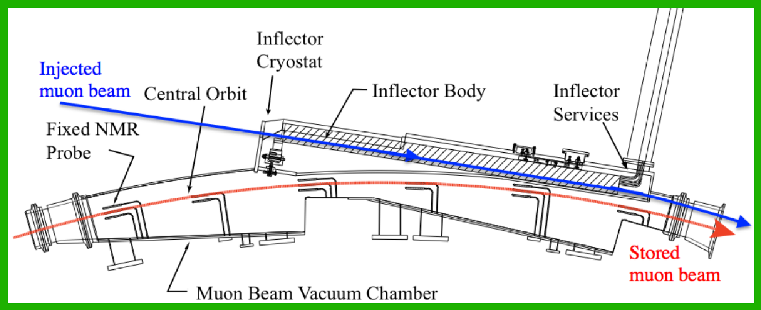


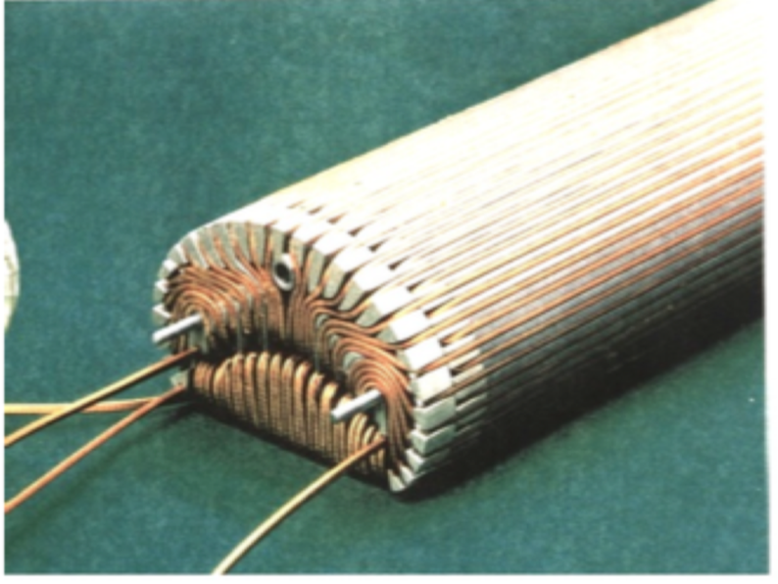
Beam Injection
Inflector Magnet
Provides field free region to deliver beam to edge of storage region
Stops strong deflection of the beam
Injected beam center 77mm off from storage region center

Slide 16
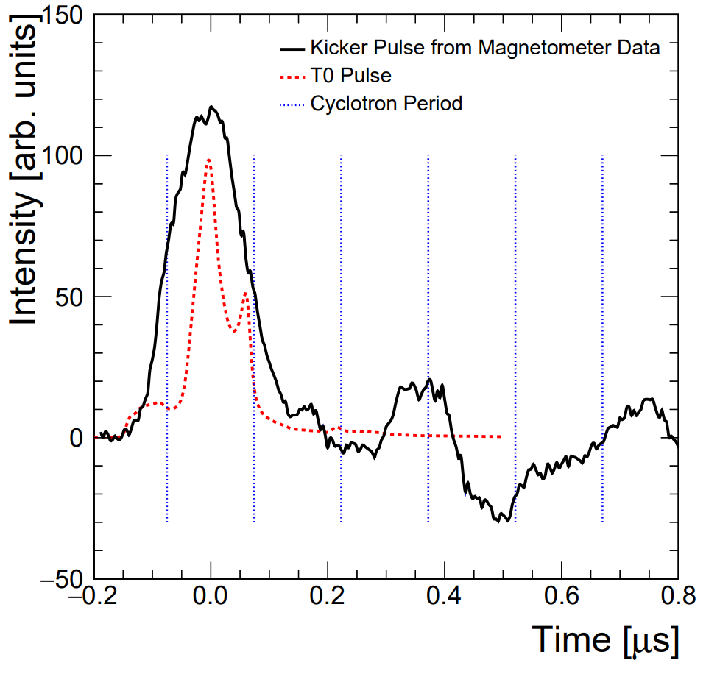

Kick Beam Onto Stable Orbit
μ⁺
Kickers
3 Pulsed Kicker Magnets
Provide 10.8 mrad “kick” to direct muons into ideal orbit (< 149 ns)

Slide 17
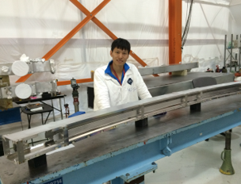
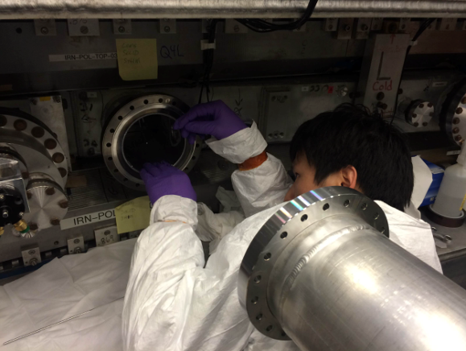
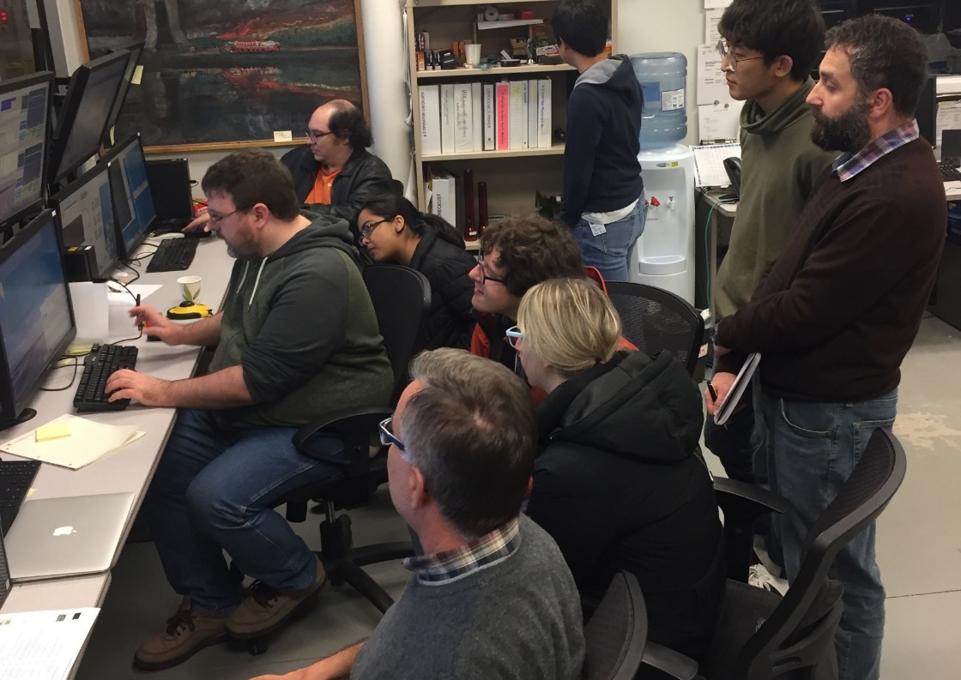
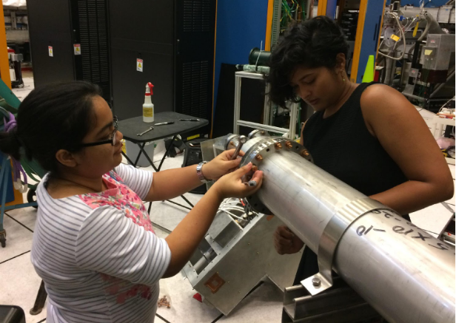
Vertical Focusing with Quadrupoles
-
-
4 Electrostatic Quadrupole (ESQ)
Provide weak vertical focusing of the beam
4 sections cover 43% of ring circumference
+
Wanwei W. aligning and installing ESQs
Jason C. teaching us to use them
Meghna B. performing upgrades

Slide 18
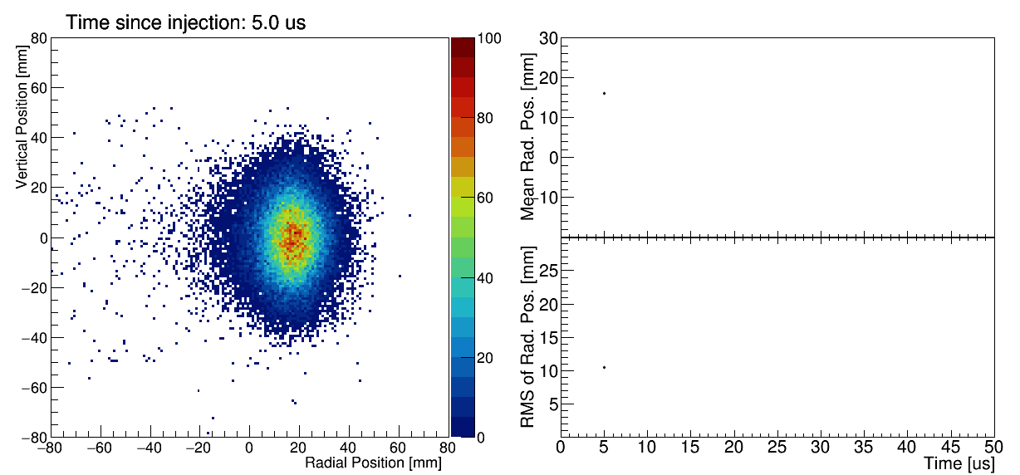
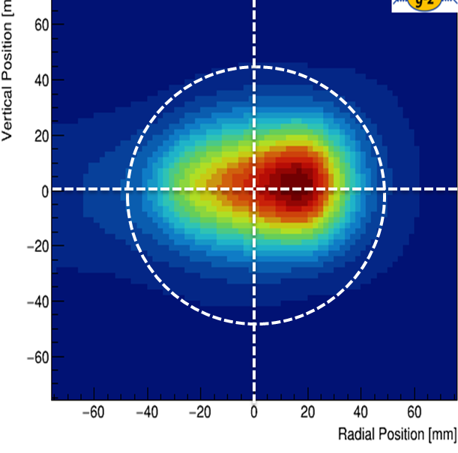
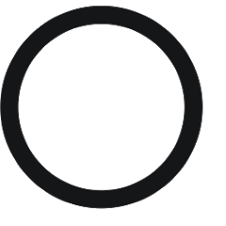
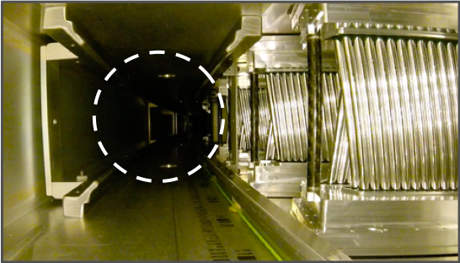
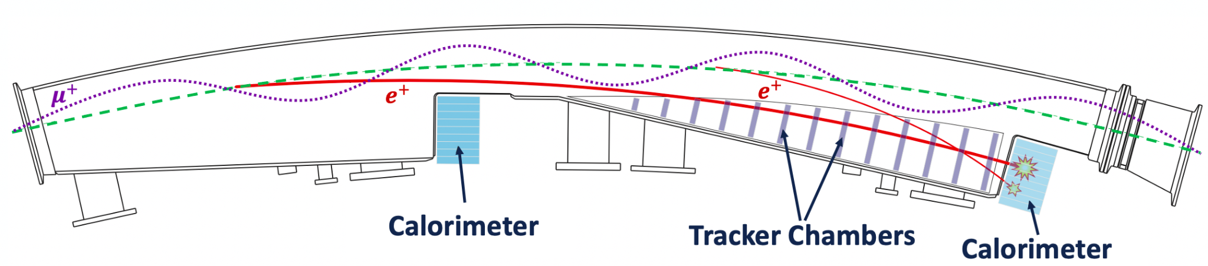
Beam Positions with Trackers
2 Straw Tracker Stations
8 modules/station, 128 straws/module
Reconstruct muon decay positions from e⁺ hits to obtain spatial beam profile

Slide 19
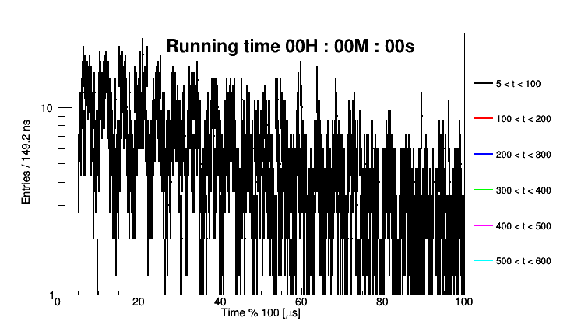
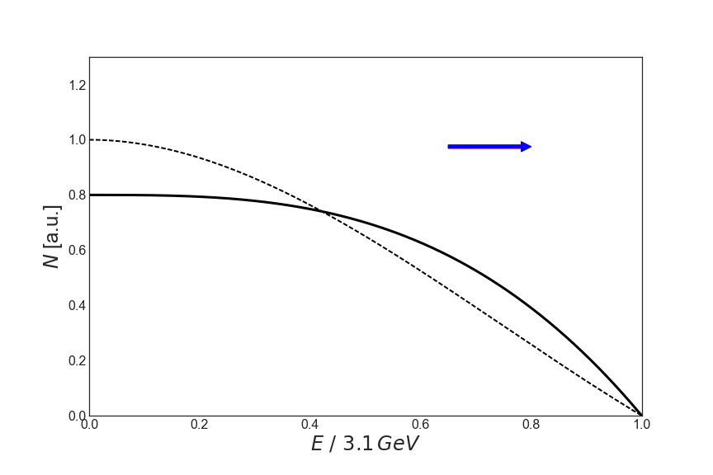
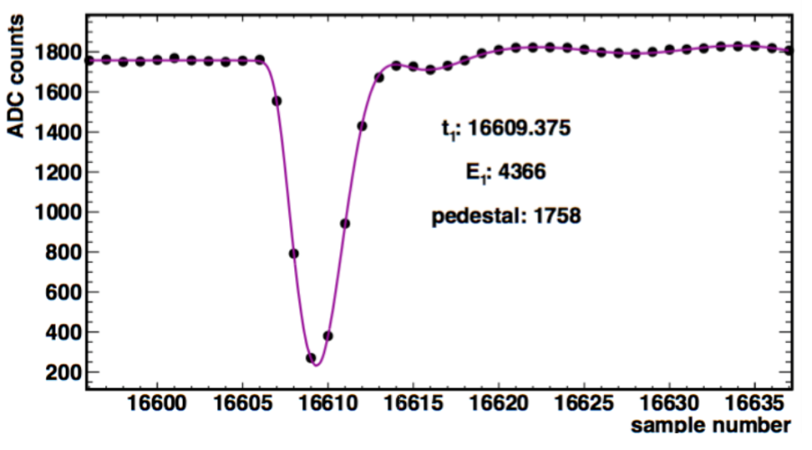
Measure Positrons with Calorimeters
. . .
24 Electromagnetic Calorimeters
9x6 arrays of PbF₂ crystals
Fast SiPM readout
Measure arrival time & energy of the decay e⁺
. . .
Calorimeters
Spin
Momentum
Software threshold

Slide 20
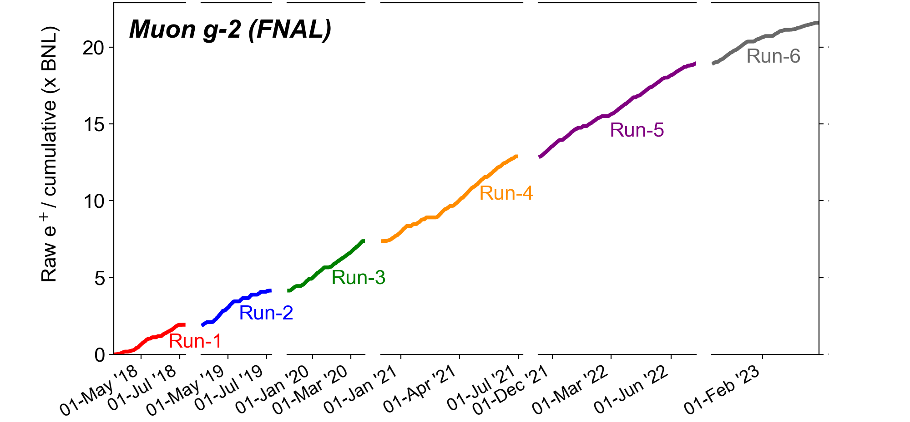
Collected statistics from Muon $g−2$ : x21.9 BNL datasets
On 27 February 2023: proposal Goal of x21 BNL datasets!

Slide 21
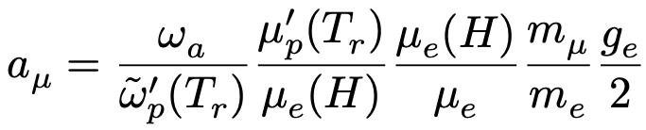
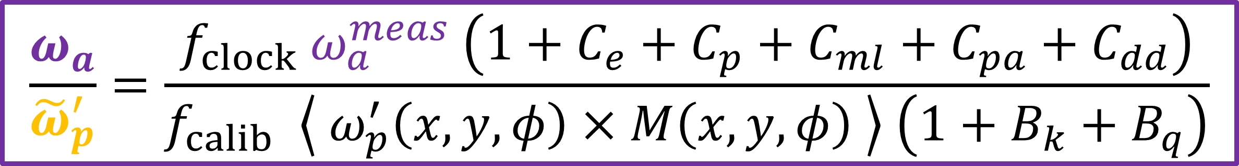
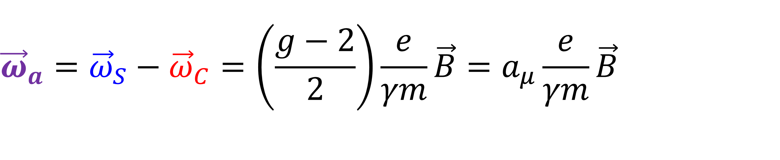

Measuring Muon g-2
Only measure frequencies!
With $ℏω_{p}=2μ_{p}\left|\vec{B}\right|$ (B measured in terms of proton Larmor precession frequency)
$${\vec{ω}}_{a}={\vec{ω}}_{S}−{\vec{ω}}_{C}=\left(\frac{g−2}{2}\right)\frac{e}{γm}\vec{B}=a_{μ}\frac{e}{γm}\vec{B}$$
We measure
From literature
3 ppb
0.3 ppt
22 ppb
$$\frac{ω_{a}}{{\tilde{ω}}_{p}^{′}}=\frac{f_{clock} ω_{a}^{meas} \left(1+C_{e}+C_{p}+C_{ml}+C_{pa}+C_{dd}\right)}{f_{calib} \left\langle ω_{p}^{′}\left(x, y, φ\right)×M\left(x, y, φ\right) \right\rangle \left(1+B_{k}+B_{q}\right)}$$

Slide 22


Measurement of precession frequency, $ω_{a}$, with positrons:
Fitting the time spectrum
The “wiggle plot”
Simple 5-parameter fit to extract $ω_{a}^{meas}$.
This model captures exponential decay and $g−2$ oscillation.
$N\left(t\right)=N_{0}e^{−t/τ_{μ}} \left[1+Acos\left(ω_{a}t+φ_{0}\right)\right]$

Slide 23




Measurement of precession frequency, $ω_{a}$, with positrons:
Fitting the time spectrum
$χ^{2}$/ndf = 51530/4150
A simple 5-parameter fit is not sufficient due to complex beam dynamics effects.
  The most significant one is due to Coherent Betatron Oscillation (CBO)
Each beam dynamic effect contributes an additional frequency component to the wiggle plot
Need to account for beam oscillations that couple to detector acceptance, muons lost before decay to positron, and detector effects such as pileup, gain.
Coherent betatron oscillation (“CBO”)

Slide 24



Measurement of precession frequency, $ω_{a}$, with positrons:
Fitting the time spectrum
$χ^{2}$/ndf = 4086/4138
FFT of fit residual shows several peaks representing beam dynamics effect components.
Modification of fit function required to incorporate beam dynamics effects.
The full model (31-parameter fit) gives good fit quality, significantly reducing fit residuals.
Simple Fit Function
Full Fit Function

Slide 25


The anomalous precession frequency corrections
$\frac{ω_{a}}{{\tilde{ω}}_{p}^{′}}$= $\frac{f_{clock} ω_{a}^{meas} \left(1+C_{e}+C_{p}+C_{ml}+C_{pa}+C_{dd}\right)}{f_{calib} \left\langle ω_{p}^{′}\left(x, y, φ\right)×M\left(x, y, φ\right) \right\rangle \left(1+B_{k}+B_{q}\right)}$
Electric field correction ($C_{e}$): Due to spread in injected muons momenta.
Pitch correction ($C_{p}$): Due to vertical oscillation of muons.
Muon loss correction ($C_{ml}$): It comes from the initial phase-momentum correlation in muons. As muons are lost in time, time-dependent change in phase is observed.
Phase acceptance correction ($C_{pa}$) : It is caused by decay-position and energy dependence of the positron phase. Early-to-late beam motion modulation leads to a time-dependent phase.
Differential decay correction ($C_{dd}$): It accounts for high-momentum muons having a longer lifetime.

Slide 26



Measurement of electric field corrections $C_{e}$
$\frac{ω_{a}}{{\tilde{ω}}_{p}^{′}}$= $\frac{f_{clock} ω_{a}^{meas} \left(1+C_{e}+C_{p}+C_{ml}+C_{pa}+C_{dd}\right)}{f_{calib} \left\langle ω_{p}^{′}\left(x, y, φ\right)×M\left(x, y, φ\right) \right\rangle \left(1+B_{k}+B_{q}\right)}$
Muons off the magic momentum ($γ=29.3, p=3.09 GeV/c)$ will produce a motional magnetic field contribution to $ω_{a}$.
$$C_{e}=2n\left(1−n\right)β^{2}\frac{\left\langle x_{e}^{2}\right\rangle }{R_{0}^{2}}$$
$n$ is the weak focusing field index ($n=\frac{∂E}{∂x}\frac{r_{0}}{vB_{0}}$)
$x_{e}$ is radial equilibrium position which is proportional to the momentum offset.

Slide 27




Measurement of pitch corrections $C_{p}$
$\frac{ω_{a}}{{\tilde{ω}}_{p}^{′}}$= $\frac{f_{clock} ω_{a}^{meas} \left(1+C_{e}+C_{p}+C_{ml}+C_{pa}+C_{dd}\right)}{f_{calib} \left\langle ω_{p}^{′}\left(x, y, φ\right)×M\left(x, y, φ\right) \right\rangle \left(1+B_{k}+B_{q}\right)}$
The vertical motion of the muon causes the vertical spin precession.
The horizontal precession ($ω_{a}$) is affected by coupled in-plane and out-of-plane precessions due to the vertical motion.
Pitch correction estimated from vertical oscillation amplitude ($A$) distribution:

Slide 28


The magnetic field corrections
$\frac{ω_{a}}{{\tilde{ω}}_{p}^{′}}$= $\frac{f_{clock} ω_{a}^{meas} \left(1+C_{e}+C_{p}+C_{ml}+C_{pa}+C_{dd}\right)}{f_{calib} \left\langle ω_{p}^{′}\left(x, y, φ\right)×M\left(x, y, φ\right) \right\rangle \left(1+B_{k}+B_{q}\right)}$
Muon weighted magnetic field: $\left\langle ω_{p}^{′}\left(x, y, φ\right)×M\left(x, y, φ\right) \right\rangle$
Kicker transient ($B_{k}$): Magnetic field change caused by residual field after kicker pulse.
Quad transient ($B_{q}$) : It is caused by vibration of ESQ plates, that perturbs the magnetic field.
$f_{calib}$is calibration factor related to the magnetic field measurement.

Slide 29


Run 2/3 : Total Uncertainties (Statistical + Systematics)
The total uncertainty is still dominated by statistical uncertainty.
$C_{e}$, $C_{p}$, $\left\langle ω_{p}^{′}\left(x, y, φ\right)×M\left(x, y, φ\right) \right\rangle$ : important for CPT and Lorentz Invariance analysis.
arXiv:2402.15410 [hep-ex]

Slide 30





FNAL Muon g-2 Run 1: Biggest SM Crack So Far!
$$a_{μ}\left(BNL\right)=116 592 089\left(63\right)×{10}^{−11} \left(540 ppb\right)$$
      Current analysis found no issues with BNL result
$$a_{μ}\left(FNAL\right)=116 592 040\left(54\right)×{10}^{−11} \left(460 ppb\right)$$
Consistent with BNL, 15% smaller uncertainty
Phys. Rev. Lett. 126, 141801 (2021)
$$a_{μ}\left(Exp−SM\right)=251\left(59\right)×{10}^{−11}$$
Tension stood at 4.2σ
$$a_{μ}\left(Exp\right)=116 592 061\left(41\right)×{10}^{−11} \left(350 ppb\right)$$
Uncertainty comparable with 370 ppb WP20 SM
Phys. Rept. 887,1 (2020)

Slide 31

FNAL Muon g-2 Run 2/3: Is the crack sealed back up?
a_{µ}(FNAL) = 116 592 055(24) x 10⁻¹¹ [203 ppb]
Phys. Rev. Lett. 131, 161802 (2023)
All measurements and combinations still dominated by statistical error
World average is almost completely determined by ultra-precise FNAL result
Theory value now up in the air
540 ppb
460 ppb
215 ppb
203 ppb
190 ppb

Slide 32

Why Frequencies? → Clocks
We’re checking if $ω_{a}$ measurements show any evidence of CPTLIV
But are our clocks sensitive to CPTLIV?

Slide 33

Muon g-2 Clock(Time) Reference
How do you make a high precision measurement?
  Compare to instruments/values that are more precise
What values do we reference (what rulers)?
  Magnetic moments, masses: µ_{p}/µ_{e}: 3 ppb, m_{µ}/m_{e}: 22 ppb
  Time/frequency: Rb-87 hyperfine transition
Rb clock: secondary standard
  Based on atomic trans, but..
  Inherent inaccuracies due to e.g. gas cell ΔP, ΔT
  Disciplines crystal osc.: gas cells reduce intensity by ~0.1% when exposed to µwave near trans. f; osc. stabilzed by detecting dip while sweeping RF synthesizer through f

Slide 34
Muon g-2 Clock(Time) Reference
Rb good enough?
  Precision of ~1 ppb, but issues with long-term stability, therefore…
GPS-disciplined Rb oscillator
  GPS uses Cs and Rb. Cs: more precise (defines 1 s), but $$$
Why do we need that particular m_{F}=0→0 transition?
  Does not depend on orientation
  CPTLV invariant! (Brillet and Hall, 1979 : Δf/f due to earth’s rotation <10⁻¹⁴, negligible for us)

Slide 35



Muon g-2 Clock(Time) Reference
What did E821 use (GPS wasn’t ready at the time)?
  LORAN-C system
    LOngRangeNavigation-Cyclan
    Hyperbolic radio navigation: timing difference between two radio signals (i.e. GPS, but with land-based radio stations)
    Based on Cs atomic clocks
    Thanks to L. Roberts, S. Baessler

Slide 36


CPTLV: SME
SME Lagrangian:
  All terms violate Lorentz invariance
  a_{κ} , b_{κ} are CPT-odd; others are CPT-even
Does not assume anything specific about the nature of the violating physics
Don’t know what particles it might or might not couple to
  Have to check all sectors!
  But there is one sector in which we have very strong evidence for new physics – muons!

Slide 37
SME Experimental Tests
UW
Adelberger
group

Slide 38
SME Experimental Tests
Similar for neutron sector

Slide 39
SME Experimental Tests

Slide 40

CPTLV: SME and Muon g-2
SME Lagrangian:
  All terms violate Lorentz invariance
  a_{κ} , b_{κ} are CPT-odd; others are CPT-even
Predicts two CPT/Lorentz Violating signatures for muon g-2:
  Gomes, Kostelecky, Vargas, Phys.Rev.D90:076009,2014
  Sidereal (or annual) variation in ω_{a}
  Difference in ω_{a} between µ⁺ / µ⁻
  Use frame where Z is the orientation of the earth’s axis relative to the fixed, distant stars, and χ is the colatitude (earth’s precession negligible in our case)
Z
χ

Slide 41

CPTLV: $μ^{+}$/$μ^{−} ω_{a}$ Difference
However, the magnetic field can vary, so when comparing frequencies, instead of ω_{a}, we use R = ω_{a}/ ω_{p}
BNL E821 Results (2008)
χ

Slide 42



CPTLV: $μ^{+}$/$μ^{−} ω_{a}$ Difference
For two experiments at different colatitudes:
  e.g. BNL & CERN, FNAL & J-PARC
BNL E821 Results (2008)
  BNL & CERN
But J-PARC can’t do $μ^{−}$…
FNAL E989 was the only and last
shot at improving this!
χ

Slide 43





CPTLV: Sidereal oscillation of $ω_{a}$
E989 Run 2 Data
M. Bhattacharya Dissertation
${{\hat{ω}}_{a}}^{μ^{±}}$: amplitude of sidereal $ω_{a}$ oscillation
Calculate R = ω_{a}/ ω_{p} on a Run-by-Run basis
  A run is ~1 hour of data
Approaches to search for oscillation
  Multi-parameter fit: good for all data
  Lomb-Scargle test: designed for unequally spaced data
Previous results:
  BNL E821
  FNAL E989 (PRELIMINARY)
$A<2.2 ppm$ $b_{T}^{μ^{+}}≤1.4×{10}^{−24} GeV$
$A<2.0 ppm$, $b_{T}^{μ^{+}}≤1.3×{10}^{−24} GeV$

Slide 44
SME Muon Sector Current Limits (Kostelecký et.al. )

Slide 45
SME Muon Sector Current Limits

Slide 46
SME Muon Sector Current Limits

Slide 47
SME Muon Sector Current Limits

Slide 48
SME Muon Sector Current Limits

Slide 49



SME and CPTLV in Muon $g−2$
CPTLV effects with the signal at sidereal frequency:
      In cartesian coordinate $c_{X or Y or antisymm XY pair}$
      In spherical coordinate $c_{kl1}$ (i.e. azimuthal index $m=1$)
CPTLV effects with the signal at sidereal frequency harmonics:
      In cartesian coordinate $c_{symm XY pair}$
      In spherical coordinate $c_{klm}$ (i.e. azimuthal index $m>1$)
No search for signal at sidereal harmonics has ever been conducted!

Slide 50

Muon g-2 Run 2/3 CPTLV Analysis
The rest of the talk is basically copied from Dr. Baisakhi Mitra’s 28 May 2024 dissertation defense!

Slide 51



SME and CPTLV in Muon $g−2$
$A_{m}$ : Total amplitude of $m^{th}$harmonic. This term is energy dependent.
$E_{0}$ : unperturbed muon energy.
$G_{jm}$ : Dimensionless factor.
$d ≤4 :$Minimal SME, $d> 4$ : Nonminimal SME.
Nonminimal terms produce effects that grow with energy.
$d$: mass dimension of the SME coefficient. odd $d$: $m_{max}=d −2$ ; even $d$: $m_{max}=d−3$.

Slide 52


SME and CPTLV in Muon $g−2$
BNL and FNAL: maximum muon energy (3.09 GeV) is the same.
  BNL data allowed limits up to $d=8$
So, E989 has reach up to $d=8 →$ $m_{max}=5$, i.e. coefficients possible up to 5th harmonic.
  ${\check{H}}_{nj1}$, ${\check{H}}_{nj2}$, ${\check{H}}_{nj3}$, ${\check{H}}_{nj4}$, ${\check{H}}_{nj5}$
  ${\check{g}}_{nj1}$, ${\check{g}}_{nj2}$, ${\check{g}}_{nj3}$, ${\check{g}}_{nj4}$, ${\check{g}}_{nj5}$
E989 will conduct first-ever search at sidereal harmonics

Slide 53



CPTLV Analysis Framework
CPTLV Oscillation Amplitude
Blinding & Extraction
R_{µ} Time Series Extraction
Analyzer verification on the entire dataset
Extraction of Unix timestamp for each run
Extraction of ${\tilde{ω}}_{p}^{′}$for each run
Extraction of $R_{μ}=$ $\frac{ω_{a}}{{\tilde{ω}}_{p}^{′}}$for each run

Slide 54


Analyzer verification on the entire dataset
Analysis done on Run 2, Run 3a, and Run 3b datasets.
Full-fit with 31 parameters performed on Run 2, Run 3a and Run 3b datasets.
  $ω_{a}^{m}=ω_{ref}∙\left(1+\left[R−∆R\right]×{10}^{−6}\right)$, $∆R$ is common software blinding offset

Slide 55


Extraction of Unix timestamp and ${\tilde{ω}}_{p}^{′}$for each run: Run 2

Slide 56


Extraction of $R_{μ}=$ $\frac{ω_{a}}{{\tilde{ω}}_{p}^{′}}$for each run: Determination of $ω_{a}$ per run
Preparation of per run wiggle plot:
  Previous analyses: Threshold method (T)
    Each positron above threshold equally weighted
  Current Run 2/3 analysis: Asymmetry weighted method (A):
    Each positron is weighted by asymmetry $A(E)$, which is a function of energy. More statistically powerful than T method.
$ω_{a}$ per run extraction : 5-parameter fit applied to per run wiggle plot.
$N\left(t\right)=N_{0}e^{−t/τ_{μ}} \left[1+Acos\left(ω_{a}t+φ_{0}\right)\right]$

Slide 57


Extraction of $R_{μ}=$ $\frac{ω_{a}}{{\tilde{ω}}_{p}^{′}}$for each run: Determining $ω_{a}$ per run
Per run data suffers from poor statistics in late time bins.
Traditional Chi-square fit method uses dynamic end time to cut off low statistic late time bins from the fit.
Poisson statistics is excellent in handling low statistics. Maximum Likelihood Estimator (MLE) with Poisson statistics used.

Slide 58



Extraction of $R_{μ}=$ $\frac{ω_{a}}{{\tilde{ω}}_{p}^{′}}$for each run: Chi-square method and MLE method: Run 2

Slide 59



Extraction of $R_{μ}=$ $\frac{ω_{a}}{{\tilde{ω}}_{p}^{′}}$for each run: Chi-square method and MLE method: Run 3a

Slide 60



Extraction of $R_{μ}=$ $\frac{ω_{a}}{{\tilde{ω}}_{p}^{′}}$for each run: Chi-square method and MLE method: Run 3b

Slide 61








Extraction of $R_{μ}=$ $\frac{ω_{a}}{{\tilde{ω}}_{p}^{′}}$for each run: Comparison for Run 2
${|ω}_{a}/2π\left(MLE\right)$ $− ω_{a}/2π\left(DYN\right)|$vs $N_{0}$
$ω_{a}/2π$ vs $N_{0}$
$N_{0}$ vs Run Duration
Conclusion: Even after applying dynamic-fit end time, Chi-Square $ω_{a}$ histogram has some outliers. The outlier runs have very small duration ($\sim$ minutes). Those runs excluded from the analysis.

Slide 62


Total run statistics used in CPTLV analysis

Slide 63


Extraction of oscillation amplitude from Run-by-Run$R_{μ}$: Using MPF
Time domain extraction: Using Multi-Parameter fit (MPF)
$R_{μ}= C_{0}+ \frac{A}{{\tilde{ω}}_{p}^{′}}\sin\left(2π{nf}_{s}t+φ\right)$
  $C_{0}$: Constant
  $A$: oscillation amplitude
  $f_{s}$: Sidereal frequency
  $n$: Sidereal harmonic (1,2,3,4,5)
Run 2 Preliminary

Slide 64


Extraction of oscillation amplitude from Run-by-Run$R_{μ}$: Using GLS
Frequency domain extraction: Using Generalized Lomb-Scargle periodogram method.
Spectral analysis technique for unequally spaced data
Time domain model: $g\left(t\right)=\operatorname{acos}\left(2πft\right)+bsin\left(2πft\right)+c$
Minimization of $χ^{2}$ at frequency $f$ to obtain minimum $χ^{2}$ = $\tilde{χ^{2}}$
Lomb Power at $f$: $P_{S}\left(f\right)=\frac{[\tilde{χ_{0}^{2}}−\tilde{χ^{2}}(f)]}{\tilde{χ_{0}^{2}}}$, where $\tilde{χ_{0}^{2}}$ is $\tilde{χ^{2}}$for $g\left(t\right)=c.$

Slide 65

Bias Test for the Blinding procedure
Blinding parameter: Injected amplitude $A_{blinded}$ (ppm) at sidereal frequency and harmonics. $0.5$ppm $≤ A_{blinded}$ $≤$ $5$ ppm.
Conclusion: Blinding algorithm is not biased.

Slide 66
Systematic Uncertainties
Magnetic Field related
systematics
Detector gain calibration
related systematics
Beam dynamics
related systematics

Slide 67


Magnetic Field related systematics
Search for any potential signal in $\tilde{ω_{p}^{′}}$ at the sidereal frequency and its harmonics.
  Set a limit on the oscillation amplitude of $\tilde{ω_{p}^{′}}$ at the sidereal frequency and its harmonics.
For most of the harmonics, magnetic field oscillation amplitude is larger in Run 2 than in Run 3. It is expected because of improved hall cooling in Run 3.
The maximum oscillation amplitude is 0.025 ppm that is less than sensitivity limit 0.5 ppm

Slide 68



Magnetic Field related systematics: Spectral analysis
Generalized Lomb Scargle Periodogram (GLS): Spectral analysis technique to analyze non-uniformly spaced time series data. Spectral power or Lomb power is normalized. Maximum Lomb Power = 1.
The red dotted lines indicate sidereal frequency and its harmonics.
Conclusion: Spectral analysis of $\tilde{ω_{p}^{′}}$ vs time data shows no significant peak .

Slide 69

Detector gain calibration related systematics
Gain: The ratio of a positron detectors (calorimeters) output to its input.
Calorimeters: A positron of a certain energy generates an output signal of a certain size in the SiPM sensors.
The output of SiPM sensors is converted to energy units by calibration procedures.
Ideally, this ratio should remain constant in time so that the calibration remains accurate.
The gain of the calorimeters can vary due to temperature variation.
Long term effects ($\sim$hours) are important for CPTLV: Out-of-fill (OOF) gain correction. This correction concerns long-time scale gain drifts, which are primarily due to temperature.

Slide 70



Detector gain calibration related systematics: OOF gain correction
The red dotted lines indicate sidereal frequency and its harmonics.
Conclusion: The Spectral analysis of OOF gain correction vs time shows no distinct peak. Therefore, this systematics does not have an effect on CPTLV analysis

Slide 71

Beam dynamics related systematic uncertainties: Study of Run-by-Run CBO parameter
For combined Run 2+ Run 3a+ Run 3b dataset
Conclusion: Distribution of difference in $R_{μ}$from 5-parameter fit and 9-parameter fit (including CBO parameters) is clustered between 0-300 ppb, below sensitivity limit.

Slide 72


Beam dynamics related systematic uncertainties: Study of Run-by-Run Electric Field Correction: $C_{e}$
Conclusion: Only Run 3b has a distinct peak at sidereal frequency. Amplitude of oscillation corresponding to this peak is 11 ppb, below the sensitivity limit.

Slide 73



Beam dynamics related systematic uncertainties: Study of Run-by-Run Pitch Correction: $C_{p}$
Conclusion: Only Run 2 has a distinct peak at sidereal frequency. Amplitude of oscillation corresponding to this peak is 0.45 ppb, below the sensitivity limit.

Slide 74

Results
CPTLV analysis is not yet unblinded for the entire Run 2 and Run 3 dataset.
The new analysis model has been tested on the preliminary Run 2 dataset. Features of the new analysis framework:
  Asymmetry-weighted method is used to extract $ω_{a}$data, instead of Threshold method.
  A detailed systematic study is performed which includes gain related, and beam dynamics related systematics along with the magnetic field related systematics.
  Generalized Lomb-Scargle method is used for the spectral analysis.

Slide 75

Results: Preliminary Run 2

Slide 76

Results: Preliminary Run 2
10,000 MC datasets generated with 1.74 ppm sinusoidal signal injected at sidereal frequency. Distribution of Lomb Power at sidereal frequency is plotted for those 10,000 MC datasets.
The red dotted line indicates the Normalized Lomb power at the sidereal frequency in the real Run 2 dataset. Total bin count above the red dotted line is 9502, which indicates confidence level of 95.02%.

Slide 77

Results: Preliminary Run 2
Sidereal oscillation amplitude at sidereal frequency:
$A_{1}^{+}<1.74 ppm$, $b_{T}^{μ^{+}}≤1.10×{10}^{−24} GeV$
  Previous T-method analysis on Preliminary Run 2 data: $A_{1}^{+}<2.0 ppm$, $b_{T}^{μ^{+}}≤1.3×{10}^{−24} GeV$
  Sensitivity has increased due to use of the Asymmetry-weighted method.
With Run 2 and Run 3 unblinded data, sensitivity limit should subceed $1×{10}^{−24} GeV$
With Runs 4-6, sensitivity will improve by about another factor of 2

Slide 78

Prospects: Sidereal Measurement
Muon g-2 is an extremely sensitive laboratory to test SM / search for (and possibly identify!) BSM physics.
Previous studies indicate that sensitivity roughly scales with ω_{a} uncertainty.
  E989 uncertainty aiming for x4 improvement compared to BNL E821.
E989 sensitivity to sidereal variation should be at ~ $5×{10}^{−25}$ GeV level.
Performing first-ever search for CPTLV at sidereal harmonic frequencies
First-ever search for annual variation
  Not done in E821 because 3-month runs were always at the same time of year.
  E989 data covers ~10 calendar months out of the year
E989
E821

Slide 79











Thanks to the UMiss Muon g-2 Group
Postdocs
Breese Quinn
Jenny Holzbauer
Alex Keshavarzi
Jason Crnkovic
On Kim
Undergraduate Student
Graduate Students
Byungchul Yu
Sam Krishnamurthy
Wanwei Wu
Meghna Bhattacharya
Baisakhi Mitra
Undergrads Cooper Crawley, Lane Taylor

Slide 80











Acknowledgements
Department of Energy (USA),
National Science Foundation (USA),
Istituto Nazionale di Fisica Nucleare (Italy),
Science and Technology Facilities Council (UK),
Royal Society (UK),
Leverhulme Trust (UK),
European Union's Horizon 2020,
Strong 2020 (EU),
German Research Foundation (DFG),
National Natural Science Foundation of China,
MSIP, NRF and IBS-R017-D1 (Republic of Korea)
Thanks also to all engineers, techs and support staffs at all our collaborating institutions for their work which made g-2 successful!!

Slide 81

Thank You, UCL!

Slide 82
Backup Slides

