Slide 1



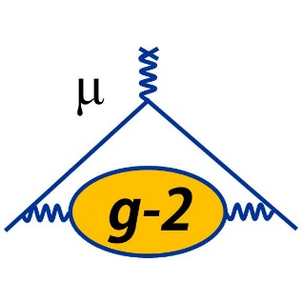

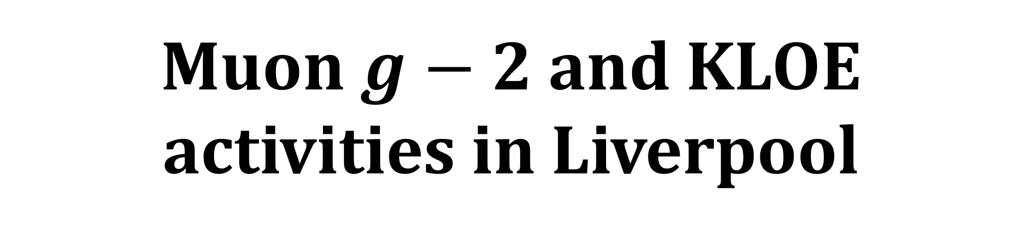
Muon $g−2$ and KLOE activities in Liverpool
Lorenzo Cotrozzi
Particle Physics Annual Meeting 2024 | Liverpool
23/05/2024

Slide 2
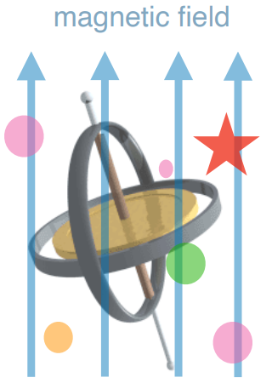
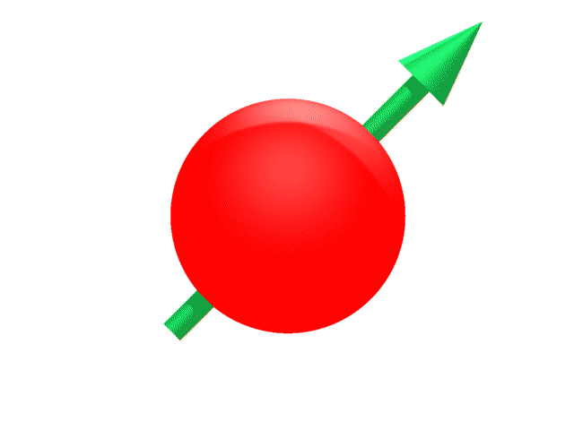
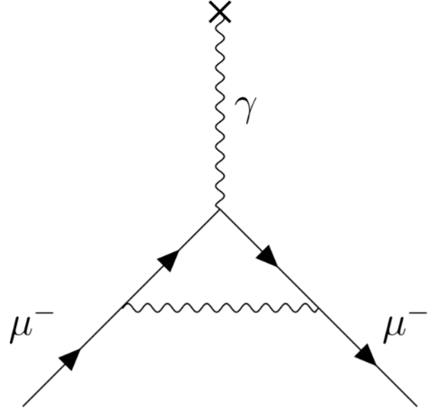

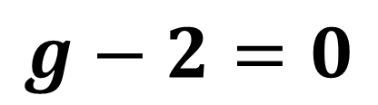

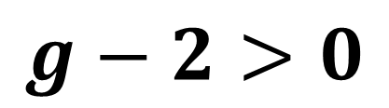
The anomalous magnetic moment
Particle with spin in magnetic B-field: $\vec{μ}≡g\frac{e}{2m}\vec{S}$ → $τ=\vec{μ}×\vec{B}$, $U=−\vec{μ}⋅\vec{B}$
Dirac’s prediction for spin-$\frac{1}{2}$ charged particles: $g=2$
Radiative corrections in Quantum Field Theories: $g≠2$
Kusch and Foley’s measurement/
Schwinger’s prediction:
(1948, electron $g_{e}−2$)
$\frac{g_{e}−2}{2}≡a_{e}≈0.00116$
1st order QED term: $\frac{α}{2π}$
universal to all leptons: $e$, $μ$, $τ$
$$g−2=0$$
$$g−2>0$$

Slide 3
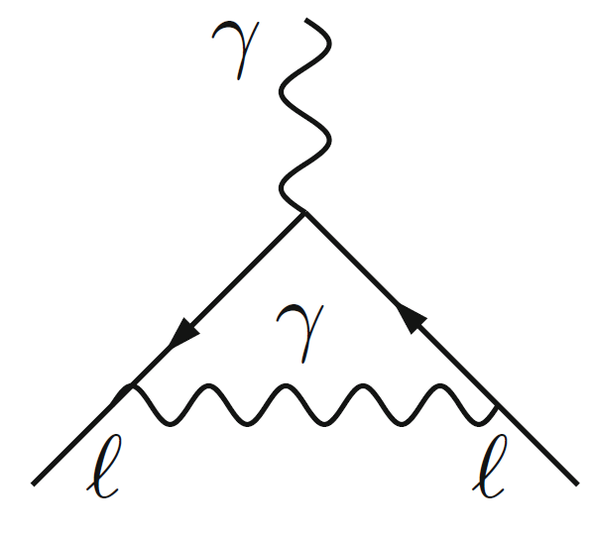
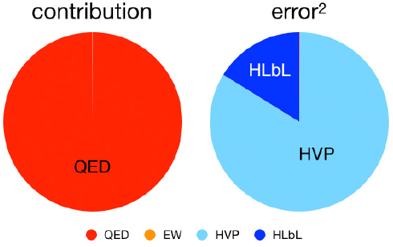
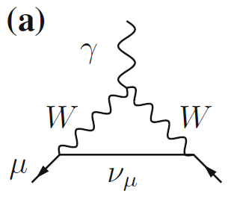
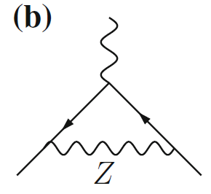
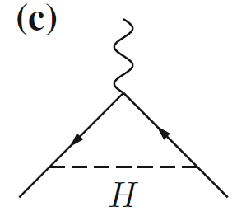
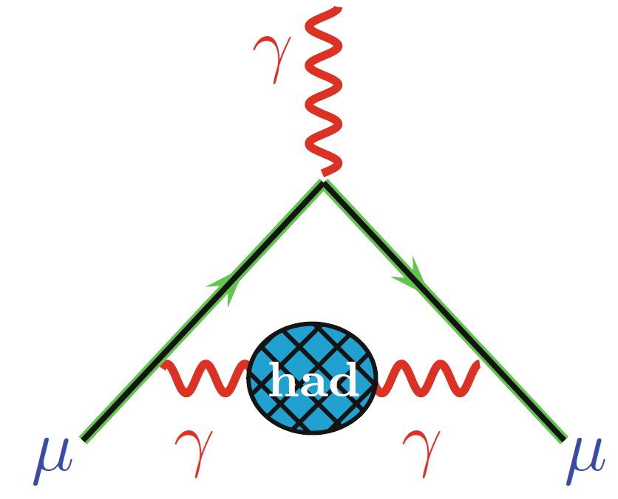
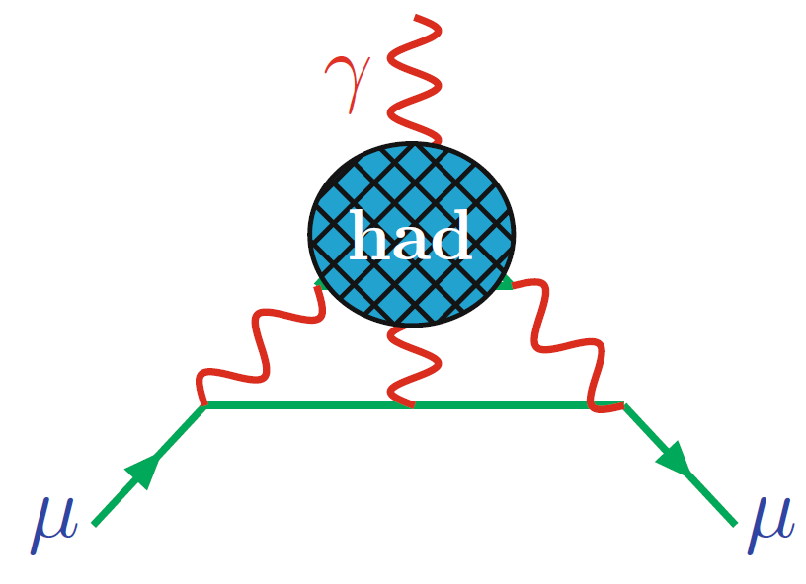
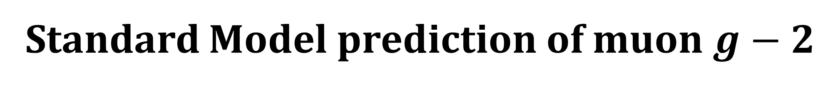
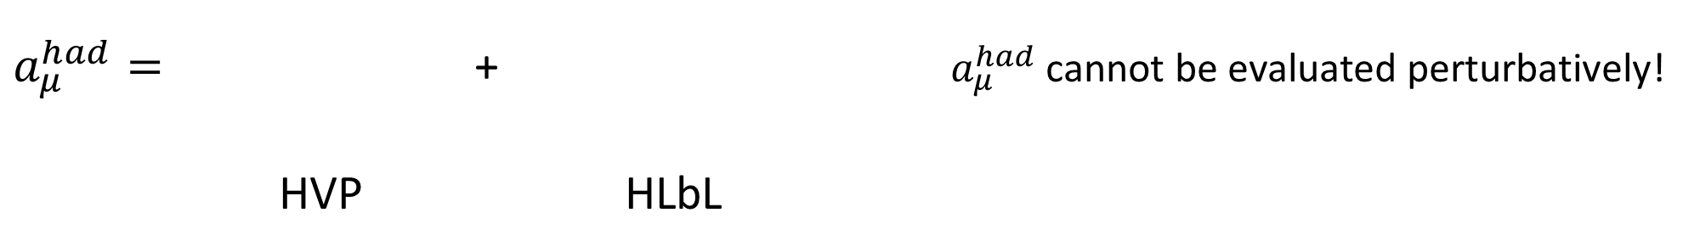
Standard Model prediction of muon $g−2$
$a_{μ}≡\frac{g_{μ}−2}{2}$ $a_{μ}^{SM}=a_{μ}^{QED}+a_{μ}^{EW}+a_{μ}^{had}$
$a_{μ}^{QED}=$ + over 14’000 diagrams
$a_{μ}^{EW}=$ + + + …
$a_{μ}^{had}=$ + $a_{μ}^{had}$cannot be evaluated perturbatively!
HVP HLbL
QCD dominates the uncertainty

Slide 4
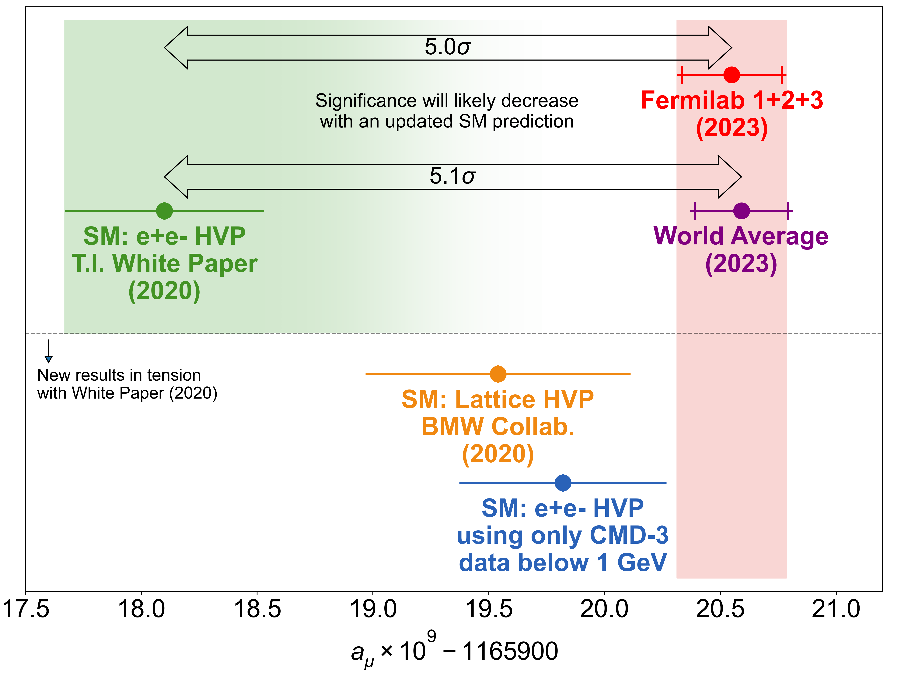
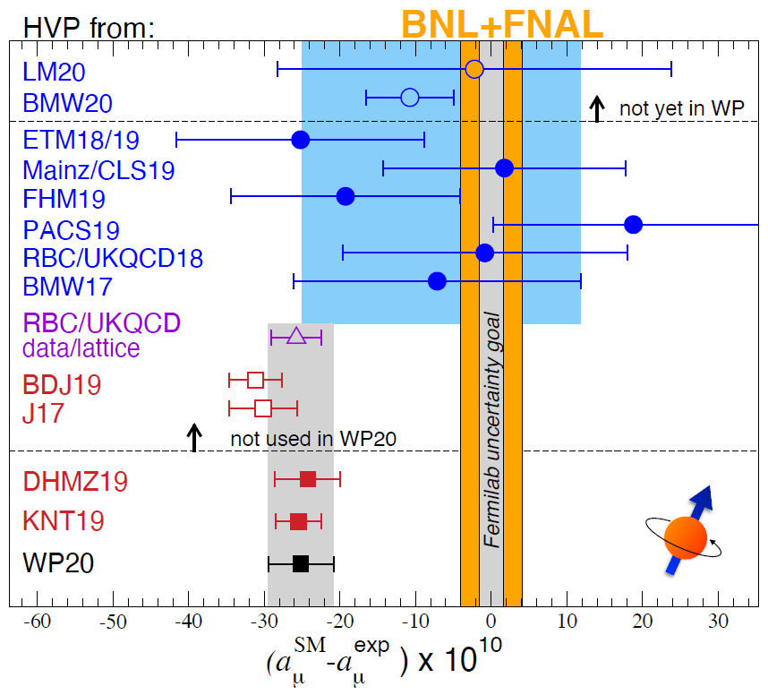

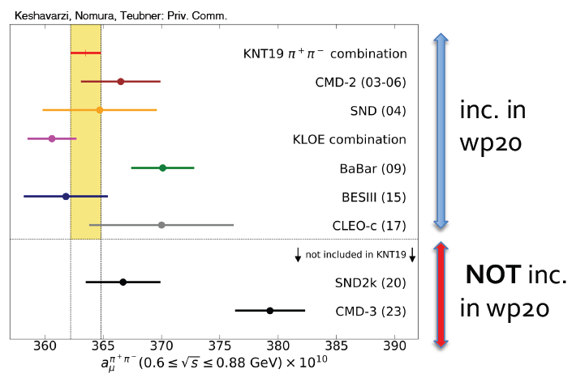

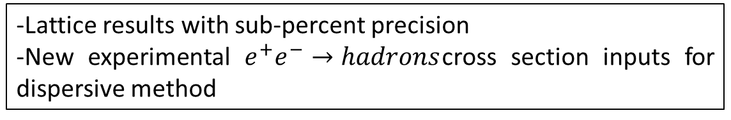
Tensions in theoretical prediction
-Lattice results with sub-percent precision
-New experimental $e^{+}e^{−}→hadrons$cross section inputs for dispersive method

Slide 5
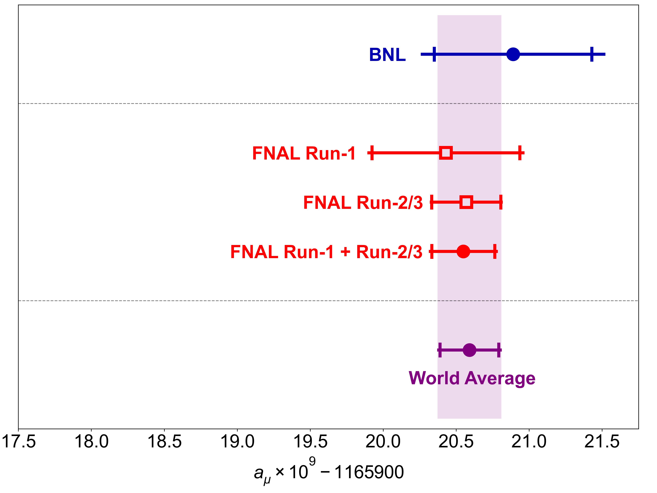
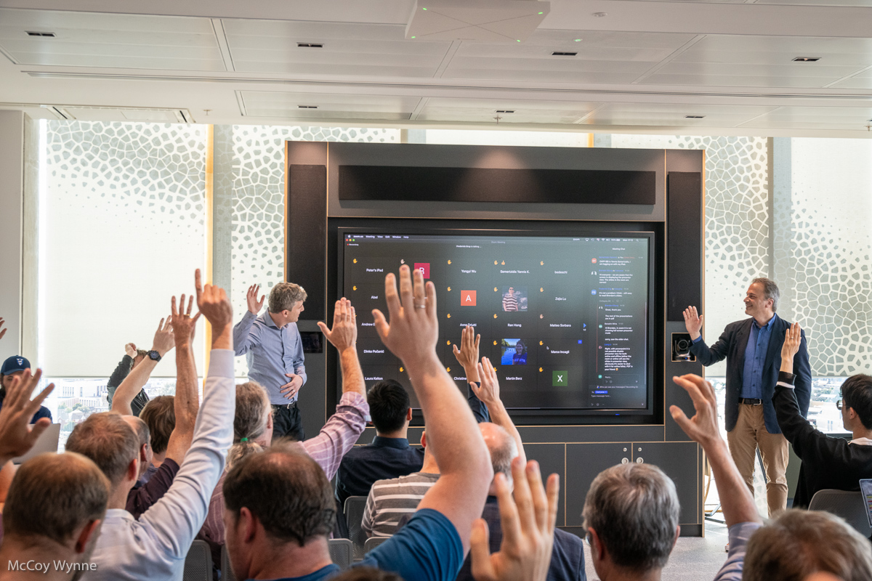
2023 Muon g-2 results
D. P. Aguillard et al, Phys. Rev. Lett. 131.161802 (2023)
D. P. Aguillard et al, arxiv:2402.15410 (2024)
Accepted yesterday for publication on PRD!
2006: 540 ppb
April 7th, 2021
August 10th, 2023
(203 ppb)
2023: 190 ppb
Unblinding last year (last step before release of result), here at The Spine :D

Slide 6
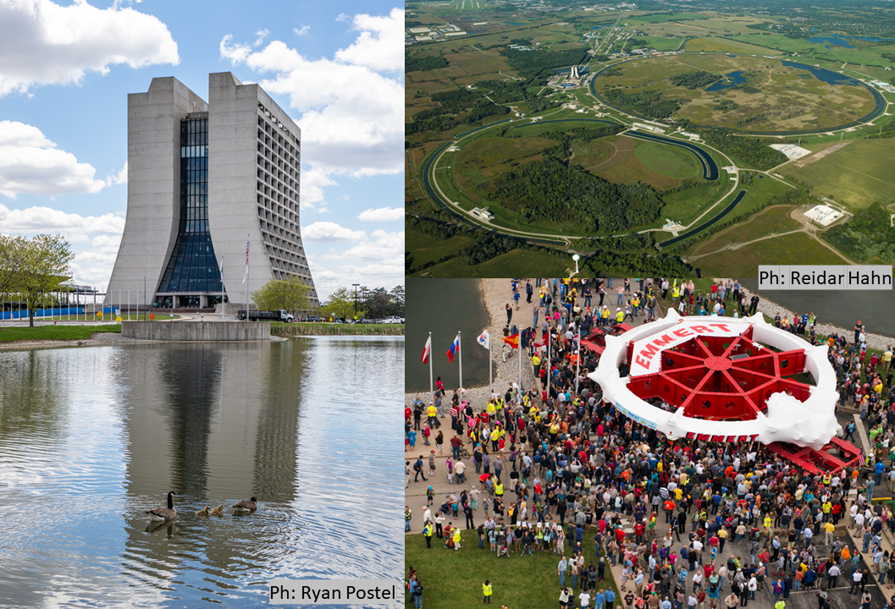
Experiment at Fermilab Muon Campus
Liverpool contributions highlighted throughout the slides

Slide 7
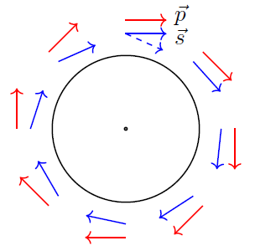
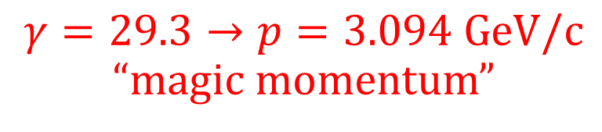
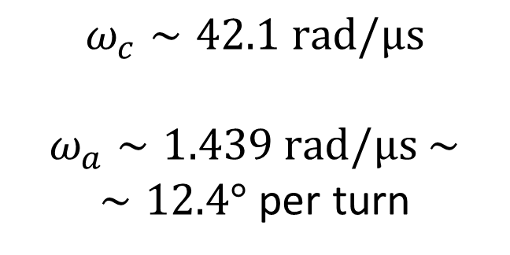
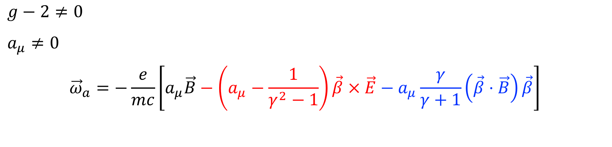

Anomalous spin precession in B-field
$g−2≠0$
$a_{μ}≠0$
$${\vec{ω}}_{a}=−\frac{e}{mc}\left[a_{μ}\vec{B}−\left(a_{μ}−\frac{1}{γ^{2}−1}\right)\vec{β}×\vec{E}−a_{μ}\frac{γ}{γ+1}\left(\vec{β}⋅\vec{B}\right)\vec{β}\right]$$
$→$ spin precesses with anomalous frequency ${\vec{ω}}_{a}={\vec{ω}}_{spin}−{\vec{ω}}_{c}$
$γ=29.3→p=3.094 GeV/c$ “magic momentum”
$$ω_{c}∼42.1 rad/μs$$
$ω_{a}∼1.439 rad/μs$ $∼$
$∼12.4°$ per turn
$$\vec{β}⋅\vec{B}=0$$

Slide 8
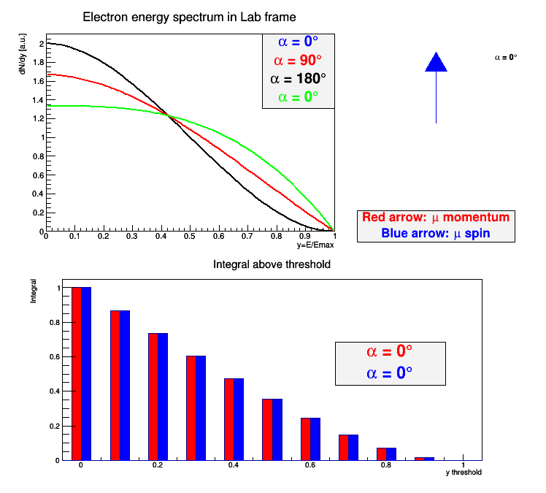
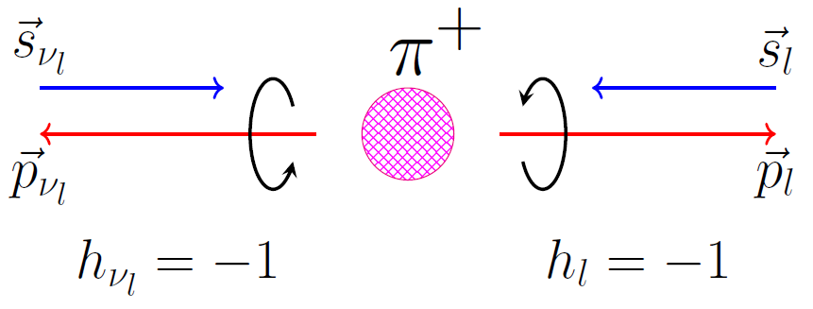
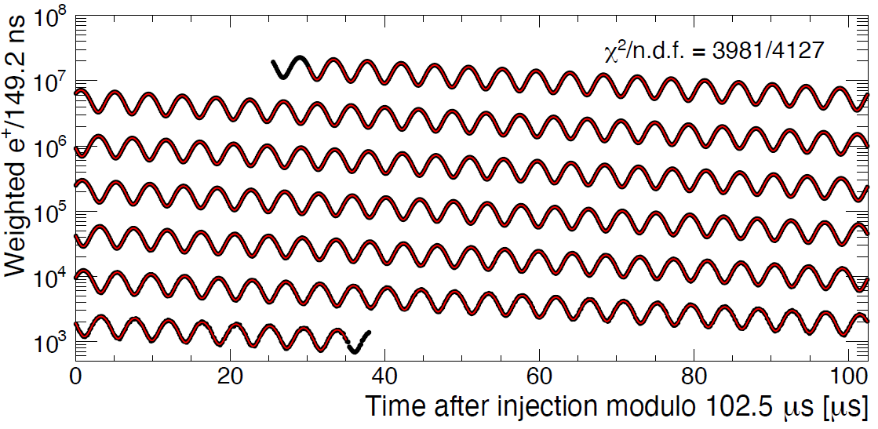
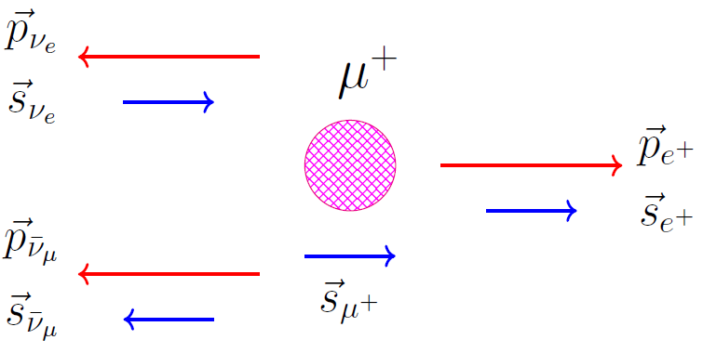

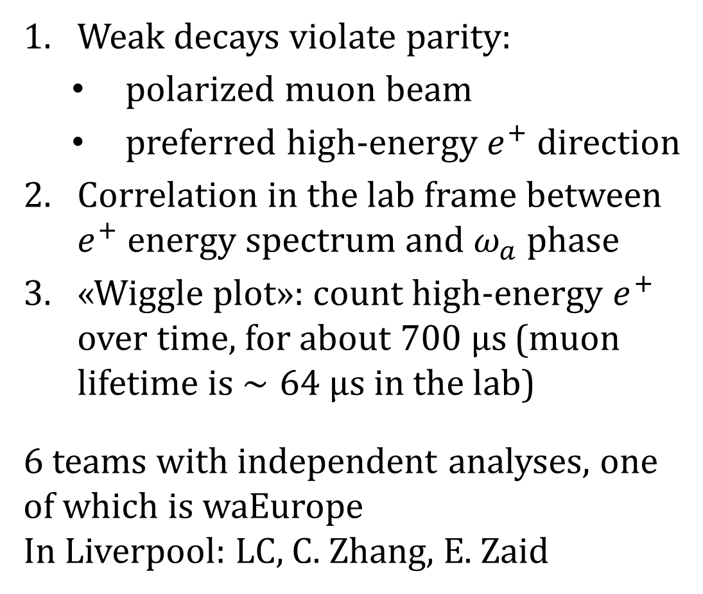
Principle of $ω_{a}$ measurement
Weak decays violate parity:
  polarized muon beam
  preferred high-energy $e^{+}$ direction
Correlation in the lab frame between $e^{+}$ energy spectrum and $ω_{a}$ phase
«Wiggle plot»: count high-energy $e^{+}$ over time, for about $700 μs$ (muon lifetime is $∼64 μs$ in the lab)
6 teams with independent analyses, one of which is waEurope
In Liverpool: LC, C. Zhang, E. Zaid
My PhD Thesis,
March 2024

Slide 9
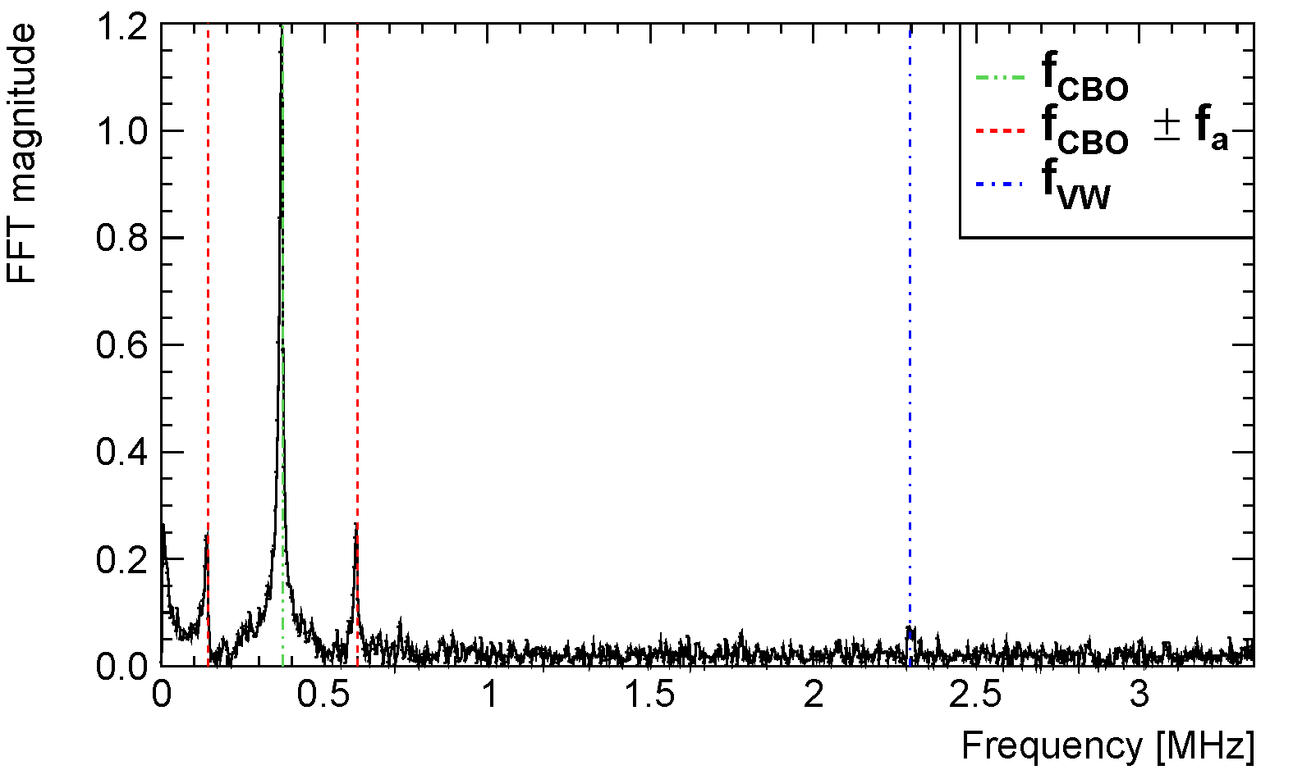
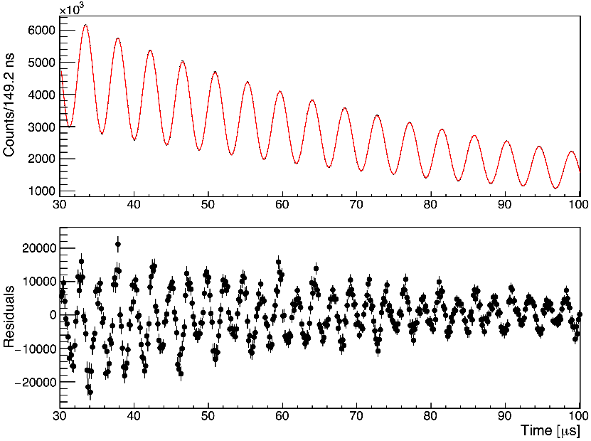
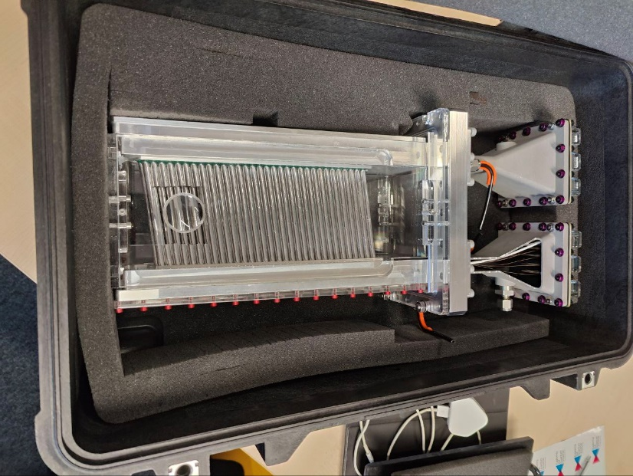

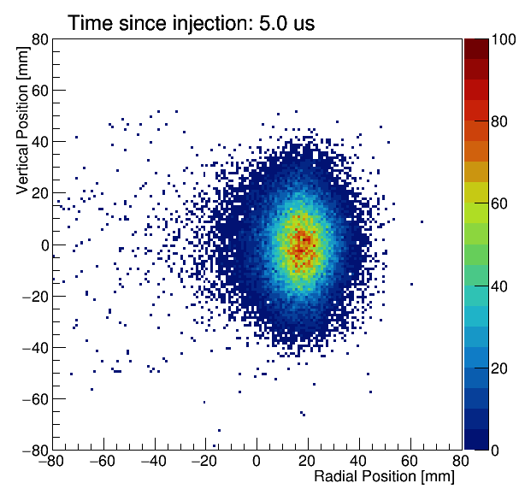
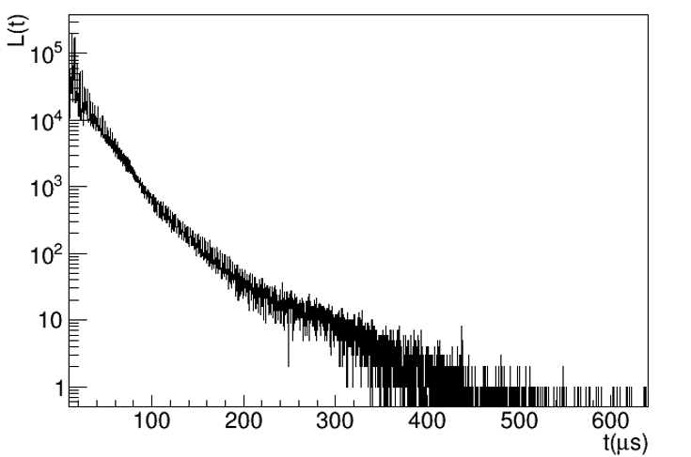

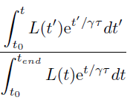

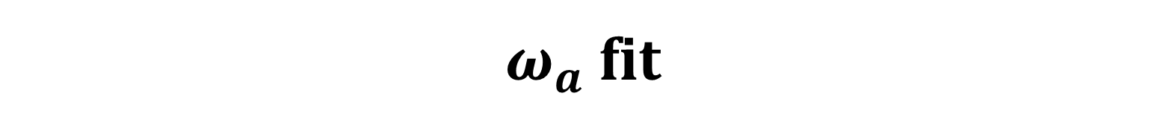
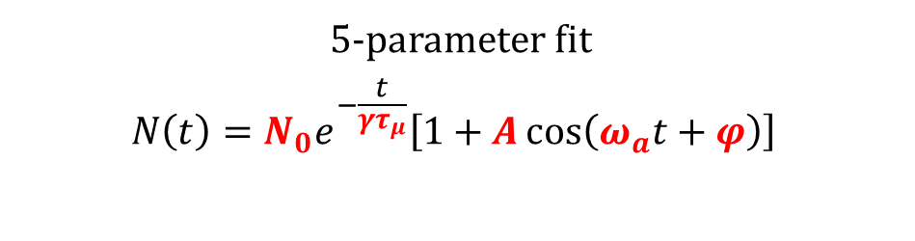
$ω_{a}$ fit
5-parameter fit
$$N\left(t\right)=N_{0}e^{−\frac{t}{γτ_{μ}}}\left[1+A\cos\left(ω_{a}t+φ\right)\right]$$
FFT of residuals
Muon losses over time
Tracker built in Liverpool! Tracker plot →
Coherent betatron oscillations (CBO)

Slide 10
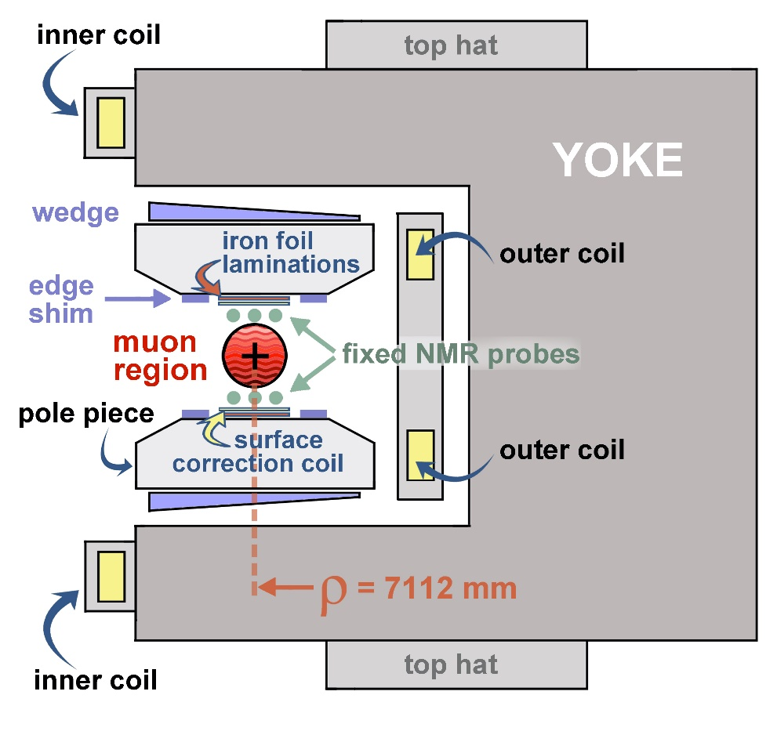
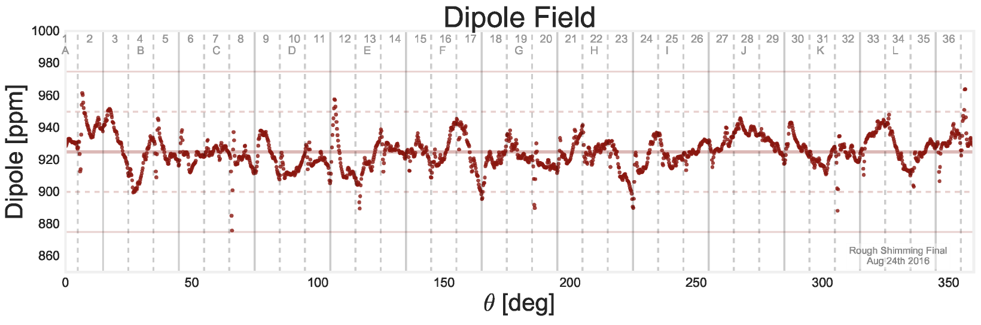

Magnetic field
$3.1$-GeV muons are stored for $700 μs$ in the superconductive storage ring, kept at $∼5$K
Highly uniform vertical magnetic field: $1.45$ T
Shimmed passively by wedges, iron top hats and surface iron foils
Actively stabilized by surface current coils
14 ppm RMS across azimuth

Slide 11
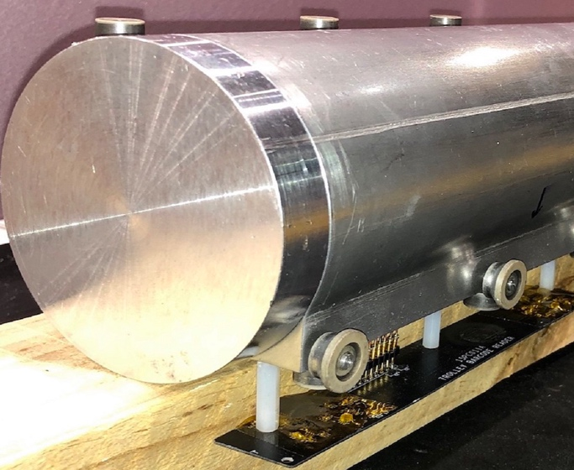
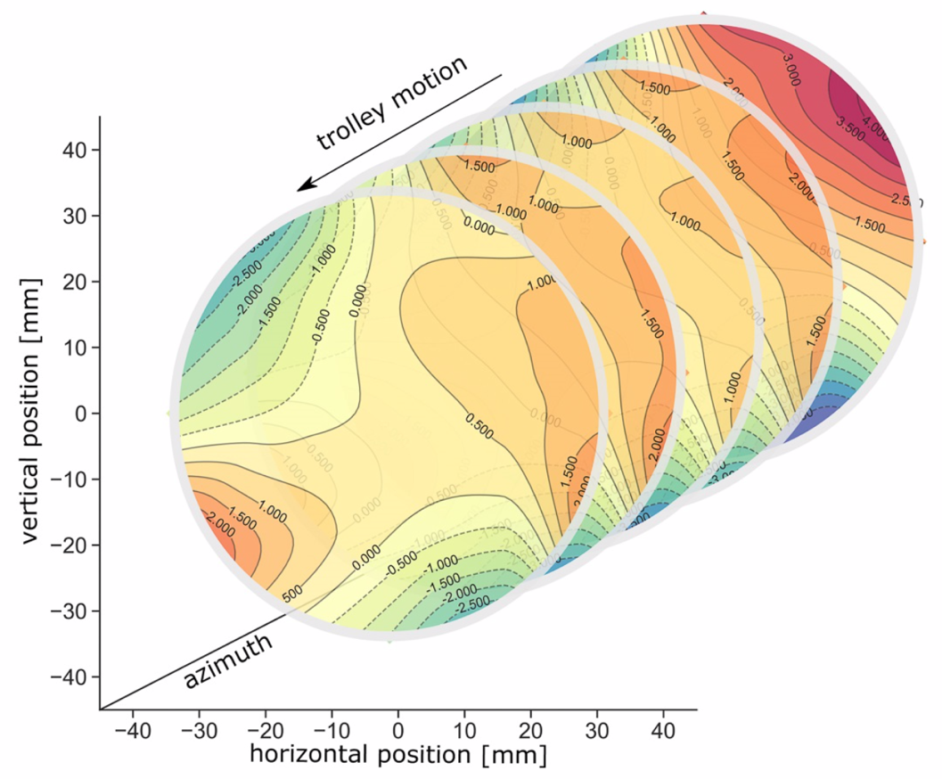
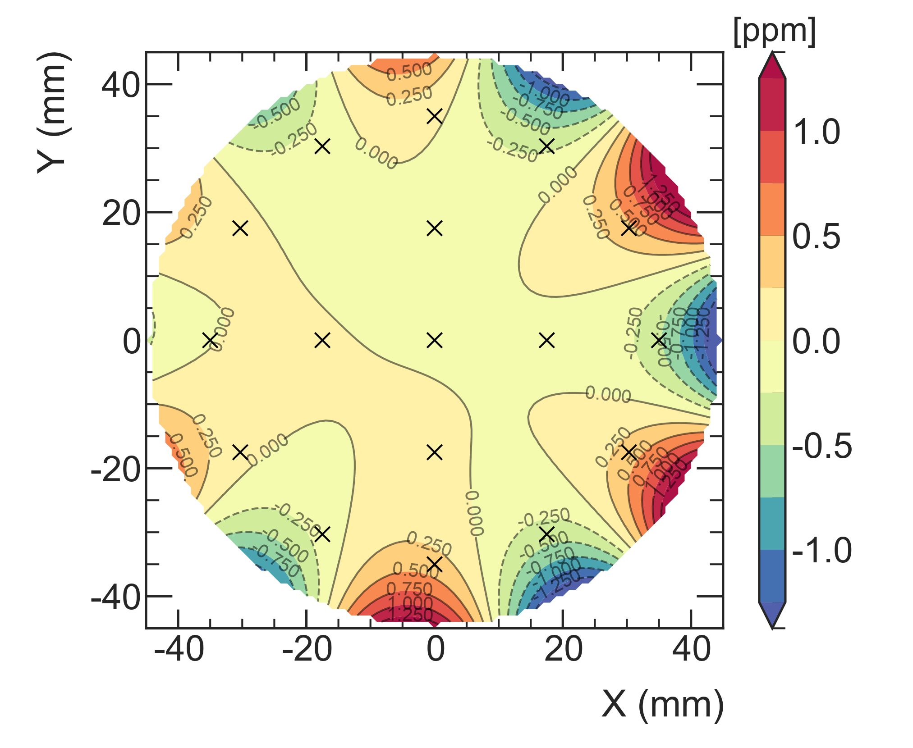
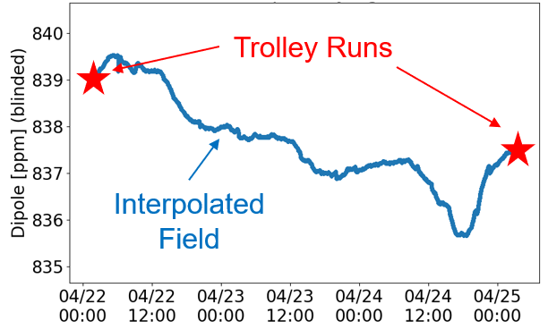
Principle of $ω_{p}$ measurement $\left(ℏω_{p}=2μ_{p}B\right)$
S. Charity coordinates the analysis
17 NMR (Nuclear Magnetic Resonance) probes: placed on trolley for special runs, every 2 or 3 days between muon fills, to provide 3-D map
17 petroleum jelly NMR probes
2D field maps (~8000 points)
Azimuthally-Averaged
Variation < 1 ppm
378 fixed NMR probes continuously monitor field during muon storage at 72 azimuthal locations
Absolute calibration with water probes
Field is weighted with muon distribution, measured by trackers

Slide 12
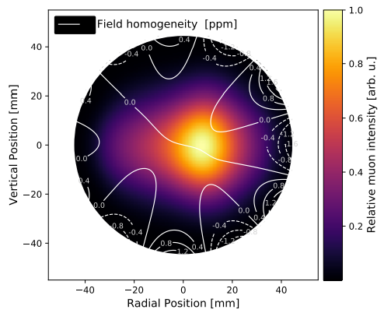
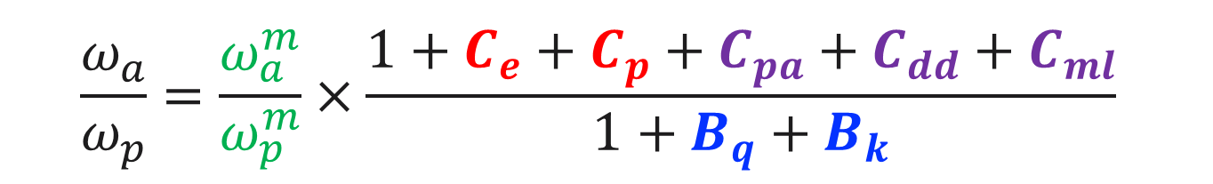




Master formula for $a_{μ}$
  $$a_{μ}=\frac{ω_{a}}{ω_{p}}×\frac{μ_{p}^{′}\left(T_{r}\right)}{μ_{e}\left(H\right)}\frac{μ_{e}\left(H\right)}{μ_{e}}\frac{m_{μ}}{m_{e}}\frac{g_{e}}{2}$$
External factors, known to 25 ppb
Beam dynamics corrections
E. Bottalico coordinates the BD analysis; also contribution by C. Zhang
Make spin precess slower
  $$\frac{ω_{a}}{ω_{p}}=\frac{ω_{a}^{m}}{ω_{p}^{m}}×\frac{1+C_{e}+C_{p}+C_{pa}+C_{dd}+C_{ml}}{1+B_{q}+B_{k}}$$
Make phase change within $700 μs$
$m$=Measured values
Induce transient magnetic fields

Slide 13


Improvements from Run-1 to Run-2/3
Running improvements: fixed damaged resistors in ESQ system, which limited systematics; stabilized temperature; improved kicker
$∼5$x more muon decays → $∼$2.2 reduction in statistical uncertainty
Analysis improvements (more CBO studies, reduced pileup thanks to new reconstructions, more transient field measurements…)
Dataset | Stat. unc. [ppb]
Run-1 | 434
Run-2/3 | 201
Combined Run-1+Run-2/3 | 185
FNAL design goal | 100
70 ppb systematic uncertainty: exceeded goal of 100 ppb!

Slide 14



Search for Muon EDM @FNAL
Motivation:
Intrinsic EDM: $H=−\vec{μ}⋅\vec{B}+\vec{d}⋅\vec{E}$
SM prediction $∼{10}^{−35}e⋅cm$, well beyond experimental limits. BNL: $1.9×{10}^{−19}e⋅cm$
CP-odd → would be new source of CP-violation in leptons
Principle of measurement:
EDM introduces tilt in precession plane: measure EDM directly from tracker data, vertical angle vs time
Carried out in Liverpool by J. Price (coordinator), D. Vasilkova, K. Ferraby

Slide 15

Muon EDM @ FNAL: challenges and status
Systematic sources of uncertainty:
Detector acceptance, corrected by MC acceptance maps
Non-zero radial field: from Run-4/5/6 studies, extrapolated to Run-2/3, it resulted that this is not a systematic limitation
MC/Data matching
Expected limits (assuming zero signal):
Run-1 (under review): $\left|d_{μ}\right|<2.0×{10}^{−19}e⋅cm$
Run-2/3 (analysis ongoing): $\left|d_{μ}\right|<2.8×{10}^{−20}e⋅cm$
Also see presentation tomorrow morning by K. Ferraby

Slide 16


Future Muon g-2 results @ FNAL
Dataset | Stat. unc. [ppb]
Run-1 | 434
Run-2/3 | 201
Combined Run-1+Run-2/3 | 185
Expected total from Run-1 to Run-6 | $≤$100
In Liverpool: many Run Coordinators, sub-system/on-call experts throughout the years
We expect to complete the analysis by 2025
Quadrupole Radio-Frequency switched on during Run-5 → reduced radial and vertical motion of muons, more stable beam and less muon losses
Ongoing studies to reduce largest systematics: C. Zhang leads of one of the task forces

Slide 17



KLOE HVP analysis
Data-driven approach for the theoretical prediction of $a_{μ}$ (hadronic contribution): experimental efforts to discern the current tensions
KLOE HVP will perform the analysis of $e^{+}e^{−}→π^{+}π^{−}$ cross section: this channel contributes as $∼65\%$ to $a_{μ}^{HLO}$
This analysis will:
Use 1.7 $fb^{−1}$ from 2004/2005 data, with 25 million $ππγ$ events never analyzed before
Improve previous KLOE analyses, e.g.: MC/data tuning, tracking efficiencies, background subtractions, new MC for radiative corrections, …, new blinding!
Liverpool leads all aspects of this analysis

Slide 18



Experimental facility in Frascati
Mostly operated at $\sqrt{s}=1020$ MeV (510 MeV e+, 510 MeV e-)
Method of Radiative return: hard ISR photon allows to scan over continuous $\sqrt{s}$ range

Slide 19





KLOE detectors
Tracker
Calorimeter
Excellent momentum resolution:
$$σ_{p}/p=0.4\%$$
$σ_{rφ}=150μm$, $σ_{z}=2$mm
Excellent time resolution:
$$σ_{t}\left[ps\right]=54/\sqrt{E\left[GeV\right]}⊕100$$
$$σ_{E}/E=5.7\%/\sqrt{E\left[GeV\right]}$$

Slide 20



Much theory work
ISR technique to scan $\sqrt{s}$ : radiator function $H\left(s,M_{had}^{2}\right)$ relates differential cross section $e^{+}e^{−}→π^{+}π^{−}γ$ to $e^{+}e^{−}→π^{+}π^{−}$
Phokhara MC calculates: ISR at NLO; Radiative corrections such as vacuum polarisation and FSR

Slide 21


Normalisation to muon ISR
Two methods to extract cross section:
KLOE08, KLOE10: absolute normalisation to luminosity (from Bhabha events):
$\frac{dσ_{ππγ}}{dM_{ππ}^{2}}=\frac{N−N_{bkg}}{ΔM_{ππ}^{2}}⋅\frac{1}{ε}⋅\frac{1}{\int{L dt}}$ → $σ_{ππ}\left(M_{ππ}^{2}\right)=s⋅$ $\frac{dσ_{ππγ}}{dM_{ππ}^{2}}⋅\frac{1}{H\left(s,M_{ππ}^{2}\right)}$
KLOE12: normalize $ππγ$ sample with $μμγ$ events → for each energy bin:
${\left|F_{2π}\left(s^{′}\right)\right|}^{2}=\frac{4\left(1+2m_{μ}^{2}/s′\right)β_{μ}}{β_{π}^{3}}⋅\frac{dσ_{ππγ}/dM_{ππ}^{2}}{dσ_{μμγ}/dM_{μμ}^{2}}$ → $σ_{ππ}\left(s^{′}\right)=\frac{πα^{2}β_{π}^{3}}{3s^{′}}⋅{\left|F_{2π}\left(s^{′}\right)\right|}^{2}$
Advantage of muon ISR normalization: systematic effects and radiative corrections cancel!

Slide 22



Experimental goals for new KLOE HVP analysis
JHEP 1803 (2018) 173
Combination of previous KLOE measurements:
$$a_{μ}^{ππ}\left[0.1<s<0.95{GeV}^{2}\right]=489.8±{1.7}_{stat}±{4.8}_{sys}×{10}^{−10}$$
Goal for new analysis: reduce uncertainties, achieve $0.4\%$ total ($0.1\%$ stat., $0.2\%$ th. and $0.3\%$ syst.)

Slide 23

Overview of g-2/KLOE Liverpool activities
  Muon g-2 @ FNAL:
    Strong involvement in operations while running (ended Summer 2023)
    $ω_{a}$ analyzers: L.C., C. Zhang, E. Zaid
    $ω_{p}$ analyzer: S. Charity (coordinator)
    Beam dynamics analyzers: E. Bottalico (coordinator), C. Zhang
    EDM: J. Price (coordinator), D. Vasilkova, K. Ferraby
    Various institutional roles (e.g. co-spokesperson G. Venanzoni)
    Help in analysis/review of other Beyond SM searches (Dark Matter, CPT/LIV)
  KLOE HVP analysis:
    From HEP department: G. Venanzoni, P. Beltrame, L.C., F. Ignatov, A. Kumari, N. Vestergaard, E. Zaid
    From Theoretical department: T. Teubner, W.J. Torres-Bobadilla, T. Dave, J. Paltrinieri, P. Petit-Rosas, A. Wright

Slide 24




THANK YOU FOR
YOUR ATTENTION!
lorenzo.cotrozzi@liverpool.ac.uk
July 2023 collaboration meeting @ Liverpool, UK

Slide 25




FNAL accelerator complex
Bunches of $4×{10}^{12}$ protons @ 8 GeV
Boosted and delivered via the recycler ring every 1.4 s
Collide against fixed target and generate pions
Pions decay into muons along $∼2$ km line in Delivery Ring
Muons are injected into the 7 m radius $g−2$ storage ring

Slide 26



Laser-based gain monitoring system
Built by INFN/CNR-INO: time synchronization and calibration of 1296 SiPMs on timescales from ns to days/weeks. Gain changes dominated $ω_{a}$ systematics at BNL: exceeded goal of 20 ppb at FNAL.
Standard operating mode:
Sync pulse: time synchronization at $∼50$ ps
In-Fill pulses: monitor rate-dependent gain changes at ${10}^{−4}$ during $700 μs$ of $μ^{+}$ beam
Out-of-Fill pulses: monitor stability over days

Slide 27



CBO model: frequency vs time
CBO dominated Run-1 systematics (38 ppb).
Now reduced to 21 ppb!
Exponential relaxation of CBO frequency
Run-1: faulty ESQ resistors enhanced this effect 10 times!
Sliding window fits to determine lifetime and constrain it in $ω_{a}$ fits
→
Run-1
Run-2/3

Slide 28


Blinded analysis
Hardware: main clock is tuned at $(40−ε)$ MHz
Offset only known to two scientists external to the
collaboration
Software: each $ω_{a}$ analyzer applies their own, secret offset to their results

