Slide 1


Legend neutrinoless double β decay
Particle Physics Annual Meeting May 2023
Andy Boston, Andy Mehta, Dan Judson, Chris Everett

Slide 2
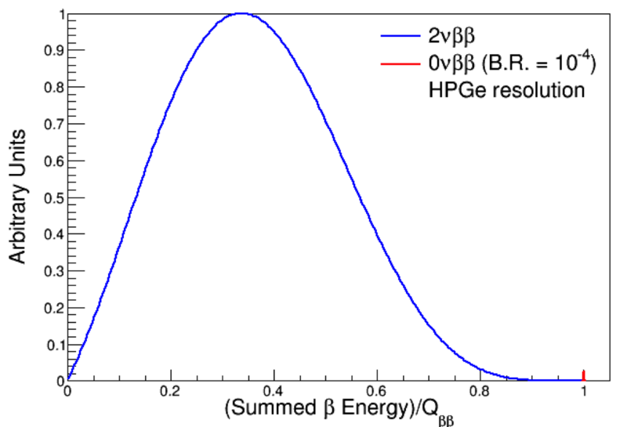
Neutrinoless double β decay
Process could occur if neutrinos are their own anti-particle (Majorana)
Q=E(e₁)+E(e₂) for 0vββ
Q<E(e₁)+E(e₂) for vvββ
⁷⁶Ge isotope used as it can also be part of the detector
vvββ
0vββ
https://warwick.ac.uk/study/csde/gsp/eportfolio/directory/crs/phsgbu/research/phdresearch/theory/betadecay/neutrinoless/

Slide 3
Legend Experiment
LEGEND-200: a 200 kg mass experiment, installed in the GERDA LAr cryostat at LNGS, Gran Sasso
Approved experiment at LNGS, with data taking in progress
First results hopefully this summer
LEGEND-1000: a 1T ⁷⁶Ge will require a new underground infrastructure and additional R&D to further reduce backgrounds
Start running later this decade likely at Gran Sasso
Cost in US funding terms ~$1 B

Slide 4
Legend Experiment Sensitivity
Huge improvement over current experiments
Almost all of inverted ordering probed
And some of normal ordering

Slide 5
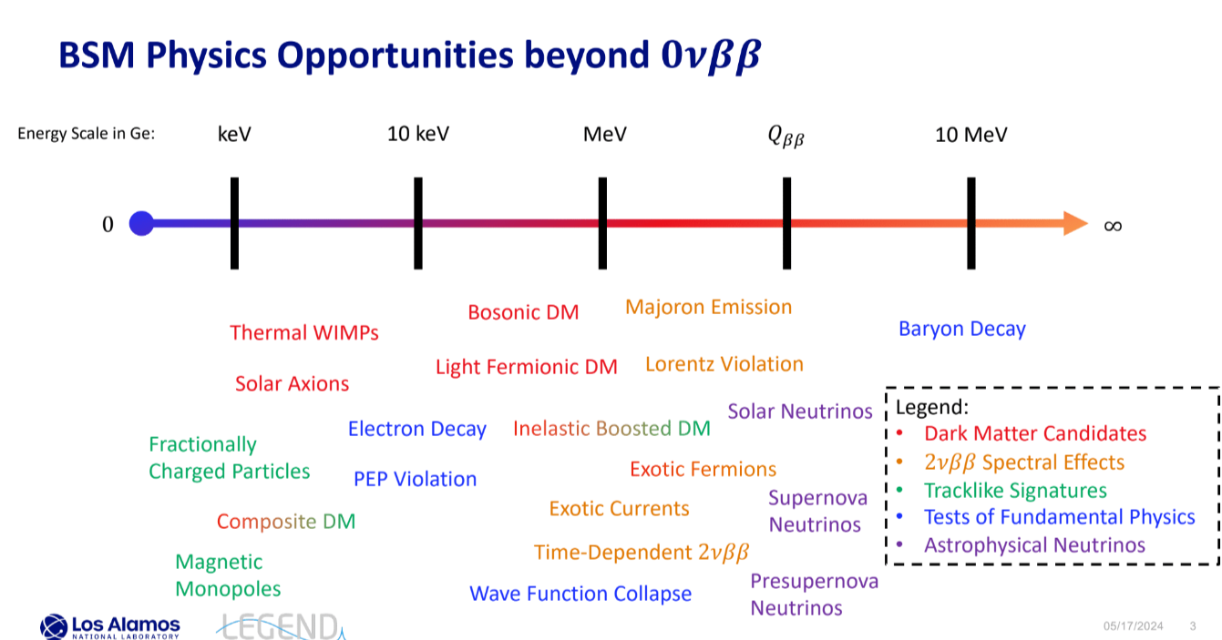
Summary

Slide 6
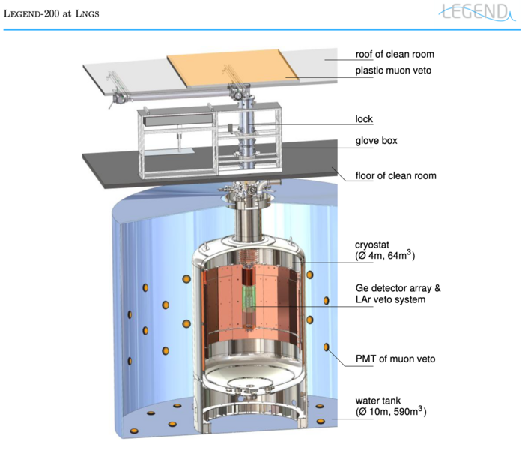
Legend Experiment
LEGEND-200: a 200 kg mass experiment, installed in the GERDA LAr cryostat at LNGS, Gran Sasso
Approved experiment at LNGS, with data taking in progress
First results hopefully this summer
LEGEND-1000: a 1T ⁷⁶Ge will require a new underground infrastructure and additional R&D to further reduce backgrounds
Start running later this decade
Cost in US funding terms ~$1 B

Slide 7
Legend at Gran Sasso

Slide 8
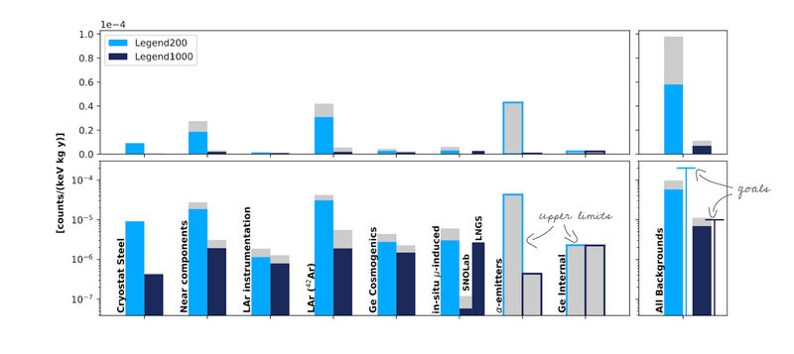
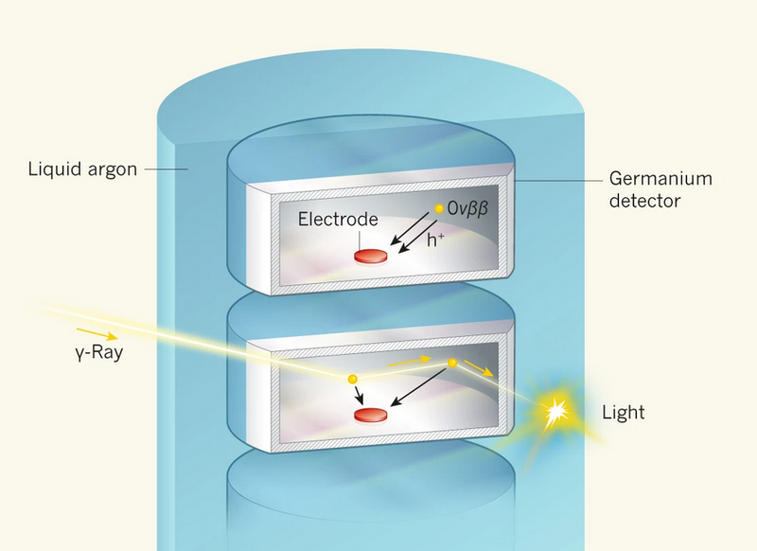
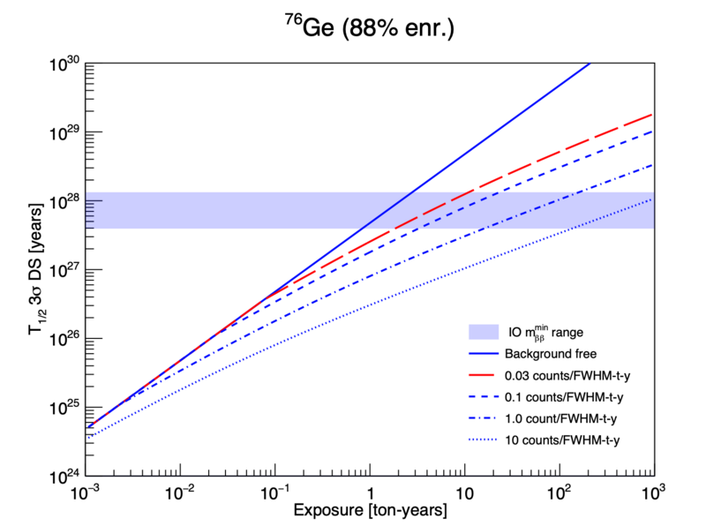
Backgrounds
Due to excellent energy resolution supressing non-β backgrounds is crucial
Ge has excellent separation potential
Ar, LAr and water vetoes crucial

Slide 9
Legend Detectors
92% Enriched in ⁷⁶Ge
Energy resolution 0.05%
p-type detectors: Insensitive to alphas on n⁺ outer contact
Each detector 2.6 kg – 4× less background
400 detectors in total arrayed in strings

Slide 10
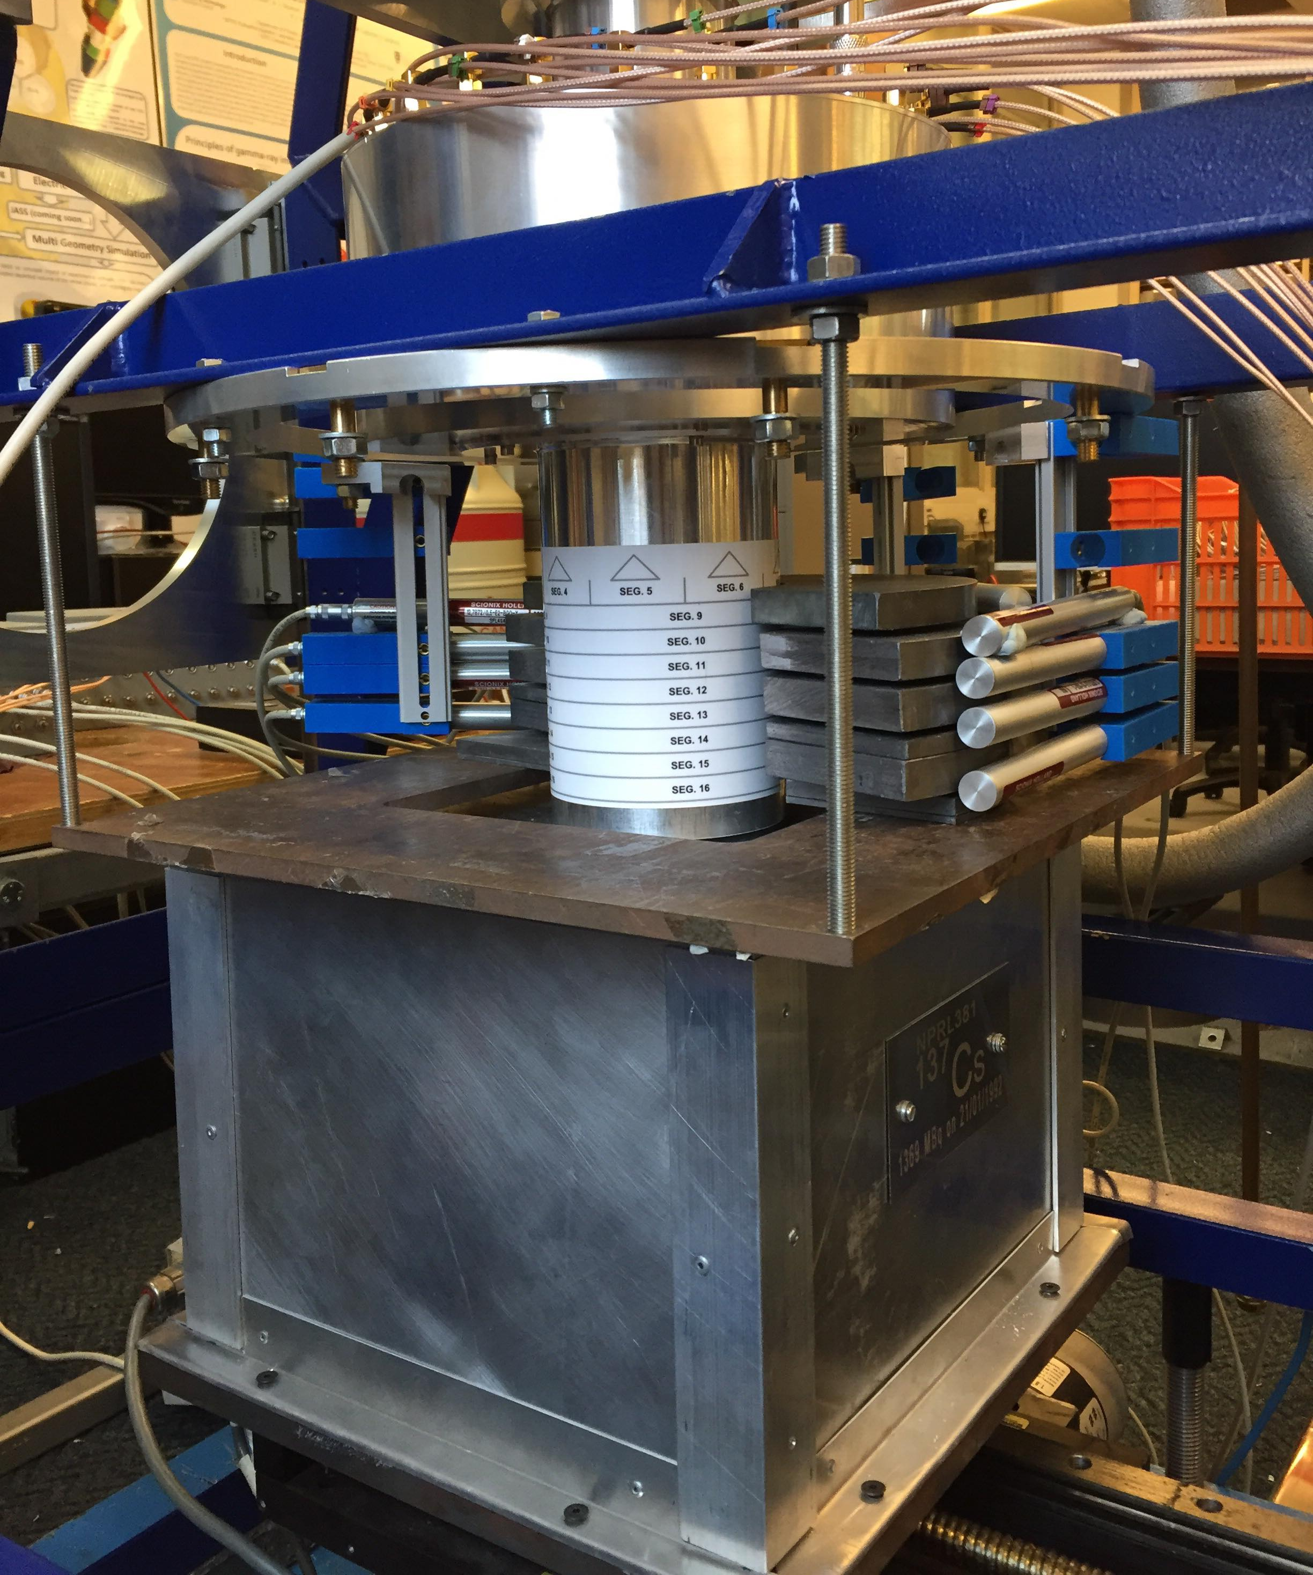
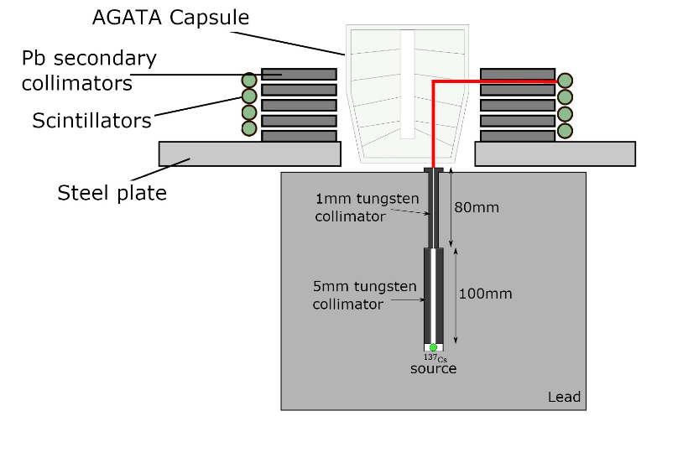
Liverpool Involvement
Germanium detector characterisation
Each detector needs individual calibration
Detector calibration/data quality enhancement
Detector procurement and characterisation for LEGEND-1000
Data Analysis for LEGEND-200 + 1000
Andy Boston is currently LEGEND UK PI
Legend Detector

Slide 11
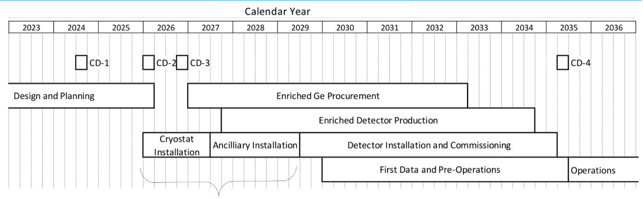
Summary
LEGEND 1000 is the leading future experiment in neutrinoless double beta decay
Has sensitivity to virtually all of inverted hierarchy phase-space
Liverpool are involved with detector procurement and characterisation and data analysis

Slide 12
Backup

Slide 13
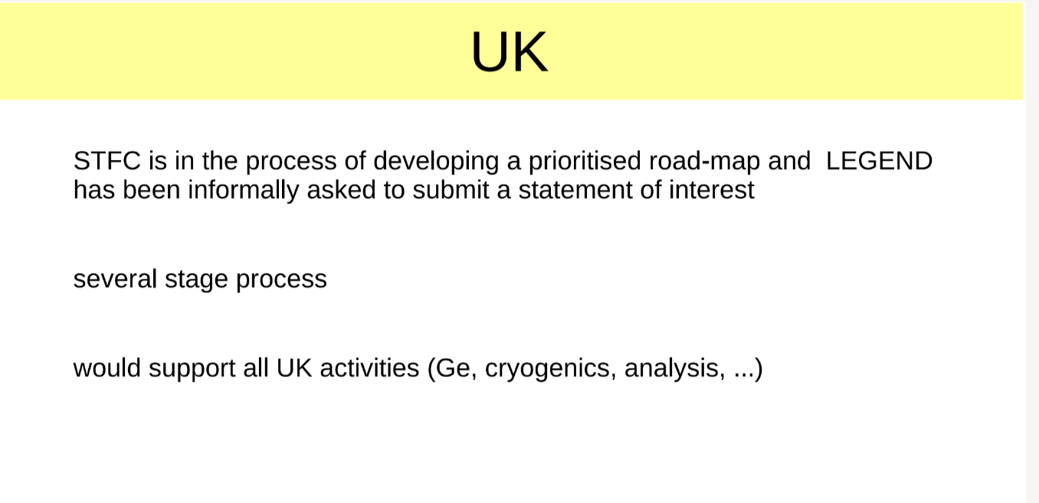

Slide 14
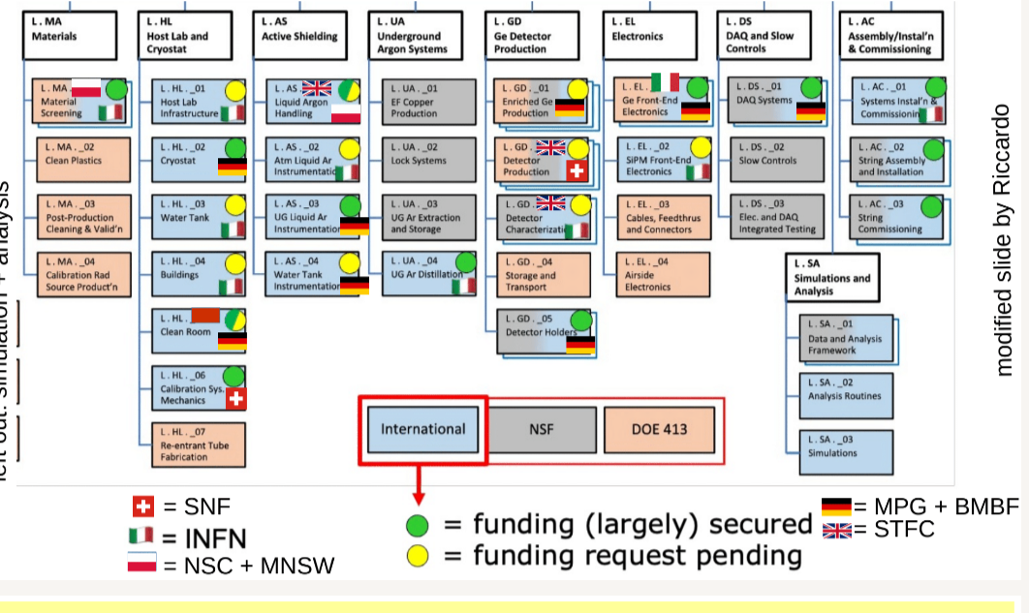
International Involvement

Slide 15
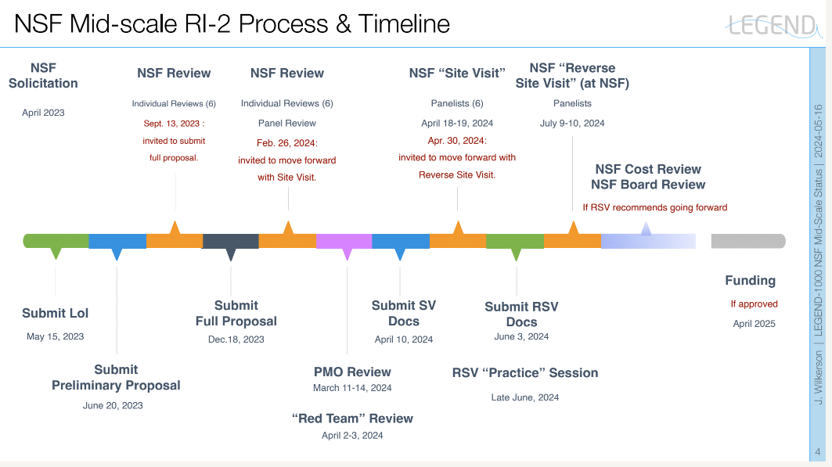

Slide 16
