Slide 1

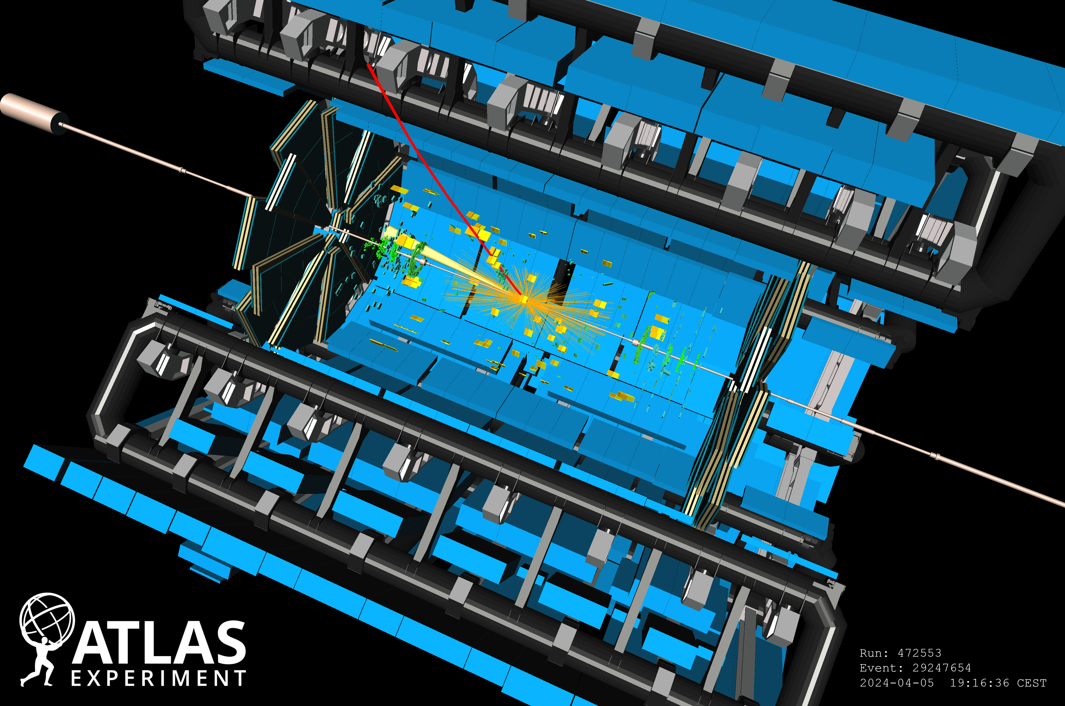
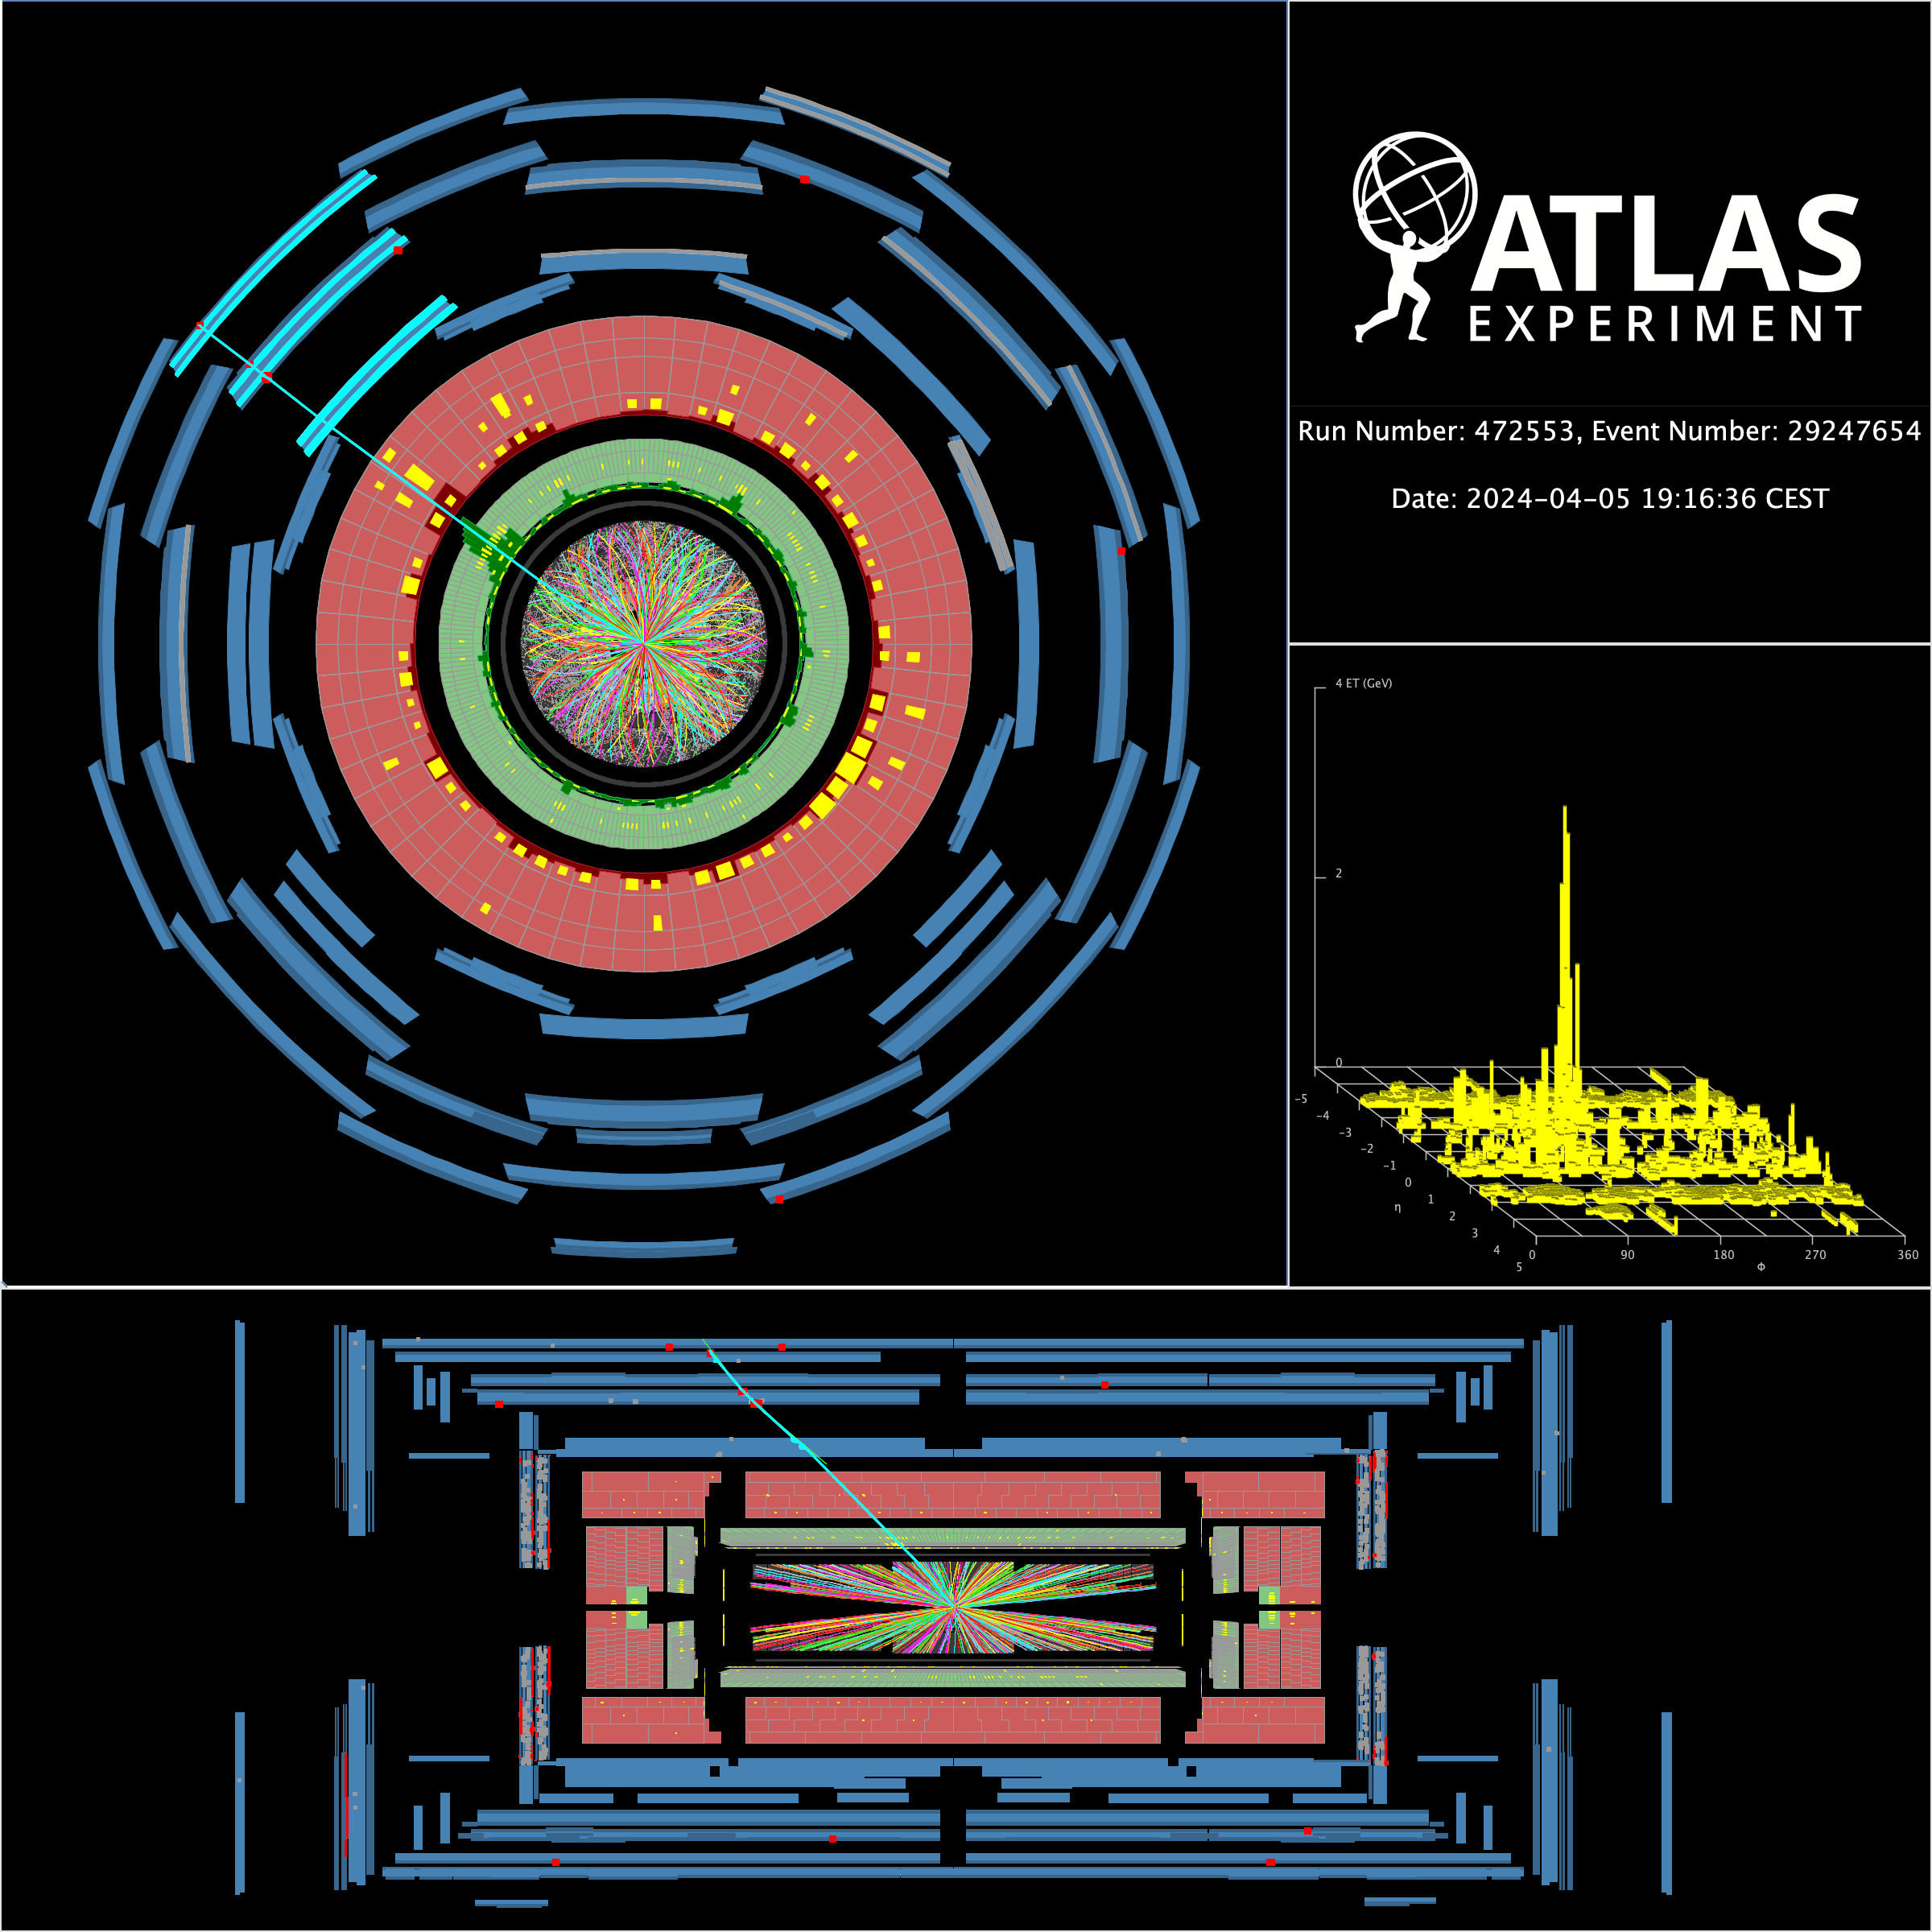
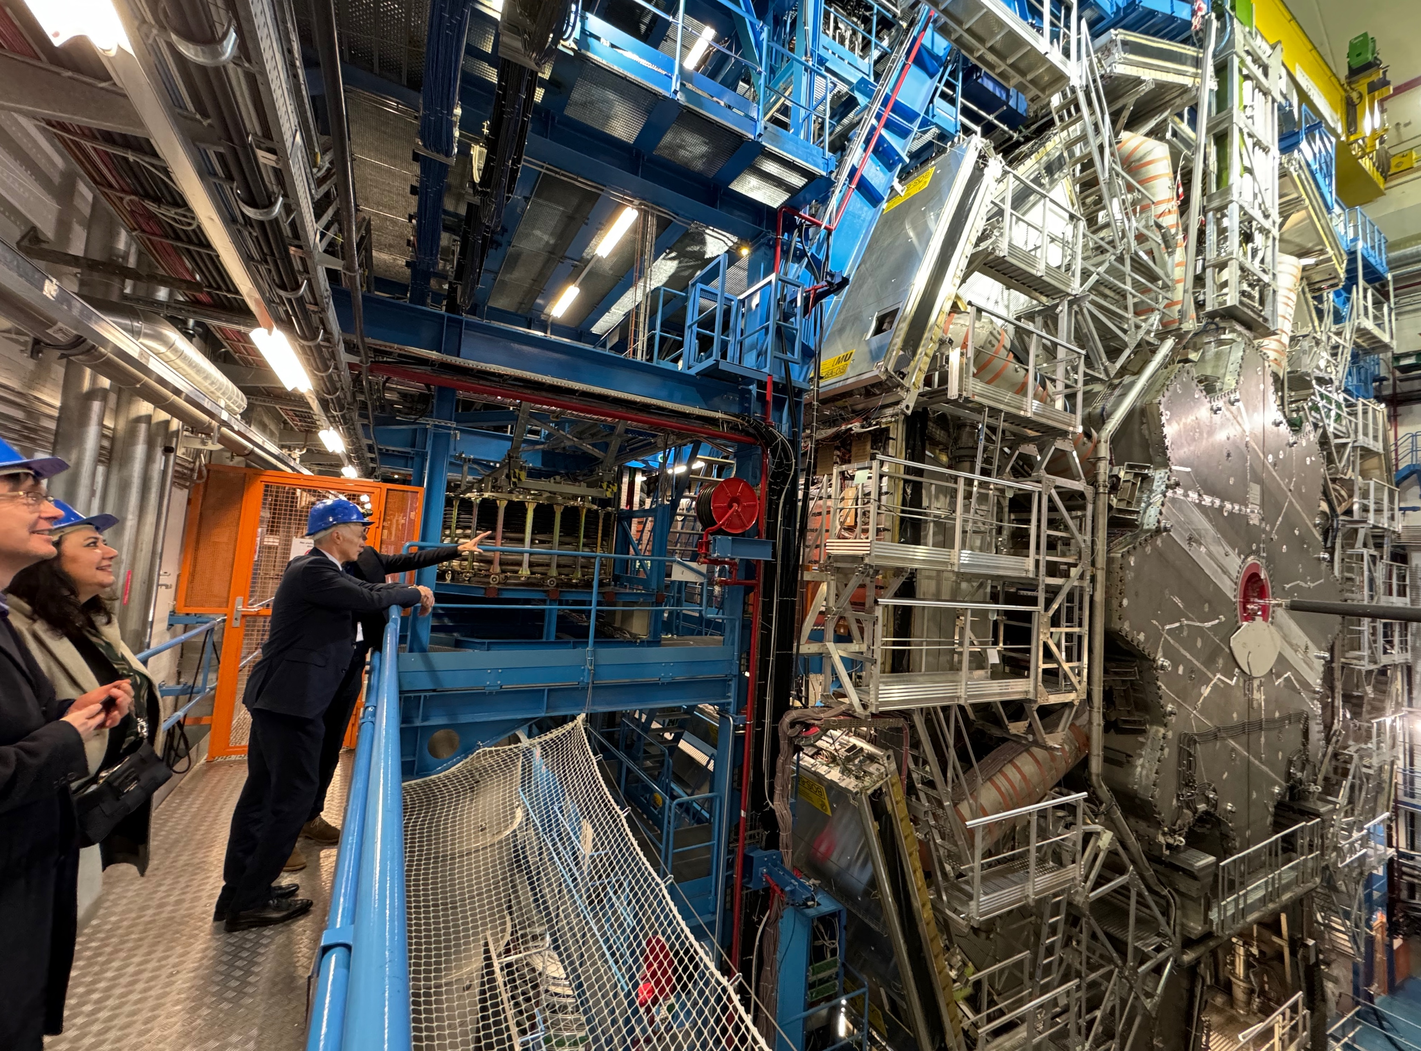
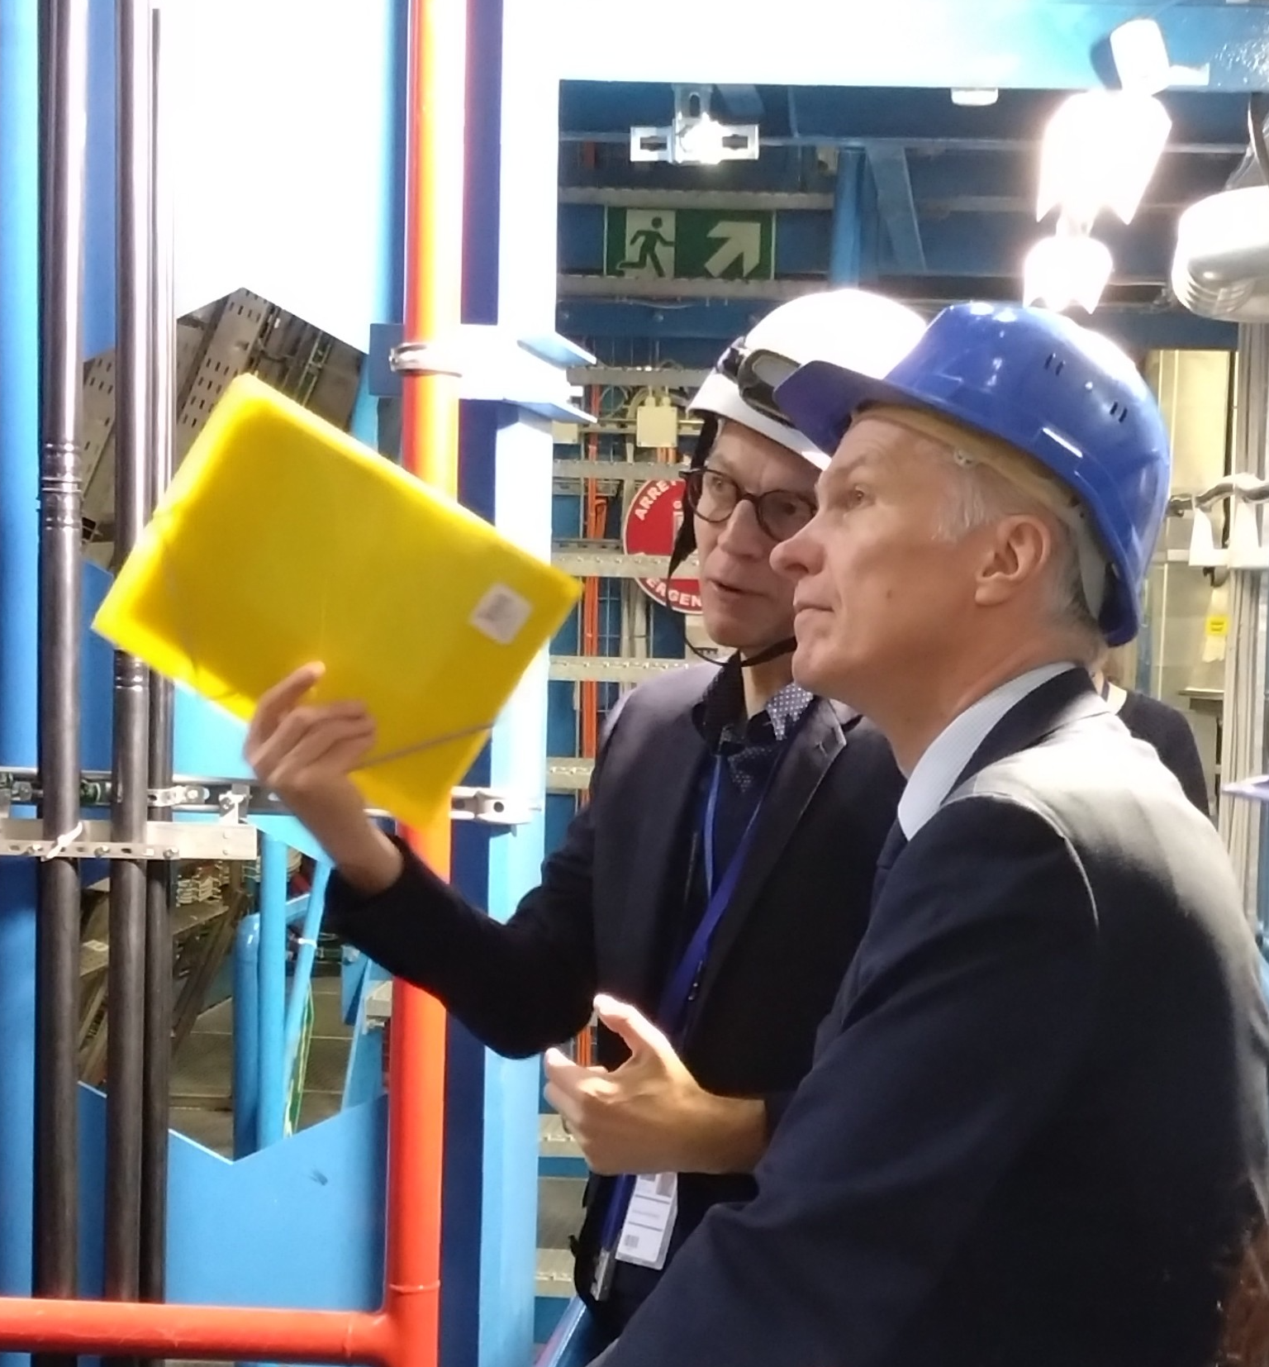
ATLAS
Monica D’Onofrio
On behalf of the ATLAS Liv group
HEP meeting, 23 May 2024

Slide 2
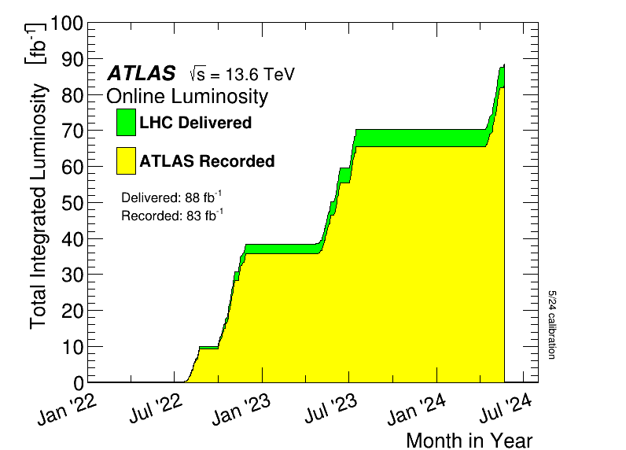

ATLAS in Run 3 and Liverpool activities
ATLAS has resumed data-taking operations (Run 3) in July 2022 at c.o.m. energy of 13.6 TeV, has collected data in 2023 and is again taking data in 2024 at record luminosity!
The Liverpool ATLAS team works on several analyses and studies relevant for the whole collaboration
Who we are:
  7 academics: Monica (TL – until end 2024!), Carl, Andy, Jan, Nikos, Uta, Max (emeritus), Sergey (low FTE)
  Three PDRAs: Cristiano, Joe (supported by MUCCA grant) + Jordy Degens who started last summer
    See his talk next!
  8 PhD students:
    Y1: Mehul (welcome)
    Y2: Joshua, Buphesh, Rob (welcome)
    Y3: Rebecca
    Y4: Ting, Conor, Sam
+ ATLAS Upgrade Team
(see talk later in this session)
→ with PhD students also contributing!
Congratulations to new doctors since last meeting: - Ricardo, Adam, James

Slide 3
ATLAS in Run 3 and Liverpool activities: physics
What we do: contributions to physics and operations
ATLAS Liverpool physics
From CG submission, publications where Liv members led in the period Jan 2021, Dec 2023
Higgs physics:
SM higgs, BSM higgses,
di-Higgs
B-/c-jet tagging
Tau ID and
Classification
Searches:
SUSY Dark Matter, LeptoQuark, Dark Sector, Axion-like particles
Precision and rare processes:
W mass, W/Z p_{T}, high-mass DY cross sections, rare tau decays
  Lot of physics measurements and searches at the energy frontier, with synergies and complementarities
  → excellent feedback from CG reviewers on Liv ATLAS programme
Analysis software
Luminosity measurements

Slide 4
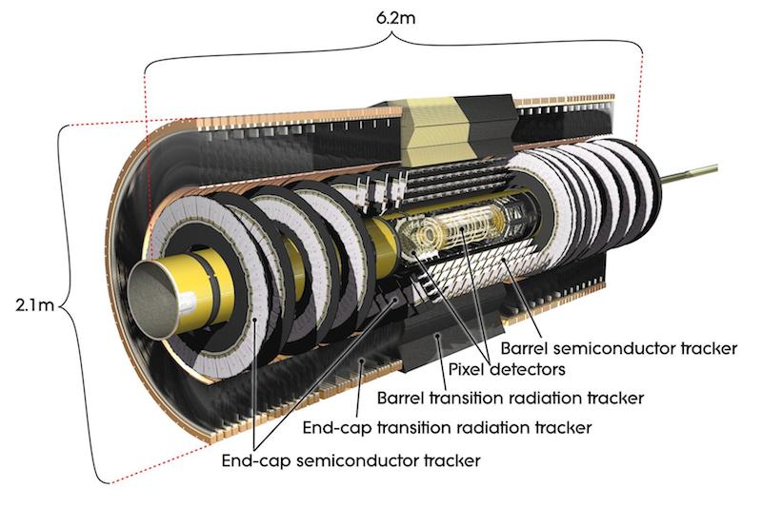
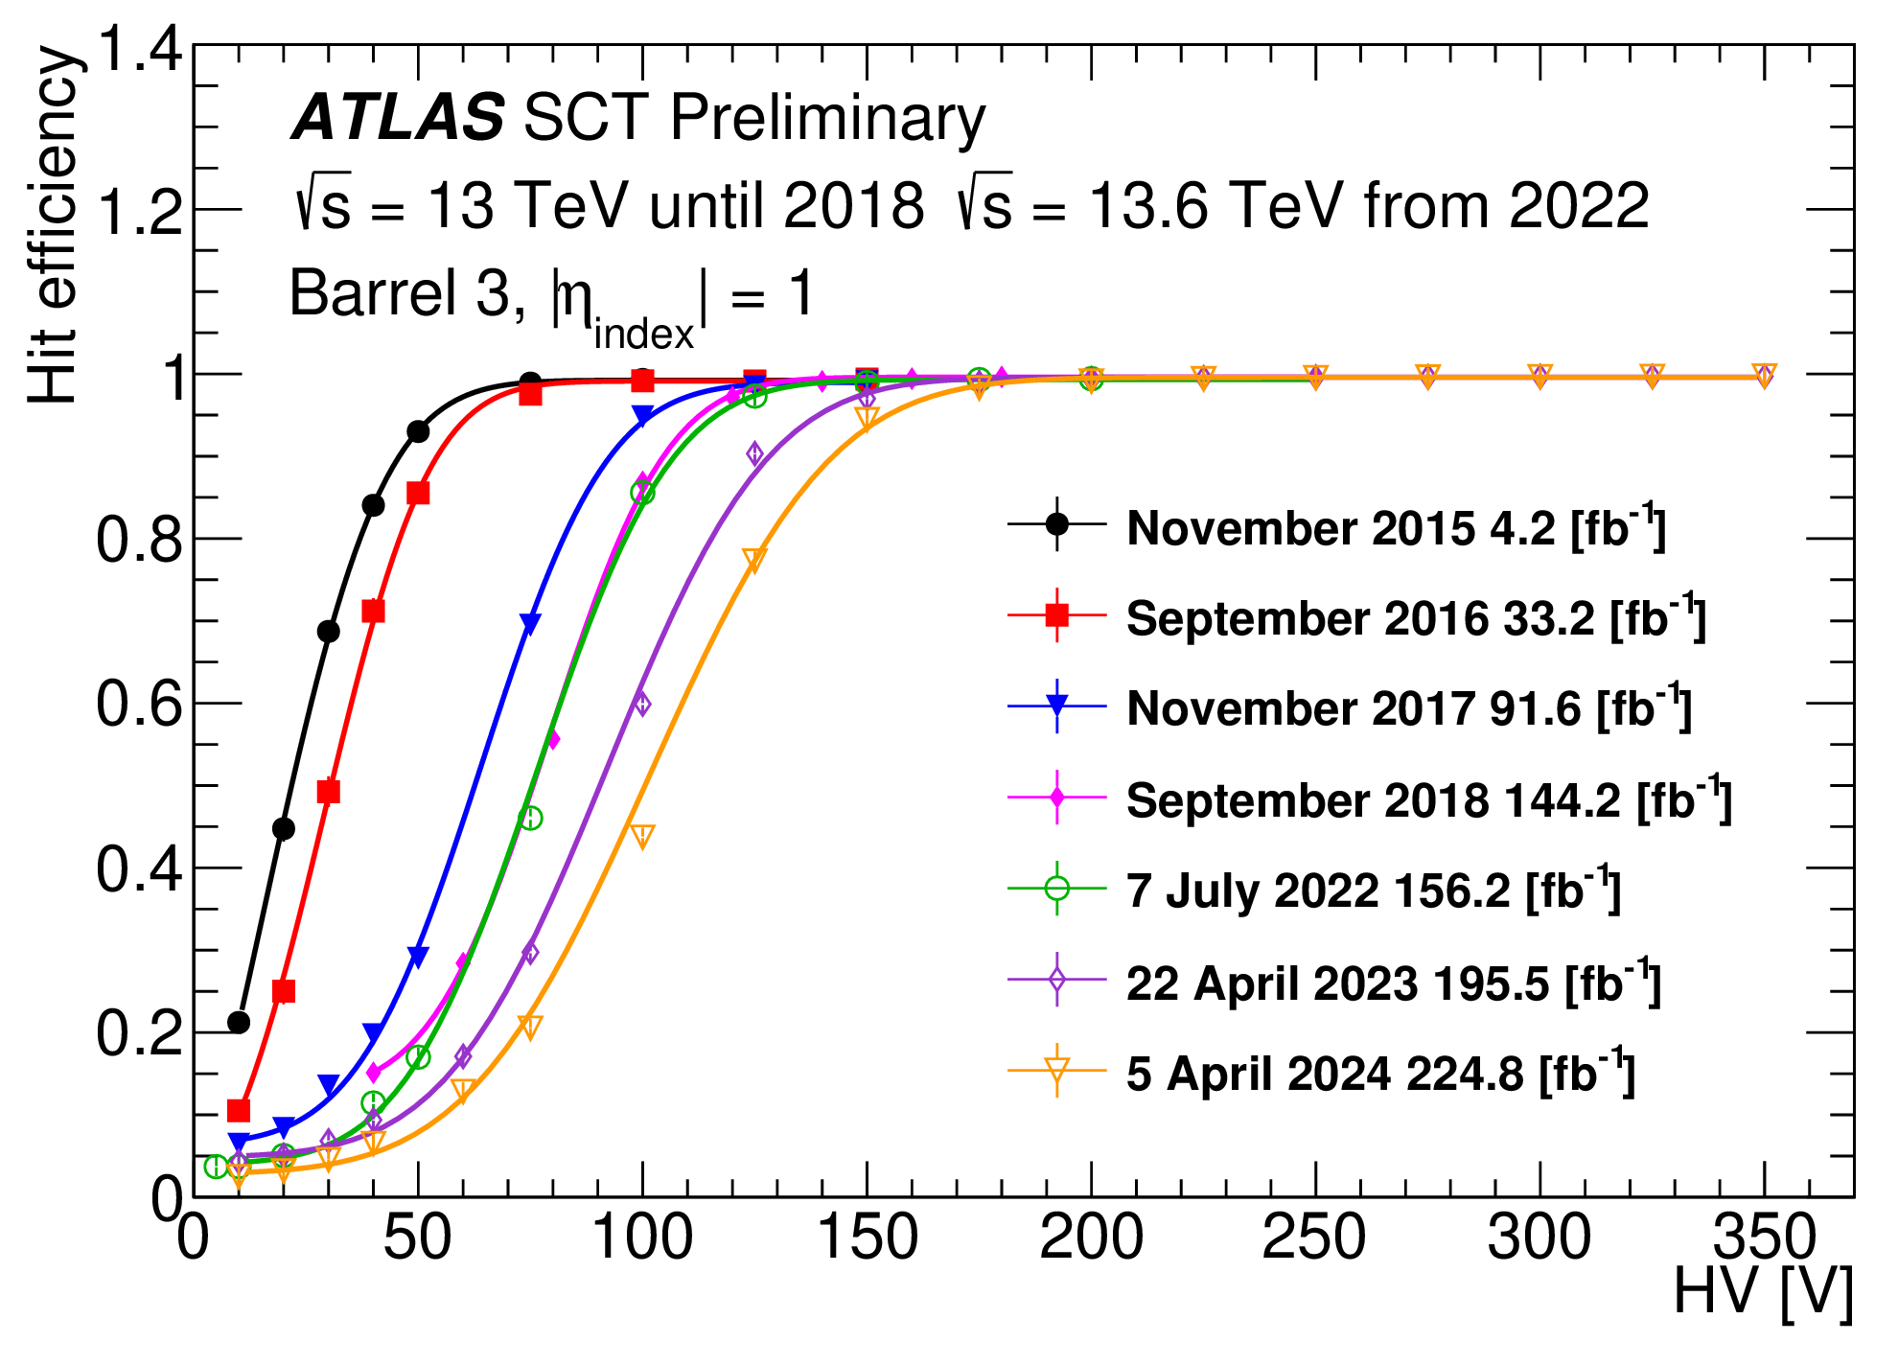
ATLAS in Run 3 and Liverpool activities: operations
What we do: contributions to physics and operations
Cristiano, in LTA at CERN, coordinates the SCT offline software activities and contribute to daily operations with a small team of experts ensuring correct SCT settings and efficient operation
Together with Rebecca, PhD, the team continues to support SCT activities with studies carried to ensure the stability of performance (see also talk Rebecca’s talk)

Slide 5
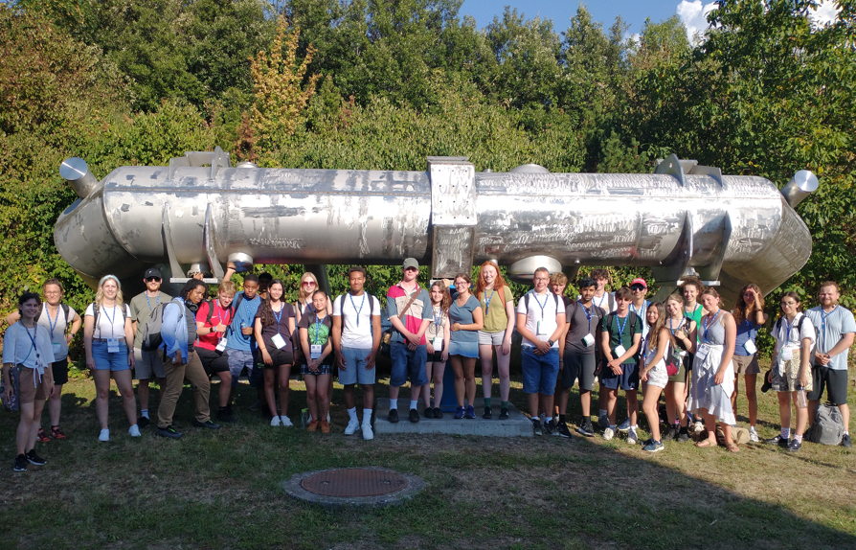

ATLAS Liverpool and beyond: roles, events, spin-off
Leadership roles
Collaborations and impact-generated activities (physics-related)
  Close interplay with FASER physics (Monica, Carl, PhD Lottie Cavanagh and Sinead Eley): dark photons, ALPs
  Applied ML-techniques developed within ATLAS to diverse fields: MUCCA consortium (HEP, medical, neuroscience), joined PhD with ARO and health and life science (Rob, PhD – Monica, Nikos), joined PhD project in space science (with Engineering and ESA – Monica)
  Contributions to future facilities: FCC-ee (Nikos, Andy), LHeC and FCC-eh (Uta, Monica), FCC-hh (Monica, Carl, Jordy, Cristiano), FPF (Carl, Monica) i.e. precision SM physics, Higgs and BSM searches
Various training/outreach events organised around our activities/by group members
• Cristiano: SCT software coordinator, convener of Unconventional Signatures group (~150 members)
• Monica: (Deputy) UK PI ATLAS, member of Collaboration Board Chair Advisory group
• Carl: Chair of Physics Validation Task Force until 2023
• Nikos: ATLAS LHC Higgs group convener for extended Higgs sector & NMSSM groups
• Andy: Analysis release coordinator
• Uta: Z-counting Luminosity group leader
+ members/chair of editorial boards, UK and international panels and boards, organisers of workshops and representing the group and UoL in international conferences (Moriond, LHCP etc..)
Liv@CERN summer school
GNN School and xAI @Liverpool (Sept 2023)

Slide 6
SM measurements and rare processes
ATLAS Liverpool physics
Higgs physics:
SM higgs, BSM higgses,
di-Higgs
B-/c-jet tagging
Tau ID and
Classification
Searches:
SUSY Dark Matter, LeptoQuark, Dark Sector, Axion-like particles
Precision and rare processes:
W mass, W/Z p_{T}, high-mass DY cross sections, rare tau decays
Analysis software
Luminosity measurements

Slide 7
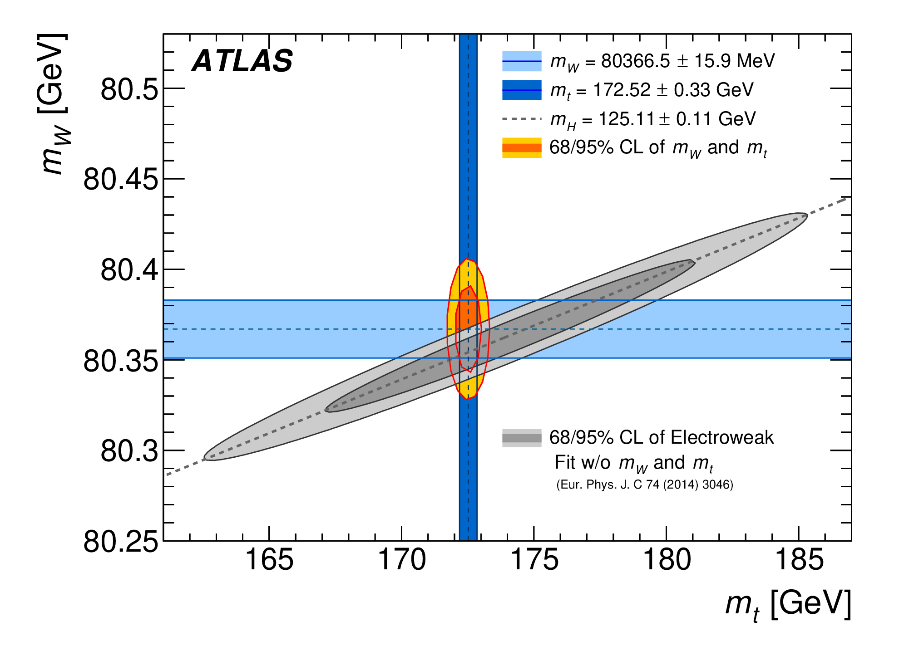
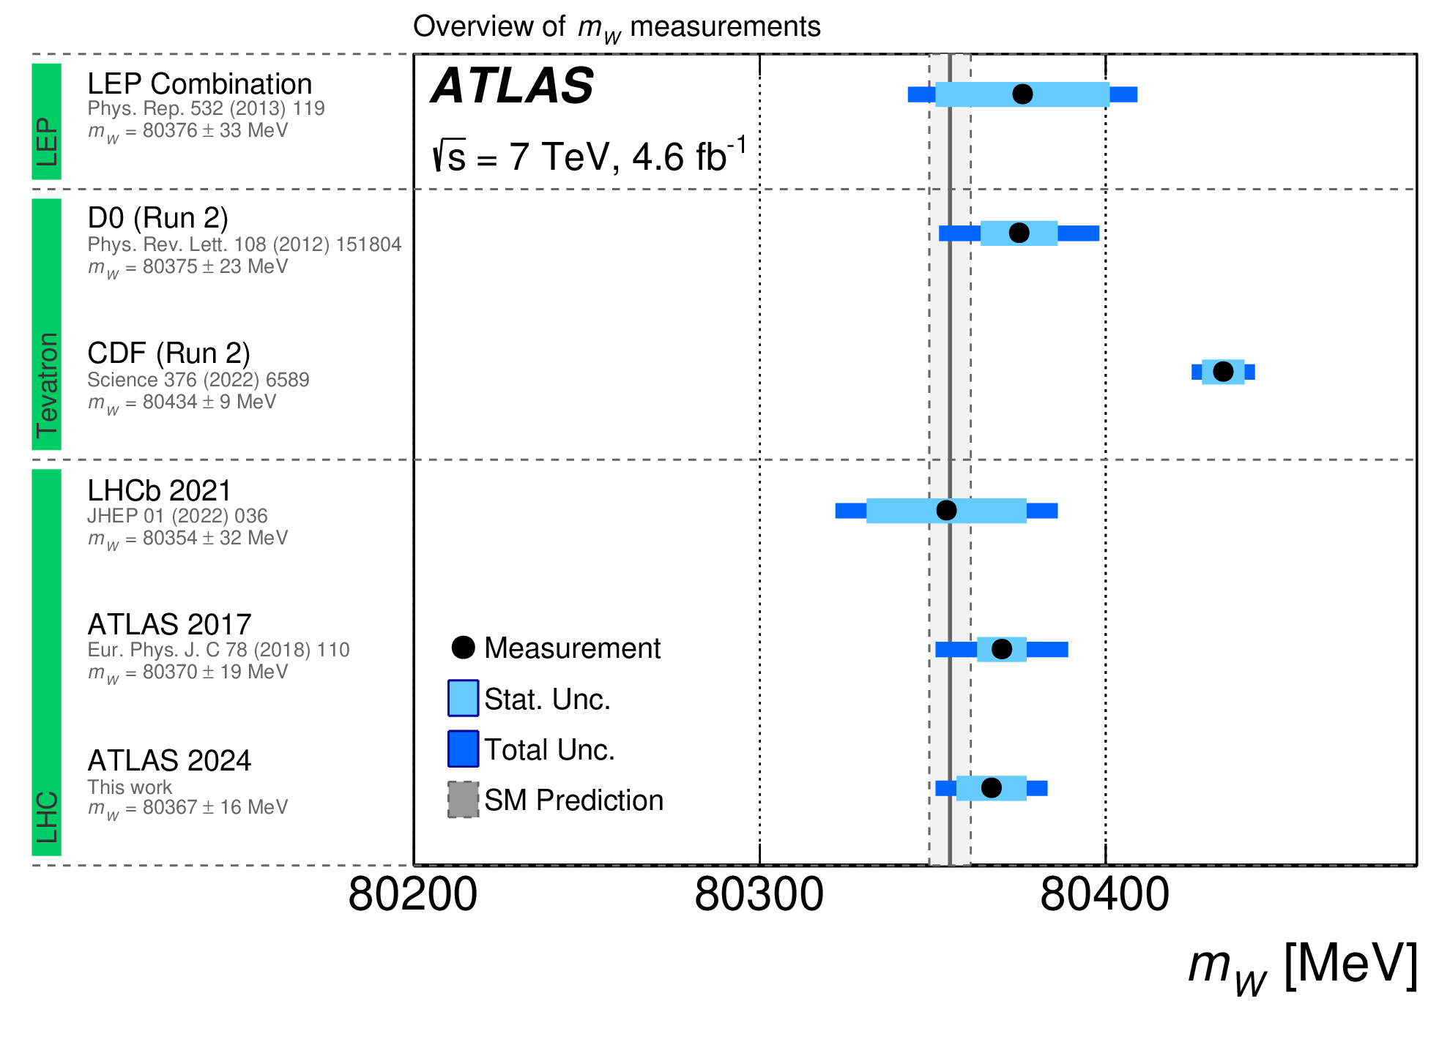
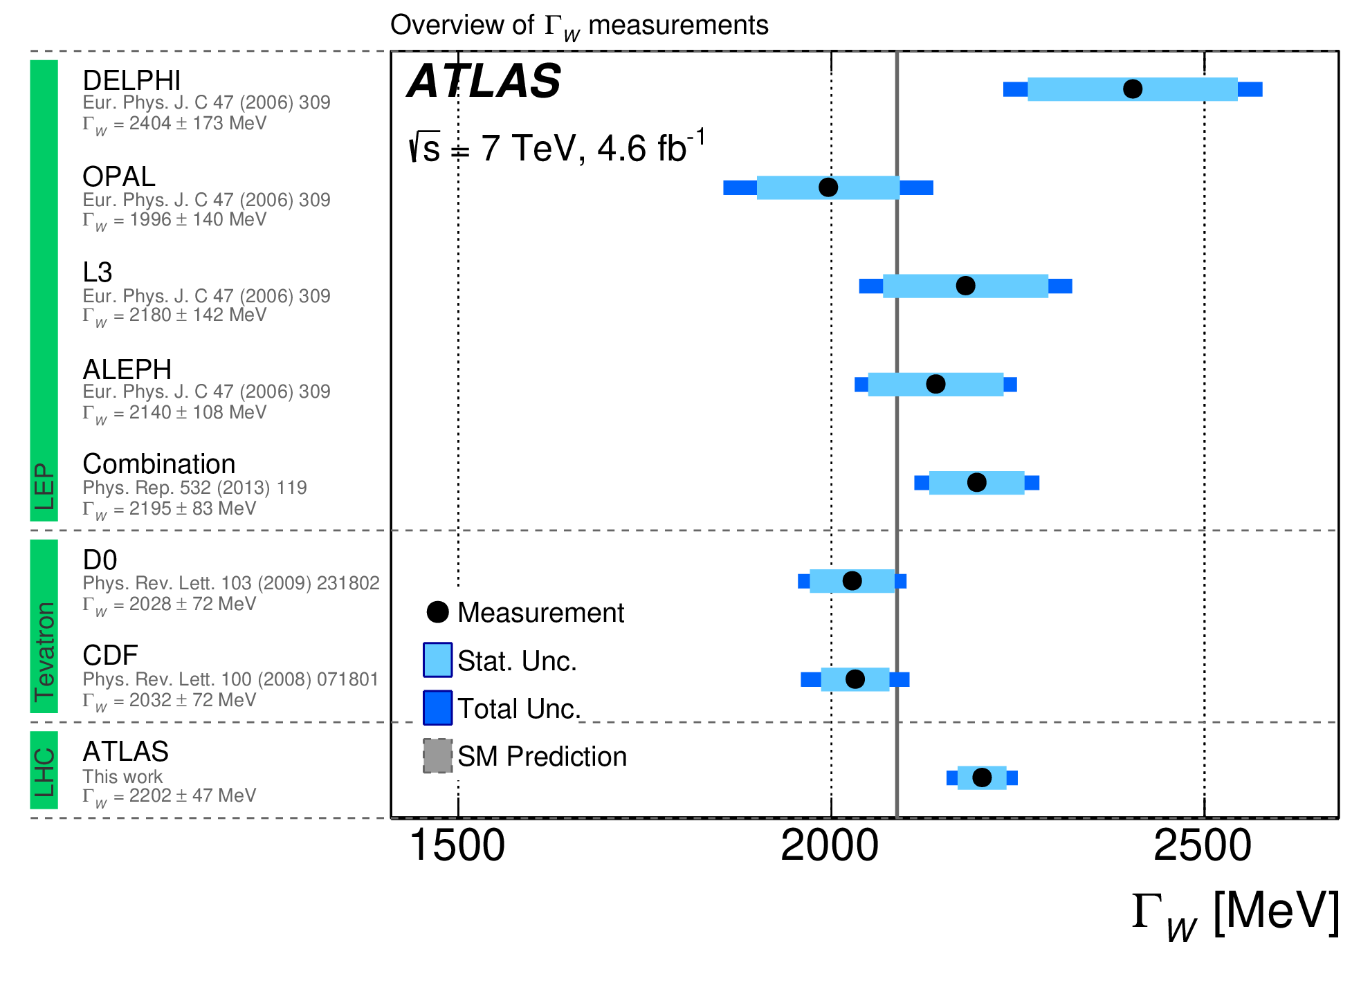
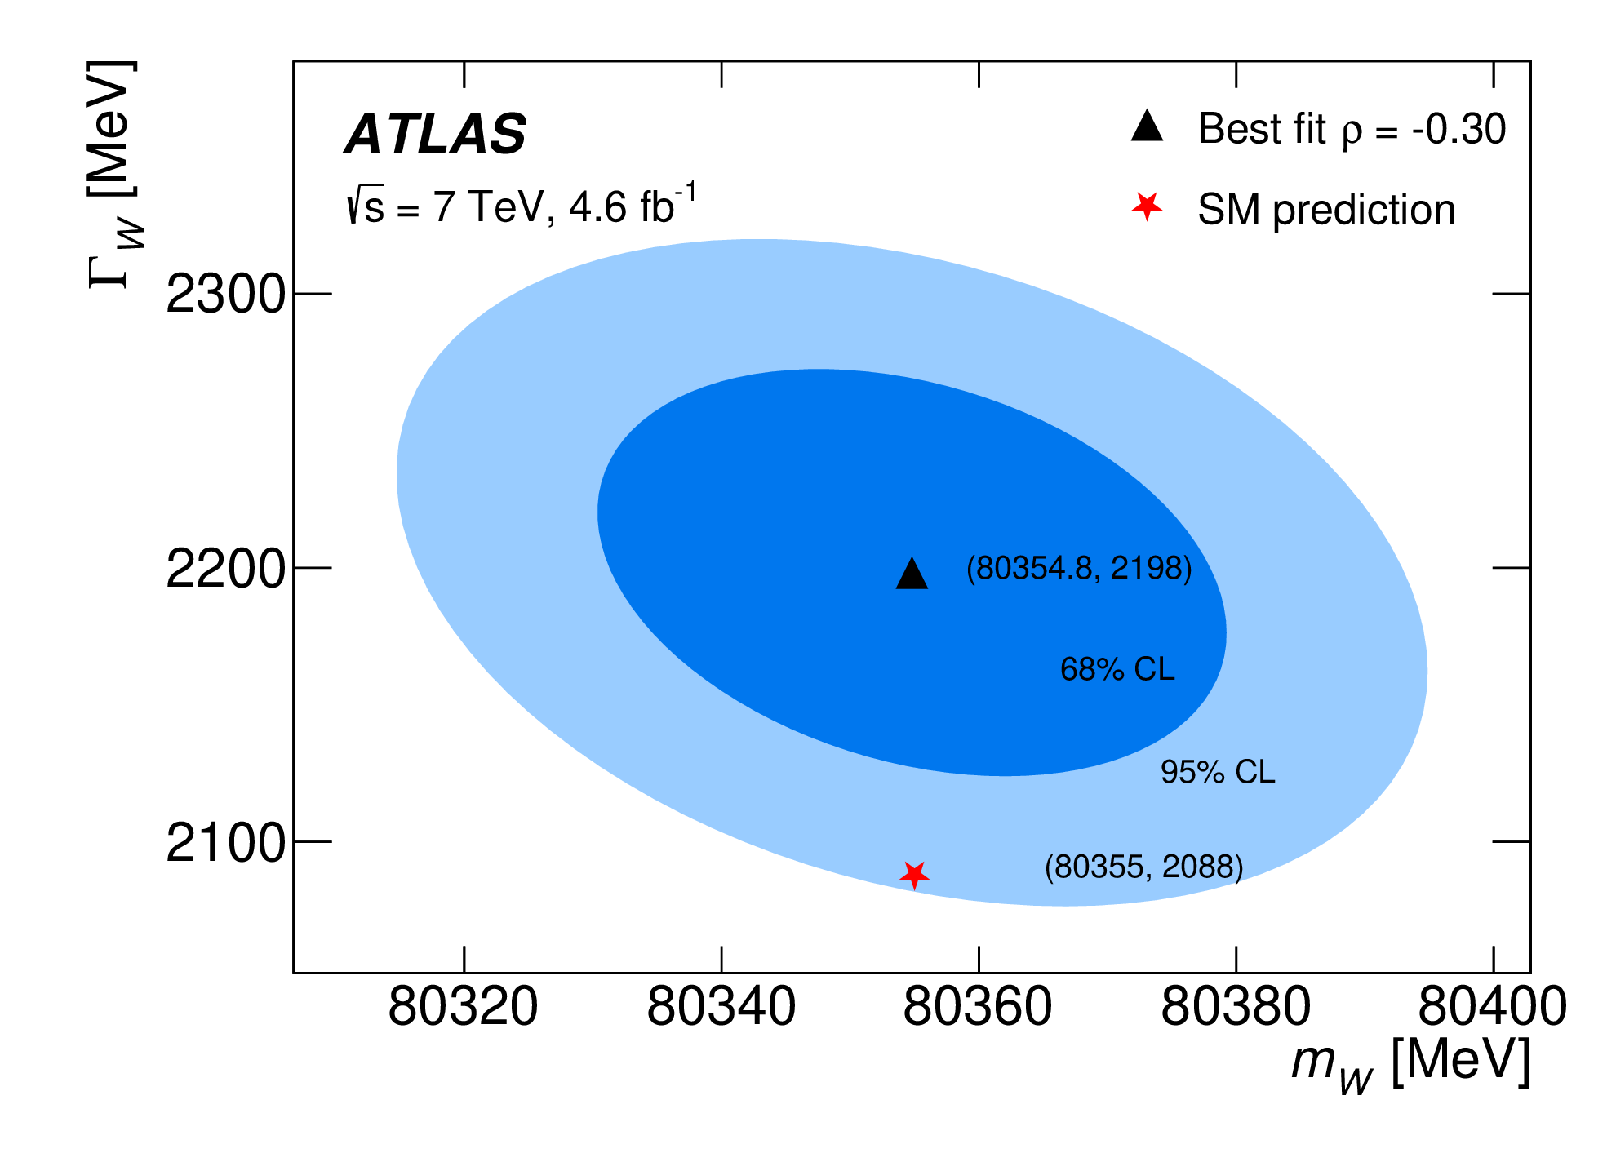
Ultra-precision measurements: W mass
https://arxiv.org/abs/2403.15085
Liverpool leads the efforts on W mass precision measurements for years → Mainly driven by Jan, new effort in progress (Josh)
Re-analysis of Run 1 data further improved W mass and width measurements
CERN Press Release
Now working on improvements to reach 10 MeV (Jan, Josh)

Slide 8
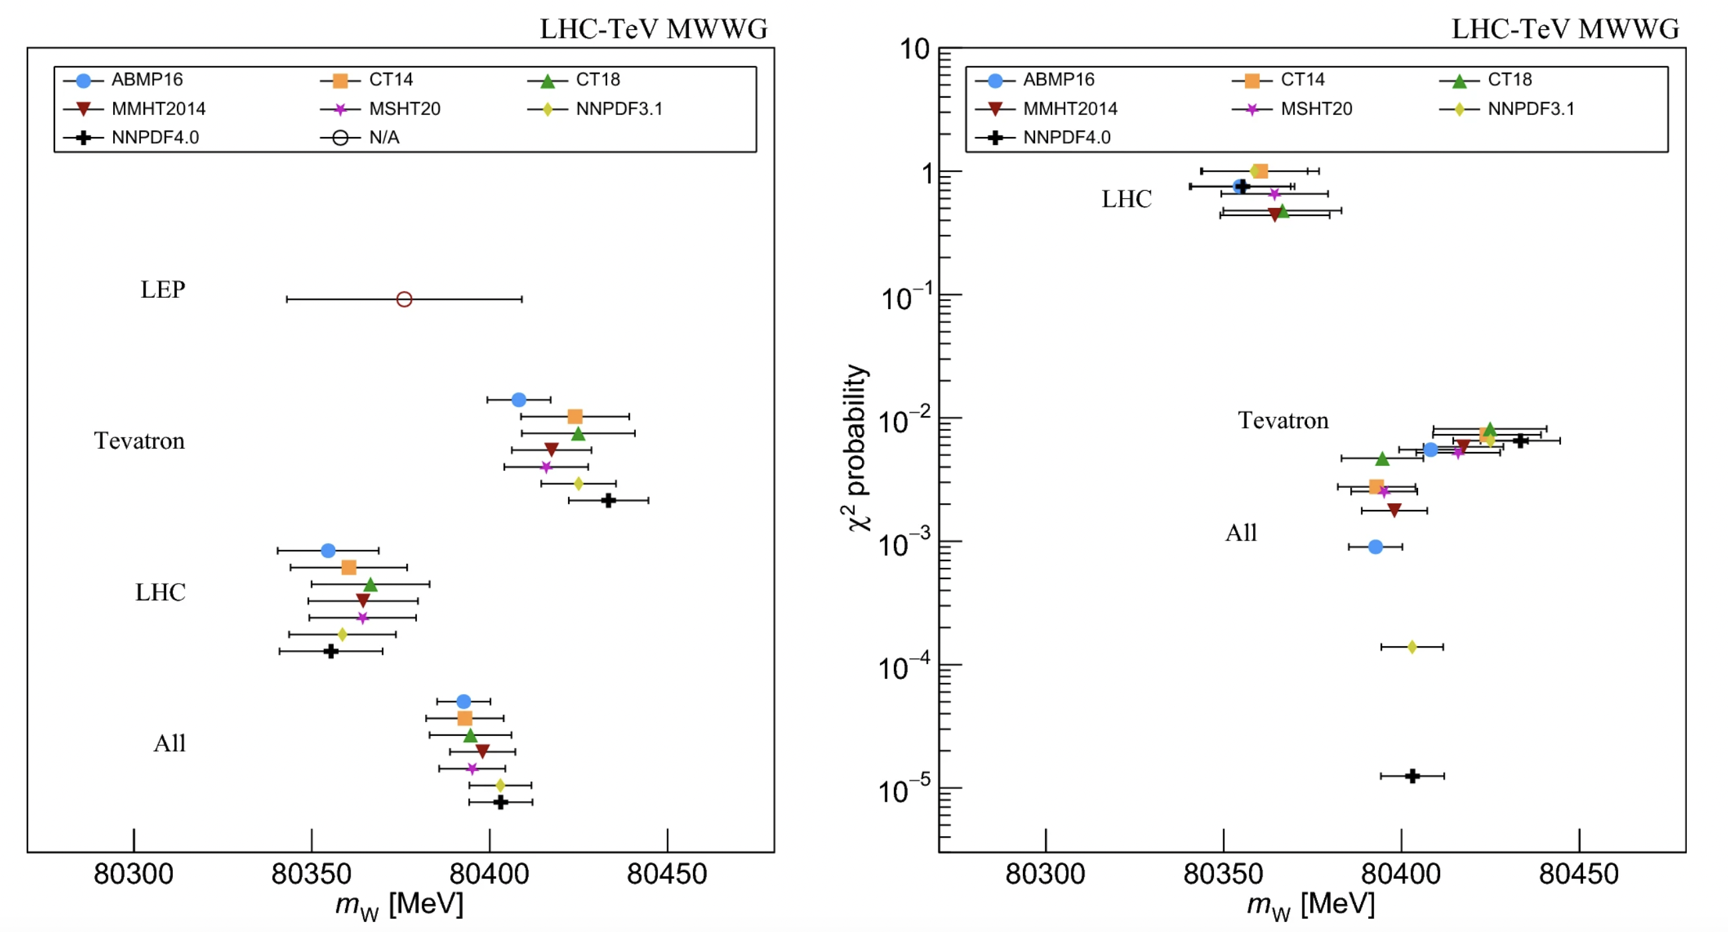
Ultra-precision measurements: W mass
https://arxiv.org/abs/2403.15085
Liverpool leads the efforts on W mass precision measurements for years → Mainly driven by Jan, new effort in progress (Josh)
Compatibility studies from LHC EWWG mW combination (Jan)
CERN Press Release
Eur. Phys. J. C 84, 451 (2024)
Tension with Tevatron (CDF results now very clear!)

Slide 9
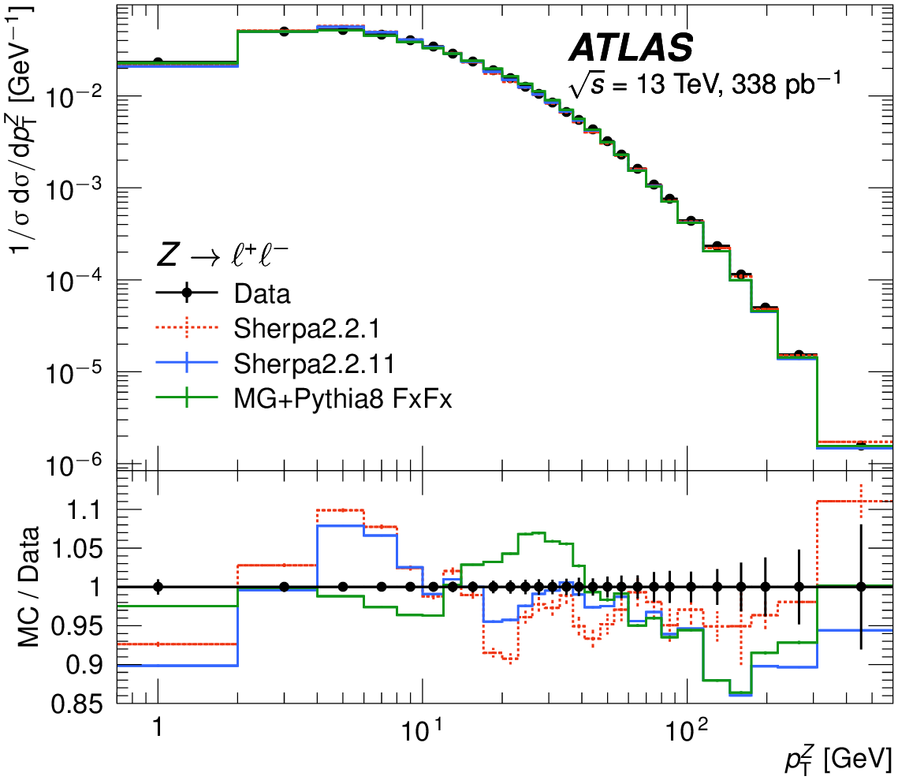
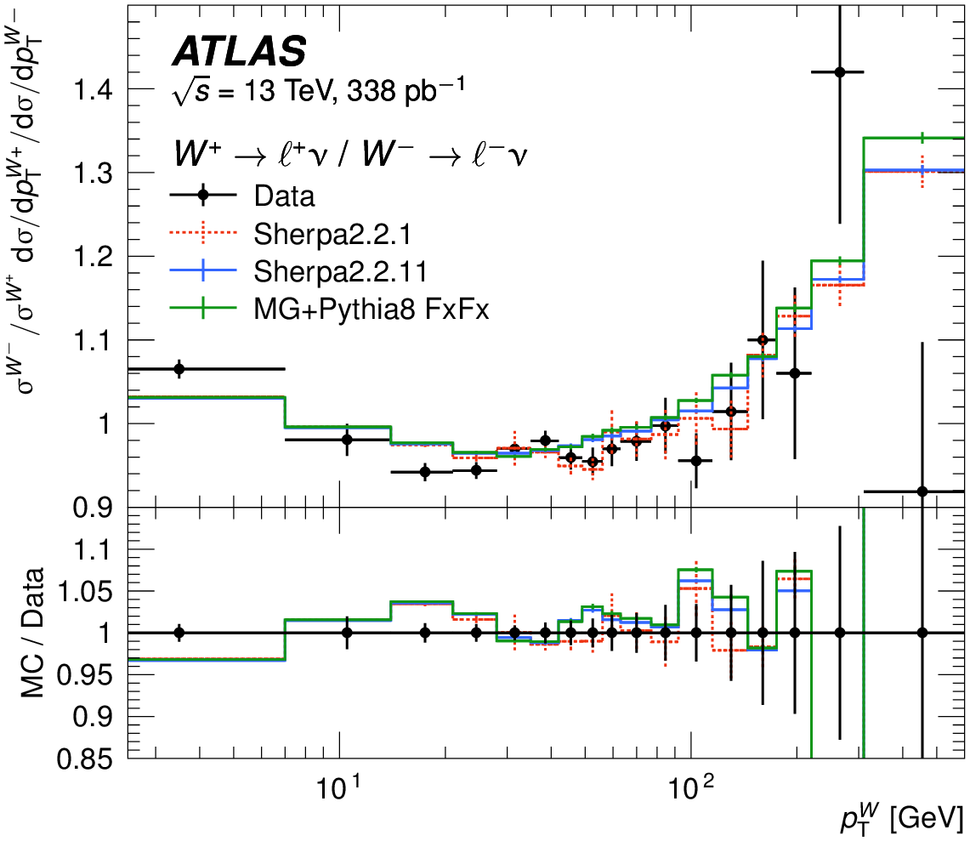
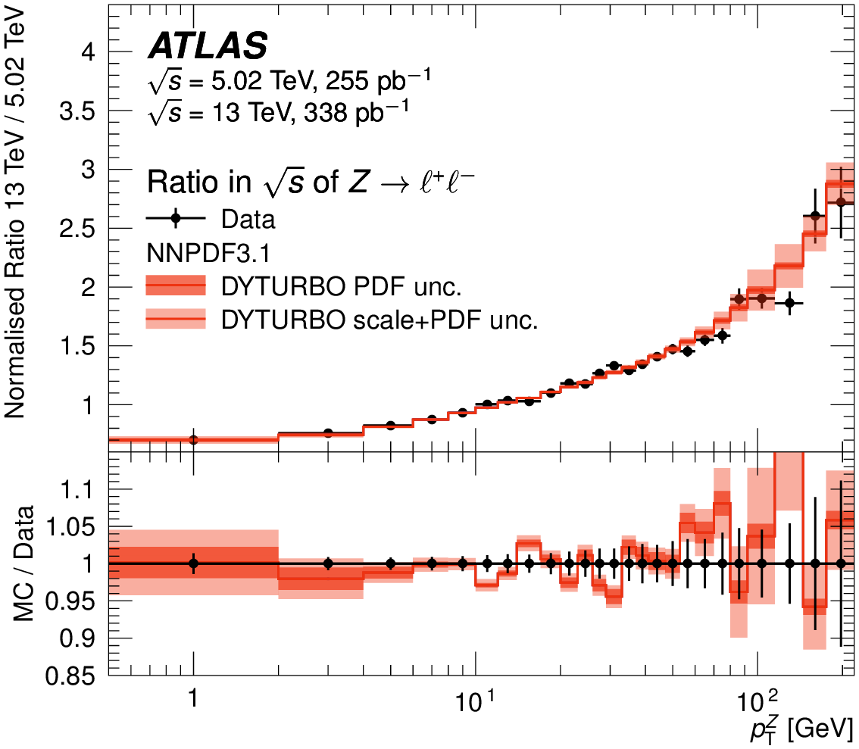
SM precision measurements as a probe for NP (1)
Searches for high-mass DY resonances and for non-resonant effects in NC DY serve as basis for dedicated precision measurements → powerful SM probe: can be used to extract (photon) PDF, test lepton universality, but also crucial for W mass measurements as well as tuning of Monte Carlo
  Published this year – pT W and pT Z precision measurements (Jan, Uta, Max):
    Use dedicated runs with reduced instantaneous luminosity at 13 TeV and 5.02 TeV c.o.m. energy
https://arxiv.org/abs/2404.06204
Deviations from data of MC generators predictions observed, resummed predictions match data better

Slide 10
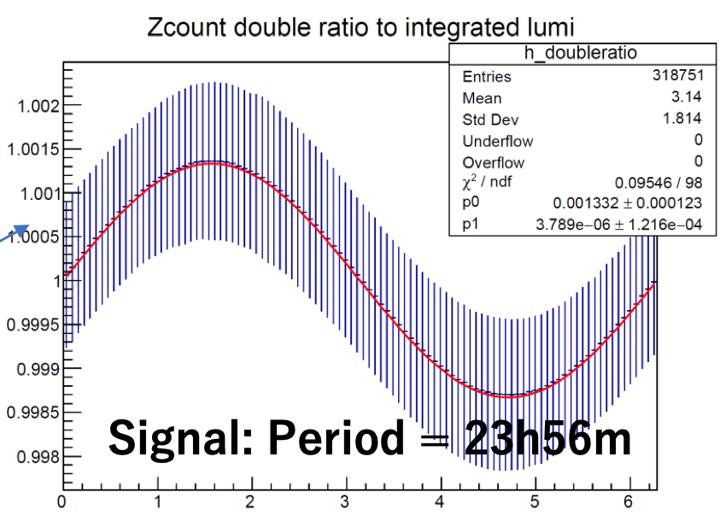
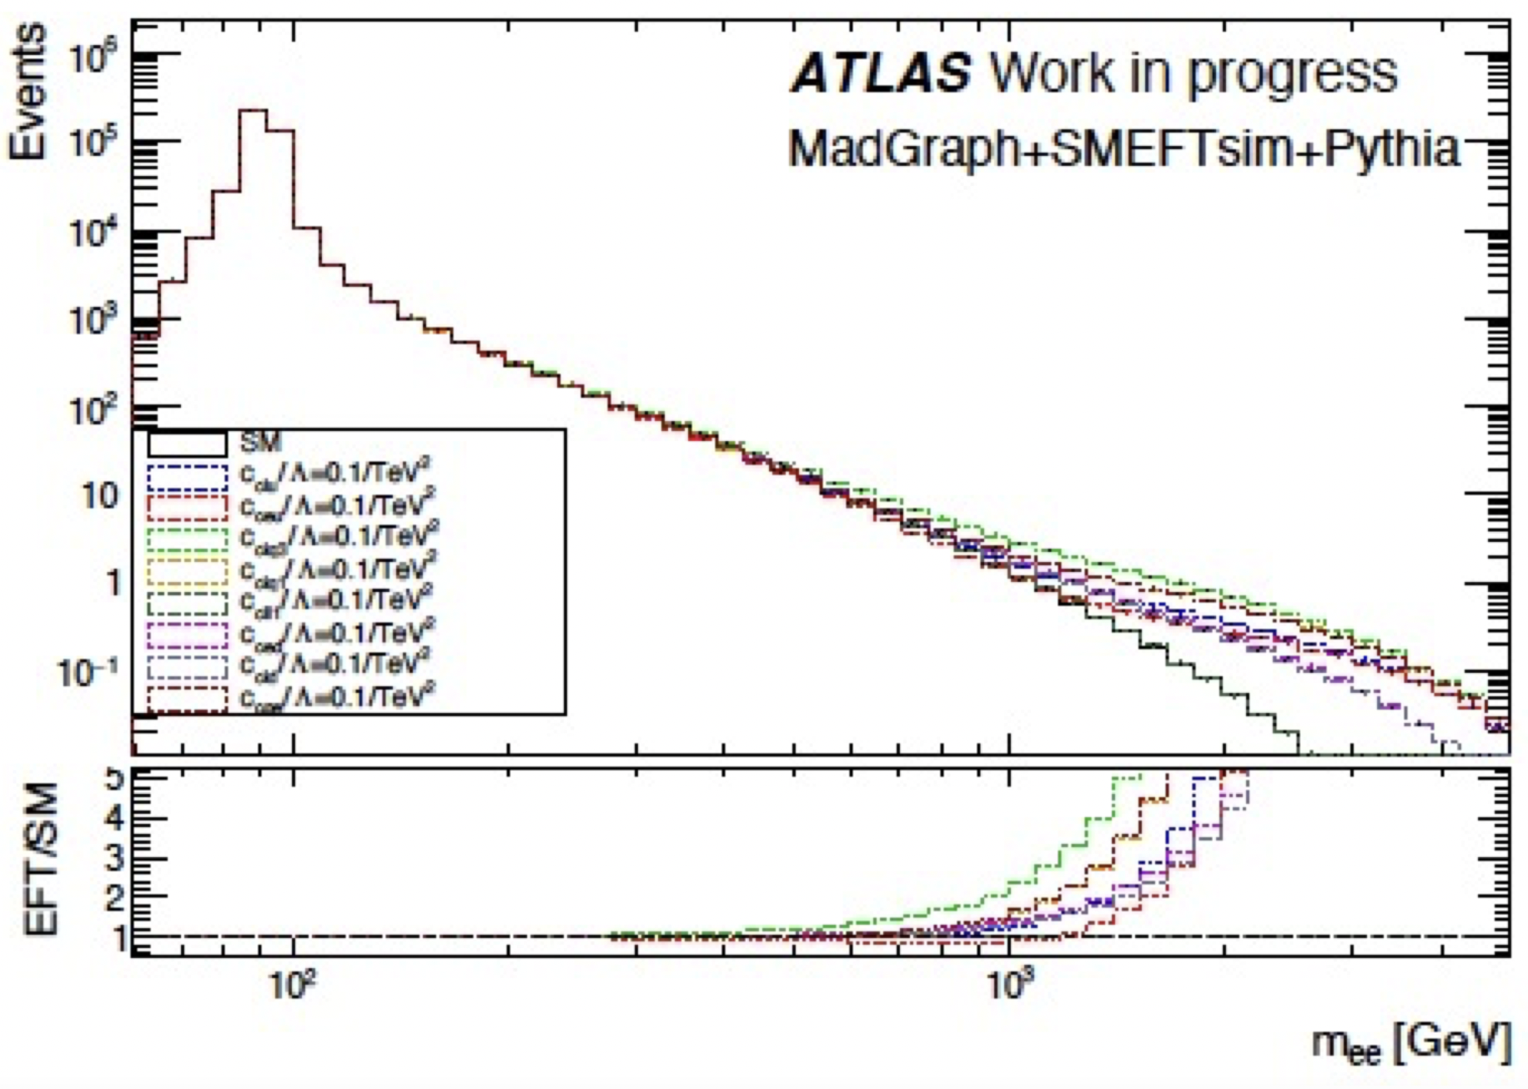
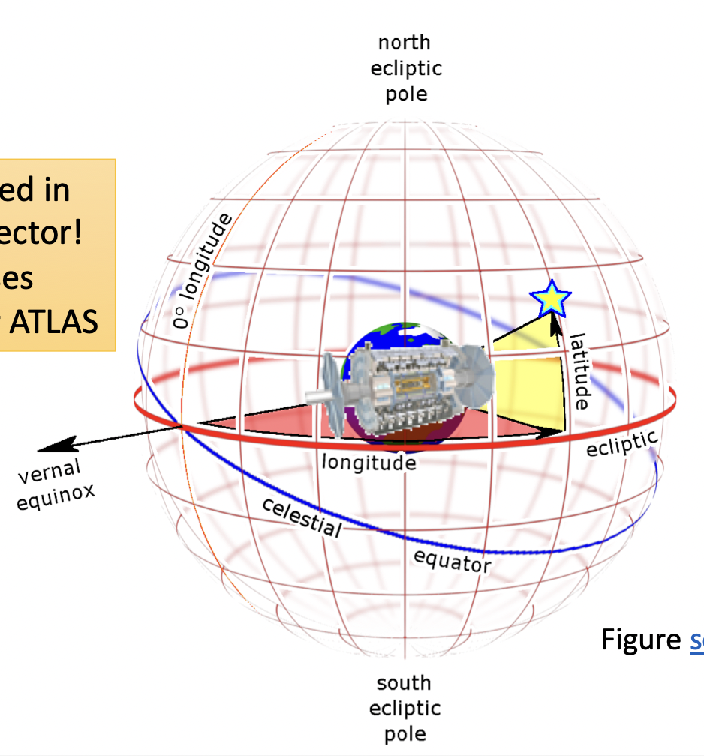
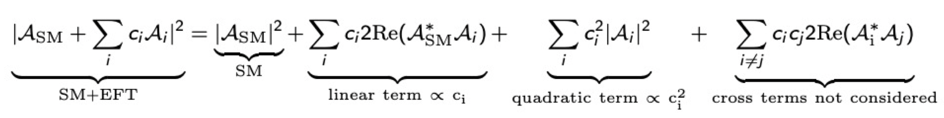
SM precision measurements as a probe for NP (2)
Searches for high-mass DY resonances and for non-resonant effects in NC DY serve as basis for dedicated precision measurements → powerful SM probe: can be used to extract (photon) PDF, test lepton universality, but also crucial for W mass measurements as well as tuning of Monte Carlo
  Drell-Yan precision measurements in lepton+E_{T}Miss (Uta, Jan, Sam) – in progress
  Reinterpretation in EFT framework of dilepton DY studies AND as Search for Lorentz- and CPT invariance violating signatures, measuring observables over phase of periodic intervals (Uta,focus of Ricardo's thesis)
  Precise test of lepton flavour universality in 𝑊-boson decays - Jan, https://arxiv.org/abs/2403.02133
  see also talk from Sam last year

Slide 11
BSM searches
ATLAS Liverpool physics
Higgs physics:
SM higgs, BSM higgses,
di-Higgs
B-/c-jet tagging
Tau ID and
Classification
Searches:
SUSY Dark Matter, LeptoQuark, Dark Sector, Axion-like particles
Precision and rare processes:
W mass, W/Z p_{T}, high-mass DY cross sections, rare tau decays
Analysis software
Luminosity measurements

Slide 12
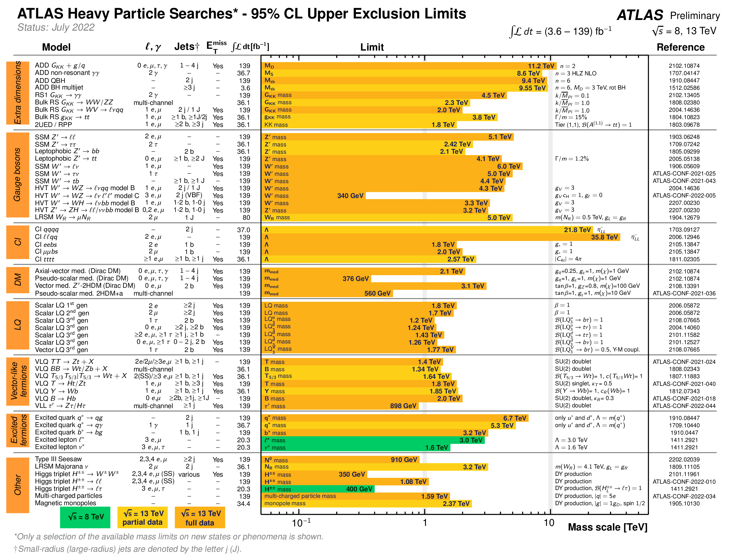
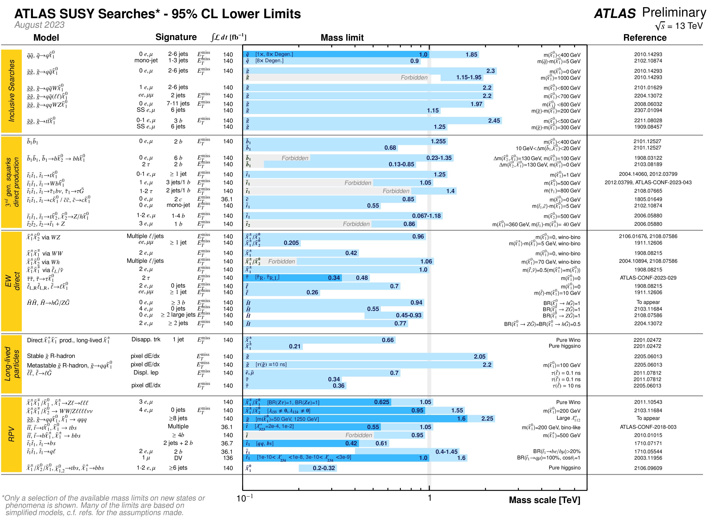
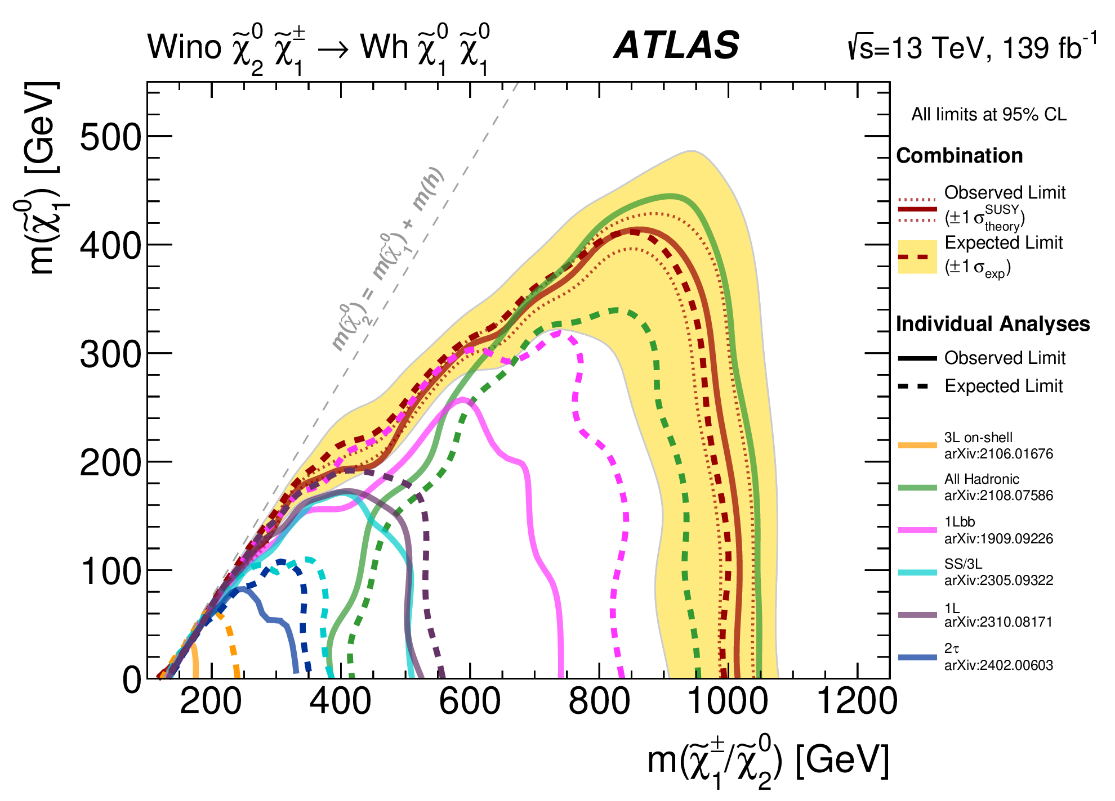
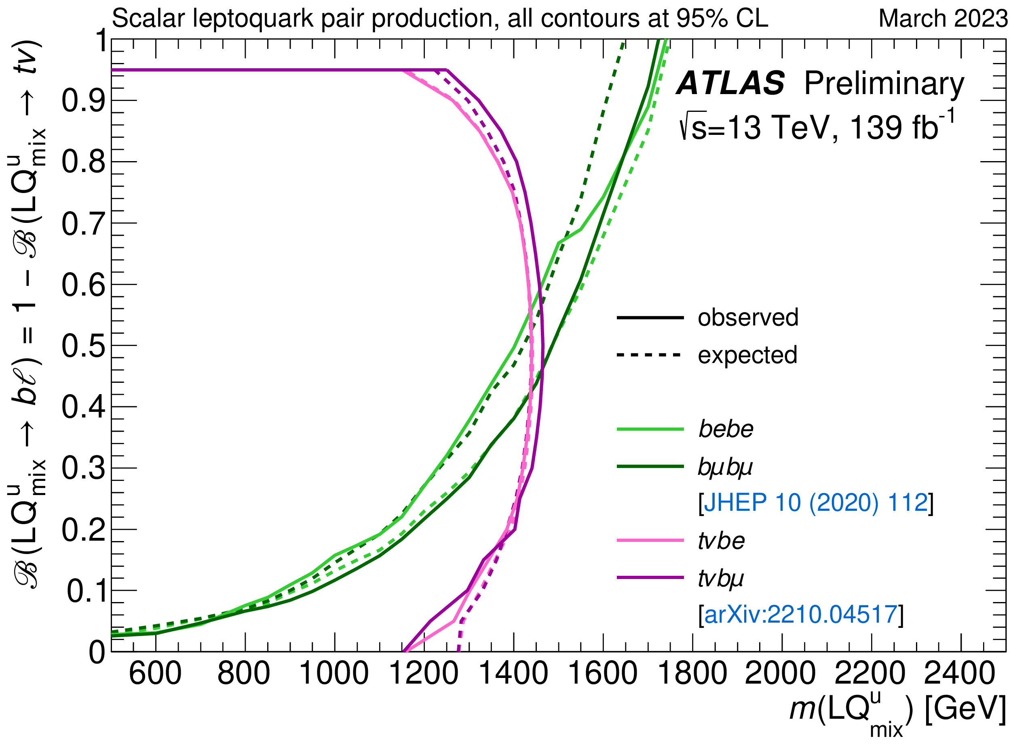
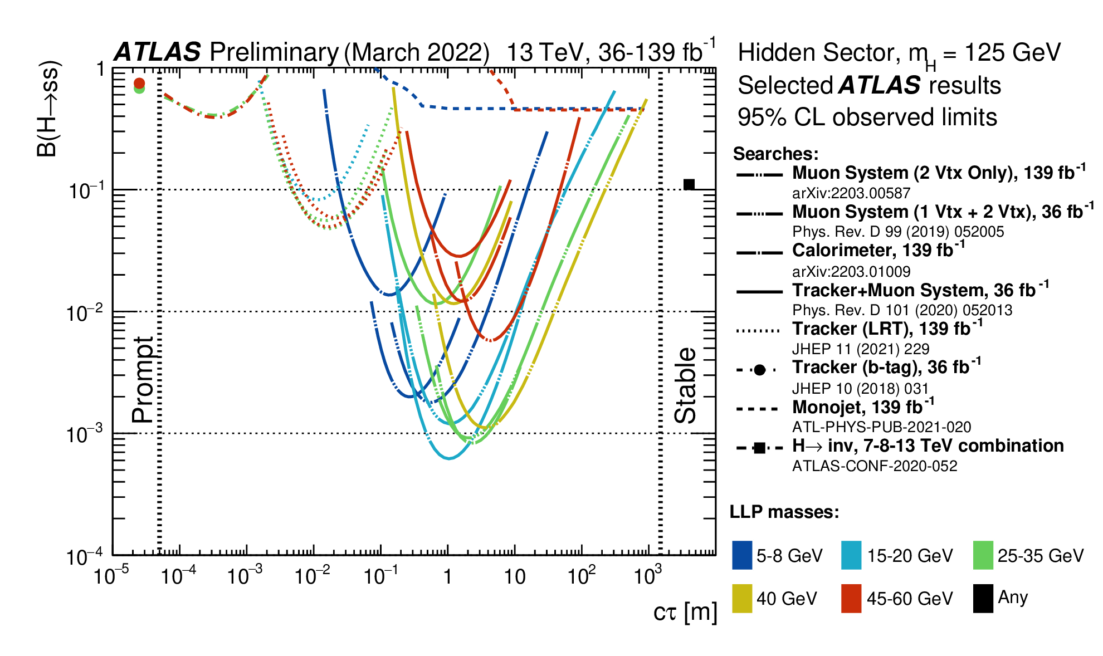
Huge effort in ATLAS to search for New Physics!
= topics/papers we worked/led in the past years

Slide 13
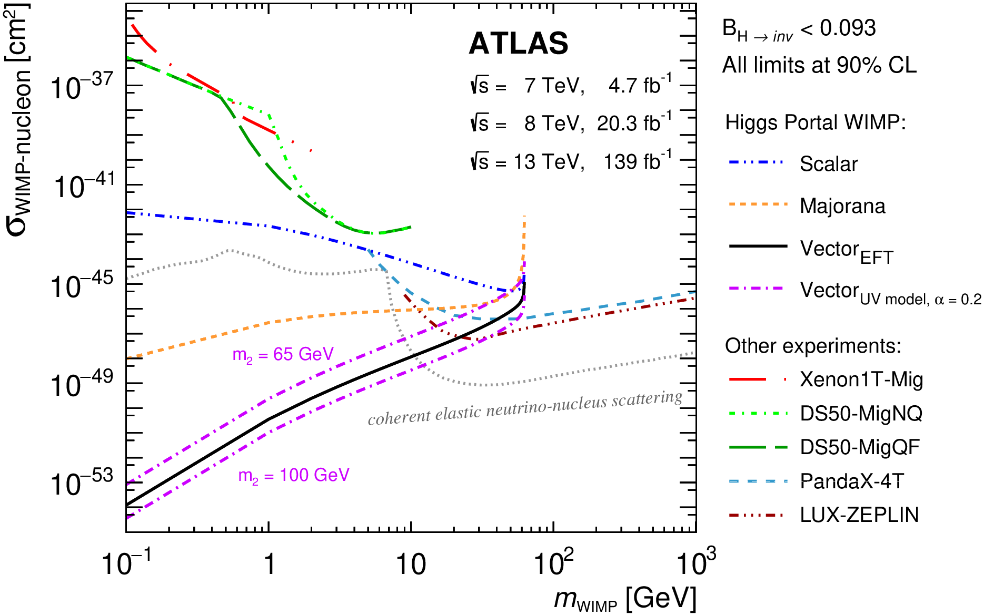
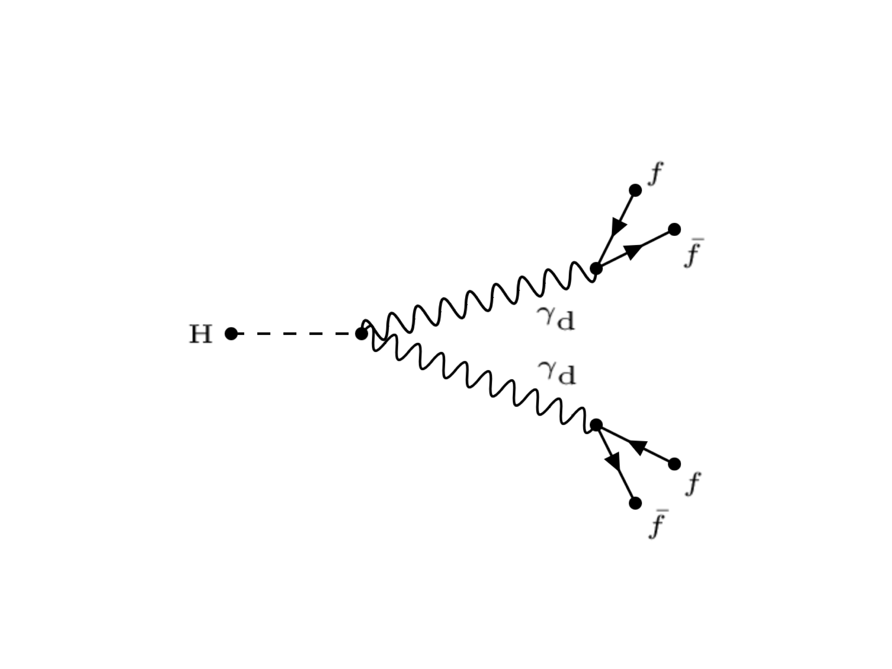
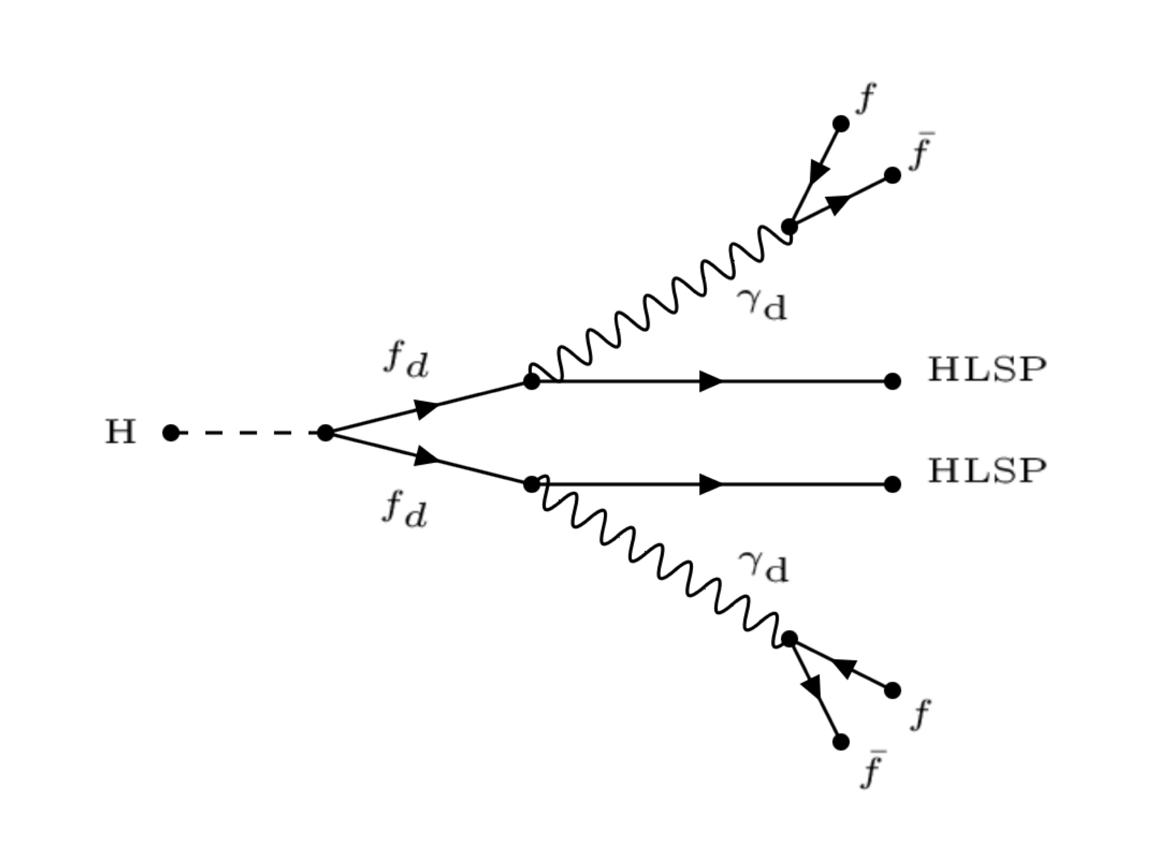
Searches for new physics: using the Higgs boson
ATL-PHYS-PUB-2023-018
In recent years, (part of the) group has focused on searches for new physics using the Higgs boson as a portal.
  New particles might arise in the decays of the Higgs boson
    Most recent BR limits on Higgs to invisible: 9.3% - room for NP!
A typical benchmark model: dark photons, γ_{D}
  Might arise in Higgs decays either directly or in cascade
  The dark photons decay into SM particles (if their mass is below twice DM candidate mass)
Using previously published results (Monica, Andy, Matt)
H → γ_{D}γ_{D}
H →LSPs+ γ_{D}γ_{D}
The dark photons can be long-lived and their displaced signature must be reconstructed with dedicated techniques (unconventional signature

Slide 14

Leaving not stones unturned …
ATL-PHYS-PUB-2022-007
Analyses designed to aim for a final combination of prompt+displaced dark photons reconstructed as displaced narrow jets (lepton-jet) from Higgs decays (H via gluon-fusion, associated W and Vector-Boson-Fusion prod.)
Run 2 prompt analysis effort restarted: results for ICHEP (Cristiano)
Extend mγ_{d} mass range to 0.01-25 GeV
displacement
https://arxiv.org/abs/2311.18298
JHEP06(2023)153
Run-2 displaced analyses (ggF+WH+VBF)
Significantly improve results for mγ_{d} <200 MeV and extend sensitivity in the high mass region (> 10 GeV)
Monica, Cristiano
Very displaced region: mono-jet search reinterpretation (update in progress, Cristiano)

Slide 15
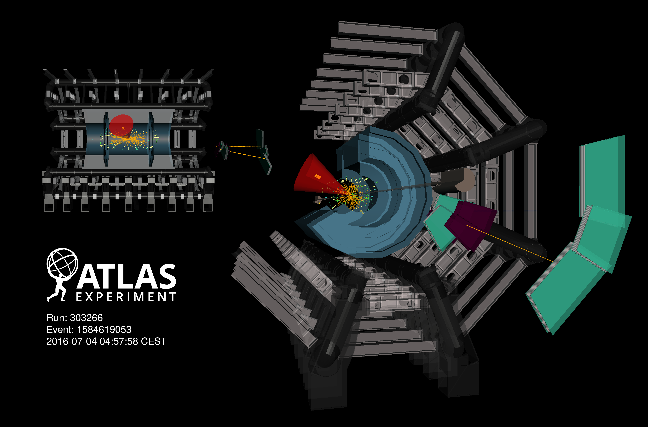
Dark-photon candidate
EXOT-2019-05

Slide 16
Dark photon searches: Run 3 and beyond
Significant improvements expected with Run 3 data
  Dark-photons reconstructed as displaced narrow jets (lepton-jet) → improvements thanks to dedicated triggers developed for Run 3 (Cristiano)
  Analysis improvements possible using Graph-neural networks (Monica, Cristiano, Joe)
xAI analysis
(Saliency Map+TracIn)
Study correlations for various DR and models assumptions
Preliminary results presented at EuCAiF2024 symposium on AI in NP, PP and astronomy

Slide 17
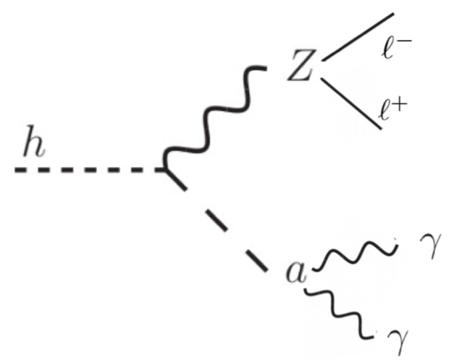
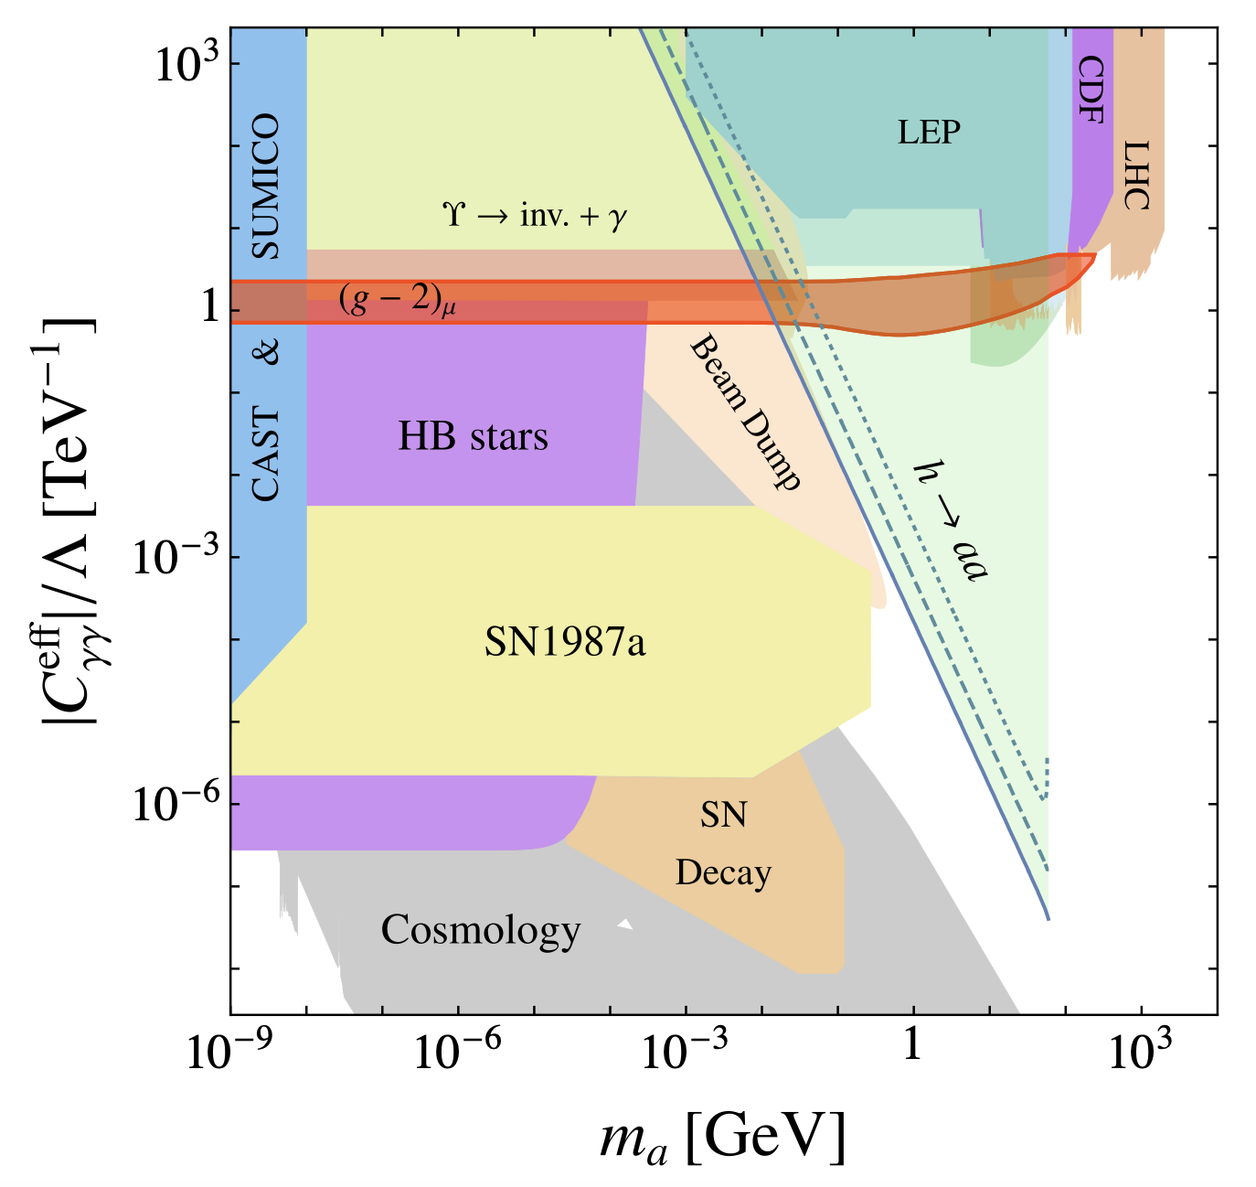
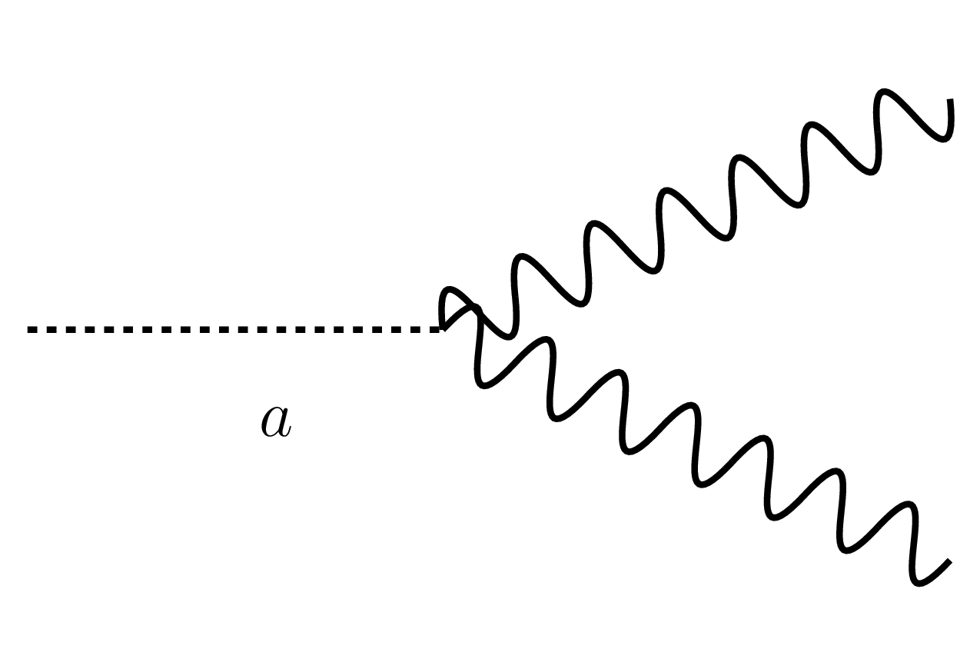
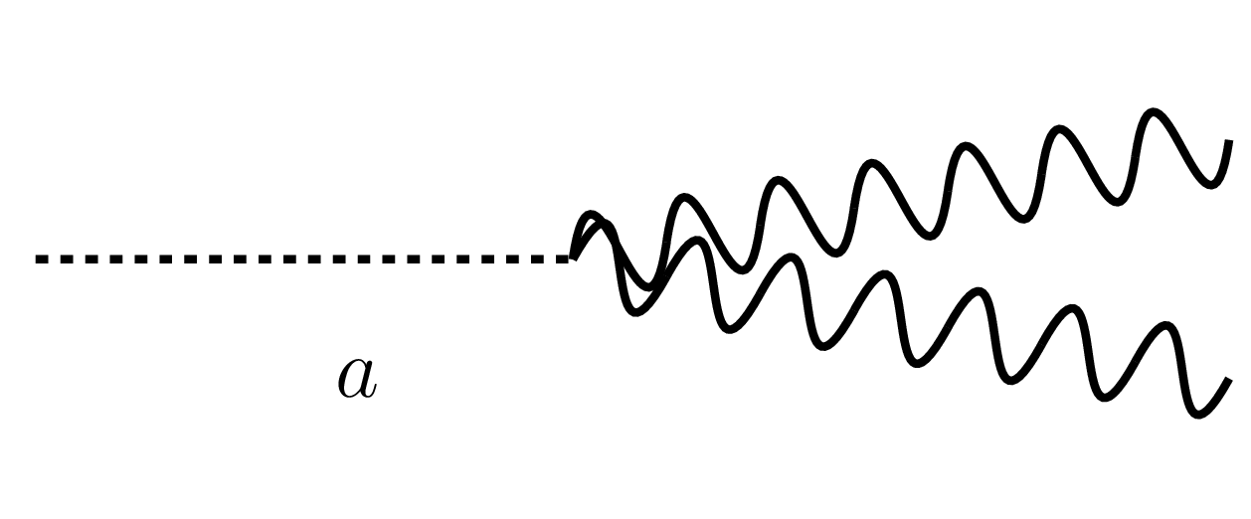
Axion like particles from Higgs boson decays
Axion-like particles (ALPs) can be produced in association with a Z boson from Higgs decay
Signature with two leptons and two collimated photons (one if signal photons are collimated)
Dedicated Liverpool effort on all fronts:
  Prompt decays (Nikos, Cristiano, Adam PhD)
    Phys. Lett. B 848 (2024) 138536
  Displaced decays (Monica, Nikos, Cristiano, Rebecca PhD)
    In progress, see also Rebecca's talk – use of GNN approach from dark-photon
Preferred parameter space where g-2 anomaly can be explained
arXiv:1708.00443
<2 GeV
>2 GeV
h—> Za,
OUR TARGET: ALPs pseudo-scalar particles: mass range up to ~34 GeV

Slide 18
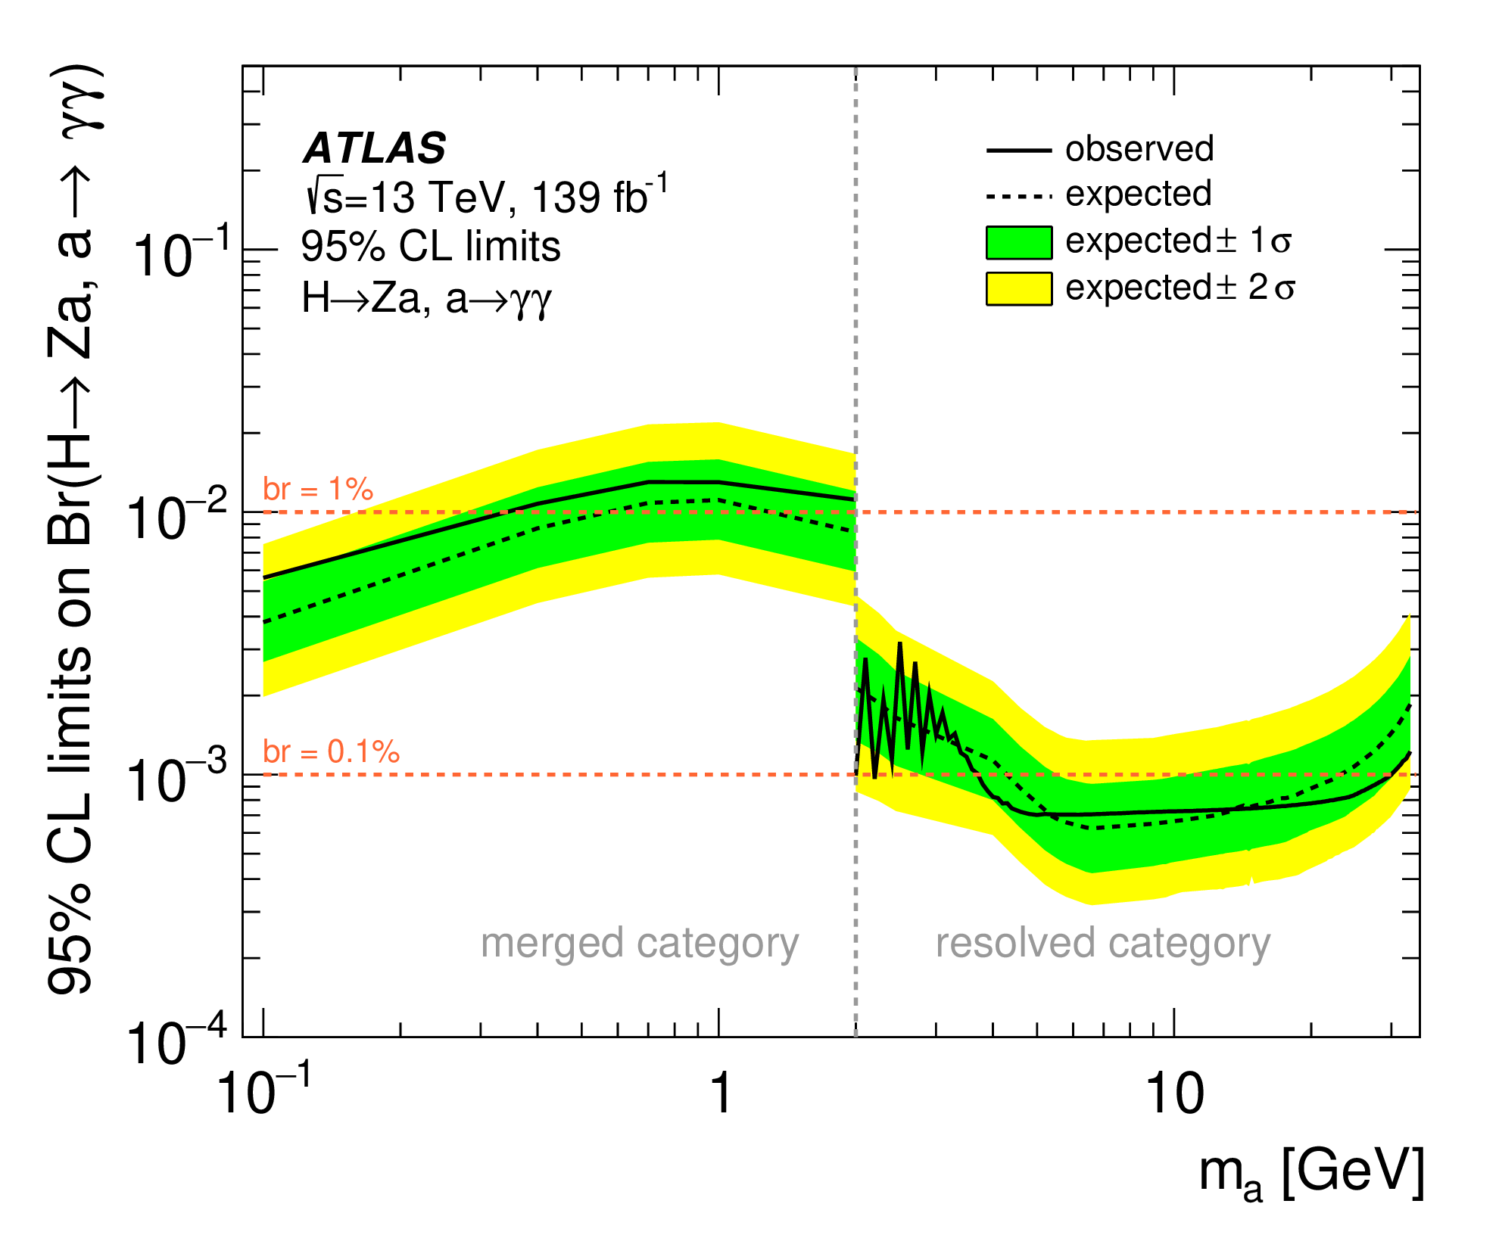
Axion like particles from Higgs boson decays
Axion-like particles (ALPs) can be produced in association with a Z boson from Higgs decay
Signature with two leptons and two collimated photons (one if signal photons are collimated)
Dedicated Liverpool effort on all fronts:
  Prompt decays (Nikos, Cristiano, Adam PhD)
    Phys. Lett. B 848 (2024) 138536
  Displaced decays (Monica, Nikos, Cristiano, Rebecca PhD)
    In progress, see also Rebecca's talk – use of GNN approach from dark-photon
<2 GeV
>2 GeV

Slide 19
Axion like particles from Higgs boson decays
Axion-like particles (ALPs) can be produced in association with a Z boson from Higgs decay
Signature with two leptons and two collimated photons (one if signal photons are collimated)
Dedicated Liverpool effort on all fronts:
  Prompt decays (Nikos, Cristiano, Adam PhD)
    Phys. Lett. B 848 (2024) 138536
  Displaced decays (Monica, Nikos, Cristiano, Rebecca PhD)
    In progress, see also Rebecca's talk – use of GNN approach from dark-photon
  In addition, new PhD (Oct 2024) will study ALPs from ultraperipheral heavy ion collisions (Nikos, Monica)
<2 GeV
>2 GeV
Displaced region

Slide 20
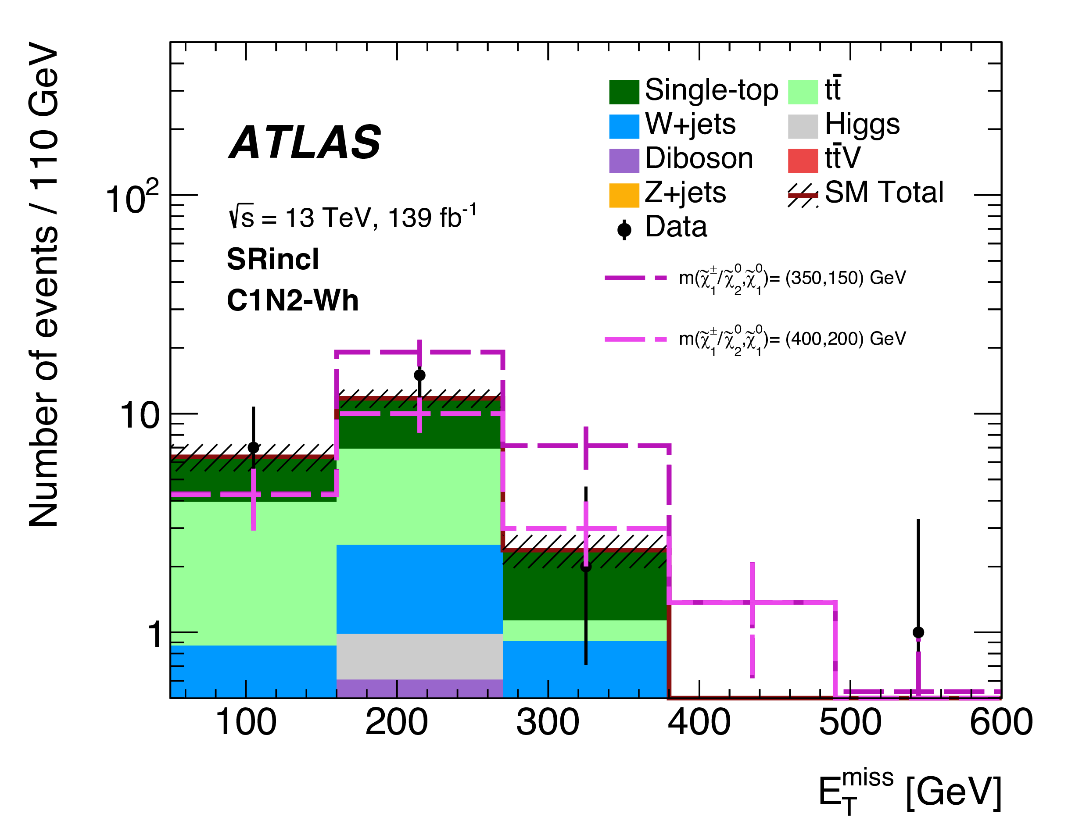
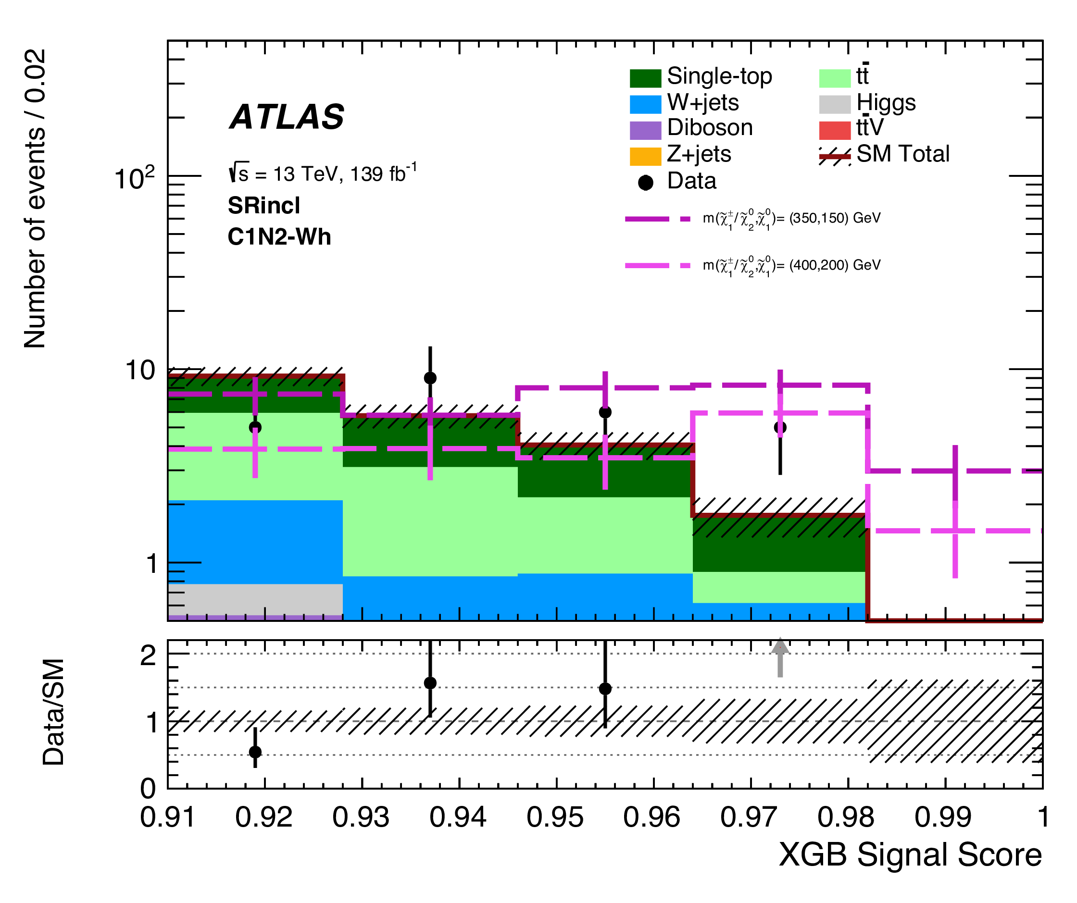
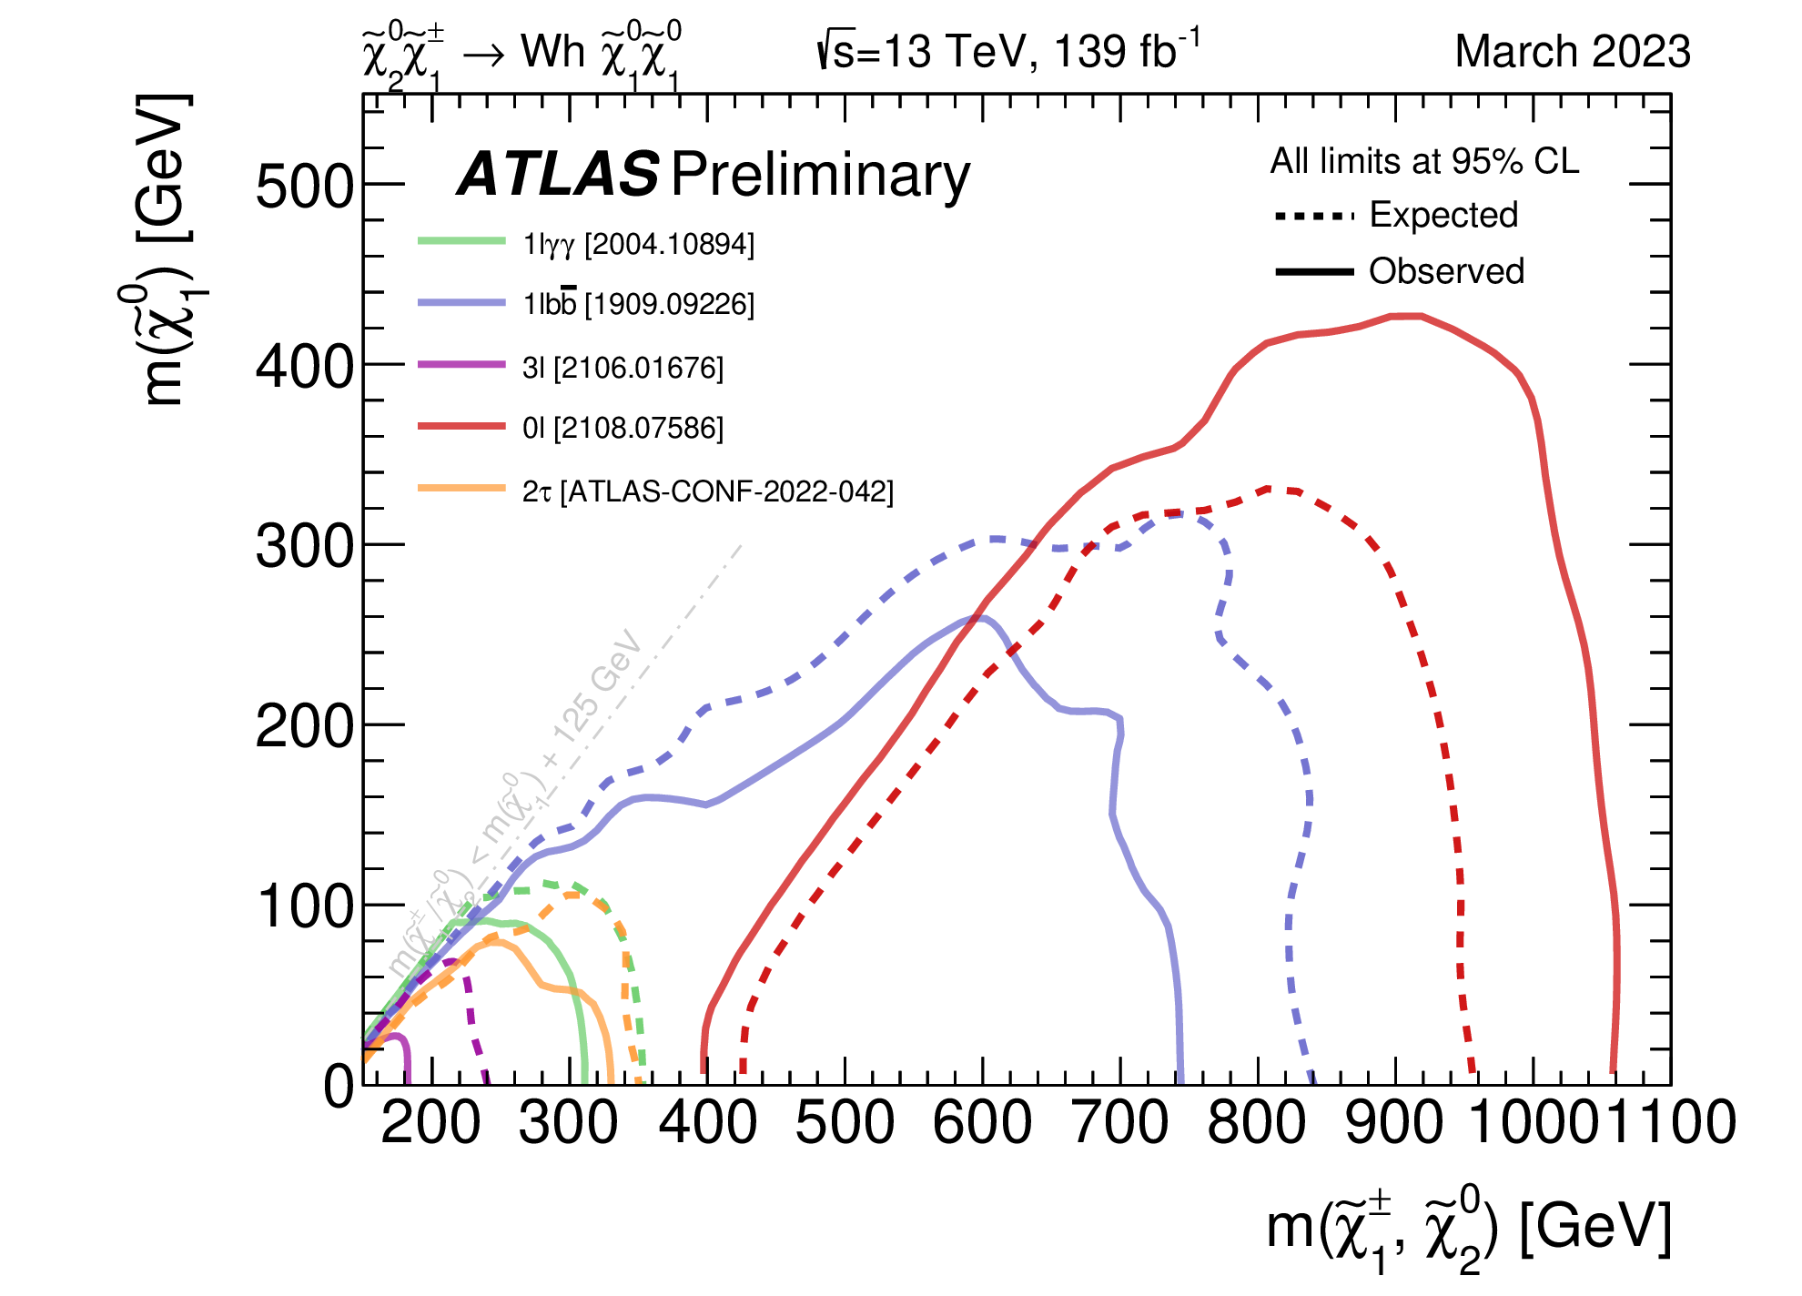
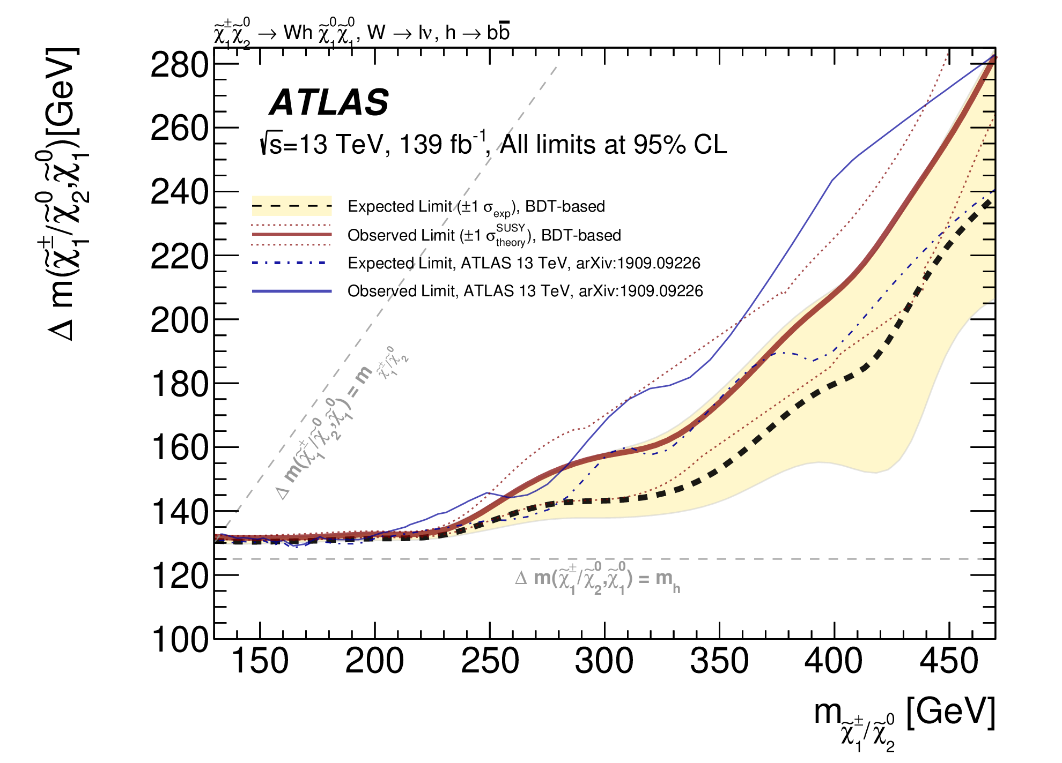
(WIMP) Dark Matter from SUSY and beyond
SUSY-like DM candidates in prompt and long-lived signatures remain a key target for ATLAS and are being finalised using Run-2 data by Liverpool members
Prompt: missing transverse momentum signature
Targets mildly compressed SUSY scenarios
JHEP12(2023)167
Monica, Joe
GNN-based improved studies using published datasets in progress
Great contributions from our BSc and Mphys students Lennox and Sam (+Monica, Joe, Carl)
  Use ML techniques to target difficult phase space
  Part of the legacy paper – statistical combination of all searches for SUSY EWK production
https://arxiv.org/abs/2402.08347

Slide 21
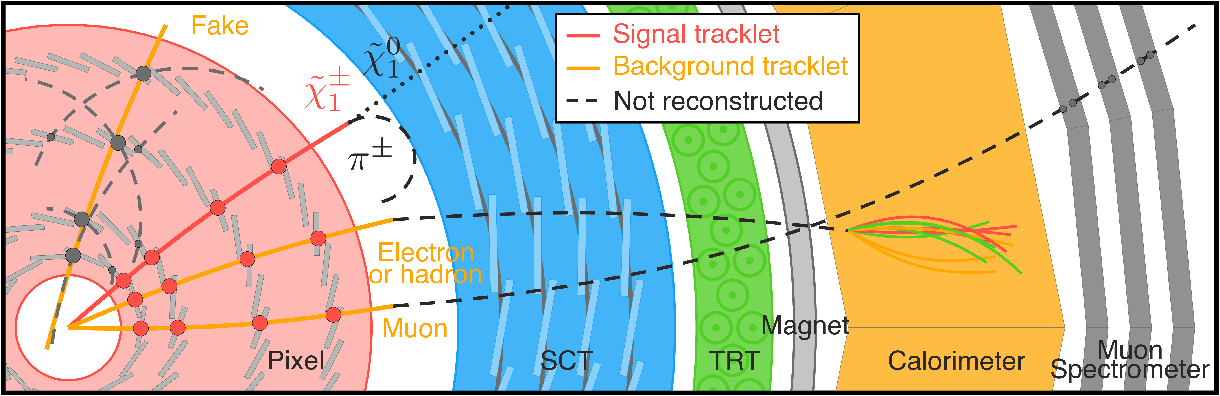
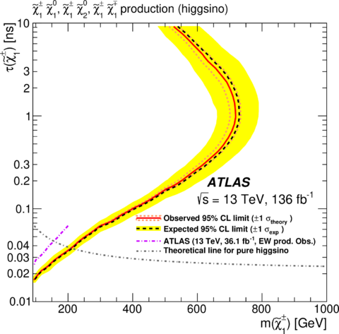
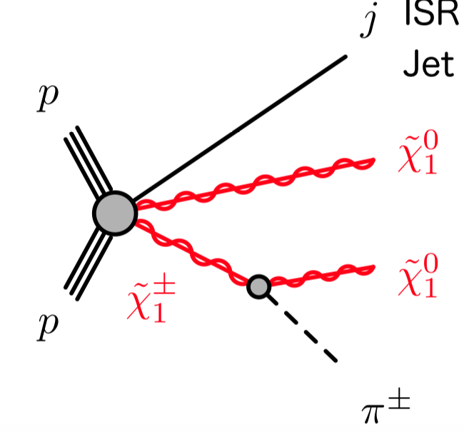
(WIMP) Dark Matter from SUSY and beyond
SUSY-like DM candidates in prompt and long-lived signatures remain a key target for ATLAS and are being finalised using Run-2 data by Liverpool members
Displaced: Disappearing track signature
Targets very compressed SUSY scenarios, and various DM models (Monica, James now PhD! )
Eur. Phys. J. C 82 (2022) 606
Finalizing analysis that uses dedicated tools to reconstruct the soft pion from decay chain:
Use 3 or 4 layers of the pixel detector
Important for Run 3 and Run 4

Slide 22
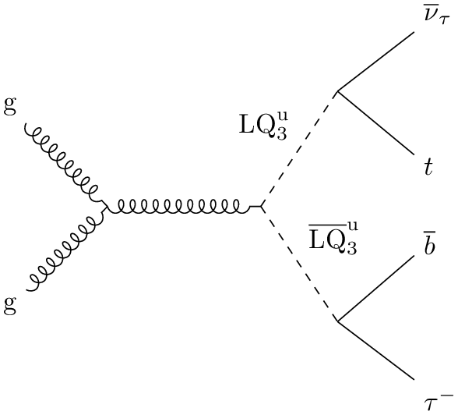
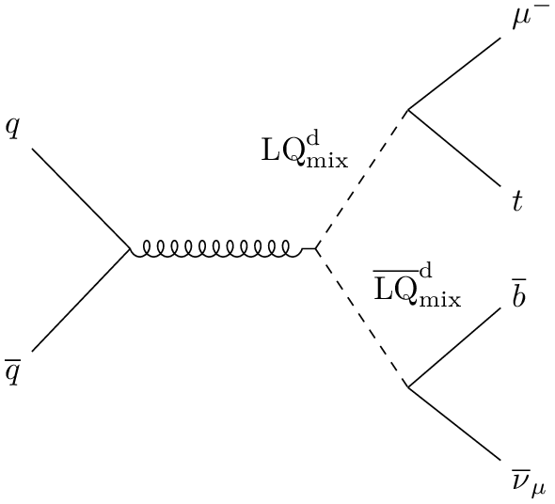
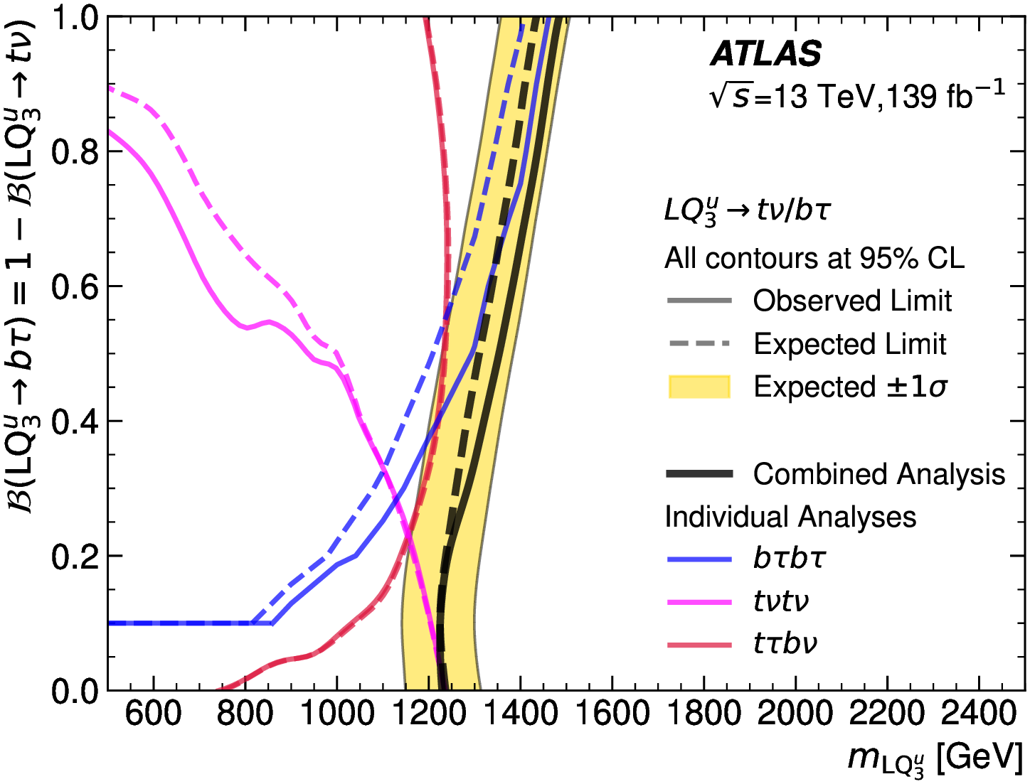
More than DM: Leptoquarks (LQ)
Leptoquarks couple to both quarks and leptons
  Provide connection between similar sections of SM
  Offers potential explanation of flavour anomalies & g-2
Historically, Liverpool focused on third-generation with LQLQ → bτbτ (Carl – published in 2023), bb+MET (Monica), lqlq (q=l, c, b) (Andy, Monica, Adam Jaspan)
Run-2 combination (Andy)
  Provide improved sensitivity compared to individual results
  Consider 3rd generation and mixed scenarios
  World-leading results to date
Run 3: analysis starting (Andy, Mehul)
https://arxiv.org/abs/2401.11928

Slide 23
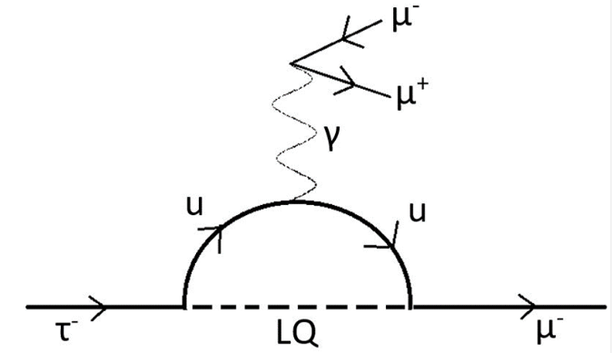
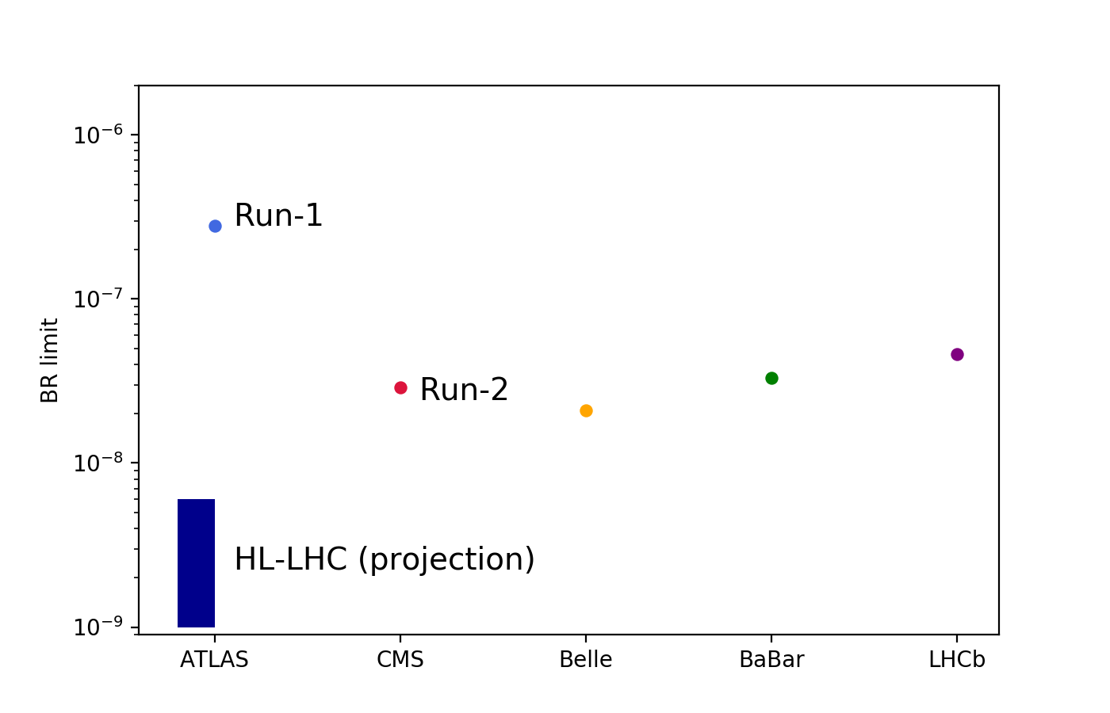
More than DM: Charged Lepton Flavour Violation
Carl, Conor-PhD, Jan
Run 2 cLFV τ → 3μ search
  4 orders of magnitude less constrained than muon LFV
  Observation would be clear sign of new physics
  Potential explanation of flavour anomalies & g-2
Liverpool-only analysis
  Matt was analysis coordinator until Oct 2022
    now Conor took the lead
  No previous Run-2 ATLAS search
  Subject of Conor’s thesis (see talk at IoP)
  Aiming for publication in 2025
SM:
BR(τ◊3μ) ~10⁻⁵⁵ – 10⁻⁵⁶
?
Current experimental limits:
* Best limit from Belle: 2.1 x 10⁻⁸
* CMS partial Run-2: 1.1 x 10⁻⁷

Slide 24
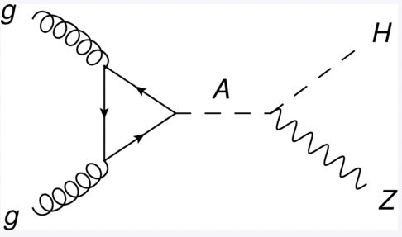
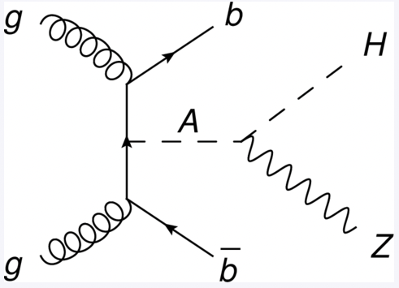
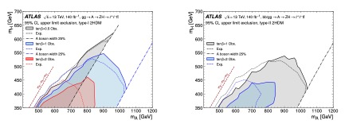
Beyond the SM Higgs: 2HDM models
Two-Higgs-doublet models are a class of well-motivated beyond SM theories incorporating Dark Matter. They predict additional, heavier higgs bosons and can have a variety of signatures
  E.g.
A → ZH
Group is contributing to these searches since years (Nikos)
2HDM as well as model independent limits in m(top-antitop) and mbb
https://link.springer.com/article/10.1007/JHEP02(2024)197
Additional results on 2HDM models thanks to di-Higgs searches (see Jordy’s talk)

Slide 25
Higgs physics see Jordy’s talk
ATLAS Liverpool physics
Higgs physics:
SM higgs, BSM higgses,
di-Higgs
B-/c-jet tagging
Tau ID and
Classification
Searches:
SUSY Dark Matter, LeptoQuark, Dark Sector, Axion-like particles
Precision and rare processes:
W mass, W/Z p_{T}, high-mass DY cross sections, rare tau decays
Analysis software
Luminosity measurements

Slide 26
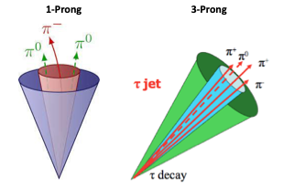


A word on efforts of general relevance..
The group is particularly engaged in providing the best tools for all analyses
  Analysis Software (Andy), Run 3 triggers (Cristiano), pile-up simulation (Carl), MC generators (Jan)
  Physics objects: flavour tagging (Andy, Nikos); tau ID and classification (Joe, Nikos, Monica, Rob, Jordy Mehul)
Work focus on
B-jet and c-jet calibration
C-jet mistagging and c-jet ID
Work focus on ID of tau decaying hadronically
New GN-based taggers being exploited
Use Graph NN (all) to identify and classify tau decays and reject background from jets
→ Comparing our GN approach (Joe) to GN from b-tagging in progress
→ See also Mehul and Rob talks

Slide 27


A word on efforts of general relevance..
The group is particularly engaged in providing the best tools for all analyses
  Analysis Software (Andy), Run 3 triggers (Cristiano), pile-up simulation (Carl), MC generators (Jan)
  Luminosity: contributed to best ever measurements (already shown last year), work on Z-counting method pioneered by Liverpool continuing (Uta, Jan, Sam, Josh)
Run 2 Luminosity uncertainty: 0.83%
Run 3 cross-checks from Z-counting crucials → stable with pile-up (see also talk from Josh)
Eur. Phys. J. C 83 (2023) 982

Slide 28
Conclusion
Great results published, several members of the team invited for plenary talks, workshops and seminars:
  Legacy papers using Run-2 data are being completed, ~3-4 papers expected to be published by end of 2024
  Run 3 analysis in the making, especially on topics such as di-Higgs (see Jordy’s talk), LQ and long-lived particles
Lot of efforts in keeping the detector running at highest efficiencies, and in maintaining and updating trigger and software for Run 3 data studies
But also – new ideas coming in: despite what some might think, ATLAS is a very dynamic environment → from testing new theories (e.g. Hidden sectors) to exploiting known effects (quantum entanglement, CPT invariance), from using AI techniques to exploring new signatures (i.e. GNNs, ultra-peripheral heavy ions), lot of space for novelties in exploring the largest and most varied dataset in the world ☺ - without mentioning that if you want to know more about EWSB, you have to get to di-Higgs first ….
Happy to say that Liverpool is continuing to play a huge role in ATLAS ☺
Never underestimate the usefulness of having a working GPD experiment!

Slide 29
Back up

Slide 30



More lepton-jets..
Lepton-jet can rise up in many uncovered signatures…
Top + LJ (VLT dark photon)
tauLJ + X
Prompt jet or MET + LJ
Run3 effort just started:
Maverick top quark (VLT), a hypothetical heavy fourth generation quark.
Prompt analysis —> LJ tools already available
Event selection is at least one electron, no
muons and at least three jets, where at
least one is b-tagged
Tested in Run2 but inconclusive results:
inelastic dark matter models (https://arxiv.org/abs/1508.03050) yet to be explored in ATLAS
Prompt analysis —> LJ tools already available
Difficult task without a dedicated LJ + MET/jet trigger —> could Run3 CaloRatio + X
Samples and UFO model already in ATLAS
Yet unexplored… but synergies with di-tau searches (diTau tagger):
set limits on dark photon couplings to third generation
New trigger strategies for Run3

Slide 31





Probing displaced photons
Target key discriminants for long-lived photons: anomalous shower shape, delayed timing and secondary vertices.
Calo images and graph to reconstruct decays within calorimeter from shower shapes
Photon timing to target non-pointing photons
Calo vertexing to reconstruct secondary vertex within the ID

