Slide 1



ARIADNE SiPM readout R&D + Darkside Cold test
Sudikshan Ravinthiran

Slide 2
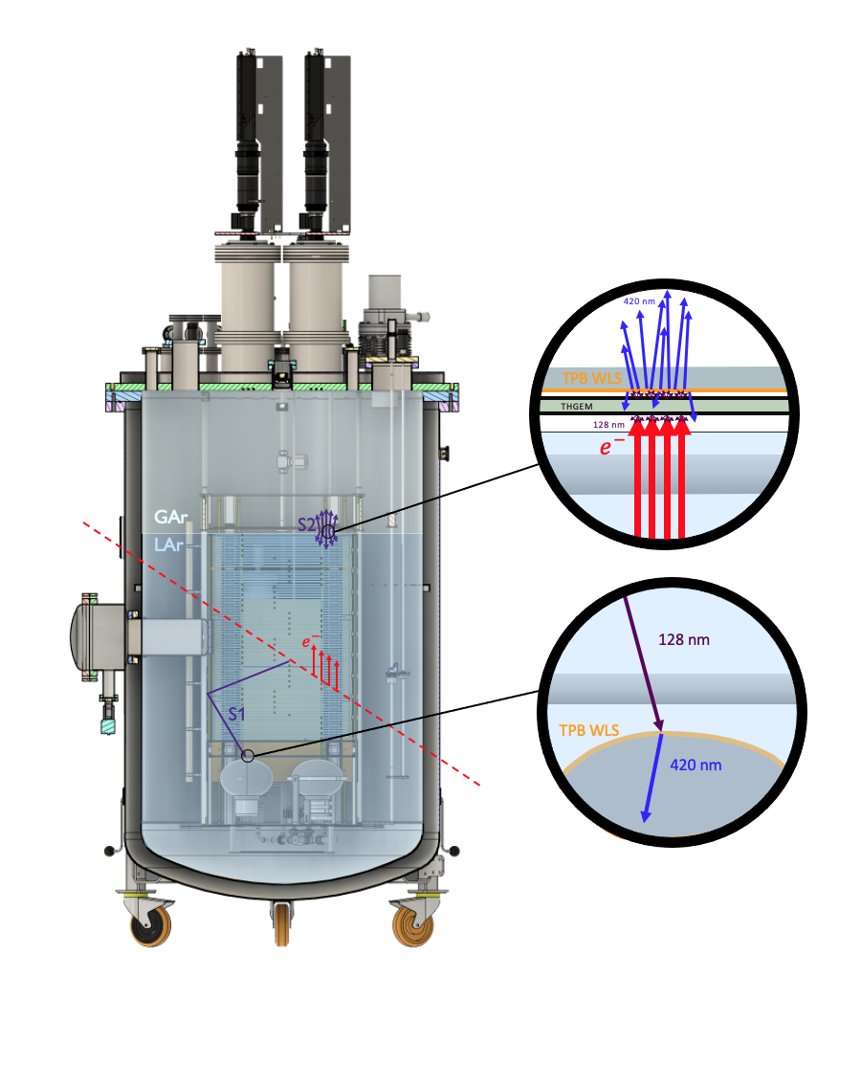
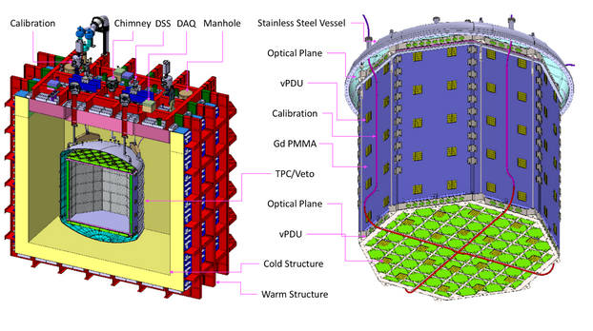
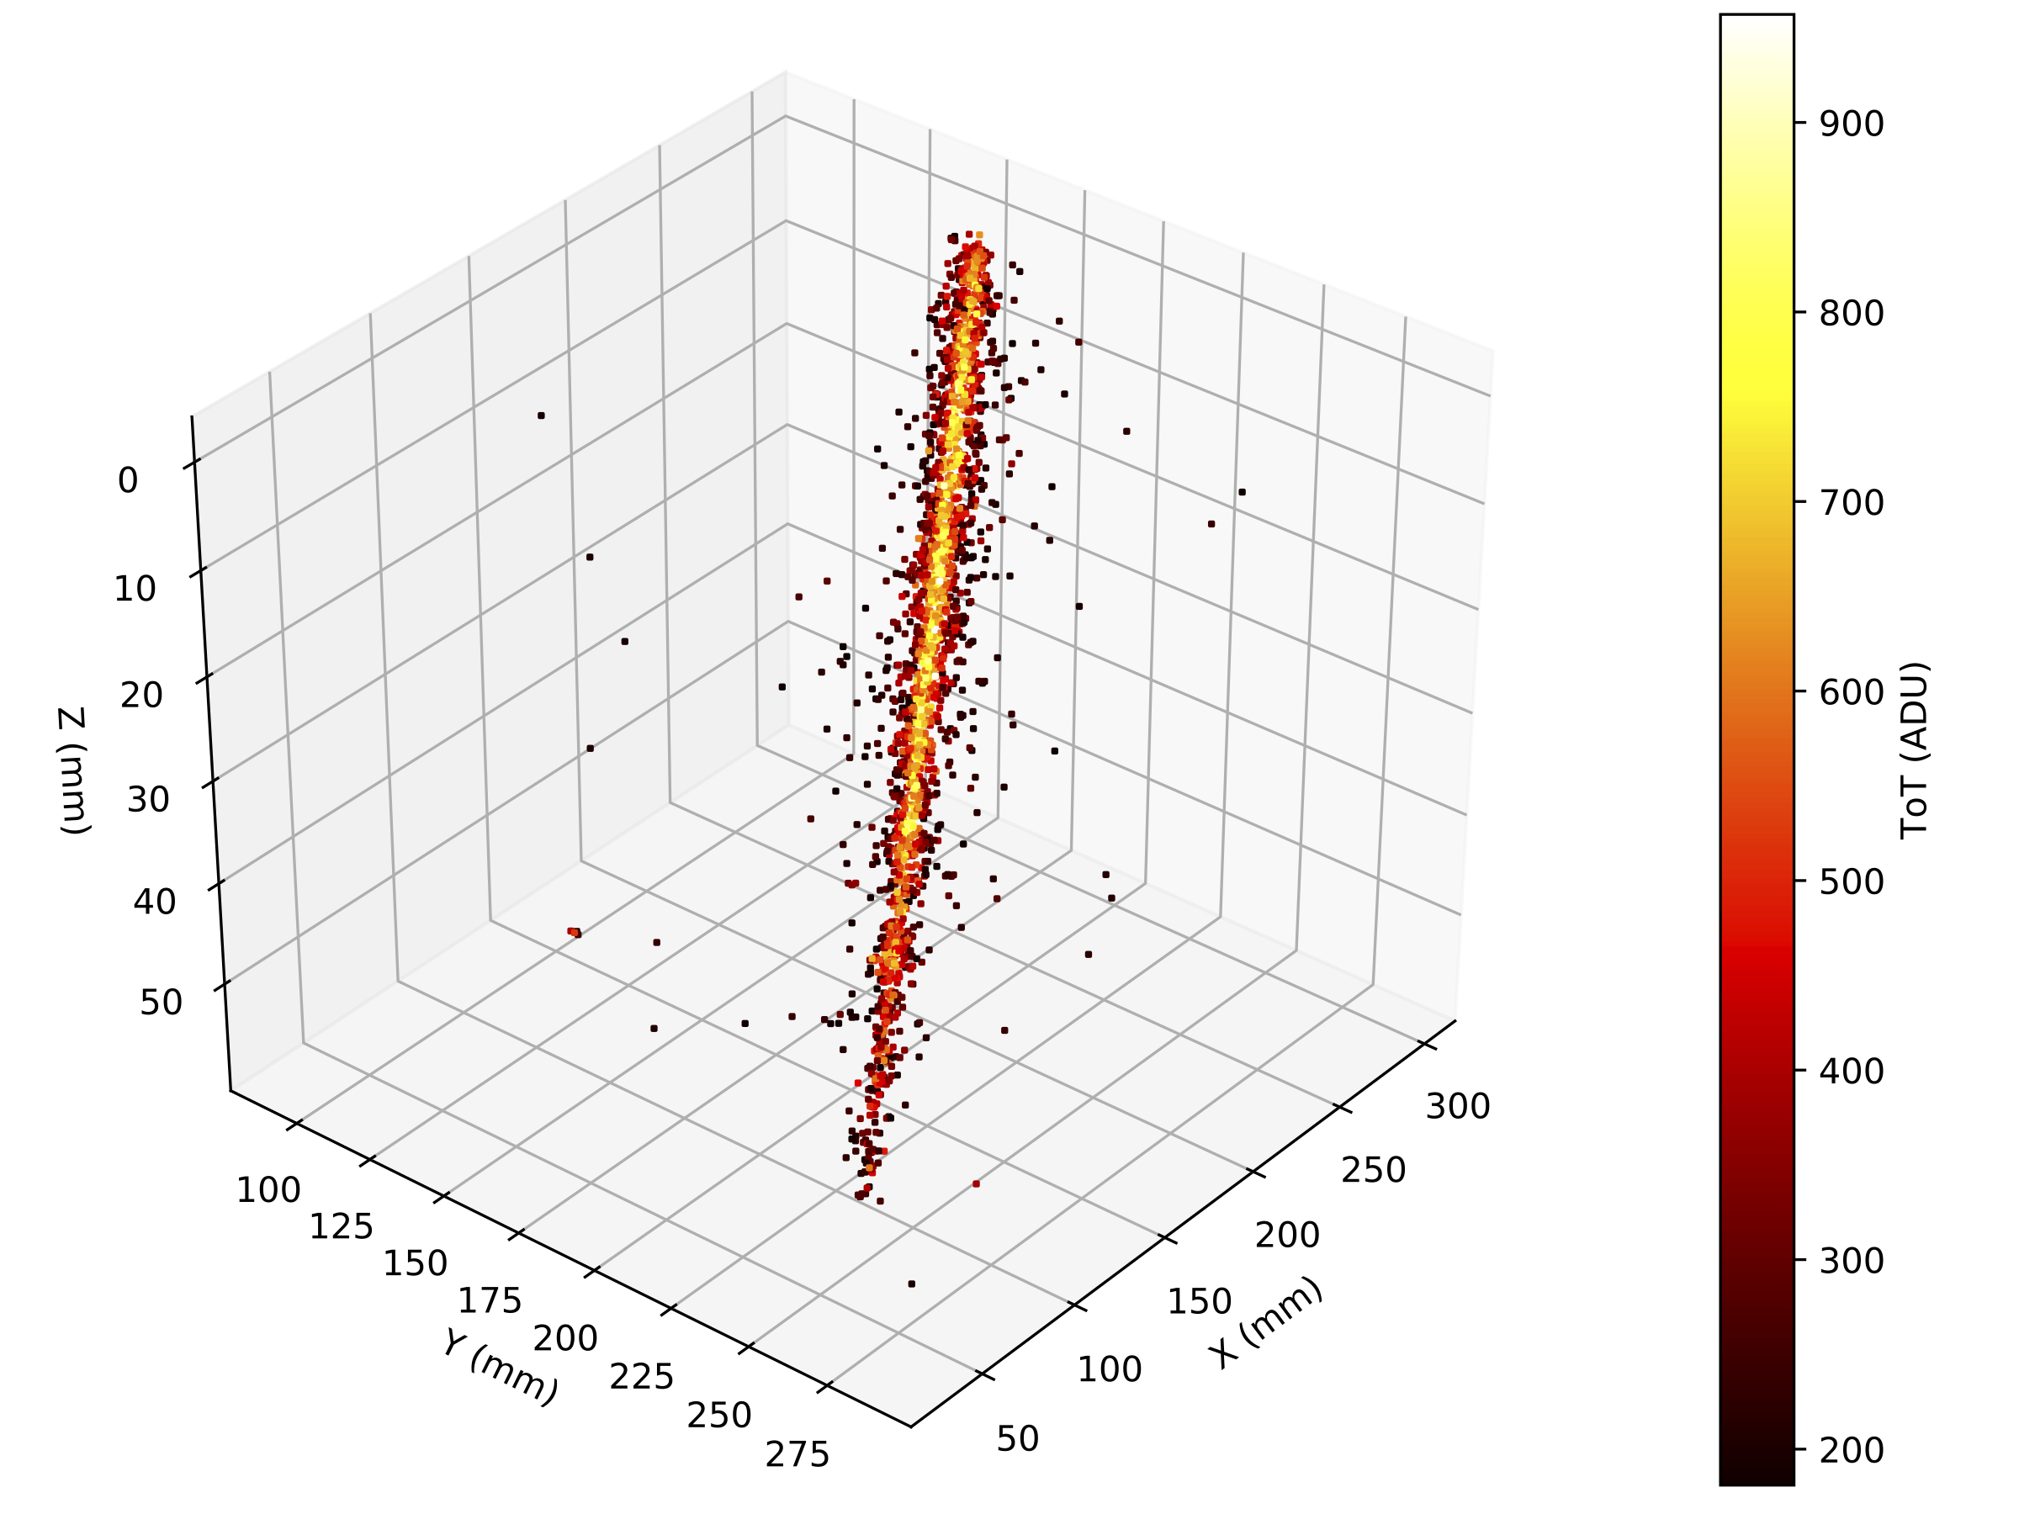
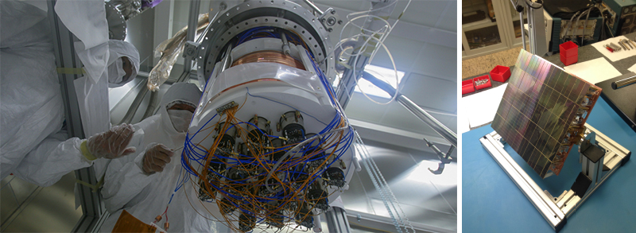
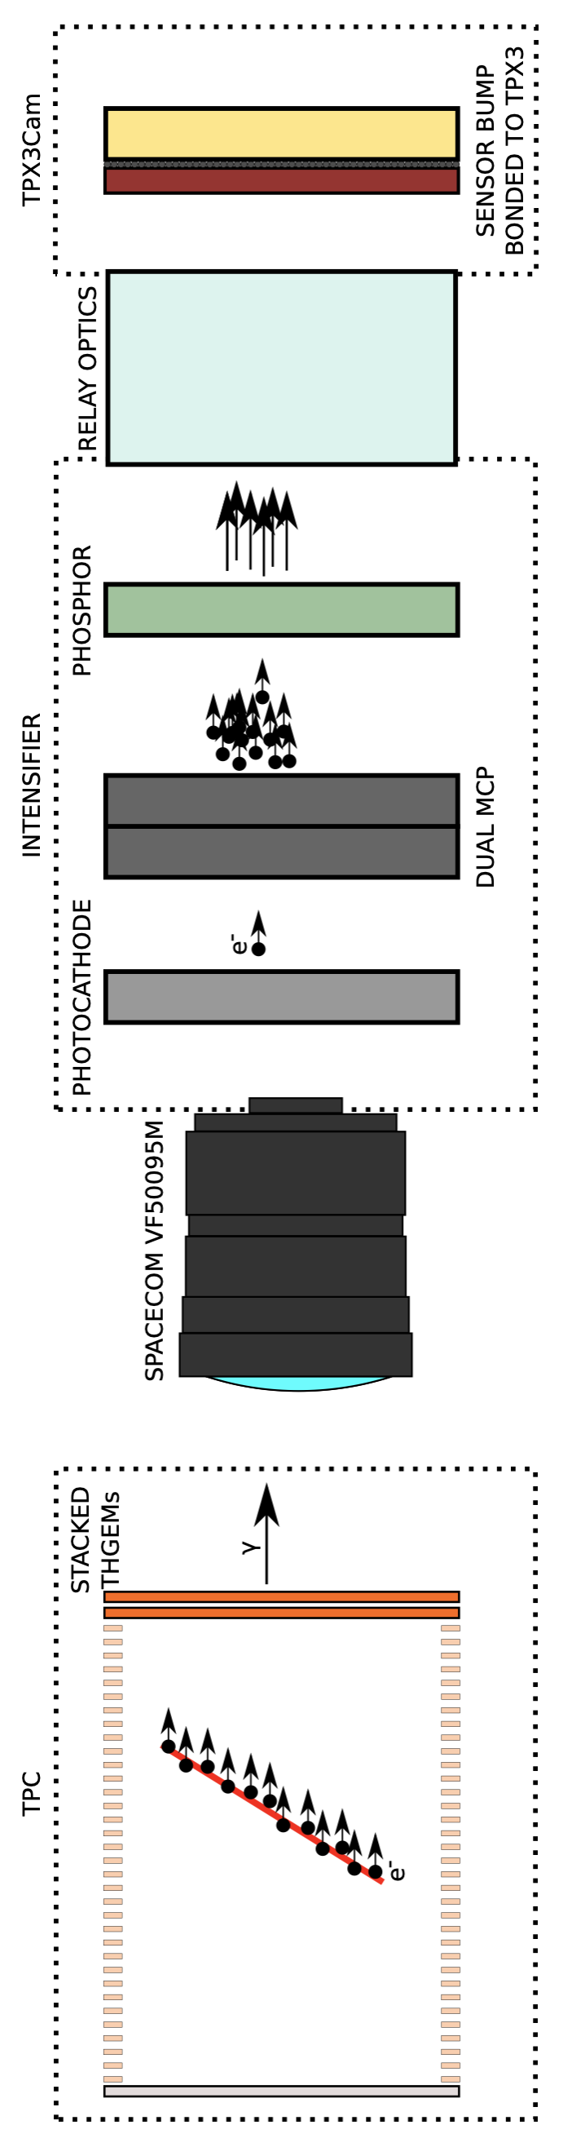
Photon detection systems for Liquid Argon Time Projection Chambers
Ariadne Darkside-20k
43 cm
Imaging detection of events under Liquid Argon
1 ton dual-phase LAr TPC
Uses THGEM amplify signals in the gas phase.
Uses Timepix cameras
Detects signals in the visible range
Designed to detect particles tracks using S2 signals
Direct WIMP search detector
50 ton dual-phase LAr TPC
Uses Silicon Photomultiplers (SiPMs) tiles (Solid State single photon sensitive device)
Detects signals in the visible range
Designed to detect WIMP dark matter with masses around 1TeV.
TPC is shielded by a “Neutron Veto” designed to capture neutrons before they reach the TPC.

Slide 3
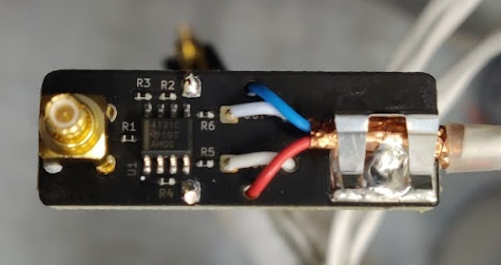
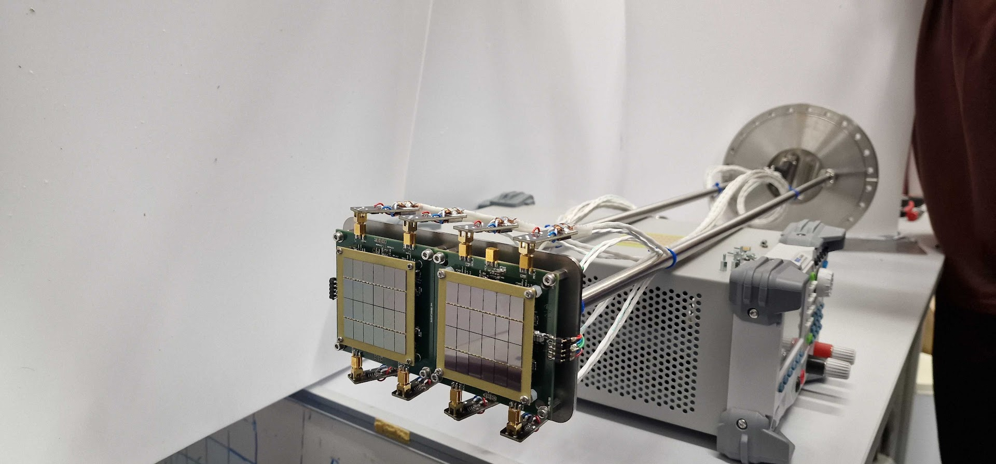
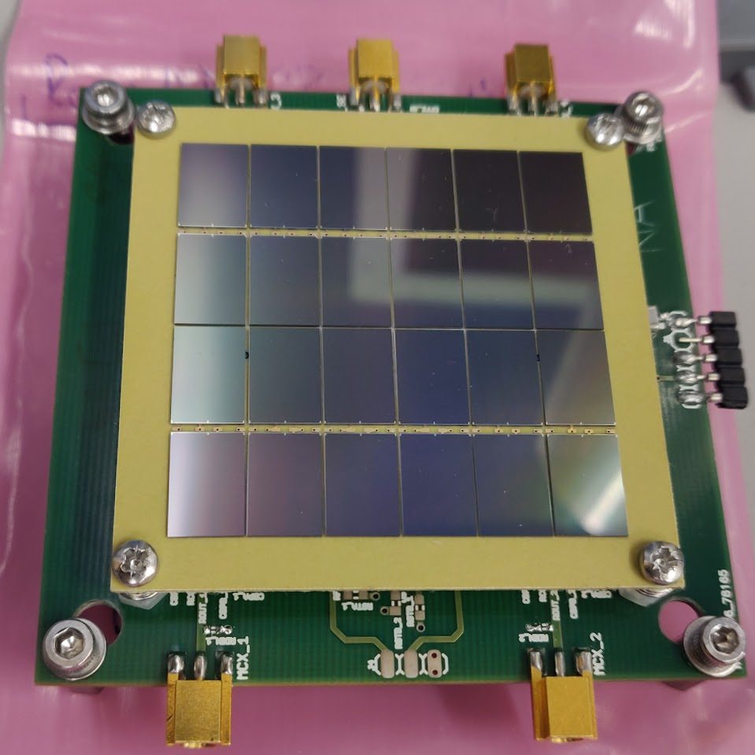
SiPM assembly
Single ended to differential signal converter
SiPM is place 5cm above the TPB plate in one quadrant.
SiPM connected with FEB board

Slide 4
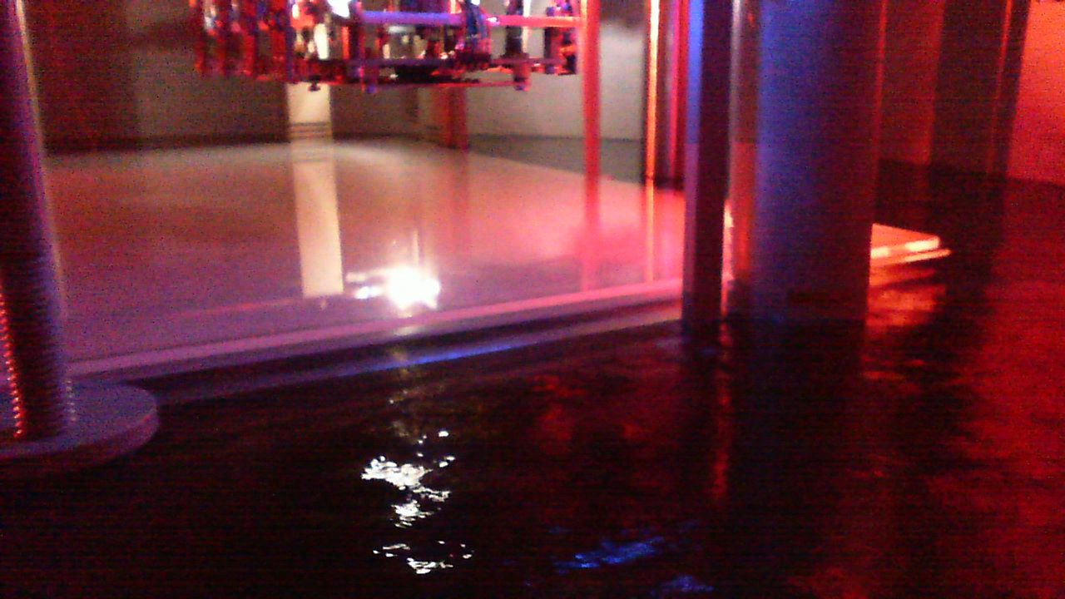
SiPM view inside ARIADNE
S2
S1

Slide 5
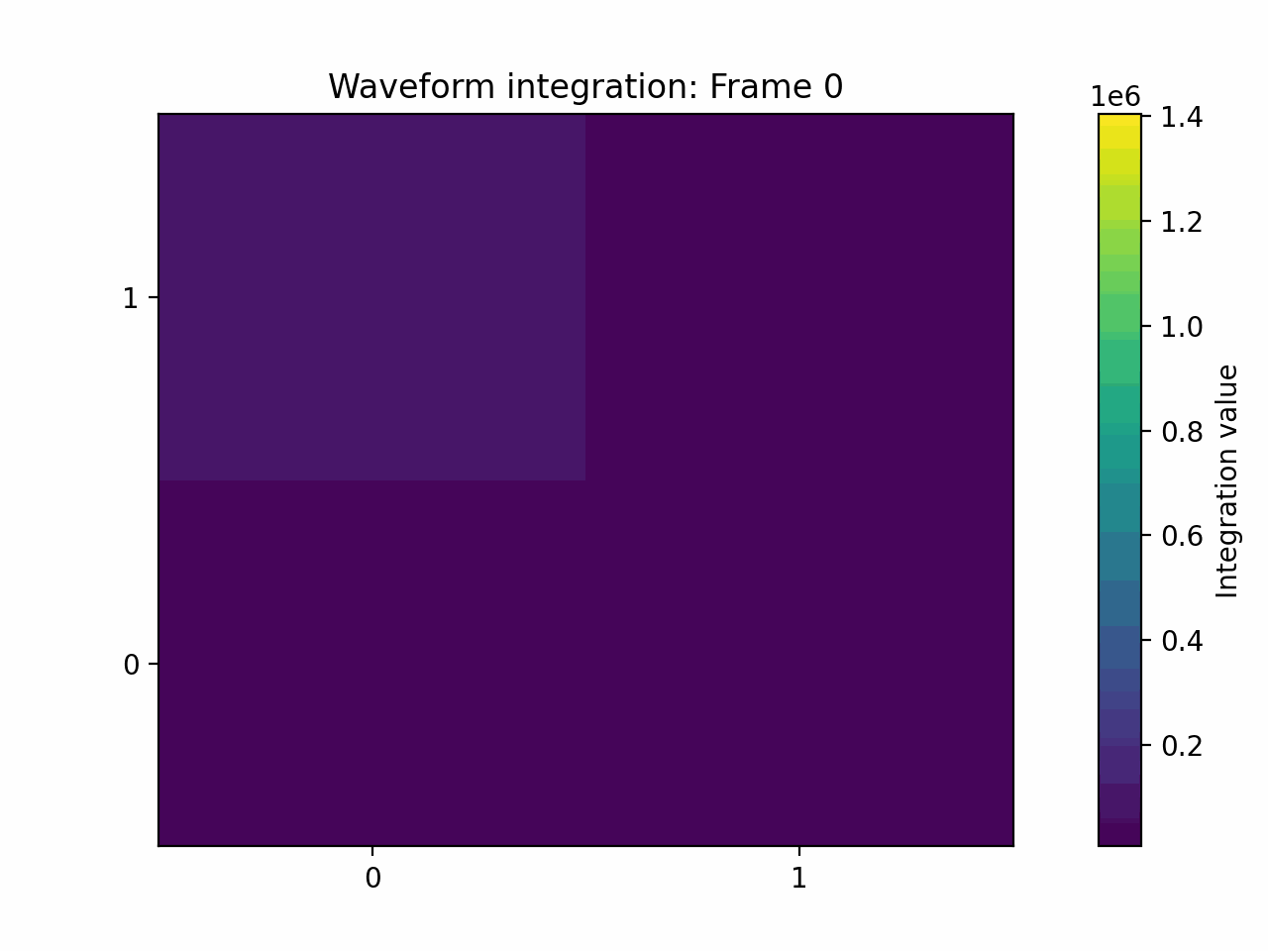
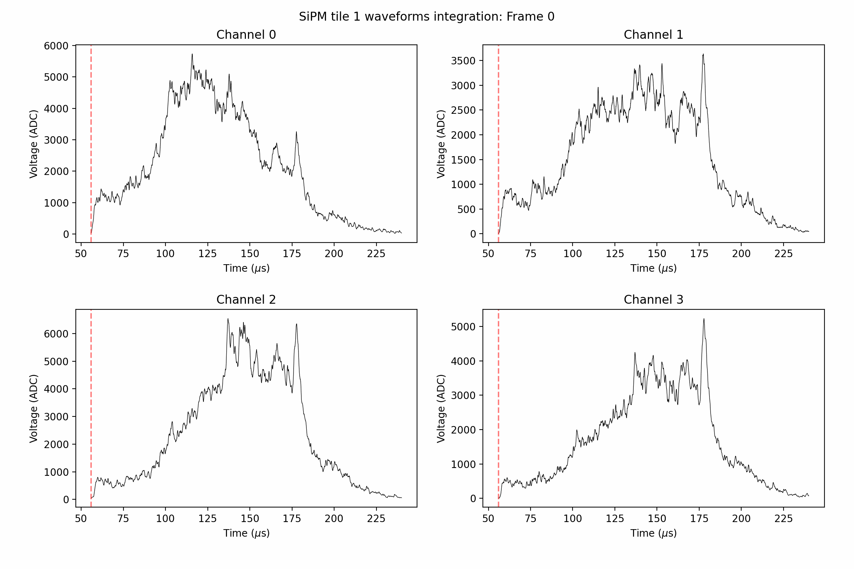
Integration display from S2 signal
The S2 signal lasted for 184 us and integrations were calculated for every 1.84 us (giving you 100 sections/frames)

Slide 6
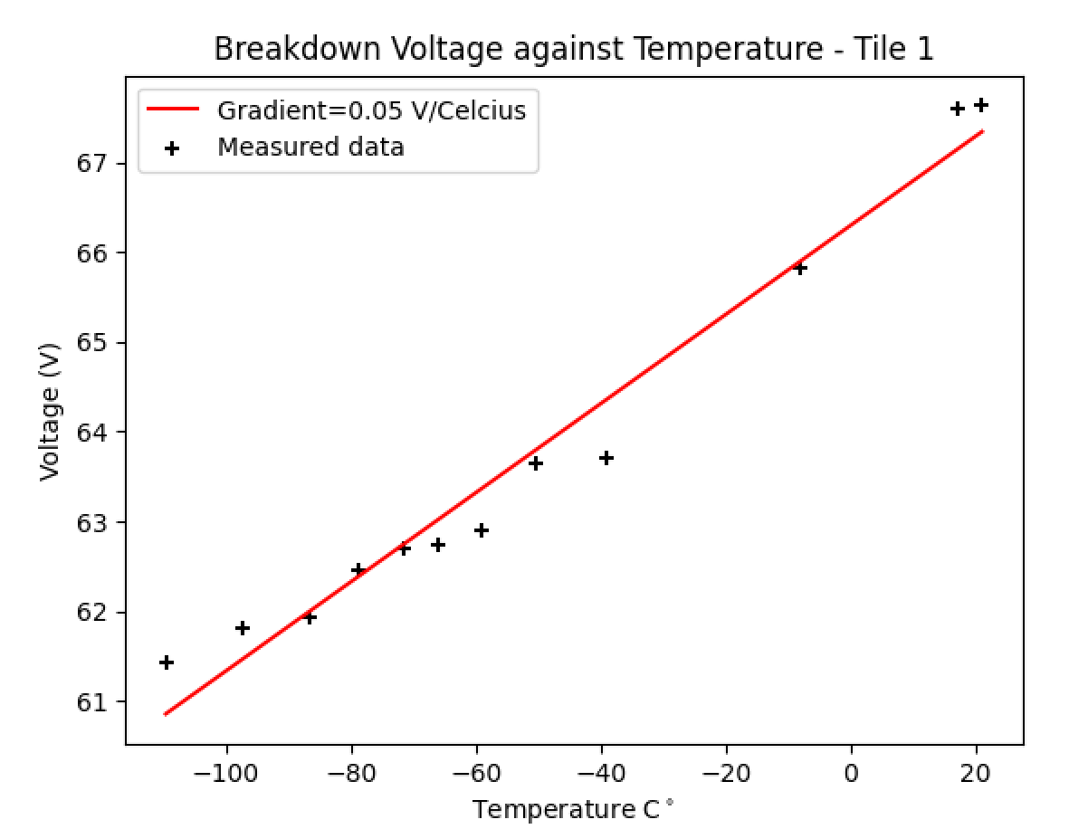
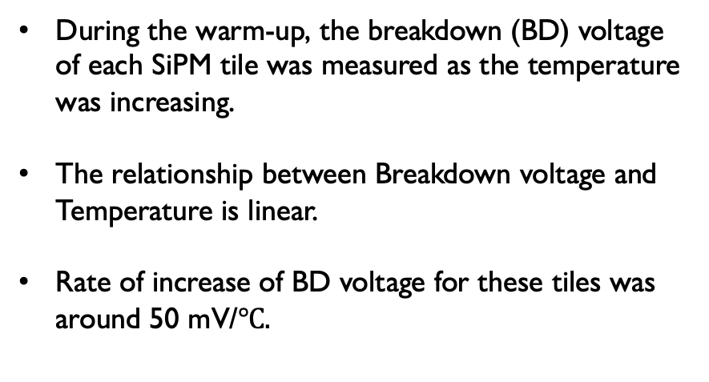
Breakdown Voltage against Temperature
During the warm-up, the breakdown (BD) voltage of each SiPM tile was measured as the temperature was increasing.
The relationship between Breakdown voltage and Temperature is linear.
Rate of increase of BD voltage for these tiles was around 50 mV/$℃.$

Slide 7
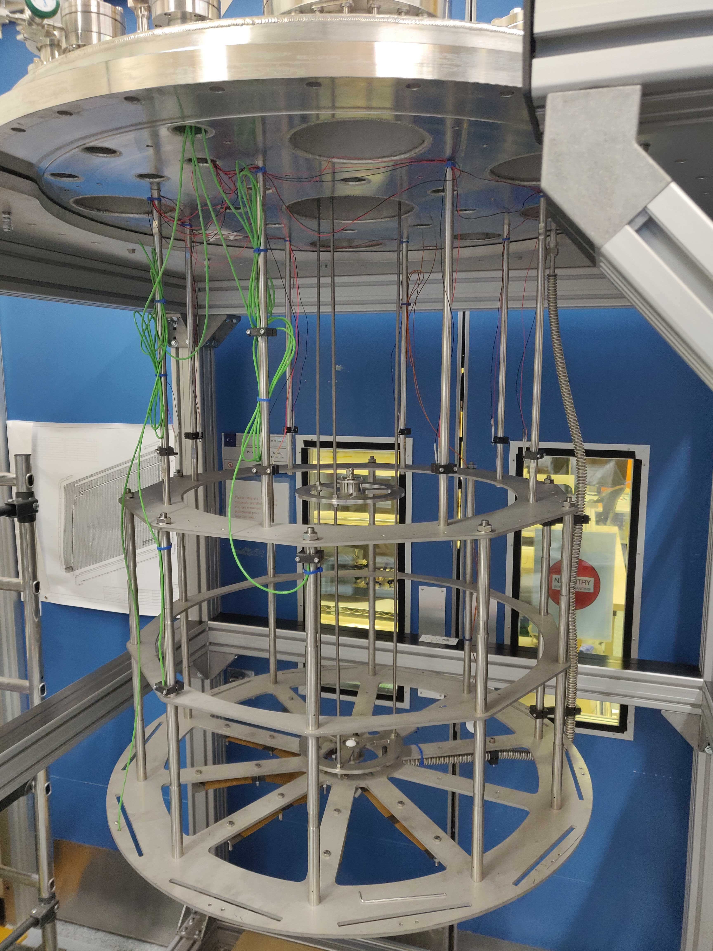
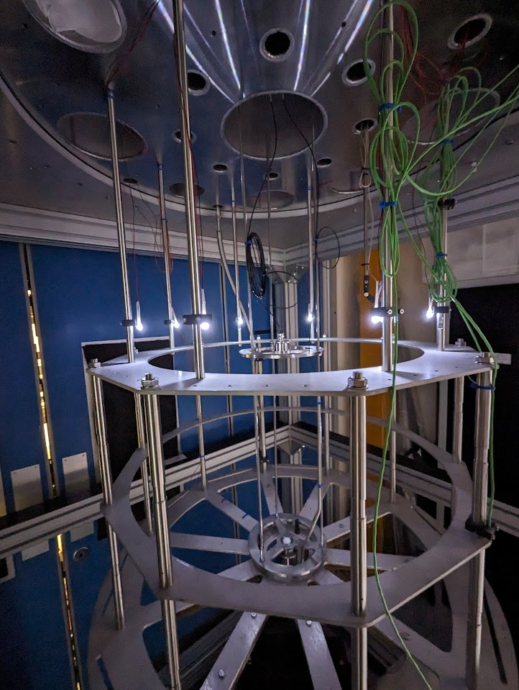
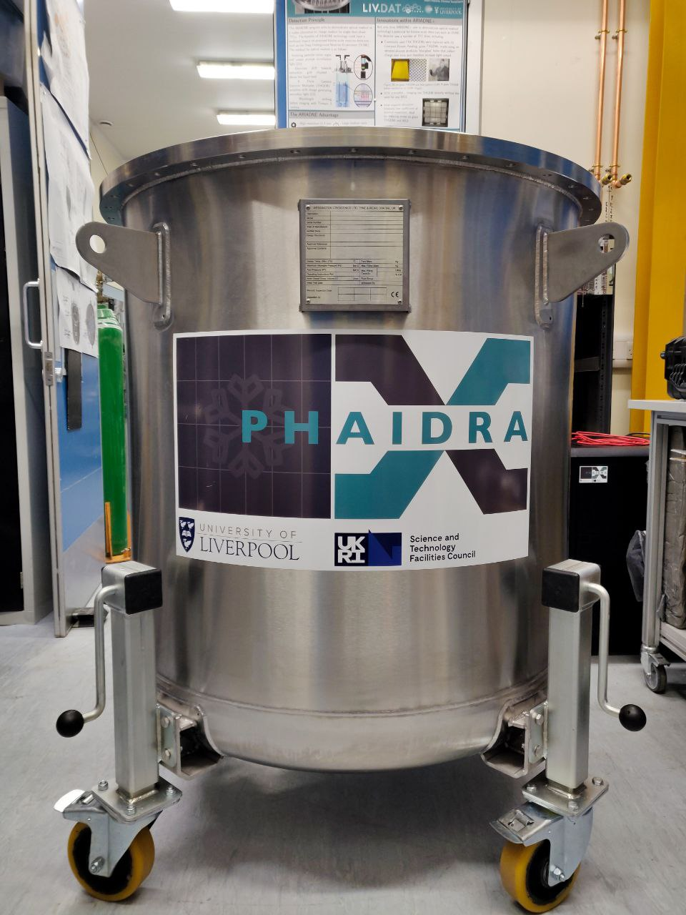
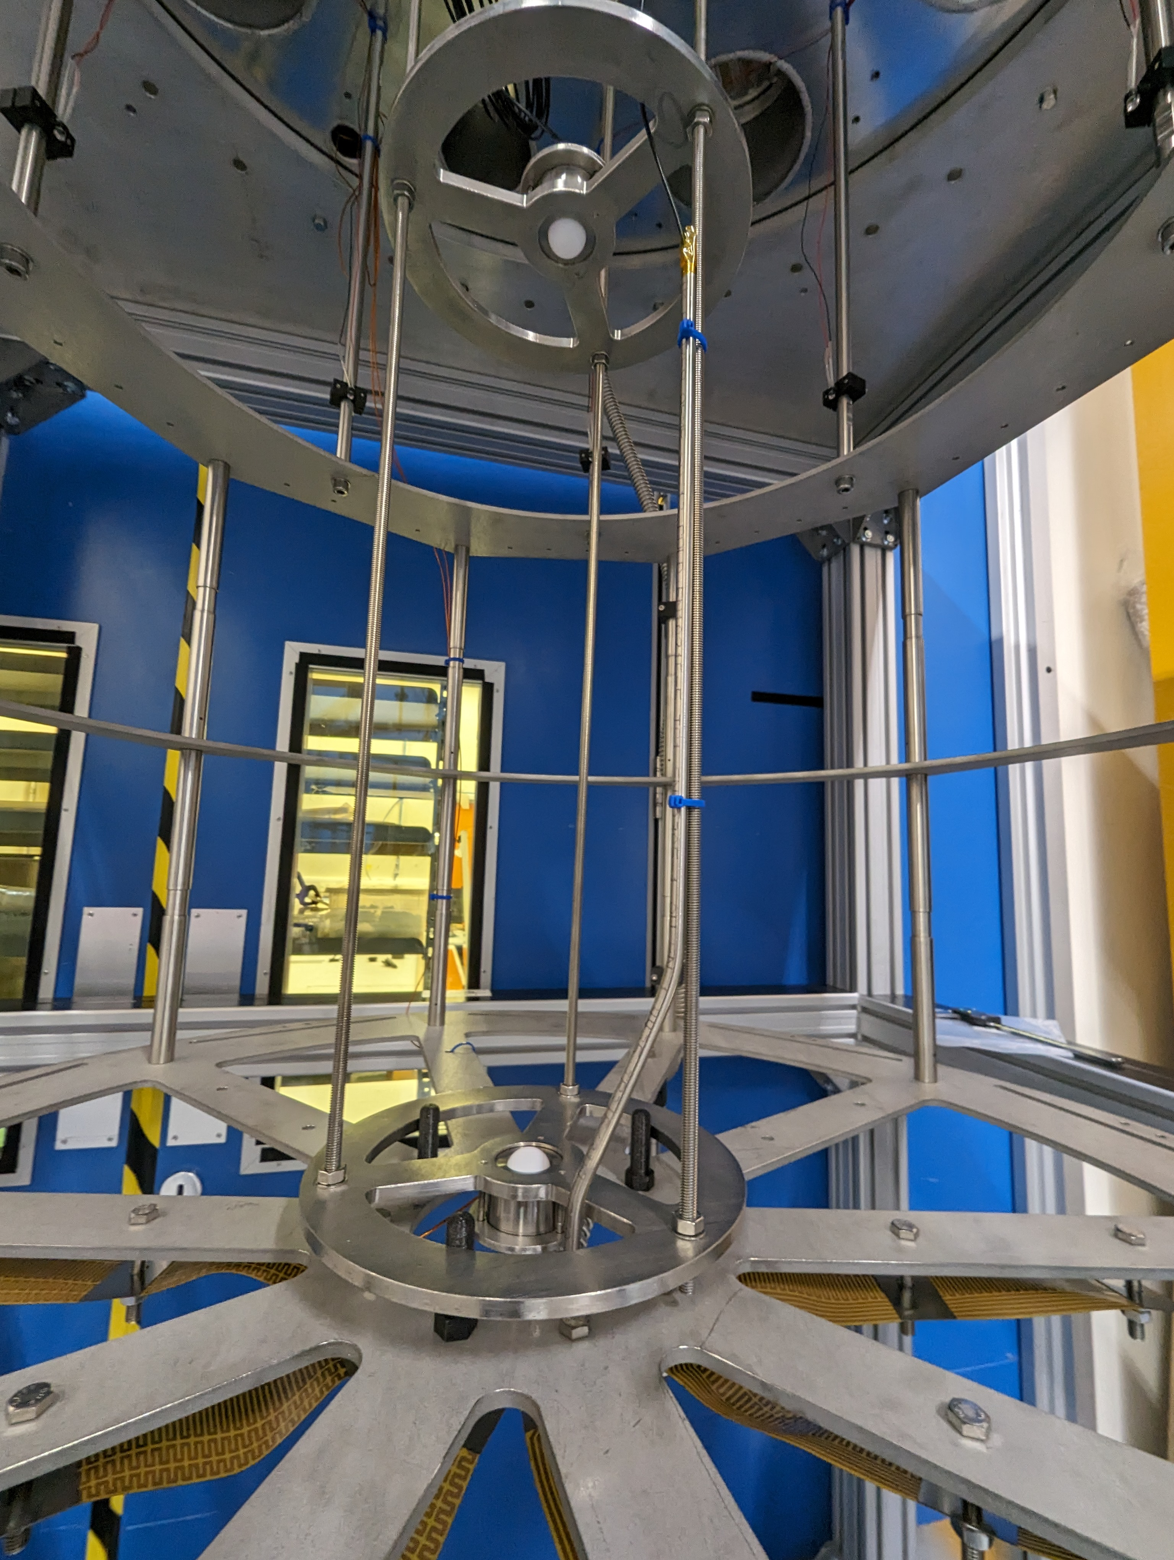
PHAIDRA
Cold test stand to characterise Veto Photo Detection Units (VPDU). Can hold up to 20 VPDUS.
650 litre capacity. Planned to be filled with Nitrogen for initial VPDU cold test.
Laser diffuser at the top and bottom side of the fixture cage.
LEDs and webcam fixed at the top for internal view of the vessel.

Slide 8
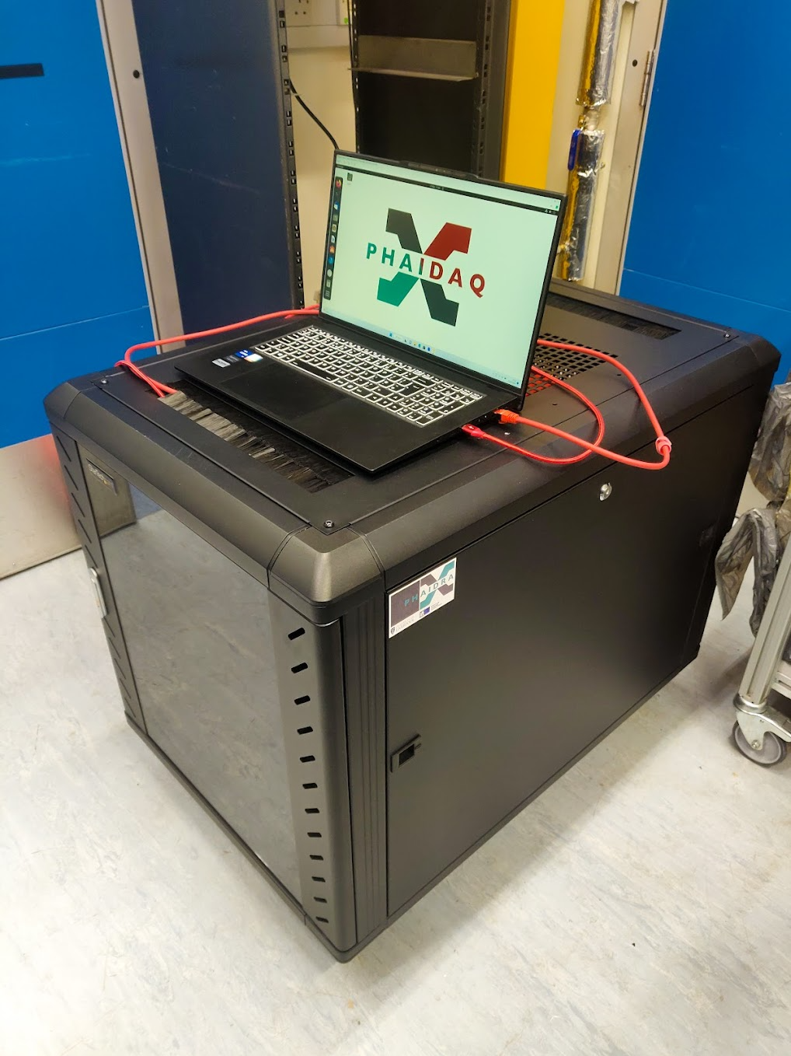
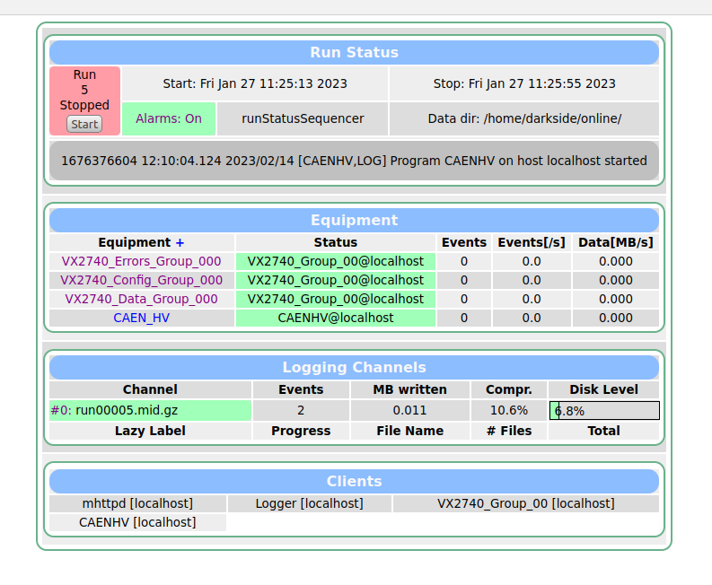
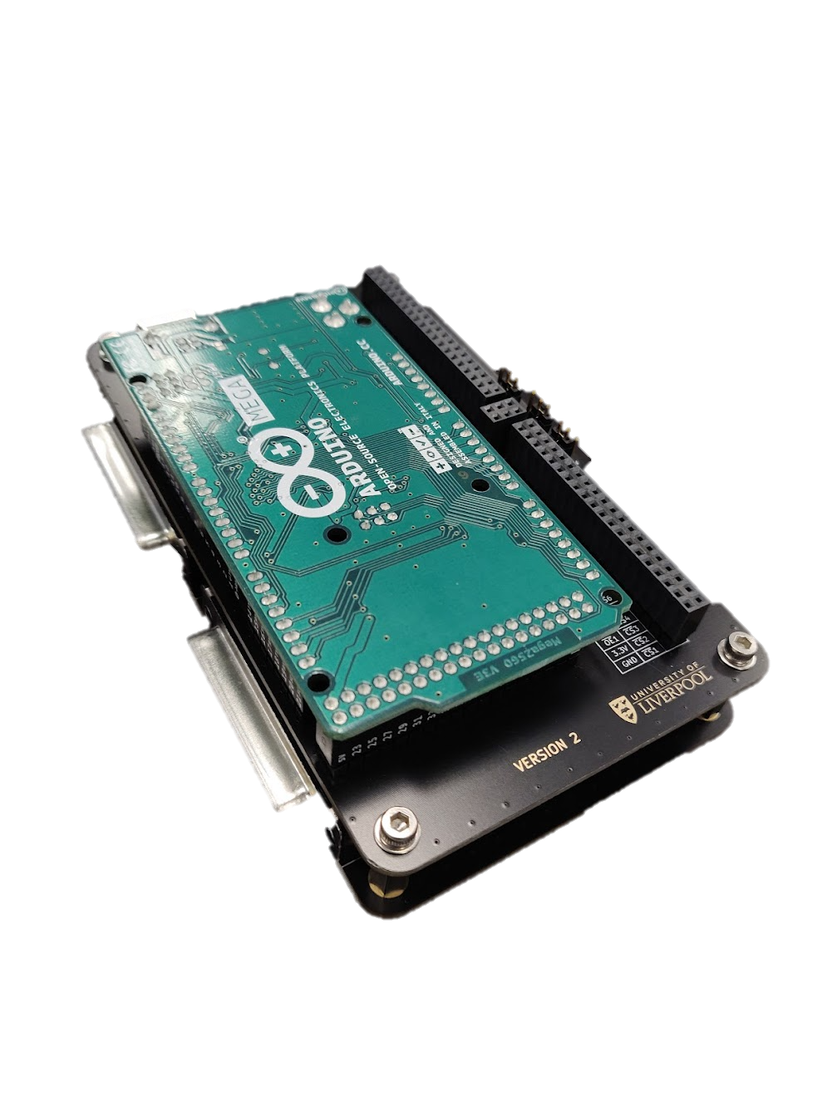
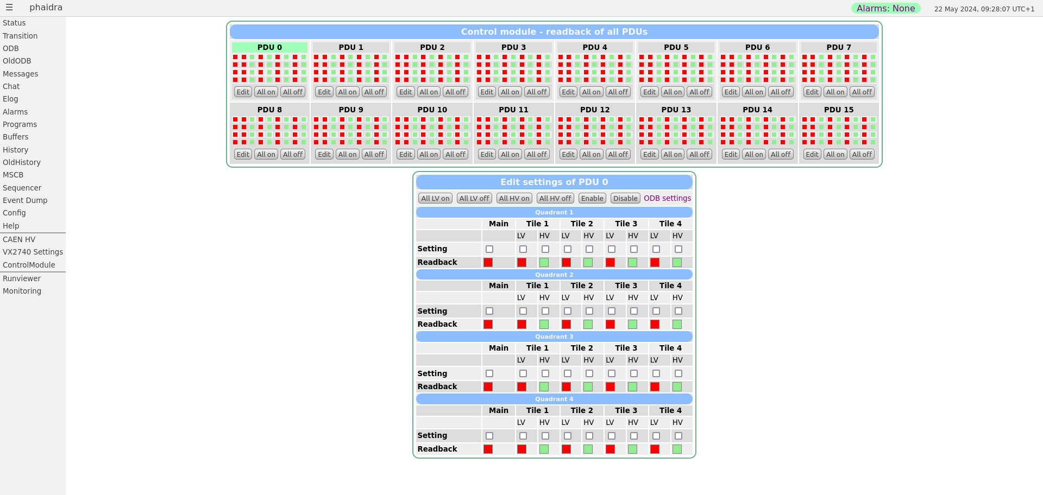
PHAIDAQ
Midas based DAQ with added interactive control panel. This is standardised within the Darkside test facilities.
Able to control High/Low voltage and acquire signal data with CAEN boards and digitizer.
UK made steering module implemented with the DAQ to control LV/HV of multiple VPDUs.
Steering module design will be used in the final Darkside experiment to control the PDUs.
Setup to send data to the Grid to share within the Darkside-UK groups.

Slide 9
Thank You!

Slide 10
Backup slides

Slide 11
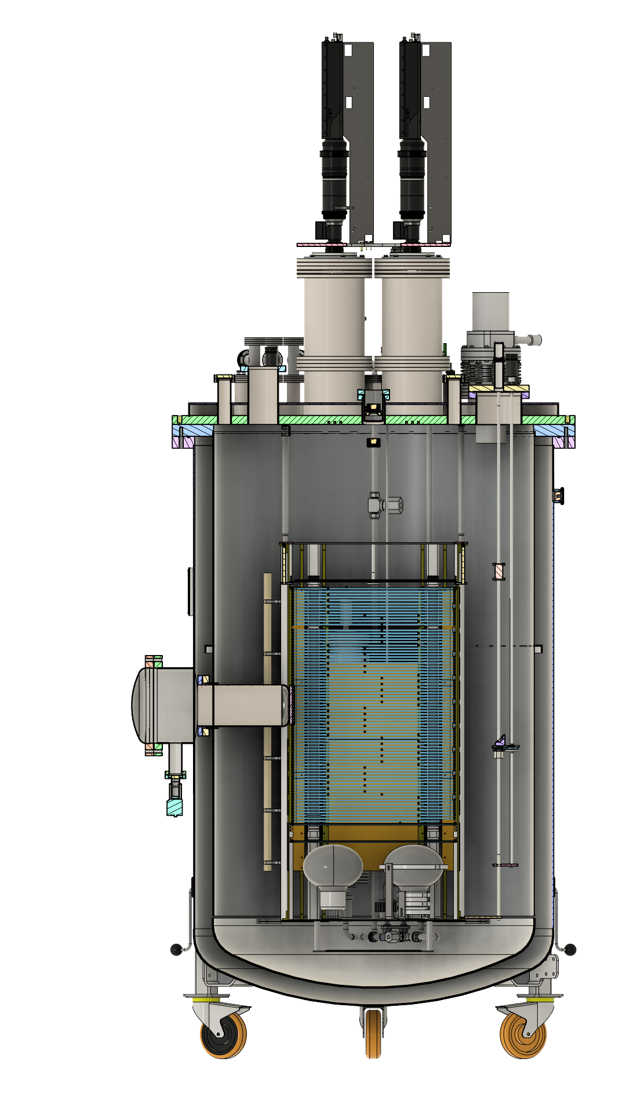
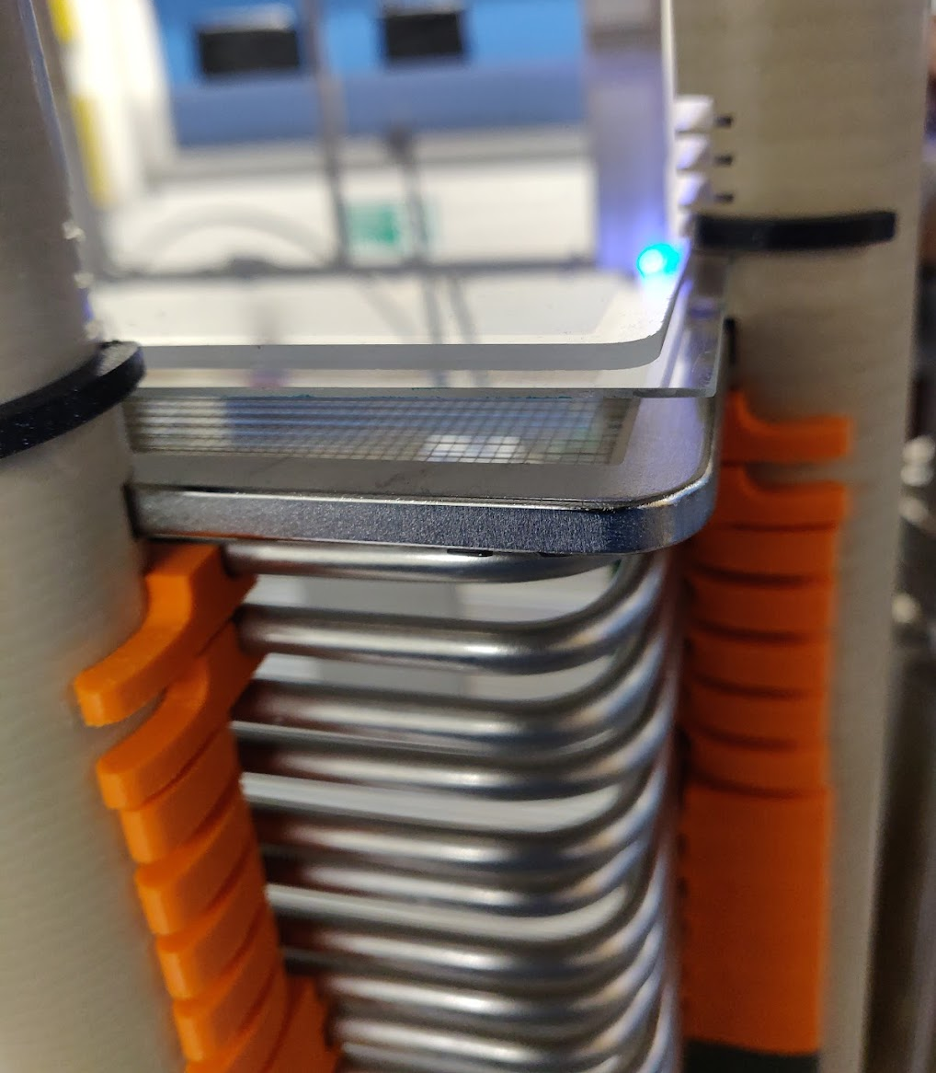
ARIADNE
1 ton dual-phase LAr based detector.
54x54x80 cm field cage at the centre of the detector.
79 stainless stell field-shaping rings spaced each other by 1cm.
Cathode and Extraction grid located below and above the field cage respectively.
53x53 cm and thickness of 1mm THGEM is places 11mm above the extraction grid. Holes are arranged in hexagonal arrays with a pitch of 800 μm.
Glass plate coated with TPB located 2mm above the THGEM.
4 TPB coated Hamamatsu 8-inch PMTs located below the cathode grid.

Slide 12
BD Voltage - IV curve
A light leak is introduced in the system to allow a higher current draw in the SiPMs.
At a certain voltage, the current drawn increases rapidly.
Applying two linear fits before and after the spike, allows us to identify the Breakdown voltage of the tile.

