Slide 1
LSDC Report
LIVERPOOL PP GROUP MEETING
Tim Jones
(May ‘24)

Slide 2
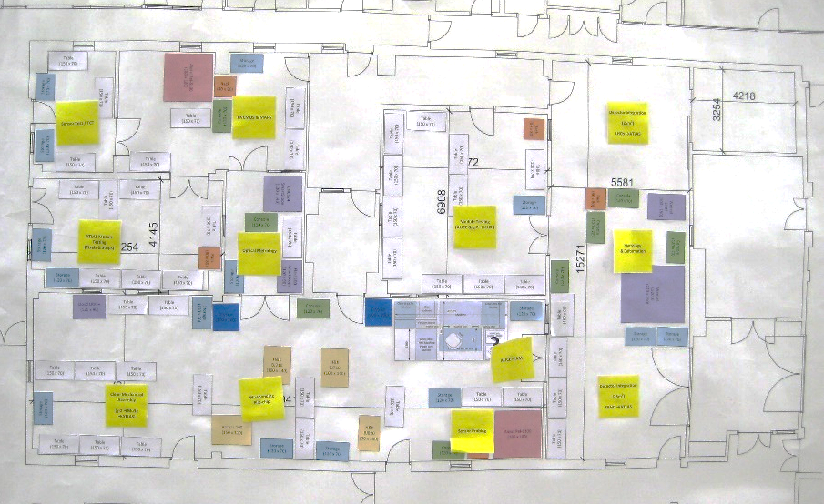
Liverpool Semiconductor Detector Centre
Goal is to support the delivery of detector sub-systems to major national and international programmes and support our generic detector development programmes
Facilities: 100 m² of Class 5 (100) and 250 m² Class 7 (10,000) clean rooms
Staff: Mike Lockwood,
Tom Lee (→ATLAS), Paul Cook (→ BUTTON),
Alan Taylor (PhD)
Staffing is a critical issue – need support / cover for Mike.
Major Activities
Mu3e, ATLAS ITk, Darkside20k SiPM array assembly, Generic Detector R&D, &c
Tom
Mike

Slide 3
Operations
Garments
Last year – reported efforts to reduce costs by signing new contract with alternative company …..
One year later – alternative company never came good on promises – still with original supplier – but at much reduced cost. Well done Mike !
Workshop Refurbishment
Contributed to 50% of cost of upgrading compressors
Donation of Wenzel LH87 CMM to workshop (not enough space in LSDC)
HVAC
Major equipment failure – 1/3 of LSDC has NO COOLING !
FRCS declined to fund replacement so coming out of LSDC/Workshop operations budget
Order approved 22/5 – hoping for work to start June 4th
Metrology
Large volume CMM (LS1010 2x1x1m) down for > 1 year – investing in making better use of Faro Vantage Laser Tracker (software upgrade) and Gsi V-Stars/N Photogrammetry system (training)
Intention is to scrap LS1010 unless ……
Wenzel visiting in June to see if the damaged granite beam can be repaired / replaced. Seems likely but …. None of the existing motors etc are available – no point in spending £££ if there is no guaranteed longevity / economical maintenance path.
Bid for new intermediate scale CMM put to Faculty during 2023 – considered a good case but has not been approved at the moment.

Slide 4
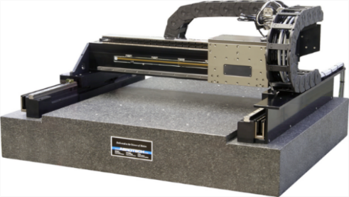
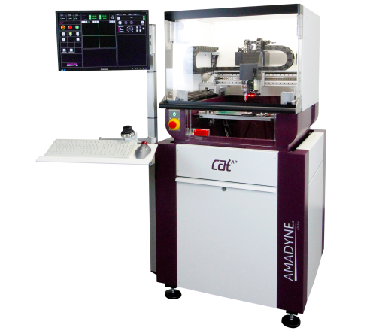
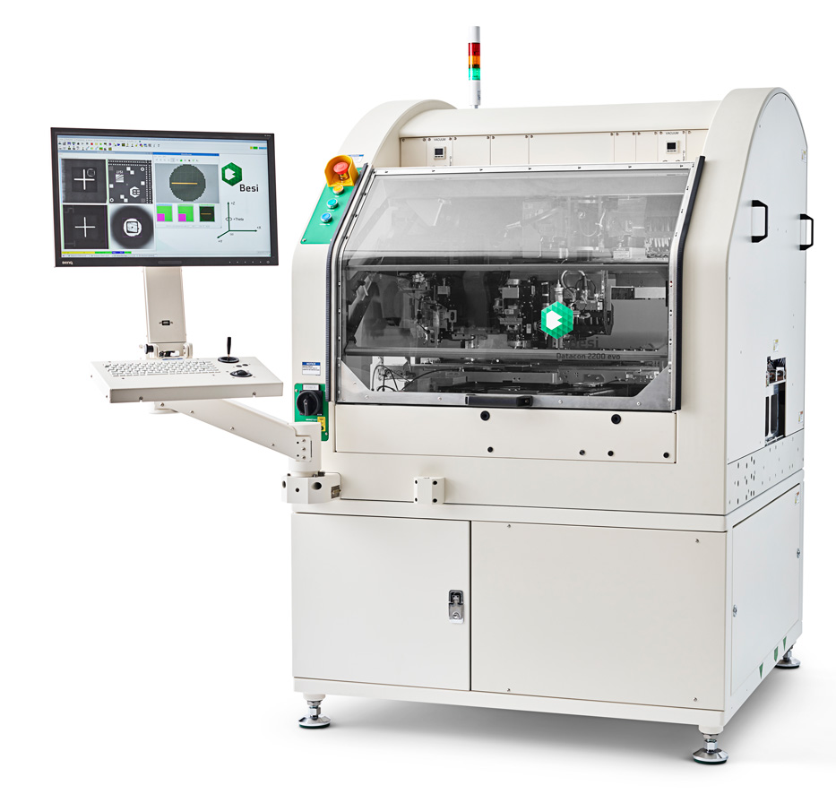
Equipment
PPCG22-25 Equipment
As part of the PP CG we bid (and received funding for) an Aerotech Gantry Positioning System
Concern over effort needed to develop gantry into fully operational system
Looked into Die Placers as an alternative
Incorporates motion control, optics, pattern-recognition systems, Pick & Place, upgrades for adhesive deposition, thermal/UV cure processing, etc…
Likely use-cases …
Assembly of collections of HV-CMOS ASICs (eg Mighty-tracker) into multi-ASIC units (similar to ALICIA for ALICE)
Assembly of SiPM arrays
Tender documents in preparation

Slide 5
Challenges
Space
Construction of ATLAS ITk Barrel Strip & Endcap Pixel
60% of LSDC at peak production (2025-26)
Class 5 (strip & pixel modules assembly): 30% of available space + majority share of wirebonding / pull testing
Class 7 (strip & pixel module testing, pixel endcap integration) ~ 70% of available space
Equipment
Ageing equipment (some now > 20y old) – replace or move on ?
Commissioning new equipment takes time and effort – best if there is a clear project ‘need’
Use demise of old (outdated) systems to review future needs & move on from the past – but can only do that if people say – “Do we have … / If we had one of these …..”
Funding (LSDC / DDMF / AML):
1 facility-day for LSDC + Workshop ‘costs’ £6k so for 230 days total = £1.4M
We are never ‘fully-funded’ - most grants were issued when facility-day costs 50% less.
Income for 24-24 ~ £450k, salaries = £24k/month, operations ~ £20k/month
Income only just about matches necessary spend – not a lot of leeway for emergency spend to keep facilities running OK.
New Projects (CG25-29):
ATLAS ITk construction is done by March ‘27 – 18 months into CG25-29
Between 2018 and 2024 ATLAS paid in £130k p.a. into LSDC & Workshop operations account and funded 1FTE in workshop
Probably no single large-scale project in the near future – need to find multiple (2-3) projects, with SRF funding

