Slide 1
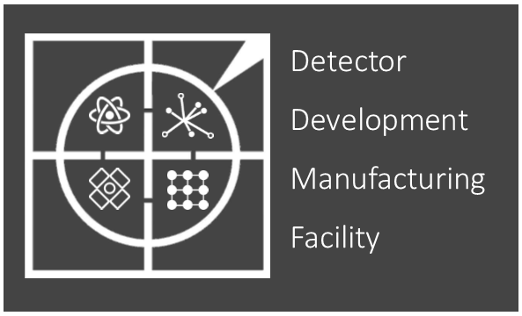
2023-24 Review
Mark Whitley

Slide 2
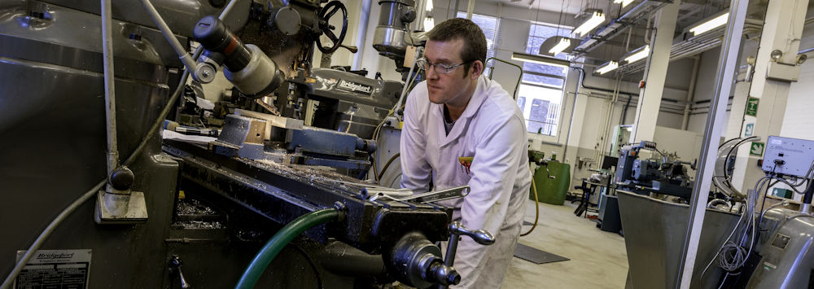
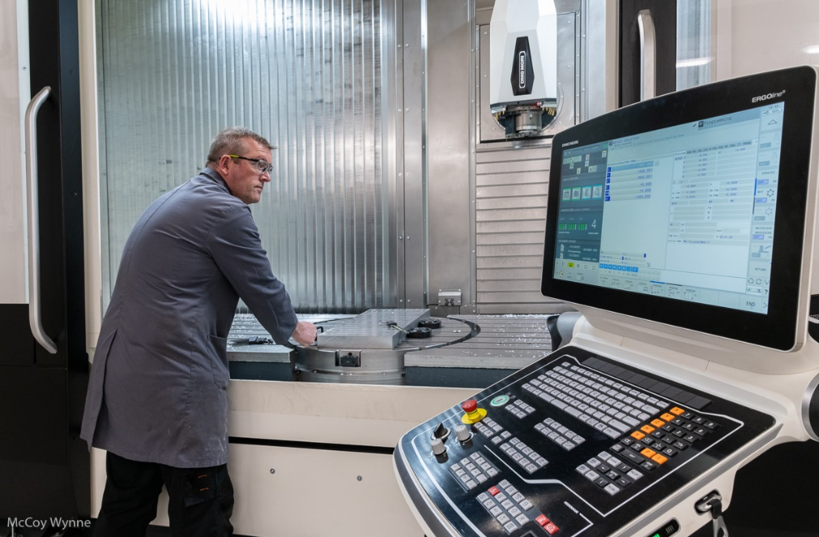
Comings and goings…
Farewell to Emlyn Jones
Emlyn has now moved on to work for the National Oceanography Centre.

Slide 3
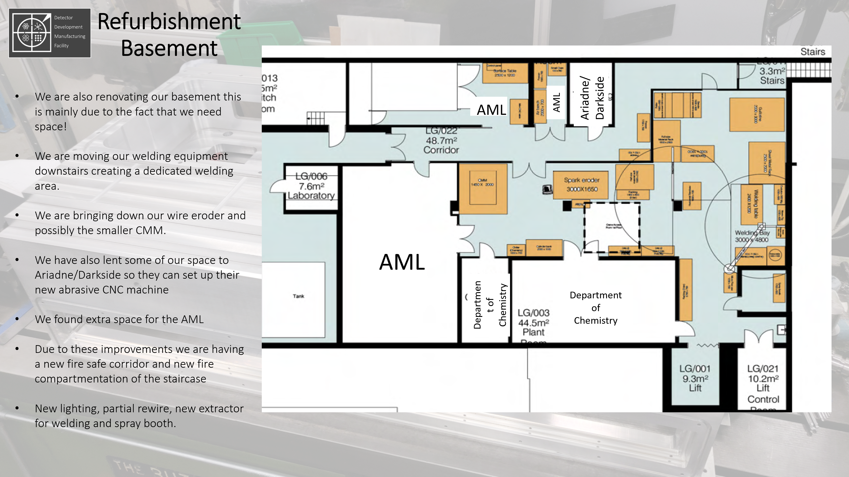
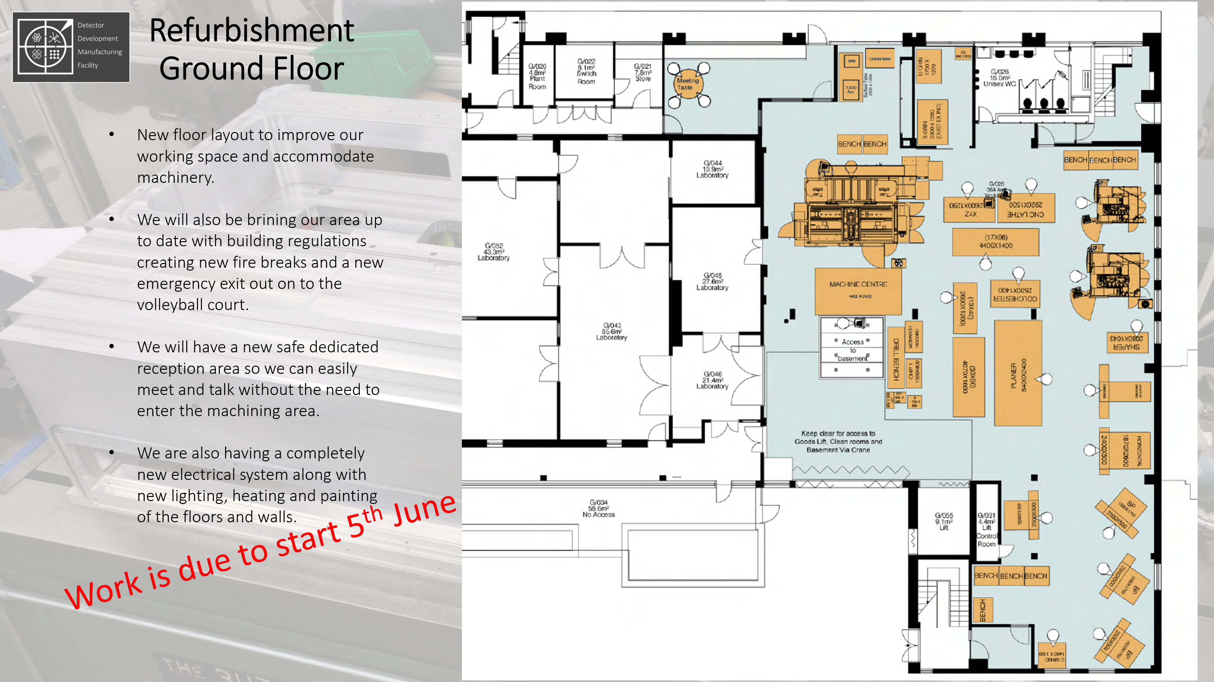
Recap

Slide 4
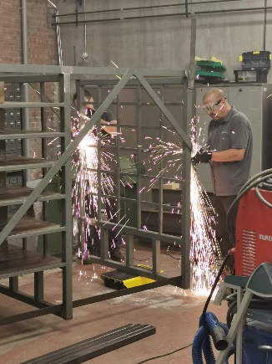
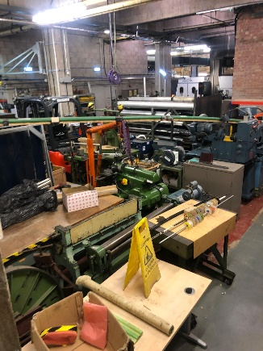
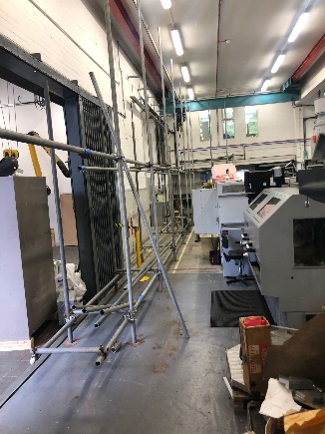
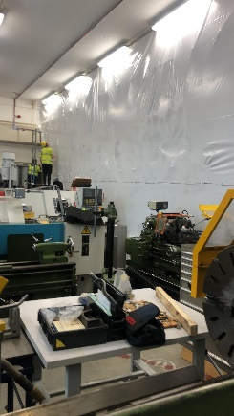
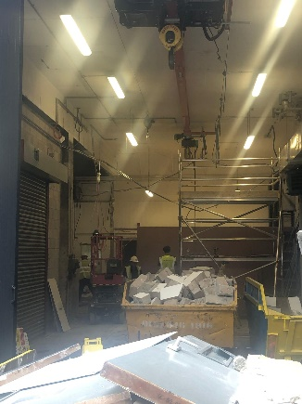
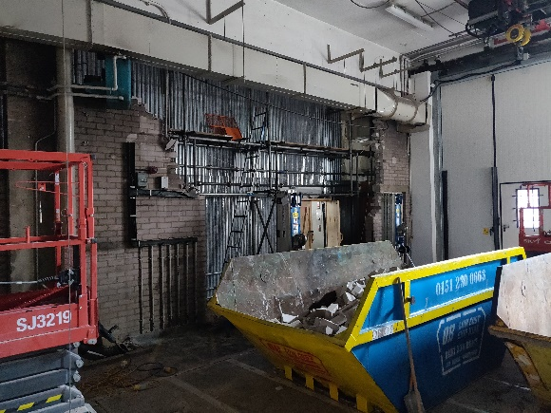
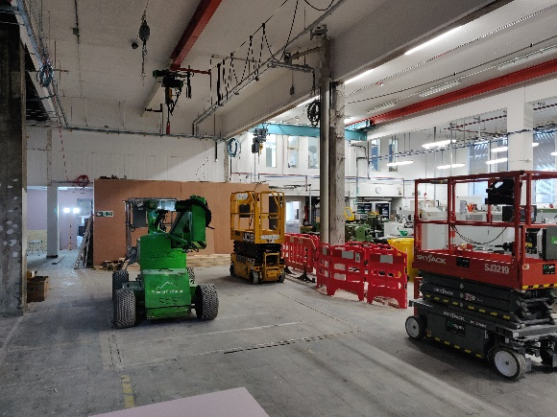
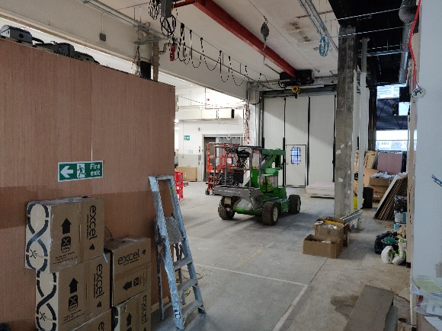
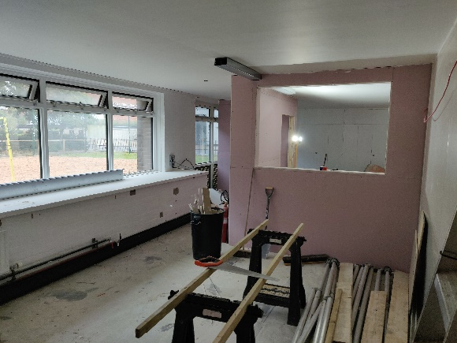
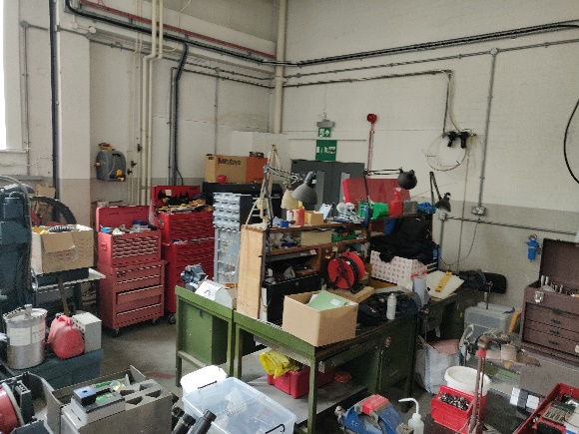
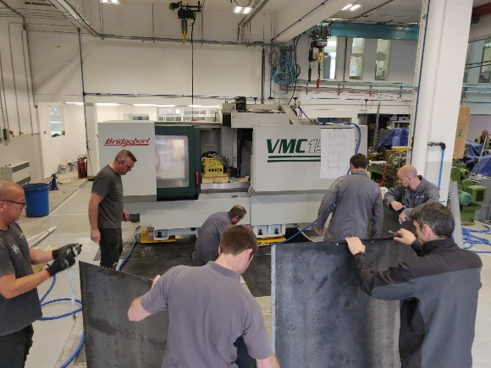
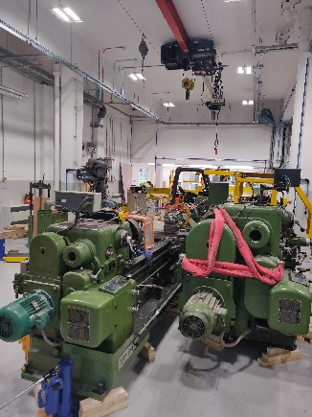
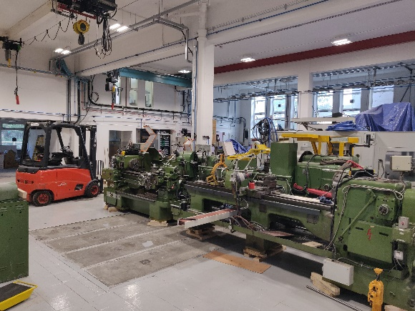
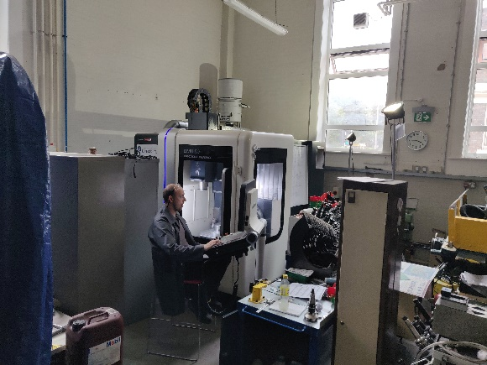
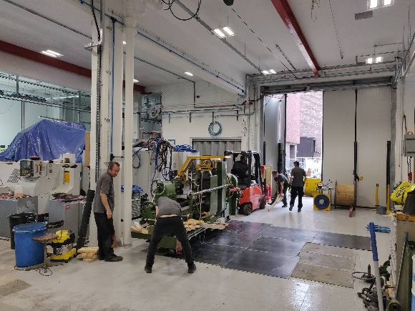
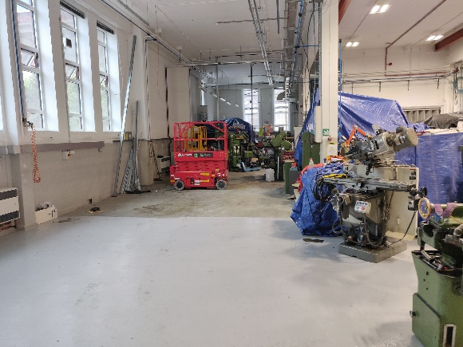
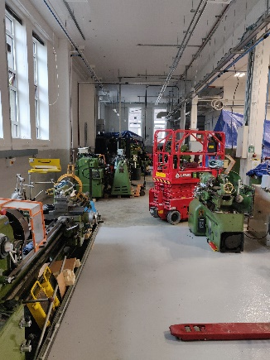
All change!
This has been a very disruptive year. Here are a few pictures of the chaos!

Slide 5
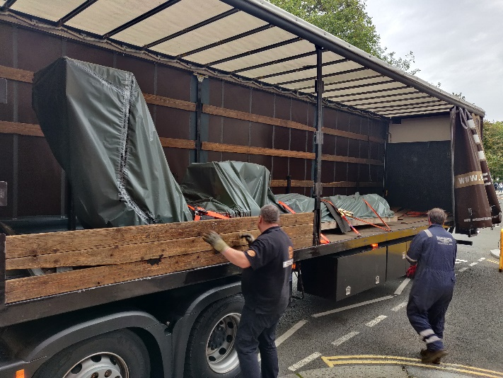
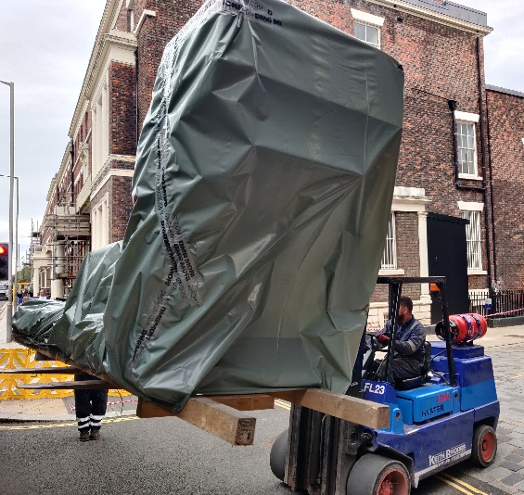
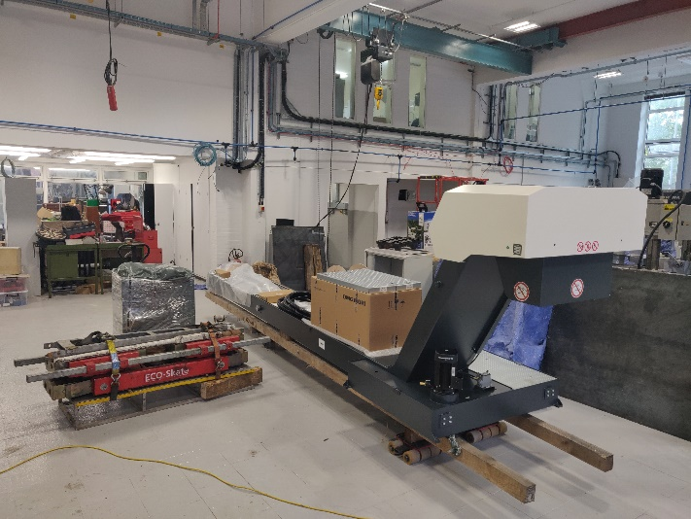
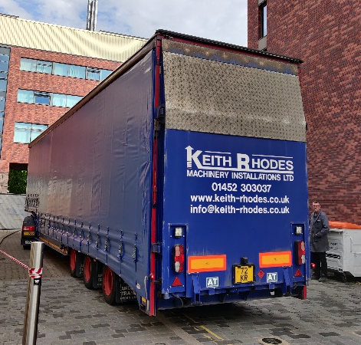
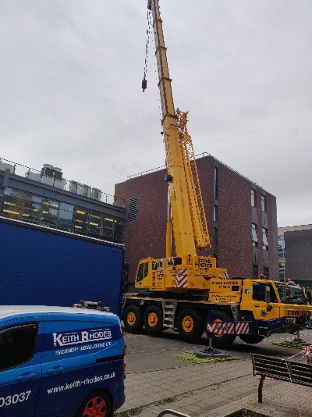
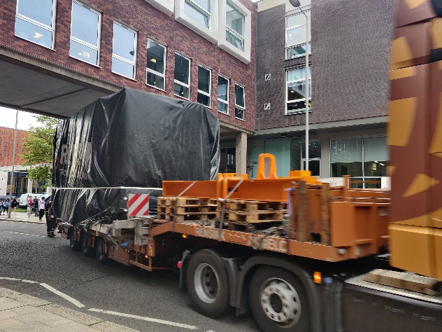
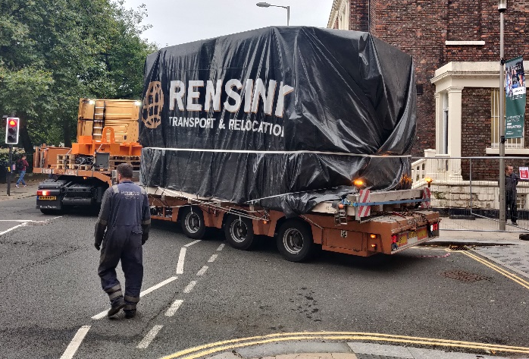
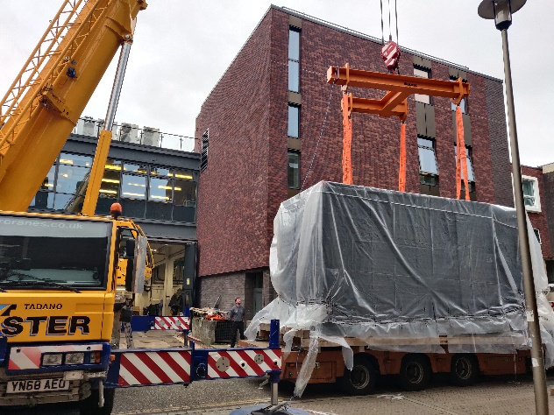
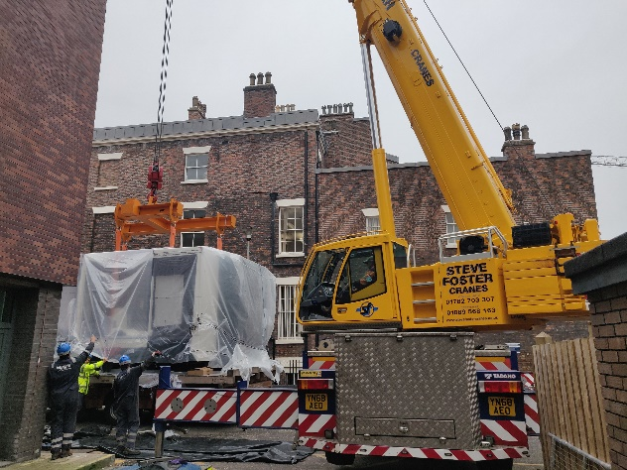
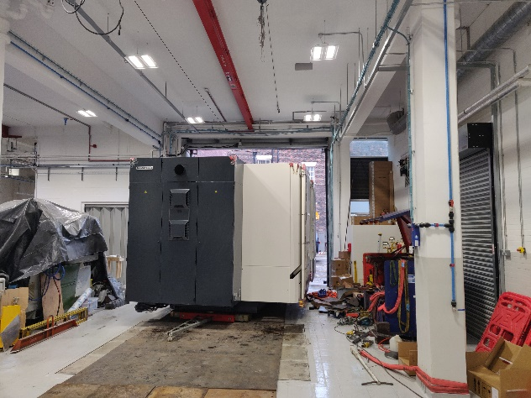
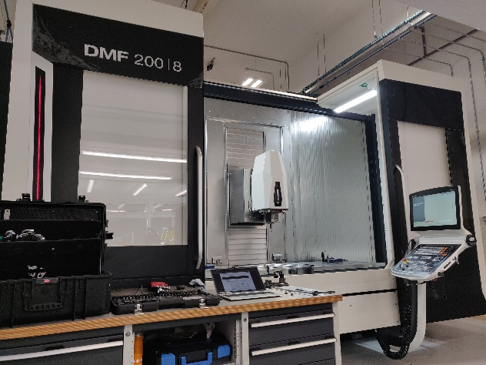
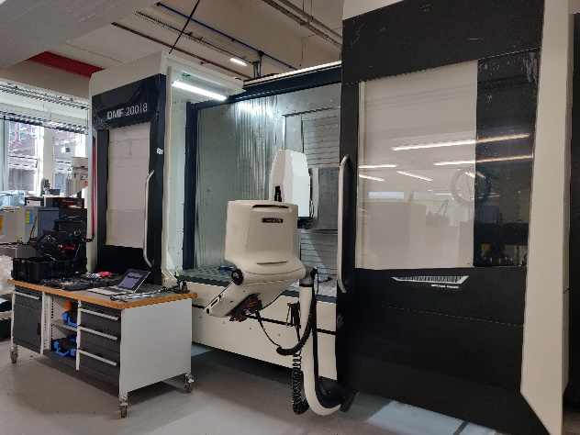
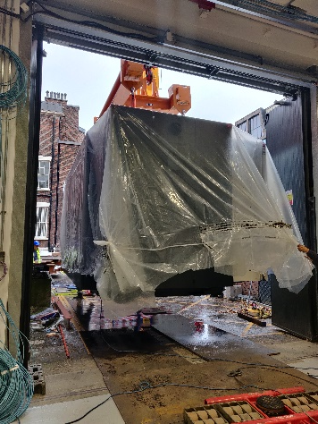
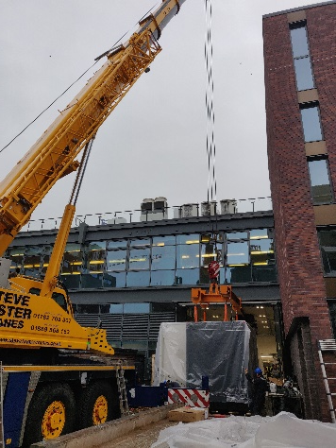
New machine: DMG Mori DMF200/8
After several delays, our new machine arrived on 26th & 27th September

Slide 6
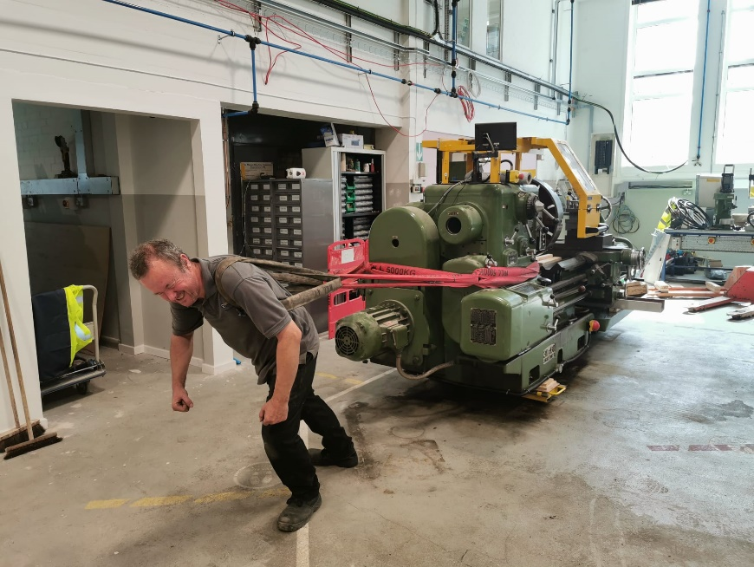
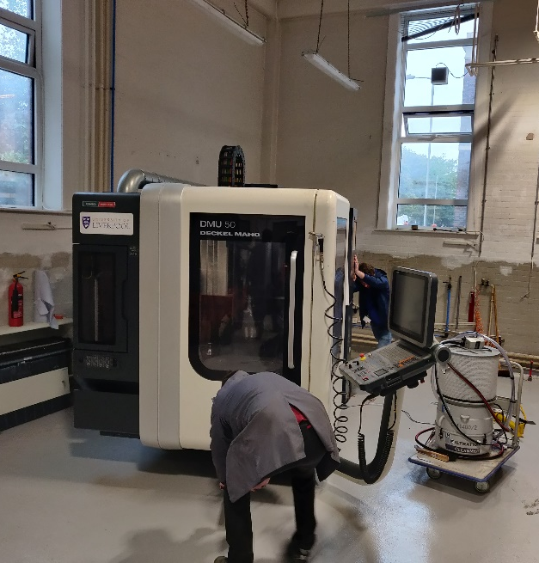
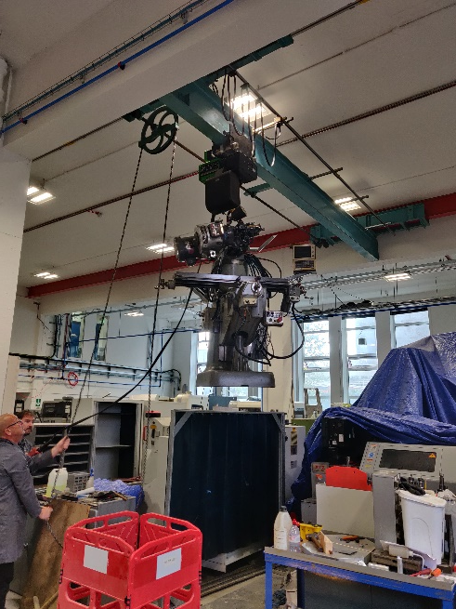
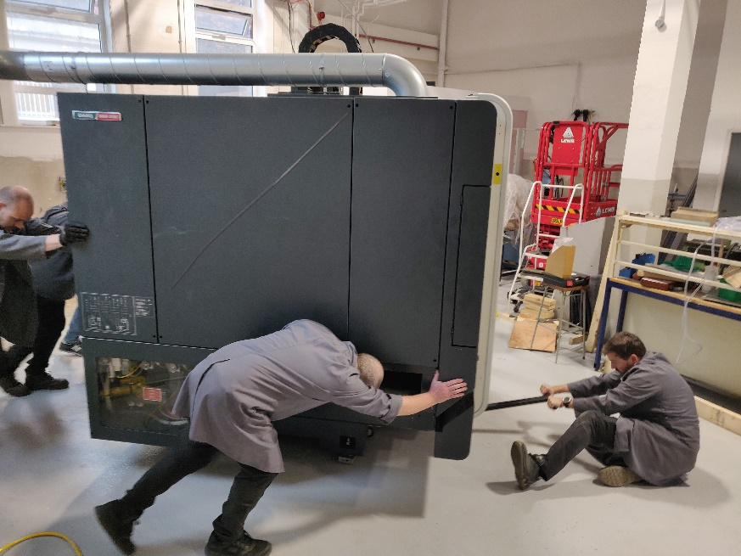
More machine moving
5000 kg
6200 Kg
7500 Kg
1000 Kg
No Engineers were harmed in the moving of our machines!

Slide 7
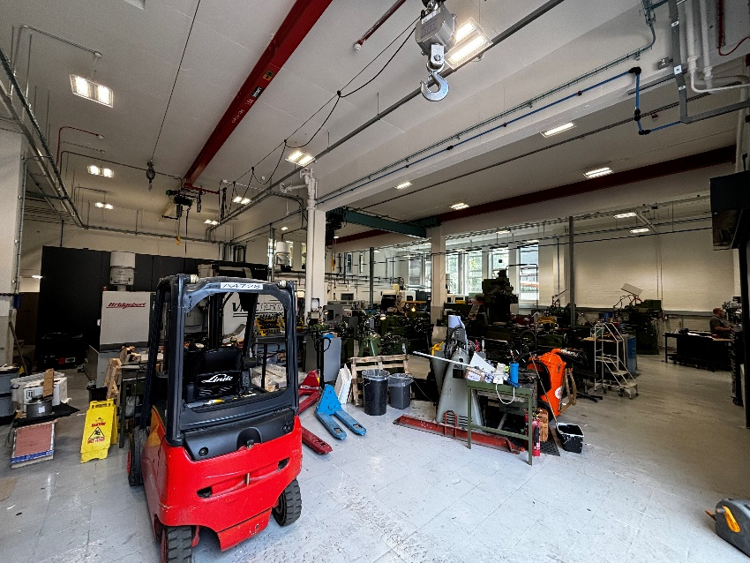
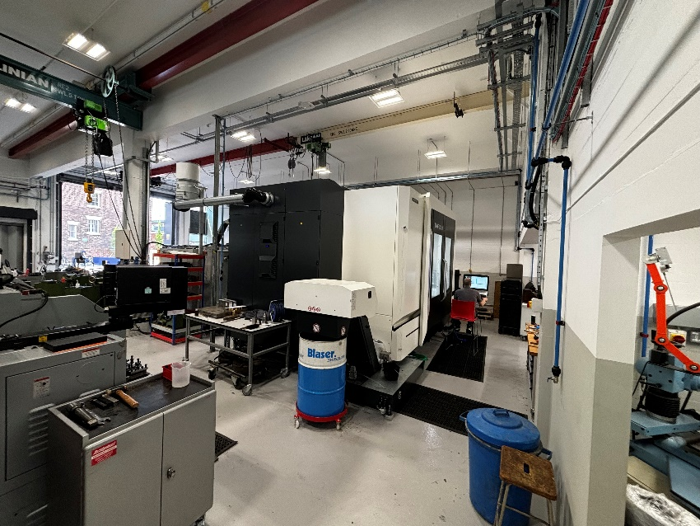
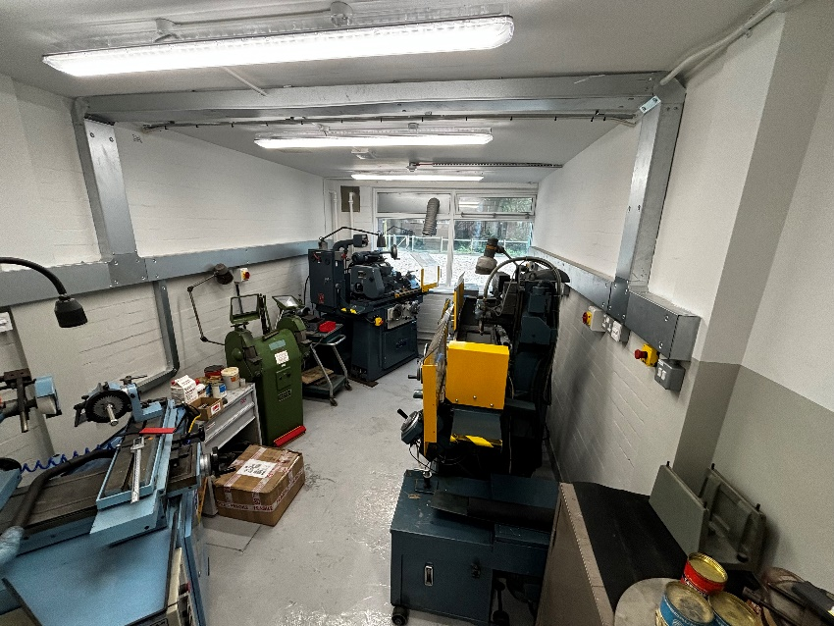
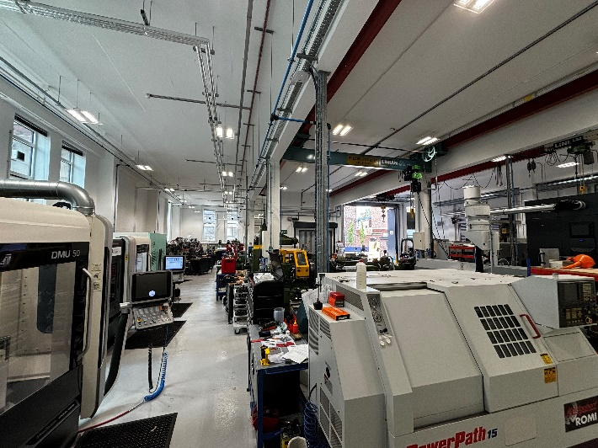
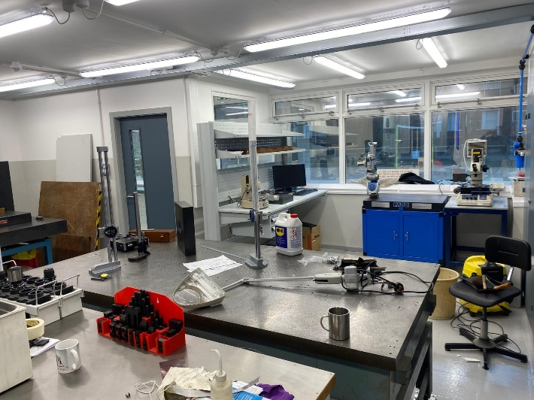
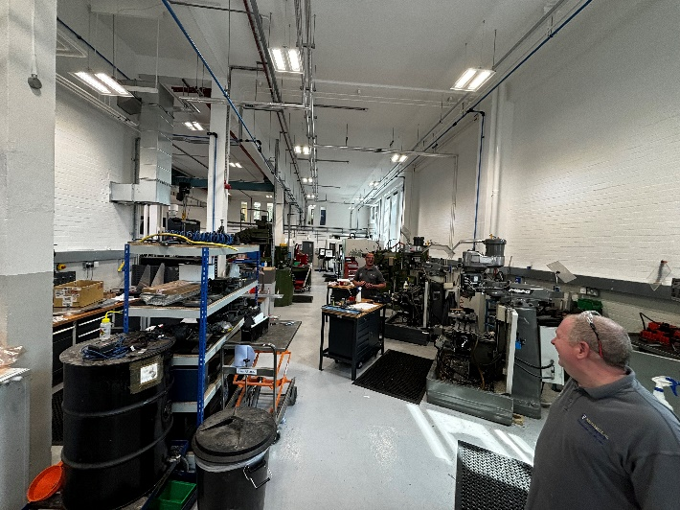
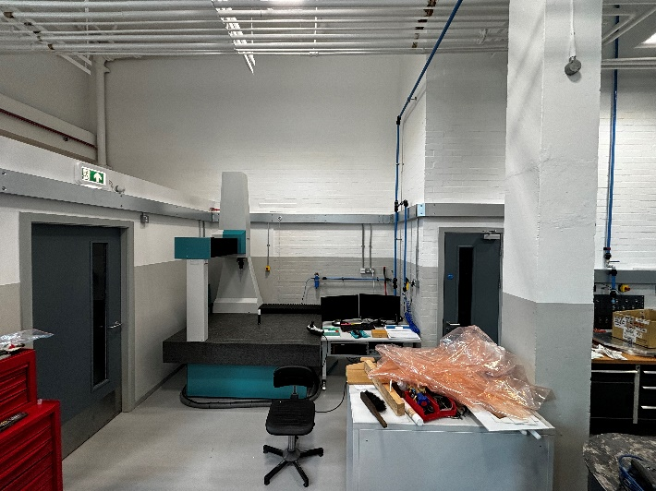
Nearly there!
Ground floor almost complete, which is great. We/FRCS are struggling with funding to complete the original programme of work. We have been told that this work will hopefully be included in the coming years FRCS planning.

Slide 8
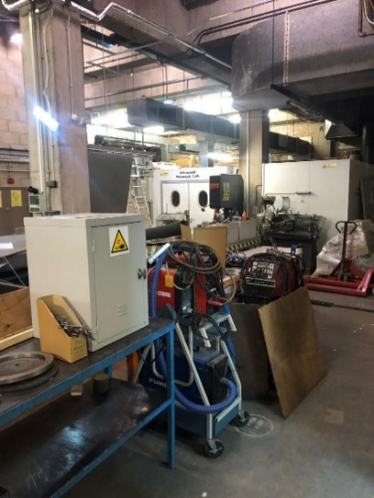
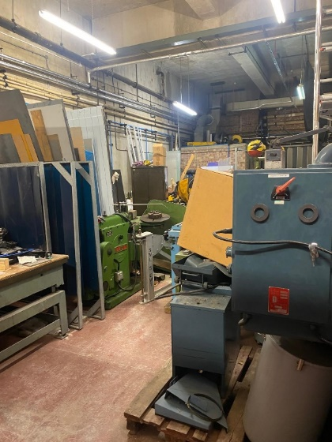
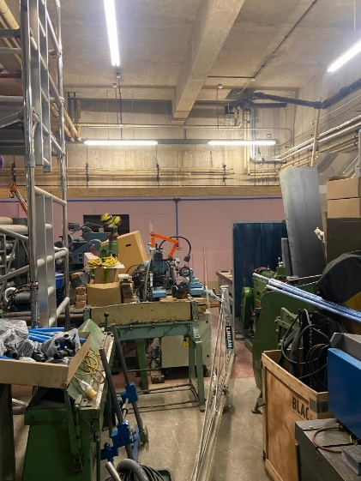
Basement improvement works and new fire corridor

Slide 9
Basement Improvements

Slide 10
Our new bandsaw
Basement Improvements
Relocated welding bay now in use with new improved extraction
Refurbished basement
This area has new power supplies, compressed air supply and new lighting. Both the walls and floor have been painted. We have a lot of work still to do but this area is now a much better place for us to work.
Two new 22Kw Compressors

Slide 11
Thanks to Tim Jones and Dan who both continue to be patient and have been very helpful counsel for me throughout this whole process
Thank You
Thanks to the DDMF team who have gone above and beyond, helping to ensure that we were never the bottle neck. They have moved so much equipment at very short notice and have continued making parts for you
Thanks to Tim Veal, Monica and Joost who stepped in when it was necessary helping to persuade FRCS to do what they were supposed to do
Thanks to Tom O'Brien (FRCS) who has managed our project.

Slide 12
Showcase

Slide 13
Showcase

Slide 14
Showcase
Parts for Atlas half cylinder assembly
Atlas
Above parts being manufactured with thickness
tolerance of ± 25µm and parallel to 50µm.
Below same parts assembled in the cleanroom holding a half cylinder

Slide 15
AML
Onyx (Nylon + chopped Carbon fibre) 3D printed parts
Co-curing using carbon foam core structures

Slide 16
AML
Prototypes for Atlas half cylinders

Slide 17
None of this would be possible without…
Daniel Hollywood
Rob Malley
Luke Marshall
Tony Watling
Tom Gibbs
Paul Sinclair
Paul Cook
Emlyn Jones
Kevin McCormick
A massive thank you to them for their excellent effort, help and support throughout what has been another challenging year

Slide 18
That’s all folks
thanks for listening
Notes:
15

