Slide 1
AION : Progress towards Strontium Atom Interferometry at RAL Space
Kamran Hussain
Liverpool HEP annual summer meeting 2024
Kamran Hussain
Kamran.Hussain@liverpool.ac.uk
24/05/24
Kamran Hussain
Kamran.Hussain@liverpool.ac.uk
DD/MM/YY

Slide 2
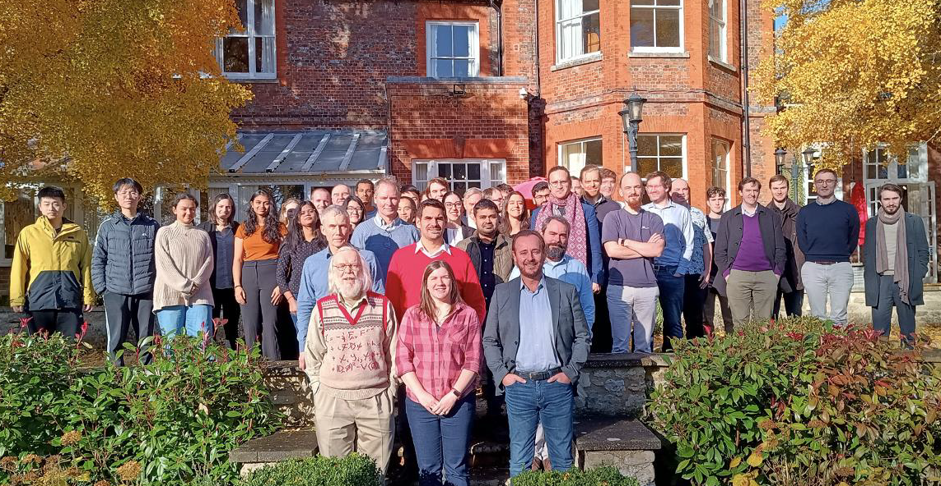
Atom Interferometry Observatory and Network (AION)
1.
Atom Interferometry Observatory and Network (AION) is a consortium of seven UK institutions :
University of Birmingham
University of Cambridge
Imperial College London
Kings College London
University of Liverpool
Rutherford Appleton Laboratory (RAL)
University of Oxford
Shared goal of developing Atom Interferometers for fundamental physics research
Kamran Hussain
Kamran.Hussain@liverpool.ac.uk
24/05/24
Kamran Hussain
Kamran.Hussain@liverpool.ac.uk
DD/MM/YY

Slide 3
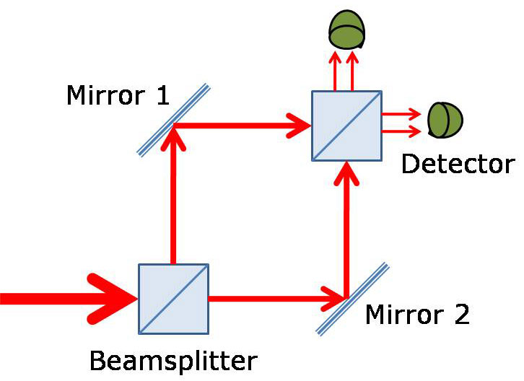
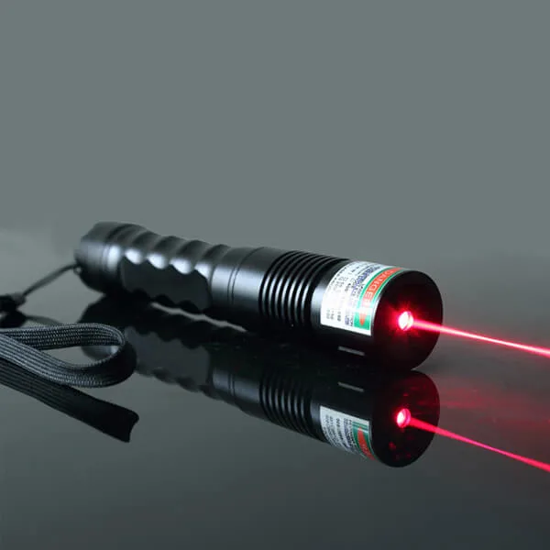
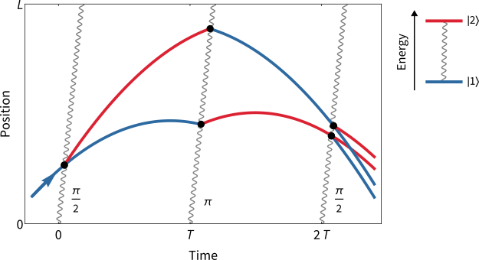
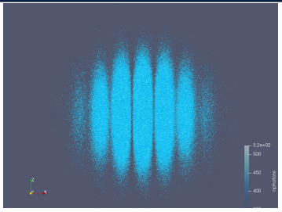
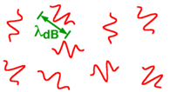
What is Atom Interferometry?
2.
Light interferometry
Interferometer: Mach-Zehnder
Detection: Fringe patterns
Source: Coherent light
Atom interferometry
Source: “Cold” coherent atoms
Kamran Hussain
Kamran.Hussain@liverpool.ac.uk
24/05/24
Kamran Hussain
Kamran.Hussain@liverpool.ac.uk
DD/MM/YY

Slide 4
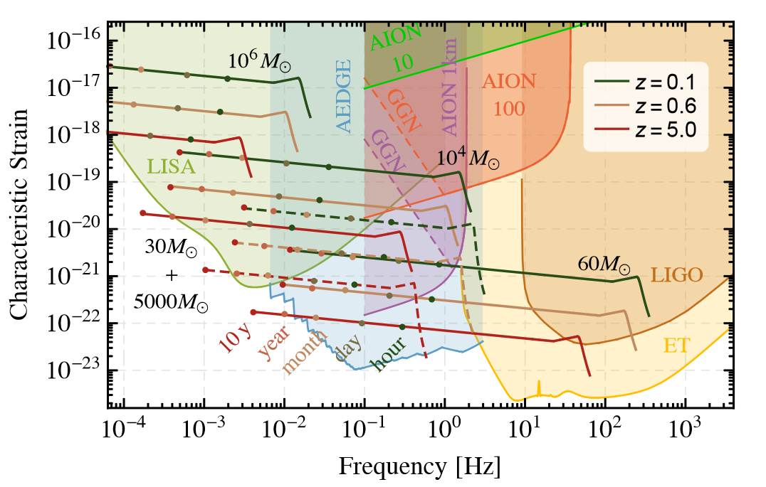
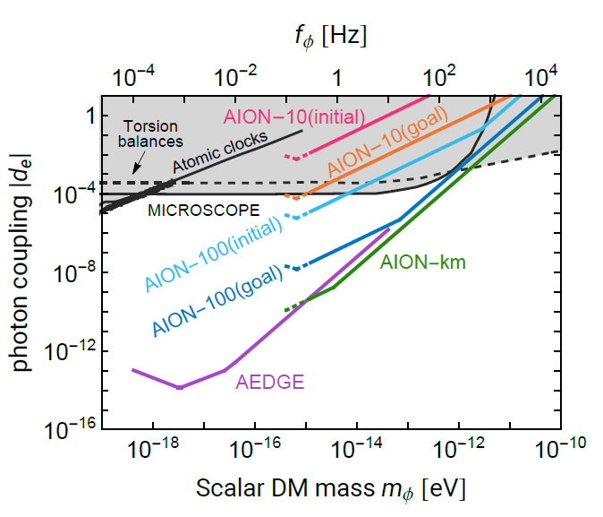
Physics case
3.
Sensitivity increases with baseline length
There technical challenges with developing scalable atom interferometers
Sensitivity to Gravitational waves in the deci-Hertz range (0.1 - 10 Hz)
Intermediate mass black hole mergers
Type 1A supernova from white dwarf mergers
Atom Interferometers are unable to probe a frequency range inaccessible to both LIGO and LISA
Probe for Ultra-Light Dark Matter (ULDM) candidates
ULDM behaves as an oscillating field, which would couple to atomic energy levels resulting in changes to the fine structure constant and electron mass
Kamran Hussain
Kamran.Hussain@liverpool.ac.uk
24/05/24
Kamran Hussain
Kamran.Hussain@liverpool.ac.uk
DD/MM/YY

Slide 5
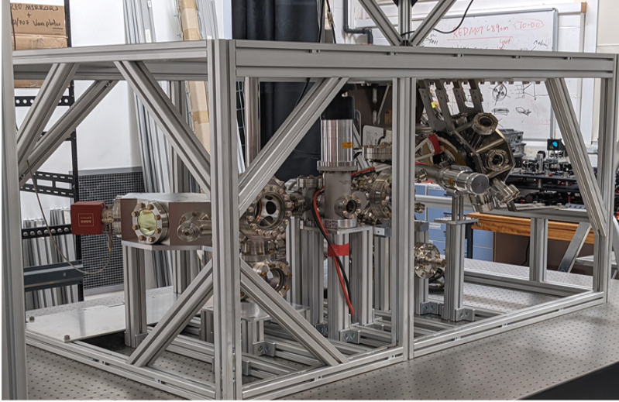
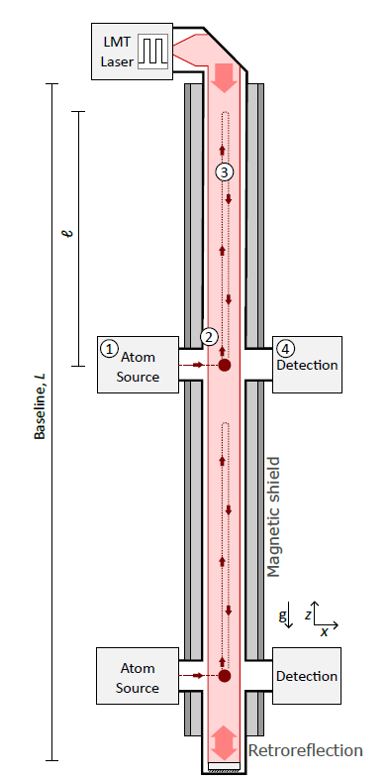
Long baseline atom interferometry
4.
AION-1km
AION-100
AION-10
Local prototype system (AION-1)
Develop the cold atom technology for scalability
Kamran Hussain
Kamran.Hussain@liverpool.ac.uk
24/05/24
Kamran Hussain
Kamran.Hussain@liverpool.ac.uk
DD/MM/YY

Slide 6
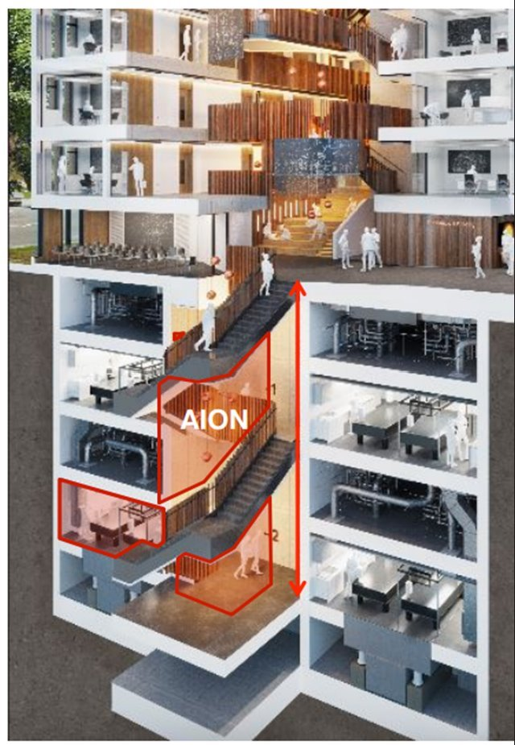
Long baseline atom interferometry
5.
AION-1km
Planned construction of a 10 m atom interferometer at the University of Oxford Beecroft building
AION-100
AION-10
Local prototype system (AION-1)
Kamran Hussain
Kamran.Hussain@liverpool.ac.uk
24/05/24
Kamran Hussain
Kamran.Hussain@liverpool.ac.uk
DD/MM/YY

Slide 7
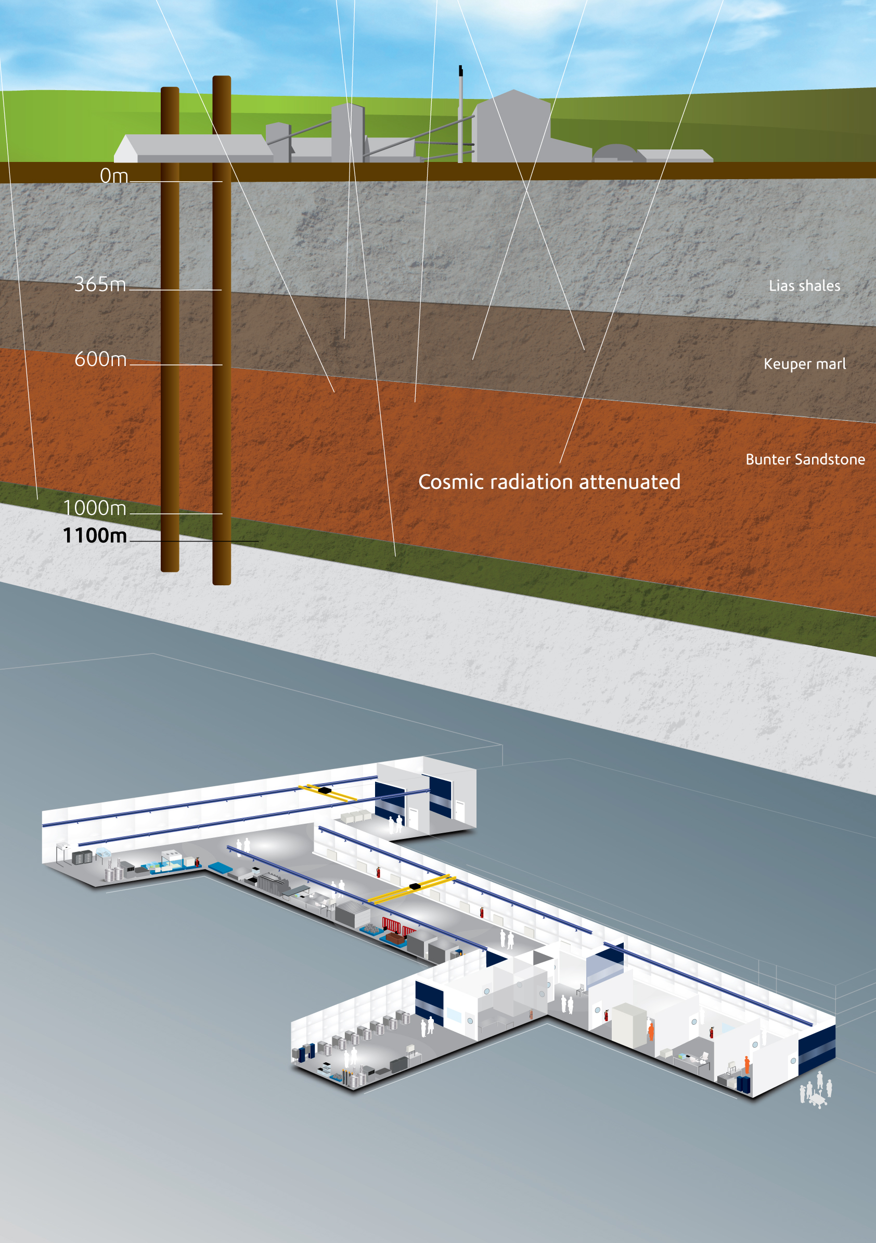
Long baseline atom interferometry
6.
AION-1km
Boulby Underground Laboratory as a potential site for a 100m and 1 km interferometer
AION-100
AION-10
Local prototype system (AION-1)
Kamran Hussain
Kamran.Hussain@liverpool.ac.uk
24/05/24
Kamran Hussain
Kamran.Hussain@liverpool.ac.uk
DD/MM/YY

Slide 8
Strontium Interferometry
7.
5s6s ³S₁
5s5p ¹P₁
679 nm
707 nm
5s4d¹D₂
J=2
Laser cooling and fluorescence detection
461 nm
(30 MHz)
Sub-micro kelvin laser cooling
689 nm
(7.5 kHz)
J=1
J=0
5s5p ³P_{J}
698 nm
(1 mHz)
5s² ¹S₀
Long-lived metastable state
Used for interferometry pulses
Kamran Hussain
Kamran.Hussain@liverpool.ac.uk
24/05/24
Kamran Hussain
Kamran.Hussain@liverpool.ac.uk
DD/MM/YY

Slide 9
AION-10 overview
8.
Centralised Design
Atom transport & launch
Prototype 10m differential interferometry
& Atomic oven design
Phase shear imaging
State squeezing
Instrument engineering and magnetic shielding
Large momentum transfer
Sensitivities and phenomenology studies
Integration into detector
Kamran Hussain
Kamran.Hussain@liverpool.ac.uk
24/05/24
Kamran Hussain
Kamran.Hussain@liverpool.ac.uk
DD/MM/YY

Slide 10
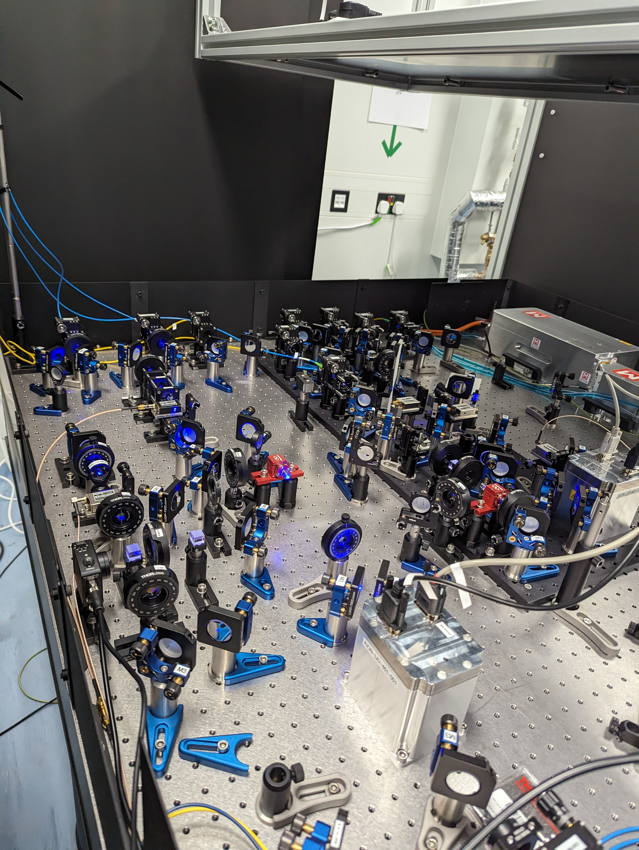
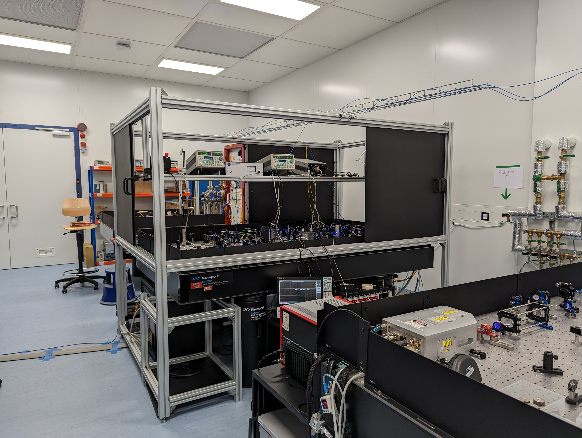
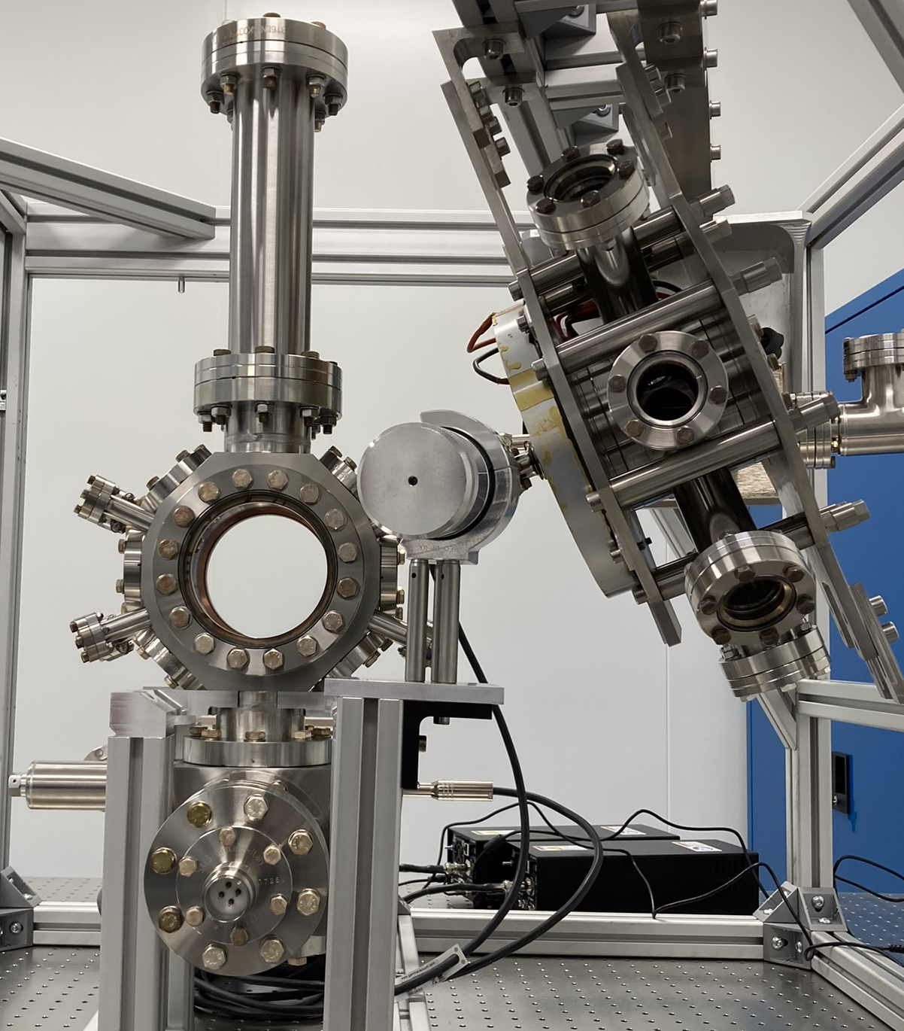
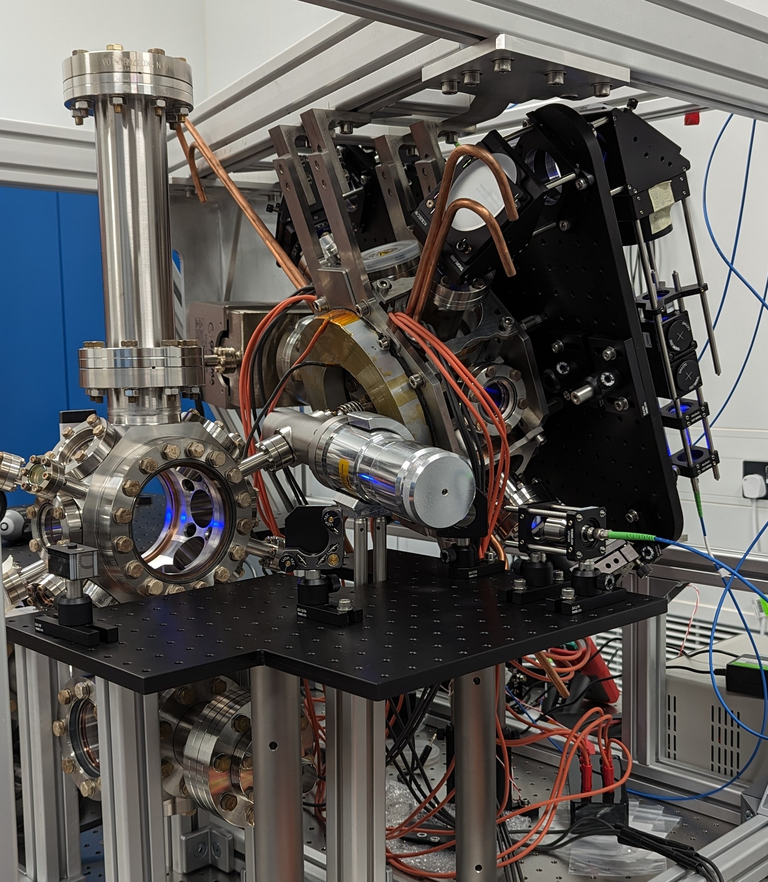
Strontium lab at RAL Space
9.
Kamran Hussain
Kamran.Hussain@liverpool.ac.uk
24/05/24
Kamran Hussain
Kamran.Hussain@liverpool.ac.uk
DD/MM/YY

Slide 11
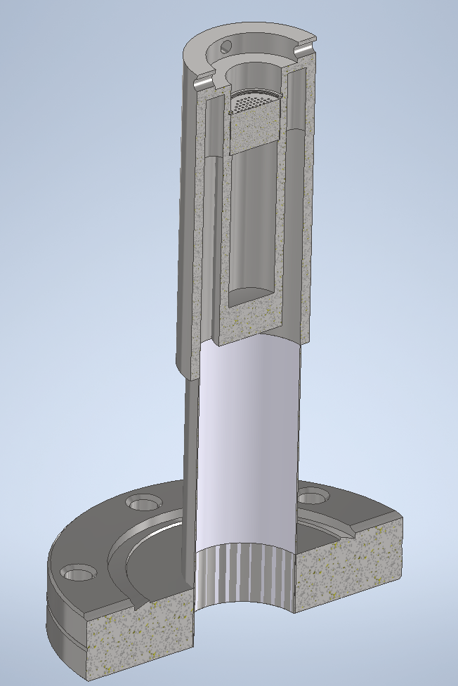
Progress towards cold atoms
10.
Strontium Oven
700 K
Strontium atoms
Kamran Hussain
Kamran.Hussain@liverpool.ac.uk
24/05/24
Kamran Hussain
Kamran.Hussain@liverpool.ac.uk
DD/MM/YY

Slide 12
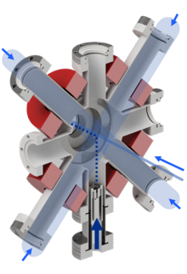
Progress towards cold atoms
11.
Strontium Oven
700 K
2D Blue MOT
461 nm
~mK
Permanent magnets
Two perpendicular beams used to cool the atoms in two directions
Permanent magnetics used to spatial confine the atoms in the center of the chamber
The combination of laser cooling and magnetic trap is known as a Magneto-Optical Trap (MOT)
Strontium oven
Kamran Hussain
Kamran.Hussain@liverpool.ac.uk
24/05/24
Kamran Hussain
Kamran.Hussain@liverpool.ac.uk
DD/MM/YY

Slide 13
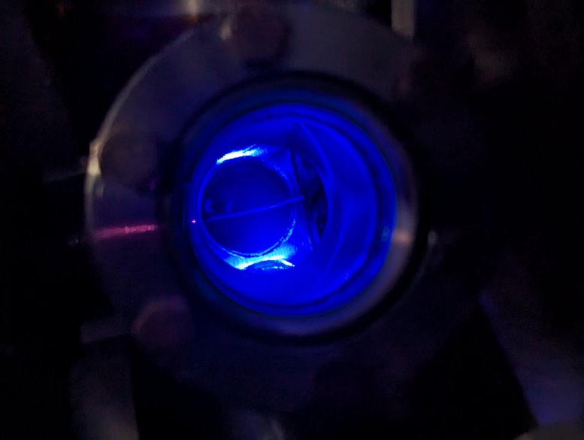
Progress towards cold atoms
12.
Strontium Oven
700 K
2D Blue MOT
461 nm
~mK
Kamran Hussain
Kamran.Hussain@liverpool.ac.uk
24/05/24
Kamran Hussain
Kamran.Hussain@liverpool.ac.uk
DD/MM/YY

Slide 14
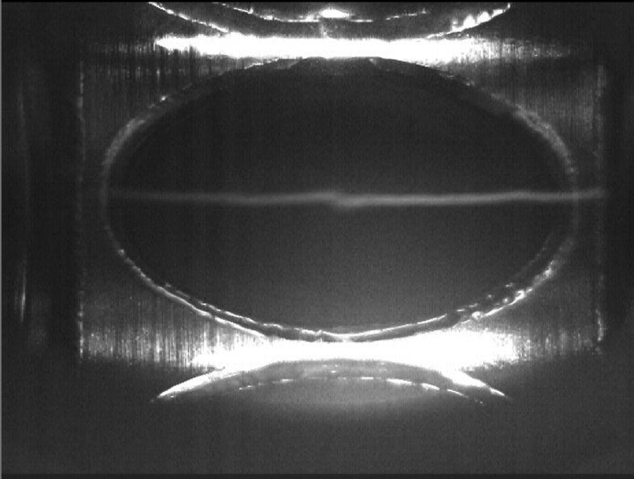
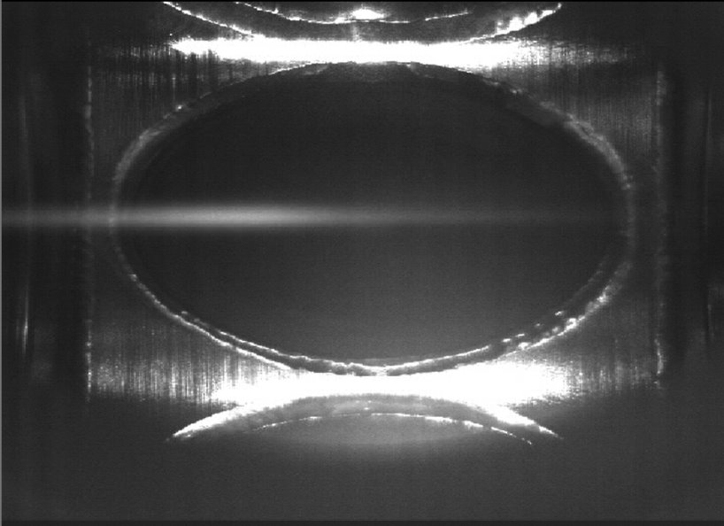
Progress towards cold atoms
13.
Strontium Oven
700 K
2D Blue MOT
461 nm
~mK
"Push" beam
2D MOT
2D MOT (with push beam applied)
Kamran Hussain
Kamran.Hussain@liverpool.ac.uk
24/05/24
Kamran Hussain
Kamran.Hussain@liverpool.ac.uk
DD/MM/YY

Slide 15
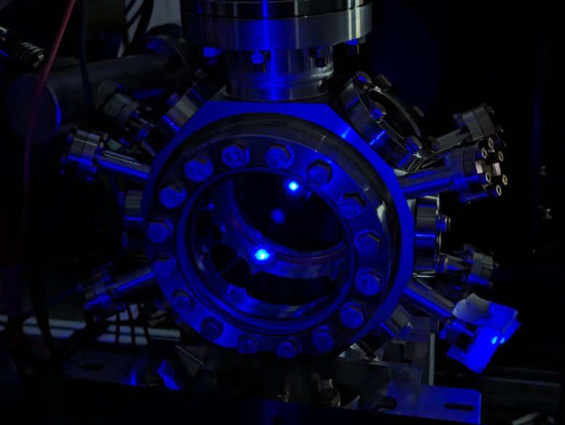
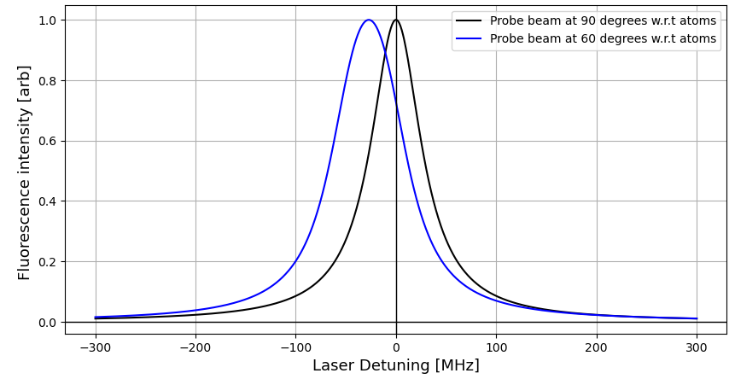
Laser induced fluorescence spectroscopy
14.
Chamber 2 fluorescence observed​
​
Extract atom cloud size​ using CCD
Observing fluorescence at different position within the chamber, to determine atomic beam divergence
fluorescence
Probe beam scatter off viewport window
Laser-induced fluorescence spectroscopy to evaluate atomic beam velocities into chamber 2.
These measurements are prone to Doppler broadening effects and is angle depend.
Kamran Hussain
Kamran.Hussain@liverpool.ac.uk
24/05/24
Kamran Hussain
Kamran.Hussain@liverpool.ac.uk
DD/MM/YY

Slide 16
3D MOT
15.
Strontium Oven
700 K
2D Blue MOT
461 nm
~mK
3D Blue MOT
461 nm
<mK
Coils
Kamran Hussain
Kamran.Hussain@liverpool.ac.uk
24/05/24
Kamran Hussain
Kamran.Hussain@liverpool.ac.uk
DD/MM/YY

Slide 17
Characterisation of the atom beam at each stage
16.
Characterisation of the atomic beam velocities via fluorescence spectroscopy allows for the 2D MOT beam parameters to be optimised to maximise the number of atoms travelling into the second chamber
3D MOT characterisation is through "loading rate" measurement which gives an indication as how effective the trap is by measuring the number of atoms inside the MOT, typically done using fluorescence
3D MOT temperature characterisation via a time of flight measurement
Kamran Hussain
Kamran.Hussain@liverpool.ac.uk
24/05/24
Kamran Hussain
Kamran.Hussain@liverpool.ac.uk
DD/MM/YY

Slide 18
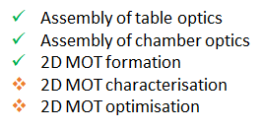
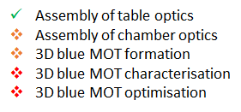
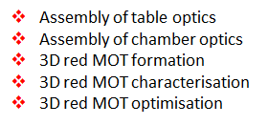
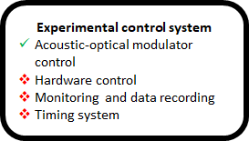
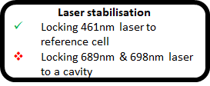
Summary
17.
Cold atoms
Strontium Oven
700 K
2D Blue MOT
461 nm
~mK
3D Blue MOT
461 nm
<mK
3D Red MOT
689 nm
~µK
Dipole Trap
1064 nm
<µK
Prototype Interferometry
Phase shear imaging
Kamran Hussain
Kamran.Hussain@liverpool.ac.uk
24/05/24
Kamran Hussain
Kamran.Hussain@liverpool.ac.uk
DD/MM/YY

