Slide 1
VIDARR -
Monitoring ⁹⁰Sr via anti-neutrino detection
Joel Dasari
Supervisory Team
jdasari@liverpool.ac.uk
J. Coleman, C. Metelko, Y. Schnellbach, R.Collins – University of Liverpool
R. Mills – NNL
I. Teasdale – Sellafield Ltd.

Slide 2
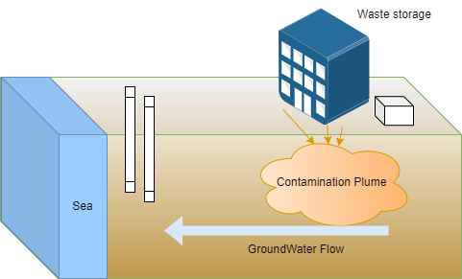
Problem
Current detection methods
Time consuming
Secondary waste
Expensive
Requires personnel access:
Potential contamination
Radiation exposure
Fission product beta emitters are difficult to measure:
Dispersion in water table
Radiation shielding by soil and rock distributions.
Sr-90, a prominent toxic fission product, is leaking into the water table.
Interaction mechanism same as calcium - bone absorption leading to cancer
Monitoring its activity in the environment is important given its radiotoxicity
Waste Store
Boreholes
Groundwater Flow

Slide 3
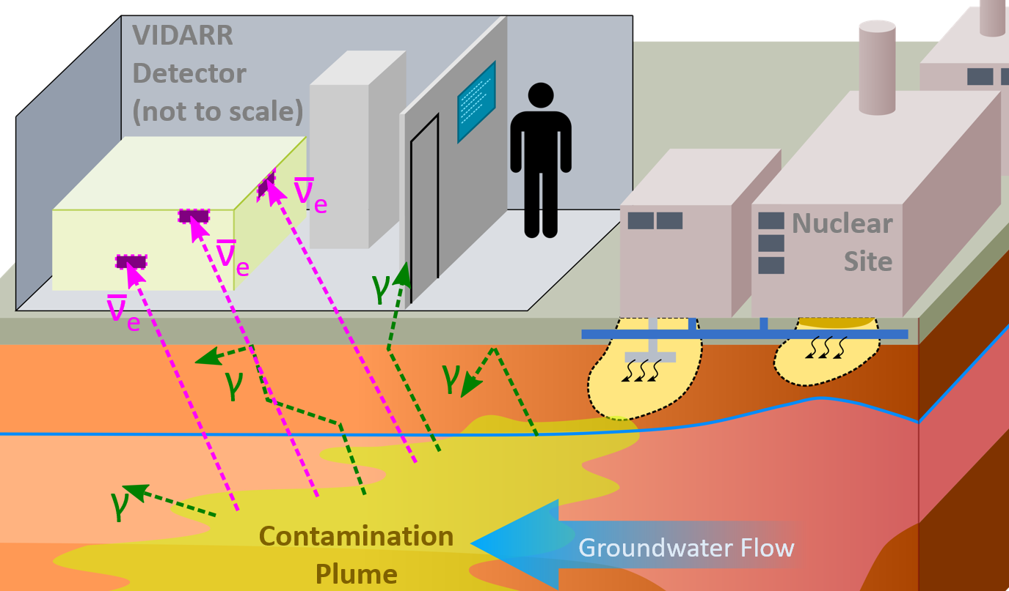
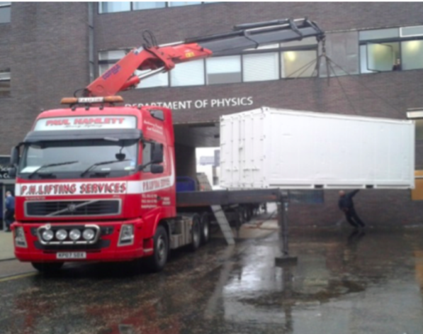
Solution
Motivation
Cowan and Reines 1956-1957
Non-proliferation purposes suggested in 1978
IAEA workshop and report created set of “Desirements”
VIDARR A mobile, non intrusive detector
VIDARR is the first of its kind for real-time in situ Sr-90 monitoring

Slide 4
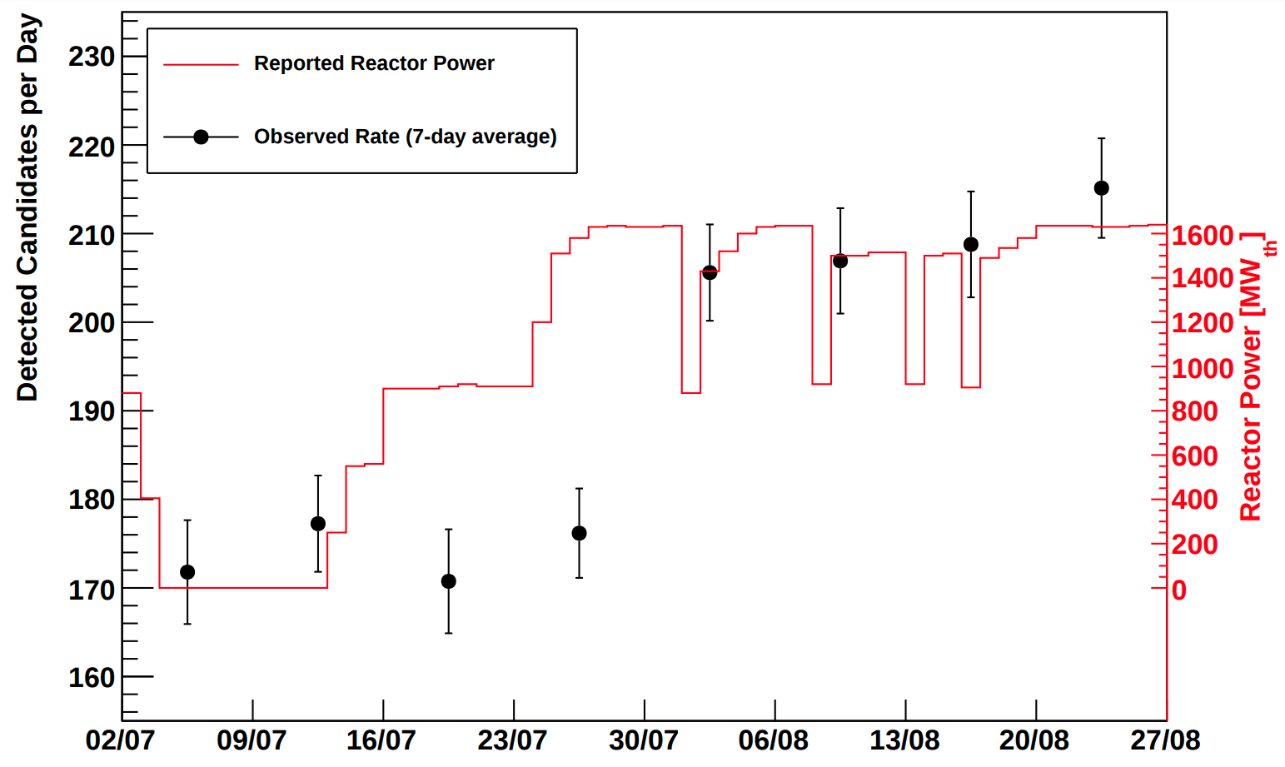
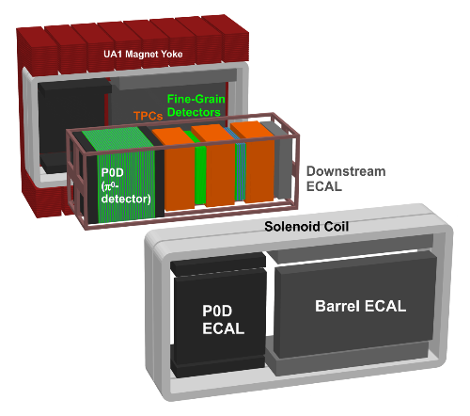
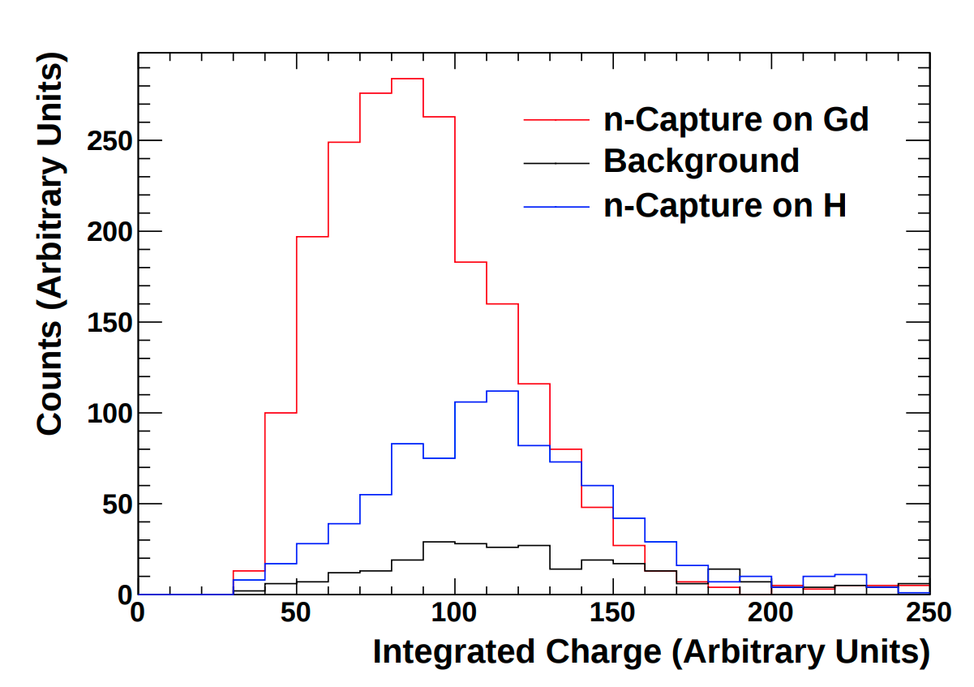
Proof of Concept
VIDARR uses revised T2K ND280 ECal technology to detect emitted ν̅e from fission fragments.
Field tests conducted at Wylfa Magnox Reactor, ~60 meters from the core.
Aims to detect anti-neutrino events via prompt positron signals and delayed neutron capture.
Successfully detected anti-neutrino events.
Top - Daily count rates of detected anti-neutrino candidates averaged over 7-day interval
Left - charge deposit
for neutron capture events in a small prototype detector

Slide 5
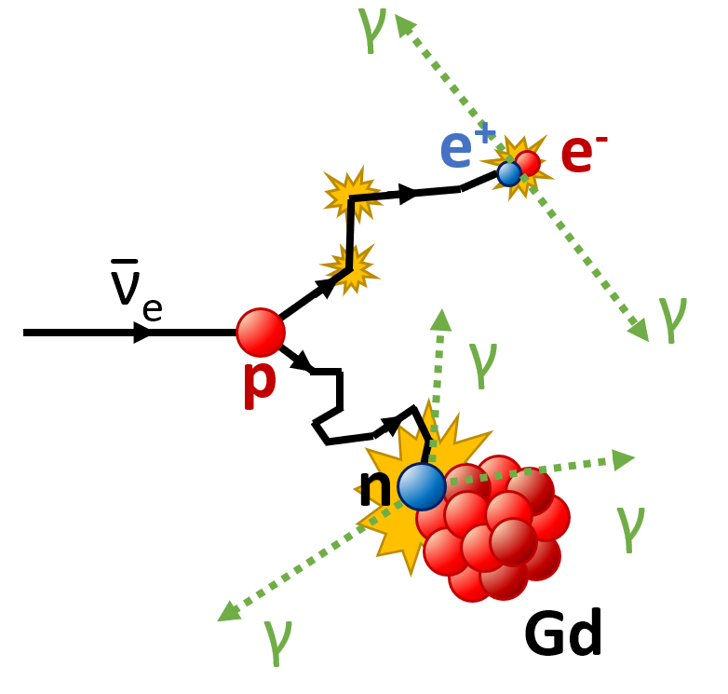
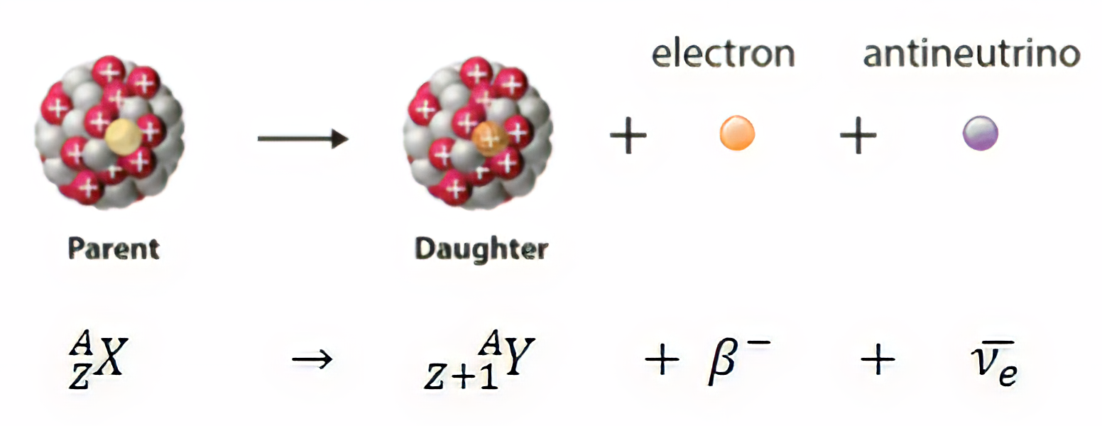
Anti
Neutrinos
Inverse Beta Decay
Well known method for anti-neutrino detection.
anti-neutrinos interacting with protons to undergo IBD
Detection of:
Positron
Followed by thermal neutron
Results in distinctive delayed coincidence signal
Weakly interacting nature allows for direct and unshieldable observation
Anti-neutrinos production, and average energy are dependent on the parent nuclei (90Sr)
Inverse beta decay visual in VIDARR

Slide 6
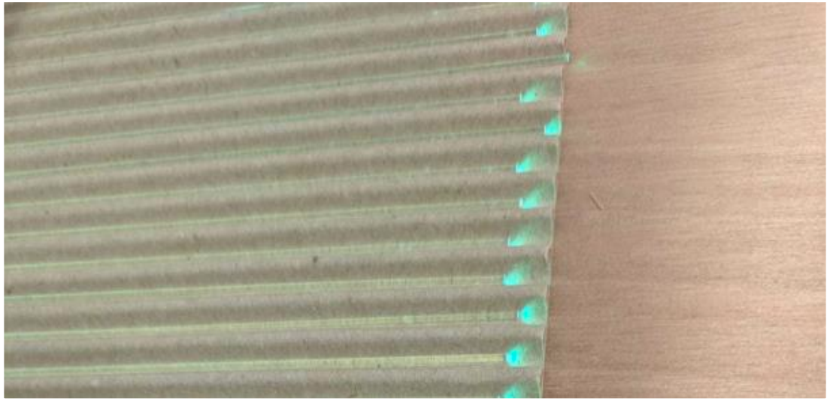
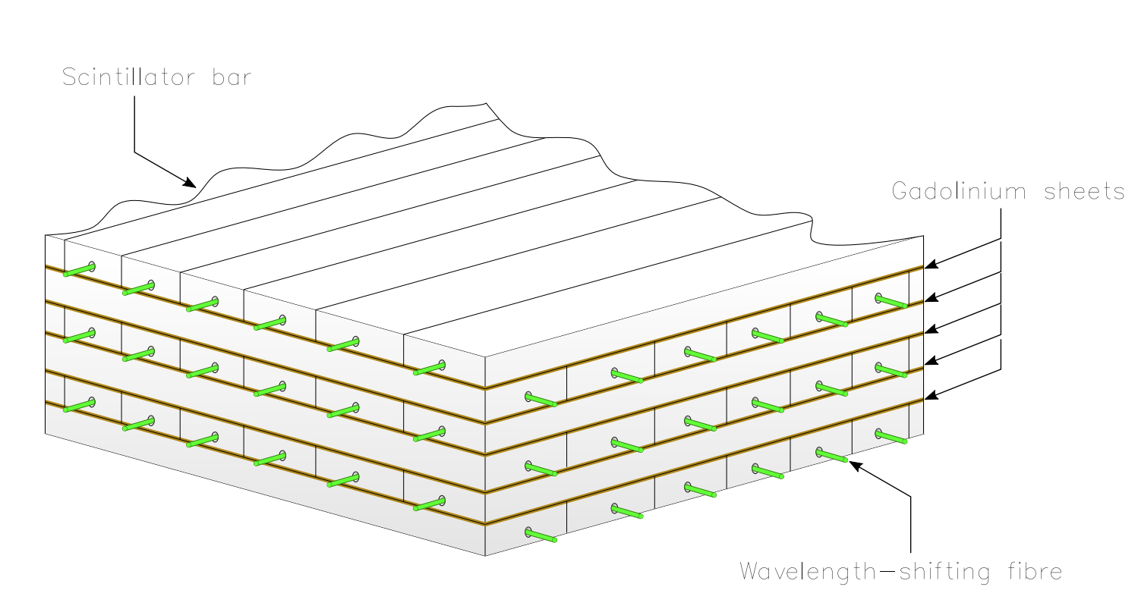
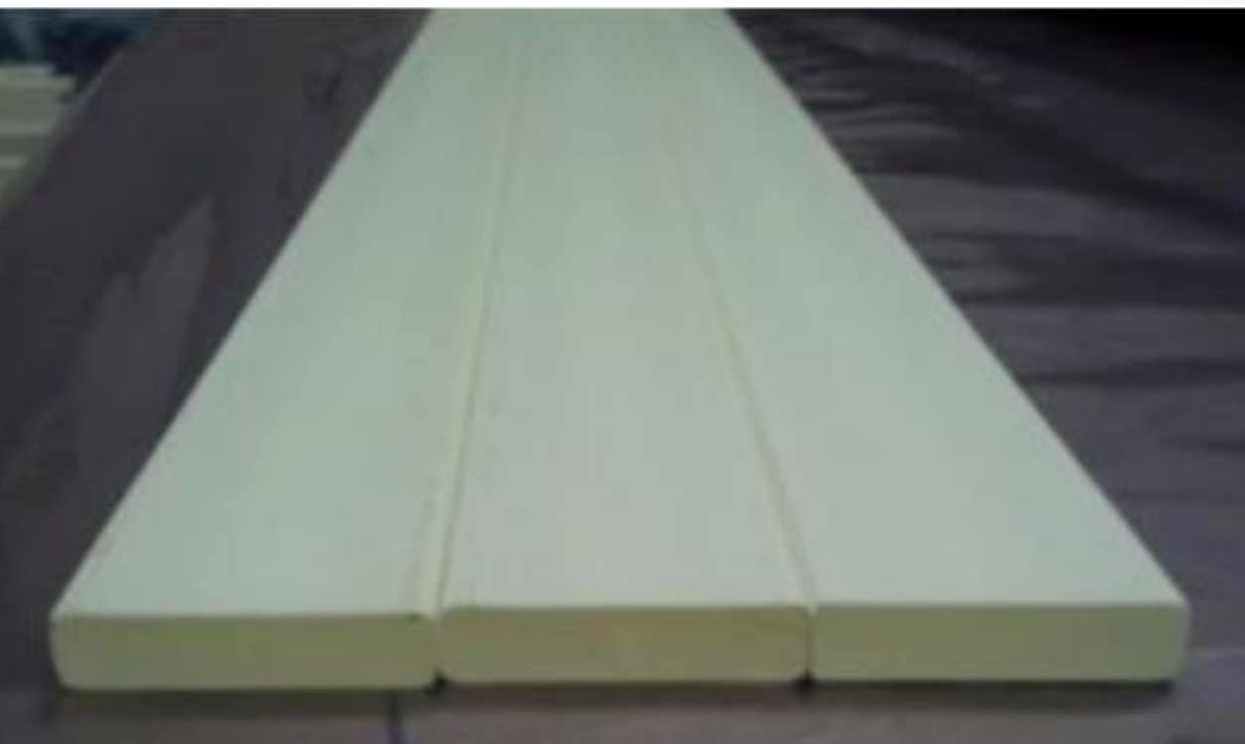
VIDARR Technology
1 tonne plastic scintillator
2660 channels
Scintillating bars doped with fluors and TiO2 coating
Wavelength shifting fibres for light capture
Gadolinium sheets interleaved between scintillator layers for neutron capture.
Multi-Pixel Photon Counters MPPCs

Slide 7
Simulation Work
IBD Event Sim
Neutrino Source Sim
Detector
IBD event • positron - red • neutron -blue
Distribution of anti-neutrinos from a monolithic source in detector

Slide 8
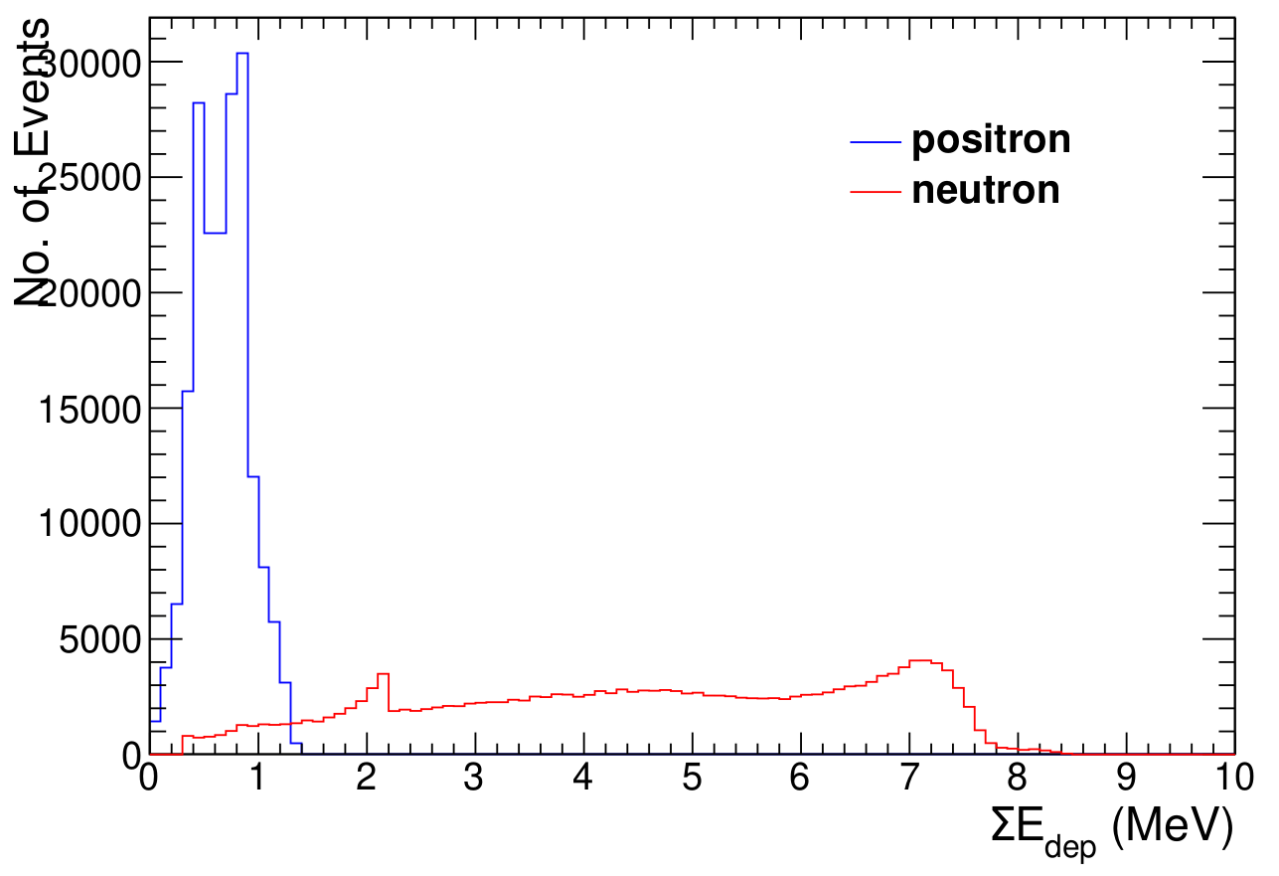
IBD event simulation results
Energy deposition in Simulation of 10,000 IBD events
Quenching + attenuation present in energy deposition
Initial IBD energy
Positron - 0.5-1 MeV
Neutron - 0.03 KeV
Back-2-Back Gammas
¹⁵⁷Gd(n, γ)¹⁵⁸Gd Neutron capture on Gd
¹H(n, γ)²H Neutron capture

Slide 9
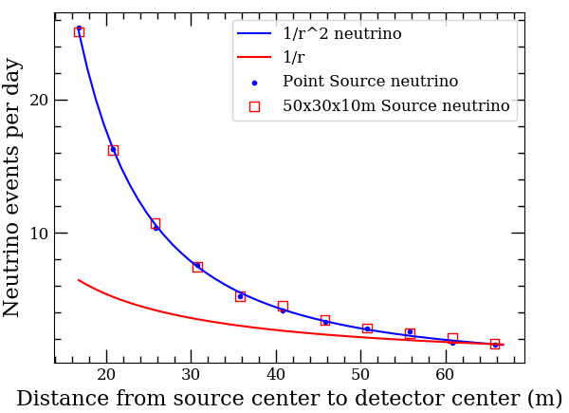
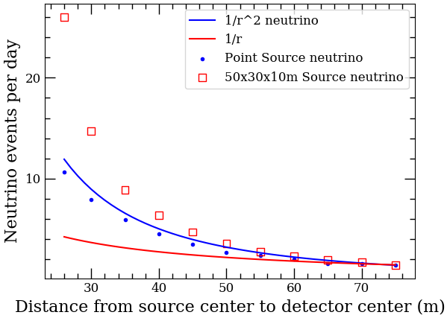
Neutrino Source Simulation
Model Nuclear Waste Source in Simulation
Activity
Detected events
Study to inform feasibility
How long to get significance
Where to position
70 m
60 m
50 m
40 m
VIDARR Position 1
VIDARR Position 2
Waste Building
VIDARR
Position 1
VIDARR
Position 2

Slide 10
Signal to background
No. of antineutrino like events interacting at varying distances.
Bottom - detector deployment for each distance to reach 5 sigma
5σ
1σ
Notes:
Left legend bigger
Building -

Slide 11
Market
Future Work
Sr-90 Monitoring
Key segments:
Spent fuel
Nuclear (fission) waste
Disaster/test sites
Over 15 Global sites Identified
Simulate Triangulation to determine unknown sources
Analysis of deployment data
Continued Detector maintenance
Conclusion
Reactor Monitoring
Over 600 Global sites Identified

Slide 12
Thank You.

Slide 13
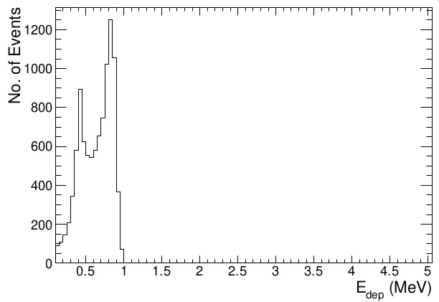
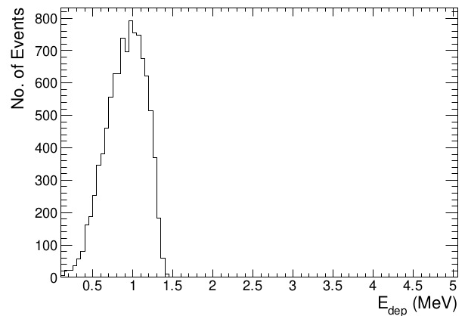
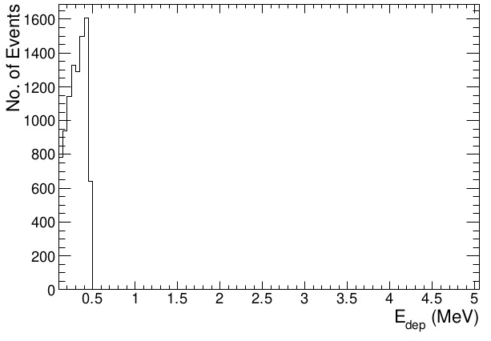
IBD event simulation results
Separating Positron Deposited Energy
EDep_{Gamma}
EDep_{Positron + Gamma}
EDep_{Positron}

