Slide 1
Clustering and Data Visualisation Algorithms for Astrophysics (and other applications)
(Potential Dr.) Dharmesh Mistry
Dr. Adam Thomas Knowles
Data Science Research Centre, LJMU
STFC Summer School 2024

Slide 2
Presenters
Dr. Adam Thomas Knowles
Postdoctoral Research Associate – Data Science Research Centre, Liverpool John Moores University
Dr. Adam T. Knowles completed his Ph.D. in Astrophysics at The University of Central Lancashire, focusing on Stellar Population Modelling and Galactic Chemical Evolution. His work has involved spectral models of stars, integrated stellar populations, and the use of high-performance computing for galaxy formation research.
Adam is now a Postdoctoral Research Associate at the Data Science Research Centre at Liverpool John Moores University. His research involves Machine Learning and AI for healthcare applications, particularly in developing digital twin technologies. For the EU Horizon funded TARGET project.
(Potential Dr) Dharmesh Mistry
Postdoctoral Research Associate at the Data Science Research Centre, Liverpool John Moores University (LJMU). His research develops machine learning architectures, including digital twin technologies, for the EU Horizon project TARGET, aimed at atrial fibrillation-related stroke prevention and management.
Dharmesh completed his master's and Ph.D. at LJMU’s Astrophysics Research Institute, specialising in machine learning for automating the identification of rare binary star systems. He has extensive expertise in classification, clustering, dimensionality reduction, and data augmentation. Dharmesh’s work bridges data science and astrophysics, bringing an interdisciplinary perspective to his research.

Slide 3
What will the workshop cover?
Introduction to dimensionality reduction algorithms
Principal Component Analysis (PCA)
t-distributed Stochastic Neighbourhood Embedding (t-SNE)
Introduction to clustering algorithms
K-Means
Hierarchical Density-Based Spatial Clustering of Applications with Noise (HDBSCAN)
Hands on exercises with two example datasets:
Stellar spectra
Varieties of Democracy
Group work and Q & A

Slide 4
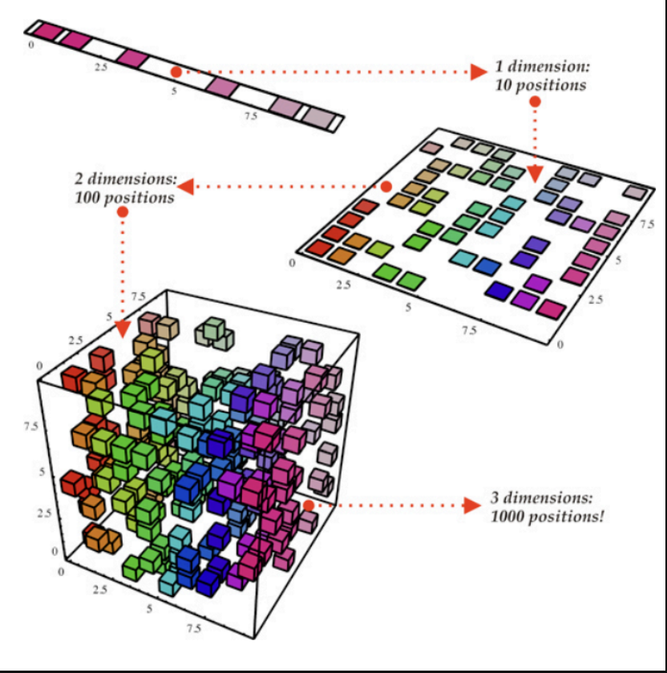
Understanding dimensionality reduction
What is Dimensionality Reduction?
Definition: Dimensionality reduction is a technique used to reduce the number of input variables in a dataset while retaining as much information as possible.
Purpose: It simplifies the dataset, making it easier to visualise, analyse, and process without losing significant information.
Why is it Important?
Visualisation: Reduces complex data to 2D or 3D, making it easier to visualise patterns and relationships.
Computational Efficiency: Reduces the computational cost and time for processing and analyzing large datasets.
Noise Reduction: Helps in removing irrelevant or redundant features, leading to improved model performance.
Notes:
Dimensionality reduction can significantly aid computational efficiency by reducing the number of features in a dataset while retaining most of the relevant information. Here’s an example to illustrate this:
Imagine you are working with a dataset that has 1,000 features (variables) and 10,000 samples (data points).
Training a machine learning model on this high-dimensional dataset can be computationally expensive and time-consuming due to the sheer volume of data and the complexity of the calculations involved.
By applying a dimensionality reduction technique such as Principal Component Analysis (PCA), you can transform the original 1,000 features into a smaller set of, say, 50 principal components. These principal components are linear combinations of the original features and capture most of the variance in the data.

Slide 5
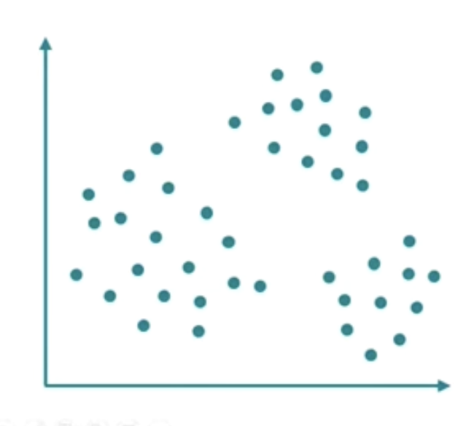
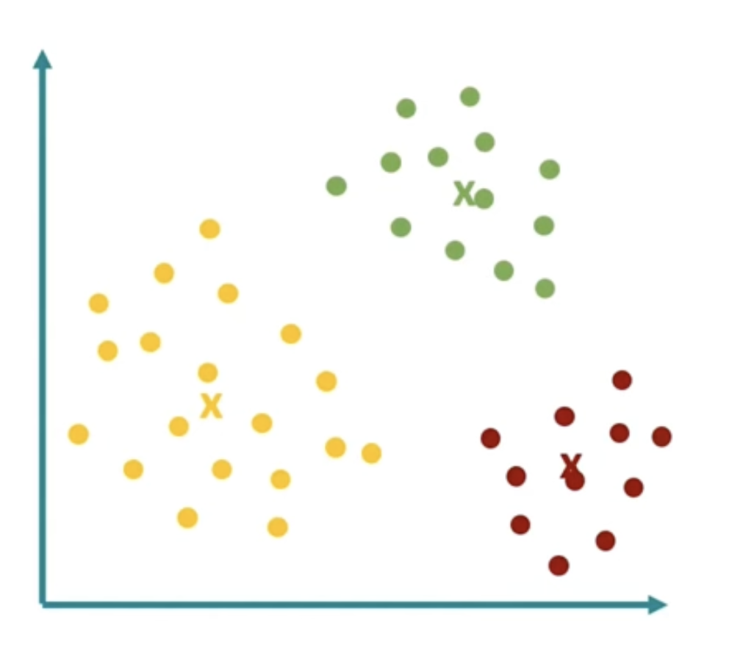
Understanding Clustering
What is Clustering?
Definition: Clustering is a technique used to group similar data points together based on their characteristics. Each group, or cluster, contains data points that are more similar to each other than to those in other clusters.
Purpose: It helps to identify and understand the natural structure within a dataset.
Why is it Important?
Pattern Recognition: Helps in discovering inherent groupings in data, such as customer segments, disease subtypes, or regions of interest in astronomical data.
Data Summarisation: Reduces the complexity of data by summarising it into meaningful clusters, making it easier to analyse and interpret.
Feature Engineering: Provides insights that can be used to create new features for machine learning models, improving their performance.
Notes:
Feature Engineering:
Creating Cluster-Based Features: The cluster assignments can be used as new features in machine learning models. For example, adding a feature that indicates the cluster membership of each data point can help models learn patterns more effectively.
Example: In customer segmentation, clustering can group customers with similar purchasing behaviour. These cluster labels can then be used as features in a predictive model to forecast customer churn or target marketing efforts. A customer belonging to a high-value cluster might be given a different marketing strategy than one from a low-value cluster.

Slide 6
Applications of dimensionality reduction and clustering
Astrophysics
Dimensionality reduction used to analyse spectral data from stars and galaxies. By reducing dimensions of spectral data, we can identify patterns that help classify different types of celestial objects and study their properties. For example, separate different stellar populations based on their spectral characteristics.
Clustering algorithms used to classify galaxies based on their morphological features and spectral properties. By clustering galaxies into different groups, researchers can study the distribution of galaxy types across the universe and gain insights into galaxy formation and evolution processes.
Healthcare
Dimensionality reduction has been used to visualise high-dimensional genomic data. For instance, in cancer research, t-SNE helps in visualising and distinguishing different cancer subtypes based on gene expression data.
Clustering techniques are used to segment patients based on various health metrics and clinical data. By grouping patients with similar health profiles, healthcare providers can design targeted treatment plans to improve patient outcomes.
Marketing
Dimensionality reduction is used to reduce the dimensionality of customer data, which includes various attributes like purchase history, demographics, and online behaviour. By reducing the number of variables, marketers can more easily visualise customer segments and identify key factors driving customer behavior.
K-means clustering is widely used in market segmentation to group customers into distinct segments based on their purchasing patterns and preferences for tailor marketing strategies.

Slide 7
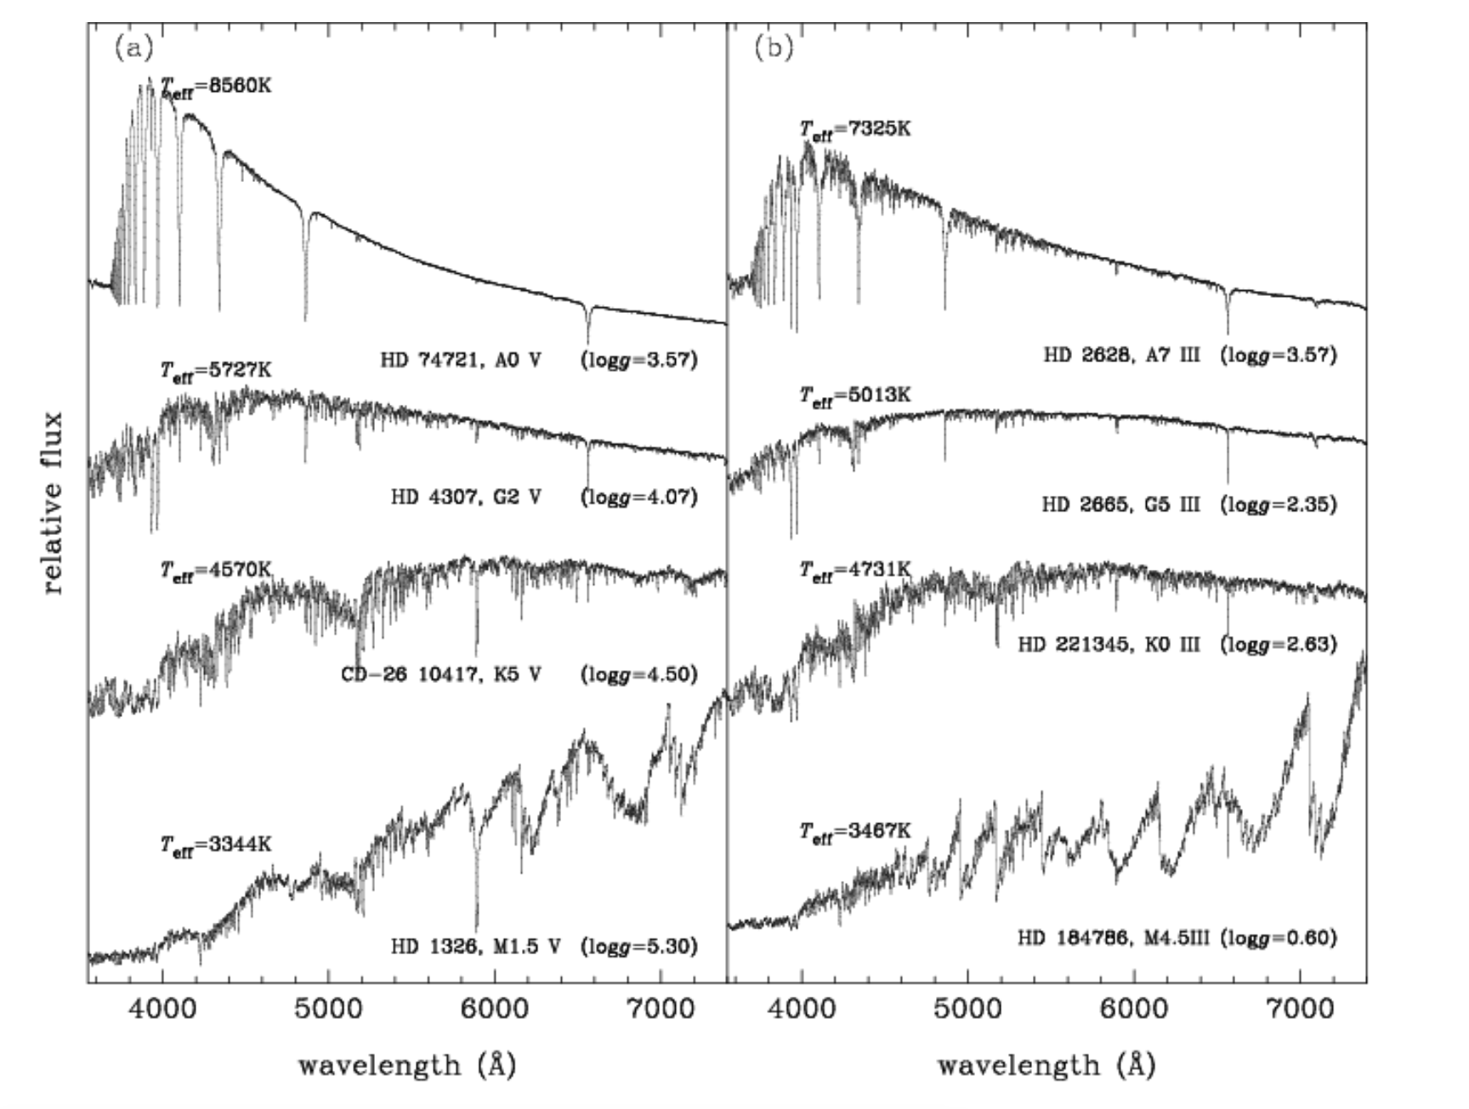
Datasets: Stellar Spectral Dataset
Empirical Stellar Spectra
801 stars from the Medium resolution Isaac Newton Library of Empirical Spectra (MILES) (Sánchez-Blázquez et al. 2006, FalcÓn-Barroso et al. 2011)
Milky Way stars with Effective Temperature, Surface Gravity, [Fe/H] and [Mg/Fe] measured
λ=3500–7500Å, FWHM=2.5Å, S/N ratio approx. over 100${\text{Å}}^{−1}$, all stars normalised with uniformly calibrated flux
Useful for determining stellar parameters like effective temperature and surface gravity through template matching.
Sánchez-Blázquez P. , et al., 2006, MNRAS , 371, 703
FalcÓn-Barroso J., et al., 2011, A&A , 532, 95
STFC Summer School 2024
Notes:
Effective Temperature
Surface Gravity
[Fe/H] – spectroscopic metallicity
[α/Fe] – α abundances in relation to iron
Probably need to define the square bracket notation (e.g. abundances relative to the Sun -
http://astro.vaporia.com/start/bracketnotation.html)
These are the parameters of the individual stars in the library
A stellar library is a collection of spectra of individual stars. It is a general tool in astronomy and is used by astronomers working on a wide variety of scientific topics, including exoplanets, stellar astrophysics, galactic and extragalactic astronomy, and cosmology.
Empirical stellar spectral libraries are one of the most universally applicable tools in modern astronomy. They have applications in both extragalactic and stellar studies. The former include the modelling of unresolved stellar populations of distant galaxies and are used as templates to measure the stellar velocity dispersions in galaxies (gives you an estimate of their mass) as well as their constitute stellar population properties. These stellar population properties can provide clues about how that galaxy formed. The stellar applications include measuring stellar parameters such as effective temperatures and surface by template matching.
This Milky Way star data set here come from one of the most popular observed stellar libraries – The Medium resolution Isaac Newton Library of Empirical Spectra (MILES). See this website - http://miles.iac.es/ for further details
The observations were taken at the Isaac Newton Group of Telescope on La Palma and consists of ~1000 stars that have measured atmospheric stellar parameters of effective temperature, surface gravity, metallicity [Fe/H] and α element abundances (here [Mg/Fe] is used as a proxy for all α elements – they tend to all be approx. the same)
The atmospheric parameters of [Fe/H] (metallicity) and [α/Fe] (α-process elements (O, Ne, Mg, Si, S, Ar, Ca) are particularly useful for probing the formation histories of galaxies. Such patterns are intimately linked to the Star Formation History experienced by a galaxy, as dying stars release their freshly-forged elements in characteristic time scales that depend on their masses. It provides a probe of Galactic Chemical Evolution.
This is due to the different nucleosynthetic sources of enrichment of these element groups.
Iron peak elements tend to enrich the interstellar medium through Type Ia supernovae over long time periods (Gyrs) and α elements originate from Type II supernovae over shorter time periods (Myrs).
These parameters ([α/Fe] vs [Fe/H]) can be used to identify different clusters and populations of stars within the Milky Way (The thick disk have high α abundances, low [Fe/H] and the thin disk has low [α/Fe], solar [Fe/H]). The same type of analysis can then be done for external galaxies to investigate their formation histories.
For further info see these resources:
https://ned.ipac.caltech.edu/level5/March03/McWilliam/McWilliam6.html#6.1
http://astro.vaporia.com/start/alphafehfediagram.html
https://dictionary.obspm.fr/index.php?showAll=1&formSearchTextfield=alpha+element
https://galaxiesbook.org/chapters/II-05.-Chemical-Evolution.html
https://arxiv.org/pdf/2102.04561
What is a Stellar Library?
A stellar library is a collection of spectra of individual stars.
It is a crucial tool in astronomy used across various scientific fields like exoplanets, stellar astrophysics, galactic and extragalactic astronomy, and cosmology.
Applications of Stellar Libraries:
Extragalactic Studies:
Modeling unresolved stellar populations in distant galaxies.
Measuring stellar velocity dispersions to estimate galaxy mass and understand their formation histories.
Stellar Studies:
Determining stellar parameters like effective temperature and surface gravity through template matching.

Slide 8
Datasets: Stellar Spectral Dataset
Key Parameters in Stellar Libraries
Effective Temperature, T_eff: Indicates the surface temperature of a star.
Surface Gravity, log g: Measures the gravitational pull at the surface of a star.
Metallicity [Fe/H]: Represents the abundance of iron compared to hydrogen. Defined using square bracket notation relative to the Sun.
Alpha Abundance [α/Fe]: Represents the abundance of alpha elements like oxygen, magnesium, silicon, etc., relative to iron.
Importance of [Fe/H] and [α/Fe] in Galactic Studies:
help trace the formation and evolutionary history of galaxies.
([Fe/H] Enriched via Type Ia supernovae over long periods (Gyrs).
[α/Fe] Enriched via Type II supernovae over shorter periods (Myrs).
Thick Disk Stars: High [α/Fe], low [Fe/H].
Thin Disk Stars: Low [α/Fe], solar [Fe/H].
Analysing these parameters helps identify different star clusters and populations within the Milky Way and other galaxies.
STFC Summer School 2024
Notes:
he parameters [Fe/H] (metallicity) and [α/Fe] (alpha element abundance) provide crucial insights into the formation and evolutionary history of galaxies through the study of stellar populations. Here's how these parameters can help:
Metallicity ([Fe/H])
Definition: [Fe/H] is the logarithmic measure of a star's iron abundance relative to hydrogen, compared to the Sun.
Significance:
Chemical Enrichment: A higher [Fe/H] value indicates a greater presence of iron, suggesting that the star formed later in the galaxy's history after multiple generations of stars had lived and died, enriching the interstellar medium with heavy elements through supernova explosions.
Chronology: Stars with low [Fe/H] are older and formed in the early galaxy when the interstellar medium had less heavy element enrichment. Conversely, stars with high [Fe/H] are younger and formed when the interstellar medium was more enriched with metals.
Alpha Element Abundance ([α/Fe])
Definition: [α/Fe] measures the abundance of alpha elements (e.g., O, Ne, Mg, Si, S, Ar, Ca) relative to iron.
Significance:
Supernova Contributions: Alpha elements are primarily produced in Type II supernovae (massive stars that explode relatively quickly after formation), while iron is produced in both Type II and Type Ia supernovae (older stars that explode after a longer period).
Star Formation Rates: A high [α/Fe] ratio indicates that the star formed during a period of rapid star formation, where Type II supernovae dominated the chemical enrichment before Type Ia supernovae could contribute significantly to iron levels.
Galactic Evolution: By examining the [α/Fe] ratio, astronomers can infer the star formation history and chemical evolution of different parts of a galaxy. For instance, a high [α/Fe] in the thick disk stars suggests a rapid early star formation period, while a lower [α/Fe] in the thin disk stars indicates a more prolonged star formation history.
Combining [Fe/H] and [α/Fe]
Formation Histories: The combination of [Fe/H] and [α/Fe] allows astronomers to trace the formation and evolutionary history of galaxies. Different populations of stars with varying [Fe/H] and [α/Fe] ratios reveal the timeline of star formation and chemical enrichment events.
Galactic Structure: These parameters help differentiate between different structural components of galaxies, such as the thin disk, thick disk, bulge, and halo, each having distinct formation histories.
Comparative Analysis: By comparing the [Fe/H] and [α/Fe] distributions in different galaxies, astronomers can study the universality and diversity of galaxy formation processes.
Example: Milky Way
In the Milky Way, stars in the thick disk generally have higher [α/Fe] ratios and lower [Fe/H] values, indicating they formed early in the galaxy’s history during a period of rapid star formation. In contrast, thin disk stars have lower [α/Fe] ratios and higher [Fe/H] values, suggesting a slower, more extended period of star formation. This analysis helps to reconstruct the sequence of events in the galaxy’s formation and evolution.
Conclusion
In summary, the parameters [Fe/H] and [α/Fe] are powerful tools in astrophysics, providing detailed insights into the processes of star formation, chemical enrichment, and the evolutionary pathways of galaxies. By studying these parameters, astronomers can piece together the history of galaxies, enhancing our understanding of the universe.

Slide 9
Datasets: Variety of Democracy (VDEM)
What is V-Dem - Varieties of Democracy?
V-Dem is a research project and dataset that measures and analyses democracy worldwide. Provides nuanced and detailed data on various aspects of democracy for most countries over an extended period - from the early 20th century to the present.
Key Features:
Over 450 indicators covering different dimensions of democracy, such as electoral democracy, liberal democracy, participatory democracy, deliberative democracy, and egalitarian democracy.
Data collection is based on expert surveys, where country experts rate various aspects of democracy.
Examples of indicators:
Electoral Integrity: measures the extent to which elections are free and fair, including factors like transparency, impartiality of electoral management bodies, and the absence of electoral fraud or coercion.
Freedom of the Press: measures the extent to which journalists can operate independently, without censorship or interference, reflecting the level of media freedom and pluralism within a country.
Dataset
Each row of table is a country and each column an indicator converted to continuous variables
STFC Summer School 2024
Notes:
he parameters [Fe/H] (metallicity) and [α/Fe] (alpha element abundance) provide crucial insights into the formation and evolutionary history of galaxies through the study of stellar populations. Here's how these parameters can help:
Metallicity ([Fe/H])
Definition: [Fe/H] is the logarithmic measure of a star's iron abundance relative to hydrogen, compared to the Sun.
Significance:
Chemical Enrichment: A higher [Fe/H] value indicates a greater presence of iron, suggesting that the star formed later in the galaxy's history after multiple generations of stars had lived and died, enriching the interstellar medium with heavy elements through supernova explosions.
Chronology: Stars with low [Fe/H] are older and formed in the early galaxy when the interstellar medium had less heavy element enrichment. Conversely, stars with high [Fe/H] are younger and formed when the interstellar medium was more enriched with metals.
Alpha Element Abundance ([α/Fe])
Definition: [α/Fe] measures the abundance of alpha elements (e.g., O, Ne, Mg, Si, S, Ar, Ca) relative to iron.
Significance:
Supernova Contributions: Alpha elements are primarily produced in Type II supernovae (massive stars that explode relatively quickly after formation), while iron is produced in both Type II and Type Ia supernovae (older stars that explode after a longer period).
Star Formation Rates: A high [α/Fe] ratio indicates that the star formed during a period of rapid star formation, where Type II supernovae dominated the chemical enrichment before Type Ia supernovae could contribute significantly to iron levels.
Galactic Evolution: By examining the [α/Fe] ratio, astronomers can infer the star formation history and chemical evolution of different parts of a galaxy. For instance, a high [α/Fe] in the thick disk stars suggests a rapid early star formation period, while a lower [α/Fe] in the thin disk stars indicates a more prolonged star formation history.
Combining [Fe/H] and [α/Fe]
Formation Histories: The combination of [Fe/H] and [α/Fe] allows astronomers to trace the formation and evolutionary history of galaxies. Different populations of stars with varying [Fe/H] and [α/Fe] ratios reveal the timeline of star formation and chemical enrichment events.
Galactic Structure: These parameters help differentiate between different structural components of galaxies, such as the thin disk, thick disk, bulge, and halo, each having distinct formation histories.
Comparative Analysis: By comparing the [Fe/H] and [α/Fe] distributions in different galaxies, astronomers can study the universality and diversity of galaxy formation processes.
Example: Milky Way
In the Milky Way, stars in the thick disk generally have higher [α/Fe] ratios and lower [Fe/H] values, indicating they formed early in the galaxy’s history during a period of rapid star formation. In contrast, thin disk stars have lower [α/Fe] ratios and higher [Fe/H] values, suggesting a slower, more extended period of star formation. This analysis helps to reconstruct the sequence of events in the galaxy’s formation and evolution.
Conclusion
In summary, the parameters [Fe/H] and [α/Fe] are powerful tools in astrophysics, providing detailed insights into the processes of star formation, chemical enrichment, and the evolutionary pathways of galaxies. By studying these parameters, astronomers can piece together the history of galaxies, enhancing our understanding of the universe.

Slide 10
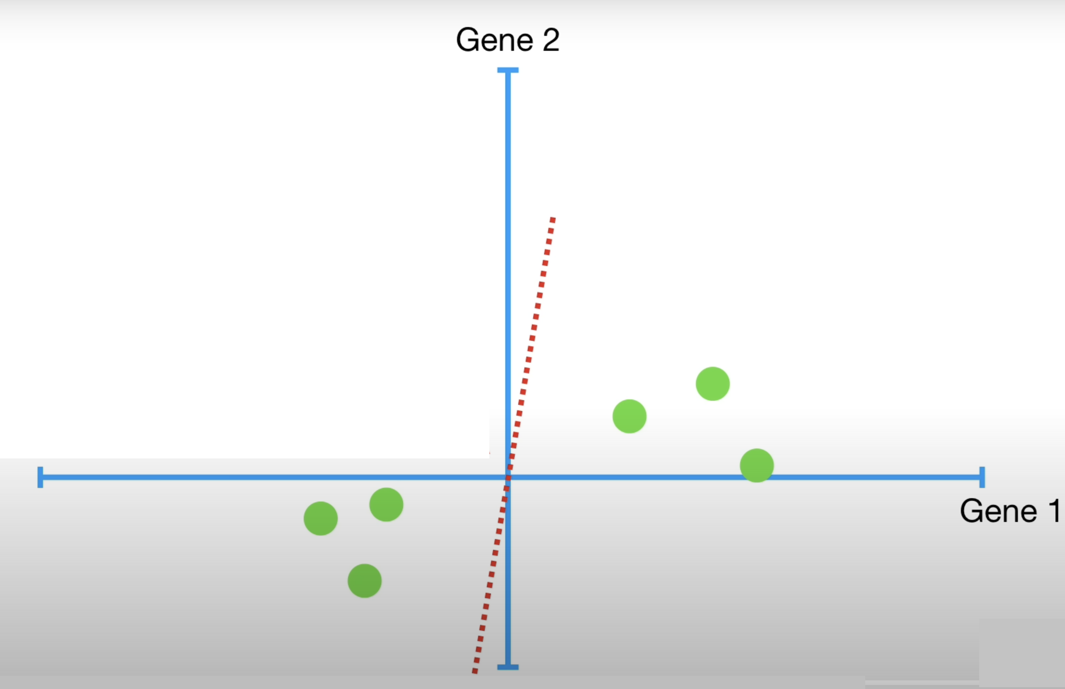
Principle Component Analysis (PCA)
Step 1: Centre / normalise the data
Step 2: Find the line of best fit
Draw random line through origin
Credit figure : StatQuest (www.statquest.org, www.youtube.com@statquest)
Notes:
Step 1: Centre / normalize the data, i.e., for each dimension (column) subtract the mean and divide by the standard deviation
Step 2: Find the best fit line to the data.
To do this, draw a random line that goes through the origin

Slide 11
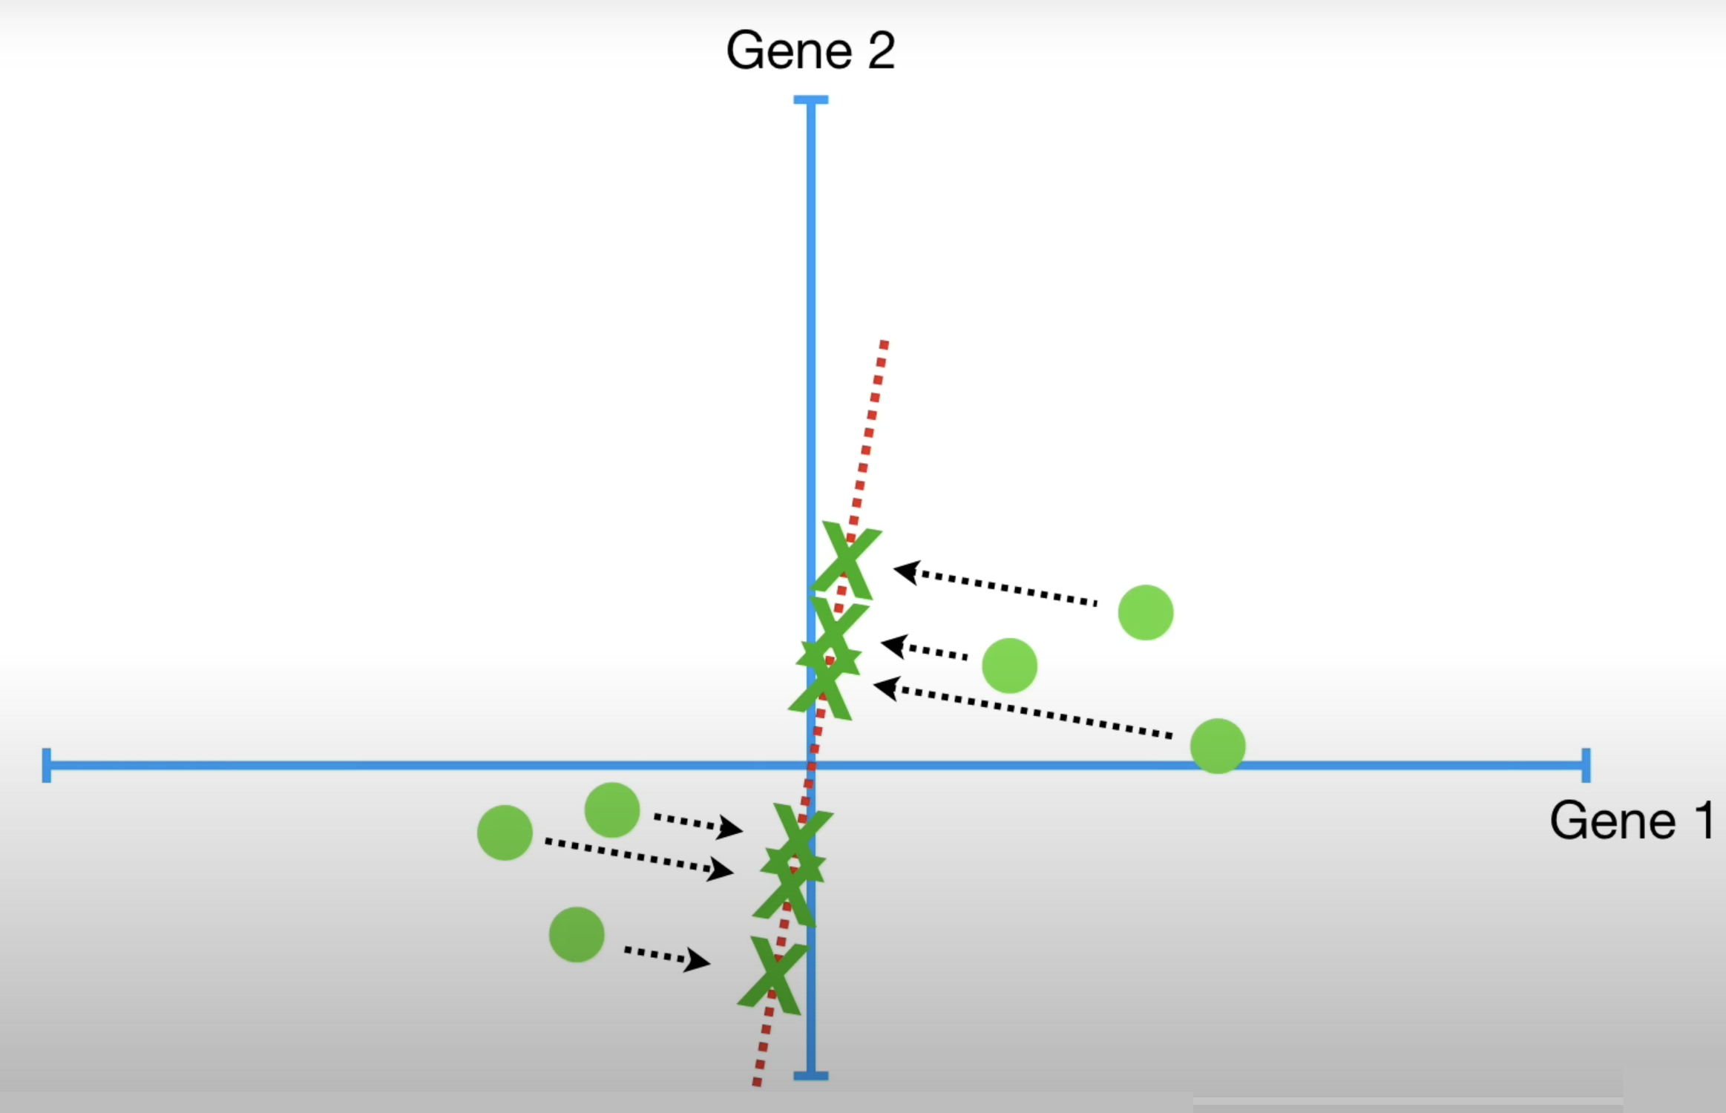
Principle Component Analysis (PCA)
Step 1: Centre / normalise the data
Step 2: Find the line of best fit to the data
Draw random line through origin
Project data points onto line
Credit figure : StatQuest (www.statquest.org, www.youtube.com@statquest)
Notes:
Then project the data points onto the line

Slide 12
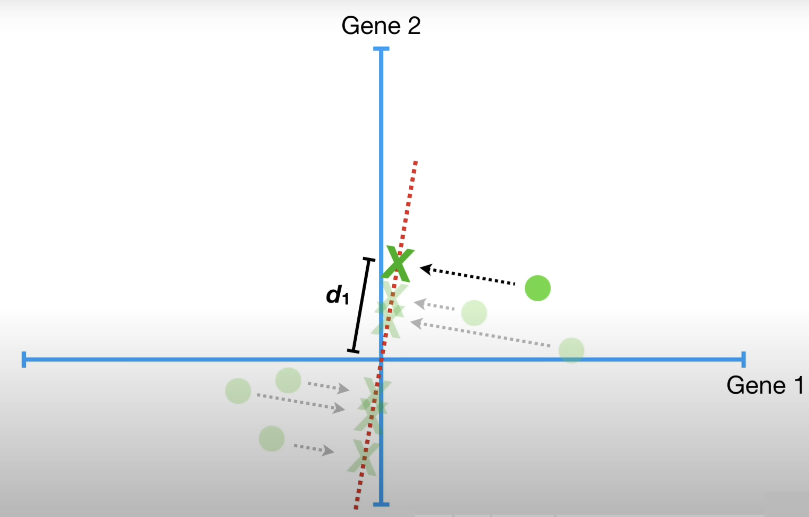
Principle Component Analysis (PCA)
Step 1: Centre / normalise the data
Step 2: Find the line of best fit to the data
Draw random line through origin
Project data points onto line
Calculate the distance from each projected point to the origin
Calculate the sum of the square of each distance
Credit figure : StatQuest (www.statquest.org, www.youtube.com@statquest)
Notes:
Calculate the distance from each projected point to the origin, then calculate the sum of the square of the distances

Slide 13
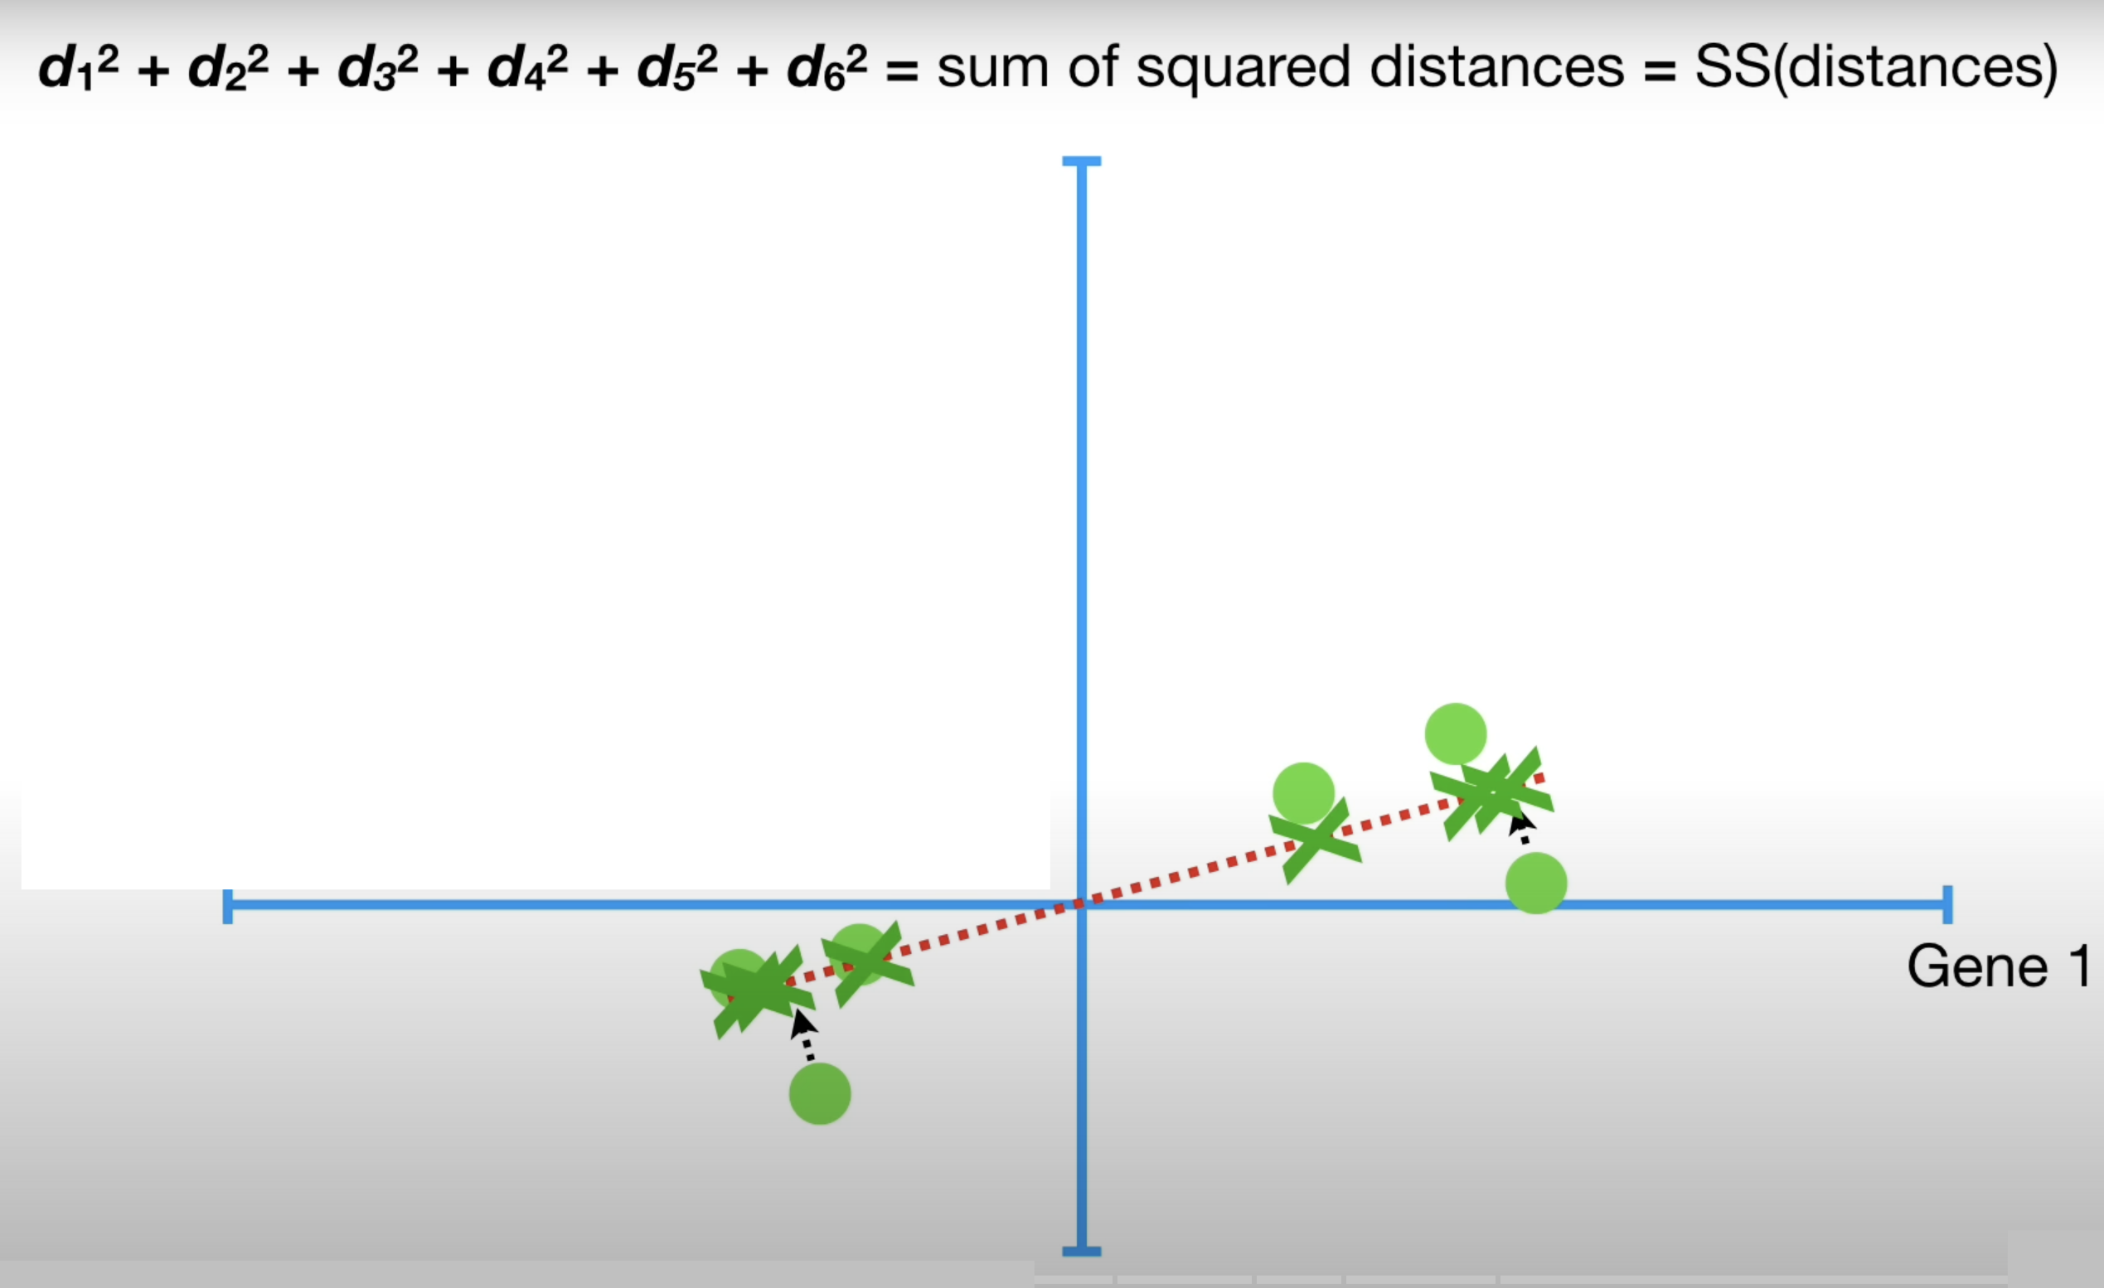
Principle Component Analysis (PCA)
Step 1: Centre / normalise the data
Step 2: Find the line of best fit to the data
Draw random line through origin
Project data points onto line
Calculate the distance from each projected point to the origin
Calculate the sum of the square of each distance
Line which maximises SSD is our best fitting line
Line of best fit maximises
d₁
Credit figure : StatQuest (www.statquest.org, www.youtube.com@statquest)
Notes:
Step 1: Centre / normalize the data, i.e., for each dimension (column) subtract the mean and divide by the standard deviation
Step 2: Find the best fit line to the data.
To do this, draw a random line that goes through the origin

Slide 14
Principle Component Analysis (PCA)
Step 1: Centre / normalise the data
Step 2: Find the line of best fit to the data
Step 3: Define Principal Component 1, Eigenvector and Eigenvalue
This line is called Principal Component 1 (PC1 for short)
Principal Component 1 (PC1 for short)
Credit figure : StatQuest (www.statquest.org, www.youtube.com@statquest)
Notes:
Step 1: Centre / normalize the data, i.e., for each dimension (column) subtract the mean and divide by the standard deviation
Step 2: Find the best fit line to the data.
To do this, draw a random line that goes through the origin

Slide 15
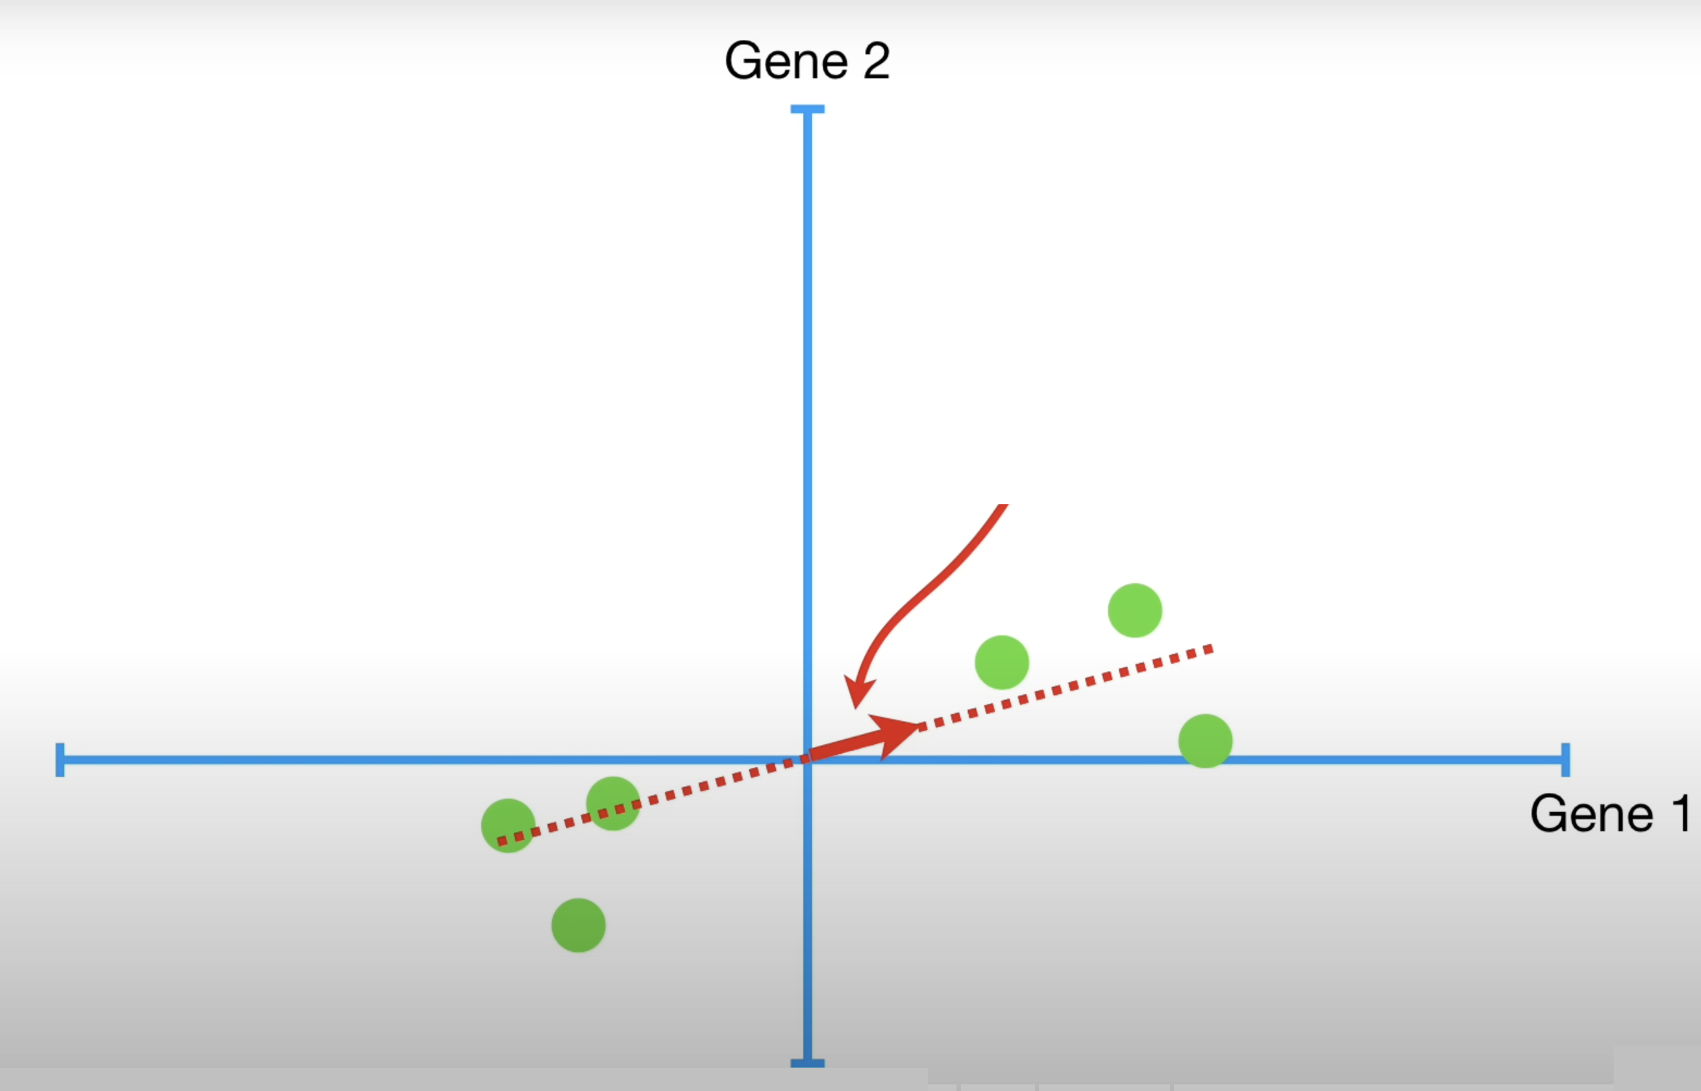
Principle Component Analysis (PCA)
Step 1: Centre / normalise the data
Step 2: Find the line of best fit to the data
Step 3: Define Principal Component 1, Eigenvector and Eigenvalue
This line is called Principal Component 1 (PC1 for short)
Eigenvector for PC1 = unit vector in direction of PC1
Eigenvector for PC1
Credit figure: StatQuest (www.statquest.org, www.youtube.com@statquest)
Notes:
Step 1: Centre / normalize the data, i.e., for each dimension (column) subtract the mean and divide by the standard deviation
Step 2: Find the best fit line to the data.
To do this, draw a random line that goes through the origin

Slide 16
Principle Component Analysis (PCA)
Step 1: Centre / normalise the data
Step 2: Find the line of best fit to the data
Step 3: Define Principal Component 1, Eigenvector and Eigenvalue
This line is called Principal Component 1 (PC1 for short)
Eigenvector for PC1 = unit vector in direction of PC1
Eigenvalue for PC1 = average SS(distances for PC1)
Eigenvalue for PC1 is the average of SS(distances) for PC1
$\frac{SS(distances for PC1)}{n−1}$ = Eigenvalue for PC1
Eigenvalue may be described as a measure of variance (spread)
Eigenvector for PC1
d₁
Credit figure: StatQuest (www.statquest.org, www.youtube.com@statquest)
Notes:
Step 1: Centre / normalize the data, i.e., for each dimension (column) subtract the mean and divide by the standard deviation
Step 2: Find the best fit line to the data.
To do this, draw a random line that goes through the origin

Slide 17
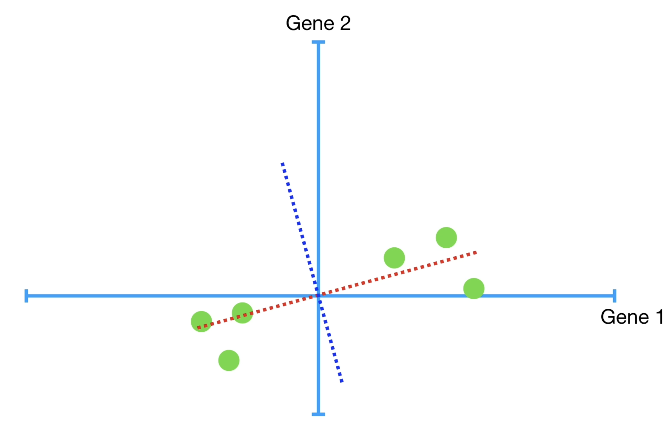
Principle Component Analysis (PCA)
Step 1: Centre / normalise the data
Step 2: Find the line of best fit to the data
Step 3: Define Principal Component 1, Eigenvector and Eigenvalue
Step 4: Define Principal Component 2, eigenvector and eigenvalue
PC2 = next best fitting line through the origin
PC2 = perpendicular to PC1
Principal Component 2 (PC2)
Credit figure: StatQuest (www.statquest.org, www.youtube.com@statquest)
Notes:
Step 1: Centre / normalize the data, i.e., for each dimension (column) subtract the mean and divide by the standard deviation
Step 2: Find the best fit line to the data.
To do this, draw a random line that goes through the origin

Slide 18
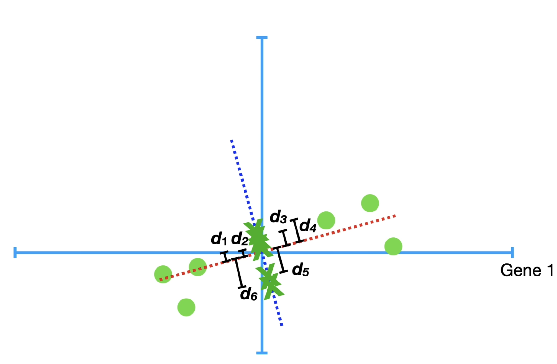
Principle Component Analysis (PCA)
Step 1: Centre / normalise the data
Step 2: Find the line of best fit to the data
Step 3: Define Principal Component 1, Eigenvector and Eigenvalue
Step 4: Define further PCs, eigenvectors and eigenvalues
PC2 = next best fitting line through the origin
PC2 = perpendicular to PC1
Eigenvector and eigenvector for PC2 defines similarly to PC1
$\frac{SS(distances for PC2)}{n−1}$ = Eigenvalue for PC2
Principal Component 2 (PC2)
Eigenvector for PC2
Credit figure: StatQuest (www.statquest.org, www.youtube.com@statquest)
Notes:
Step 1: Centre / normalize the data, i.e., for each dimension (column) subtract the mean and divide by the standard deviation
Step 2: Find the best fit line to the data.
To do this, draw a random line that goes through the origin

Slide 19
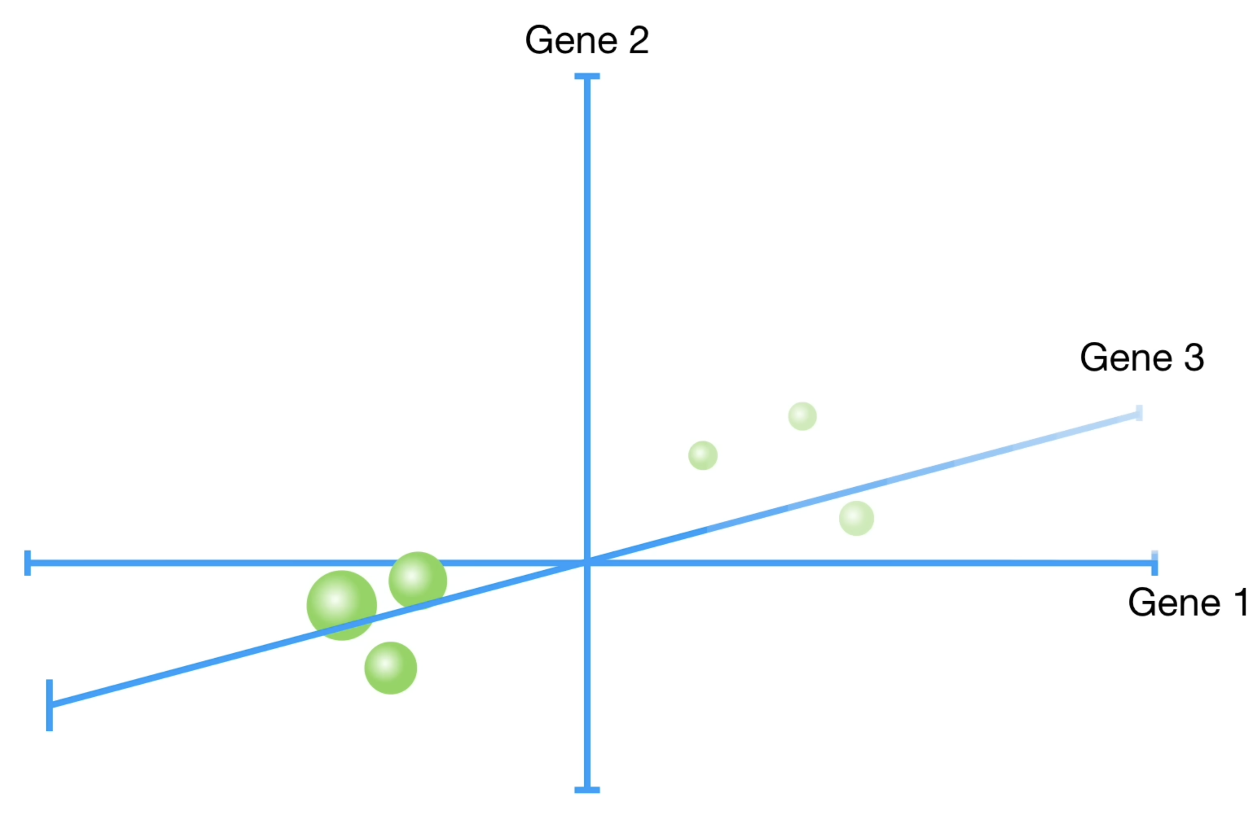
Principle Component Analysis (PCA)
Step 1: Centre / normalise the data
Step 2: Find the line of best fit to the data
Step 3: Define Principal Component 1, Eigenvector and Eigenvalue
Step 4: Define Principal Component 2, eigenvector and eigenvalue
PC2 = next best fitting line through the origin
PC2 = perpendicular to PC1
Eigenvector and eigenvector for PC2 defines similarly to PC1
Method extends to further dimension
Credit figure: StatQuest (www.statquest.org, www.youtube.com@statquest)
Notes:
Step 1: Centre / normalize the data, i.e., for each dimension (column) subtract the mean and divide by the standard deviation
Step 2: Find the best fit line to the data.
To do this, draw a random line that goes through the origin

Slide 20
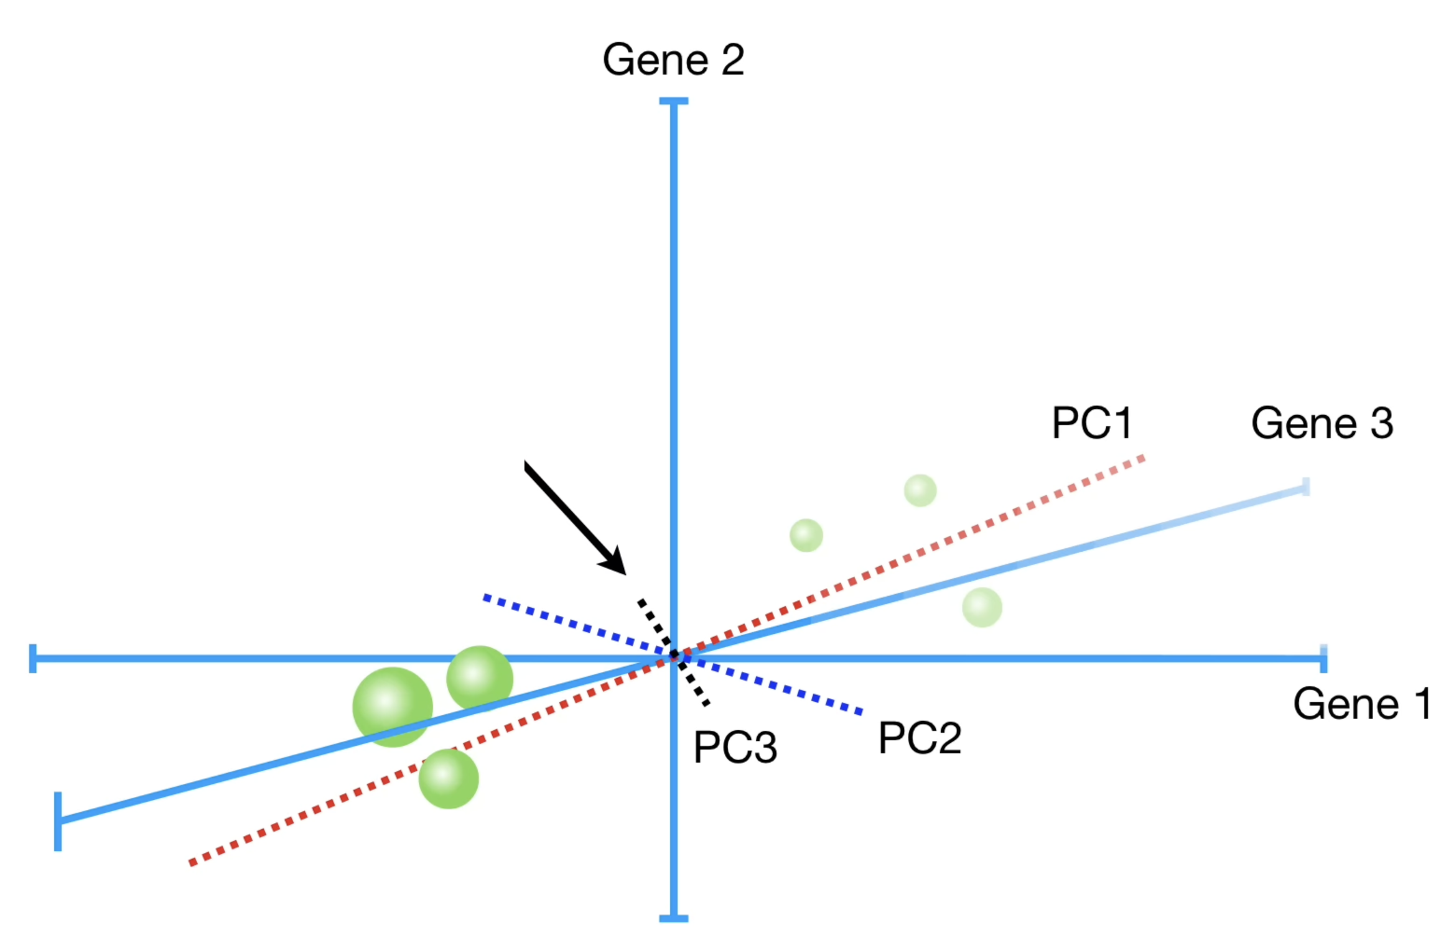
Principle Component Analysis (PCA)
Step 1: Centre / normalise the data
Step 2: Find the line of best fit to the data
Step 3: Define Principal Component 1, Eigenvector and Eigenvalue
Step 4: Define Principal Component 2, eigenvector and eigenvalue
PC2 = next best fitting line through the origin
PC2 = perpendicular to PC1
Eigenvector and eigenvector for PC2 defines similarly to PC1
Method extends to further dimension
PC3 = next best fitting line through the origin
PC3 = perpendicular to PC1 and PC2
…
Number of principal components = number of dimensions
Principal Component 3 (PC3)
Credit figure: StatQuest (www.statquest.org, www.youtube.com@statquest)
Notes:
Step 1: Centre / normalize the data, i.e., for each dimension (column) subtract the mean and divide by the standard deviation
Step 2: Find the best fit line to the data.
To do this, draw a random line that goes through the origin

Slide 21
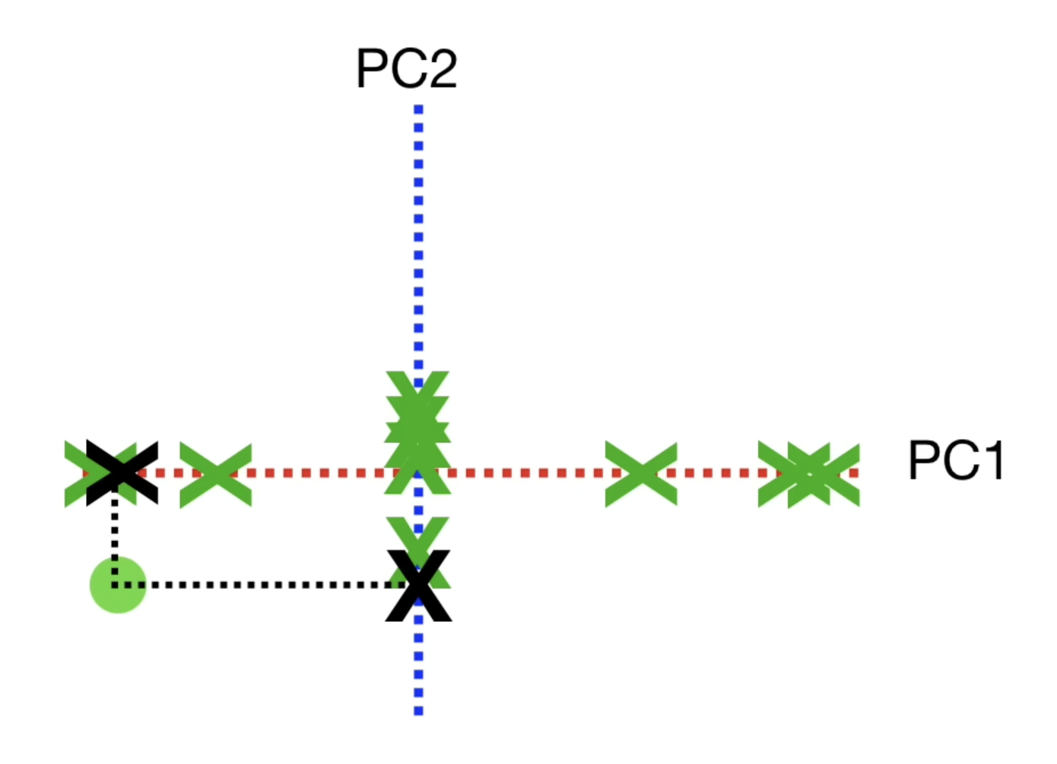
Principle Component Analysis (PCA)
Step 1: Centre / normalise the data
Step 2: Find the line of best fit to the data
Step 3: Define Principal Component 1, Eigenvector and Eigenvalue
Step 4: Define further Principal Components, eigenvectors and eigenvalues
Step 5: Reduce dimensions by plotting the PCs that account for the greatest amount of variance – largest eigenvalues.
PC1 and PC2 have highest eigenvalues
Use the projected points to find where the samples go in PCA space
Credit figure: StatQuest (www.statquest.org, www.youtube.com@statquest)
Notes:
Step 1: Centre / normalize the data, i.e., for each dimension (column) subtract the mean and divide by the standard deviation
Step 2: Find the best fit line to the data.
To do this, draw a random line that goes through the origin

Slide 22
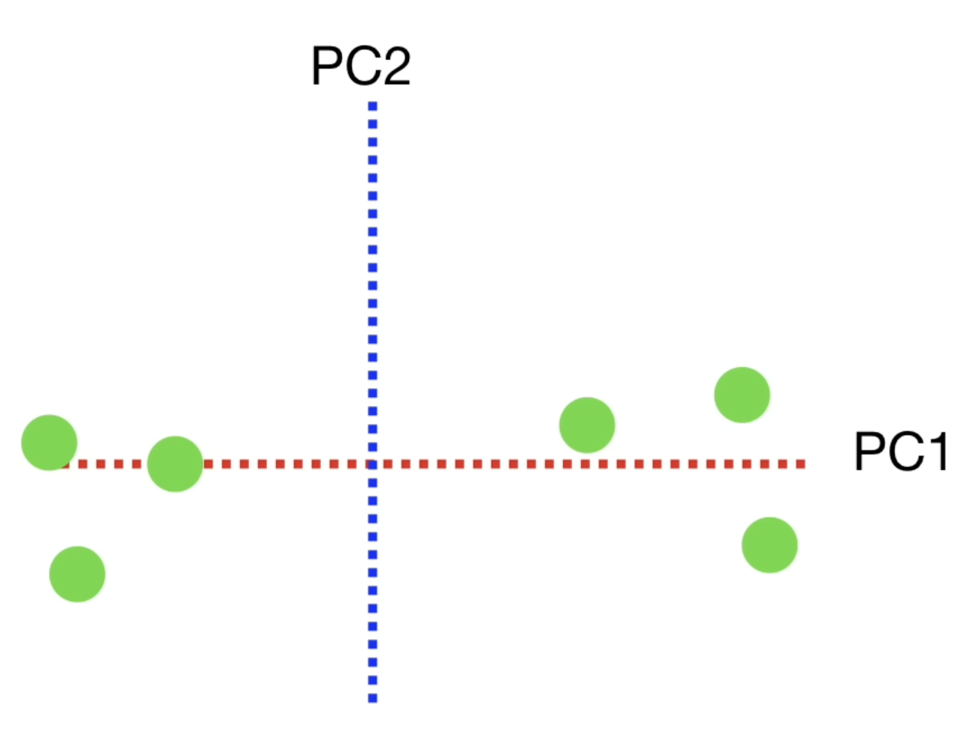
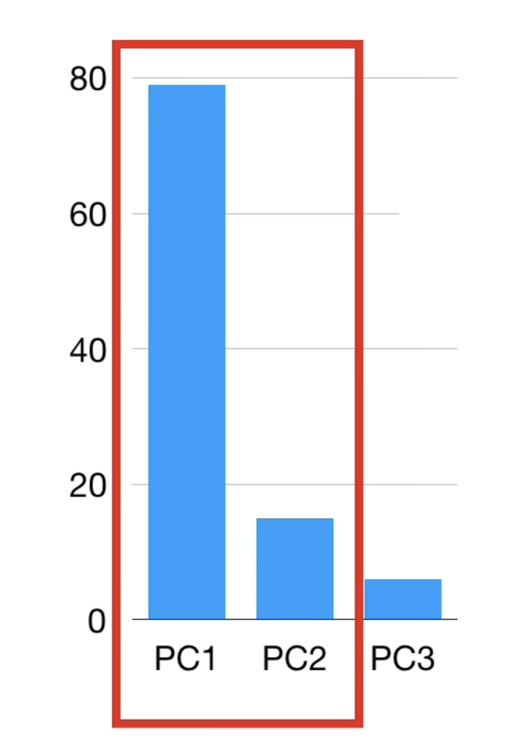
Principle Component Analysis (PCA)
Step 1: Centre / normalise the data
Step 2: Find the line of best fit to the data
Step 3: Define Principal Component 1, Eigenvector and Eigenvalue
Step 4: Define further Principal Components, eigenvectors and eigenvalues
Step 5: Reduce dimensions by plotting the PCs that account for the greatest amount of variance – largest eigenvalues.
PC1 and PC2 have highest eigenvalues
Use the projected points to find where the samples go in PCA space
Credit figure: StatQuest (www.statquest.org, www.youtube.com@statquest)
Notes:
Step 1: Centre / normalize the data, i.e., for each dimension (column) subtract the mean and divide by the standard deviation
Step 2: Find the best fit line to the data.
To do this, draw a random line that goes through the origin

Slide 23
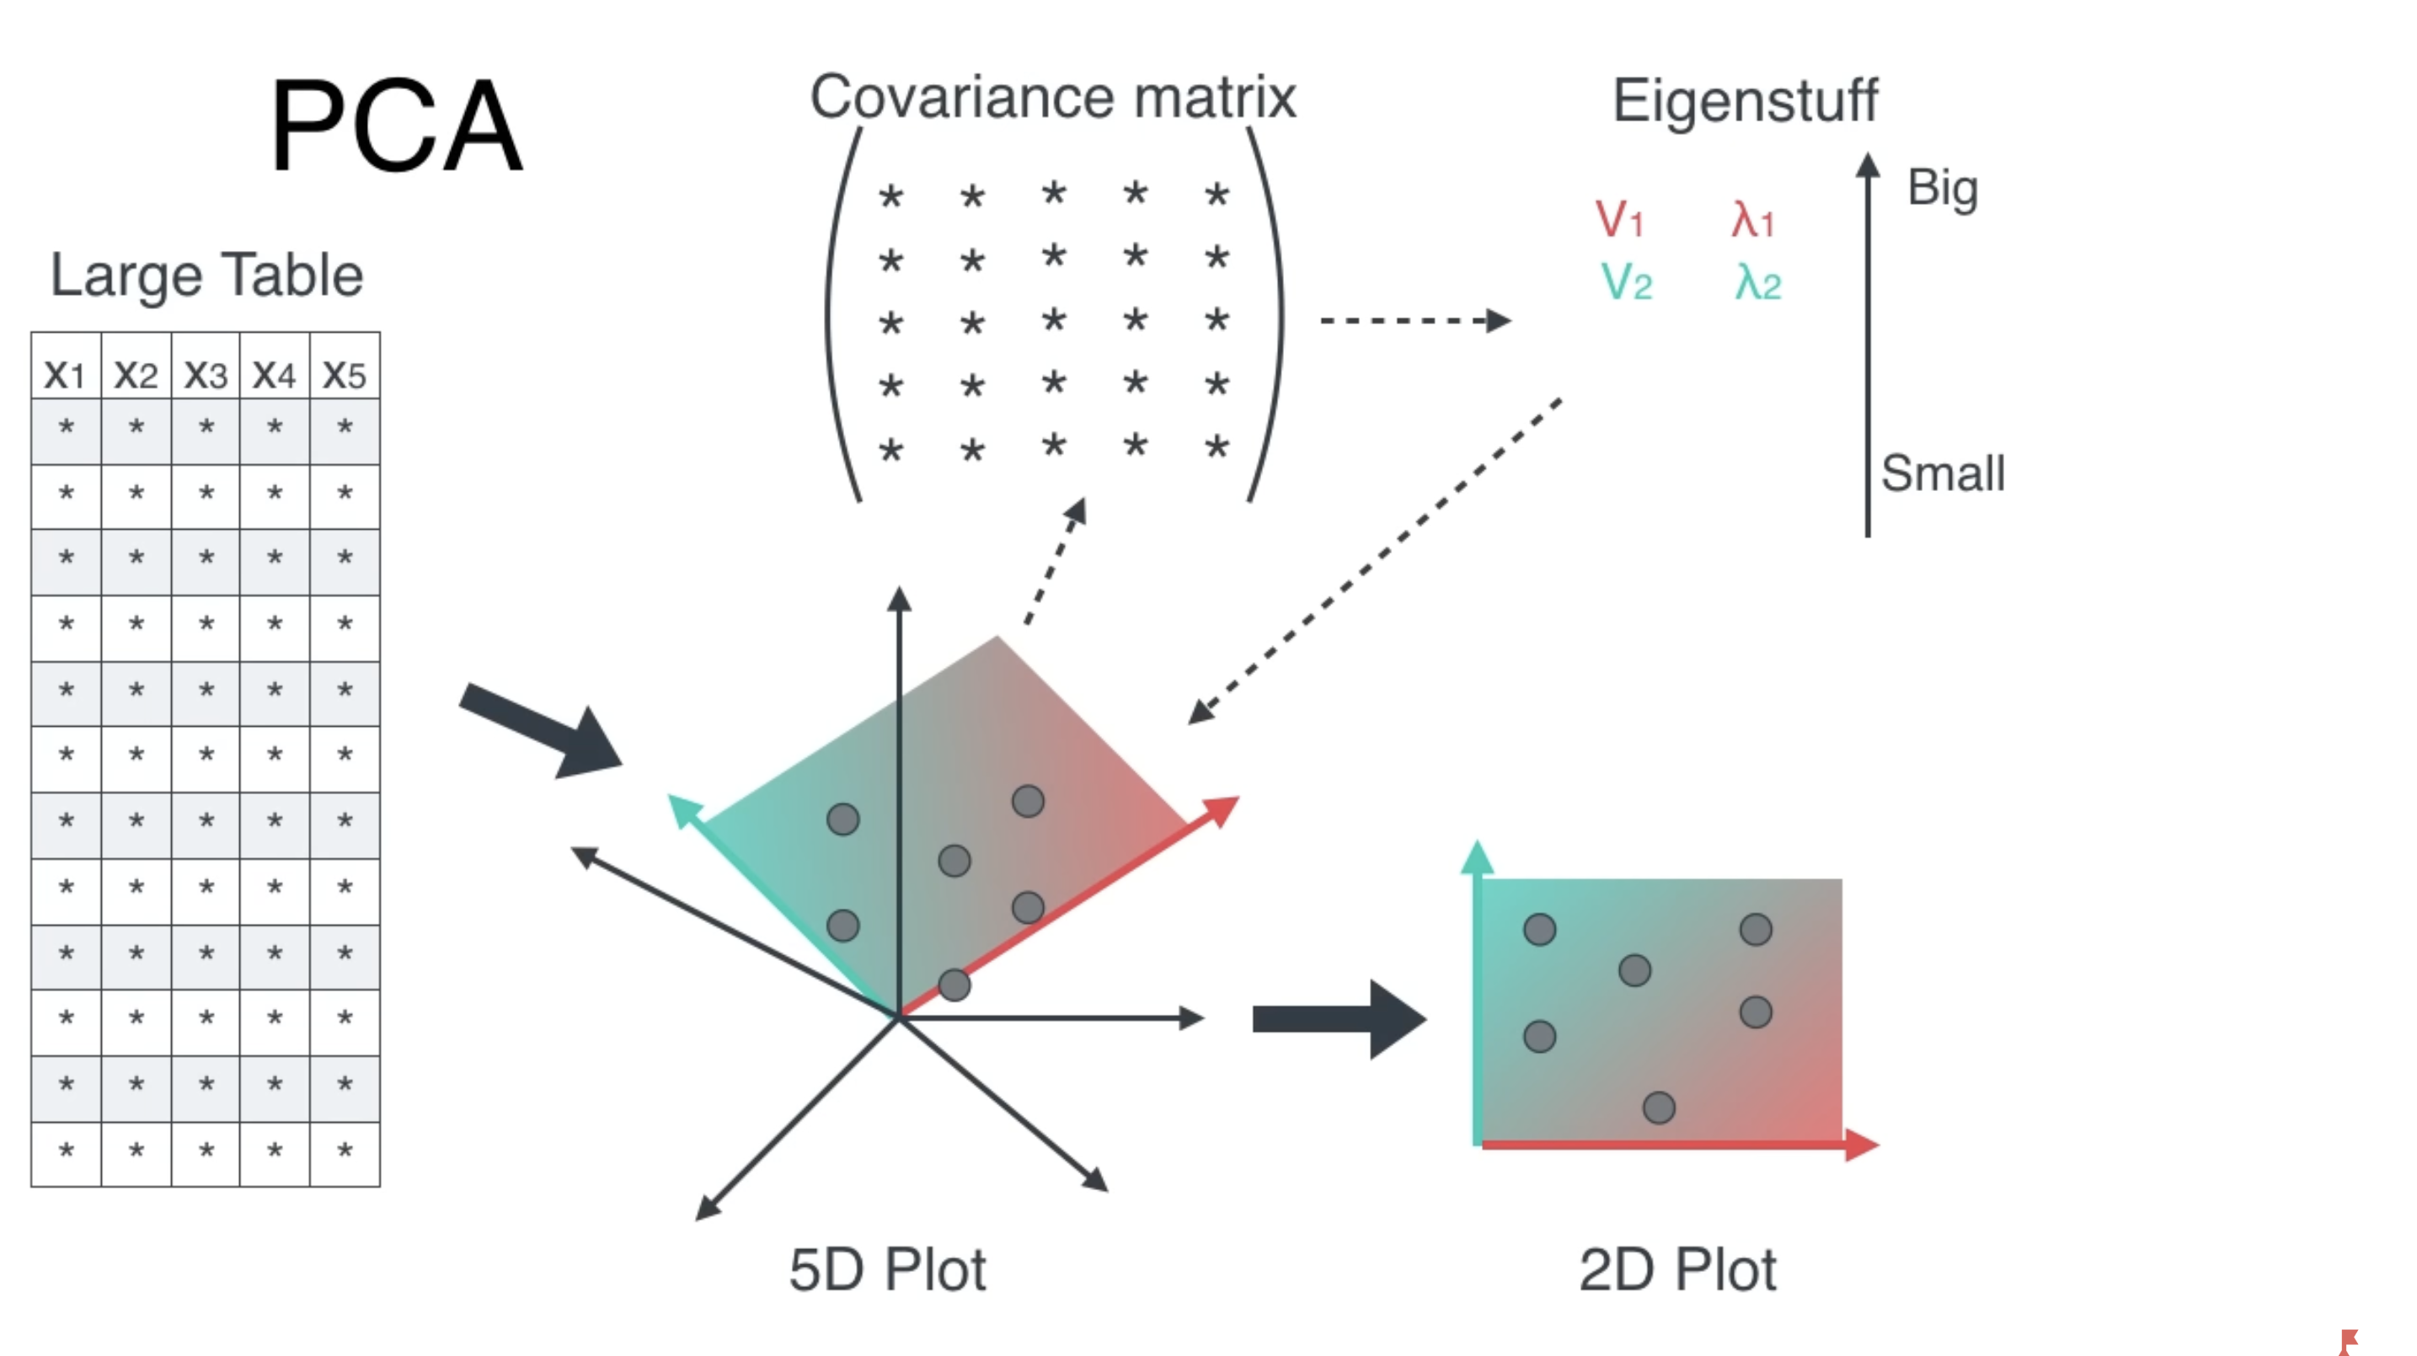
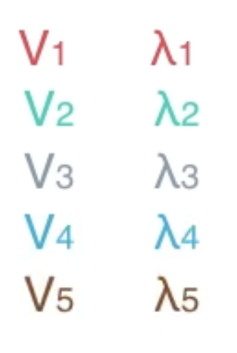
Principle Component Analysis (PCA)
A
$$A∙v=λ∙v$$
Eigenvectors Eigenvalues
Credit figure: Serrano Academy (www.youtube.com/@SerranoAcademy)
STFC Summer School 2024

Slide 24
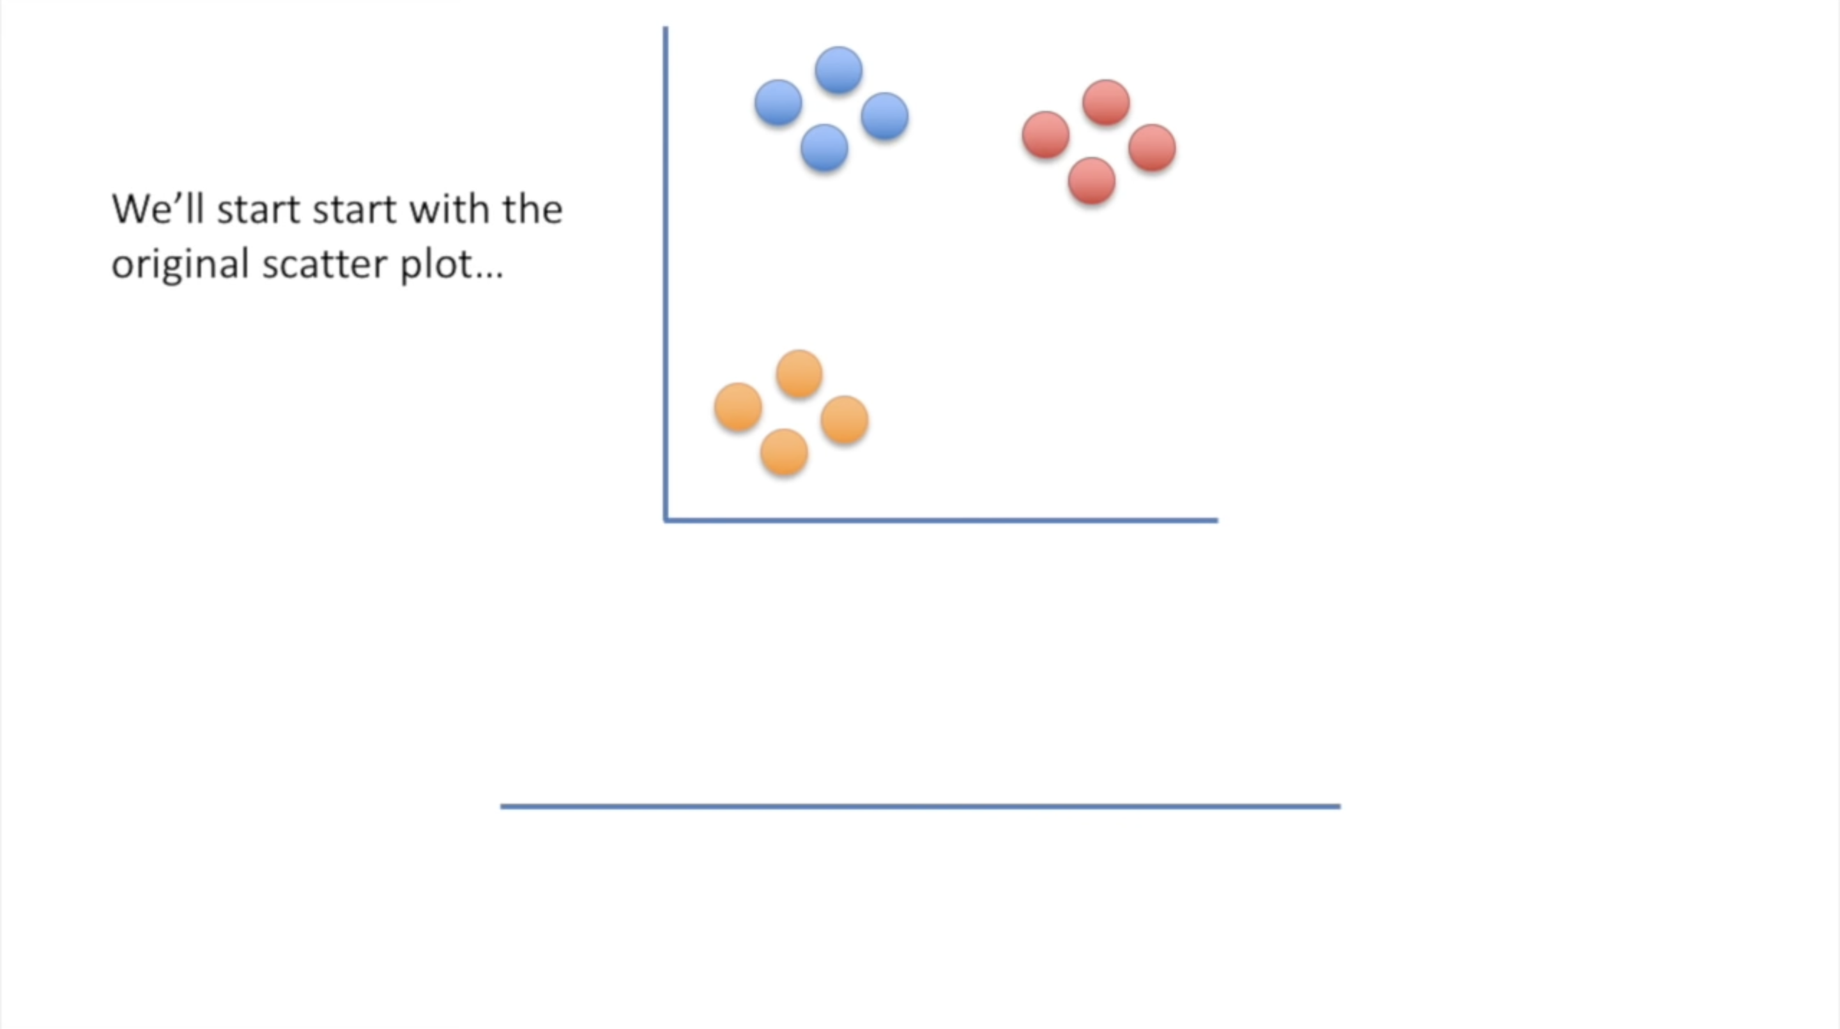
T-distributed Stochastic Neighbourhood Embedding
Credit figure: StatQuest (www.statquest.org, www.youtube.com@statquest)
STFC Summer School 2024
Notes:
Slide 1: Have high dimensional space, corresponding low dimensional space points are initially positioned randomly. Let’s use a very simple example, 2D to 1D.
Slide 2: During each iteration T_SNE makes small adjustments to the positions of each data point in lower dimensional space such that points that are close together in high dimensional space are moved together in their lower dimensional representation (attraction), while points that are far apart in higher dimensional space are moved farther apart in their lower dimensional representation (repulsion between points).
Slide 3: Eventually points that are clustered in high dimensionality space will be cluster in the low dimensional representation, this can of course be extended to much higher dimensions
Slide 4: t-SNE does this in a vary mathy way.
Given a set of data (x_i’s to x_n) in high dimensional space,
It starts by asking the question, given a data point x_i what’s the probability it would pick x_j as its neigbour?
It will be some function of distance between the data two data points P_(j|i) such that the closer the points are the higher its value, the farther away they are the lower the value.
The function should also depend on the proximity of all other data points, because one of those may be much closer.
The function should be such that if d_ij gets larger the function should get smaller, while if d_ik gets larger (negatively correlated), the function should ger larger because d_ij becomes relatively smaller (positively correlated
This function here meets those requirements – division of two gaussian functions
We can then use this formula to answer the next question, if we pick two point at random, what’s the probability they (let’s say I and j) are grouped together?
This is given by this formular here, which takes into account the probability we choose I first, and the probability we choose j first, th 1/N terms. We can call this a similarity score, based on distance, but answers the question of the probability that two points will be grouped together. We use this formula as a means of obtaining the probability distribution of high dimensional space.
How do we pick the standard deviation, sigma. We are going to make it dynamic so that it is different for each data point based on the density of points in its region of high dimensional space. We do this by setting a condition, for example we want sigma to be such that within say the first 2 standard deviations there will be four data points. Therefore if I was in a region of lowe density, sigma would have to be higher to incorporate four data points.
How do we get to the lower dimensional space, the goal is to learn a lower dimensional representation, usually 2 or 3d. We need to translate our x’s in higher dimensional space, to corresponding y’s in the lower dimensional space. We want to do so that we can preserve the similarities between data points we calculated in high dimensional space in the lower dimensional space, So if x1 and x2 are close, y1 and y2 are close.
To do this we want a caomparision of similarities of xs with similarities of ys, and adjust ys so that the similarities match. To measure low d similarities we could use the same formula, so we can use the same formula as for x’s but with y’s – Gaussian.
However, something goes wrong when we do this, the data points in lower dimensional space tend to be too squished together, making it difficult to identify structure. So instead of basing similarities on Gaussians, we use a student t-distribution, which has a longer flatter tail and is less peaked. Here is the , q_ij
Now we want these probability distributions to be similar, to be close to each other. To do this we use KL divergence which is a measure of the divergence or difference between two probability distributions, P in high d space and Q in low d space.
We can call this our loss function or error function that we wish to minimize. To do this we obtain the derivative of the formula and then shift points in low d space, our y’s, so that our loss moves towards a global minimum, the minimum of the loss function.
Now when you implement the algorithm, you need to set a few hyperparameters, that controls how the algorithms performs its actions. The most important ones are the perplexity and the n_iterations, and learning rate
n_iterations is just the number of update steps, the learning rate is the size of each step, the step size it takes towards the global minimum, too high you overshoot the minimum, too low, could get caught in a local minimum
Now remember how I discussed setting the standard deviation to control the width of the Gaussian functions. Well we do that with perplexity, without going over the maths again, perplexity is a measure of the sphere of influence of each data point - …

Slide 25
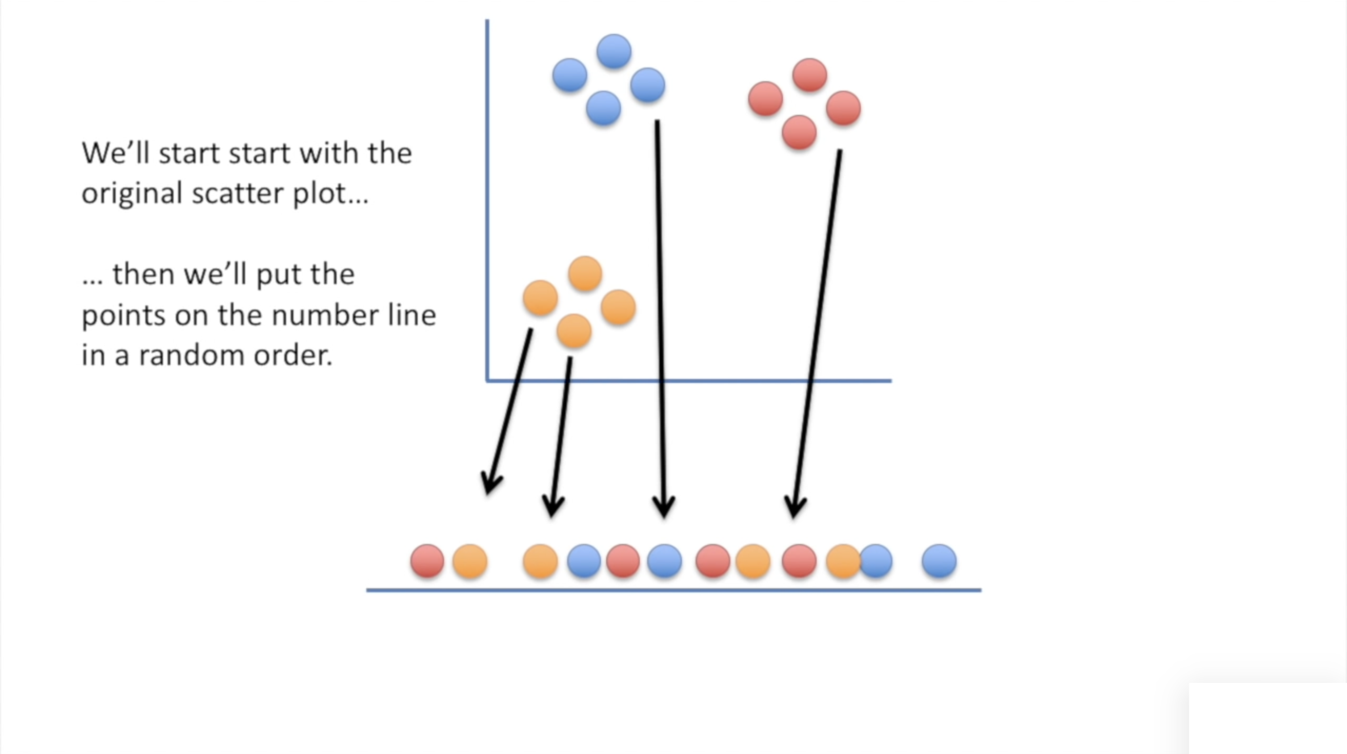
T-distributed Stochastic Neighbourhood Embedding
Credit figure: StatQuest (www.statquest.org, www.youtube.com@statquest)
STFC Summer School 2024
Notes:
Slide 1: Have high dimensional space, corresponding low dimensional space points are initially positioned randomly. Let’s use a very simple example, 2D to 1D.
Slide 2: During each iteration T_SNE makes small adjustments to the positions of each data point in lower dimensional space such that points that are close together in high dimensional space are moved together in their lower dimensional representation (attraction), while points that are far apart in higher dimensional space are moved farther apart in their lower dimensional representation (repulsion between points).
Slide 3: Eventually points that are clustered in high dimensionality space will be cluster in the low dimensional representation, this can of course be extended to much higher dimensions
Slide 4: t-SNE does this in a vary mathy way.
Given a set of data (x_i’s to x_n) in high dimensional space,
It starts by asking the question, given a data point x_i what’s the probability it would pick x_j as its neigbour?
It will be some function of distance between the data two data points P_(j|i) such that the closer the points are the higher its value, the farther away they are the lower the value.
The function should also depend on the proximity of all other data points, because one of those may be much closer.
The function should be such that if d_ij gets larger the function should get smaller, while if d_ik gets larger (negatively correlated), the function should ger larger because d_ij becomes relatively smaller (positively correlated
This function here meets those requirements – division of two gaussian functions
We can then use this formula to answer the next question, if we pick two point at random, what’s the probability they (let’s say I and j) are grouped together?
This is given by this formular here, which takes into account the probability we choose I first, and the probability we choose j first, th 1/N terms. We can call this a similarity score, based on distance, but answers the question of the probability that two points will be grouped together. We use this formula as a means of obtaining the probability distribution of high dimensional space.
How do we pick the standard deviation, sigma. We are going to make it dynamic so that it is different for each data point based on the density of points in its region of high dimensional space. We do this by setting a condition, for example we want sigma to be such that within say the first 2 standard deviations there will be four data points. Therefore if I was in a region of lowe density, sigma would have to be higher to incorporate four data points.
How do we get to the lower dimensional space, the goal is to learn a lower dimensional representation, usually 2 or 3d. We need to translate our x’s in higher dimensional space, to corresponding y’s in the lower dimensional space. We want to do so that we can preserve the similarities between data points we calculated in high dimensional space in the lower dimensional space, So if x1 and x2 are close, y1 and y2 are close.
To do this we want a caomparision of similarities of xs with similarities of ys, and adjust ys so that the similarities match. To measure low d similarities we could use the same formula, so we can use the same formula as for x’s but with y’s – Gaussian.
However, something goes wrong when we do this, the data points in lower dimensional space tend to be too squished together, making it difficult to identify structure. So instead of basing similarities on Gaussians, we use a student t-distribution, which has a longer flatter tail and is less peaked. Here is the , q_ij
Now we want these probability distributions to be similar, to be close to each other. To do this we use KL divergence which is a measure of the divergence or difference between two probability distributions, P in high d space and Q in low d space.
We can call this our loss function or error function that we wish to minimize. To do this we obtain the derivative of the formula and then shift points in low d space, our y’s, so that our loss moves towards a global minimum, the minimum of the loss function.
Now when you implement the algorithm, you need to set a few hyperparameters, that controls how the algorithms performs its actions. The most important ones are the perplexity and the n_iterations, and learning rate
n_iterations is just the number of update steps, the learning rate is the size of each step, the step size it takes towards the global minimum, too high you overshoot the minimum, too low, could get caught in a local minimum
Now remember how I discussed setting the standard deviation to control the width of the Gaussian functions. Well we do that with perplexity, without going over the maths again, perplexity is a measure of the sphere of influence of each data point - …

Slide 26
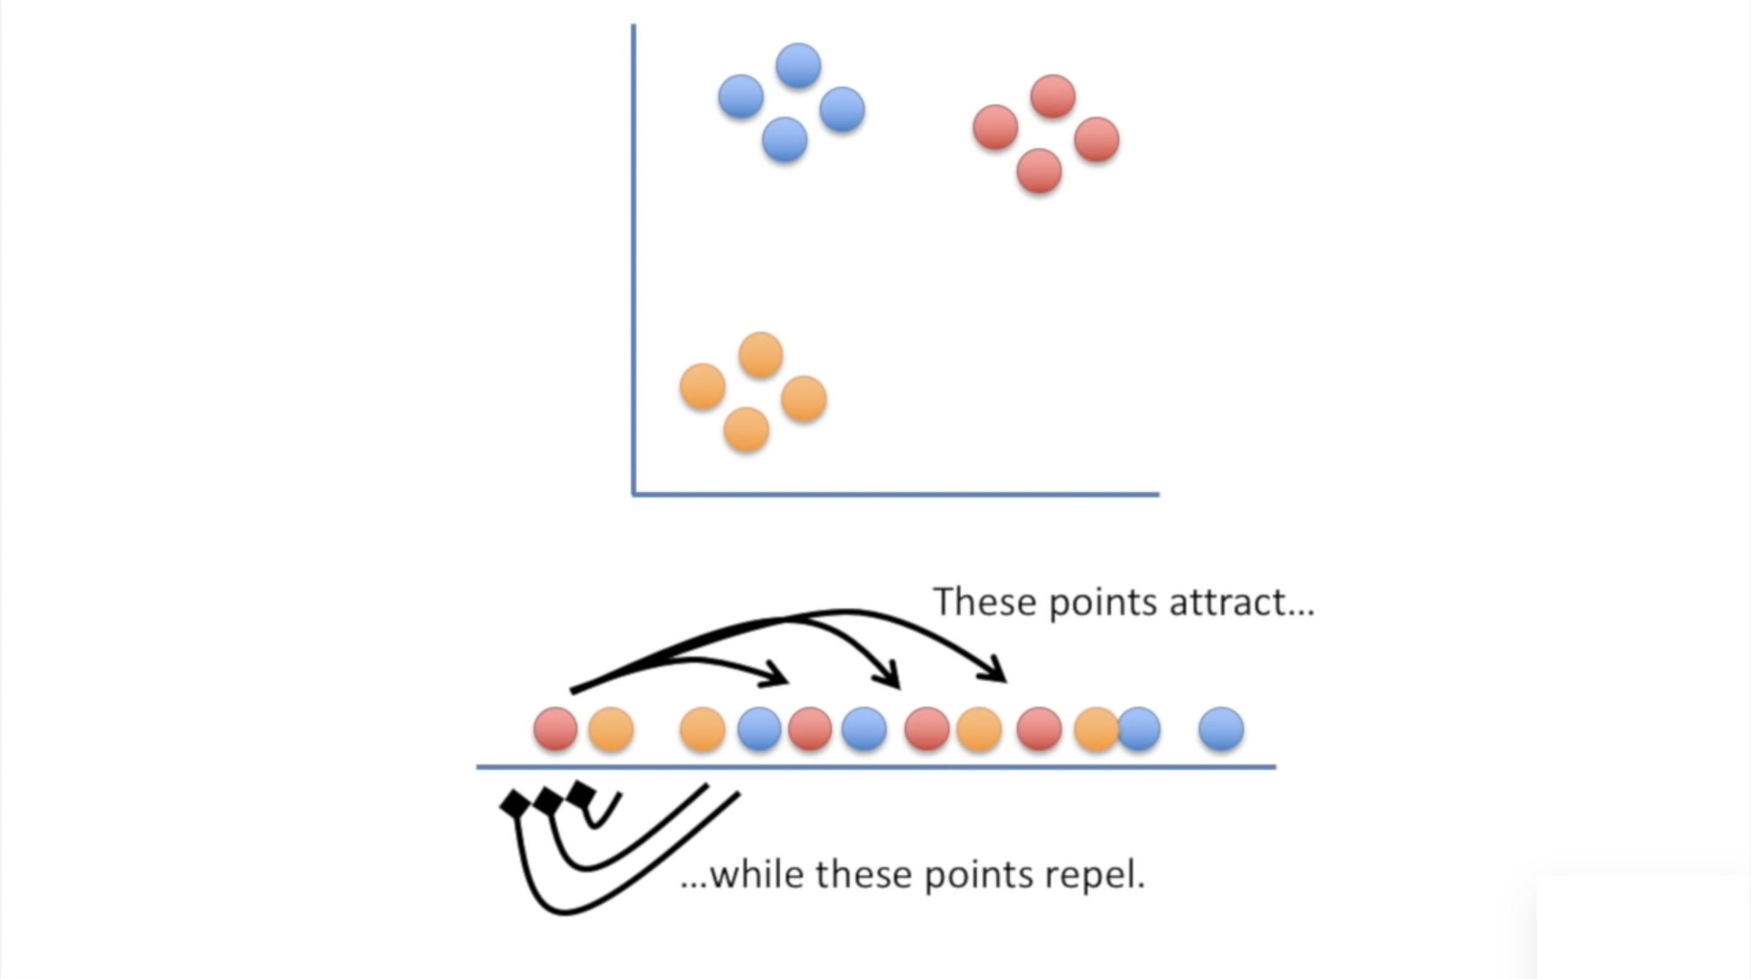
T-distributed Stochastic Neighbourhood Embedding
Credit figure: StatQuest (www.statquest.org, www.youtube.com@statquest)
STFC Summer School 2024
Notes:
Slide 1: Have high dimensional space, corresponding low dimensional space points are initially positioned randomly. Let’s use a very simple example, 2D to 1D.
Slide 2: During each iteration T_SNE makes small adjustments to the positions of each data point in lower dimensional space such that points that are close together in high dimensional space are moved together in their lower dimensional representation (attraction), while points that are far apart in higher dimensional space are moved farther apart in their lower dimensional representation (repulsion between points).
Slide 3: Eventually points that are clustered in high dimensionality space will be cluster in the low dimensional representation, this can of course be extended to much higher dimensions
Slide 4: t-SNE does this in a vary mathy way.
Given a set of data (x_i’s to x_n) in high dimensional space,
It starts by asking the question, given a data point x_i what’s the probability it would pick x_j as its neigbour?
It will be some function of distance between the data two data points P_(j|i) such that the closer the points are the higher its value, the farther away they are the lower the value.
The function should also depend on the proximity of all other data points, because one of those may be much closer.
The function should be such that if d_ij gets larger the function should get smaller, while if d_ik gets larger (negatively correlated), the function should ger larger because d_ij becomes relatively smaller (positively correlated
This function here meets those requirements – division of two gaussian functions
We can then use this formula to answer the next question, if we pick two point at random, what’s the probability they (let’s say I and j) are grouped together?
This is given by this formular here, which takes into account the probability we choose I first, and the probability we choose j first, th 1/N terms. We can call this a similarity score, based on distance, but answers the question of the probability that two points will be grouped together. We use this formula as a means of obtaining the probability distribution of high dimensional space.
How do we pick the standard deviation, sigma. We are going to make it dynamic so that it is different for each data point based on the density of points in its region of high dimensional space. We do this by setting a condition, for example we want sigma to be such that within say the first 2 standard deviations there will be four data points. Therefore if I was in a region of lowe density, sigma would have to be higher to incorporate four data points.
How do we get to the lower dimensional space, the goal is to learn a lower dimensional representation, usually 2 or 3d. We need to translate our x’s in higher dimensional space, to corresponding y’s in the lower dimensional space. We want to do so that we can preserve the similarities between data points we calculated in high dimensional space in the lower dimensional space, So if x1 and x2 are close, y1 and y2 are close.
To do this we want a caomparision of similarities of xs with similarities of ys, and adjust ys so that the similarities match. To measure low d similarities we could use the same formula, so we can use the same formula as for x’s but with y’s – Gaussian.
However, something goes wrong when we do this, the data points in lower dimensional space tend to be too squished together, making it difficult to identify structure. So instead of basing similarities on Gaussians, we use a student t-distribution, which has a longer flatter tail and is less peaked. Here is the , q_ij
Now we want these probability distributions to be similar, to be close to each other. To do this we use KL divergence which is a measure of the divergence or difference between two probability distributions, P in high d space and Q in low d space.
We can call this our loss function or error function that we wish to minimize. To do this we obtain the derivative of the formula and then shift points in low d space, our y’s, so that our loss moves towards a global minimum, the minimum of the loss function.
Now when you implement the algorithm, you need to set a few hyperparameters, that controls how the algorithms performs its actions. The most important ones are the perplexity and the n_iterations, and learning rate
n_iterations is just the number of update steps, the learning rate is the size of each step, the step size it takes towards the global minimum, too high you overshoot the minimum, too low, could get caught in a local minimum
Now remember how I discussed setting the standard deviation to control the width of the Gaussian functions. Well we do that with perplexity, without going over the maths again, perplexity is a measure of the sphere of influence of each data point - …

Slide 27
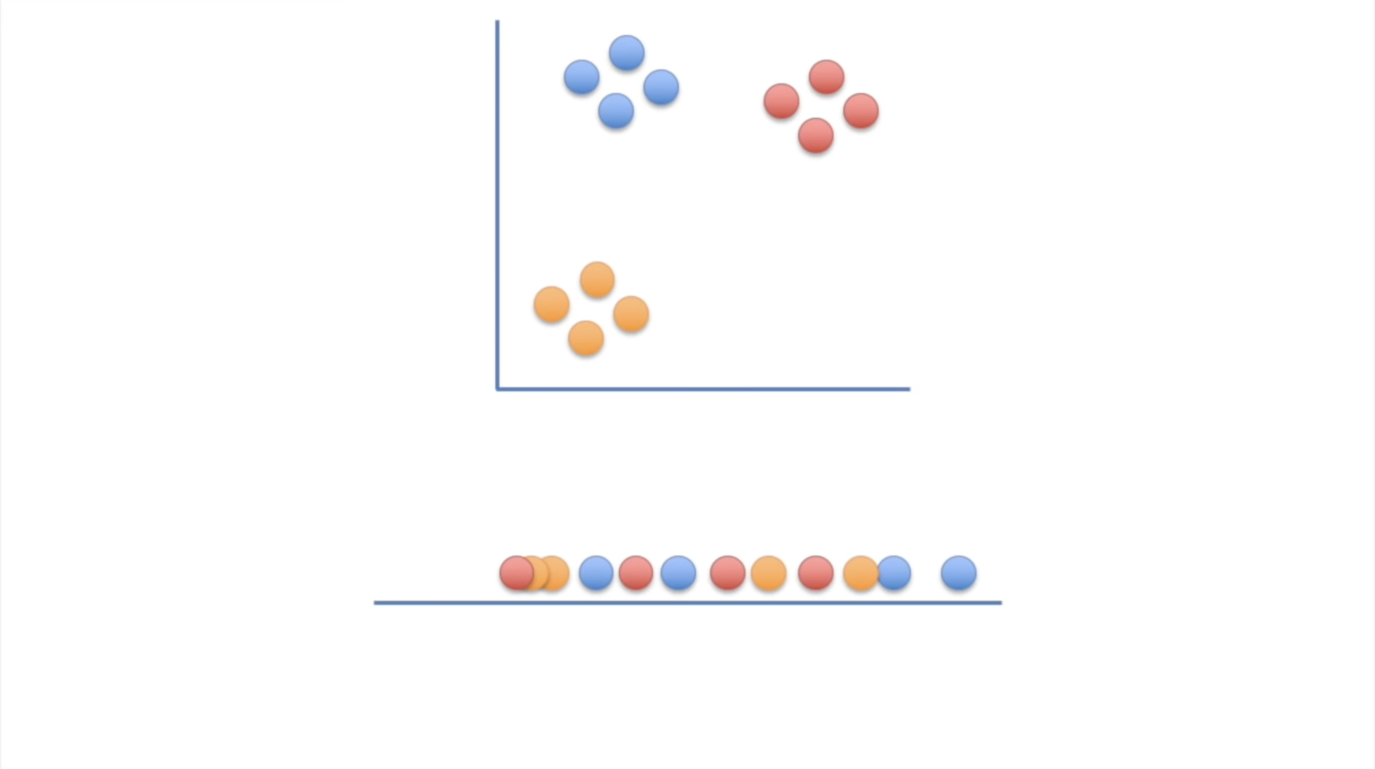
T-distributed Stochastic Neighbourhood Embedding
Credit figure: StatQuest (www.statquest.org, www.youtube.com@statquest)
STFC Summer School 2024
Notes:
Slide 1: Have high dimensional space, corresponding low dimensional space points are initially positioned randomly. Let’s use a very simple example, 2D to 1D.
Slide 2: During each iteration T_SNE makes small adjustments to the positions of each data point in lower dimensional space such that points that are close together in high dimensional space are moved together in their lower dimensional representation (attraction), while points that are far apart in higher dimensional space are moved farther apart in their lower dimensional representation (repulsion between points).
Slide 3: Eventually points that are clustered in high dimensionality space will be cluster in the low dimensional representation, this can of course be extended to much higher dimensions
Slide 4: t-SNE does this in a vary mathy way.
Given a set of data (x_i’s to x_n) in high dimensional space,
It starts by asking the question, given a data point x_i what’s the probability it would pick x_j as its neigbour?
It will be some function of distance between the data two data points P_(j|i) such that the closer the points are the higher its value, the farther away they are the lower the value.
The function should also depend on the proximity of all other data points, because one of those may be much closer.
The function should be such that if d_ij gets larger the function should get smaller, while if d_ik gets larger (negatively correlated), the function should ger larger because d_ij becomes relatively smaller (positively correlated
This function here meets those requirements – division of two gaussian functions
We can then use this formula to answer the next question, if we pick two point at random, what’s the probability they (let’s say I and j) are grouped together?
This is given by this formular here, which takes into account the probability we choose I first, and the probability we choose j first, th 1/N terms. We can call this a similarity score, based on distance, but answers the question of the probability that two points will be grouped together. We use this formula as a means of obtaining the probability distribution of high dimensional space.
How do we pick the standard deviation, sigma. We are going to make it dynamic so that it is different for each data point based on the density of points in its region of high dimensional space. We do this by setting a condition, for example we want sigma to be such that within say the first 2 standard deviations there will be four data points. Therefore if I was in a region of lowe density, sigma would have to be higher to incorporate four data points.
How do we get to the lower dimensional space, the goal is to learn a lower dimensional representation, usually 2 or 3d. We need to translate our x’s in higher dimensional space, to corresponding y’s in the lower dimensional space. We want to do so that we can preserve the similarities between data points we calculated in high dimensional space in the lower dimensional space, So if x1 and x2 are close, y1 and y2 are close.
To do this we want a caomparision of similarities of xs with similarities of ys, and adjust ys so that the similarities match. To measure low d similarities we could use the same formula, so we can use the same formula as for x’s but with y’s – Gaussian.
However, something goes wrong when we do this, the data points in lower dimensional space tend to be too squished together, making it difficult to identify structure. So instead of basing similarities on Gaussians, we use a student t-distribution, which has a longer flatter tail and is less peaked. Here is the , q_ij
Now we want these probability distributions to be similar, to be close to each other. To do this we use KL divergence which is a measure of the divergence or difference between two probability distributions, P in high d space and Q in low d space.
We can call this our loss function or error function that we wish to minimize. To do this we obtain the derivative of the formula and then shift points in low d space, our y’s, so that our loss moves towards a global minimum, the minimum of the loss function.
Now when you implement the algorithm, you need to set a few hyperparameters, that controls how the algorithms performs its actions. The most important ones are the perplexity and the n_iterations, and learning rate
n_iterations is just the number of update steps, the learning rate is the size of each step, the step size it takes towards the global minimum, too high you overshoot the minimum, too low, could get caught in a local minimum
Now remember how I discussed setting the standard deviation to control the width of the Gaussian functions. Well we do that with perplexity, without going over the maths again, perplexity is a measure of the sphere of influence of each data point - …

Slide 28
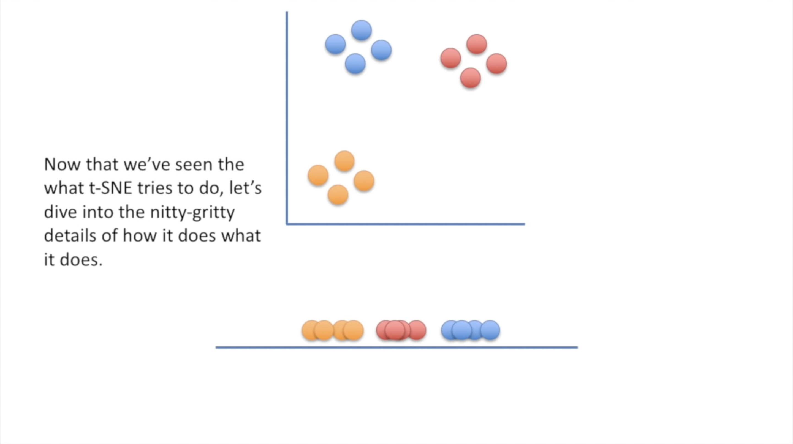
T-distributed Stochastic Neighbourhood Embedding
Credit figure: StatQuest (www.statquest.org, www.youtube.com@statquest)
STFC Summer School 2024
Notes:
Slide 1: Have high dimensional space, corresponding low dimensional space points are initially positioned randomly. Let’s use a very simple example, 2D to 1D.
Slide 2: During each iteration T_SNE makes small adjustments to the positions of each data point in lower dimensional space such that points that are close together in high dimensional space are moved together in their lower dimensional representation (attraction), while points that are far apart in higher dimensional space are moved farther apart in their lower dimensional representation (repulsion between points).
Slide 3: Eventually points that are clustered in high dimensionality space will be cluster in the low dimensional representation, this can of course be extended to much higher dimensions
Slide 4: t-SNE does this in a vary mathy way.
Given a set of data (x_i’s to x_n) in high dimensional space,
It starts by asking the question, given a data point x_i what’s the probability it would pick x_j as its neigbour?
It will be some function of distance between the data two data points P_(j|i) such that the closer the points are the higher its value, the farther away they are the lower the value.
The function should also depend on the proximity of all other data points, because one of those may be much closer.
The function should be such that if d_ij gets larger the function should get smaller, while if d_ik gets larger (negatively correlated), the function should ger larger because d_ij becomes relatively smaller (positively correlated
This function here meets those requirements – division of two gaussian functions
We can then use this formula to answer the next question, if we pick two point at random, what’s the probability they (let’s say I and j) are grouped together?
This is given by this formular here, which takes into account the probability we choose I first, and the probability we choose j first, th 1/N terms. We can call this a similarity score, based on distance, but answers the question of the probability that two points will be grouped together. We use this formula as a means of obtaining the probability distribution of high dimensional space.
How do we pick the standard deviation, sigma. We are going to make it dynamic so that it is different for each data point based on the density of points in its region of high dimensional space. We do this by setting a condition, for example we want sigma to be such that within say the first 2 standard deviations there will be four data points. Therefore if I was in a region of lowe density, sigma would have to be higher to incorporate four data points.
How do we get to the lower dimensional space, the goal is to learn a lower dimensional representation, usually 2 or 3d. We need to translate our x’s in higher dimensional space, to corresponding y’s in the lower dimensional space. We want to do so that we can preserve the similarities between data points we calculated in high dimensional space in the lower dimensional space, So if x1 and x2 are close, y1 and y2 are close.
To do this we want a caomparision of similarities of xs with similarities of ys, and adjust ys so that the similarities match. To measure low d similarities we could use the same formula, so we can use the same formula as for x’s but with y’s – Gaussian.
However, something goes wrong when we do this, the data points in lower dimensional space tend to be too squished together, making it difficult to identify structure. So instead of basing similarities on Gaussians, we use a student t-distribution, which has a longer flatter tail and is less peaked. Here is the , q_ij
Now we want these probability distributions to be similar, to be close to each other. To do this we use KL divergence which is a measure of the divergence or difference between two probability distributions, P in high d space and Q in low d space.
We can call this our loss function or error function that we wish to minimize. To do this we obtain the derivative of the formula and then shift points in low d space, our y’s, so that our loss moves towards a global minimum, the minimum of the loss function.
Now when you implement the algorithm, you need to set a few hyperparameters, that controls how the algorithms performs its actions. The most important ones are the perplexity and the n_iterations, and learning rate
n_iterations is just the number of update steps, the learning rate is the size of each step, the step size it takes towards the global minimum, too high you overshoot the minimum, too low, could get caught in a local minimum
Now remember how I discussed setting the standard deviation to control the width of the Gaussian functions. Well we do that with perplexity, without going over the maths again, perplexity is a measure of the sphere of influence of each data point - …

Slide 29
T-distributed Stochastic Neighbourhood Embedding
t-SNE computes the probability distribution, P, of data points $\{x_{1},{ x}_{2}, …, x_{N}\}$
in high dimensional space
computes the probability distribution, Q, of corresponding data points $\{y_{1}, y_{2}, …, y_{N}\}$ in low dimensional space
and adjust points in low dimensional space so that Q matches P, i.e., the probability distributions are equal
Here’s how, with some maths, …, I’m sorry
STFC Summer School 2024
Notes:
Slide 1: Have high dimensional space, corresponding low dimensional space points are initially positioned randomly. Let’s use a very simple example, 2D to 1D.
Slide 2: During each iteration T_SNE makes small adjustments to the positions of each data point in lower dimensional space such that points that are close together in high dimensional space are moved together in their lower dimensional representation (attraction), while points that are far apart in higher dimensional space are moved farther apart in their lower dimensional representation (repulsion between points).
Slide 3: Eventually points that are clustered in high dimensionality space will be cluster in the low dimensional representation, this can of course be extended to much higher dimensions
Slide 4: t-SNE does this in a vary mathy way.
Given a set of data (x_i’s to x_n) in high dimensional space,
It starts by asking the question, given a data point x_i what’s the probability it would pick x_j as its neigbour?
It will be some function of distance between the data two data points P_(j|i) such that the closer the points are the higher its value, the farther away they are the lower the value.
The function should also depend on the proximity of all other data points, because one of those may be much closer.
The function should be such that if d_ij gets larger the function should get smaller, while if d_ik gets larger (negatively correlated), the function should ger larger because d_ij becomes relatively smaller (positively correlated
This function here meets those requirements – division of two gaussian functions
We can then use this formula to answer the next question, if we pick two point at random, what’s the probability they (let’s say I and j) are grouped together?
This is given by this formular here, which takes into account the probability we choose I first, and the probability we choose j first, th 1/N terms. We can call this a similarity score, based on distance, but answers the question of the probability that two points will be grouped together. We use this formula as a means of obtaining the probability distribution of high dimensional space.
How do we pick the standard deviation, sigma. We are going to make it dynamic so that it is different for each data point based on the density of points in its region of high dimensional space. We do this by setting a condition, for example we want sigma to be such that within say the first 2 standard deviations there will be four data points. Therefore if I was in a region of lowe density, sigma would have to be higher to incorporate four data points.
How do we get to the lower dimensional space, the goal is to learn a lower dimensional representation, usually 2 or 3d. We need to translate our x’s in higher dimensional space, to corresponding y’s in the lower dimensional space. We want to do so that we can preserve the similarities between data points we calculated in high dimensional space in the lower dimensional space, So if x1 and x2 are close, y1 and y2 are close.
To do this we want a caomparision of similarities of xs with similarities of ys, and adjust ys so that the similarities match. To measure low d similarities we could use the same formula, so we can use the same formula as for x’s but with y’s – Gaussian.
However, something goes wrong when we do this, the data points in lower dimensional space tend to be too squished together, making it difficult to identify structure. So instead of basing similarities on Gaussians, we use a student t-distribution, which has a longer flatter tail and is less peaked. Here is the , q_ij
Now we want these probability distributions to be similar, to be close to each other. To do this we use KL divergence which is a measure of the divergence or difference between two probability distributions, P in high d space and Q in low d space.
We can call this our loss function or error function that we wish to minimize. To do this we obtain the derivative of the formula and then shift points in low d space, our y’s, so that our loss moves towards a global minimum, the minimum of the loss function.
Now when you implement the algorithm, you need to set a few hyperparameters, that controls how the algorithms performs its actions. The most important ones are the perplexity and the n_iterations, and learning rate
n_iterations is just the number of update steps, the learning rate is the size of each step, the step size it takes towards the global minimum, too high you overshoot the minimum, too low, could get caught in a local minimum
Now remember how I discussed setting the standard deviation to control the width of the Gaussian functions. Well we do that with perplexity, without going over the maths again, perplexity is a measure of the sphere of influence of each data point - …

Slide 30
T-distributed Stochastic Neighbourhood Embedding
Suppose we have a set of N points in high dimensional space
$$\{x_{1},{ x}_{2}, …, x_{N}\}$$
Q: Given $x_{i}$, what’s the probability it would pick $x_{j}$ as it’s neighbour?
The equation must depend on the distance between $x_{i}$ and $x_{j}$
It must also depend on the distance of $x_{i}$ from all other data points $x_{k}$
$$P_{j|i}=\frac{\exp\left[−\frac{{\left\|x_{i}−x_{j}\right\|}^{2}}{2σ_{i}^{2}}\right]}{\sum_{k≠i}{\exp\left[−\frac{{\left\|x_{i}−x_{k}\right\|}^{2}}{2σ_{i}^{2}}\right]}}$$
$P_{j|i}$neg. corr. with ${\left\|x_{i}−x_{j}\right\|}^{2}$
Ratio of
two Gaussians
$P_{j|i}$ pos. corr. with ${\left\|x_{i}−x_{k}\right\|}^{2}$
STFC Summer School 2024
Notes:
Given a set of data (x_i’s to x_n) in high dimensional space,
It starts by asking the question, given a data point x_i what’s the probability it would pick x_j as its neigbour?
It will be some function of distance between the data two data points P_(j|i) such that the closer the points are the higher its value, the farther away they are the lower the value.
The function should also depend on the proximity of all other data points, because one of those may be much closer.
The function should be such that if d_ij gets larger the function should get smaller, while if d_ik gets larger (negatively correlated), the function should ger larger because d_ij becomes relatively smaller (positively correlated
This function here meets those requirements – division of two gaussian functions
We can then use this formula to answer the next question, if we pick two point at random, what’s the probability they (let’s say I and j) are grouped together?
This is given by this formular here, which takes into account the probability we choose I first, and the probability we choose j first, th 1/N terms. We can call this a similarity score, based on distance, but answers the question of the probability that two points will be grouped together. We use this formula as a means of obtaining the probability distribution of high dimensional space.
How do we pick the standard deviation, sigma. We are going to make it dynamic so that it is different for each data point based on the density of points in its region of high dimensional space. We do this by setting a condition, for example we want sigma to be such that within say the first 2 standard deviations there will be four data points. Therefore if I was in a region of lowe density, sigma would have to be higher to incorporate four data points.
How do we get to the lower dimensional space, the goal is to learn a lower dimensional representation, usually 2 or 3d. We need to translate our x’s in higher dimensional space, to corresponding y’s in the lower dimensional space. We want to do so that we can preserve the similarities between data points we calculated in high dimensional space in the lower dimensional space, So if x1 and x2 are close, y1 and y2 are close.
To do this we want a caomparision of similarities of xs with similarities of ys, and adjust ys so that the similarities match. To measure low d similarities we could use the same formula, so we can use the same formula as for x’s but with y’s – Gaussian.
However, something goes wrong when we do this, the data points in lower dimensional space tend to be too squished together, making it difficult to identify structure. So instead of basing similarities on Gaussians, we use a student t-distribution, which has a longer flatter tail and is less peaked. Here is the , q_ij
Now we want these probability distributions to be similar, to be close to each other. To do this we use KL divergence which is a measure of the divergence or difference between two probability distributions, P in high d space and Q in low d space.
We can call this our loss function or error function that we wish to minimize. To do this we obtain the derivative of the formula and then shift points in low d space, our y’s, so that our loss moves towards a global minimum, the minimum of the loss function.
Now when you implement the algorithm, you need to set a few hyperparameters, that controls how the algorithms performs its actions. The most important ones are the perplexity and the n_iterations, and learning rate
n_iterations is just the number of update steps, the learning rate is the size of each step, the step size it takes towards the global minimum, too high you overshoot the minimum, too low, could get caught in a local minimum
Now remember how I discussed setting the standard deviation to control the width of the Gaussian functions. Well we do that with perplexity, without going over the maths again, perplexity is a measure of the sphere of influence of each data point - …

Slide 31
T-distributed Stochastic Neighbourhood Embedding
Since points are picked at random, we need to ask:
Q: If we pick points at random, what’s the probability that $i$ and $j$ are grouped together
$$P_{ij}=\frac{\frac{1}{N}P_{j|i}+\frac{1}{N}P_{i|j}}{2N}$$
This has the property that $P_{ij}=P_{ji}$
We can sum over all data points to acquire the probability distribution in high dimensional space, P
STFC Summer School 2024
Notes:
Given a set of data (x_i’s to x_n) in high dimensional space,
It starts by asking the question, given a data point x_i what’s the probability it would pick x_j as its neigbour?
It will be some function of distance between the data two data points P_(j|i) such that the closer the points are the higher its value, the farther away they are the lower the value.
The function should also depend on the proximity of all other data points, because one of those may be much closer.
The function should be such that if d_ij gets larger the function should get smaller, while if d_ik gets larger (negatively correlated), the function should ger larger because d_ij becomes relatively smaller (positively correlated
This function here meets those requirements – division of two gaussian functions
We can then use this formula to answer the next question, if we pick two point at random, what’s the probability they (let’s say I and j) are grouped together?
This is given by this formular here, which takes into account the probability we choose I first, and the probability we choose j first, th 1/N terms. We can call this a similarity score, based on distance, but answers the question of the probability that two points will be grouped together. We use this formula as a means of obtaining the probability distribution of high dimensional space.
How do we pick the standard deviation, sigma. We are going to make it dynamic so that it is different for each data point based on the density of points in its region of high dimensional space. We do this by setting a condition, for example we want sigma to be such that within say the first 2 standard deviations there will be four data points. Therefore if I was in a region of lowe density, sigma would have to be higher to incorporate four data points.
How do we get to the lower dimensional space, the goal is to learn a lower dimensional representation, usually 2 or 3d. We need to translate our x’s in higher dimensional space, to corresponding y’s in the lower dimensional space. We want to do so that we can preserve the similarities between data points we calculated in high dimensional space in the lower dimensional space, So if x1 and x2 are close, y1 and y2 are close.
To do this we want a caomparision of similarities of xs with similarities of ys, and adjust ys so that the similarities match. To measure low d similarities we could use the same formula, so we can use the same formula as for x’s but with y’s – Gaussian.
However, something goes wrong when we do this, the data points in lower dimensional space tend to be too squished together, making it difficult to identify structure. So instead of basing similarities on Gaussians, we use a student t-distribution, which has a longer flatter tail and is less peaked. Here is the , q_ij
Now we want these probability distributions to be similar, to be close to each other. To do this we use KL divergence which is a measure of the divergence or difference between two probability distributions, P in high d space and Q in low d space.
We can call this our loss function or error function that we wish to minimize. To do this we obtain the derivative of the formula and then shift points in low d space, our y’s, so that our loss moves towards a global minimum, the minimum of the loss function.
Now when you implement the algorithm, you need to set a few hyperparameters, that controls how the algorithms performs its actions. The most important ones are the perplexity and the n_iterations, and learning rate
n_iterations is just the number of update steps, the learning rate is the size of each step, the step size it takes towards the global minimum, too high you overshoot the minimum, too low, could get caught in a local minimum
Now remember how I discussed setting the standard deviation to control the width of the Gaussian functions. Well we do that with perplexity, without going over the maths again, perplexity is a measure of the sphere of influence of each data point - …

Slide 32
T-distributed Stochastic Neighbourhood Embedding
For low dimensional space, we could do the same thing to acquire the probability distribution, Q
where we have the corresponding points
$$\{y_{1}, y_{2}, …, y_{N}\}$$
Problem: using the ratio of two Gaussians causes point in low dimensional space to be crowded together
Solution: Used a student t-distribution – flatter tail
$$q_{ij}=\frac{{\left(1+{\left\|y_{i}−y_{j}\right\|}^{2}\right)}^{−1}}{\sum_{k≠l}{{ \left(1+{\left\|y_{k}−y_{l}\right\|}^{2}\right)}^{−1}}}$$
STFC Summer School 2024
Notes:
Given a set of data (x_i’s to x_n) in high dimensional space,
It starts by asking the question, given a data point x_i what’s the probability it would pick x_j as its neigbour?
It will be some function of distance between the data two data points P_(j|i) such that the closer the points are the higher its value, the farther away they are the lower the value.
The function should also depend on the proximity of all other data points, because one of those may be much closer.
The function should be such that if d_ij gets larger the function should get smaller, while if d_ik gets larger (negatively correlated), the function should ger larger because d_ij becomes relatively smaller (positively correlated
This function here meets those requirements – division of two gaussian functions
We can then use this formula to answer the next question, if we pick two point at random, what’s the probability they (let’s say I and j) are grouped together?
This is given by this formular here, which takes into account the probability we choose I first, and the probability we choose j first, th 1/N terms. We can call this a similarity score, based on distance, but answers the question of the probability that two points will be grouped together. We use this formula as a means of obtaining the probability distribution of high dimensional space.
How do we pick the standard deviation, sigma. We are going to make it dynamic so that it is different for each data point based on the density of points in its region of high dimensional space. We do this by setting a condition, for example we want sigma to be such that within say the first 2 standard deviations there will be four data points. Therefore if I was in a region of lowe density, sigma would have to be higher to incorporate four data points.
How do we get to the lower dimensional space, the goal is to learn a lower dimensional representation, usually 2 or 3d. We need to translate our x’s in higher dimensional space, to corresponding y’s in the lower dimensional space. We want to do so that we can preserve the similarities between data points we calculated in high dimensional space in the lower dimensional space, So if x1 and x2 are close, y1 and y2 are close.
To do this we want a caomparision of similarities of xs with similarities of ys, and adjust ys so that the similarities match. To measure low d similarities we could use the same formula, so we can use the same formula as for x’s but with y’s – Gaussian.
However, something goes wrong when we do this, the data points in lower dimensional space tend to be too squished together, making it difficult to identify structure. So instead of basing similarities on Gaussians, we use a student t-distribution, which has a longer flatter tail and is less peaked. Here is the , q_ij
Now we want these probability distributions to be similar, to be close to each other. To do this we use KL divergence which is a measure of the divergence or difference between two probability distributions, P in high d space and Q in low d space.
We can call this our loss function or error function that we wish to minimize. To do this we obtain the derivative of the formula and then shift points in low d space, our y’s, so that our loss moves towards a global minimum, the minimum of the loss function.
Now when you implement the algorithm, you need to set a few hyperparameters, that controls how the algorithms performs its actions. The most important ones are the perplexity and the n_iterations, and learning rate
n_iterations is just the number of update steps, the learning rate is the size of each step, the step size it takes towards the global minimum, too high you overshoot the minimum, too low, could get caught in a local minimum
Now remember how I discussed setting the standard deviation to control the width of the Gaussian functions. Well we do that with perplexity, without going over the maths again, perplexity is a measure of the sphere of influence of each data point - …

Slide 33
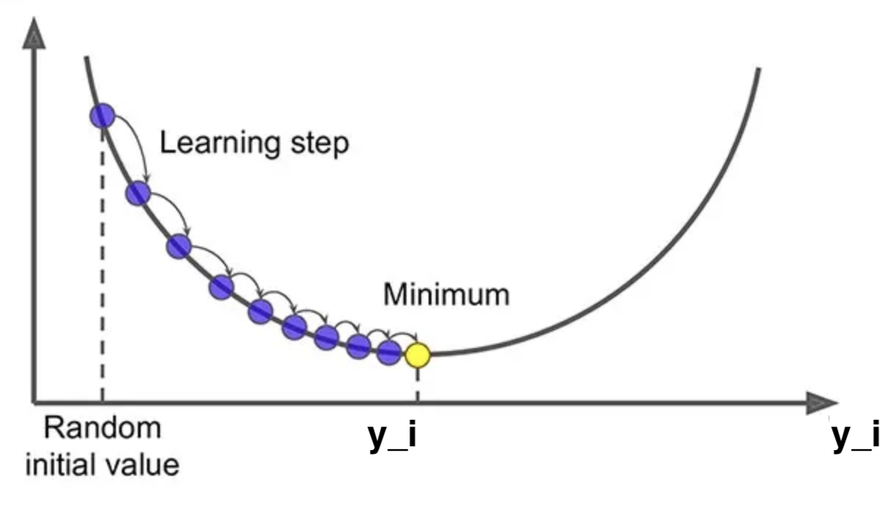
T-distributed Stochastic Neighbourhood Embedding
Want probability distributions in low and high dimensional space to be equal: $Q≈P$
Use Kulback Leibler (KL) divergence - measure of the divergence or difference between two probability distributions
$$KL(P||Q)=\sum_{i≠j}{p_{ij}}\log\left[\frac{p_{ij}}{q_{ij}}\right]$$
Minimise by adjusting $\left\{y_{1}, y_{2}, …, y_{N}\right\}$ using gradient descent algorithm
$$y_{i}≔y_{i}−α\frac{∂KL}{∂y_{i}}$$
minimise
STFC Summer School 2024
Notes:
Given a set of data (x_i’s to x_n) in high dimensional space,
It starts by asking the question, given a data point x_i what’s the probability it would pick x_j as its neigbour?
It will be some function of distance between the data two data points P_(j|i) such that the closer the points are the higher its value, the farther away they are the lower the value.
The function should also depend on the proximity of all other data points, because one of those may be much closer.
The function should be such that if d_ij gets larger the function should get smaller, while if d_ik gets larger (negatively correlated), the function should ger larger because d_ij becomes relatively smaller (positively correlated
This function here meets those requirements – division of two gaussian functions
We can then use this formula to answer the next question, if we pick two point at random, what’s the probability they (let’s say I and j) are grouped together?
This is given by this formular here, which takes into account the probability we choose I first, and the probability we choose j first, th 1/N terms. We can call this a similarity score, based on distance, but answers the question of the probability that two points will be grouped together. We use this formula as a means of obtaining the probability distribution of high dimensional space.
How do we pick the standard deviation, sigma. We are going to make it dynamic so that it is different for each data point based on the density of points in its region of high dimensional space. We do this by setting a condition, for example we want sigma to be such that within say the first 2 standard deviations there will be four data points. Therefore if I was in a region of lowe density, sigma would have to be higher to incorporate four data points.
How do we get to the lower dimensional space, the goal is to learn a lower dimensional representation, usually 2 or 3d. We need to translate our x’s in higher dimensional space, to corresponding y’s in the lower dimensional space. We want to do so that we can preserve the similarities between data points we calculated in high dimensional space in the lower dimensional space, So if x1 and x2 are close, y1 and y2 are close.
To do this we want a caomparision of similarities of xs with similarities of ys, and adjust ys so that the similarities match. To measure low d similarities we could use the same formula, so we can use the same formula as for x’s but with y’s – Gaussian.
However, something goes wrong when we do this, the data points in lower dimensional space tend to be too squished together, making it difficult to identify structure. So instead of basing similarities on Gaussians, we use a student t-distribution, which has a longer flatter tail and is less peaked. Here is the , q_ij
Now we want these probability distributions to be similar, to be close to each other. To do this we use KL divergence which is a measure of the divergence or difference between two probability distributions, P in high d space and Q in low d space.
We can call this our loss function or error function that we wish to minimize. To do this we obtain the derivative of the formula and then shift points in low d space, our y’s, so that our loss moves towards a global minimum, the minimum of the loss function.
Now when you implement the algorithm, you need to set a few hyperparameters, that controls how the algorithms performs its actions. The most important ones are the perplexity and the n_iterations, and learning rate
n_iterations is just the number of update steps, the learning rate is the size of each step, the step size it takes towards the global minimum, too high you overshoot the minimum, too low, could get caught in a local minimum
Now remember how I discussed setting the standard deviation to control the width of the Gaussian functions. Well we do that with perplexity, without going over the maths again, perplexity is a measure of the sphere of influence of each data point - …

Slide 34
T-distributed Stochastic Neighbourhood Embedding
Hyperparameters:
Learning rate: step size in the gradient descent optimisation process. It controls how much the low-dimensional points are adjusted during each/ Typical Values: Common values range from 10 to 1000.
Number of iterations: The number of iterations specifies how many times the gradient descent update rule is applied.
Perplexity: controls how many nearby data points (neighbours) are taken into account when computing the probability distribution in the high-dimensional space.
STFC Summer School 2024
Notes:
Given a set of data (x_i’s to x_n) in high dimensional space,
It starts by asking the question, given a data point x_i what’s the probability it would pick x_j as its neigbour?
It will be some function of distance between the data two data points P_(j|i) such that the closer the points are the higher its value, the farther away they are the lower the value.
The function should also depend on the proximity of all other data points, because one of those may be much closer.
The function should be such that if d_ij gets larger the function should get smaller, while if d_ik gets larger (negatively correlated), the function should ger larger because d_ij becomes relatively smaller (positively correlated
This function here meets those requirements – division of two gaussian functions
We can then use this formula to answer the next question, if we pick two point at random, what’s the probability they (let’s say I and j) are grouped together?
This is given by this formular here, which takes into account the probability we choose I first, and the probability we choose j first, th 1/N terms. We can call this a similarity score, based on distance, but answers the question of the probability that two points will be grouped together. We use this formula as a means of obtaining the probability distribution of high dimensional space.
How do we pick the standard deviation, sigma. We are going to make it dynamic so that it is different for each data point based on the density of points in its region of high dimensional space. We do this by setting a condition, for example we want sigma to be such that within say the first 2 standard deviations there will be four data points. Therefore if I was in a region of lowe density, sigma would have to be higher to incorporate four data points.
How do we get to the lower dimensional space, the goal is to learn a lower dimensional representation, usually 2 or 3d. We need to translate our x’s in higher dimensional space, to corresponding y’s in the lower dimensional space. We want to do so that we can preserve the similarities between data points we calculated in high dimensional space in the lower dimensional space, So if x1 and x2 are close, y1 and y2 are close.
To do this we want a caomparision of similarities of xs with similarities of ys, and adjust ys so that the similarities match. To measure low d similarities we could use the same formula, so we can use the same formula as for x’s but with y’s – Gaussian.
However, something goes wrong when we do this, the data points in lower dimensional space tend to be too squished together, making it difficult to identify structure. So instead of basing similarities on Gaussians, we use a student t-distribution, which has a longer flatter tail and is less peaked. Here is the , q_ij
Now we want these probability distributions to be similar, to be close to each other. To do this we use KL divergence which is a measure of the divergence or difference between two probability distributions, P in high d space and Q in low d space.
We can call this our loss function or error function that we wish to minimize. To do this we obtain the derivative of the formula and then shift points in low d space, our y’s, so that our loss moves towards a global minimum, the minimum of the loss function.
Now when you implement the algorithm, you need to set a few hyperparameters, that controls how the algorithms performs its actions. The most important ones are the perplexity and the n_iterations, and learning rate
n_iterations is just the number of update steps, the learning rate is the size of each step, the step size it takes towards the global minimum, too high you overshoot the minimum, too low, could get caught in a local minimum
Now remember how I discussed setting the standard deviation to control the width of the Gaussian functions. Well we do that with perplexity, without going over the maths again, perplexity is a measure of the sphere of influence of each data point - …

Slide 35
T-distributed Stochastic Neighbourhood Embedding
Hyperparameters:
Perplexity: controls how many nearby data points (neighbours) are taken into account when computing the probability distribution in the high-dimensional space.
$$P_{j|i}=\frac{\exp\left[−\frac{{\left\|x_{i}−x_{j}\right\|}^{2}}{2σ_{i}^{2}}\right]}{\sum_{k≠i}{\exp\left[−\frac{{\left\|x_{i}−x_{k}\right\|}^{2}}{2σ_{i}^{2}}\right]}}$$
Effectively sets $σ$ by specifying the number of data point with a certain number of standard deviations from $x_{i}$.
Points in higher density regions will have lower $σ$, while points in lower density regions have higher $σ$
STFC Summer School 2024
Notes:
Given a set of data (x_i’s to x_n) in high dimensional space,
It starts by asking the question, given a data point x_i what’s the probability it would pick x_j as its neigbour?
It will be some function of distance between the data two data points P_(j|i) such that the closer the points are the higher its value, the farther away they are the lower the value.
The function should also depend on the proximity of all other data points, because one of those may be much closer.
The function should be such that if d_ij gets larger the function should get smaller, while if d_ik gets larger (negatively correlated), the function should ger larger because d_ij becomes relatively smaller (positively correlated
This function here meets those requirements – division of two gaussian functions
We can then use this formula to answer the next question, if we pick two point at random, what’s the probability they (let’s say I and j) are grouped together?
This is given by this formular here, which takes into account the probability we choose I first, and the probability we choose j first, th 1/N terms. We can call this a similarity score, based on distance, but answers the question of the probability that two points will be grouped together. We use this formula as a means of obtaining the probability distribution of high dimensional space.
How do we pick the standard deviation, sigma. We are going to make it dynamic so that it is different for each data point based on the density of points in its region of high dimensional space. We do this by setting a condition, for example we want sigma to be such that within say the first 2 standard deviations there will be four data points. Therefore if I was in a region of lowe density, sigma would have to be higher to incorporate four data points.
How do we get to the lower dimensional space, the goal is to learn a lower dimensional representation, usually 2 or 3d. We need to translate our x’s in higher dimensional space, to corresponding y’s in the lower dimensional space. We want to do so that we can preserve the similarities between data points we calculated in high dimensional space in the lower dimensional space, So if x1 and x2 are close, y1 and y2 are close.
To do this we want a caomparision of similarities of xs with similarities of ys, and adjust ys so that the similarities match. To measure low d similarities we could use the same formula, so we can use the same formula as for x’s but with y’s – Gaussian.
However, something goes wrong when we do this, the data points in lower dimensional space tend to be too squished together, making it difficult to identify structure. So instead of basing similarities on Gaussians, we use a student t-distribution, which has a longer flatter tail and is less peaked. Here is the , q_ij
Now we want these probability distributions to be similar, to be close to each other. To do this we use KL divergence which is a measure of the divergence or difference between two probability distributions, P in high d space and Q in low d space.
We can call this our loss function or error function that we wish to minimize. To do this we obtain the derivative of the formula and then shift points in low d space, our y’s, so that our loss moves towards a global minimum, the minimum of the loss function.
Now when you implement the algorithm, you need to set a few hyperparameters, that controls how the algorithms performs its actions. The most important ones are the perplexity and the n_iterations, and learning rate
n_iterations is just the number of update steps, the learning rate is the size of each step, the step size it takes towards the global minimum, too high you overshoot the minimum, too low, could get caught in a local minimum
Now remember how I discussed setting the standard deviation to control the width of the Gaussian functions. Well we do that with perplexity, without going over the maths again, perplexity is a measure of the sphere of influence of each data point - …

Slide 36
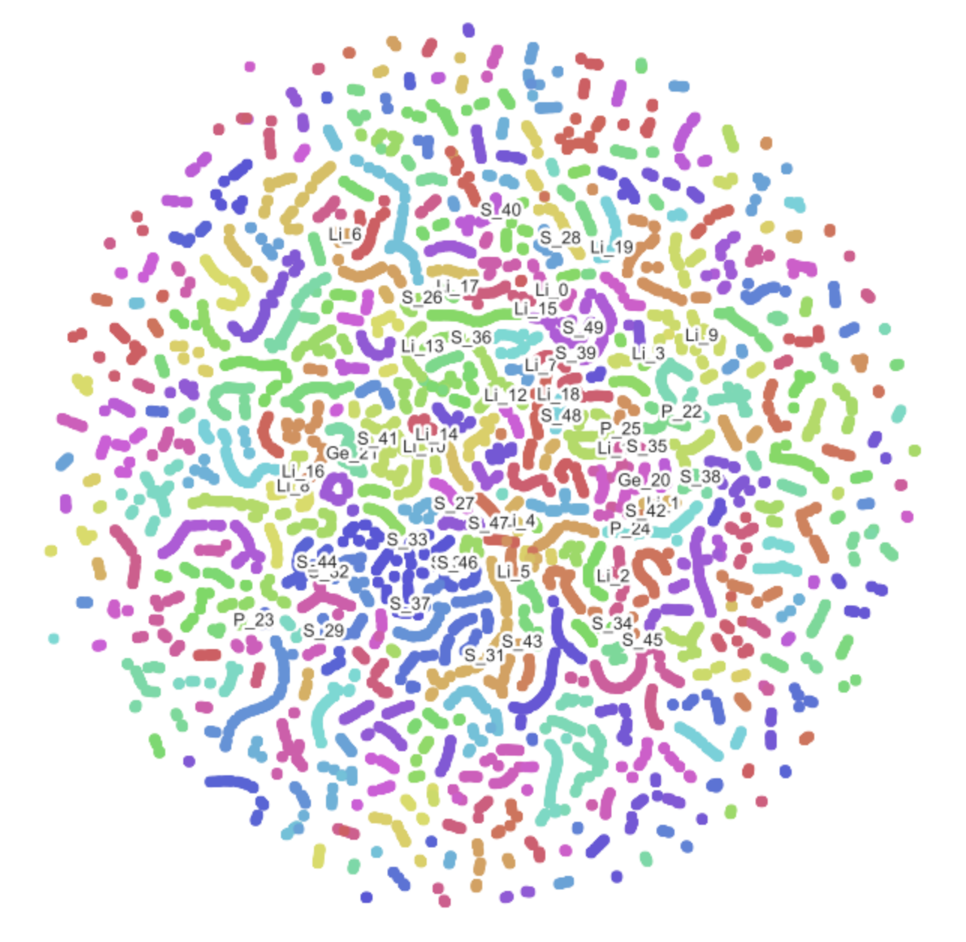
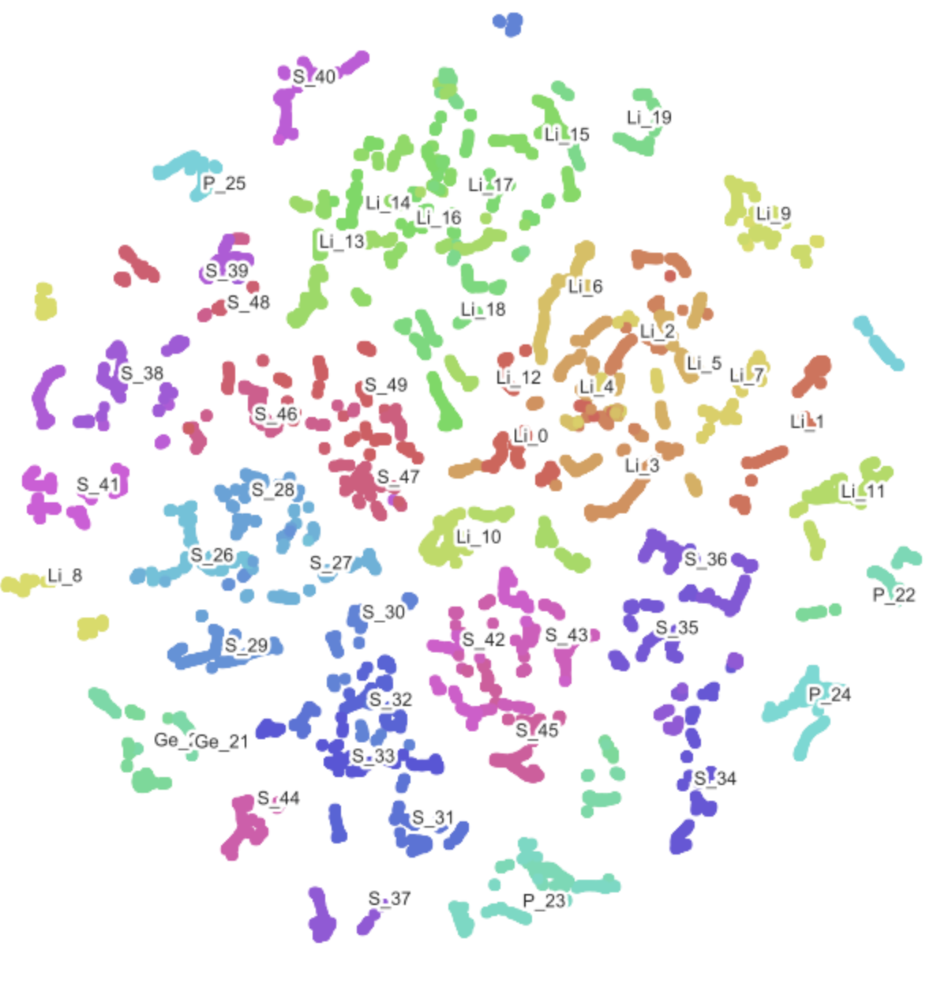
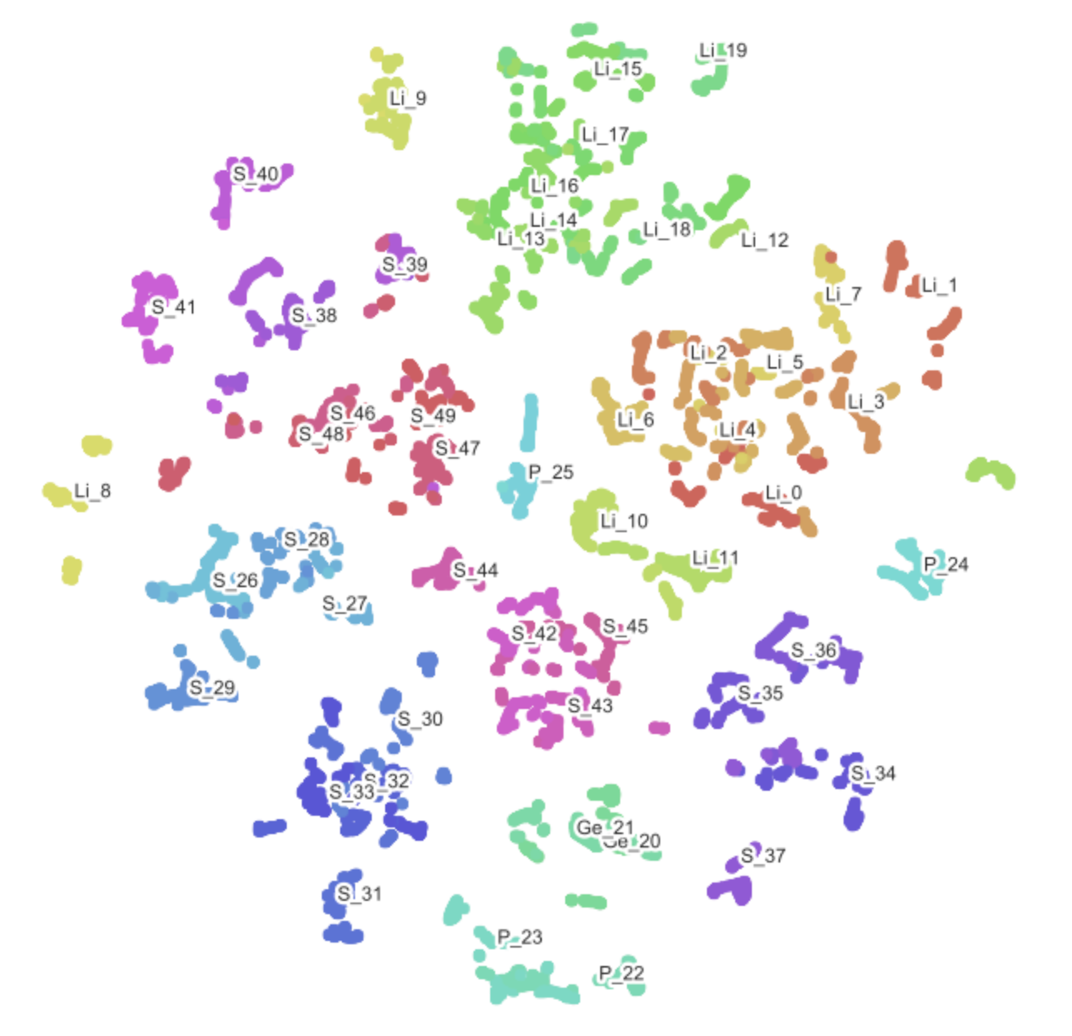
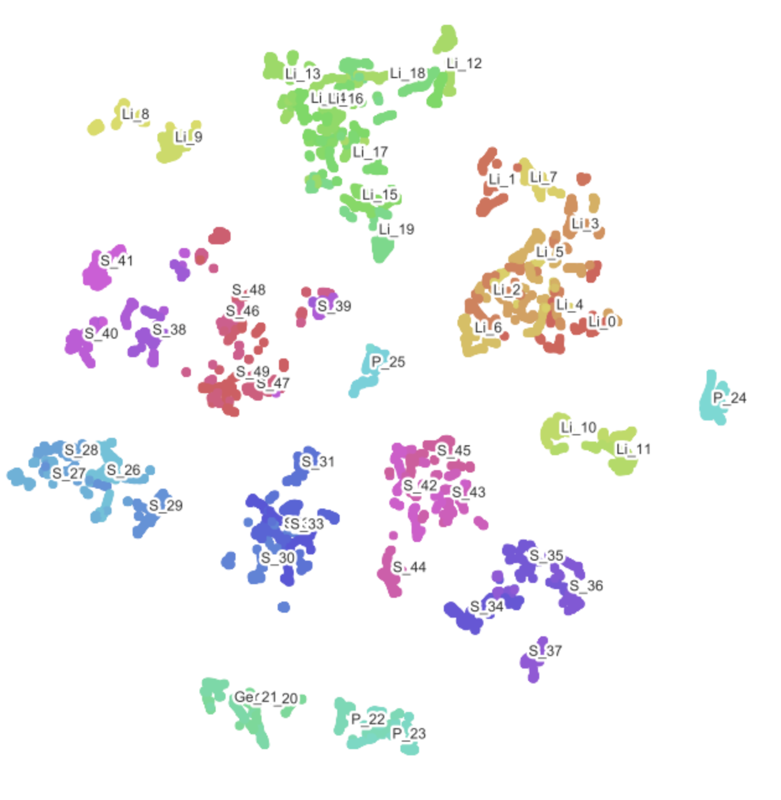
T-distributed Stochastic Neighbourhood Embedding
Hyperparameters:
Perplexity: controls how many nearby data points (neighbours) are taken into account when computing the probability distribution in the high-dimensional space.
Low perplexity: small tight clusters with few points
High perplexity: larger clusters
Perplexity
STFC Summer School 2024
Notes:
Given a set of data (x_i’s to x_n) in high dimensional space,
It starts by asking the question, given a data point x_i what’s the probability it would pick x_j as its neigbour?
It will be some function of distance between the data two data points P_(j|i) such that the closer the points are the higher its value, the farther away they are the lower the value.
The function should also depend on the proximity of all other data points, because one of those may be much closer.
The function should be such that if d_ij gets larger the function should get smaller, while if d_ik gets larger (negatively correlated), the function should ger larger because d_ij becomes relatively smaller (positively correlated
This function here meets those requirements – division of two gaussian functions
We can then use this formula to answer the next question, if we pick two point at random, what’s the probability they (let’s say I and j) are grouped together?
This is given by this formular here, which takes into account the probability we choose I first, and the probability we choose j first, th 1/N terms. We can call this a similarity score, based on distance, but answers the question of the probability that two points will be grouped together. We use this formula as a means of obtaining the probability distribution of high dimensional space.
How do we pick the standard deviation, sigma. We are going to make it dynamic so that it is different for each data point based on the density of points in its region of high dimensional space. We do this by setting a condition, for example we want sigma to be such that within say the first 2 standard deviations there will be four data points. Therefore if I was in a region of lowe density, sigma would have to be higher to incorporate four data points.
How do we get to the lower dimensional space, the goal is to learn a lower dimensional representation, usually 2 or 3d. We need to translate our x’s in higher dimensional space, to corresponding y’s in the lower dimensional space. We want to do so that we can preserve the similarities between data points we calculated in high dimensional space in the lower dimensional space, So if x1 and x2 are close, y1 and y2 are close.
To do this we want a caomparision of similarities of xs with similarities of ys, and adjust ys so that the similarities match. To measure low d similarities we could use the same formula, so we can use the same formula as for x’s but with y’s – Gaussian.
However, something goes wrong when we do this, the data points in lower dimensional space tend to be too squished together, making it difficult to identify structure. So instead of basing similarities on Gaussians, we use a student t-distribution, which has a longer flatter tail and is less peaked. Here is the , q_ij
Now we want these probability distributions to be similar, to be close to each other. To do this we use KL divergence which is a measure of the divergence or difference between two probability distributions, P in high d space and Q in low d space.
We can call this our loss function or error function that we wish to minimize. To do this we obtain the derivative of the formula and then shift points in low d space, our y’s, so that our loss moves towards a global minimum, the minimum of the loss function.
Now when you implement the algorithm, you need to set a few hyperparameters, that controls how the algorithms performs its actions. The most important ones are the perplexity and the n_iterations, and learning rate
n_iterations is just the number of update steps, the learning rate is the size of each step, the step size it takes towards the global minimum, too high you overshoot the minimum, too low, could get caught in a local minimum
Now remember how I discussed setting the standard deviation to control the width of the Gaussian functions. Well we do that with perplexity, without going over the maths again, perplexity is a measure of the sphere of influence of each data point - …

Slide 37
K-Means Clustering
Step 1: Define the number of clusters
Number of clusters, k, must be defined
Subject knowledge helps
Here we will guess k=3
Credit figures for K-Means: http://www.youtube.com/@datatab
Notes:
We have a dataset – find clusters that are present in the data
Step 1: First define the number of clusters you believe exist in your dataset, requires some subject knowledge. This is the k in k means, here k=3
Step 2: Randomly place three cluster centroids which represent the centres of each of our proposed clusters.
Step 3: Calculate the distance from each data point to each of the cluster centroids, and assign each data point to the closest centroid.
All points assigned to a given cluster centroid define a cluster so we have the three clusters defined here
Step 4: calculate the centre of each cluster – this will be the mean position of all the data points assigned to a given cluster
Step 5: Update the position of each cluster centroid to the mean position of all the data points assigned to it.
Now repeat steps 3 – 5, i.e., calculate distance of each point to each centroid, assign each point to the closest centroid to form new clusters, update centroid position to the mean of data points assigned to it.
Repeat until centroids move no further, or until n_iterations reached.
Be aware that different random initialization of cluster centroid positions may yield different end results
We need to identify optimal number of clusters, we may not know, we can use Elbow method
calculate the sum of squared distances between each data point and its final cluster centroid for different values of k clusters, the elbow point, the number cluster after which the reduction in the sum of squared distance only reduces by a small amount is used.
Sillhoutte method is a measure of how similar an object is to its own cluster compated to other clusters.
The sillhoutte score is given as:

Slide 38
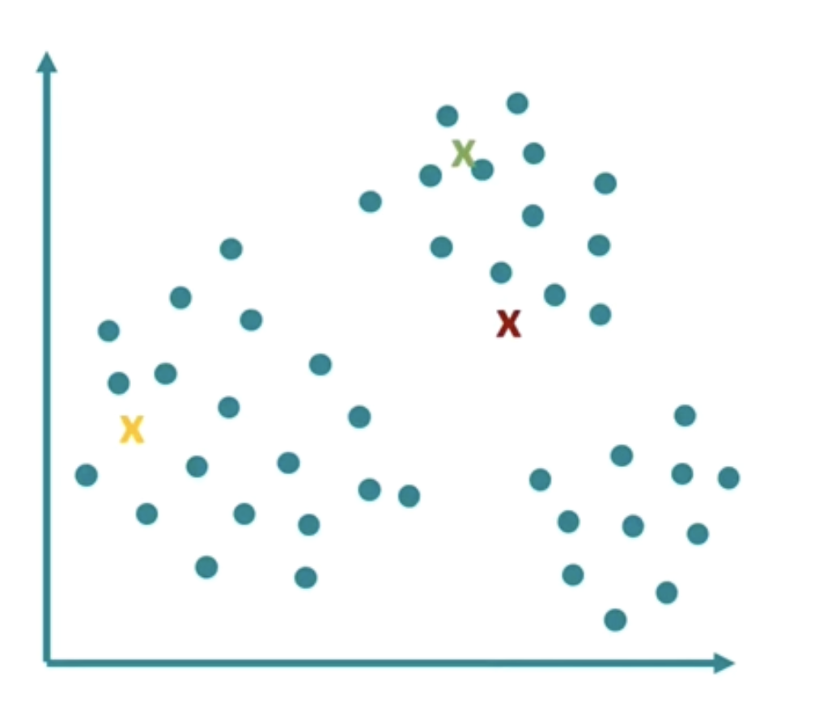
K-Means Clustering
Step 1: Define the number of clusters
Step 2: Randomly position the cluster centroids
Cluster centroids define the centres of each proposed cluster
Assigned randomly in data space
Notes:
We have a dataset – find clusters that are present in the data
Step 1: First define the number of clusters you believe exist in your dataset, requires some subject knowledge. This is the k in k means, here k=3
Step 2: Randomly place three cluster centroids which represent the centres of each of our proposed clusters.
Step 3: Calculate the distance from each data point to each of the cluster centroids, and assign each data point to the closest centroid.
All points assigned to a given cluster centroid define a cluster so we have the three clusters defined here
Step 4: calculate the centre of each cluster – this will be the mean position of all the data points assigned to a given cluster
Step 5: Update the position of each cluster centroid to the mean position of all the data points assigned to it.
Now repeat steps 3 – 5, i.e., calculate distance of each point to each centroid, assign each point to the closest centroid to form new clusters, update centroid position to the mean of data points assigned to it.
Repeat until centroids move no further, or until n_iterations reached.
Be aware that different random initialization of cluster centroid positions may yield different end results
We need to identify optimal number of clusters, we may not know, we can use Elbow method
calculate the sum of squared distances between each data point and its final cluster centroid for different values of k clusters, the elbow point, the number cluster after which the reduction in the sum of squared distance only reduces by a small amount is used.
Sillhoutte method is a measure of how similar an object is to its own cluster compated to other clusters.
The sillhoutte score is given as:

Slide 39
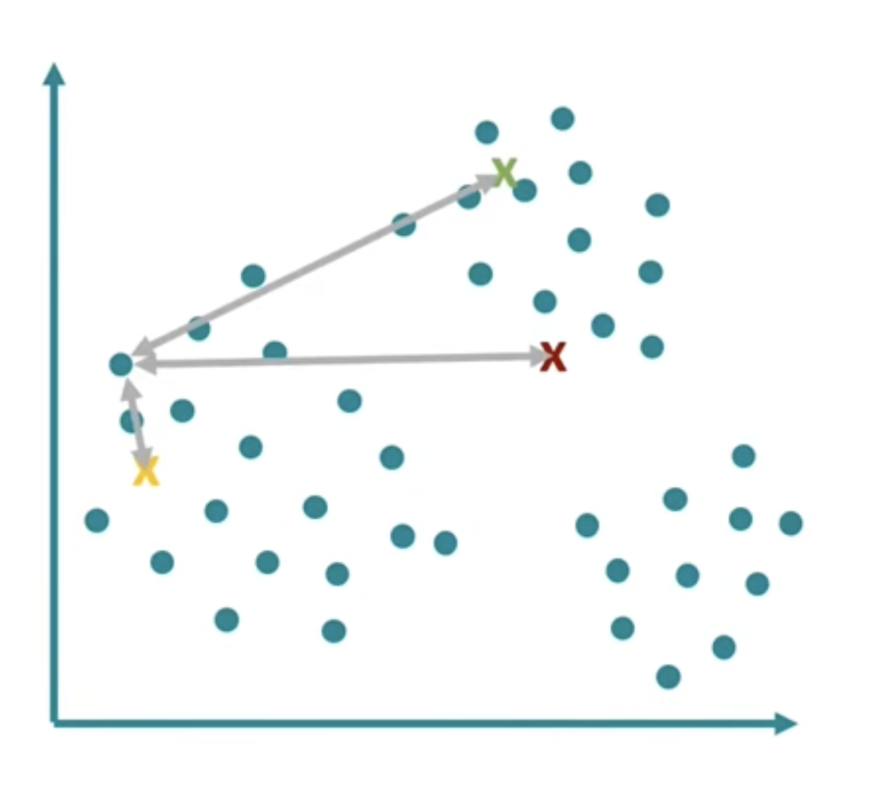
K-Means Clustering
Step 1: Define the number of clusters
Step 2: Randomly position the cluster centroids
Step 3: Assign points to cluster centroids
Calculate the distance from each point to each cluster centroid
Assign each point to the centroid that is closest
All points assigned to a given centroid define a cluster
Notes:
We have a dataset – find clusters that are present in the data
Step 1: First define the number of clusters you believe exist in your dataset, requires some subject knowledge. This is the k in k means, here k=3
Step 2: Randomly place three cluster centroids which represent the centres of each of our proposed clusters.
Step 3: Calculate the distance from each data point to each of the cluster centroids, and assign each data point to the closest centroid.
All points assigned to a given cluster centroid define a cluster so we have the three clusters defined here
Step 4: calculate the centre of each cluster – this will be the mean position of all the data points assigned to a given cluster
Step 5: Update the position of each cluster centroid to the mean position of all the data points assigned to it.
Now repeat steps 3 – 5, i.e., calculate distance of each point to each centroid, assign each point to the closest centroid to form new clusters, update centroid position to the mean of data points assigned to it.
Repeat until centroids move no further, or until n_iterations reached.
Be aware that different random initialization of cluster centroid positions may yield different end results
We need to identify optimal number of clusters, we may not know, we can use Elbow method
calculate the sum of squared distances between each data point and its final cluster centroid for different values of k clusters, the elbow point, the number cluster after which the reduction in the sum of squared distance only reduces by a small amount is used.
Sillhoutte method is a measure of how similar an object is to its own cluster compated to other clusters.
The sillhoutte score is given as:

Slide 40
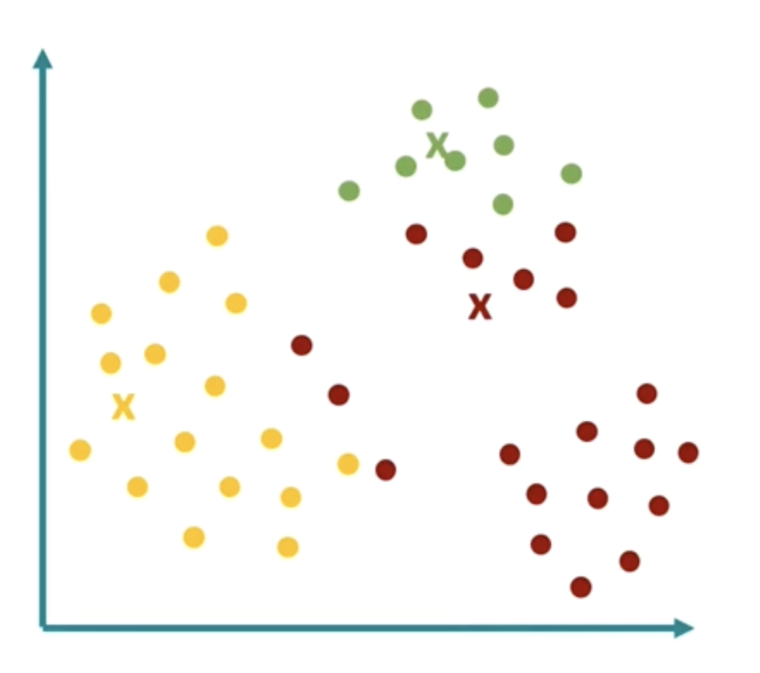
K-Means Clustering
Step 1: Define the number of clusters
Step 2: Randomly position the cluster centroids
Step 3: Assign points to cluster centroids
Calculate the distance from each point to each cluster centroid
Assign each point to the centroid that is closest
All points assigned to a given centroid define a cluster
Notes:
We have a dataset – find clusters that are present in the data
Step 1: First define the number of clusters you believe exist in your dataset, requires some subject knowledge. This is the k in k means, here k=3
Step 2: Randomly place three cluster centroids which represent the centres of each of our proposed clusters.
Step 3: Calculate the distance from each data point to each of the cluster centroids, and assign each data point to the closest centroid.
All points assigned to a given cluster centroid define a cluster so we have the three clusters defined here
Step 4: calculate the centre of each cluster – this will be the mean position of all the data points assigned to a given cluster
Step 5: Update the position of each cluster centroid to the mean position of all the data points assigned to it.
Now repeat steps 3 – 5, i.e., calculate distance of each point to each centroid, assign each point to the closest centroid to form new clusters, update centroid position to the mean of data points assigned to it.
Repeat until centroids move no further, or until n_iterations reached.
Be aware that different random initialization of cluster centroid positions may yield different end results
We need to identify optimal number of clusters, we may not know, we can use Elbow method
calculate the sum of squared distances between each data point and its final cluster centroid for different values of k clusters, the elbow point, the number cluster after which the reduction in the sum of squared distance only reduces by a small amount is used.
Sillhoutte method is a measure of how similar an object is to its own cluster compated to other clusters.
The sillhoutte score is given as:

Slide 41
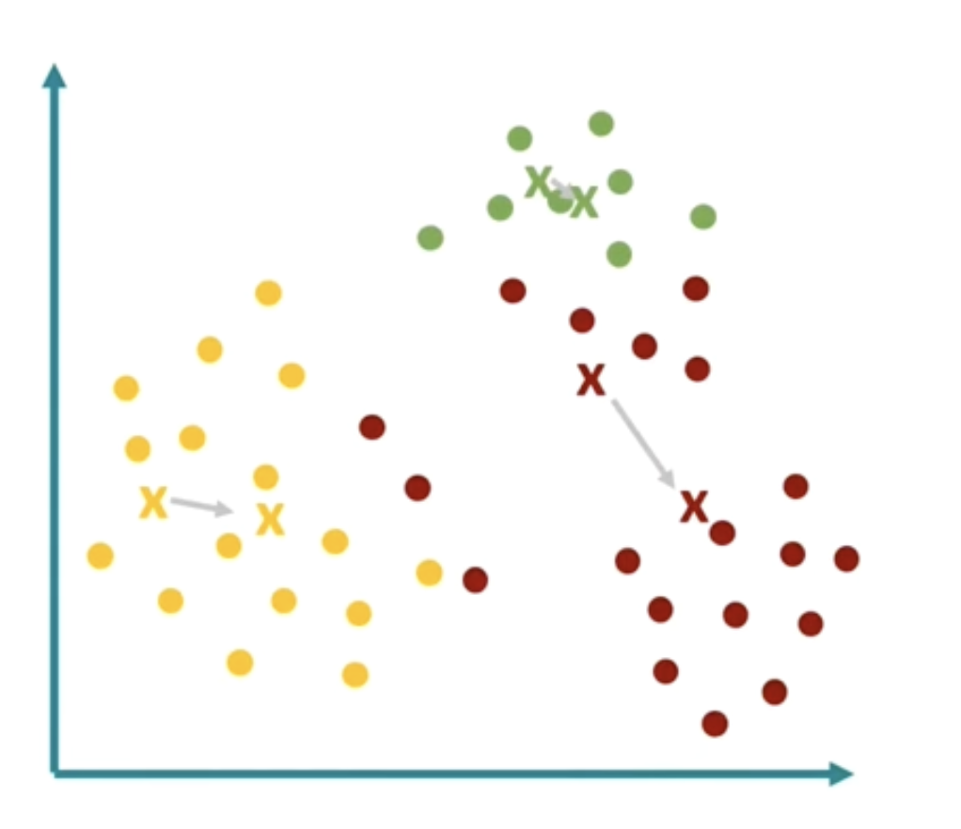
K-Means Clustering
Step 1: Define the number of clusters
Step 2: Randomly position the cluster centroids
Step 3: Assign points to cluster centroids
Step 4: Calculate the mean position of each cluster
i.e., the centre of each cluster
Notes:
We have a dataset – find clusters that are present in the data
Step 1: First define the number of clusters you believe exist in your dataset, requires some subject knowledge. This is the k in k means, here k=3
Step 2: Randomly place three cluster centroids which represent the centres of each of our proposed clusters.
Step 3: Calculate the distance from each data point to each of the cluster centroids, and assign each data point to the closest centroid.
All points assigned to a given cluster centroid define a cluster so we have the three clusters defined here
Step 4: calculate the centre of each cluster – this will be the mean position of all the data points assigned to a given cluster
Step 5: Update the position of each cluster centroid to the mean position of all the data points assigned to it.
Now repeat steps 3 – 5, i.e., calculate distance of each point to each centroid, assign each point to the closest centroid to form new clusters, update centroid position to the mean of data points assigned to it.
Repeat until centroids move no further, or until n_iterations reached.
Be aware that different random initialization of cluster centroid positions may yield different end results
We need to identify optimal number of clusters, we may not know, we can use Elbow method
calculate the sum of squared distances between each data point and its final cluster centroid for different values of k clusters, the elbow point, the number cluster after which the reduction in the sum of squared distance only reduces by a small amount is used.
Sillhoutte method is a measure of how similar an object is to its own cluster compated to other clusters.
The sillhoutte score is given as:

Slide 42
K-Means Clustering
Step 1: Define the number of clusters
Step 2: Randomly position the cluster centroids
Step 3: Assign points to cluster centroids
Step 4: Calculate the mean position of each cluster
Step 5: Update cluster centroid positions
Reposition the centroids to the mean position of their cluster
Notes:
We have a dataset – find clusters that are present in the data
Step 1: First define the number of clusters you believe exist in your dataset, requires some subject knowledge. This is the k in k means, here k=3
Step 2: Randomly place three cluster centroids which represent the centres of each of our proposed clusters.
Step 3: Calculate the distance from each data point to each of the cluster centroids, and assign each data point to the closest centroid.
All points assigned to a given cluster centroid define a cluster so we have the three clusters defined here
Step 4: calculate the centre of each cluster – this will be the mean position of all the data points assigned to a given cluster
Step 5: Update the position of each cluster centroid to the mean position of all the data points assigned to it.
Now repeat steps 3 – 5, i.e., calculate distance of each point to each centroid, assign each point to the closest centroid to form new clusters, update centroid position to the mean of data points assigned to it.
Repeat until centroids move no further, or until n_iterations reached.
Be aware that different random initialization of cluster centroid positions may yield different end results
We need to identify optimal number of clusters, we may not know, we can use Elbow method
calculate the sum of squared distances between each data point and its final cluster centroid for different values of k clusters, the elbow point, the number cluster after which the reduction in the sum of squared distance only reduces by a small amount is used.
Sillhoutte method is a measure of how similar an object is to its own cluster compated to other clusters.
The sillhoutte score is given as:

Slide 43
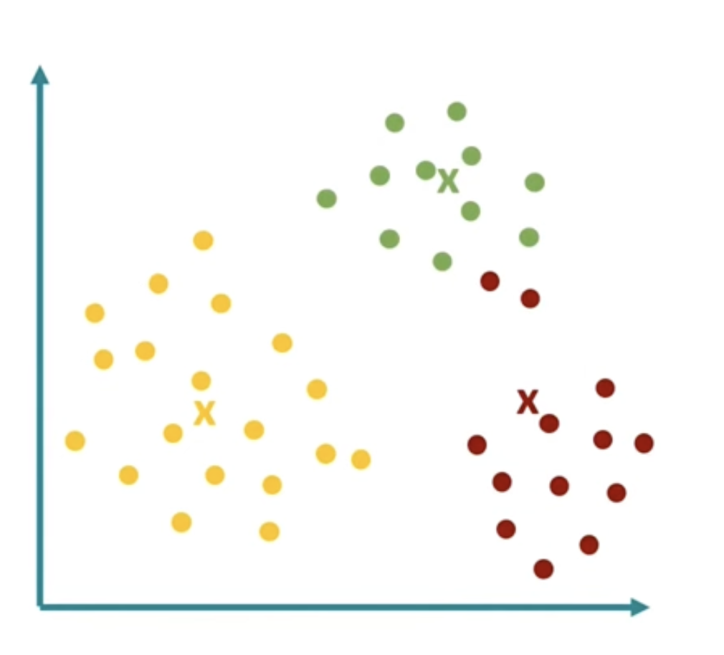
K-Means Clustering
Step 1: Define the number of clusters
Step 2: Randomly position the cluster centroids
Step 3: Assign points to cluster centroids
Step 4: Calculate the mean position of each cluster
Step 5: Update cluster centroid positions
Step 6: Assign points to new clusters
Since centroid positions are at different locations
Assign each data point to the cluster centroid that is closest to it.
Notes:
We have a dataset – find clusters that are present in the data
Step 1: First define the number of clusters you believe exist in your dataset, requires some subject knowledge. This is the k in k means, here k=3
Step 2: Randomly place three cluster centroids which represent the centres of each of our proposed clusters.
Step 3: Calculate the distance from each data point to each of the cluster centroids, and assign each data point to the closest centroid.
All points assigned to a given cluster centroid define a cluster so we have the three clusters defined here
Step 4: calculate the centre of each cluster – this will be the mean position of all the data points assigned to a given cluster
Step 5: Update the position of each cluster centroid to the mean position of all the data points assigned to it.
Now repeat steps 3 – 5, i.e., calculate distance of each point to each centroid, assign each point to the closest centroid to form new clusters, update centroid position to the mean of data points assigned to it.
Repeat until centroids move no further, or until n_iterations reached.
Be aware that different random initialization of cluster centroid positions may yield different end results
We need to identify optimal number of clusters, we may not know, we can use Elbow method
calculate the sum of squared distances between each data point and its final cluster centroid for different values of k clusters, the elbow point, the number cluster after which the reduction in the sum of squared distance only reduces by a small amount is used.
Sillhoutte method is a measure of how similar an object is to its own cluster compated to other clusters.
The sillhoutte score is given as:

Slide 44
K-Means Clustering
Step 1: Define the number of clusters
Step 2: Randomly position the cluster centroids
Step 3: Assign points to cluster centroids
Step 4: Calculate the mean position of each cluster
Step 5: Update cluster centroid positions
Step 6: Assign points to new clusters
Steps 4 – 6 are repeated until cluster centroid position do not change anymore
Notes:
We have a dataset – find clusters that are present in the data
Step 1: First define the number of clusters you believe exist in your dataset, requires some subject knowledge. This is the k in k means, here k=3
Step 2: Randomly place three cluster centroids which represent the centres of each of our proposed clusters.
Step 3: Calculate the distance from each data point to each of the cluster centroids, and assign each data point to the closest centroid.
All points assigned to a given cluster centroid define a cluster so we have the three clusters defined here
Step 4: calculate the centre of each cluster – this will be the mean position of all the data points assigned to a given cluster
Step 5: Update the position of each cluster centroid to the mean position of all the data points assigned to it.
Now repeat steps 3 – 5, i.e., calculate distance of each point to each centroid, assign each point to the closest centroid to form new clusters, update centroid position to the mean of data points assigned to it.
Repeat until centroids move no further, or until n_iterations reached.
Be aware that different random initialization of cluster centroid positions may yield different end results
We need to identify optimal number of clusters, we may not know, we can use Elbow method
calculate the sum of squared distances between each data point and its final cluster centroid for different values of k clusters, the elbow point, the number cluster after which the reduction in the sum of squared distance only reduces by a small amount is used.
Sillhoutte method is a measure of how similar an object is to its own cluster compated to other clusters.
The sillhoutte score is given as:

Slide 45
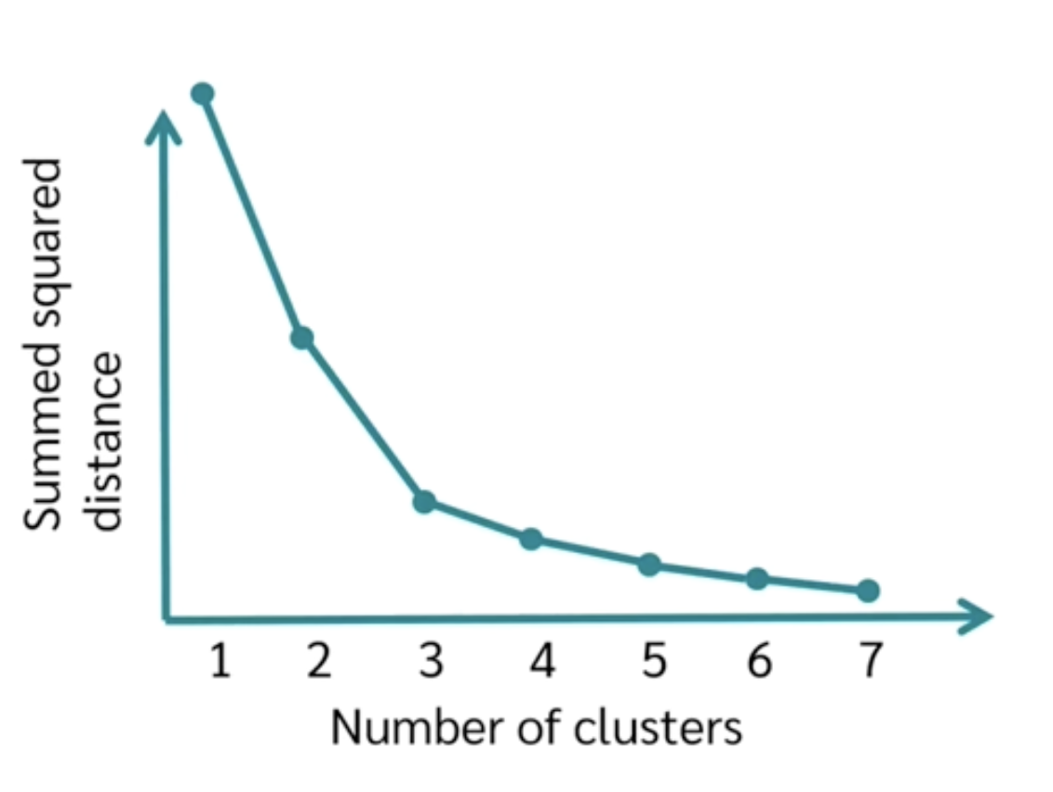
K-Means Clustering
Optimal K: Elbow Method
Calculate the sum of squared distances between each point and its cluster centroid
Do this for increasing values of k
Find the the value of k beyond which the sum of squared distances only reduces slightly
This is our optimal value
Notes:
We have a dataset – find clusters that are present in the data
Step 1: First define the number of clusters you believe exist in your dataset, requires some subject knowledge. This is the k in k means, here k=3
Step 2: Randomly place three cluster centroids which represent the centres of each of our proposed clusters.
Step 3: Calculate the distance from each data point to each of the cluster centroids, and assign each data point to the closest centroid.
All points assigned to a given cluster centroid define a cluster so we have the three clusters defined here
Step 4: calculate the centre of each cluster – this will be the mean position of all the data points assigned to a given cluster
Step 5: Update the position of each cluster centroid to the mean position of all the data points assigned to it.
Now repeat steps 3 – 5, i.e., calculate distance of each point to each centroid, assign each point to the closest centroid to form new clusters, update centroid position to the mean of data points assigned to it.
Repeat until centroids move no further, or until n_iterations reached.
Be aware that different random initialization of cluster centroid positions may yield different end results
We need to identify optimal number of clusters, we may not know, we can use Elbow method
calculate the sum of squared distances between each data point and its final cluster centroid for different values of k clusters, the elbow point, the number cluster after which the reduction in the sum of squared distance only reduces by a small amount is used.
Sillhoutte method is a measure of how similar an object is to its own cluster compated to other clusters.
The sillhoutte score is given as:

Slide 46
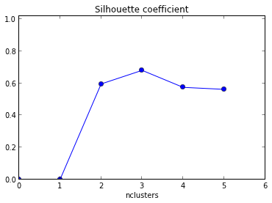
K-Means Clustering
Optimal K: Sillhouette score
For each data point calculate the average distance to all other points in its cluster, $a$
For each data point, calculate the average distance to all points in the neighbouring clusters, $b$
Compute the Sillhouette score for a data point using
$$s=\frac{b−a}{max⁡(a,b)}$$
Scores range from -1 to 1.
S=1 means the point is well matched to its own cluster and poorly matched to neighbouring clusters.
S=1 indicates the datapoint is on or close to a decision boundary between clusters,
S= -1 suggests the points may have been assigned to the wrong cluster.
Calculate the average Sillhouette score for all data points.
Do this for several values of k.
Notes:
We have a dataset – find clusters that are present in the data
Step 1: First define the number of clusters you believe exist in your dataset, requires some subject knowledge. This is the k in k means, here k=3
Step 2: Randomly place three cluster centroids which represent the centres of each of our proposed clusters.
Step 3: Calculate the distance from each data point to each of the cluster centroids, and assign each data point to the closest centroid.
All points assigned to a given cluster centroid define a cluster so we have the three clusters defined here
Step 4: calculate the centre of each cluster – this will be the mean position of all the data points assigned to a given cluster
Step 5: Update the position of each cluster centroid to the mean position of all the data points assigned to it.
Now repeat steps 3 – 5, i.e., calculate distance of each point to each centroid, assign each point to the closest centroid to form new clusters, update centroid position to the mean of data points assigned to it.
Repeat until centroids move no further, or until n_iterations reached.
Be aware that different random initialization of cluster centroid positions may yield different end results
We need to identify optimal number of clusters, we may not know, we can use Elbow method
calculate the sum of squared distances between each data point and its final cluster centroid for different values of k clusters, the elbow point, the number cluster after which the reduction in the sum of squared distance only reduces by a small amount is used.
Sillhoutte method is a measure of how similar an object is to its own cluster compated to other clusters.
The sillhoutte score is given as:

Slide 47
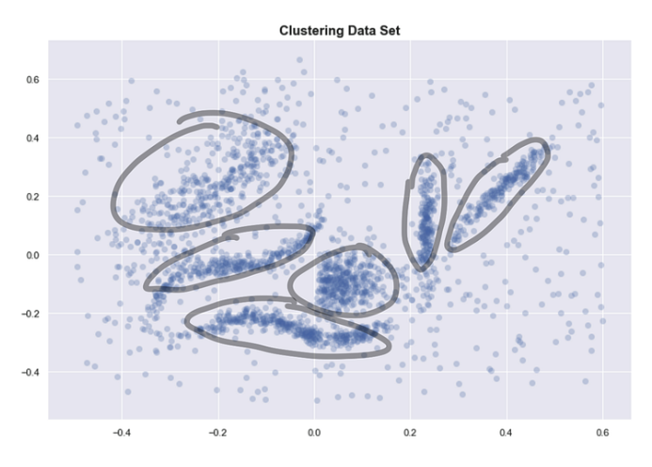
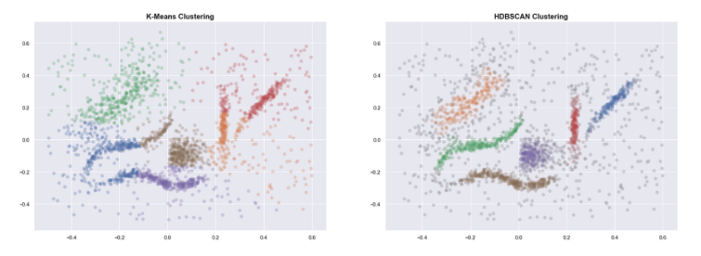
HDBSCAN Hierarchical Density-Based Spatial Clustering of Applications with Noise
Why density based?
K-Means assumes cluster are:
‘round’ or spherical
Equally sized
Equally dense
Not contaminated by noise/outliers
HDBSCAN is density based and accepts clusters with
Arbitrary shapes
Different sizes
Different densities (Hierarchical)
Identifies noise/outliers

Slide 48
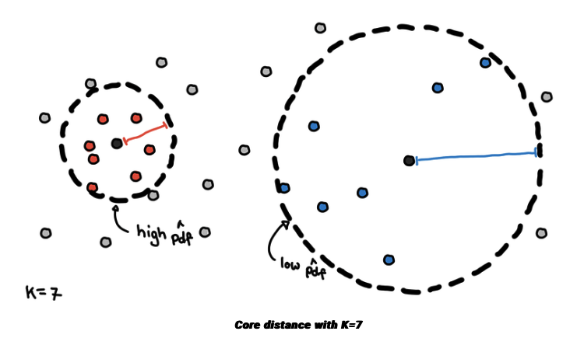
HDBSCAN Hierarchical Density-Based Spatial Clustering of Applications with Noise
How do we estimate densities?
We measure the “core distance” of each point
This is the distance of a point to its K-th nearest neighbour
Points in denser regions would have smaller core distances while points in sparser regions would have larger core distances
We can derive an estimate of the density by getting the inverse of it
Credit figure: https://pberba.github.io/stats/2020/07/08/intro-hdbscan/

Slide 49
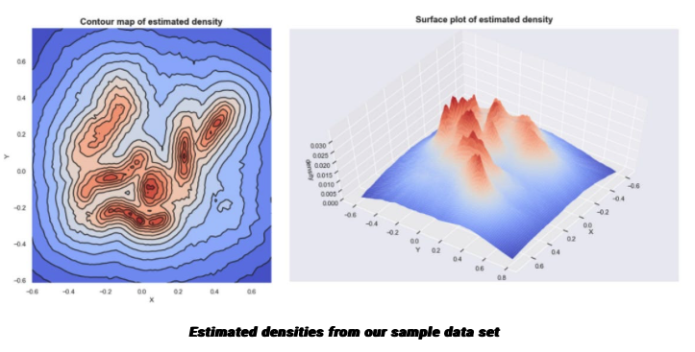
HDBSCAN Hierarchical Density-Based Spatial Clustering of Applications with Noise
Density Map
If we plot these densities, we can see that the mountains of this density landscape correspond to the different clusters of the data.
Credit figure: https://pberba.github.io/stats/2020/07/08/intro-hdbscan/

Slide 50
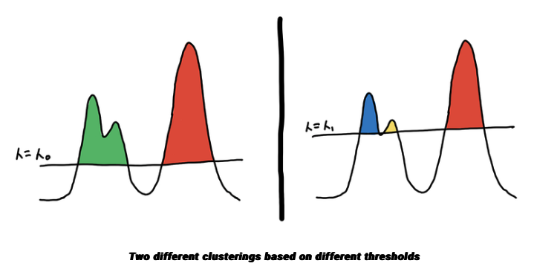
HDBSCAN Hierarchical Density-Based Spatial Clustering of Applications with Noise
Density Map – Cluster Selection
If we plot these densities, we can see that the mountains of this density landscape correspond to the different clusters of the data.
One way to select clusters is to pick a global threshold. By getting the points with densities (inverse core distances) above the threshold, and grouping these points together, we get our clusters.
Credit figure: https://pberba.github.io/stats/2020/07/08/intro-hdbscan/

Slide 51
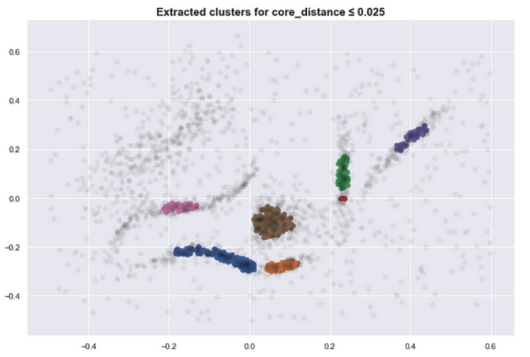
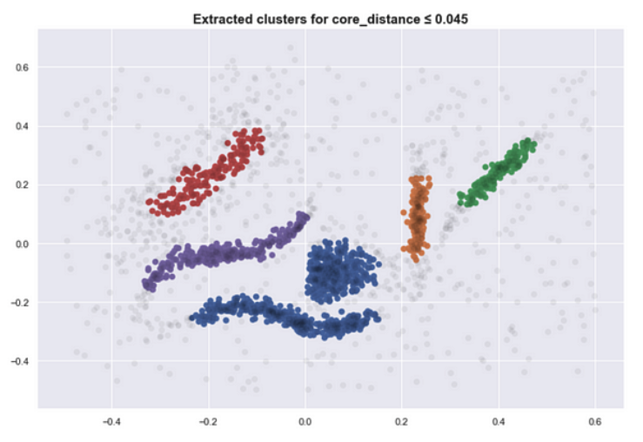
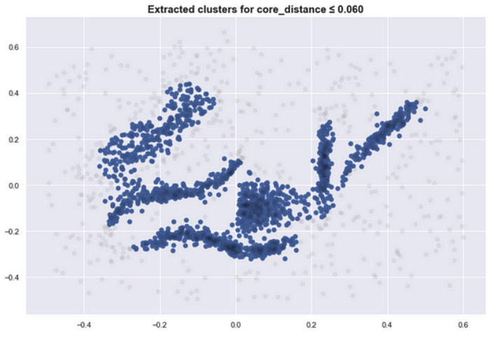
HDBSCAN Hierarchical Density-Based Spatial Clustering of Applications with Noise
Density Map – Cluster Selection
If we plot these densities, we can see that the mountains of this density landscape correspond to the different clusters of the data.
One way to select clusters is to pick a global threshold. By getting the points with densities (inverse core distances) above the threshold, and grouping these points together, we get our clusters.
Imagine islands on the ocean, where the sea level is the threshold and the different islands are your clusters. The land below the sea level is noise.
As the sea level goes down, new islands appear and some islands combine to form bigger islands. Here are several clusters that result as we lower the sea level, i.e., lower the density (inverse core distance) threshold)
Credit figure: https://pberba.github.io/stats/2020/07/08/intro-hdbscan/

Slide 52
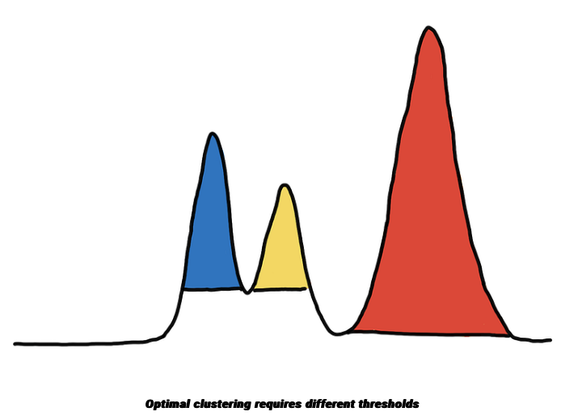
HDBSCAN Hierarchical Density-Based Spatial Clustering of Applications with Noise
Cluster Selection for varying densities
Clusters likely have varying densities
If we use just one threshold in the example, we either over-group the blue and yellow clusters or we fail to include the entire red cluster
Credit figure: https://pberba.github.io/stats/2020/07/08/intro-hdbscan/

Slide 53
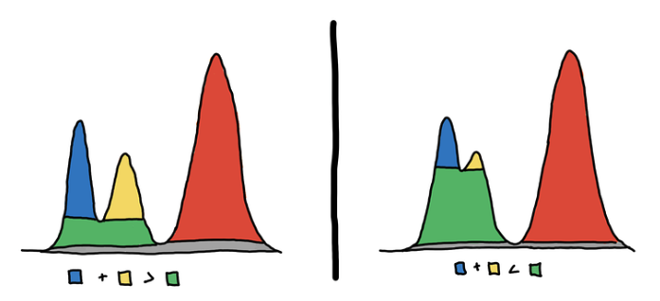
HDBSCAN Hierarchical Density-Based Spatial Clustering of Applications with Noise
Cluster Selection for varying densities
Clusters likely have varying densities
If we use just one threshold in the example, we either over-group the blue and yellow clusters or we fail to include the entire red cluster
You might be tempted to think that each peak in the density should be one cluster, however, this will not always be optimal.
On the left, there should be 3 clusters, and on the right, there should be 2 clusters.
HDBSCAN builds a hierarchy to figure out which peaks end up merging together and in what order, and then for each cluster it asks, is it better to keep this cluster or split it up into its subclusters?
Decide whether or not two peaks are part of the same mountain
Credit figure: https://pberba.github.io/stats/2020/07/08/intro-hdbscan/

Slide 54
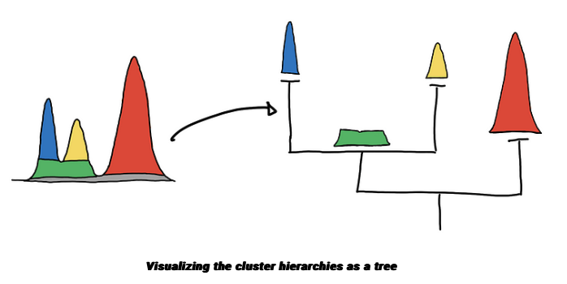
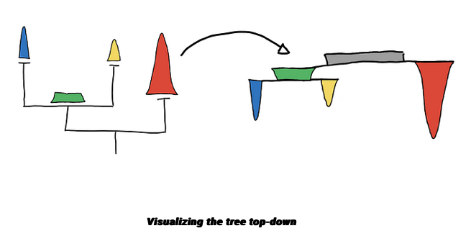
HDBSCAN Hierarchical Density-Based Spatial Clustering of Applications with Noise
Constructing the hierarchy
By getting the groups (individual mountains) at different values of threshold, 𝜆, we get a hierarchy
As you lower the sea level, the islands will start to “grow” and eventually islands will start to connect with one another.
To be able to capture and represent these relationships between clusters (islands), we represent it as a hierarchy tree.
trees are drawn top-down, where the root is at the top and the tree grows downward.
Credit figure: https://pberba.github.io/stats/2020/07/08/intro-hdbscan/

Slide 55
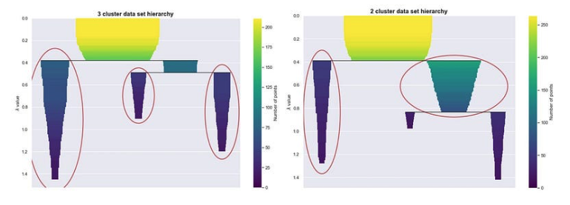
HDBSCAN Hierarchical Density-Based Spatial Clustering of Applications with Noise
Choosing clusters
We look at which branch “persists” more.
Cluster stability (persistence) is represented by the areas of the different colored regions in the hierarchy plot.
HDBSCAN use cluster stability to answer what are mountain, and what are just mountain features
When the two peaks are actually two mountains, the sum of the volume of the two peaks is larger than the volume of their base.
When the peaks are just features of a single mountain, then the volume of the base would be larger than the sum of the peaks’ volume
Credit figure: https://pberba.github.io/stats/2020/07/08/intro-hdbscan/

Slide 56
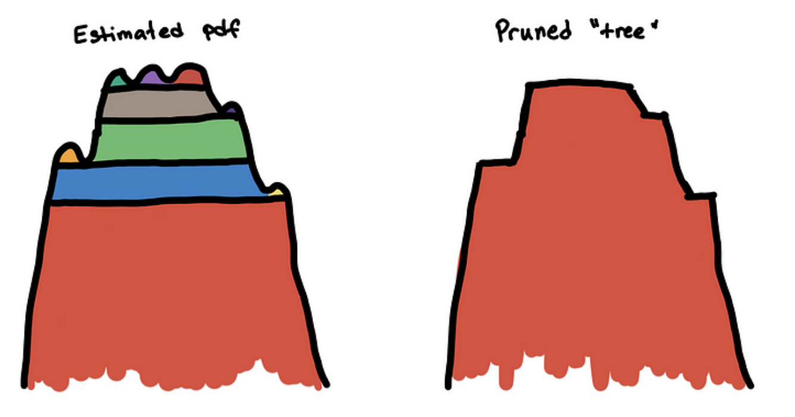
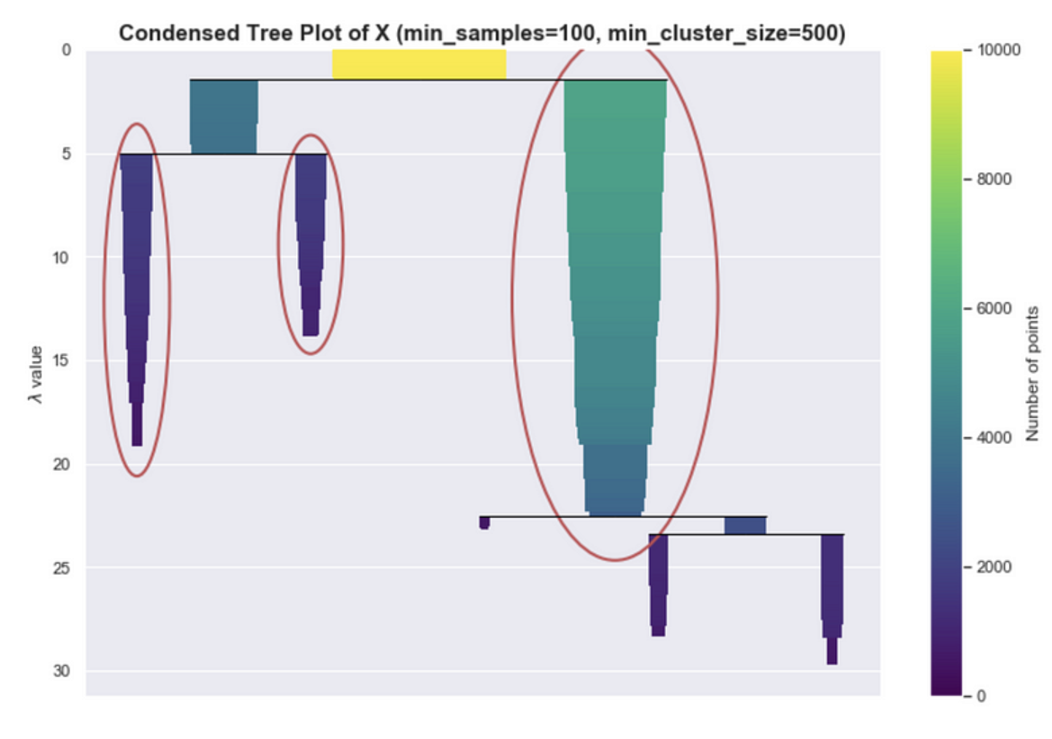
HDBSCAN Hierarchical Density-Based Spatial Clustering of Applications with Noise
Hyperparameters
min_cluster_size
The underlying PDF that we are trying to estimate may not be smooth. This affects the persistence measures of the clusters
little bumps are interpreted as mini-clusters, the persistence measures of the true clusters are divided into small segments.
To solve this, we flatten these small bumps using this hyperparameter; “trimming” the clusters that are not big enough in the hierarchy tree.
Dictates the maximum size of a “bump” before it is considered a peak. Increasing the value of min_cluster_size smoothes the estimated PDF so that the true peaks of the distributions become prominent.
min_samples
Core distance is defined as the distance to the K-th nearest neighbour. The hyperparameter K is referred to as min_samples in the HDBSCAN API.
Higher values lead to more stringent density requirements for cluster formation.
Lower values enable the identification of smaller clusters and outliers.
cluster_selection_epsilon
Affects the selection of clusters by specifying the maximum distance allowed from a cluster's core point to a neighboring point for it to be included in the cluster.
Fine-tunes the boundary of clusters, influencing the granularity of cluster boundaries.
Points within cluster_selection_epsilon distance from a cluster's core point are considered part of the cluster.
Helps in capturing points that are close to but not densely packed with the cluster's core.
Credit figure: https://pberba.github.io/stats/2020/07/08/intro-hdbscan/

