Slide 1
Progress with the 1S-module
Introduction & Status
Duncan Parker (dparker@ic.ac.uk)
13/11/2024

Slide 2
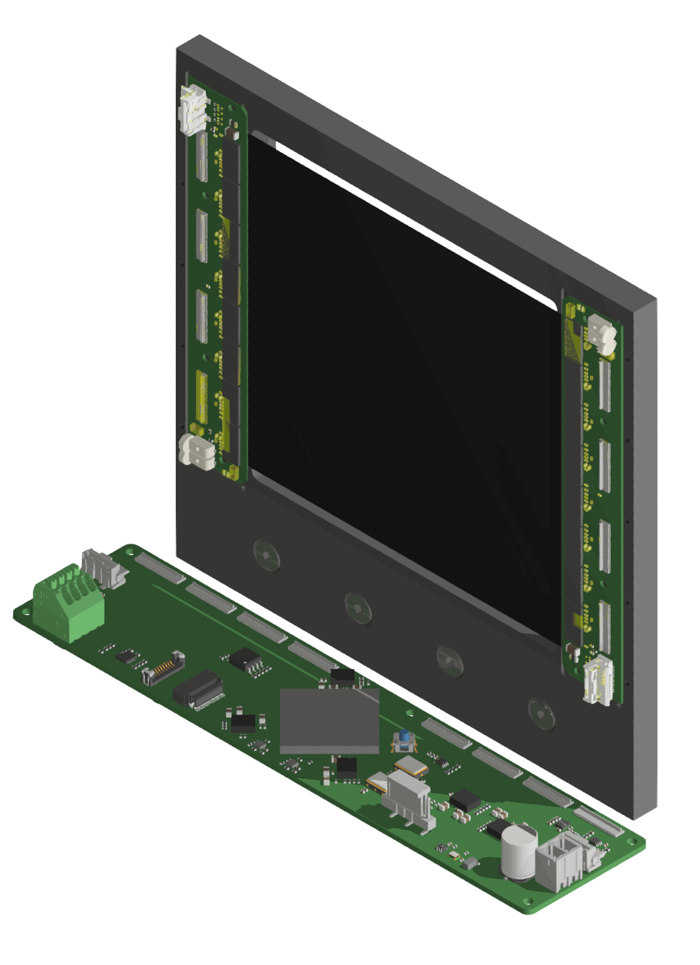
Progress with 1S-module
Aims of Project
Produce a design for tracking stages that are suitable for:
Beam Telescopes
Fixed Target experiments
R&D activities
To leverage/piggyback on new technologies and designs developed for the CMS upgrade:
Silicon Sensors
ASICs
Backend hardware (Serenity)
To use as much as possible COTS hardware to:
Avoid exotic technologies such as HDI flex PCBs
Reduce cost
Simplify system support requirements
Make design iterable at 'normal' costs...
Illustrative picture

Slide 3
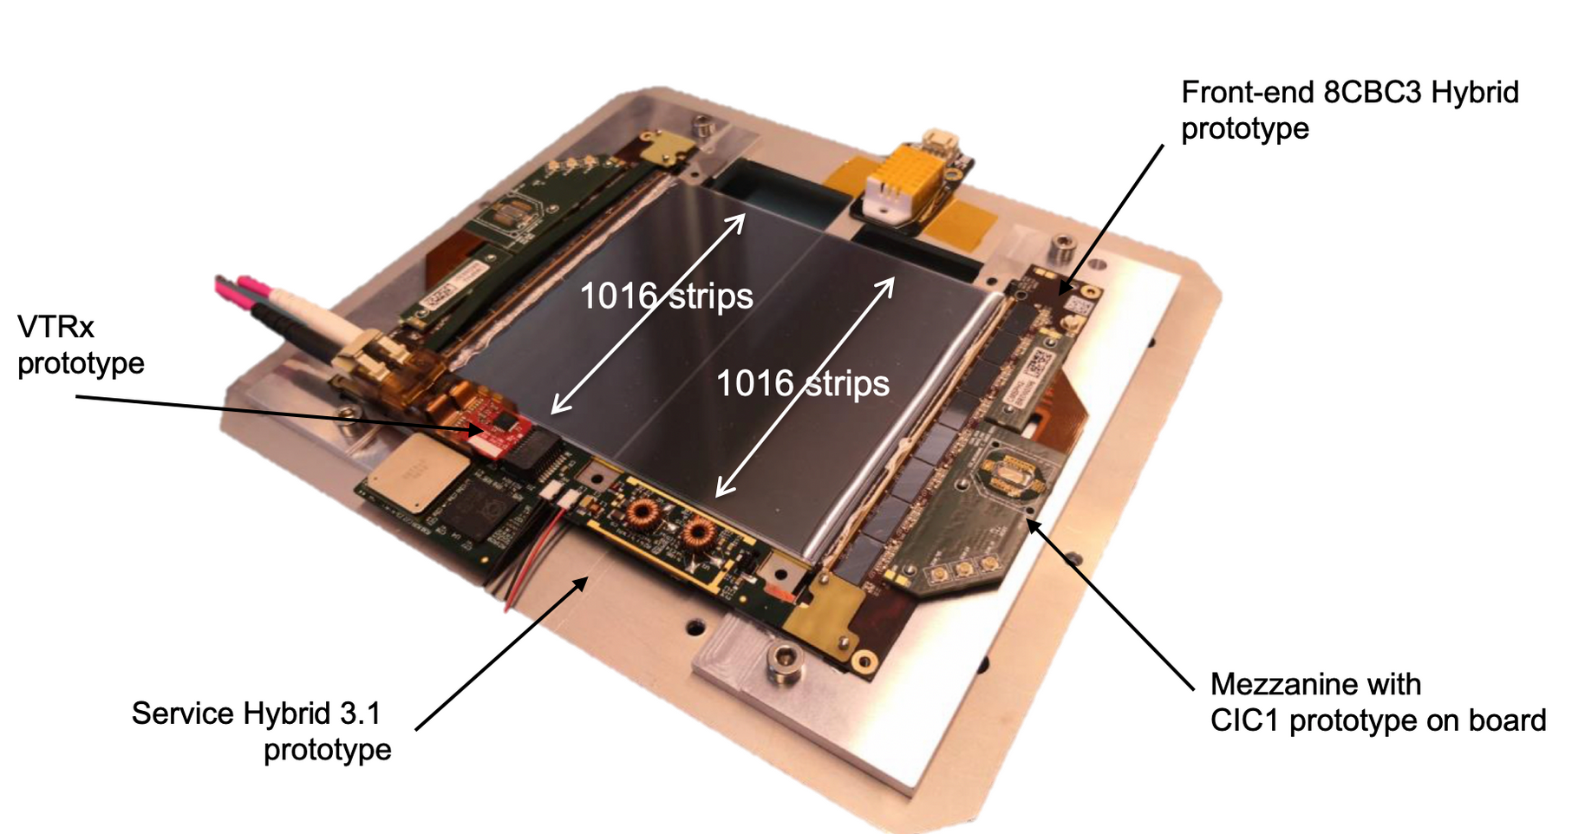
Progress with 1S-module
A Quick look at the CERN 2S module
Double sensor arrangement for resolving bends
Little benefit in many applications
Introduces additional material into beam path
Front-end & Service Hybrid Board
High B Field, High radiation tolerance design
Custom devices:
    CBC3 & CIC
    LPGBT & VTRx
    Power Hybrids
2S Devices are scarce
Availability will be a consequence of module surplus
All needed to work in CMS constraints, but come with many overheads.
https://cds.cern.ch/record/2703569/plots

Slide 4
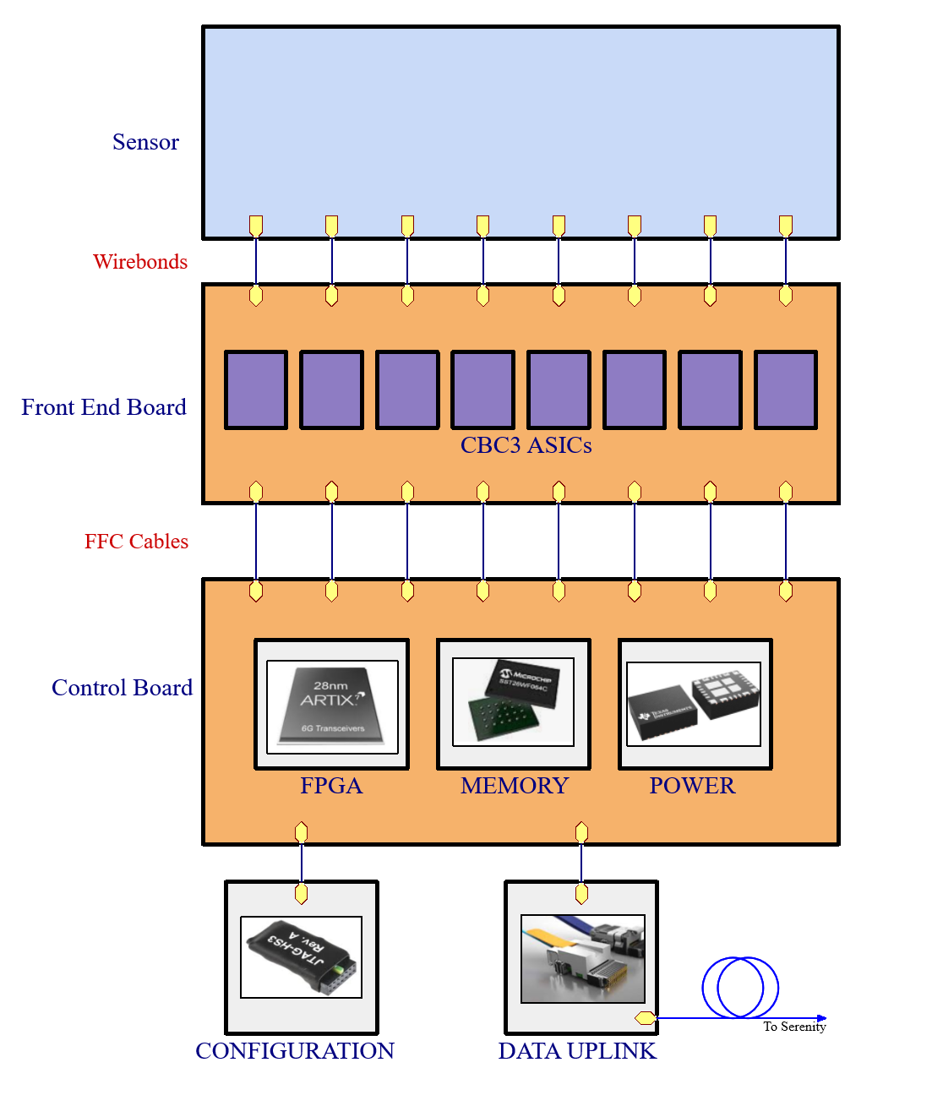
Progress with 1S-module
Introducing the 1S module
Our design consists of
A single CMS Silicon strip sensor:
1016 channels @ 90 um
2 Front end boards:
8 x CBC ASICs
~1k wire bond pads to sensor
Sensor bias filtering and distribution
Connectors to control board
Control board:
FPGA
Power conversion
Bias control
Fibre interface to DAQ

Slide 5
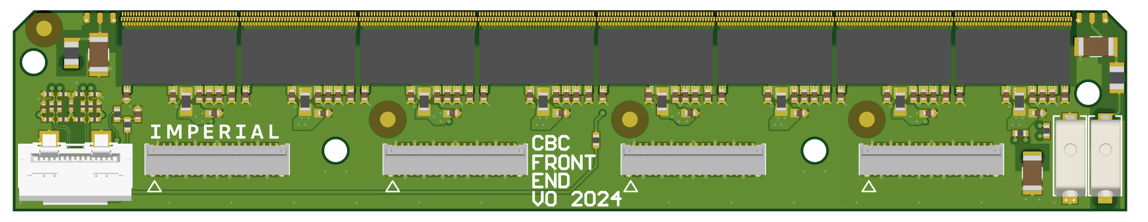
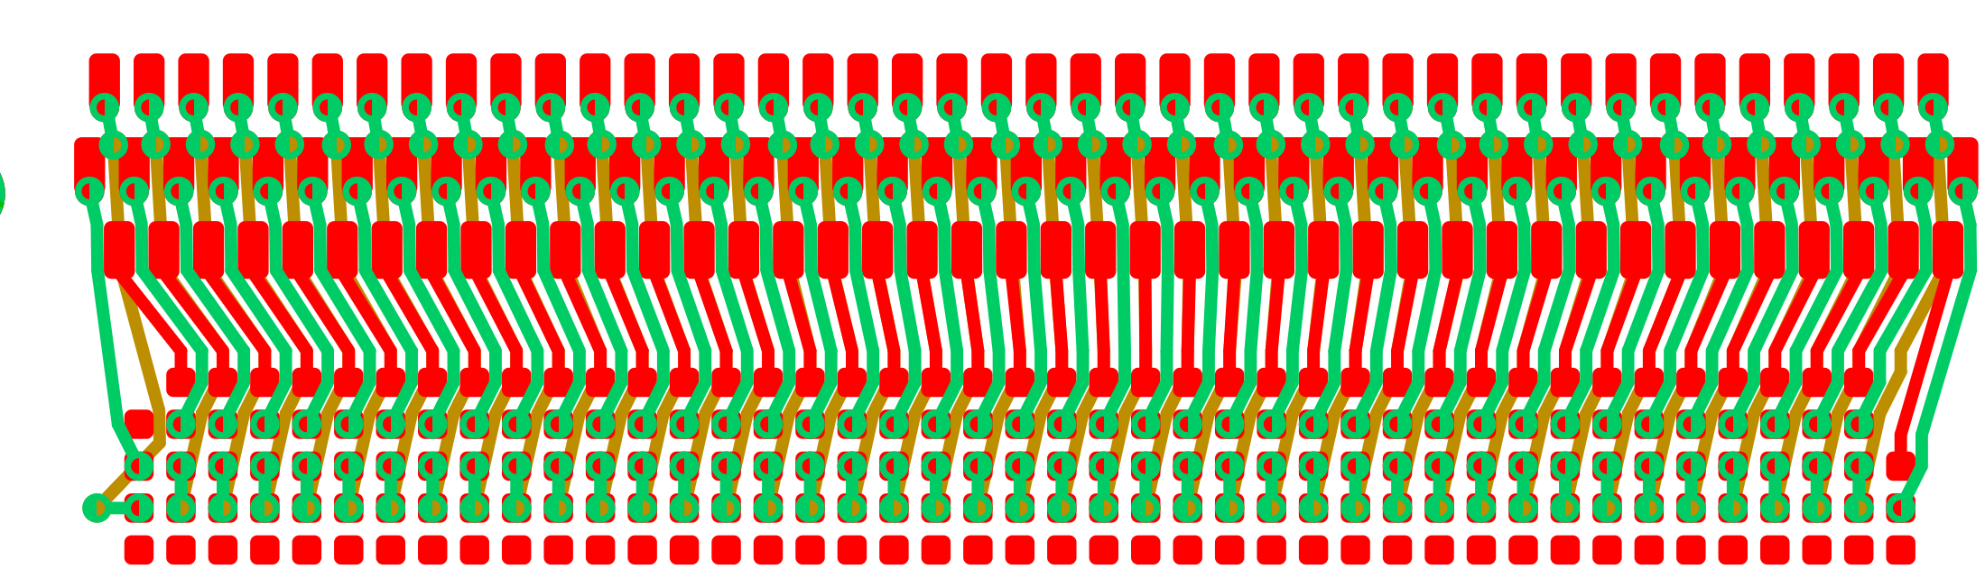

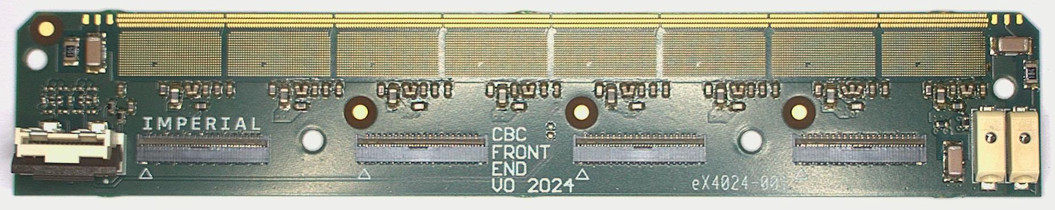
Progress with 1S-module
Front End Board
107mm
Features:
~1000 Wire bond pads for sensor connections
Sites for 8 CBC3 ASICs
Connectors for data, clock, power
Bias distribution
Strategy here is maximum simplicity:
Complexity (and design risk) is offloaded to other board
This also means we have smaller and cheaper PCB
Board Specs:
8 Layer HDI
80um track and gap
160um uVias
Total via count = 12K or 5.8/mm^2!
Cost per bare board is 340 EUR or 17¢/mm^2

Slide 6
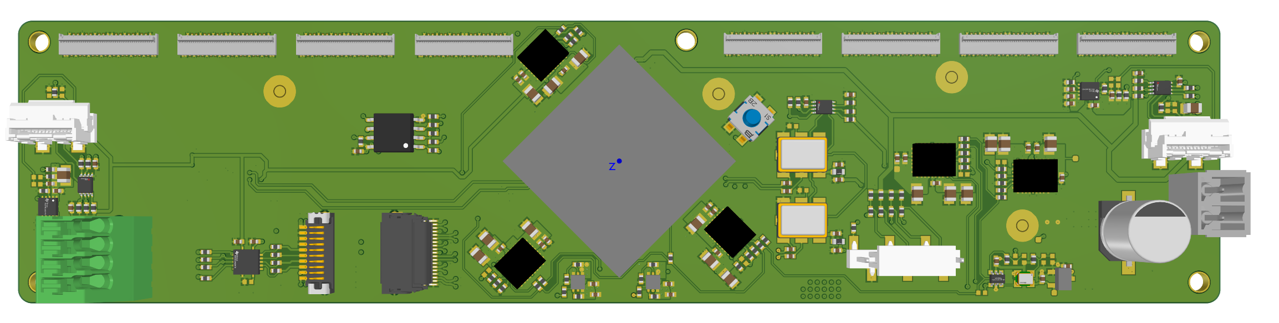
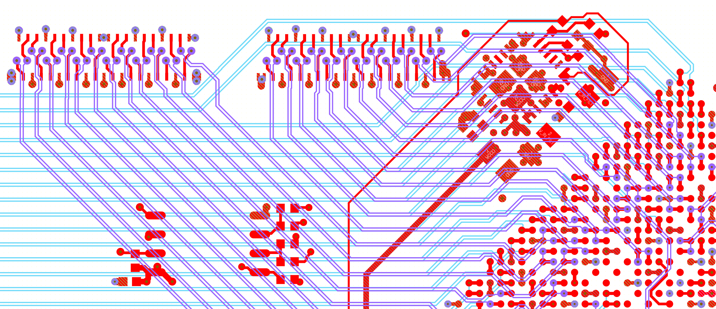
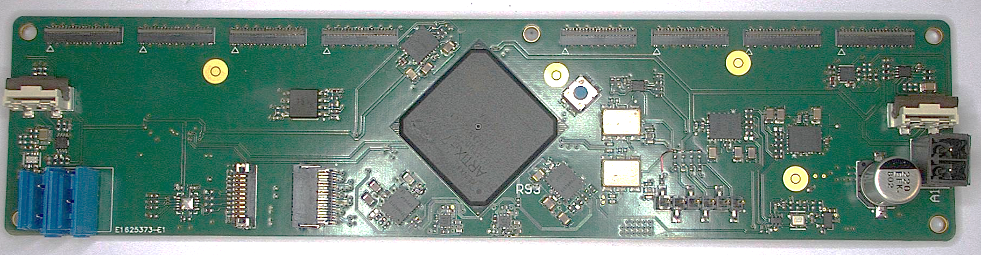
Progress with 1S-module
Control Board
175mm
Features:
AMD Artix XC7A100T FPGA (484 balls)
Connections to 2 Frontend boards:
    16 CBC3 ASICs
    96 links at 320Mb/s = total 30Gb/s
4 channel Firefly transceiver site: 25Gb/s to Serenity
On board HV bias regulator
Board Specs:
8 Layer standard tech
125 um track/gap
Via count 1,300
Cost per board 80 EUR or 1.4 ¢/mm^2 (more than 10x cheaper than front end boards!)

Slide 7
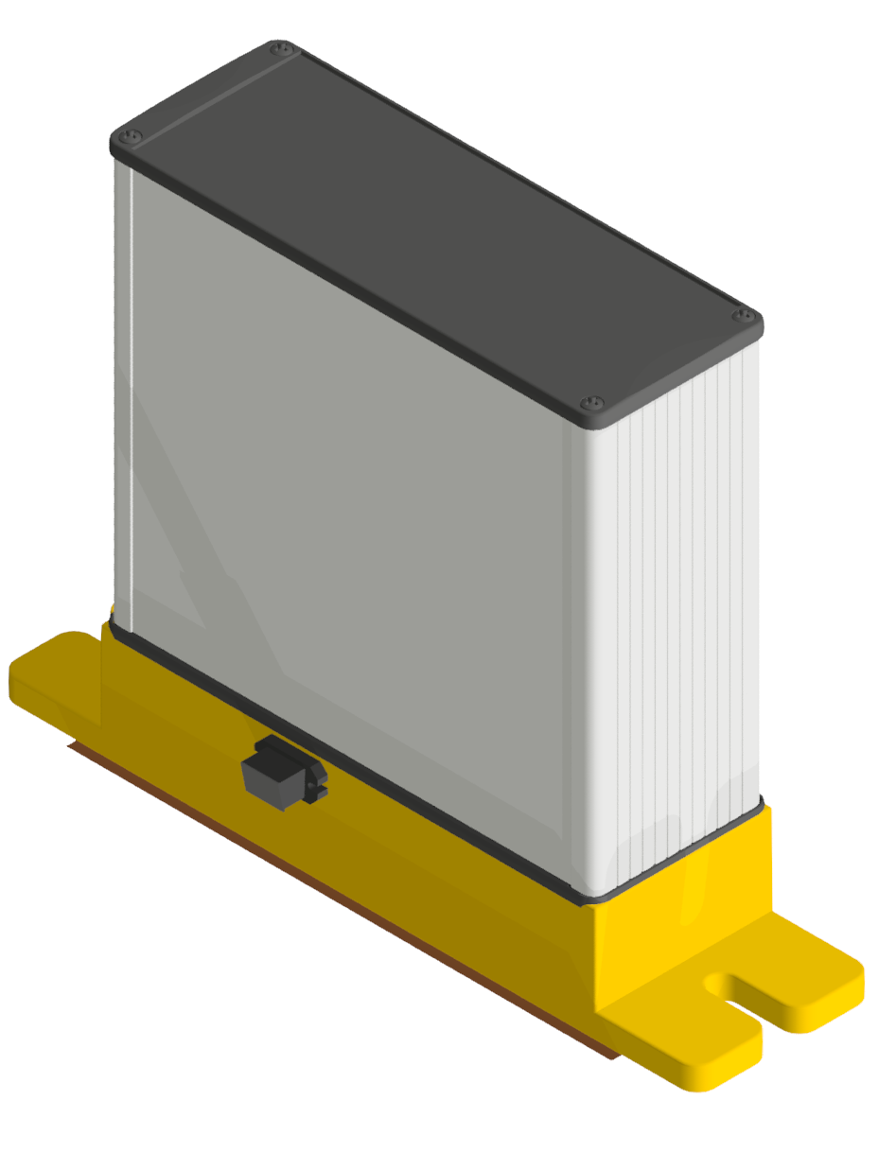
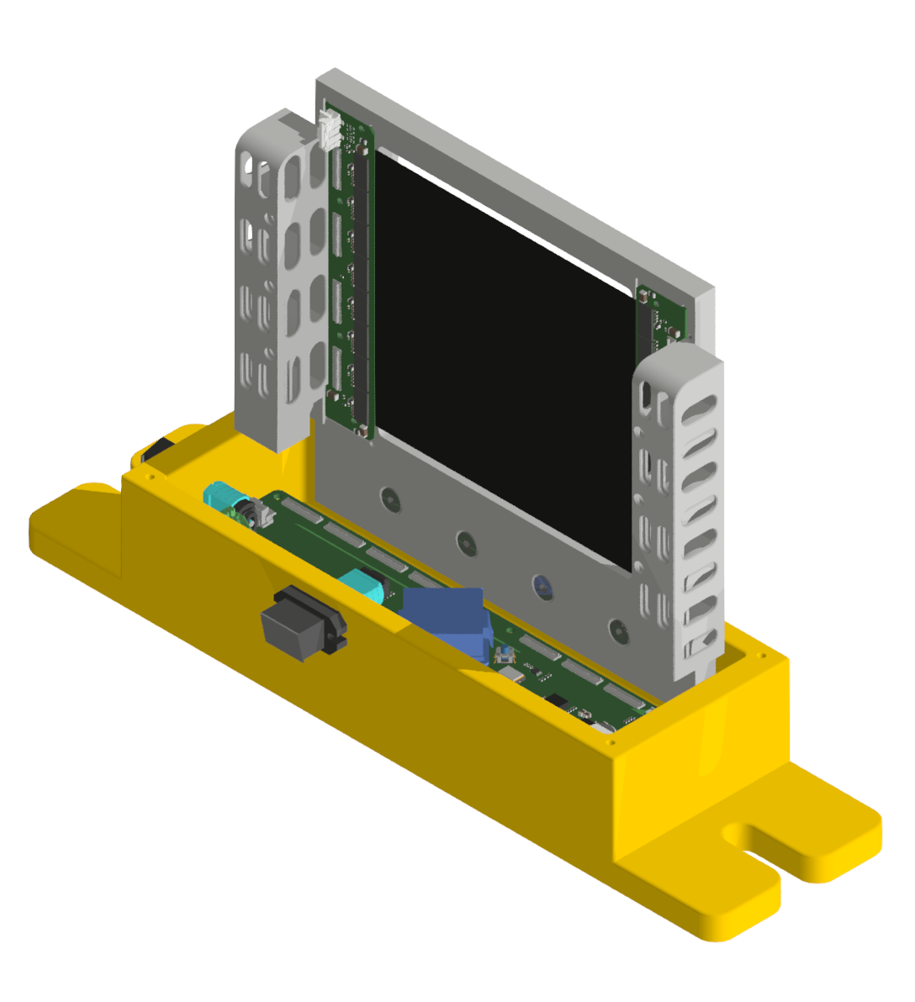
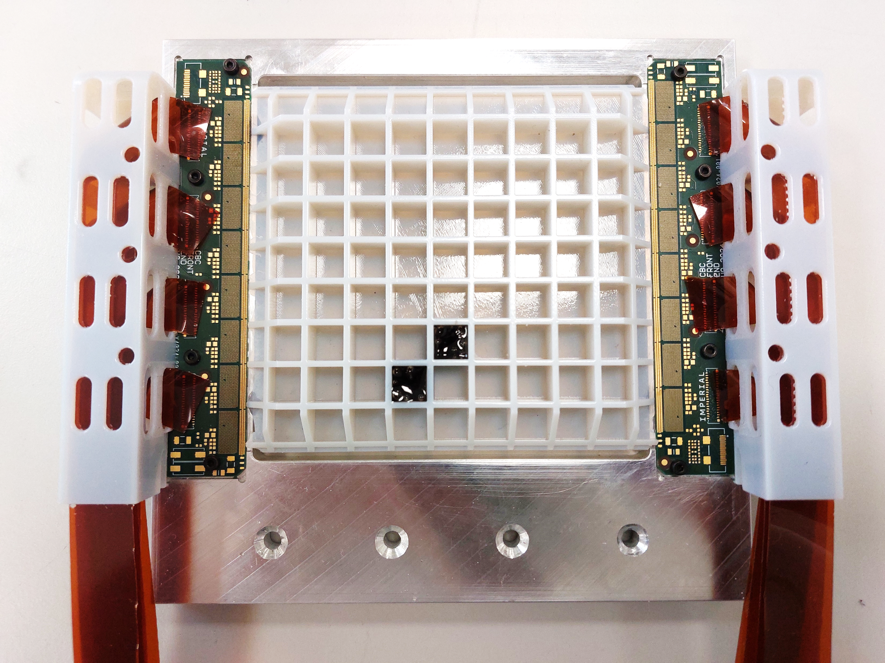
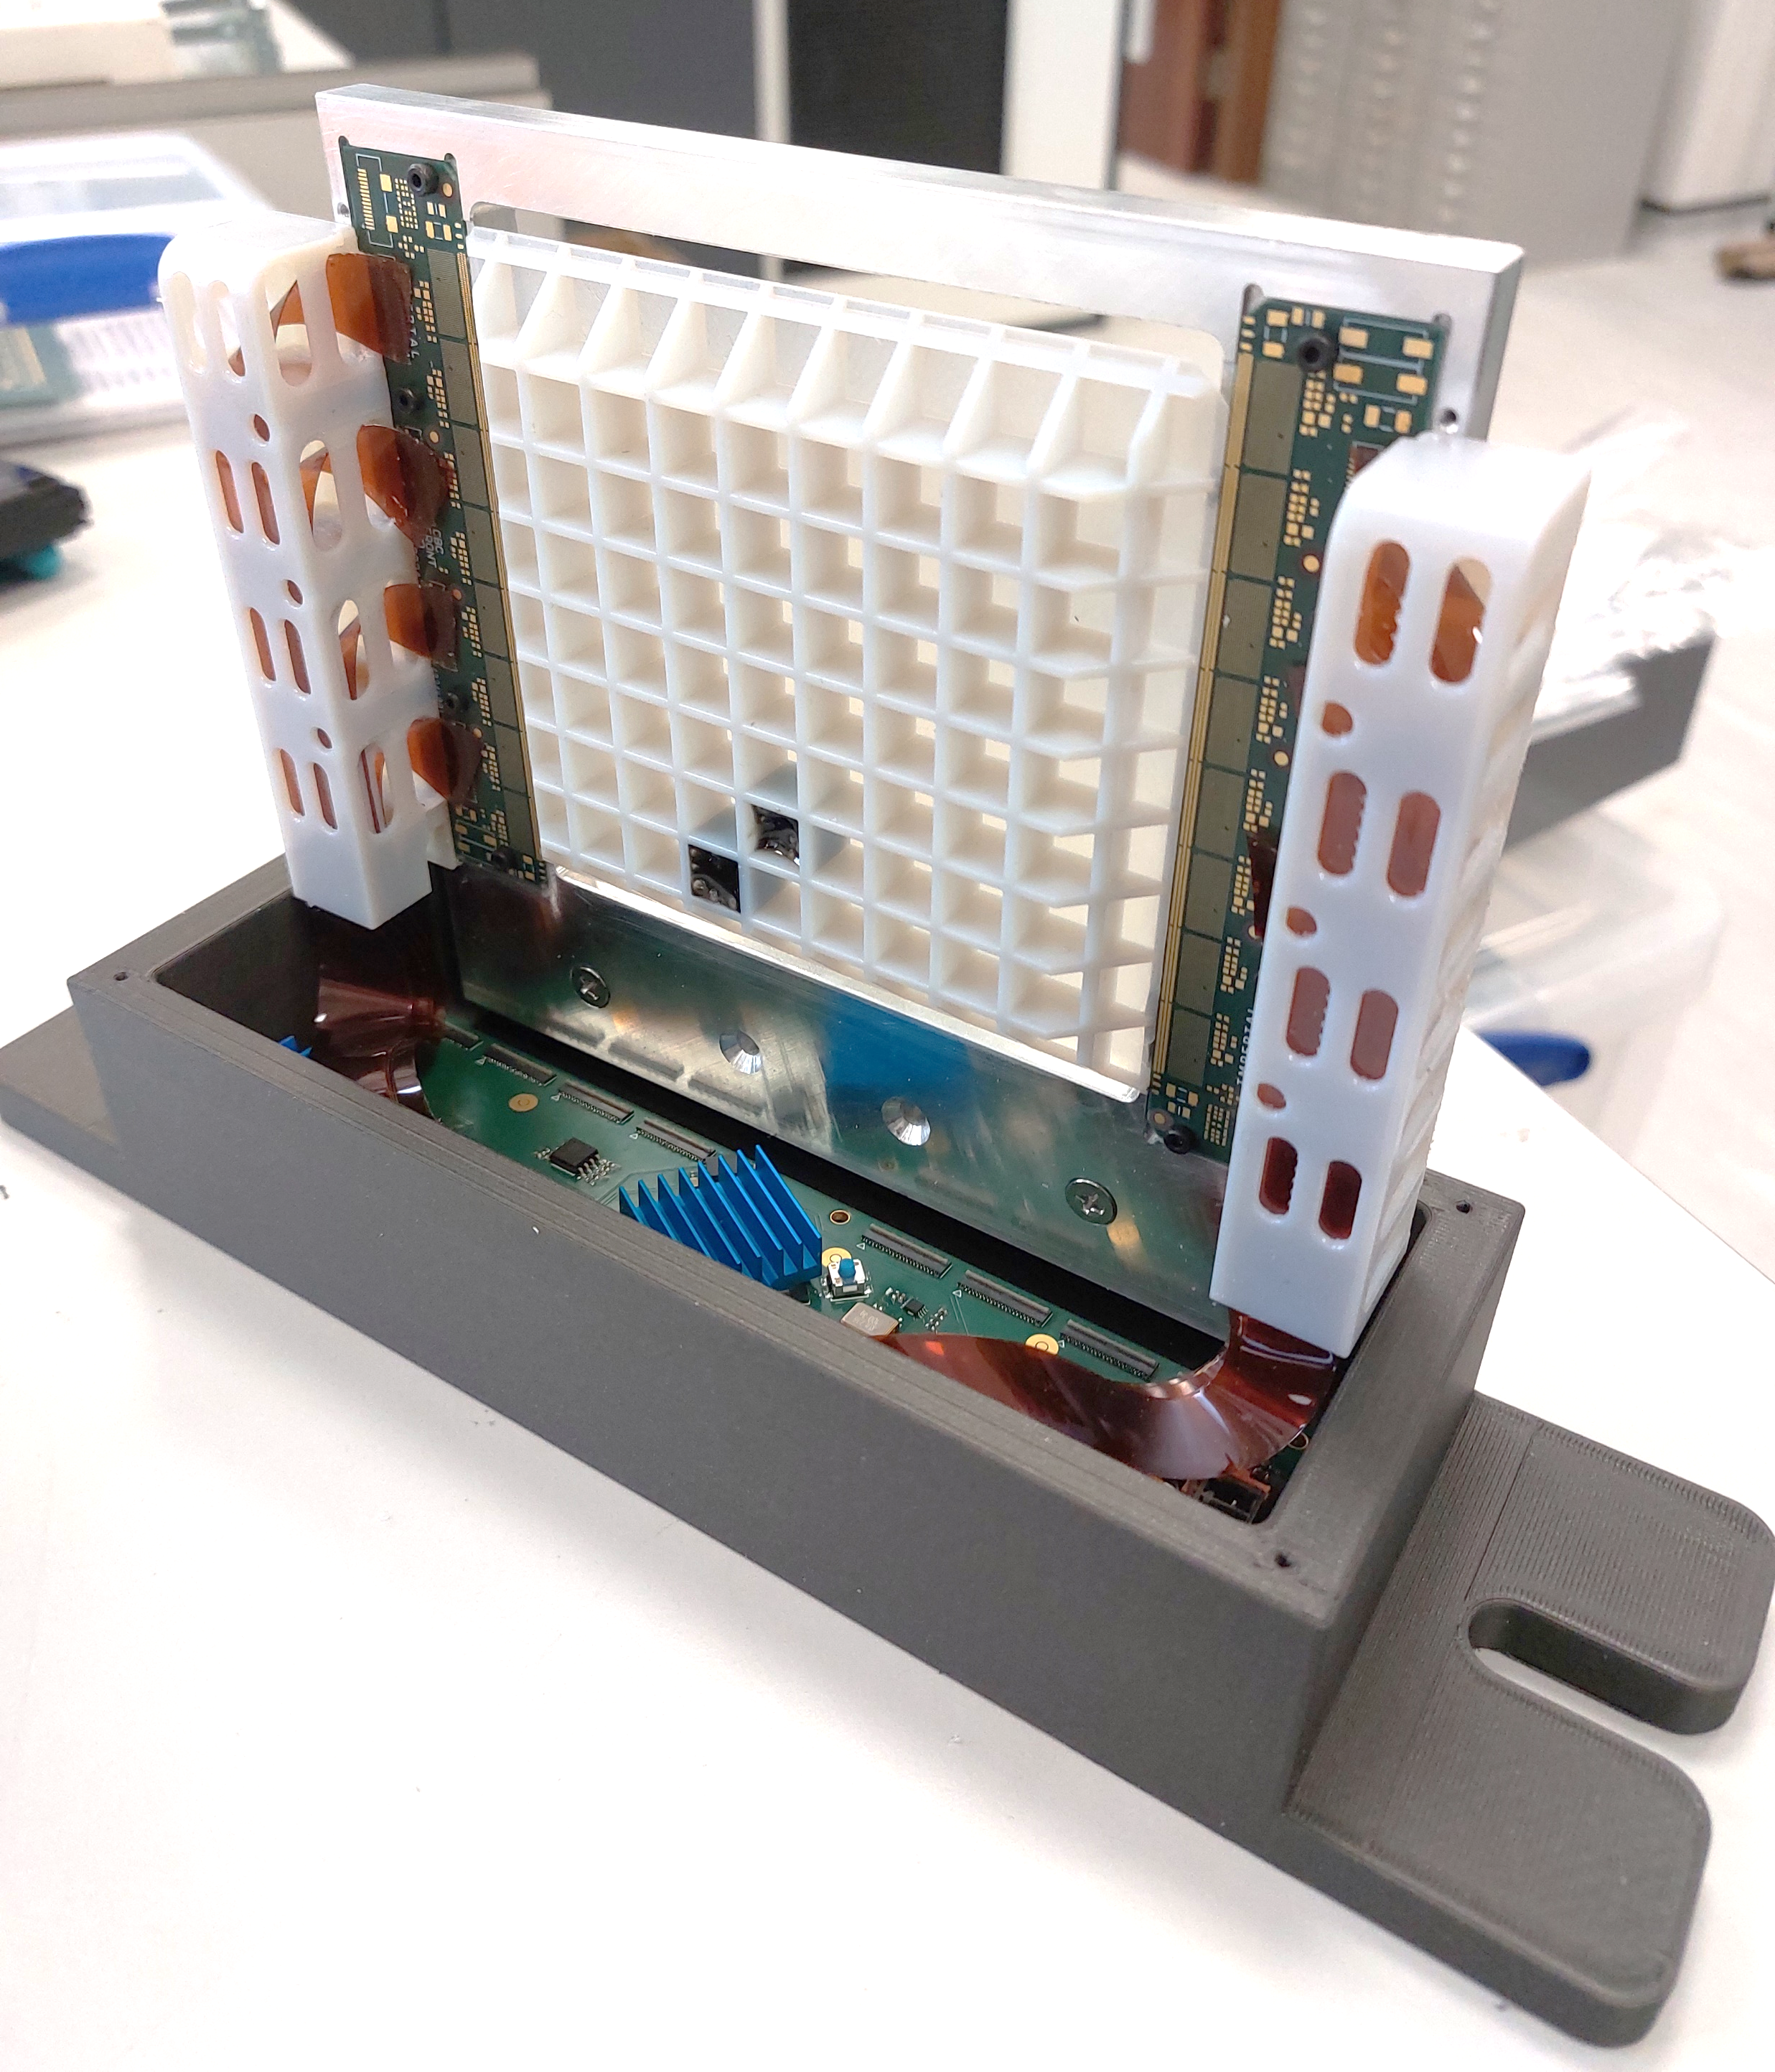
Progress with 1S-module
Mechanical Support
loosely defined as we lack the time resources.
Consequently, working towards a functional electronics demonstration.
Acceptable that future mechanical constraints require electronics revision
A simple mechanical support system does exist:
Suitable to demo electronics in a test beam
Mix of 3d printed and machined alu plate
Little consideration to:
    Thermal management
    Dimensional Stability
    Alignment

Slide 8
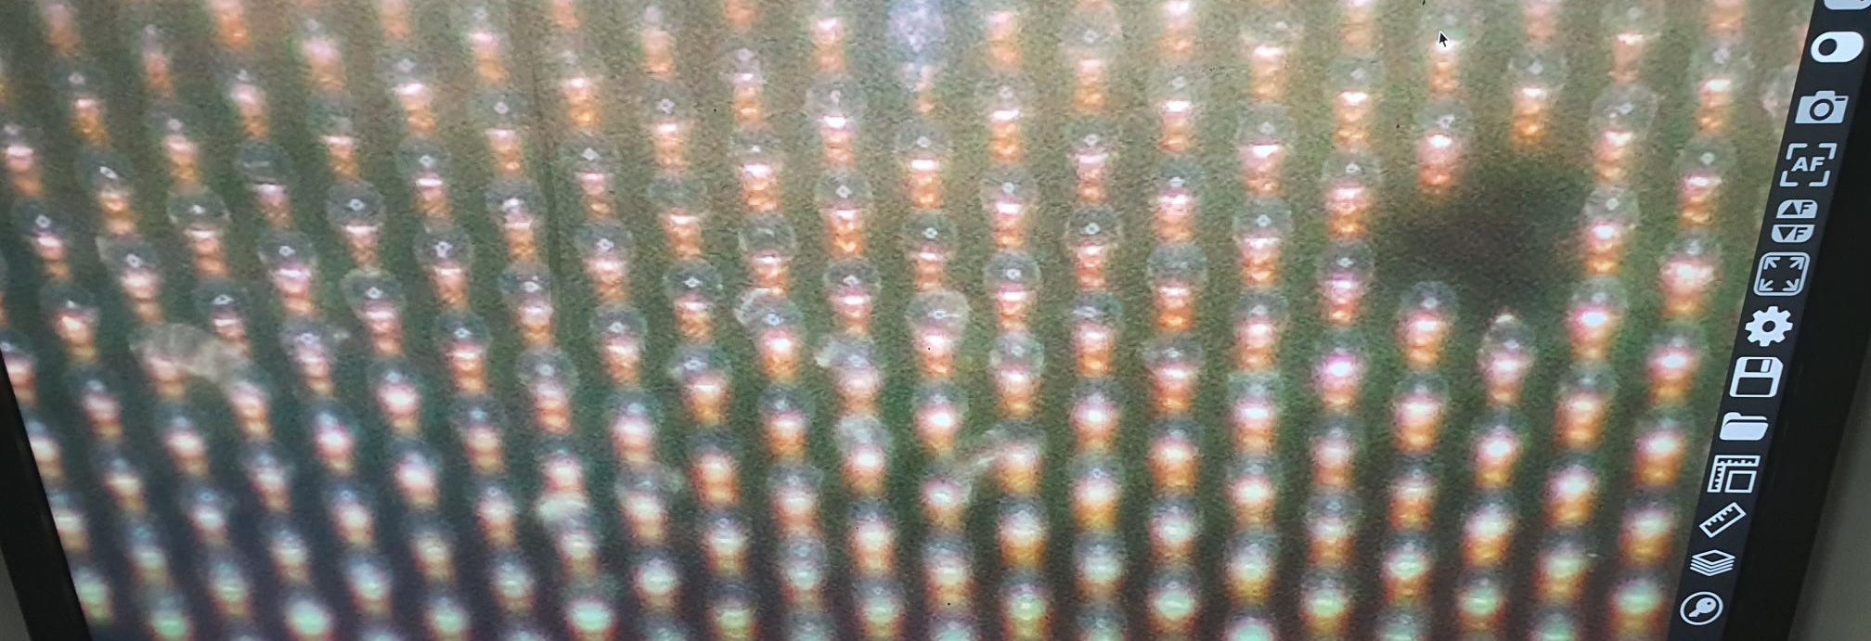
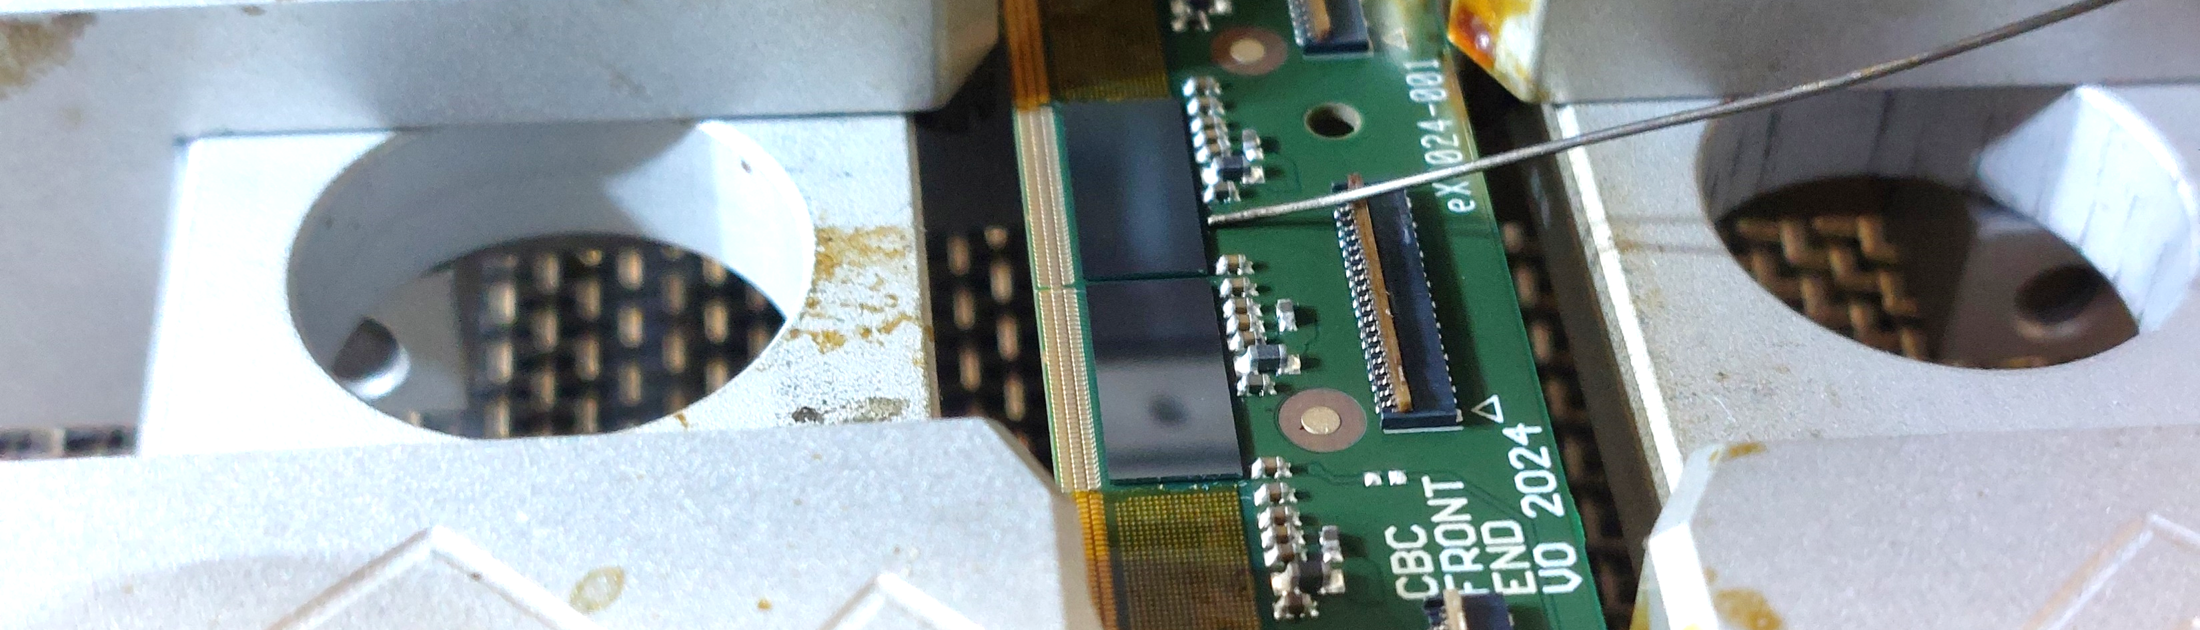
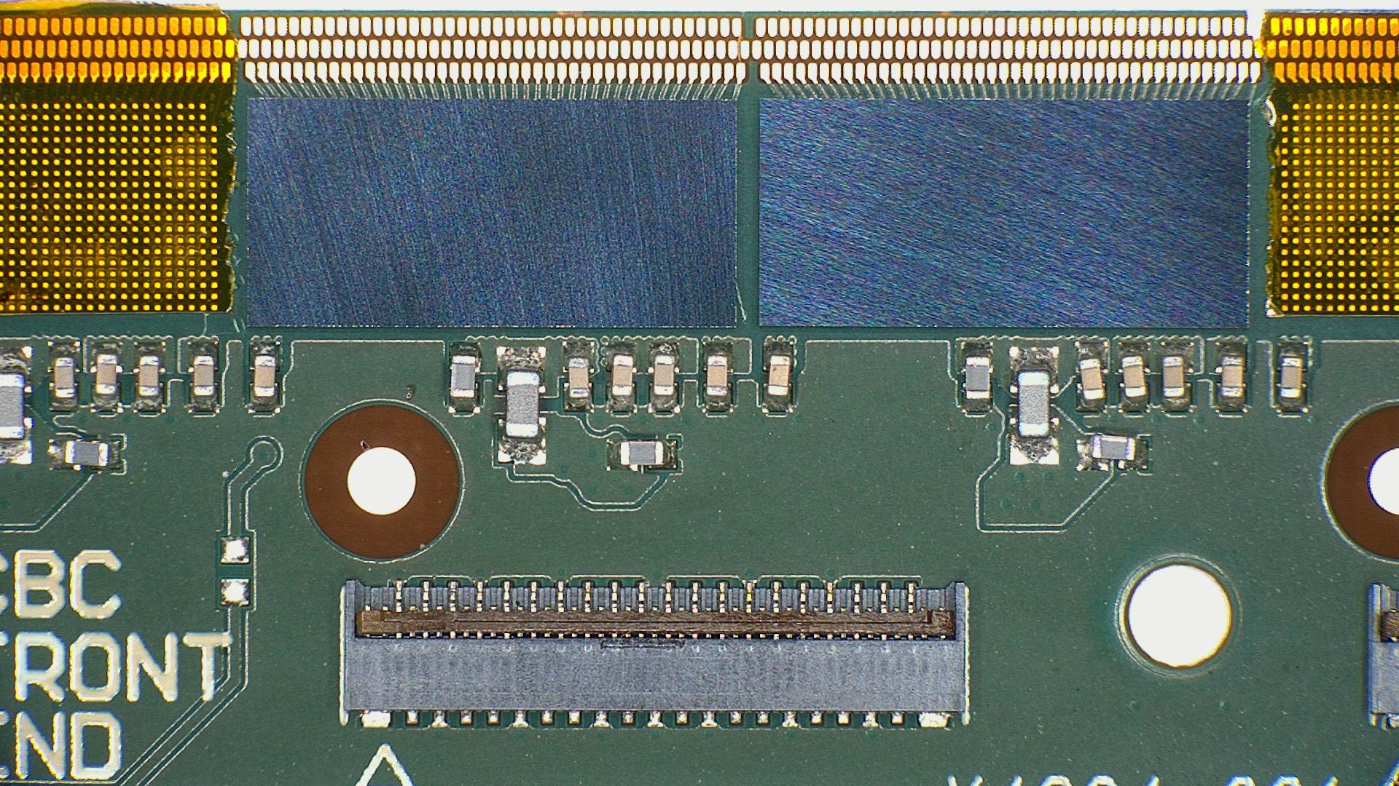
Progress with 1S-module
Device Assembly
Assembly facilities at IC
Automated pick and place
Reflow machines
Rework/Precision placement machines.
Manual wire bonder
New processes to learn – assembly of CBC3 ASICs a 250um pitch bump bonded flip chip:
Chip dipping technique to deposit ~50um film of flux on each solder ball.
Tuning flux viscosity
Precision alignment
Objective: to achieve sufficient yield to assemble one or two complete modules.

Slide 9
Progress with 1S-module
Current Status
We have 5x assembled Control boards
    Done:
    All passed smoke tests
    4 with all power rails functional
    4 with FPGA visible and programmable
    4 with some transceiver links functional
    To do:
    Develop firmware
    Interface with front end board
    Interface with Serenity
    Read test pulses
We have 5x assembled Front End Boards
(mostly Minus ASICs)
Done:
    One board has 2 ASICs assembled and has passed smoke tests. (significant!)
    To Do:
    Fully populate 8 ASICs on 4 boards
    Interface to Control Board
    Attach Sensor to mechanical support
    Wire bonds made to sensor
    Many of these tasks need firmware and hardware support!

Slide 10
Progress with 1S-module
Collaboration
We are seeking collaboration!
We looking for partners with skills/facilities:
    Cleanroom module assembly
    Bump bond flip chip assembly hardware and expertise
    Large scale Wire Bonding
    Mechanical design expertise
    Module level testing
    Finally, the system is modular. With limited effort we can revise for different:
    Sensors
    ASICs
    Backend hardware

Slide 11
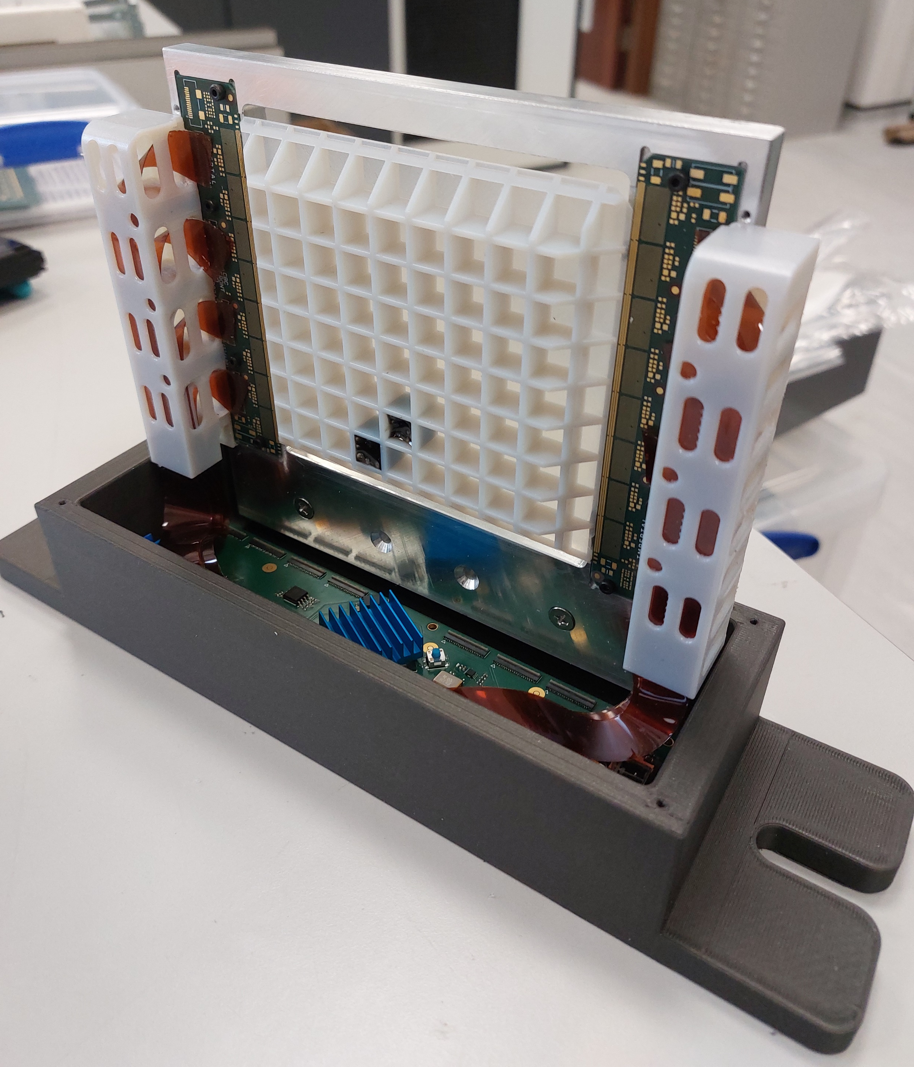
Progress with 1S-module
End of Slides

