Slide 1
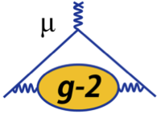
Current work and future plans of the FNAL EDM
2nd December
Katie Ferraby
1

Slide 2
EDM signature
Muon EDM causes the precession plane to tilt towards the centre of the storage ring.
The average vertical angle of the positrons oscillates at the g-2 frequency, and has an amplitude proportional to the EDM signal.
We use a ~sinusoidal fit to the average positron vertical angle to get amplitude of oscillation
Can convert this to the tilt in the precession plane to extract the EDM.
2

Slide 3
EDM fit function
Amplitude $\frac{π}{2}$ out of phase with the g-2 oscillation
Amplitude in phase with the g-2 oscillation
$$\left\langle θ_{y}\right\rangle =\frac{A_{EDM}sin\left(ωt+∅\right)+A_{g−2}cos\left(ωt+∅\right)+c}{1+A_{N}cos\left(ωt+∅\right)}$$
Amplitude from the number of positrons oscillation
Definition: You “reset” the time after a g-2 period so you get the time elapsed in the current cycle
$$t=t^{′} \% T_{g−2}$$
We split the data into eight momentum bins and ‘modulo’ it:
“1700-3100”, “1000-2500”, “1000-1250”, “1250-1500”, “1500-1750”, “1750-2000”, “2000-2250”, “2250-2500” MeV
3

Slide 4
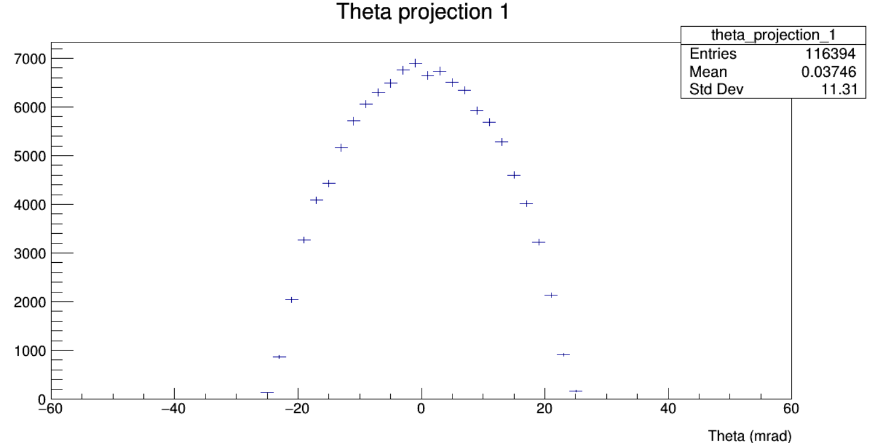
$$N_{D}$$
$$N_{U}$$
$$A_{±}=\frac{N_{U}−N_{D}}{N_{U}+N_{D}}=\frac{\sum_{θ_{y}>0}{p\left(θ,λ\right)}−\sum_{θ_{y}<0}{p\left(θ,λ\right)}}{\sum{p\left(θ,λ\right)}}$$
$${\left\langle θ\right\rangle }_{λ}=\frac{\sum{θp\left(θ,λ\right)}}{\sum{p\left(θ,λ\right)}}$$
We compare the statistical sensitivity of the two methods to parameterise the tilt; $A_{±}$ and $\left\langle θ_{y}\right\rangle$
4

Slide 5
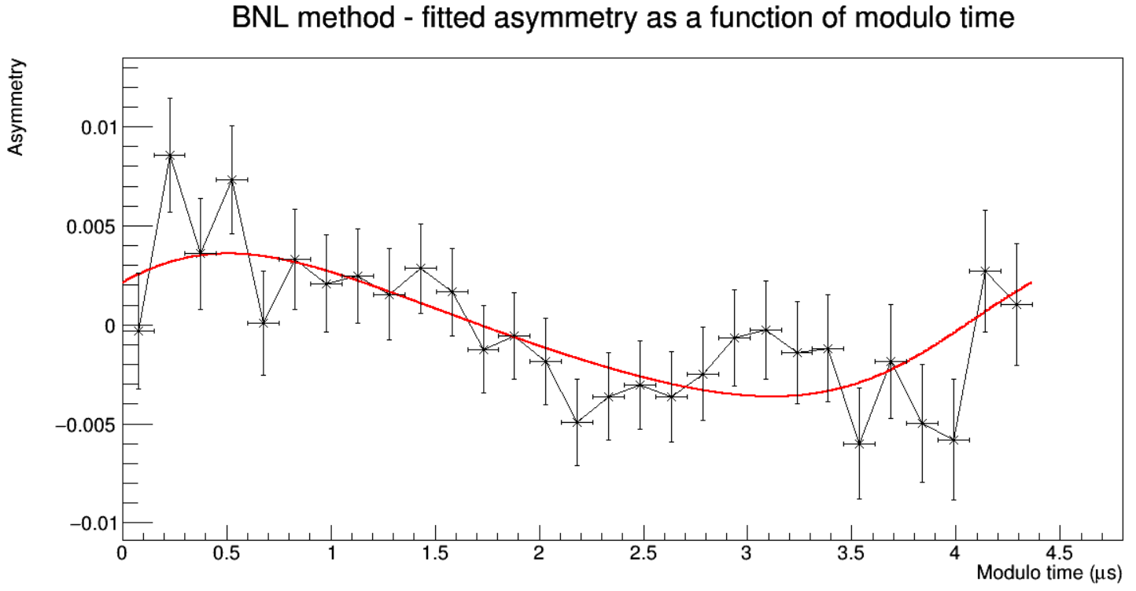
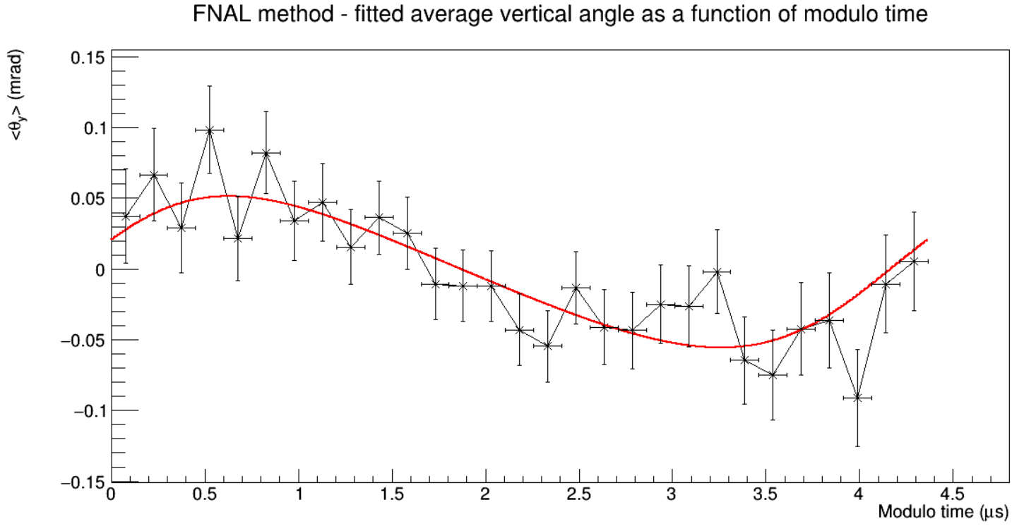
Fitted EDM plots
These plots use MC truth.
In the Monte Carlo data, there is an EDM signal. The data is then blinded before the fits are applied by adding in an EDM of unknown size, to test the blinding.
If there was no EDM, and no blinding applied, the average vertical angle would be flat.
The fits for the “2000-2250” MeV momentum range shows the fit.
5

Slide 6
Figure of Merit (FOM)
We have no sensitivity to the EDM when the y-value equals 0
We have maximum sensitivity when the y-value is at the max amplitude
The no EDM plot has no oscillation in $θ_{y}$ Flat, all zeros plot for no EDM
The no EDM plot and the EDM plot have the same error bars
6

Slide 7
FOM for the two methods
I calculated the FOM values for each momentum range for $A_{EDM}$ and the FOM value for the full momentum range for the average vertical angle and asymmetry methods.
For these fit parameter:
$\left(\frac{{FOM}_{FNAL}−{FOM}_{BNL}}{{FOM}_{FNAL}}\right)×100=40.75$
Therefore, it is better to use the average vertical angle method as the statistical sensitivity is ~40% better than the asymmetry method.
7

Slide 8
Motivation for future plans
We’ve seen that using the average angle method is ~40% better than using the asymmetry method.
We now want to test a weighted average angle method and calculate its FOM.
We will weight based on the most sensitive vertical angles to an EDM for a given positron momentum
New weighting terms
$${\left\{θ_{y}\right\}}_{λ}=\frac{\sum{θp\left(θ,λ\right)ω\left(θ,λ\right)}}{\sum{p\left(θ,λ\right)ω\left(θ,λ\right)}}$$
8

Slide 9
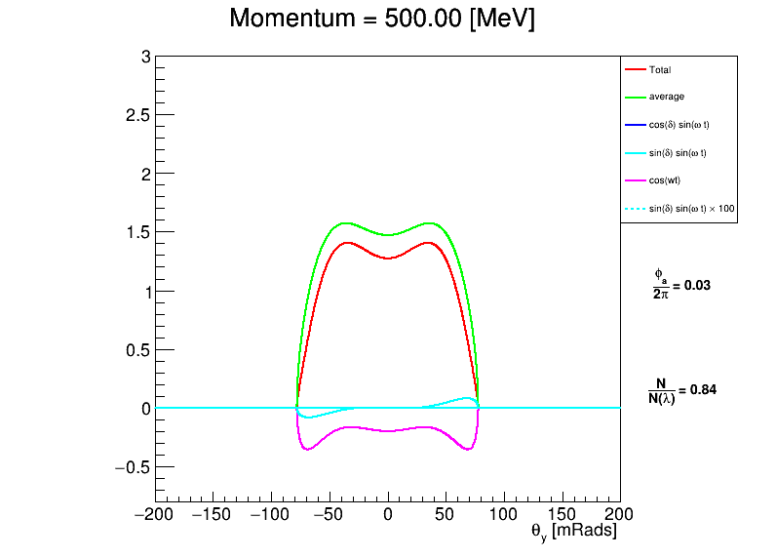
Visualising the oscillation
9

Slide 10
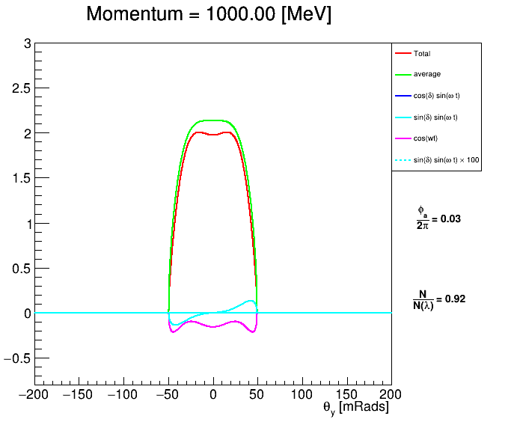
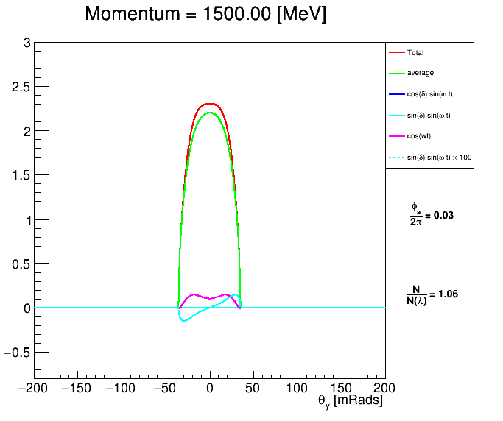
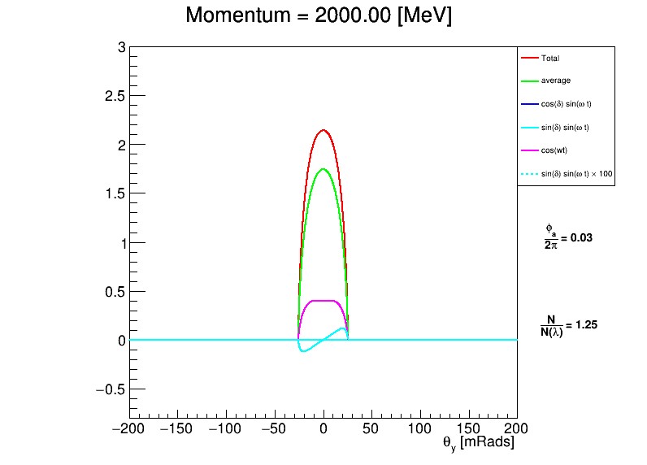
Visualising the oscillation
10

Slide 11
Conclusion
Run 2/3 EDM result is expected early 2025, will be statistics limited
I’ve set up my analysis to replicate the result (from Dominika and Lucy, main EDM analysers)
Cross check my code with the run 2/3 result
Optimise the sensitivity using the weighted average method
Run over the full (including run 4/5/6) dataset
Approximately 4 times more data than run 2/3
11

Slide 12
Thank you!
12

