Slide 1
2S Module Simulation in FairMUonE
Giorgia Cacciola
16/12/2024

Slide 2
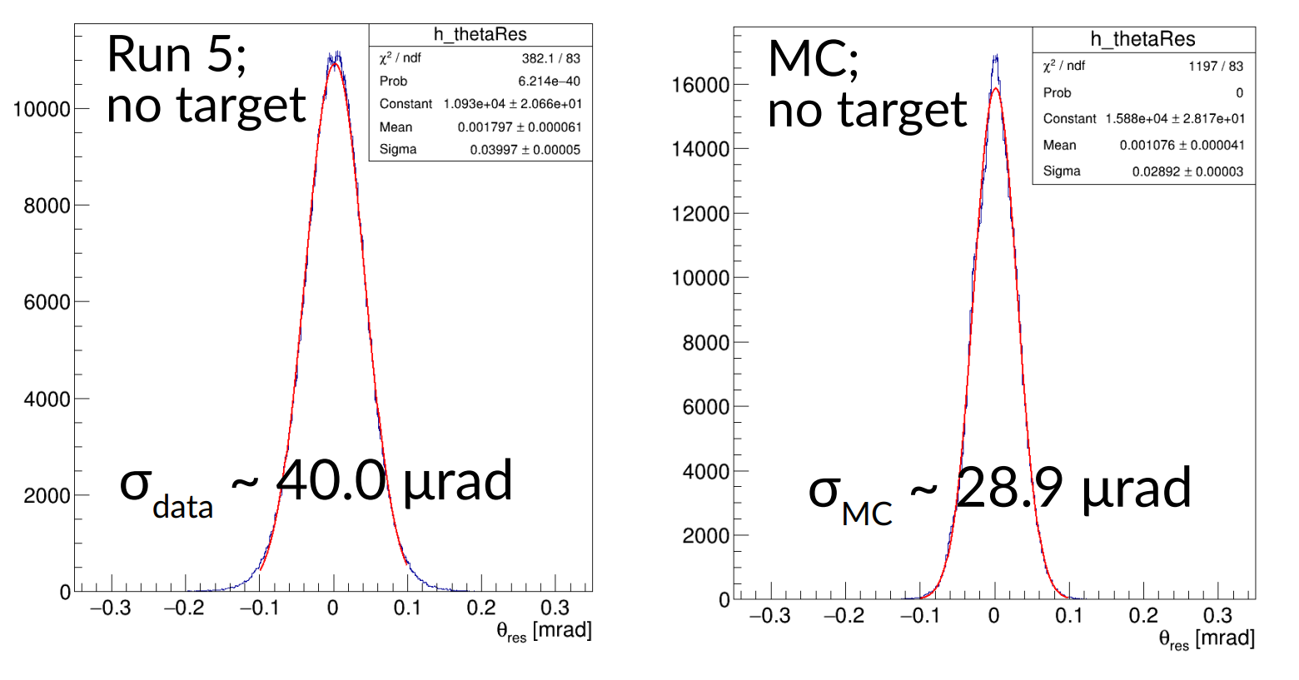
Motivation
There is a difference of ~30% in the angular resolution of 160 GeV μ between data and MC
The intrinsic angular resolution is one of the main systematic effects for our measurement
1

Slide 3
2 aspects were looked at :
How the delta rays are simulated and how we can improve it.
by adding a production cut that allows more low energy secondary particles to be generated
How we can modify FairMUonE to allow GEANT4 to sample the position of the muon with finer granularity.
By forcing the simulation to take the position of the particles at small steps throughout the silicon
2

Slide 4
Large angles affect efficiency
Spoil resolution of muons
Clusters larger than 4 are rejected
 | Current Version of FairMUonE | Addition of delta ray production
Range Cut | 2.3 cm | 10 microns
Energy Threshold | 9.6186 MeV | 31.6994 keV
3

Slide 5
Comparison of the energy deposited before and after adding the production of delta rays
4
With delta ray production
Shift due to the inclusion of more low energy particles than before
Without delta ray production
Threshold : 0
Number of Events : 100,000
Module: 0 , Sensor: 0
Simulation time taken : Before ≈ 90 minutes After ≈ 144 minutes
Adding the delta ray production increased the simulation time by ≈ 60%

Slide 6
In the current version of FairMUonE: the entering and exiting positions of a sensor are used and then is manually divided into 10 micron segments in the digitisation.
For this reason the simulation that would be closest to the July singularity would be to do a simulation of 10 micron step
5

Slide 7
Step simulation
To implement a small step length we force a maximum step length.
The rest of the function was also changed so that all the information was saved after each step in the silicon
New Parameters added
Position at the end of each step
Energy deposited at the end of each step
Step length
Time of step
Step number
6

Slide 8
Comparison of energy deposit of Current version of FairMUonE with delta ray production and 10 micron step simulation (also with delta ray production)
10 micron step simulation
The plot for the energy deposit of the 10 micron step simulation is done by summing the energy deposited after each step to find the total energy deposited in one sensor
Current version of FairMUonE with delta rays
Threshold : 0
Number of Events : 100,000
Module: 0 , Sensor: 0
7

Slide 9
Comparison of Charge deposited in simulation with 10 micron steps and simulation using the current setup of FairMUonE.
10 micron step simulation
The charge shown is of the charge deposited in one strip
Current version of FairMUonE
Threshold : 0
Number of Events : 100,000
Module: 0 , Sensor: 0
8

Slide 10
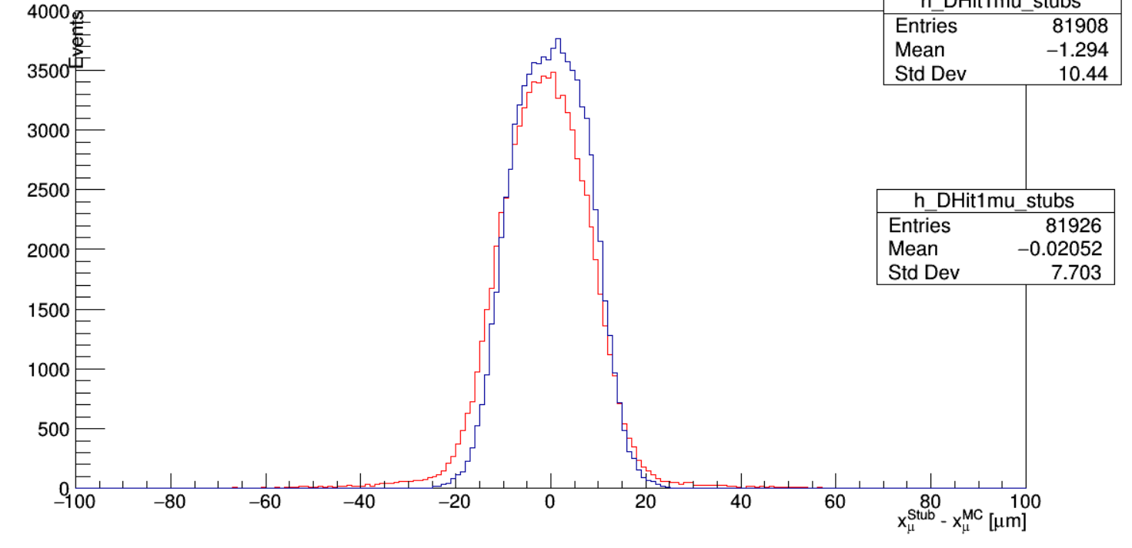
Comparison of Resolution between 10 micron step simulation and Current version of FairMUonE
10 micron step simulation
Current version of FairMUonE
9

Slide 11
Conclusions
To improve the 2S module simulation the approach was changed by :
Reducing the maximum step length which in turn increased the sampling
Lowering the threshold at which secondary particles can be produced.
Consistency checks were done to make sure the new approach was working as it should be.
Despite the changes made to the simulation we do not see significant improvement
10

