Slide 1
Mu3e
Charlie Kinsman

Slide 2
Charged Lepton Flavour Violation
The Standard Model in its most basic form describes lepton flavour as a conserved quantity and the neutrino as massless.
This has been proven wrong with the evidence of a massive neutrino and lepton flavour violation in the neutral sector (neutrino oscillations).

Slide 3
Charged Lepton Flavour Violation
The Standard Model in its most basic form describes lepton flavour as a conserved quantity and the neutrino as massless.
This has been proven wrong with the evidence of a massive neutrino and lepton flavour violation in the neutral sector (neutrino oscillations).
Charged Lepton Flavour Violation is forbidden at the tree level and is only accessed through neutrino oscillations at higher order diagram or through slepton mixing in SUSY models.
These processes are heavily suppressed, with a branching ratio of $<{10}^{−54}$.
Evidence of a branching ratio higher than this is evidence of physics beyond the Standard Model

Slide 4
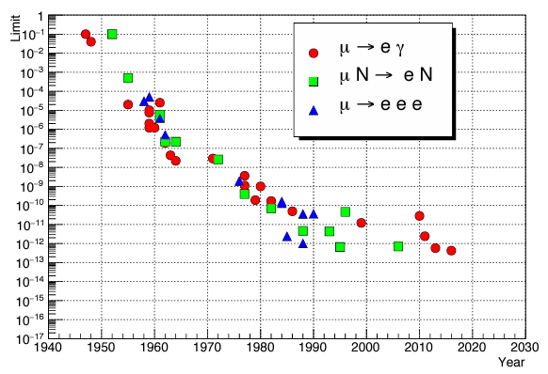
Charged Lepton Flavour Violation
MEG-II 2023 Result
Mu3e Final Sensitivity

Slide 5
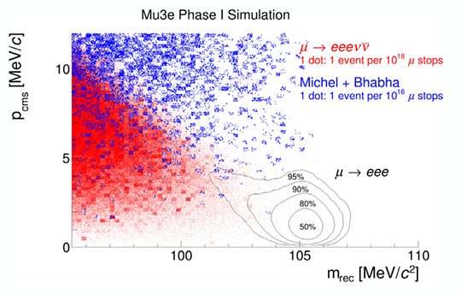
Mu3e Physics
Mu3e aims to observe the decay: $μ^{+}→e^{+}e^{+}$ $e^{−}$
If not exclude a branching ratio of ${>10}^{−16}$ (Phase II) at a $90\%$ confidence interval.
We exploit the kinematic feature below:
$\sum{p}=0$ and $\sum{E}=m_{μ}$
By reconstructing the tracks and deducing their momenta will be used to identify signal events.
For this an excellent mass (and therefore momentum) resolution is required to discriminate signal events from background.

Slide 6
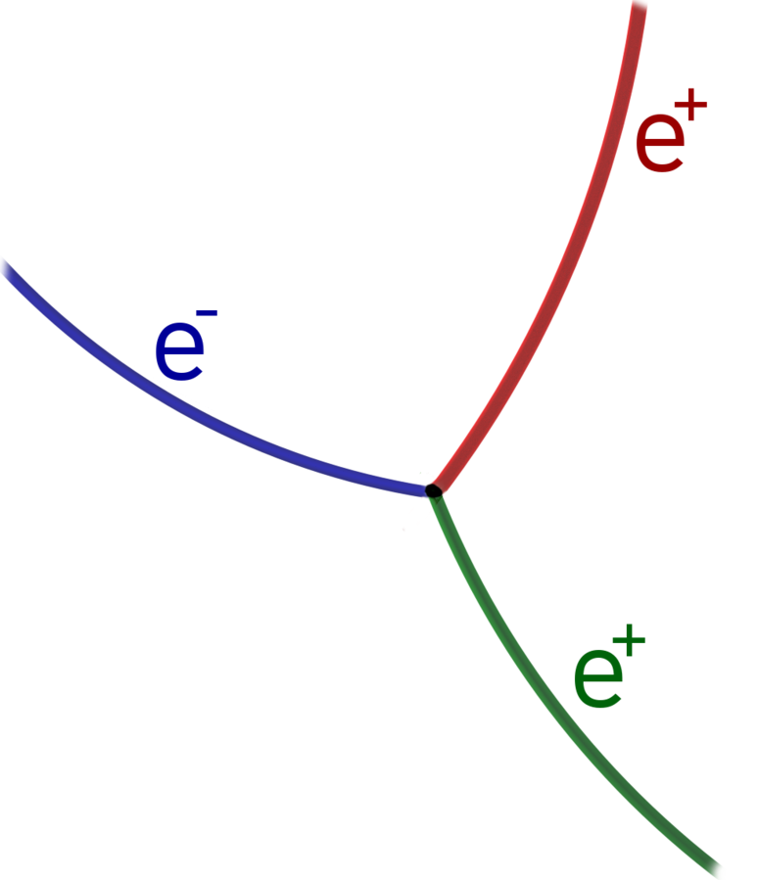
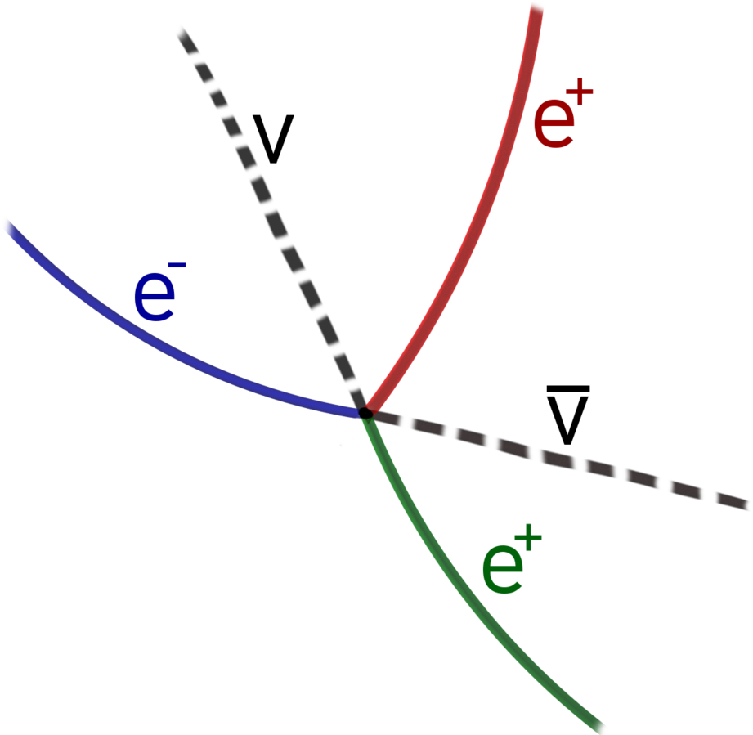
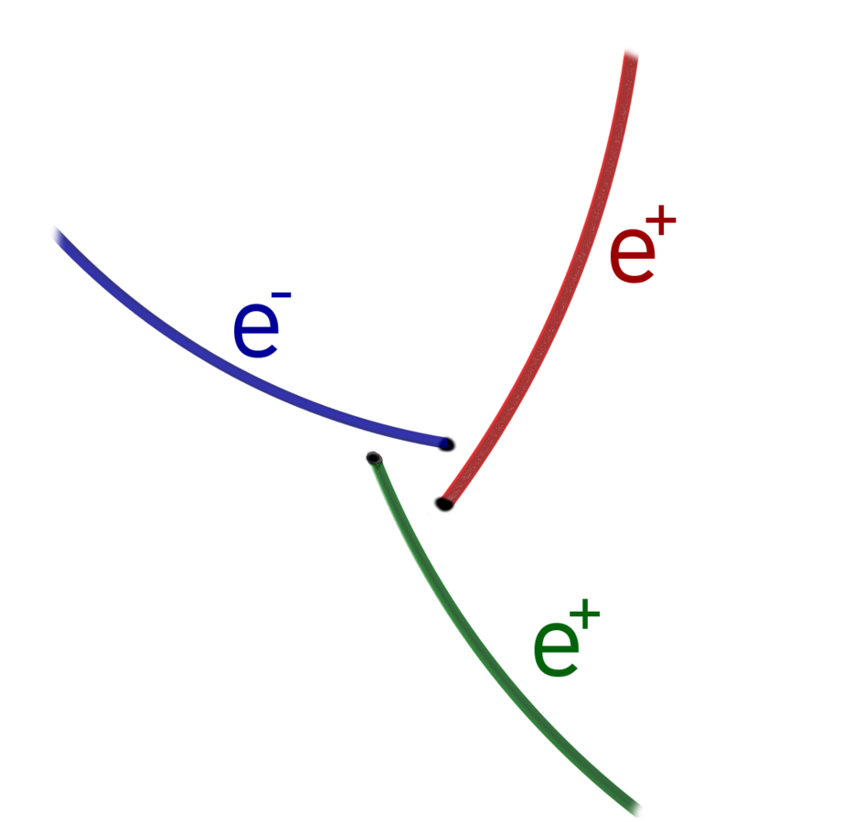
Background
Signal Event:
Three decay products from a single vertex.
$\sum{p}=0$ and $\sum{E}=m_{μ}$
Internal Conversion:
Physical Background (Standard Model approved decay).
Three decay products from a single vertex.
$\sum{p}≠0$ and $\sum{E}≠m_{μ}$
Combinatorial Background:
Background from algorithm.
Michel decays that recurl multiple times and overlap.
Combined with radiative decays or Bhabha.

Slide 7
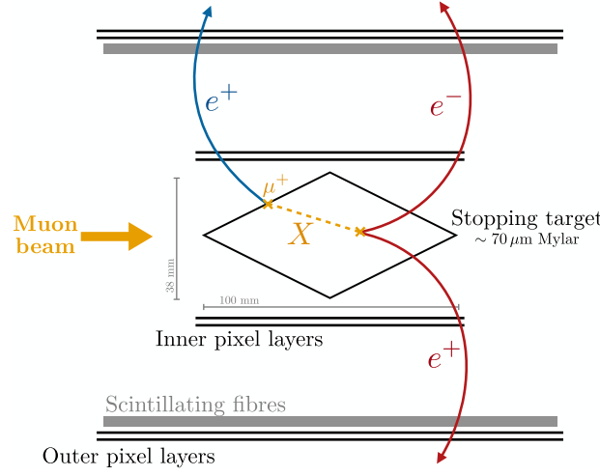
Other BSM Physics
The Mu3e detector could also be used to detect further beyond the Standard Model decay channels.
Examples of this are:
$μ→eX$ which would present as a peak in the Michel spectrum.
Decay of muon to dark photon and electron, with the dark photon further decaying to $e^{+}e^{−}$ pair.
Muon decay to electron and axion-like particle. This would promptly decay to $e^{+}e^{−}$ pair.
Muon decay to electron, two neutrinos and axion-like particle. This again would promptly decay to $e^{+}e^{−}$ pair.
This analysis would be looking for a displaced vertex, but in most cases still be able to exploit the kinematic feature of the muons rest mass.

Slide 8
Experimental Design
This shows a basic view of the phase-I Mu3e detector.
Muons are deposited on the surface of the stopping target.
After decay, the products are driven into helices by the magnet that sits around the detector.
A series of layers of pixel detectors take measurements of the position of the decay products in flight.
A layer of scintillating fibres in the central station and scintillating tiles in the recurl stations provide temporal information on the tracks.
Precise measurements of the track position and momentum are required; therefore the task is to reduce the material budget and therefore the multiple scattering.

Slide 9
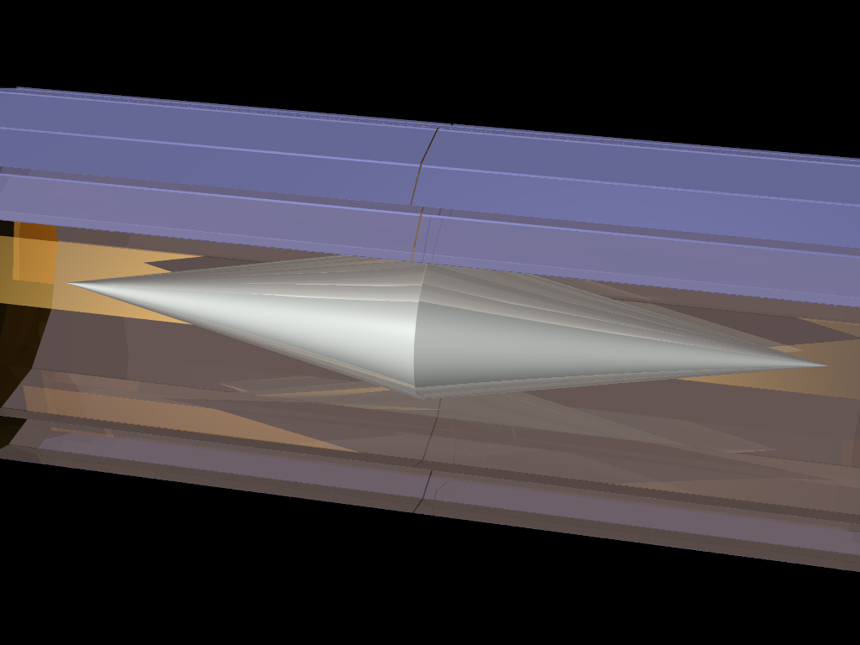
Muon Beam and Stopping Target
The experiment is based at PSI using the CMBL.
This will deliver a muon rate $∼{10}^{8}μ^{+}$/s.
These are deposited on the stopping target to bring them to rest.
The target is a double cone with an opening angle of ${23.8}^{°}$. The material is $≈90μm$ Mylar.
The aim is to reduce the material budget and therefore the radiation length. A double cone at a low angle increases the stopping power in the beam direction but not in the decay direction. It also spreads out the decay vertices across itself.
Mylar is a low-Z material, further reducing the multiple scattering.
Approximately $95.5\%$ of the muons are stopped on the target.

Slide 10
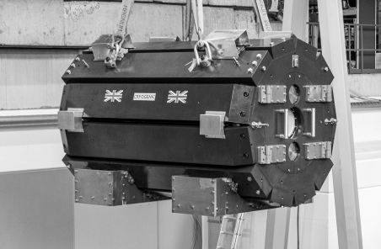
Magnet
To experiment sits in a homogenous, solenoidal 1T magnet. This forces the decay products into characteristic helices.
Accurate measurements of the momentum $(\frac{σ_{p}}{p}=0.01$) of the particles are required to suppress the physical background. A 1T magnet increases the lever arm and drives the decay products into the recurl stations.
With a 1T magnet, particles with a momentum $<10MeV$ are rejected.
The magnet must have a stability ${∆B}/B≤{10}^{−4}$ over 100 data-taking days. Inhomogeneities are required to be $≤{10}^{−3}$ in a $60cm$ radius around the magnet centre.

Slide 11
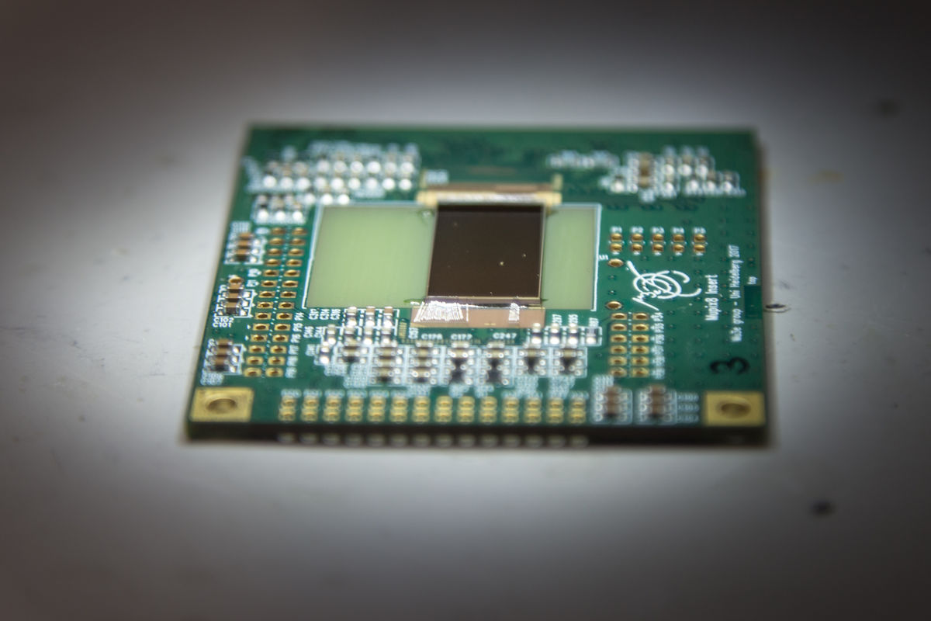
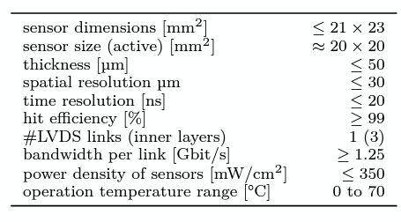
Pixel Detector
The pixel detectors provide positional information on the tracks as they pass through the detector.
This is achieved using a HV-CMOS sensor comprising of $256×200$ pixels of pitch $80×80μm^{2}$.
To reduce the material budget, the sensors are back-thinned such that the total depth is $50μm$. This results in a radiation length $X/{X_{0}}=0.115\%$ per tracking layer.
The spatial resolution of these sensors should be $≤30μm.$
The hit efficiency of MuPix11 is $≥99\%.$

Slide 12
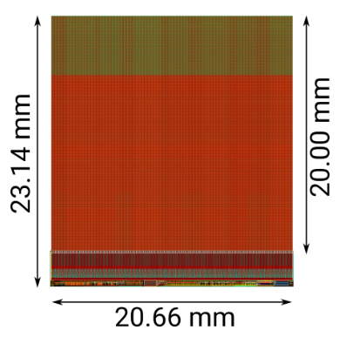
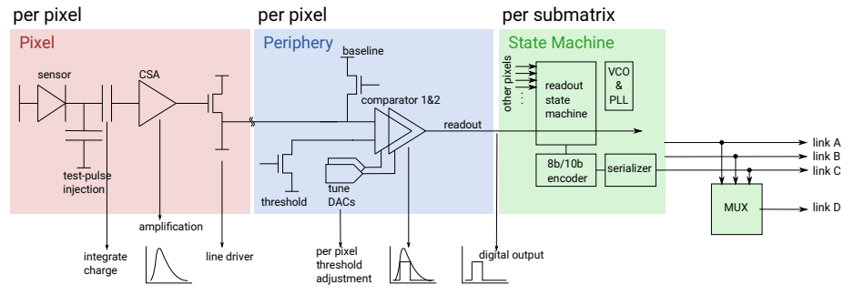
HV-MAPS and MuPix11
This technology should collect charge via drift, with a $\sim 5ns$ time resolution.
The pixel detectors used are constructed with a CMOS complimentary metal-oxide semiconductor) fabrication process. Described as complimentary due to the use of both P and N-channel transistors, also referred to as ‘floating logic’.
The advantage of using this design allows for an excellent fill-factor, can be very radiation hardened, and a high bias voltage can be applied to increase the size of the depletion zone thus increasing the hit efficiency to $≥99\%.$
CMOS devices also allow readout circuitry to be buried in the N-well. The circuitry for MuPix can be seen here.

Slide 13
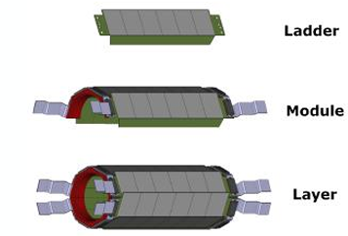
Ladders and Modules
The individual sensors are placed next to each other as a ‘ladder’.
These ladders are then placed in parallel next to each other in groups of 4 as a module.
A layer is series of modules sat parallel to each other as shown to the right.
Each layer is cooled with a $50g/s$, $5kW$ helium cooling system.
The radiation length of a given layer is $X/{X_{0}}≈0.1\%$

Slide 14
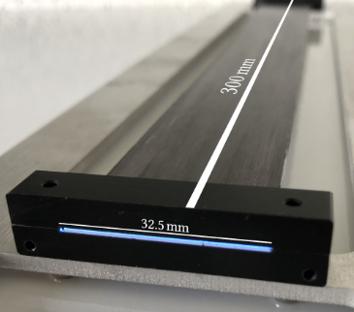
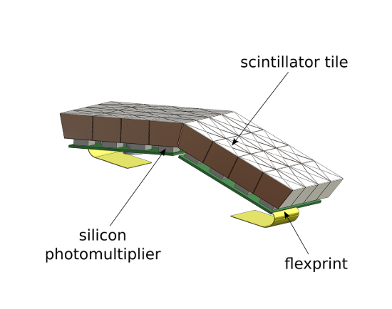
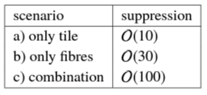
Timing Detectors
Combinatorial background is the coincidence of multiple decays overlapping in the same frame. Suppression of this is achieved with excellent timing resolution and good vertexing. The additional suppression due to timing with different sub-detectors is shown here.
This timing is achieved with scintillating fibres in the central station and scintillating tiles in the recurl stations. Both are arranged as a cylindrical layer such as the pixel detectors. The efficiency of these detectors is $95−100\%.$
The fibres produce a time resolution of $<0.5ns$ and the tiles produce a resolution $≈100ps$. $59\%$ of the decay products reach the tile detectors.
The radiation length of the fibres is $<0.3\%.$

Slide 15
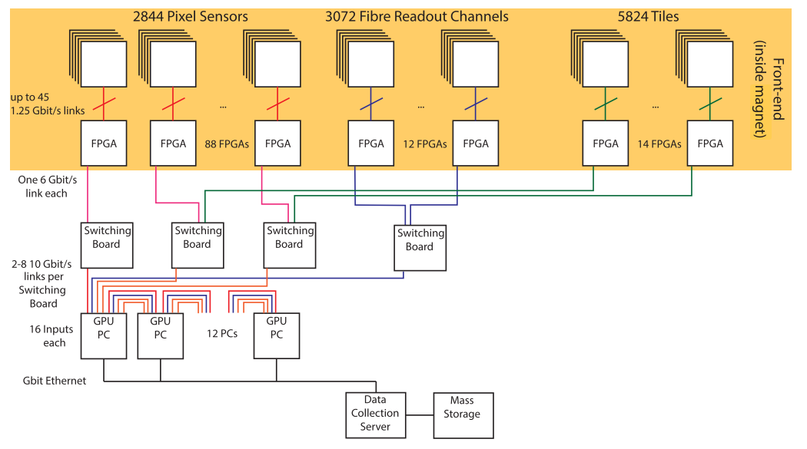
Data Acquisition
The detector has no hardware trigger and therefore sends zero-suppressed hit information continuously.
Frontend FPGA’s take data from the MuPix and MuTrig sensors and package it.
This is passed through to the switching boards which acts as a switch between the FPGAs and filter farm, allowing the latter to see the full detector.
The switching PCs are equipped with a combination of FPGA’s and GPUs to complete online selection.

Slide 16
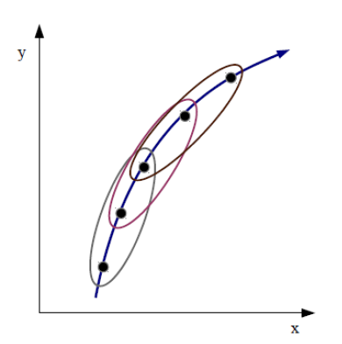
Tracking in the Mu3e Experiment
The Mu3e experiment is sat in a homogenous magnetic field and therefore the decay products trajectory are described by a helix.
The base unit for the fitting is a triplet of hits. The fitting is factorised into a circle fit in the plane transverse to the magnetic field and a straight line fit in the longitudinal plane. The scattering angles due to multiple scattering are treated as the only source of uncertainty in the fitting.
The task is to find a three-dimensional curvature whereby the below equation is minimised:
$χ^{2}\left(R_{3D}\right)= \frac{Φ_{MS}{(R_{3D})}^{2}}{σ_{φ}^{2}}+\frac{Θ_{MS}{(R_{3D})}^{2}}{σ_{θ}^{2}}$

Slide 17
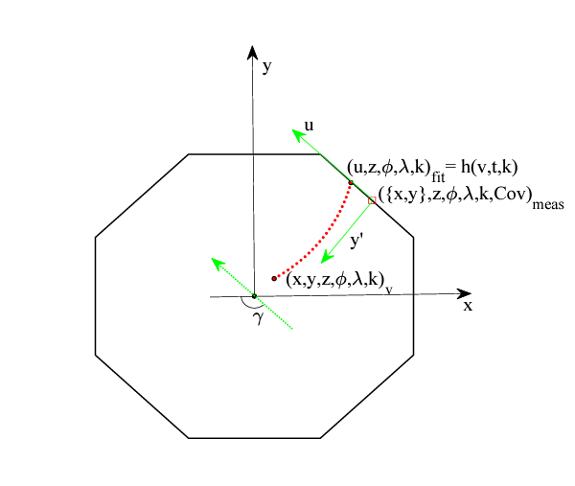
Vertexing in Mu3e
The purpose of the algorithm is both to find and fit a given vertex.
Every ++- combination in a 64ns frame is considered.
The vertex finding is achieved by taking the trajectories of the three tracks and propagating back from a reference surface (the first pixel layer) back to the stopping target.
The average of these three propagations is the first guess.
By using the errors associated with the tracking (hit resolution, multiple scattering and energy loss), a least squares fitting algorithm can be applied to fit a vertex and further minimise the $χ^{2}$ value.

Slide 18
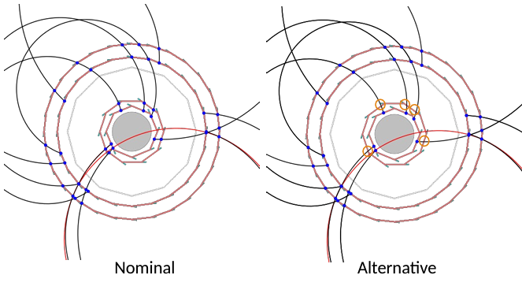
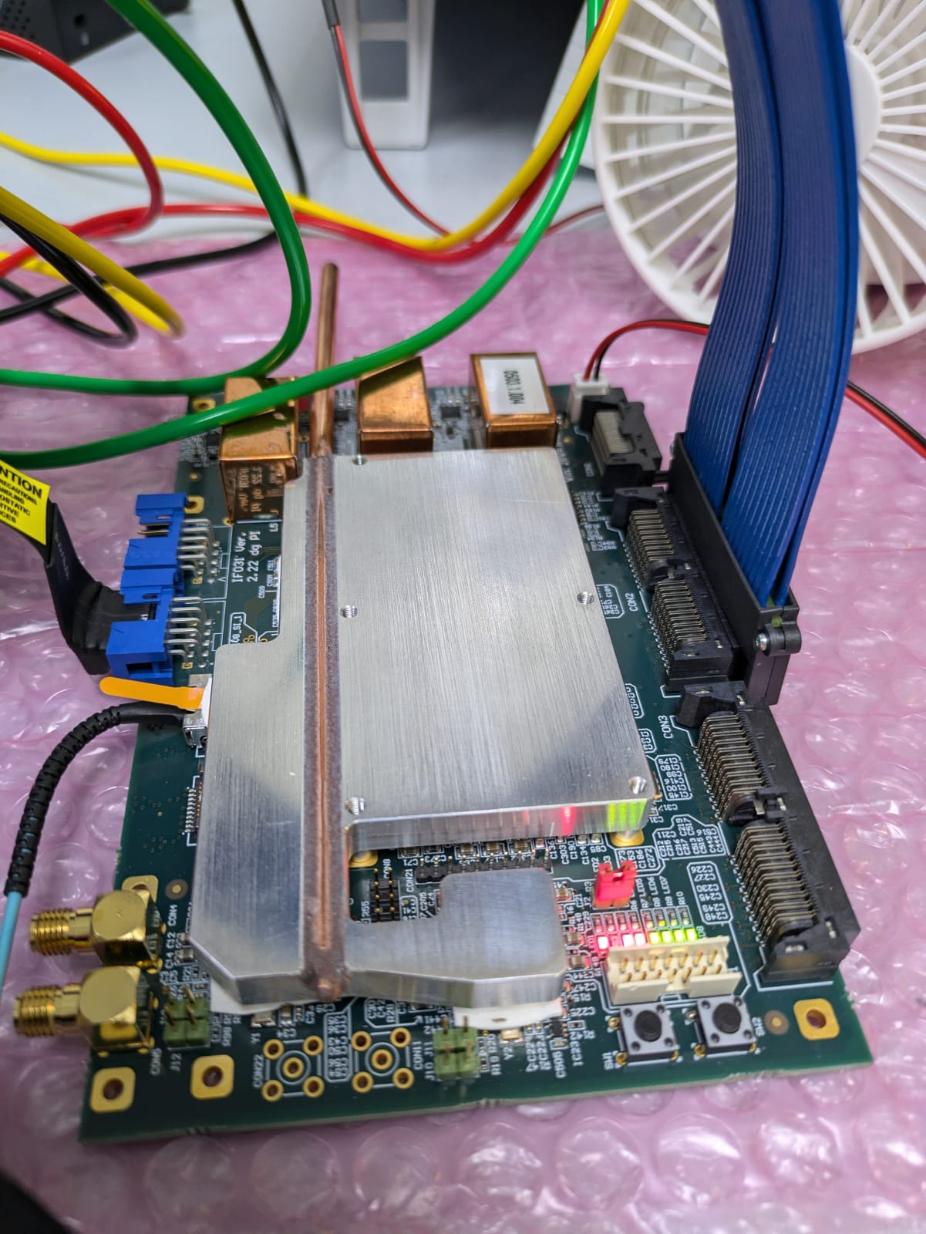
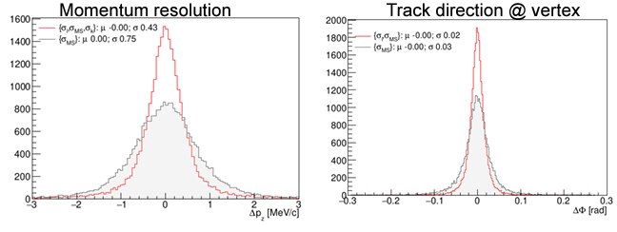
Liverpool Activities
Staff Members:
Joost Vossebeld
Helen Hayward
Nikos Rompotis
Paolo Beltrame
Mark Wong
Matthew Brown
Andrea Loreti
PhD Students:
Jak Woodford
Charlie Kinsman
Sean Hughes
Undergraduate Students:
Ting Chan
Kameron Vickers
Dan King

Slide 19
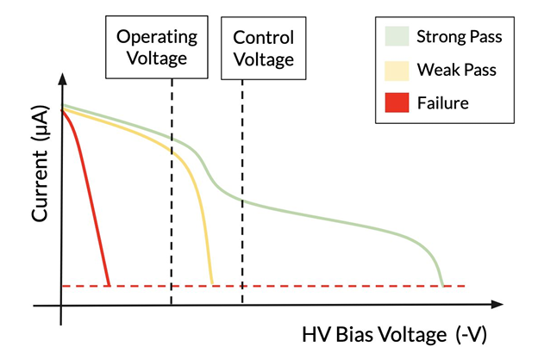
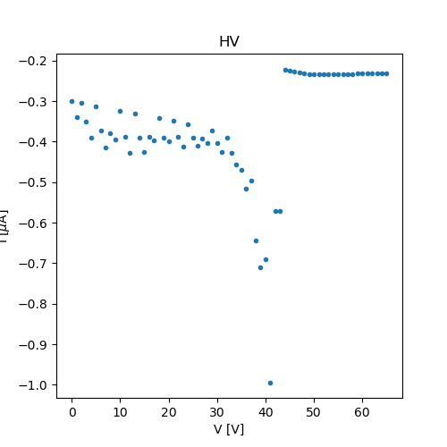
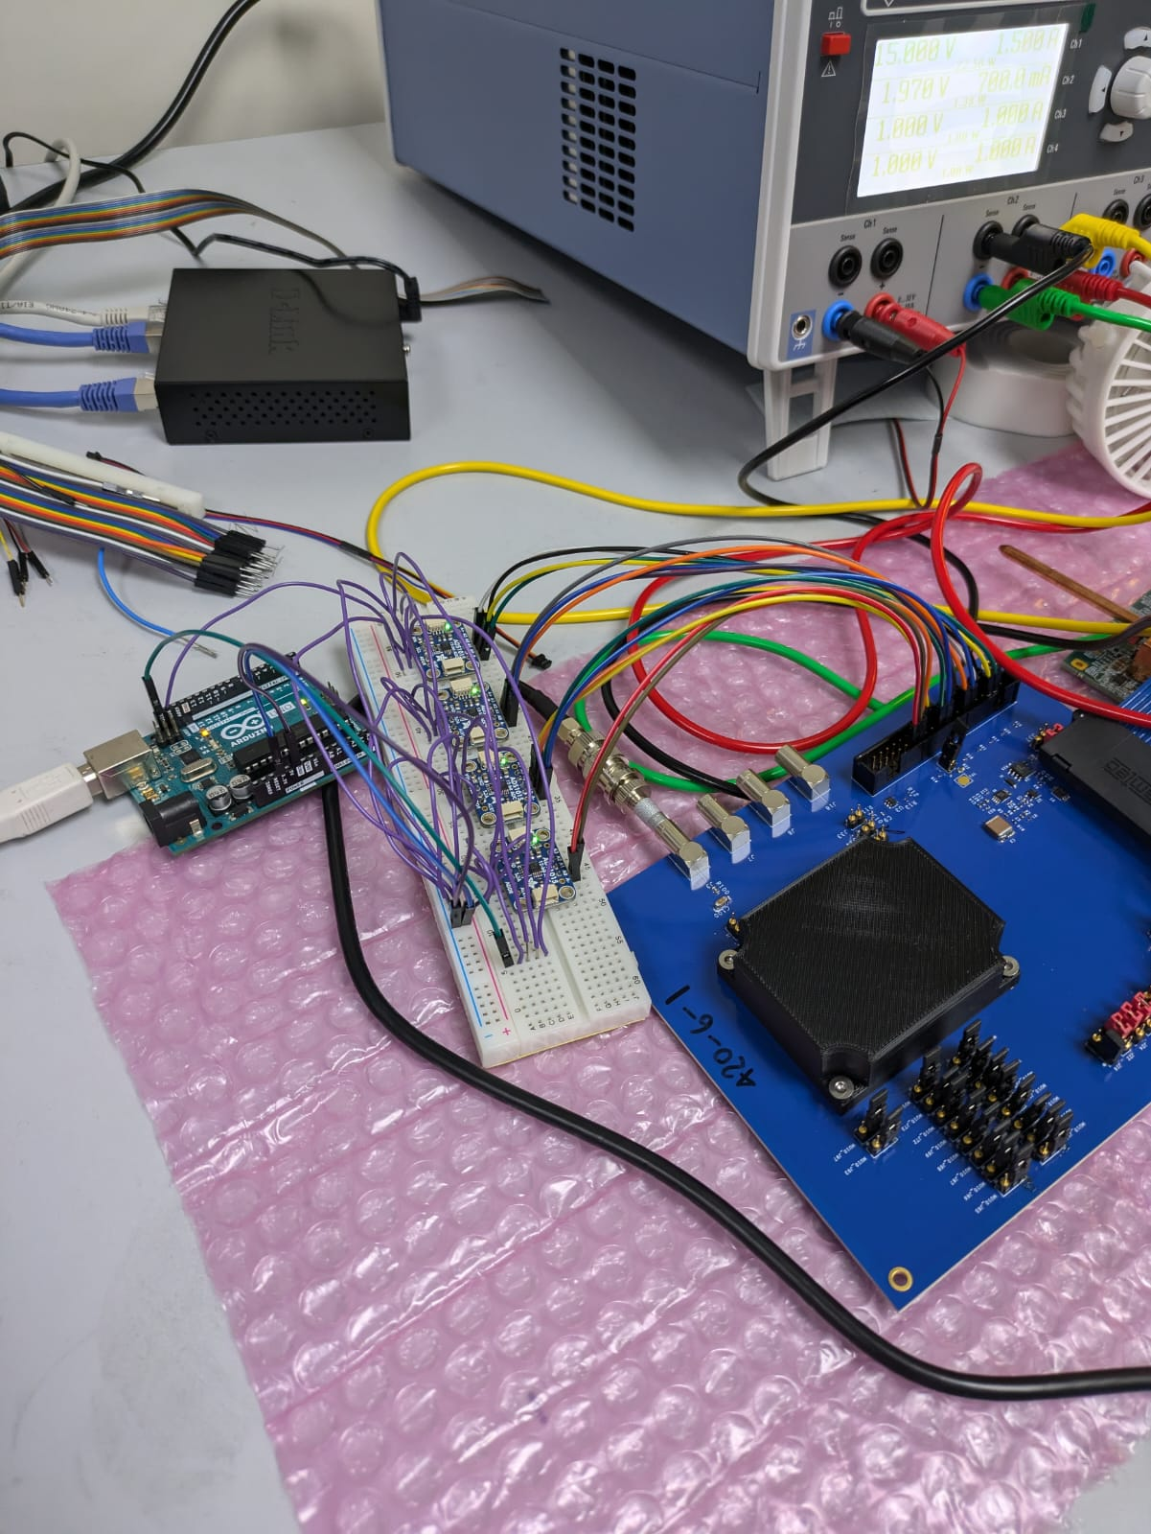
Pixel and Module QC
In the clean room we have a setup that is going to complete pixel and module quality control tests.
This consists of a probe station looking for mechanical faults and defects.
We currently have a PC that completes electrical QC tests by taking DAQ variables from our pixel probe card.

Slide 20
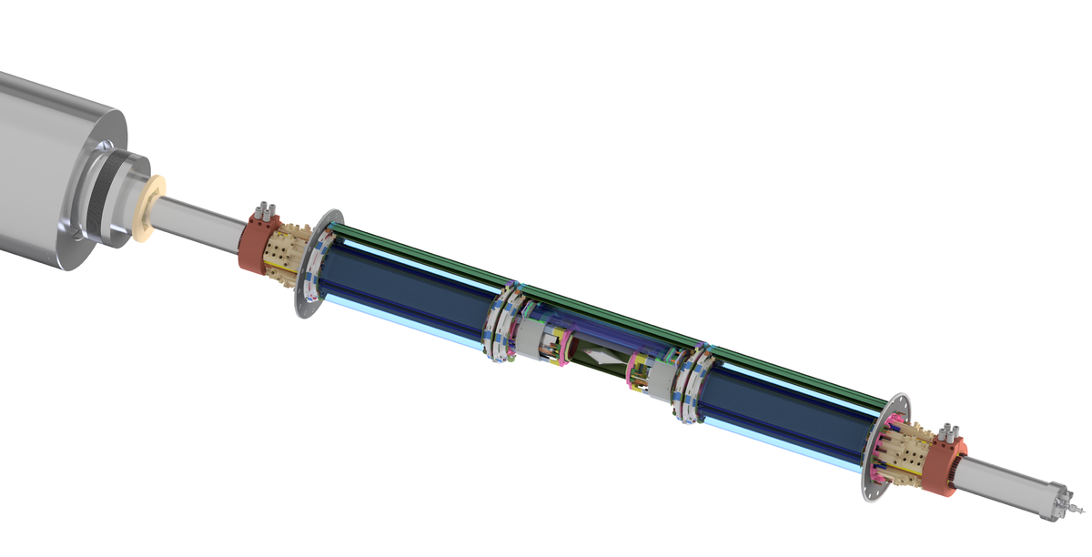
Thank You

Slide 21
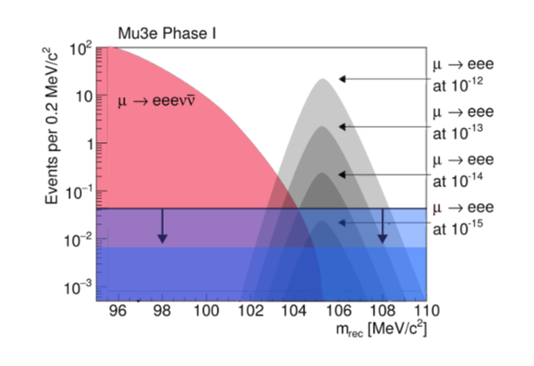
Background

Slide 22
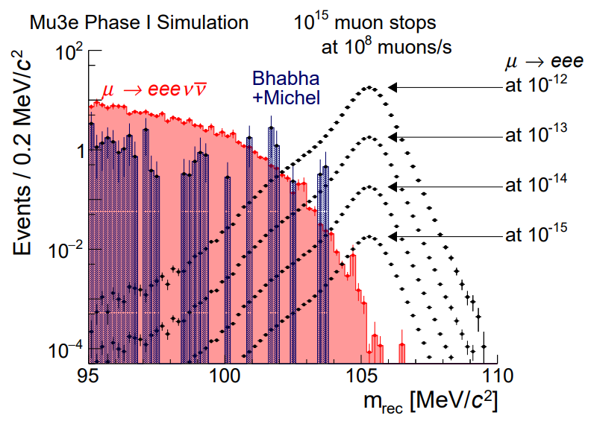
Background

Slide 23
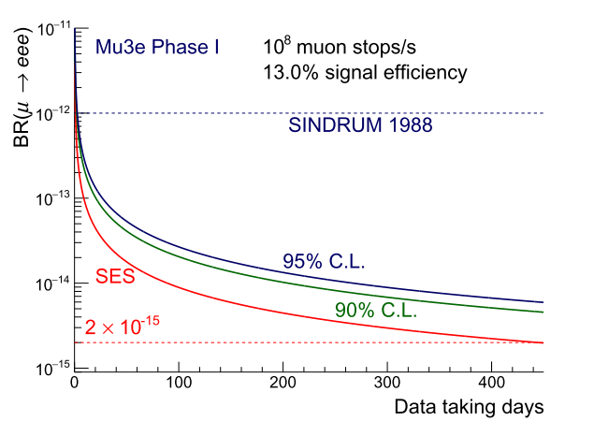

Slide 24
