Slide 1
Skills and Competence Framework
Prof Dr Carsten P Welsch

Slide 2
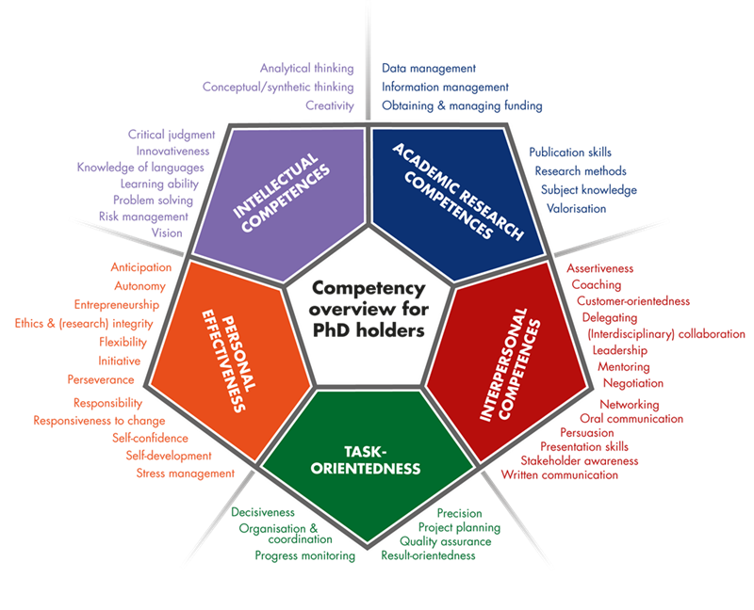
Postgraduate Training
MSc standard;
PhD part of training in most countries;
Broad skills;
Blue sky research vs. applied physics.

Slide 3
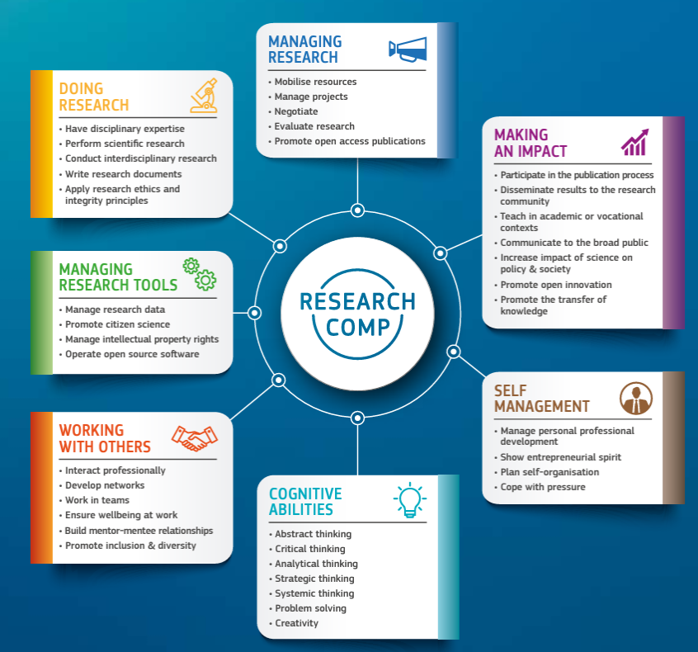
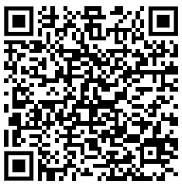
European Competence Framework

Slide 4
Researcher Training
Major challenge: We live in one of the most dynamic times where the required skills for researchers are changing at record speed.
Key skills now required are not even mentioned in any of the major competence frameworks, e.g. digital literacy, prompt engineering, opportunities and challenges related to tools such as ChatGPT, looking after each other.
Consortia are powerful way to go beyond framework and define future best practice – your feedback is crucial!
Role of industry? We need to re-think researcher training…in particular the opportunities from placements, as we do in LIV.INNO ☺

Slide 5
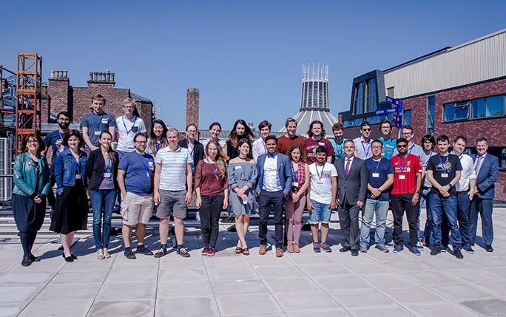
Researcher Training
Joint organization leads to improved efficiency and better experience.
Close links allow to identify best practice and share experiences.

Slide 6
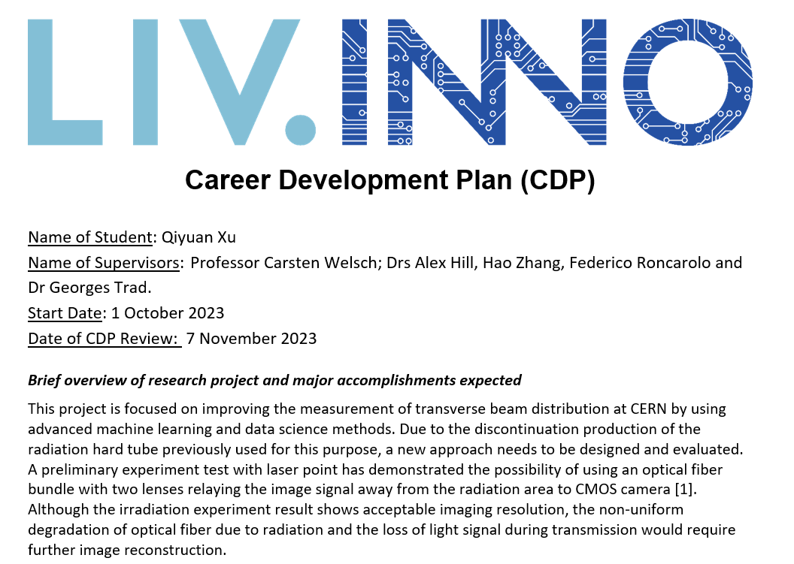
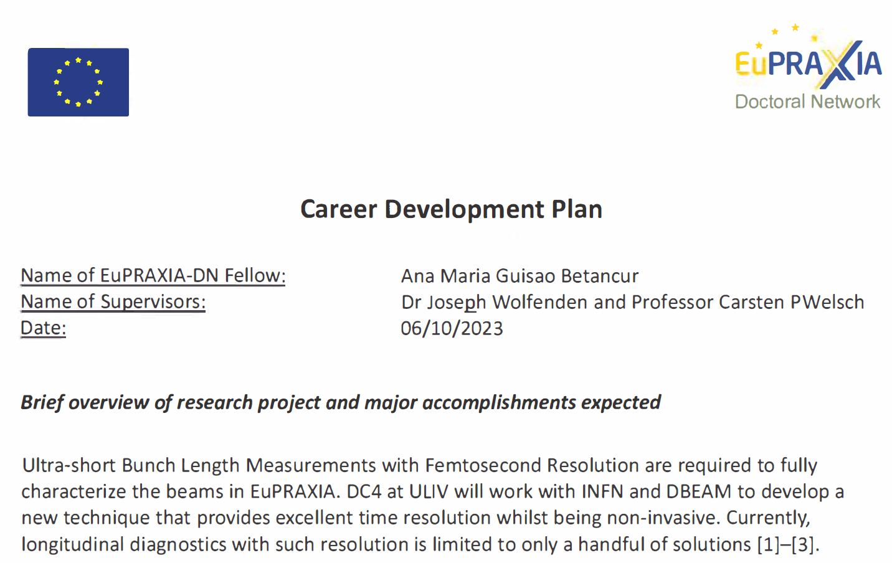
Career Development Plan

Slide 7
Summary
PhD is a unique opportunity to develop a wide range of skills
Self-assess your skills set, refine and develop it with the help of your supervisory team (and fellow students) on a regular basis. Build this into your CDPs.
Share good practice, help shape your overall training. You are in the driver’s seat!
Enjoy!

