Slide 1
Welcome!
Dr Joseph Wolfenden
University of Liverpool

Slide 2

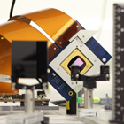
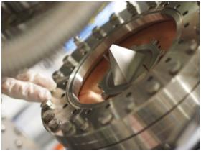
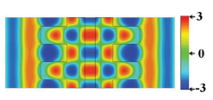
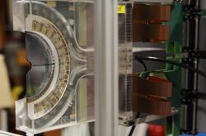
QUASAR Group Research
PI: Prof. Carsten Welsch
Frontier Accelerators
  Particle Colliders (e.g. LHC and its upgrades); Antimatter R&D – in particular: AEgIS; PERLE, CLARA and RUEDI: Design, optimization and R&D into underpinning technologies
Novel Accelerators
  Plasma wakefield accelerators (AWAKE and EuPRAXIA), ultra-compact dielectric laser and carbon nanotube accelerators: Numerical studies and advanced diagnostics R&D
Accelerator Applications
  Medical Applications, commercialization of our R&D: Imaging, treatment, sensors
Underpinning everything: Data Science

Slide 3
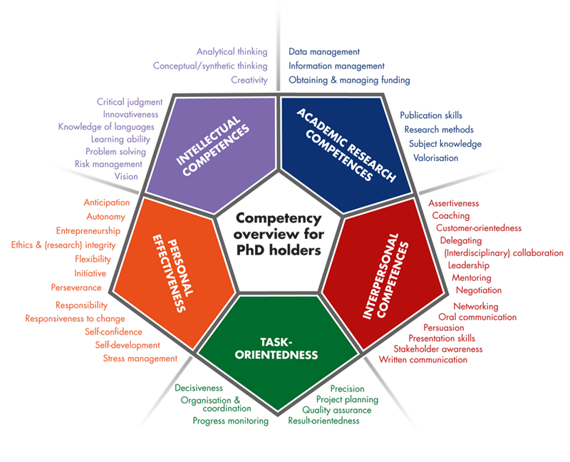
Postgraduate Training
MSc standard;
PhD part of training in most countries;
Broad skills;
Blue sky research vs. applied physics.

Slide 4
“Classic“ PhD training
Focus on academic career path;
Scientific papers as key quality indicator;
Training through (often blue sky) research;
Very little training in complementary skills – researchers often need to be (re)trained on the job;
Students or researchers?
Evolution: Doctoral networks and Centers for Doctoral Training

Slide 5
Marie Curie networks
Introduced in EU Framework Programme
2016: 100,000 Marie Curie researchers (!)
Currently around 15,000 active Fellows
Provides support for early career and experienced researchers (young Postdocs).
Goals:
Improve employability of researchers;
Better training through demonstrated international mobility;
Maintain Europe‘s leadership position in R&D.

Slide 6
Centers for Doctoral Training
Funded by STFC through bespoke calls
Liverpool one of the few universities that were successful in getting a data science CDT awarded – twice (!)
We are training ~80 PhD students in total
Mandatory 6-month industry placement part of every project
Goals:
Improve cross-sector mobility
Prepare for current career challenges – „the 100-year life“

Slide 7







Unique track record
Beam Diagnostics 2008 - 2012
  21 Fellows, 32 partners www.liv.ac.uk/ditanet
Laser Applications 2011 - 2015
  19 Fellows, 38 Partners www.la3net.nu
Accelerator Optimization 2011 - 2015
  23 Fellows, 35 Partners www.opac-project.eu
Medical Applications 2016 - 2020
  15 Fellows, 33 Partners www.oma-project.eu
Antimatter R&D 2017 - 2021
  16 Fellows, 35 Partners www.ava-project.eu
EuPRAXIA-DN 2023 - 2026
  12 Fellows, 23 Partners www.eupraxia-dn.org
MSCA Networks
Data Intensive Science 2017 - present
  ~80 PhD students, 2 universities + industry
  www.livdat.org and www.livinno.org
Centres for Doctoral Training

Slide 8
What is EuPRAXIA-DN?
MSCA Doctoral Network with a budget of 3.2M €;
12 high-level Fellowships (10 Fellows will be funded by the EU, another two by the UKRI guarantee funds);
Interdisciplinary and cross-sector plasma accelerator research and training program carried out between universities, research centres and industry;
Allows for organizing (large) number of events;
Recognized importance of plasma accelerator R&D at European level!

Slide 9








Beneficiaries

Slide 10














Partner Organizations

Slide 11



Research
Laser & Plasma
Facility Design & Optimization
Applications
The network's main scientific and technological objectives are split into three closely interlinked work packages.

Slide 12
Training & Events
International school on plasma accelerators;
EuPRAXIA camps on focused research topics – always across the different project work packages;
Researcher skills training designed to prepare all Fellows for their future careers and make them attractive for employers in academia and industry;
Final conference and outreach symposium to present project results.
Events are open to all fellows and wider community !

Slide 13


Slide 14
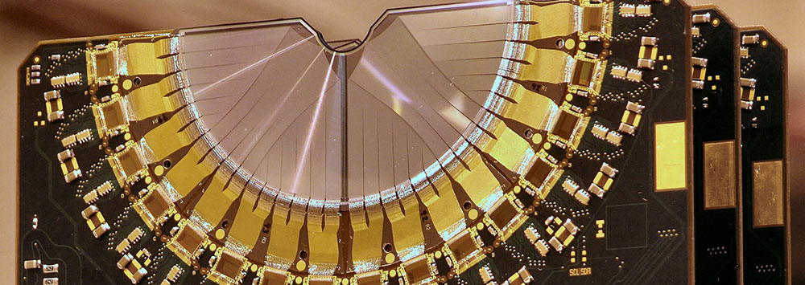
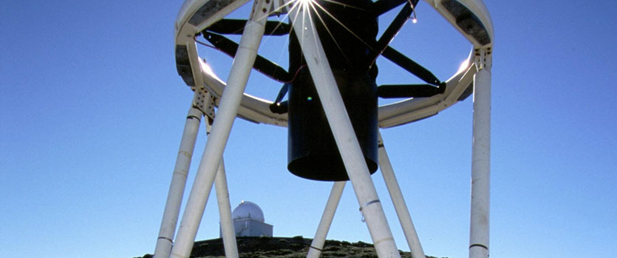
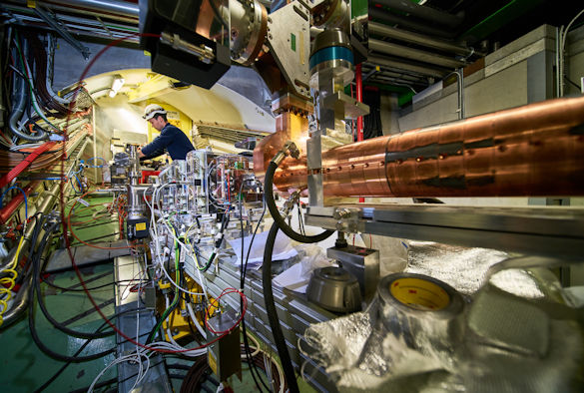
What is LIV.INNO?
LIV.INNO will focus on innovation in STFC science and industry applications.
Perfectly aligned with institutional DIGITAL research themes, benefiting from Virtual Engineering Centre, new £12M Digital Innovation Facility, and LJMU’s robotic telescope.
Wider impact through placements, outreach symposium, and “DataAid”.
LIV.INNO Research & Impact Board will support responsible research and translation.
Notes:
the quality and diversity in the scientific areas to be addressed by the centre, including appropriateness with regards to data intensive science
the alignment of the centre to wider host institution strategies
the potential impact which could arise as a result of the centre’s success, both in terms of academic and scientific benefit, and wider economic and societal benefit
the extent to which responsible research and innovation will be supported and delivered in the centre’s research activities.

Slide 15
Your training timeline
Year 1
Year 2
Year 3
Year 4
 | Taster placements | Industry placements
Complementary Skills School Canvas course Data Science |  | School on Data Science and Applications | Advanced Skills School
Data Science School |  | Outreach Symposium | Careers Workshop
PGCert in Big Data |  | Data Science in Healthcare Workshop
Cohort visit to the STFC Hartree Centre | LIV.INNO Student Seminars
PGR training courses by clusters and LIV.INNO Virtual Seminars
Specialist courses by Hartree and Nvidia |  | DataAid
Development Needs Analysis/CDP, updated quarterly

Slide 16
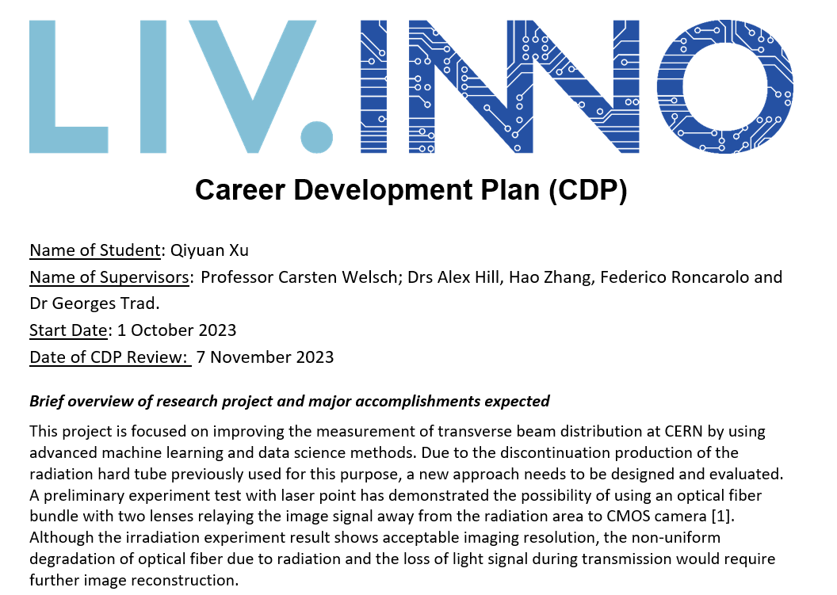
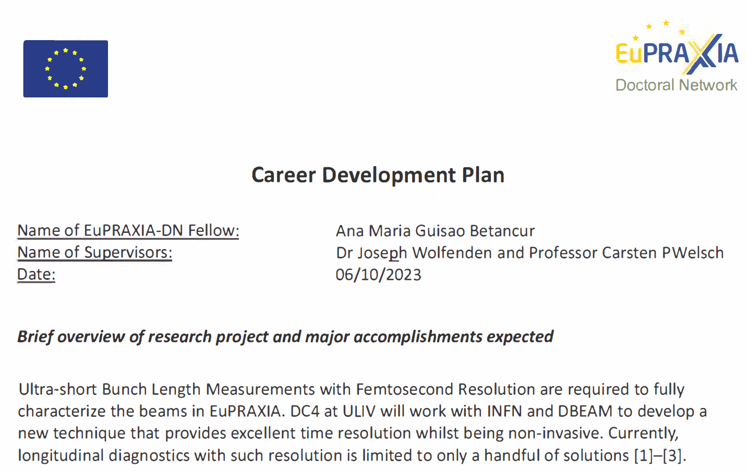
Career Development Plan

Slide 17
Training
Local training by host:
CDT and network-based schools;
Researcher secondments to partner organizations;
Secondments to partners from industry;
Training in career skills
Motivation: Ideal Training.

Slide 18
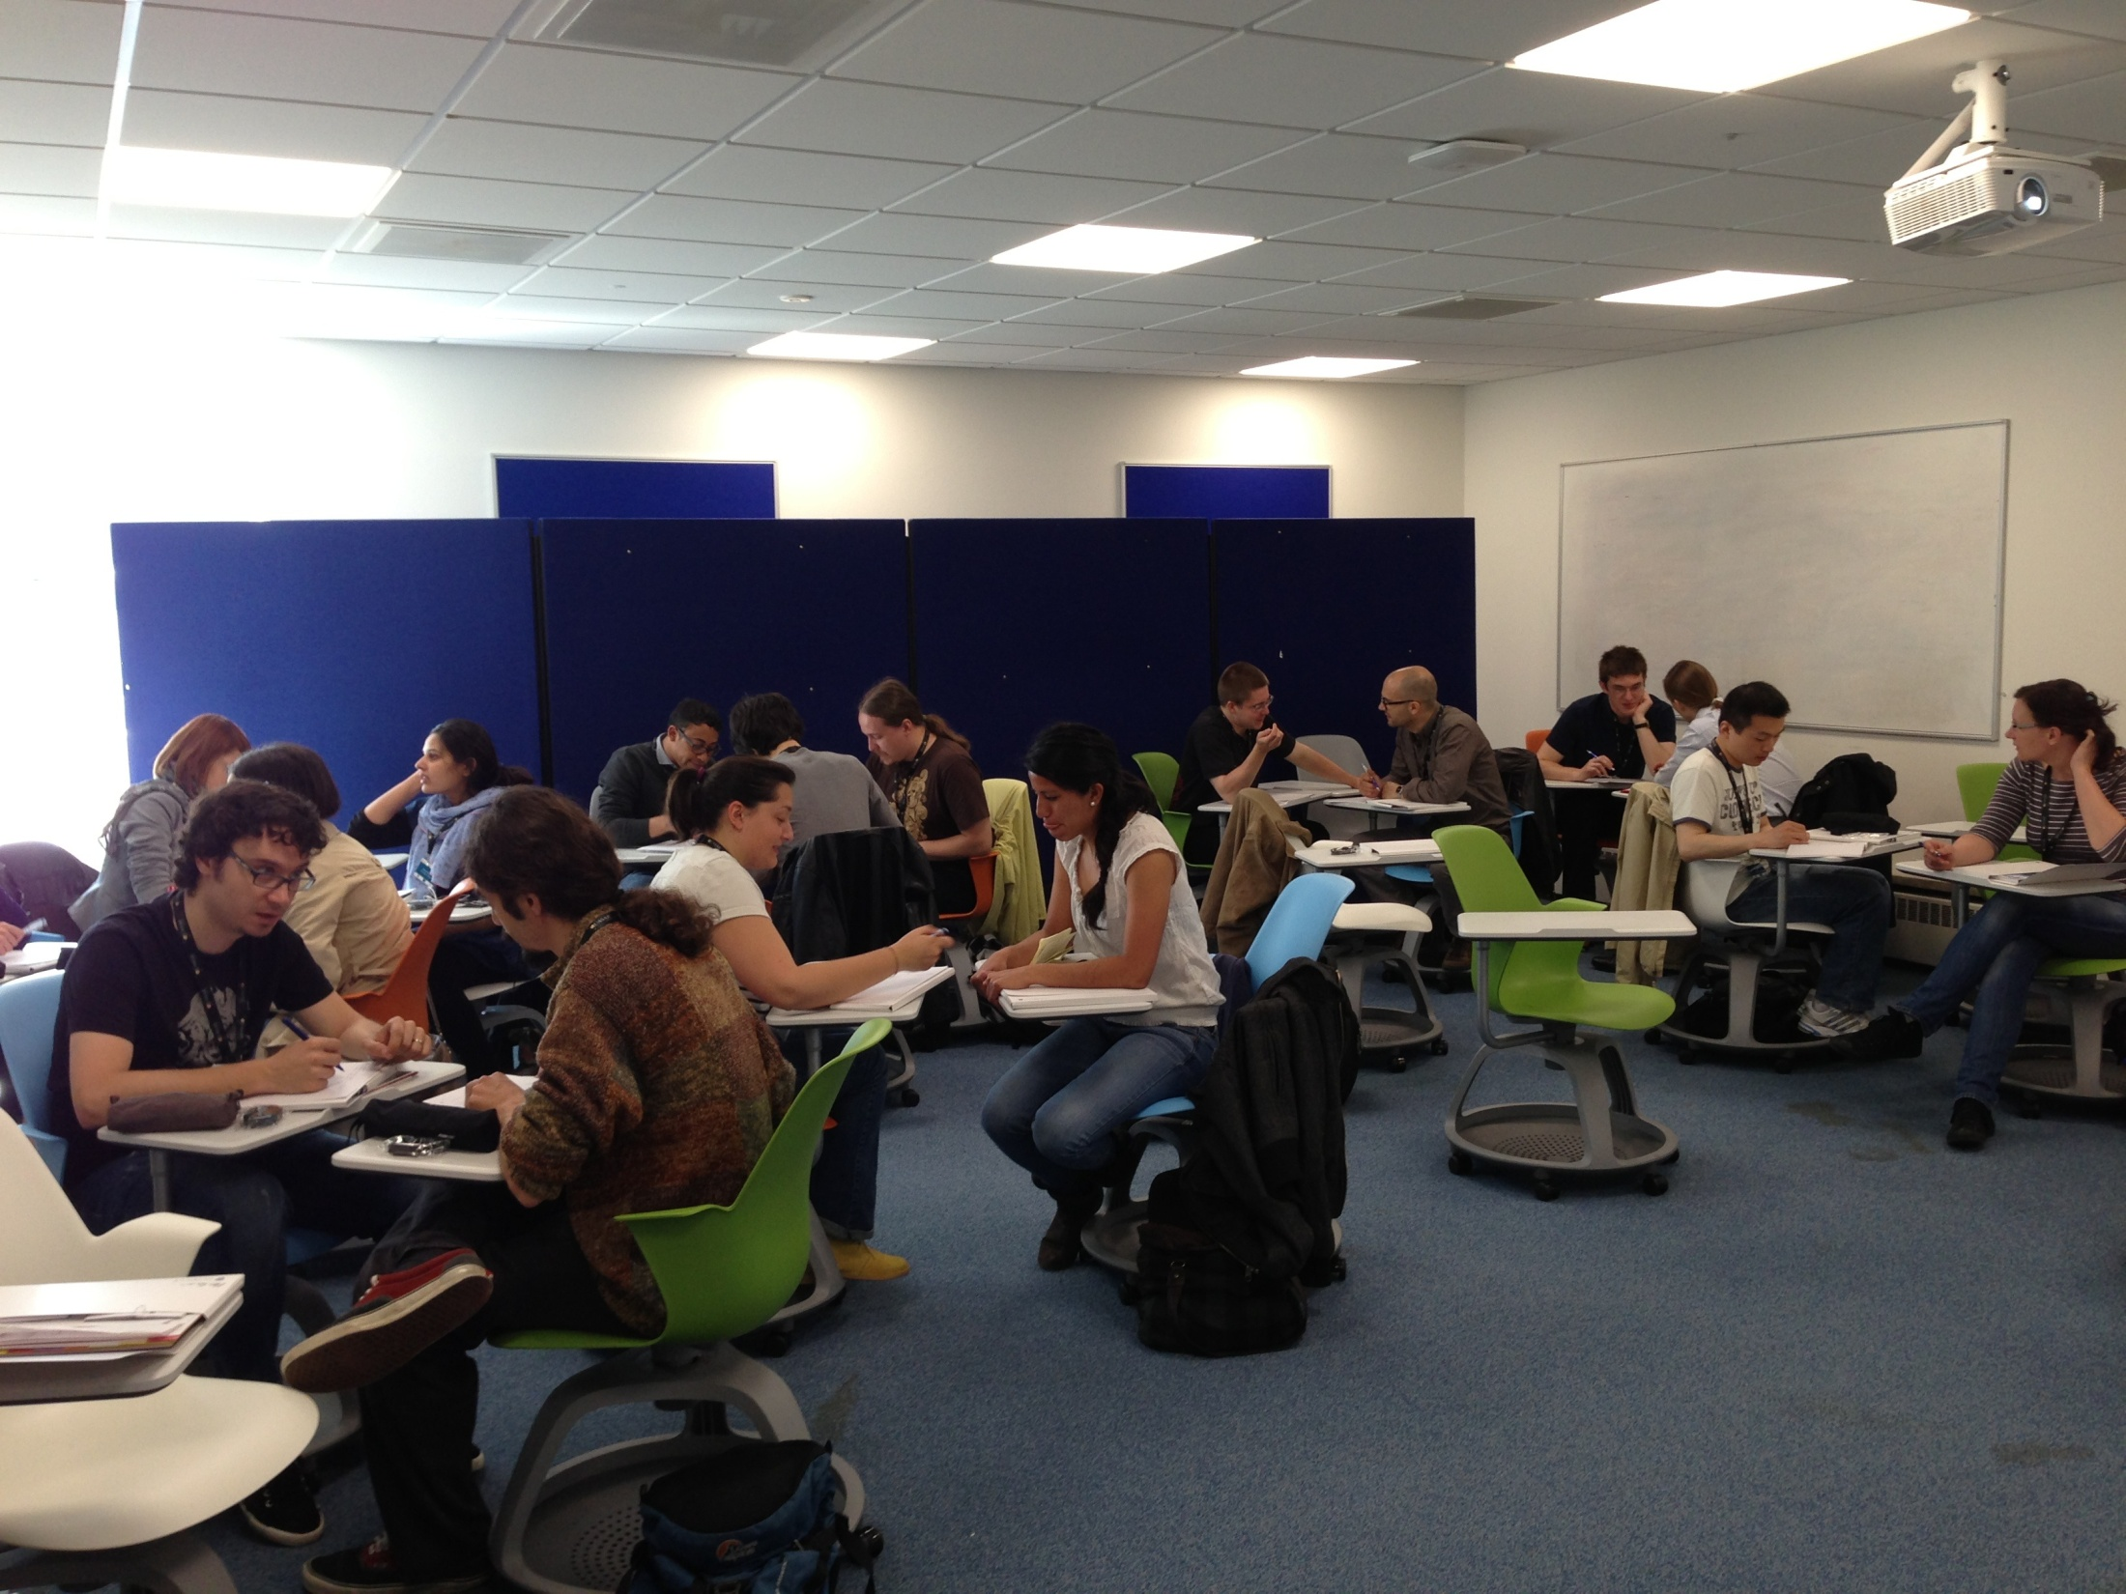
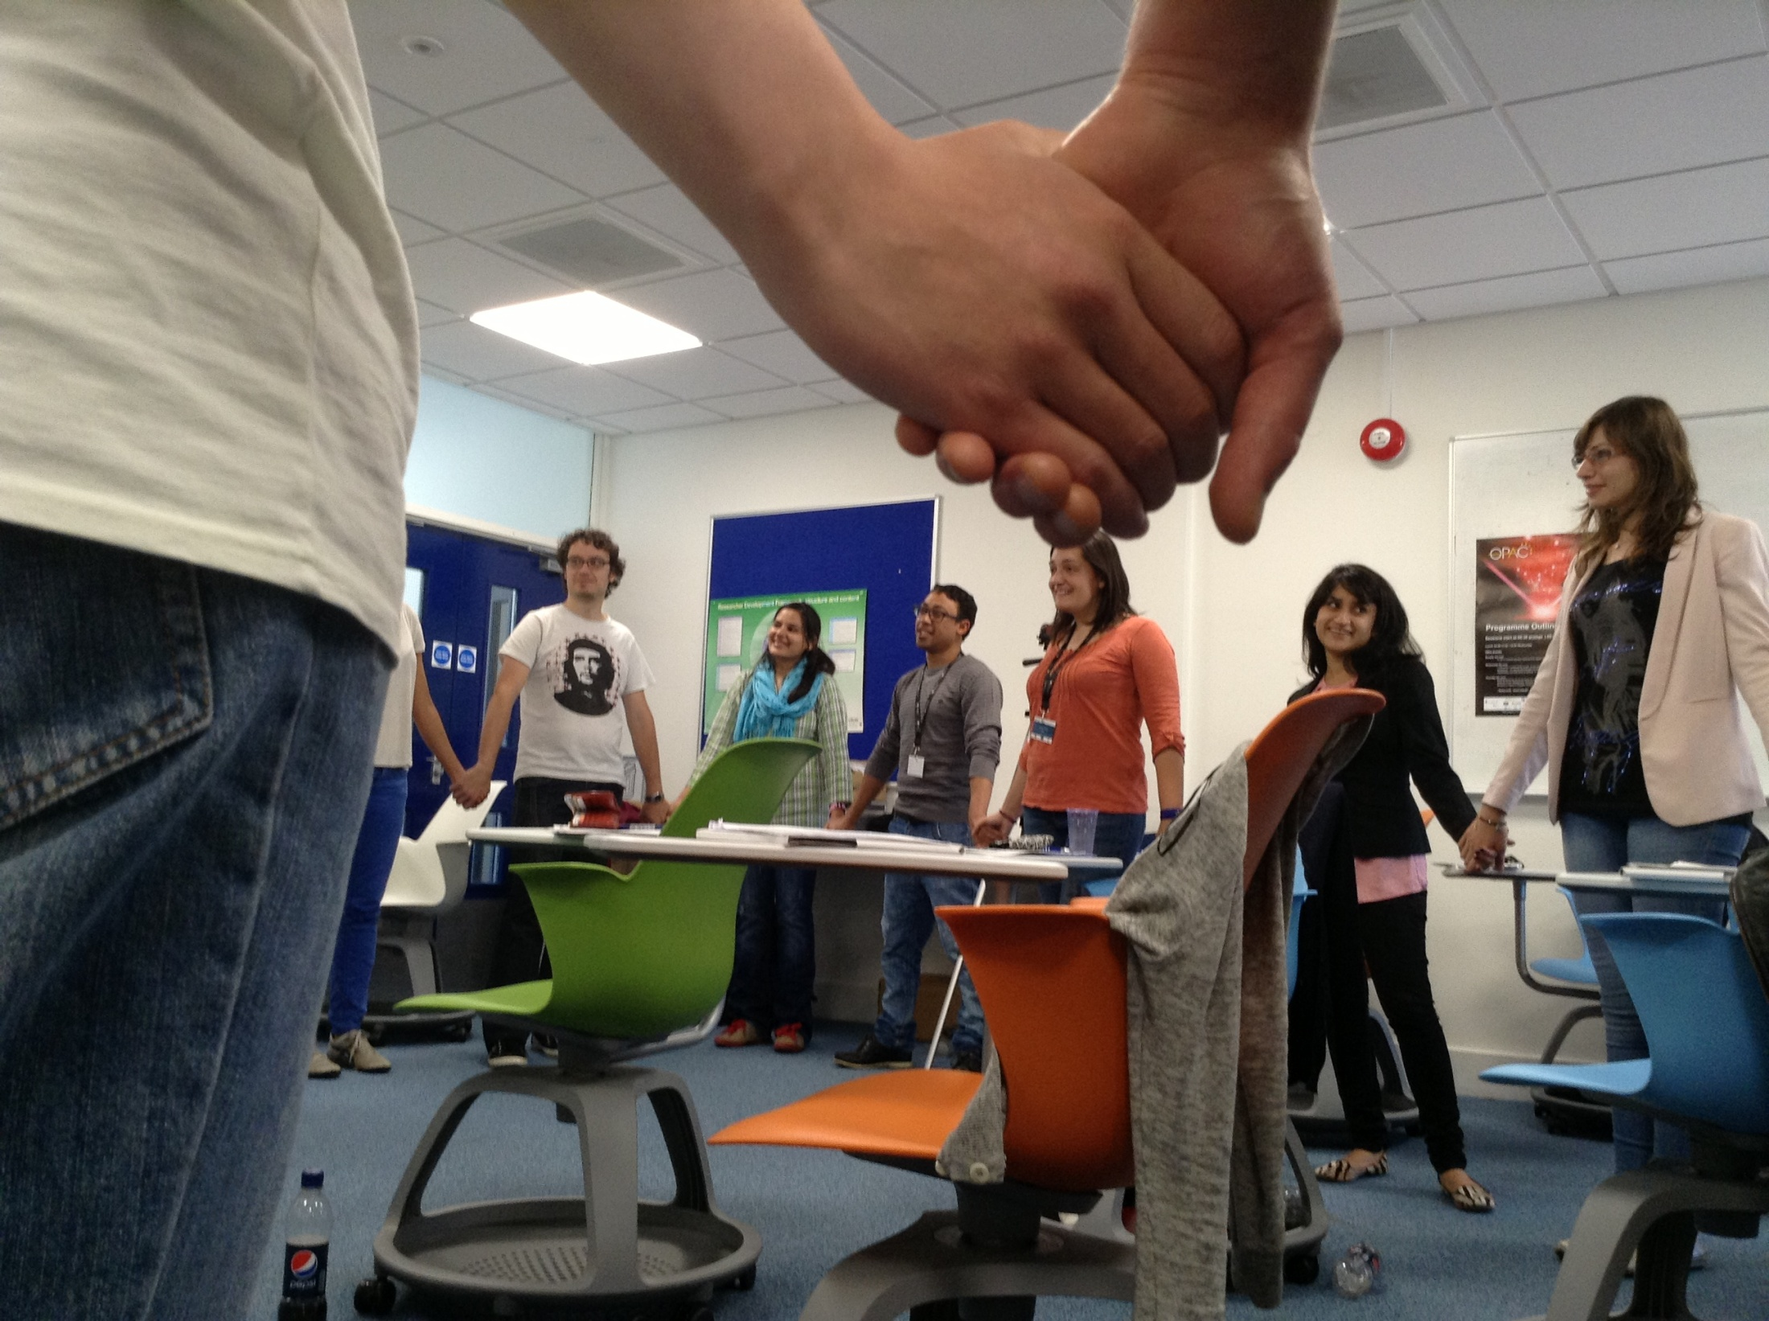

Course Structure
Project-specific part
  Presentation skills
  Scientific writing
  Project management
Generic skills through outreach project
  Team working
  Proposal writing
  Peer review
  Working under (time) pressure
“I hadn’t really thought of myself
as a project manager until today!”

Slide 19
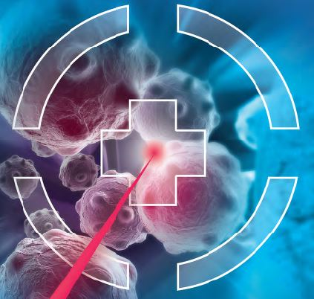



Time | Monday | Tuesday | Wednesday | Thursday | Friday
9.00 10.00 – Break | Introduction Paired Introductions Presentation skills Basics of research presentations – an introduction to the Do’s and Don’ts of research presentations Science Communication Focus on writing for the general public The writing process and structure Thinking about the audience Tips | Introduction to Project Management: Stakeholder analysis Milestones Deliverables Task schedule Risk assessment Breakdown structure/network diagrams/Gantt chart Applying these to your PhD/research project | 8.00 Transport to Daresbury Presentation skills Participants give 10-minute presentation in small groups about their PhD project All presentations will be video recorded Feedback by: presenter, fellow students, (3) Tutor | Independent team work: Outreach project | The Presentations (Followed by Questions)
 |  |  |  | Mental health awareness Managing your PhD
10.30 – 11.30
11.30 – 12.30
12.30 – 13.30 | Lunch
14.30 – Break | Outreach project – introduction Outreach project – planning | Independent Teamwork : Outreach project Teams to work on their outreach projects applying project management methodologies. Introduction to Peer Review | Visit to Cockcroft Institute Tour of facilities 16.30 Transport to Liverpool Social activity | Independent team work: Outreach project Produce proposal Prepare presentation Skills and Competence Framework Independent team work By 17:00 – submit outreach project proposal Special dinner
15.00 – 17.00
Notes:
News

Slide 20
Start and end of Appointment
Project info, grant agreement, rules and regulations –SharePoint
First Career Development Plan to project manager
CV type photo, project description and info to comms officer for website
You will also need to complete a confidential questionnaire at the end with:
  Background, career plans, etc
  Nationality, age, gender, discipline
  Assessment of the time spent in the network and of training received

Slide 21
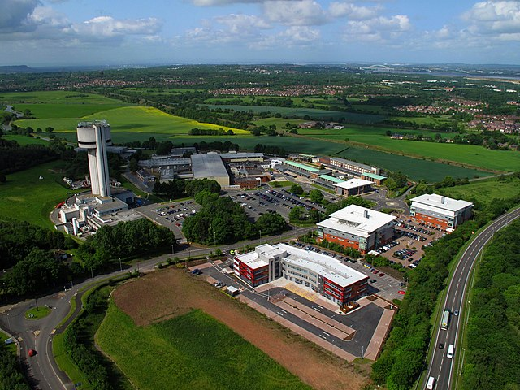
Wednesday
Whole day at Daresbury Laboratory
Minibus will leave from the Foundation Building in Liverpool at 8am
Presentation skills training
  Bring your talk
  Meeting in 3 break-out rooms
  10 minutes per talk; strict limit!
  Review video and feedback:
    Speaker
    Group
    Tutor
  More details later today
Site visit, followed by social round of darts in Liverpool.

Slide 22

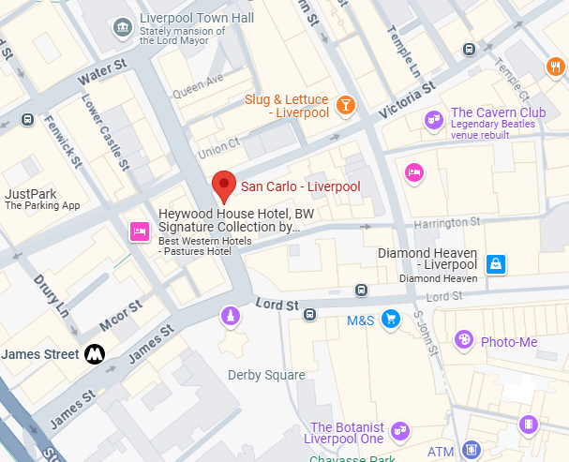
Formal dinner @ San Carlo
Starts at 19:30
Dress code: smart

