Slide 1

PRESENTATION SKILLS
J. WOLFENDEN
LIV.INNO Introductory Skills School
20/01/2025

Slide 2

Presentation Skills
J. Wolfenden
LIV.INNO Introductory Skills School – 20/01/2025

Slide 3
Overview
Things to think about before you start making your presentation
How to layout content on slides to make them look nice
Skills and concepts to think about and practise to present well
Discussion around Q&A’s
J. Wolfenden - LIV.INNO Introductory Skills School - 20/01/2025

Slide 4




Overview
1
Before you start…
2
Good slides?
3
Presenting!
4
Questions?
J. Wolfenden - LIV.INNO Introductory Skills School - 20/01/2025

Slide 5
Before you start…

Slide 6
Previous experience
Types of presentation?
A good presentation?
Key elements?
Role of slides?
J. Wolfenden - LIV.INNO Introductory Skills School - 20/01/2025

Slide 7






Presentation building blocks
Key message?
What?
Why?
Target audience?
Timing?
Importance?
J. Wolfenden - LIV.INNO Introductory Skills School - 20/01/2025

Slide 8
Good slides?

Slide 9
Layout basics
Find your own style
J. Wolfenden - LIV.INNO Introductory Skills School - 20/01/2025

Slide 10

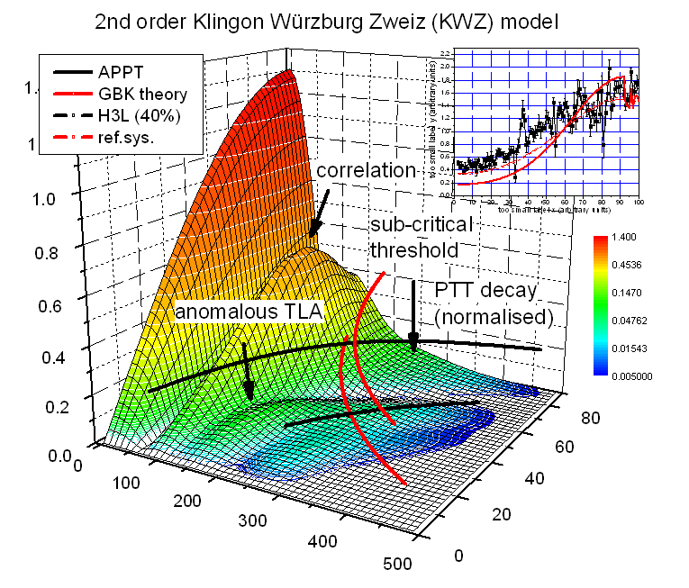
Layout basics
Use images and graphics
Graphics!
Plots!*
J. Wolfenden - LIV.INNO Introductory Skills School - 20/01/2025

Slide 11
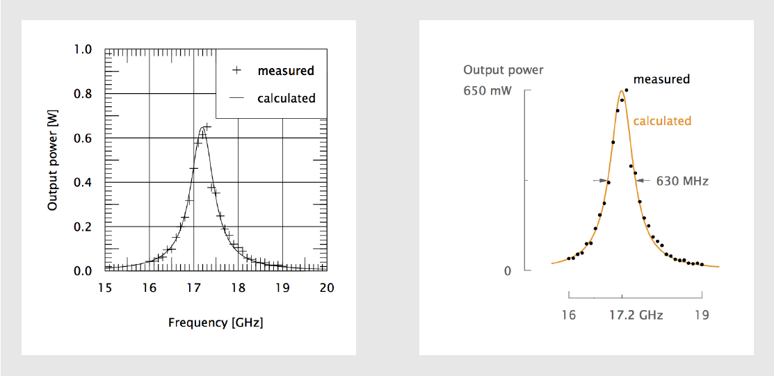
Layout basics
Graphics!
Plots!*
J. Wolfenden - LIV.INNO Introductory Skills School - 20/01/2025

Slide 12

Layout basics
Graphics!
Plots!*
J. Wolfenden - LIV.INNO Introductory Skills School - 20/01/2025

Slide 13
Layout basics
Fonts! Fonts! Fonts! Fonts! Fonts! Fonts! Fonts!
Fonts! Fonts! Fonts! Fonts! Fonts! Fonts! Fonts!
24pt
Size! Size! Size! Size! Size! Size! Size! Size! Size! Size! Size! Size! Size!
Use colour to highlight text, but, be careful of contrast!
J. Wolfenden - LIV.INNO Introductory Skills School - 20/01/2025

Slide 14
Layout basics
Don’t be afraid of white space
J. Wolfenden - LIV.INNO Introductory Skills School - 20/01/2025

Slide 15




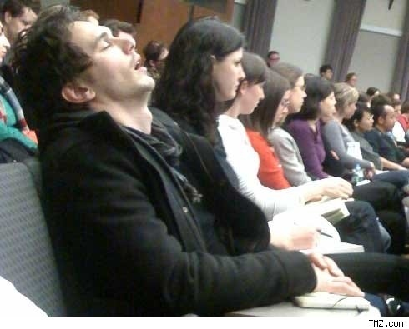










Layout basics
J. Wolfenden - LIV.INNO Introductory Skills School - 20/01/2025

Slide 16
Layout basics
J. Wolfenden - LIV.INNO Introductory Skills School - 20/01/2025

Slide 17

Extras
Animation
J. Wolfenden - LIV.INNO Introductory Skills School - 20/01/2025

Slide 18
Extras
Transitions
J. Wolfenden - LIV.INNO Introductory Skills School - 20/01/2025

Slide 19
Extras
Transitions
J. Wolfenden - LIV.INNO Introductory Skills School - 20/01/2025

Slide 20
Extras
Transitions
J. Wolfenden - LIV.INNO Introductory Skills School - 20/01/2025

Slide 21
Extras
Transitions
J. Wolfenden - LIV.INNO Introductory Skills School - 20/01/2025

Slide 22
Extras
Transitions
J. Wolfenden - LIV.INNO Introductory Skills School - 20/01/2025

Slide 23
Extras
Transitions
J. Wolfenden - LIV.INNO Introductory Skills School - 20/01/2025

Slide 24
Extras
Transitions
J. Wolfenden - LIV.INNO Introductory Skills School - 20/01/2025

Slide 25
Extras
Transitions
J. Wolfenden - LIV.INNO Introductory Skills School - 20/01/2025

Slide 26
Extras
Transitions
J. Wolfenden - LIV.INNO Introductory Skills School - 20/01/2025

Slide 27



Extras
Extra Q&A
slides
1 slide/min
J. Wolfenden - LIV.INNO Introductory Skills School - 20/01/2025

Slide 28
Presenting!

Slide 29

Performance
Be loud, clear, and concise
Use short simple sentences
Avoid jargon and abbreviation
J. Wolfenden - LIV.INNO Introductory Skills School - 20/01/2025

Slide 30




Performance
Enthusiasm!
Gesticulate!
Eye contact!
Timing!
J. Wolfenden - LIV.INNO Introductory Skills School - 20/01/2025

Slide 31
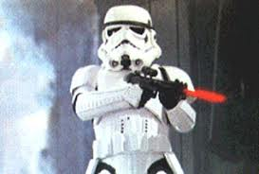
Performance
Don’t wave a laser pointer at the audience
J. Wolfenden - LIV.INNO Introductory Skills School - 20/01/2025

Slide 32

Performance - example
J. Wolfenden - LIV.INNO Introductory Skills School - 20/01/2025

Slide 33



Practise
Rehearse out loud at least 4 times!
1
2
3
No Sound
No Video
With Both
Um…
Err…
Like…
Sorry…
J. Wolfenden - LIV.INNO Introductory Skills School - 20/01/2025

Slide 34



Feedback
Positive
Listen
Direct
Ask
Objective
Reflect
J. Wolfenden - LIV.INNO Introductory Skills School - 20/01/2025

Slide 35
Questions?

Slide 36

Questions
Questions are not an exam
It’s not a race
If you don’t know the answer, say so!
J. Wolfenden - LIV.INNO Introductory Skills School - 20/01/2025

Slide 37
Thank you for listening
J. Wolfenden, with thanks to C. Welsch and R. Torres
LIV.INNO Introductory Skills School – 20/01/2025

Slide 38


Slide 39
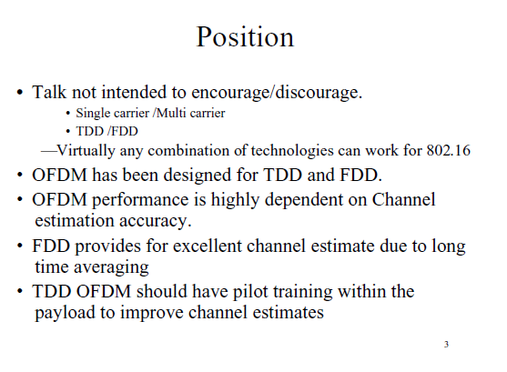

Slide 40
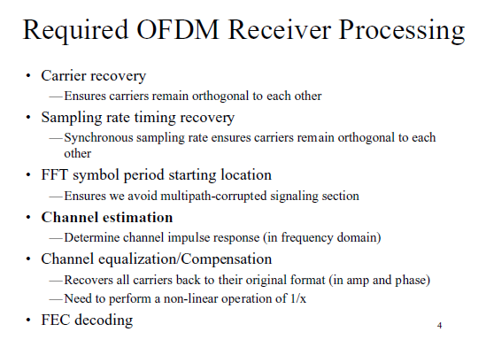

Slide 41
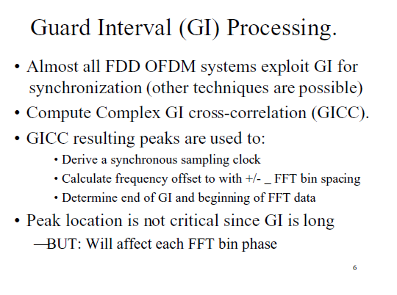

Slide 42


Slide 43
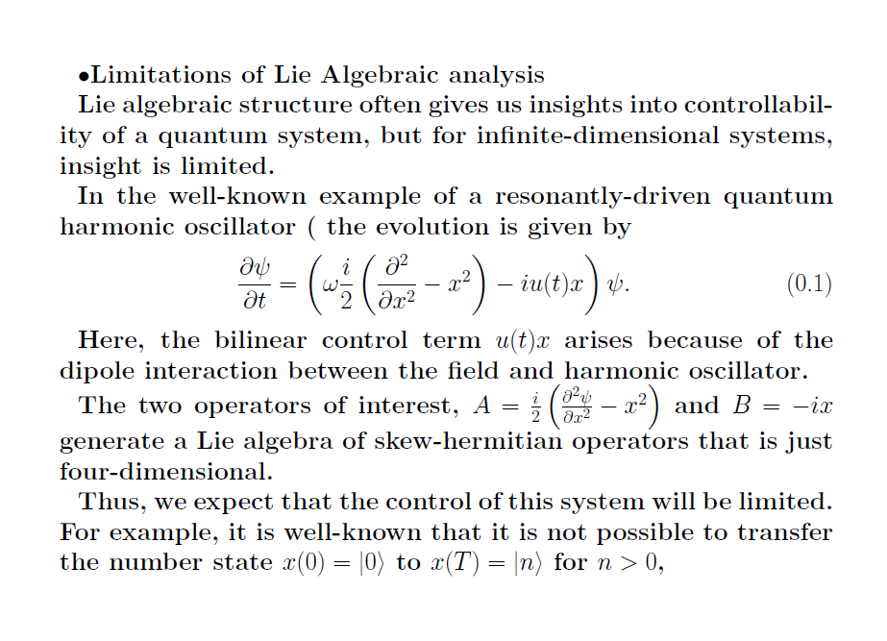

Slide 44
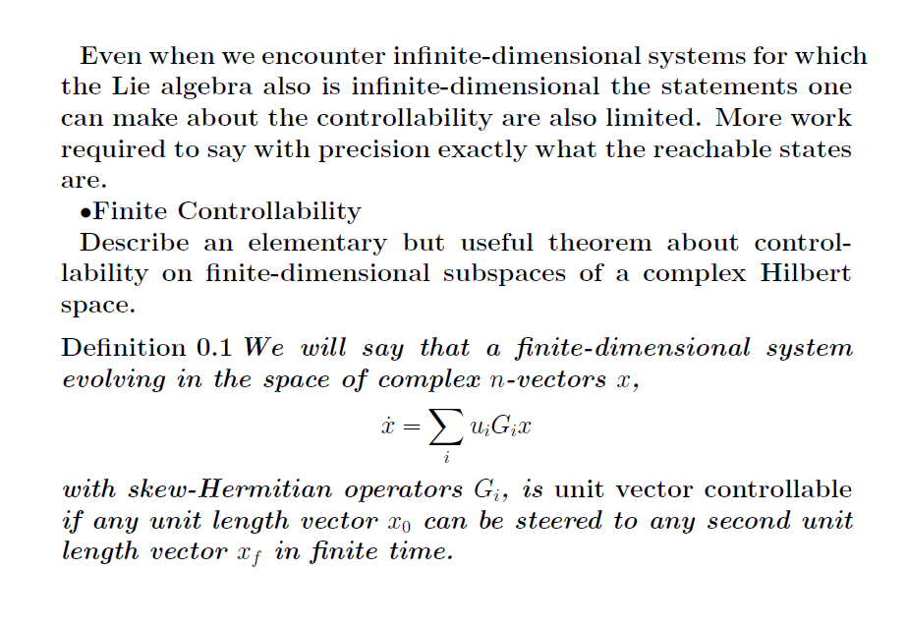

Slide 45
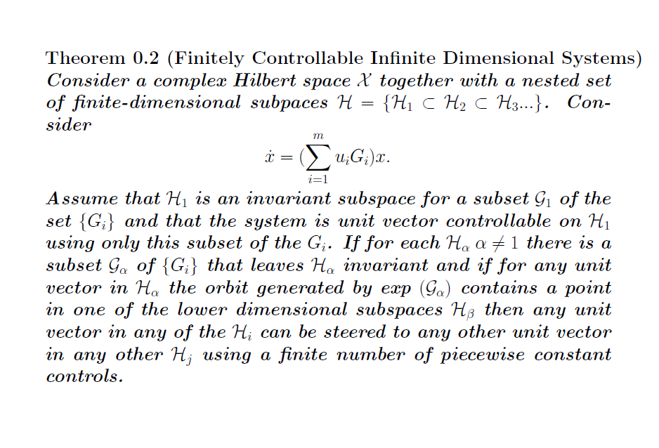

Slide 46


Slide 47


Slide 48


Slide 49
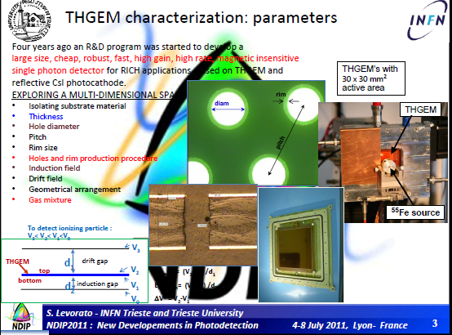

Slide 50
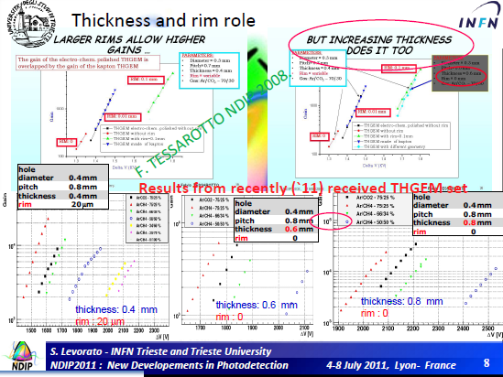

Slide 51
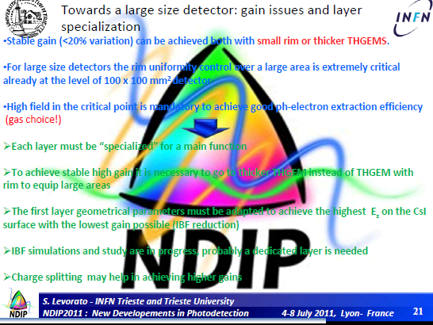

Slide 52
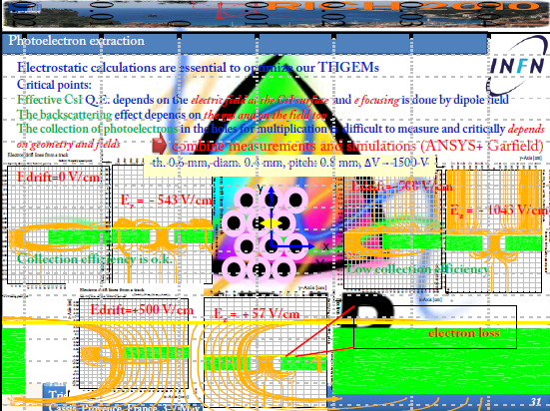

Slide 53
