Slide 1
Science Communication
Naomi Smith
University of Liverpool

Slide 2
Science communication – session overview
Why do we need to communicate our research to others?
How do we go about doing this?
Writing news articles
Social media

Slide 3
Why do we do we communicate our research to others?
To be transparent about what we are doing and why
To help us better understand the public and the public understand us
To show a commitment to our work having a wider societal benefit
To allow the public to take part in informed debate about what we do
To show the relevance of research to people’s every day lives
Public engagement is usually a requirement of any funding. It should be seen as an integral part of the project and not just as a small add on which is required to satisfy funders.

Slide 4
Gathering the key facts
Establish the key facts:
Who
What
When
Where
Why
How
Example on BBC news: https://www.bbc.co.uk/news/science-environment-66964430
5W + H

Slide 5
Exercise
Introduce yourself
What is your name? (Who)
What is your PhD project? (What, When, Where, How)
Why did you choose this project? (Why)

Slide 6
Is it newsworthy?
IMPACT
Will it change my life?
PROXIMITY
Is it close to home?
NOVEL/ODDITY
Is it quirky or weird?
PROMINENCE
Were high profile people involved?
CONFLICT
Is there controversy or violence?
HUMAN INTEREST
Has a person done something amazing?
TIMELINESS
Is it new news?

Slide 7
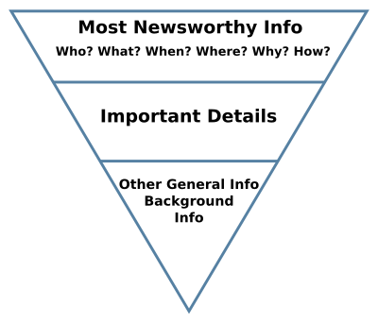
Prioritise key information – inverted pyramid
Why should I care?
Reader can leave at this point and
still understand the story
Strong conclusion e.g. call to action
Credit: https://en.wikipedia.org/wiki/Inverted_pyramid_%28journalism%29
Story can be cut from bottom if necessary

Slide 8
Active and Passive Voices
Active voice: I wrote the computer code
Subject + verb + object
Clear and concise
Passive voice: The computer code was written
Object + verb
Who wrote the code?
Object + verb + (subject) – The computer code was written by me

Slide 9
Active and Passive Voices
Avoid using passive voice except:
When performer is unknown or irrelevant – e.g. my car was stolen
When the object is the main topic – e.g. the software was used for data analysis
To avoid blame or confrontation – e.g. mistakes were made
Where active voice would sound odd

Slide 10
Writing in Plain English
Be clear and concise
Use accurate grammar
Make the language accessible
Make it so it can read quickly
Adapt language to target audience’s knowledge level
One idea per sentence
One topic per paragraph
Favour active voice
Favour present tense
Use simple familiar words
Omit redundant words
Avoid abbreviations and acronyms

Slide 11
Jargon
Specialised terminology associated with a field or area of activity
Jargon: Degradation of luminescent polymers
Exercise: Break this down to try to de-jargon it
Plain language: How glow in the dark objects lose their glow

Slide 12
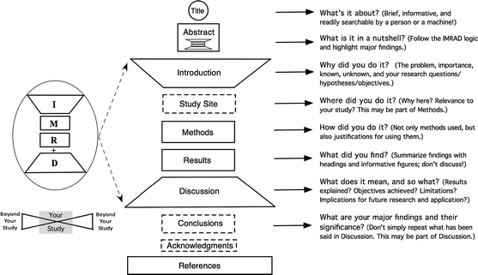
News articles vs Research papers
News articles and research papers have different structures, language, purpose and audience to that of a news article
https://link.springer.com/article/10.1007/s10980-011-9674-3

Slide 13
Using artificial intelligence
Pros
Can produce a first version quickly
Can suggest catchy headlines
Can suggest ways to change your text
Cons
Can include incorrect information
Can make things up
The tone can be completely wrong
Be careful not to input information into AI which is private, sensitive or confidential (including your own unpublished research!)

Slide 14
Exercise
Covert a scientific paper into a news article
Publication = BBC news website
Headline
100-200 words
You have 20 minutes

Slide 15
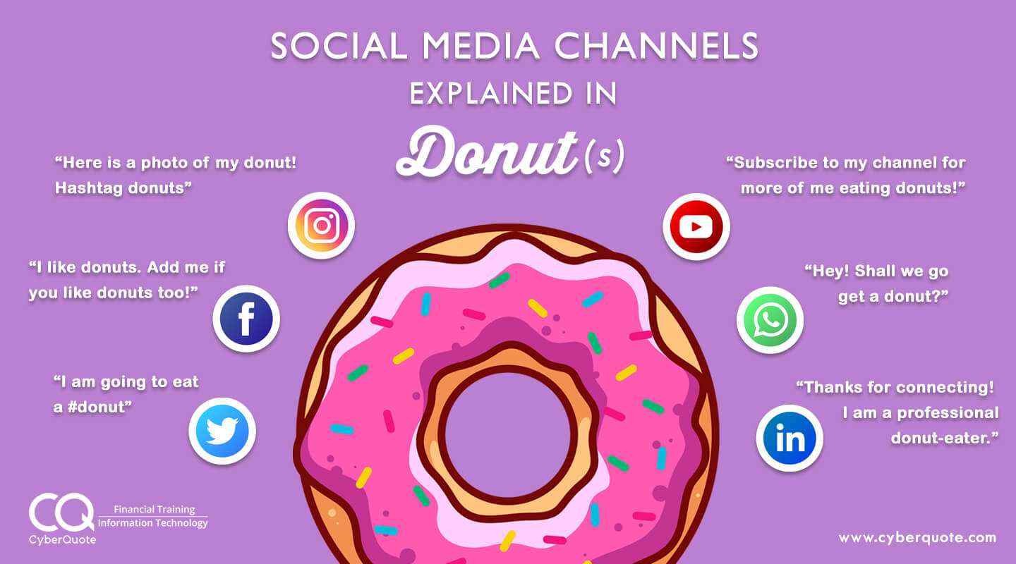
Social media

Slide 16
Exercise
Covert a news story into a Social Media Post
Condense Information
Grab readers attention
Use relevant hashtags
State which social media channel
Max two sentences plus hashtags
You have 10 minutes

Slide 17
Science communication – summary
Importance of writing skills
Establishing key facts
Is it newsworthy?
Use of language
Audience
How news articles and research appearance differ
Social media

Slide 18
Science Communication
Naomi Smith
University of Liverpool

